Slide 1






11. Nested Logit Models

Slide 2
Extended Formulation of the MNL
Groups of similar alternatives
Compound Utility: U(Alt)=U(Alt|Branch)+U(branch)
Behavioral implications – Correlations across branches
LIMB
Travel
BRANCH
Private
Public
TWIG
Air
Car
Train
Bus

Slide 3
Degenerate Branches
Shoe Choice
Choice Situation
Purchase
Opt Out
Choose Brand
Brand
None
Brand1
Brand2
Brand3

Slide 4
Correlation Structure for a Two Level Model
Within a branch
  Identical variances (IIA applies)
  Covariance (all same) = variance at higher level
Branches have different variances (scale factors)
Nested logit probabilities: Generalized Extreme Value
Prob[Alt,Branch] = Prob(branch) * Prob(Alt|Branch)

Slide 5
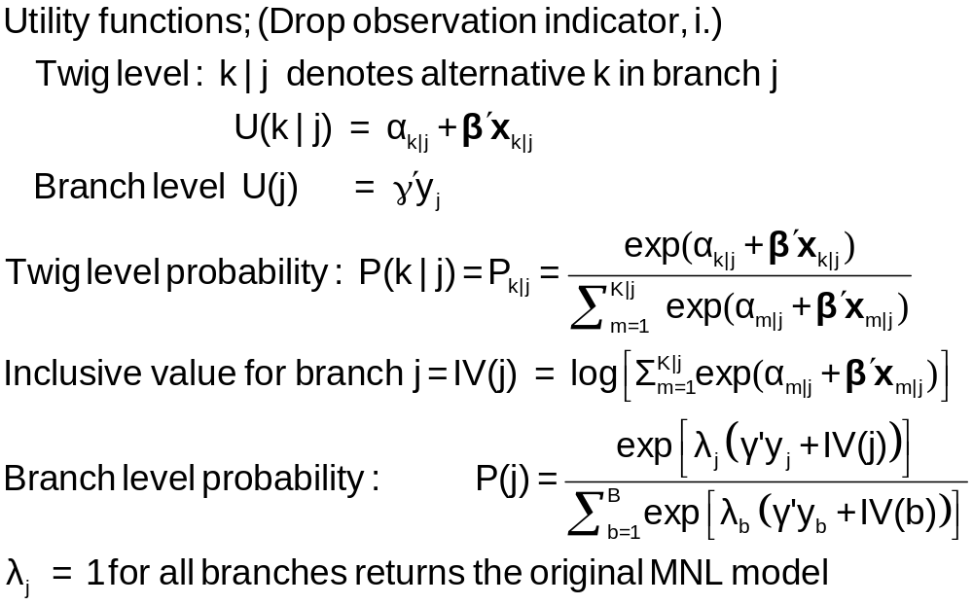
Probabilities for a Nested Logit Model

Slide 6
Estimation Strategy for Nested Logit Models
Two step estimation
  For each branch, just fit MNL
    Loses efficiency – replicates coefficients
    Does not insure consistency with utility maximization
  For branch level, fit separate model, just including y and the inclusive values
    Again loses efficiency
    Not consistent with utility maximization – note the form of the
    branch probability
Full information ML
Fit the entire model at once, imposing all restrictions

Slide 7
Estimates of a Nested Logit Model
NLOGIT ; Lhs=mode
; Rhs=gc,ttme,invt,invc
; Rh2=one,hinc
; Choices=air,train,bus,car
; Tree=Travel[Private(Air,Car),
Public(Train,Bus)]
; Show tree
; Effects: invc(*)
; Describe
; RU1 $ Selects branch normalization

Slide 8
Model Structure
Tree Structure Specified for the Nested Logit Model
Sample proportions are marginal, not conditional.
Choices marked with * are excluded for the IIA test.
----------------+----------------+----------------+----------------+------+---
Trunk (prop.)|Limb (prop.)|Branch (prop.)|Choice (prop.)|Weight|IIA
----------------+----------------+----------------+----------------+------+---
Trunk{1} 1.00000|TRAVEL 1.00000|PRIVATE .55714|AIR .27619| 1.000|
| | |CAR .28095| 1.000|
| |PUBLIC .44286|TRAIN .30000| 1.000|
| | |BUS .14286| 1.000|
----------------+----------------+----------------+----------------+------+---
+---------------------------------------------------------------+
| Model Specification: Table entry is the attribute that |
| multiplies the indicated parameter. |
+--------+------+-----------------------------------------------+
| Choice |******| Parameter |
| |Row 1| GC TTME INVT INVC A_AIR |
| |Row 2| AIR_HIN1 A_TRAIN TRA_HIN3 A_BUS BUS_HIN4 |
+--------+------+-----------------------------------------------+
|AIR | 1| GC TTME INVT INVC Constant |
| | 2| HINC none none none none |
|CAR | 1| GC TTME INVT INVC none |
| | 2| none none none none none |
|TRAIN | 1| GC TTME INVT INVC none |
| | 2| none Constant HINC none none |
|BUS | 1| GC TTME INVT INVC none |
| | 2| none none none Constant HINC |
+---------------------------------------------------------------+

Slide 9
MNL Starting Values
-----------------------------------------------------------
Discrete choice (multinomial logit) model
Dependent variable Choice
Log likelihood function -172.94366
Estimation based on N = 210, K = 10
R2=1-LogL/LogL* Log-L fncn R-sqrd R2Adj
Constants only -283.7588 .3905 .3787
Chi-squared[ 7] = 221.63022
Prob [ chi squared > value ] = .00000
Response data are given as ind. choices
Number of obs.= 210, skipped 0 obs
--------+--------------------------------------------------
Variable| Coefficient Standard Error b/St.Er. P[|Z|>z]
--------+--------------------------------------------------
GC| .07578*** .01833 4.134 .0000
TTME| -.10289*** .01109 -9.280 .0000
INVT| -.01399*** .00267 -5.240 .0000
INVC| -.08044*** .01995 -4.032 .0001
A_AIR| 4.37035*** 1.05734 4.133 .0000
AIR_HIN1| .00428 .01306 .327 .7434
A_TRAIN| 5.91407*** .68993 8.572 .0000
TRA_HIN3| -.05907*** .01471 -4.016 .0001
A_BUS| 4.46269*** .72333 6.170 .0000
BUS_HIN4| -.02295 .01592 -1.442 .1493
--------+--------------------------------------------------

Slide 10
FIML Parameter Estimates
-----------------------------------------------------------
FIML Nested Multinomial Logit Model
Dependent variable MODE
Log likelihood function -166.64835
The model has 2 levels.
Random Utility Form 1:IVparms = LMDAb|l
Number of obs.= 210, skipped 0 obs
--------+--------------------------------------------------
Variable| Coefficient Standard Error b/St.Er. P[|Z|>z]
--------+--------------------------------------------------
|Attributes in the Utility Functions (beta)
GC| .06579*** .01878 3.504 .0005
TTME| -.07738*** .01217 -6.358 .0000
INVT| -.01335*** .00270 -4.948 .0000
INVC| -.07046*** .02052 -3.433 .0006
A_AIR| 2.49364** 1.01084 2.467 .0136
AIR_HIN1| .00357 .01057 .337 .7358
A_TRAIN| 3.49867*** .80634 4.339 .0000
TRA_HIN3| -.03581*** .01379 -2.597 .0094
A_BUS| 2.30142*** .81284 2.831 .0046
BUS_HIN4| -.01128 .01459 -.773 .4395
|IV parameters, lambda(b|l),gamma(l)
PRIVATE| 2.16095*** .47193 4.579 .0000
PUBLIC| 1.56295*** .34500 4.530 .0000
|Underlying standard deviation = pi/(IVparm*sqr(6)
PRIVATE| .59351*** .12962 4.579 .0000
PUBLIC| .82060*** .18114 4.530 .0000
--------+--------------------------------------------------

Slide 11
| Elasticity averaged over observations. |
| Attribute is INVC in choice AIR |
| Decomposition of Effect if Nest Total Effect|
| Trunk Limb Branch Choice Mean St.Dev|
| Branch=PRIVATE |
| * Choice=AIR .000 .000 -2.456 -3.091 -5.547 3.525 |
| Choice=CAR .000 .000 -2.456 2.916 .460 3.178 |
| Branch=PUBLIC |
| Choice=TRAIN .000 .000 3.846 .000 3.846 4.865 |
| Choice=BUS .000 .000 3.846 .000 3.846 4.865 |
+-----------------------------------------------------------------------+
| Attribute is INVC in choice CAR |
| Branch=PRIVATE |
| Choice=AIR .000 .000 -.757 .650 -.107 .589 |
| * Choice=CAR .000 .000 -.757 -.830 -1.587 1.292 |
| Branch=PUBLIC |
| Choice=TRAIN .000 .000 .647 .000 .647 .605 |
| Choice=BUS .000 .000 .647 .000 .647 .605 |
+-----------------------------------------------------------------------+
| Attribute is INVC in choice TRAIN |
| Branch=PRIVATE |
| Choice=AIR .000 .000 1.340 .000 1.340 1.475 |
| Choice=CAR .000 .000 1.340 .000 1.340 1.475 |
| Branch=PUBLIC |
| * Choice=TRAIN .000 .000 -1.986 -1.490 -3.475 2.539 |
| Choice=BUS .000 .000 -1.986 2.128 .142 1.321 |
+-----------------------------------------------------------------------+
| Attribute is INVC in choice BUS |
| Branch=PRIVATE |
| Choice=AIR .000 .000 .547 .000 .547 .871 |
| Choice=CAR .000 .000 .547 .000 .547 .871 |
| Branch=PUBLIC |
| Choice=TRAIN .000 .000 -.841 .888 .047 .678 |
| * Choice=BUS .000 .000 -.841 -1.469 -2.310 1.119 |
Estimated Elasticities – Note Decomposition

Slide 12
Testing vs. the MNL
Log likelihood for the NL model
Constrain IV parameters to equal 1 with
; IVSET(list of branches)=[1]
Use likelihood ratio test
For the example:
  LogL = -166.68435
  LogL (MNL) = -172.94366
  Chi-squared with 2 d.f. = 2(-166.68435-(-172.94366))
  = 12.51862
  The critical value is 5.99 (95%)
  The MNL is rejected (as usual)

Slide 13
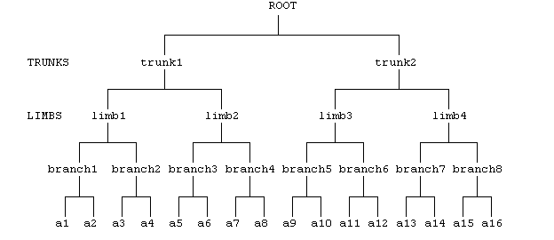
Higher Level Trees
E.g., Location (Neighborhood)
Housing Type (Rent, Buy, House, Apt)
Housing (# Bedrooms)

Slide 14
Degenerate Branches
LIMB
Travel
BRANCH
Fly
Ground
TWIG
Air
Train
Car
Bus

Slide 15
NL Model with Degenerate Branch
-----------------------------------------------------------
FIML Nested Multinomial Logit Model
Dependent variable MODE
Log likelihood function -148.63860
--------+--------------------------------------------------
Variable| Coefficient Standard Error b/St.Er. P[|Z|>z]
--------+--------------------------------------------------
|Attributes in the Utility Functions (beta)
GC| .44230*** .11318 3.908 .0001
TTME| -.10199*** .01598 -6.382 .0000
INVT| -.07469*** .01666 -4.483 .0000
INVC| -.44283*** .11437 -3.872 .0001
A_AIR| 3.97654*** 1.13637 3.499 .0005
AIR_HIN1| .02163 .01326 1.631 .1028
A_TRAIN| 6.50129*** 1.01147 6.428 .0000
TRA_HIN2| -.06427*** .01768 -3.635 .0003
A_BUS| 4.52963*** .99877 4.535 .0000
BUS_HIN3| -.01596 .02000 -.798 .4248
|IV parameters, lambda(b|l),gamma(l)
FLY| .86489*** .18345 4.715 .0000
GROUND| .24364*** .05338 4.564 .0000
|Underlying standard deviation = pi/(IVparm*sqr(6)
FLY| 1.48291*** .31454 4.715 .0000
GROUND| 5.26413*** 1.15331 4.564 .0000
--------+--------------------------------------------------

Slide 16
Estimates of a Nested Logit Model
NLOGIT ; lhs=mode
; rhs=gc,ttme,invt,invc
; rh2=one,hinc
; choices=air,train,bus,car
; tree=Travel[Fly(Air),
Ground(Train,Car,Bus)]
; show tree
; effects:gc(*)
; Describe $

Slide 17
Nested Logit Model
-----------------------------------------------------------
FIML Nested Multinomial Logit Model
Dependent variable MODE
Log likelihood function -168.81283 (-148.63860 with RU1)
--------+--------------------------------------------------
Variable| Coefficient Standard Error b/St.Er. P[|Z|>z]
--------+--------------------------------------------------
|Attributes in the Utility Functions (beta)
GC| .06527*** .01787 3.652 .0003
TTME| -.06114*** .01119 -5.466 .0000
INVT| -.01231*** .00283 -4.354 .0000
INVC| -.07018*** .01951 -3.597 .0003
A_AIR| 1.22545 .87245 1.405 .1601
AIR_HIN1| .01501 .01226 1.225 .2206
A_TRAIN| 3.44408*** .68388 5.036 .0000
TRA_HIN2| -.02823*** .00852 -3.311 .0009
A_BUS| 2.58400*** .63247 4.086 .0000
BUS_HIN3| -.00726 .01075 -.676 .4993
|IV parameters, RU2 form = mu(b|l),gamma(l)
FLY| 1.00000 ......(Fixed Parameter)......
GROUND| .47778*** .10508 4.547 .0000
|Underlying standard deviation = pi/(IVparm*sqr(6)
FLY| 1.28255 ......(Fixed Parameter)......
GROUND| 2.68438*** .59041 4.547 .0000
--------+--------------------------------------------------

Slide 18
Using Degenerate Branches to Reveal Scaling
LIMB
Travel
BRANCH
Fly
Rail
Drive
GrndPblc
TWIG
Air
Train
Car
Bus

Slide 19
Scaling in Transport Modes
-----------------------------------------------------------
FIML Nested Multinomial Logit Model
Dependent variable MODE
Log likelihood function -182.42834
The model has 2 levels.
Nested Logit form:IVparms=Taub|l,r,Sl|r
& Fr.No normalizations imposed a priori
Number of obs.= 210, skipped 0 obs
--------+--------------------------------------------------
Variable| Coefficient Standard Error b/St.Er. P[|Z|>z]
--------+--------------------------------------------------
|Attributes in the Utility Functions (beta)
GC| .09622** .03875 2.483 .0130
TTME| -.08331*** .02697 -3.089 .0020
INVT| -.01888*** .00684 -2.760 .0058
INVC| -.10904*** .03677 -2.966 .0030
A_AIR| 4.50827*** 1.33062 3.388 .0007
A_TRAIN| 3.35580*** .90490 3.708 .0002
A_BUS| 3.11885** 1.33138 2.343 .0192
|IV parameters, tau(b|l,r),sigma(l|r),phi(r)
FLY| 1.65512** .79212 2.089 .0367
RAIL| .92758*** .11822 7.846 .0000
LOCLMASS| 1.00787*** .15131 6.661 .0000
DRIVE| 1.00000 ......(Fixed Parameter)......
--------+--------------------------------------------------
NLOGIT ; Lhs=mode
; Rhs=gc,ttme,invt,invc,one
; Choices=air,train,bus,car
; Tree=Fly(Air),
Rail(train),
LoclMass(bus),
Drive(Car)
; ivset:(drive)=[1]$

Slide 20
Simulating the Nested Logit Model
NLOGIT ; lhs=mode;rhs=gc,ttme,invt,invc ; rh2=one,hinc
; choices=air,train,bus,car
; tree=Travel[Private(Air,Car),Public(Train,Bus)]
; simulation = *
; scenario:gc(car)=[*]1.5
+------------------------------------------------------+
|Simulations of Probability Model |
|Model: FIML: Nested Multinomial Logit Model |
|Number of individuals is the probability times the |
|number of observations in the simulated sample. |
|Column totals may be affected by rounding error. |
|The model used was simulated with 210 observations.|
+------------------------------------------------------+
-------------------------------------------------------------------------
Specification of scenario 1 is:
Attribute Alternatives affected Change type Value
--------- ------------------------------- ------------------- ---------
GC CAR Scale base by value 1.500
Simulated Probabilities (shares) for this scenario:
+----------+--------------+--------------+------------------+
|Choice | Base | Scenario | Scenario - Base |
| |%Share Number |%Share Number |ChgShare ChgNumber|
+----------+--------------+--------------+------------------+
|AIR | 26.515 56 | 8.854 19 |-17.661% -37 |
|TRAIN | 29.782 63 | 12.487 26 |-17.296% -37 |
|BUS | 14.504 30 | 71.824 151 | 57.320% 121 |
|CAR | 29.200 61 | 6.836 14 |-22.364% -47 |
|Total |100.000 210 |100.000 210 | .000% 0 |
+----------+--------------+--------------+------------------+

Slide 21
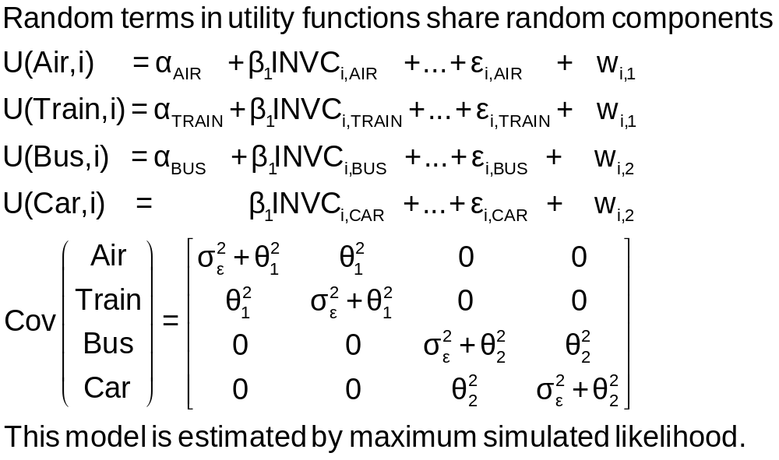
An Error Components Model

Slide 22
Error Components Logit Model
-----------------------------------------------------------
Error Components (Random Effects) model
Dependent variable MODE
Log likelihood function -182.27368
Response data are given as ind. choices
Replications for simulated probs. = 25
Halton sequences used for simulations
ECM model with panel has 70 groups
Fixed number of obsrvs./group= 3
Hessian is not PD. Using BHHH estimator
Number of obs.= 210, skipped 0 obs
--------+--------------------------------------------------
Variable| Coefficient Standard Error b/St.Er. P[|Z|>z]
--------+--------------------------------------------------
|Nonrandom parameters in utility functions
GC| .07293*** .01978 3.687 .0002
TTME| -.10597*** .01116 -9.499 .0000
INVT| -.01402*** .00293 -4.787 .0000
INVC| -.08825*** .02206 -4.000 .0001
A_AIR| 5.31987*** .90145 5.901 .0000
A_TRAIN| 4.46048*** .59820 7.457 .0000
A_BUS| 3.86918*** .67674 5.717 .0000
|Standard deviations of latent random effects
SigmaE01| .27336 3.25167 -.084 .9330
SigmaE02| 1.21988 .94292 1.294 .1958
--------+--------------------------------------------------

