Slide 1



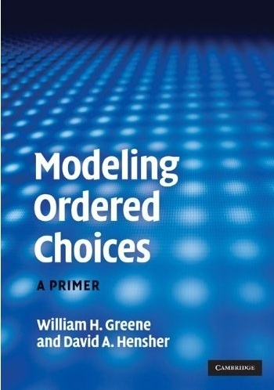

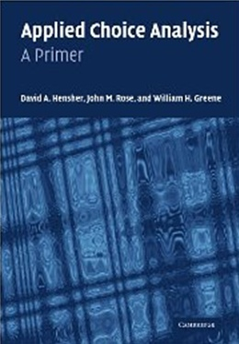
12. Random Parameters Logit Models

Slide 2
Random Parameters Model
Allow model parameters as well as constants to be random
Allow multiple observations with persistent effects
Allow a hierarchical structure for parameters – not completely random
U_{itj} = β₁’x_{i1tj} + β_{2i}’x_{i2tj} + γz_{it} + ε_{ijt}
Random parameters in multinomial logit model
  β1 = nonrandom (fixed) parameters
  β2i = random parameters that may vary across
  individuals and across time
Maintain I.I.D. assumption for ε_{ijt} (given β)

Slide 3
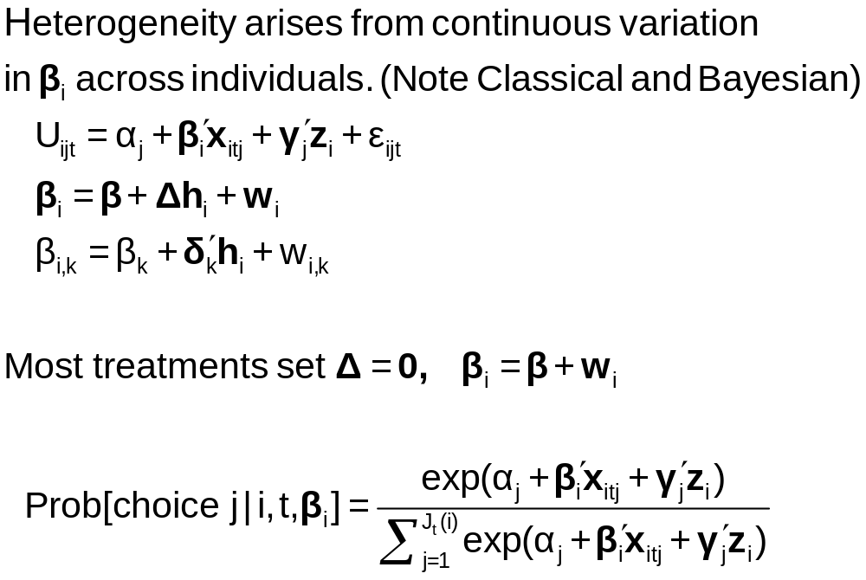
Continuous Random Variation in Preference Weights

Slide 4
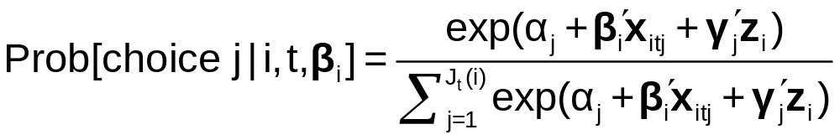
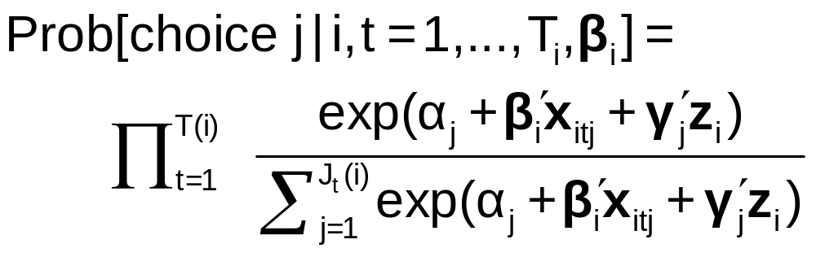
The Random Parameters Logit Model
Multiple choice situations: Independent conditioned on the individual specific parameters

Slide 5
Modeling Variations
Parameter specification
  “Nonrandom” – variance = 0
  Correlation across parameters – random parts correlated
  Fixed mean – not to be estimated. Free variance
  Fixed range – mean estimated, triangular from 0 to 2β
  Hierarchical structure - β_{ik} = β_{k} + δ_{k}’h_{i}
Stochastic specification
  Normal, uniform, triangular (tent) distributions
  Strictly positive – lognormal parameters (e.g., on income)
  Autoregressive: v(i,t,k) = u(i,t,k) + r(k)v(i,t-1,k) [this picks up time effects in multiple choice situations, e.g., fatigue.]

Slide 6
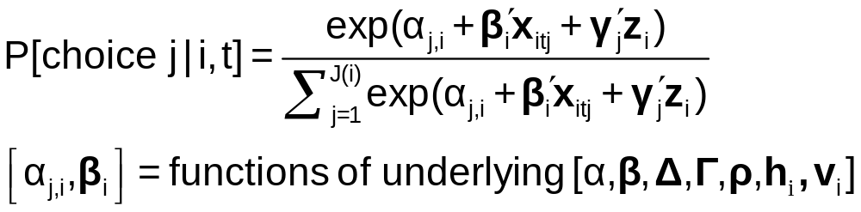
Estimating the Model
Denote by β₁ all “fixed” parameters
Denote by β_{2i} all random and hierarchical parameters

Slide 7
Estimating the RPL Model
Estimation: β₁
β_{2it} = β₂ + Δh_{i} + Γv_{i,t}
Uncorrelated: Γ is diagonal
Autocorrelated: v_{i,t} = Rv_{i,t-1} + u_{i,t}
(1) Estimate “structural parameters”
(2) Estimate individual specific utility parameters
(3) Estimate elasticities, etc.

Slide 8
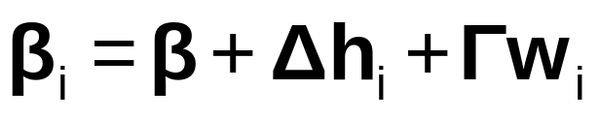
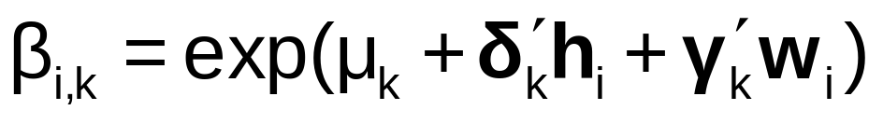
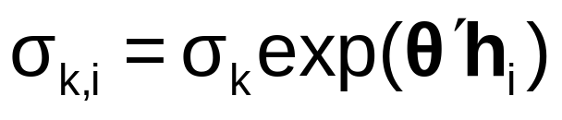
Model Extensions
AR(1): w_{i,k,t} = ρ_{k}w_{i,k,t-1} + v_{i,k,t}
Dynamic effects in the model
Restricting sign – lognormal distribution:
Restricting Range and Sign: Using triangular distribution and range = 0 to 2β.
Heteroscedasticity and heterogeneity

Slide 9
Application: Shoe Brand Choice
Simulated Data: Stated Choice,
  400 respondents,
  8 choice situations, 3,200 observations
3 choice/attributes + NONE
  Fashion = High / Low
  Quality = High / Low
  Price = 25/50/75,100 coded 1,2,3,4
Heterogeneity: Sex (Male=1), Age (<25, 25-39, 40+)
Underlying data generated by a 3 class latent class process (100, 200, 100 in classes)

Slide 10
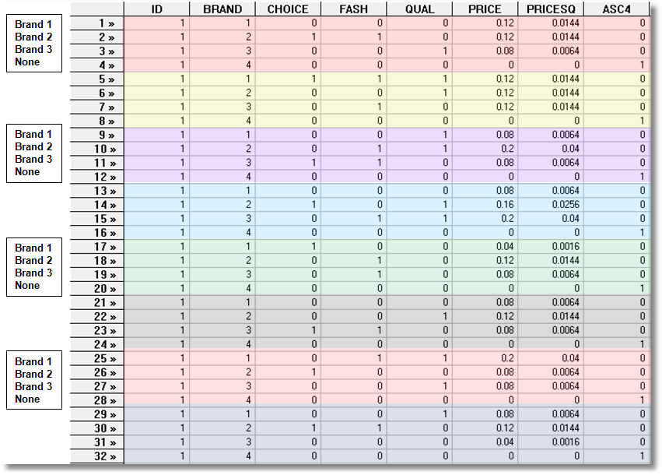
Stated Choice Experiment: Unlabeled Alternatives, One Observation
t=1
t=2
t=3
t=4
t=5
t=6
t=7
t=8

Slide 11
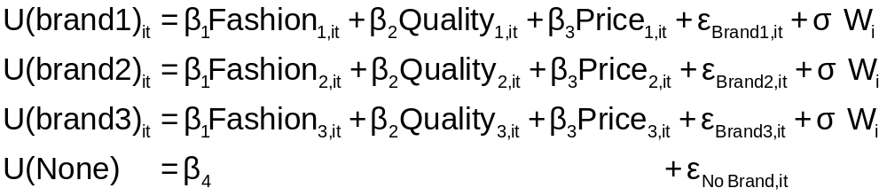
Error Components Logit Modeling
Alternative approach to building cross choice correlation
Common ‘effects.’ W_{i} is a ‘random individual effect.’

Slide 12
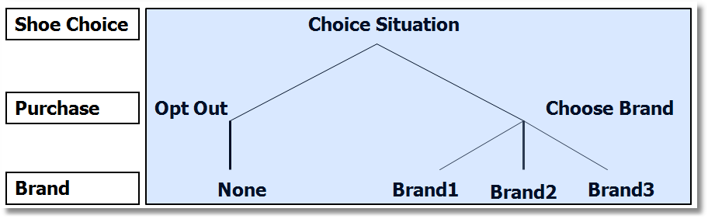
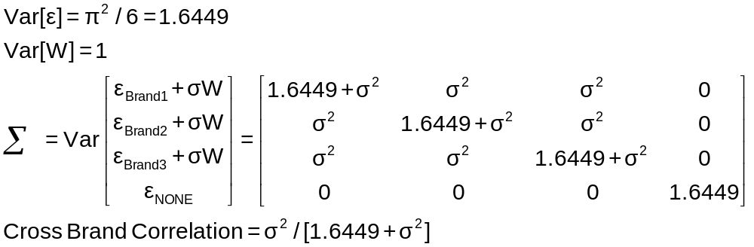
Implied Covariance Matrix
Nested Logit Formulation

Slide 13
Error Components Logit Model
-----------------------------------------------------------
Error Components (Random Effects) model
Dependent variable CHOICE
Log likelihood function -4158.45044
Estimation based on N = 3200, K = 5
Response data are given as ind. choices
Replications for simulated probs. = 50
Halton sequences used for simulations
ECM model with panel has 400 groups
Fixed number of obsrvs./group= 8
Number of obs.= 3200, skipped 0 obs
--------+--------------------------------------------------
Variable| Coefficient Standard Error b/St.Er. P[|Z|>z]
--------+--------------------------------------------------
|Nonrandom parameters in utility functions
FASH| 1.47913*** .06971 21.218 .0000
QUAL| 1.01385*** .06580 15.409 .0000
PRICE| -11.8052*** .86019 -13.724 .0000
ASC4| .03363 .07441 .452 .6513
SigmaE01| .09585*** .02529 3.791 .0002
--------+--------------------------------------------------
Random Effects Logit Model
Appearance of Latent Random
Effects in Utilities
Alternative E01
+-------------+---+
| BRAND1 | * |
+-------------+---+
| BRAND2 | * |
+-------------+---+
| BRAND3 | * |
+-------------+---+
| NONE | |
+-------------+---+
Correlation = {0.0959² / [1.6449 + 0.0959²]}^{1/2} = 0.0954

Slide 14
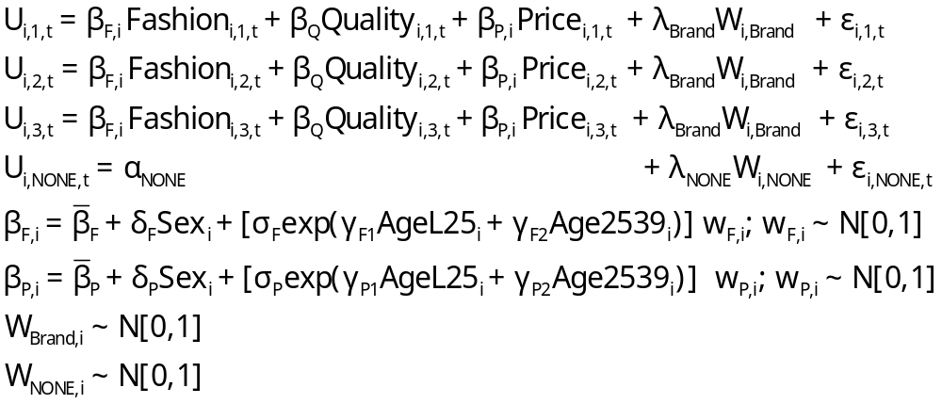
Extended MNL Model
Utility Functions

Slide 15
Extending the Basic MNL Model
Random Utility

Slide 16
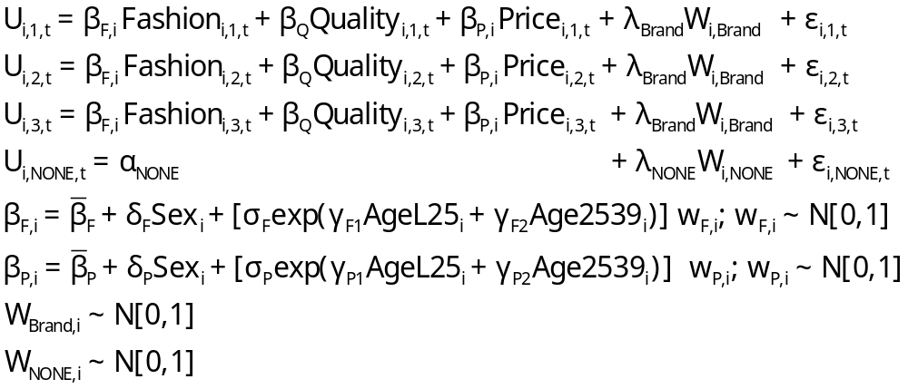
Error Components Logit Model
Error Components

Slide 17
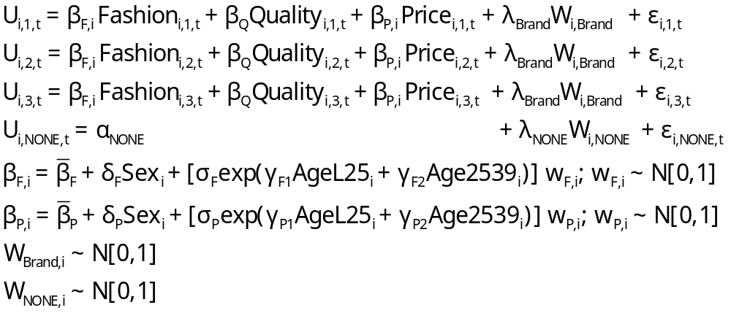
Random Parameters Model

Slide 18
Heterogeneous (in the Means)
Random Parameters Model

Slide 19
Heterogeneity in Both
Means and Variances

Slide 20
-----------------------------------------------------------
Random Parms/Error Comps. Logit Model
Dependent variable CHOICE
Log likelihood function -4019.23544 (-4158.50286 for MNL)
Restricted log likelihood -4436.14196 (Chi squared = 278.5)
Chi squared [ 12 d.f.] 833.81303
Significance level .00000
McFadden Pseudo R-squared .0939795
Estimation based on N = 3200, K = 12
Information Criteria: Normalization=1/N
Normalized Unnormalized
AIC 2.51952 8062.47089
Fin.Smpl.AIC 2.51955 8062.56878
Bayes IC 2.54229 8135.32176
Hannan Quinn 2.52768 8088.58926
R2=1-LogL/LogL* Log-L fncn R-sqrd R2Adj
No coefficients -4436.1420 .0940 .0928
Constants only -4391.1804 .0847 .0836
At start values -4158.5029 .0335 .0323
Response data are given as ind. choices
Replications for simulated probs. = 50
Halton sequences used for simulations
RPL model with panel has 400 groups
Fixed number of obsrvs./group= 8
Hessian is not PD. Using BHHH estimator
Number of obs.= 3200, skipped 0 obs
--------+--------------------------------------------------

Slide 21
Estimated RP/ECL Model
--------+--------------------------------------------------
Variable| Coefficient Standard Error b/St.Er. P[|Z|>z]
--------+--------------------------------------------------
|Random parameters in utility functions
FASH| .62768*** .13498 4.650 .0000
PRICE| -7.60651*** 1.08418 -7.016 .0000
|Nonrandom parameters in utility functions
QUAL| 1.07127*** .06732 15.913 .0000
ASC4| .03874 .09017 .430 .6675
|Heterogeneity in mean, Parameter:Variable
FASH:AGE| 1.73176*** .15372 11.266 .0000
FAS0:AGE| .71872*** .18592 3.866 .0001
PRIC:AGE| -9.38055*** 1.07578 -8.720 .0000
PRI0:AGE| -4.33586*** 1.20681 -3.593 .0003
|Distns. of RPs. Std.Devs or limits of triangular
NsFASH| .88760*** .07976 11.128 .0000
NsPRICE| 1.23440 1.95780 .631 .5284
|Heterogeneity in standard deviations
|(cF1, cF2, cP1, cP2 omitted...)
|Standard deviations of latent random effects
SigmaE01| .23165 .40495 .572 .5673
SigmaE02| .51260** .23002 2.228 .0258
--------+--------------------------------------------------
Note: ***, **, * = Significance at 1%, 5%, 10% level.
-----------------------------------------------------------
Random Effects Logit
Model Appearance of
Latent Random Effects
in Utilities
Alternative E01 E02
+-------------+---+---+
| BRAND1 | * | |
+-------------+---+---+
| BRAND2 | * | |
+-------------+---+---+
| BRAND3 | * | |
+-------------+---+---+
| NONE | | * |
+-------------+---+---+
Heterogeneity in Means.
Delta: 2 rows, 2 cols.
AGE25 AGE39
FASH 1.73176 .71872
PRICE -9.38055 -4.33586

Slide 22
Estimated Elasticities
Multinomial Logit
+---------------------------------------------------+
| Elasticity averaged over observations.|
| Attribute is PRICE in choice BRAND1 |
| Effects on probabilities of all choices in model: |
| * = Direct Elasticity effect of the attribute. |
| Mean St.Dev |
| * Choice=BRAND1 -.9210 .4661 |
| Choice=BRAND2 .2773 .3053 |
| Choice=BRAND3 .2971 .3370 |
| Choice=NONE .2781 .2804 |
+---------------------------------------------------+
| Attribute is PRICE in choice BRAND2 |
| Choice=BRAND1 .3055 .1911 |
| * Choice=BRAND2 -1.2692 .6179 |
| Choice=BRAND3 .3195 .2127 |
| Choice=NONE .2934 .1711 |
+---------------------------------------------------+
| Attribute is PRICE in choice BRAND3 |
| Choice=BRAND1 .3737 .2939 |
| Choice=BRAND2 .3881 .3047 |
| * Choice=BRAND3 -.7549 .4015 |
| Choice=NONE .3488 .2670 |
+---------------------------------------------------+
+--------------------------+
| Effects on probabilities |
| * = Direct effect te. |
| Mean St.Dev |
| PRICE in choice BRAND1 |
| * BRAND1 -.8895 .3647 |
| BRAND2 .2907 .2631 |
| BRAND3 .2907 .2631 |
| NONE .2907 .2631 |
+--------------------------+
| PRICE in choice BRAND2 |
| BRAND1 .3127 .1371 |
| * BRAND2 -1.2216 .3135 |
| BRAND3 .3127 .1371 |
| NONE .3127 .1371 |
+--------------------------+
| PRICE in choice BRAND3 |
| BRAND1 .3664 .2233 |
| BRAND2 .3664 .2233 |
| * BRAND3 -.7548 .3363 |
| NONE .3664 .2233 |
+--------------------------+

Slide 23
Estimating Individual Distributions
Form posterior estimates of E[β_{i}|data_{i}]
Use the same methodology to estimate E[β_{i}²|data_{i}] and Var[β_{i}|data_{i}]
Plot individual “confidence intervals” (assuming near normality)
Sample from the distribution and plot kernel density estimates

Slide 24
What is the ‘Individual Estimate?’
Point estimate of mean, variance and range of
random variable β_{i} | data_{i}.
Value is NOT an estimate of β_{i} ; it is an estimate
of E[β_{i} | data_{i}]
This would be the best estimate of the actual
realization β_{i}|data_{i}
An interval estimate would account for the sampling
‘variation’ in the estimator of Ω.
Bayesian counterpart to the preceding: Posterior
mean and variance. Same kind of plot could be done.

Slide 25
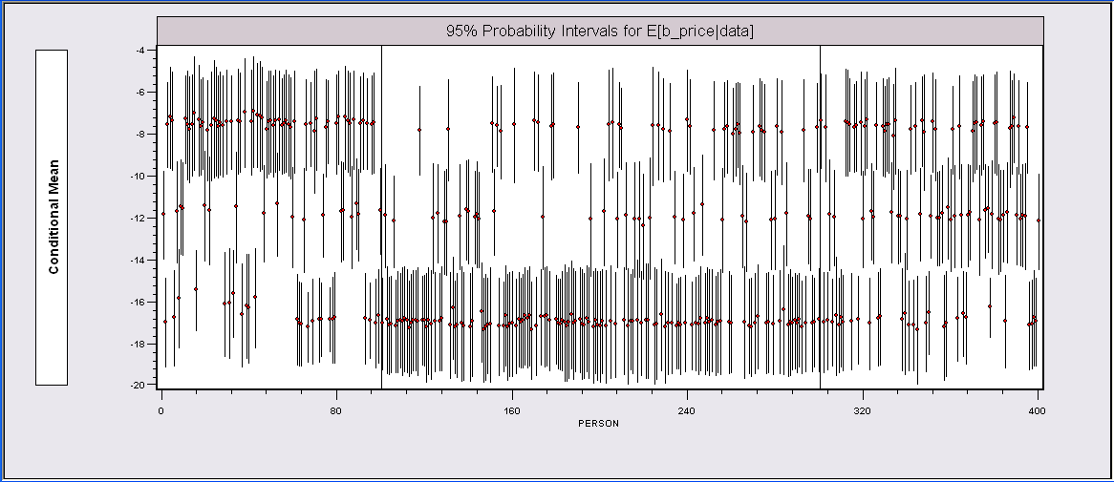
Individual E[β_{i}|data_{i}] Estimates*
The random parameters model is uncovering the latent class feature of the data.
*The intervals could be made wider to account for the sampling
variability of the underlying (classical) parameter estimators.

Slide 26
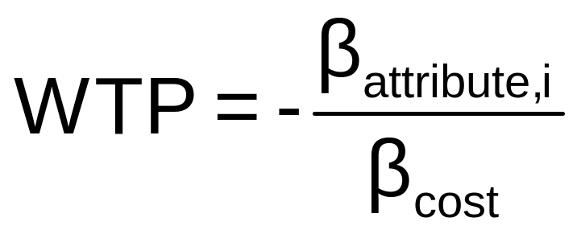
WTP Application (Value of Time Saved)
Estimating Willingness to Pay for
Increments to an Attribute in a
Discrete Choice Model
Random

Slide 27
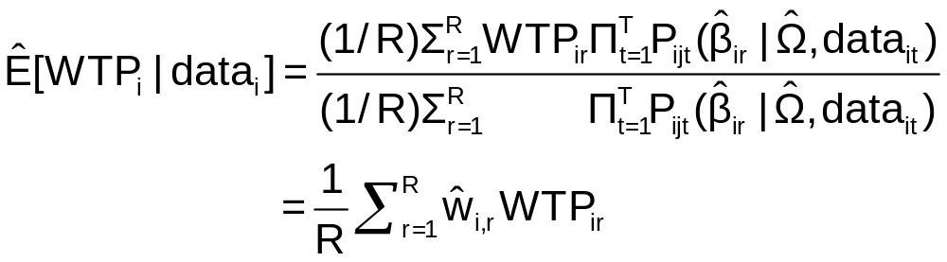
Extending the RP Model to WTP
Use the model to estimate conditional
distributions for any function of
parameters
Willingness to pay = -β_{i,time} / β_{i,cost}
Use simulation method

Slide 28
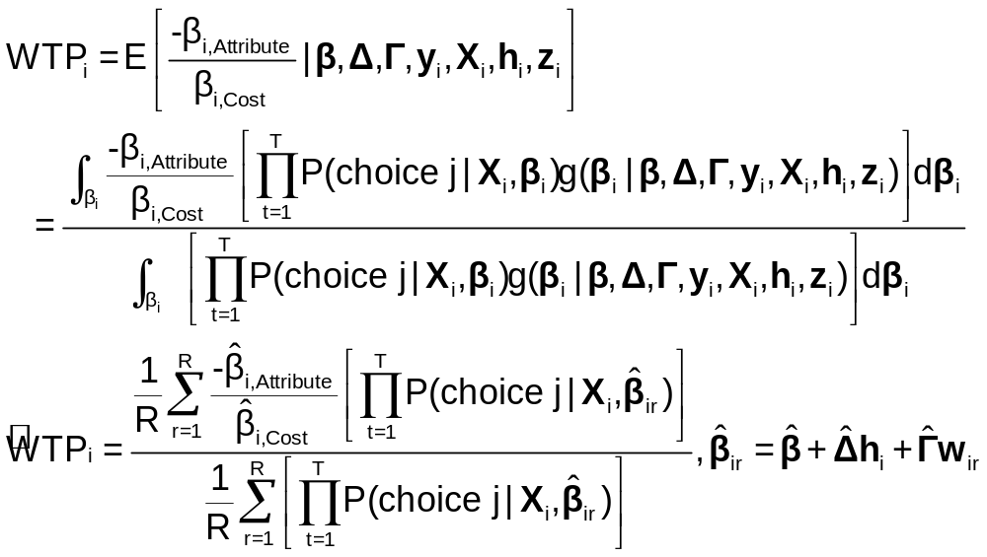
Sumulation of WTP from β_{i}

Slide 29
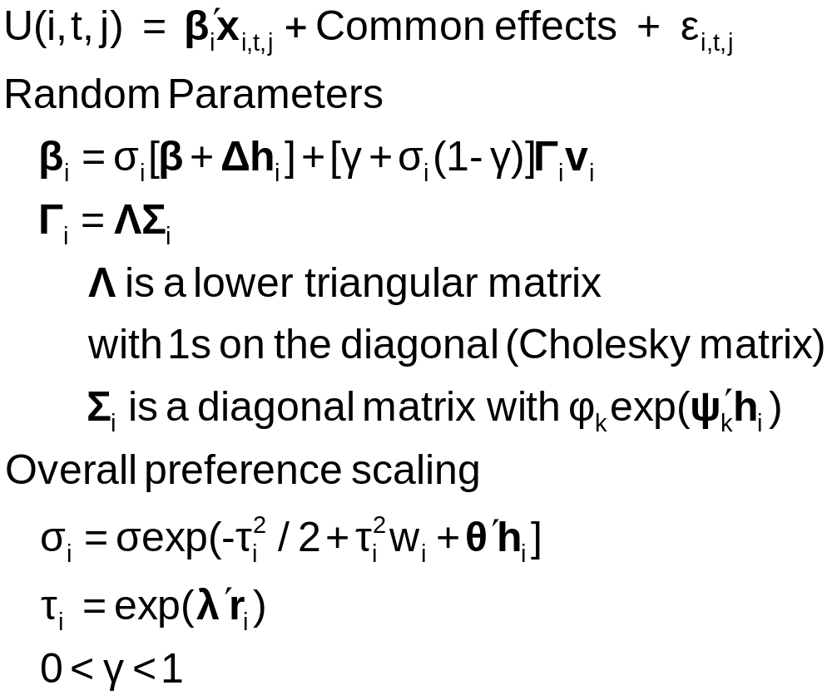
Extension: Generalized Mixed Logit Model

Slide 30
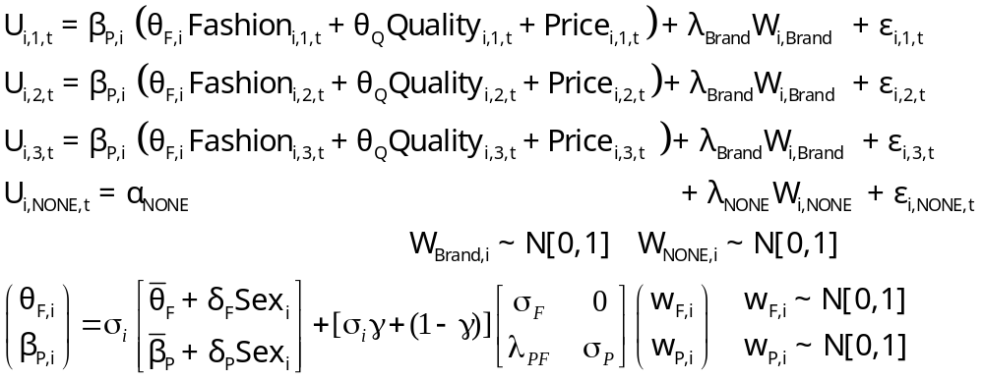
Extension: Estimation in Willingness to Pay Space
Both parameters in the WTP calculation are random.

Slide 31
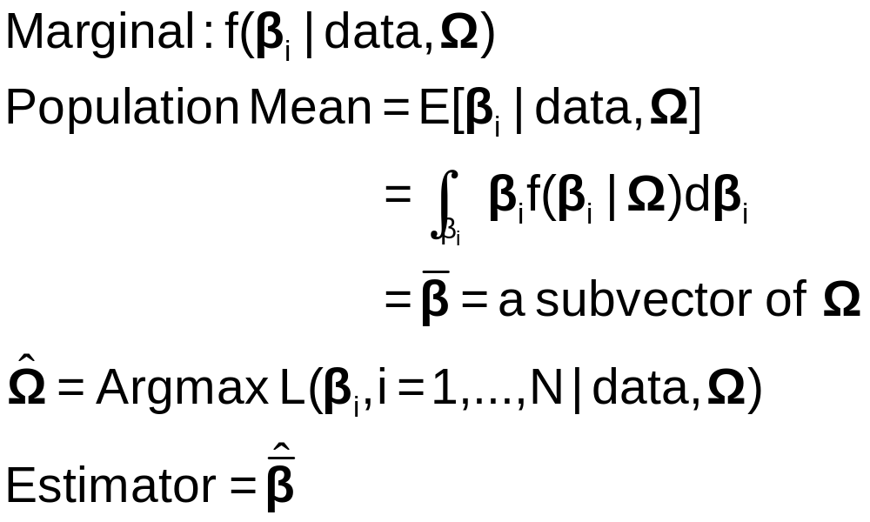
Appendix: Classical Estimation Platform - The Likelihood
Expected value over all possible realizations of β_{i} (according to the estimated asymptotic distribution). I.e., over all possible samples.

Slide 32

Simulation Based Estimation
Choice probability = P[data |β(β₁,β₂,Δ,Γ,R,h_{i},v_{i,t})]
Need to integrate out the unobserved random term
E{P[data | β(β₁,β₂,Δ,Γ,R,h_{i},v_{i,t})]}
= P[…|v_{i,t}]f(v_{i,t})dv_{i,t}
Integration is done by simulation
  Draw values of v and compute β then probabilities
  Average many draws
  Maximize the sum of the logs of the averages
  (See Train[Cambridge, 2003] on simulation methods.)

Slide 33
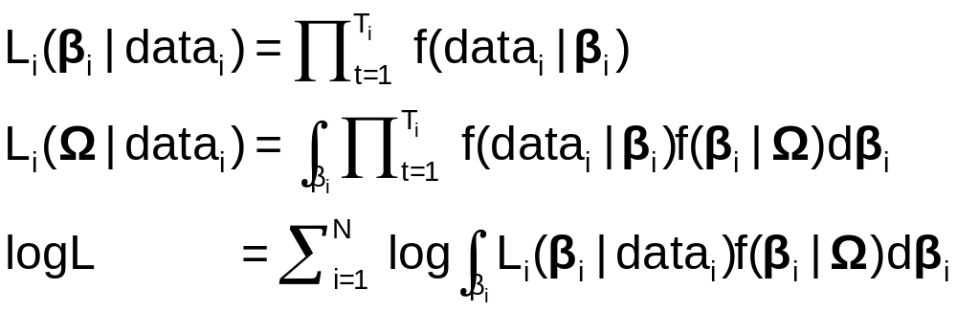
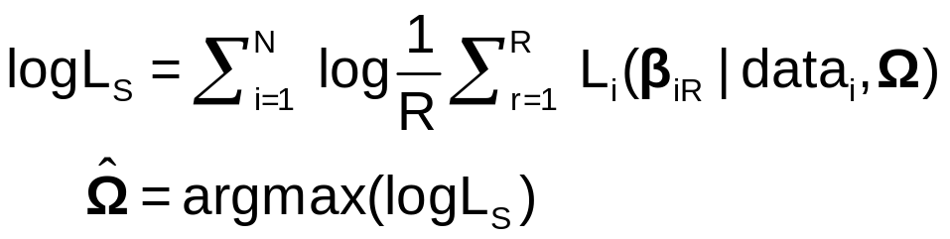
Maximum Simulated Likelihood
True log likelihood
Simulated log likelihood

