Slide 1






13. Latent Class Logit Models

Slide 2
Discrete Parameter Heterogeneity
Latent Classes

Slide 3
Latent Class Probabilities
Ambiguous – Classical Bayesian model?
  The randomness of the class assignment is from the point of view of the observer, not a natural process governed by a discrete distribution.
Equivalent to random parameters models with discrete parameter variation
  Using nested logits, etc. does not change this
  Precisely analogous to continuous ‘random parameter’ models

Slide 4
A Latent Class MNL Model
Within a “class”
Class sorting is probabilistic (to the analyst) determined by individual characteristics

Slide 5
Estimates from the LCM
Taste parameters within each class β_{q}
Parameters of the class probability model, θ_{q}
For each person:
  Posterior estimates of the class they are in q|i
  Posterior estimates of their taste parameters E[β_{q}|i]
  Posterior estimates of their behavioral parameters, elasticities, marginal effects, etc.

Slide 6
Using the Latent Class Model
Computing posterior (individual specific) class probabilities
Computing posterior (individual specific) taste parameters

Slide 7
Application: Shoe Brand Choice
Simulated Data: Stated Choice, 400 respondents, 8 choice situations, 3,200 observations
3 choice/attributes + NONE
  Fashion = High / Low
  Quality = High / Low
  Price = 25/50/75,100 coded 1,2,3,4
Heterogeneity: Sex, Age (<25, 25-39, 40+)
Underlying data generated by a 3 class latent class process (100, 200, 100 in classes)

Slide 8
One Class MNL Estimates
-----------------------------------------------------------
Discrete choice (multinomial logit) model
Dependent variable Choice
Log likelihood function -4158.50286
Estimation based on N = 3200, K = 4
R2=1-LogL/LogL* Log-L fncn R-sqrd R2Adj
Constants only -4391.1804 .0530 .0510
Response data are given as ind. choices
Number of obs.= 3200, skipped 0 obs
--------+--------------------------------------------------
Variable| Coefficient Standard Error b/St.Er. P[|Z|>z]
--------+--------------------------------------------------
FASH|1| 1.47890*** .06777 21.823 .0000
QUAL|1| 1.01373*** .06445 15.730 .0000
PRICE|1| -11.8023*** .80406 -14.678 .0000
ASC4|1| .03679 .07176 .513 .6082
--------+--------------------------------------------------

Slide 9
Application: Brand Choice
True underlying model is a three class LCM
NLOGIT
; Lhs=choice
; Choices=Brand1,Brand2,Brand3,None
; Rhs = Fash,Qual,Price,ASC4
; LCM=Male,Age25,Age39
; Pts=3
; Pds=8
; Par (Save posterior results) $

Slide 10
Three Class LCM
Normal exit from iterations. Exit status=0.
-----------------------------------------------------------
Latent Class Logit Model
Dependent variable CHOICE
Log likelihood function -3649.13245
Restricted log likelihood -4436.14196
Chi squared [ 20 d.f.] 1574.01902
Significance level .00000
McFadden Pseudo R-squared .1774085
Estimation based on N = 3200, K = 20
R2=1-LogL/LogL* Log-L fncn R-sqrd R2Adj
No coefficients -4436.1420 .1774 .1757
Constants only -4391.1804 .1690 .1673
At start values -4158.5428 .1225 .1207
Response data are given as ind. choices
Number of latent classes = 3
Average Class Probabilities
.506 .239 .256
LCM model with panel has 400 groups
Fixed number of obsrvs./group= 8
Number of obs.= 3200, skipped 0 obs
--------+--------------------------------------------------
LogL for one class MNL = -4158.503
Based on the LR statistic it would seem unambiguous to reject the one class model. The degrees of freedom for the test are uncertain, however.

Slide 11
Estimated LCM: Utilities
--------+--------------------------------------------------
Variable| Coefficient Standard Error b/St.Er. P[|Z|>z]
--------+--------------------------------------------------
|Utility parameters in latent class -->> 1
FASH|1| 3.02570*** .14549 20.796 .0000
QUAL|1| -.08782 .12305 -.714 .4754
PRICE|1| -9.69638*** 1.41267 -6.864 .0000
ASC4|1| 1.28999*** .14632 8.816 .0000
|Utility parameters in latent class -->> 2
FASH|2| 1.19722*** .16169 7.404 .0000
QUAL|2| 1.11575*** .16356 6.821 .0000
PRICE|2| -13.9345*** 1.93541 -7.200 .0000
ASC4|2| -.43138** .18514 -2.330 .0198
|Utility parameters in latent class -->> 3
FASH|3| -.17168 .16725 -1.026 .3047
QUAL|3| 2.71881*** .17907 15.183 .0000
PRICE|3| -8.96483*** 1.93400 -4.635 .0000
ASC4|3| .18639 .18412 1.012 .3114

Slide 12
Estimated LCM: Class Probability Model
--------+--------------------------------------------------
Variable| Coefficient Standard Error b/St.Er. P[|Z|>z]
--------+--------------------------------------------------
|This is THETA(01) in class probability model.
Constant| -.90345** .37612 -2.402 .0163
_MALE|1| .64183* .36245 1.771 .0766
_AGE25|1| 2.13321*** .32096 6.646 .0000
_AGE39|1| .72630* .43511 1.669 .0951
|This is THETA(02) in class probability model.
Constant| .37636 .34812 1.081 .2796
_MALE|2| -2.76536*** .69325 -3.989 .0001
_AGE25|2| -.11946 .54936 -.217 .8279
_AGE39|2| 1.97657*** .71684 2.757 .0058
|This is THETA(03) in class probability model.
Constant| .000 ......(Fixed Parameter)......
_MALE|3| .000 ......(Fixed Parameter)......
_AGE25|3| .000 ......(Fixed Parameter)......
_AGE39|3| .000 ......(Fixed Parameter)......
--------+--------------------------------------------------

Slide 13
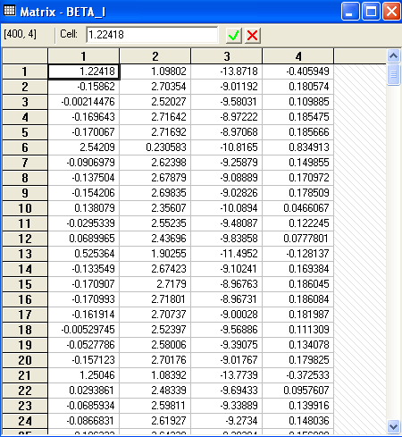
Estimated LCM:
Conditional Parameter Estimates

Slide 14
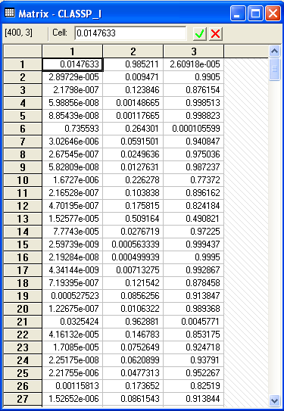
Estimated LCM: Conditional (Posterior) Class Probabilities

Slide 15
Average Estimated Class Probabilities
MATRIX ; list ; 1/400 * classp_i'1$
Matrix Result has 3 rows and 1 columns.
1
+--------------
1| .50555
2| .23853
3| .25593
This is how the data were simulated. Class probabilities are .5, .25, .25. The model ‘worked.’

Slide 16
Elasticities
+---------------------------------------------------+
| Elasticity averaged over observations.|
| Effects on probabilities of all choices in model: |
| * = Direct Elasticity effect of the attribute. |
| Attribute is PRICE in choice BRAND1 |
| Mean St.Dev |
| * Choice=BRAND1 -.8010 .3381 |
| Choice=BRAND2 .2732 .2994 |
| Choice=BRAND3 .2484 .2641 |
| Choice=NONE .2193 .2317 |
+---------------------------------------------------+
| Attribute is PRICE in choice BRAND2 |
| Choice=BRAND1 .3106 .2123 |
| * Choice=BRAND2 -1.1481 .4885 |
| Choice=BRAND3 .2836 .2034 |
| Choice=NONE .2682 .1848 |
+---------------------------------------------------+
| Attribute is PRICE in choice BRAND3 |
| Choice=BRAND1 .3145 .2217 |
| Choice=BRAND2 .3436 .2991 |
| * Choice=BRAND3 -.6744 .3676 |
| Choice=NONE .3019 .2187 |
+---------------------------------------------------+
Elasticities are computed by averaging individual elasticities computed at the expected (posterior) parameter vector.
This is an unlabeled choice experiment. It is not possible to attach any significance to the fact that the elasticity is different for Brand1 and Brand 2 or Brand 3.

Slide 17
Application: Long Distance Drivers’
Preference for Road Environments
New Zealand survey, 2000, 274 drivers
Mixed revealed and stated choice experiment
4 Alternatives in choice set
  The current road the respondent is/has been using;
  A hypothetical 2-lane road;
  A hypothetical 4-lane road with no median;
  A hypothetical 4-lane road with a wide grass median.
16 stated choice situations for each with 2 choice profiles
  choices involving all 4 choices
  choices involving only the last 3 (hypothetical)
Hensher and Greene, A Latent Class Model for Discrete Choice Analysis: Contrasts with Mixed Logit – Transportation Research B, 2003

Slide 18
Attributes
Time on the open road which is free flow (in minutes);
Time on the open road which is slowed by other traffic (in minutes);
Percentage of total time on open road spent with other vehicles close behind (ie tailgating) (%);
Curviness of the road (A four-level attribute - almost straight, slight, moderate, winding);
Running costs (in dollars);
Toll cost (in dollars).

Slide 19
Experimental Design
The four levels of the six attributes chosen are:
Free Flow Travel Time: -20%, -10%, +10%, +20%
Time Slowed Down: -20%, -10%, +10%, +20%
Percent of time with vehicles close behind:
-50%, -25%, +25%, +50%
Curviness:almost, straight, slight, moderate, winding
Running Costs: -10%, -5%, +5%, +10%
Toll cost for car and double for truck if trip duration is:
1 hours or less 0, 0.5, 1.5, 3
Between 1 hour and 2.5 hours 0, 1.5, 4.5, 9
More than 2.5 hours 0, 2.5, 7.5, 15

Slide 20
Estimated Latent Class Model

Slide 21
Estimated Value of Time Saved

Slide 22
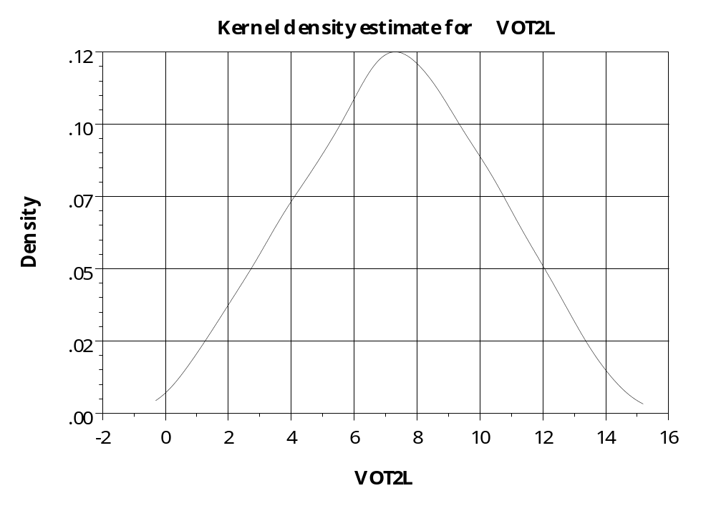
Distribution of Parameters –
Value of Time on 2 Lane Road

Slide 23

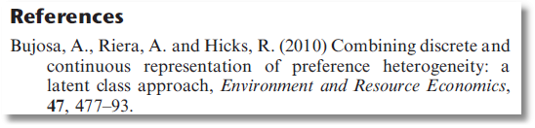
Latent Class Mixed Logit

Slide 24
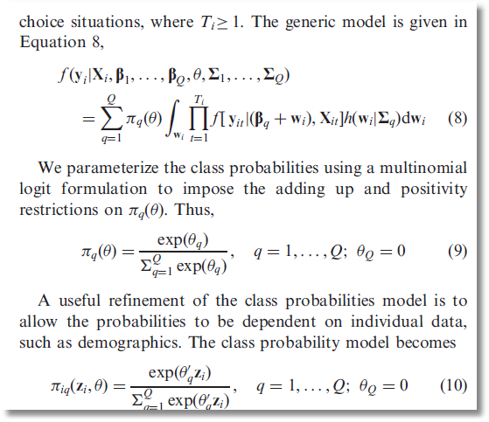
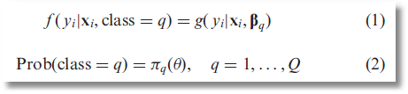
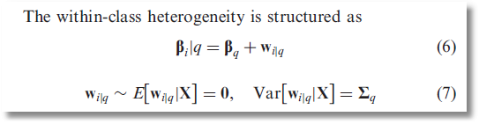

Slide 25
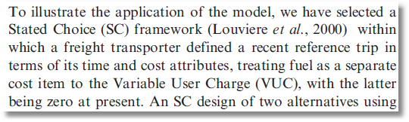
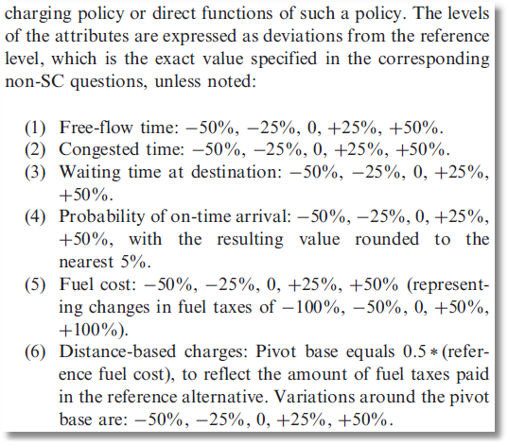
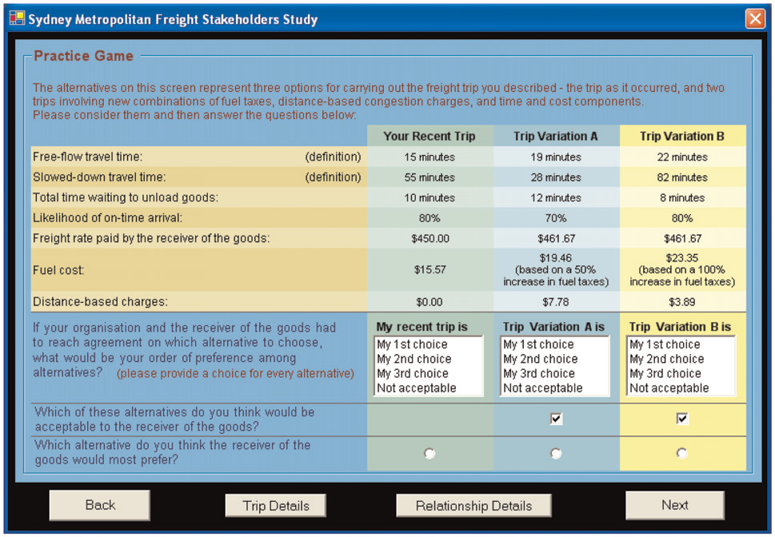

Slide 26
