Slide 1






14. Scaling and Heteroscedasticity

Slide 2
Using Degenerate Branches to Reveal Scaling
LIMB
Travel
BRANCH
Fly
Rail
Drive
GrndPblc
TWIG
Air
Train
Car
Bus

Slide 3
Scaling in Transport Modes
-----------------------------------------------------------
FIML Nested Multinomial Logit Model
Dependent variable MODE
Log likelihood function -182.42834
The model has 2 levels.
Nested Logit form:IVparms=Taub|l,r,Sl|r
& Fr.No normalizations imposed a priori
Number of obs.= 210, skipped 0 obs
--------+--------------------------------------------------
Variable| Coefficient Standard Error b/St.Er. P[|Z|>z]
--------+--------------------------------------------------
|Attributes in the Utility Functions (beta)
GC| .09622** .03875 2.483 .0130
TTME| -.08331*** .02697 -3.089 .0020
INVT| -.01888*** .00684 -2.760 .0058
INVC| -.10904*** .03677 -2.966 .0030
A_AIR| 4.50827*** 1.33062 3.388 .0007
A_TRAIN| 3.35580*** .90490 3.708 .0002
A_BUS| 3.11885** 1.33138 2.343 .0192
|IV parameters, tau(b|l,r),sigma(l|r),phi(r)
FLY| 1.65512** .79212 2.089 .0367
RAIL| .92758*** .11822 7.846 .0000
LOCLMASS| 1.00787*** .15131 6.661 .0000
DRIVE| 1.00000 ......(Fixed Parameter)......
--------+--------------------------------------------------
NLOGIT ; Lhs=mode
; Rhs=gc,ttme,invt,invc,one
; Choices=air,train,bus,car
; Tree=Fly(Air),
Rail(train),
LoclMass(bus),
Drive(Car)
; ivset:(drive)=[1]$

Slide 4
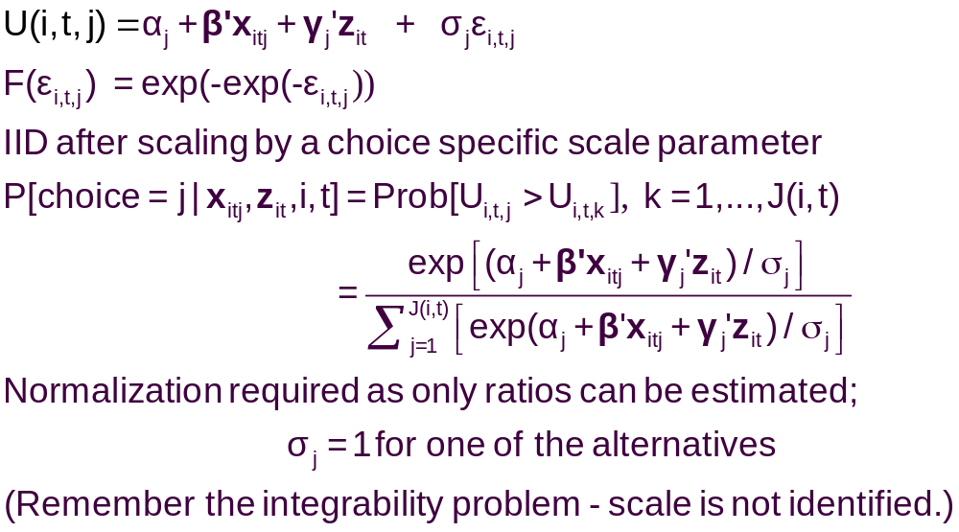
A Model with Choice Heteroscedasticity

Slide 5
Heteroscedastic Extreme Value Model (1)
+---------------------------------------------+
| Start values obtained using MNL model |
| Maximum Likelihood Estimates |
| Log likelihood function -184.5067 |
| Dependent variable Choice |
| Response data are given as ind. choice. |
| Number of obs.= 210, skipped 0 bad obs. |
+---------------------------------------------+
+--------+--------------+----------------+--------+--------+
|Variable| Coefficient | Standard Error |b/St.Er.|P[|Z|>z]|
+--------+--------------+----------------+--------+--------+
GC | .06929537 .01743306 3.975 .0001
TTME | -.10364955 .01093815 -9.476 .0000
INVC | -.08493182 .01938251 -4.382 .0000
INVT | -.01333220 .00251698 -5.297 .0000
AASC | 5.20474275 .90521312 5.750 .0000
TASC | 4.36060457 .51066543 8.539 .0000
BASC | 3.76323447 .50625946 7.433 .0000

Slide 6
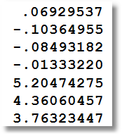
Heteroscedastic Extreme Value Model (2)
+---------------------------------------------+
| Heteroskedastic Extreme Value Model |
| Log likelihood function -182.4440 | (MNL logL was -184.5067)
| Number of parameters 10 |
| Restricted log likelihood -291.1218 |
+---------------------------------------------+
+--------+--------------+----------------+--------+--------+
|Variable| Coefficient | Standard Error |b/St.Er.|P[|Z|>z]|
+--------+--------------+----------------+--------+--------+
---------+Attributes in the Utility Functions (beta)
GC | .11903513 .06402510 1.859 .0630
TTME | -.11525581 .05721397 -2.014 .0440
INVC | -.15515877 .07928045 -1.957 .0503
INVT | -.02276939 .01122762 -2.028 .0426
AASC | 4.69411460 2.48091789 1.892 .0585
TASC | 5.15629868 2.05743764 2.506 .0122
BASC | 5.03046595 1.98259353 2.537 .0112
---------+Scale Parameters of Extreme Value Distns Minus 1.0
s_AIR | -.57864278 .21991837 -2.631 .0085
s_TRAIN | -.45878559 .34971034 -1.312 .1896
s_BUS | .26094835 .94582863 .276 .7826
s_CAR | .000000 ......(Fixed Parameter).......
---------+Std.Dev=pi/(theta*sqr(6)) for H.E.V. distribution.
s_AIR | 3.04385384 1.58867426 1.916 .0554
s_TRAIN | 2.36976283 1.53124258 1.548 .1217
s_BUS | 1.01713111 .76294300 1.333 .1825
s_CAR | 1.28254980 ......(Fixed Parameter).......
Normalized for estimation
Structural parameters

Slide 7
HEV Model - Elasticities
+---------------------------------------------------+
| Elasticity averaged over observations.|
| Attribute is INVC in choice AIR |
| Effects on probabilities of all choices in model: |
| * = Direct Elasticity effect of the attribute. |
| Mean St.Dev |
| * Choice=AIR -4.2604 1.6745 |
| Choice=TRAIN 1.5828 1.9918 |
| Choice=BUS 3.2158 4.4589 |
| Choice=CAR 2.6644 4.0479 |
| Attribute is INVC in choice TRAIN |
| Choice=AIR .7306 .5171 |
| * Choice=TRAIN -3.6725 4.2167 |
| Choice=BUS 2.4322 2.9464 |
| Choice=CAR 1.6659 1.3707 |
| Attribute is INVC in choice BUS |
| Choice=AIR .3698 .5522 |
| Choice=TRAIN .5949 1.5410 |
| * Choice=BUS -6.5309 5.0374 |
| Choice=CAR 2.1039 8.8085 |
| Attribute is INVC in choice CAR |
| Choice=AIR .3401 .3078 |
| Choice=TRAIN .4681 .4794 |
| Choice=BUS 1.4723 1.6322 |
| * Choice=CAR -3.5584 9.3057 |
+---------------------------------------------------+
Multinomial Logit
+---------------------------+
| INVC in AIR |
| Mean St.Dev |
| * -5.0216 2.3881 |
| 2.2191 2.6025 |
| 2.2191 2.6025 |
| 2.2191 2.6025 |
| INVC in TRAIN |
| 1.0066 .8801 |
| * -3.3536 2.4168 |
| 1.0066 .8801 |
| 1.0066 .8801 |
| INVC in BUS |
| .4057 .6339 |
| .4057 .6339 |
| * -2.4359 1.1237 |
| .4057 .6339 |
| INVC in CAR |
| .3944 .3589 |
| .3944 .3589 |
| .3944 .3589 |
| * -1.3888 1.2161 |
+---------------------------+

Slide 8
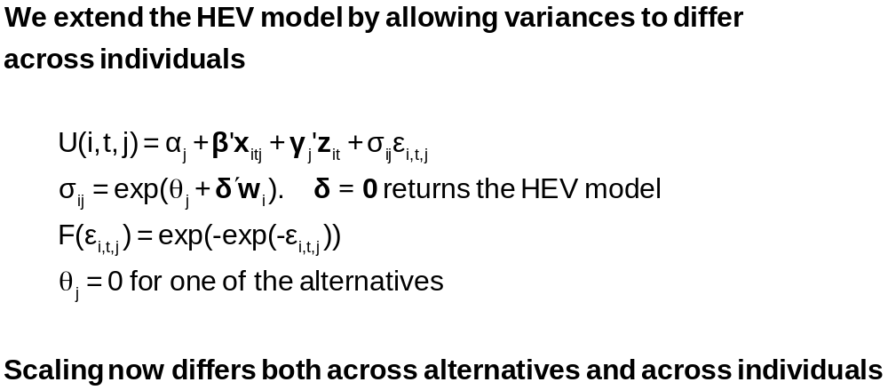
Variance Heterogeneity in MNL

Slide 9
Application: Shoe Brand Choice
Simulated Data: Stated Choice, 400 respondents, 8 choice situations, 3,200 observations
3 choice/attributes + NONE
  Fashion = High / Low
  Quality = High / Low
  Price = 25/50/75,100 coded 1,2,3,4
Heterogeneity: Sex, Age (<25, 25-39, 40+)
Underlying data generated by a 3 class latent class process (100, 200, 100 in classes)

Slide 10
Multinomial Logit Baseline Values
+---------------------------------------------+
| Discrete choice (multinomial logit) model |
| Number of observations 3200 |
| Log likelihood function -4158.503 |
| Number of obs.= 3200, skipped 0 bad obs. |
+---------------------------------------------+
+--------+--------------+----------------+--------+--------+
|Variable| Coefficient | Standard Error |b/St.Er.|P[|Z|>z]|
+--------+--------------+----------------+--------+--------+
FASH | 1.47890473 .06776814 21.823 .0000
QUAL | 1.01372755 .06444532 15.730 .0000
PRICE | -11.8023376 .80406103 -14.678 .0000
ASC4 | .03679254 .07176387 .513 .6082

Slide 11
Multinomial Logit Elasticities
+---------------------------------------------------+
| Elasticity averaged over observations.|
| Attribute is PRICE in choice BRAND1 |
| Effects on probabilities of all choices in model: |
| * = Direct Elasticity effect of the attribute. |
| Mean St.Dev |
| * Choice=BRAND1 -.8895 .3647 |
| Choice=BRAND2 .2907 .2631 |
| Choice=BRAND3 .2907 .2631 |
| Choice=NONE .2907 .2631 |
| Attribute is PRICE in choice BRAND2 |
| Choice=BRAND1 .3127 .1371 |
| * Choice=BRAND2 -1.2216 .3135 |
| Choice=BRAND3 .3127 .1371 |
| Choice=NONE .3127 .1371 |
| Attribute is PRICE in choice BRAND3 |
| Choice=BRAND1 .3664 .2233 |
| Choice=BRAND2 .3664 .2233 |
| * Choice=BRAND3 -.7548 .3363 |
| Choice=NONE .3664 .2233 |
+---------------------------------------------------+

Slide 12
HEV Model without Heterogeneity
+---------------------------------------------+
| Heteroskedastic Extreme Value Model |
| Dependent variable CHOICE |
| Number of observations 3200 |
| Log likelihood function -4151.611 |
| Response data are given as ind. choice. |
+---------------------------------------------+
+--------+--------------+----------------+--------+--------+
|Variable| Coefficient | Standard Error |b/St.Er.|P[|Z|>z]|
+--------+--------------+----------------+--------+--------+
---------+Attributes in the Utility Functions (beta)
FASH | 1.57473345 .31427031 5.011 .0000
QUAL | 1.09208463 .22895113 4.770 .0000
PRICE | -13.3740754 2.61275111 -5.119 .0000
ASC4 | -.01128916 .22484607 -.050 .9600
---------+Scale Parameters of Extreme Value Distns Minus 1.0
s_BRAND1| .03779175 .22077461 .171 .8641
s_BRAND2| -.12843300 .17939207 -.716 .4740
s_BRAND3| .01149458 .22724947 .051 .9597
s_NONE | .000000 ......(Fixed Parameter).......
---------+Std.Dev=pi/(theta*sqr(6)) for H.E.V. distribution.
s_BRAND1| 1.23584505 .26290748 4.701 .0000
s_BRAND2| 1.47154471 .30288372 4.858 .0000
s_BRAND3| 1.26797496 .28487215 4.451 .0000
s_NONE | 1.28254980 ......(Fixed Parameter).......
Essentially no differences in variances across choices

Slide 13
Homogeneous HEV Elasticities
Multinomial Logit
+---------------------------------------------------+
| Attribute is PRICE in choice BRAND1 |
| Mean St.Dev |
| * Choice=BRAND1 -1.0585 .4526 |
| Choice=BRAND2 .2801 .2573 |
| Choice=BRAND3 .3270 .3004 |
| Choice=NONE .3232 .2969 |
| Attribute is PRICE in choice BRAND2 |
| Choice=BRAND1 .3576 .1481 |
| * Choice=BRAND2 -1.2122 .3142 |
| Choice=BRAND3 .3466 .1426 |
| Choice=NONE .3429 .1411 |
| Attribute is PRICE in choice BRAND3 |
| Choice=BRAND1 .4332 .2532 |
| Choice=BRAND2 .3610 .2116 |
| * Choice=BRAND3 -.8648 .4015 |
| Choice=NONE .4156 .2436 |
+---------------------------------------------------+
| Elasticity averaged over observations.|
| Effects on probabilities of all choices in model: |
| * = Direct Elasticity effect of the attribute. |
+---------------------------------------------------+
+--------------------------+
| PRICE in choice BRAND1|
| Mean St.Dev |
| * -.8895 .3647 |
| .2907 .2631 |
| .2907 .2631 |
| .2907 .2631 |
| PRICE in choice BRAND2|
| .3127 .1371 |
| * -1.2216 .3135 |
| .3127 .1371 |
| .3127 .1371 |
| PRICE in choice BRAND3|
| .3664 .2233 |
| .3664 .2233 |
| * -.7548 .3363 |
| .3664 .2233 |
+--------------------------+

Slide 14
Heteroscedasticity Across Individuals
+---------------------------------------------+
| Heteroskedastic Extreme Value Model | Homog-HEV MNL
| Log likelihood function -4129.518[10] | -4151.611[7] -4158.503[4]
+---------------------------------------------+
+--------+--------------+----------------+--------+--------+
|Variable| Coefficient | Standard Error |b/St.Er.|P[|Z|>z]|
+--------+--------------+----------------+--------+--------+
---------+Attributes in the Utility Functions (beta)
FASH | 1.01640726 .20261573 5.016 .0000
QUAL | .55668491 .11604080 4.797 .0000
PRICE | -7.44758292 1.52664112 -4.878 .0000
ASC4 | .18300524 .09678571 1.891 .0586
---------+Scale Parameters of Extreme Value Distributions
s_BRAND1| .81114924 .10099174 8.032 .0000
s_BRAND2| .72713522 .08931110 8.142 .0000
s_BRAND3| .80084114 .10316939 7.762 .0000
s_NONE | 1.00000000 ......(Fixed Parameter).......
---------+Heterogeneity in Scales of Ext.Value Distns.
MALE | .21512161 .09359521 2.298 .0215
AGE25 | .79346679 .13687581 5.797 .0000
AGE39 | .38284617 .16129109 2.374 .0176

Slide 15
Variance Heterogeneity Elasticities
Multinomial Logit
+---------------------------------------------------+
| Attribute is PRICE in choice BRAND1 |
| Mean St.Dev |
| * Choice=BRAND1 -.8978 .5162 |
| Choice=BRAND2 .2269 .2595 |
| Choice=BRAND3 .2507 .2884 |
| Choice=NONE .3116 .3587 |
| Attribute is PRICE in choice BRAND2 |
| Choice=BRAND1 .2853 .1776 |
| * Choice=BRAND2 -1.0757 .5030 |
| Choice=BRAND3 .2779 .1669 |
| Choice=NONE .3404 .2045 |
| Attribute is PRICE in choice BRAND3 |
| Choice=BRAND1 .3328 .2477 |
| Choice=BRAND2 .2974 .2227 |
| * Choice=BRAND3 -.7458 .4468 |
| Choice=NONE .4056 .3025 |
+---------------------------------------------------+
+--------------------------+
| PRICE in choice BRAND1|
| Mean St.Dev |
| * -.8895 .3647 |
| .2907 .2631 |
| .2907 .2631 |
| .2907 .2631 |
| PRICE in choice BRAND2|
| .3127 .1371 |
| * -1.2216 .3135 |
| .3127 .1371 |
| .3127 .1371 |
| PRICE in choice BRAND3|
| .3664 .2233 |
| .3664 .2233 |
| * -.7548 .3363 |
| .3664 .2233 |
+--------------------------+

Slide 16


Slide 17
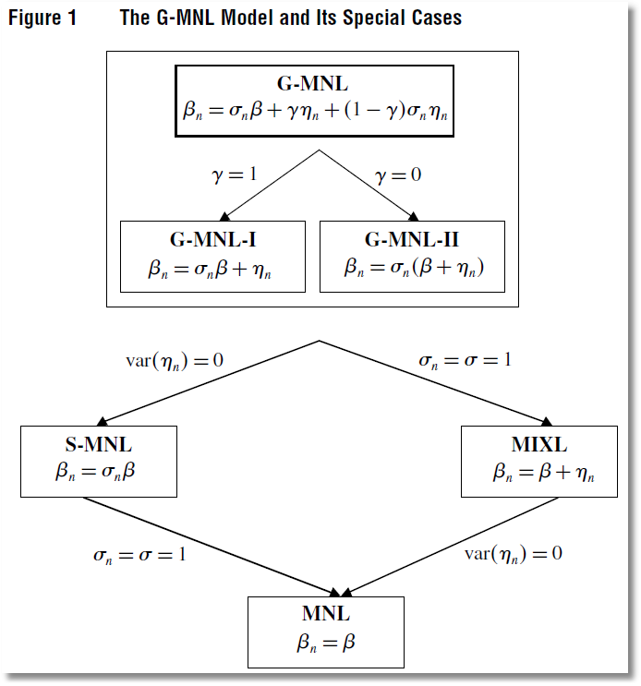

Slide 18
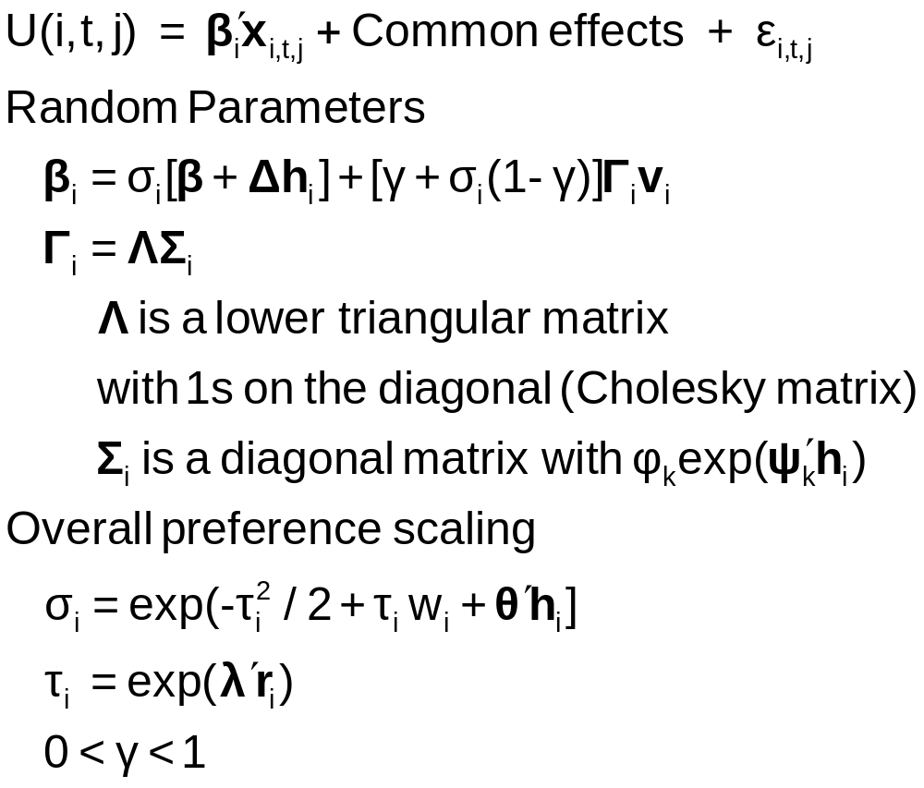
Generalized Mixed Logit Model

Slide 19
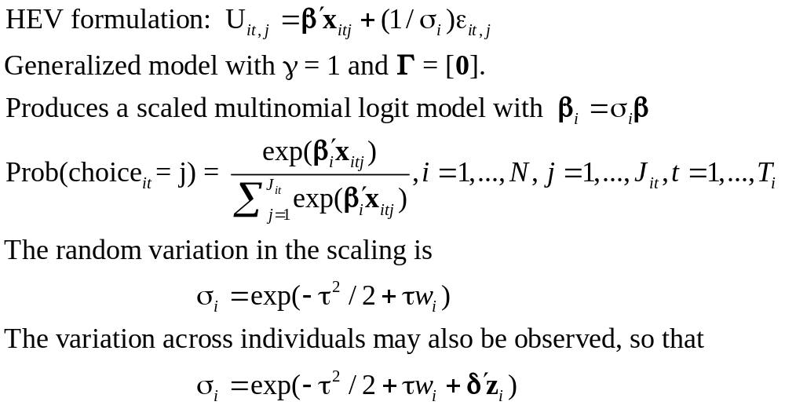
Unobserved Heterogeneity in Scaling

Slide 20
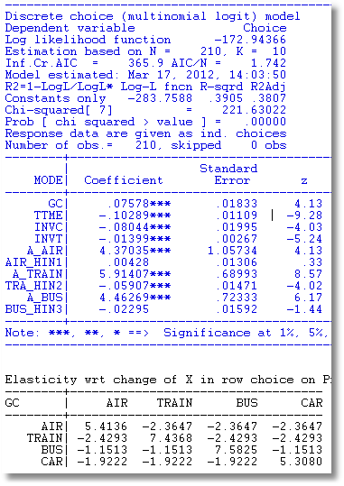
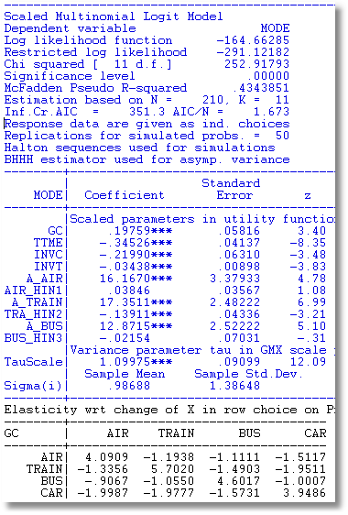
Scaled MNL

Slide 21
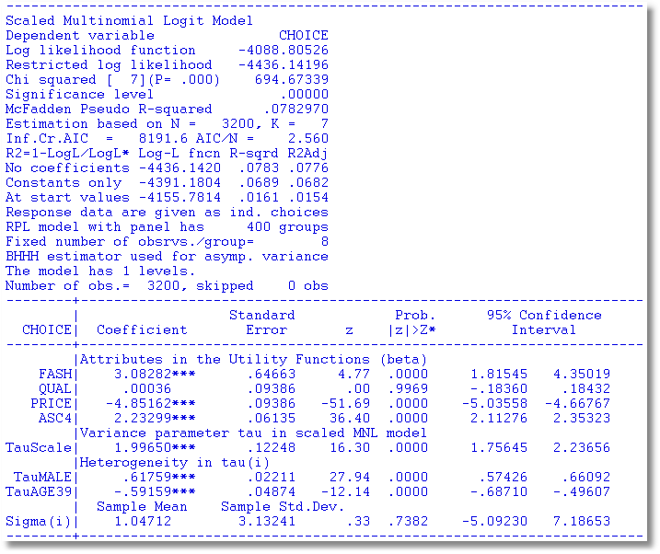
Observed and Unobserved Heterogeneity

Slide 22
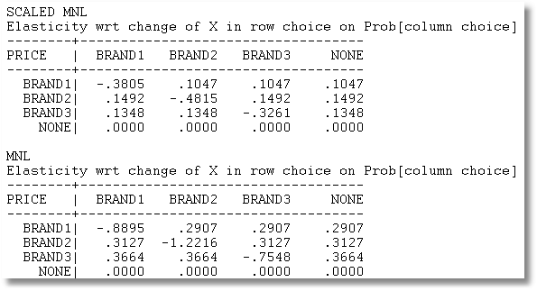
Price Elasticities

Slide 23

Scaling as Unobserved Heterogeneity

Slide 24
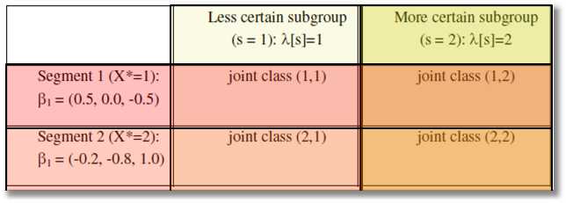
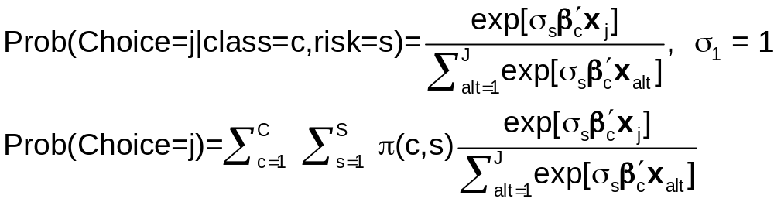
Two Way Latent Class?

