Slide 1






15. Stated Preference Experiments

Slide 2
Panel Data
Repeated Choice Situations
Typically RP/SP constructions (experimental)
Accommodating “panel data”
  Multinomial Probit [Marginal, impractical]
  Latent Class
  Mixed Logit

Slide 3
Application: Shoe Brand Choice
Simulated Data: Stated Choice,
  400 respondents,
  8 choice situations, 3,200 observations
3 choice/attributes + NONE
  Fashion = High / Low
  Quality = High / Low
  Price = 25/50/75,100 coded 1,2,3,4
Heterogeneity: Sex (Male=1), Age (<25, 25-39, 40+)
Underlying data generated by a 3 class latent class process (100, 200, 100 in classes)

Slide 4

Stated Choice Experiment: Unlabeled Alternatives, One Observation
t=1
t=2
t=3
t=4
t=5
t=6
t=7
t=8

Slide 5


Slide 6
Customers’ Choice of Energy Supplier
California, Stated Preference Survey
361 customers presented with 8-12 choice situations
Supplier attributes:
  Fixed price: cents per kWh
  Length of contract
  Local utility
  Well-known company
  Time-of-day rates (11¢ in day, 5¢ at night)
  Seasonal rates (10¢ in summer, 8¢ in winter, 6¢ in spring/fall)

Slide 7
Revealed and Stated Preference Data
Pure RP Data
  Market (ex-post, e.g., supermarket scanner data)
  Individual observations
Pure SP Data
  Contingent valuation
Combined (Enriched) RP/SP
  Mixed data
  Expanded choice sets

Slide 8
Customers’ Choice of Energy Supplier
California, Stated Preference Survey
361 customers presented with 8-12 choice situations
Supplier attributes:
  Fixed price: cents per kWh
  Length of contract
  Local utility
  Well-known company
  Time-of-day rates (11¢ in day, 5¢ at night)
  Seasonal rates (10¢ in summer, 8¢ in winter, 6¢ in spring/fall)

Slide 9
Population Parameter Distributions
Normal for:
  Contract length
  Local utility
  Well-known company
Log-normal for:
  Time-of-day rates
  Seasonal rates
Price coefficient held fixed

Slide 10
Estimated Model
Estimate Std error
Price -.883 0.050
Contract mean -.213 0.026
std dev .386 0.028
Local mean 2.23 0.127
std dev 1.75 0.137
Known mean 1.59 0.100
std dev .962 0.098
TOD mean* 2.13 0.054
std dev* .411 0.040
Seasonal mean* 2.16 0.051
std dev* .281 0.022
*Parameters of underlying normal. β_{i} = exp(mean+sd*w_{i})

Slide 11
Distribution of Brand Value
Standard deviation
=1.75¢
10% dislike local utility
0
2.23¢
Brand value of local utility

Slide 12
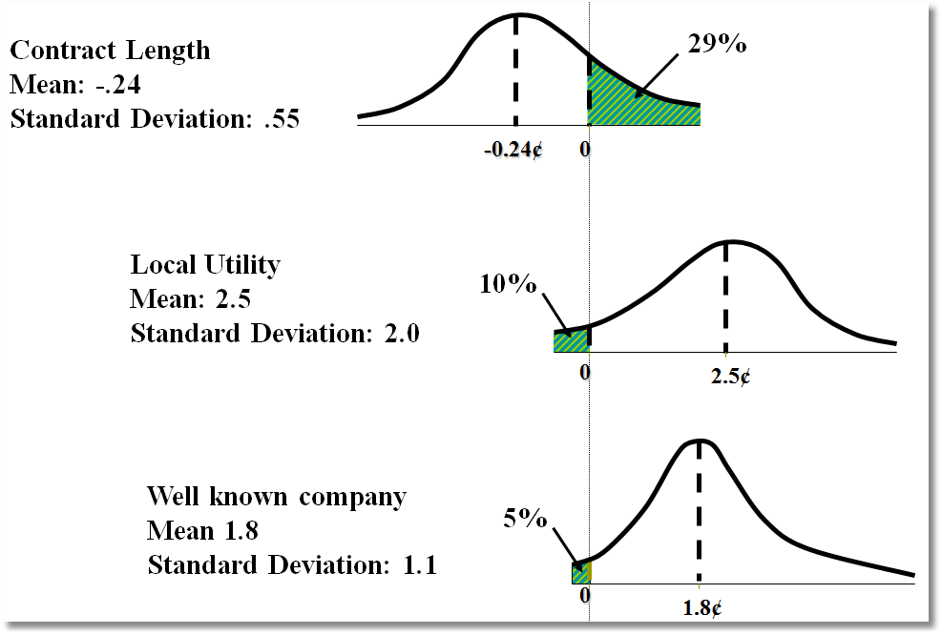
Random Parameter Distributions

Slide 13
Time of Day Rates (Customers do not like - lognormal)
Time-of-day Rates
-10.4
0
Seasonal Rates
-10.2
0

Slide 14
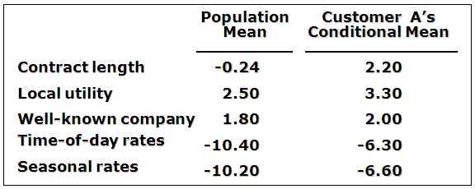
Expected Preferences of Each Customer
Customer likes long-term contract, local utility, and non-fixed rates.
Local utility can retain and make profit from this customer by offering a long-term contract with time-of-day or seasonal rates.

Slide 15
Choice Strategy
Hensher, D.A., Rose, J. and Greene, W. (2005) The Implications on Willingness to Pay of Respondents Ignoring Specific Attributes (DoD#6) Transportation, 32 (3), 203-222.
Hensher, D.A. and Rose, J.M. (2009) Simplifying Choice through Attribute Preservation or Non-Attendance: Implications for Willingness to Pay, Transportation Research Part E, 45, 583-590.
Rose, J., Hensher, D., Greene, W. and Washington, S. Attribute Exclusion Strategies in Airline Choice: Accounting for Exogenous Information on Decision Maker Processing Strategies in Models of Discrete Choice, Transportmetrica, 2011
Hensher, D.A. and Greene, W.H. (2010) Non-attendance and dual processing of common-metric attributes in choice analysis: a latent class specification, Empirical Economics 39 (2), 413-426
Campbell, D., Hensher, D.A. and Scarpa, R. Non-attendance to Attributes in Environmental Choice Analysis: A Latent Class Specification, Journal of Environmental Planning and Management, proofs 14 May 2011.
Hensher, D.A., Rose, J.M. and Greene, W.H. Inferring attribute non-attendance from stated choice data: implications for willingness to pay estimates and a warning for stated choice experiment design, 14 February 2011, Transportation, online 2 June 2001 DOI 10.1007/s11116-011-9347-8.

Slide 16
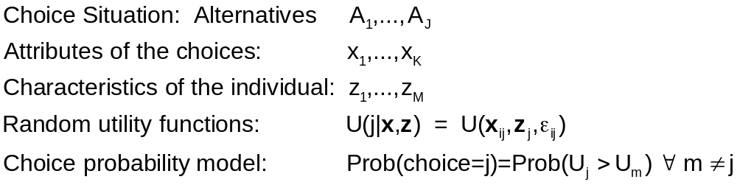
Decision Strategy in
Multinomial Choice

Slide 17
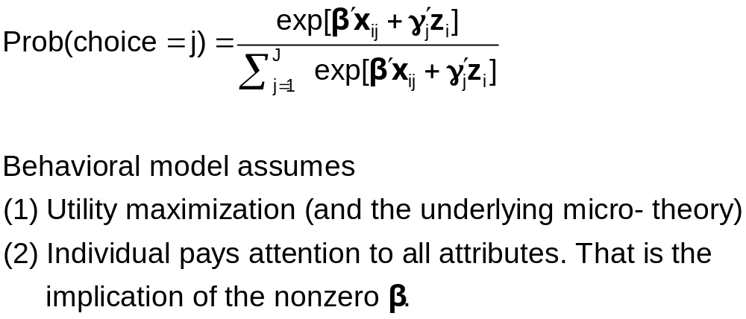
Multinomial Logit Model

Slide 18
Individual Explicitly Ignores Attributes
Hensher, D.A., Rose, J. and Greene, W. (2005) The Implications on Willingness to Pay of Respondents Ignoring Specific Attributes (DoD#6) Transportation, 32 (3), 203-222.
Hensher, D.A. and Rose, J.M. (2009) Simplifying Choice through Attribute Preservation or Non-Attendance: Implications for Willingness to Pay, Transportation Research Part E, 45, 583-590.
Rose, J., Hensher, D., Greene, W. and Washington, S. Attribute Exclusion Strategies in Airline Choice: Accounting for Exogenous Information on Decision Maker Processing Strategies in Models of Discrete Choice, Transportmetrica, 2011
Choice situations in which the individual explicitly states that they ignored certain attributes in their decisions.

Slide 19
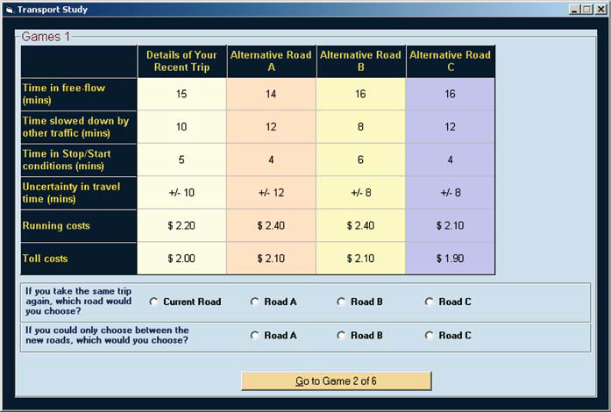
Stated Choice Experiment
Ancillary questions: Did you ignore any of these attributes?

Slide 20
Appropriate Modeling Strategy
Fix ignored attributes at zero? Definitely not!
  Zero is an unrealistic value of the attribute (price)
  The probability is a function of x_{ij} – x_{il}, so the substitution distorts the probabilities
Appropriate model: for that individual, the specific coefficient is zero – consistent with the utility assumption. A person specific, exogenously determined model
Surprisingly simple to implement

Slide 21
Individual Implicitly Ignores Attributes
Hensher, D.A. and Greene, W.H. (2010) Non-attendance and dual processing of common-metric attributes in choice analysis: a latent class specification, Empirical Economics 39 (2), 413-426
Campbell, D., Hensher, D.A. and Scarpa, R. Non-attendance to Attributes in Environmental Choice Analysis: A Latent Class Specification, Journal of Environmental Planning and Management, proofs 14 May 2011.
Hensher, D.A., Rose, J.M. and Greene, W.H. Inferring attribute non-attendance from stated choice data: implications for willingness to pay estimates and a warning for stated choice experiment design, 14 February 2011, Transportation, online 2 June 2001 DOI 10.1007/s11116-011-9347-8.

Slide 22
Stated Choice Experiment
Individuals seem to be ignoring attributes. Uncertain to the analyst

Slide 23
The 2^{K} model
The analyst believes some attributes are ignored. There is no indicator.
Classes distinguished by which attributes are ignored
Same model applies, now a latent class. For K attributes there are 2^{K} candidate coefficient vectors

Slide 24
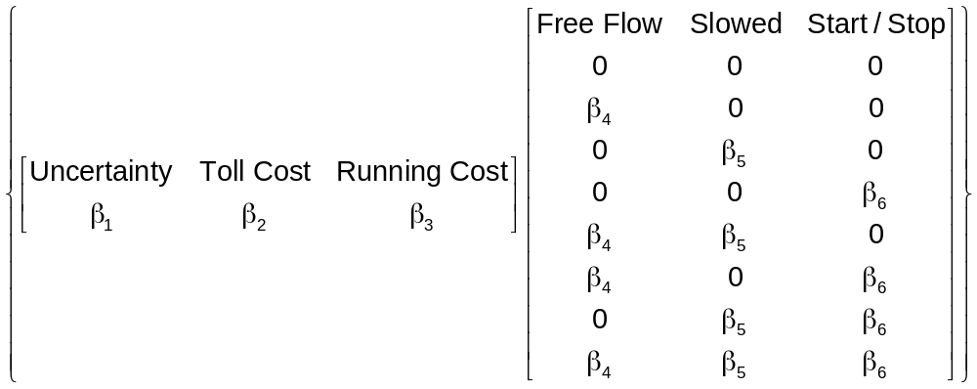
A Latent Class Model

Slide 25
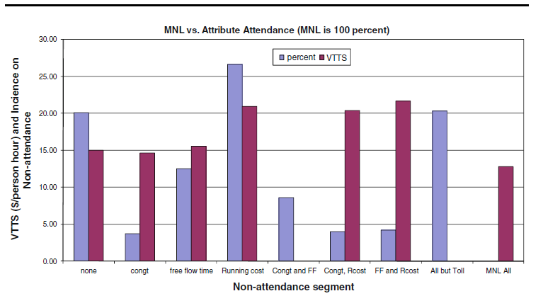
Results for the 2^{K} model

Slide 27
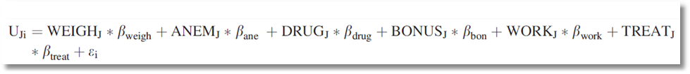
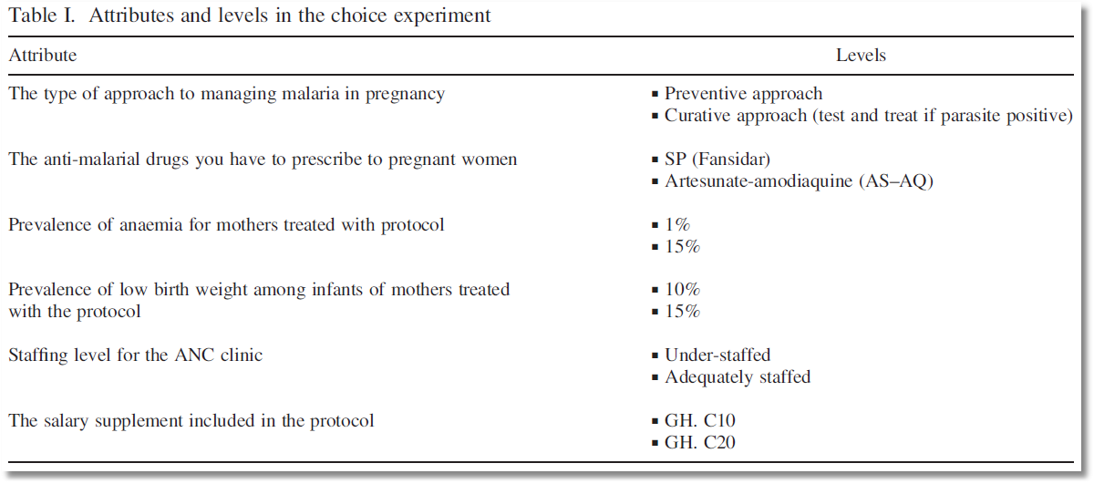
Choice Model with 6 Attributes

Slide 28
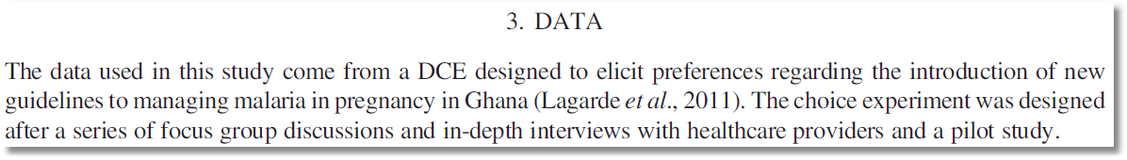
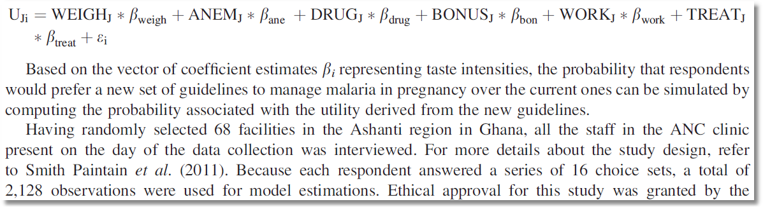
Stated Choice Experiment

Slide 29
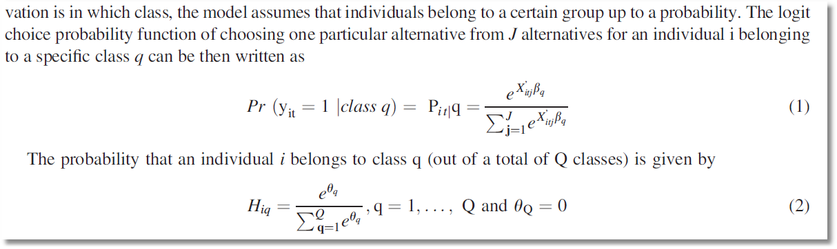
Latent Class Model – Prior Class Probabilities

Slide 30
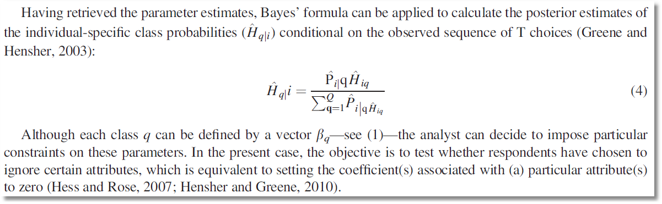
Latent Class Model – Posterior Class Probabilities

Slide 31
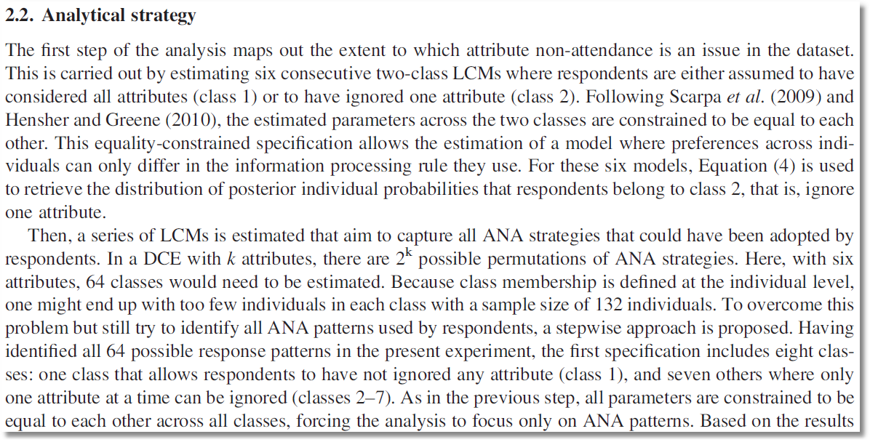
6 attributes implies 64 classes. Strategy to reduce the computational burden on a small sample

Slide 32
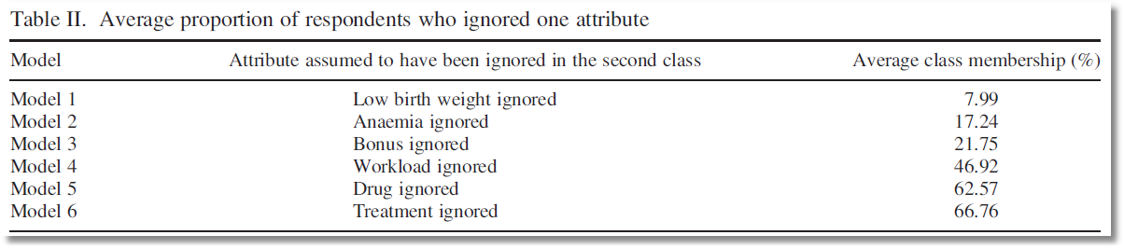
Posterior probabilities of membership in the nonattendance class for 6 models

Slide 33
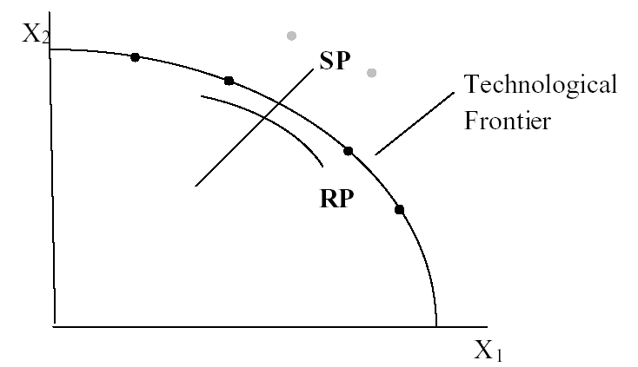
Revealed vs. Stated Preference Data
Advantage: Actual observations on actual behavior
Disadvantage: Limited range of choice sets and attributes – does not allow analysis of switching behavior.

Slide 34
Application
Survey sample of 2,688 trips, 2 or 4 choices per situation
Sample consists of 672 individuals
Choice based sample
Revealed/Stated choice experiment:
Revealed: Drive,ShortRail,Bus,Train
Hypothetical: Drive,ShortRail,Bus,Train,LightRail,ExpressBus
Attributes:
Cost –Fuel or fare
Transit time
Parking cost
Access and Egress time

Slide 35
Mixed Logit Approaches
Pivot SP choices around an RP outcome.
Scaling is handled directly in the model
Continuity across choice situations is handled by random elements of the choice structure that are constant through time
  Preference weights – coefficients
  Scaling parameters
    Variances of random parameters
    Overall scaling of utility functions

Slide 36
Pooling RP and SP Data Sets
Enrich the attribute set by replicating choices
E.g.:
  RP: Bus,Car,Train (actual)
  SP: Bus(1),Car(1),Train(1)
  Bus(2),Car(2),Train(2),…
How to combine?

Slide 37
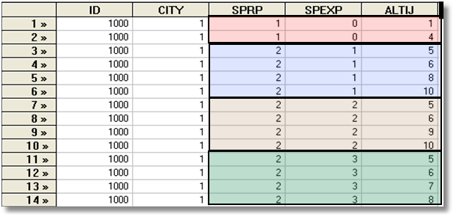
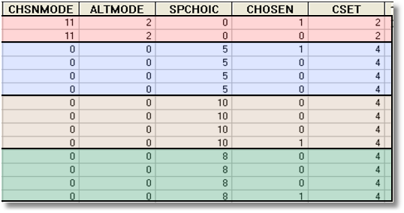
Each person makes four choices from a choice set that includes either 2 or 4 alternatives.
The first choice is the RP between two of the 4 RP alternatives
The second-fourth are the SP among four of the 6 SP alternatives.
There are 10 alternatives in total.
A Stated Choice Experiment with Variable Choice Sets

Slide 38
Enriched Data Set – Vehicle Choice
Choosing between Conventional, Electric and LPG/CNG Vehicles in Single-Vehicle Households
David A. Hensher William H. Greene
Institute of Transport Studies Department of Economics
School of Business Stern School of Business
The University of Sydney New York University
NSW 2006 Australia New York USA
September 2000

Slide 39
Fuel Types Study
Conventional, Electric, Alternative
1,400 Sydney Households
Automobile choice survey
RP + 3 SP fuel classes

Slide 40
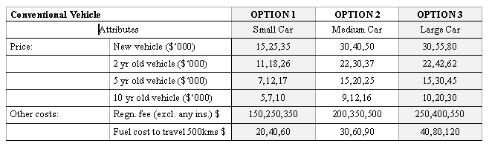
Attribute Space: Conventional

Slide 41
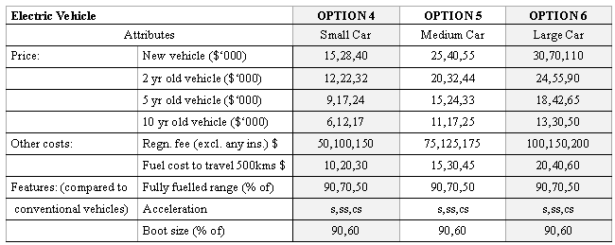
Attribute Space: Electric

Slide 42
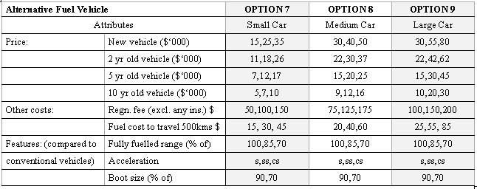
Attribute Space: Alternative

Slide 43
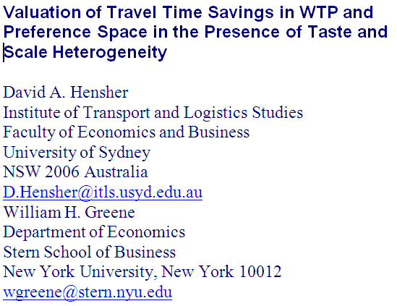

Slide 44
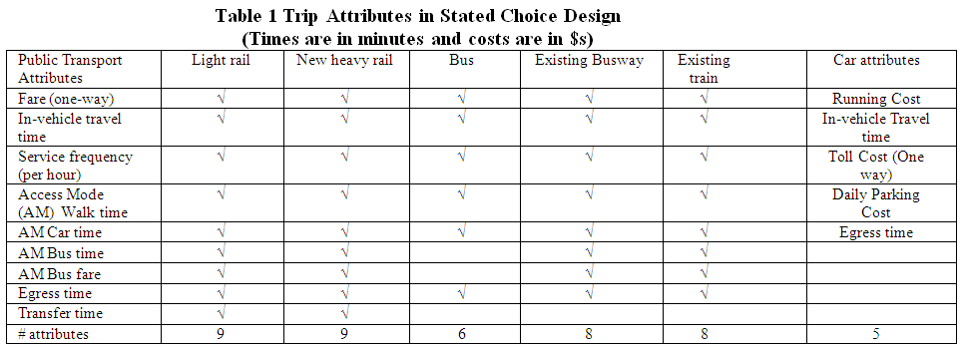
Experimental Design

Slide 45
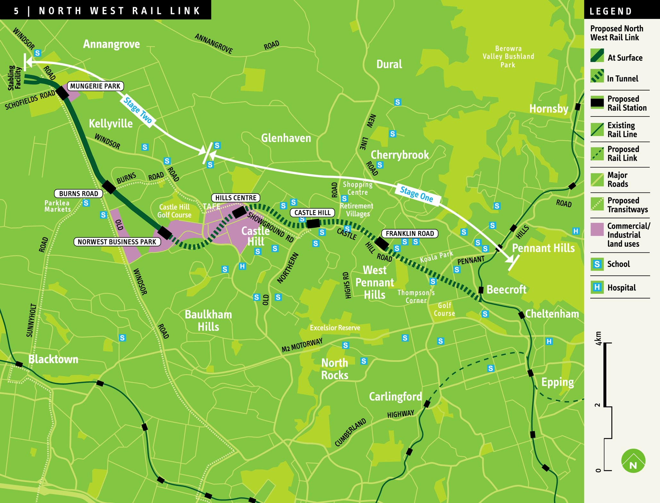
An SP Study Using WTP Space

