Slide 1






16. Censoring, Tobit and Two Part Models

Slide 2
Censoring and Corner Solution Models
Censoring model:
y = T(y*) = 0 if y* < 0
y = T(y*) = y* if y* > 0.
Corner solution:
y = 0 if some exogenous condition is met;
y = g(x)+e if the condition is not met.
We then model P(y=0) and E[y|x,y>0].
Hurdle Model:
y = 0 with P(y=0|z)
Model E[y|x,y > 0]

Slide 3
The Tobit Model
y* = x’β+ε,
y = Max(0,y*),
ε ~ N[0,σ²]
Variation: Nonzero lower limit
Upper limit
Both tails censored
Easy to accommodate. (Already done in major software.)
Log likelihood and Estimation. See Appendix.
(Tobin: “Estimation of Relationships for Limited Dependent Variables,” Econometrica, 1958. Tobin’s probit?)

Slide 4
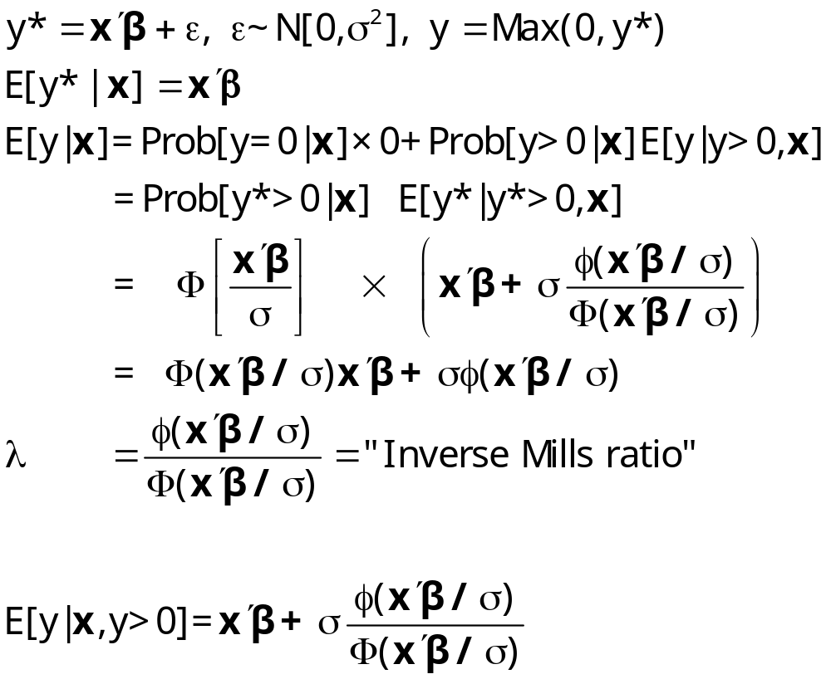
Conditional Mean Functions

Slide 5
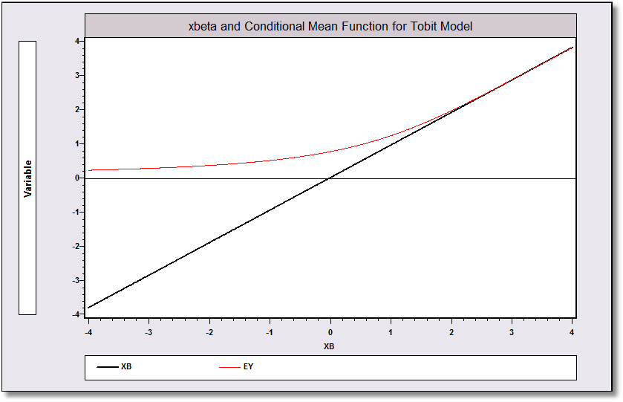
Conditional Means

Slide 6
Predictions and Residuals
What variable do we want to predict?
  y*? Probably not – not relevant
  y? Randomly drawn observation from the population
  y | y>0? Maybe. Depends on the desired function
What is the residual?
  y – prediction? Probably not. What do you do with the zeros?
  Anything - xβ? Probably not. xβ is not the mean.
What are the partial effects? Which conditional mean?

Slide 7
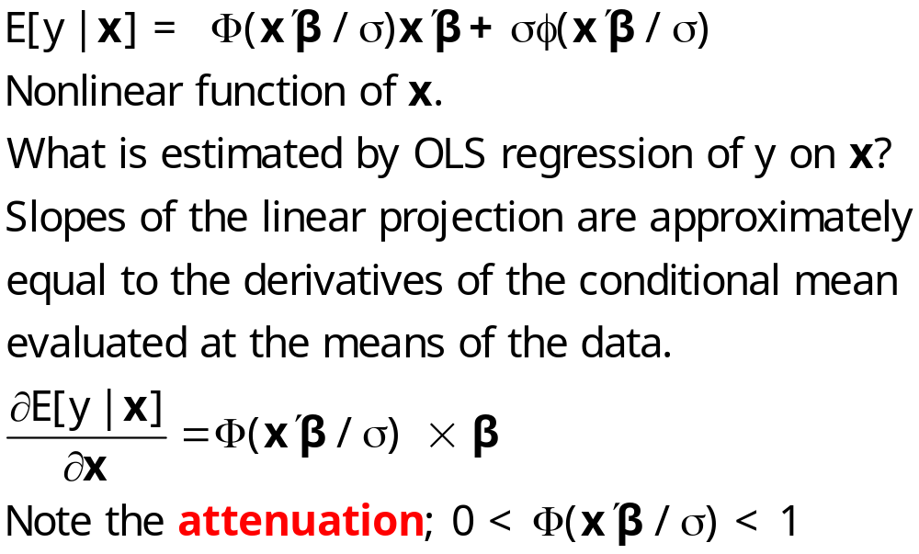
OLS is Inconsistent - Attenuation

Slide 8
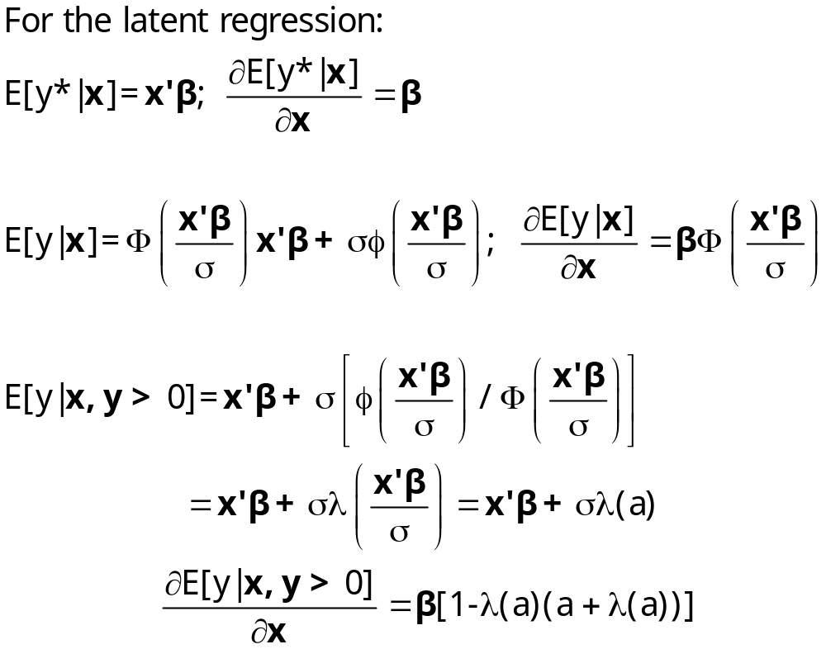
Partial Effects in Censored Regressions

Slide 9
Application: Fair’s Data
Fair’s (1977) Extramarital Affairs Data, 601 observations. Psychology Today.
Source: Fair (1977) and http://fairmodel.econ.yale.edu/rayfair/pdf/1978ADAT.ZIP.
Several variables not used are denoted X1, ..., X5.
y = Number of affairs in the past year,
(0,1,2,3,4-10=7, more=12, mean = 1.46. (Frequencies 451, 34, 17, 19, 42, 38)
z1 = Sex, 0=female; mean=.476
z2 = Age, mean=32.5
z3 = Number of years married, mean=8.18
z4 = Children, 0=no; mean=.715
z5 = Religiousness, 1=anti, …,5=very. Mean=3.12
z6 = Education, years, 9, 12, 16, 17, 18, 20; mean=16.2
z7 = Occupation, Hollingshead scale, 1,…,7; mean=4.19
z8 = Self rating of marriage. 1=very unhappy; 5=very happy
Fair, R., “A Theory of Extramarital Affairs,” Journal of Political Economy, 1978.
Fair, R., “A Note on Estimation of the Tobit Model,” Econometrica, 1977.

Slide 10
Fair’s Study
Corner solution model
Discovered the EM method in the Econometrica paper
Used the tobit instead of the Poisson (or some other) count model
Did not account for the censoring at the high end of the data

Slide 11
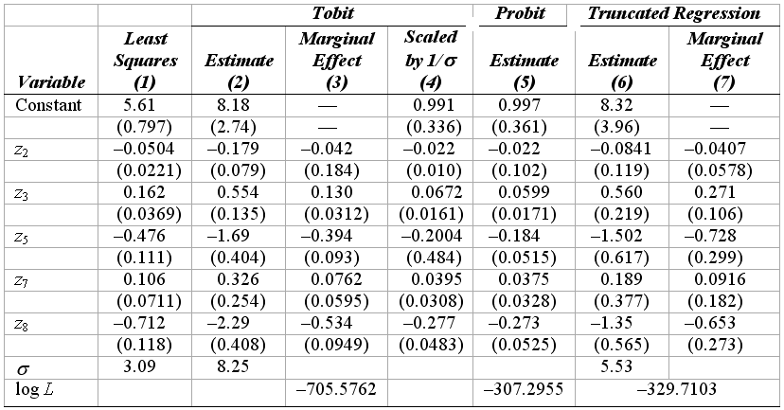
Estimated Tobit Model

Slide 12
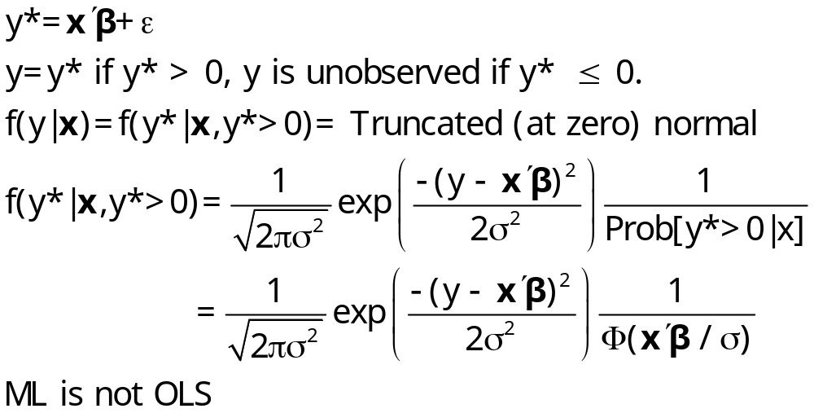
Discarding the Limit Data

Slide 13
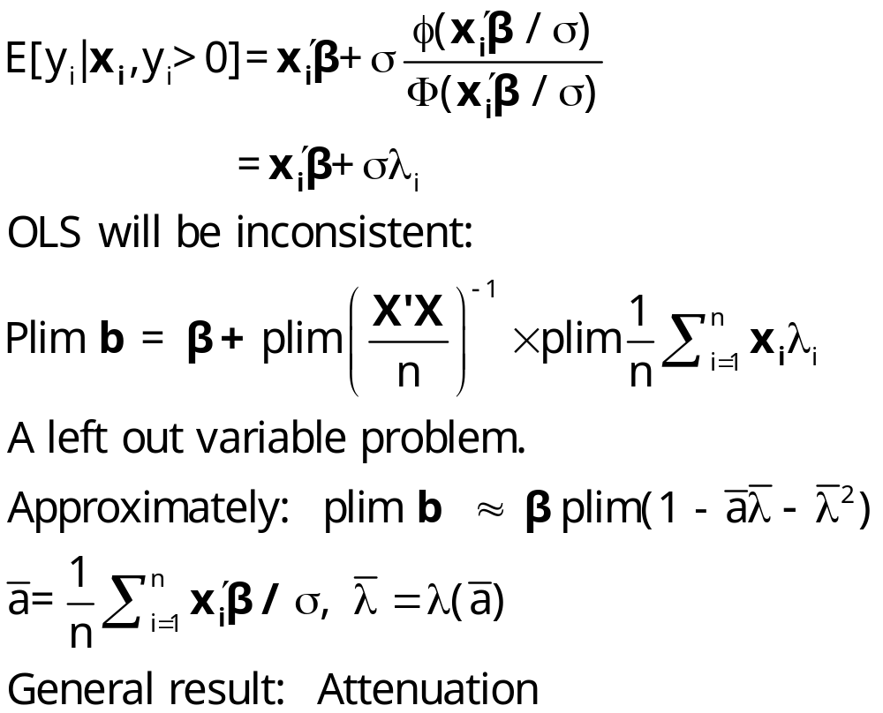
Regression with the Truncated Distribution

Slide 14
Estimated Tobit Model

Slide 15
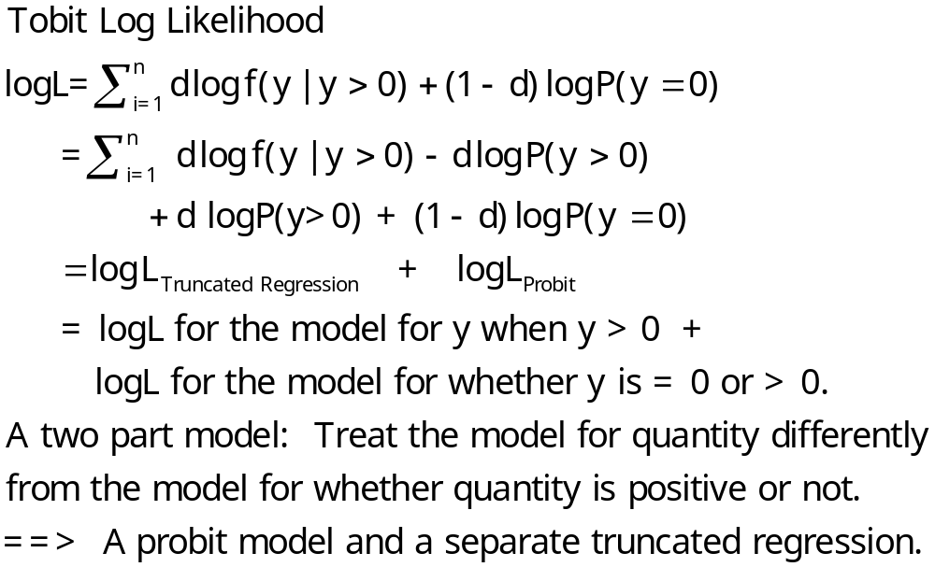
Two Part Specifications

Slide 16
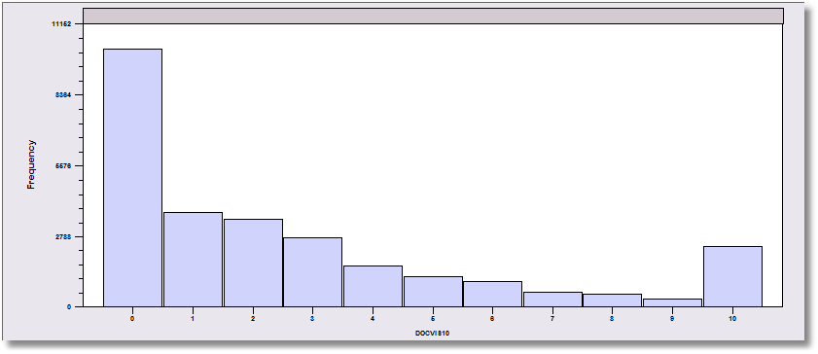
Doctor Visits (Censored at 10)

Slide 17
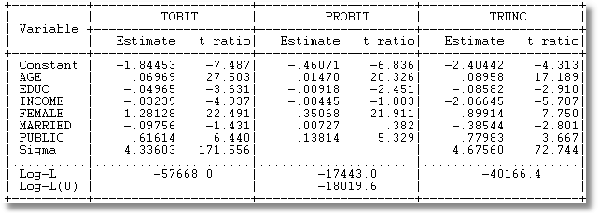

Two Part Hurdle Model
Critical chi squared [7] = 14.1. The tobit model is rejected.

Slide 18
Panel Data Application
Pooling: Standard results, incuding “cluster” estimator(s) for asymptotic covariance matrices
Random effects
  Butler and Moffitt – same as for probit
  Mundlak/Wooldridge extension – group means
  Extension to random parameters and latent class models
Fixed effects: Some surprises (Greene, Econometric Reviews, 2005)

Slide 19
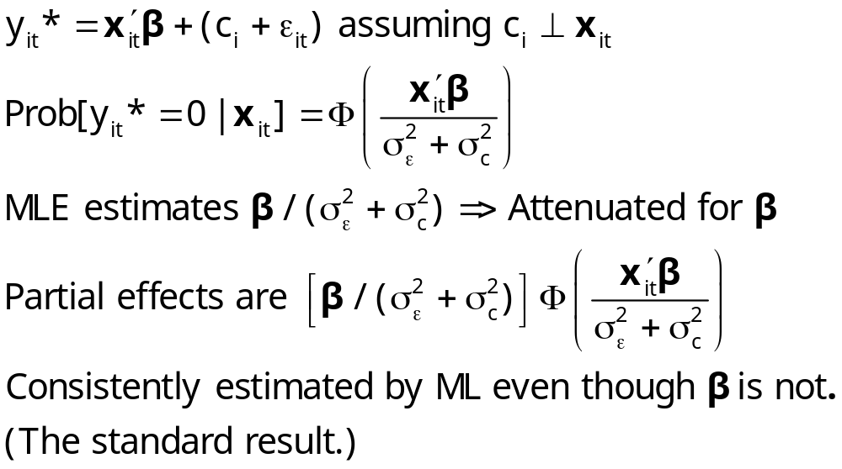
Neglected Heterogeneity

Slide 20
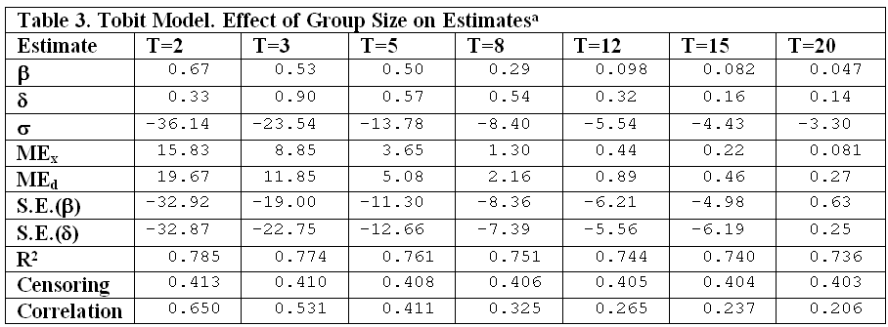
Fixed Effects MLE for Tobit
No bias in slopes. Large bias in estimator of σ

Slide 21
Appendix: Tobit Math

Slide 22
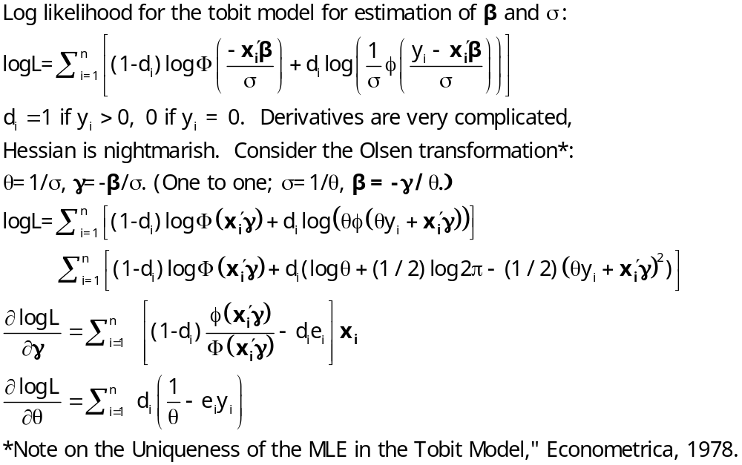
Estimating the Tobit Model

Slide 23
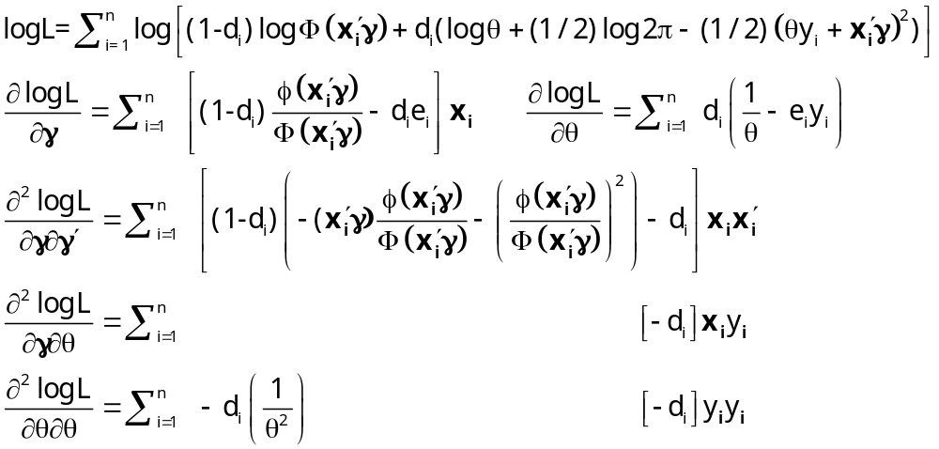
Hessian for Tobit Model

Slide 24
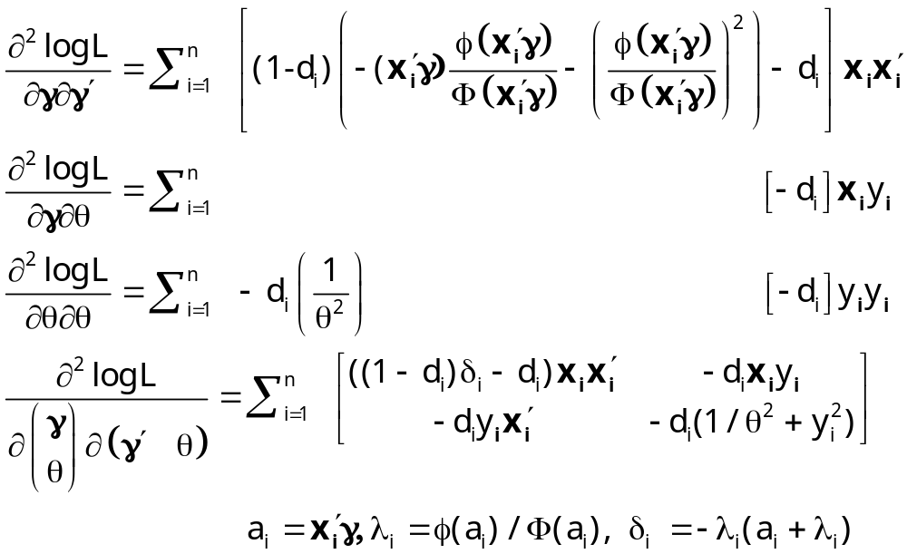
Simplified Hessian

Slide 25
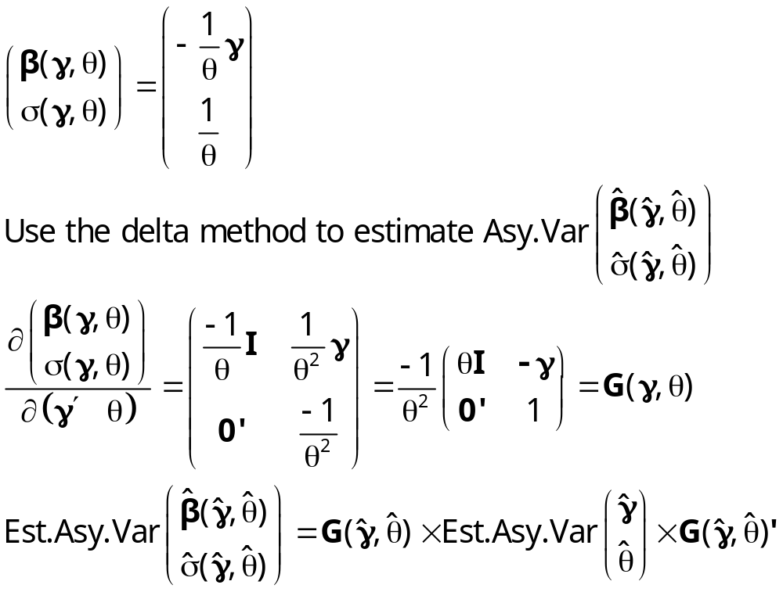
Recovering Structural Parameters

