Slide 1






17. Duration Modeling

Slide 2
Modeling Duration
Time until retirement
Time until business failure
Time until exercise of a warranty
Length of an unemployment spell
Length of time between children
Time between business cycles
Time between wars or civil insurrections
Time between policy changes
Etc.

Slide 3
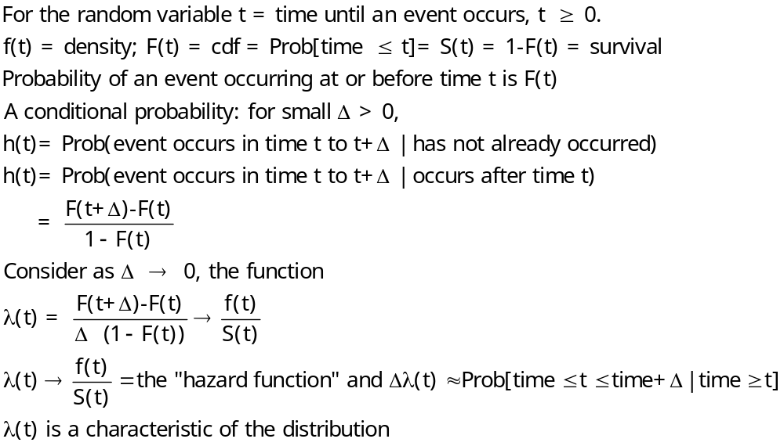
The Hazard Function

Slide 4
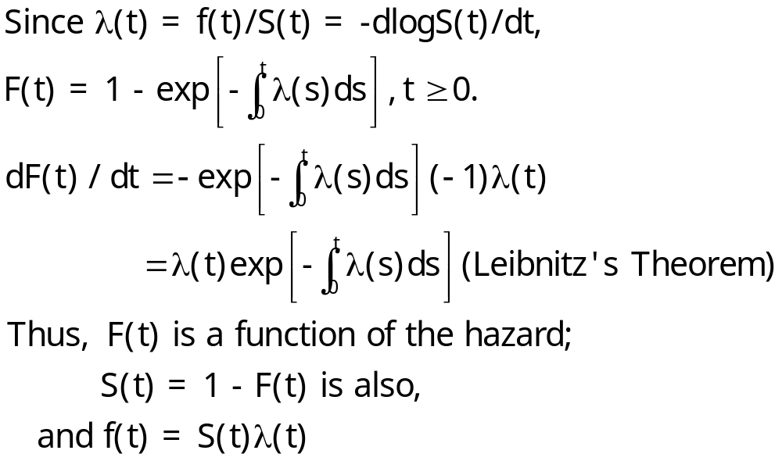
Hazard Function

Slide 5
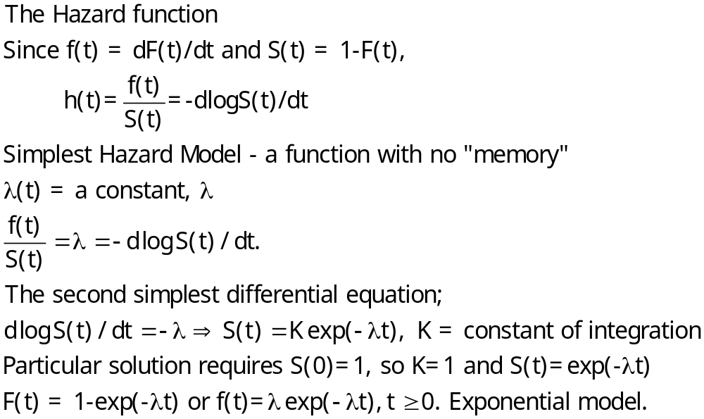
A Simple Hazard Function

Slide 6
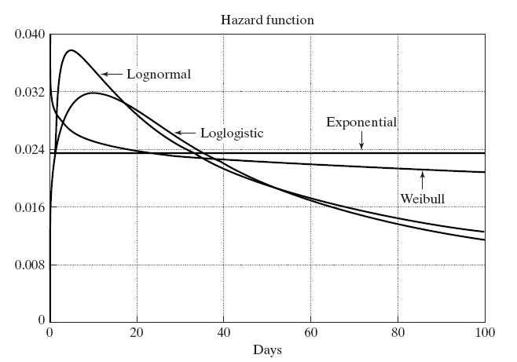
Duration Dependence

Slide 7
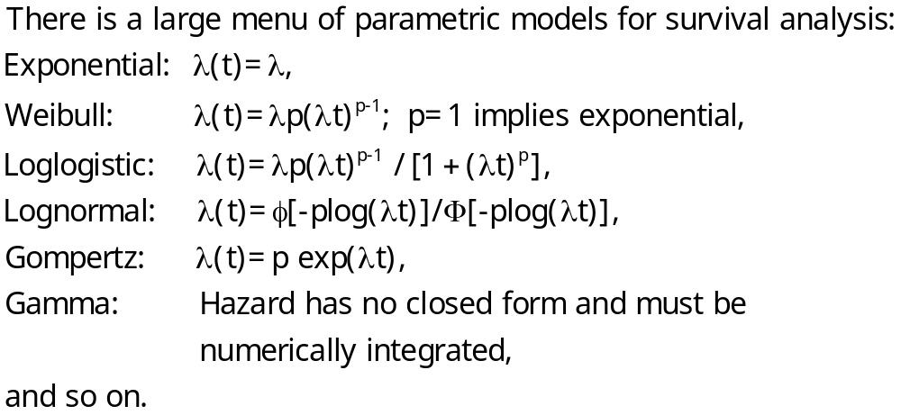
Parametric Models of Duration

Slide 8
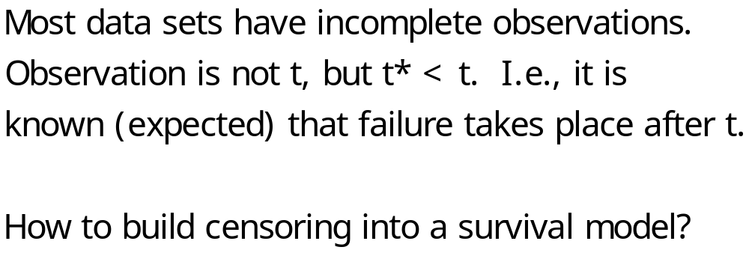
Censoring

Slide 9
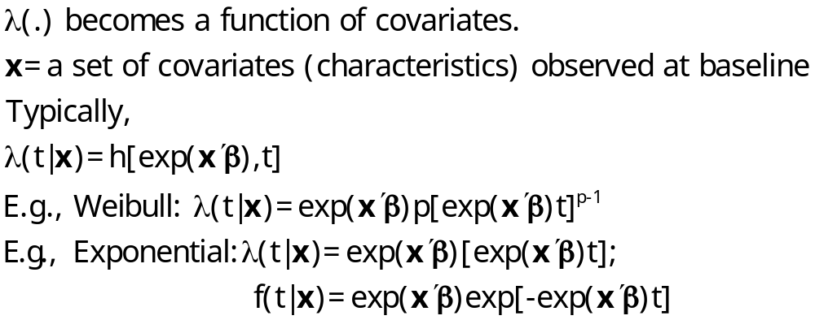
Accelerated Failure Time Models

Slide 10
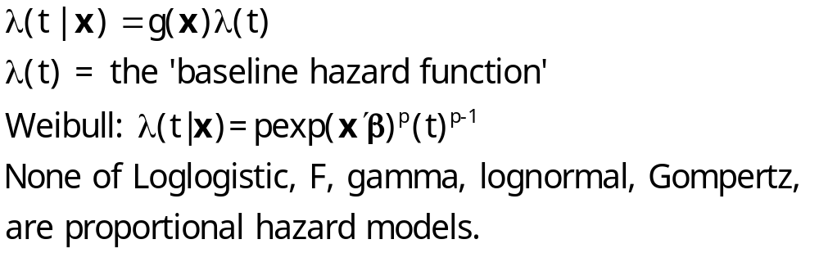
Proportional Hazards Models

Slide 11
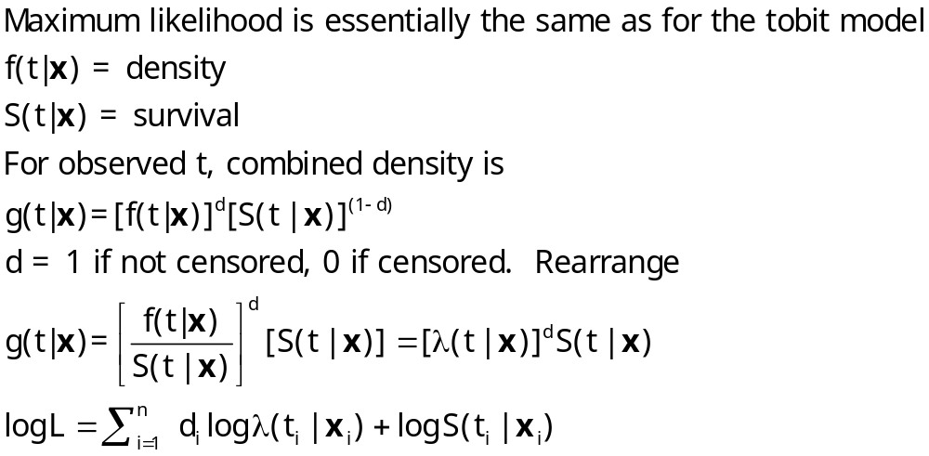
ML Estimation of Parametric Models

Slide 12
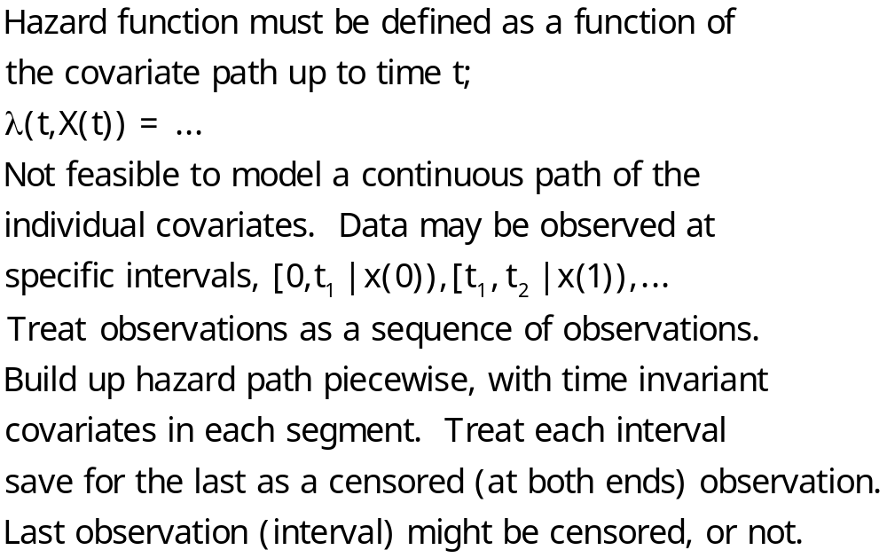
Time Varying Covariates

Slide 13
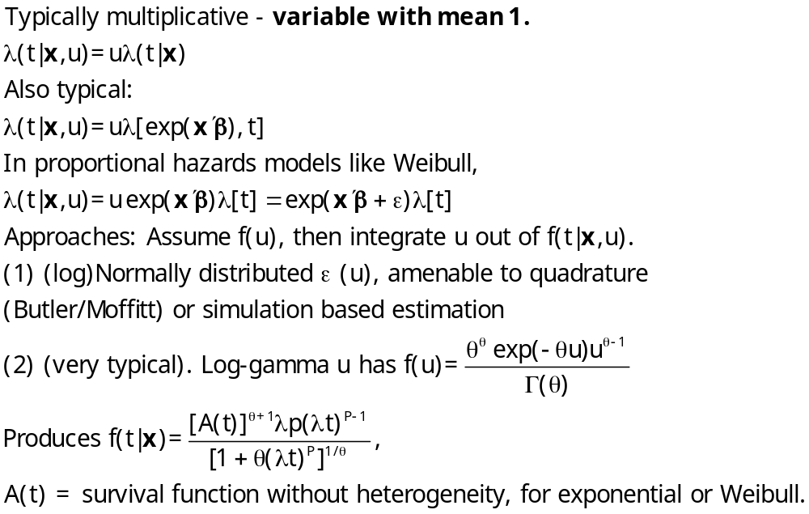
Unobserved Heterogeneity

Slide 14
Interpretation
What are the coefficients?
Are there ‘marginal effects?’
What quantities are of interest in the study?

Slide 15
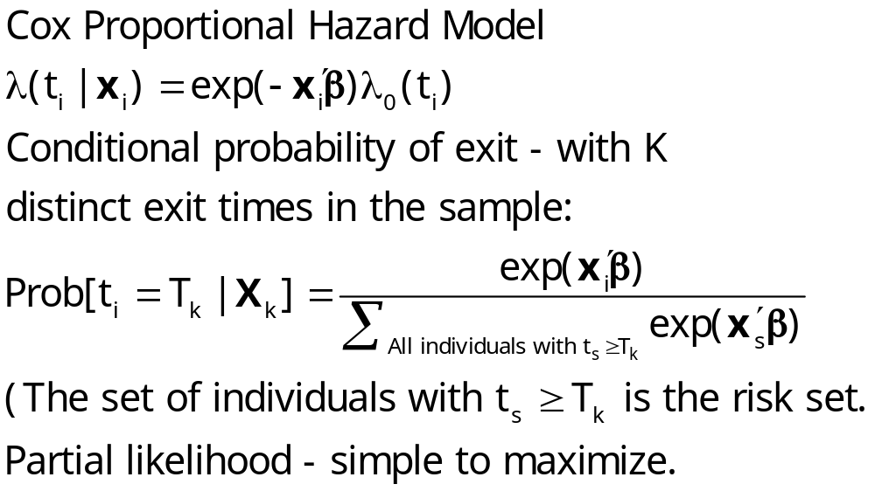
Cox’s Semiparametric Model

Slide 16
Nonparametric Approach
Based simply on counting observations
  K spells = ending times 1,…,K
  d_{j} = # spells ending at time t_{j}
  m_{j} = # spells censored in interval [t_{j} , t_{j+1})
  r_{j} = # spells in the risk set at time t_{j} = Σ (d_{j}+m_{j})
Estimated hazard, h(t_{j}) = d_{j}/r_{j}
Estimated survival = Π_{j} [1 – h(t_{j})]
(Kaplan-Meier “product limit” estimator)

Slide 17
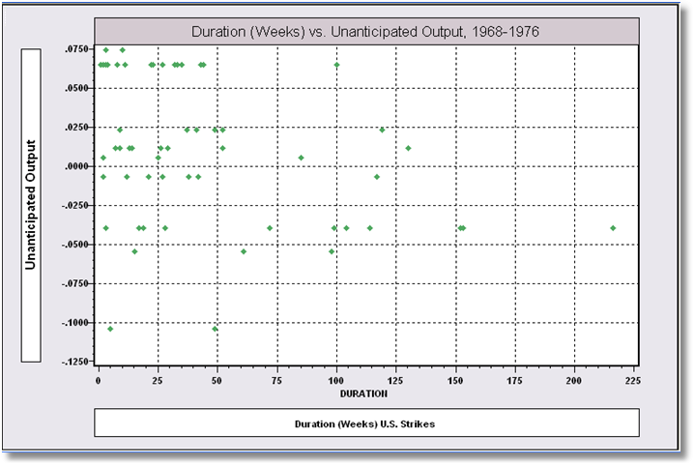
Kennan’s Strike Duration Data

Slide 18
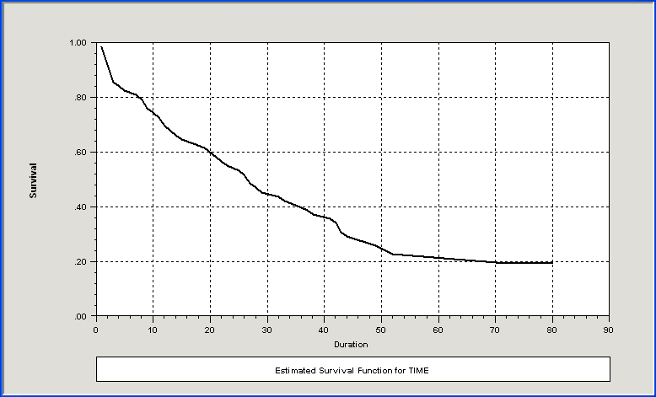
Kaplan Meier Survival Function

Slide 19
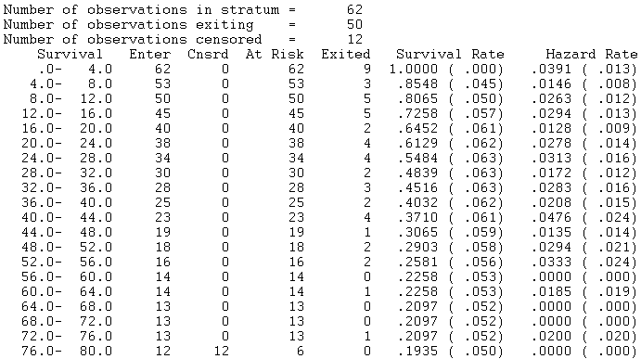
Hazard Rates

Slide 20
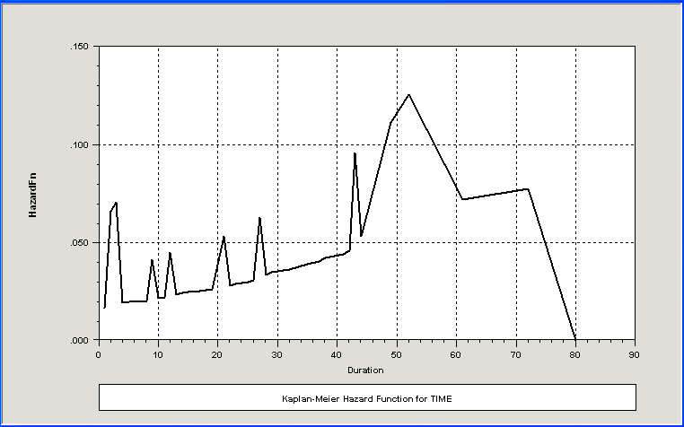
Kaplan Meier Hazard Function

Slide 21
Weibull Accelerated
Proportional Hazard Model
+---------------------------------------------+
| Loglinear survival model: WEIBULL |
| Log likelihood function -97.39018 |
| Number of parameters 3 |
| Akaike IC= 200.780 Bayes IC= 207.162 |
+---------------------------------------------+
+---------+--------------+----------------+--------+---------+----------+
|Variable | Coefficient | Standard Error |b/St.Er.|P[|Z|>z] | Mean of X|
+---------+--------------+----------------+--------+---------+----------+
RHS of hazard model
Constant 3.82757279 .15286595 25.039 .0000
PROD -10.4301961 3.26398911 -3.196 .0014 .01102306
Ancillary parameters for survival
Sigma 1.05191710 .14062354 7.480 .0000

Slide 22
Weibull Model
+----------------------------------------------------------------+
| Parameters of underlying density at data means: |
| Parameter Estimate Std. Error Confidence Interval |
| ------------------------------------------------------------ |
| Lambda .02441 .00358 .0174 to .0314 |
| P .95065 .12709 .7016 to 1.1997 |
| Median 27.85629 4.09007 19.8398 to 35.8728 |
| Percentiles of survival distribution: |
| Survival .25 .50 .75 .95 |
| Time 57.75 27.86 11.05 1.80 |
+----------------------------------------------------------------+

Slide 23
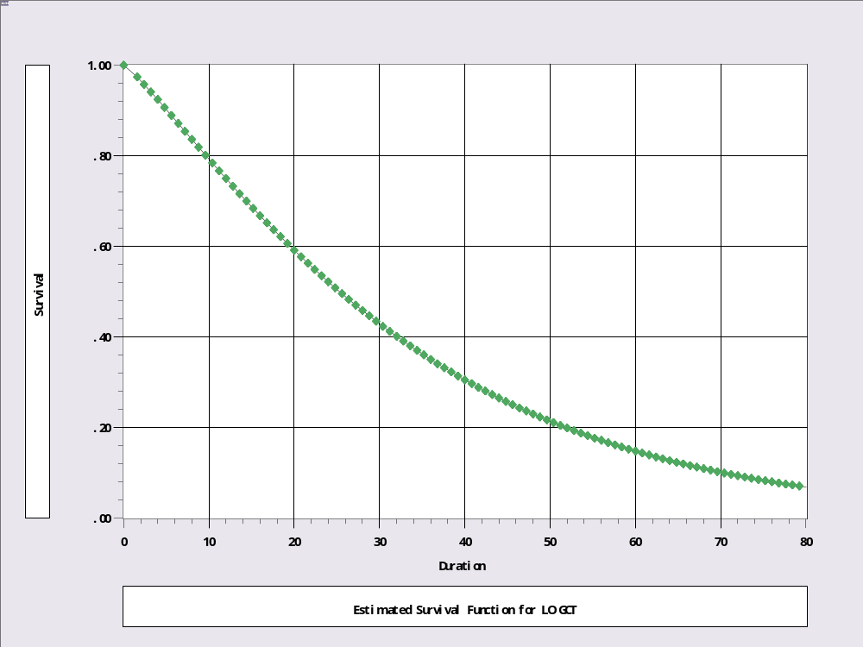
Survival Function

Slide 24
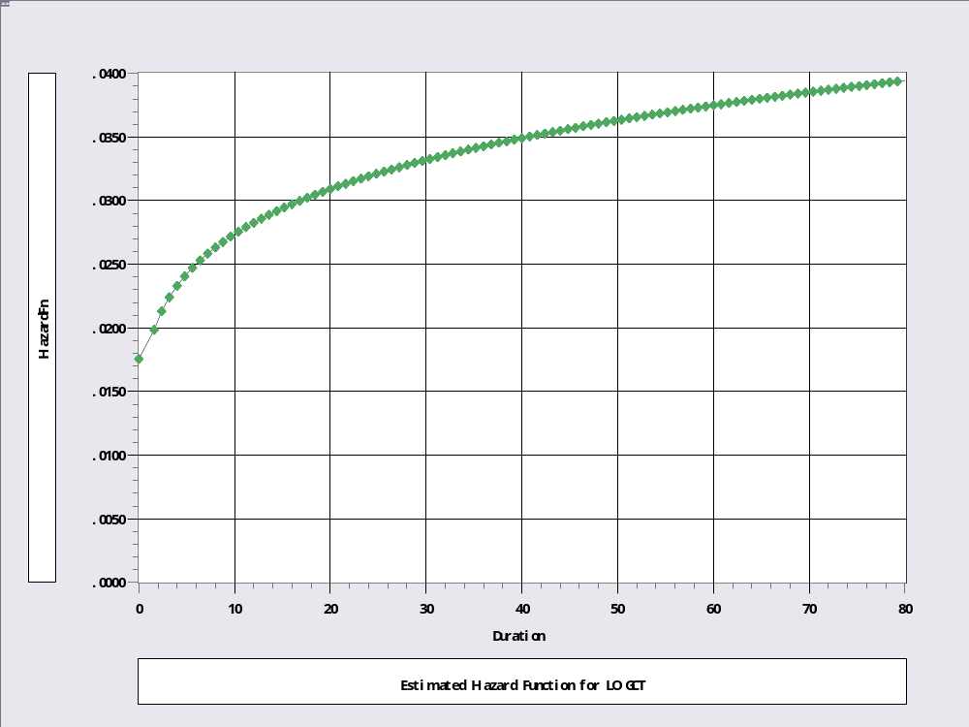
Hazard Function with Positive Duration Dependence for All t

Slide 25
Loglogistic Model
+---------------------------------------------+
| Loglinear survival model: LOGISTIC |
| Dependent variable LOGCT |
| Log likelihood function -97.53461 |
+---------------------------------------------+
+---------+--------------+----------------+--------+---------+----------+
|Variable | Coefficient | Standard Error |b/St.Er.|P[|Z|>z] | Mean of X|
+---------+--------------+----------------+--------+---------+----------+
RHS of hazard model
Constant 3.33044203 .17629909 18.891 .0000
PROD -10.2462322 3.46610670 -2.956 .0031 .01102306
Ancillary parameters for survival
Sigma .78385188 .10475829 7.482 .0000
+---------------------------------------------+
| Loglinear survival model: WEIBULL |
| Log likelihood function -97.39018 |
|Variable | Coefficient | Standard Error |b/St.Er.|P[|Z|>z] | Mean of X|
+---------+--------------+----------------+--------+---------+----------+
RHS of hazard model
Constant 3.82757279 .15286595 25.039 .0000
PROD -10.4301961 3.26398911 -3.196 .0014 .01102306
Ancillary parameters for survival
Sigma 1.05191710 .14062354 7.480 .0000

Slide 26
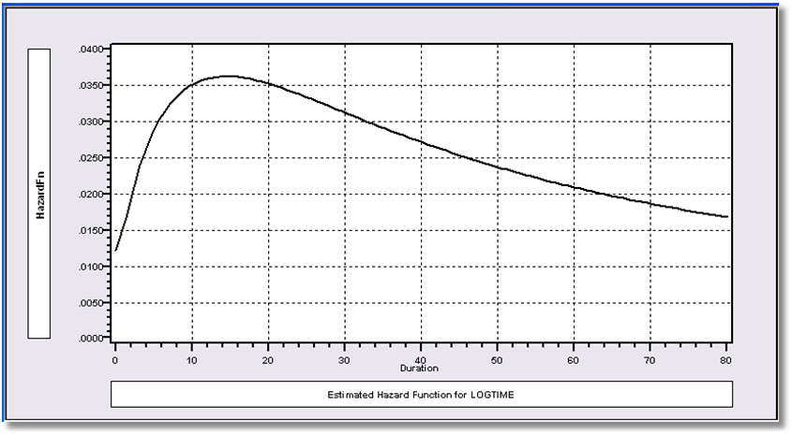
Loglogistic Hazard Model

Slide 27


Slide 28
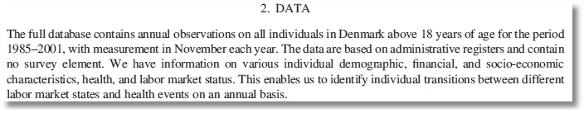


Slide 29
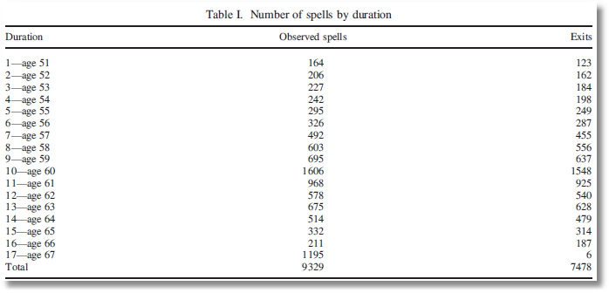

Slide 30
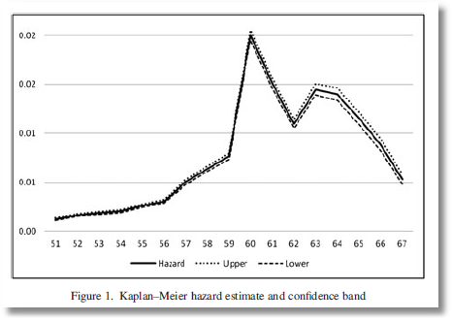

Slide 31
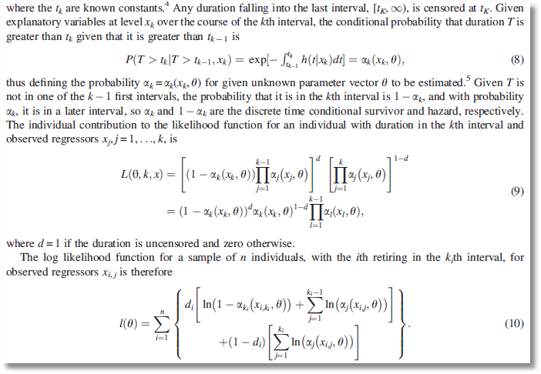

Slide 32
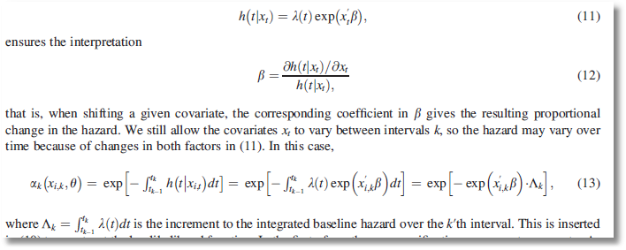

Slide 33
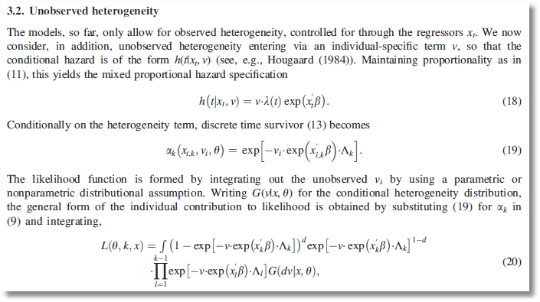

Slide 34
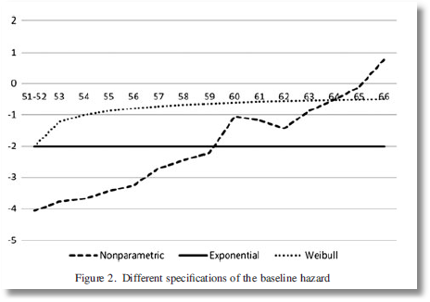
Log Baseline Hazards

Slide 35
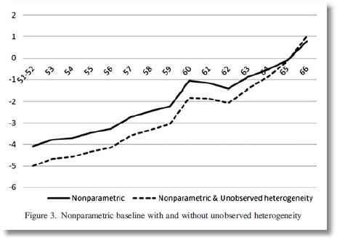
Log Baseline Hazards - Heterogeneity

