Slide 1



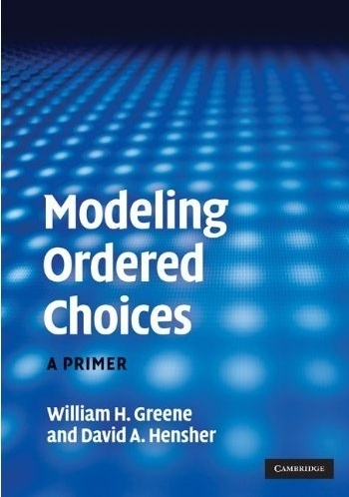

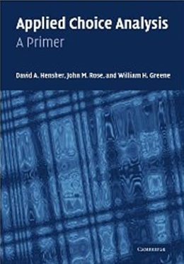
2. Binary Choice Estimation

Slide 2
Modeling Binary Choice

Slide 3
Agenda
Models for Binary Choice
Specification
Maximum Likelihood Estimation
Estimating Partial Effects
Measuring Fit
Testing Hypotheses
Panel Data Models

Slide 4
Application: Health Care Usage
German Health Care Usage Data (GSOEP)
Data downloaded from Journal of Applied Econometrics Archive. This is an unbalanced panel with 7,293 individuals, Varying Numbers of Periods They can be used for regression, count models, binary choice, ordered choice, and bivariate binary choice. There are altogether 27,326 observations. The number of observations ranges from 1 to 7. Frequencies are: 1=1525, 2=2158, 3=825, 4=926, 5=1051, 6=1000, 7=987.
Variables in the file are
DOCTOR = 1(Number of doctor visits > 0)
HOSPITAL = 1(Number of hospital visits > 0)
HSAT = health satisfaction, coded 0 (low) - 10 (high)
DOCVIS = number of doctor visits in last three months
HOSPVIS = number of hospital visits in last calendar year
PUBLIC = insured in public health insurance = 1; otherwise = 0
ADDON = insured by add-on insurance = 1; otherwise = 0
HHNINC = household nominal monthly net income in German marks / 10000.
(4 observations with income=0 were dropped)
HHKIDS = children under age 16 in the household = 1; otherwise = 0
EDUC = years of schooling
AGE = age in years
FEMALE = 1 for female headed household, 0 for male
Notes:
4

Slide 5


Slide 6
Application
27,326 Observations
  1 to 7 years, panel
  7,293 households observed
  We use the 1994 year, 3,337 household observations
Descriptive Statistics
=========================================================
Variable Mean Std.Dev. Minimum Maximum
--------+------------------------------------------------
DOCTOR| .657980 .474456 .000000 1.00000
AGE| 42.6266 11.5860 25.0000 64.0000
HHNINC| .444764 .216586 .340000E-01 3.00000
FEMALE| .463429 .498735 .000000 1.00000

Slide 7
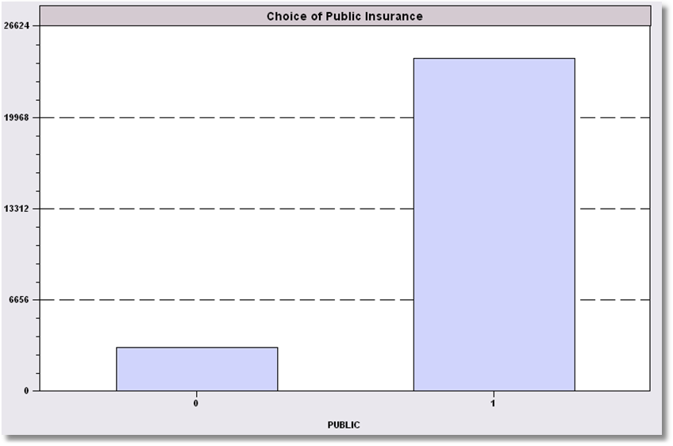
Simple Binary Choice: Insurance

Slide 8
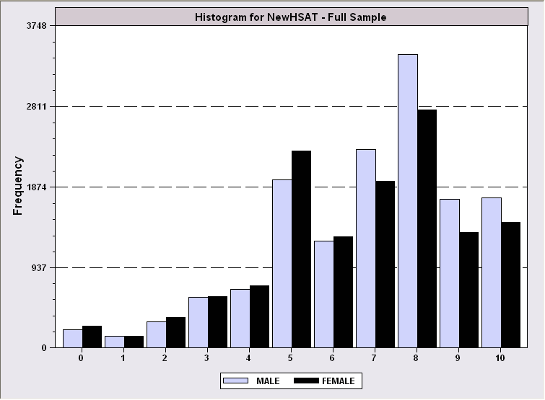
Censored Health Satisfaction Scale
0 = Not Healthy
1 = Healthy

Slide 9
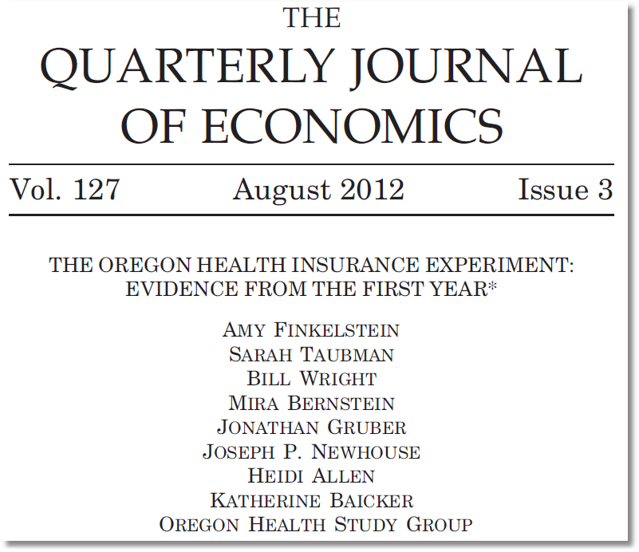
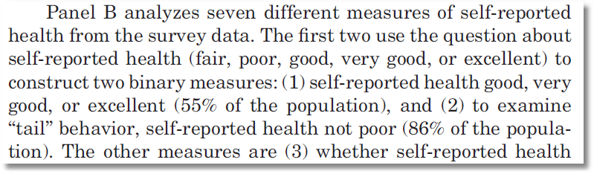

Slide 10
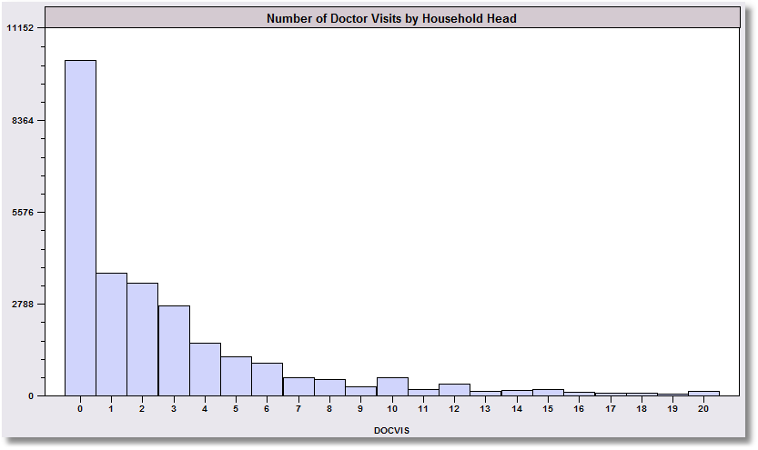
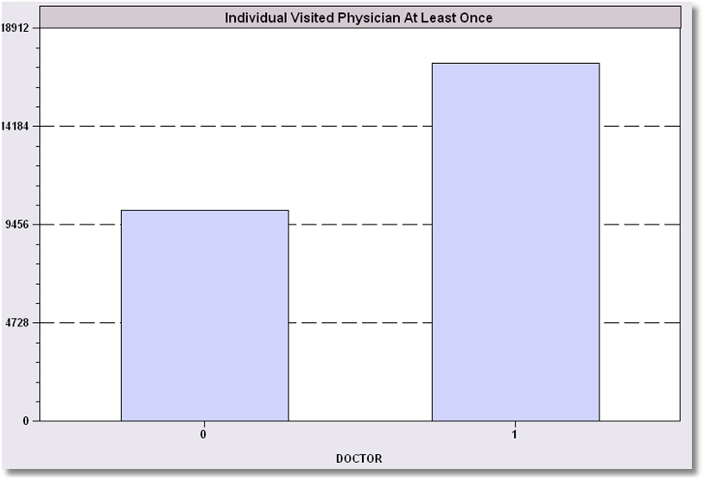
Count Transformed to Indicator

Slide 11
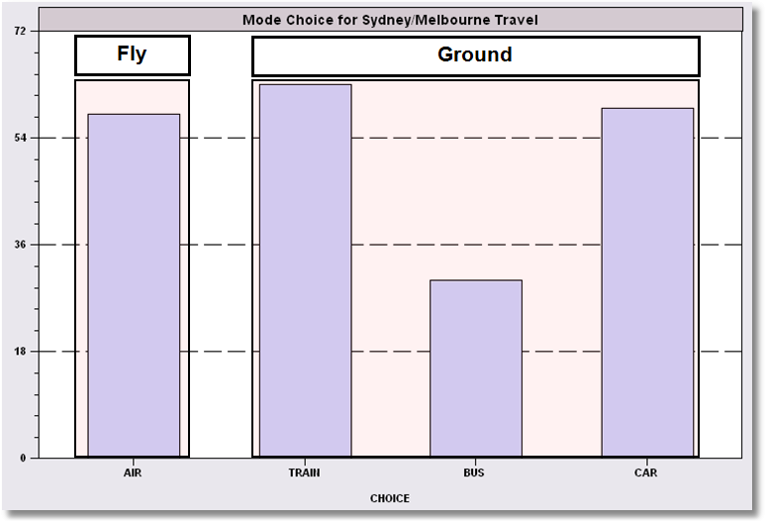
Redefined Multinomial Choice

Slide 12
A Random Utility Approach
Underlying Preference Scale, U*(choices)
Revelation of Preferences:
  U*(choices) < 0 Choice “0”
  U*(choices) > 0 Choice “1”

Slide 13
A Model for Binary Choice
Yes or No decision (Buy/NotBuy, Do/NotDo)
Example, choose to visit physician or not
Net utility = U_{visit} – U_{not visit}
Model: Net utility of visit at least once
U_{visit} = α+β₁Age + β₂Income + γSex + ε
Choose to visit if net utility is positive
Data: X = [1,age,income,sex]
y = 1 if choose visit, ⬄ U_{visit} > 0, 0 if not.
Random Utility

Slide 14
Choosing Between Two Alternatives
Modeling the Binary Choice
  U_{visit} = α + β₁ Age + β₂ Income + β₃ Sex + ε
Chooses to visit: U_{visit} > 0
α + β₁ Age + β₂ Income + β₃ Sex + ε > 0
ε > -[α + β₁ Age + β₂ Income + β₃ Sex ]

Slide 15
An Econometric Model
Choose to visit iff Uvisit > 0
  Uvisit = α + β₁ Age + β₂ Income + β₃ Sex + ε
  Uvisit > 0 ⇔ ε > -(α + β₁ Age + β₂ Income + β₃ Sex)
  ε < α + β₁ Age + β₂ Income + β₃ Sex
Probability model: For any person observed by the analyst,
Prob(visit) = Prob[ε < α + β₁ Age + β₂ Income + β₃ Sex]
Note the relationship between the unobserved ε and the outcome

Slide 16
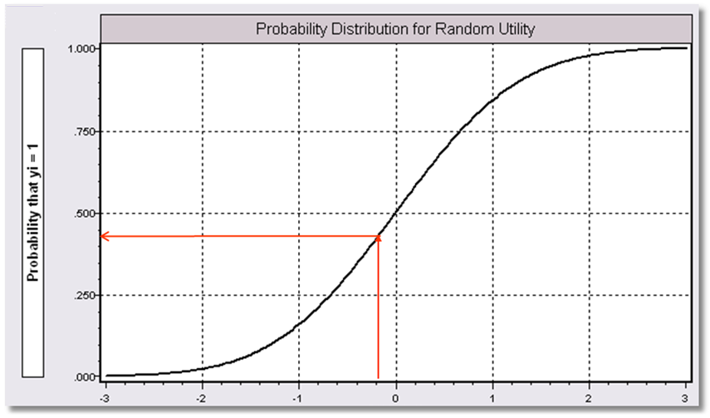
α+β₁Age + β₂ Income + β3 Sex

Slide 17
Modeling Approaches
Nonparametric – “relationship”
  Minimal Assumptions
  Minimal Conclusions
Semiparametric – “index function”
  Stronger assumptions
  Robust to model misspecification (heteroscedasticity)
  Still weak conclusions
Parametric – “Probability function and index”
  Strongest assumptions – complete specification
  Strongest conclusions
  Possibly less robust. (Not necessarily)
The Linear Probability “Model”

Slide 18
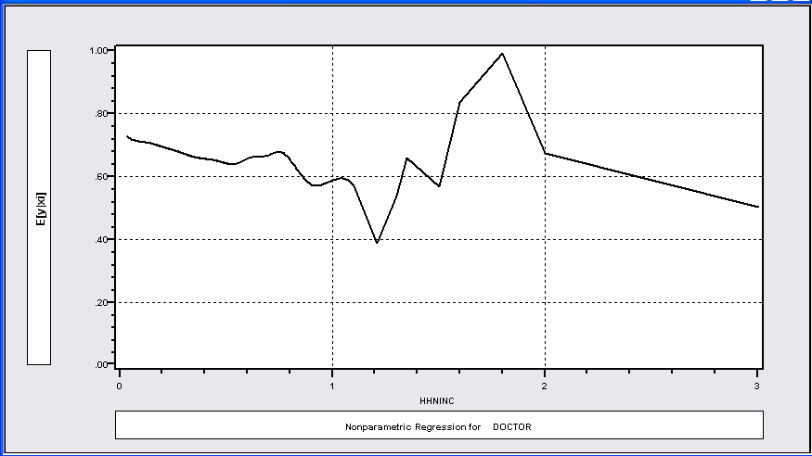
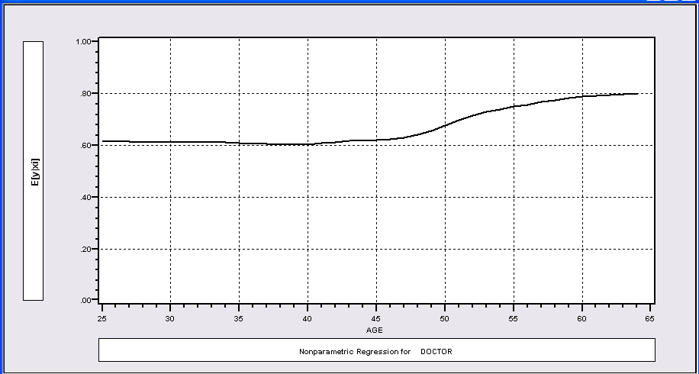
Nonparametric Regressions
P(Visit)=f(Age)
P(Visit)=f(Income)

Slide 19
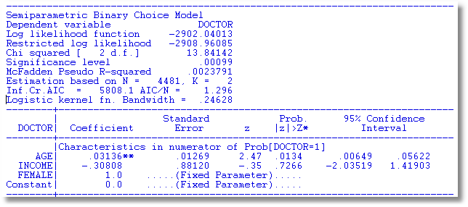
Klein and Spady Semiparametric
No specific distribution assumed
Note necessary normalizations. Coefficients are relative to FEMALE.
Prob(y_{i} = 1 | x_{i} ) =G(β’x) G is estimated by kernel methods

Slide 20
Fully Parametric
Index Function: U* = β’x + ε
Observation Mechanism: y = 1[U* > 0]
Distribution: ε ~ f(ε); Normal, Logistic, …
Maximum Likelihood Estimation:
Max(β) logL = Σ_{i} log Prob(Y_{i} = y_{i}|x_{i})

Slide 21
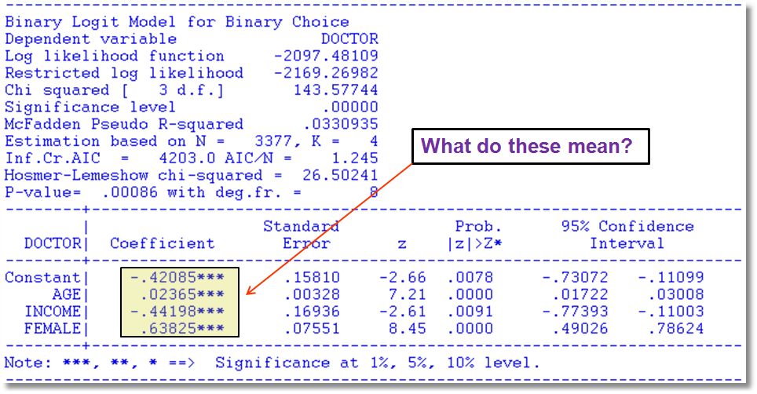
Fully Parametric Logit Model

Slide 22
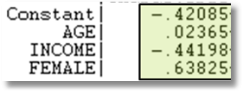

Parametric vs. Semiparametric
Parametric Logit Klein/Spady Semiparametric
.02365/.63825 = .04133
-.44198/.63825 = -.69249

Slide 23
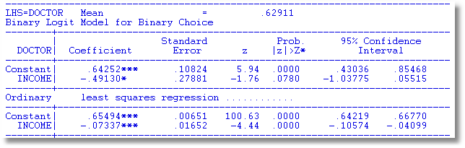
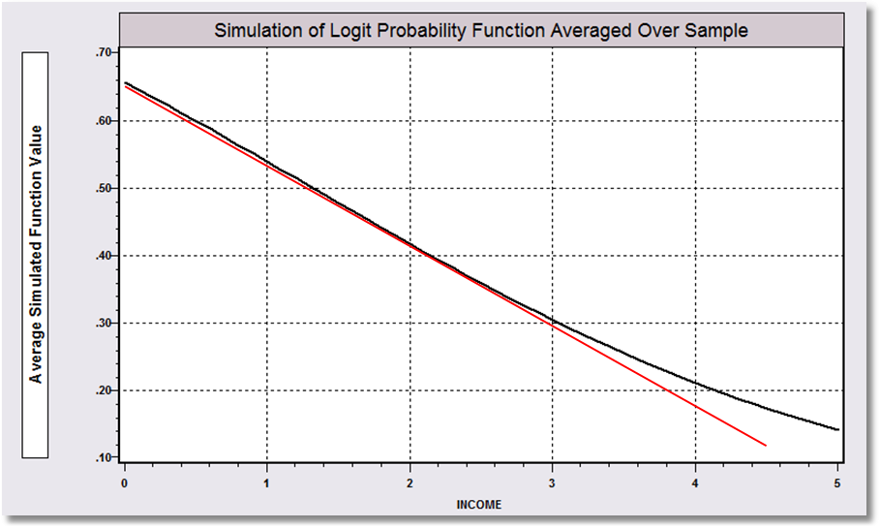
Linear Probability vs. Logit Binary Choice Model

Slide 24
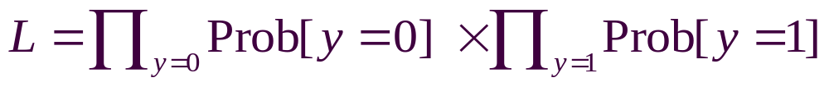
Parametric Model Estimation
How to estimate α, β₁, β₂, β₃?
  It’s not regression
  The technique of maximum likelihood
  Prob[y=1] =
  Prob[ε > -(α + β₁ Age + β₂ Income + β₃ Sex)]
  Prob[y=0] = 1 - Prob[y=1]
  Requires a model for the probability

Slide 25
Completing the Model: F(ε)
The distribution
  Normal: PROBIT, natural for behavior
  Logistic: LOGIT, allows “thicker tails”
  Gompertz: EXTREME VALUE, asymmetric
  Others: mostly experimental
Does it matter?
  Yes, large difference in estimates
  Not much, quantities of interest are more stable.

Slide 26
Fully Parametric Logit Model

Slide 27
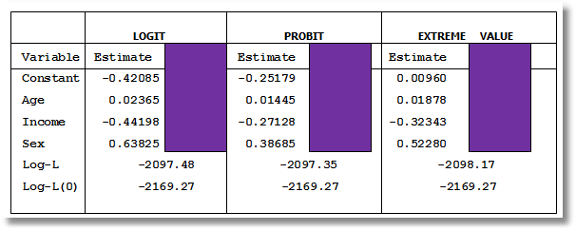
Estimated Binary Choice Models

Slide 28
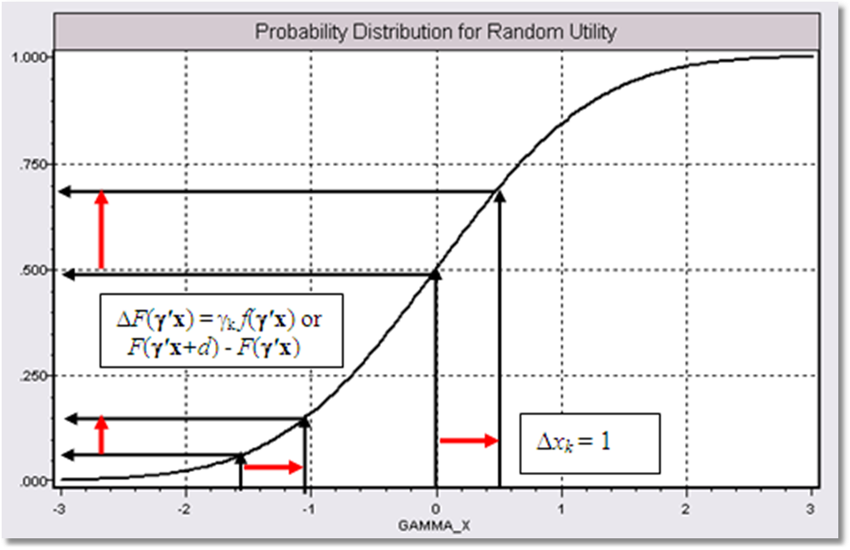
Effect on Predicted Probability of an Increase in Age
α + β₁ (Age+1) + β₂ (Income) + β₃ Sex
(β₁ > 0)

Slide 29
Partial Effects in Probability Models
Prob[Outcome] = some F(α+β₁Income…)
“Partial effect” = ∂F(α+β₁Income…) / ∂”x” (derivative)
  Partial effects are derivatives
  Result varies with model
    Logit: ∂F(α+β₁Income…) /∂x = Prob * (1-Prob) × β
    Probit: ∂ F(α+β₁Income…)/∂x = Normal density × β
    Extreme Value: ∂ F(α+β₁Income…)/∂x = Prob * (-log Prob) × β
  Scaling usually erases model differences

Slide 30
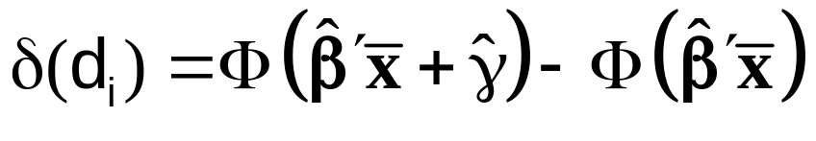
Partial Effect for a Dummy Variable
Prob[y_{i} = 1|x_{i},d_{i}] = F(β’x_{i}+γd_{i})
= conditional mean
Partial effect of d
Prob[y_{i} = 1|x_{i},d_{i}=1] - Prob[y_{i} = 1|x_{i},d_{i}=0]
Partial effect at the data means
Probit:

Slide 31
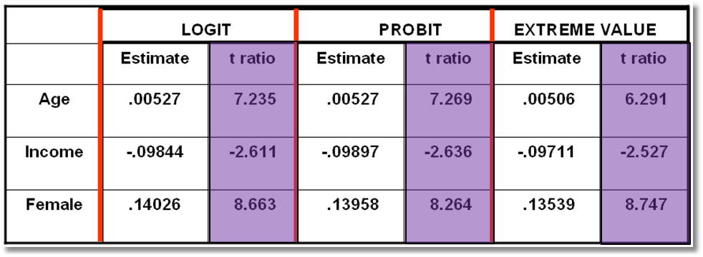

Estimated Partial Effects
LPM Estimates Partial Effects

Slide 32
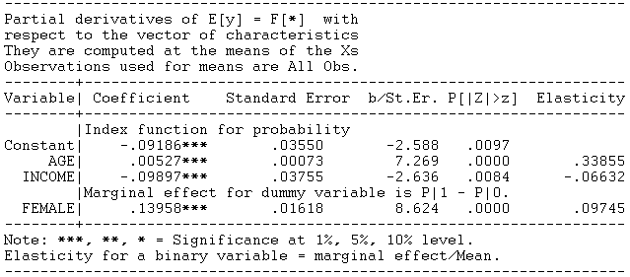
Probit Partial Effect – Dummy Variable

Slide 33
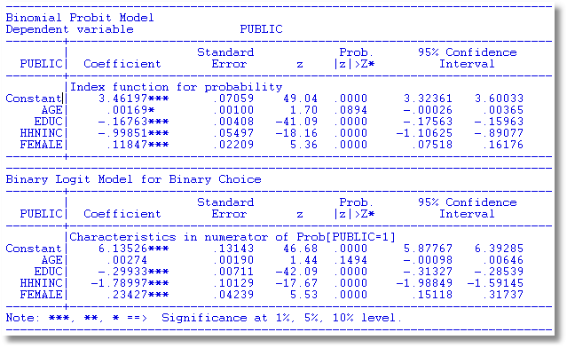
Binary Choice Models: Probit vs. Logit

Slide 34
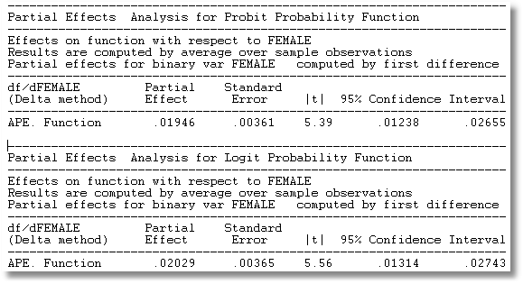
Average Partial Effects: Probit vs. Logit
Other things equal, the take up rate is about .02 higher in female headed households. The gross rates do not account for the facts that female headed households are a little older and a bit less educated, and both effects would push the take up rate up.

Slide 35
Computing Partial Effects
Compute at the data means?
  Simple
  Inference is well defined.
Average the individual effects
  More appropriate?
  Asymptotic standard errors are problematic.

Slide 36
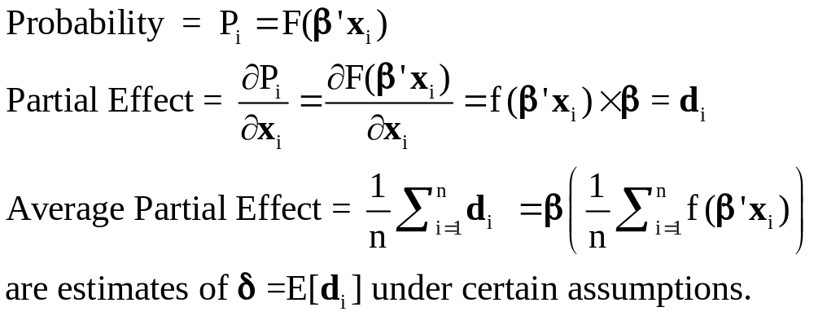
Average Partial Effects

Slide 37
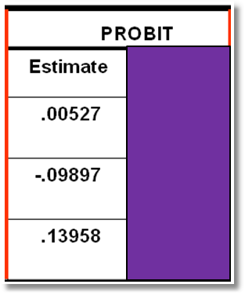
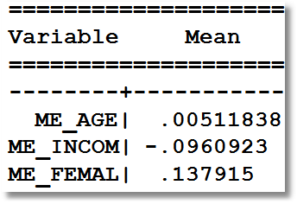
APE vs. Partial Effects at Means
Partial Effects at Means
Average Partial Effects

Slide 38
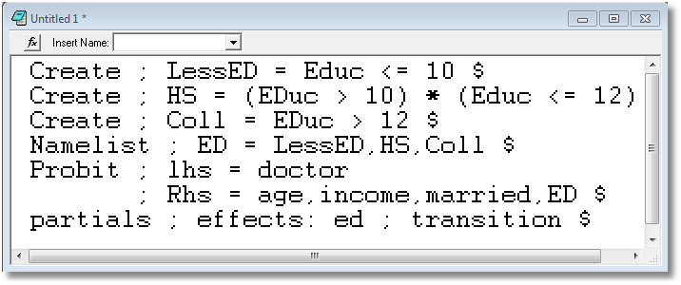
Partial Effects for Categories: Transitions

Slide 39
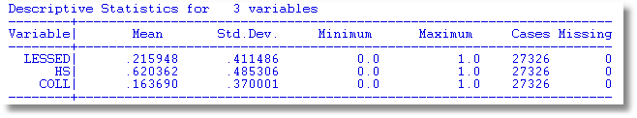
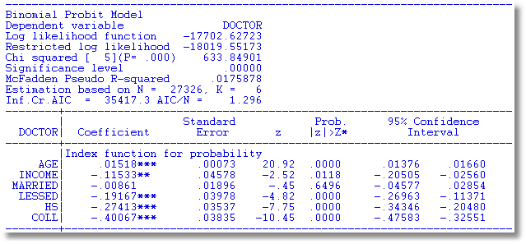

Slide 40
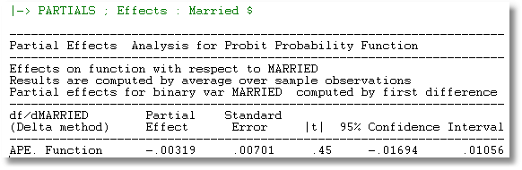

Slide 41
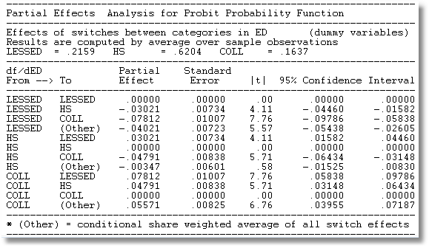

Slide 42
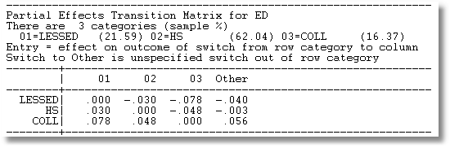

Slide 43
A Nonlinear Effect
P = F(age, age², income, female)
----------------------------------------------------------------------
Binomial Probit Model
Dependent variable DOCTOR
Log likelihood function -2086.94545
Restricted log likelihood -2169.26982
Chi squared [ 4 d.f.] 164.64874
Significance level .00000
--------+-------------------------------------------------------------
Variable| Coefficient Standard Error b/St.Er. P[|Z|>z] Mean of X
--------+-------------------------------------------------------------
|Index function for probability
Constant| 1.30811*** .35673 3.667 .0002
AGE| -.06487*** .01757 -3.693 .0002 42.6266
AGESQ| .00091*** .00020 4.540 .0000 1951.22
INCOME| -.17362* .10537 -1.648 .0994 .44476
FEMALE| .39666*** .04583 8.655 .0000 .46343
--------+-------------------------------------------------------------
Note: ***, **, * = Significance at 1%, 5%, 10% level.
----------------------------------------------------------------------

Slide 44
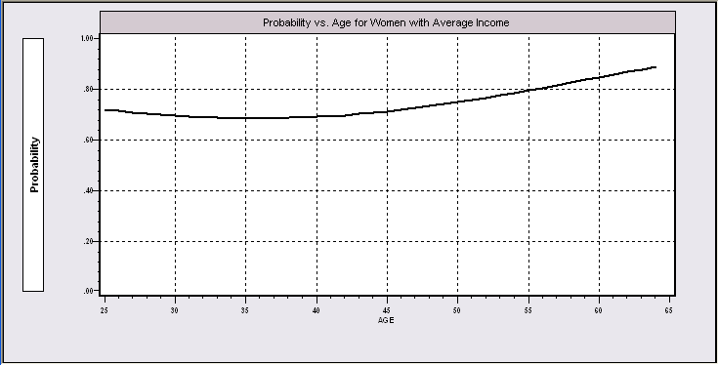
Nonlinear Effects
This is the probability implied by the model.

Slide 45
Partial Effects? No
----------------------------------------------------------------------
Partial derivatives of E[y] = F[*] with
respect to the vector of characteristics
They are computed at the means of the Xs
Observations used for means are All Obs.
--------+-------------------------------------------------------------
Variable| Coefficient Standard Error b/St.Er. P[|Z|>z] Elasticity
--------+-------------------------------------------------------------
|Index function for probability
AGE| -.02363*** .00639 -3.696 .0002 -1.51422
AGESQ| .00033*** .729872D-04 4.545 .0000 .97316
INCOME| -.06324* .03837 -1.648 .0993 -.04228
|Marginal effect for dummy variable is P|1 - P|0.
FEMALE| .14282*** .01620 8.819 .0000 .09950
--------+-------------------------------------------------------------
Separate “partial effects” for Age and Age² make no sense.
They are not varying “partially.”

Slide 46
Practicalities of Nonlinearities
PROBIT ; Lhs=doctor
; Rhs=one,age,agesq,income,female
; Partial effects $
PROBIT ; Lhs=doctor
; Rhs=one,age,age*age,income,female $
PARTIALS ; Effects : age $

Slide 47
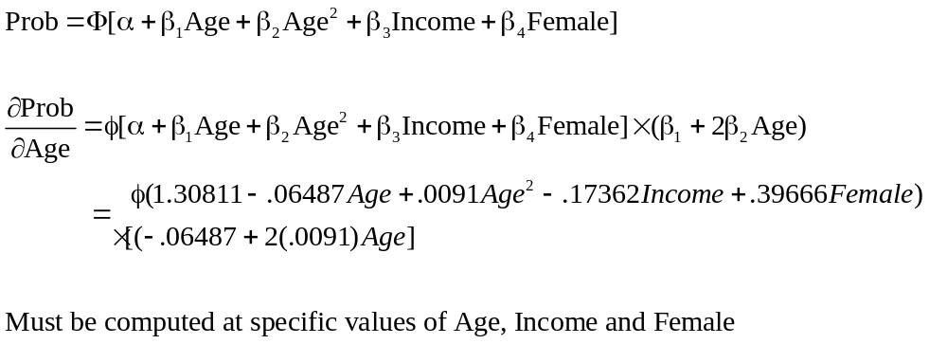
Partial Effect for Nonlinear Terms

Slide 48
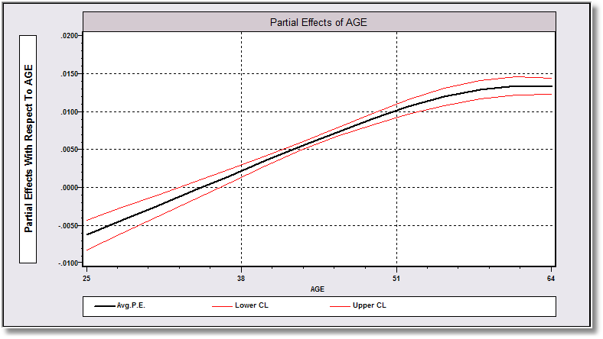
Average Partial Effect: Averaged over Sample Incomes and Genders for Specific Values of Age

Slide 49
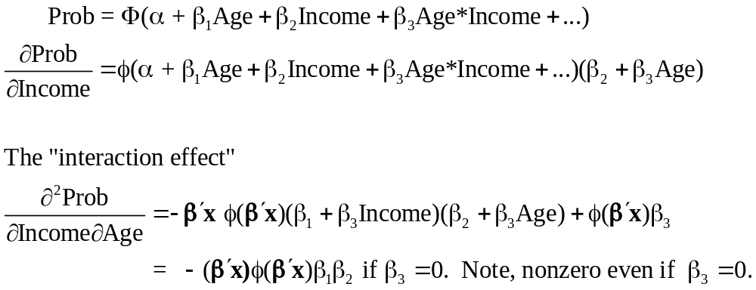
Interaction Effects

Slide 50
Partial Effects?
The software does not know that Age_Inc = Age*Income.
----------------------------------------------------------------------
Partial derivatives of E[y] = F[*] with
respect to the vector of characteristics
They are computed at the means of the Xs
Observations used for means are All Obs.
--------+-------------------------------------------------------------
Variable| Coefficient Standard Error b/St.Er. P[|Z|>z] Elasticity
--------+-------------------------------------------------------------
|Index function for probability
Constant| -.18002** .07421 -2.426 .0153
AGE| .00732*** .00168 4.365 .0000 .46983
INCOME| .11681 .16362 .714 .4753 .07825
AGE_INC| -.00497 .00367 -1.355 .1753 -.14250
|Marginal effect for dummy variable is P|1 - P|0.
FEMALE| .13902*** .01619 8.586 .0000 .09703
--------+-------------------------------------------------------------

Slide 51
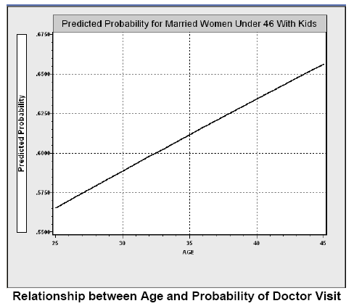
Direct Effect of Age

Slide 52
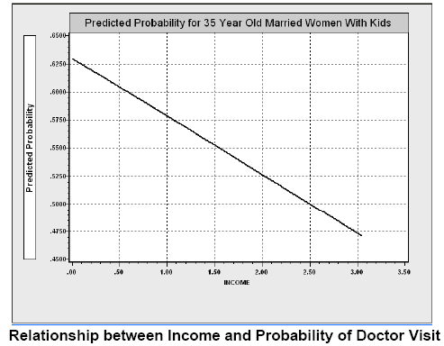
Income Effect

Slide 53
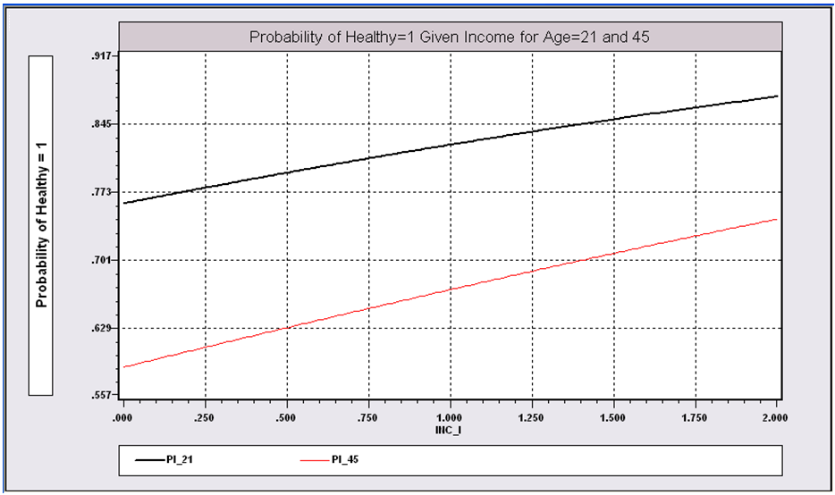
Income Effect on Health for Different Ages

Slide 54
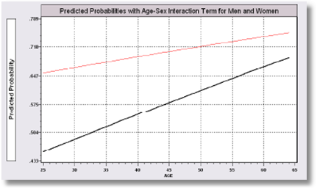
Gender – Age Interaction Effects

Slide 55
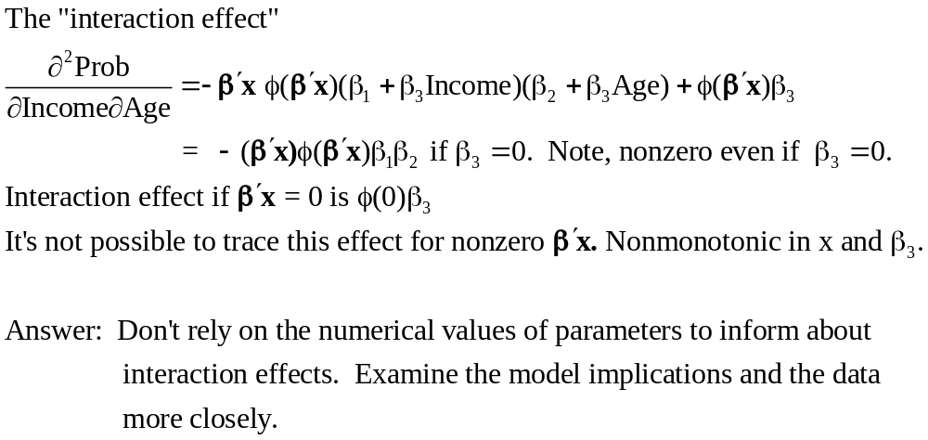
Interaction Effect

Slide 56
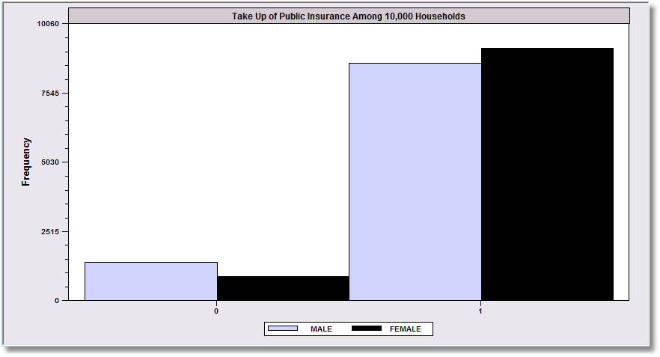
Margins and Odds Ratios
.8617
.9144
.1383
.0856
Overall take up rate of public insurance is greater for females than
males. What does the binary choice model say about the difference?

Slide 57
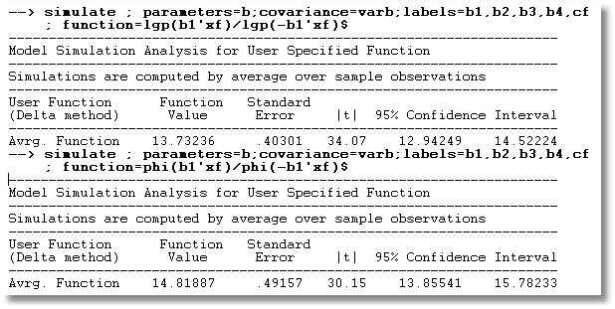
Odds Ratios for Insurance Takeup Model
Logit vs. Probit

Slide 58
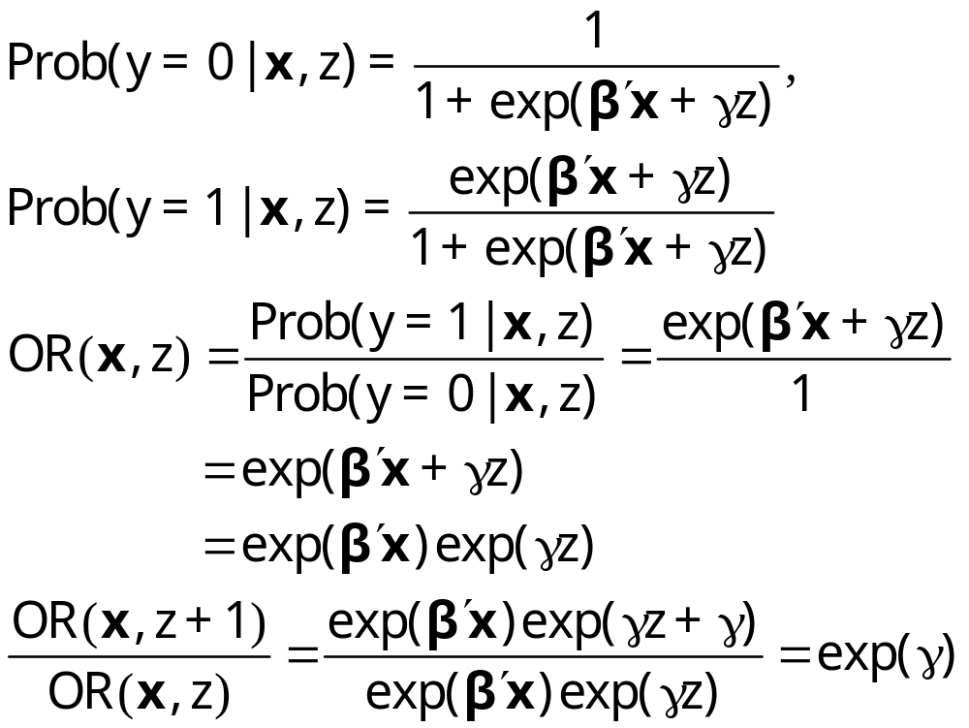
Odds Ratios
This calculation is not meaningful if the model is not a binary logit model

Slide 59
Odds Ratio
Exp(γ) = multiplicative change in the odds ratio when z changes by 1 unit.
dOR(x,z)/dx = OR(x,z)*β, not exp(β)
The “odds ratio” is not a partial effect – it is not a derivative.
It is only meaningful when the odds ratio is itself of interest and the change of the variable by a whole unit is meaningful.
“Odds ratios” might be interesting for dummy variables

Slide 60
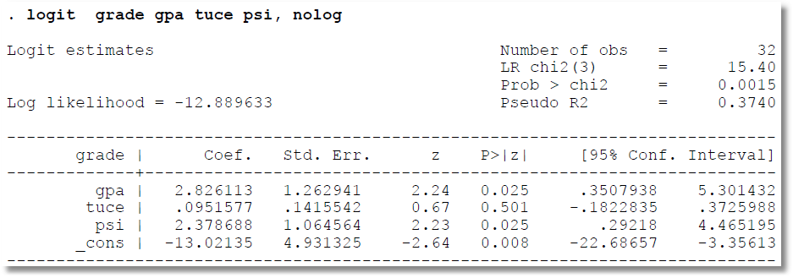
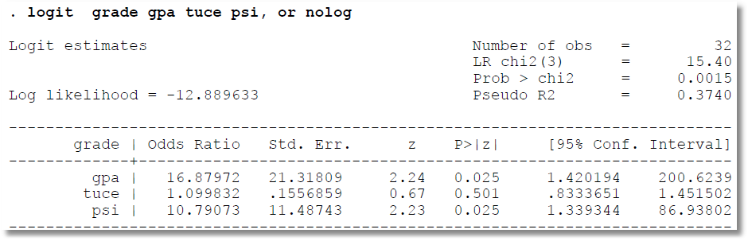
Odds Ratio = exp(b)

Slide 61
Standard Error = exp(b)*Std.Error(b)
Delta Method

Slide 62
z and P values are taken from
original coefficients, not the OR

Slide 63
Confidence limits are exp(b-1.96s) to exp(b+1.96s), not OR ± S.E.

Slide 64
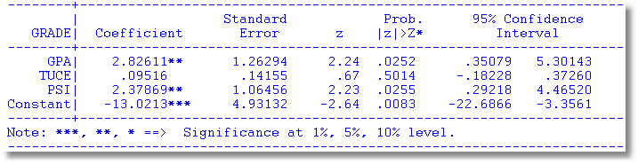
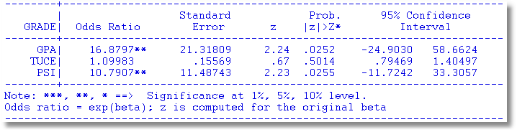


Slide 65
Margins are about units of measurement
Partial Effect
Odds Ratio
Takeup rate for female headed households is about 91.7%
Other things equal, female headed households are about .02 (about 2.1%) more likely to take up the public insurance
The odds that a female headed household takes up the insurance is about 14.
The odds go up by about 26% for a female headed household compared to a male headed household.

Slide 66
Measures of Fit in Binary Choice Models

Slide 67
How Well Does the Model Fit?
There is no R squared.
  Least squares for linear models is computed to maximize R²
  There are no residuals or sums of squares in a binary choice model
  The model is not computed to optimize the fit of the model to the data
How can we measure the “fit” of the model to the data?
  “Fit measures” computed from the log likelihood
    “Pseudo R squared” = 1 – logL/logL0
    Also called the “likelihood ratio index”
    Others… - these do not measure fit.
  Direct assessment of the effectiveness of the model at predicting the outcome

Slide 68

Fitstat
8 R-Squareds that range from .273 to .810

Slide 69
Pseudo R Squared
1 – LogL(model)/LogL(constant term only)
Also called “likelihood ratio index”
Bounded by 0 and 1-ε
Increases when variables are added to the model
Values between 0 and 1 have no meaning
Can be surprisingly low.
Should not be used to compare nonnested models
  Use logL
  Use information criteria to compare nonnested models
Notes:
69

Slide 70
Modifications of LRI Do Not Fix It
+----------------------------------------+
| Fit Measures for Binomial Choice Model |
| Logit model for variable DOCTOR |
+----------------------------------------+
| Y=0 Y=1 Total|
| Proportions .34202 .65798 1.00000|
| Sample Size 1155 2222 3377|
+----------------------------------------+
| Log Likelihood Functions for BC Model |
| P=0.50 P=N1/N P=Model| P=.5 => No Model. P=N1/N => Constant only
| LogL = -2340.76 -2169.27 -2085.92| Log likelihood values used in LRI
+----------------------------------------+
| Fit Measures based on Log Likelihood |
| McFadden = 1-(L/L0) = .03842|
| Estrella = 1-(L/L0)^(-2L0/n) = .04909| 1 – (1-LRI)^(-2L0/N)
| R-squared (ML) = .04816| 1 - exp[-(1/N)model chi-squard]
| Akaike Information Crit. = 1.23892| Multiplied by 1/N
| Schwartz Information Crit. = 1.24981| Multiplied by 1/N
+----------------------------------------+
| Fit Measures Based on Model Predictions|
| Efron = .04825| Note huge variation. This severely limits
| Ben Akiva and Lerman = .57139| the usefulness of these measures.
| Veall and Zimmerman = .08365|
| Cramer = .04771|
+----------------------------------------+

Slide 71

Fit Measures for a Logit Model

Slide 72
Fit Measures Based on Predictions
Computation
  Use the model to compute predicted probabilities
  Use the model and a rule to compute predicted y = 0 or 1
Fit measure compares predictions to actuals

Slide 73

Predicting the Outcome
Predicted probabilities
P = F(a + b₁Age + b₂Income + b₃Female+…)
Predicting outcomes
  Predict y=1 if P is “large”
  Use 0.5 for “large” (more likely than not)
  Generally, use
Count successes and failures

Slide 74


Slide 75

Cramer Fit Measure
+----------------------------------------+
| Fit Measures Based on Model Predictions|
| Efron = .04825|
| Veall and Zimmerman = .08365|
| Cramer = .04771|
+----------------------------------------+

Slide 76

Comparing Groups: Oaxaca Decomposition

Slide 77

Oaxaca (and other) Decompositions

