Slide 1




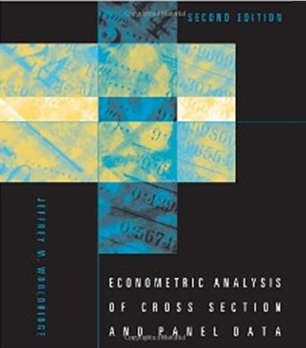

1. Descriptive Tools, Regression, Panel Data

Slide 2
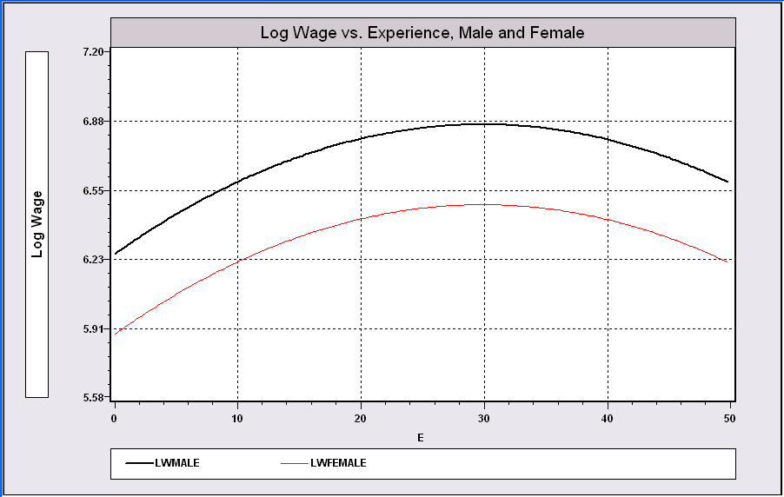
Model Building in Econometrics
Parameterizing the model
  Nonparametric analysis
  Semiparametric analysis
  Parametric analysis
Sharpness of inferences follows from the strength of the assumptions
A Model Relating (Log)Wage
to Gender and Experience

Slide 3
Cornwell and Rupert Panel Data
Cornwell and Rupert Returns to Schooling Data, 595 Individuals, 7 Years
Variables in the file are
EXP = work experience
WKS = weeks worked
OCC = occupation, 1 if blue collar,
IND = 1 if manufacturing industry
SOUTH = 1 if resides in south
SMSA = 1 if resides in a city (SMSA)
MS = 1 if married
FEM = 1 if female
UNION = 1 if wage set by union contract
ED = years of education
LWAGE = log of wage = dependent variable in regressions
These data were analyzed in Cornwell, C. and Rupert, P., "Efficient Estimation with Panel Data: An Empirical Comparison of Instrumental Variable Estimators," Journal of Applied Econometrics, 3, 1988, pp. 149-155.
Notes:
3

Slide 4


Slide 5
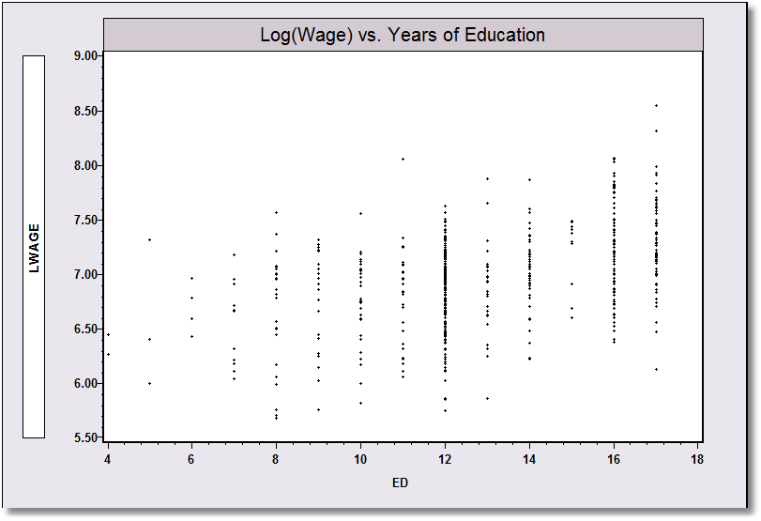
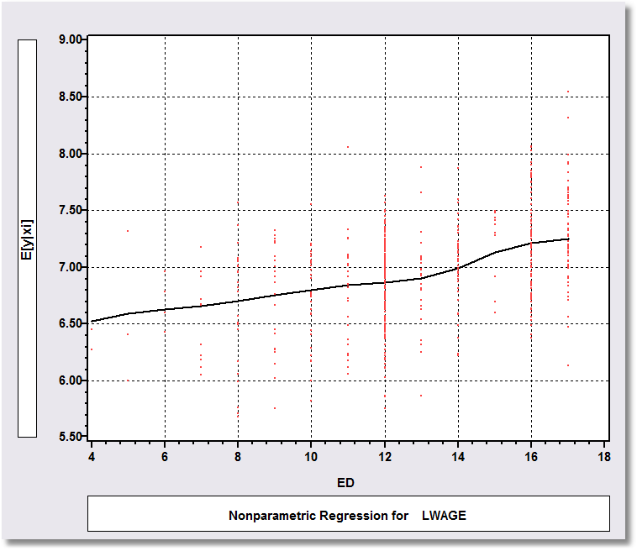
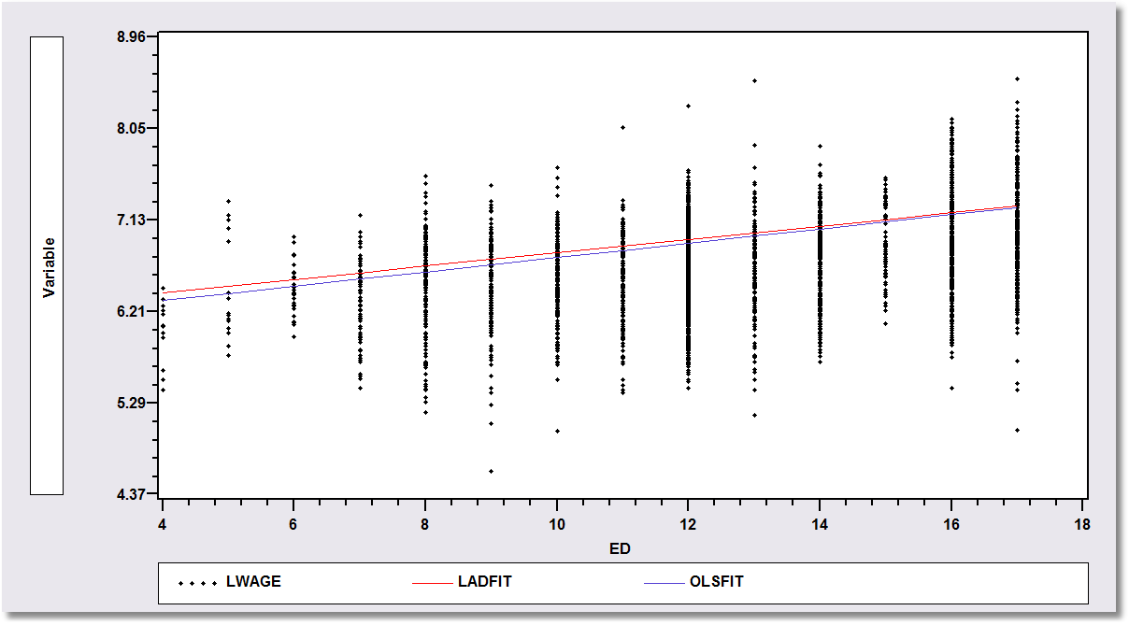
Application: Is there a relationship between Log(wage) and Education?
Nonparametric Regression
Kernel regression of y on x
Semiparametric Regression: Least absolute deviations regression of y on x
Parametric Regression: Least squares – maximum likelihood – regression of y on x

Slide 6
A First Look at the Data
Descriptive Statistics
Basic Measures of Location and Dispersion
Graphical Devices
  Box Plots
  Histogram
  Kernel Density Estimator

Slide 7
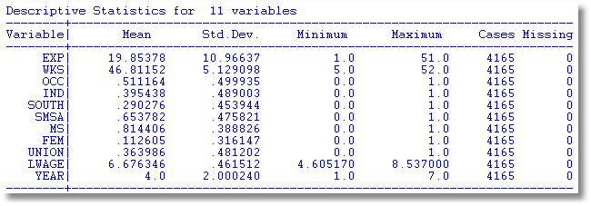
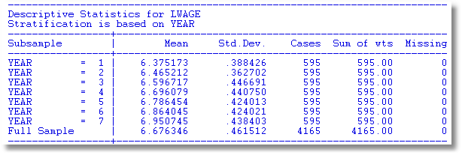

Slide 8
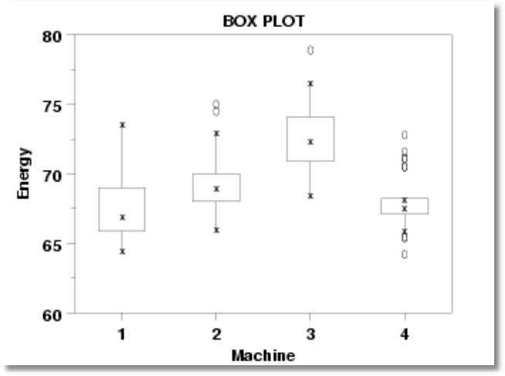
Box Plots

Slide 9
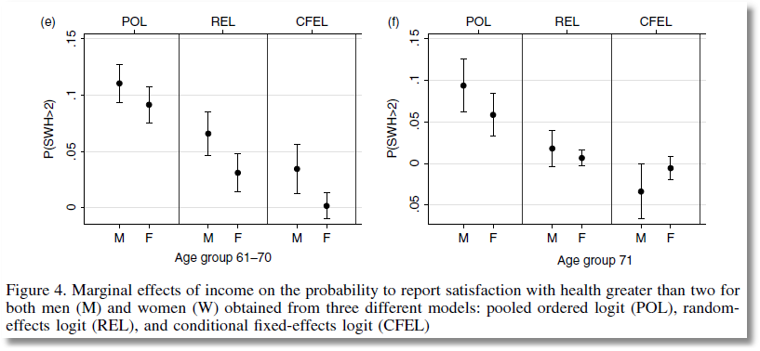
From Jones and Schurer (2011)

Slide 10
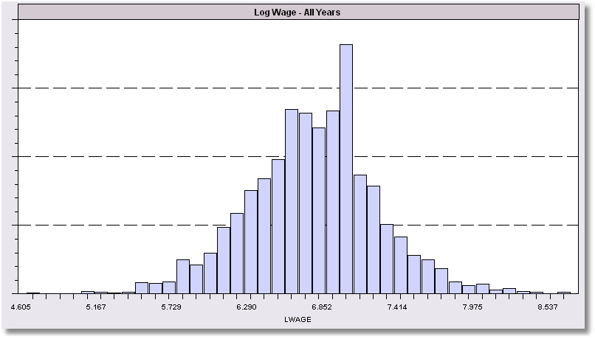
Histogram for LWAGE

Slide 11
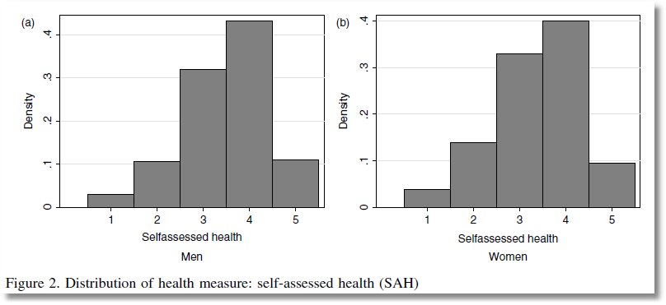

Slide 12
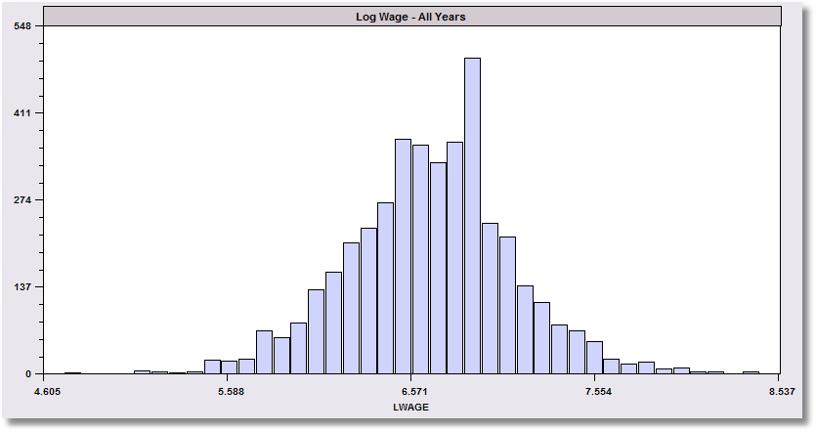
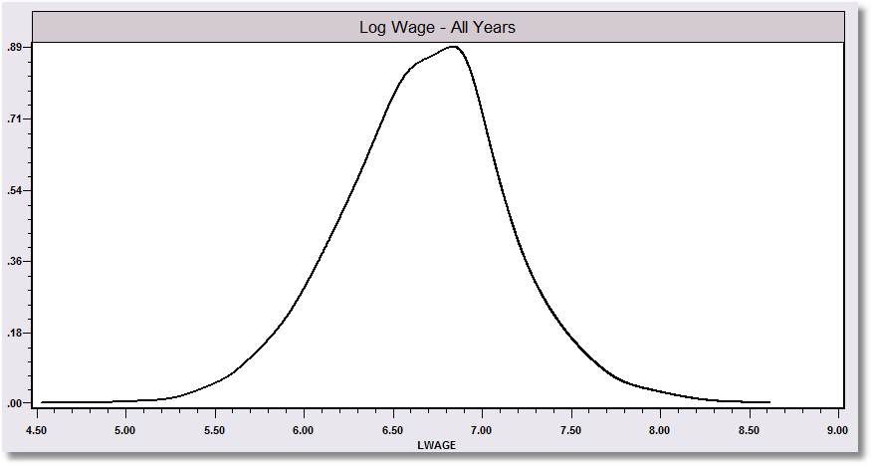
The kernel density estimator is a histogram (of sorts).

Slide 13
Kernel Density Estimator

Slide 14
Kernel Estimator for LWAGE

Slide 15
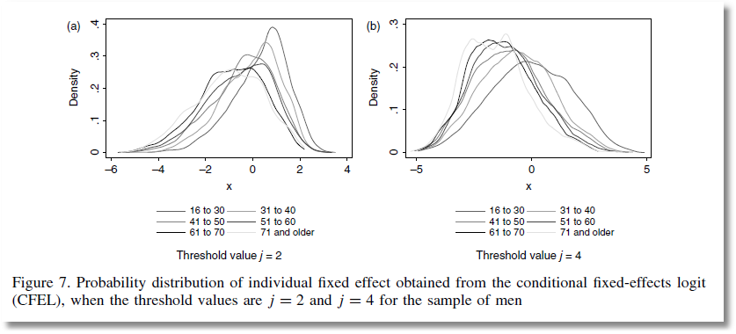
From Jones and Schurer (2011)

Slide 16
Objective: Impact of Education on (log) Wage
Specification: What is the right model to use to analyze this association?
Estimation
Inference
Analysis

Slide 17
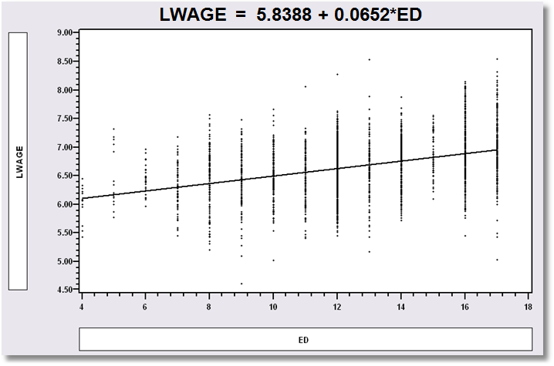
Simple Linear Regression
LWAGE = 5.8388 + 0.0652*ED

Slide 18
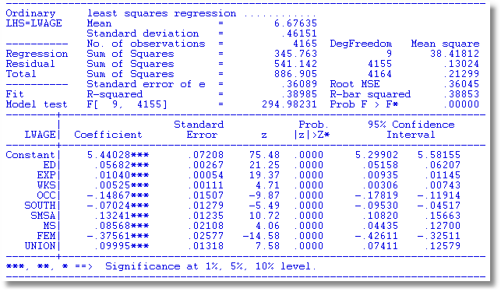
Multiple Regression

Slide 19

Specification: Quadratic Effect of Experience

Slide 20
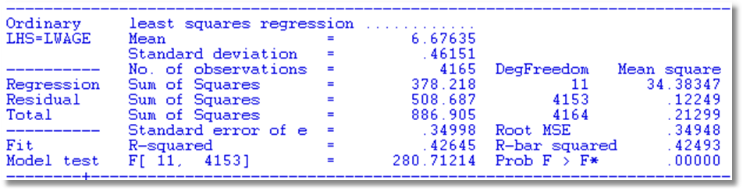
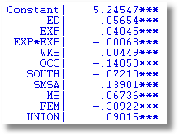
Partial Effects
Education: .05654
Experience .04045 - 2*.00068*Exp
FEM -.38922

Slide 21
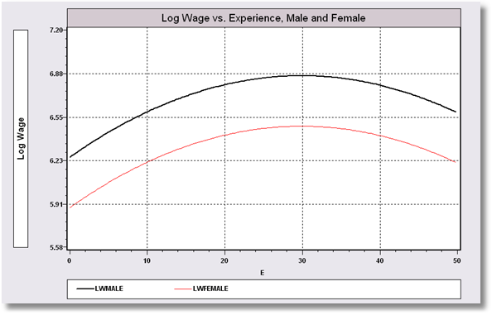
Model Implication: Effect of Experience and Male vs. Female

Slide 22
Hypothesis Test About Coefficients
Hypothesis
  Null: Restriction on β: Rβ – q = 0
  Alternative: Not the null
Approaches
  Fitting Criterion: R² decrease under the null?
  Wald: Rb – q close to 0 under the alternative?

Slide 23
Hypotheses
All Coefficients = 0?
R = [ 0 | I ] q = [0]
ED Coefficient = 0?
R = 0,1,0,0,0,0,0,0,0,0,0
q = 0
No Experience effect?
R = 0,0,1,0,0,0,0,0,0,0,0
0,0,0,1,0,0,0,0,0,0,0
q = 0
0

Slide 24
Hypothesis Test Statistics

Slide 25
Hypothesis: All Coefficients Equal Zero
All Coefficients = 0?
R = [0 | I] q = [0]
R₁² = .41826
R₀² = .00000
F = 298.7 with [10,4154]
Wald = b₂₋₁₁[V₂₋₁₁]⁻¹b₂₋₁₁
= 2988.3355
Note that Wald = JF
= 10(298.7)
(some rounding error)

Slide 26
Hypothesis: Education Effect = 0
ED Coefficient = 0?
R = 0,1,0,0,0,0,0,0,0,0,0,0
q = 0
R₁² = .41826
R₀² = .35265 (not shown)
F = 468.29
Wald = (.05654-0)²/(.00261)²
= 468.29
Note F = t² and Wald = F
For a single hypothesis about 1 coefficient.

Slide 27
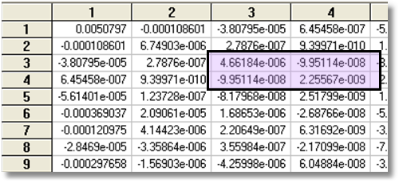
Hypothesis: Experience Effect = 0
No Experience effect?
R = 0,0,1,0,0,0,0,0,0,0,0
0,0,0,1,0,0,0,0,0,0,0
q = 0
0
R₀² = .33475, R₁² = .41826
F = 298.15
Wald = 596.3 (W* = 5.99)

Slide 28
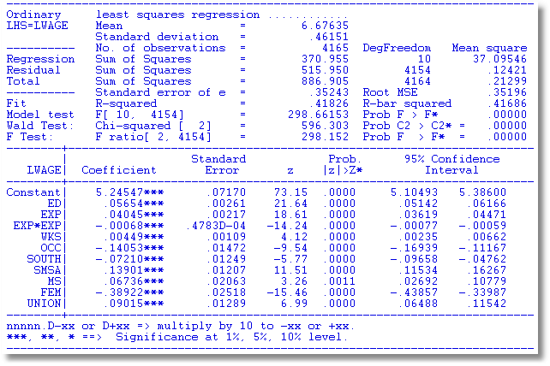
Built In Test

Slide 29
Robust Covariance Matrix
What does robustness mean?
Robust to: Heteroscedasticty
Not robust to:
  Autocorrelation
  Individual heterogeneity
  The wrong model specification
‘Robust inference’

Slide 30
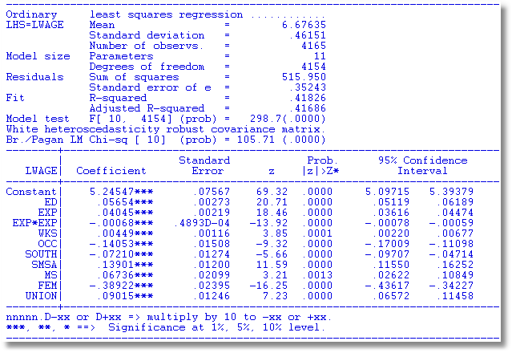
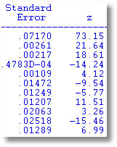
Robust Covariance Matrix
Uncorrected

Slide 31
Bootstrapping

Slide 32
Estimating the Asymptotic
Variance of an Estimator
Known form of asymptotic variance: Compute from known results
Unknown form, known generalities about properties: Use bootstrapping
  Root N consistency
  Sampling conditions amenable to central limit theorems
  Compute by resampling mechanism within the sample.

Slide 33
Bootstrapping
Method:
1. Estimate parameters using full sample: → b
2. Repeat R times:
Draw n observations from the n, with replacement
Estimate β with b(r).
3. Estimate variance with
V = (1/R)Σ_{r} [b(r) - b][b(r) - b]’
(Some use mean of replications instead of b. Advocated (without motivation) by original designers of the method.)

Slide 34
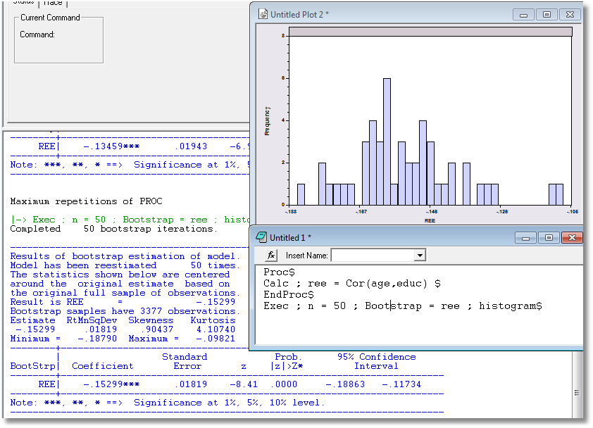
Application: Correlation between Age and Education

Slide 35
Bootstrap Regression - Replications
namelist;x=one,y,pg$ Define X
regress;lhs=g;rhs=x$ Compute and display b
proc Define procedure
regress;quietly;lhs=g;rhs=x$ … Regression (silent)
endproc Ends procedure
execute;n=20;bootstrap=b$ 20 bootstrap reps
matrix;list;bootstrp $ Display replications

Slide 36
Results of Bootstrap Procedure
--------+-------------------------------------------------------------
Variable| Coefficient Standard Error t-ratio P[|T|>t] Mean of X
--------+-------------------------------------------------------------
Constant| -79.7535*** 8.67255 -9.196 .0000
Y| .03692*** .00132 28.022 .0000 9232.86
PG| -15.1224*** 1.88034 -8.042 .0000 2.31661
--------+-------------------------------------------------------------
Completed 20 bootstrap iterations.
----------------------------------------------------------------------
Results of bootstrap estimation of model.
Model has been reestimated 20 times.
Means shown below are the means of the
bootstrap estimates. Coefficients shown
below are the original estimates based
on the full sample.
bootstrap samples have 36 observations.
--------+-------------------------------------------------------------
Variable| Coefficient Standard Error b/St.Er. P[|Z|>z] Mean of X
--------+-------------------------------------------------------------
B001| -79.7535*** 8.35512 -9.545 .0000 -79.5329
B002| .03692*** .00133 27.773 .0000 .03682
B003| -15.1224*** 2.03503 -7.431 .0000 -14.7654
--------+-------------------------------------------------------------

Slide 37
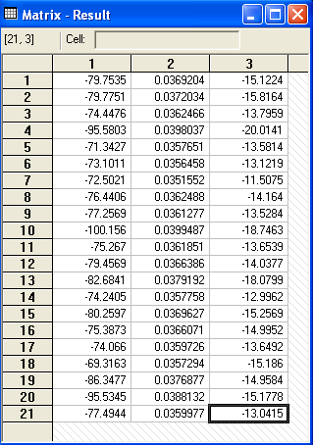
Bootstrap Replications
Full sample result
Bootstrapped sample results

Slide 38
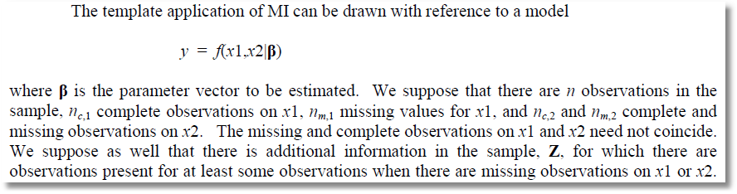
Multiple Imputation for Missing Data

Slide 39
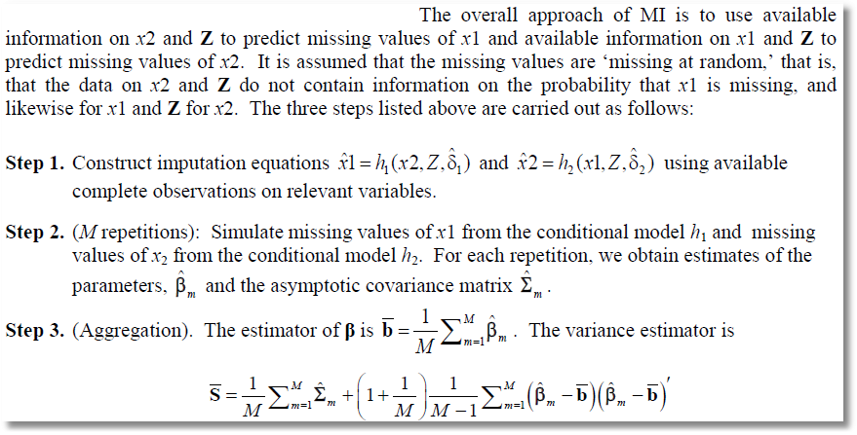
Imputed Covariance Matrix

Slide 40
Implementation
SAS, Stata: Create full data sets with imputed values inserted. M = 5 is the familiar standard number of imputed data sets.
NLOGIT/LIMDEP
  Create an internal map of the missing values and a set of engines for filling missing values
  Loop through imputed data sets during estimation.
  M may be arbitrary – memory usage and data storage are independent of M.

