Slide 1
Microeconometric Modeling
William Greene
Stern School of Business
New York University

Slide 2
4. Quantile Regresion

Slide 3
Quantile Regression
Q(y|x,α) = β′x, α = quantile
Estimated by linear programming
Q(y|x,.50) = β′x, .50 ➔ median regression
Median regression estimated by LAD (estimates same parameters as mean regression if symmetric conditional distribution)
Why use quantile (median) regression?
  Semiparametric
  Robust to some extensions (heteroscedasticity?)
  Complete characterization of conditional distribution

Slide 4
Estimated Variance for
Quantile Regression
Asymptotic Theory
Bootstrap – an ideal application

Slide 6
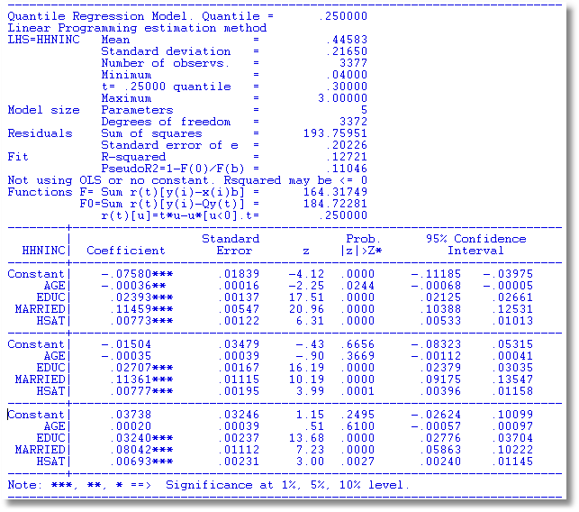
α = .25
α = .50
α = .75

Slide 7
OLS vs. Least Absolute Deviations
----------------------------------------------------------------------
Least absolute deviations estimator...............
Residuals Sum of squares = 1537.58603
Standard error of e = 6.82594
Fit R-squared = .98284
Adjusted R-squared = .98180
Sum of absolute deviations = 189.3973484
--------+-------------------------------------------------------------
Variable| Coefficient Standard Error b/St.Er. P[|Z|>z] Mean of X
--------+-------------------------------------------------------------
|Covariance matrix based on 50 replications.
Constant| -84.0258*** 16.08614 -5.223 .0000
Y| .03784*** .00271 13.952 .0000 9232.86
PG| -17.0990*** 4.37160 -3.911 .0001 2.31661
--------+-------------------------------------------------------------
Ordinary least squares regression ............
Residuals Sum of squares = 1472.79834
Standard error of e = 6.68059 Standard errors are based on
Fit R-squared = .98356 50 bootstrap replications
Adjusted R-squared = .98256
--------+-------------------------------------------------------------
Variable| Coefficient Standard Error t-ratio P[|T|>t] Mean of X
--------+-------------------------------------------------------------
Constant| -79.7535*** 8.67255 -9.196 .0000
Y| .03692*** .00132 28.022 .0000 9232.86
PG| -15.1224*** 1.88034 -8.042 .0000 2.31661
--------+-------------------------------------------------------------

Slide 8
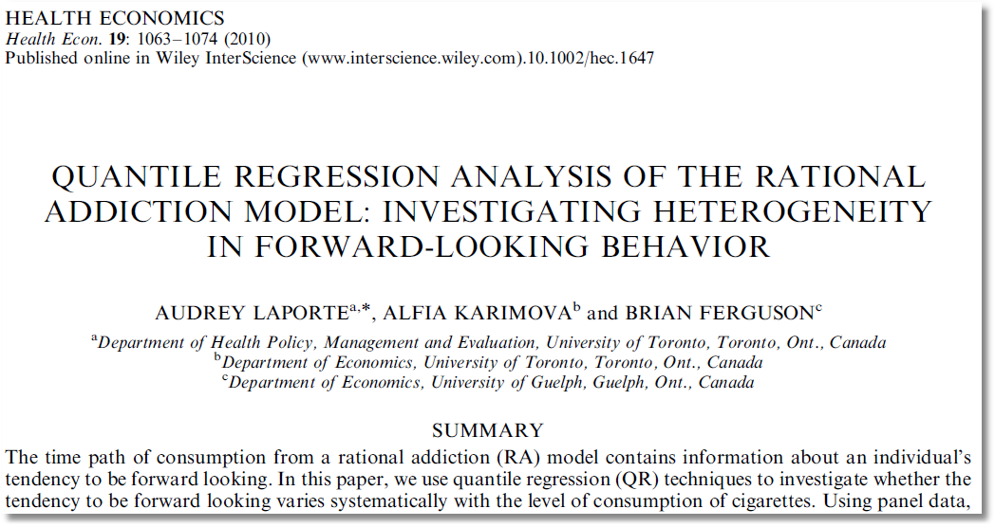

Slide 9
