Slide 1
Discrete Choice Modeling
William Greene
Stern School of Business
New York University

Slide 2
6. NonLINEAR models

Slide 3
Agenda
Nonlinear Models
Estimation Theory for Nonlinear Models
  Estimators
  Properties
  M Estimation
    Nonlinear Least Squares
    Maximum Likelihood Estimation
  GMM Estimation
    Minimum Distance Estimation
    Minimum Chi-square Estimation
Computation – Nonlinear Optimization
  Nonlinear Least Squares
  Newton-like Algorithms; Gradient Methods
(Background: JW, Chapters 12-14, Greene, Chapters 7,12-14)

Slide 4
What is the ‘Model?’
Unconditional ‘characteristics’ of a population
Conditional moments: E[g(y)|x]: median, mean, variance, quantile, correlations, probabilities…
Conditional probabilities and densities
Conditional means and regressions
Fully parametric and semiparametric specifications
  Parametric specification: Known up to parameter θ
  Conditional means: E[y|x] = m(x, θ)

Slide 5
What is a Nonlinear Model?
Model: E[g(y)|x] = m(x,θ)
Objective:
  Learn about θ from y, X
  Usually “estimate” θ
Linear Model: Closed form; = h(y, X)
Nonlinear Model
  Not necessarily wrt m(x,θ). E.g., y = exp(θ’x + ε)
  Wrt estimator: Implicitly defined. h(y, X, )=0, E.g., E[y|x]= exp(θ’x)

Slide 6
What is an Estimator?
Point and Interval
Classical and Bayesian

Slide 7
Parameters
Model parameters
The parameter space:
Estimators of ‘parameters’
The true parameter(s)

Slide 8
The Conditional Mean Function

Slide 9
M Estimation
Classical estimation method

Slide 10
An Analogy Principle for M Estimation

Slide 11
Estimation

Slide 12
Identification

Slide 13
Continuity

Slide 14
Consistency

Slide 15
Asymptotic Normality of M Estimators

Slide 16
Asymptotic Normality

Slide 17
Asymptotic Normality

Slide 18
Asymptotic Variance

Slide 19
Estimating the Variance

Slide 20
Nonlinear Least Squares

Slide 21
Application - Income
German Health Care Usage Data, 7,293 Individuals, Varying Numbers of Periods
Variables in the file are
Data downloaded from Journal of Applied Econometrics Archive. This is an unbalanced panel with 7,293 individuals. They can be used for regression, count models, binary choice, ordered choice, and bivariate binary choice. This is a large data set. There are altogether 27,326 observations. The number of observations ranges from 1 to 7. (Frequencies are: 1=1525, 2=2158, 3=825, 4=926, 5=1051, 6=1000, 7=987). Note, the variable NUMOBS below tells how many observations there are for each person. This variable is repeated in each row of the data for the person. (Downloaded from the JAE Archive)
HHNINC = household nominal monthly net income in German marks / 10000.
(4 observations with income=0 were dropped)
HHKIDS = children under age 16 in the household = 1; otherwise = 0
EDUC = years of schooling
AGE = age in years

Slide 22
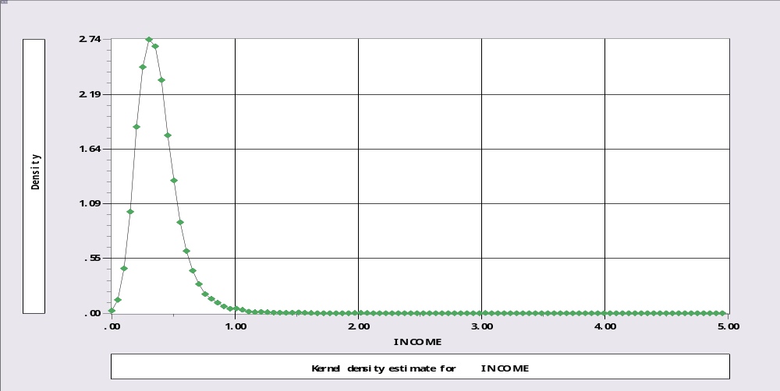
Income Data

Slide 23
Exponential Model

Slide 24
Conventional Variance Estimator
Sometimes omitted.

Slide 25
Estimator for the M Estimator

Slide 26
Computing NLS
Reject; hhninc=0$
Calc ; b0=log(xbr(hhninc))$
Names ; x=one,educ,married,age$
Nlsq ; labels=a0,a1,a2,a3
; start=b0,0,0,0
; fcn=exp(a0’x)
; lhs=hhninc;output=3$
Create; thetai = exp(x'b)
; ei=hhninc-thetai
; gi2=(ei*thetai)^2
; hi=hhninc*thetai$
Matrix; varM = <x'[hi] x> * x'[gi2]x * <x'[hi] x> $
Matrix; stat(b,varM,x)$

Slide 27
Iterations … Convergence
Begin NLSQ iterations. Linearized regression.
Iteration= 1; Sum of squares= 854.681775 ; Gradient= 90.0964694
Iteration= 2; Sum of squares= 766.073500 ; Gradient= 2.38006397
Iteration= 3; Sum of squares= 763.757721 ; Gradient= .300030163E-02
Iteration= 4; Sum of squares= 763.755005 ; Gradient= .307466962E-04
Iteration= 5; Sum of squares= 763.754978 ; Gradient= .365064970E-06
Iteration= 6; Sum of squares= 763.754978 ; Gradient= .433325697E-08
Iteration= 7; Sum of squares= 763.754978 ; Gradient= .514374906E-10
Iteration= 8; Sum of squares= 763.754978 ; Gradient= .610586853E-12
Iteration= 9; Sum of squares= 763.754978 ; Gradient= .724960231E-14
Iteration= 10; Sum of squares= 763.754978 ; Gradient= .860927011E-16
Iteration= 11; Sum of squares= 763.754978 ; Gradient= .102139114E-17
Iteration= 12; Sum of squares= 763.754978 ; Gradient= .118640949E-19
Iteration= 13; Sum of squares= 763.754978 ; Gradient= .125019054E-21
Convergence achieved

Slide 28
NLS Estimates
+----------------------------------------------------+
| User Defined Optimization |
| Nonlinear least squares regression |
| LHS=HHNINC Mean = .3521352 |
| Standard deviation = .1768699 |
| Residuals Sum of squares = 763.7550 |
+----------------------------------------------------+
+---------+--------------+----------------+--------+---------+
|Variable | Coefficient | Standard Error |b/St.Er.|P[|Z|>z] |
+---------+--------------+----------------+--------+---------+
Conventional Estimates
Constant -1.89118955 .01879455 -100.624 .0000
EDUC .05471841 .00102649 53.306 .0000
MARRIED .23756387 .00765477 31.035 .0000
AGE .00081033 .00026344 3.076 .0021
+---------+--------------+----------------+--------+---------+
Recomputed variances using sandwich estimator for M Estimation.
B_1 -1.89118955 .01910054 -99.012 .0000
B_2 .05471841 .00115059 47.557 .0000
B_3 .23756387 .00842712 28.190 .0000
B_4 .00081033 .00026137 3.100 .0019

Slide 29
Hypothesis Tests for M Estimation

Slide 30
Change in the Criterion Function

Slide 31
Score Test

Slide 32
Exponential Model

Slide 33
Wald Test
Matrix ; List ; R=[0,1,0,0 / 0,0,1,0 / 0,0,0,1]
; c=R*b ; Vc = R*Varb*R'
; Wald = c'<VC>c $
Matrix R has 3 rows and 4 columns.
.0000000D+00 1.00000 .0000000D+00 .0000000D+00
.0000000D+00 .0000000D+00 1.00000 .0000000D+00
.0000000D+00 .0000000D+00 .0000000D+00 1.00000
Matrix C has 3 rows and 1 columns.
.05472
.23756
.00081
Matrix VC has 3 rows and 3 columns.
.1053686D-05 .4530603D-06 .3649631D-07
.4530603D-06 .5859546D-04 -.3565863D-06
.3649631D-07 -.3565863D-06 .6940296D-07
Matrix WALD has 1 rows and 1 columns.
3627.17514

Slide 34
Change in Function
Calc ; M = sumsqdev $ (from unrestricted)
Calc ; b0 = log(xbr(hhninc)) $
Nlsq ; labels=a0,a1,a2,a3;start=b0,0,0,0
; fcn=exp(a0+a1*educ+a2*married+a3*age)
; fix=a1,a2,a3 ? Fixes at start values
; lhs=hhninc $
Calc ; M0 = sumsqdev $

Slide 35
Constrained Estimation
Nonlinear Estimation of Model Parameters
Method=BFGS ; Maximum iterations=100
Start values: -.10437D+01
1st derivs. -.26609D-10
Parameters: -.10437D+01
Itr 1 F= .4273D+03 gtHg= .2661D-10
* Converged
NOTE: Convergence in initial iterations is rarely
at a true function optimum. This may not be a
solution (especially if initial iterations stopped).
Exit from iterative procedure. 1 iterations completed.
Why did this occur? The starting value is the minimizer of the constrained function

Slide 36
Constrained Estimates
+----------------------------------------------------+
| User Defined Optimization |
| Nonlinear least squares regression |
| LHS=HHNINC Mean = .3521352 |
| Standard deviation = .1768699 |
| Residuals Sum of squares = 854.6818 |
+----------------------------------------------------+
+---------+--------------+----------------+--------+---------+
|Variable | Coefficient | Standard Error |b/St.Er.|P[|Z|>z] |
+---------+--------------+----------------+--------+---------+
A0 -1.04374019 .00303865 -343.488 .0000
A1 .000000 ......(Fixed Parameter).......
A2 .000000 ......(Fixed Parameter).......
A3 .000000 ......(Fixed Parameter).......
--> calc ; m0=sumsqdev ; list ; df = 2*(m0 - m) $
DF = 181.854

Slide 37
LM Test

Slide 38
LM Test
Name ;x=one,educ,married,age$
Create ;thetai=exp(x'b);ei=hhninc-thetai$
Create ;gi=ei*thetai ; gi2 = gi*gi $
Matrix ; list ; LM = 1'[gi]x * <x'[gi2]x> * x'[gi]1 $
Matrix LM has 1 rows and 1 columns.
1
+--------------
1| 1915.03286

Slide 39
Maximum Likelihood Estimation
Fully parametric estimation
  Density of y_{i} is fully specified
The likelihood function = the joint density of the observed random variable.
Example: density for the exponential model

Slide 40
The Likelihood Function

Slide 41
Log Likelihood Function

Slide 42
Conditional and Unconditional Likelihood

Slide 43
Concentrated Log Likelihood

Slide 44
A Concentrated Log Likelihood

Slide 45
ML and M Estimation

Slide 46
Regularity Conditions
Conditions for the MLE to be consistent, etc.
Augment the continuity and identification conditions for M estimation
Regularity:
  Three times continuous differentiability of the log density
  Finite third moments of log density
  Conditions needed to obtain expected values of derivatives of log density are met.
(See Greene (Chapter 14))

Slide 47
Consistency and Asymptotic
Normality of the MLE
Conditions are identical to those for M estimation
Terms in proofs are log density and its derivatives
Nothing new is needed.
  Law of large numbers
  Lindberg-Feller central limit applies to derivatives of the log likelihood.

Slide 48
Asymptotic Variance of the MLE

Slide 49
The Information Matrix Equality

Slide 50
Three Variance Estimators
Negative inverse of expected second derivatives matrix. (Usually not known)
Negative inverse of actual second derivatives matrix.
Inverse of variance of first derivatives

Slide 51
Asymptotic Efficiency
M estimator based on the conditional mean is semiparametric. Not necessarily efficient.
MLE is fully parametric. It is efficient among all consistent and asymptotically normal estimators when the density is as specified.
This is the Cramer-Rao bound.
Note the implied comparison to nonlinear least squares for the exponential regression model.

Slide 52
Invariance

Slide 53
Application: Exponential Regression
+---------------------------------------------+
| Exponential (Loglinear) Regression Model |
| Maximum Likelihood Estimates |
| Dependent variable HHNINC |
| Number of observations 27322 |
| Iterations completed 10 |
| Log likelihood function 1539.191 |
| Number of parameters 4 |
| Restricted log likelihood 1195.070 |
| Chi squared 688.2433 |
| Degrees of freedom 3 |
+---------------------------------------------+
+---------+--------------+----------------+--------+---------+----------+
|Variable | Coefficient | Standard Error |b/St.Er.|P[|Z|>z] | Mean of X|
+---------+--------------+----------------+--------+---------+----------+
Parameters in conditional mean function
Constant -1.82555590 .04219675 -43.263 .0000
EDUC .05545277 .00267224 20.751 .0000 11.3201838
MARRIED .23664845 .01460746 16.201 .0000 .75869263
AGE -.00087436 .00057331 1.525 .1272 43.5271942
NLS Results with recomputed variances using results for M Estimation.
B_1 -1.89118955 .01910054 -99.012 .0000
B_2 .05471841 .00115059 47.557 .0000
B_3 .23756387 .00842712 28.190 .0000
B_4 .00081033 .00026137 3.100 .0019

Slide 54
Variance Estimators

Slide 55
Three Variance Estimators

Slide 56
Variance Estimators
Loglinear ; Lhs=hhninc;Rhs=x ; Model = Exponential
create;thetai=exp(x'b);hi=hhninc/thetai;gi2=(hi-1)^2$
matr;he=<x'x> ; ha=<x'[hi]x> ; bhhh=<x'[gi2]x>$
matr;stat(b,ha);stat(b,he);stat(b,bhhh)$
+---------+--------------+----------------+--------+---------+
|Variable | Coefficient | Standard Error |b/St.Er.|P[|Z|>z] |
+---------+--------------+----------------+--------+---------+
B_1 -1.82555590 .11129890 -16.402 .0000 ACTUAL
B_2 .05545277 .00617308 8.983 .0000
B_3 .23664845 .04609371 5.134 .0000
B_4 -.00087436 .00164729 -.531 .5956
+---------+--------------+----------------+--------+---------+
B_1 -1.82555590 .04237258 -43.083 .0000 EXPECTED
B_2 .05545277 .00264541 20.962 .0000
B_3 .23664845 .01442783 16.402 .0000
B_4 -.00087436 .00055100 -1.587 .1125
+---------+--------------+----------------+--------+---------+
B_1 -1.82555590 .05047329 -36.169 .0000 BHHH
B_2 .05545277 .00326769 16.970 .0000
B_3 .23664845 .01604572 14.748 .0000
B_4 -.00087436 .00062011 -1.410 .1585

Slide 57
Hypothesis Tests
Trinity of tests for nested hypotheses
  Wald
  Likelihood ratio
  Lagrange multiplier
All as defined for the M estimators

Slide 58
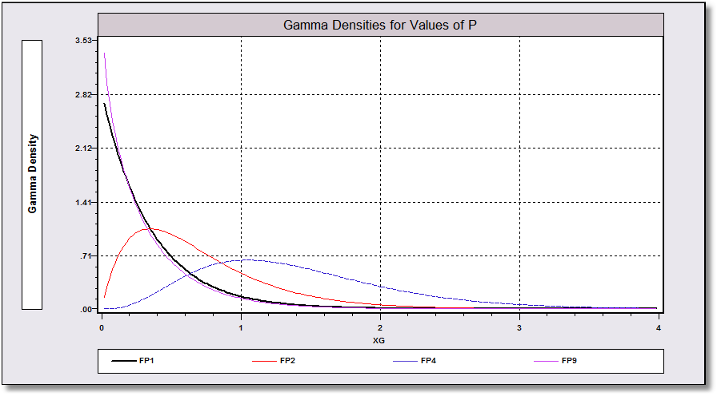
Example: Exponential vs. Gamma
Exponential: P = 1
P > 1

Slide 59
Log Likelihood

Slide 60
Estimated Gamma Model
+---------------------------------------------+
| Gamma (Loglinear) Regression Model |
| Dependent variable HHNINC |
| Number of observations 27322 |
| Iterations completed 18 |
| Log likelihood function 14237.33 |
| Number of parameters 5 |
| Restricted log likelihood 1195.070 |
| Chi squared 26084.52 |
| Degrees of freedom 4 |
| Prob[ChiSqd > value] = .0000000 |
+---------------------------------------------+
+---------+--------------+----------------+--------+---------+----------+
|Variable | Coefficient | Standard Error |b/St.Er.|P[|Z|>z] | Mean of X|
+---------+--------------+----------------+--------+---------+----------+
Parameters in conditional mean function
Constant 3.45583194 .02043321 169.128 .0000
EDUC -.05545277 .00118268 -46.888 .0000 11.3201838
MARRIED -.23664845 .00646494 -36.605 .0000 .75869263
AGE .00087436 .00025374 3.446 .0006 43.5271942
Scale parameter for gamma model
P_scale 5.10528380 .04232988 120.607 .0000

Slide 61
Testing P = 1
Wald: W = (5.10528380-1)²/.04232988²
= 9405.7
Likelihood Ratio:
  logL|(P=1)= 1539.19
  logL|P = 14237.33
  LR = 2(14237.33 - 1539.19) = 25396.27
Lagrange Multiplier…

Slide 62
Derivatives for the LM Test

Slide 63
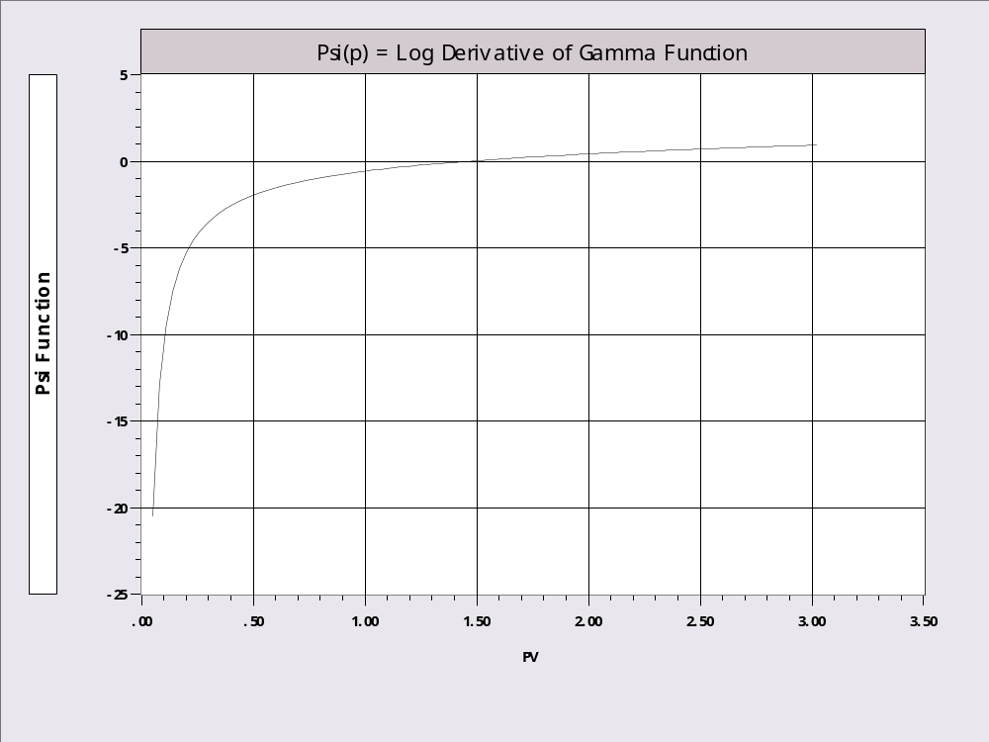
Psi Function = dlogΓ(P)/dP

Slide 64
Derivatives

Slide 65
Score Test

Slide 66
Calculated LM Statistic
Create ;thetai=exp(x’b) ; gi=(hhninc/thetai – 1)
Create ;gpi=log(hhninc/thetai)-psi(1)$
Create ;g1i=gi;g2i=gi*educ;g3i=gi*married;g4i=gi*age;g5i=gpi$
Namelist;ggi=g1i,g2i,g3i,g4i,g5i$
Matrix ;list ; lm = 1'ggi * <ggi'ggi> * ggi'1 $
Matrix LM
1
+--------------
1| 26596.92
? Use built-in procedure.
? LM is computed with actual Hessian instead of BHHH
logl;lhs=hhninc;rhs=one,educ,married,age;model=g;start=b,1;maxit=0$
| LM Stat. at start values 9602.409 |

Slide 67
Clustered Data and Partial Likelihood

Slide 68
Inference with ‘Clustering’

Slide 69
Cluster Estimation
+---------------------------------------------+
| Exponential (Loglinear) Regression Model |
| Maximum Likelihood Estimates |
+---------------------------------------------+
+-----------------------------------------------------------------------+
| Covariance matrix for the model is adjusted for data clustering. |
| Sample of 27322 observations contained 7293 clusters defined by |
| variable ID which identifies by a value a cluster ID. |
+-----------------------------------------------------------------------+
+---------+--------------+----------------+--------+---------+----------+
|Variable | Coefficient | Standard Error |b/St.Er.|P[|Z|>z] | Mean of X|
+---------+--------------+----------------+--------+---------+----------+
Parameters in conditional mean function
Constant 1.82555590 .03215706 56.770 .0000
EDUC -.05545277 .00195517 -28.362 .0000 11.3201838
MARRIED -.23664845 .01338104 -17.685 .0000 .75869263
AGE .00087436 .00044694 1.956 .0504 43.5271942
+---------+--------------+----------------+--------+---------+----------+
Uncorrected Standard Errors
Constant 1.82555590 .04219675 43.263 .0000
EDUC -.05545277 .00267224 -20.751 .0000 11.3201838
MARRIED -.23664845 .01460746 -16.201 .0000 .75869263
AGE .00087436 .00057331 1.525 .1272 43.5271942

Slide 70
On Clustering
The theory is very loose.
That the marginals would be correctly specified while there remains ‘correlation’ across observations is ambiguous
It seems to work pretty well in practice (anyway)
BUT… It does not imply that one can safely just pool the observations in a panel and ignore unobserved common effects.
The correction redeems the variance of an estimator, not the estimator, itself.

Slide 71
‘Robust’ Estimation
If the model is misspecified in some way, then the information matrix equality does not hold.
Assuming the estimator remains consistent, the appropriate asymptotic covariance matrix would be the ‘robust’ matrix, actually, the original one.

Slide 72
Two Step Estimation and Murphy/Topel

Slide 73
Two Step Estimation

Slide 74
Murphy-Topel - 1

Slide 75
Murphy-Topel - 2

Slide 76
Application of M&T
Names ; z1=one,age,bluec$
Logit ; lhs=hhkids ; rhs=z1 ; prob=prifkids $
Matrix ; v1=varb$
Create ; gi1=hhkids-prifkids$
Names ; z2 = one,educ,married,age,prifkids
Loglinear; lhs=hhninc;rhs=z2;model=e$
Matrix ; v2=varb$
Create ; gi2=hhninc*exp(z2'b)-1$
Create ; hi2=gi2*b(5)*prifkids*(1-prifkids)$
Create ; varc=gi1*gi2 ; varr=gi1*hi2$
Matrix ; c=z2'[varc]z1 ; r=z2'[varr]z1$
Matrix ; q=c*v1*c'-c*v1*r'-r*v1*c’
; mt=v2+v2*q*v2;stat(b,mt)$

Slide 77
M&T Application
+---------------------------------------------+
| Multinomial Logit Model |
| Dependent variable HHKIDS |
+---------+--------------+----------------+--------+---------+----------+
|Variable | Coefficient | Standard Error |b/St.Er.|P[|Z|>z] | Mean of X|
+---------+--------------+----------------+--------+---------+----------+
Characteristics in numerator of Prob[Y = 1]
Constant 2.61232320 .05529365 47.245 .0000
AGE -.07036132 .00125773 -55.943 .0000 43.5271942
BLUEC -.02474434 .03052219 -.811 .4175 .24379621
+---------------------------------------------+
| Exponential (Loglinear) Regression Model |
| Dependent variable HHNINC |
+---------+--------------+----------------+--------+---------+----------+
|Variable | Coefficient | Standard Error |b/St.Er.|P[|Z|>z] | Mean of X|
+---------+--------------+----------------+--------+---------+----------+
Parameters in conditional mean function
Constant -3.79588863 .44440782 -8.541 .0000
EDUC -.05580594 .00267736 -20.844 .0000 11.3201838
MARRIED -.20232648 .01487166 -13.605 .0000 .75869263
AGE .08112565 .00633014 12.816 .0000 43.5271942
PRIFKIDS 5.23741034 .41248916 12.697 .0000 .40271576
+---------+--------------+----------------+--------+---------+
B_1 -3.79588863 .44425516 -8.544 .0000
B_2 -.05580594 .00267540 -20.859 .0000
B_3 -.20232648 .01486667 -13.609 .0000
B_4 .08112565 .00632766 12.821 .0000
B_5 5.23741034 .41229755 12.703 .0000
Why so little change? N = 27,000+. No new variation.

Slide 78
GMM Estimation

Slide 79
GMM Estimation-1
GMM is broader than M estimation and ML estimation
Both M and ML are GMM estimators.

Slide 80
GMM Estimation - 2

Slide 81
Optimization - Algorithms

Slide 82
Optimization

Slide 83
Algorithms

Slide 84
Line Search Methods

Slide 85
Quasi-Newton Methods

Slide 86
Stopping Rule

Slide 87
For Example
Nonlinear Estimation of Model Parameters
Method=BFGS ; Maximum iterations= 4
Convergence criteria:gtHg .1000D-05 chg.F .0000D+00 max|dB| .0000D+00
Start values: -.10437D+01 .00000D+00 .00000D+00 .00000D+00 .10000D+01
1st derivs. -.23934D+05 -.26990D+06 -.18037D+05 -.10419D+07 .44370D+05
Parameters: -.10437D+01 .00000D+00 .00000D+00 .00000D+00 .10000D+01
Itr 1 F= .3190D+05 gtHg= .1078D+07 chg.F= .3190D+05 max|db|= .1042D+13
Try = 0 F= .3190D+05 Step= .0000D+00 Slope= -.1078D+07
Try = 1 F= .4118D+06 Step= .1000D+00 Slope= .2632D+08
Try = 2 F= .5425D+04 Step= .5214D-01 Slope= .8389D+06
Try = 3 F= .1683D+04 Step= .4039D-01 Slope= -.1039D+06
1st derivs. -.45100D+04 -.45909D+05 -.18517D+04 -.95703D+05 -.53142D+04
Parameters: -.10428D+01 .10116D-01 .67604D-03 .39052D-01 .99834D+00
Itr 2 F= .1683D+04 gtHg= .1064D+06 chg.F= .3022D+05 max|db|= .4538D+07
Try = 0 F= .1683D+04 Step= .0000D+00 Slope= -.1064D+06
Try = 1 F= .1006D+06 Step= .4039D-01 Slope= .7546D+07
Try = 2 F= .1839D+04 Step= .4702D-02 Slope= .1847D+06
Try = 3 F= .1582D+04 Step= .1855D-02 Slope= .7570D+02
...
1st derivs. -.32179D-05 -.29845D-04 -.28288D-05 -.16951D-03 .73923D-06
Itr 20 F= .1424D+05 gtHg= .1389D-07 chg.F= .1155D-08 max|db|= .1706D-08
* Converged
Normal exit from iterations. Exit status=0.
Function= .31904974915D+05, at entry, -.14237328819D+05 at exit

