Slide 1

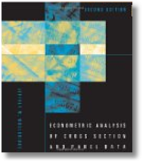
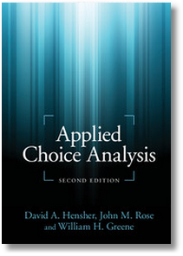


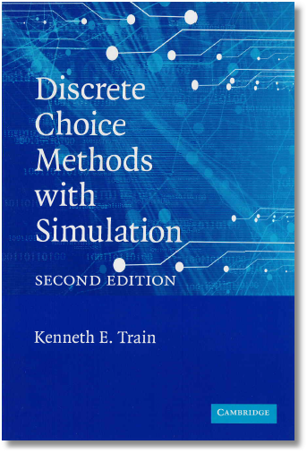
Discrete Choice Modeling
0 Introduction
1 Summary
2 Binary Choice
3 Panel Data
4 Bivariate Probit
5 Ordered Choice
6 Count Data
7 Multinomial Choice
8 Nested Logit
9 Heterogeneity
10 Latent Class
11 Mixed Logit
12 Stated Preference
13 Hybrid Choice
14 Spatial Data
William Greene
Stern School of Business
New York University

Slide 2
Discrete Choice Modeling
Theoretical Foundations
Econometric Methodology
  Regression Analysis
  Binary Choice Models
  Discrete Choice Models
  Multinomial Choice Models
Model Building, Econometric Methods
  Statistical Bases, Specification Issues
  Estimation, Coefficients, Partial Effects
  Analysis
  Inference and Hypothesis Testing
Applications

Slide 3
Agenda
Day 1: Foundations
0 Introduction
1 Methodology: Basic Regression Modeling
2 Binary Choice: Estimation, Inference, Analysis, Partial Effects
3 Panel Data: Fixed and Random Effects
4 Bivariate Probit: Bivariate, Recursive and Multivariate Models
Day 2: Model Extensions; Multinomial Choice
5 Ordered Choice: Ordered Probit, Vignettes
6 Count Data: Poisson, Negative Binomial, Two Part Models
7 Multinomial Choice: The Multinomial Logit Model
8 Nested Logit: Nesting, Multinomial Probit Model
Day 3: Multinomial Choice, Advanced Models, Stated Choice
9 Heterogeneity: Scale Effects, WTP, RP and LC
10 Latent Class: Finite Mixtures, Attribute Nonattendance
11 Mixed Logit: Random Parameter Models
12 Stated Preference: Choice Experiments, Best/Worst Data
13 Hybrid Choice: Mixed Discrete and Continuous Choice
14 (Time permitting) Discrete Choice Models for Spatial Data

