Slide 1
Discrete Choice Modeling
0 Introduction
1 Summary
2 Binary Choice
3 Panel Data
4 Bivariate Probit
5 Ordered Choice
6 Count Data
7 Multinomial Choice
8 Nested Logit
9 Heterogeneity
10 Latent Class
11 Mixed Logit
12 Stated Preference
13 Hybrid Choice
William Greene
Stern School of Business
New York University

Slide 2
Objectives in Model Building
Specification: guided by underlying theory
  Modeling framework
  Functional forms
Estimation: coefficients, partial effects, model implications
Statistical inference: hypothesis testing
Prediction: individual and aggregate
Model assessment (fit, adequacy) and evaluation
Model extensions
  Interdependencies, multiple part models
  Heterogeneity
  Endogeneity and “causal inference”
Exploration: Estimation and inference methods

Slide 3
Regression Basics
The “MODEL”
  Modeling the conditional mean – Regression
Other features of interest
  Modeling quantiles
  Conditional variances or covariances
  Modeling probabilities for discrete choice
  Modeling other features of the population

Slide 4
Application: Health Care Usage
German Health Care Usage Data, 7,293 Individuals, Varying Numbers of Periods
Data downloaded from Journal of Applied Econometrics Archive. This is an unbalanced panel with 7,293 individuals. They can be used for regression, count models, binary choice, ordered choice, and bivariate binary choice. This is a large data set. There are altogether 27,326 observations. The number of observations ranges from 1 to 7. (Frequencies are: 1=1525, 2=2158, 3=825, 4=926, 5=1051, 6=1000, 7=987).
(Downloaded from the JAE Archive)
Variables in the file are
DOCTOR = 1(Number of doctor visits > 0)
HOSPITAL = 1(Number of hospital visits > 0)
HSAT = health satisfaction, coded 0 (low) - 10 (high)
DOCVIS = number of doctor visits in last three months
HOSPVIS = number of hospital visits in last calendar year
PUBLIC = insured in public health insurance = 1; otherwise = 0
ADDON = insured by add-on insurance = 1; otherswise = 0
HHNINC = household nominal monthly net income in German marks / 10000.
(4 observations with income=0 were dropped)
HHKIDS = children under age 16 in the household = 1; otherwise = 0
EDUC = years of schooling
AGE = age in years
MARRIED = marital status
Notes:
4

Slide 5

Household Income
Kernel Density Estimator Histogram

Slide 6
Regression – Income on Education
----------------------------------------------------------------------
Ordinary least squares regression ............
LHS=LOGINC Mean = -.92882
Standard deviation = .47948
Number of observs. = 887
Model size Parameters = 2
Degrees of freedom = 885
Residuals Sum of squares = 183.19359
Standard error of e = .45497
Fit R-squared = .10064
Adjusted R-squared = .09962
Model test F[ 1, 885] (prob) = 99.0(.0000)
Diagnostic Log likelihood = -559.06527
Restricted(b=0) = -606.10609
Chi-sq [ 1] (prob) = 94.1(.0000)
Info criter. LogAmemiya Prd. Crt. = -1.57279
--------+-------------------------------------------------------------
Variable| Coefficient Standard Error b/St.Er. P[|Z|>z] Mean of X
--------+-------------------------------------------------------------
Constant| -1.71604*** .08057 -21.299 .0000
EDUC| .07176*** .00721 9.951 .0000 10.9707
--------+-------------------------------------------------------------
Note: ***, **, * = Significance at 1%, 5%, 10% level.
----------------------------------------------------------------------

Slide 7
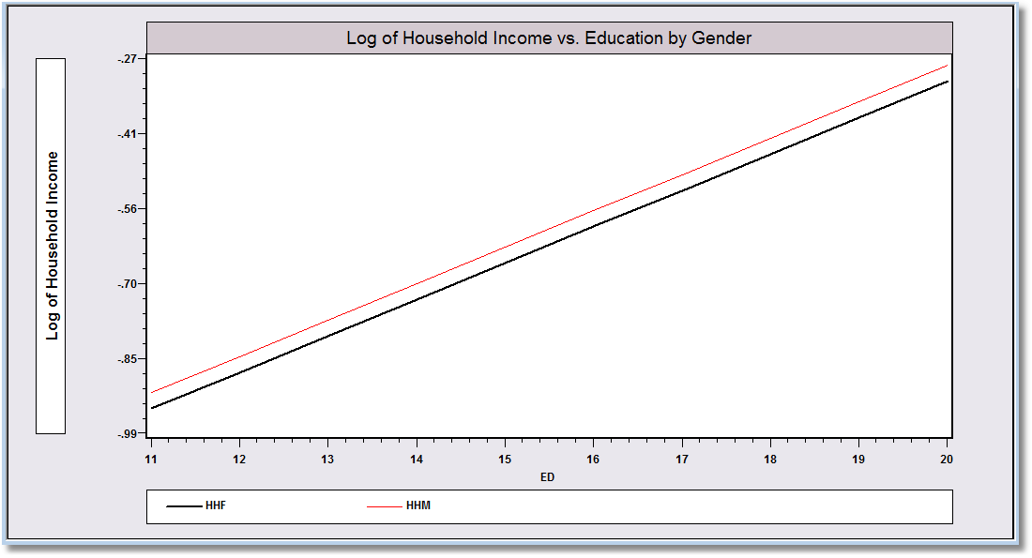
Specification and Functional Form
----------------------------------------------------------------------
Ordinary least squares regression ............
LHS=LOGINC Mean = -.92882
Standard deviation = .47948
Number of observs. = 887
Model size Parameters = 3
Degrees of freedom = 884
Residuals Sum of squares = 183.00347
Standard error of e = .45499
Fit R-squared = .10157
Adjusted R-squared = .09954
Model test F[ 2, 884] (prob) = 50.0(.0000)
Diagnostic Log likelihood = -558.60477
Restricted(b=0) = -606.10609
Chi-sq [ 2] (prob) = 95.0(.0000)
Info criter. LogAmemiya Prd. Crt. = -1.57158
--------+-------------------------------------------------------------
Variable| Coefficient Standard Error b/St.Er. P[|Z|>z] Mean of X
--------+-------------------------------------------------------------
Constant| -1.68303*** .08763 -19.207 .0000
EDUC| .06993*** .00746 9.375 .0000 10.9707
FEMALE| -.03065 .03199 -.958 .3379 .42277
--------+-------------------------------------------------------------

Slide 8
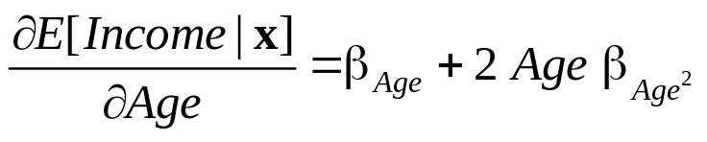
Interesting Partial Effects
----------------------------------------------------------------------
Ordinary least squares regression ............
LHS=LOGINC Mean = -.92882
Standard deviation = .47948
Number of observs. = 887
Model size Parameters = 5
Degrees of freedom = 882
Residuals Sum of squares = 171.87964
Standard error of e = .44145
Fit R-squared = .15618
Adjusted R-squared = .15235
Model test F[ 4, 882] (prob) = 40.8(.0000)
Diagnostic Log likelihood = -530.79258
Restricted(b=0) = -606.10609
Chi-sq [ 4] (prob) = 150.6(.0000)
Info criter. LogAmemiya Prd. Crt. = -1.62978
--------+-------------------------------------------------------------
Variable| Coefficient Standard Error b/St.Er. P[|Z|>z] Mean of X
--------+-------------------------------------------------------------
Constant| -5.26676*** .56499 -9.322 .0000
EDUC| .06469*** .00730 8.860 .0000 10.9707
FEMALE| -.03683 .03134 -1.175 .2399 .42277
AGE| .15567*** .02297 6.777 .0000 50.4780
AGE² | -.00161*** .00023 -7.014 .0000 2620.79
--------+-------------------------------------------------------------

Slide 9
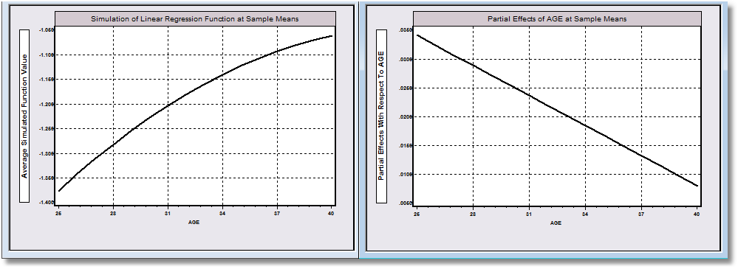
Function: Log Income | Age Partial Effect wrt Age

Slide 10
Modeling Categorical Variables
Theoretical foundations
Econometric methodology
  Models
  Statistical bases
  Econometric methods
Applications

Slide 11
Categorical Variables
Observed outcomes
  Inherently discrete: number of occurrences, e.g., family size
  Multinomial: The observed outcome indexes a set of unordered labeled choices.
  Implicitly continuous: The observed data are discrete by construction, e.g., revealed preferences; our main subject
  Discrete, cardinal: Counts of occurrences
Implications
  For model building
  For analysis and prediction of behavior

Slide 12
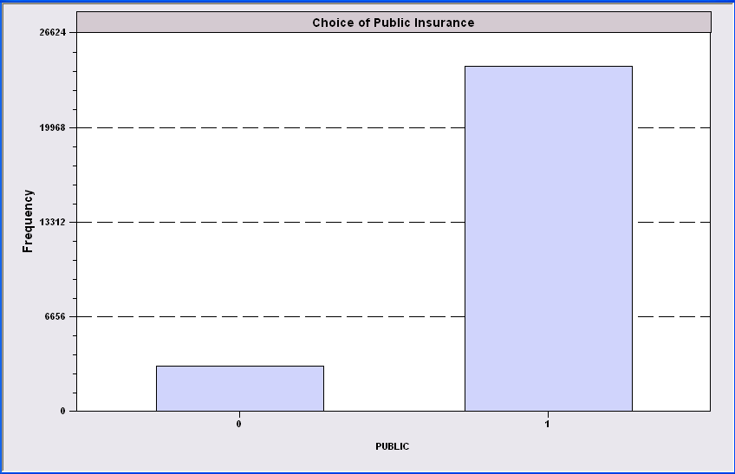
Simple Binary Choice: Insurance

Slide 13

Ordered Outcome
Self Reported Health Satisfaction

Slide 14
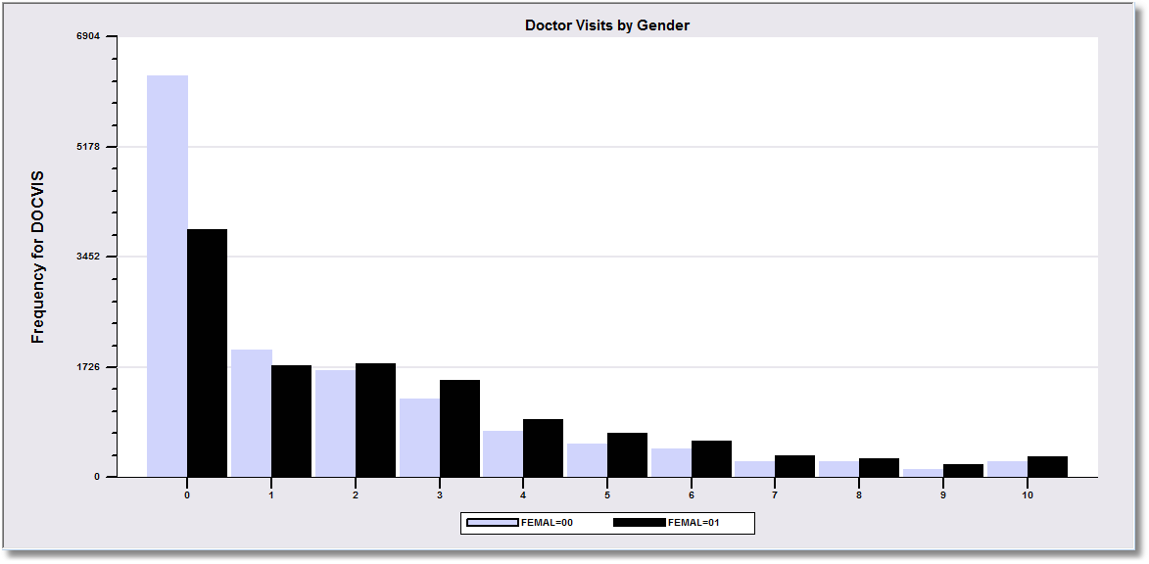
Counts of Occurrences

Slide 15

Multinomial Unordered Choice

