Slide 1
Discrete Choice Modeling
0 Introduction
1 Summary
2 Binary Choice
3 Panel Data
4 Bivariate Probit
5 Ordered Choice
6 Count Data
7 Multinomial Choice
8 Nested Logit
9 Heterogeneity
10 Latent Class
11 Mixed Logit
12 Stated Preference
13 Hybrid Choice
William Greene
Stern School of Business
New York University

Slide 2
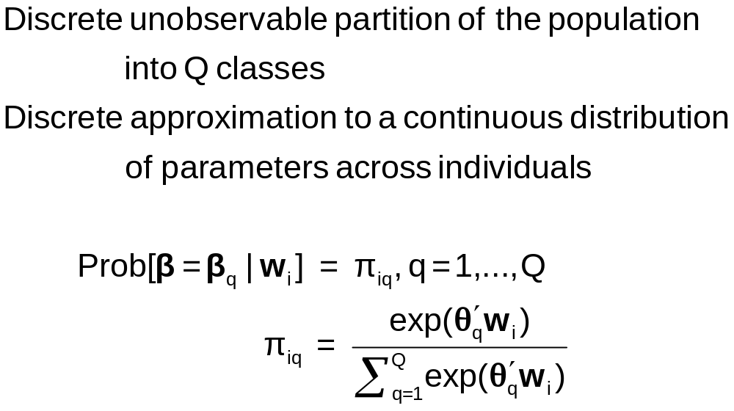
Discrete Parameter Heterogeneity
Latent Classes

Slide 3
Latent Class Probabilities
Ambiguous – Classical Bayesian model?
  The randomness of the class assignment is from the point of view of the observer, not a natural process governed by a discrete distribution.
Equivalent to random parameters models with discrete parameter variation
  Using nested logits, etc. does not change this
  Precisely analogous to continuous ‘random parameter’ models
Not always equivalent – zero inflation models – in which classes have completely different models

Slide 4
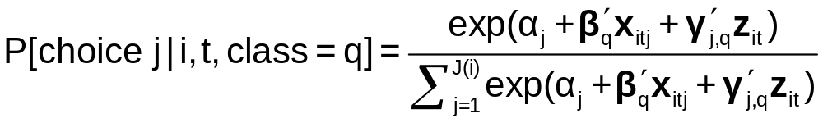
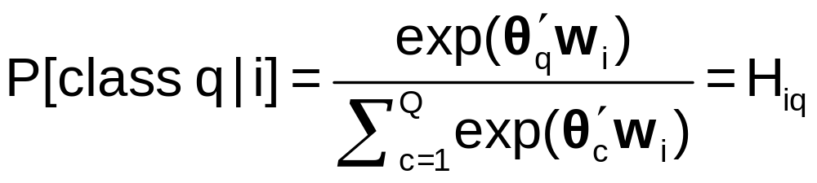
A Latent Class MNL Model
Within a “class”
Class sorting is probabilistic (to the analyst) determined by individual characteristics

Slide 5
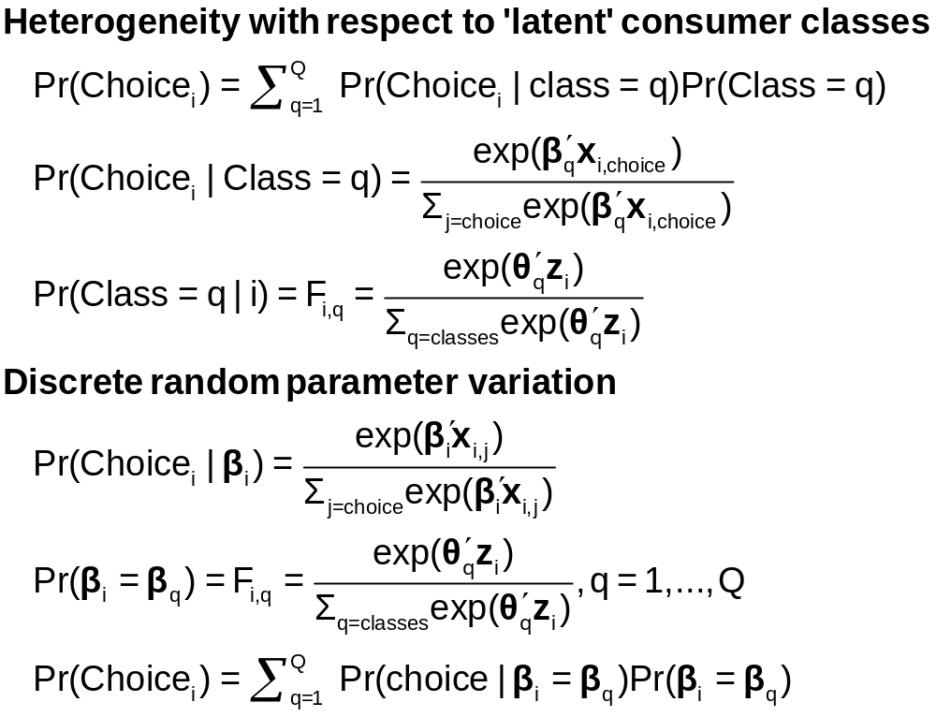
Two Interpretations of Latent Classes

Slide 6
Estimates from the LCM
Taste parameters within each class β_{q}
Parameters of the class probability model, θ_{q}
For each person:
  Posterior estimates of the class they are in q|i
  Posterior estimates of their taste parameters E[β_{q}|i]
  Posterior estimates of their behavioral parameters, elasticities, marginal effects, etc.

Slide 7
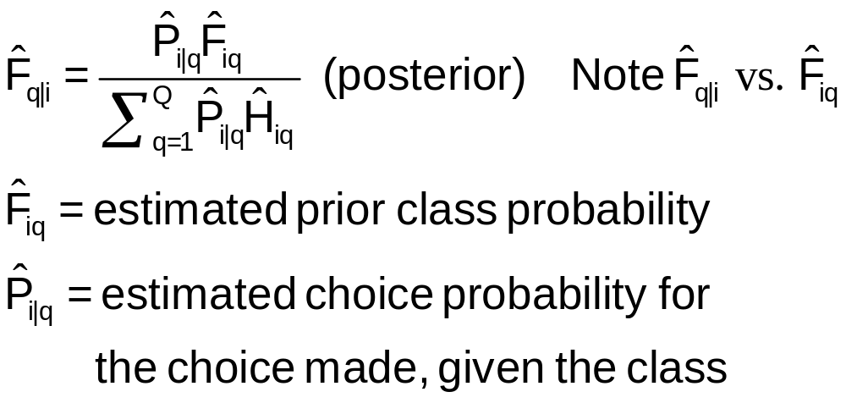
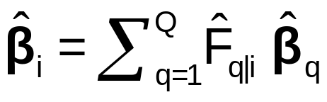
Using the Latent Class Model
Computing posterior (individual specific) class probabilities
Computing posterior (individual specific) taste parameters

Slide 8
Application: Shoe Brand Choice
Simulated Data: Stated Choice, 400 respondents, 8 choice situations, 3,200 observations
3 choice/attributes + NONE
  Fashion = High / Low
  Quality = High / Low
  Price = 25/50/75,100 coded 1,2,3,4
Heterogeneity: Sex (Male=1), Age (<25, 25-39, 40+)
Underlying data generated by a 3 class latent class process (100, 200, 100 in classes)
Thanks to www.statisticalinnovations.com (Latent Gold)

Slide 9
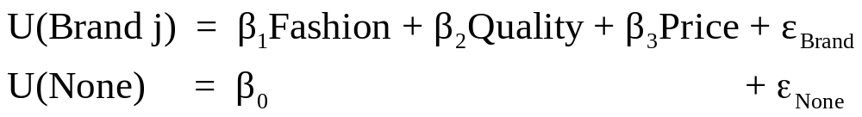
Degenerate Branches
Shoe Choice
Choice Situation
Purchase
Opt Out
Choose Brand
Brand
None
Brand1
Brand2
Brand3

Slide 10
One Class MNL Estimates
-----------------------------------------------------------
Discrete choice (multinomial logit) model
Dependent variable Choice
Log likelihood function -4158.50286
Estimation based on N = 3200, K = 4
R2=1-LogL/LogL* Log-L fncn R-sqrd R2Adj
Constants only -4391.1804 .0530 .0510
Response data are given as ind. choices
Number of obs.= 3200, skipped 0 obs
--------+--------------------------------------------------
Variable| Coefficient Standard Error b/St.Er. P[|Z|>z]
--------+--------------------------------------------------
FASH|1| 1.47890*** .06777 21.823 .0000
QUAL|1| 1.01373*** .06445 15.730 .0000
PRICE|1| -11.8023*** .80406 -14.678 .0000
ASC4|1| .03679 .07176 .513 .6082
--------+--------------------------------------------------

Slide 11
Application: Brand Choice
True underlying model is a three class LCM
NLOGIT
; Lhs=choice
; Choices=Brand1,Brand2,Brand3,None
; Rhs = Fash,Qual,Price,ASC4
; LCM=Male,Age25,Age39
; Pts=3
; Pds=8
; Parameters (Save posterior results) $

Slide 12
Three Class LCM
Normal exit from iterations. Exit status=0.
-----------------------------------------------------------
Latent Class Logit Model
Dependent variable CHOICE
Log likelihood function -3649.13245
Restricted log likelihood -4436.14196
Chi squared [ 20 d.f.] 1574.01902
Significance level .00000
McFadden Pseudo R-squared .1774085
Estimation based on N = 3200, K = 20
R2=1-LogL/LogL* Log-L fncn R-sqrd R2Adj
No coefficients -4436.1420 .1774 .1757
Constants only -4391.1804 .1690 .1673
At start values -4158.5428 .1225 .1207
Response data are given as ind. choices
Number of latent classes = 3
Average Class Probabilities
.506 .239 .256
LCM model with panel has 400 groups
Fixed number of obsrvs./group= 8
Number of obs.= 3200, skipped 0 obs
--------+--------------------------------------------------
LogL for one class MNL = -4158.503
Based on the LR statistic it would seem unambiguous to reject the one class model. The degrees of freedom for the test are uncertain, however.

Slide 13
Estimated LCM: Utilities
--------+--------------------------------------------------
Variable| Coefficient Standard Error b/St.Er. P[|Z|>z]
--------+--------------------------------------------------
|Utility parameters in latent class -->> 1
FASH|1| 3.02570*** .14549 20.796 .0000
QUAL|1| -.08782 .12305 -.714 .4754
PRICE|1| -9.69638*** 1.41267 -6.864 .0000
ASC4|1| 1.28999*** .14632 8.816 .0000
|Utility parameters in latent class -->> 2
FASH|2| 1.19722*** .16169 7.404 .0000
QUAL|2| 1.11575*** .16356 6.821 .0000
PRICE|2| -13.9345*** 1.93541 -7.200 .0000
ASC4|2| -.43138** .18514 -2.330 .0198
|Utility parameters in latent class -->> 3
FASH|3| -.17168 .16725 -1.026 .3047
QUAL|3| 2.71881*** .17907 15.183 .0000
PRICE|3| -8.96483*** 1.93400 -4.635 .0000
ASC4|3| .18639 .18412 1.012 .3114

Slide 14
Estimated LCM: Class Probability Model
--------+--------------------------------------------------
Variable| Coefficient Standard Error b/St.Er. P[|Z|>z]
--------+--------------------------------------------------
|This is THETA(01) in class probability model.
Constant| -.90345** .37612 -2.402 .0163
_MALE|1| .64183* .36245 1.771 .0766
_AGE25|1| 2.13321*** .32096 6.646 .0000
_AGE39|1| .72630* .43511 1.669 .0951
|This is THETA(02) in class probability model.
Constant| .37636 .34812 1.081 .2796
_MALE|2| -2.76536*** .69325 -3.989 .0001
_AGE25|2| -.11946 .54936 -.217 .8279
_AGE39|2| 1.97657*** .71684 2.757 .0058
|This is THETA(03) in class probability model.
Constant| .000 ......(Fixed Parameter)......
_MALE|3| .000 ......(Fixed Parameter)......
_AGE25|3| .000 ......(Fixed Parameter)......
_AGE39|3| .000 ......(Fixed Parameter)......
--------+--------------------------------------------------

Slide 15
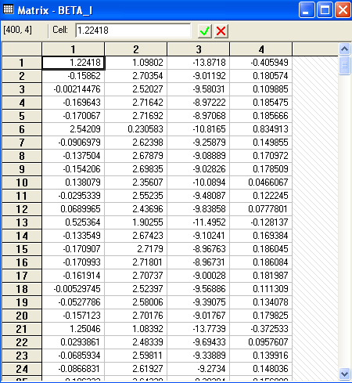
Estimated LCM:
Conditional Parameter Estimates

Slide 16
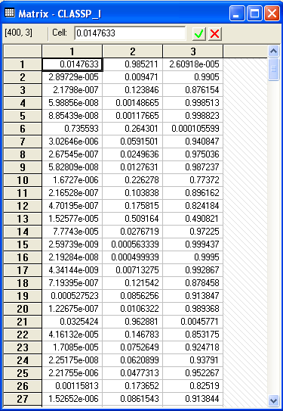
Estimated LCM: Conditional (Posterior) Class Probabilities

Slide 17
Average Estimated Class Probabilities
MATRIX ; list ; 1/400 * classp_i'1$
Matrix Result has 3 rows and 1 columns.
1
+--------------
1| .50555
2| .23853
3| .25593
This is how the data were simulated. Class probabilities are .5, .25, .25. The model ‘worked.’

Slide 18
Elasticities
+---------------------------------------------------+
| Elasticity averaged over observations.|
| Effects on probabilities of all choices in model: |
| * = Direct Elasticity effect of the attribute. |
| Attribute is PRICE in choice BRAND1 |
| Mean St.Dev |
| * Choice=BRAND1 -.8010 .3381 |
| Choice=BRAND2 .2732 .2994 |
| Choice=BRAND3 .2484 .2641 |
| Choice=NONE .2193 .2317 |
+---------------------------------------------------+
| Attribute is PRICE in choice BRAND2 |
| Choice=BRAND1 .3106 .2123 |
| * Choice=BRAND2 -1.1481 .4885 |
| Choice=BRAND3 .2836 .2034 |
| Choice=NONE .2682 .1848 |
+---------------------------------------------------+
| Attribute is PRICE in choice BRAND3 |
| Choice=BRAND1 .3145 .2217 |
| Choice=BRAND2 .3436 .2991 |
| * Choice=BRAND3 -.6744 .3676 |
| Choice=NONE .3019 .2187 |
+---------------------------------------------------+
Elasticities are computed by averaging individual elasticities computed at the expected (posterior) parameter vector.
This is an unlabeled choice experiment. It is not possible to attach any significance to the fact that the elasticity is different for Brand1 and Brand 2 or Brand 3.

Slide 19
Application: Long Distance Drivers’
Preference for Road Environments
New Zealand survey, 2000, 274 drivers
Mixed revealed and stated choice experiment
4 Alternatives in choice set
  The current road the respondent is/has been using;
  A hypothetical 2-lane road;
  A hypothetical 4-lane road with no median;
  A hypothetical 4-lane road with a wide grass median.
16 stated choice situations for each with 2 choice profiles
  choices involving all 4 choices
  choices involving only the last 3 (hypothetical)
Hensher and Greene, A Latent Class Model for Discrete Choice Analysis: Contrasts with Mixed Logit – Transportation Research B, 2003

Slide 20
Attributes
Time on the open road which is free flow (in minutes);
Time on the open road which is slowed by other traffic (in minutes);
Percentage of total time on open road spent with other vehicles close behind (ie tailgating) (%);
Curviness of the road (A four-level attribute - almost straight, slight, moderate, winding);
Running costs (in dollars);
Toll cost (in dollars).

Slide 21
Experimental Design
The four levels of the six attributes chosen are:
Free Flow Travel Time: -20%, -10%, +10%, +20%
Time Slowed Down: -20%, -10%, +10%, +20%
Percent of time with vehicles close behind:
-50%, -25%, +25%, +50%
Curviness:almost, straight, slight, moderate, winding
Running Costs: -10%, -5%, +5%, +10%
Toll cost for car and double for truck if trip duration is:
1 hours or less 0, 0.5, 1.5, 3
Between 1 hour and 2.5 hours 0, 1.5, 4.5, 9
More than 2.5 hours 0, 2.5, 7.5, 15

Slide 22
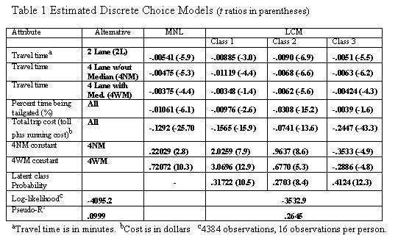
Estimated Latent Class Model

Slide 23
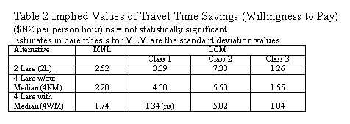
Estimated Value of Time Saved

Slide 24
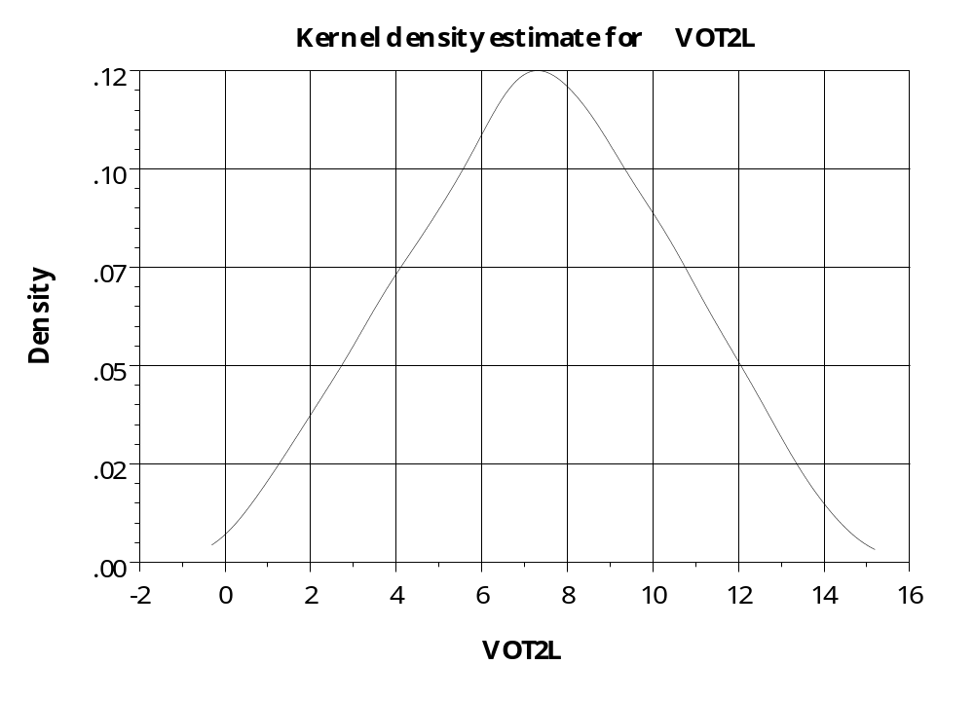
Distribution of Parameters –
Value of Time on 2 Lane Road

Slide 25
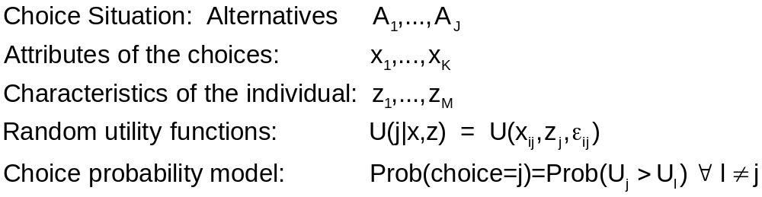
Decision Strategy in Multinomial Choice

Slide 26
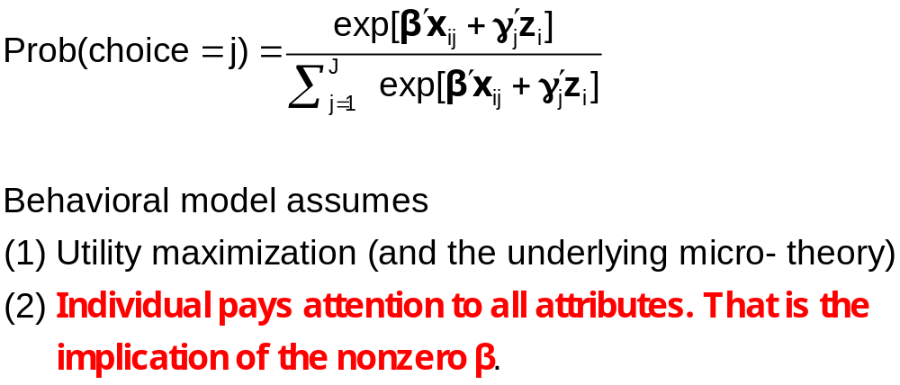
Multinomial Logit Model

Slide 27
Individual Explicitly Ignores Attributes
Hensher, D.A., Rose, J. and Greene, W. (2005) The Implications on Willingness to Pay of Respondents Ignoring Specific Attributes (DoD#6) Transportation, 32 (3), 203-222.
Hensher, D.A. and Rose, J.M. (2009) Simplifying Choice through Attribute Preservation or Non-Attendance: Implications for Willingness to Pay, Transportation Research Part E, 45, 583-590.
Rose, J., Hensher, D., Greene, W. and Washington, S. Attribute Exclusion Strategies in Airline Choice: Accounting for Exogenous Information on Decision Maker Processing Strategies in Models of Discrete Choice, Transportmetrica, 2011
Choice situations in which the individual explicitly states that they ignored certain attributes in their decisions.

Slide 28
Appropriate Modeling Strategy
Fix ignored attributes at zero? Definitely not!
  Zero is an unrealistic value of the attribute (price)
  The probability is a function of x_{ij} – x_{il}, so the substitution distorts the probabilities
Appropriate model: for that individual, the specific coefficient is zero – consistent with the utility assumption. A person specific, exogenously determined model
Surprisingly simple to implement

Slide 29
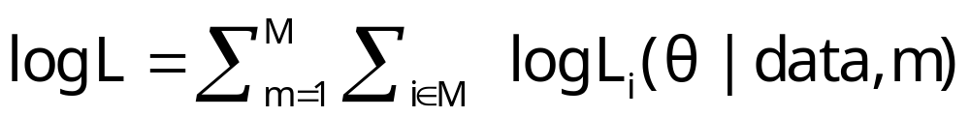
Choice Strategy Heterogeneity
Methodologically, a rather minor point – construct appropriate likelihood given known information
Not a latent class model. Classes are not latent.
Not the ‘variable selection’ issue (the worst form of “stepwise” modeling)
Familiar strategy gives the wrong answer.

Slide 30
Application: Sydney
Commuters’ Route Choice
Stated Preference study – several possible choice situations considered by each person
Multinomial and mixed (random parameters) logit
Consumers included data on which attributes were ignored.
Ignored attributes visibly coded as ignored are automatically treated by constraining β=0 for that observation.

Slide 31
Data for Application of Information Strategy
Stated/Revealed preference study, Sydney car commuters. 500+ surveyed, about 10 choice situations for each.
Existing route vs. 3 proposed alternatives.
Attribute design
  Original: respondents presented with 3, 4, 5, or 6 attributes
  Attributes – four level design.
    Free flow time
    Slowed down time
    Stop/start time
    Trip time variability
    Toll cost
    Running cost
  Final: respondents use only some attributes and indicate when surveyed which ones they ignored

Slide 32
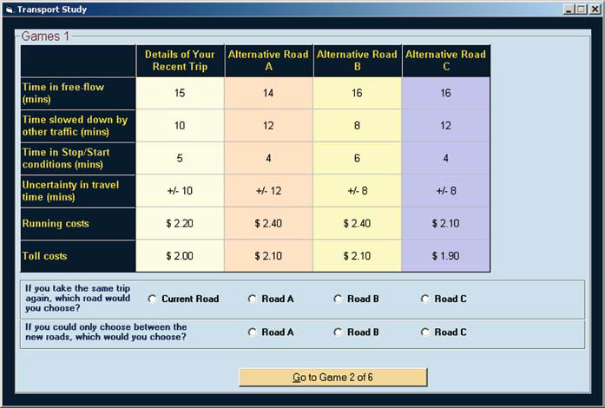
Stated Choice Experiment
Ancillary questions: Did you ignore any of these attributes?

Slide 33
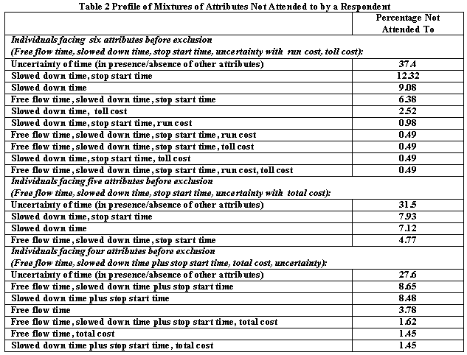

Slide 34
Individual Implicitly Ignores Attributes
Hensher, D.A. and Greene, W.H. (2010) Non-attendance and dual processing of common-metric attributes in choice analysis: a latent class specification, Empirical Economics 39 (2), 413-426
Campbell, D., Hensher, D.A. and Scarpa, R. Non-attendance to Attributes in Environmental Choice Analysis: A Latent Class Specification, Journal of Environmental Planning and Management, proofs 14 May 2011.
Hensher, D.A., Rose, J.M. and Greene, W.H. Inferring attribute non-attendance from stated choice data: implications for willingness to pay estimates and a warning for stated choice experiment design, 14 February 2011, Transportation, online 2 June 2001 DOI 10.1007/s11116-011-9347-8.

Slide 35
Stated Choice Experiment
Individuals seem to be ignoring attributes. Unknown to the analyst

Slide 36
The 2^{K} model
The analyst believes some attributes are ignored. There is no indicator.
Classes distinguished by which attributes are ignored
Same model applies, now a latent class. For K attributes there are 2^{K} candidate coefficient vectors

Slide 37
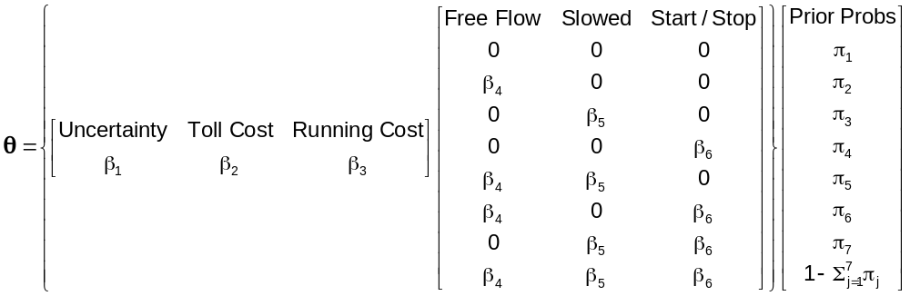
Latent Class Models with
Cross Class Restrictions
8 Class Model: 6 structural utility parameters, 7 unrestricted prior probabilities.
Reduced form has 8(6)+8 = 56 parameters. (π_{j} = exp(α_{j})/∑_{j}exp(α_{j}), α_{J} = 0.)
EM Algorithm: Does not provide any means to impose cross class restrictions.
“Bayesian” MCMC Methods: May be possible to force the restrictions – it will not be simple.
Conventional Maximization: Simple

Slide 38
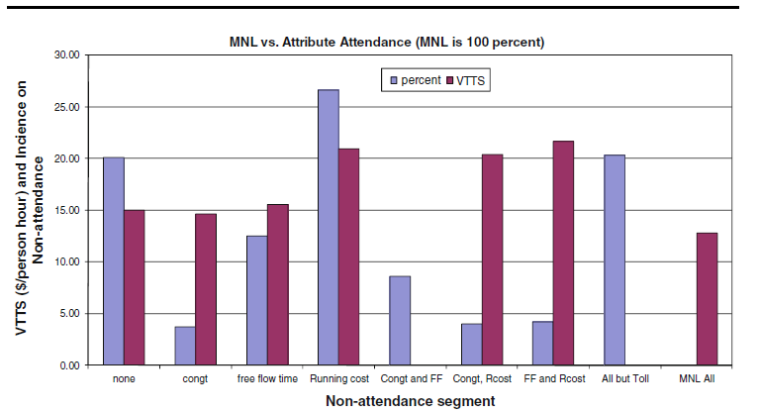
Results for the 2^{K} model

Slide 39


Slide 40
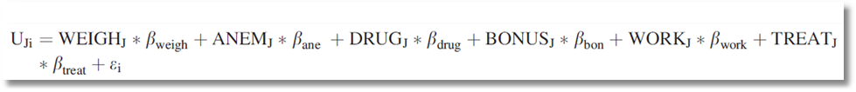
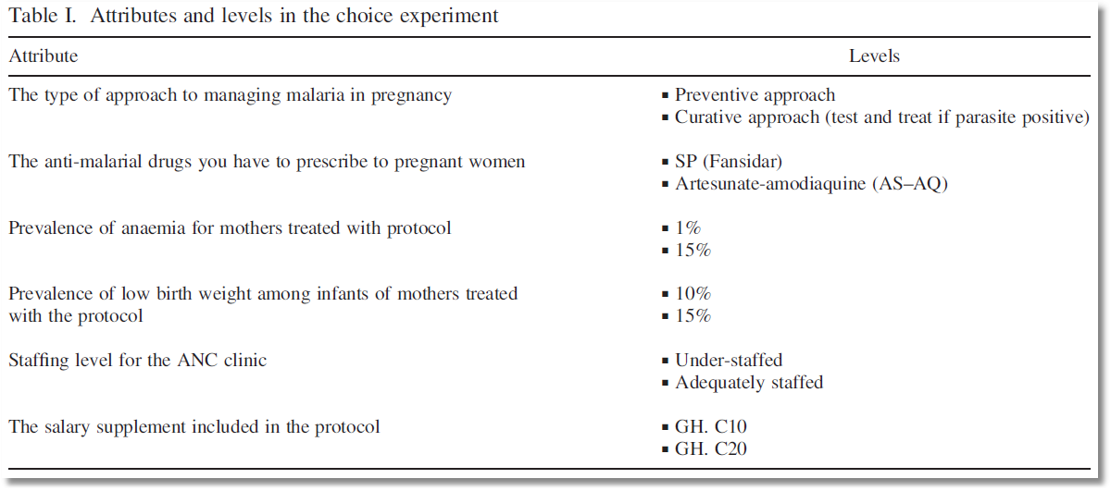
Choice Model with 6 Attributes

Slide 41
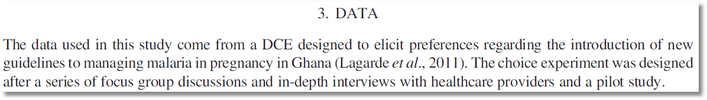
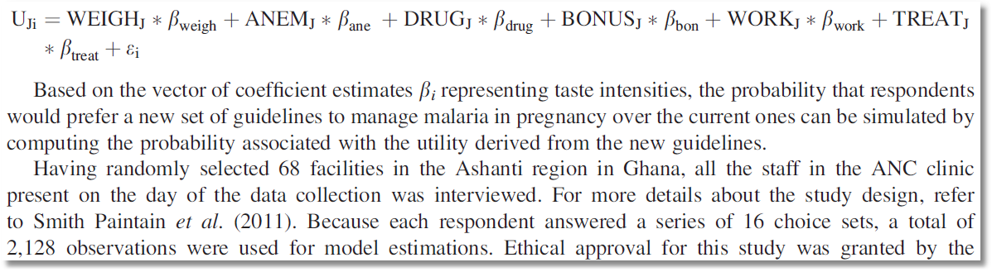
Stated Choice Experiment

Slide 42
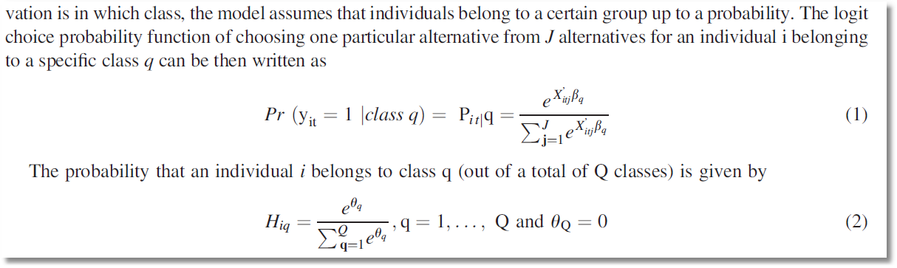
Latent Class Model – Prior Class Probabilities

Slide 43
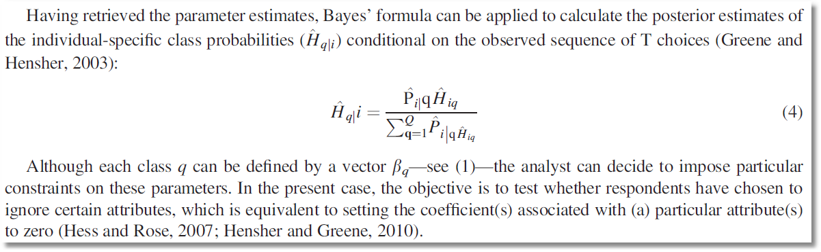
Latent Class Model – Posterior Class Probabilities

Slide 44
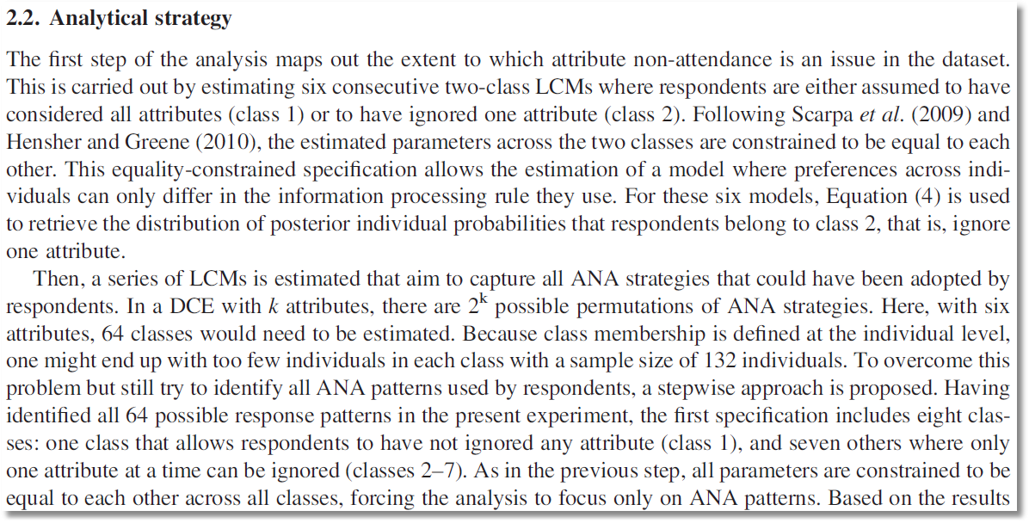
6 attributes implies 64 classes. Strategy to reduce the computational burden on a small sample

Slide 45
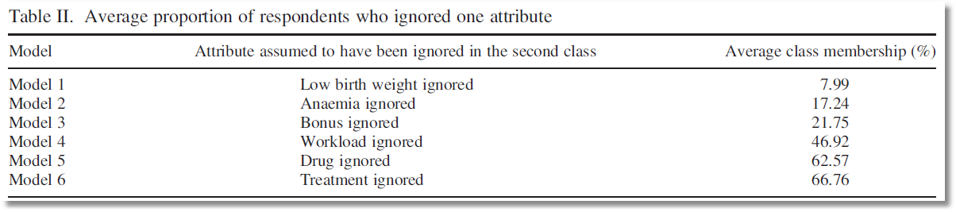
Posterior probabilities of membership in the nonattendance class for 6 models

Slide 46
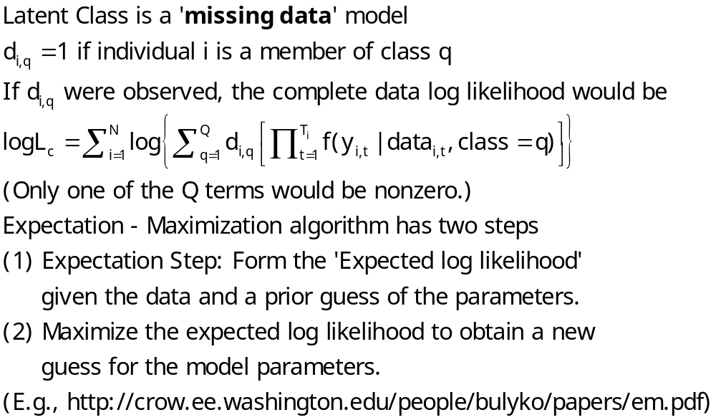
The EM Algorithm

Slide 47
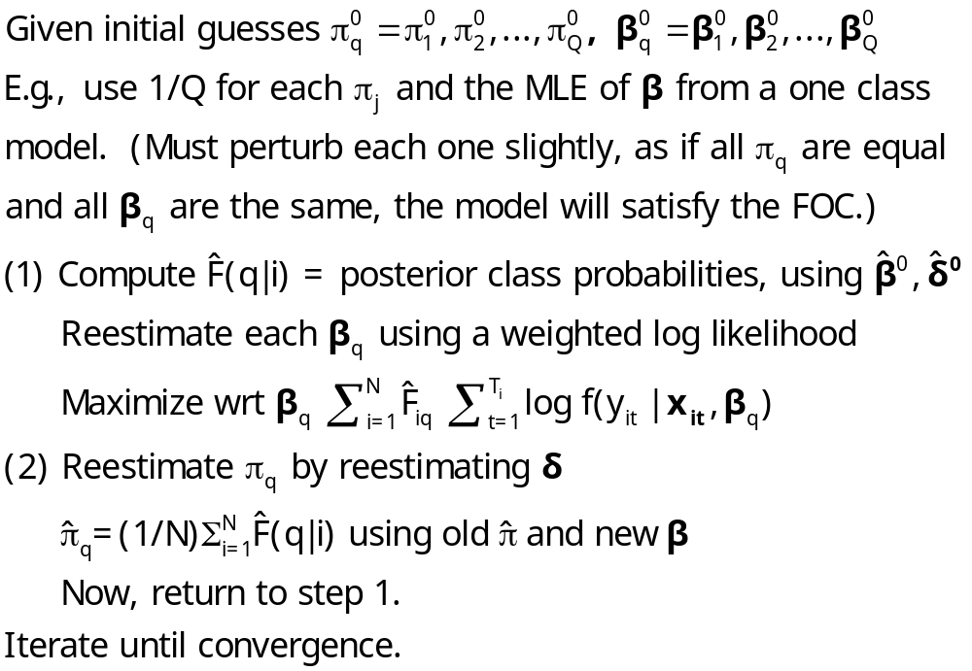
Implementing EM for LC Models

