Slide 1
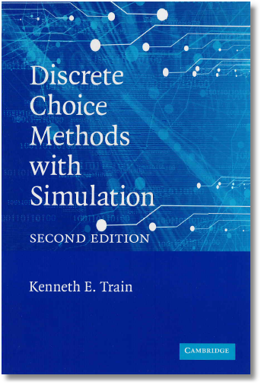
Discrete Choice Modeling
0 Introduction
1 Summary
2 Binary Choice
3 Panel Data
4 Bivariate Probit
5 Ordered Choice
6 Count Data
7 Multinomial Choice
8 Nested Logit
9 Heterogeneity
10 Latent Class
11 Mixed Logit
12 Stated Preference
13 Hybrid Choice
William Greene
Stern School of Business
New York University

Slide 2
Random Parameters Model
Allow model parameters as well as constants to be random
Allow multiple observations with persistent effects
Allow a hierarchical structure for parameters – not completely random
U_{itj} = β₁’x_{i1tj} + β_{2i}’x_{i2tj} + γ_{i}’z_{it} + ε_{ijt}
Random parameters in multinomial logit model
  β1 = nonrandom (fixed) parameters
  β2i = random parameters that may vary across
  individuals and across time
Maintain I.I.D. assumption for ε_{ijt} (given β)

Slide 3
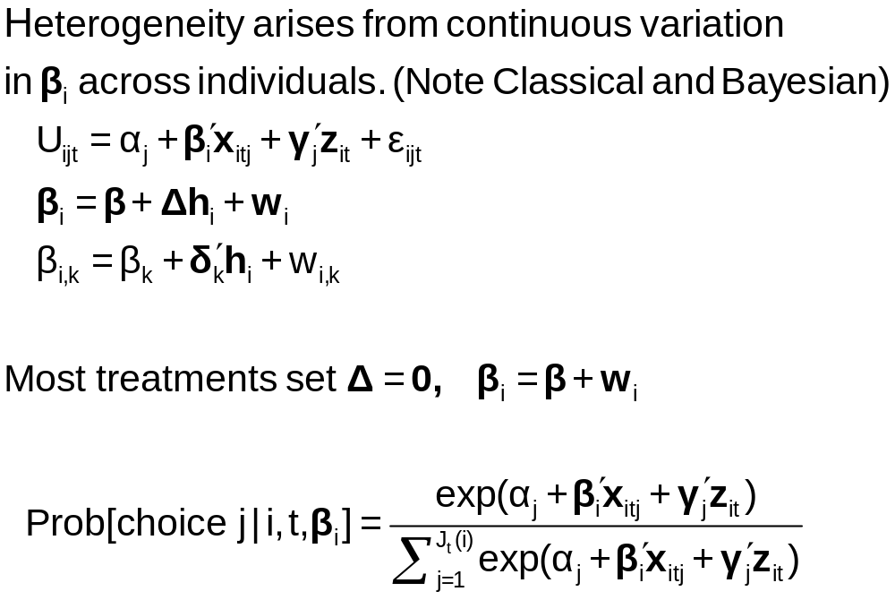
Continuous Random Variation in Preference Weights

Slide 4
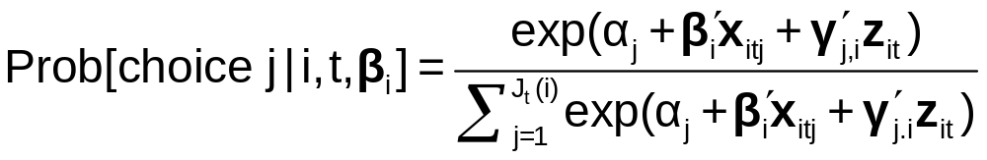
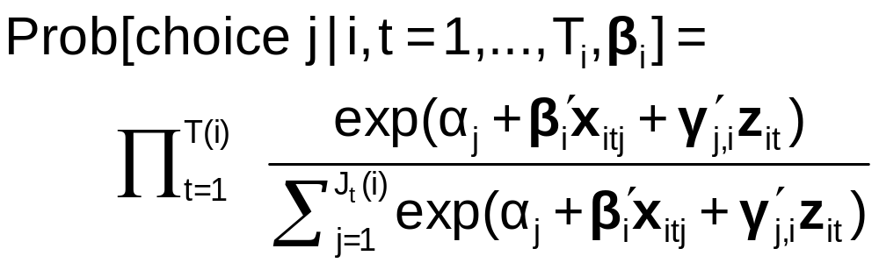
The Random Parameters Logit Model
Multiple choice situations: Independent conditioned on the individual specific parameters

Slide 5
Modeling Variations
Parameter specification
  “Nonrandom” – variance = 0
  Correlation across parameters – random parts correlated
  Fixed mean – not to be estimated. Free variance
  Fixed range – mean estimated, triangular from 0 to 2β
  Hierarchical structure - β_{ik} = β_{k} + δ_{k}’z_{i}
Stochastic specification
  Normal, uniform, triangular (tent) distributions
  Strictly positive – lognormal parameters (e.g., on income)
  Autoregressive: v(i,t,k) = u(i,t,k) + r(k)v(i,t-1,k) [this picks up time effects in multiple choice situations, e.g., fatigue.]

Slide 6
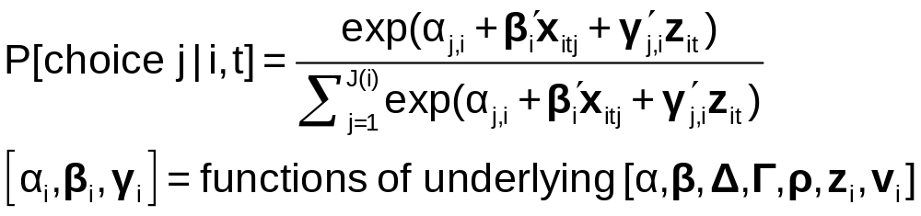
Estimating the Model
Denote by β₁ all “fixed” parameters in the model
Denote by β_{2i,t} all random and hierarchical parameters in the model

Slide 7
Customers’ Choice of Energy Supplier
California, Stated Preference Survey
361 customers presented with 8-12 choice situations each
Supplier attributes:
  Fixed price: cents per kWh
  Length of contract
  Local utility
  Well-known company
  Time-of-day rates (11¢ in day, 5¢ at night)
  Seasonal rates (10¢ in summer, 8¢ in winter, 6¢ in spring/fall)
(TrainCalUtilitySurvey.lpj)

Slide 8
Population Distributions
Normal for:
  Contract length
  Local utility
  Well-known company
Log-normal for:
  Time-of-day rates
  Seasonal rates
Price coefficient held fixed

Slide 9
Estimated Model
Estimate Std error
Price -.883 0.050
Contract mean -.213 0.026
std dev .386 0.028
Local mean 2.23 0.127
std dev 1.75 0.137
Known mean 1.59 0.100
std dev .962 0.098
TOD mean* 2.13 0.054
std dev* .411 0.040
Seasonal mean* 2.16 0.051
std dev* .281 0.022
*Parameters of underlying normal.

Slide 10
Distribution of Brand Value
Standard deviation
=2.0¢
10% dislike local utility
0
2.5¢
Brand value of local utility

Slide 11
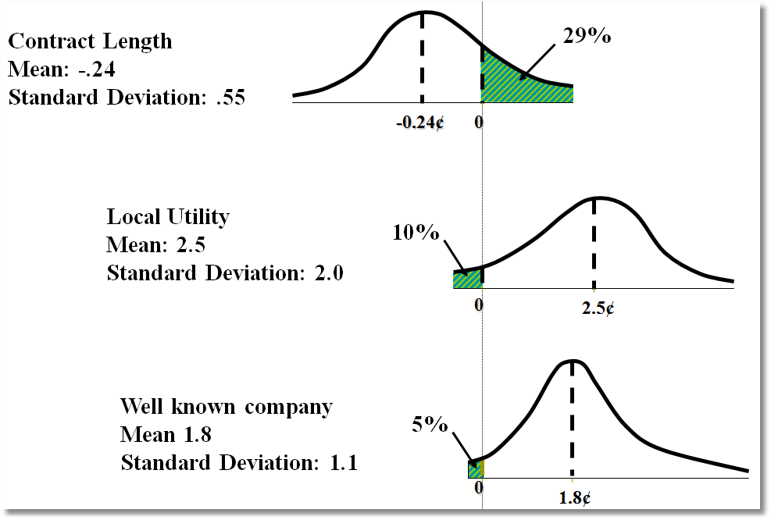
Random Parameter Distributions

Slide 12
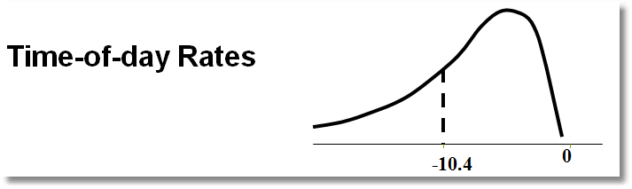
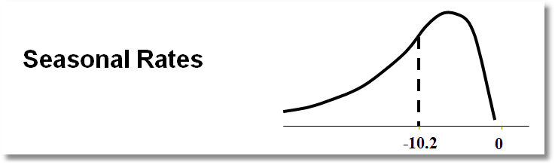
Time of Day Rates (Customers do not like – lognormal coefficient. Multiply variable by -1.)

Slide 13
Estimating Individual Parameters
Model estimates = structural parameters, α, β, ρ, Δ, Σ, Γ
Objective, a model of individual specific parameters, β_{i}
Can individual specific parameters be estimated?
  Not quite – β_{i} is a single realization of a random process; one random draw.
  We estimate E[β_{i} | all information about i]
  (This is also true of Bayesian treatments, despite claims to the contrary.)

Slide 14
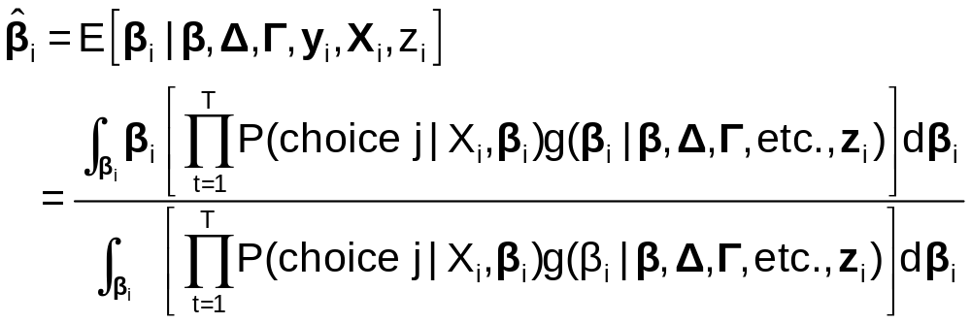
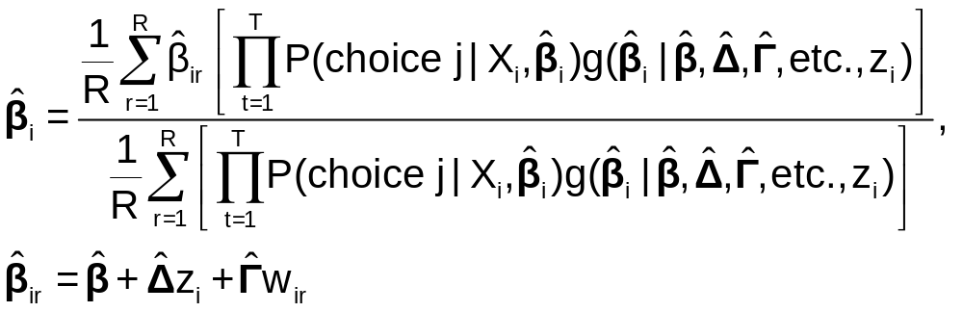
Posterior Estimation of β_{i}
Estimate by simulation

Slide 15
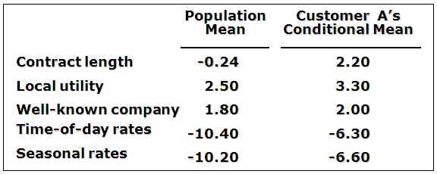
Expected Preferences of Each Customer
Customer likes long-term contract, local utility, and non-fixed rates.
Local utility can retain and make profit from this customer by offering a long-term contract with time-of-day or seasonal rates.

Slide 16
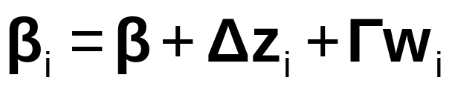
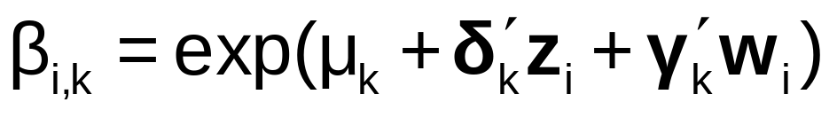
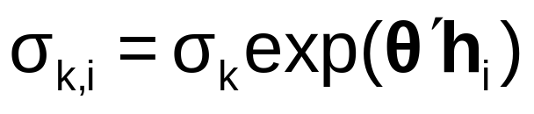
Model Extensions
AR(1): w_{i,k,t} = ρ_{k}w_{i,k,t-1} + v_{i,k,t}
Dynamic effects in the model
Restricting sign – lognormal distribution:
Restricting Range and Sign: Using triangular distribution and range = 0 to 2β.
Heteroscedasticity and heterogeneity

Slide 17
Application: Shoe Brand Choice
Simulated Data: Stated Choice,
  400 respondents,
  8 choice situations, 3,200 observations
3 choice/attributes + NONE
  Fashion = High / Low
  Quality = High / Low
  Price = 25/50/75,100 coded 1,2,3,4
Heterogeneity: Sex (Male=1), Age (<25, 25-39, 40+)
Underlying data generated by a 3 class latent class process (100, 200, 100 in classes)

Slide 18

Stated Choice Experiment: Unlabeled Alternatives, One Observation
t=1
t=2
t=3
t=4
t=5
t=6
t=7
t=8

Slide 19
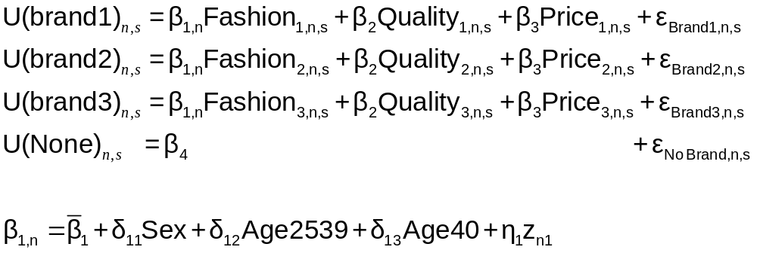
Random Parameters Logit Model
Individual parameters

Slide 20
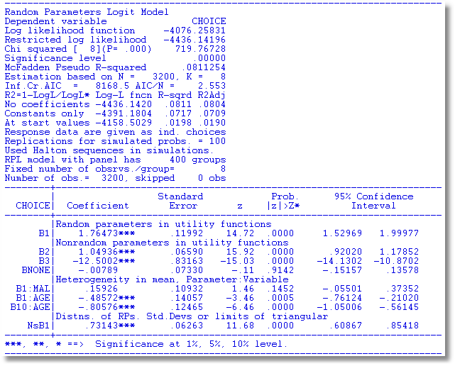
Individual parameters

Slide 21
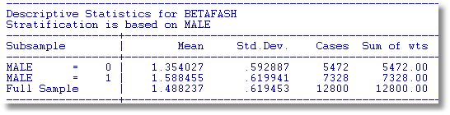
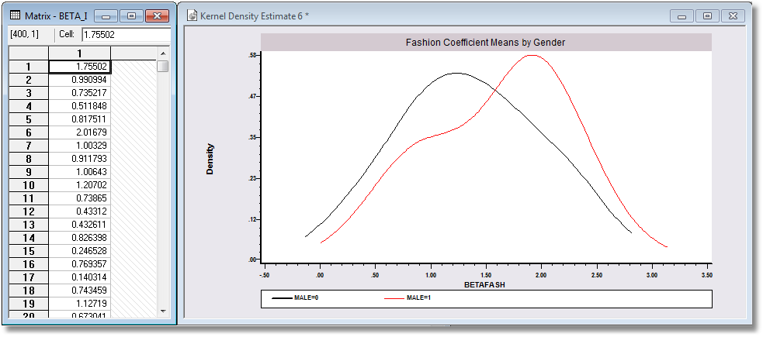
Individual parameters

Slide 22
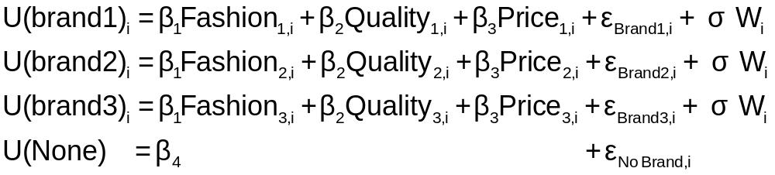
Error Components Logit Modeling
Alternative approach to building cross choice correlation
Common ‘effects.’ W_{i} is a ‘random individual effect.’

Slide 23
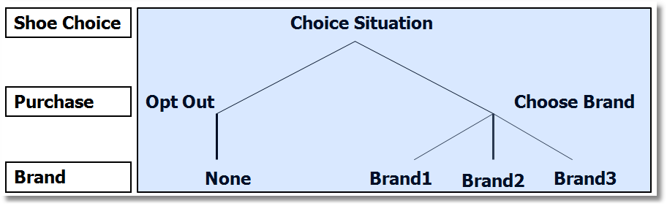
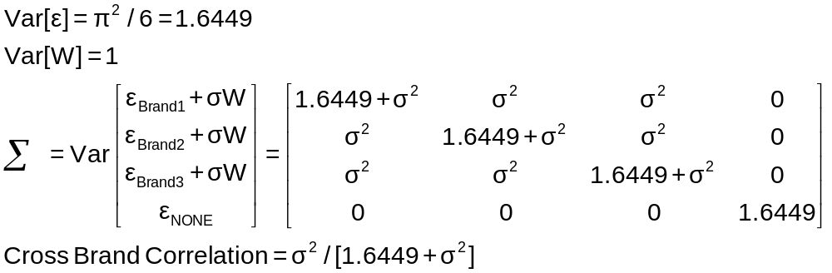
Implied Covariance Matrix
Nested Logit Formulation

Slide 24
Error Components Logit Model
-----------------------------------------------------------
Error Components (Random Effects) model
Dependent variable CHOICE
Log likelihood function -4158.45044
Estimation based on N = 3200, K = 5
Response data are given as ind. choices
Replications for simulated probs. = 50
Halton sequences used for simulations
ECM model with panel has 400 groups
Fixed number of obsrvs./group= 8
Number of obs.= 3200, skipped 0 obs
--------+--------------------------------------------------
Variable| Coefficient Standard Error b/St.Er. P[|Z|>z]
--------+--------------------------------------------------
|Nonrandom parameters in utility functions
FASH| 1.47913*** .06971 21.218 .0000
QUAL| 1.01385*** .06580 15.409 .0000
PRICE| -11.8052*** .86019 -13.724 .0000
ASC4| .03363 .07441 .452 .6513
SigmaE01| .09585*** .02529 3.791 .0002
--------+--------------------------------------------------
Random Effects Logit Model
Appearance of Latent Random
Effects in Utilities
Alternative E01
+-------------+---+
| BRAND1 | * |
+-------------+---+
| BRAND2 | * |
+-------------+---+
| BRAND3 | * |
+-------------+---+
| NONE | |
+-------------+---+
Correlation = {0.0959² / [1.6449 + 0.0959²]}^{1/2} = 0.0954

Slide 25
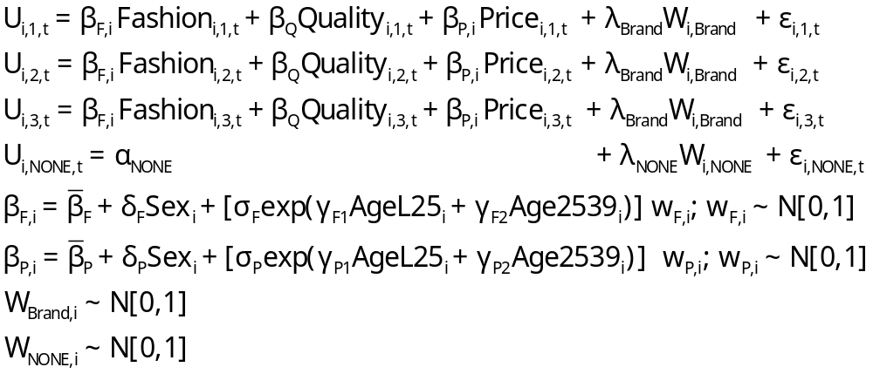
Extended MNL Model
Utility Functions

Slide 26
Extending the Basic MNL Model
Random Utility

Slide 27
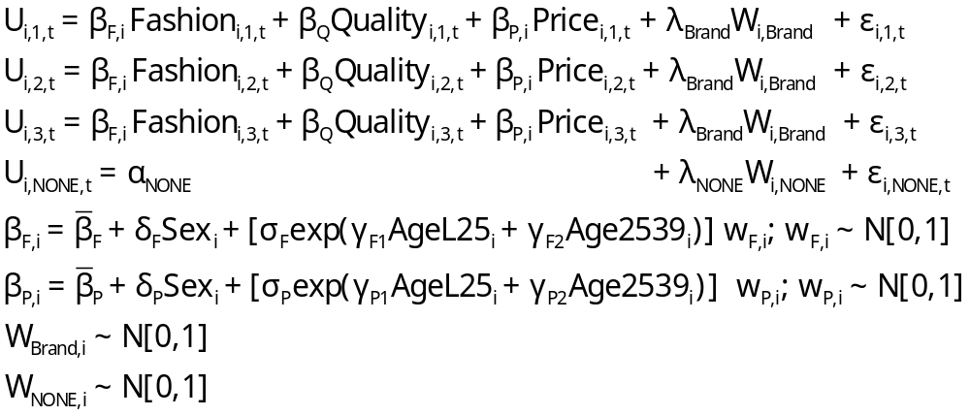
Error Components Logit Model
Error Components

Slide 28
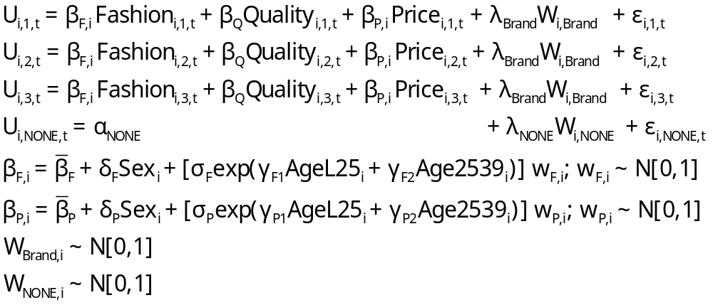
Random Parameters Model
Random Parameters

Slide 29
Heterogeneous (in the Means)
Random Parameters Model
Heterogeneity in Means

Slide 30
Heterogeneity in Both
Means and Variances
Heteroscedasticity

Slide 31
---------------------------------------------------------------
Random Parms/Error Comps. Logit Model
Dependent variable CHOICE
Log likelihood function -4019.23544 (-4158.50286 for MNL)
Restricted log likelihood -4436.14196 (Chi squared = 278.5)
Chi squared [ 12 d.f.] 833.81303
Significance level .00000
McFadden Pseudo R-squared .0939795
Estimation based on N = 3200, K = 12
Information Criteria: Normalization=1/N
Normalized Unnormalized
AIC 2.51952 8062.47089
R2=1-LogL/LogL* Log-L fncn R-sqrd R2Adj
No coefficients -4436.1420 .0940 .0928
Constants only -4391.1804 .0847 .0836
At start values -4158.5029 .0335 .0323
Response data are given as ind. choices
Replications for simulated probs. = 50
Halton sequences used for simulations
RPL model with panel has 400 groups
Fixed number of obsrvs./group= 8
Number of obs.= 3200, skipped 0 obs
---------------------------------------------------------------

Slide 32
Estimated RP/ECL Model
--------+--------------------------------------------------
Variable| Coefficient Standard Error b/St.Er. P[|Z|>z]
--------+--------------------------------------------------
|Random parameters in utility functions
FASH| .62768*** .13498 4.650 .0000
PRICE| -7.60651*** 1.08418 -7.016 .0000
|Nonrandom parameters in utility functions
QUAL| 1.07127*** .06732 15.913 .0000
ASC4| .03874 .09017 .430 .6675
|Heterogeneity in mean, Parameter:Variable
FASH:AGE| 1.73176*** .15372 11.266 .0000
FAS0:AGE| .71872*** .18592 3.866 .0001
PRIC:AGE| -9.38055*** 1.07578 -8.720 .0000
PRI0:AGE| -4.33586*** 1.20681 -3.593 .0003
|Distns. of RPs. Std.Devs or limits of triangular
NsFASH| .88760*** .07976 11.128 .0000
NsPRICE| 1.23440 1.95780 .631 .5284
|Heterogeneity in standard deviations
|(cF1, cF2, cP1, cP2 omitted...)
|Standard deviations of latent random effects
SigmaE01| .23165 .40495 .572 .5673
SigmaE02| .51260** .23002 2.228 .0258
--------+--------------------------------------------------
Note: ***, **, * = Significance at 1%, 5%, 10% level.
-----------------------------------------------------------
Random Effects Logit
Model Appearance of
Latent Random Effects
in Utilities
Alternative E01 E02
+-------------+---+---+
| BRAND1 | * | |
+-------------+---+---+
| BRAND2 | * | |
+-------------+---+---+
| BRAND3 | * | |
+-------------+---+---+
| NONE | | * |
+-------------+---+---+
Heterogeneity in Means.
Delta: 2 rows, 2 cols.
AGE25 AGE39
FASH 1.73176 .71872
PRICE -9.38055 -4.33586

Slide 33
Estimated Elasticities
Multinomial Logit
+---------------------------------------------------+
| Elasticity averaged over observations.|
| Attribute is PRICE in choice BRAND1 |
| Effects on probabilities of all choices in model: |
| * = Direct Elasticity effect of the attribute. |
| Mean St.Dev |
| * Choice=BRAND1 -.9210 .4661 |
| Choice=BRAND2 .2773 .3053 |
| Choice=BRAND3 .2971 .3370 |
| Choice=NONE .2781 .2804 |
+---------------------------------------------------+
| Attribute is PRICE in choice BRAND2 |
| Choice=BRAND1 .3055 .1911 |
| * Choice=BRAND2 -1.2692 .6179 |
| Choice=BRAND3 .3195 .2127 |
| Choice=NONE .2934 .1711 |
+---------------------------------------------------+
| Attribute is PRICE in choice BRAND3 |
| Choice=BRAND1 .3737 .2939 |
| Choice=BRAND2 .3881 .3047 |
| * Choice=BRAND3 -.7549 .4015 |
| Choice=NONE .3488 .2670 |
+---------------------------------------------------+
+--------------------------+
| Effects on probabilities |
| * = Direct effect te. |
| Mean St.Dev |
| PRICE in choice BRAND1 |
| * BRAND1 -.8895 .3647 |
| BRAND2 .2907 .2631 |
| BRAND3 .2907 .2631 |
| NONE .2907 .2631 |
+--------------------------+
| PRICE in choice BRAND2 |
| BRAND1 .3127 .1371 |
| * BRAND2 -1.2216 .3135 |
| BRAND3 .3127 .1371 |
| NONE .3127 .1371 |
+--------------------------+
| PRICE in choice BRAND3 |
| BRAND1 .3664 .2233 |
| BRAND2 .3664 .2233 |
| * BRAND3 -.7548 .3363 |
| NONE .3664 .2233 |
+--------------------------+

Slide 34
Estimating Individual Distributions
Form posterior estimates of E[β_{i}|data_{i}]
Use the same methodology to estimate E[β_{i}²|data_{i}] and Var[β_{i}|data_{i}]
Plot individual “confidence intervals” (assuming near normality)
Sample from the distribution and plot kernel density estimates

Slide 35
What is the ‘Individual Estimate?’
Point estimate of mean, variance and range of
random variable β_{i} | data_{i}.
Value is NOT an estimate of β_{i} ; it is an estimate
of E[β_{i} | data_{i}]
This would be the best estimate of the actual
realization β_{i}|data_{i}
An interval estimate would account for the sampling
‘variation’ in the estimator of Ω.
Bayesian counterpart to the preceding: Posterior
mean and variance. Same kind of plot could be done.

Slide 36
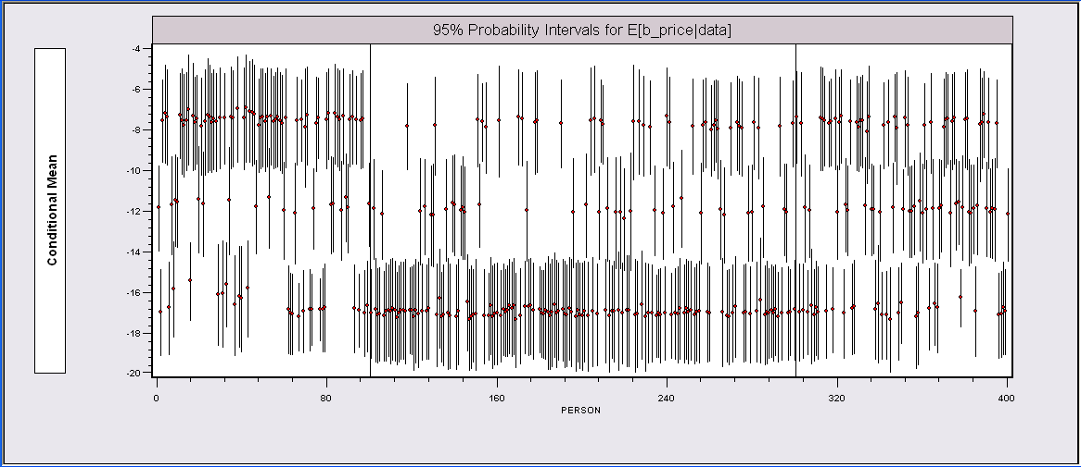
Individual E[β_{i}|data_{i}] Estimates*
The random parameters model is uncovering the latent class feature of the data.
*The intervals could be made wider to account for the sampling
variability of the underlying (classical) parameter estimators.

Slide 37
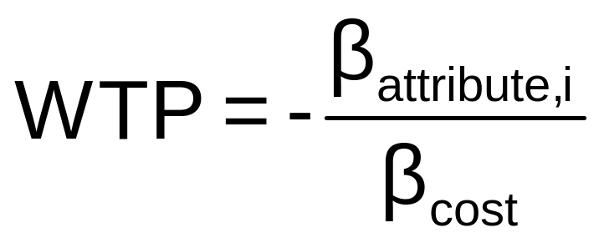
WTP Application (Value of Time Saved)
Estimating Willingness to Pay for Increments to an Attribute in a Discrete Choice Model
WTP = MU(attribute) / MU(Income)
Random

Slide 38
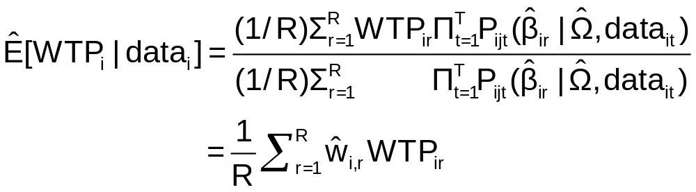
Extending the RP Model to WTP
Use the model to estimate conditional
distributions for any function of
parameters
Willingness to pay = -β_{i,time} / β_{i,cost}
Use simulation method

Slide 39
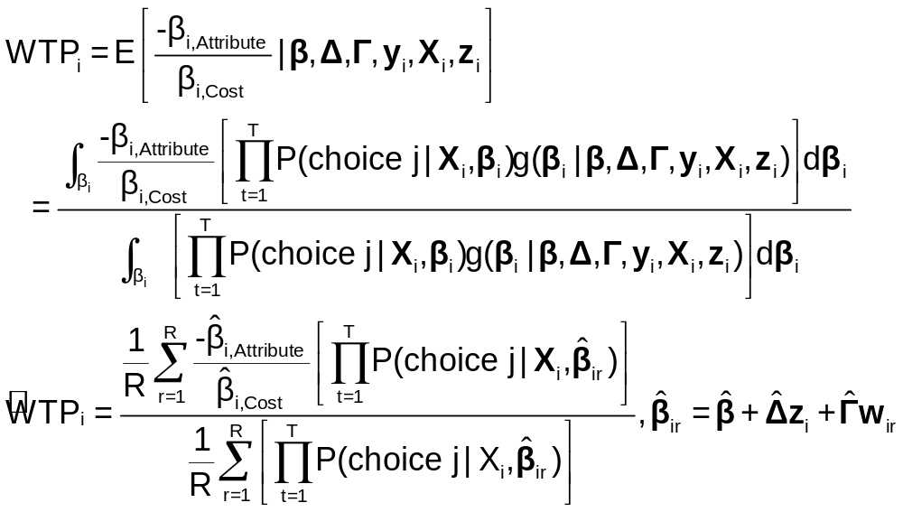
Simulation of WTP from β_{i}

Slide 40
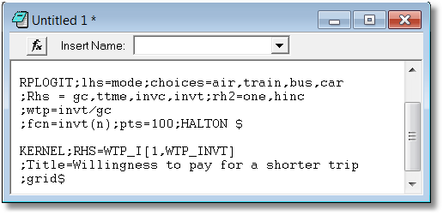
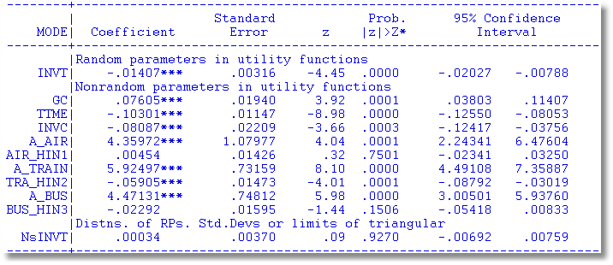

Slide 41
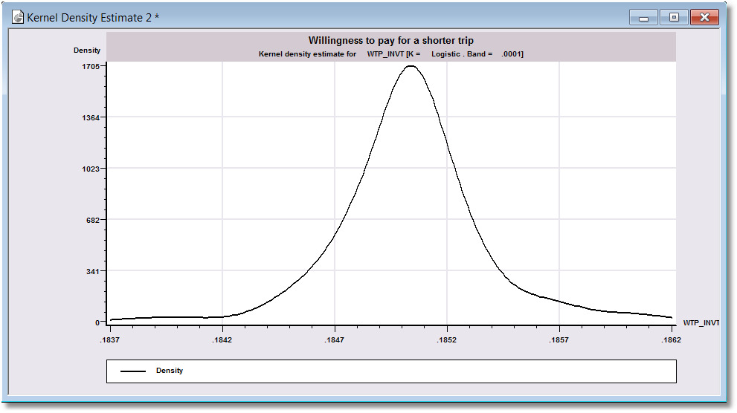
WTP

Slide 42
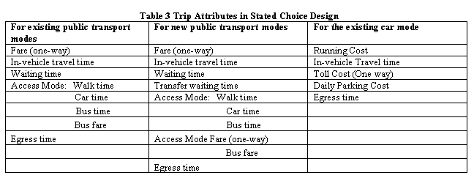
Stated Choice Experiment: Travel
Mode by Sydney Commuters

Slide 43
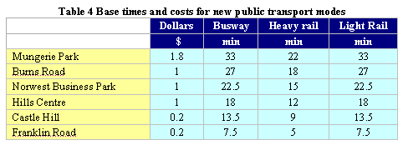
Would You Use a New Mode?

Slide 44
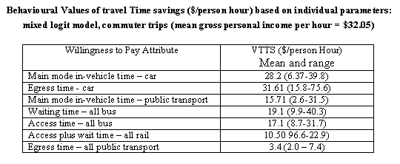
Value of Travel Time Saved

Slide 45
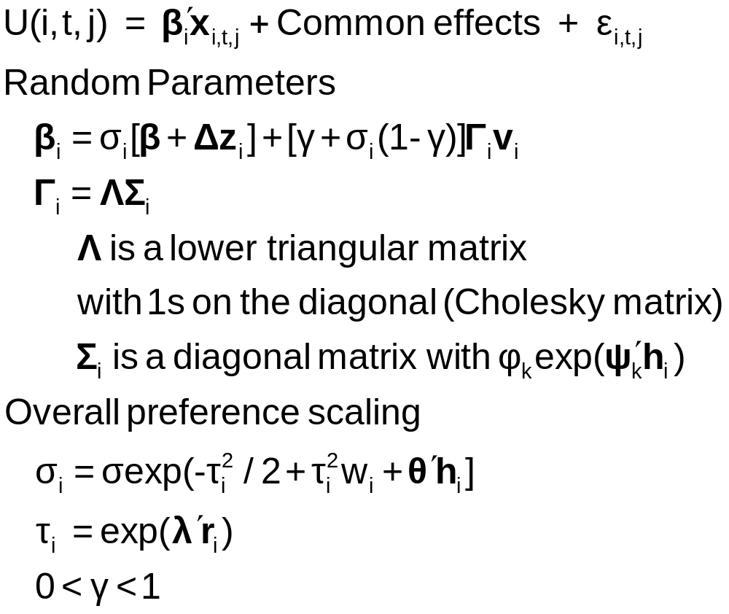
A Generalized Mixed Logit Model

Slide 46
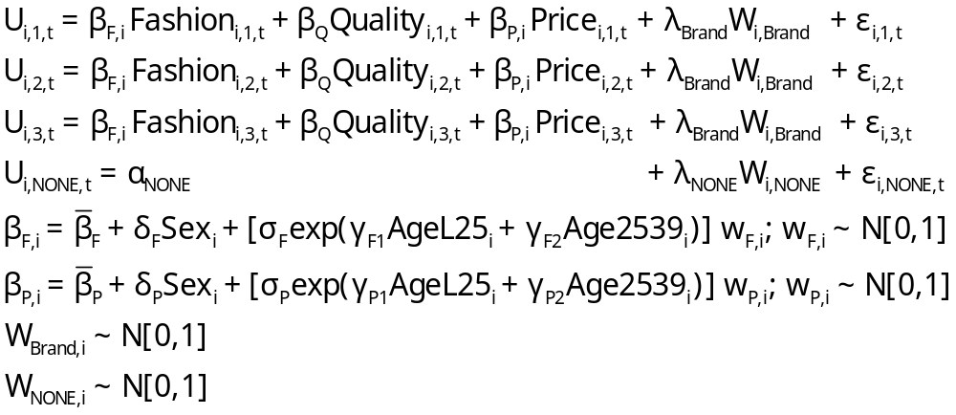
Generalized Multinomial Choice Model

Slide 47
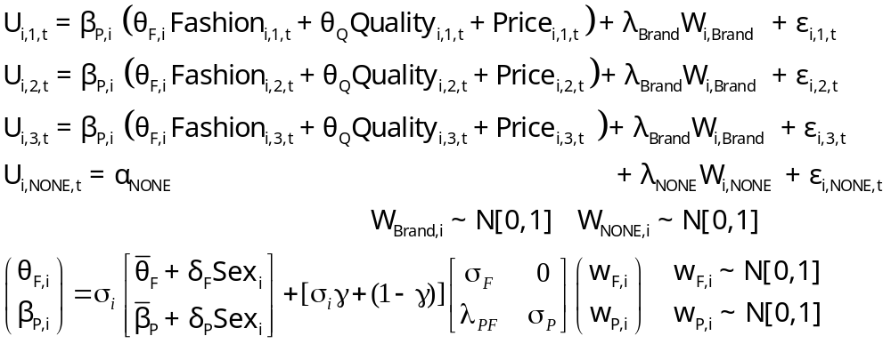
Estimation in Willingness to Pay Space
Both parameters in the WTP calculation are random.

Slide 48
--------+--------------------------------------------------
Variable| Coefficient Standard Error b/St.Er. P[|Z|>z]
--------+--------------------------------------------------
|Random parameters in utility functions
QUAL| -.32668*** .04302 -7.593 .0000 1.01373 renormalized
PRICE| 1.00000 ......(Fixed Parameter)...... -11.80230 renormalized
|Nonrandom parameters in utility functions
FASH| 1.14527*** .05788 19.787 .0000 1.4789 not rescaled
ASC4| .84364*** .05554 15.189 .0000 .0368 not rescaled
|Heterogeneity in mean, Parameter:Variable
QUAL:AGE| .05843 .04836 1.208 .2270 interaction terms
QUA0:AGE| -.11620 .13911 -.835 .4035
PRIC:AGE| .23958 .25730 .931 .3518
PRI0:AGE| 1.13921 .76279 1.493 .1353
|Diagonal values in Cholesky matrix, L.
NsQUAL| .13234*** .04125 3.208 .0013 correlated parameters
CsPRICE| .000 ......(Fixed Parameter)...... but coefficient is fixed
|Below diagonal values in L matrix. V = L*Lt
PRIC:QUA| .000 ......(Fixed Parameter)......
|Heteroscedasticity in GMX scale factor
sdMALE| .23110 .14685 1.574 .1156 heteroscedasticity
|Variance parameter tau in GMX scale parameter
TauScale| 1.71455*** .19047 9.002 .0000 overall scaling, tau
|Weighting parameter gamma in GMX model
GammaMXL| .000 ......(Fixed Parameter)......
|Coefficient on PRICE in WTP space form
Beta0WTP| -3.71641*** .55428 -6.705 .0000 new price coefficient
S_b0_WTP| .03926 .40549 .097 .9229 standard deviation
| Sample Mean Sample Std.Dev.
Sigma(i)| .70246 1.11141 .632 .5274 overall scaling
|Standard deviations of parameter distributions
sdQUAL| .13234*** .04125 3.208 .0013
sdPRICE| .000 ......(Fixed Parameter)......
--------+--------------------------------------------------
Estimated Model for WTP

Slide 49

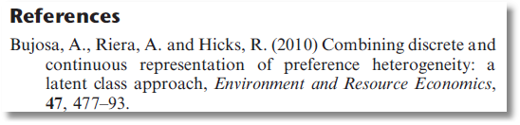
Latent Class Mixed Logit

Slide 50
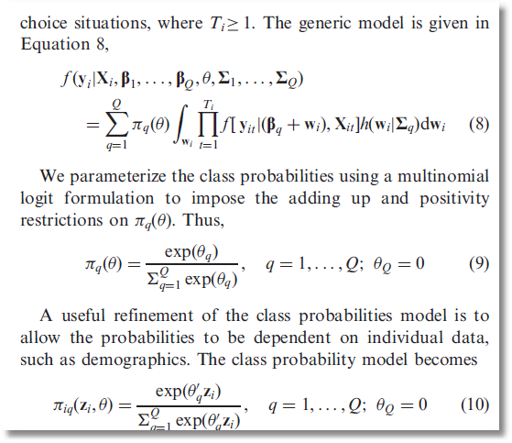
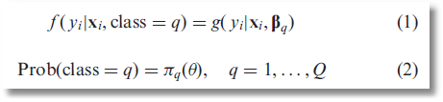
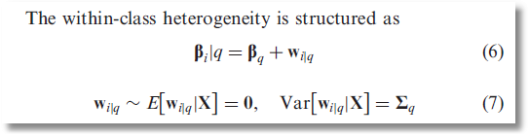

Slide 51
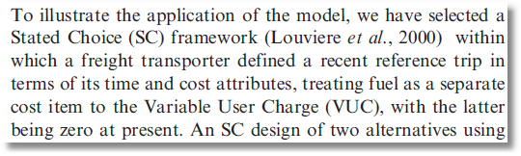
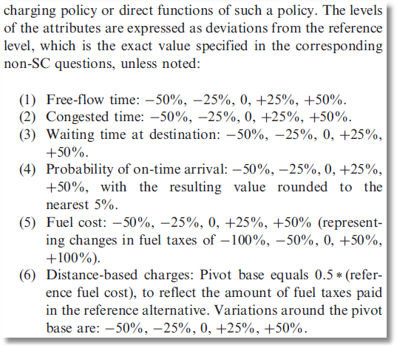
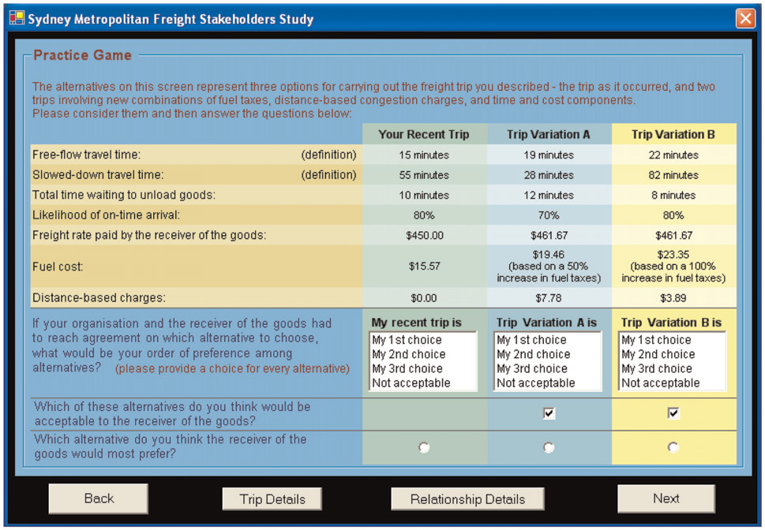

Slide 52
