Slide 1
Discrete Choice Modeling
0 Introduction
1 Summary
2 Binary Choice
3 Panel Data
4 Bivariate Probit
5 Ordered Choice
6 Count Data
7 Multinomial Choice
8 Nested Logit
9 Heterogeneity
10 Latent Class
11 Mixed Logit
12 Stated Preference
13 Hybrid Choice
William Greene
Stern School of Business
New York University

Slide 2
Revealed and Stated Preference Data
Pure RP Data
  Market (ex-post, e.g., supermarket scanner data)
  Individual observations
Pure SP Data
  Contingent valuation
  (?) Validity
Combined (Enriched) RP/SP
  Mixed data
  Expanded choice sets

Slide 3
Application
Survey sample of 2,688 trips, 2 or 4 choices per situation
Sample consists of 672 individuals
Choice based sample
Revealed/Stated choice experiment:
Revealed: Drive,ShortRail,Bus,Train
Hypothetical: Drive,ShortRail,Bus,Train,LightRail,ExpressBus
Attributes:
Cost –Fuel or fare
Transit time
Parking cost
Access and Egress time

Slide 4
Application: Shoe Brand Choice
Simulated Data: Stated Choice,
  400 respondents,
  8 choice situations, 3,200 observations
3 choice/attributes + NONE
  Fashion = High / Low
  Quality = High / Low
  Price = 25/50/75,100 coded 1,2,3,4
Heterogeneity: Sex (Male=1), Age (<25, 25-39, 40+)
Underlying data generated by a 3 class latent class process (100, 200, 100 in classes)

Slide 5

Stated Choice Experiment: Unlabeled Alternatives, One Observation
t=1
t=2
t=3
t=4
t=5
t=6
t=7
t=8

Slide 6
Customers’ Choice of Energy Supplier
California, Stated Preference Survey
361 customers presented with 8-12 choice situations each
Supplier attributes:
  Fixed price: cents per kWh
  Length of contract
  Local utility
  Well-known company
  Time-of-day rates (11¢ in day, 5¢ at night)
  Seasonal rates (10¢ in summer, 8¢ in winter, 6¢ in spring/fall)

Slide 7


Slide 8
Panel Data
Repeated Choice Situations
Typically RP/SP constructions (experimental)
Accommodating “panel data”
  Multinomial Probit [marginal, impractical]
  Latent Class
  Mixed Logit

Slide 9
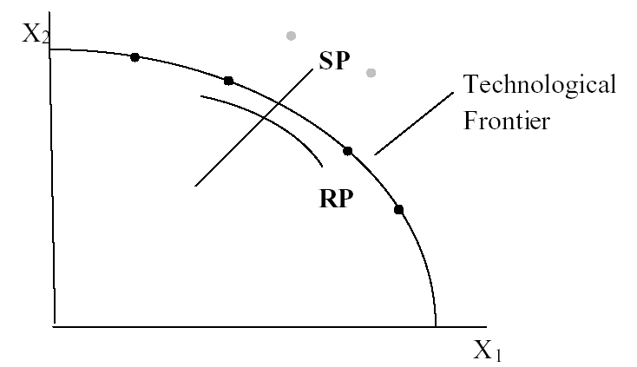
Revealed Preference Data
Advantage: Actual observations on actual behavior
Disadvantage: Limited range of choice sets and attributes – does not allow analysis of switching behavior.

Slide 10
Pooling RP and SP Data Sets - 1
Enrich the attribute set by replicating choices
E.g.:
  RP: Bus,Car,Train (actual)
  SP: Bus(1),Car(1),Train(1)
  Bus(2),Car(2),Train(2),…
How to combine?

Slide 11
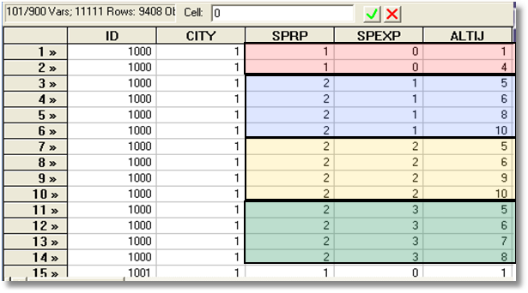
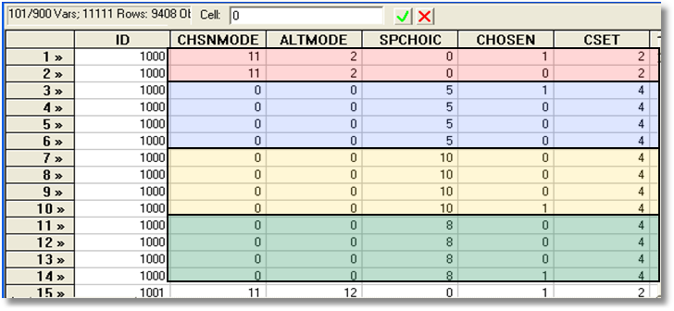
Each person makes four choices from a choice set that includes either two or four alternatives.
The first choice is the RP between two of the RP alternatives
The second-fourth are the SP among four of the six SP alternatives.
There are ten alternatives in total.

Slide 12
Stated Preference Data
Pure hypothetical – does the subject take it seriously?
No necessary anchor to real market situations
Vast heterogeneity across individuals

Slide 13
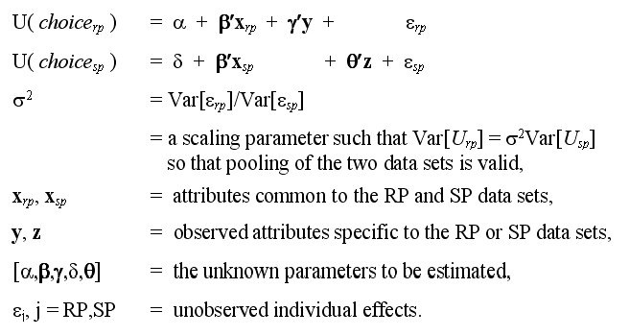
An Underlying Random Utility Model

Slide 14
Nested Logit Approach
Mode
RP
Car Train Bus SPCar SPTrain SPBus
Use a two level nested model, and constrain three SP IV parameters to be equal.

Slide 15
Enriched Data Set – Vehicle Choice
Choosing between Conventional, Electric and LPG/CNG Vehicles in Single-Vehicle Households
David A. Hensher William H. Greene
Institute of Transport Studies Department of Economics
School of Business Stern School of Business
The University of Sydney New York University
NSW 2006 Australia New York USA
September 2000

Slide 16
Fuel Types Study
Conventional, Electric, Alternative
1,400 Sydney Households
Automobile choice survey
RP + 3 SP fuel classes
Nested logit – 2 level approach – to handle the scaling issue

Slide 17
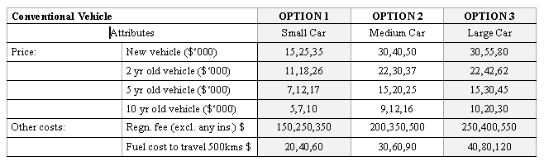
Attribute Space: Conventional

Slide 18
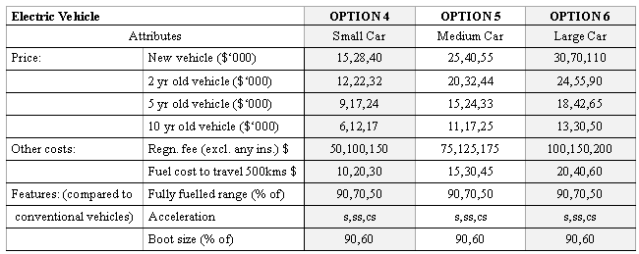
Attribute Space: Electric

Slide 19
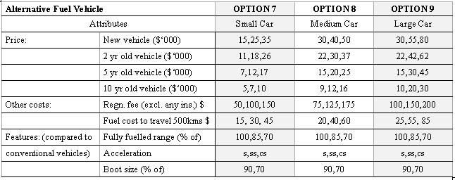
Attribute Space: Alternative

Slide 20
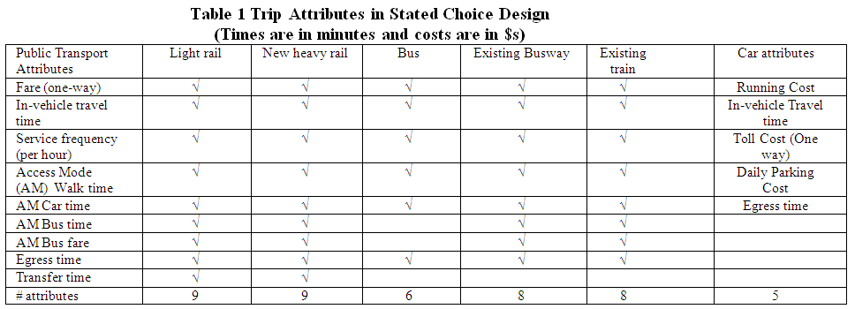
Experimental Design

Slide 21
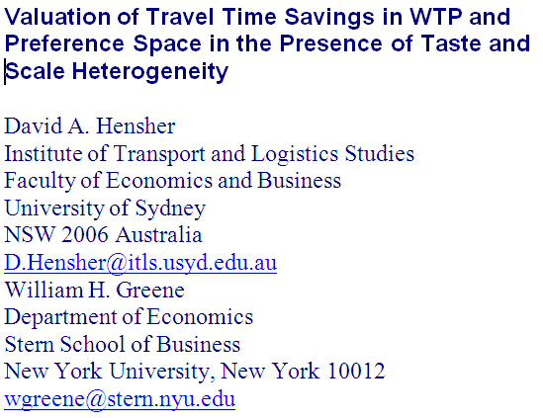

Slide 22
Mixed Logit Approaches
Pivot SP choices around an RP outcome.
Scaling is handled directly in the model
Continuity across choice situations is handled by random elements of the choice structure that are constant through time
  Preference weights – coefficients
  Scaling parameters
    Variances of random parameters
    Overall scaling of utility functions

Slide 23
Application
Survey sample of 2,688 trips, 2 or 4 choices per situation
Sample consists of 672 individuals
Choice based sample
Revealed/Stated choice experiment:
Revealed: Drive,ShortRail,Bus,Train
Hypothetical: Drive,ShortRail,Bus,Train,LightRail,ExpressBus
Attributes:
Cost –Fuel or fare
Transit time
Parking cost
Access and Egress time

Slide 24
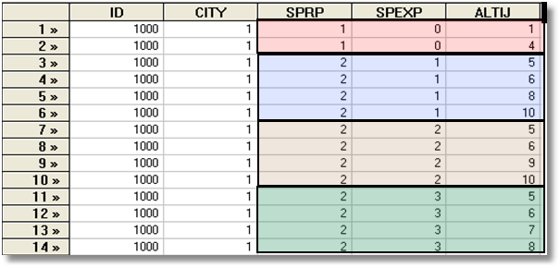
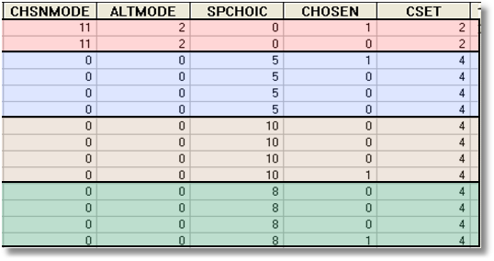
Each person makes four choices from a choice set that includes either 2 or 4 alternatives.
The first choice is the RP between two of the 4 RP alternatives
The second-fourth are the SP among four of the 6 SP alternatives.
There are 10 alternatives in total.
A Stated Choice Experiment with Variable Choice Sets

Slide 25
Experimental Design

