Slide 1
Discrete Choice Modeling
0 Introduction
1 Summary
2 Binary Choice
3 Panel Data
4 Bivariate Probit
5 Ordered Choice
6 Count Data
7 Multinomial Choice
8 Nested Logit
9 Heterogeneity
10 Latent Class
11 Mixed Logit
12 Stated Preference
13 Hybrid Choice
William Greene
Stern School of Business
New York University

Slide 2
What is a hybrid choice model?
Incorporates latent variables in choice model
Extends development of discrete choice model to incorporate other aspects of preference structure of the chooser
Develops endogeneity of the preference structure.

Slide 3
Endogeneity
"Recent Progress on Endogeneity in Choice Modeling" with Jordan Louviere & Kenneth Train & Moshe Ben-Akiva & Chandra Bhat & David Brownstone & Trudy Cameron & Richard Carson & J. Deshazo & Denzil Fiebig & William Greene & David Hensher & Donald Waldman, 2005. Marketing Letters Springer, vol. 16(3), pages 255-265, December.
Narrow view: U(i,j) = b’x(i,j) + ε(i,j), x(i,j) correlated with ε(i,j)
(Berry, Levinsohn, Pakes, brand choice for cars, endogenous price attribute.)
Implications for estimators that assume it is.
Broader view: Sounds like heterogeneity.
  Preference structure: RUM vs. RRM
  Heterogeneity in choice strategy – e.g., omitted attribute models
  Heterogeneity in taste parameters: location and scaling
  Heterogeneity in functional form: Possibly nonlinear utility functions

Slide 4
Heterogeneity
Narrow view: Random variation in marginal utilities and scale
  RPM, LCM
  Scaling model
  Generalized Mixed model
Broader view: Heterogeneity in preference weights
  RPM and LCM with exogenous variables
  Scaling models with exogenous variables in variances
  Looks like hierarchical models

Slide 5
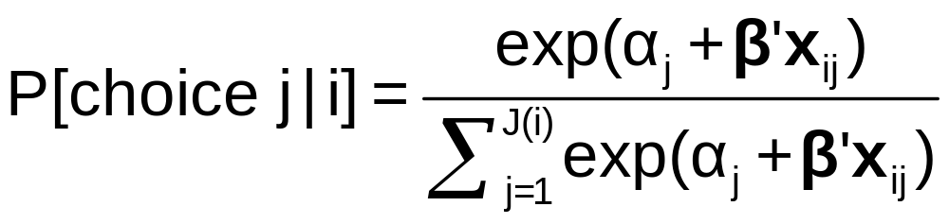
Heterogeneity and the MNL Model

Slide 6
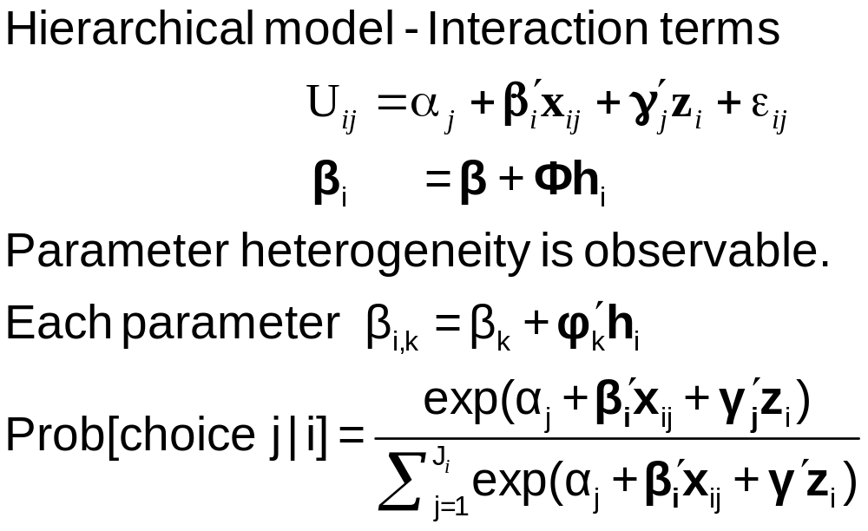
Observable Heterogeneity in
Preference Weights

Slide 7
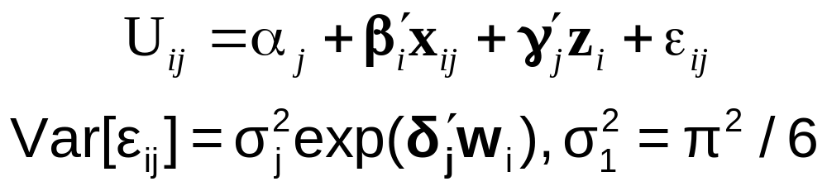
‘Quantifiable’ Heterogeneity in Scaling
w_{i} = observable characteristics:
age, sex, income, etc.

Slide 8
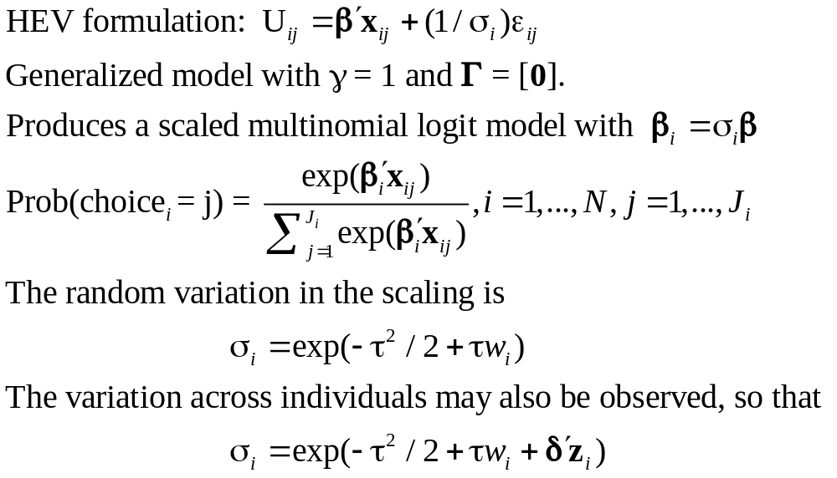
Unobserved Heterogeneity in Scaling

Slide 9
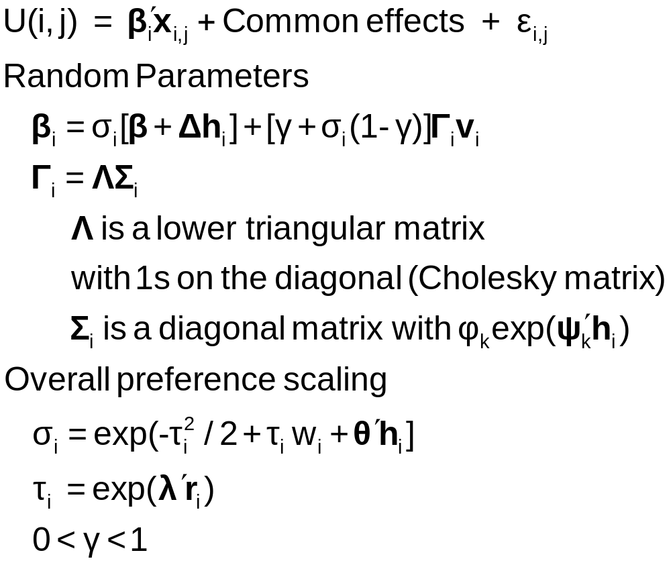
Generalized Mixed Logit Model

Slide 10
A helpful way to view hybrid choice models
Adding attitude variables to the choice model
In some formulations, it makes them look like mixed parameter models
“Interactions” is a less useful way to interpret

Slide 11
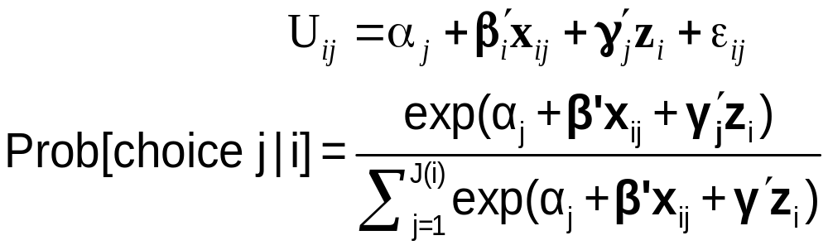
Observable Heterogeneity in Utility Levels
Choice, e.g., among brands of cars
x_{itj} = attributes: price, features
z_{it} = observable characteristics: age, sex, income

Slide 12
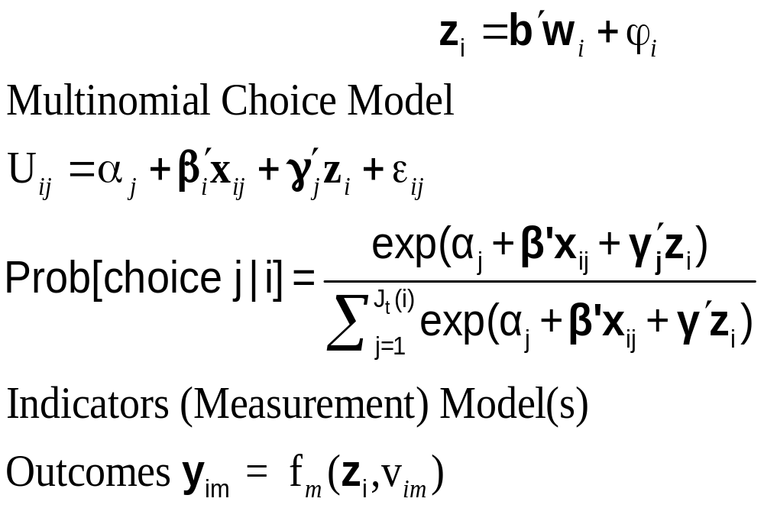
Unbservable heterogeneity in utility levels and other preference indicators

Slide 13


Slide 14
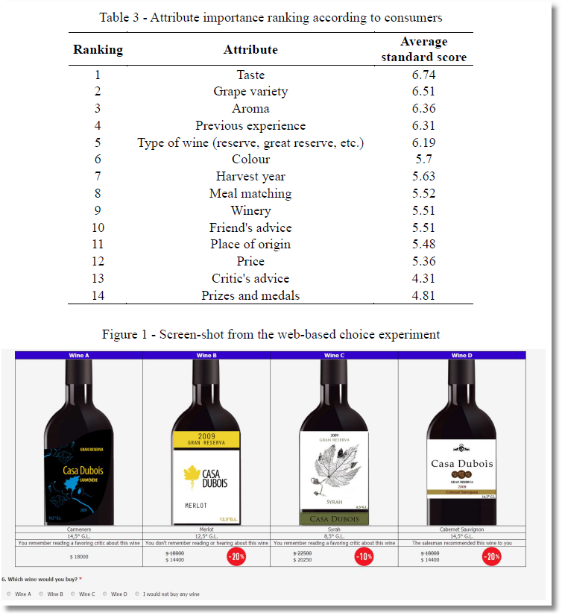

Slide 15
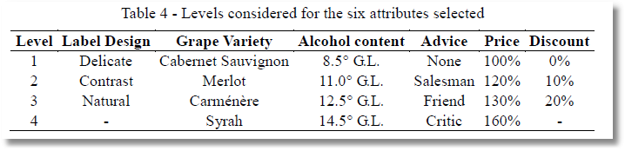

Slide 16
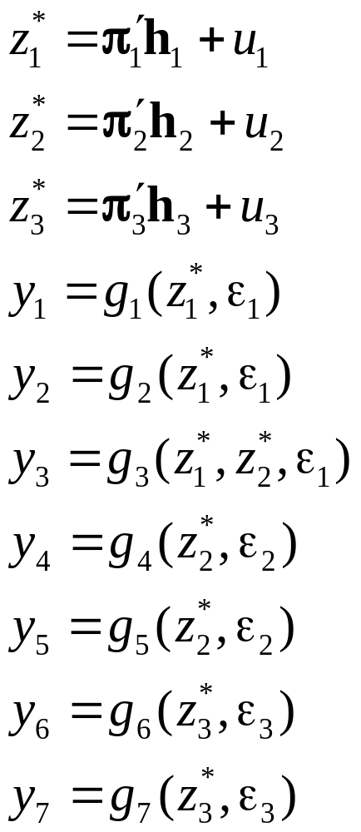
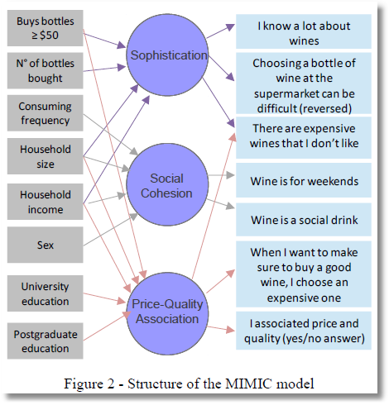
Observed Latent Observed
x → z* → y

Slide 17
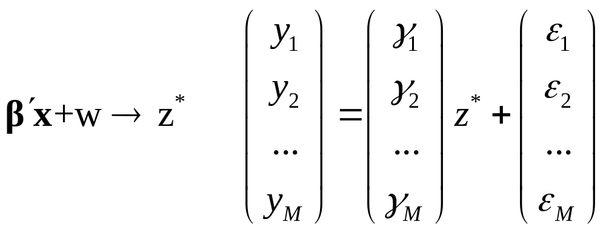
MIMIC Model
Multiple Causes and Multiple Indicators
X z* Y

Slide 18
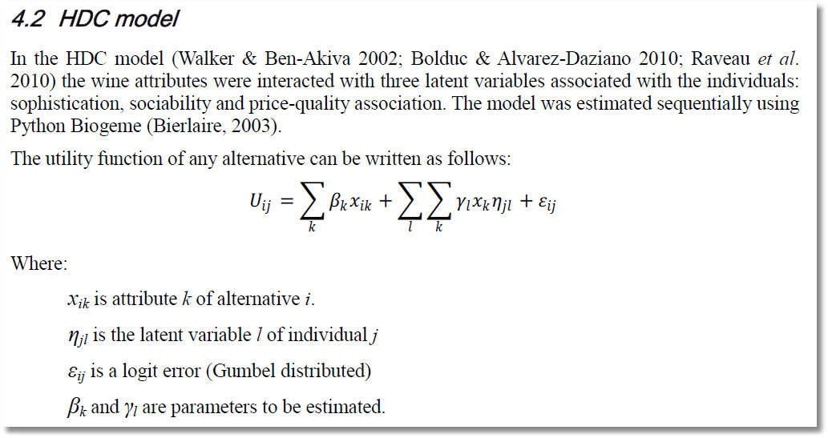
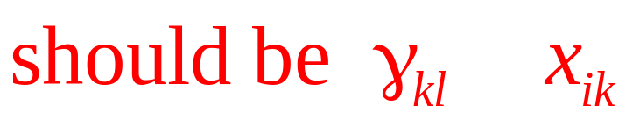
Note. Alternative i, Individual j.

Slide 19
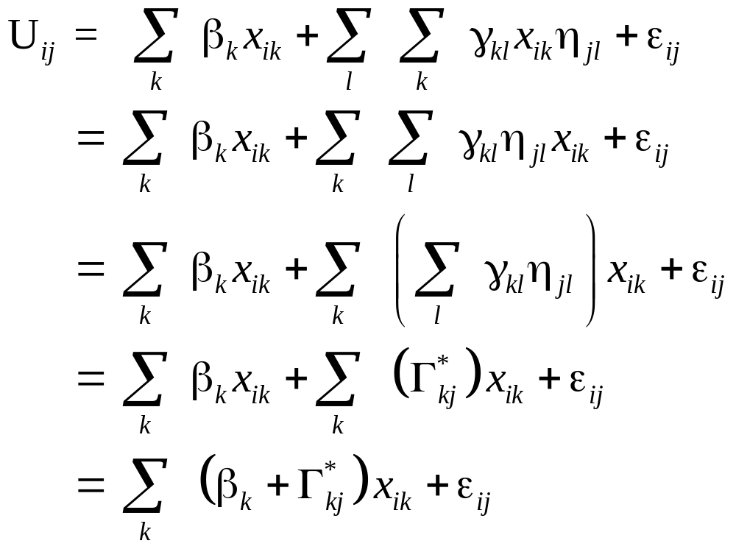
This is a mixed logit model. The interesting extension is the source of the individual heterogeneity in the random parameters.

Slide 20


Slide 21
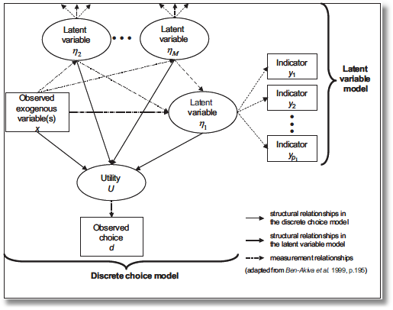
“Integrated Model”
Incorporate attitude measures in preference structure

Slide 22
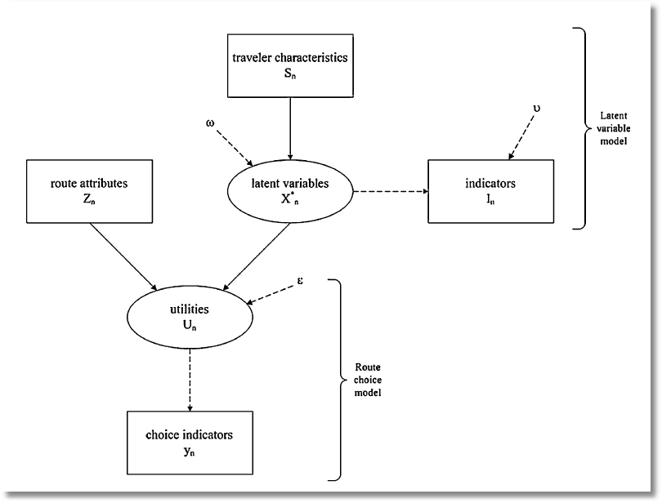
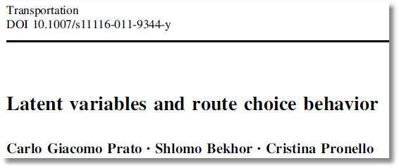

Slide 23
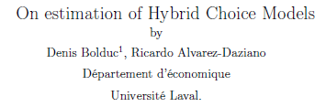
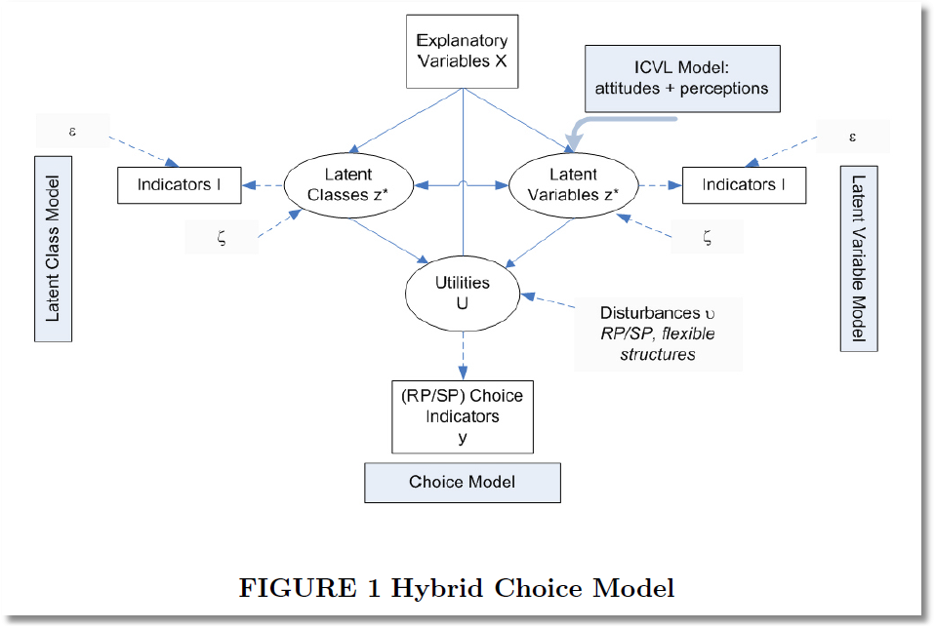

Slide 24
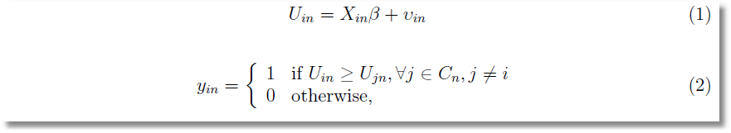
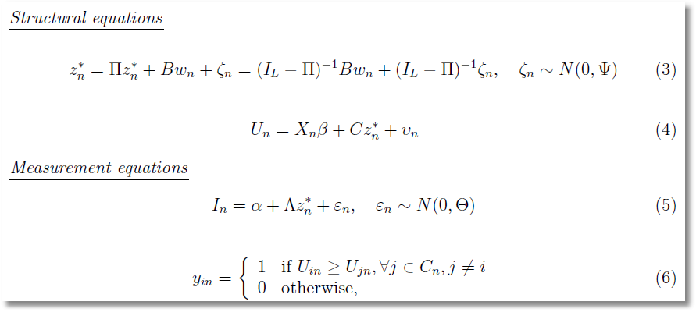

Slide 25
Hybrid choice
Equations of the MIMIC Model

Slide 26
Identification Problems
Identification of latent variable models with cross sections
How to distinguish between different latent variable models. How many latent variables are there? More than 0. Less than or equal to the number of indicators.
Parametric point identification

Slide 29
Caution

Slide 30
Swait, J., “A Structural Equation Model of Latent Segmentation and Product Choice for Cross Sectional Revealed Preference Choice Data,” Journal of Retailing and Consumer Services, 1994
Bahamonde-Birke and Ortuzar, J., “On the Variabiity of Hybrid Discrete Choice Models, Transportmetrica, 2012
Vij, A. and J. Walker, “Preference Endogeneity in Discrete Choice Models,” TRB, 2013
Sener, I., M. Pendalaya, R., C. Bhat, “Accommodating Spatial Correlation Across Choice Alternatives in Discrete Choice Models: An Application to Modeling Residential Location Choice Behavior,” Journal of Transport Geography, 2011
Palma, D., Ortuzar, J., G. Casaubon, L. Rizzi, Agosin, E., “Measuring Consumer Preferences Using Hybrid Discrete Choice Models,” 2013
Daly, A., Hess, S., Patruni, B., Potoglu, D., Rohr, C., “Using Ordered Attitudinal Indicators in a Latent Variable Choice Model: A Study of the Impact of Security on Rail Travel Behavior”

