Slide 1
Nonlinear Models with Spatial Data
William Greene
Stern School of Business, New York University
Washington D.C.
July 12, 2013

Slide 2
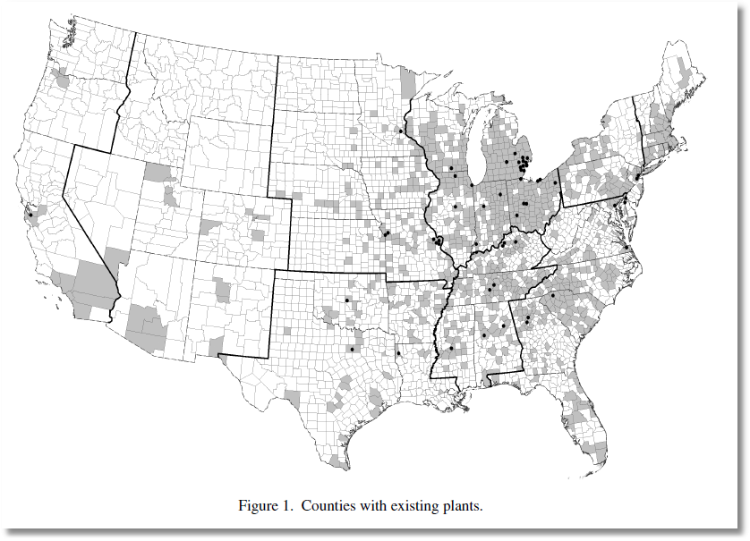
Y=1[New Plant Located in County]
Klier and McMillen: Clustering of Auto Supplier Plants in the United States. JBES, 2008

Slide 3
Outcome Models for Spatial Data
❶ Spatial Regression Models
❷ Estimation and Analysis
❸ Nonlinear Models and Spatial Regression
❹ Nonlinear Models: Specification, Estimation
  Discrete Choice: Binary, Ordered, Multinomial, Counts
  Sample Selection
  Stochastic Frontier

Slide 4
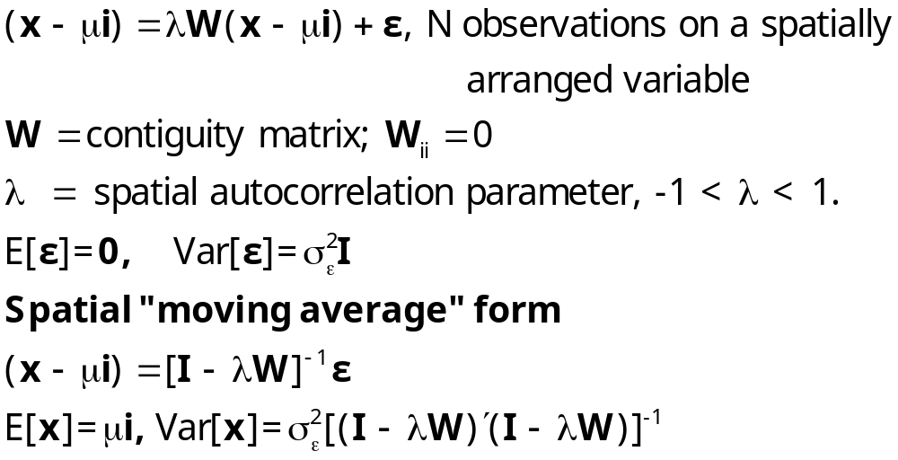
Spatial Autocorrelation

Slide 5
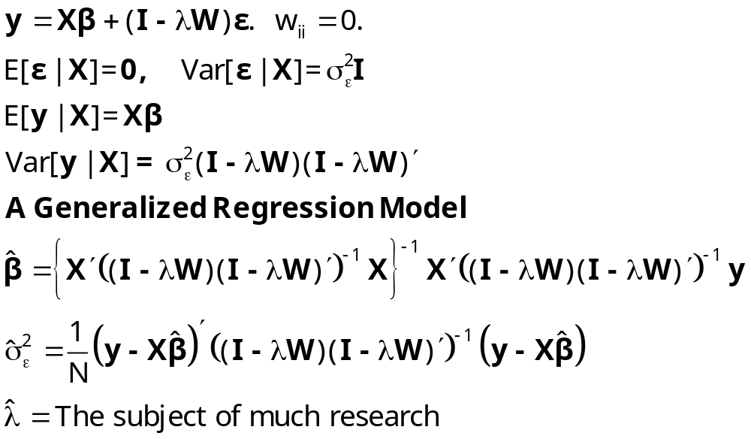
Spatial Autocorrelation in Regression

Slide 6
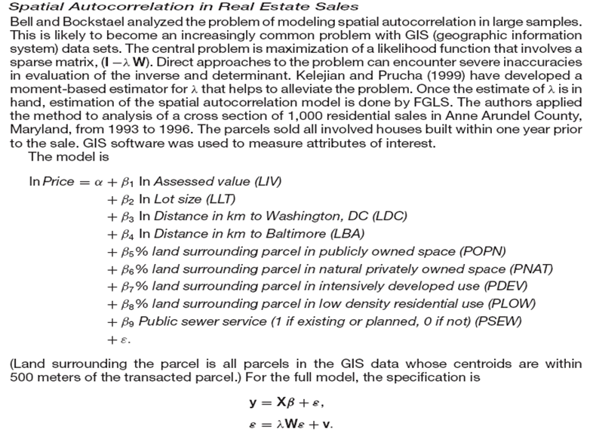
Bell and Bockstael (2000) Spatial Autocorrelation in Real Estate Sales

Slide 7
Agreed Upon Objective:
Practical Obstacles
Problem: Maximize logL involving sparse
(I-W)
Inaccuracies in determinant and inverse
Kelejian and Prucha (1999) moment based
estimator of 
Followed by FGLS

Slide 8
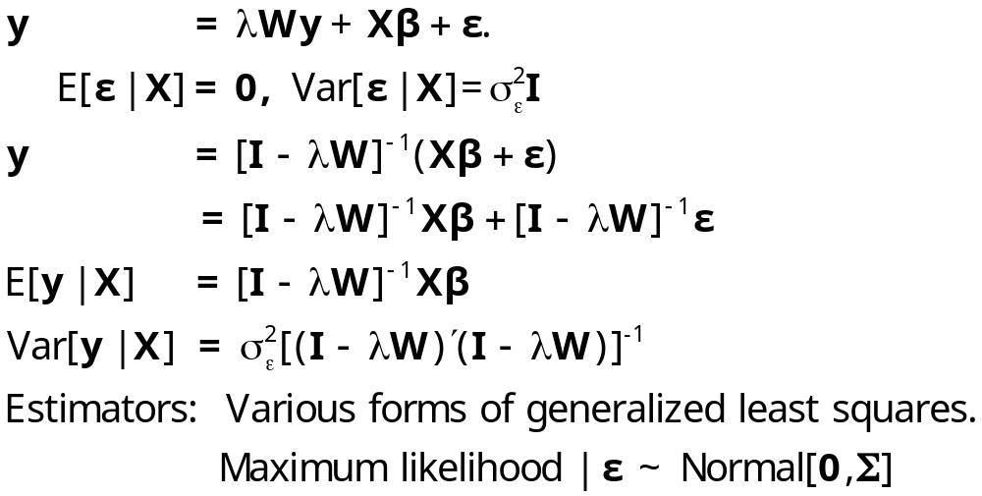
Spatial Autoregression in a Linear Model

Slide 9
Complications of the Generalized
Regression Model
❶ Potentially very large N – GIS data on agriculture
plots
❷ Estimation of . There is no natural residual based
estimator
❸ Complicated covariance structures – no simple
transformations

Slide 10
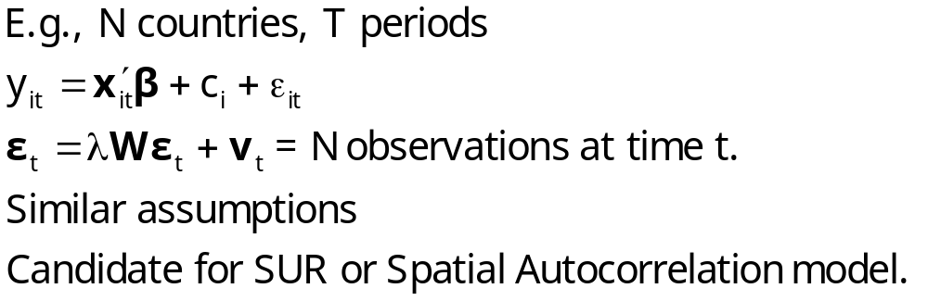
Panel Data Application

Slide 11
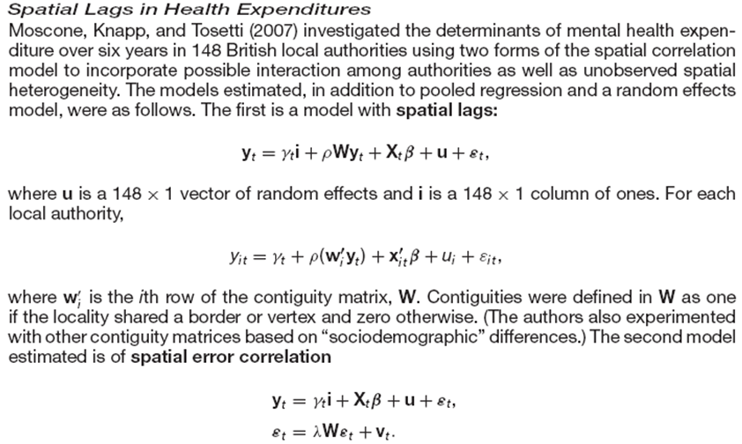
Spatial Autocorrelation in a Panel

Slide 12
Analytical Environment
❶ Generalized linear regression
❷ Complicated disturbance covariance matrix
❸ Estimation platform: Generalized least
squares or maximum likelihood (normality)
❹ Central problem, estimation of 

Slide 13
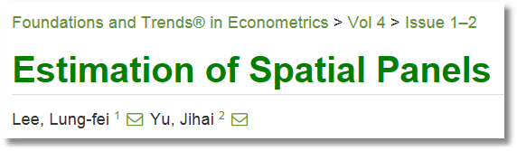
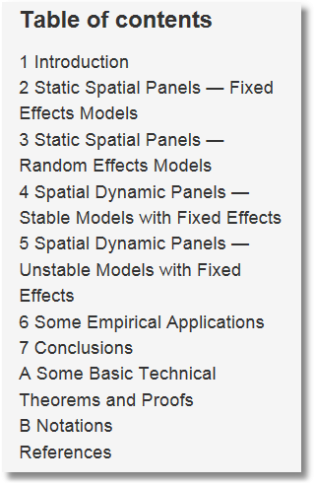


Slide 14
Outcomes in Nonlinear Settings
❶ Land use intensity in Austin, Texas – Discrete Ordered
Intensity = 1,2,3,4
❷ Land Usage Types in France, 1,2,3 – Discrete Unordered
❸ Oak Tree Regeneration in Pennsylvania – Count
Number = 0,1,2,… (Many zeros)
❹ Teenagers in the Bay area:
physically active = 1 or physically inactive = 0 – Binary
❺ Pedestrian Injury Counts in Manhattan – Count
❻ Efficiency of Farms in West-Central Brazil – Nonlinear
Model (Stochastic frontier)
❼ Catch by Alaska trawlers in a nonrandom sample

Slide 15
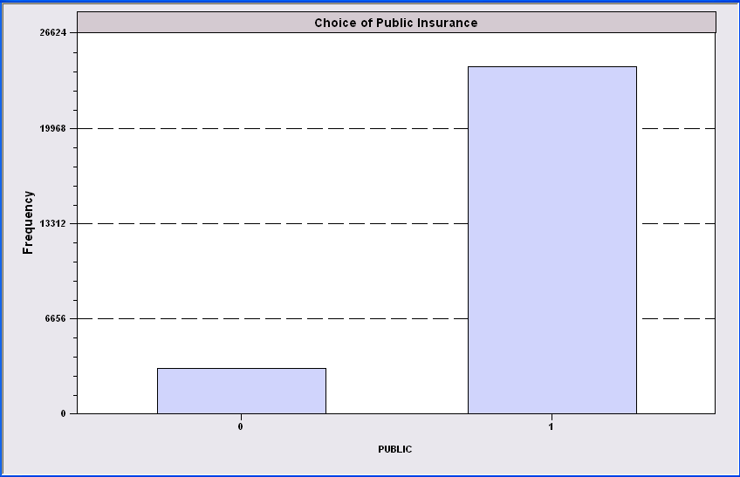

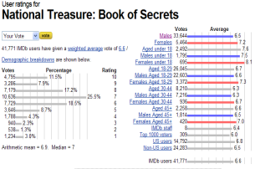
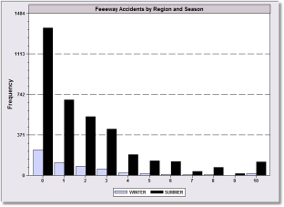
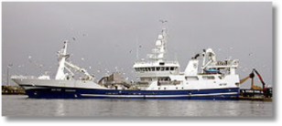
Nonlinear Outcomes
❶ Discrete revelation of choice indicates
latent underlying preferences
  ① Binary choice between two alternatives
  ② Unordered choice among multiple choices ④
  ③ Ordered choice revealing underlying
  strength of preferences
❷ Counts of events
❸ Stochastic frontier and efficiency
❹ Nonrandom sample selection

Slide 16
Modeling Discrete Outcomes
❶ “Dependent Variable” typically labels an outcome
  No quantitative meaning
  Conditional relationship to covariates
❷ No “regression” relationship in most cases.
• Models are often not conditional means.
• The “model” is usually a probability
❸ Nonlinear models – usually not estimated by any type
of linear least squares

Slide 17
Nonlinear Spatial Modeling
❶ Discrete outcome y_{it} = 0, 1, …, J for
some finite or infinite (count case) J.
  i = 1,…,n
  t = 1,…,T
❷ Covariates x_{it}
❸ Conditional Probability (y_{it} = j)
= a function of x_{it}.

Slide 18


Slide 19
Issues in Spatial Discrete Choice
A series of Issues
❶ Spatial dependence between alternatives: Nested logit
❷ Spatial dependence in the LPM: Solves some practical problems. A bad model
❸ Spatial probit and logit: Probit is generally more amenable to modeling
❹ Statistical mechanics: Social interactions – not practical
❺ Autologistic model: Spatial dependency between outcomes or utillities.
See below
❻ Variants of autologistic: The model based on observed outcomes is
incoherent (“selfcontradictory”)
❼ Endogenous spatial weights
❽ Spatial heterogeneity: Fixed and random effects. Not practical.
The model discussed below

Slide 20
Two Platforms
❶ Random Utility for Preference Models
Outcome reveals underlying utility
  Binary: u* = θ’x y = 1 if u* > 0
  Ordered: u* = θ’x y = j if μ_{j-1} < u* < μ_{j}
  Unordered: u*(j) = θ’x_{j} , y = j if u*(j) > u*(k)
❷ Nonlinear Regression for Count Models
Outcome is governed by a nonlinear
regression
  E[y|x] = g(θ,x)

Slide 21
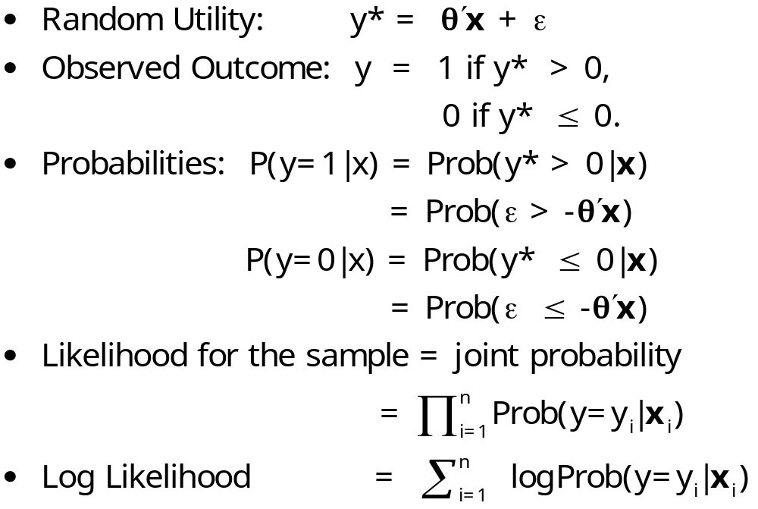
Maximum Likelihood Estimation
Cross Section Case: Binary Outcome

Slide 22
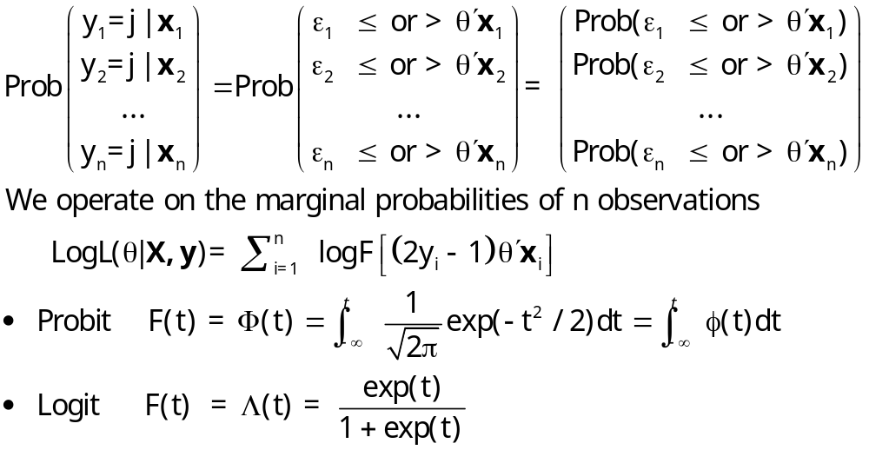
Cross Section Case: n observations

Slide 23
How to Induce Correlation
❶ Joint distribution of multiple observations
❷ Correlation of unobserved heterogeneity
❸ Correlation of latent utility

Slide 24
Bivariate Counts
❶ Intervening variable approach
Y₁ = X₁ + Z, Y₂ = Y₂ + Z; All 3 Poisson distributed
Only allows positive correlation.
Limited to two outcomes
❷ Bivariate conditional means
₁ = exp(x₁ + ₁), ₂ = exp(x₂ + ₂), Cor(₁,₂)=
|Cor(y1,y2)| << || (Due to residual variation)
❸ Copula functions – Useful for bivariate. Less so if > 2.

Slide 25
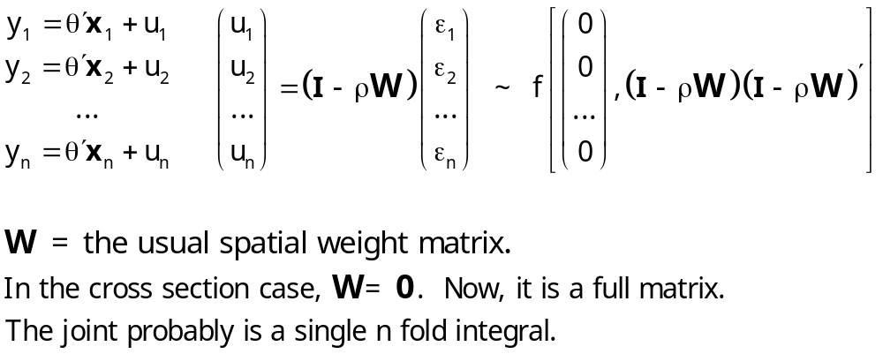
Spatially Correlated Observations
Correlation Based on Unobservables

Slide 26
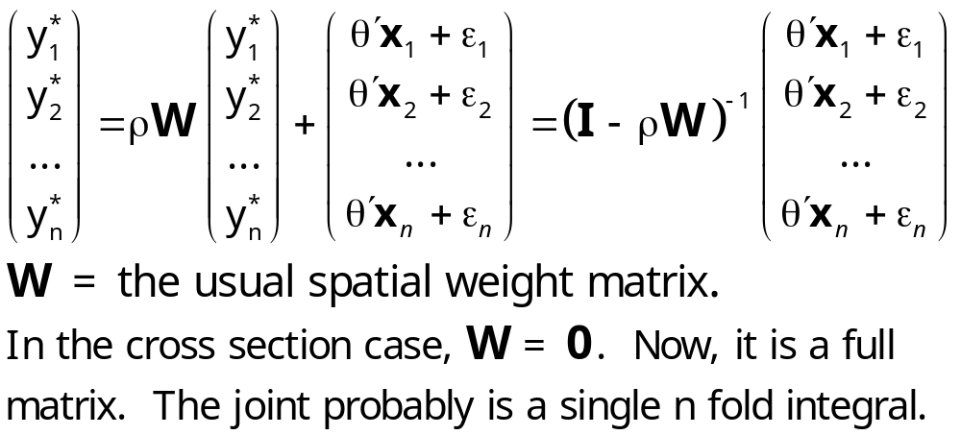
Spatially Correlated Observations
Correlated Utilities

Slide 27
Log Likelihood
❶ In the unrestricted spatial case, the log
likelihood is one term,
❷ LogL = log Prob(y₁|x₁, y₂|x₂, … ,y_{n}|x_{n})
❸ In the discrete choice case, the
probability will be an n fold integral,
usually for a normal distribution.

Slide 28
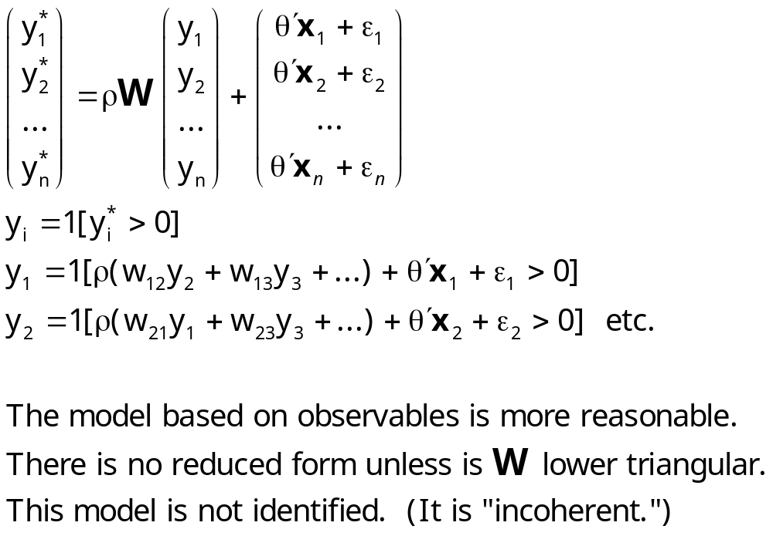
A Theoretical Behavioral Conflict

Slide 29
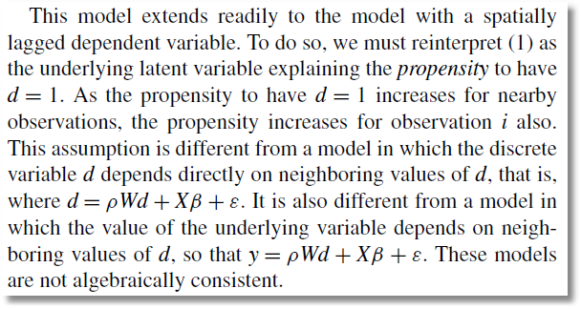
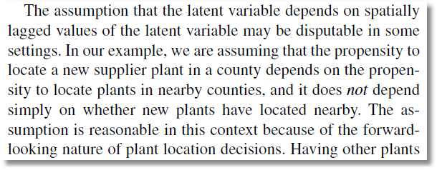
See Maddala (1983)
From Klier and McMillen (2012)

Slide 30
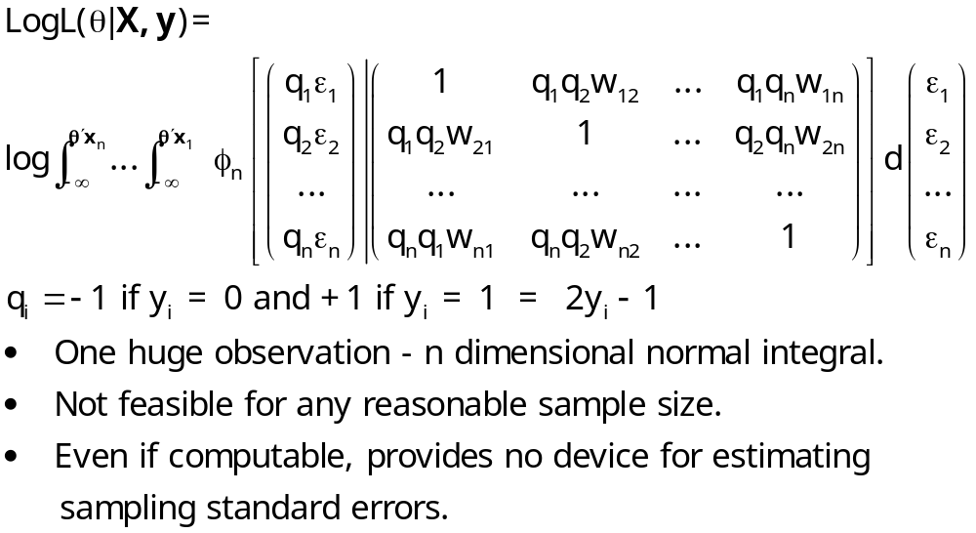
LogL for an Unrestricted BC Model

Slide 31
Solution Approaches for Binary Choice
❶ Distinguish between private and
social shocks and use pseudo-ML
❷ Approximate the joint density and
use GMM with the EM algorithm
❸ Parameterize the spatial correlation
and use copula methods
❹ Define neighborhoods – make W a
sparse matrix and use pseudo-ML
❺ Others …

Slide 32
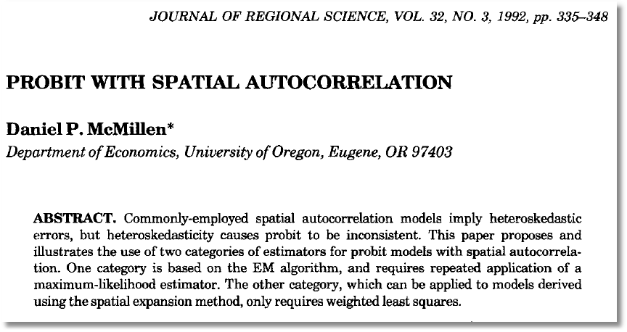

Slide 33
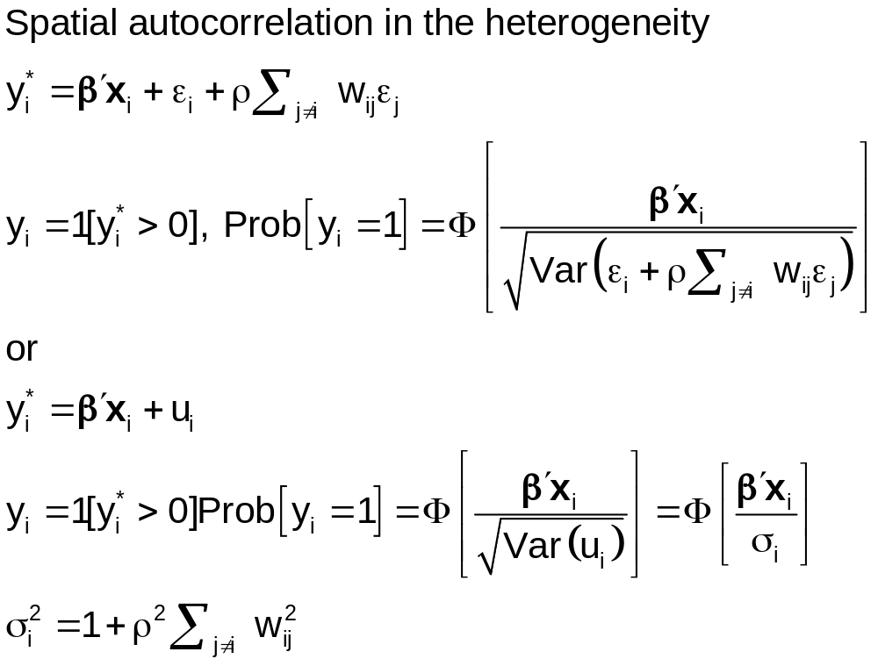

Slide 34
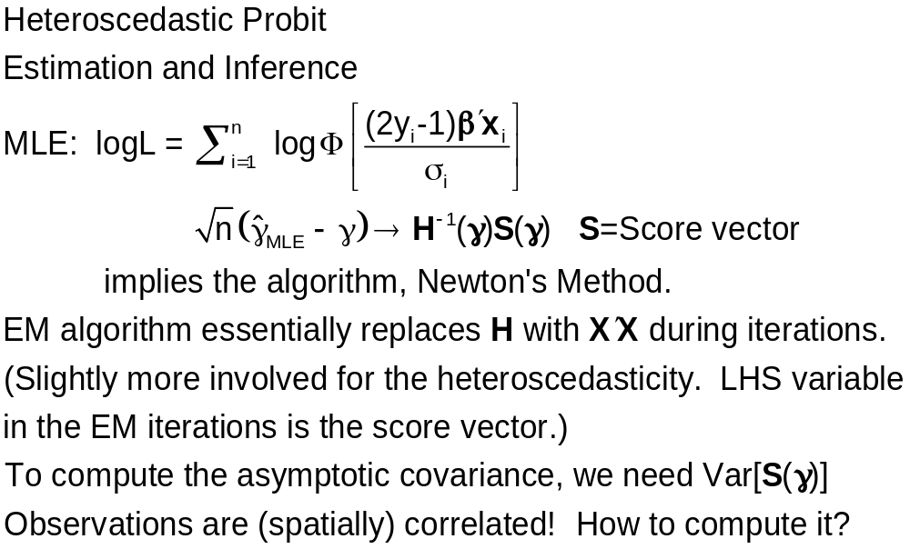

Slide 35
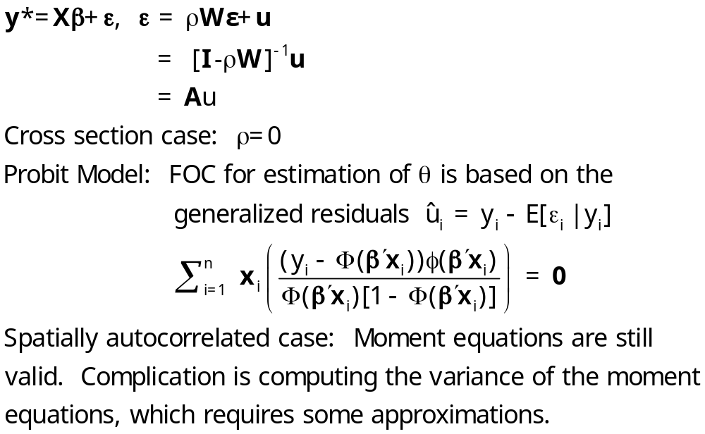
GMM
Pinske, J. and Slade, M., (1998) “Contracting in Space: An Application of Spatial Statistics to Discrete Choice Models,” Journal of Econometrics, 85, 1, 125-154.
Pinkse, J. , Slade, M. and Shen, L (2006) “Dynamic Spatial Discrete Choice Using One Step GMM: An Application to Mine Operating Decisions”, Spatial Economic Analysis, 1: 1, 53 — 99.

Slide 36
GMM Approach
❶ Spatial autocorrelation induces
heteroscedasticity that is a function of 
❷ Moment equations include the
heteroscedasticity and an additional
instrumental variable for identifying .
❸ LM test of = 0 is carried out under the null
hypothesis that = 0.
❹ Application: Contract type in pricing for 118
Vancouver service stations.

Slide 37
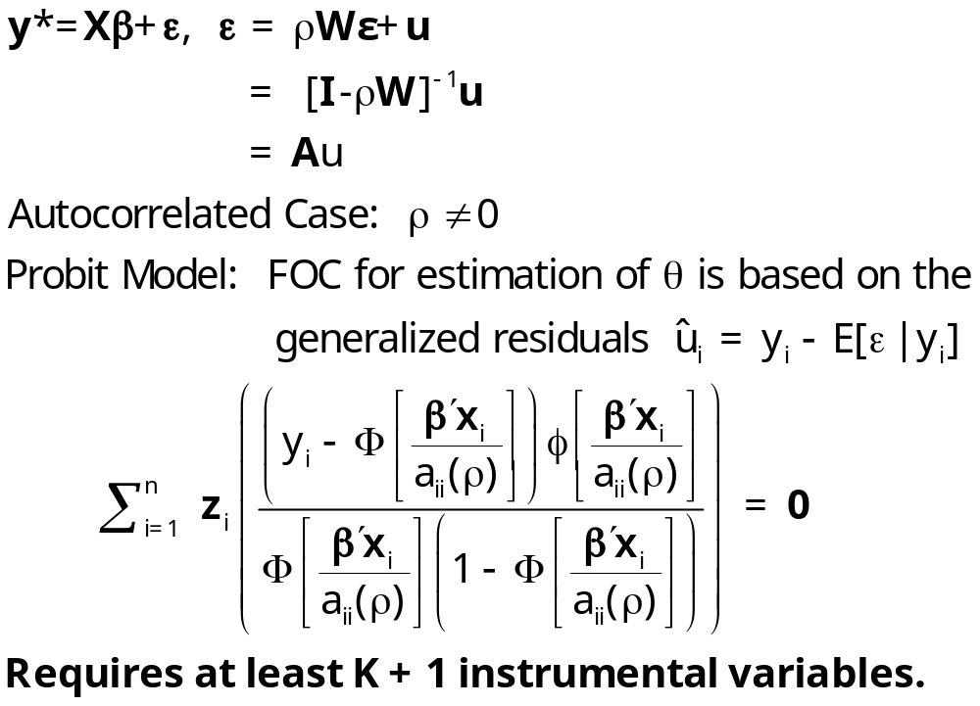
GMM

Slide 38
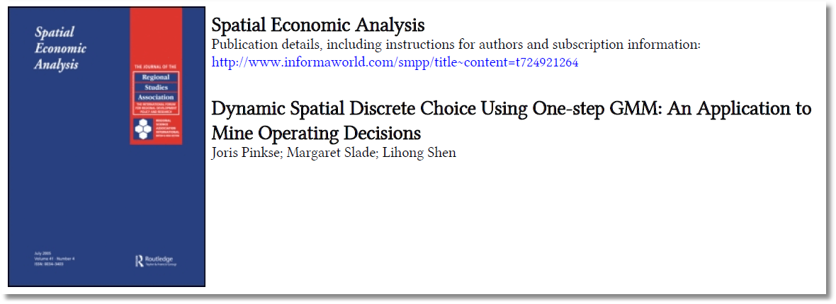
Extension to Dynamic Choice Model
Pinske, Slade, Shen (2006)

Slide 39

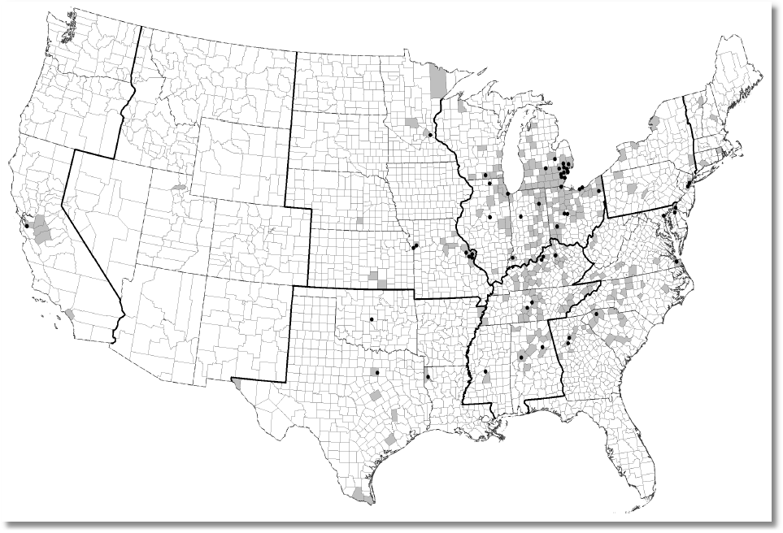

Slide 41
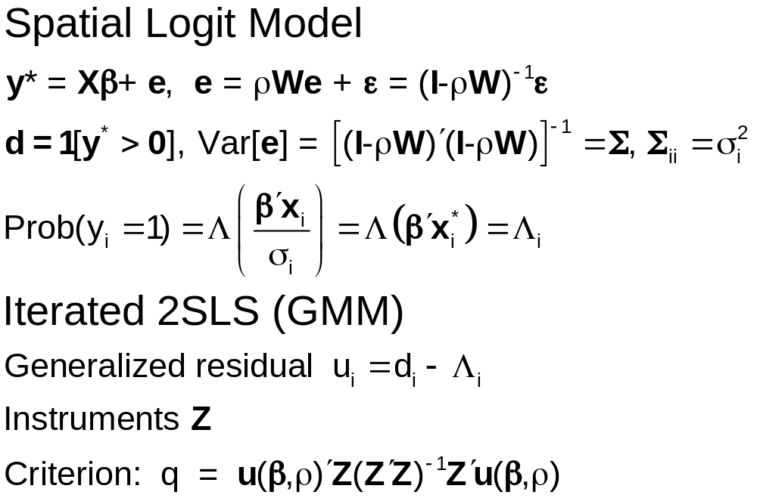

Slide 42
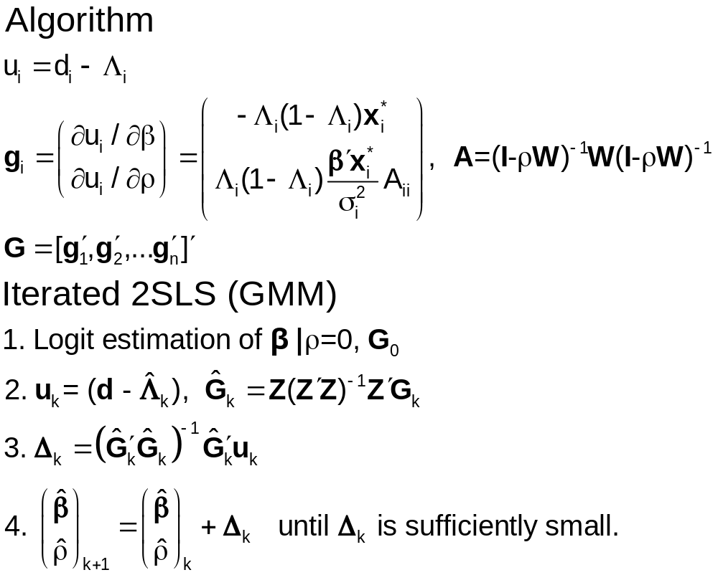

Slide 43
LM Test?
If  = 0, g = 0 because A_{ii} = 0
At the initial logit values, g = 0
Thus, if  = 0, g = 0
How to test  = 0 using an LM style test.
Same problem shows up in RE models
But, here,  is in the interior of the parameter space!

Slide 44
Pseudo Maximum Likelihood
❶ Maximize a likelihood function that
approximates the true one
❷ Produces consistent estimators of
parameters
❸ How to obtain standard errors?
❹ Asymptotic normality? Conditions for
CLT are more difficult to establish.

Slide 45
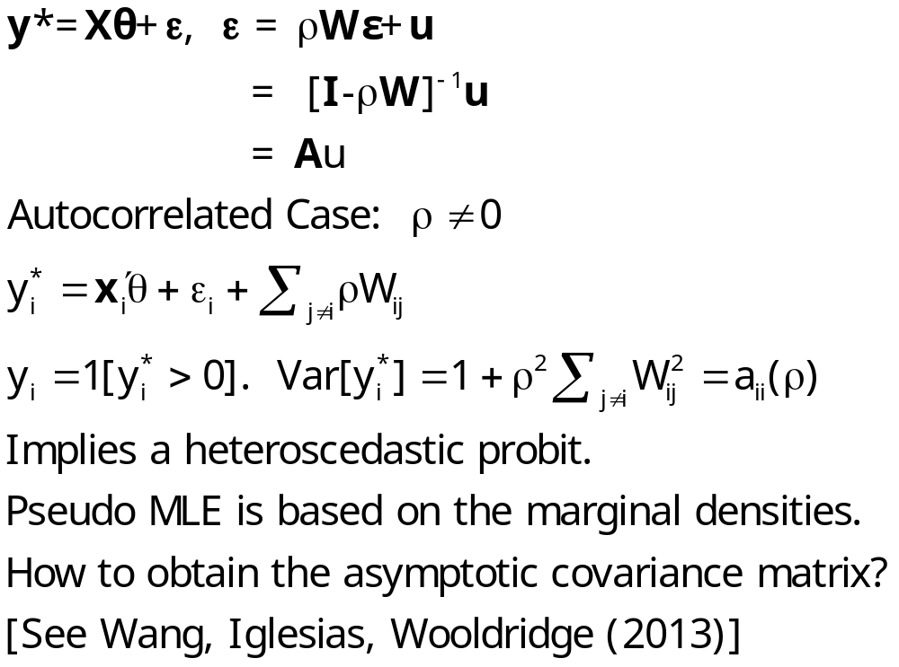
Pseudo MLE

Slide 46
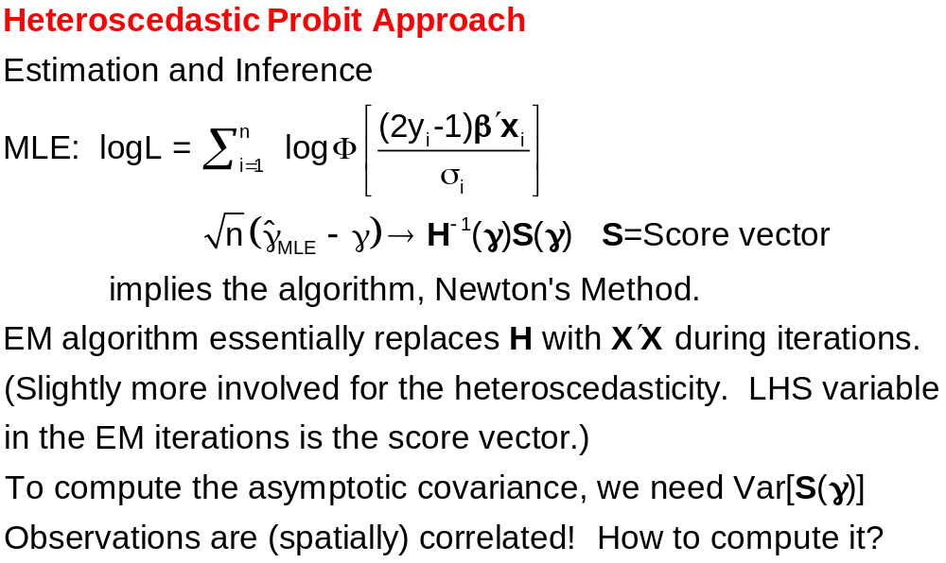

Slide 47
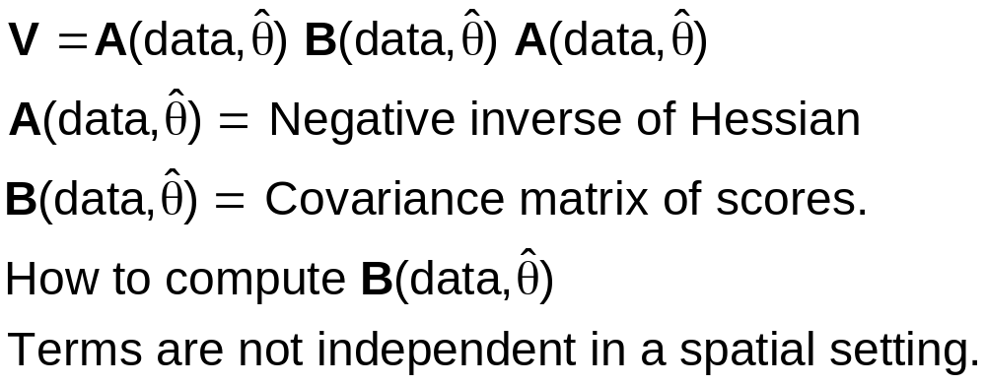
Covariance Matrix for Pseudo MLE

Slide 48
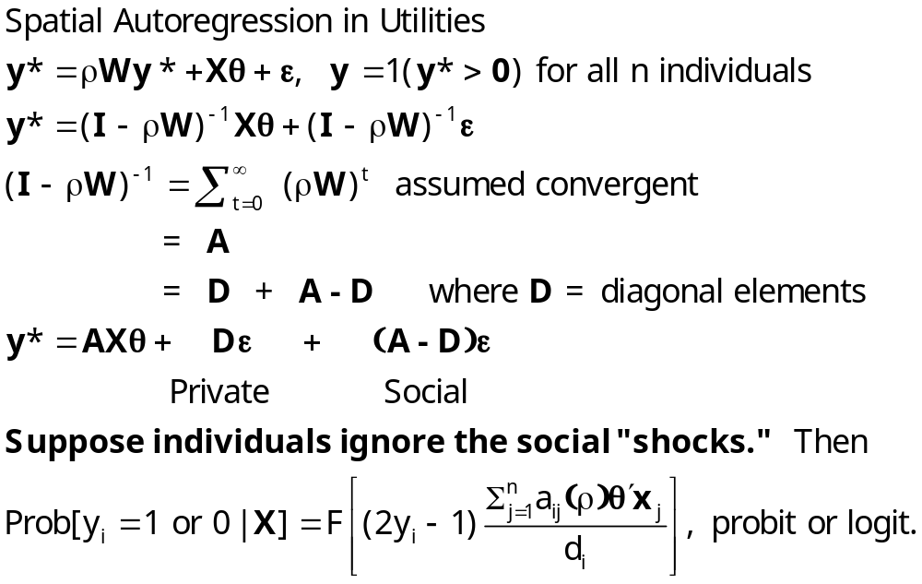
‘Pseudo’ Maximum Likelihood
Smirnov, A., “Modeling Spatial Discrete Choice,” Regional Science and Urban Economics, 40, 2010.

Slide 49
Pseudo Maximum Likelihood
❶ Bases correlation in underlying utilities
❷ Assumes away the correlation in the reduced form
❸ Makes a behavioral assumption
❹ Requires inversion of (I-W)
❺ Computation of (I-W) is part of the optimization
process -  is estimated with  .
❻ Does not require multidimensional integration (for a logit
model, requires no integration)

Slide 50
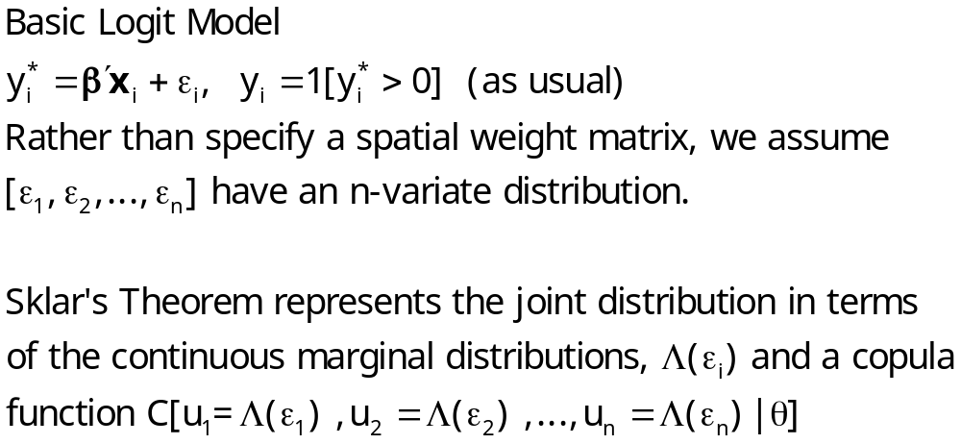
Copula Method and Parameterization
Bhat, C. and Sener, I., (2009) “A copula-based closed-form binary logit choice model
for accommodating spatial correlation across observational units,” Journal of Geographical Systems, 11, 243–272

Slide 51
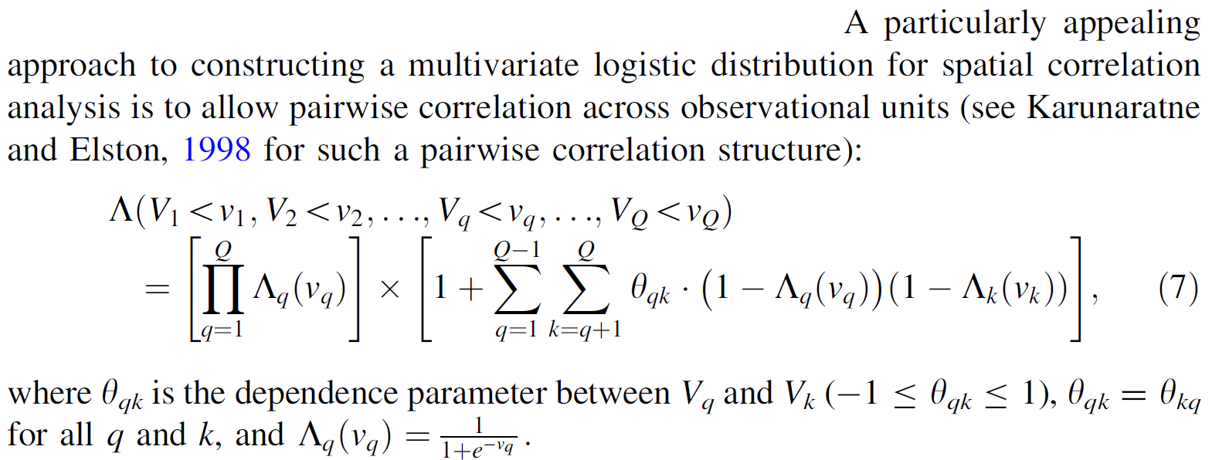
Copula Representation

Slide 52
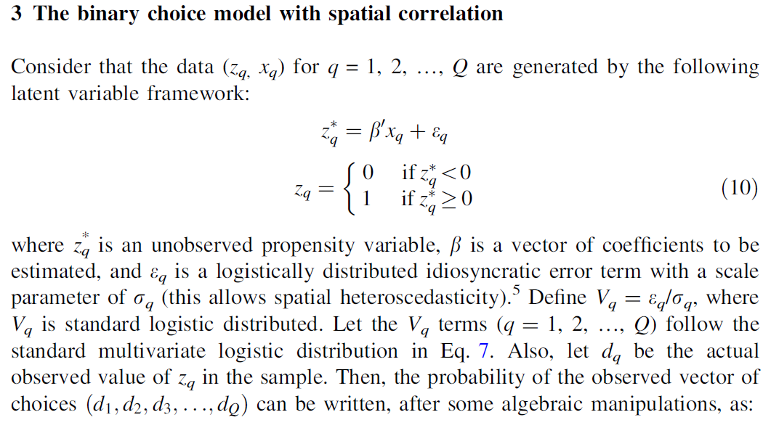
Model

Slide 53
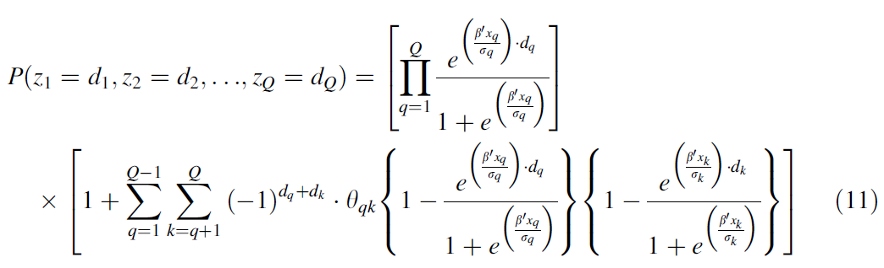
Likelihood

Slide 54
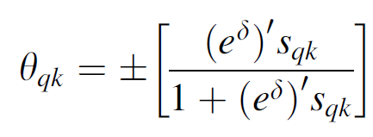
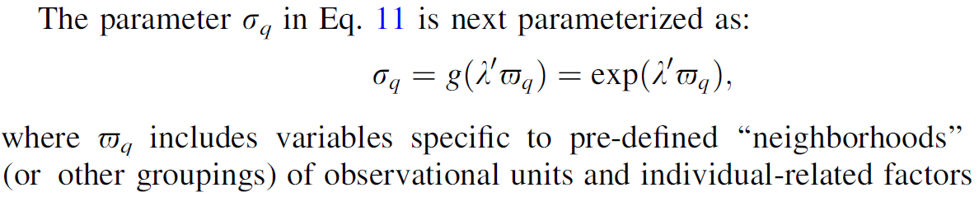
Parameterization

Slide 55
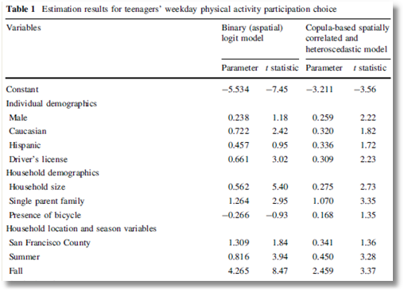

Slide 56
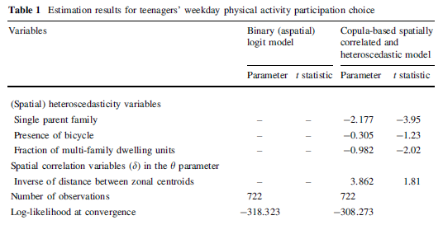

Slide 57
Other Approaches
Case A (1992) Neighborhood influence and technological change. Economics 22:491–508
Beron KJ, Vijverberg WPM (2004) Probit in a spatial context: a monte carlo analysis. In: Anselin L, Florax RJGM, Rey SJ (eds) Advances in spatial econometrics: methodology, tools and applications. Springer, Berlin
❶ Case (1992): Define “regions” or neighborhoods. No
correlation across regions. Produces essentially a
panel data probit model. (Wang et al. (2013))
❷ Beron and Vijverberg (2003): Brute force integration
using GHK simulator in a probit model.
❸ Lesage: Bayesian - MCMC
❹ Others. See Bhat and Sener (2009).

Slide 58


Slide 59
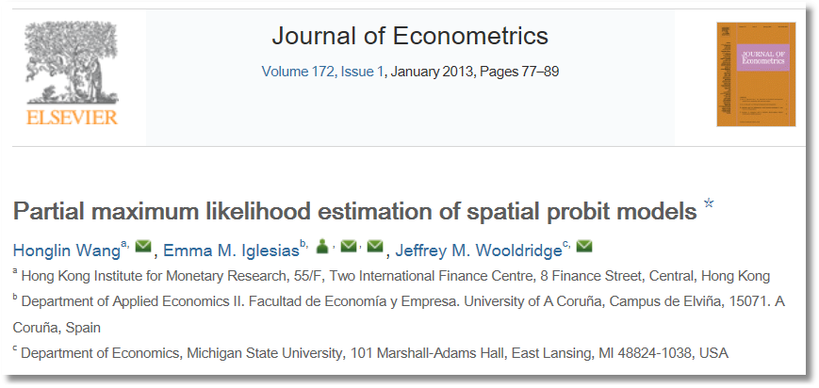
See also Arbia, G., “Pairwise Likelihood Inference for Spatial Regressions Estimated on Very Large Data Sets” Manuscript, Catholic University del Sacro Cuore, Rome, 2012.

Slide 60
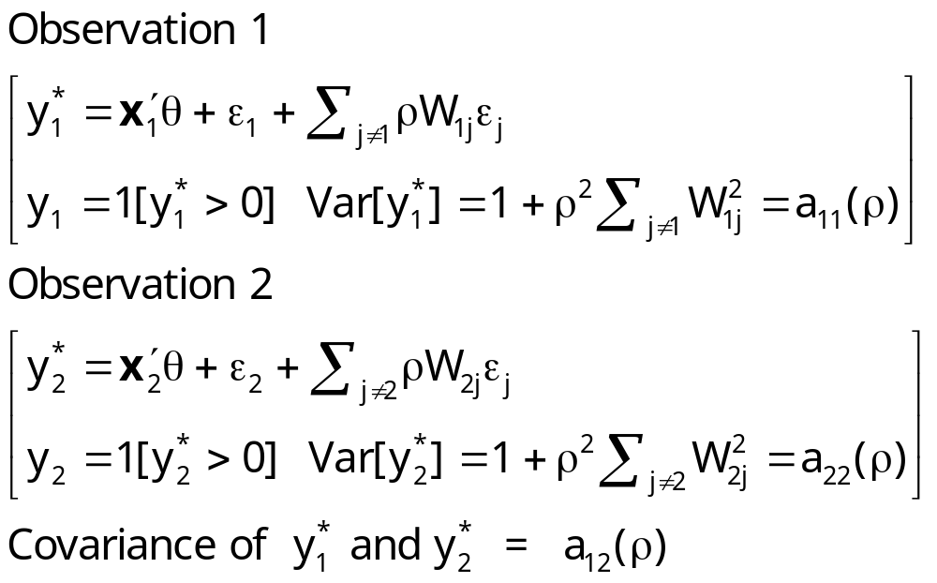
Partial MLE

Slide 61
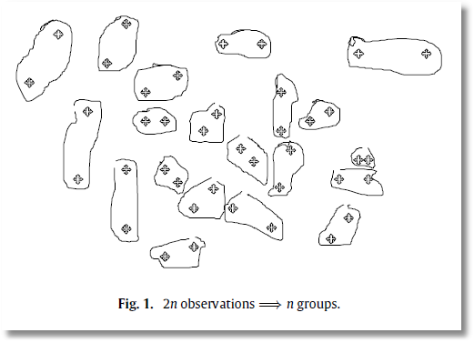
Bivariate Probit
❶ Pseudo MLE
❷ Consistent
❸ Asymptotically normal?
  Resembles time series case
  Correlation need not fade with ‘distance’
❹ Better than Pinske/Slade Univariate Probit?
❺ How to choose the pairings?

Slide 62
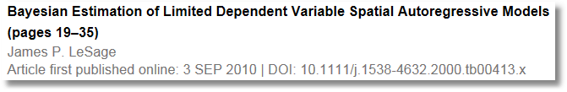


Slide 63
Lesage methods - MCMC
SEM Model…
Bayesian MCMC
Data augmentation for unobserved y
Quirks about sampler for rho.

Slide 64
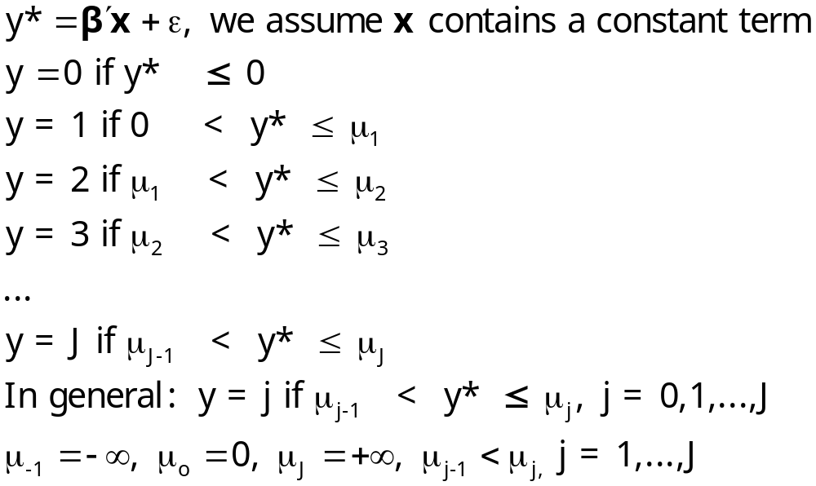

Ordered Probability Model

Slide 65
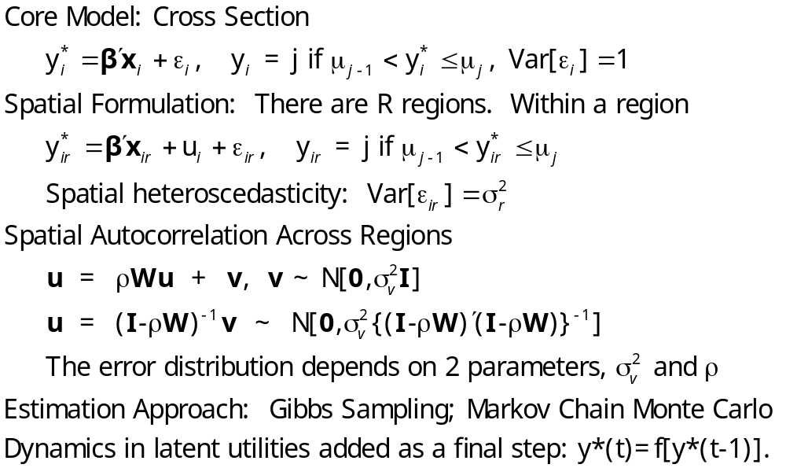
A Spatial Ordered Choice Model
Wang, C. and Kockelman, K., (2009) Bayesian Inference for Ordered Response Data with a Dynamic Spatial Ordered Probit Model, Working Paper, Department of Civil and Environmental Engineering, Bucknell University.

Slide 66
An Ordered Probability Model

Slide 67
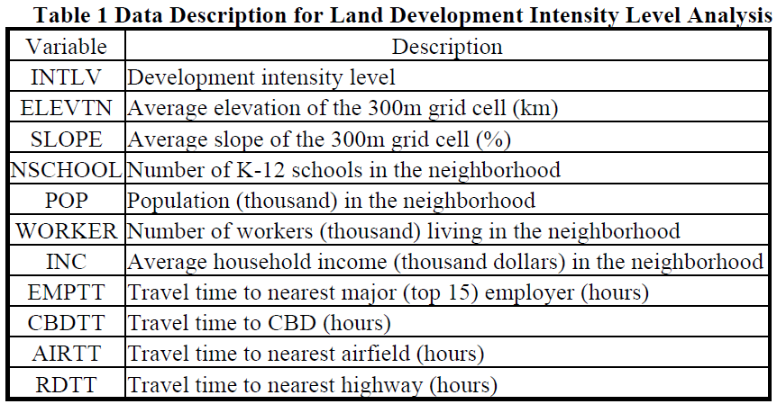
OCM for Land Use Intensity

Slide 68
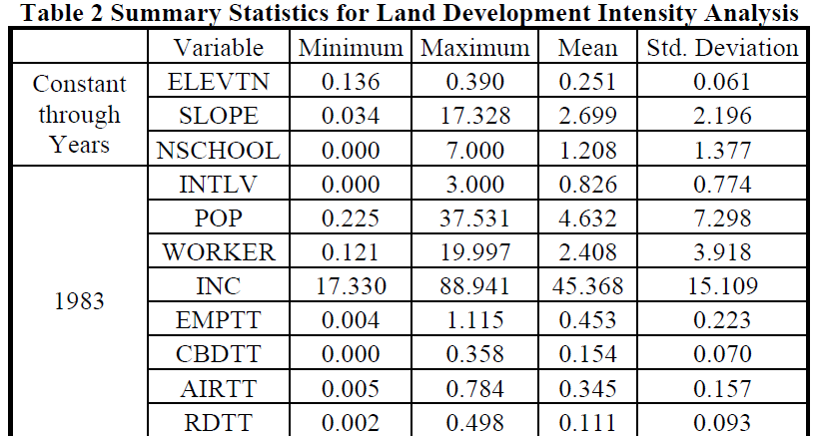
OCM for Land Use Intensity

Slide 69

Estimated Dynamic OCM

Slide 70


Slide 71






Slide 72

Data Augmentation

Slide 73

Unordered Multinomial Choice

Slide 74

Spatial Multinomial Probit
Chakir, R. and Parent, O. (2009) “Determinants of land use changes: A spatial multinomial probit approach, Papers in Regional Science, 88, 2, 328-346.

Slide 75


Slide 76


Slide 77



Slide 78



Random Parameters Models

Slide 79




Slide 80


Canonical Model
Rathbun, S and Fei, L (2006) “A Spatial Zero-Inflated Poisson Regression Model for Oak Regeneration,” Environmental Ecology Statistics, 13, 2006, 409-426

Slide 81


Canonical Model for Counts
Rathbun, S and Fei, L (2006) “A Spatial Zero-Inflated Poisson Regression Model for Oak Regeneration,” Environmental Ecology Statistics, 13, 2006, 409-426

Slide 82
Zero Inflation
❶ There are two states
  Always zero
  Zero is one possible value, or 1,2,…
❷ Prob(0) = Prob(state 1) +
Prob(state 2) P(0|state 2)

Slide 83


A Blend of Ordered Choice and Count Data Models
Numbers of firms locating in Texas counties: Count data (Poisson)
Bicycle and pedestrian injuries in census tracts in Manhattan. (Count data and ordered outcomes)

Slide 84

Kriging

Slide 85


Slide 86


Slide 87
Spatial Autocorrelation in a Sample Selection Model
Flores-Lagunes, A. and Schnier, K., “Sample selection and Spatial Dependence,” Journal of Applied Econometrics, 27, 2, 2012, pp. 173-204.
Alaska Department of Fish and Game.
Pacific cod fishing eastern Bering Sea – grid of locations
Observation = ‘catch per unit effort’ in grid square
Data reported only if 4+ similar vessels fish in the region
1997 sample = 320 observations with 207 reported full data

Slide 88
Spatial Autocorrelation in a Sample Selection Model
Flores-Lagunes, A. and Schnier, K., “Sample selection and Spatial Dependence,” Journal of Applied Econometrics, 27, 2, 2012, pp. 173-204.
LHS is catch per unit effort = CPUE
Site characteristics: MaxDepth, MinDepth, Biomass
Fleet characteristics:
  Catcher vessel (CV = 0/1)
  Hook and line (HAL = 0/1)
  Nonpelagic trawl gear (NPT = 0/1)
  Large (at least 125 feet) (Large = 0/1)

Slide 89

Spatial Autocorrelation in a Sample Selection Model

Slide 90

Spatial Autocorrelation in a Sample Selection Model

Slide 91

Spatial Weights

Slide 92

Two Step Estimation
❶
❷

Slide 93


Slide 94

Spatial Stochastic Frontier

Slide 95



247 Spanish Dairy Farms, 6 Years

Slide 96

A True Random Effects Model
Spatial Stochastic Frontier Models; Accounting for Unobserved Local Determinants of Inefficiency
Schmidt, Moriera, Helfand, Fonseca; Journal of Productivity Analysis, 2009.

Slide 97



Slide 98


Estimation by Maximum Likelihood

Slide 99
LeSage (2000) on Timing
“The Bayesian probit and tobit spatial autoregressive models described here have been applied to samples of 506 and 3,107 observations. The time required to produce estimates was around 350 seconds for the 506 observations sample and 900 seconds for the case infolving 3,107 observations. … (inexpensive Apple G3 computer running at 266 Mhz.)”

Slide 100

Time and Space (In Your Computer)

Slide 101



Slide 102

Thank you

Slide 103
①②③④⑤
❶❷❸❹❺❻

