Slide 1
Discrete Choice Modeling
0 Introduction
1 Summary
2 Binary Choice
3 Panel Data
4 Bivariate Probit
5 Ordered Choice
6 Count Data
7 Multinomial Choice
8 Nested Logit
9 Heterogeneity
10 Latent Class
11 Mixed Logit
12 Stated Preference
13 Hybrid Choice
14. Spatial Data
15. Aggregate Market Data
William Greene
Stern School of Business
New York University

Slide 2
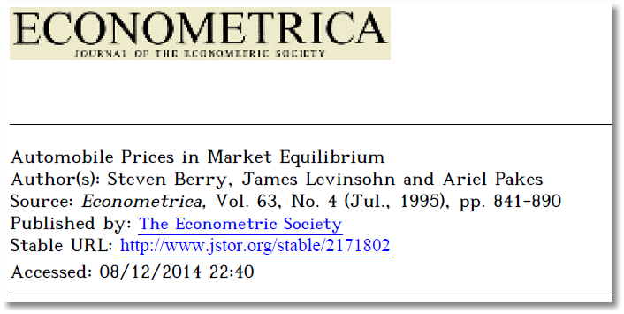
Aggregate Data and Multinomial Choice:
The Model of Berry, Levinsohn and Pakes

Slide 3
Resources
Automobile Prices in Market Equilibrium, S. Berry, J. Levinsohn, A. Pakes, Econometrica, 63, 4, 1995, 841-890. (BLP)
  http://people.stern.nyu.edu/wgreene/Econometrics/BLP.pdf
A Practitioner’s Guide to Estimation of Random-Coefficients Logit Models of Demand, A. Nevo, Journal of Economics and Management Strategy, 9, 4, 2000, 513-548
  http://people.stern.nyu.edu/wgreene/Econometrics/Nevo-BLP.pdf
A New Computational Algorithm for Random Coefficients Model with Aggregate-level Data, Jinyoung Lee, UCLA Economics, Dissertation, 2011
  http://people.stern.nyu.edu/wgreene/Econometrics/Lee-BLP.pdf

Slide 4
Theoretical Foundation
Consumer market for J differentiated brands of a good
  j =1,…, J_{t} brands or types
  i = 1,…, N consumers
  t = i,…,T “markets” (like panel data)
Consumer i’s utility for brand j (in market t) depends on
  p = price
  x = observable attributes
  f = unobserved attributes
  w = unobserved heterogeneity across consumers
  ε = idiosyncratic aspects of consumer preferences
Observed data consist of aggregate choices, prices and features of the brands.

Slide 5
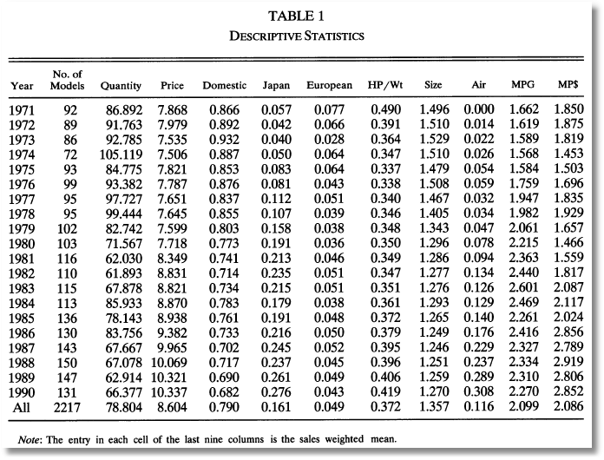
BLP Automobile Market
J_{t}
t

Slide 6

Random Utility Model
Utility: U_{ijt}=U(w_{i},p_{jt},x_{jt},f_{jt}|θ), i = 1,…,(large)N, j=1,…,J
  w_{i} = individual heterogeneity; time (market) invariant. w has a continuous distribution across the population.
  p_{jt}, x_{jt}, f_{jt}, = price, observed attributes, unobserved features of brand j; all may vary through time (across markets)
Revealed Preference: Choice j provides maximum utility
Across the population, given market t, set of prices p_{t} and features (X_{t},f_{t}), there is a set of values of w_{i} that induces choice j, for each j=1,…,J_{t}; then, s_{j}(p_{t},X_{t},f_{t}|θ) is the market share of brand j in market t.
There is an outside good that attracts a nonnegligible market share, j=0. Therefore,

Slide 7
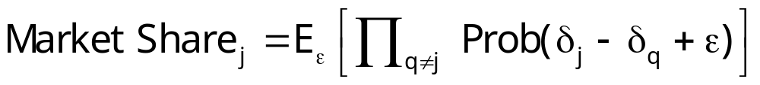
Functional Form
(Assume one market for now so drop “’t.”)
U_{ij}=U(w_{i},p_{j},x_{j},f_{j}|θ)= x_{j}'β – αp_{j} + f_{j} + ε_{ij}
= δ_{j} + ε_{ij}
E_{consumers i}[ε_{ij}] = 0, δ_{j} is E[Utility].
Will assume logit form to make integration unnecessary. The expectation has a closed form.

Slide 8
Heterogeneity
Assumptions so far imply IIA. Cross price elasticities depend only on market shares.
Individual heterogeneity: Random parameters
U_{ij}=U(w_{i},p_{j},x_{j},f_{j}|θ_{i})= x_{j}'β_{i} – αp_{j} + f_{j} + ε_{ij}
β_{ik} = β_{k} + σ_{k}v_{ik}.
The mixed model only imposes IIA for a particular consumer, but not for the market as a whole.

Slide 9
Endogenous Prices: Demand side
U_{ij}=U(w_{i},p_{j},x_{j},f_{j}|θ)= x_{j}'β_{i} – αp_{j} + f_{j} + ε_{ij}
f_{j} is unobserved
Utility responds to the unobserved f_{j}
Price p_{j} is partly determined by features f_{j}.
In a choice model based on observables, price is correlated with the unobservables that determine the observed choices.

Slide 10
Endogenous Price: Supply Side
There are a small number of competitors in this market
Price is determined by firms that maximize profits given the features of its products and its competitors.
mc_{j} = g(observed cost characteristics c,
unobserved cost characteristics h)
At equilibrium, for a profit maximizing firm that produces one product,
s_{j} + (p_{j}-mc_{j})∂s_{j}/∂p_{j} = 0
Market share depends on unobserved cost characteristics as well as unobserved demand characteristics, and price is correlated with both.

Slide 11
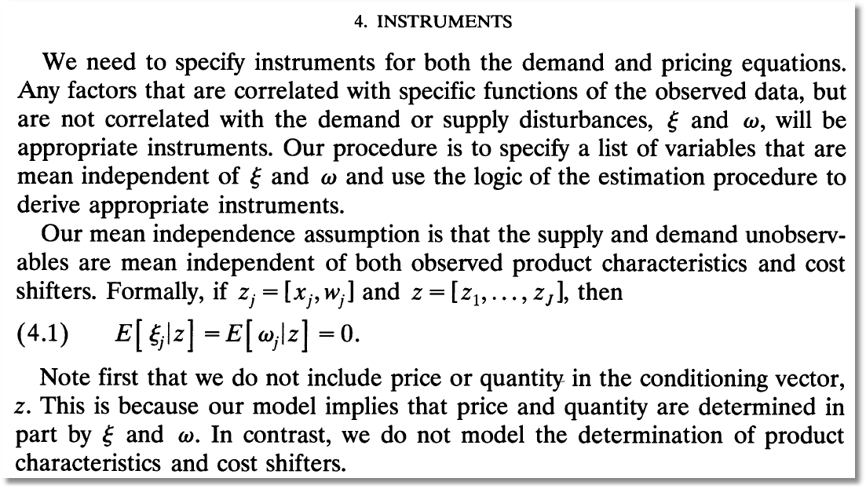
Instrumental Variables
(ξ and ω are our h and f.)

Slide 12
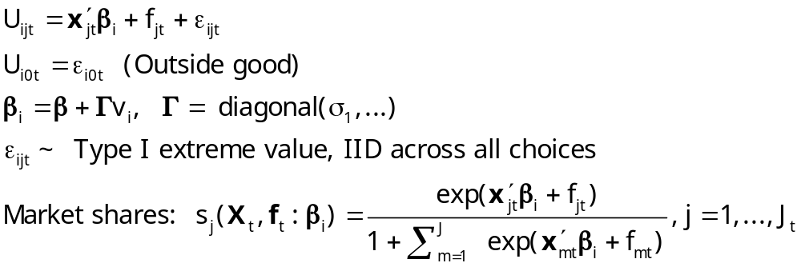
Econometrics: Essential Components

Slide 13
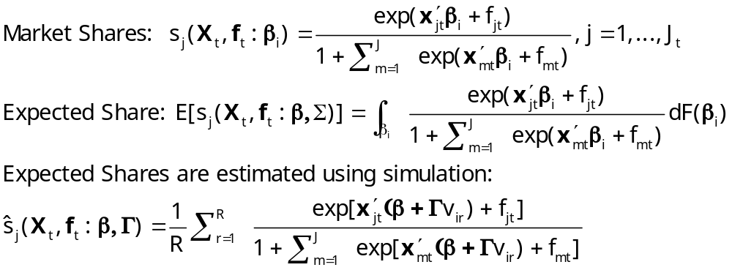
Econometrics

Slide 14
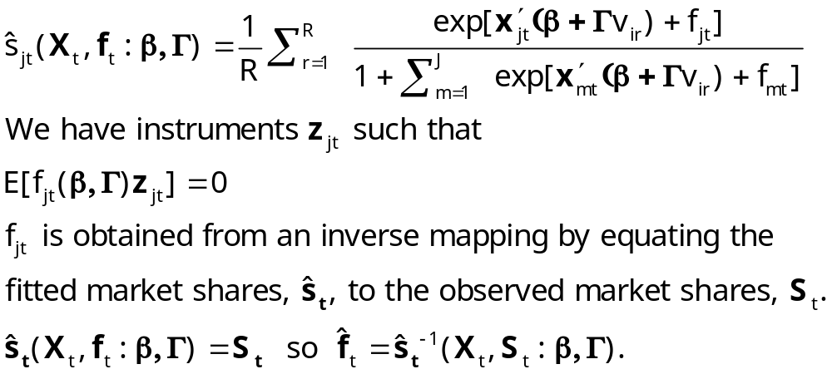
GMM Estimation Strategy - 1

Slide 15
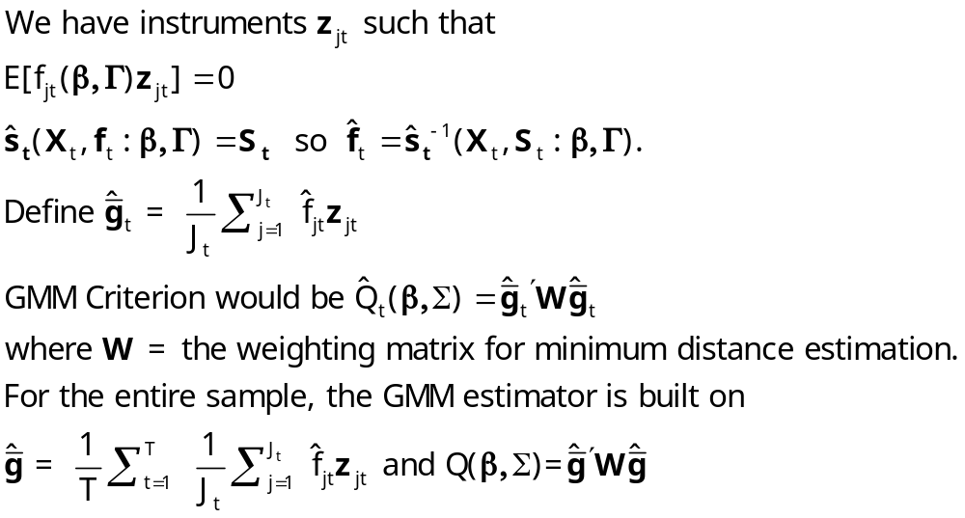
GMM Estimation Strategy - 2

Slide 16
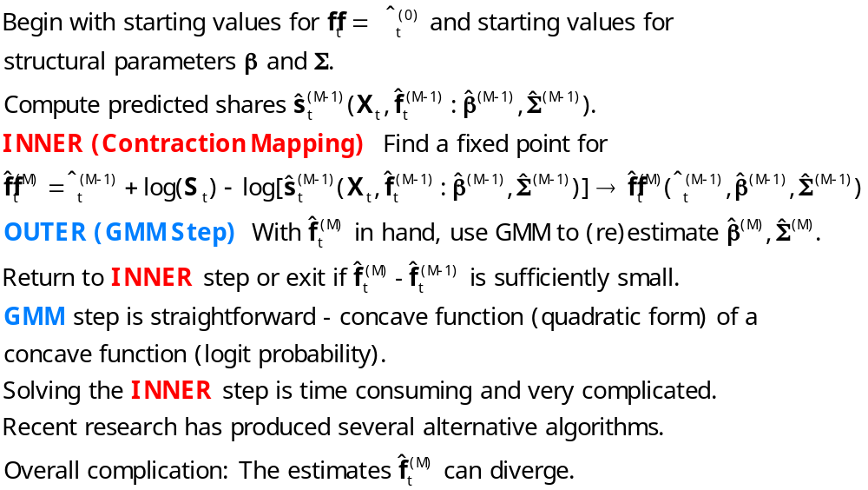
BLP Iteration

Slide 17

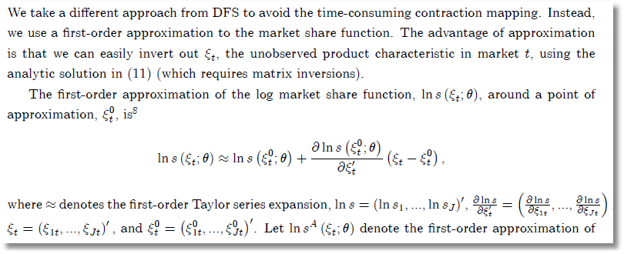
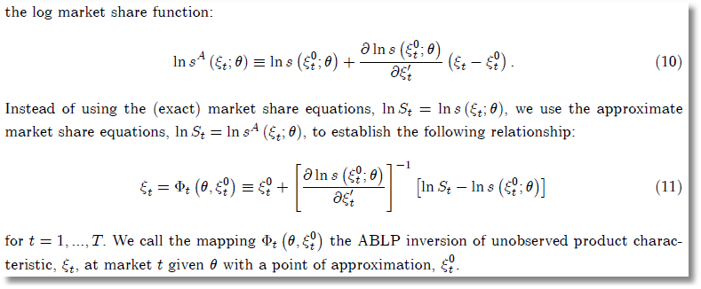
ABLP Iteration
ξ_{t} is
our f_{t}.
θ is our
(β,Σ)
No superscript is our (M); superscript 0 is our (M-1).

Slide 18
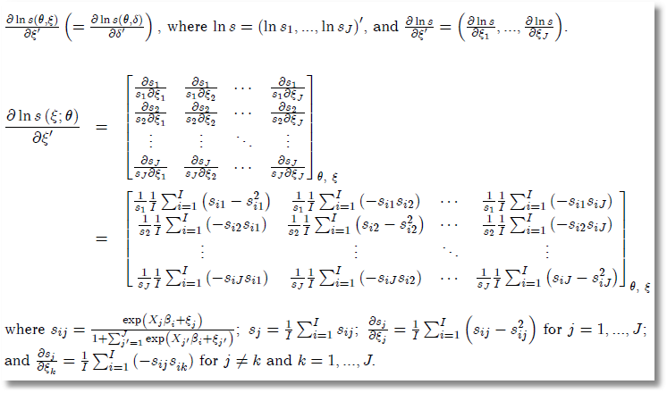
Side Results

Slide 19
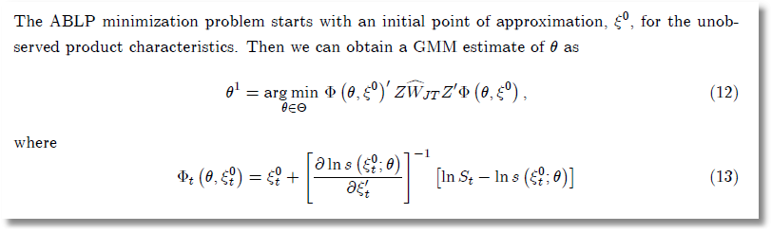
ABLP Iterative Estimator

Slide 20
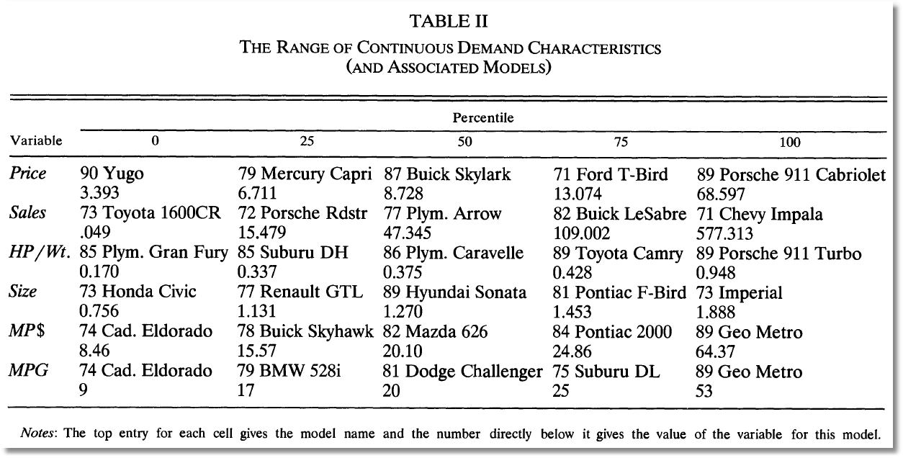
BLP Design Data

Slide 21
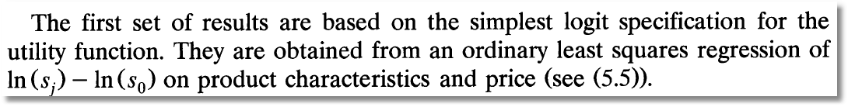
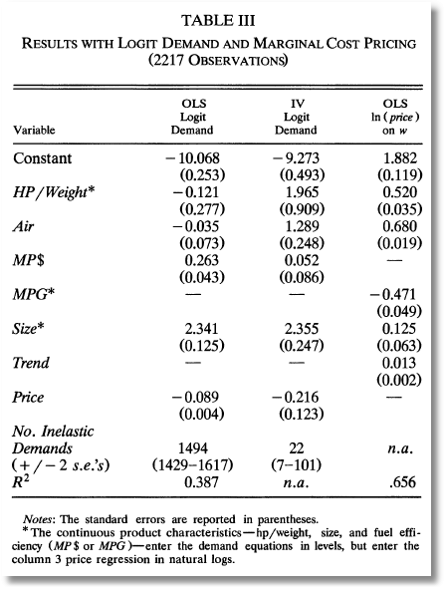
Exogenous price and nonrandom parameters

Slide 22
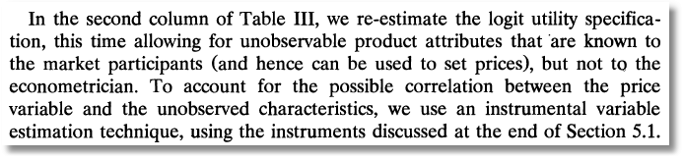
IV Estimation

Slide 23
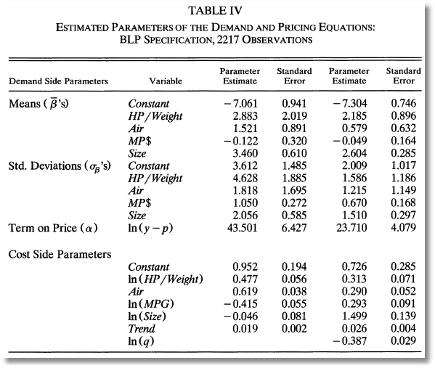
Full Model

Slide 24
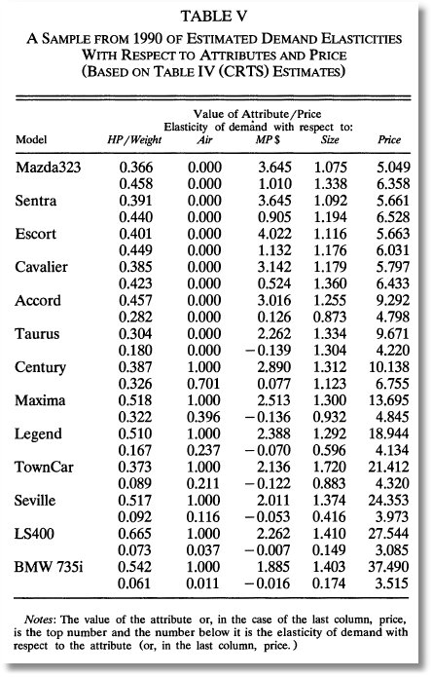
Some Elasticities

