Slide 1
Discrete Choice Modeling
0 Introduction
1 Summary
2 Binary Choice
3 Panel Data
4 Bivariate Probit
5 Ordered Choice
6 Count Data
7 Multinomial Choice
8 Nested Logit
9 Heterogeneity
10 Latent Class
11 Mixed Logit
12 Stated Preference
13 Hybrid Choice
William Greene
Stern School of Business
New York University

Slide 2
A Random Utility Approach
Underlying Preference Scale, U*(choices)
Revelation of Preferences:
  U*(choices) < 0 Choice “0”
  U*(choices) > 0 Choice “1”

Slide 3

Binary Outcome: Visit Doctor

Slide 4
A Model for Binary Choice
Yes or No decision (Buy/NotBuy, Do/NotDo)
Example, choose to visit physician or not
Model: Net utility of visit at least once
U_{visit} = α+β₁Age + β₂Income + γSex + ε
Choose to visit if net utility is positive
Net utility = U_{visit} – U_{not visit}
Data: X = [1,age,income,sex]
y = 1 if choose visit, ⬄ U_{visit} > 0, 0 if not.
Random Utility

Slide 5
Choosing Between the Two Alternatives
Modeling the Binary Choice
Net Utility = U_{visit} – U_{not} _{visit}
Normalize U_{not} _{visit} = 0
Net U_{visit} = α + β₁ Age + β₂ Income + β₃ Sex + ε
Chooses to visit: U_{visit} > 0
α + β₁ Age + β₂ Income + β₃ Sex + ε > 0
ε > -[α + β₁ Age + β₂ Income + β₃ Sex ]

Slide 6
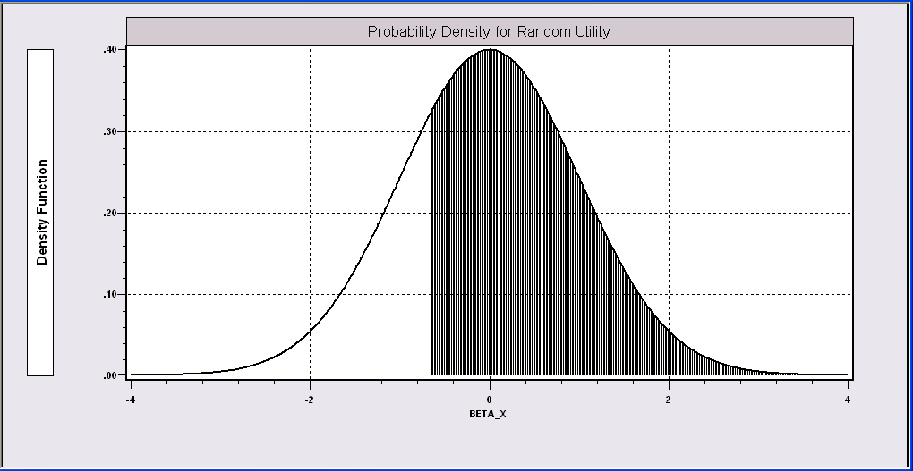
Probability Model for Choice Between Two Alternatives
Probability is governed by ε, the random part of the utility function.
ε > -[α + β₁Age + β₂Income + β₃Sex ]

Slide 7
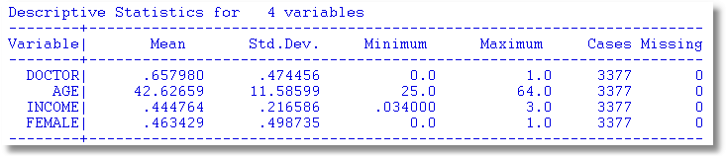
Application
27,326 Observations
  1 to 7 years, panel
  7,293 households observed
  We use the 1994 year, 3,337 household observations

Slide 8
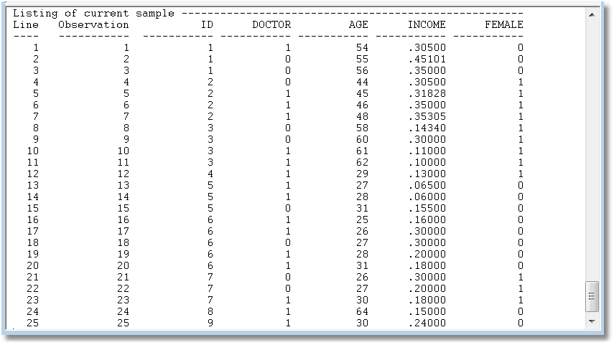
Binary Choice Data

Slide 9
An Econometric Model
Choose to visit iff Uvisit > 0
  Uvisit = α + β₁ Age + β₂ Income + β₃ Sex + ε
  Uvisit > 0 ⇔ ε > -(α + β₁ Age + β₂ Income + β₃ Sex)
  ε < α + β₁ Age + β₂ Income + β₃ Sex
Probability model: For any person observed by the analyst,
Prob(visit) = Prob[ε < α + β₁ Age + β₂ Income + β₃ Sex]
Note the relationship between the unobserved ε and the outcome

Slide 10
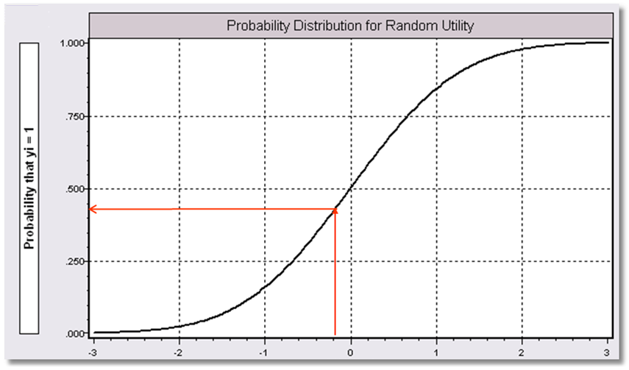
α+β₁Age + β₂ Income + β3 Sex

Slide 11
Modeling Approaches
Nonparametric – “relationship”
  Minimal Assumptions
  Minimal Conclusions
Semiparametric – “index function”
  Stronger assumptions
  Robust to model misspecification (heteroscedasticity)
  Still weak conclusions
Parametric – “Probability function and index”
  Strongest assumptions – complete specification
  Strongest conclusions
  Possibly less robust. (Not necessarily)
The linear probability “model”

Slide 12
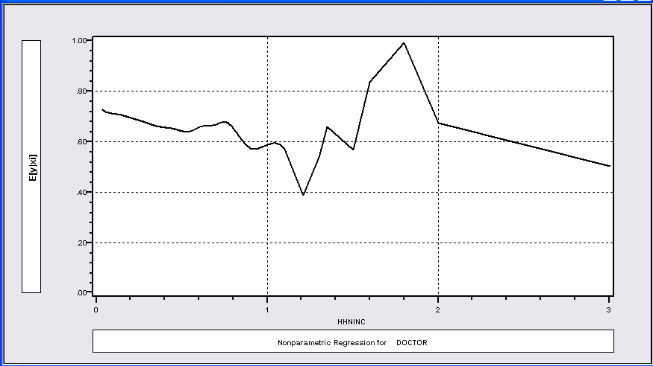
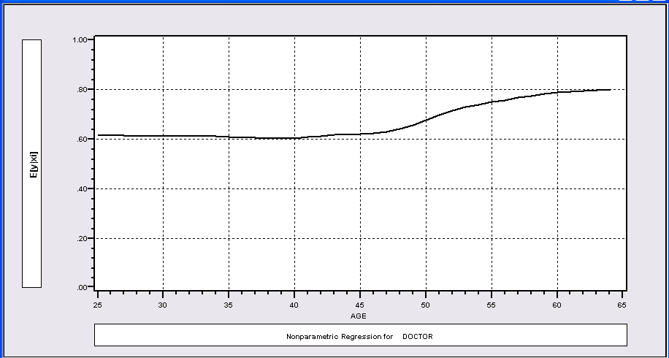
Nonparametric Regressions
P(Visit)=f(Age)
P(Visit)=f(Income)

Slide 13
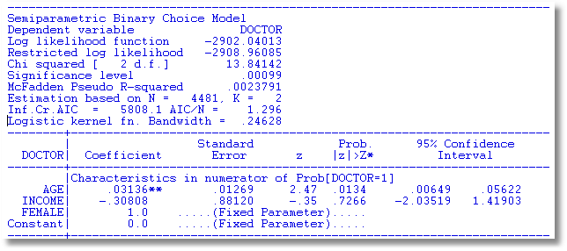
Klein and Spady Semiparametric
No specific distribution assumed
Note necessary normalizations. Coefficients are relative to FEMALE.
Prob(y_{i} = 1 | x_{i} ) =G(β’x) G is estimated by kernel methods

Slide 14
Fully Parametric
Index Function: U* = β’x + ε
Observation Mechanism: y = 1[U* > 0]
Distribution: ε ~ f(ε); Normal, Logistic, …
Maximum Likelihood Estimation:
Max(β) logL = Σ_{i} log Prob(Y_{i} = y_{i}|x_{i})

Slide 15
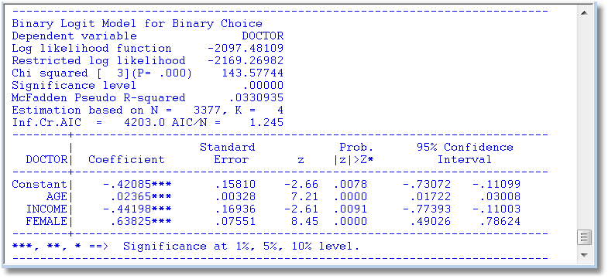
Parametric: Logit Model
What do these mean?

Slide 16
Parametric Model Estimation
How to estimate α, β₁, β₂, β₃?
  The technique of maximum likelihood
  Prob[y=1] =
  Prob[ε > -(α + β₁ Age + β₂ Income + β₃ Sex)]
  Prob[y=0] = 1 - Prob[y=1]
Requires a model for the probability

Slide 17
Completing the Model: F(ε)
The distribution
  Normal: PROBIT, natural for behavior
  Logistic: LOGIT, allows “thicker tails”
  Gompertz: EXTREME VALUE, asymmetric
  Others…
Does it matter?
  Yes, large difference in estimates
  Not much, quantities of interest are more stable.

Slide 18
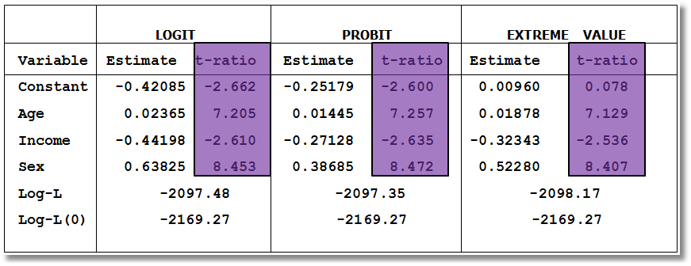
Estimated Binary Choice Models
Log-L(0) = log likelihood for a model that has only a constant term.
Ignore the t ratios for now.

Slide 19
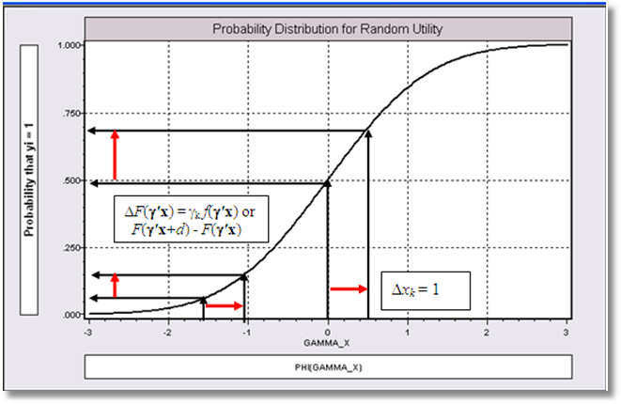
Effect on Predicted Probability of an Increase in Age
α + β₁ (Age+1) + β₂ (Income) + β₃ Sex
(β₁ is positive)

Slide 20
Partial Effects in Probability Models
Prob[Outcome] = some F(α+β₁Income…)
“Partial effect” = ∂F(α+β₁Income…) / ∂”x” (derivative)
  Partial effects are derivatives
  Result varies with model
    Logit: ∂F(α+β₁Income…) /∂x = Prob * (1-Prob) × β
    Probit: ∂ F(α+β₁Income…)/∂x = Normal density × β
    Extreme Value: ∂ F(α+β₁Income…)/∂x = Prob * (-log Prob) × β
  Scaling usually erases model differences

Slide 21
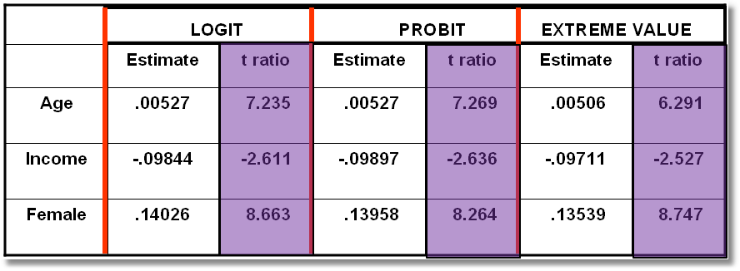
Estimated Partial Effects

Slide 22
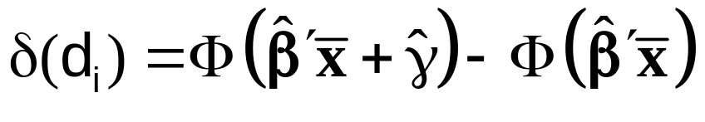
Partial Effect for a Dummy Variable
Prob[y_{i} = 1|x_{i},d_{i}] = F(β’x_{i}+γd_{i})
= conditional mean
Partial effect of d
Prob[y_{i} = 1|x_{i}, d_{i}=1] - Prob[y_{i} = 1|x_{i}, d_{i}=0]
Probit:

Slide 23
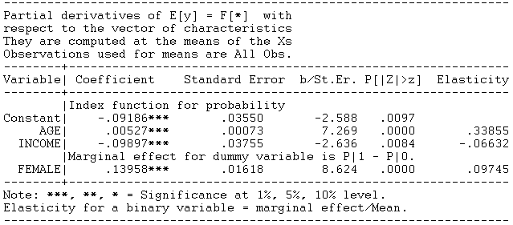
Partial Effect – Dummy Variable

Slide 24
Computing Partial Effects
Compute at the data means?
  Simple
  Inference is well defined.
Average the individual effects
  More appropriate?
  Asymptotic standard errors are complicated.

Slide 25
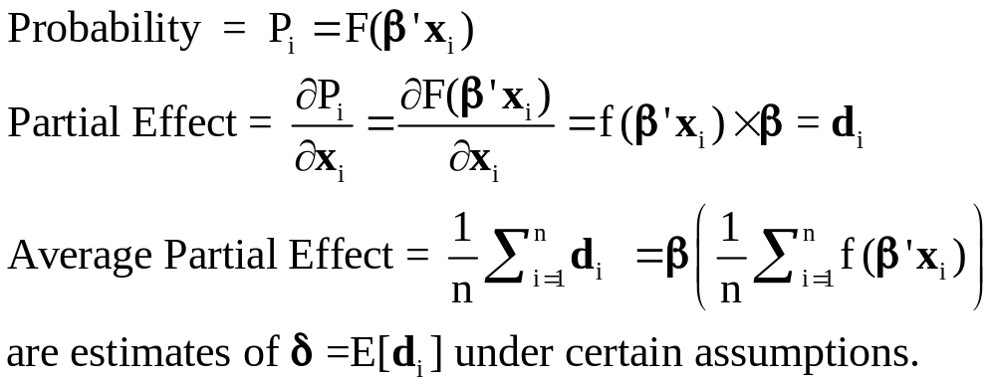
Average Partial Effects

Slide 26
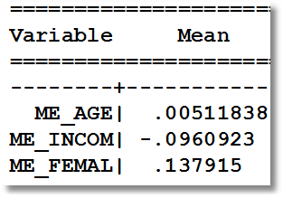
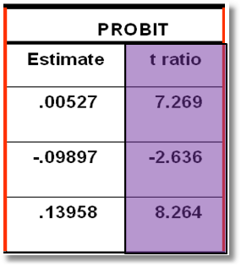
Average Partial Effects vs. Partial Effects at Data Means

Slide 27
Practicalities of Nonlinearities
The software does not know that agesq = age².
PROBIT ; Lhs=doctor
; Rhs=one,age,agesq,income,female
; Partial effects $
PROBIT ; Lhs=doctor
; Rhs=one,age,age*age,income,female $
PARTIALS ; Effects : age $
The software knows that age * age is age².

Slide 28
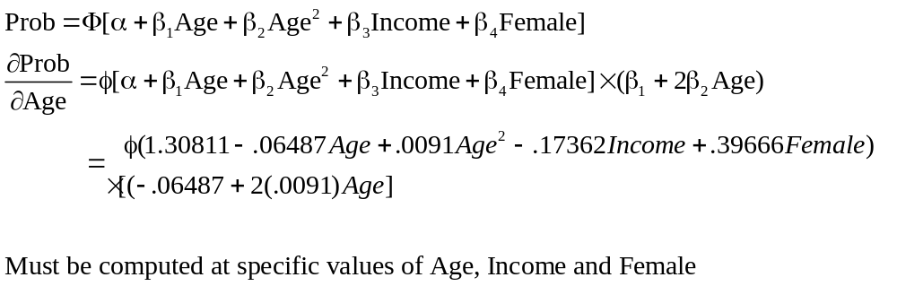
Partial Effect for Nonlinear Terms

Slide 29
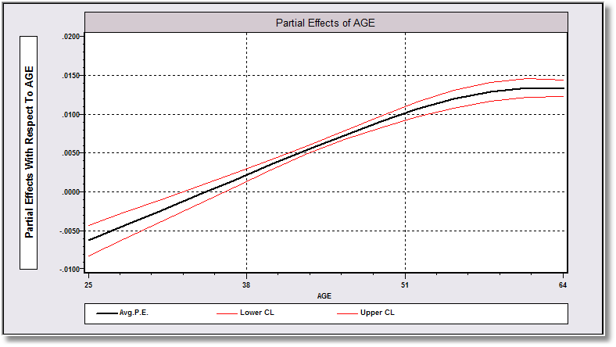
Average Partial Effect: Averaged over Sample Incomes and Genders for Specific Values of Age

Slide 30
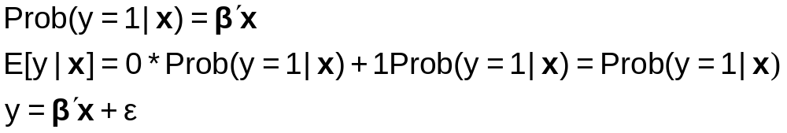

The Linear Probability “Model”

Slide 31
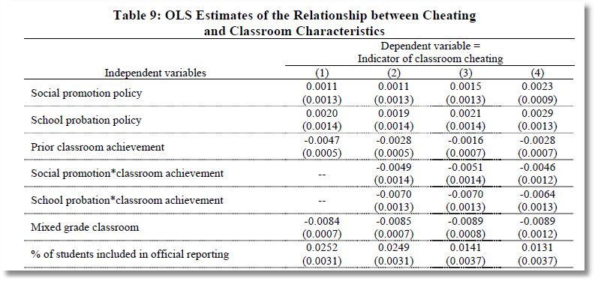
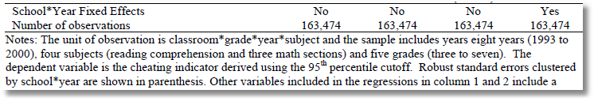
The Dependent Variable equals zero for 98.9% of the observations. In the sample of 163,474 observations, the LHS variable equals 1 about 1,500 times.

Slide 32
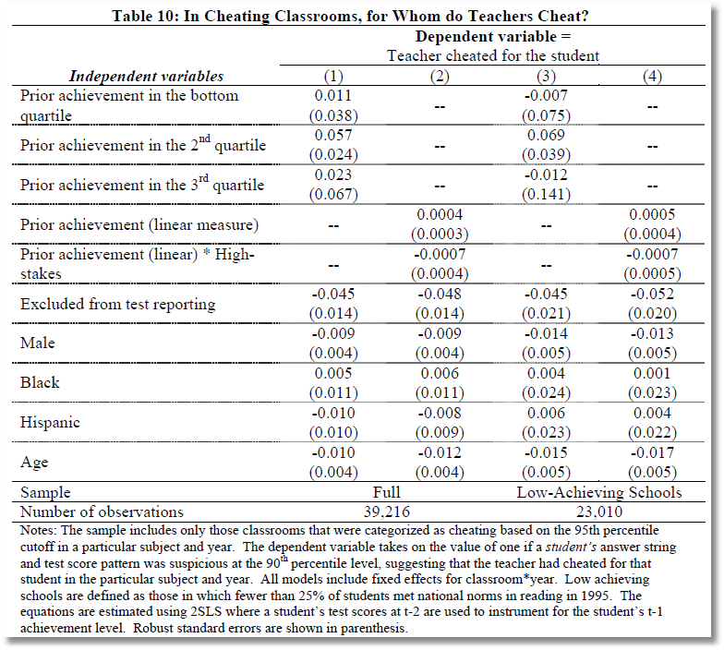
2SLS for a binary dependent variable.

Slide 33
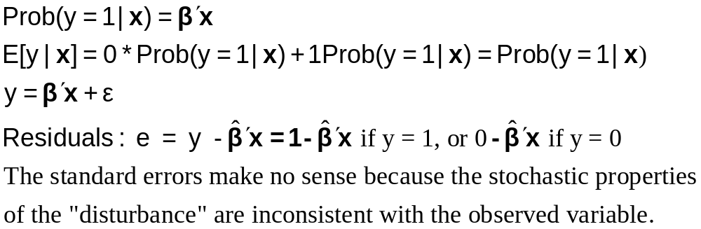
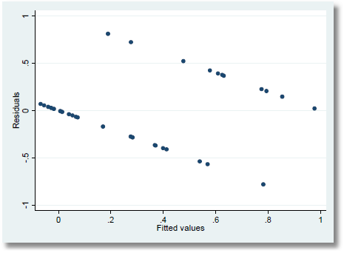

Slide 34
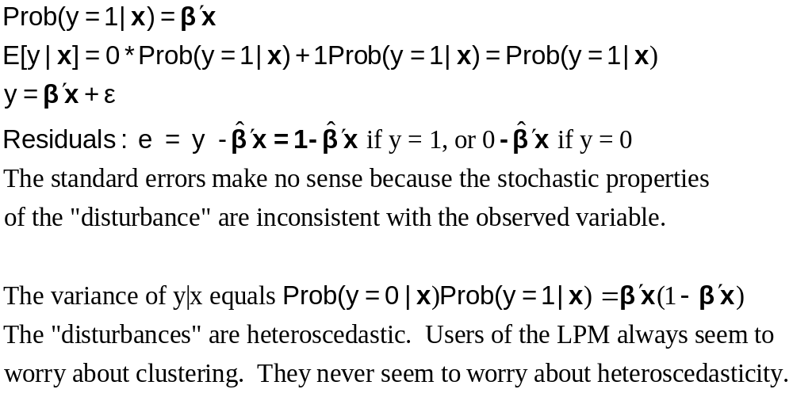

Slide 35
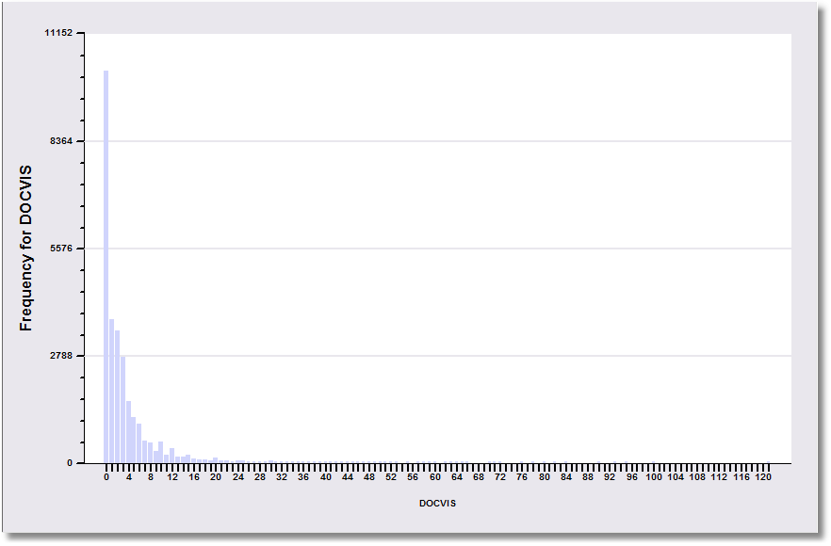
1.7% of the observations are > 20
DV = 1(DocVis > 20)

Slide 36
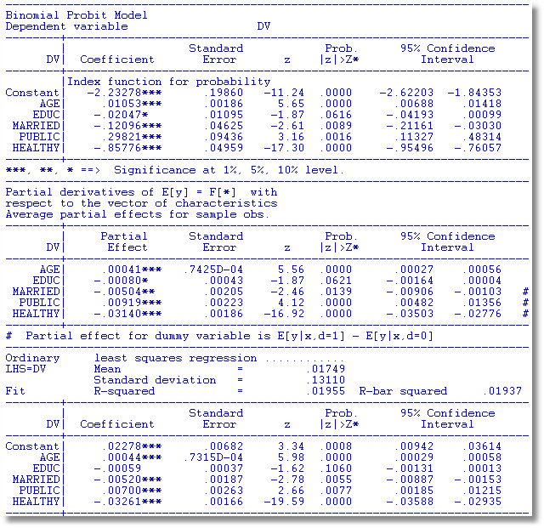
What does OLS Estimate?
MLE
Average Partial Effects
OLS Coefficients

Slide 37
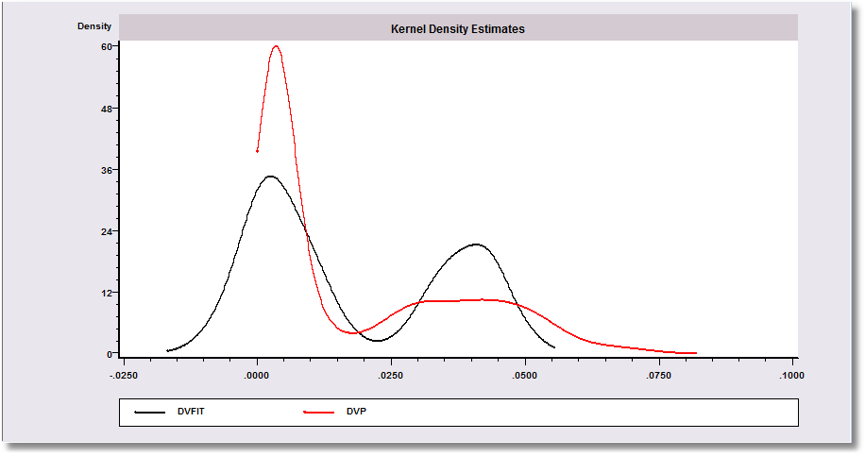

Slide 38
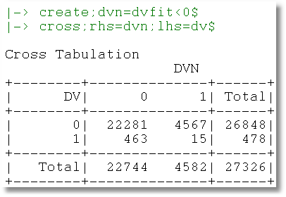
Negative Predicted Probabilities

Slide 39
Measuring Fit

Slide 40
How Well Does the Model Fit?
There is no R squared.
  Least squares for linear models is computed to maximize R²
  There are no residuals or sums of squares in a binary choice model
  The model is not computed to optimize the fit of the model to the data
How can we measure the “fit” of the model to the data?
  “Fit measures” computed from the log likelihood
    “Pseudo R squared” = 1 – logL/logL0
    Also called the “likelihood ratio index”
    Others… - these do not measure fit.
  Direct assessment of the effectiveness of the model at predicting the outcome

Slide 41
Log Likelihoods
logL = ∑_{i} log density (y_{i}|x_{i},β)
For probabilities
  Density is a probability
  Log density is < 0
  LogL is < 0
For other models, log density can be positive or negative.
  For linear regression,
  logL=-N/2(1+log2π+log(e’e/N)]
  Positive if s² < .058497

Slide 42
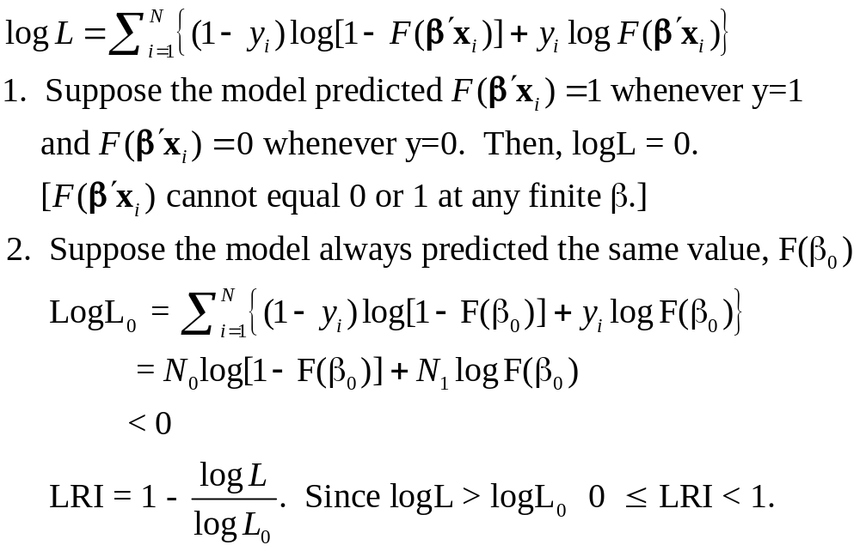
Likelihood Ratio Index

Slide 43
The Likelihood Ratio Index
Bounded by 0 and 1-ε
Rises when the model is expanded
Values between 0 and 1 have no meaning
Can be strikingly low.
Should not be used to compare models
  Use logL
  Use information criteria to compare nonnested models
Notes:
43

Slide 44
Fit Measures Based on LogL
----------------------------------------------------------------------
Binary Logit Model for Binary Choice
Dependent variable DOCTOR
Log likelihood function -2085.92452 Full model LogL
Restricted log likelihood -2169.26982 Constant term only LogL0
Chi squared [ 5 d.f.] 166.69058
Significance level .00000
McFadden Pseudo R-squared .0384209 1 – LogL/logL0
Estimation based on N = 3377, K = 6
Information Criteria: Normalization=1/N
Normalized Unnormalized
AIC 1.23892 4183.84905 -2LogL + 2K
Fin.Smpl.AIC 1.23893 4183.87398 -2LogL + 2K + 2K(K+1)/(N-K-1)
Bayes IC 1.24981 4220.59751 -2LogL + KlnN
Hannan Quinn 1.24282 4196.98802 -2LogL + 2Kln(lnN)
--------+-------------------------------------------------------------
Variable| Coefficient Standard Error b/St.Er. P[|Z|>z] Mean of X
--------+-------------------------------------------------------------
|Characteristics in numerator of Prob[Y = 1]
Constant| 1.86428*** .67793 2.750 .0060
AGE| -.10209*** .03056 -3.341 .0008 42.6266
AGESQ| .00154*** .00034 4.556 .0000 1951.22
INCOME| .51206 .74600 .686 .4925 .44476
AGE_INC| -.01843 .01691 -1.090 .2756 19.0288
FEMALE| .65366*** .07588 8.615 .0000 .46343
--------+-------------------------------------------------------------

Slide 45
Fit Measures Based on Predictions
Computation
  Use the model to compute predicted probabilities
  Use the model and a rule to compute predicted y = 0 or 1
Fit measure compares predictions to actuals

Slide 46
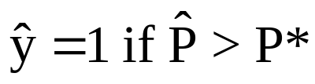
Predicting the Outcome
Predicted probabilities
P = F(a + b₁Age + b₂Income + b₃Female+…)
Predicting outcomes
  Predict y=1 if P is “large”
  Use 0.5 for “large” (more likely than not)
  Generally, use
Count successes and failures

Slide 47
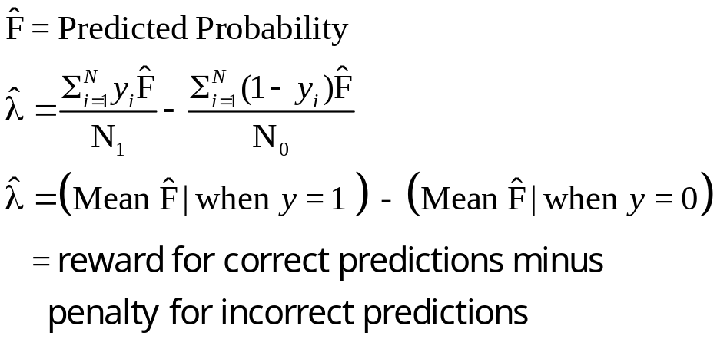
Cramer Fit Measure
+----------------------------------------+
| Fit Measures Based on Model Predictions|
| Efron = .04825|
| Ben Akiva and Lerman = .57139|
| Veall and Zimmerman = .08365|
| Cramer = .04771|
+----------------------------------------+

Slide 48
Hypothesis Testing in Binary Choice Models

Slide 49
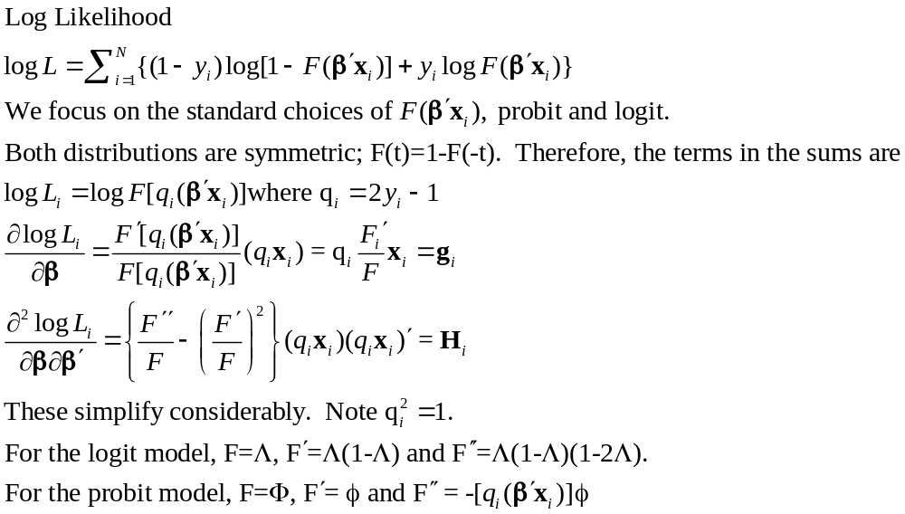
Covariance Matrix for the MLE

Slide 50
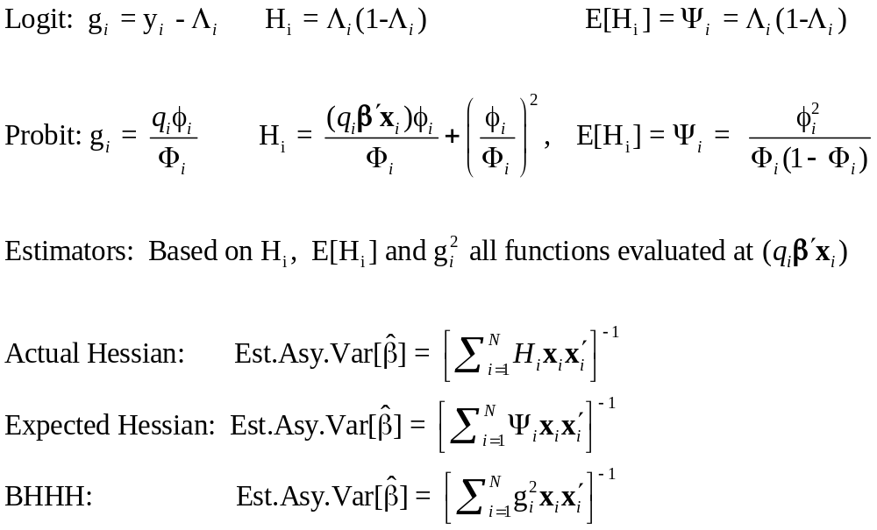
Simplifications

Slide 51
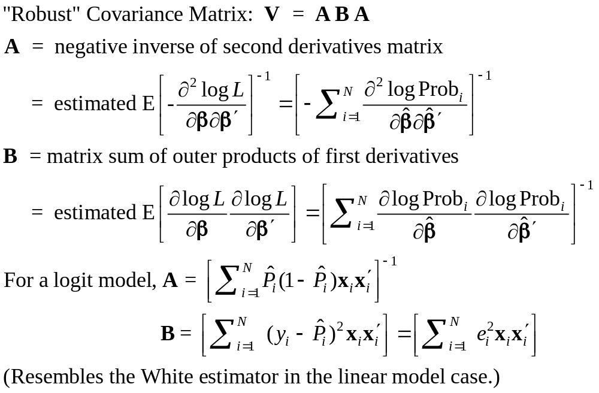
Robust Covariance Matrix

Slide 52
Robust Covariance Matrix for Logit Model
--------+-------------------------------------------------------------
Variable| Coefficient Standard Error b/St.Er. P[|Z|>z] Mean of X
--------+-------------------------------------------------------------
|Robust Standard Errors
Constant| 1.86428*** .68442 2.724 .0065
AGE| -.10209*** .03115 -3.278 .0010 42.6266
AGESQ| .00154*** .00035 4.446 .0000 1951.22
INCOME| .51206 .75103 .682 .4954 .44476
AGE_INC| -.01843 .01703 -1.082 .2792 19.0288
FEMALE| .65366*** .07585 8.618 .0000 .46343
--------+-------------------------------------------------------------
|Conventional Standard Errors Based on Second Derivatives
Constant| 1.86428*** .67793 2.750 .0060
AGE| -.10209*** .03056 -3.341 .0008 42.6266
AGESQ| .00154*** .00034 4.556 .0000 1951.22
INCOME| .51206 .74600 .686 .4925 .44476
AGE_INC| -.01843 .01691 -1.090 .2756 19.0288
FEMALE| .65366*** .07588 8.615 .0000 .46343

Slide 53
Base Model for Hypothesis Tests
----------------------------------------------------------------------
Binary Logit Model for Binary Choice
Dependent variable DOCTOR
Log likelihood function -2085.92452
Restricted log likelihood -2169.26982
Chi squared [ 5 d.f.] 166.69058
Significance level .00000
McFadden Pseudo R-squared .0384209
Estimation based on N = 3377, K = 6
Information Criteria: Normalization=1/N
Normalized Unnormalized
AIC 1.23892 4183.84905
--------+-------------------------------------------------------------
Variable| Coefficient Standard Error b/St.Er. P[|Z|>z] Mean of X
--------+-------------------------------------------------------------
|Characteristics in numerator of Prob[Y = 1]
Constant| 1.86428*** .67793 2.750 .0060
AGE| -.10209*** .03056 -3.341 .0008 42.6266
AGESQ| .00154*** .00034 4.556 .0000 1951.22
INCOME| .51206 .74600 .686 .4925 .44476
AGE_INC| -.01843 .01691 -1.090 .2756 19.0288
FEMALE| .65366*** .07588 8.615 .0000 .46343
--------+-------------------------------------------------------------
H₀: Age is not a significant
determinant of
Prob(Doctor = 1)
H₀: β₂ = β₃ = β₅ = 0

Slide 54
Likelihood Ratio Tests
Null hypothesis restricts the parameter vector
Alternative relaxes the restriction
Test statistic: Chi-squared =
2 (LogL|Unrestricted model –
LogL|Restrictions) > 0
Degrees of freedom = number of restrictions

Slide 55
LR Test of H₀
UNRESTRICTED MODEL
Binary Logit Model for Binary Choice
Dependent variable DOCTOR
Log likelihood function -2085.92452
Restricted log likelihood -2169.26982
Chi squared [ 5 d.f.] 166.69058
Significance level .00000
McFadden Pseudo R-squared .0384209
Estimation based on N = 3377, K = 6
Information Criteria: Normalization=1/N
Normalized Unnormalized
AIC 1.23892 4183.84905
RESTRICTED MODEL
Binary Logit Model for Binary Choice
Dependent variable DOCTOR
Log likelihood function -2124.06568
Restricted log likelihood -2169.26982
Chi squared [ 2 d.f.] 90.40827
Significance level .00000
McFadden Pseudo R-squared .0208384
Estimation based on N = 3377, K = 3
Information Criteria: Normalization=1/N
Normalized Unnormalized
AIC 1.25974 4254.13136
Chi squared[3] = 2[-2085.92452 - (-2124.06568)] = 77.46456

Slide 56
Wald Test
Unrestricted parameter vector is estimated
Discrepancy: q= Rb – m (or r(b,m) if nonlinear) is computed
Variance of discrepancy is estimated:
Var[q] = R V R’
Wald Statistic is q’[Var(q)]⁻¹q = q’[RVR’]⁻¹q

Slide 57
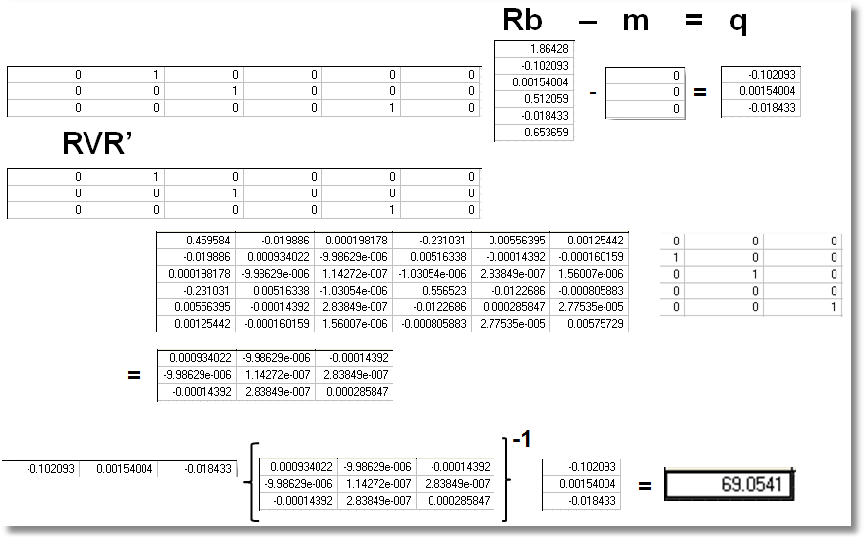
Wald Test
Chi squared[3] = 69.0541

Slide 58
Lagrange Multiplier Test
Restricted model is estimated
Derivatives of unrestricted model and variances of derivatives are computed at restricted estimates
Wald test of whether derivatives are zero tests the restrictions
Usually hard to compute – difficult to program the derivatives and their variances.

Slide 59
LM Test for a Logit Model
Compute b₀ (subject to restictions)
(e.g., with zeros in appropriate positions.
Compute P_{i}(b₀) for each observation.
Compute e_{i}(b₀) = [y_{i} – P_{i}(b₀)]
Compute g_{i}(b₀) = x_{i}e_{i} using full x_{i} vector
LM = [Σ_{i}g_{i}(b₀)]’[Σ_{i}g_{i}(b₀)g_{i}(b₀)]⁻¹[Σ_{i}g_{i}(b₀)]

Slide 60
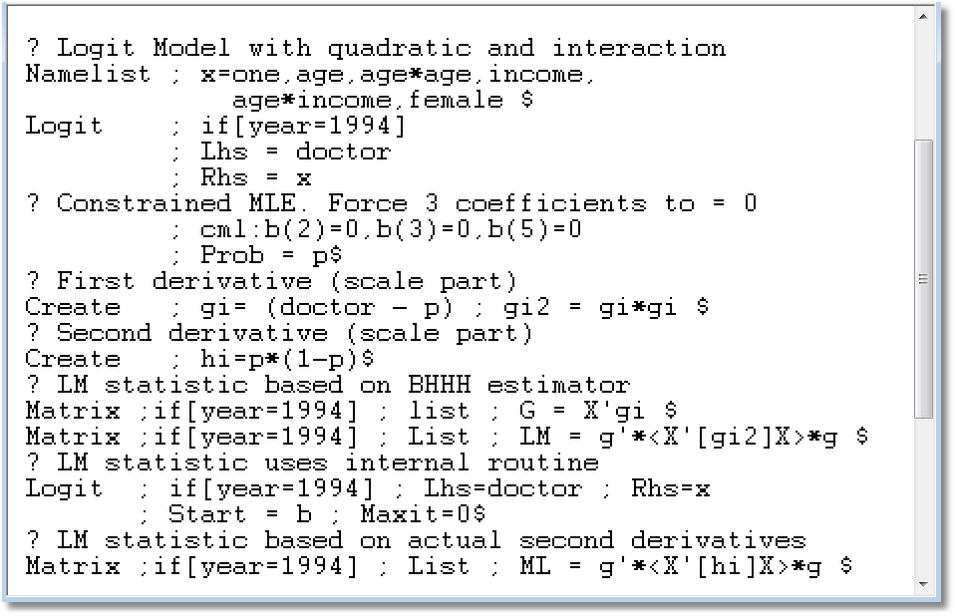

Slide 61
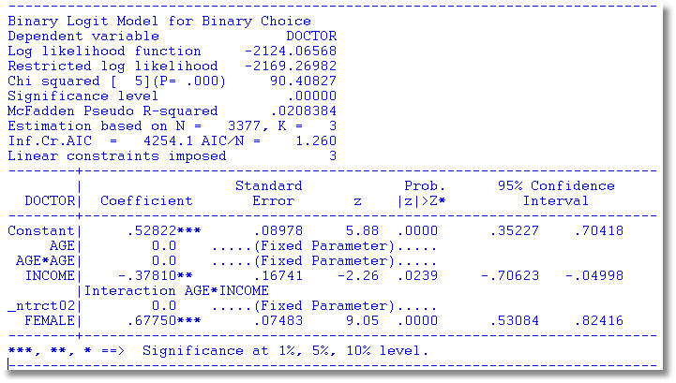

Slide 62
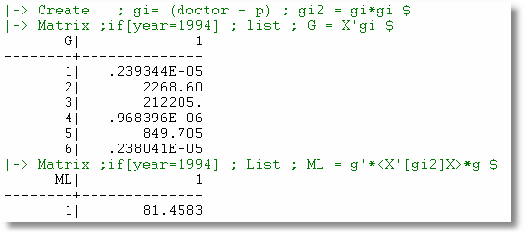
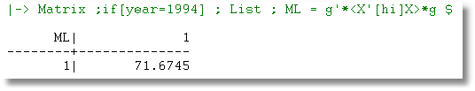
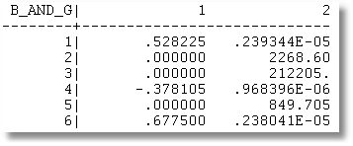

Slide 63
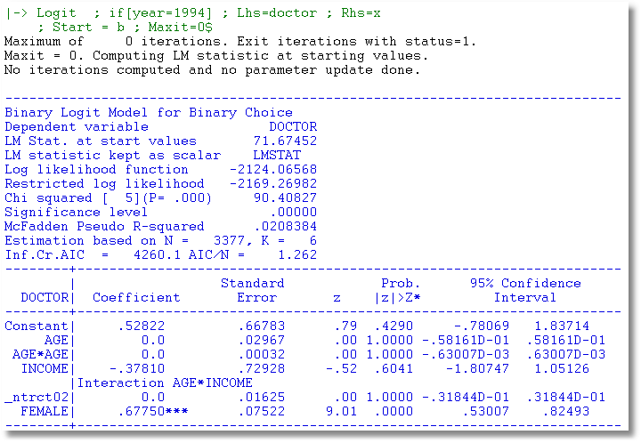

Slide 64
Inference About
Partial Effects

Slide 65
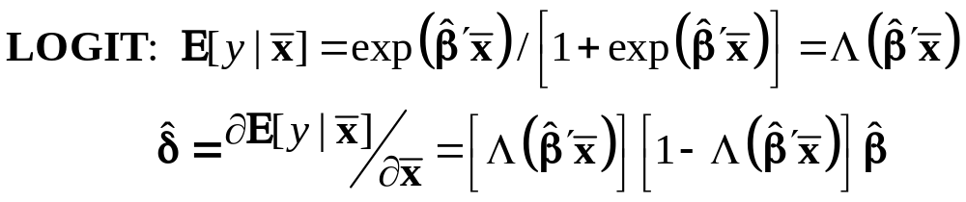
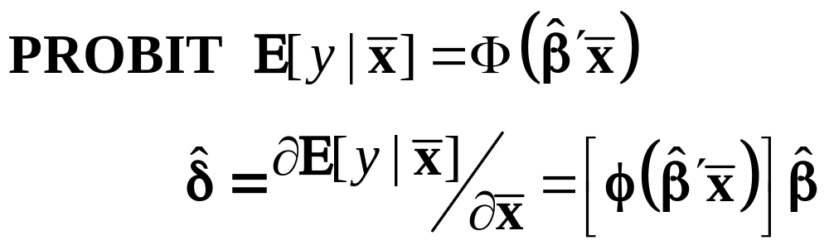
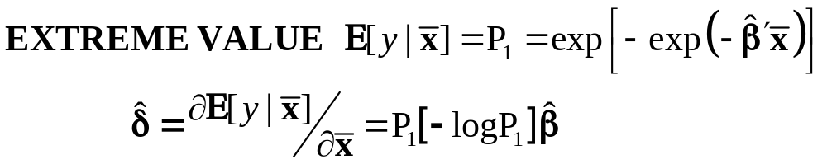
Marginal Effects for Binary Choice

Slide 66
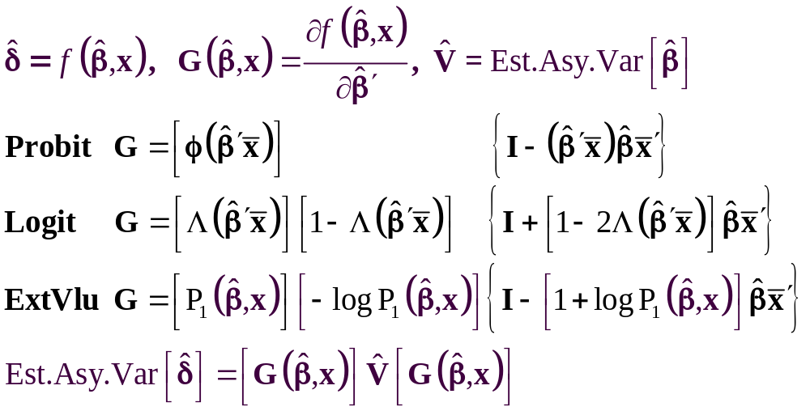
The Delta Method

Slide 67
Computing Effects
Compute at the data means?
  Simple
  Inference is well defined
Average the individual effects
  More appropriate?
  Asymptotic standard errors more complicated.
Is testing about marginal effects meaningful?
  f(b’x) must be > 0; b is highly significant
  How could f(b’x)*b equal zero?

Slide 68
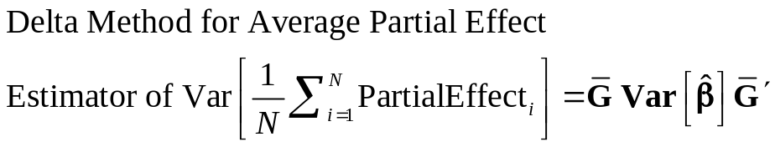
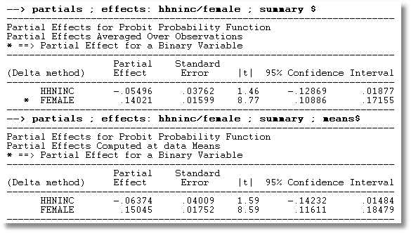
APE vs. Partial Effects at the Mean

Slide 69
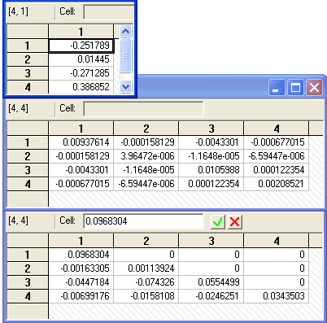
Method of Krinsky and Robb
Estimate β by Maximum Likelihood with b
Estimate asymptotic covariance matrix with V
Draw R observations b(r) from the normal
population N[b,V]
b(r) = b + C*v(r), v(r) drawn from N[0,I]
C = Cholesky matrix, V = CC’
Compute partial effects d(r) using b(r)
Compute the sample variance of d(r),r=1,…,R
Use the sample standard deviations of the R observations to estimate the sampling standard errors for the partial effects.

Slide 70
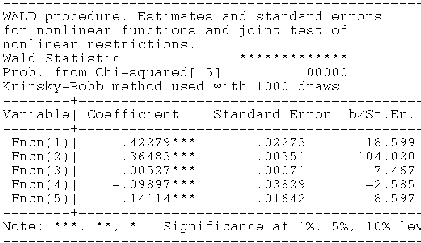

Krinsky and Robb
Delta Method

Slide 71

Partial Effect for Nonlinear Terms

Slide 72
Average Partial Effect: Averaged over Sample Incomes and Genders for Specific Values of Age

Slide 73
Endogeneity

Slide 74
Endogenous RHS Variable
U* = β’x + θh + ε
y = 1[U* > 0]
E[ε|h] ≠ 0 (h is endogenous)
  Case 1: h is continuous
  Case 2: h is binary = a treatment effect
Approaches
  Parametric: Maximum Likelihood
  Semiparametric (not developed here):
    GMM
    Various approaches for case 2

Slide 75
Endogenous Continuous Variable
U* = β’x + θh + ε
y = 1[U* > 0] ⇐
h = α’z + u
E[ε|h] ≠ 0 ⬄ Cov[u, ε] ≠ 0
Additional Assumptions:
(u,ε) ~ N[(0,0),(σ_{u}², ρσ_{u}, 1)]
z = a valid set of exogenous
variables, uncorrelated with (u,ε)
Correlation = ρ.
This is the source of the endogeneity
This is not IV estimation. Z may be uncorrelated with X without problems.

Slide 76


Endogenous Income
Income responds to
Age, Age², Educ, Married, Kids, Gender
0 = Not Healthy
1 = Healthy
Healthy = 0 or 1
Age, Married, Kids, Gender, Income
Determinants of Income (observed and unobserved) also determine health satisfaction.
Notes:
76

Slide 77

Estimation by ML (Control Function)

Slide 78

Two Approaches to ML

Slide 79
FIML Estimates
----------------------------------------------------------------------
Probit with Endogenous RHS Variable
Dependent variable HEALTHY
Log likelihood function -6464.60772
--------+-------------------------------------------------------------
Variable| Coefficient Standard Error b/St.Er. P[|Z|>z] Mean of X
--------+-------------------------------------------------------------
|Coefficients in Probit Equation for HEALTHY
Constant| 1.21760*** .06359 19.149 .0000
AGE| -.02426*** .00081 -29.864 .0000 43.5257
MARRIED| -.02599 .02329 -1.116 .2644 .75862
HHKIDS| .06932*** .01890 3.668 .0002 .40273
FEMALE| -.14180*** .01583 -8.959 .0000 .47877
INCOME| .53778*** .14473 3.716 .0002 .35208
|Coefficients in Linear Regression for INCOME
Constant| -.36099*** .01704 -21.180 .0000
AGE| .02159*** .00083 26.062 .0000 43.5257
AGESQ| -.00025*** .944134D-05 -26.569 .0000 2022.86
EDUC| .02064*** .00039 52.729 .0000 11.3206
MARRIED| .07783*** .00259 30.080 .0000 .75862
HHKIDS| -.03564*** .00232 -15.332 .0000 .40273
FEMALE| .00413** .00203 2.033 .0420 .47877
|Standard Deviation of Regression Disturbances
Sigma(w)| .16445*** .00026 644.874 .0000
|Correlation Between Probit and Regression Disturbances
Rho(e,w)| -.02630 .02499 -1.052 .2926
--------+-------------------------------------------------------------

Slide 80

Partial Effects: Scaled Coefficients

Slide 81

Partial Effects
θ = 0.53778
The scale factor is computed using the model coefficients, means of the variables and 35,000 draws from the standard normal population.

Slide 82
Endogenous Binary Variable
U* = β’x + θh + ε
y = 1[U* > 0]
h* = α’z + u
h = 1[h* > 0]
E[ε|h*] ≠ 0 ⬄ Cov[u, ε] ≠ 0
Additional Assumptions:
(u,ε) ~ N[(0,0),(σ_{u}², ρσ_{u}, 1)]
z = a valid set of exogenous
variables, uncorrelated with (u,ε)
⇐
Correlation = ρ.
This is the source of the endogeneity
This is not IV estimation. Z may be uncorrelated with X without problems.

Slide 83


Endogenous Binary Variable
Doctor = F(age,age²,income,female,Public)
Public = F(age,educ,income,married,kids,female)

Slide 84
FIML Estimates
----------------------------------------------------------------------
FIML Estimates of Bivariate Probit Model
Dependent variable DOCPUB
Log likelihood function -25671.43905
Estimation based on N = 27326, K = 14
--------+-------------------------------------------------------------
Variable| Coefficient Standard Error b/St.Er. P[|Z|>z] Mean of X
--------+-------------------------------------------------------------
|Index equation for DOCTOR
Constant| .59049*** .14473 4.080 .0000
AGE| -.05740*** .00601 -9.559 .0000 43.5257
AGESQ| .00082*** .681660D-04 12.100 .0000 2022.86
INCOME| .08883* .05094 1.744 .0812 .35208
FEMALE| .34583*** .01629 21.225 .0000 .47877
PUBLIC| .43533*** .07357 5.917 .0000 .88571
|Index equation for PUBLIC
Constant| 3.55054*** .07446 47.681 .0000
AGE| .00067 .00115 .581 .5612 43.5257
EDUC| -.16839*** .00416 -40.499 .0000 11.3206
INCOME| -.98656*** .05171 -19.077 .0000 .35208
MARRIED| -.00985 .02922 -.337 .7361 .75862
HHKIDS| -.08095*** .02510 -3.225 .0013 .40273
FEMALE| .12139*** .02231 5.442 .0000 .47877
|Disturbance correlation
RHO(1,2)| -.17280*** .04074 -4.241 .0000
--------+-------------------------------------------------------------

Slide 85

Partial Effects

Slide 86
Identification Issues
Exclusions are not needed for estimation
Identification is, in principle, by “functional form”
Researchers usually have a variable in the treatment equation that is not in the main probit equation “to improve identification”
A fully simultaneous model
  y1 = f(x1,y2), y2 = f(x2,y1)
  Not identified even with exclusion restrictions
  (Model is “incoherent”)

