Slide 1
Discrete Choice Modeling
0 Introduction
1 Summary
2 Binary Choice
3 Panel Data
4 Bivariate Probit
5 Ordered Choice
6 Count Data
7 Multinomial Choice
8 Nested Logit
9 Heterogeneity
10 Latent Class
11 Mixed Logit
12 Stated Preference
13 Hybrid Choice
William Greene
Stern School of Business
New York University

Slide 2


Slide 3


Slide 4


Slide 5


Slide 6


Slide 7


Slide 8


Slide 9


Slide 10


Slide 11
Application: Health Care Panel Data
German Health Care Usage Data, 7,293 Individuals, Varying Numbers of Periods
Data downloaded from Journal of Applied Econometrics Archive. This is an unbalanced panel with 7,293 individuals. They can be used for regression, count models, binary choice, ordered choice, and bivariate binary choice. There are altogether 27,326 observations. The number of observations ranges from 1 to 7. (Frequencies are: 1=1525, 2=2158, 3=825, 4=926, 5=1051, 6=1000, 7=987).
Variables in the file are
DOCTOR = 1(Number of doctor visits > 0)
HOSPITAL = 1(Number of hospital visits > 0)
HSAT = health satisfaction, coded 0 (low) - 10 (high)
DOCVIS = number of doctor visits in last three months
HOSPVIS = number of hospital visits in last calendar year
PUBLIC = insured in public health insurance = 1; otherwise = 0
ADDON = insured by add-on insurance = 1; otherswise = 0
HHNINC = household nominal monthly net income in German marks / 10000.
(4 observations with income=0 were dropped)
HHKIDS = children under age 16 in the household = 1; otherwise = 0
EDUC = years of schooling
AGE = age in years
MARRIED = marital status
Notes:
11

Slide 12

Unbalanced Panels
Most theoretical results are for balanced panels.
Most real world panels are unbalanced.
Often the gaps are caused by attrition.
The major question is whether the gaps are ‘missing completely at random.’ If not, the observation mechanism is endogenous, and at least some methods will produce questionable results.
Researchers rarely have any reason to treat the data as nonrandomly sampled. (This is good news.)
Group Sizes

Slide 13
Unbalanced Panels and Attrition ‘Bias’
Test for ‘attrition bias.’ (Verbeek and Nijman, Testing for Selectivity Bias in Panel Data Models, International Economic Review, 1992, 33, 681-703.
  Variable addition test using covariates of presence in the panel
  Nonconstructive – what to do next?
Do something about attrition bias. (Wooldridge, Inverse Probability Weighted M-Estimators for Sample Stratification and Attrition, Portuguese Economic Journal, 2002, 1: 117-139)
  Stringent assumptions about the process
  Model based on probability of being present in each wave of the panel

Slide 14
Panel Data Binary Choice Models
Random Utility Model for Binary Choice
U_{it} = α + β’x_{it} + ε_{it} + Person i specific effect
Fixed effects using “dummy” variables
U_{it} = α_{i} + β’x_{it} + ε_{it}
Random effects using omitted heterogeneity
U_{it} = α + β’x_{it} + ε_{it} + u_{i}
Same outcome mechanism: Y_{it} = 1[U_{it} > 0]

Slide 15
Pooled Model

Slide 16
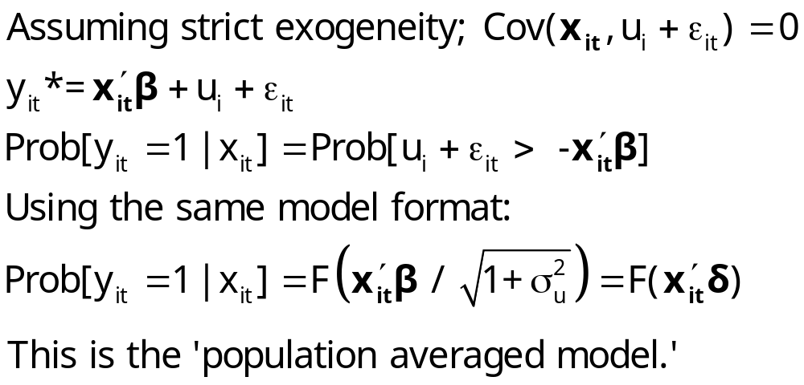
Ignoring Unobserved Heterogeneity

Slide 17
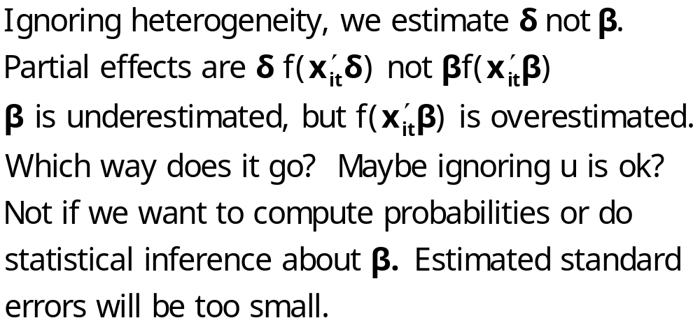
Ignoring Heterogeneity in the RE Model

Slide 18
Ignoring Heterogeneity (Broadly)
Presence will generally make parameter estimates look smaller than they would otherwise.
Ignoring heterogeneity will definitely distort standard errors.
Partial effects based on the parametric model may not be affected very much.
Is the pooled estimator ‘robust?’ Less so than in the linear model case.

Slide 19
Pooled vs. RE Panel Estimator
----------------------------------------------------------------------
Binomial Probit Model
Dependent variable DOCTOR
--------+-------------------------------------------------------------
Variable| Coefficient Standard Error b/St.Er. P[|Z|>z] Mean of X
--------+-------------------------------------------------------------
Constant| .02159 .05307 .407 .6842
AGE| .01532*** .00071 21.695 .0000 43.5257
EDUC| -.02793*** .00348 -8.023 .0000 11.3206
HHNINC| -.10204** .04544 -2.246 .0247 .35208
--------+-------------------------------------------------------------
Unbalanced panel has 7293 individuals
--------+-------------------------------------------------------------
Constant| -.11819 .09280 -1.273 .2028
AGE| .02232*** .00123 18.145 .0000 43.5257
EDUC| -.03307*** .00627 -5.276 .0000 11.3206
HHNINC| .00660 .06587 .100 .9202 .35208
Rho| .44990*** .01020 44.101 .0000
--------+-------------------------------------------------------------

Slide 20
Partial Effects
----------------------------------------------------------------------
Partial derivatives of E[y] = F[*] with
respect to the vector of characteristics
They are computed at the means of the Xs
Observations used for means are All Obs.
--------+-------------------------------------------------------------
Variable| Coefficient Standard Error b/St.Er. P[|Z|>z] Elasticity
--------+-------------------------------------------------------------
|Pooled
AGE| .00578*** .00027 21.720 .0000 .39801
EDUC| -.01053*** .00131 -8.024 .0000 -.18870
HHNINC| -.03847** .01713 -2.246 .0247 -.02144
--------+-------------------------------------------------------------
|Based on the panel data estimator
AGE| .00620*** .00034 18.375 .0000 .42181
EDUC| -.00918*** .00174 -5.282 .0000 -.16256
HHNINC| .00183 .01829 .100 .9202 .00101
--------+-------------------------------------------------------------

Slide 21
Effect of Clustering
Y_{it} must be correlated with Y_{is} across periods
Pooled estimator ignores correlation
Broadly, y_{it} = E[y_{it}|x_{it}] + w_{it},
  E[y_{it}|x_{it}] = Prob(y_{it} = 1|x_{it})
  w_{it} is correlated across periods
Assuming the marginal probability is the same, the pooled estimator is consistent. (We just saw that it might not be.)
Ignoring the correlation across periods generally leads to underestimating standard errors.

Slide 22
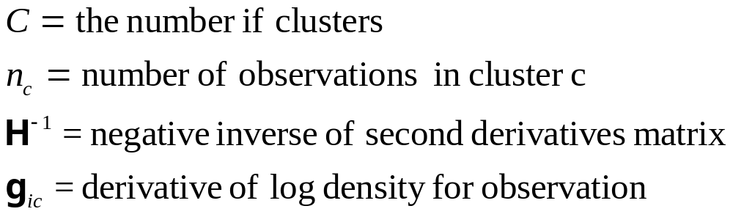
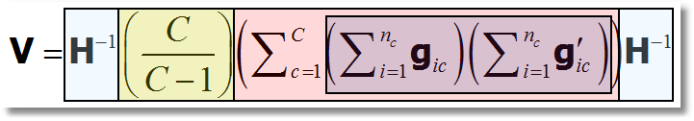
‘Cluster’ Corrected Covariance Matrix

Slide 23
Cluster Correction: Doctor
----------------------------------------------------------------------
Binomial Probit Model
Dependent variable DOCTOR
Log likelihood function -17457.21899
--------+-------------------------------------------------------------
Variable| Coefficient Standard Error b/St.Er. P[|Z|>z] Mean of X
--------+-------------------------------------------------------------
| Conventional Standard Errors
Constant| -.25597*** .05481 -4.670 .0000
AGE| .01469*** .00071 20.686 .0000 43.5257
EDUC| -.01523*** .00355 -4.289 .0000 11.3206
HHNINC| -.10914** .04569 -2.389 .0169 .35208
FEMALE| .35209*** .01598 22.027 .0000 .47877
--------+-------------------------------------------------------------
| Corrected Standard Errors
Constant| -.25597*** .07744 -3.305 .0009
AGE| .01469*** .00098 15.065 .0000 43.5257
EDUC| -.01523*** .00504 -3.023 .0025 11.3206
HHNINC| -.10914* .05645 -1.933 .0532 .35208
FEMALE| .35209*** .02290 15.372 .0000 .47877
--------+-------------------------------------------------------------

Slide 24
Random Effects

Slide 25
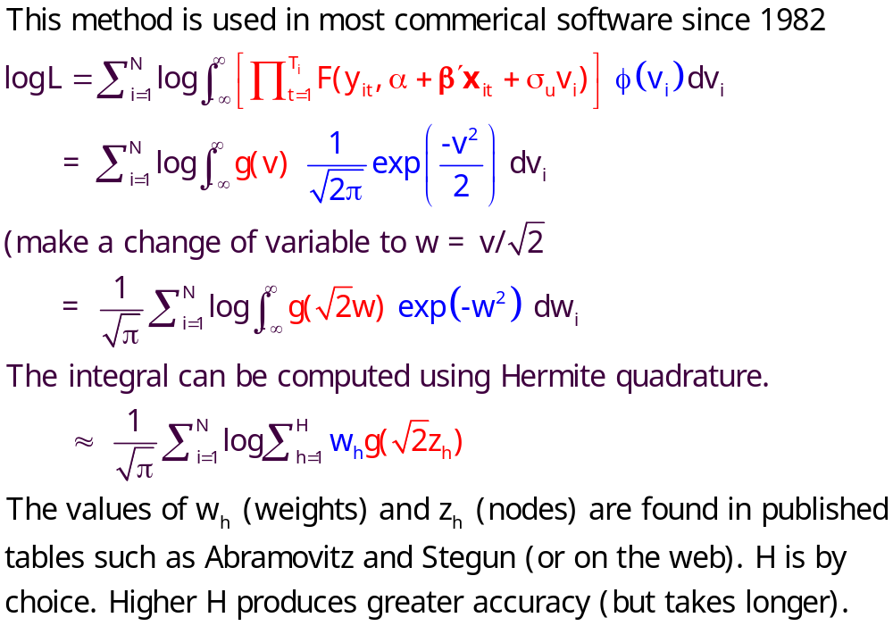
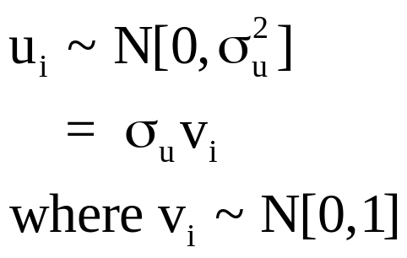
Quadrature – Butler and Moffitt (1982)

Slide 26
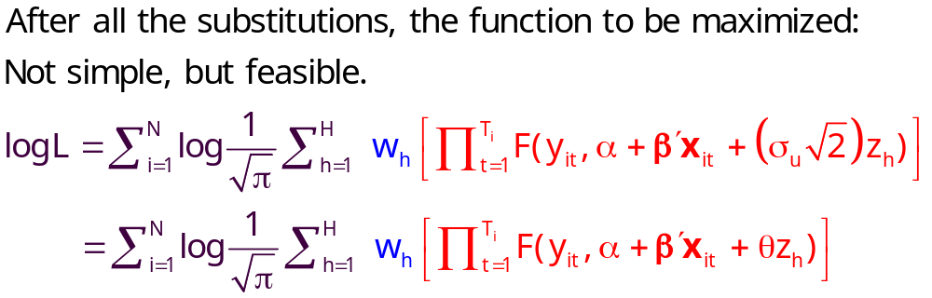
Quadrature Log Likelihood

Slide 27
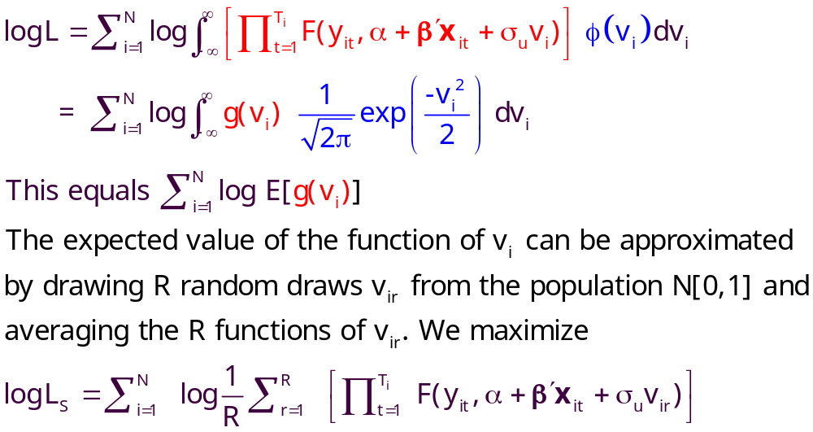
Simulation Based Estimator

Slide 28
Random Effects Model: Quadrature
----------------------------------------------------------------------
Random Effects Binary Probit Model
Dependent variable DOCTOR
Log likelihood function -16290.72192 ⬅ Random Effects
Restricted log likelihood -17701.08500 ⬅ Pooled
Chi squared [ 1 d.f.] 2820.72616
Estimation based on N = 27326, K = 5
Unbalanced panel has 7293 individuals
--------+-------------------------------------------------------------
Variable| Coefficient Standard Error b/St.Er. P[|Z|>z] Mean of X
--------+-------------------------------------------------------------
Constant| -.11819 .09280 -1.273 .2028
AGE| .02232*** .00123 18.145 .0000 43.5257
EDUC| -.03307*** .00627 -5.276 .0000 11.3206
HHNINC| .00660 .06587 .100 .9202 .35208
Rho| .44990*** .01020 44.101 .0000
--------+-------------------------------------------------------------
|Pooled Estimates
Constant| .02159 .05307 .407 .6842
AGE| .01532*** .00071 21.695 .0000 43.5257
EDUC| -.02793*** .00348 -8.023 .0000 11.3206
HHNINC| -.10204** .04544 -2.246 .0247 .35208
--------+-------------------------------------------------------------

Slide 29
Random Parameter Model
----------------------------------------------------------------------
Random Coefficients Probit Model
Dependent variable DOCTOR (Quadrature Based)
Log likelihood function -16296.68110 (-16290.72192)
Restricted log likelihood -17701.08500
Chi squared [ 1 d.f.] 2808.80780
Simulation based on 50 Halton draws
--------+-------------------------------------------------
Variable| Coefficient Standard Error b/St.Er. P[|Z|>z]
--------+-------------------------------------------------
|Nonrandom parameters
AGE| .02226*** .00081 27.365 .0000 ( .02232)
EDUC| -.03285*** .00391 -8.407 .0000 (-.03307)
HHNINC| .00673 .05105 .132 .8952 ( .00660)
|Means for random parameters
Constant| -.11873** .05950 -1.995 .0460 (-.11819)
|Scale parameters for dists. of random parameters
Constant| .90453*** .01128 80.180 .0000
--------+-------------------------------------------------------------
Using quadrature, a = -.11819. Implied ρ from these estimates is
.90454²/(1+.90453²) = .449998 compared to .44990 using quadrature.

Slide 30
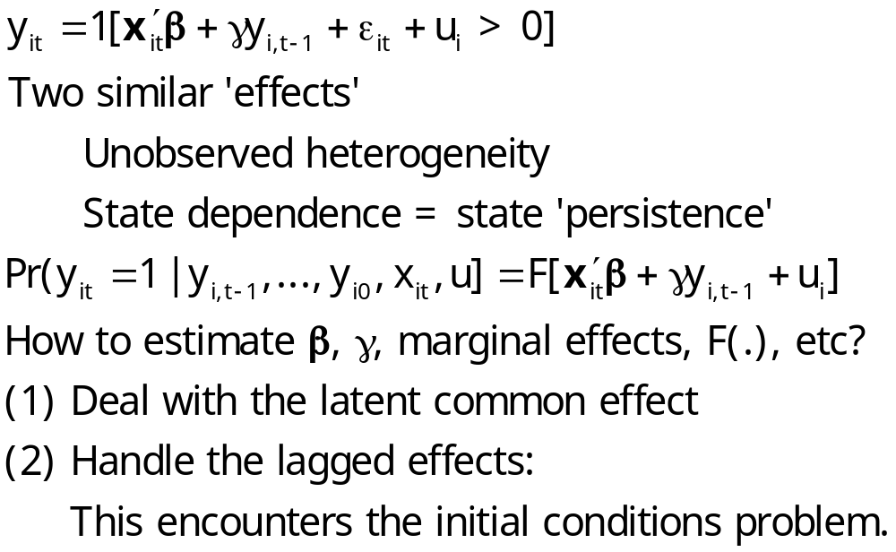
A Dynamic Model

Slide 31
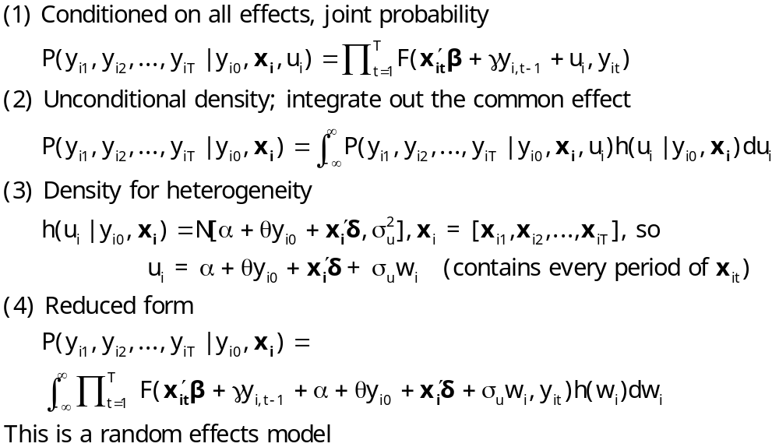
Dynamic Probit Model: A Standard Approach

Slide 32
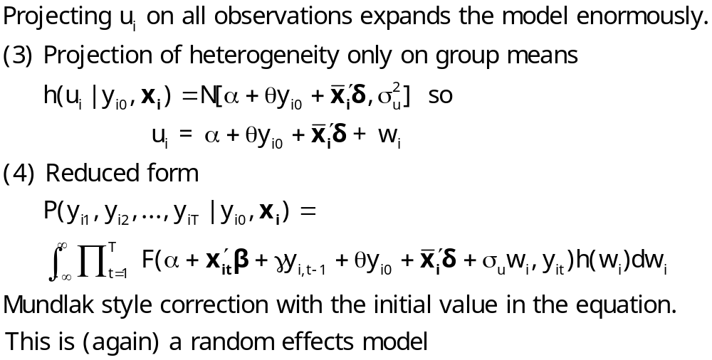
Simplified Dynamic Model

Slide 33
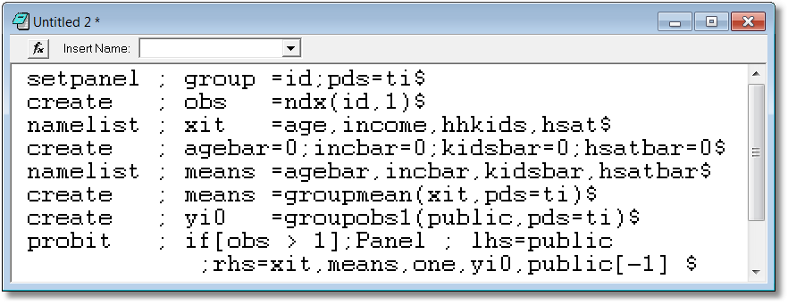
A Dynamic Model for Public Insurance
Age
Household Income
Kids in the household
Health Status
Add initial value, lagged value, group means

Slide 34
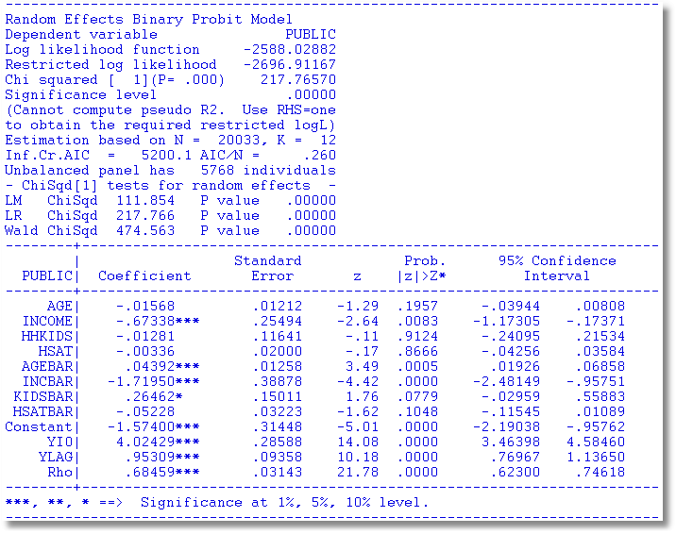
Dynamic Common Effects Model

Slide 35
Fixed Effects

Slide 36
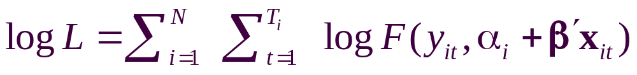
Fixed Effects Models
Estimate with dummy variable coefficients
Uit = α_{i} + β’xit + ε_{it}
Can be done by “brute force” for 10,000s of individuals
F(.) = appropriate probability for the observed outcome
Compute β and α_{i} for i=1,…,N (may be large)
See FixedEffects.pdf in course materials.

Slide 37
Unconditional Estimation
Maximize the whole log likelihood
Difficult! Many (thousands) of parameters.
Feasible – NLOGIT (2001) (“Brute force”)

Slide 38
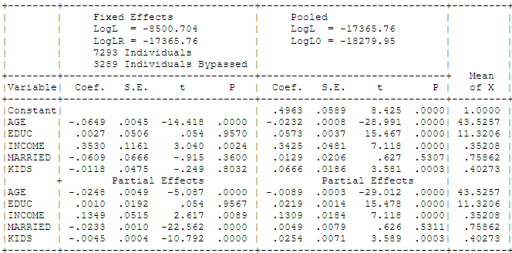
Fixed Effects Health Model
Groups in which y_{it} is always = 0 or always = 1. Cannot compute α_{i}.

Slide 39
Conditional Estimation
Principle: f(y_{i1},y_{i2},… | some statistic) is free of the fixed effects for some models.
Maximize the conditional log likelihood, given the statistic.
Can estimate β without having to estimate α_{i}.
Only feasible for the logit model. (Poisson and a few other continuous variable models. No other discrete choice models.)

Slide 40
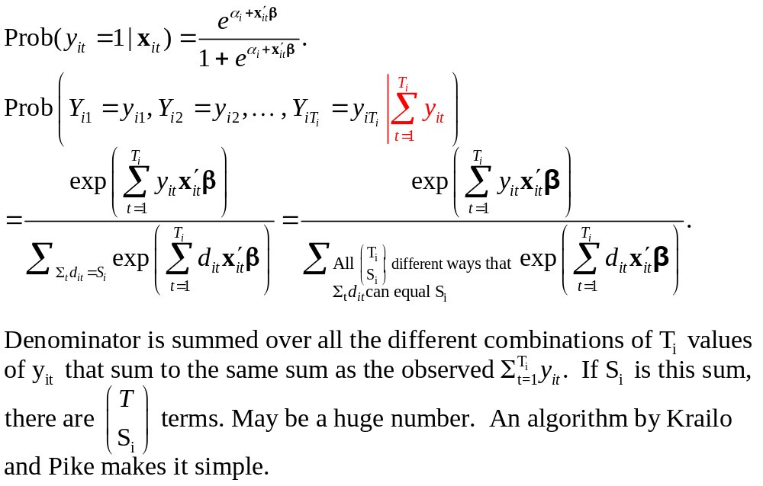
Binary Logit Conditional Probabiities

Slide 41
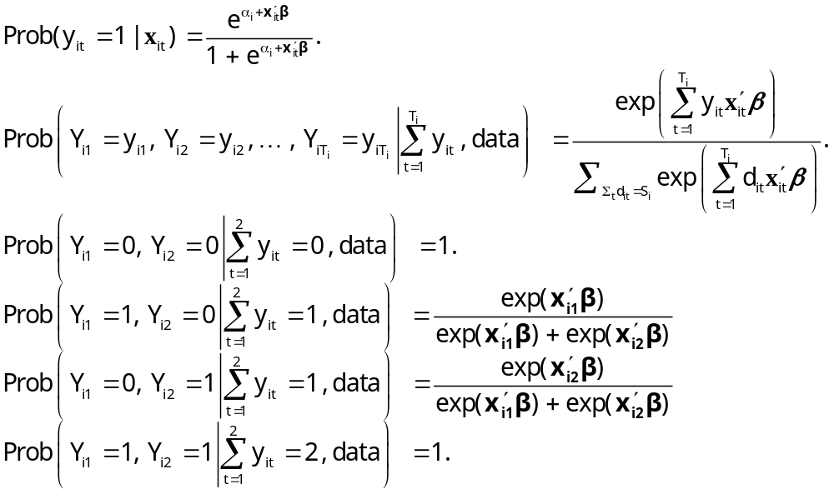
Example: Two Period Binary Logit

Slide 42
Estimating Partial Effects
“The fixed effects logit estimator of β immediately gives us the effect of each element of x_{i} on the log-odds ratio… Unfortunately, we cannot estimate the partial effects… unless we plug in a value for α_{i}. Because the distribution of α_{i} is unrestricted – in particular, E[α_{i}] is not necessarily zero – it is hard to know what to plug in for α_{i}. In addition, we cannot estimate average partial effects, as doing so would require finding E[Λ(x_{it} β+ α_{i})], a task that apparently requires specifying a distribution for α_{i}.”
(Wooldridge, 2010)
Notes:
42

Slide 43
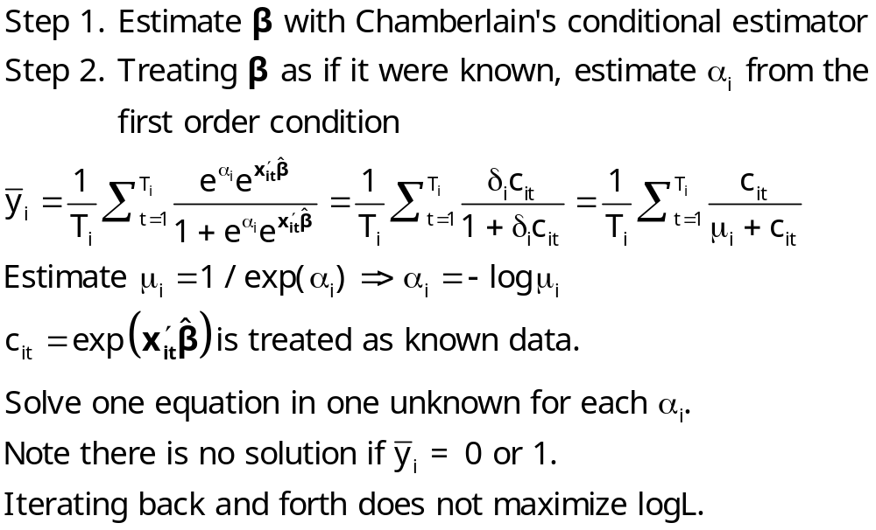
Logit Constant Terms

Slide 44
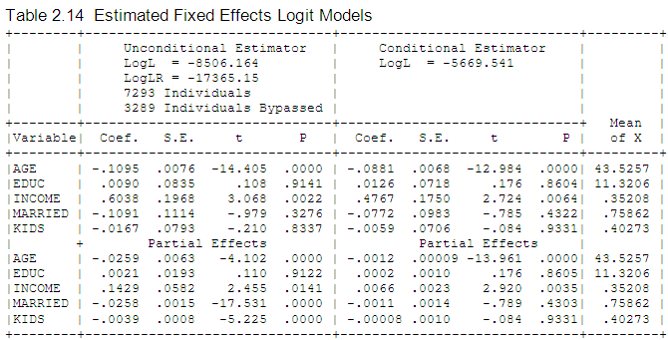
Fixed Effects Logit Health Model: Conditional vs. Unconditional

Slide 45
Advantages and Disadvantages of the FE Model
Advantages
  Allows correlation of effect and regressors
  Fairly straightforward to estimate
  Simple to interpret
Disadvantages
  Model may not contain time invariant variables
  Not necessarily simple to estimate if very large samples (Stata just creates the thousands of dummy variables)
  The incidental parameters problem: Small T bias

Slide 46
Incidental Parameters Problems: Conventional Wisdom
General: The unconditional MLE is biased in samples with fixed T except in special cases such as linear or Poisson regression (even when the FEM is the right model).
  The conditional estimator (that bypasses
  estimation of α_{i}) is consistent.
Specific: Upward bias (experience with probit and logit) in estimators of β

Slide 47
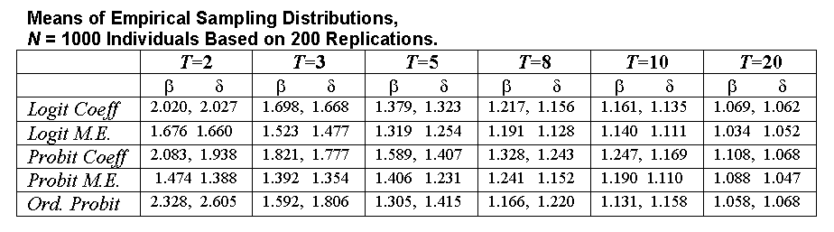
A Monte Carlo Study of the
FE Estimator: Probit vs. Logit
Estimates of Coefficients and Marginal Effects at the Implied Data Means
Results are scaled so the desired quantity being estimated
(β, δ, marginal effects) all equal 1.0 in the population.

Slide 48
Bias Correction Estimators
Motivation: Undo the incidental parameters bias in the fixed effects probit model:
  (1) Maximize a penalized log likelihood function, or
  (2) Directly correct the estimator of β
Advantages
  For (1) estimates α_{i} so enables partial effects
  Estimator is consistent under some circumstances
  (Possibly) corrects in dynamic models
Disadvantage
  No time invariant variables in the model
  Practical implementation
  Extension to other models? (Ordered probit model (maybe) – see JBES 2009)

Slide 49
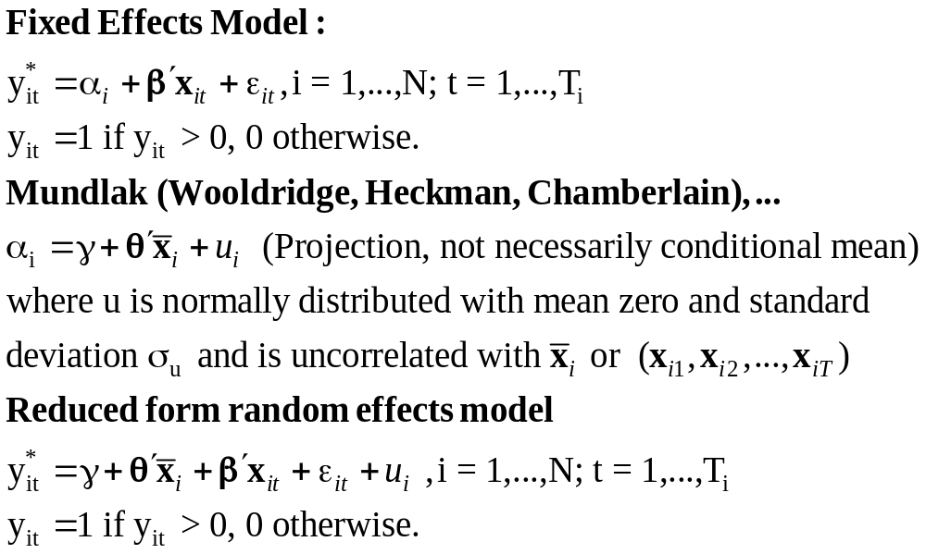
A Mundlak Correction for the FE Model

Slide 50
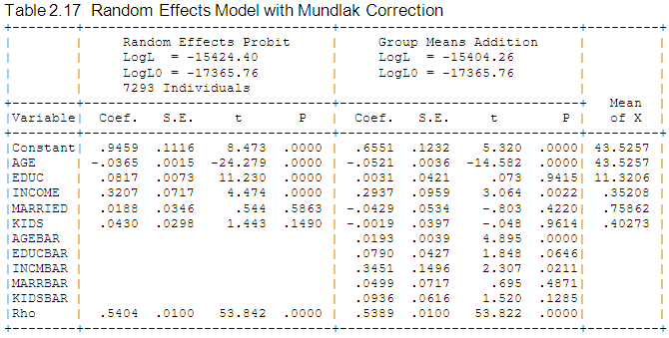
Mundlak Correction

Slide 51
A Variable Addition Test for FE vs. RE
The Wald statistic of 45.27922 and the likelihood ratio statistic of 40.280 are both far larger than the critical chi squared with 5 degrees of freedom, 11.07. This suggests that for these data, the fixed effects model is the preferred framework.

Slide 52
Fixed Effects Models Summary
Incidental parameters problem if T < 10 (roughly)
Inconvenience of computation
Appealing specification
Alternative semiparametric estimators?
  Theory not well developed for T > 2
  Not informative for anything but slopes (e.g., predictions and marginal effects)
Ignoring the heterogeneity definitely produces an inconsistent estimator (even with cluster correction!)
A Hobson’s choice
Mundlak correction is a useful common approach.

Slide 53

A Study of Health Status in the Presence of Attrition

Slide 54
Model for Self Assessed Health
British Household Panel Survey (BHPS)
  Waves 1-8, 1991-1998
  Self assessed health on 0,1,2,3,4 scale
  Sociological and demographic covariates
  Dynamics – inertia in reporting of top scale
Dynamic ordered probit model
  Balanced panel – analyze dynamics
  Unbalanced panel – examine attrition

Slide 55
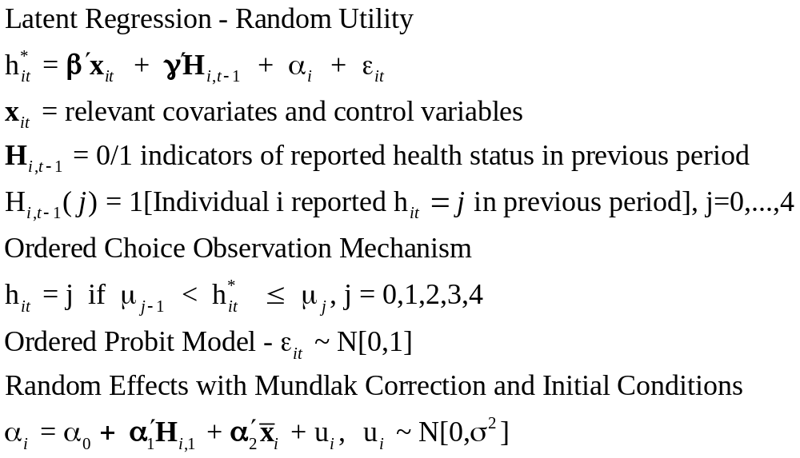
Dynamic Ordered Probit Model
It would not be appropriate to include h_{i,t-1} itself in the model as this is a label, not a measure

Slide 56
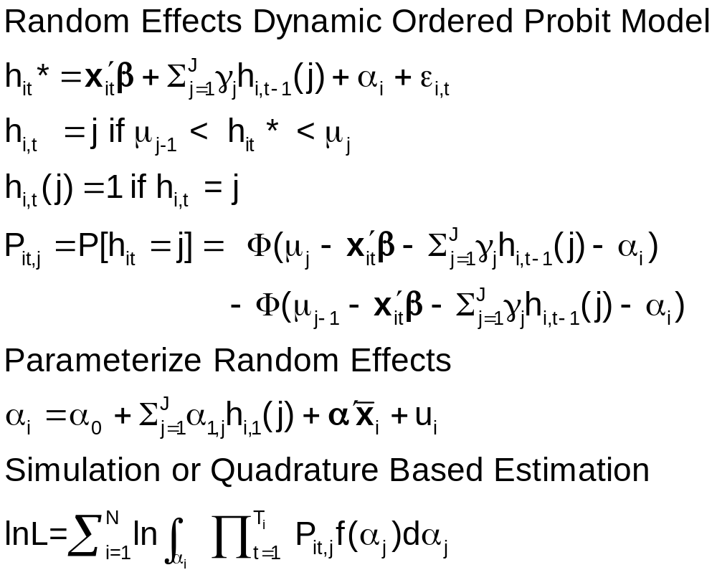
Random Effects Dynamic Ordered Probit Model

Slide 57
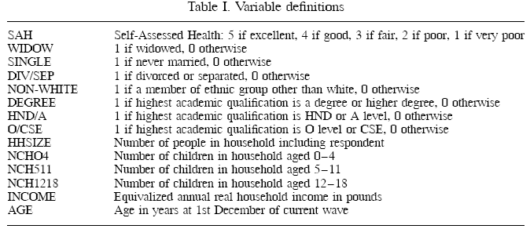
Data

Slide 58
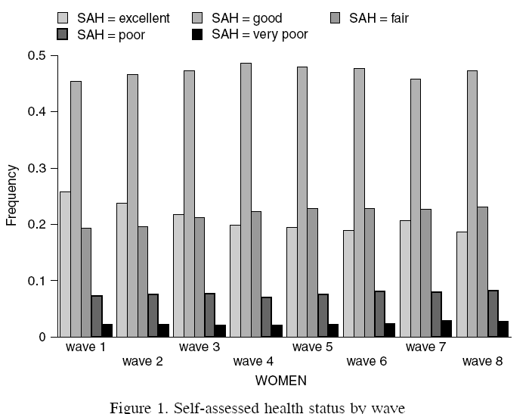
Variable of Interest

Slide 59
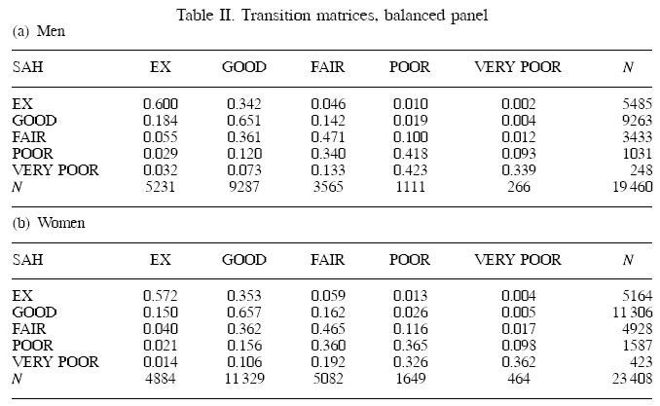
Dynamics

Slide 60
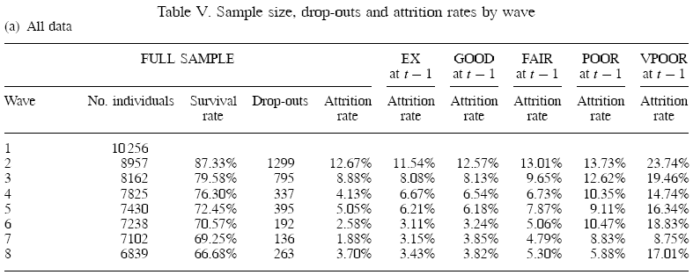
Attrition

Slide 61
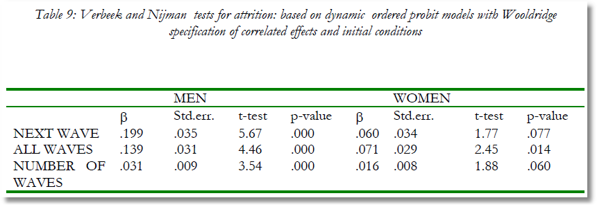
Testing for Attrition Bias
Three dummy variables added to full model with unbalanced panel suggest presence of attrition effects.

Slide 62
Probability Weighting Estimators
A Patch for Attrition
(1) Fit a participation probit equation for each wave.
(2) Compute p(i,t) = predictions of participation for each individual in each period.
  Special assumptions needed to make this work
Ignore common effects and fit a weighted pooled log likelihood: Σ_{i} Σ_{t} [d_{it}/p(i,t)]logLP_{it}.

Slide 63
Attrition Model with IP Weights
Assumes (1) Prob(attrition|all data) = Prob(attrition|selected variables) (ignorability)
(2) Attrition is an ‘absorbing state.’ No reentry.
Obviously not true for the GSOEP data above.
Can deal with point (2) by isolating a subsample of those present at wave 1 and the monotonically shrinking subsample as the waves progress.

Slide 64
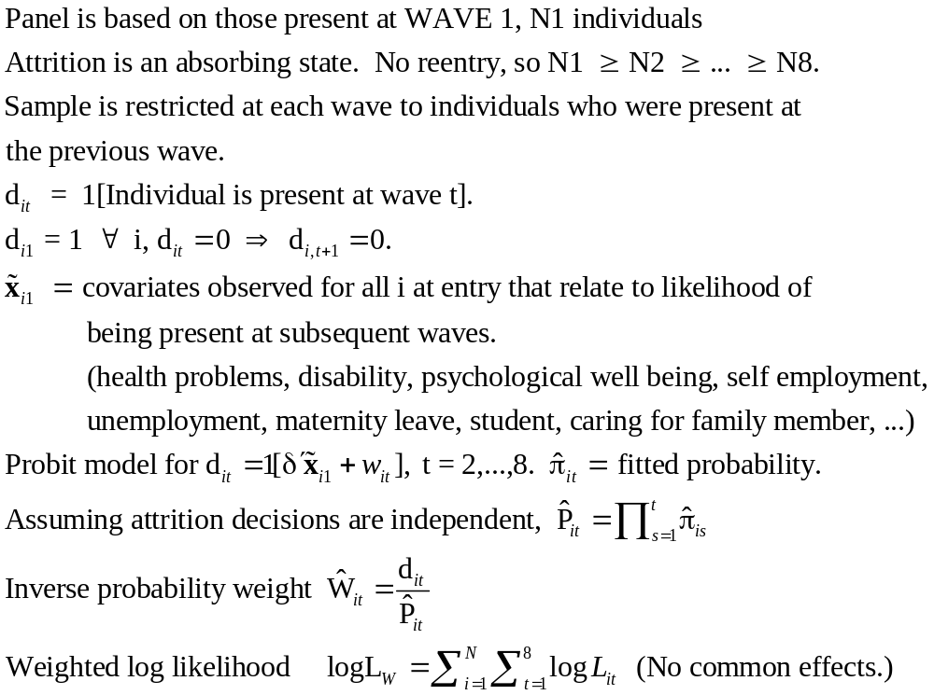
Inverse Probability Weighting

Slide 65

Estimated Partial Effects by Model

Slide 66
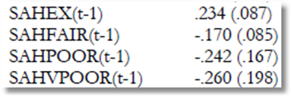
Partial Effect for a Category
These are 4 dummy variables for state in the previous period. Using first differences, the 0.234 estimated for SAHEX means transition from EXCELLENT in the previous period to GOOD in the previous period, where GOOD is the omitted category. Likewise for the other 3 previous state variables. The margin from ‘POOR’ to ‘GOOD’ was not interesting in the paper. The better margin would have been from EXCELLENT to POOR, which would have (EX,POOR) change from (1,0) to (0,1).

