Slide 1
Discrete Choice Modeling
0 Introduction
1 Summary
2 Binary Choice
3 Panel Data
4 Bivariate Probit
5 Ordered Choice
6 Count Data
7 Multinomial Choice
8 Nested Logit
9 Heterogeneity
10 Latent Class
11 Mixed Logit
12 Stated Preference
13 Hybrid Choice
William Greene
Stern School of Business
New York University

Slide 2
Multivariate Binary Choice Models
Bivariate Probit Models
  Analysis of bivariate choices
  Marginal effects
  Prediction
Simultaneous Equations and Recursive Models
A Sample Selection Bivariate Probit Model
The Multivariate Probit Model
  Specification
  Simulation based estimation
  Inference
  Partial effects and analysis
The ‘panel probit model’

Slide 3
Application: Health Care Usage
German Health Care Usage Data, 7,293 Individuals, Varying Numbers of Periods
Variables in the file are
Data downloaded from Journal of Applied Econometrics Archive. This is an unbalanced panel with 7,293 individuals. They can be used for regression, count models, binary choice, ordered choice, and bivariate binary choice. This is a large data set. There are altogether 27,326 observations. The number of observations ranges from 1 to 7. (Frequencies are: 1=1525, 2=1079, 3=825, 4=926, 5=1051, 6=1000, 7=887). Note, the variable NUMOBS below tells how many observations there are for each person. This variable is repeated in each row of the data for the person.
DOCTOR = 1(Number of doctor visits > 0)
HOSPITAL = 1(Number of hospital visits > 0)
HSAT = health satisfaction, coded 0 (low) - 10 (high)
DOCVIS = number of doctor visits in last three months
HOSPVIS = number of hospital visits in last calendar year
PUBLIC = insured in public health insurance = 1; otherwise = 0
ADDON = insured by add-on insurance = 1; otherswise = 0
HHNINC = household nominal monthly net income in German marks / 10000.
(4 observations with income=0 were dropped)
HHKIDS = children under age 16 in the household = 1; otherwise = 0
EDUC = years of schooling
AGE = age in years
MARRIED = marital status
EDUC = years of education

Slide 4
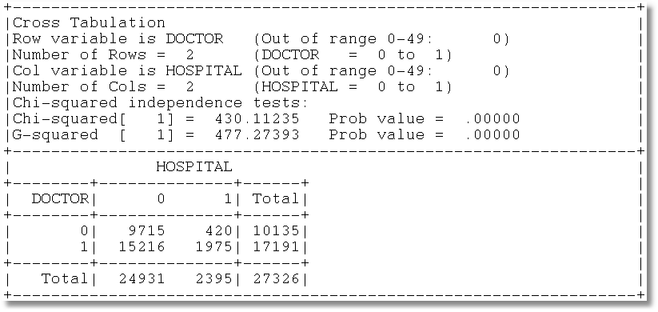
Gross Relation Between Two Binary Variables
Cross Tabulation Suggests Presence or
Absence of a Bivariate Relationship

Slide 5
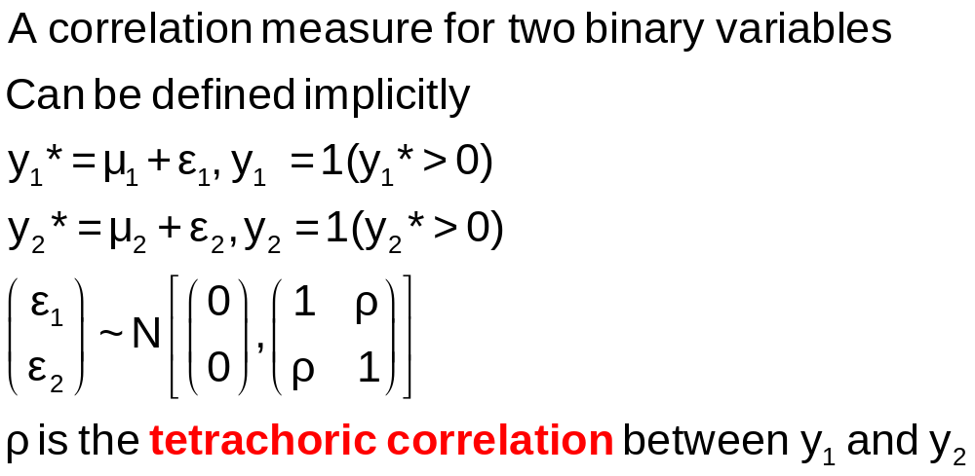
Tetrachoric Correlation

Slide 6
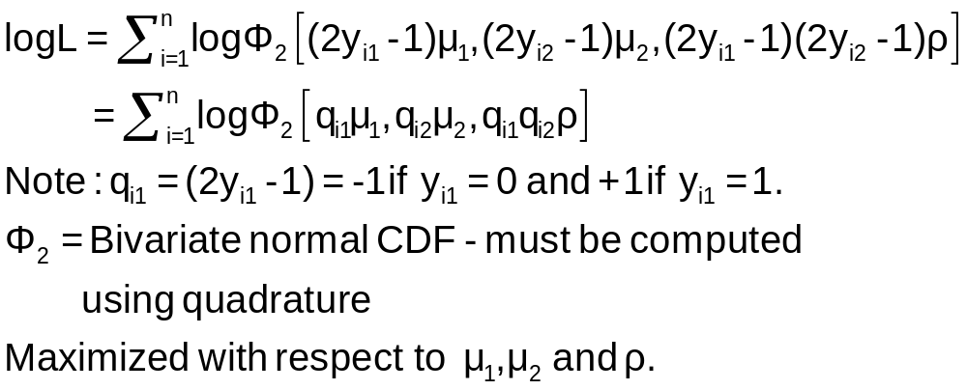
Log Likelihood Function

Slide 7
Estimation
+---------------------------------------------+
| FIML Estimates of Bivariate Probit Model |
| Maximum Likelihood Estimates |
| Dependent variable DOCHOS |
| Weighting variable None |
| Number of observations 27326 |
| Log likelihood function -25898.27 |
| Number of parameters 3 |
+---------------------------------------------+
+---------+--------------+----------------+--------+---------+
|Variable | Coefficient | Standard Error |b/St.Er.|P[|Z|>z] |
+---------+--------------+----------------+--------+---------+
Index equation for DOCTOR
Constant .32949128 .00773326 42.607 .0000
Index equation for HOSPITAL
Constant -1.35539755 .01074410 -126.153 .0000
Tetrachoric Correlation between DOCTOR and HOSPITAL
RHO(1,2) .31105965 .01357302 22.918 .0000

Slide 8
A Bivariate Probit Model
Two Equation Probit Model
(More than two equations comes later)
No bivariate logit – there is no reasonable bivariate counterpart
Why fit the two equation model?
  Analogy to SUR model: Efficient
  Make tetrachoric correlation conditional on covariates – i.e., residual correlation

Slide 9
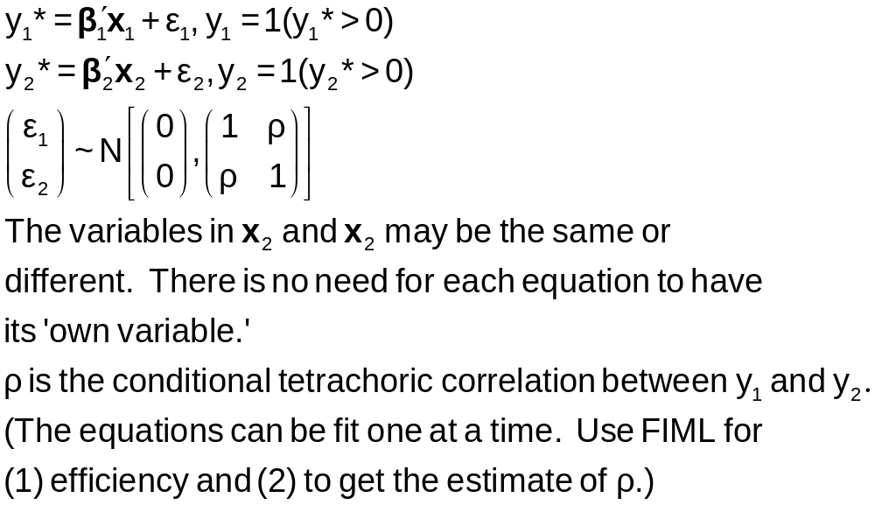
Bivariate Probit Model

Slide 10
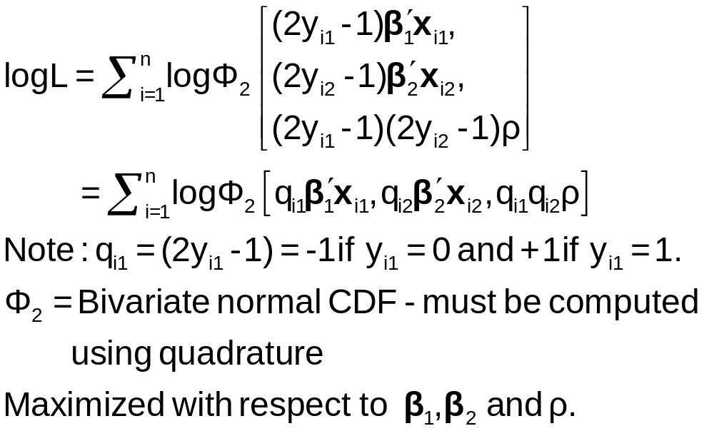
ML Estimation of the
Bivariate Probit Model

Slide 11
Application to Health Care Data
x1=one,age,female,educ,married,working
x2=one,age,female,hhninc,hhkids
BivariateProbit ;lhs=doctor,hospital
;rh1=x1
;rh2=x2;marginal effects $

Slide 12
Parameter Estimates
----------------------------------------------------------------------
FIML Estimates of Bivariate Probit Model
Dependent variable DOCHOS
Log likelihood function -25323.63074
Estimation based on N = 27326, K = 12
--------+-------------------------------------------------------------
Variable| Coefficient Standard Error b/St.Er. P[|Z|>z] Mean of X
--------+-------------------------------------------------------------
|Index equation for DOCTOR
Constant| -.20664*** .05832 -3.543 .0004
AGE| .01402*** .00074 18.948 .0000 43.5257
FEMALE| .32453*** .01733 18.722 .0000 .47877
EDUC| -.01438*** .00342 -4.209 .0000 11.3206
MARRIED| .00224 .01856 .121 .9040 .75862
WORKING| -.08356*** .01891 -4.419 .0000 .67705
|Index equation for HOSPITAL
Constant| -1.62738*** .05430 -29.972 .0000
AGE| .00509*** .00100 5.075 .0000 43.5257
FEMALE| .12143*** .02153 5.641 .0000 .47877
HHNINC| -.03147 .05452 -.577 .5638 .35208
HHKIDS| -.00505 .02387 -.212 .8323 .40273
|Disturbance correlation
RHO(1,2)| .29611*** .01393 21.253 .0000
--------+-------------------------------------------------------------

Slide 13
Marginal Effects
What are the marginal effects
  Effect of what on what?
  Two equation model, what is the conditional mean?
Possible margins?
  Derivatives of joint probability = Φ₂(β₁’x_{i1}, β₂’x_{i2},ρ)
  Partials of E[y_{ij}|x_{ij}] =Φ(β_{j}’x_{ij}) (Univariate probability)
  Partials of E[y_{i1}|x_{i1},x_{i2},y_{i2}=1] = P(y_{i1},y_{i2}=1)/Prob[y_{i2}=1]
Note marginal effects involve both sets of regressors.
If there are common variables, there are two effects
in the derivative that are added.

Slide 14
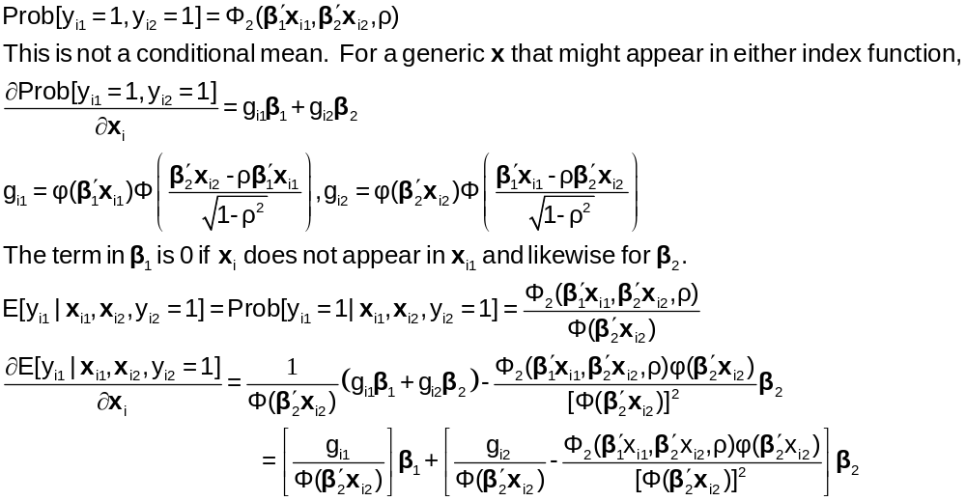
Bivariate Probit Conditional Means

Slide 15
Marginal Effects: Decomposition
+------------------------------------------------------+
| Marginal Effects for Ey1|y2=1 |
+----------+----------+----------+----------+----------+
| Variable | Efct x1 | Efct x2 | Efct z1 | Efct z2 |
+----------+----------+----------+----------+----------+
| AGE | .00383 | -.00035 | .00000 | .00000 |
| FEMALE | .08857 | -.00835 | .00000 | .00000 |
| EDUC | -.00392 | .00000 | .00000 | .00000 |
| MARRIED | .00061 | .00000 | .00000 | .00000 |
| WORKING | -.02281 | .00000 | .00000 | .00000 |
| HHNINC | .00000 | .00217 | .00000 | .00000 |
| HHKIDS | .00000 | .00035 | .00000 | .00000 |
+----------+----------+----------+----------+----------+

Slide 16
Direct Effects
Derivatives of E[y₁|x₁,x₂,y₂=1] wrt x₁
+-------------------------------------------+
| Partial derivatives of E[y1|y2=1] with |
| respect to the vector of characteristics. |
| They are computed at the means of the Xs. |
| Effect shown is total of 4 parts above. |
| Estimate of E[y1|y2=1] = .819898 |
| Observations used for means are All Obs. |
| These are the direct marginal effects. |
+-------------------------------------------+
+---------+--------------+----------------+--------+---------+----------+
|Variable | Coefficient | Standard Error |b/St.Er.|P[|Z|>z] | Mean of X|
+---------+--------------+----------------+--------+---------+----------+
AGE .00382760 .00022088 17.329 .0000 43.5256898
FEMALE .08857260 .00519658 17.044 .0000 .47877479
EDUC -.00392413 .00093911 -4.179 .0000 11.3206310
MARRIED .00061108 .00506488 .121 .9040 .75861817
WORKING -.02280671 .00518908 -4.395 .0000 .67704750
HHNINC .000000 ......(Fixed Parameter)....... .35208362
HHKIDS .000000 ......(Fixed Parameter)....... .40273000

Slide 17
Indirect Effects
Derivatives of E[y₁|x₁,x₂,y₂=1] wrt x₂
+-------------------------------------------+
| Partial derivatives of E[y1|y2=1] with |
| respect to the vector of characteristics. |
| They are computed at the means of the Xs. |
| Effect shown is total of 4 parts above. |
| Estimate of E[y1|y2=1] = .819898 |
| Observations used for means are All Obs. |
| These are the indirect marginal effects. |
+-------------------------------------------+
+---------+--------------+----------------+--------+---------+----------+
|Variable | Coefficient | Standard Error |b/St.Er.|P[|Z|>z] | Mean of X|
+---------+--------------+----------------+--------+---------+----------+
AGE -.00035034 .697563D-04 -5.022 .0000 43.5256898
FEMALE -.00835397 .00150062 -5.567 .0000 .47877479
EDUC .000000 ......(Fixed Parameter)....... 11.3206310
MARRIED .000000 ......(Fixed Parameter)....... .75861817
WORKING .000000 ......(Fixed Parameter)....... .67704750
HHNINC .00216510 .00374879 .578 .5636 .35208362
HHKIDS .00034768 .00164160 .212 .8323 .40273000

Slide 18
Marginal Effects: Total Effects
Sum of Two Derivative Vectors
+-------------------------------------------+
| Partial derivatives of E[y1|y2=1] with |
| respect to the vector of characteristics. |
| They are computed at the means of the Xs. |
| Effect shown is total of 4 parts above. |
| Estimate of E[y1|y2=1] = .819898 |
| Observations used for means are All Obs. |
| Total effects reported = direct+indirect. |
+-------------------------------------------+
+---------+--------------+----------------+--------+---------+----------+
|Variable | Coefficient | Standard Error |b/St.Er.|P[|Z|>z] | Mean of X|
+---------+--------------+----------------+--------+---------+----------+
AGE .00347726 .00022941 15.157 .0000 43.5256898
FEMALE .08021863 .00535648 14.976 .0000 .47877479
EDUC -.00392413 .00093911 -4.179 .0000 11.3206310
MARRIED .00061108 .00506488 .121 .9040 .75861817
WORKING -.02280671 .00518908 -4.395 .0000 .67704750
HHNINC .00216510 .00374879 .578 .5636 .35208362
HHKIDS .00034768 .00164160 .212 .8323 .40273000

Slide 19
Marginal Effects: Dummy Variables
Using Differences of Probabilities
+-----------------------------------------------------------+
| Analysis of dummy variables in the model. The effects are |
| computed using E[y1|y2=1,d=1] - E[y1|y2=1,d=0] where d is |
| the variable. Variances use the delta method. The effect |
| accounts for all appearances of the variable in the model.|
+-----------------------------------------------------------+
|Variable Effect Standard error t ratio (deriv) |
+-----------------------------------------------------------+
FEMALE .079694 .005290 15.065 (.080219)
MARRIED .000611 .005070 .121 (.000511)
WORKING -.022485 .005044 -4.457 (-.022807)
HHKIDS .000348 .001641 .212 (.000348)

Slide 20
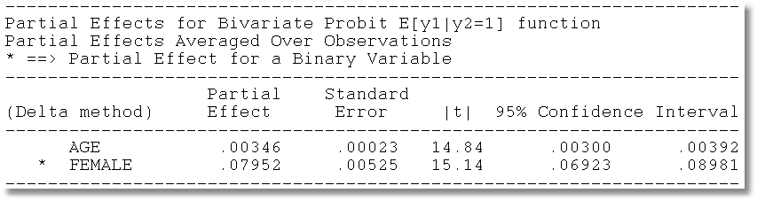
Average Partial Effects

Slide 21
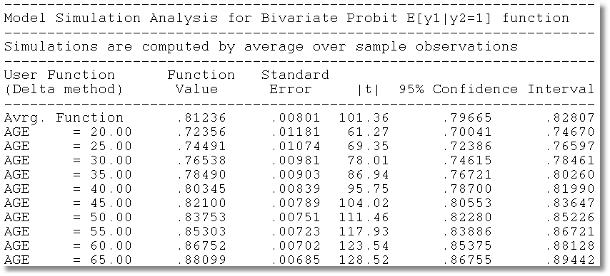
Model Simulation

Slide 22
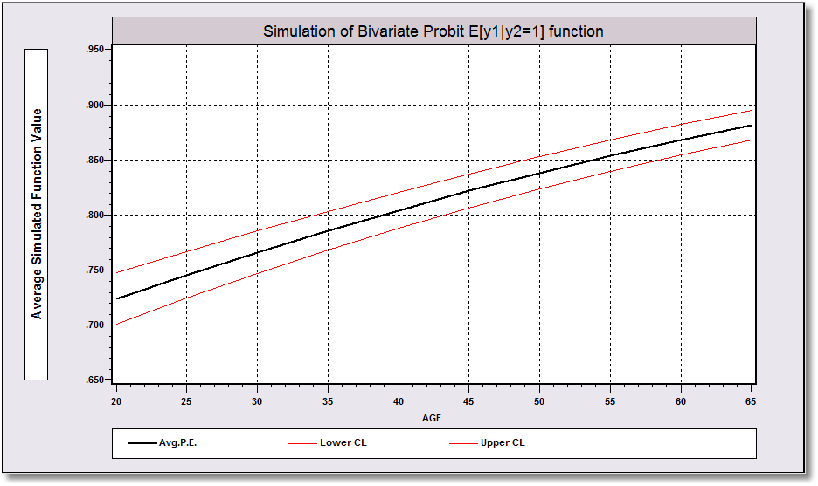
Model Simulation

Slide 23
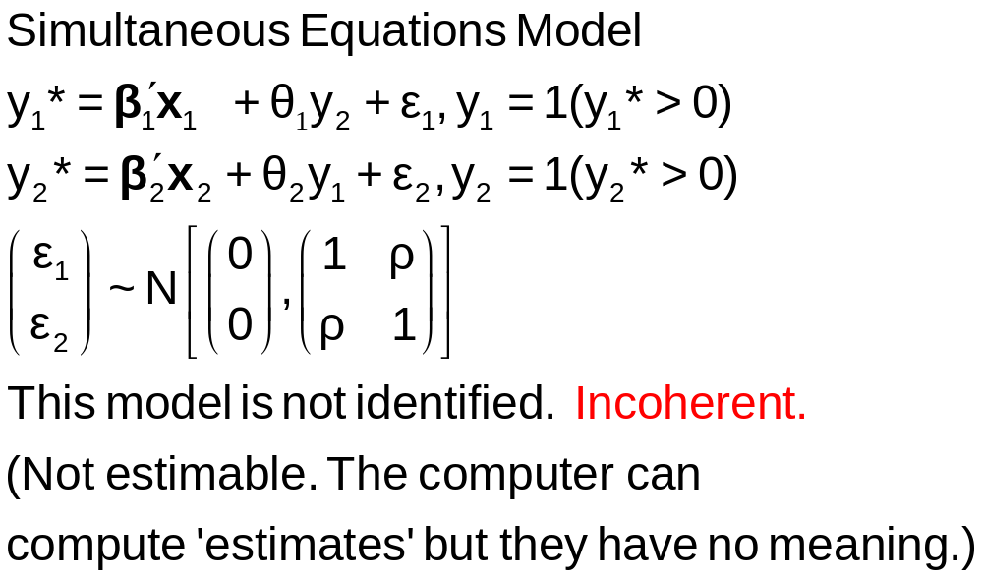
A Simultaneous Equations Model

Slide 24
Fully Simultaneous “Model”
----------------------------------------------------------------------
FIML Estimates of Bivariate Probit Model
Dependent variable DOCHOS
Log likelihood function -20318.69455
--------+-------------------------------------------------------------
Variable| Coefficient Standard Error b/St.Er. P[|Z|>z] Mean of X
--------+-------------------------------------------------------------
|Index equation for DOCTOR
Constant| -.46741*** .06726 -6.949 .0000
AGE| .01124*** .00084 13.353 .0000 43.5257
FEMALE| .27070*** .01961 13.807 .0000 .47877
EDUC| -.00025 .00376 -.067 .9463 11.3206
MARRIED| -.00212 .02114 -.100 .9201 .75862
WORKING| -.00362 .02212 -.164 .8701 .67705
HOSPITAL| 2.04295*** .30031 6.803 .0000 .08765
|Index equation for HOSPITAL
Constant| -1.58437*** .08367 -18.936 .0000
AGE| -.01115*** .00165 -6.755 .0000 43.5257
FEMALE| -.26881*** .03966 -6.778 .0000 .47877
HHNINC| .00421 .08006 .053 .9581 .35208
HHKIDS| -.00050 .03559 -.014 .9888 .40273
DOCTOR| 2.04479*** .09133 22.389 .0000 .62911
|Disturbance correlation
RHO(1,2)| -.99996*** .00048 ******** .0000
--------+-------------------------------------------------------------

Slide 25
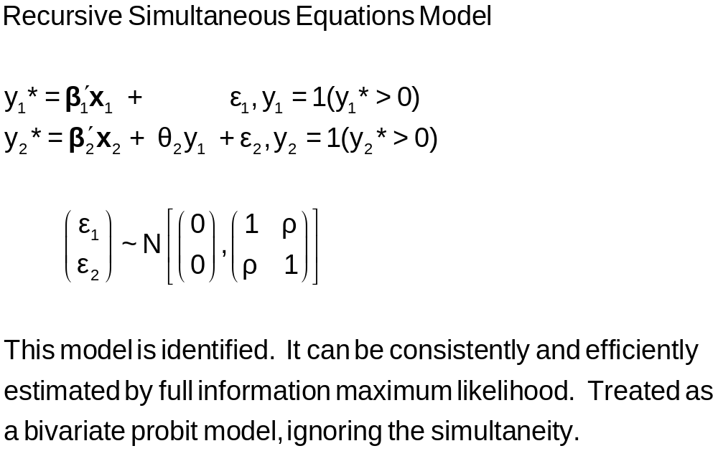
A Recursive Simultaneous
Equations Model
Bivariate ; Lhs = y1,y2 ; Rh1=…,y2 ; Rh2 = … $

Slide 26
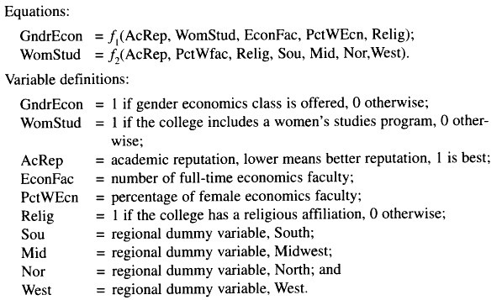
Application: Gender Economics at Liberal Arts Colleges
Journal of Economic Education, fall, 1998.

Slide 27
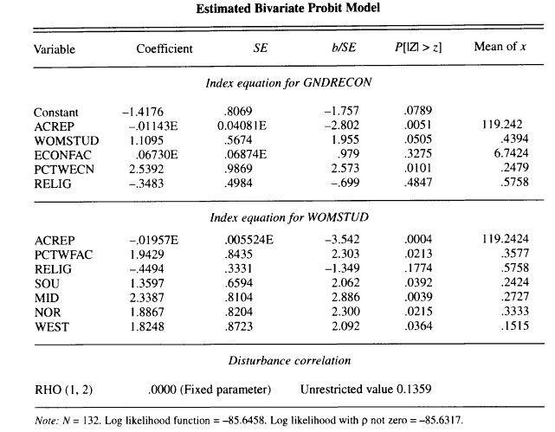
Estimated Recursive Model

Slide 28
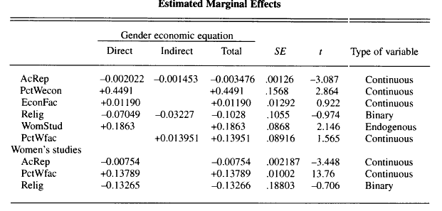
Estimated Effects: Decomposition

Slide 29


Slide 30
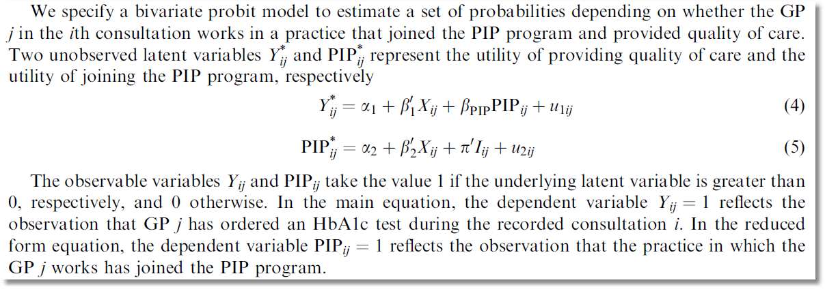
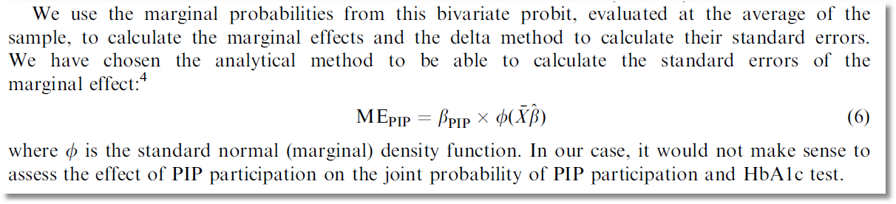

Slide 31

Causal Inference?
Causal Inference?
There is no partial (marginal) effect for PIP.
PIP cannot change partially (marginally). It changes because something
else changes. (X or I or u₂.)
The calculation of ME_{PIP} does not make sense.

Slide 32
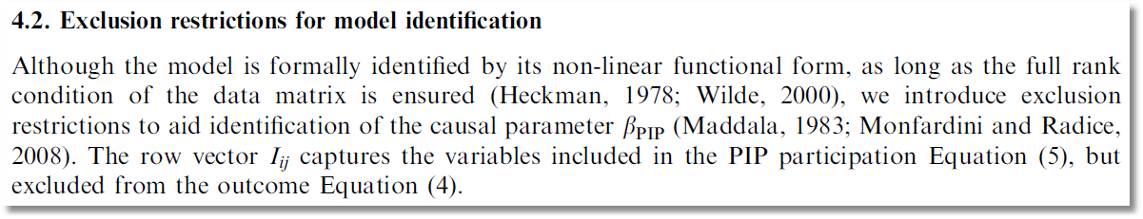

Slide 33
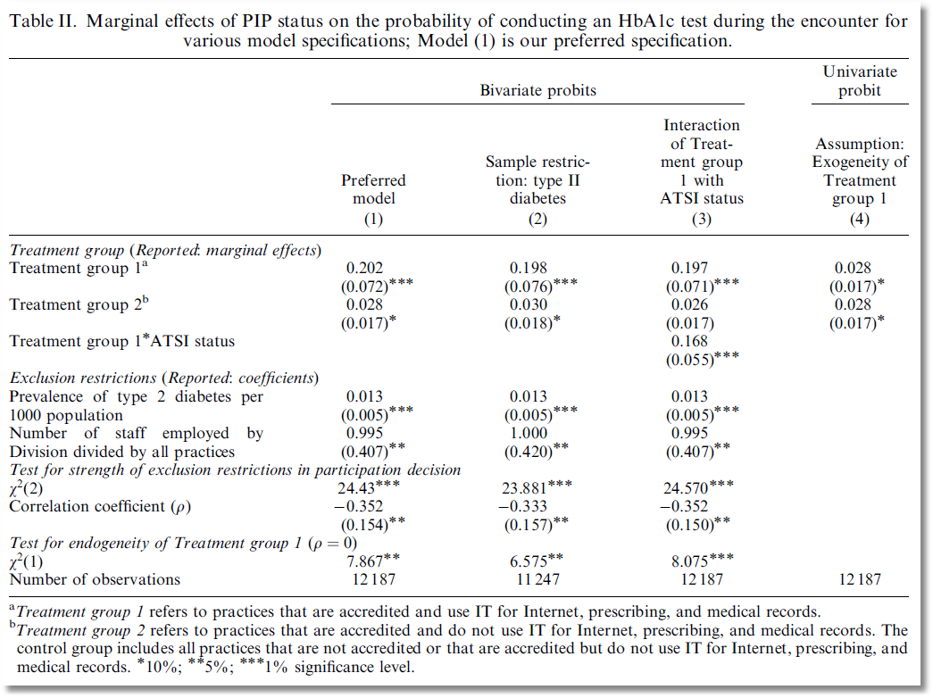

Slide 34
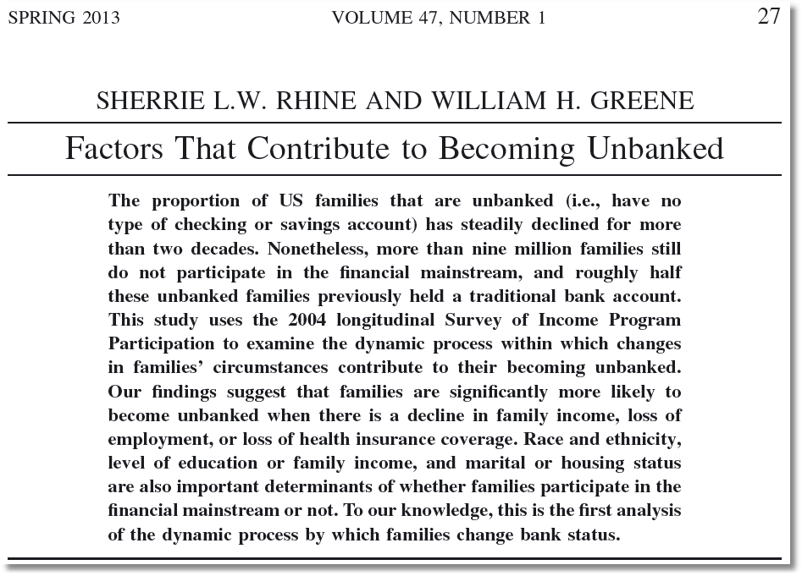

Slide 35
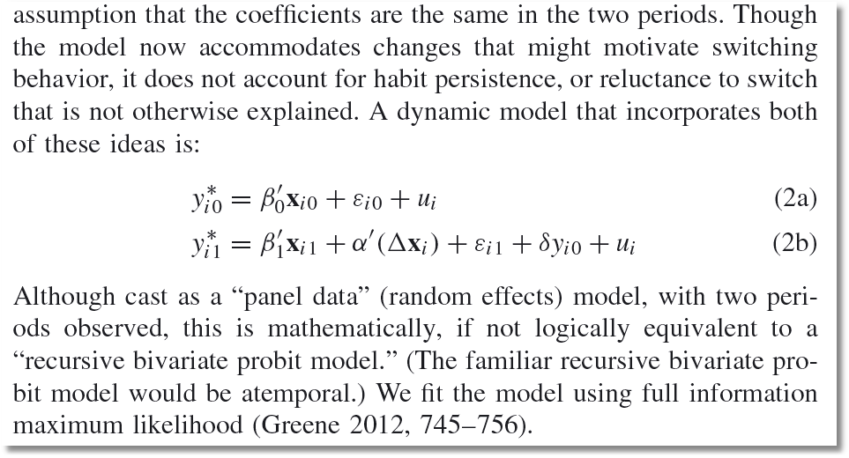

Slide 36
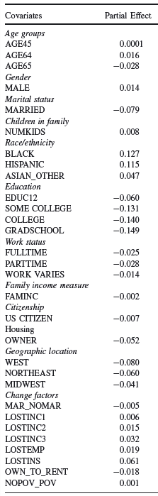


Slide 37
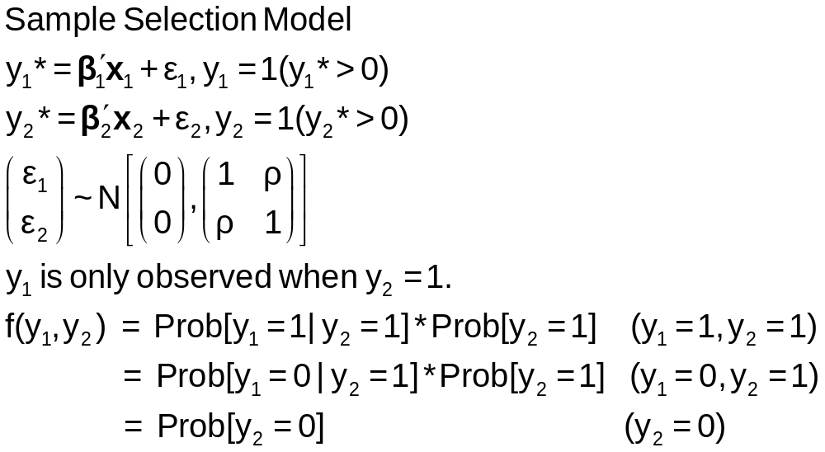
A Sample Selection Model

Slide 38
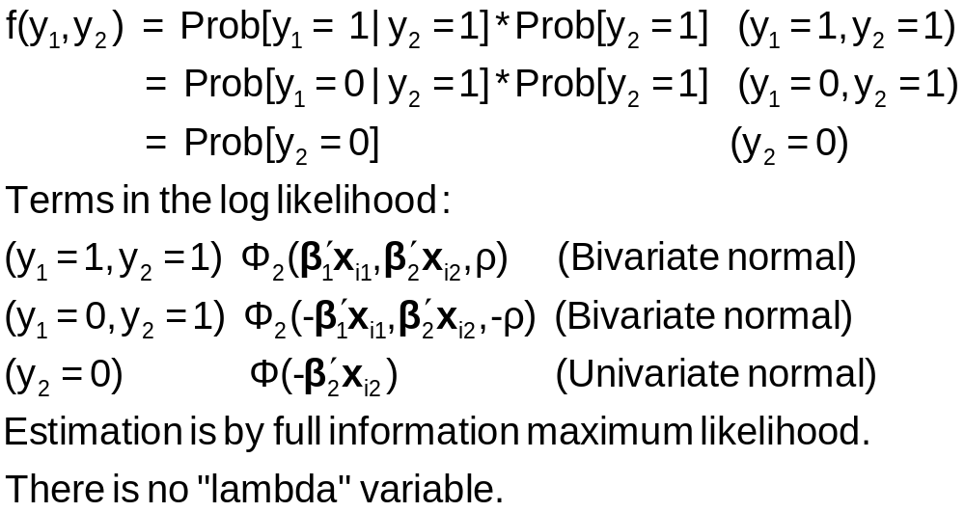
Sample Selection Model: Estimation

Slide 39
Application: Credit Scoring
American Express: 1992
N = 13,444 Applications
  Observed application data
  Observed acceptance/rejection of application
N₁ = 10,499 Cardholders
  Observed demographics and economic data
  Observed default or not in first 12 months
Full Sample is in AmEx.lpj; description shows when imported.

Slide 40
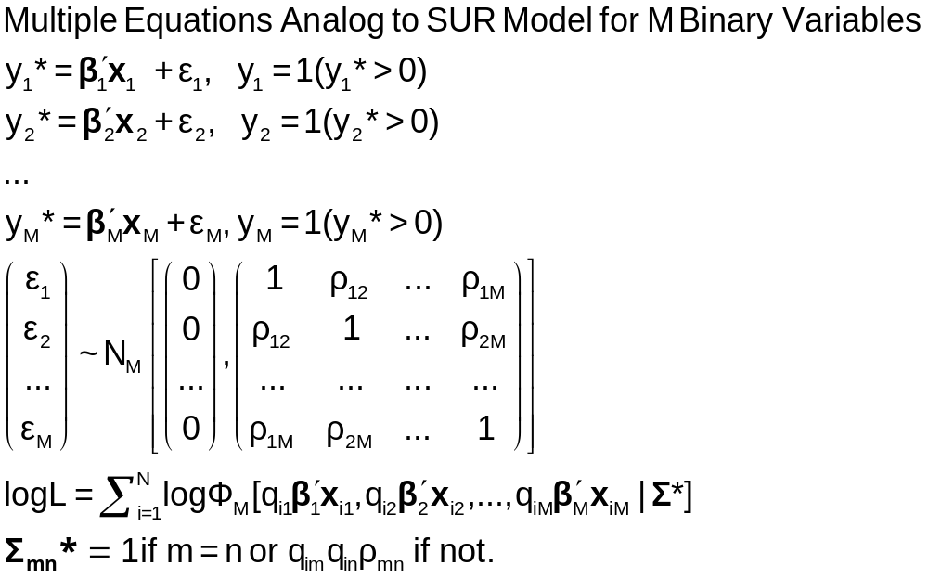
The Multivariate Probit Model

Slide 41
MLE: Simulation
Estimation of the multivariate probit model requires evaluation of M-order Integrals
The general case is usually handled with the GHK simulator. Much current research focuses on efficiency (speed) gains in this computation.
The “Panel Probit Model” is a special case.
  (Bertschek-Lechner, JE, 1999) – Construct a GMM estimator using only first order integrals of the univariate normal CDF
  (Greene, Emp.Econ, 2003) – Estimate the integrals with simulation (GHK) anyway.

Slide 42
----------------------------------------------------------------------
Multivariate Probit Model: 3 equations.
Dependent variable MVProbit
Log likelihood function -4751.09039
--------+-------------------------------------------------------------
Variable| Coefficient Standard Error b/St.Er. P[|Z|>z] Mean of X
--------+-------------------------------------------------------------
|Index function for DOCTOR
Constant| -.35527** .16715 -2.125 .0335 [-0.29987 .16195]
AGE| .01664*** .00194 8.565 .0000 43.9959 [ 0.01644 .00193]
FEMALE| .30931*** .04812 6.427 .0000 .47935 [ 0.30643 .04767]
EDUC| -.01566 .01024 -1.530 .1261 11.0909 [-0.01936 .00962]
MARRIED| -.04487 .05112 -.878 .3801 .78911 [-0.04423 .05139]
WORKING| -.14712*** .05075 -2.899 .0037 .63345 [-0.15390 .05054]
|Index function for HOSPITAL
Constant| -1.61787*** .15729 -10.286 .0000 [-1.58276 .16119]
AGE| .00717** .00283 2.536 .0112 43.9959 [ 0.00662 .00288]
FEMALE| -.00039 .05995 -.007 .9948 .47935 [-0.00407 .05991]
HHNINC| -.41050 .25147 -1.632 .1026 .29688 [-0.41080 .22891]
HHKIDS| -.01547 .06551 -.236 .8134 .44915 [-0.03688 .06615]
|Index function for PUBLIC
Constant| 1.51314*** .18608 8.132 .0000 [ 1.53542 .17060]
AGE| .00661** .00289 2.287 .0222 43.9959 [ 0.00646 .00268]
HSAT| -.06844*** .01385 -4.941 .0000 6.90062 [-0.07069 .01266]
MARRIED| -.00859 .06892 -.125 .9008 .78911 [-.00813 .06908]
|Correlation coefficients
R(01,02)| .28381*** .03833 7.404 .0000 [ was 0.29611 ]
R(01,03)| .03509 .03768 .931 .3517
R(02,03)| -.04100 .04831 -.849 .3960
--------+-------------------------------------------------------------

Slide 43
Marginal Effects
There are M equations: “Effect of what on what?”
NLOGIT computes E[y1|all other ys, all xs]
Marginal effects are derivatives of this with respect to all xs. (EXTREMELY MESSY)
Standard errors are estimated with bootstrapping.

