Slide 1

Discrete Choice Modeling
0 Introduction
1 Summary
2 Binary Choice
3 Panel Data
4 Bivariate Probit
5 Ordered Choice
6 Count Data
7 Multinomial Choice
8 Nested Logit
9 Heterogeneity
10 Latent Class
11 Mixed Logit
12 Stated Preference
13 Hybrid Choice
William Greene
Stern School of Business
New York University

Slide 2
Ordered Discrete Outcomes
E.g.: Taste test, credit rating, course grade, preference scale
Underlying random preferences:
  Existence of an underlying continuous preference scale
  Mapping to observed choices
Strength of preferences is reflected in the discrete outcome
Censoring and discrete measurement
The nature of ordered data

Slide 3
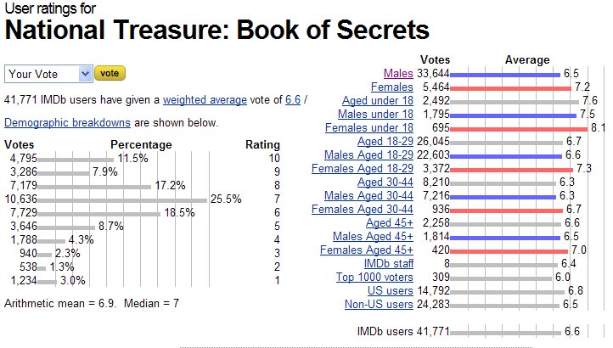
Ordered Preferences at IMDB.com

Slide 4

Health Satisfaction (HSAT)
Self administered survey: Health Care Satisfaction? (0 – 10)
Continuous Preference Scale

Slide 5
Modeling Ordered Choices
Random Utility (allowing a panel data setting)
Uit = α + β’xit + ε_{it}
= a_{it} + ε_{it}
Observe outcome j if utility is in region j
Probability of outcome = probability of cell
Pr[Yit=j] = F(μ_{j} – a_{it}) - F(μ_{j-1} – a_{it})

Slide 6
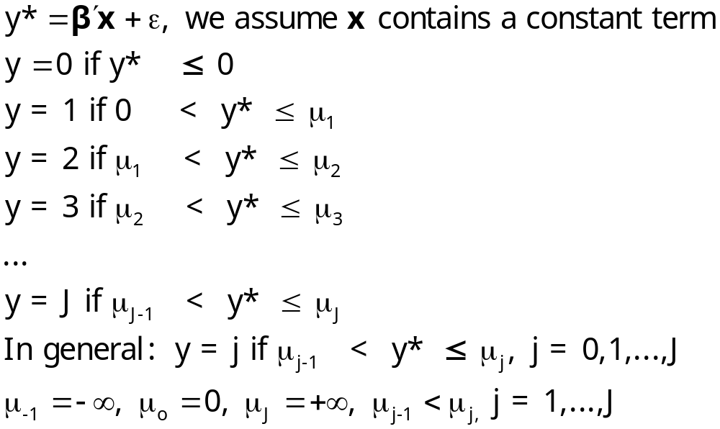
Ordered Probability Model

Slide 7

Combined Outcomes for Health Satisfaction

Slide 8
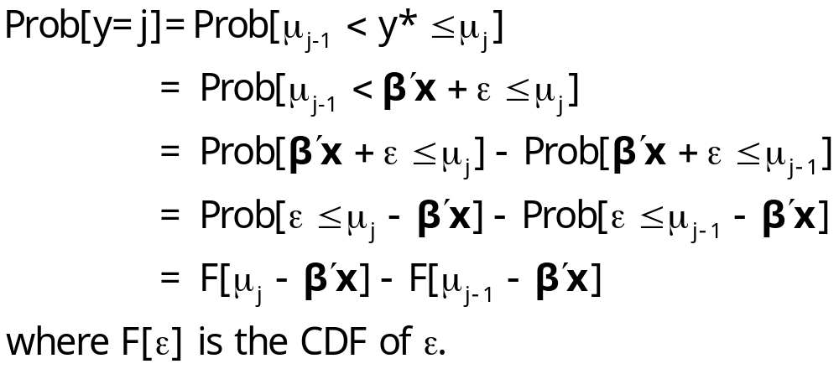
Ordered Probabilities

Slide 9
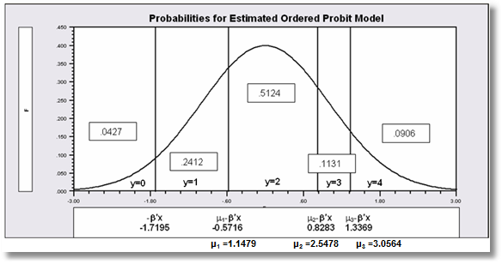

Slide 10
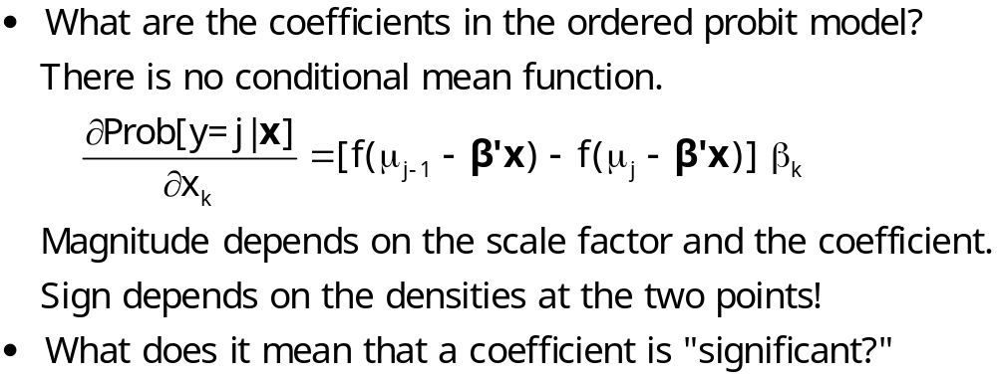
Coefficients

Slide 11
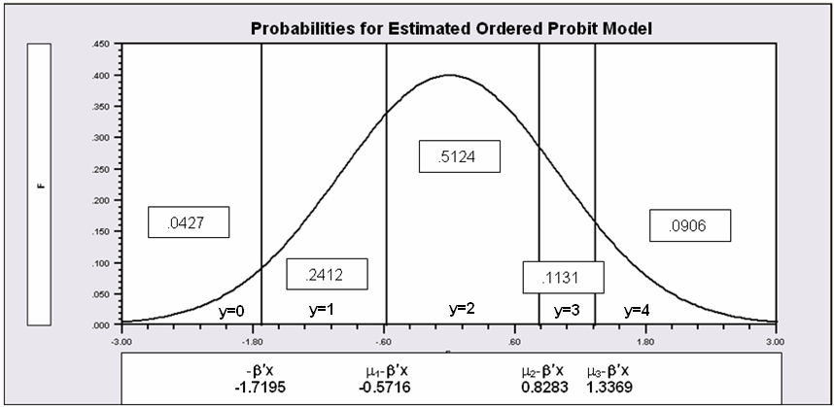
Partial Effects in the Ordered Choice Model
Assume the β_{k} is positive.
Assume that x_{k} increases.
β’x increases. μ_{j}- β’x shifts to the left for all 5 cells.
Prob[y=0] decreases
Prob[y=1] decreases – the mass shifted out is larger than the mass shifted in.
Prob[y=3] increases – same reason in reverse.
Prob[y=4] must increase.
When β_{k} > 0, increase in x_{k} decreases Prob[y=0] and increases Prob[y=J]. Intermediate cells are ambiguous, but there is only one sign change in the marginal effects from 0 to 1 to … to J

Slide 12
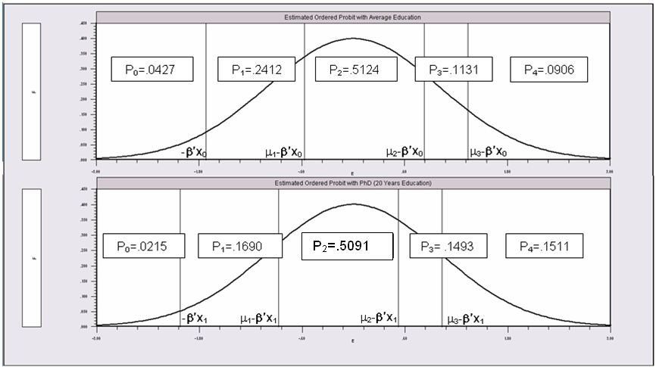
Partial Effects of 8 Years of Education

Slide 13
An Ordered Probability
Model for Health Satisfaction
+---------------------------------------------+
| Ordered Probability Model |
| Dependent variable HSAT |
| Number of observations 27326 |
| Underlying probabilities based on Normal |
| Cell frequencies for outcomes |
| Y Count Freq Y Count Freq Y Count Freq |
| 0 447 .016 1 255 .009 2 642 .023 |
| 3 1173 .042 4 1390 .050 5 4233 .154 |
| 6 2530 .092 7 4231 .154 8 6172 .225 |
| 9 3061 .112 10 3192 .116 |
+---------------------------------------------+
+---------+--------------+----------------+--------+---------+----------+
|Variable | Coefficient | Standard Error |b/St.Er.|P[|Z|>z] | Mean of X|
+---------+--------------+----------------+--------+---------+----------+
Index function for probability
Constant 2.61335825 .04658496 56.099 .0000
FEMALE -.05840486 .01259442 -4.637 .0000 .47877479
EDUC .03390552 .00284332 11.925 .0000 11.3206310
AGE -.01997327 .00059487 -33.576 .0000 43.5256898
HHNINC .25914964 .03631951 7.135 .0000 .35208362
HHKIDS .06314906 .01350176 4.677 .0000 .40273000
Threshold parameters for index
Mu(1) .19352076 .01002714 19.300 .0000
Mu(2) .49955053 .01087525 45.935 .0000
Mu(3) .83593441 .00990420 84.402 .0000
Mu(4) 1.10524187 .00908506 121.655 .0000
Mu(5) 1.66256620 .00801113 207.532 .0000
Mu(6) 1.92729096 .00774122 248.965 .0000
Mu(7) 2.33879408 .00777041 300.987 .0000
Mu(8) 2.99432165 .00851090 351.822 .0000
Mu(9) 3.45366015 .01017554 339.408 .0000

Slide 14
Ordered Probability Partial Effects
+----------------------------------------------------+
| Marginal effects for ordered probability model |
| M.E.s for dummy variables are Pr[y|x=1]-Pr[y|x=0] |
| Names for dummy variables are marked by *. |
+----------------------------------------------------+
+---------+--------------+----------------+--------+---------+----------+
|Variable | Coefficient | Standard Error |b/St.Er.|P[|Z|>z] | Mean of X|
+---------+--------------+----------------+--------+---------+----------+
These are the effects on Prob[Y=00] at means.
*FEMALE .00200414 .00043473 4.610 .0000 .47877479
EDUC -.00115962 .986135D-04 -11.759 .0000 11.3206310
AGE .00068311 .224205D-04 30.468 .0000 43.5256898
HHNINC -.00886328 .00124869 -7.098 .0000 .35208362
*HHKIDS -.00213193 .00045119 -4.725 .0000 .40273000
These are the effects on Prob[Y=01] at means.
*FEMALE .00101533 .00021973 4.621 .0000 .47877479
EDUC -.00058810 .496973D-04 -11.834 .0000 11.3206310
AGE .00034644 .108937D-04 31.802 .0000 43.5256898
HHNINC -.00449505 .00063180 -7.115 .0000 .35208362
*HHKIDS -.00108460 .00022994 -4.717 .0000 .40273000
... repeated for all 11 outcomes
These are the effects on Prob[Y=10] at means.
*FEMALE -.01082419 .00233746 -4.631 .0000 .47877479
EDUC .00629289 .00053706 11.717 .0000 11.3206310
AGE -.00370705 .00012547 -29.545 .0000 43.5256898
HHNINC .04809836 .00678434 7.090 .0000 .35208362
*HHKIDS .01181070 .00255177 4.628 .0000 .40273000

Slide 15
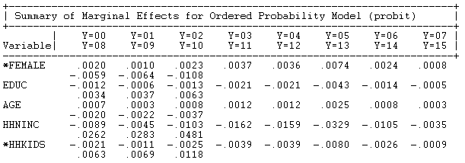
Ordered Probit Marginal Effects

Slide 16
Analysis of Model Implications
Partial Effects
Fit Measures
Predicted Probabilities
  Averaged: They match sample proportions.
  By observation
  Segments of the sample
  Related to particular variables

Slide 17
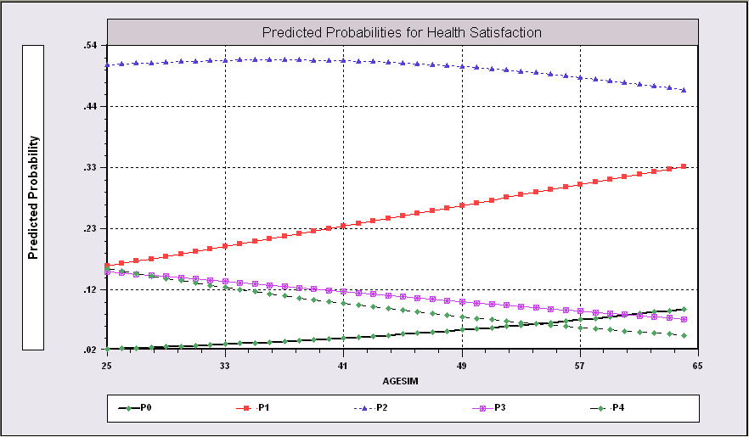
Predictions from the Model Related to Age

Slide 18
Fit Measures
There is no single “dependent variable” to explain.
There is no sum of squares or other measure of “variation” to explain.
Predictions of the model relate to a set of J+1 probabilities, not a single variable.
How to explain fit?
  Based on the underlying regression
  Based on the likelihood function
  Based on prediction of the outcome variable

Slide 19
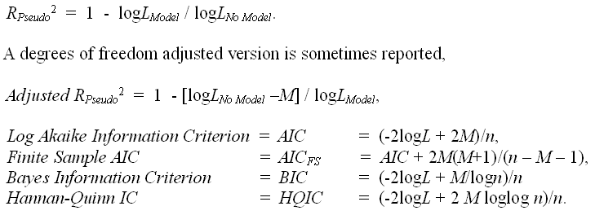
Log Likelihood Based Fit Measures

Slide 20
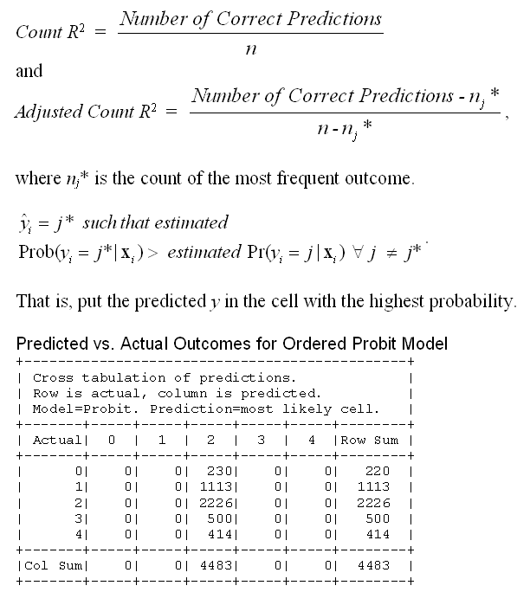

Slide 21
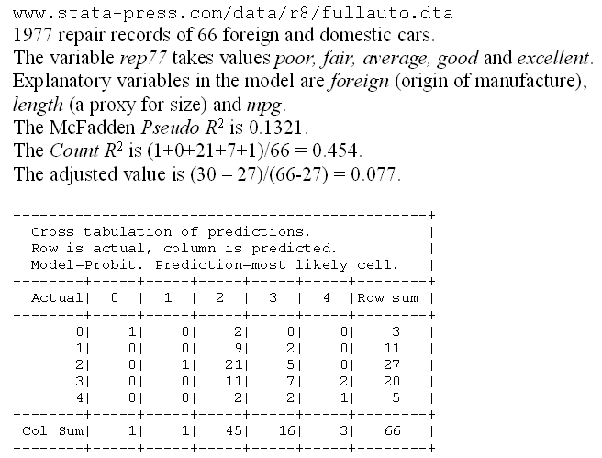
A Somewhat Better Fit

Slide 22
Different Normalizations
NLOGIT
  Y = 0,1,…,J, U* = α + β’x + ε
  One overall constant term, α
  J-1 “cutpoints;” μ₋₁ = -∞, μ₀ = 0, μ₁,… μ_{J-1}, μ_{J} = + ∞
Stata
  Y = 1,…,J+1, U* = β’x + ε
  No overall constant, α=0
  J “cutpoints;” μ₀ = -∞, μ₁,… μ_{J}, μ_{J+1} = + ∞

Slide 23
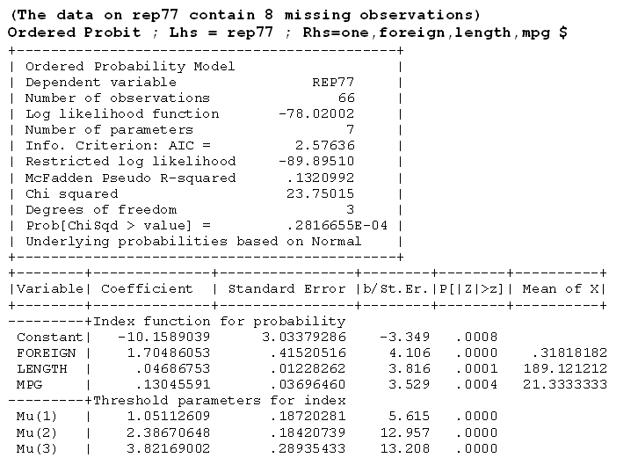



Slide 24
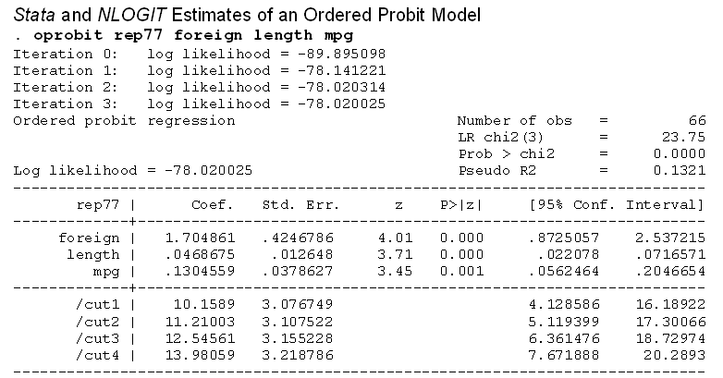



Slide 25
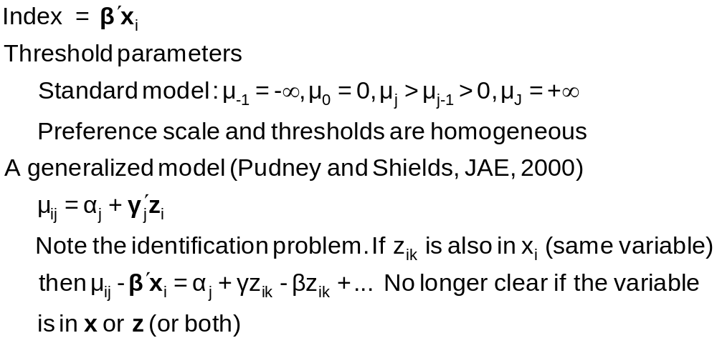
Generalizing the Ordered Probit with Heterogeneous Thresholds

Slide 26
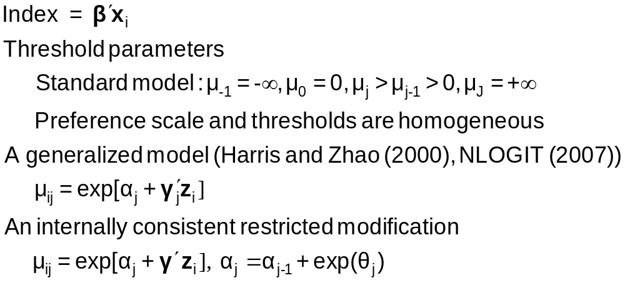
Hierarchical Ordered Probit

Slide 27
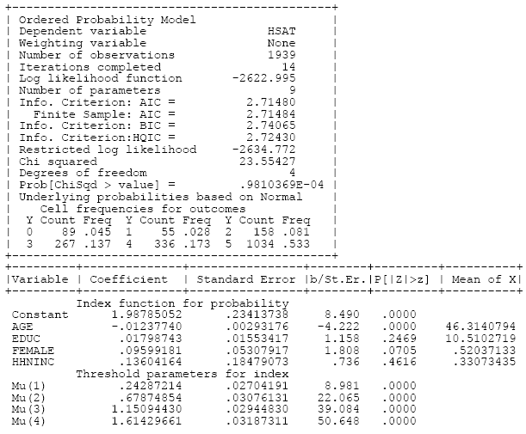
Ordered Choice Model

Slide 28
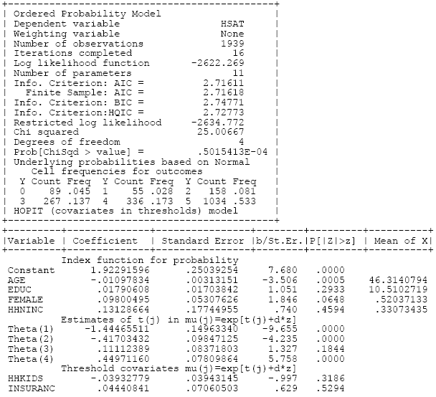
HOPit Model

Slide 29
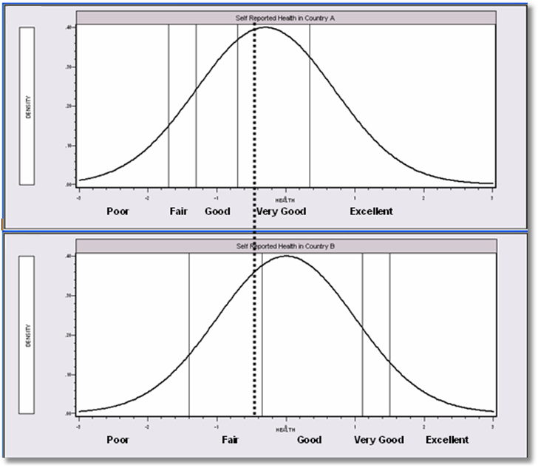
Differential Item Functioning

Slide 30
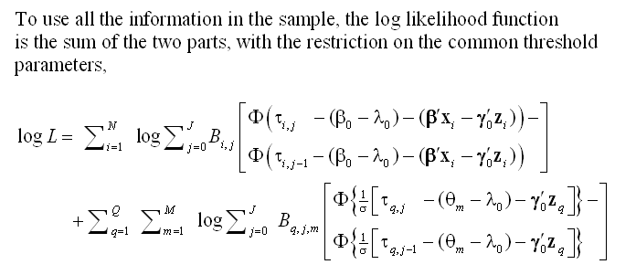
A Vignette Random Effects Model

Slide 31
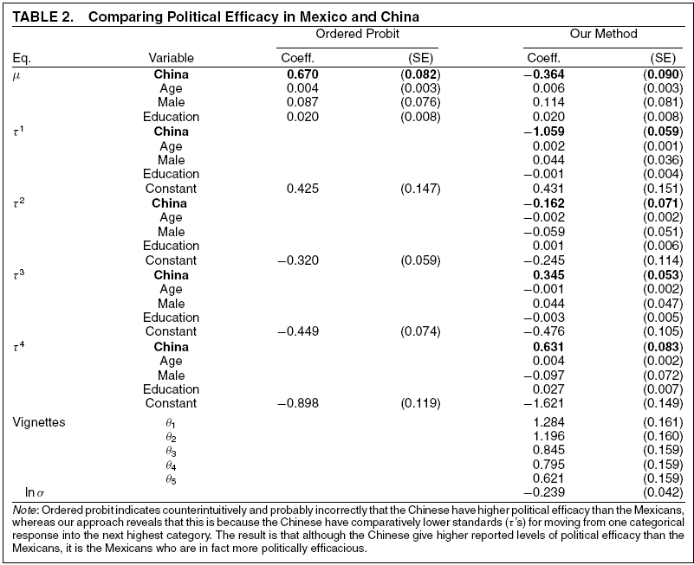
Vignettes

Slide 32


Slide 33
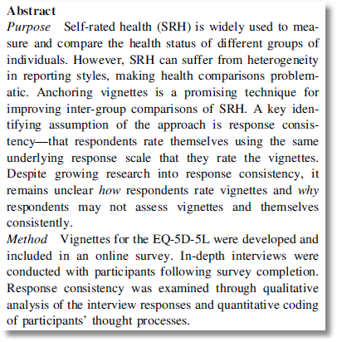

Slide 34
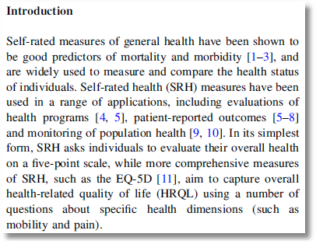

Slide 35
Panel Data
Fixed Effects
  The usual incidental parameters problem
  Practically feasible but methodologically ambiguous
  Partitioning Prob(y_{it} > j|x_{it}) produces estimable binomial logit models. (Find a way to combine multiple estimates of the same β.
Random Effects
  Standard application
  Extension to random parameters – see above

Slide 36
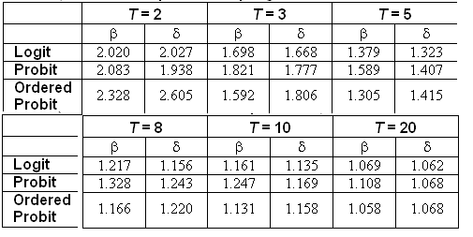
Incidental Parameters Problem
Table 9.1 Monte Carlo Analysis of the Bias of the MLE in Fixed Effects Discrete Choice Models (Means of empirical sampling distributions, N = 1,000 individuals, R = 200 replications)

Slide 37

A Dynamic Ordered Probit Model

Slide 38
Model for Self Assessed Health
British Household Panel Survey (BHPS)
  Waves 1-8, 1991-1998
  Self assessed health on 0,1,2,3,4 scale
  Sociological and demographic covariates
  Dynamics – inertia in reporting of top scale
Dynamic ordered probit model
  Balanced panel – analyze dynamics
  Unbalanced panel – examine attrition

Slide 39
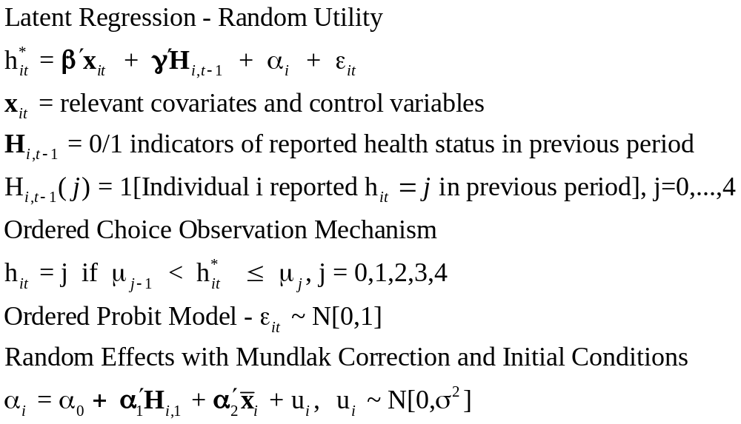
Dynamic Ordered Probit Model
It would not be appropriate to include h_{i,t-1} itself in the model as this is a label, not a measure

Slide 40
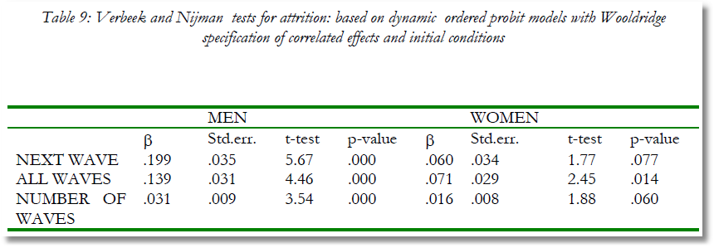
Testing for Attrition Bias
Three dummy variables added to full model with unbalanced panel suggest presence of attrition effects.

Slide 41

Attrition Model with IP Weights
Assumes (1) Prob(attrition|all data) = Prob(attrition|selected variables) (ignorability)
(2) Attrition is an ‘absorbing state.’ No reentry.
Obviously not true for the GSOEP data above.
Can deal with point (2) by isolating a subsample of those present at wave 1 and the monotonically shrinking subsample as the waves progress.

Slide 42
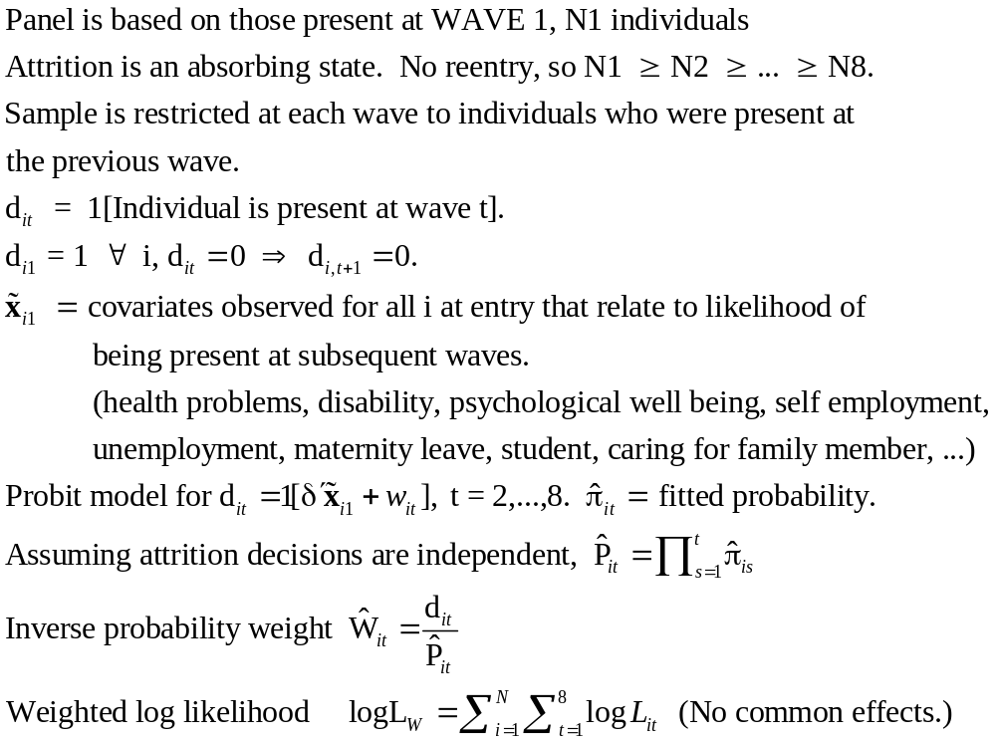
Inverse Probability Weighting

Slide 43

Estimated Partial Effects by Model

Slide 44
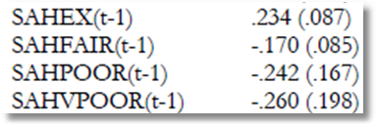
Partial Effect for a Category
These are 4 dummy variables for state in the previous period. Using first differences, the 0.234 estimated for SAHEX means transition from EXCELLENT in the previous period to GOOD in the previous period, where GOOD is the omitted category. Likewise for the other 3 previous state variables. The margin from ‘POOR’ to ‘GOOD’ was not interesting in the paper. The better margin would have been from EXCELLENT to POOR, which would have (EX,POOR) change from (1,0) to (0,1).

Slide 45
Model Extensions
Multivariate
  Bivariate
  Multivariate
Inflation and Two Part
  Zero inflation
  Sample Selection
  Endogenous Latent Class

Slide 46
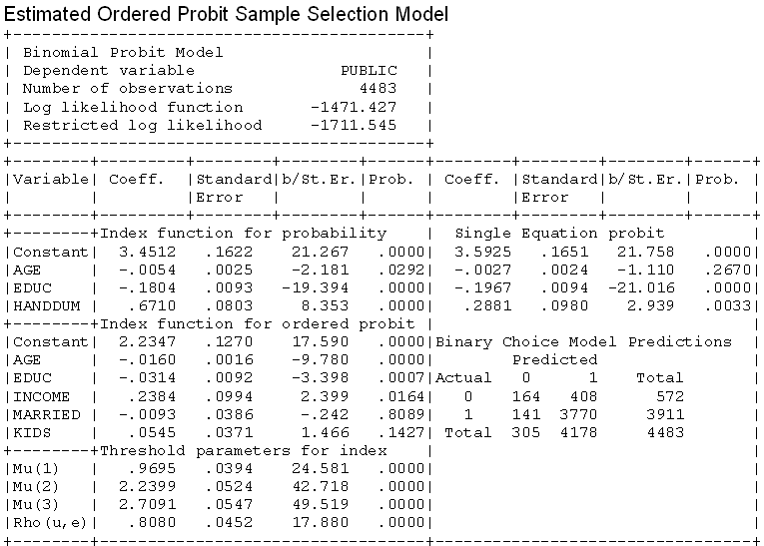
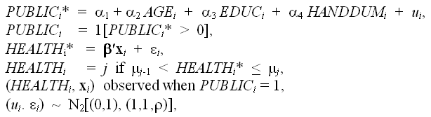
A Sample Selection Model

