Slide 1
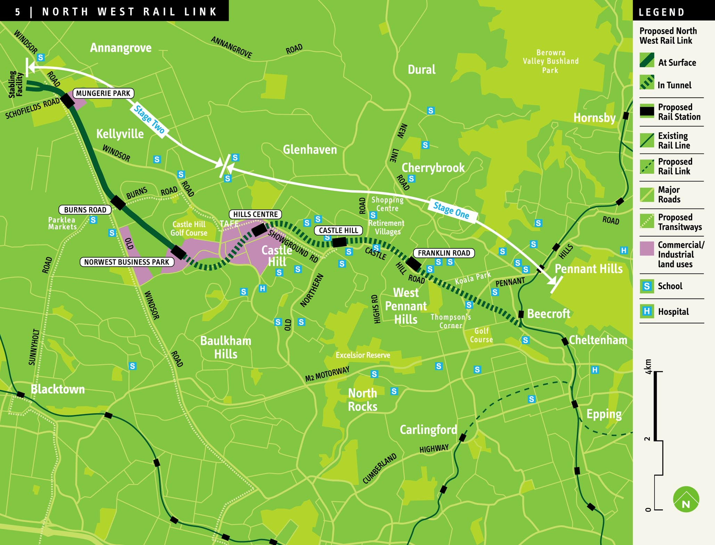

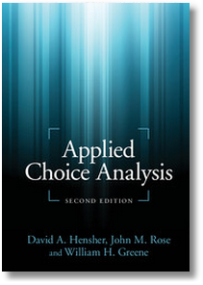
Discrete Choice Modeling
0 Introduction
1 Summary
2 Binary Choice
3 Panel Data
4 Bivariate Probit
5 Ordered Choice
6 Count Data
7 Multinomial Choice
8 Nested Logit
9 Heterogeneity
10 Latent Class
11 Mixed Logit
12 Stated Preference
13 Hybrid Choice
William Greene
Stern School of Business
New York University

Slide 2
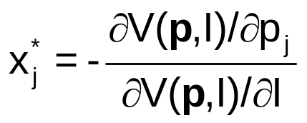
A Microeconomics Platform
Consumers Maximize Utility (!!!)
Fundamental Choice Problem: Maximize U(x₁,x₂,…) subject to prices and budget constraints
A Crucial Result for the Classical Problem:
  Indirect Utility Function: V = V(p,I)
  Demand System of Continuous Choices
  Observed data usually consist of choices, prices, income
The Integrability Problem: Utility is not revealed by demands

Slide 3
Implications for Discrete Choice Models
Theory is silent about discrete choices
Translation of utilities to discrete choice requires:
  Well defined utility indexes: Completeness of rankings
  Rationality: Utility maximization
  Axioms of revealed preferences
Consumers often act to simplify choice situations
This allows us to build “models.”
  What common elements can be assumed?
  How can we account for heterogeneity?
However, revealed choices do not reveal utility, only rankings which are scale invariant.

Slide 4
Multinomial Choice Among J Alternatives
• Random Utility Basis
Uitj = α_{ij} + β_{i}’x_{itj} + γ_{ij}z_{it} + ε_{ijt}
i = 1,…,N; j = 1,…,J(i,t); t = 1,…,T(i)
N individuals studied, J(i,t) alternatives in the choice
set, T(i) [usually 1] choice situations examined.
• Maximum Utility Assumption
Individual i will Choose alternative j in choice setting t if and only if
Uitj > Uitk for all k ≠ j.
• Underlying assumptions
  Smoothness of utilities
  Axioms of utility maximization: Transitive, Complete, Monotonic

Slide 5
Features of Utility Functions
The linearity assumption U_{itj} = α_{ij} + β_{i}′x_{itj} + γ_{j}′z_{it} + ε_{ijt}
To be relaxed later: U_{itj} = V(x_{itj},z_{it},β_{i}) + ε_{ijt}
The choice set:
  Individual (i) and situation (t) specific
  Unordered alternatives j = 1,…,J(i,t)
Deterministic (x,z,γ_{j}) and random components (α_{ij},β_{i},ε_{ijt})
Attributes of choices, x_{itj} and characteristics of the chooser, z_{it}.
  Alternative specific constants α_{ij} may vary by individual
  Preference weights, β_{i} may vary by individual
  Individual components, γ_{j} typically vary by choice, not by person
  Scaling parameters, σ_{ij} = Var[ε_{ijt}], subject to much modeling

Slide 6

Unordered Choices of 210 Travelers

Slide 7
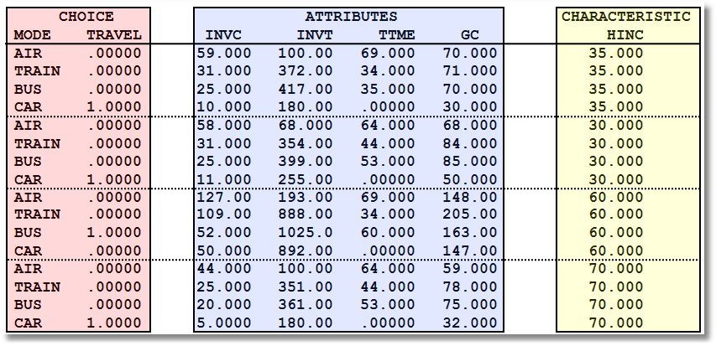
Data on Multinomial Discrete Choices

Slide 8
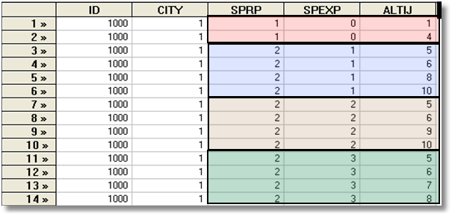
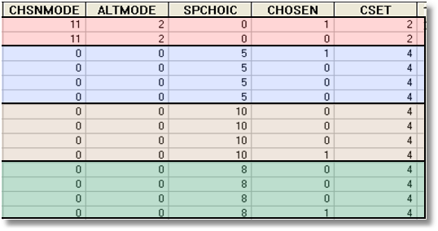
Each person makes four choices from a choice set that includes either two or four alternatives.
The first choice is the RP between two of the RP alternatives
The second-fourth are the SP among four of the six SP alternatives.
There are ten alternatives in total.
A Stated Choice Experiment with Variable Choice Sets

Slide 9

Stated Choice Experiment: Unlabeled Alternatives, One Observation
t=1
t=2
t=3
t=4
t=5
t=6
t=7
t=8

Slide 10

Unlabeled Choice Experiments
This an unlabelled choice experiment: Compare
Choice = (Air, Train, Bus, Car)
To
Choice = (Brand 1, Brand 2, Brand 3, None)
Brand 1 is only Brand 1 because it is first in
the list.
What does it mean to substitute Brand 1 for
Brand 2?
What does the own elasticity for Brand 1 mean?

Slide 11
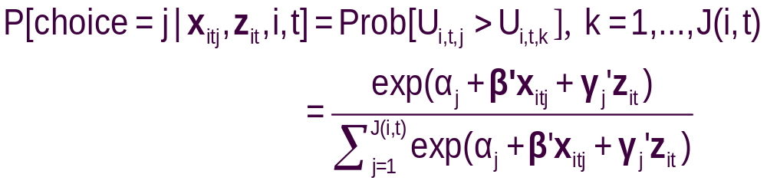
The Multinomial Logit (MNL) Model
Independent extreme value (Gumbel):
  F(εitj) = Exp(-Exp(-εitj)) (random part of each utility)
  Independence across utility functions
  Identical variances (means absorbed in constants)
  Same parameters for all individuals (temporary)
Implied probabilities for observed outcomes

Slide 12
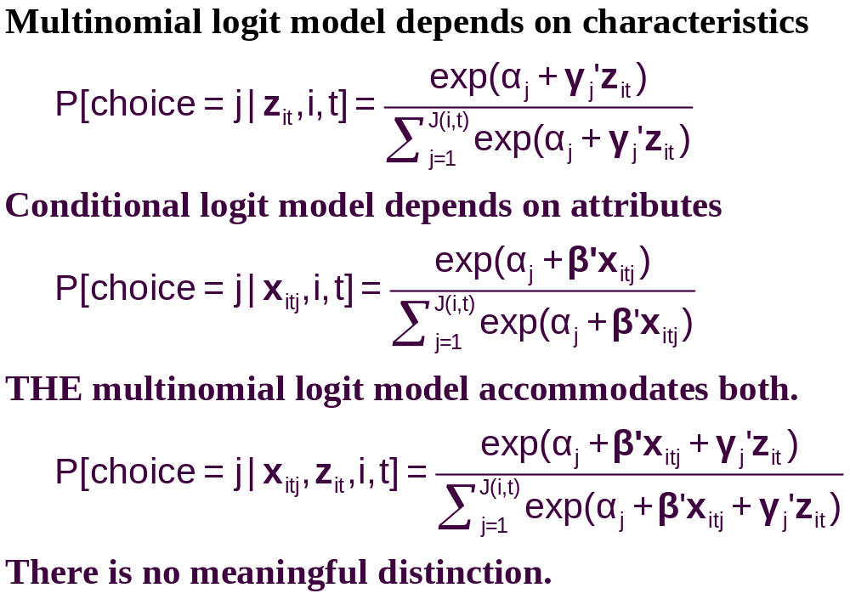
Multinomial Choice Models

Slide 13
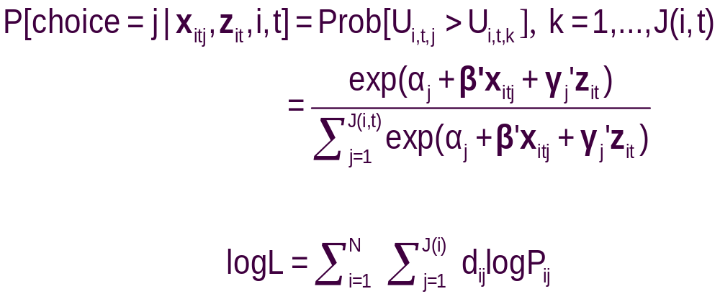
Specifying the Probabilities
• Choice specific attributes (X) vary by choices, multiply by generic
coefficients. E.g., TTME=terminal time, GC=generalized cost of travel mode
Generic characteristics (Income, constants) must be interacted with
choice specific constants.
• Estimation by maximum likelihood; d_{ij} = 1 if person i chooses j

Slide 14
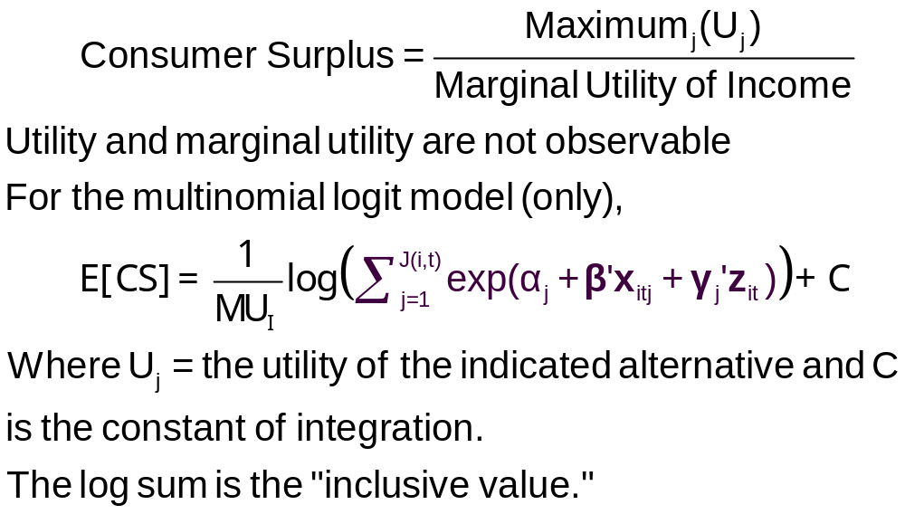
Using the Model to Measure Consumer Surplus

Slide 15
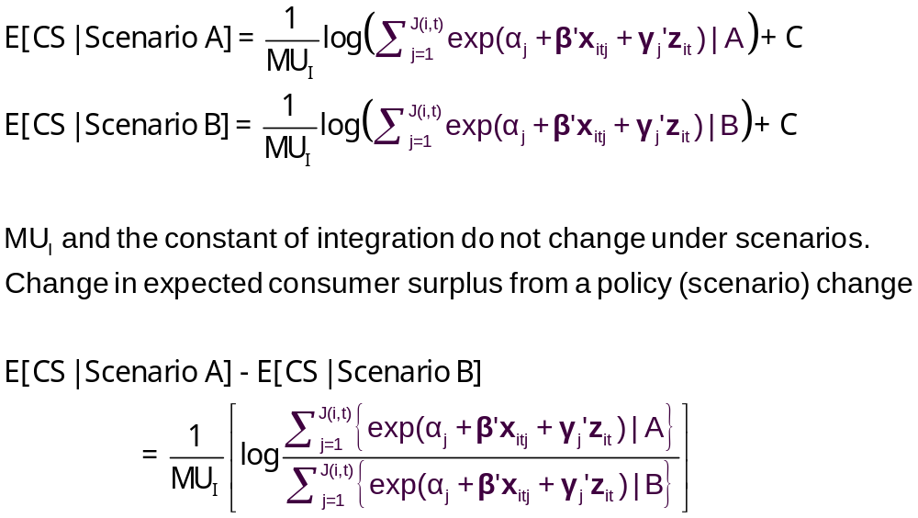
Measuring the Change in Consumer Surplus

Slide 16
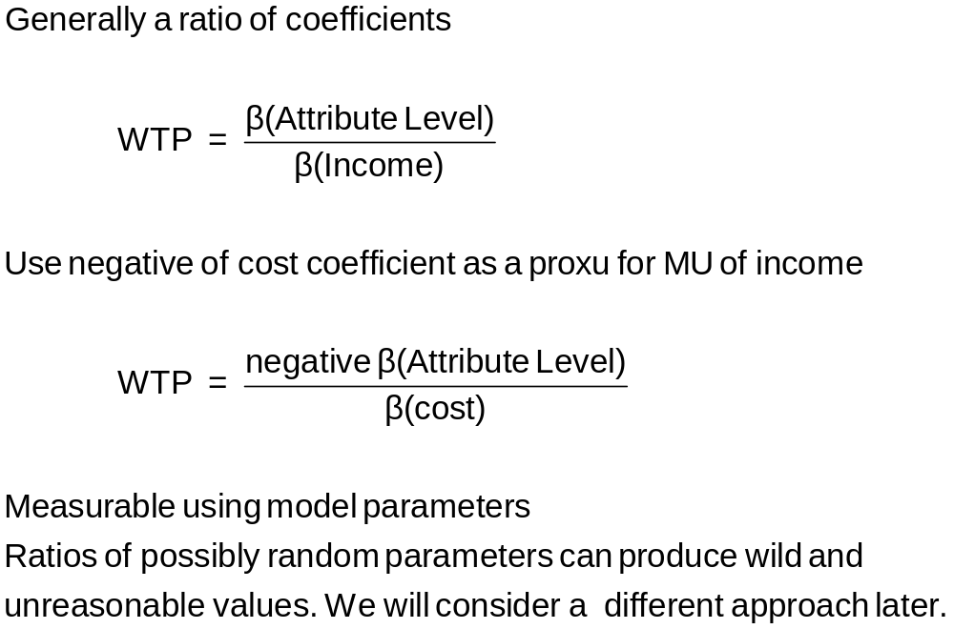
Willingness to Pay

Slide 17
Observed Data
Types of Data
  Individual choice
  Market shares – consumer markets
  Frequencies – vote counts
  Ranks – contests, preference rankings
Attributes and Characteristics
  Attributes are features of the choices such as price
  Characteristics are features of the chooser such as age, gender and income.
Choice Settings
  Cross section
  Repeated measurement (panel data)
    Stated choice experiments
    Repeated observations – THE scanner data on consumer choices

Slide 18
Choice Based Sampling
Over/Underrepresenting alternatives in the data set
May cause biases in parameter estimates. (Possibly constants only)
Certainly causes biases in estimated variances
  Weighted log likelihood, weight = πj / Fj for all i.
  Fixup of covariance matrix – use “sandwich” estimator. Using weighted Hessian and weighted BHHH in the center of the sandwich
Choice | Air | Train | Bus | Car
True | 0.14 | 0.13 | 0.09 | 0.64
Sample | 0.28 | 0.30 | 0.14 | 0.28

Slide 19
Data on Discrete Choices
CHOICE ATTRIBUTES CHARACTERISTIC
MODE TRAVEL INVC INVT TTME GC HINC
AIR .00000 59.000 100.00 69.000 70.000 35.000
TRAIN .00000 31.000 372.00 34.000 71.000 35.000
BUS .00000 25.000 417.00 35.000 70.000 35.000
CAR 1.0000 10.000 180.00 .00000 30.000 35.000
AIR .00000 58.000 68.000 64.000 68.000 30.000
TRAIN .00000 31.000 354.00 44.000 84.000 30.000
BUS .00000 25.000 399.00 53.000 85.000 30.000
CAR 1.0000 11.000 255.00 .00000 50.000 30.000
AIR .00000 127.00 193.00 69.000 148.00 60.000
TRAIN .00000 109.00 888.00 34.000 205.00 60.000
BUS 1.0000 52.000 1025.0 60.000 163.00 60.000
CAR .00000 50.000 892.00 .00000 147.00 60.000
AIR .00000 44.000 100.00 64.000 59.000 70.000
TRAIN .00000 25.000 351.00 44.000 78.000 70.000
BUS .00000 20.000 361.00 53.000 75.000 70.000
CAR 1.0000 5.0000 180.00 .00000 32.000 70.000
This is the ‘long form.’ In the ‘wide form,’ all data for the individual appear on a single ‘line’. The ‘wide form’ is unmanageable for models of any complexity and for stated preference applications.

Slide 20
An Estimated MNL Model
-----------------------------------------------------------
Discrete choice (multinomial logit) model
Dependent variable Choice
Log likelihood function -199.97662
Estimation based on N = 210, K = 5
Information Criteria: Normalization=1/N
Normalized Unnormalized
AIC 1.95216 409.95325
Fin.Smpl.AIC 1.95356 410.24736
Bayes IC 2.03185 426.68878
Hannan Quinn 1.98438 416.71880
R2=1-LogL/LogL* Log-L fncn R-sqrd R2Adj
Constants only -283.7588 .2953 .2896
Chi-squared[ 2] = 167.56429
Prob [ chi squared > value ] = .00000
Response data are given as ind. choices
Number of obs.= 210, skipped 0 obs
--------+--------------------------------------------------
Variable| Coefficient Standard Error b/St.Er. P[|Z|>z]
--------+--------------------------------------------------
GC| -.01578*** .00438 -3.601 .0003
TTME| -.09709*** .01044 -9.304 .0000
A_AIR| 5.77636*** .65592 8.807 .0000
A_TRAIN| 3.92300*** .44199 8.876 .0000
A_BUS| 3.21073*** .44965 7.140 .0000
--------+--------------------------------------------------

Slide 21
Estimated MNL Model
-----------------------------------------------------------
Discrete choice (multinomial logit) model
Dependent variable Choice
Log likelihood function -199.97662
Estimation based on N = 210, K = 5
Information Criteria: Normalization=1/N
Normalized Unnormalized
AIC 1.95216 409.95325
Fin.Smpl.AIC 1.95356 410.24736
Bayes IC 2.03185 426.68878
Hannan Quinn 1.98438 416.71880
R2=1-LogL/LogL* Log-L fncn R-sqrd R2Adj
Constants only -283.7588 .2953 .2896
Chi-squared[ 2] = 167.56429
Prob [ chi squared > value ] = .00000
Response data are given as ind. choices
Number of obs.= 210, skipped 0 obs
--------+--------------------------------------------------
Variable| Coefficient Standard Error b/St.Er. P[|Z|>z]
--------+--------------------------------------------------
GC| -.01578*** .00438 -3.601 .0003
TTME| -.09709*** .01044 -9.304 .0000
A_AIR| 5.77636*** .65592 8.807 .0000
A_TRAIN| 3.92300*** .44199 8.876 .0000
A_BUS| 3.21073*** .44965 7.140 .0000
--------+--------------------------------------------------

Slide 22
Model Fit Based on Log Likelihood
Three sets of predicted probabilities
  No model: Pij = 1/J (.25)
  Constants only: Pij = (1/N)Σi dij
  (58,63,30,59)/210=.286,.300,.143,.281
  Constants only model matches sample shares
  Estimated model: Logit probabilities
Compute log likelihood
Measure improvement in log likelihood with
Pseudo R-squared = 1 – LogL/LogL₀
(“Adjusted” for number of parameters in the model.)

Slide 23
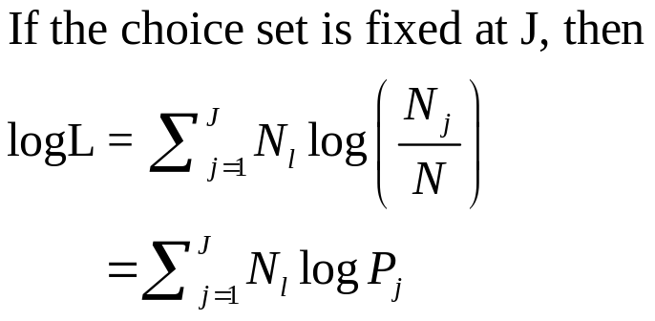
Fit the Model with Only ASCs
If the choice set varies across observations, this is the only way to obtain the restricted log likelihood.
-----------------------------------------------------------
Discrete choice (multinomial logit) model
Dependent variable Choice
Log likelihood function -283.75877
Estimation based on N = 210, K = 3
Information Criteria: Normalization=1/N
Normalized Unnormalized
AIC 2.73104 573.51754
Fin.Smpl.AIC 2.73159 573.63404
Bayes IC 2.77885 583.55886
Hannan Quinn 2.75037 577.57687
R2=1-LogL/LogL* Log-L fncn R-sqrd R2Adj
Constants only -283.7588 .0000-.0048
Response data are given as ind. choices
Number of obs.= 210, skipped 0 obs
--------+--------------------------------------------------
Variable| Coefficient Standard Error b/St.Er. P[|Z|>z]
--------+--------------------------------------------------
A_AIR| -.01709 .18491 -.092 .9263
A_TRAIN| .06560 .18117 .362 .7173
A_BUS| -.67634*** .22424 -3.016 .0026
--------+--------------------------------------------------

Slide 24
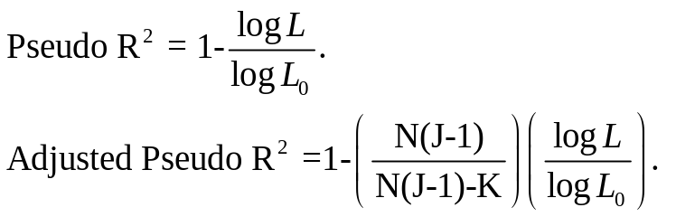
Estimated MNL Model
-----------------------------------------------------------
Discrete choice (multinomial logit) model
Dependent variable Choice
Log likelihood function -199.97662
Estimation based on N = 210, K = 5
Information Criteria: Normalization=1/N
Normalized Unnormalized
AIC 1.95216 409.95325
Fin.Smpl.AIC 1.95356 410.24736
Bayes IC 2.03185 426.68878
Hannan Quinn 1.98438 416.71880
R2=1-LogL/LogL* Log-L fncn R-sqrd R2Adj
Constants only -283.7588 .2953 .2896
Chi-squared[ 2] = 167.56429
Prob [ chi squared > value ] = .00000
Response data are given as ind. choices
Number of obs.= 210, skipped 0 obs
--------+--------------------------------------------------
Variable| Coefficient Standard Error b/St.Er. P[|Z|>z]
--------+--------------------------------------------------
GC| -.01578*** .00438 -3.601 .0003
TTME| -.09709*** .01044 -9.304 .0000
A_AIR| 5.77636*** .65592 8.807 .0000
A_TRAIN| 3.92300*** .44199 8.876 .0000
A_BUS| 3.21073*** .44965 7.140 .0000
--------+--------------------------------------------------

Slide 25
Model Fit Based on Predictions
Nj = actual number of choosers of “j.”
Nfitj = Σi Predicted Probabilities for “j”
Cross tabulate:
Predicted vs. Actual, cell prediction is cell probability
Predicted vs. Actual, cell prediction is the cell
with the largest probability
Njk = Σi dij × Predicted P(i,k)

Slide 26
Fit Measures Based on Crosstabulation
+-------------------------------------------------------+
| Cross tabulation of actual choice vs. predicted P(j) |
| Row indicator is actual, column is predicted. |
| Predicted total is F(k,j,i)=Sum(i=1,...,N) P(k,j,i). |
| Column totals may be subject to rounding error. |
+-------------------------------------------------------+
NLOGIT Cross Tabulation for 4 outcome Multinomial Choice Model
AIR TRAIN BUS CAR Total
+-------------+-------------+-------------+-------------+-------------+
AIR | 32 | 8 | 5 | 13 | 58 |
TRAIN | 8 | 37 | 5 | 14 | 63 |
BUS | 3 | 5 | 15 | 6 | 30 |
CAR | 15 | 13 | 6 | 26 | 59 |
+-------------+-------------+-------------+-------------+-------------+
Total | 58 | 63 | 30 | 59 | 210 |
+-------------+-------------+-------------+-------------+-------------+
NLOGIT Cross Tabulation for 4 outcome Constants Only Choice Model
AIR TRAIN BUS CAR Total
+-------------+-------------+-------------+-------------+-------------+
AIR | 16 | 17 | 8 | 16 | 58 |
TRAIN | 17 | 19 | 9 | 18 | 63 |
BUS | 8 | 9 | 4 | 8 | 30 |
CAR | 16 | 18 | 8 | 17 | 59 |
+-------------+-------------+-------------+-------------+-------------+
Total | 58 | 63 | 30 | 59 | 210 |
+-------------+-------------+-------------+-------------+-------------+

Slide 27
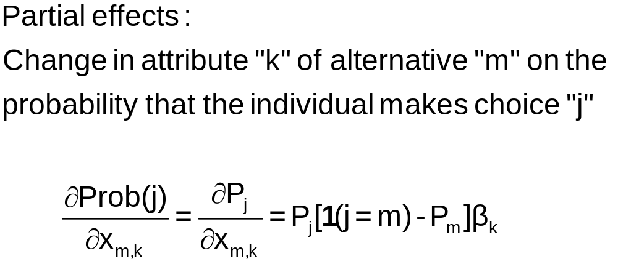
j = Train
m = Car
k = Price

Slide 28
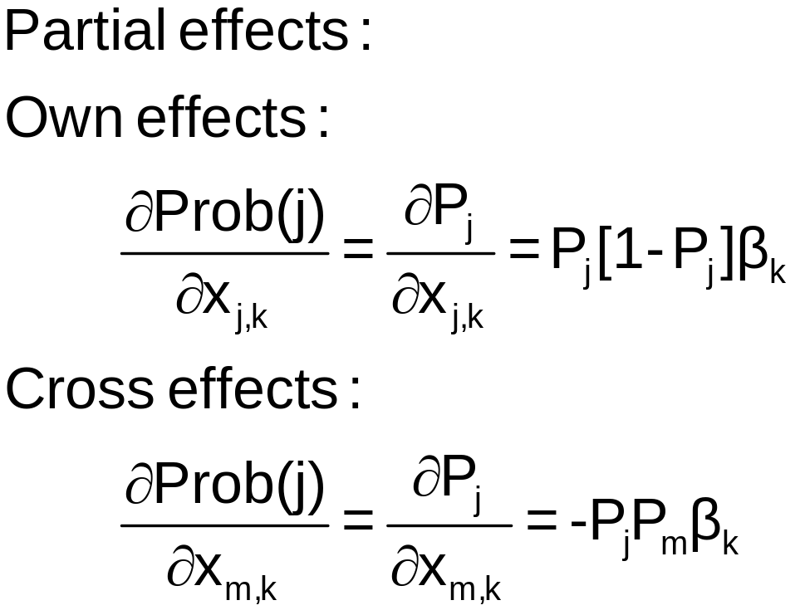
k = Price
j = Train
j = Train
m = Car

Slide 29
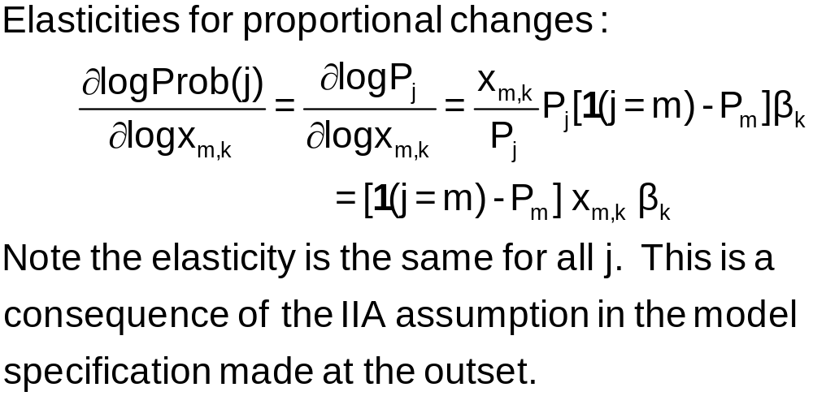

Slide 30
+---------------------------------------------------+
| Elasticity averaged over observations.|
| Attribute is INVT in choice AIR |
| Mean St.Dev |
| * Choice=AIR -.2055 .0666 |
| Choice=TRAIN .0903 .0681 |
| Choice=BUS .0903 .0681 |
| Choice=CAR .0903 .0681 |
+---------------------------------------------------+
| Attribute is INVT in choice TRAIN |
| Choice=AIR .3568 .1231 |
| * Choice=TRAIN -.9892 .5217 |
| Choice=BUS .3568 .1231 |
| Choice=CAR .3568 .1231 |
+---------------------------------------------------+
| Attribute is INVT in choice BUS |
| Choice=AIR .1889 .0743 |
| Choice=TRAIN .1889 .0743 |
| * Choice=BUS -1.2040 .4803 |
| Choice=CAR .1889 .0743 |
+---------------------------------------------------+
| Attribute is INVT in choice CAR |
| Choice=AIR .3174 .1195 |
| Choice=TRAIN .3174 .1195 |
| Choice=BUS .3174 .1195 |
| * Choice=CAR -.9510 .5504 |
+---------------------------------------------------+
| Effects on probabilities of all choices in model: |
| * = Direct Elasticity effect of the attribute. |
+---------------------------------------------------+
Note the effect of IIA on the cross effects.
Own effect
Cross effects
Elasticities are computed for each observation; the mean and standard deviation are then computed across the sample observations.

Slide 31
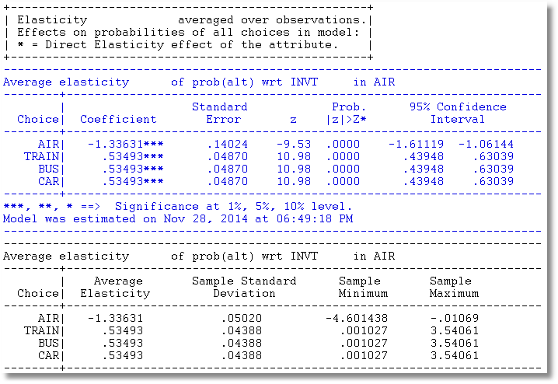
Use Krinsky and Robb to compute standard errors for Elasticities

Slide 32
Analyzing the Behavior of Market
Shares to Examine Discrete Effects
Scenario: What happens to the number of people who make specific choices if a particular attribute changes in a specified way?
Fit the model first, then using the identical model setup, add
; Simulation = list of choices to be analyzed
; Scenario = Attribute (in choices) = type of change
For the CLOGIT application
; Simulation = * ? This is ALL choices
; Scenario: GC(car)=[*]1.25$ Car_GC rises by 25%

Slide 33
Model Simulation
+---------------------------------------------+
| Discrete Choice (One Level) Model |
| Model Simulation Using Previous Estimates |
| Number of observations 210 |
+---------------------------------------------+
+------------------------------------------------------+
|Simulations of Probability Model |
|Model: Discrete Choice (One Level) Model |
|Simulated choice set may be a subset of the choices. |
|Number of individuals is the probability times the |
|number of observations in the simulated sample. |
|Column totals may be affected by rounding error. |
|The model used was simulated with 210 observations.|
+------------------------------------------------------+
-------------------------------------------------------------------------
Specification of scenario 1 is:
Attribute Alternatives affected Change type Value
--------- ------------------------------- ------------------- ---------
GC CAR Scale base by value 1.250
-------------------------------------------------------------------------
The simulator located 209 observations for this scenario.
Simulated Probabilities (shares) for this scenario:
+----------+--------------+--------------+------------------+
|Choice | Base | Scenario | Scenario - Base |
| |%Share Number |%Share Number |ChgShare ChgNumber|
+----------+--------------+--------------+------------------+
|AIR | 27.619 58 | 29.592 62 | 1.973% 4 |
|TRAIN | 30.000 63 | 31.748 67 | 1.748% 4 |
|BUS | 14.286 30 | 15.189 32 | .903% 2 |
|CAR | 28.095 59 | 23.472 49 | -4.624% -10 |
|Total |100.000 210 |100.000 210 | .000% 0 |
+----------+--------------+--------------+------------------+
Changes in the predicted market shares when GC_CAR increases by 25%.

Slide 34
More Complicated Model Simulation
In vehicle cost of CAR falls by 10%
Market is limited to ground (Train, Bus, Car)
CLOGIT ; Lhs = Mode
; Choices = Air,Train,Bus,Car
; Rhs = TTME,INVC,INVT,GC
; Rh2 = One ,Hinc
; Simulation = TRAIN,BUS,CAR
; Scenario: GC(car)=[*].9$

Slide 35
Model Estimation Step
-----------------------------------------------------------
Discrete choice (multinomial logit) model
Dependent variable Choice
Log likelihood function -172.94366
Estimation based on N = 210, K = 10
R2=1-LogL/LogL* Log-L fncn R-sqrd R2Adj
Constants only -283.7588 .3905 .3807
Chi-squared[ 7] = 221.63022
Prob [ chi squared > value ] = .00000
Response data are given as ind. choices
Number of obs.= 210, skipped 0 obs
--------+--------------------------------------------------
Variable| Coefficient Standard Error b/St.Er. P[|Z|>z]
--------+--------------------------------------------------
TTME| -.10289*** .01109 -9.280 .0000
INVC| -.08044*** .01995 -4.032 .0001
INVT| -.01399*** .00267 -5.240 .0000
GC| .07578*** .01833 4.134 .0000
A_AIR| 4.37035*** 1.05734 4.133 .0000
AIR_HIN1| .00428 .01306 .327 .7434
A_TRAIN| 5.91407*** .68993 8.572 .0000
TRA_HIN2| -.05907*** .01471 -4.016 .0001
A_BUS| 4.46269*** .72333 6.170 .0000
BUS_HIN3| -.02295 .01592 -1.442 .1493
--------+--------------------------------------------------
Alternative specific constants and interactions of ASCs and Household Income

Slide 36
+---------------------------------------------+
| Discrete Choice (One Level) Model |
| Model Simulation Using Previous Estimates |
| Number of observations 210 |
+---------------------------------------------+
+------------------------------------------------------+
|Simulations of Probability Model |
|Model: Discrete Choice (One Level) Model |
|Simulated choice set may be a subset of the choices. |
|Number of individuals is the probability times the |
|number of observations in the simulated sample. |
|The model used was simulated with 210 observations.|
+------------------------------------------------------+
-------------------------------------------------------------------------
Specification of scenario 1 is:
Attribute Alternatives affected Change type Value
--------- ------------------------------- ------------------- ---------
INVC CAR Scale base by value .900
-------------------------------------------------------------------------
The simulator located 210 observations for this scenario.
Simulated Probabilities (shares) for this scenario:
+----------+--------------+--------------+------------------+
|Choice | Base | Scenario | Scenario - Base |
| |%Share Number |%Share Number |ChgShare ChgNumber|
+----------+--------------+--------------+------------------+
|TRAIN | 37.321 78 | 35.854 75 | -1.467% -3 |
|BUS | 19.805 42 | 18.641 39 | -1.164% -3 |
|CAR | 42.874 90 | 45.506 96 | 2.632% 6 |
|Total |100.000 210 |100.000 210 | .000% 0 |
+----------+--------------+--------------+------------------+
Model Simulation Step

Slide 37
Willingness to Pay
U(alt) = a_{j} + b_{INCOME}*INCOME + b_{Attribute}*Attribute + …
WTP = MU(Attribute)/MU(Income)
When MU(Income) is not available, an approximation
often used is –MU(Cost).
U(Air,Train,Bus,Car)
= α_{alt} + β_{cost} Cost + β_{INVT} INVT + β_{TTME} TTME + ε_{alt}
WTP for less in vehicle time = -β_{INVT} / β_{COST}
WTP for less terminal time = -β_{TIME} / β_{COST}

Slide 38
WTP from CLOGIT Model
-----------------------------------------------------------
Discrete choice (multinomial logit) model
Dependent variable Choice
--------+--------------------------------------------------
Variable| Coefficient Standard Error b/St.Er. P[|Z|>z]
--------+--------------------------------------------------
GC| -.00286 .00610 -.469 .6390
INVT| -.00349*** .00115 -3.037 .0024
TTME| -.09746*** .01035 -9.414 .0000
AASC| 4.05405*** .83662 4.846 .0000
TASC| 3.64460*** .44276 8.232 .0000
BASC| 3.19579*** .45194 7.071 .0000
--------+--------------------------------------------------
WALD ; fn1=WTP_INVT=b_invt/b_gc ; fn2=WTP_TTME=b_ttme/b_gc$
-----------------------------------------------------------
WALD procedure.
--------+--------------------------------------------------
Variable| Coefficient Standard Error b/St.Er. P[|Z|>z]
--------+--------------------------------------------------
WTP_INVT| 1.22006 2.88619 .423 .6725
WTP_TTME| 34.0771 73.07097 .466 .6410
--------+--------------------------------------------------
Very different estimates suggests this might not be a very good model.

Slide 39
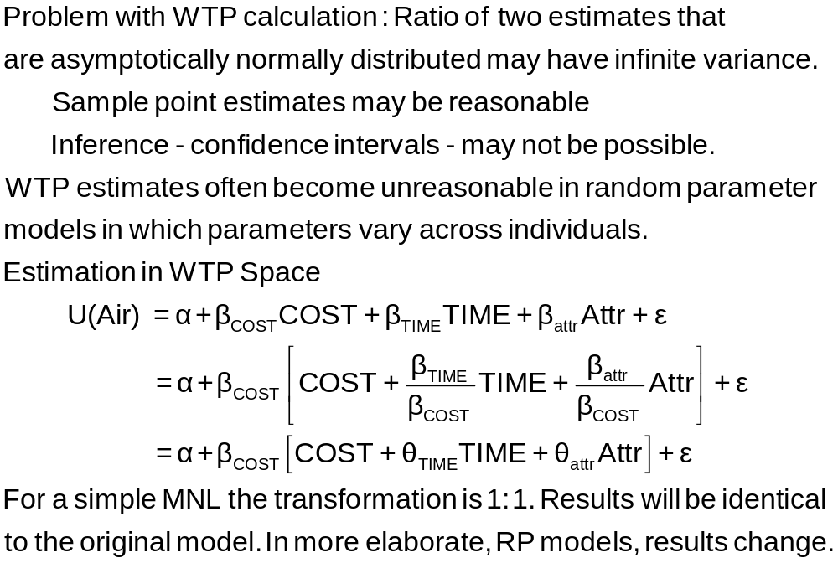
Estimation in WTP Space

Slide 40
The I.I.D Assumption
U_{itj} = α_{ij} + β’x_{itj} + γ’z_{it} + ε_{ijt}
  F(ε_{itj}) = Exp(-Exp(-εitj)) (random part of each utility)
  Independence across utility functions
  Identical variances (means absorbed in constants)
Restriction on equal scaling may be inappropriate
Correlation across alternatives may be suppressed
Equal cross elasticities is a substantive restriction
Behavioral implication of IID is independence from irrelevant
alternatives. If an alternative is removed, probability is
spread equally across the remaining alternatives. This is
unreasonable

Slide 41
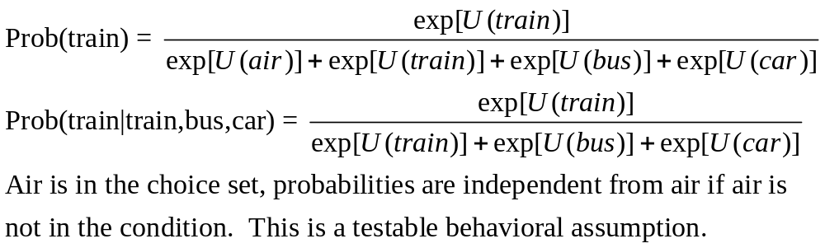
IIA Implication of IID

Slide 42
+---------------------------------------------------+
| Elasticity averaged over observations.|
| Attribute is INVT in choice AIR |
| Mean St.Dev |
| * Choice=AIR -.2055 .0666 |
| Choice=TRAIN .0903 .0681 |
| Choice=BUS .0903 .0681 |
| Choice=CAR .0903 .0681 |
+---------------------------------------------------+
| Attribute is INVT in choice TRAIN |
| Choice=AIR .3568 .1231 |
| * Choice=TRAIN -.9892 .5217 |
| Choice=BUS .3568 .1231 |
| Choice=CAR .3568 .1231 |
+---------------------------------------------------+
| Attribute is INVT in choice BUS |
| Choice=AIR .1889 .0743 |
| Choice=TRAIN .1889 .0743 |
| * Choice=BUS -1.2040 .4803 |
| Choice=CAR .1889 .0743 |
+---------------------------------------------------+
| Attribute is INVT in choice CAR |
| Choice=AIR .3174 .1195 |
| Choice=TRAIN .3174 .1195 |
| Choice=BUS .3174 .1195 |
| * Choice=CAR -.9510 .5504 |
+---------------------------------------------------+
| Effects on probabilities of all choices in model: |
| * = Direct Elasticity effect of the attribute. |
+---------------------------------------------------+
Behavioral Implication of IIA
Own effect
Cross effects
Note the effect of IIA on the cross effects.
Elasticities are computed for each observation; the mean and standard deviation are then computed across the sample observations.

Slide 43
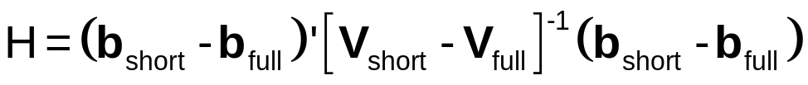
A Hausman and McFadden Test for IIA
Estimate full model with “irrelevant alternatives”
Estimate the short model eliminating the irrelevant alternatives
  Eliminate individuals who chose the irrelevant alternatives
  Drop attributes that are constant in the surviving choice set.
Do the coefficients change? Under the IIA assumption, they should not.
  Use a Hausman test:
  Chi-squared, d.f. Number of parameters estimated

Slide 44
IIA Test for Choice AIR
+--------+--------------+----------------+--------+--------+
|Variable| Coefficient | Standard Error |b/St.Er.|P[|Z|>z]|
+--------+--------------+----------------+--------+--------+
GC | .06929537 .01743306 3.975 .0001
TTME | -.10364955 .01093815 -9.476 .0000
INVC | -.08493182 .01938251 -4.382 .0000
INVT | -.01333220 .00251698 -5.297 .0000
AASC | 5.20474275 .90521312 5.750 .0000
TASC | 4.36060457 .51066543 8.539 .0000
BASC | 3.76323447 .50625946 7.433 .0000
+--------+--------------+----------------+--------+--------+
GC | .53961173 .14654681 3.682 .0002
TTME | -.06847037 .01674719 -4.088 .0000
INVC | -.58715772 .14955000 -3.926 .0001
INVT | -.09100015 .02158271 -4.216 .0000
TASC | 4.62957401 .81841212 5.657 .0000
BASC | 3.27415138 .76403628 4.285 .0000
Matrix IIATEST has 1 rows and 1 columns.
1
+--------------
1| 33.78445 Test statistic
+------------------------------------+
| Listed Calculator Results |
+------------------------------------+
Result = 9.487729 Critical value
IIA is rejected

Slide 45
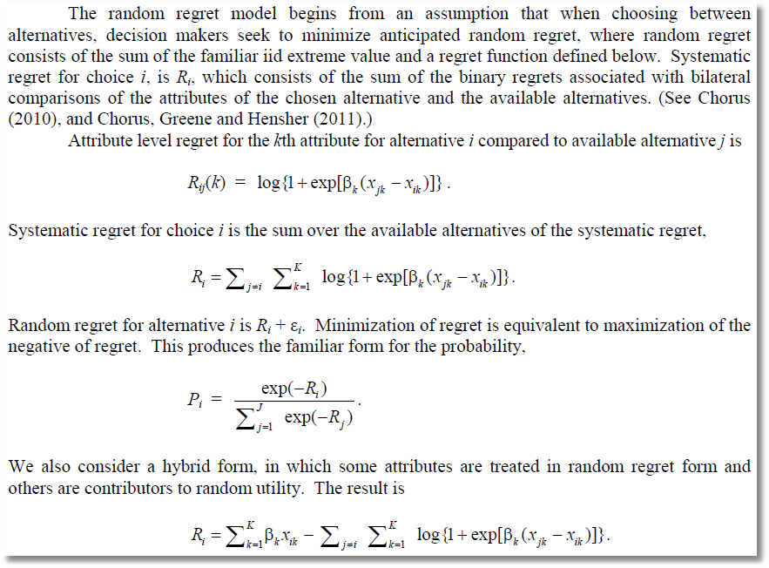
Alternative to Utility Maximization (!)
Minimizing Random Regret

Slide 46
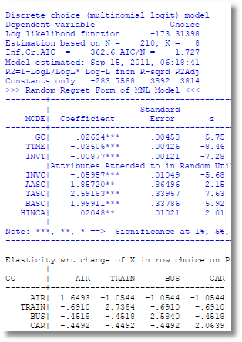
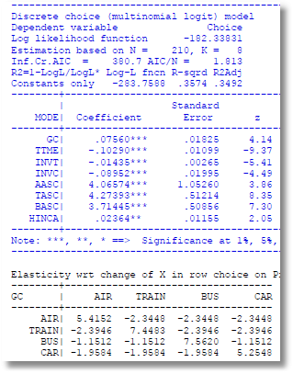
RUM vs. Random Regret

Slide 47
Fixed Effects Multinomial Logit:
Application of Minimum Distance Estimation

Slide 48
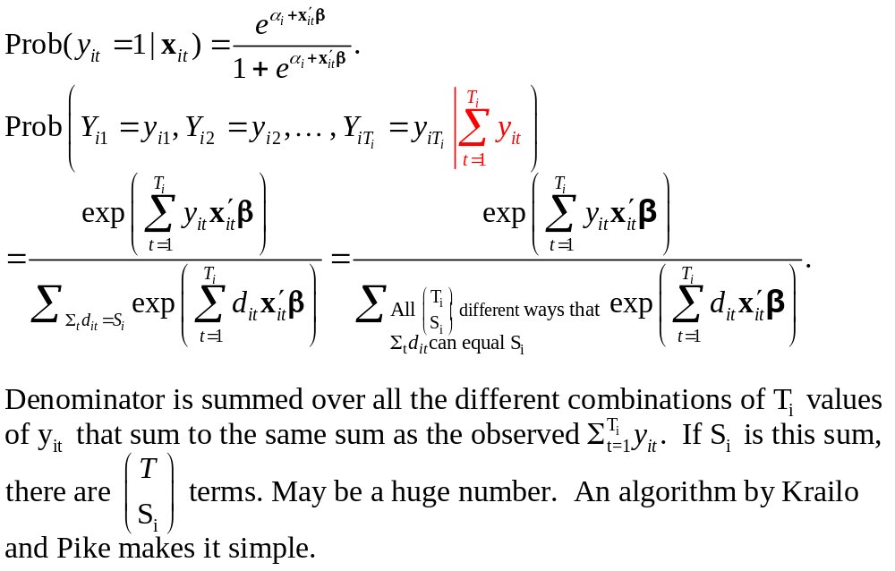
Binary Logit Conditional Probabiities

Slide 49
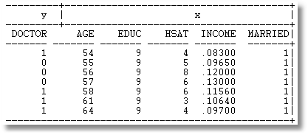
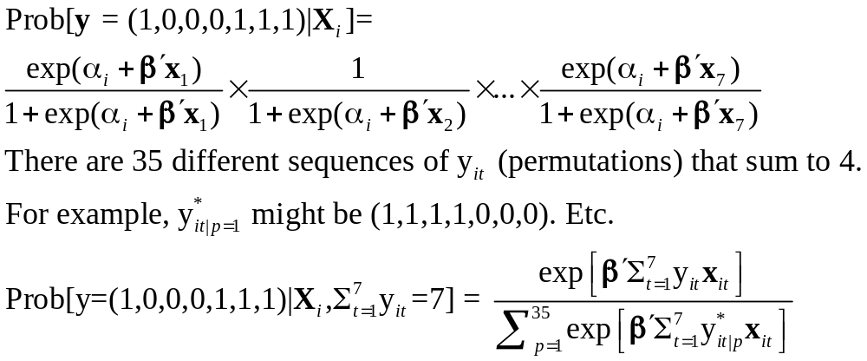
Example: Seven Period Binary Logit

Slide 50
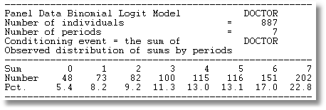
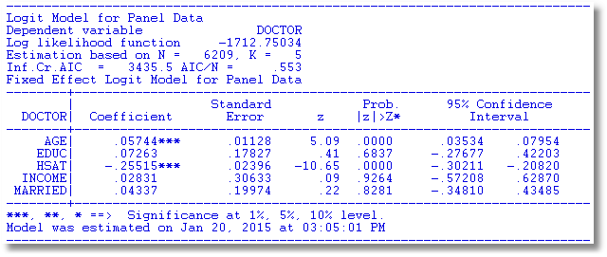

Slide 51
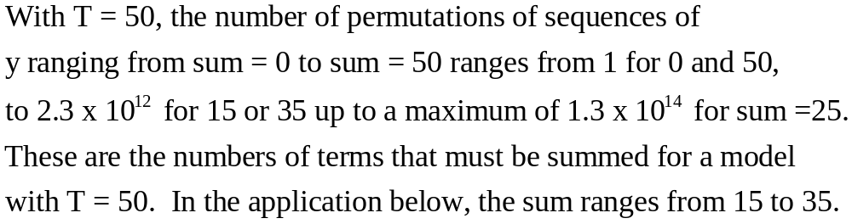
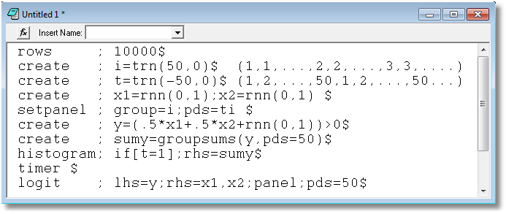

Slide 52
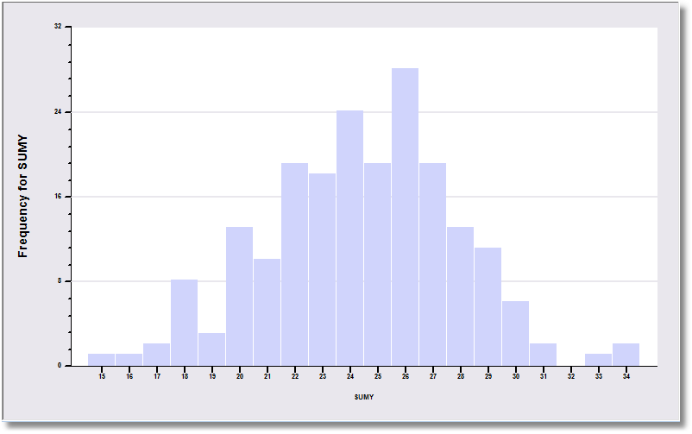
The sample is 200 individuals each observed 50 times.

Slide 53
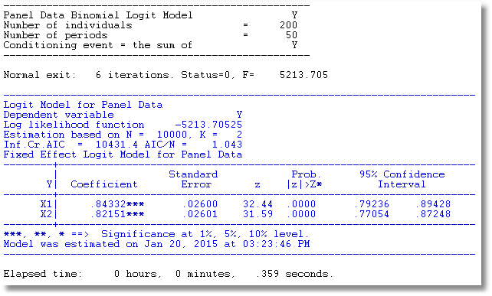
The data are generated from a probit process with b1 = b2 = .5. But, it is fit as a logit model. The coefficients obey the familiar relationship, 1.6*probit.

Slide 54
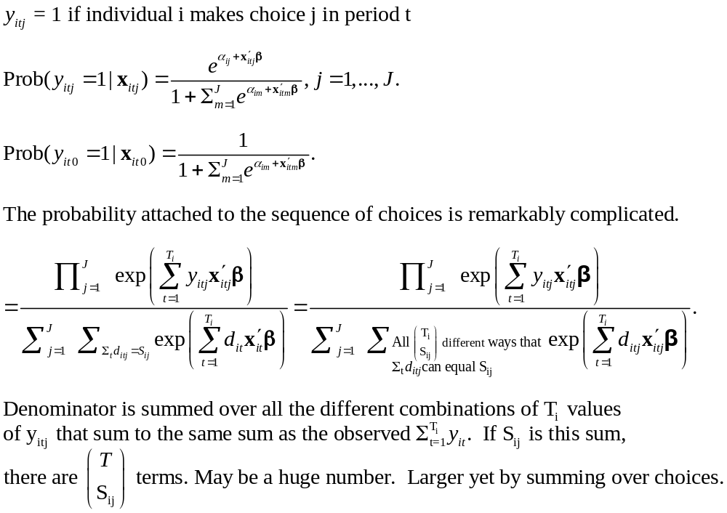
Multinomial Logit Model: J+1 choices including a base choice.

Slide 55
Estimation Strategy
Conditional ML of the full MNL model. Impressively complicated.
A Minimum Distance (MDE) Strategy
  Each alternative treated as a binary choice vs. the base provides an estimator of β
    Select subsample that chose either option j or the base
    Estimate β using this binary choice setting
    This provides J different estimators of the same β
  Optimally combine the different estimators of β

Slide 56
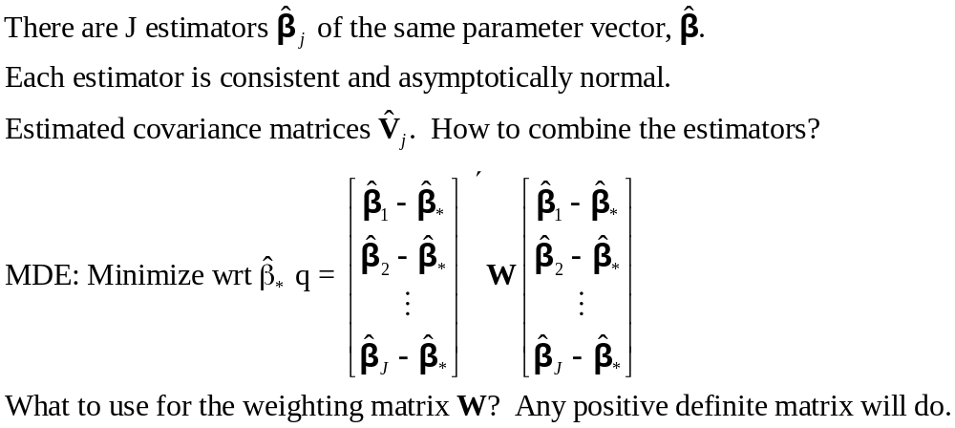
Minimum Distance Estimation

Slide 57
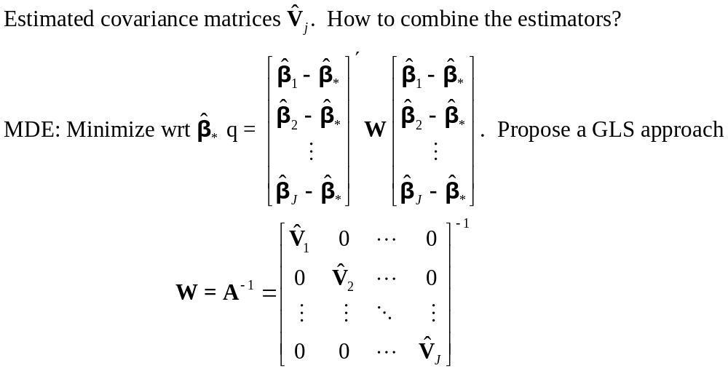
MDE Estimation

Slide 58
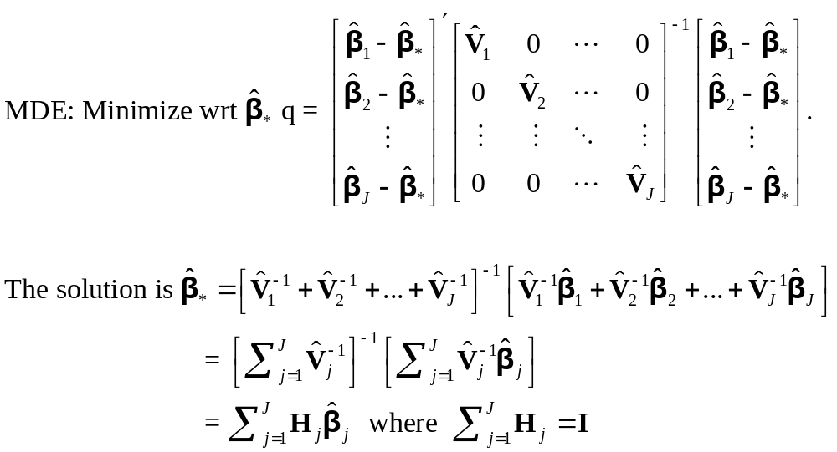
MDE Estimation

Slide 59


Slide 60
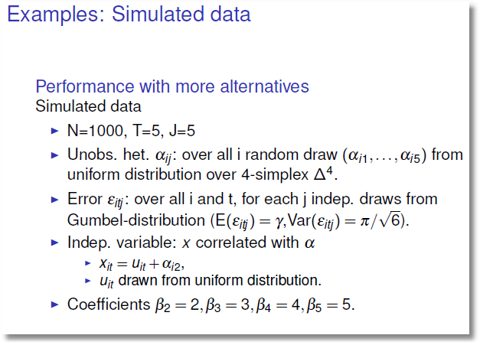

Slide 61
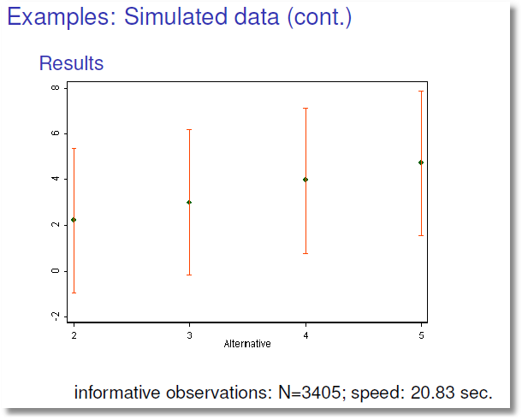

Slide 62
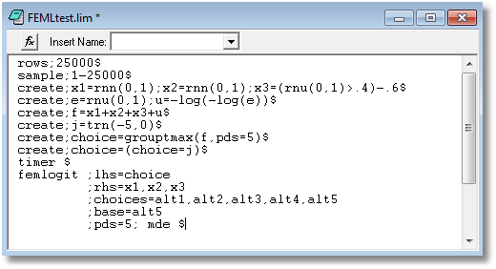

Slide 63
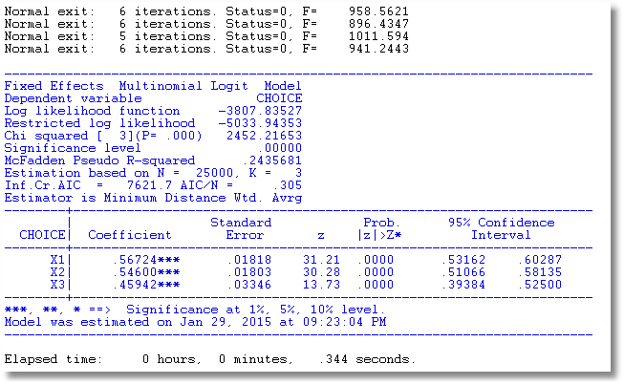

Slide 64
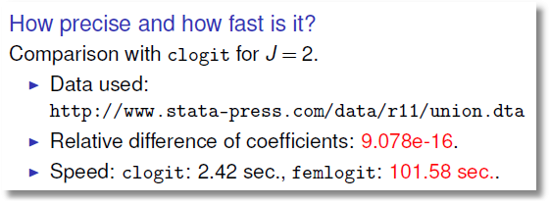
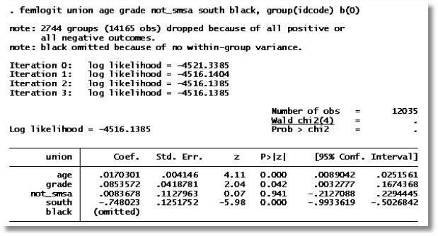

Slide 65
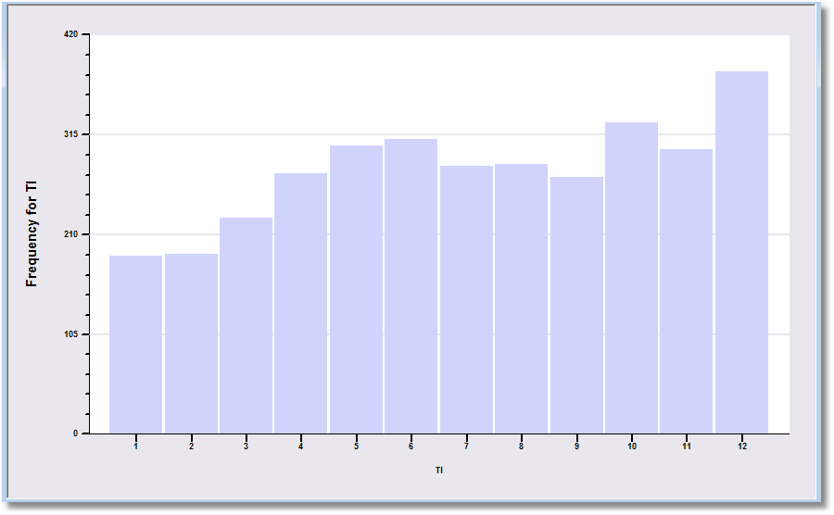

Slide 66
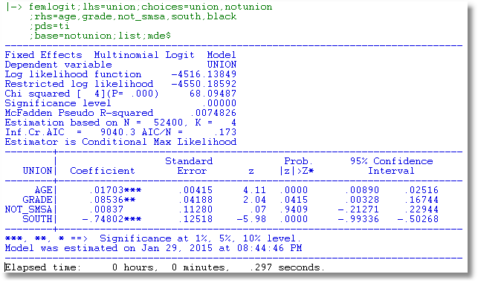

Slide 67
Why a 500 fold increase in speed?
MDE is much faster
Not using Krailo and Pike, or not using efficiently
Numerical derivatives for an extremely messy function (increase the number of function evaluations by at least 5 times)

Slide 68
Rank Data and Best/Worst

Slide 69
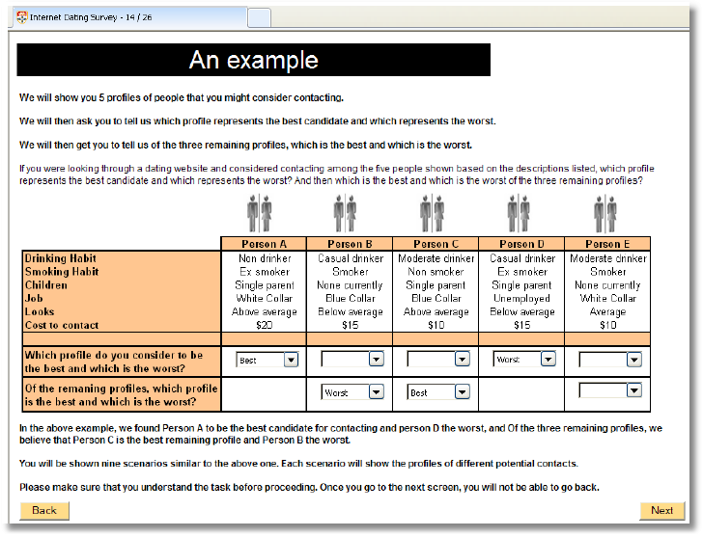

Slide 70
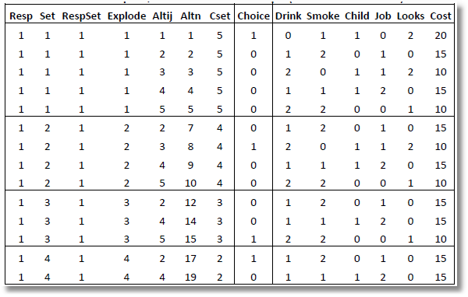
Rank Data and Exploded Logit
Alt 1 is the best overall
Alt 3 is the best among
remaining alts 2,3,4,5
Alt 5 is the best among
remaining alts 2,4,5
Alt 2 is the best among remaining alts 2,4
Alt 4 is the worst.

Slide 71
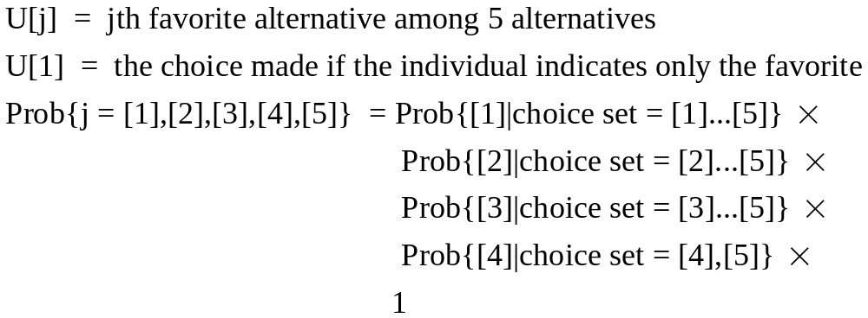
Exploded Logit

Slide 72
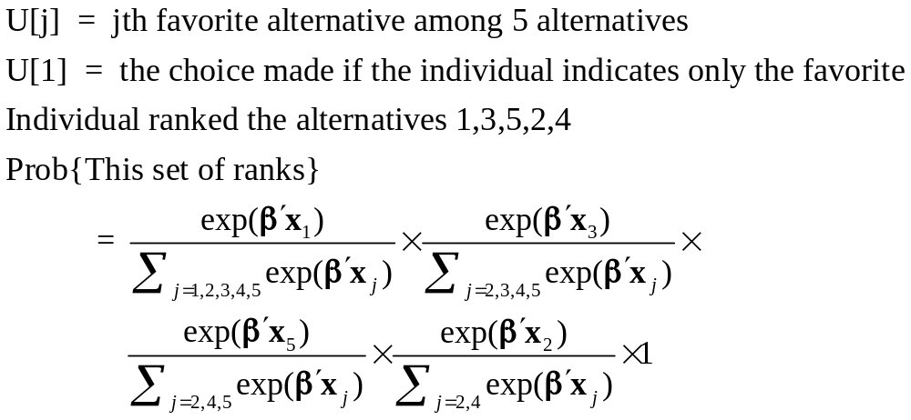
Exploded Logit

Slide 73
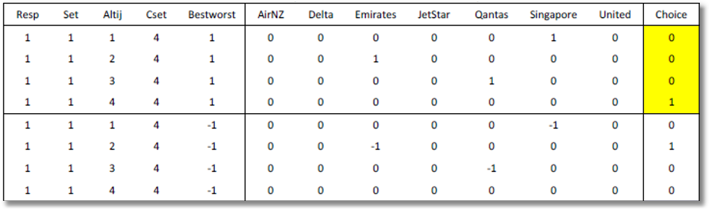
Best Worst
Individual simultaneously ranks best and worst alternatives.
Prob(alt j) = best = exp[U(j)] / Σ_{m}exp[U(m)]
Prob(alt k) = worst = exp[-U(k)] / Σ_{m}exp[-U(m)]

Slide 74


Slide 75

Choices

Slide 76
Best

Slide 77
Worst

Slide 78


Slide 79

Uses the result that if U(i,j) is the lowest utility, -U(i,j) is the highest.

Slide 80

Uses the result that if U(i,j) is the lowest utility, -U(i,j) is the highest.

Slide 81
Nested Logit Approach.

Slide 82

Nested Logit Approach – Different Scaling for Worst
8 choices are two blocks of 4.
Best in one brance, worst in the second branch

Slide 85


Slide 86

Nonlinear Utility Functions

Slide 87
Assessing Prospect Theoretic Functional Forms and Risk in a Nonlinear Logit Framework: Valuing Reliability Embedded Travel Time Savings
David Hensher
The University of Sydney, ITLS
William Greene
Stern School of Business, New York University
8th Annual Advances in Econometrics Conference
Louisiana State University
Baton Rouge, LA
November 6-8, 2009
Hensher, D., Greene, W., “Embedding Risk Attitude and Decisions Weights in Non-linear Logit to Accommodate Time Variability in the Value of Expected Travel Time Savings,” Transportation Research Part B
Notes:
87

Slide 88
Prospect Theory
Marginal value function for an attribute (outcome)
v(x_{m}) = subjective value of attribute
Decision weight w(p_{m}) = impact of a probability on
utility of a prospect
Value function V(x_{m},p_{m}) = v(x_{m})w(p_{m}) = value of a prospect that delivers outcome x_{m} with probability p_{m}
We explore functional forms for w(p_{m}) with
implications for decisions

Slide 89

An Application of Valuing Reliability (due to Ken Small)
late
late

Slide 90
Stated Choice Survey
Trip Attributes in Stated Choice Design
  Routes A and B
  Free flow travel time
  Slowed down travel time
  Stop/start/crawling travel time
  Minutes arriving earlier than expected
  Minutes arriving later than expected
  Probability of arriving earlier than expected
  Probability of arriving at the time expected
  Probability of arriving later than expected
  Running cost
  Toll Cost
Individual Characteristics: Age, Income, Gender

Slide 91

Value and Weighting Functions

Slide 92
Choice Model
U(j) = β_{ref} + β_{cost}Cost + β_{Age}Age + β_{Toll}TollASC
+ β_{curr} w(p_{curr})v(t_{curr})
+ β_{late} w(p_{late}) v(t_{late})
+ β_{early} w(p_{early})v(t_{early}) + ε_{j}
Constraint: β_{curr} = β_{late} = β_{early}
U(j) = β_{ref} + β_{cost}Cost + β_{Age}Age + β_{Toll}TollASC
+ β[w(p_{curr})v(t_{curr}) + w(p_{late})v(t_{late}) + w(p_{early})v(t_{early})]
+ ε_{j}

Slide 93
Application
2008 study undertaken in Australia
  toll vs. free roads
  stated choice (SC) experiment involving two SC alternatives (i.e., route A and route B) pivoted around the knowledge base of travellers (i.e., the current trip).
280 Individuals
32 Choice Situations (2 blocks of 16)

Slide 94

Data

Slide 95


Slide 96

Reliability Embedded Value of Travel Time Savings in Au$/hr
$4.50

