Slide 1
Discrete Choice Modeling
0 Introduction
1 Summary
2 Binary Choice
3 Panel Data
4 Bivariate Probit
5 Ordered Choice
6 Count Data
7 Multinomial Choice
8 Nested Logit
9 Heterogeneity
10 Latent Class
11 Mixed Logit
12 Stated Preference
13 Hybrid Choice
William Greene
Stern School of Business
New York University

Slide 2
What’s Wrong with the MNL Model?
Insufficiently heterogeneous:
“… economists are often more interested in aggregate effects and regard heterogeneity as a statistical nuisance parameter problem which must be addressed but not emphasized. Econometricians frequently employ methods which do not allow for the estimation of individual level parameters.” (Allenby and Rossi, Journal of Econometrics, 1999)

Slide 3
Several Types of Heterogeneity
Differences across choice makers
  Observable: Usually demographics such as age, sex
  Unobservable: Usually modeled as ‘random effects’
Choice strategy: How consumers make
decisions. (E.g., omitted attributes)
Preference Structure: Model frameworks such as latent class structures
Preferences: Model ‘parameters’
  Discrete variation – latent class
  Continuous variation – mixed models
  Discrete-Continuous variation

Slide 4
Heterogeneity in Choice Strategy
Consumers avoid ‘complexity’
  Lexicographic preferences eliminate certain choices ➔ choice set may be endogenously determined
  Simplification strategies may eliminate certain attributes
Information processing strategy is a
source of heterogeneity in the model.

Slide 5
Accommodating Heterogeneity
Observed? Enter in the model in
familiar (and unfamiliar) ways.
Unobserved? Takes the form of
randomness in the model.

Slide 6
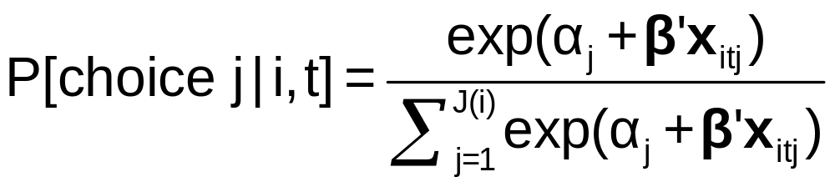
Heterogeneity and the MNL Model
Limitations of the MNL Model:
  IID ➔ IIA
  Fundamental tastes are the same across all individuals
How to adjust the model to allow variation across individuals?
  Full random variation
  Latent grouping – allow some variation

Slide 7
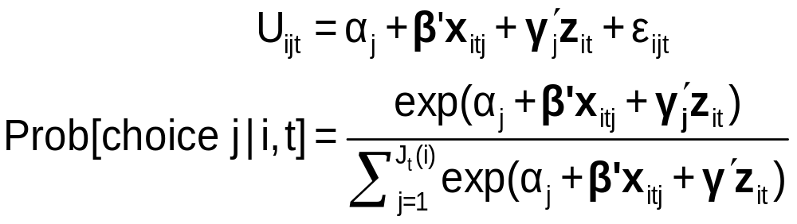
Observable Heterogeneity in Utility Levels
Choice, e.g., among brands of cars
x_{itj} = attributes: price, features
z_{it} = observable characteristics: age, sex, income

Slide 8
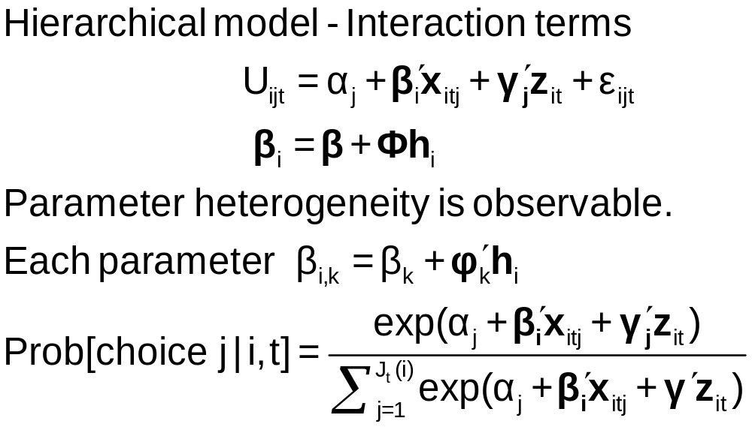
Observable Heterogeneity in
Preference Weights

Slide 9
Heteroscedasticity in the MNL Model
• Motivation: Scaling in utility functions
• If ignored, distorts coefficients
• Random utility basis
Uij = α_{j} + β’x_{ij} + γ’z_{i} + σ_{j}ε_{ij}
i = 1,…,N; j = 1,…,J(i)
F(ε_{ij}) = Exp(-Exp(-ε_{ij})) now scaled
• Extensions: Relaxes IIA
        Allows heteroscedasticity across
        choices and across individuals

Slide 10
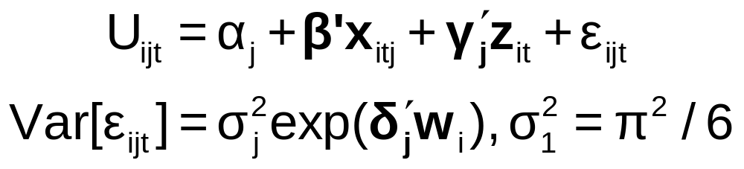
‘Quantifiable’ Heterogeneity in Scaling
w_{i} = observable characteristics:
age, sex, income, etc.

Slide 11
Modeling Unobserved Heterogeneity
Latent class – Discrete approximation
Mixed logit – Continuous
Many extensions and blends of LC and RP

Slide 12
Latent Class
Models

Slide 13
The “Finite Mixture Model”
An unknown parametric model governs an outcome y
  F(y|x,θ)
  This is the model
We approximate F(y|x,θ) with a weighted sum of specified (e.g., normal) densities:
  F(y|x,θ) ≅ Σ_{j} π_{j} G(y|x,β)
  This is a search for functional form. With a sufficient number of (normal) components, we can approximate any density to any desired degree of accuracy. (McLachlan and Peel (2000))
  There is no “mixing” process at work

Slide 14
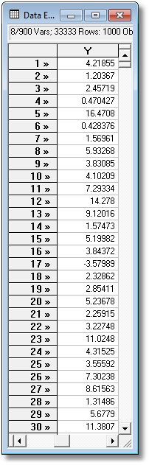
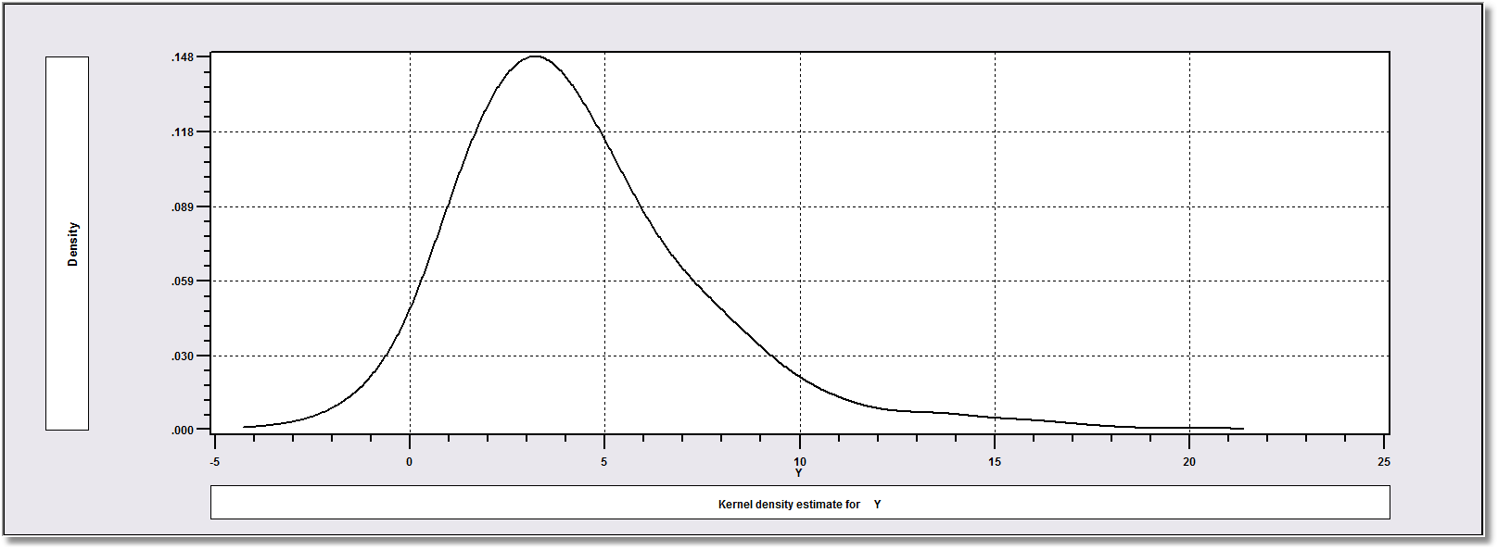
Density? Note significant mass below zero. Not a gamma or lognormal or any other familiar density.

Slide 15
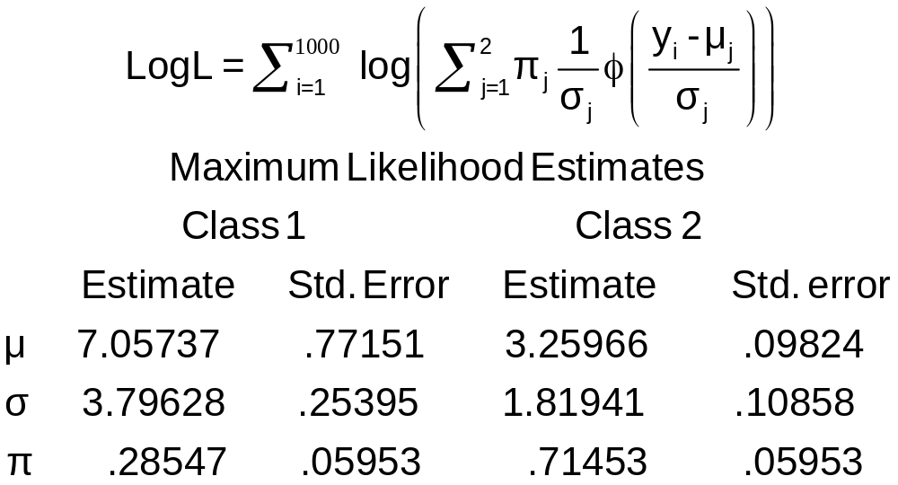
ML Mixture of Two Normal Densities

Slide 16
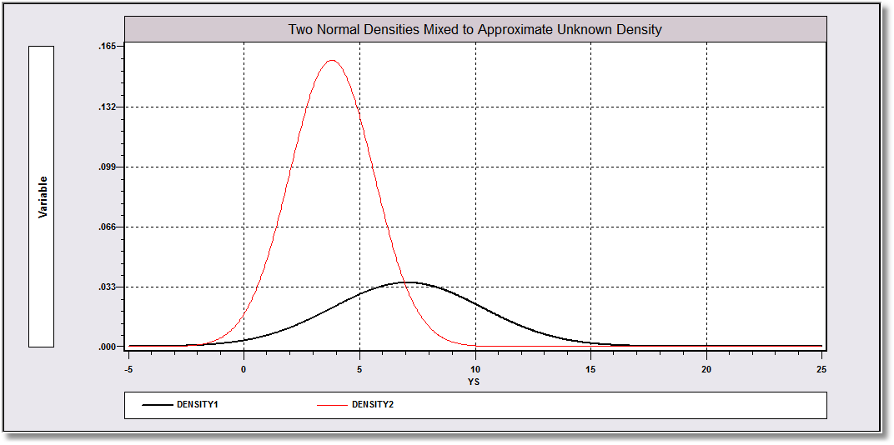
Mixing probabilities .715 and .285

Slide 17
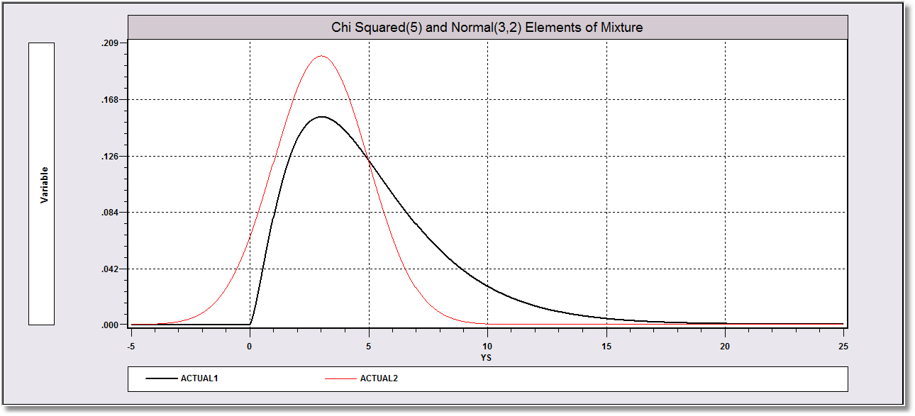
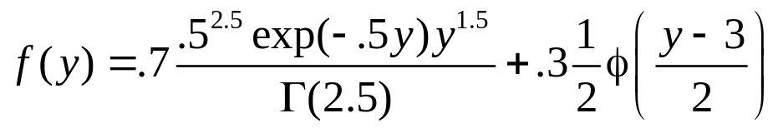
The actual process is a mix of chi squared(5) and normal(3,2) with mixing probabilities .7 and .3.

Slide 18
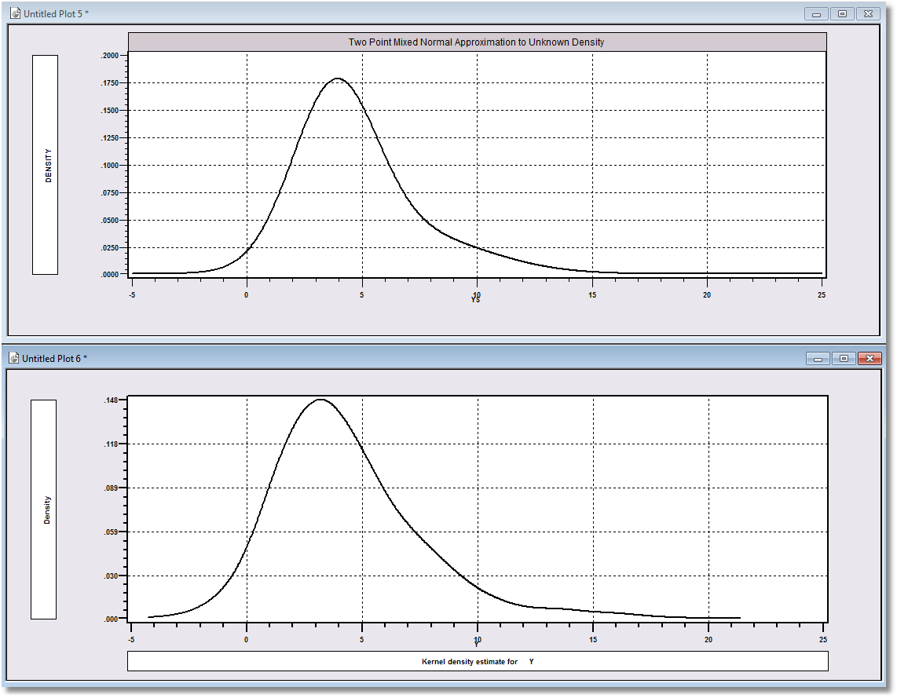
Approximation
Actual Distribution

Slide 19
Latent Classes
Population contains a mixture of individuals of different types
Common form of the generating mechanism within the classes
Observed outcome y is governed by the common process F(y|x,θ_{j} )
Classes are distinguished by the parameters, θ_{j}.

Slide 20


Slide 21
The Latent Class “Model”
Parametric Model:
  F(y|x,θ)
  E.g., y ~ N[x′β, σ²], y ~ Poisson[λ=exp(x′β)], etc.
  Density F(y|x,Θ) ≅ Σ_{j} π_{j} F(y|x,θ_{j} ),
  Θ = [θ₁, θ₂,…, θ_{J}, π₁, π₂,…, π_{J}]
  Σ_{j} π_{j} = 1
  Generating mechanism for an individual drawn at random from the mixed population is F(y|x,Θ).
  Class probabilities relate to a stable process governing the mixture of types in the population

Slide 22
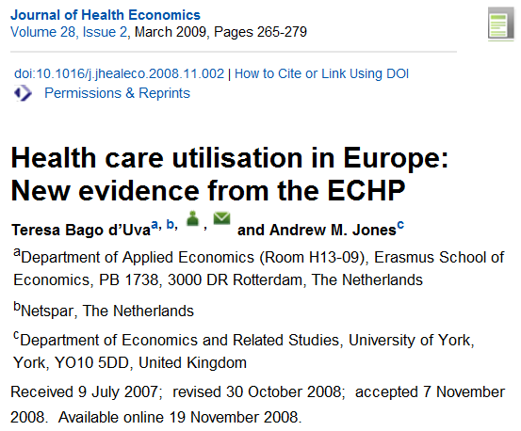

Slide 23
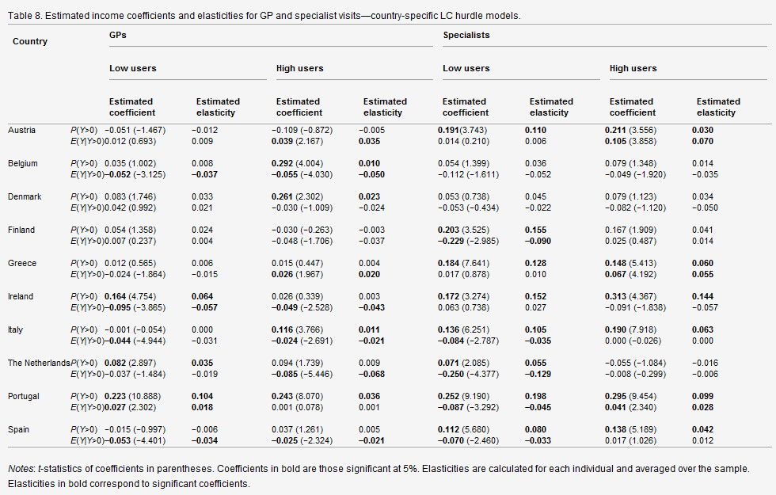

Slide 24
RANDOM Parameter
Models

Slide 25
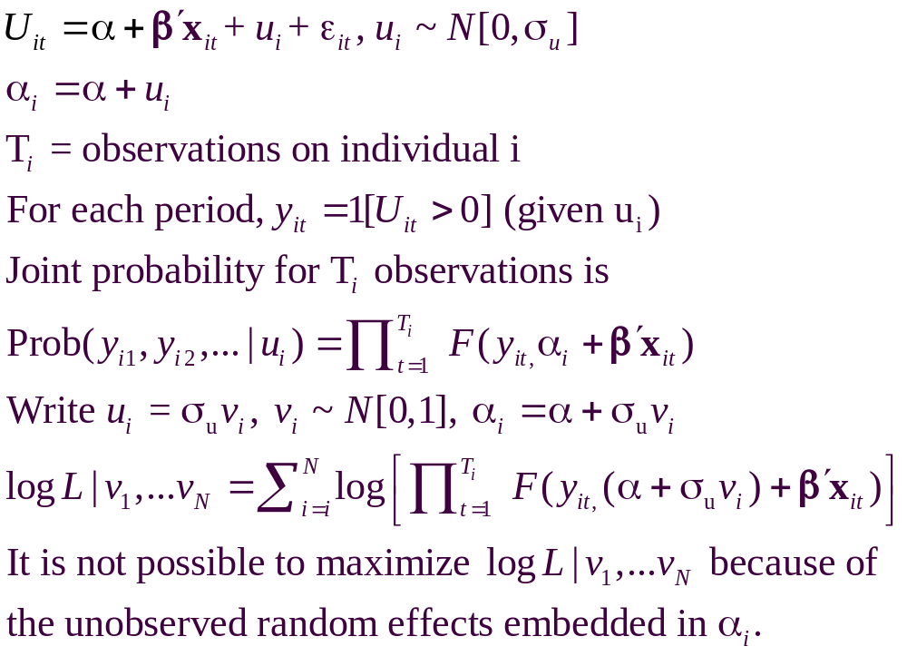
A Recast Random Effects Model

Slide 26
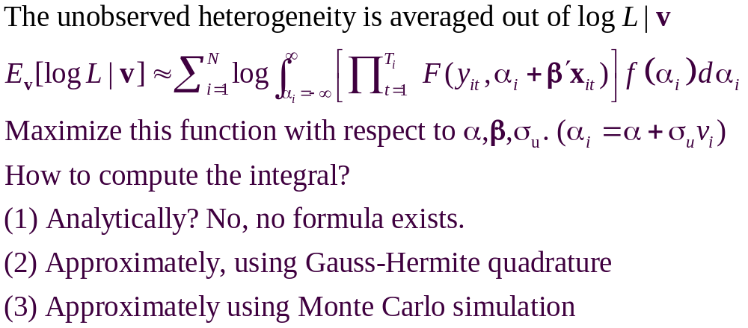
A Computable Log Likelihood

Slide 27
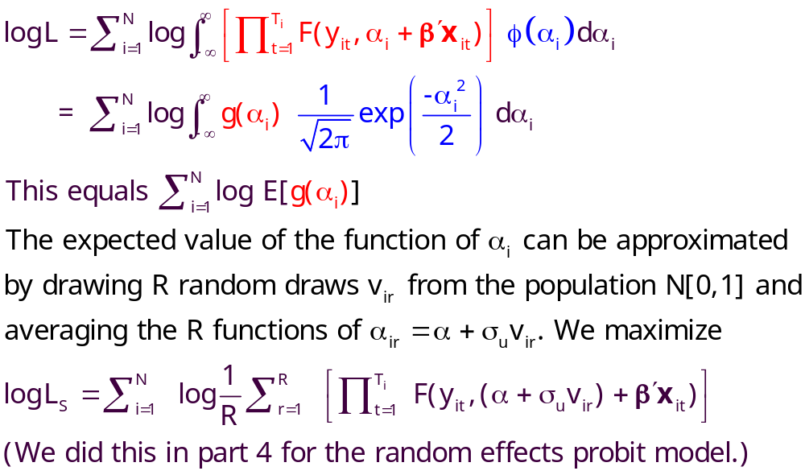
Simulation

Slide 28
Random Effects Model: Simulation
----------------------------------------------------------------------
Random Coefficients Probit Model
Dependent variable DOCTOR (Quadrature Based)
Log likelihood function -16296.68110 (-16290.72192)
Restricted log likelihood -17701.08500
Chi squared [ 1 d.f.] 2808.80780
Simulation based on 50 Halton draws
--------+-------------------------------------------------
Variable| Coefficient Standard Error b/St.Er. P[|Z|>z]
--------+-------------------------------------------------
|Nonrandom parameters
AGE| .02226*** .00081 27.365 .0000 ( .02232)
EDUC| -.03285*** .00391 -8.407 .0000 (-.03307)
HHNINC| .00673 .05105 .132 .8952 ( .00660)
|Means for random parameters
Constant| -.11873** .05950 -1.995 .0460 (-.11819)
|Scale parameters for dists. of random parameters
Constant| .90453*** .01128 80.180 .0000
--------+-------------------------------------------------------------
Implied ρ from these estimates is .90454²/(1+.90453²) = .449998.

Slide 29
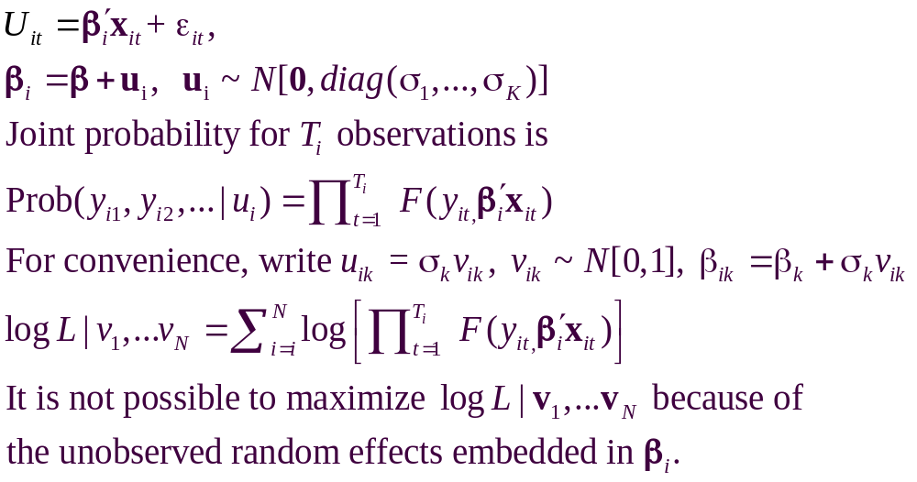
The Entire Parameter Vector is Random

Slide 30
Estimating the RPL Model
Estimation: β₁
β_{2it} = β₂ + Δz_{i} + Γv_{i,t}
Uncorrelated: Γ is diagonal
Autocorrelated: v_{i,t} = Rv_{i,t-1} + u_{i,t}
(1) Estimate “structural parameters”
(2) Estimate individual specific utility parameters
(3) Estimate elasticities, etc.

Slide 31
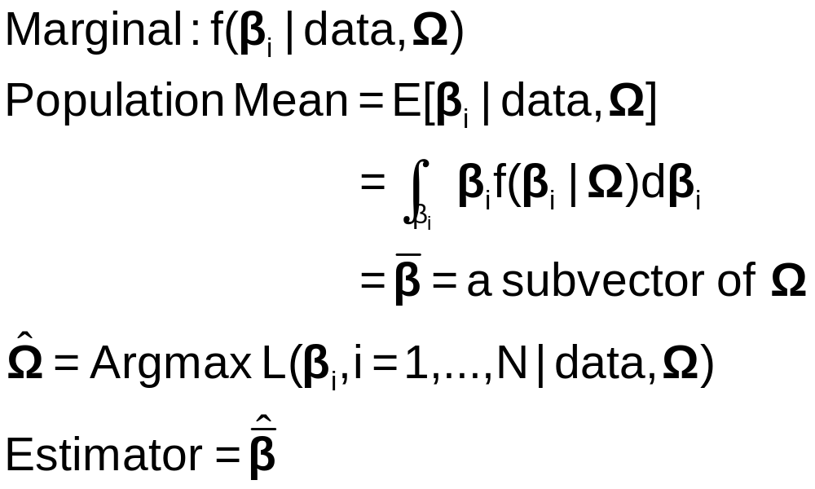
Classical Estimation Platform:
The Likelihood
Expected value over all possible realizations of β_{i}. I.e., over all possible samples.

Slide 32

Simulation Based Estimation
Choice probability = P[data |β(β₁,β₂,Δ,Γ,R,v_{i,t})]
Need to integrate out the unobserved random term
E{P[data | β(β₁,β₂,Δ,Γ,R,v_{i,t})]}
= P[…|v_{i,t}]f(v_{i,t})dv_{i,t}
Integration is done by simulation
  Draw values of v and compute β then probabilities
  Average many draws
  Maximize the sum of the logs of the averages
  (See Train[Cambridge, 2003] on simulation methods.)

Slide 33
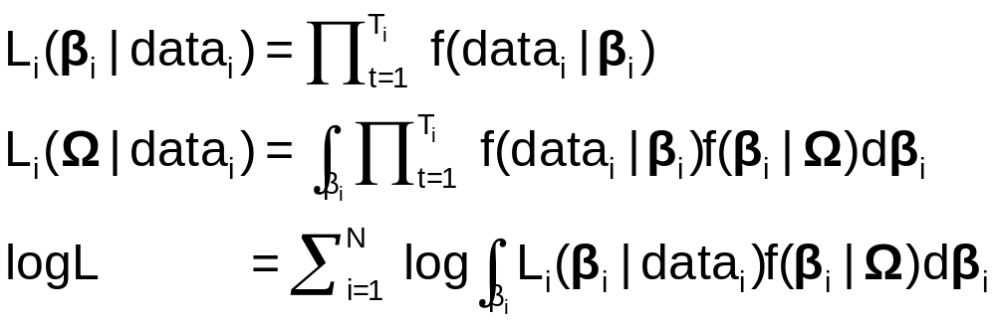
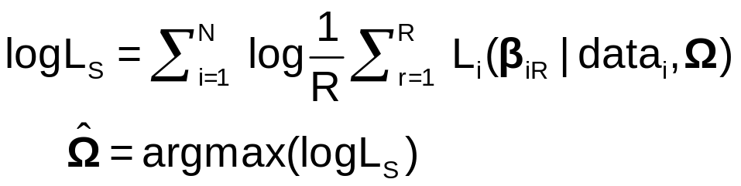
Maximum Simulated Likelihood
True log likelihood
Simulated log likelihood

Slide 34
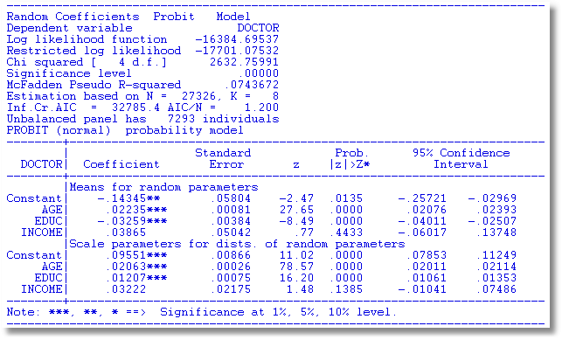
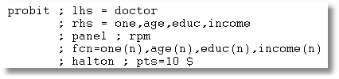

Slide 35
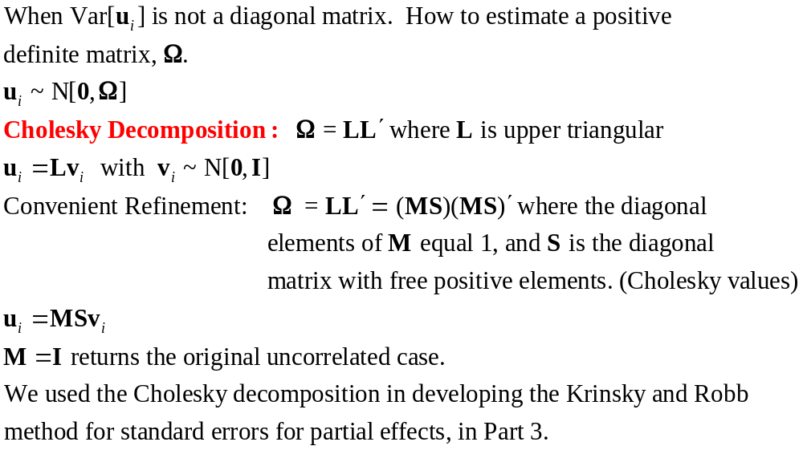

Slide 36
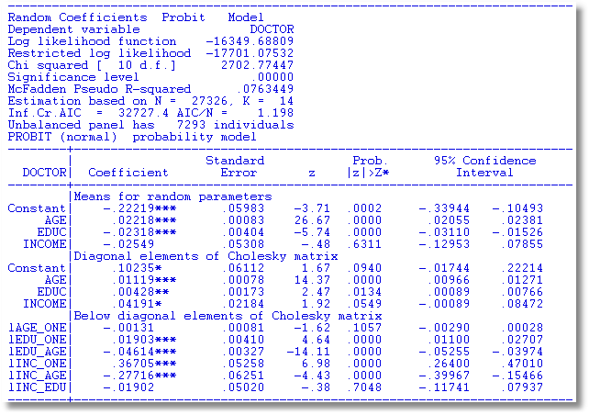
S
M

Slide 37
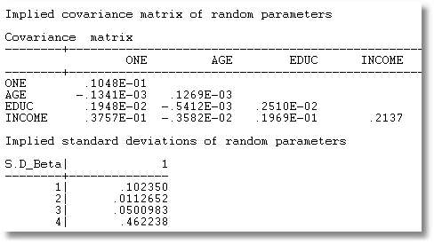
MSS′M′

Slide 38
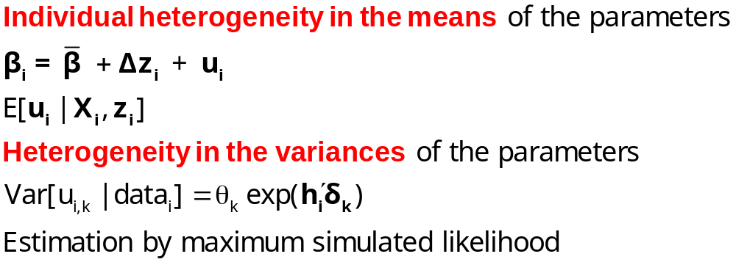
Modeling Parameter Heterogeneity

Slide 39
A Hierarchical Probit Model
U_{it} = β_{1i} + β_{2i}Age_{it} + β_{3i}Educ_{it} + β_{4i}Income_{it} + ε_{it}.
β_{1i}=β₁+Δ₁₁ Female_{i} + Δ₁₂ Married_{i} + u_{1i}
β_{2i}=β₂+Δ₂₁ Female_{i} + Δ₂₂ Married_{i} + u_{2i}
β_{3i}=β₃+Δ₃₁ Female_{i} + Δ₃₂ Married_{i} + u_{3i}
β_{4i}=β₄+Δ₄₁ Female_{i} + Δ₄₂ Married_{i} + u_{4i}
Y_{it} = 1[U_{it} > 0]
All random variables normally distributed.

Slide 40
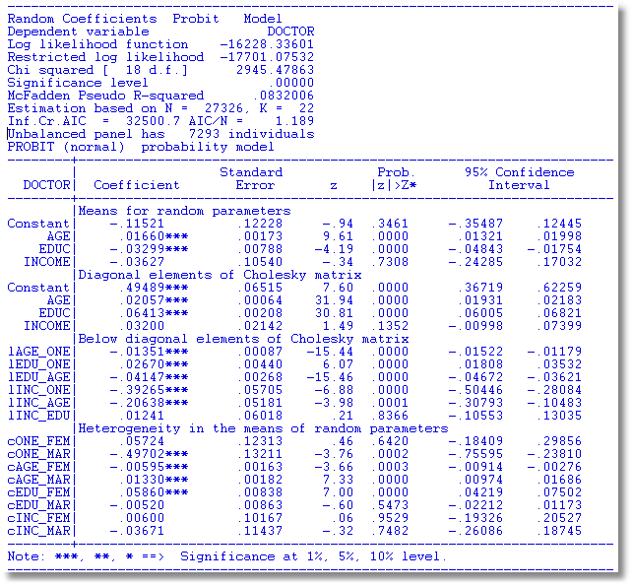

Slide 41
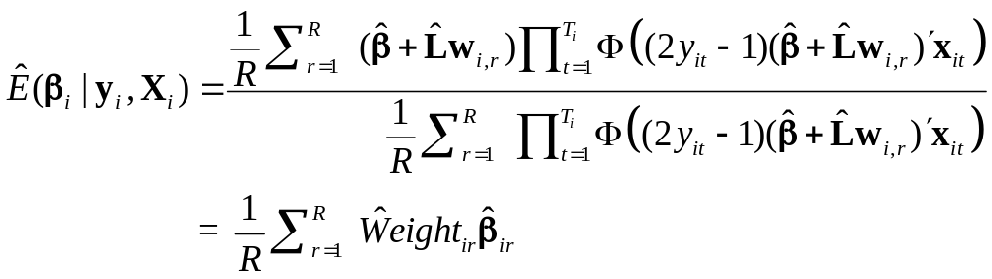
Simulating Conditional Means for Individual Parameters
Posterior estimates of E[parameters(i) | Data(i)]

Slide 42
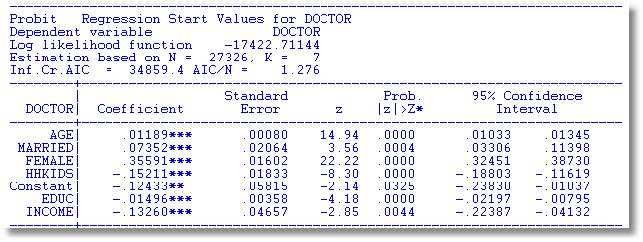

Slide 43
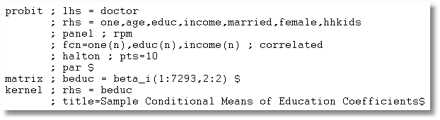

Slide 44
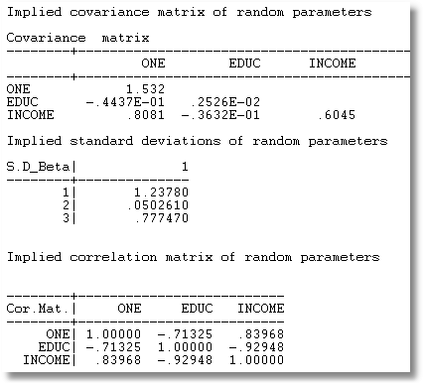
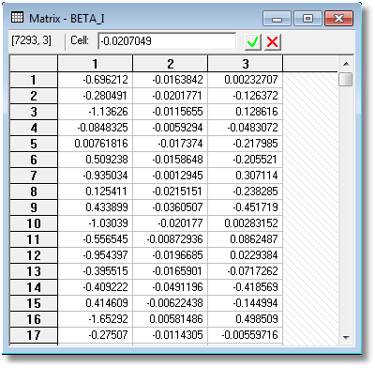

Slide 45
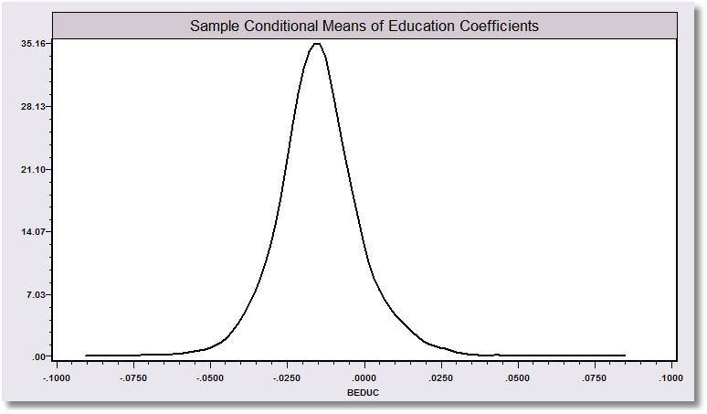
“Individual Coefficients”

Slide 46
Programs differ on the models fitted, the algorithms, the paradigm, and the extensions provided to the simplest RPM, β_{i} = β+w_{i}.
WinBUGS:
  MCMC
  User specifies the model – constructs the Gibbs Sampler/Metropolis Hastings
MLWin:
  Linear and some nonlinear – logit, Poisson, etc.
  Uses MCMC for MLE (noninformative priors)
SAS: Proc Mixed.
  Classical
  Uses primarily a kind of GLS/GMM (method of moments algorithm for loglinear models)
Stata: Classical
  Several loglinear models – GLAMM. Mixing done by quadrature.
  Maximum simulated likelihood for multinomial choice (Arne Hole, user provided)
LIMDEP/NLOGIT
  Classical
  Mixing done by Monte Carlo integration – maximum simulated likelihood
  Numerous linear, nonlinear, loglinear models
Ken Train’s Gauss Code, miscellaneous freelance R and Matlab code
  Monte Carlo integration
  Mixed Logit (mixed multinomial logit) model only (but free!)
Biogeme
  Multinomial choice models
  Many experimental models (developer’s hobby)

Slide 47
Scaling in Choice Models

Slide 48
Using Degenerate Branches to Reveal Scaling
LIMB
Travel
BRANCH
Fly
Rail
Drive
GrndPblc
TWIG
Air
Train
Car
Bus

Slide 49
Scaling in Transport Modes
-----------------------------------------------------------
FIML Nested Multinomial Logit Model
Dependent variable MODE
Log likelihood function -182.42834
The model has 2 levels.
Nested Logit form:IVparms=Taub|l,r,Sl|r
& Fr.No normalizations imposed a priori
Number of obs.= 210, skipped 0 obs
--------+--------------------------------------------------
Variable| Coefficient Standard Error b/St.Er. P[|Z|>z]
--------+--------------------------------------------------
|Attributes in the Utility Functions (beta)
GC| .09622** .03875 2.483 .0130
TTME| -.08331*** .02697 -3.089 .0020
INVT| -.01888*** .00684 -2.760 .0058
INVC| -.10904*** .03677 -2.966 .0030
A_AIR| 4.50827*** 1.33062 3.388 .0007
A_TRAIN| 3.35580*** .90490 3.708 .0002
A_BUS| 3.11885** 1.33138 2.343 .0192
|IV parameters, tau(b|l,r),sigma(l|r),phi(r)
FLY| 1.65512** .79212 2.089 .0367
RAIL| .92758*** .11822 7.846 .0000
LOCLMASS| 1.00787*** .15131 6.661 .0000
DRIVE| 1.00000 ......(Fixed Parameter)......
--------+--------------------------------------------------
NLOGIT ; Lhs=mode
; Rhs=gc,ttme,invt,invc,one
; Choices=air,train,bus,car
; Tree=Fly(Air),
Rail(train),
LoclMass(bus),
Drive(Car)
; ivset:(drive)=[1]$

Slide 50
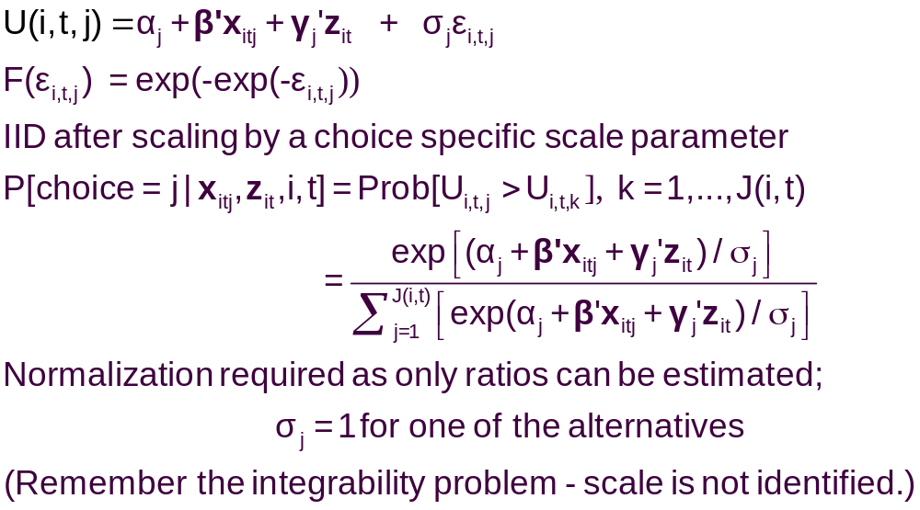
A Model with Choice Heteroscedasticity

Slide 51
Heteroscedastic Extreme Value Model (1)
+---------------------------------------------+
| Start values obtained using MNL model |
| Maximum Likelihood Estimates |
| Log likelihood function -184.5067 |
| Dependent variable Choice |
| Response data are given as ind. choice. |
| Number of obs.= 210, skipped 0 bad obs. |
+---------------------------------------------+
+--------+--------------+----------------+--------+--------+
|Variable| Coefficient | Standard Error |b/St.Er.|P[|Z|>z]|
+--------+--------------+----------------+--------+--------+
GC | .06929537 .01743306 3.975 .0001
TTME | -.10364955 .01093815 -9.476 .0000
INVC | -.08493182 .01938251 -4.382 .0000
INVT | -.01333220 .00251698 -5.297 .0000
AASC | 5.20474275 .90521312 5.750 .0000
TASC | 4.36060457 .51066543 8.539 .0000
BASC | 3.76323447 .50625946 7.433 .0000

Slide 52
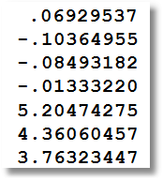
Heteroscedastic Extreme Value Model (2)
+---------------------------------------------+
| Heteroskedastic Extreme Value Model |
| Log likelihood function -182.4440 | (MNL logL was -184.5067)
| Number of parameters 10 |
| Restricted log likelihood -291.1218 |
+---------------------------------------------+
+--------+--------------+----------------+--------+--------+
|Variable| Coefficient | Standard Error |b/St.Er.|P[|Z|>z]|
+--------+--------------+----------------+--------+--------+
---------+Attributes in the Utility Functions (beta)
GC | .11903513 .06402510 1.859 .0630
TTME | -.11525581 .05721397 -2.014 .0440
INVC | -.15515877 .07928045 -1.957 .0503
INVT | -.02276939 .01122762 -2.028 .0426
AASC | 4.69411460 2.48091789 1.892 .0585
TASC | 5.15629868 2.05743764 2.506 .0122
BASC | 5.03046595 1.98259353 2.537 .0112
---------+Scale Parameters of Extreme Value Distns Minus 1.0
s_AIR | -.57864278 .21991837 -2.631 .0085
s_TRAIN | -.45878559 .34971034 -1.312 .1896
s_BUS | .26094835 .94582863 .276 .7826
s_CAR | .000000 ......(Fixed Parameter).......
---------+Std.Dev=pi/(theta*sqr(6)) for H.E.V. distribution.
s_AIR | 3.04385384 1.58867426 1.916 .0554
s_TRAIN | 2.36976283 1.53124258 1.548 .1217
s_BUS | 1.01713111 .76294300 1.333 .1825
s_CAR | 1.28254980 ......(Fixed Parameter).......
Normalized for estimation
Structural parameters

Slide 53
HEV Model - Elasticities
+---------------------------------------------------+
| Elasticity averaged over observations.|
| Attribute is INVC in choice AIR |
| Effects on probabilities of all choices in model: |
| * = Direct Elasticity effect of the attribute. |
| Mean St.Dev |
| * Choice=AIR -4.2604 1.6745 |
| Choice=TRAIN 1.5828 1.9918 |
| Choice=BUS 3.2158 4.4589 |
| Choice=CAR 2.6644 4.0479 |
| Attribute is INVC in choice TRAIN |
| Choice=AIR .7306 .5171 |
| * Choice=TRAIN -3.6725 4.2167 |
| Choice=BUS 2.4322 2.9464 |
| Choice=CAR 1.6659 1.3707 |
| Attribute is INVC in choice BUS |
| Choice=AIR .3698 .5522 |
| Choice=TRAIN .5949 1.5410 |
| * Choice=BUS -6.5309 5.0374 |
| Choice=CAR 2.1039 8.8085 |
| Attribute is INVC in choice CAR |
| Choice=AIR .3401 .3078 |
| Choice=TRAIN .4681 .4794 |
| Choice=BUS 1.4723 1.6322 |
| * Choice=CAR -3.5584 9.3057 |
+---------------------------------------------------+
Multinomial Logit
+---------------------------+
| INVC in AIR |
| Mean St.Dev |
| * -5.0216 2.3881 |
| 2.2191 2.6025 |
| 2.2191 2.6025 |
| 2.2191 2.6025 |
| INVC in TRAIN |
| 1.0066 .8801 |
| * -3.3536 2.4168 |
| 1.0066 .8801 |
| 1.0066 .8801 |
| INVC in BUS |
| .4057 .6339 |
| .4057 .6339 |
| * -2.4359 1.1237 |
| .4057 .6339 |
| INVC in CAR |
| .3944 .3589 |
| .3944 .3589 |
| .3944 .3589 |
| * -1.3888 1.2161 |
+---------------------------+

Slide 54
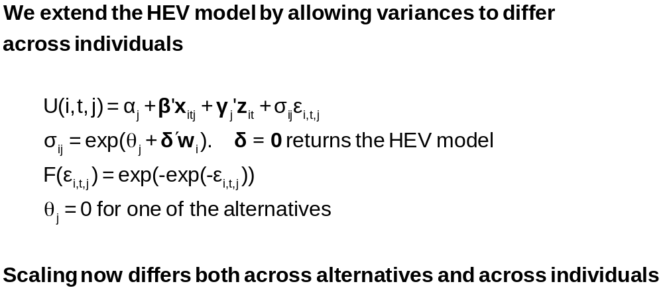
Variance Heterogeneity in MNL

Slide 55
Application: Shoe Brand Choice
Simulated Data: Stated Choice, 400 respondents, 8 choice situations, 3,200 observations
3 choice/attributes + NONE
  Fashion = High / Low
  Quality = High / Low
  Price = 25/50/75,100 coded 1,2,3,4
Heterogeneity: Sex, Age (<25, 25-39, 40+)
Underlying data generated by a 3 class latent class process (100, 200, 100 in classes)

Slide 56
Multinomial Logit Baseline Values
+---------------------------------------------+
| Discrete choice (multinomial logit) model |
| Number of observations 3200 |
| Log likelihood function -4158.503 |
| Number of obs.= 3200, skipped 0 bad obs. |
+---------------------------------------------+
+--------+--------------+----------------+--------+--------+
|Variable| Coefficient | Standard Error |b/St.Er.|P[|Z|>z]|
+--------+--------------+----------------+--------+--------+
FASH | 1.47890473 .06776814 21.823 .0000
QUAL | 1.01372755 .06444532 15.730 .0000
PRICE | -11.8023376 .80406103 -14.678 .0000
ASC4 | .03679254 .07176387 .513 .6082

Slide 57
Multinomial Logit Elasticities
+---------------------------------------------------+
| Elasticity averaged over observations.|
| Attribute is PRICE in choice BRAND1 |
| Effects on probabilities of all choices in model: |
| * = Direct Elasticity effect of the attribute. |
| Mean St.Dev |
| * Choice=BRAND1 -.8895 .3647 |
| Choice=BRAND2 .2907 .2631 |
| Choice=BRAND3 .2907 .2631 |
| Choice=NONE .2907 .2631 |
| Attribute is PRICE in choice BRAND2 |
| Choice=BRAND1 .3127 .1371 |
| * Choice=BRAND2 -1.2216 .3135 |
| Choice=BRAND3 .3127 .1371 |
| Choice=NONE .3127 .1371 |
| Attribute is PRICE in choice BRAND3 |
| Choice=BRAND1 .3664 .2233 |
| Choice=BRAND2 .3664 .2233 |
| * Choice=BRAND3 -.7548 .3363 |
| Choice=NONE .3664 .2233 |
+---------------------------------------------------+

Slide 58
HEV Model without Heterogeneity
+---------------------------------------------+
| Heteroskedastic Extreme Value Model |
| Dependent variable CHOICE |
| Number of observations 3200 |
| Log likelihood function -4151.611 |
| Response data are given as ind. choice. |
+---------------------------------------------+
+--------+--------------+----------------+--------+--------+
|Variable| Coefficient | Standard Error |b/St.Er.|P[|Z|>z]|
+--------+--------------+----------------+--------+--------+
---------+Attributes in the Utility Functions (beta)
FASH | 1.57473345 .31427031 5.011 .0000
QUAL | 1.09208463 .22895113 4.770 .0000
PRICE | -13.3740754 2.61275111 -5.119 .0000
ASC4 | -.01128916 .22484607 -.050 .9600
---------+Scale Parameters of Extreme Value Distns Minus 1.0
s_BRAND1| .03779175 .22077461 .171 .8641
s_BRAND2| -.12843300 .17939207 -.716 .4740
s_BRAND3| .01149458 .22724947 .051 .9597
s_NONE | .000000 ......(Fixed Parameter).......
---------+Std.Dev=pi/(theta*sqr(6)) for H.E.V. distribution.
s_BRAND1| 1.23584505 .26290748 4.701 .0000
s_BRAND2| 1.47154471 .30288372 4.858 .0000
s_BRAND3| 1.26797496 .28487215 4.451 .0000
s_NONE | 1.28254980 ......(Fixed Parameter).......
Essentially no differences in variances across choices

Slide 59
Homogeneous HEV Elasticities
Multinomial Logit
+---------------------------------------------------+
| Attribute is PRICE in choice BRAND1 |
| Mean St.Dev |
| * Choice=BRAND1 -1.0585 .4526 |
| Choice=BRAND2 .2801 .2573 |
| Choice=BRAND3 .3270 .3004 |
| Choice=NONE .3232 .2969 |
| Attribute is PRICE in choice BRAND2 |
| Choice=BRAND1 .3576 .1481 |
| * Choice=BRAND2 -1.2122 .3142 |
| Choice=BRAND3 .3466 .1426 |
| Choice=NONE .3429 .1411 |
| Attribute is PRICE in choice BRAND3 |
| Choice=BRAND1 .4332 .2532 |
| Choice=BRAND2 .3610 .2116 |
| * Choice=BRAND3 -.8648 .4015 |
| Choice=NONE .4156 .2436 |
+---------------------------------------------------+
| Elasticity averaged over observations.|
| Effects on probabilities of all choices in model: |
| * = Direct Elasticity effect of the attribute. |
+---------------------------------------------------+
+--------------------------+
| PRICE in choice BRAND1|
| Mean St.Dev |
| * -.8895 .3647 |
| .2907 .2631 |
| .2907 .2631 |
| .2907 .2631 |
| PRICE in choice BRAND2|
| .3127 .1371 |
| * -1.2216 .3135 |
| .3127 .1371 |
| .3127 .1371 |
| PRICE in choice BRAND3|
| .3664 .2233 |
| .3664 .2233 |
| * -.7548 .3363 |
| .3664 .2233 |
+--------------------------+

Slide 60
Heteroscedasticity Across Individuals
+---------------------------------------------+
| Heteroskedastic Extreme Value Model | Homog-HEV MNL
| Log likelihood function -4129.518[10] | -4151.611[7] -4158.503[4]
+---------------------------------------------+
+--------+--------------+----------------+--------+--------+
|Variable| Coefficient | Standard Error |b/St.Er.|P[|Z|>z]|
+--------+--------------+----------------+--------+--------+
---------+Attributes in the Utility Functions (beta)
FASH | 1.01640726 .20261573 5.016 .0000
QUAL | .55668491 .11604080 4.797 .0000
PRICE | -7.44758292 1.52664112 -4.878 .0000
ASC4 | .18300524 .09678571 1.891 .0586
---------+Scale Parameters of Extreme Value Distributions
s_BRAND1| .81114924 .10099174 8.032 .0000
s_BRAND2| .72713522 .08931110 8.142 .0000
s_BRAND3| .80084114 .10316939 7.762 .0000
s_NONE | 1.00000000 ......(Fixed Parameter).......
---------+Heterogeneity in Scales of Ext.Value Distns.
MALE | .21512161 .09359521 2.298 .0215
AGE25 | .79346679 .13687581 5.797 .0000
AGE39 | .38284617 .16129109 2.374 .0176

Slide 61
Variance Heterogeneity Elasticities
Multinomial Logit
+---------------------------------------------------+
| Attribute is PRICE in choice BRAND1 |
| Mean St.Dev |
| * Choice=BRAND1 -.8978 .5162 |
| Choice=BRAND2 .2269 .2595 |
| Choice=BRAND3 .2507 .2884 |
| Choice=NONE .3116 .3587 |
| Attribute is PRICE in choice BRAND2 |
| Choice=BRAND1 .2853 .1776 |
| * Choice=BRAND2 -1.0757 .5030 |
| Choice=BRAND3 .2779 .1669 |
| Choice=NONE .3404 .2045 |
| Attribute is PRICE in choice BRAND3 |
| Choice=BRAND1 .3328 .2477 |
| Choice=BRAND2 .2974 .2227 |
| * Choice=BRAND3 -.7458 .4468 |
| Choice=NONE .4056 .3025 |
+---------------------------------------------------+
+--------------------------+
| PRICE in choice BRAND1|
| Mean St.Dev |
| * -.8895 .3647 |
| .2907 .2631 |
| .2907 .2631 |
| .2907 .2631 |
| PRICE in choice BRAND2|
| .3127 .1371 |
| * -1.2216 .3135 |
| .3127 .1371 |
| .3127 .1371 |
| PRICE in choice BRAND3|
| .3664 .2233 |
| .3664 .2233 |
| * -.7548 .3363 |
| .3664 .2233 |
+--------------------------+

Slide 62


Slide 63
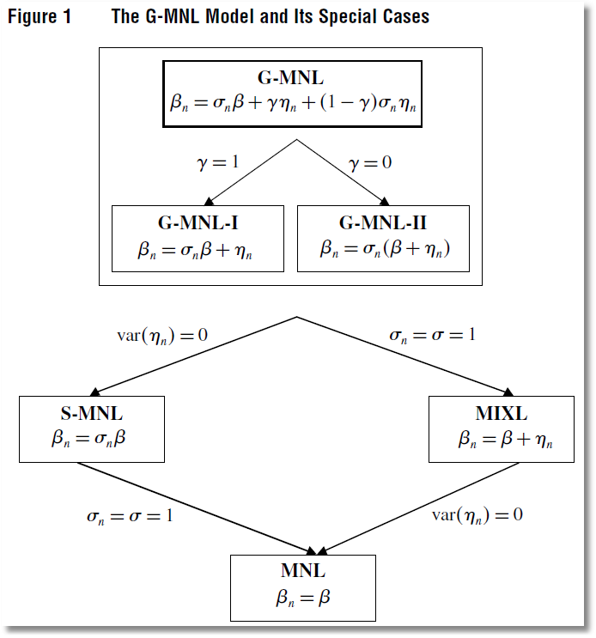

Slide 64
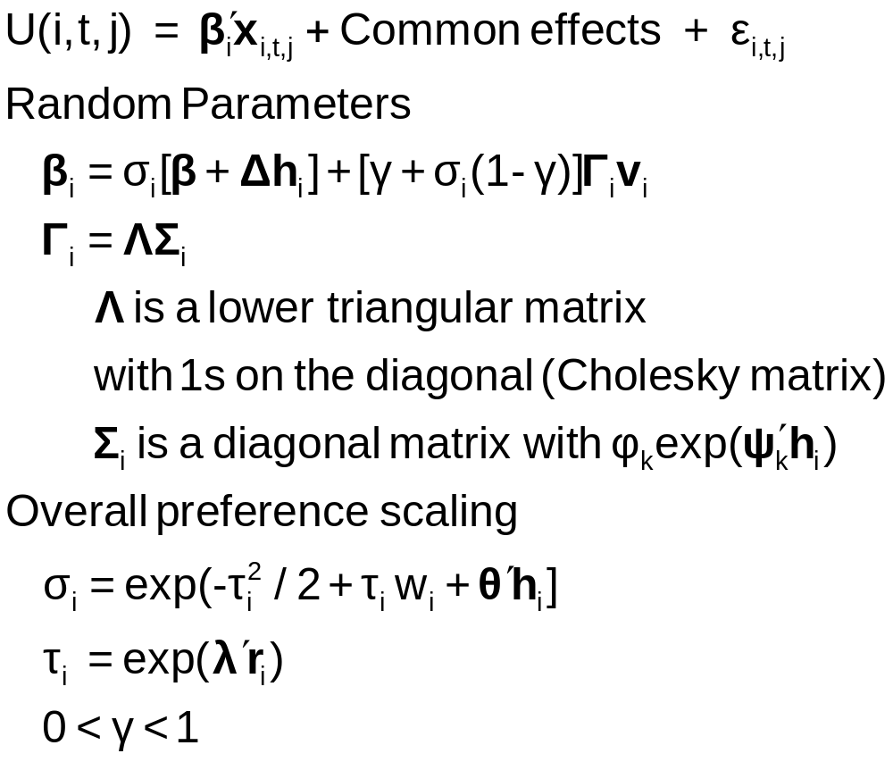
Generalized Mixed Logit Model

Slide 65
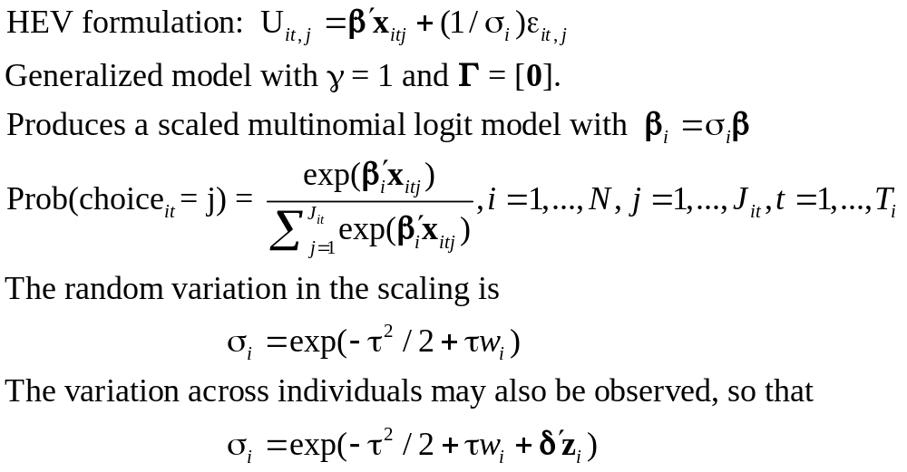
Unobserved Heterogeneity in Scaling

Slide 66
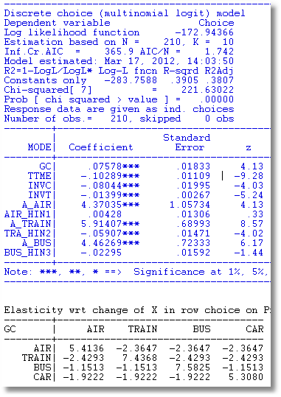
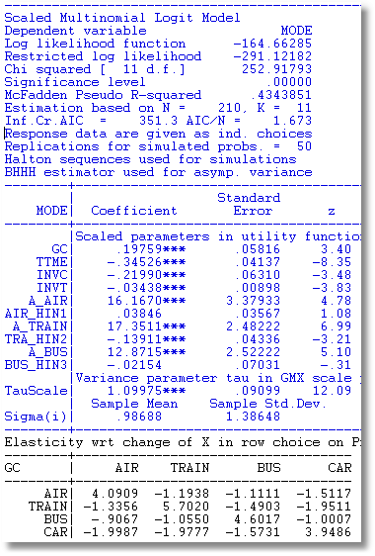
Scaled MNL

Slide 67
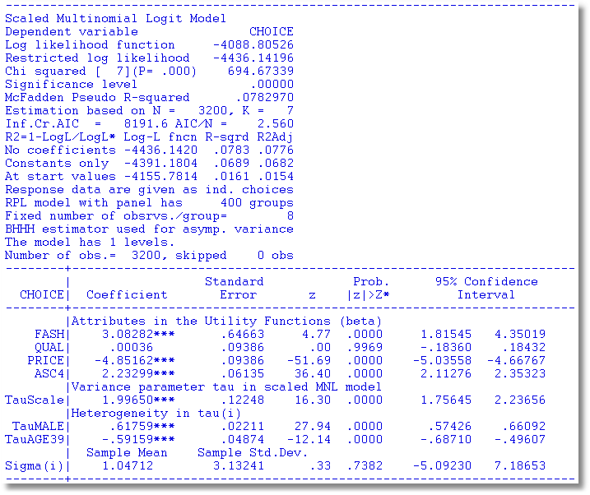
Observed and Unobserved Heterogeneity

Slide 68
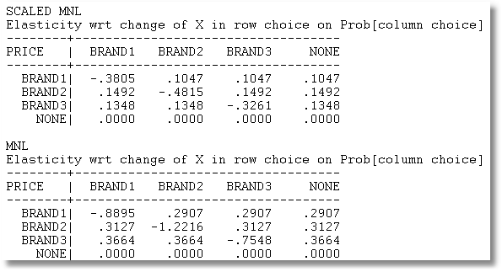
Price Elasticities

Slide 69

Scaling as Unobserved Heterogeneity

Slide 70
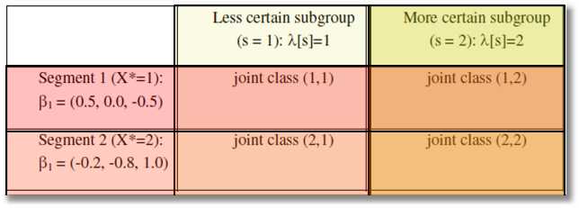
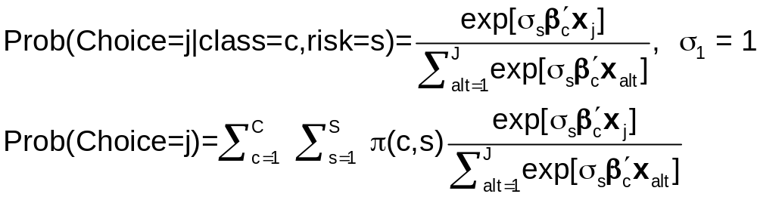
Two Way Latent Class?

Slide 71
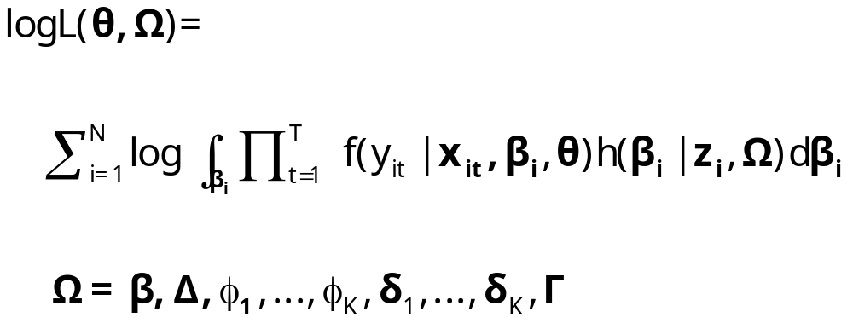
Appendix: Maximum Simulated Likelihood

Slide 72
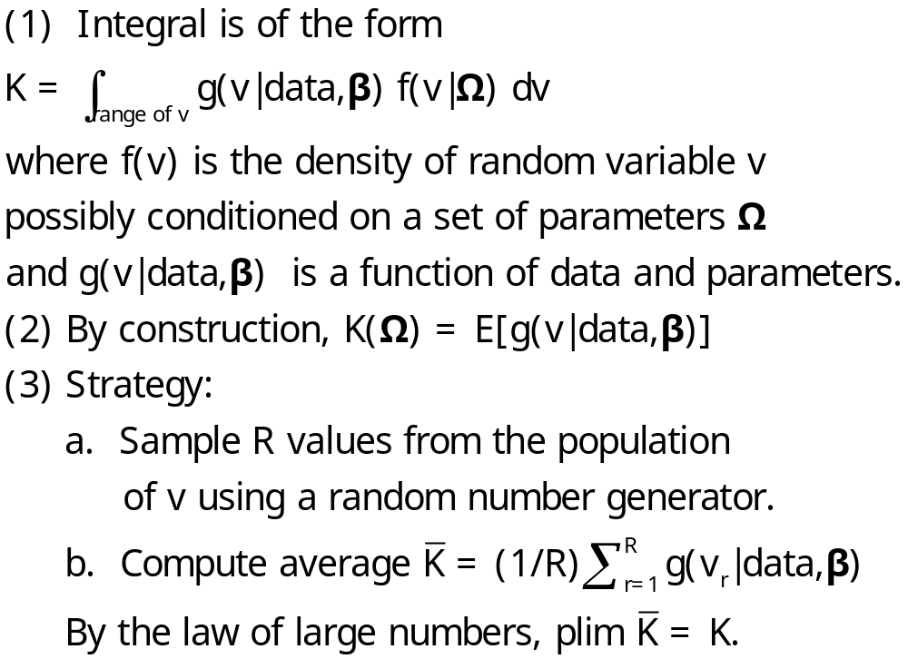
Monte Carlo Integration

Slide 73
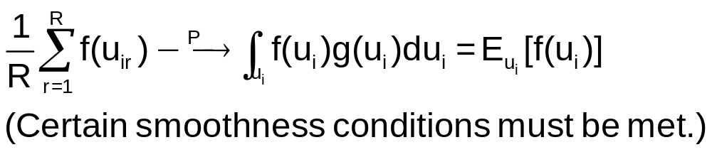
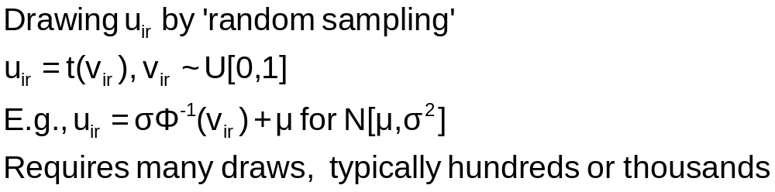
Monte Carlo Integration

Slide 74
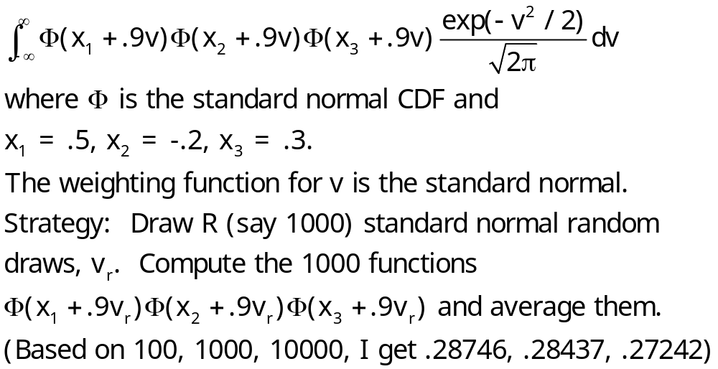
Example: Monte Carlo Integral

Slide 75

Simulated Log Likelihood for a Mixed Probit Model

Slide 76

Generating Random Draws

Slide 77

Drawing Uniform Random Numbers

Slide 78

Quasi-Monte Carlo Integration Based on Halton Sequences
For example, using base p=5, the integer r=37 has b₀ = 2, b₁ = 2, and b₂ = 1; (37=1x5² + 2x5¹ + 2x5⁰). Then
H(37|5) = 2×5⁻¹ + 2×5⁻² + 1×5⁻³ = 0.448.

Slide 79

Halton Sequences vs. Random Draws
Requires far fewer draws – for one dimension, about 1/10. Accelerates estimation by a factor of 5 to 10.

