Slide 1




Microeconometric Modeling
William Greene
Stern School of Business
New York University
New York NY USA
1.1 Descriptive Statistics
and Linear Regression

Slide 2
Data Description
Linear Regression Model
Basic Statistics
Tables
Histogram
Box Plot
Histogram
Kernel Density Estimator
Linear Model
Specification & Estimation
  Nonlinearities
  Interactions
Inference - Testing
  Wald
  F
  LM
Prediction and Model Fit
Endogeneity
  2SLS
  Control Function
  Hausman Test

Slide 3

This study is centered on a discrete data logit model

Slide 4
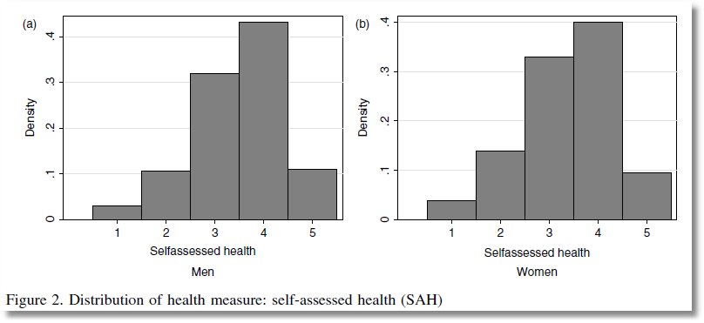
This study analyzes ‘self assessed health’ coded
1,2,3,4,5 = very low, low, med, high very high

Slide 5
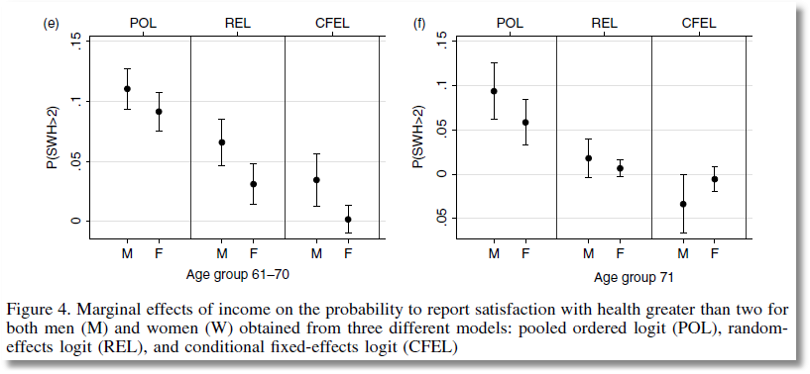

From Jones and Schurer (2011)
Stylized Box Plots

Slide 6
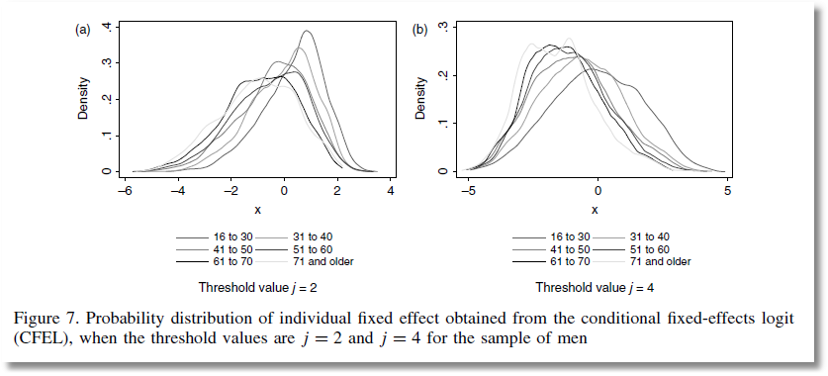
From Jones and Schurer (2011)

Slide 7
A First Look at the Data
Descriptive Statistics
Basic Measures of Location and Dispersion
Graphical Devices
  Box Plots
  Histogram
  Kernel Density Estimator

Slide 8
Cornwell and Rupert Panel Data
Cornwell and Rupert Returns to Schooling Data, 595 Individuals, 7 Years
Variables in the file are
EXP = work experience
WKS = weeks worked
OCC = occupation, 1 if blue collar,
IND = 1 if manufacturing industry
SOUTH = 1 if resides in south
SMSA = 1 if resides in a city (SMSA)
MS = 1 if married
FEM = 1 if female
UNION = 1 if wage set by union contract
ED = years of education
LWAGE = log of wage = dependent variable in regressions
These data were analyzed in Cornwell, C. and Rupert, P., "Efficient Estimation with Panel Data: An Empirical Comparison of Instrumental Variable Estimators," Journal of Applied Econometrics, 3, 1988, pp. 149-155.
Notes:
8

Slide 9


Slide 10
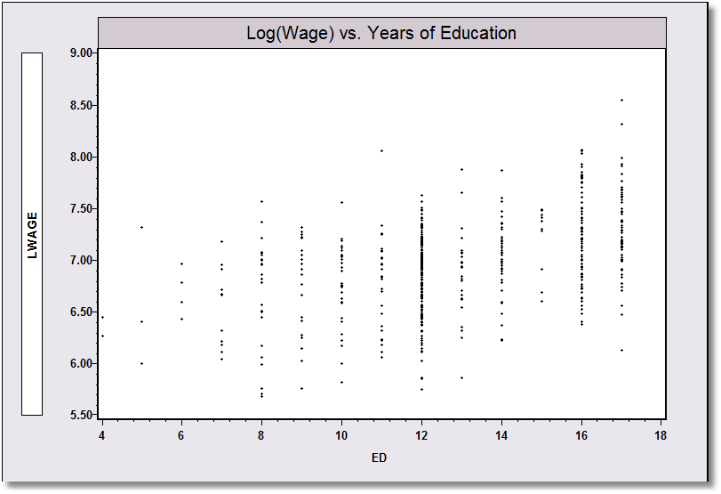
Application: Is there a relationship between (log) Wage and Education?

Slide 11
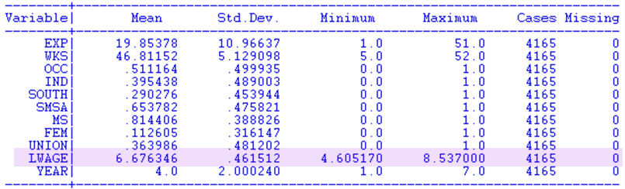
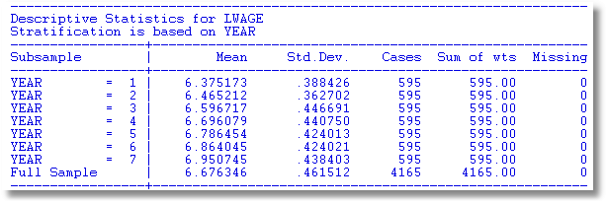

Slide 12
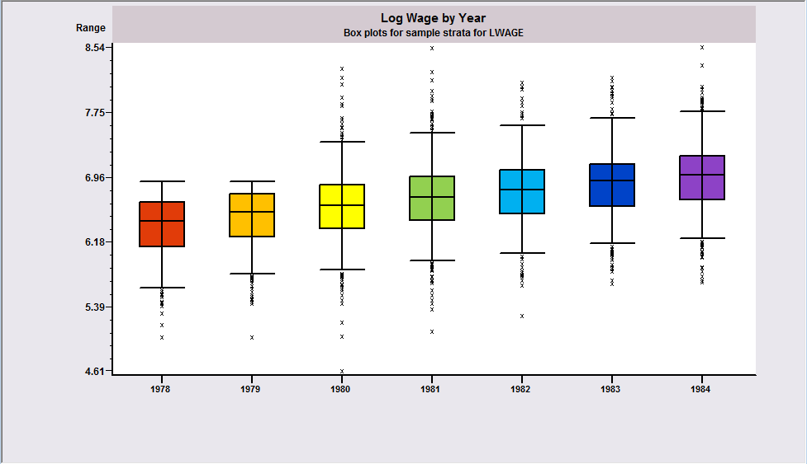
Box Plots
Shows trend in median log wage

Slide 13
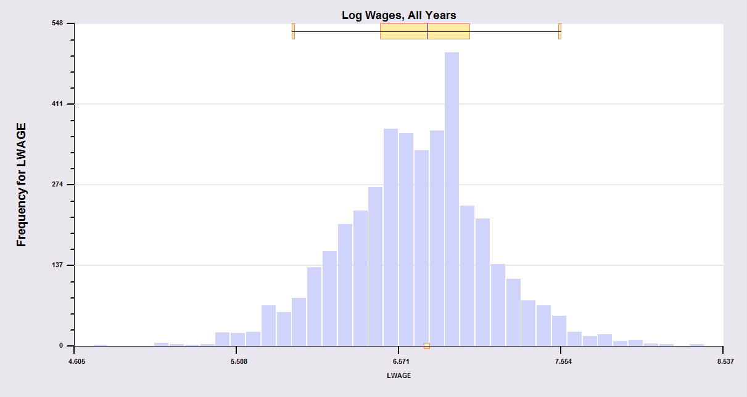
Histogram: Pooled data obscure within person variation
What is the source of the variance, variation across people or variation over time?

Slide 14
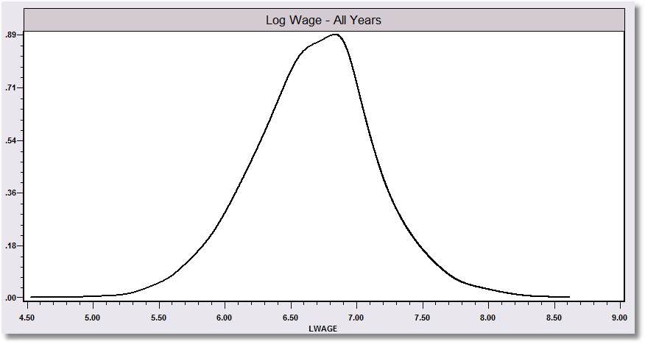
Kernel density estimator suggests the underlying distribution for a continuous variable

Slide 15
Kernel Estimator for LWAGE

Slide 16
Objective: Impact of Education on (log) Wage
Specification: What is the right model to use to analyze this association?
Estimation
Inference
Analysis

Slide 17
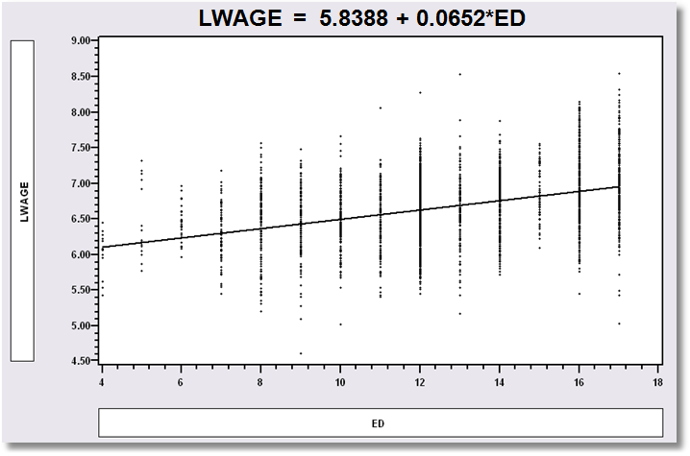
Simple Linear Regression
LWAGE = 5.8388 + 0.0652*ED

Slide 18
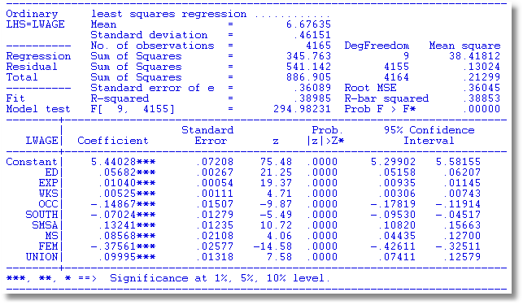
Multiple Regression

Slide 19

Nonlinear Specification:
Quadratic Effect of Experience

Slide 20
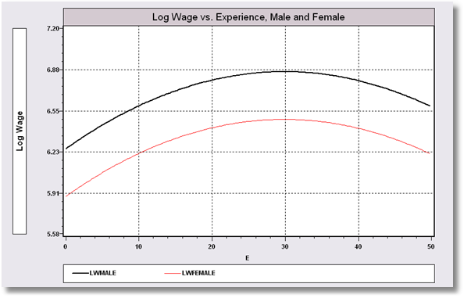
Model Implication: Effect of Experience and Male vs. Female

Slide 21
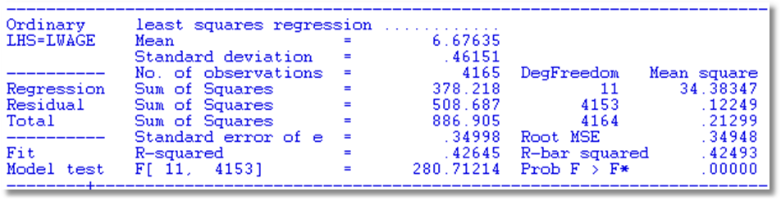
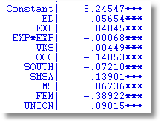
Partial Effect of Experience:
Coefficients do not tell the story
Education: .05654
Experience: .04045 - 2*.00068*Exp
FEM: -.38922

Slide 22
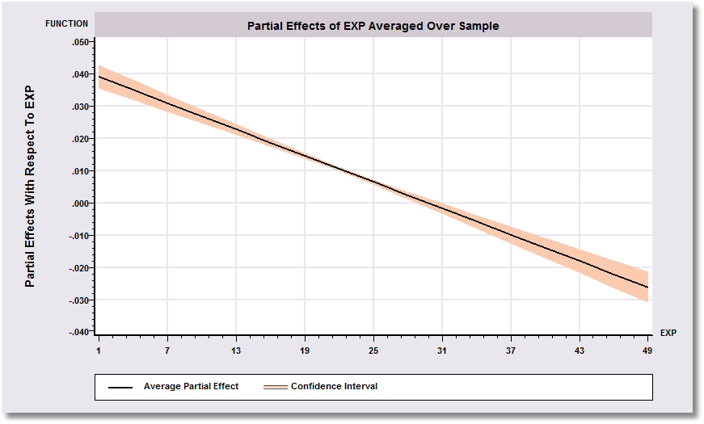
Effect of Experience = .04045 - 2*.00068*Exp
Positive from 1 to 30, negative after.

Slide 23
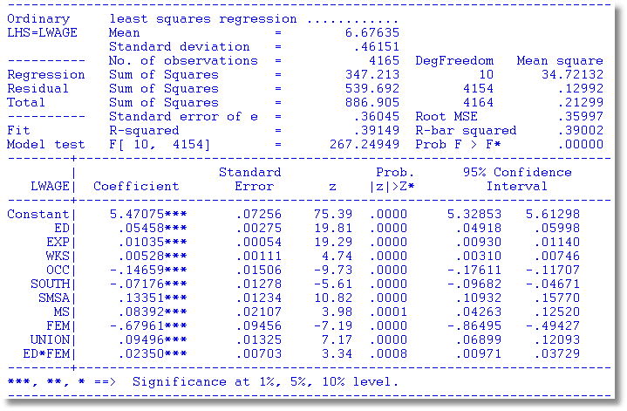
Interaction Effect
Gender Difference in Partial Effects

Slide 24
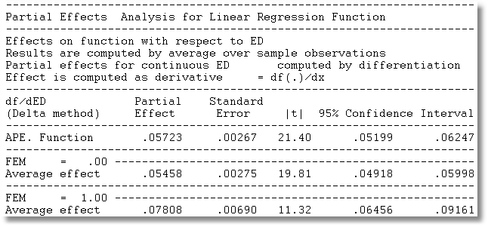
Partial Effect of a Year of Education
∂E[logWage]/∂ED=β_{ED} + β_{ED*FEM} *FEM
Note, the effect is positive.
Effect is larger for women.

Slide 25
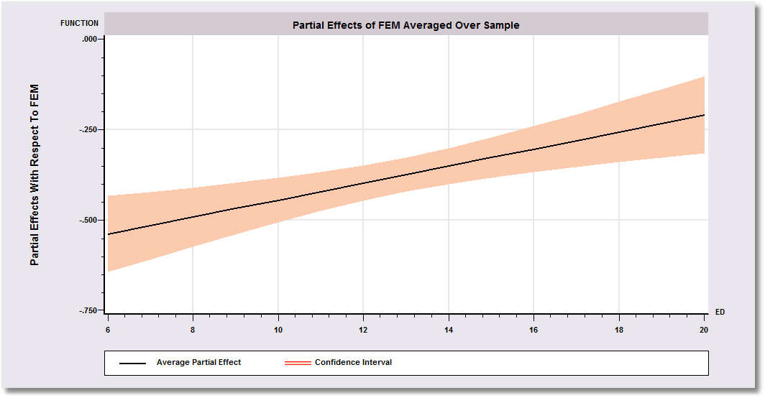
Gender Effect Varies by Years of Education
-0.67961 is misleading

Slide 26
Hypothesis Tests About Coefficients
Nested Models:
  Model A: A theory about the world (Alternative)
  Model 0: A restriction on model A (Null)
  Model 0 is contained in (nested in) Model A.
Hypothesis (for now)
  Null: Restriction on β: Rβ – q = 0
  Alternative: Not the null
Approaches
  Fitting Criterion: R² decrease under the null?
  Wald: Rb – q close to 0 under the alternative?
  LM: Does the null model appear to be inadequate

Slide 27
Hypothesis of the Model:
All Coefficients Equal Zero
All Coefficients = 0?
R = [0 | I] q = [0]
R₁² = .41826
R₀² = .00000
F = 298.7 with [10,4154]
Wald = b₂₋₁₁[V₂₋₁₁]⁻¹b₂₋₁₁
= 2988.3355
Note that Wald = JF
= 10(298.7)
(some rounding error)
LM = 888.5

Slide 28
Hypotheses
All Coefficients = 0?
R = [ 0 | I ] q = [0]
ED Coefficient = 0?
R = 0,1,0,0,0,0,0,0,0,0,0
q = 0
No Experience effect?
R = 0,0,1,0,0,0,0,0,0,0,0
0,0,0,1,0,0,0,0,0,0,0
q = 0
0

Slide 29
Hypothesis: Education Effect = 0
Is Education “significant?”
I.e., significantly different from zero
ED Coefficient = 0?
R = 0,1,0,0,0,0,0,0,0,0,0,0
q = 0
R₁² = .41826
R₀² = .35265 (not shown)
F = 468.29
Wald = (.05654-0)²/(.00261)²
= 468.29
Note F = t² and
Wald = F for 1 for a single hypothesis about 1 coefficient.

Slide 30
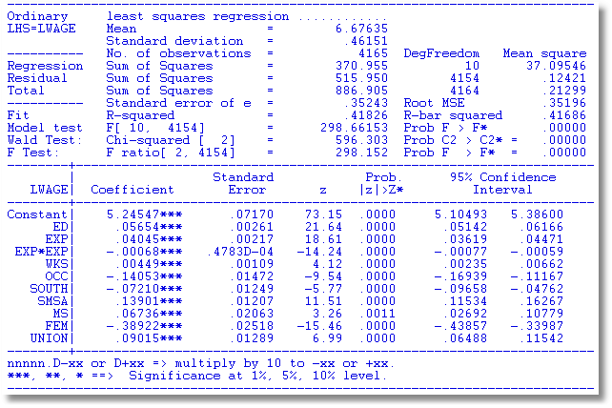
Testing Strategy 1. Does the restriction significantly change the estimation criterion?
Does the model fit better when Exp and Exp² are included then when not? Fit both models and compare.
Hypothesis: Education Effect = 0
R₀² = .33475,
R₁² = .41826
F = 298.15

Slide 31
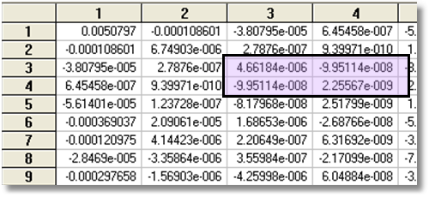
Testing Strategy 2. Do the estimated coefficients on
Exp and Exp² appear to be close to zero?
Fit the full model and measure how far the coefficients are from zero with a Wald statistic.
R = 0,0,1,0,0,0,0,0,0,0,0
0,0,0,1,0,0,0,0,0,0,0
q = 0
0
Wald = 596.3 (W* = 5.99)

Slide 32
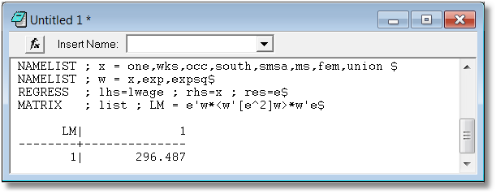
Testing Strategy 3. Do Exp and Exp² appear to be omitted variables from the regression when they are left out? If so, then they should be correlated with the residuals.
Fit the restricted model and examine the covariance of the residuals with (Exp,Exp²).
Chi-Squared = e′ W * (W′ [e²]W)⁻¹ W′ e
An easy way (produces a slightly different answer): LM = n R² (e on W). = 357.787

Slide 33
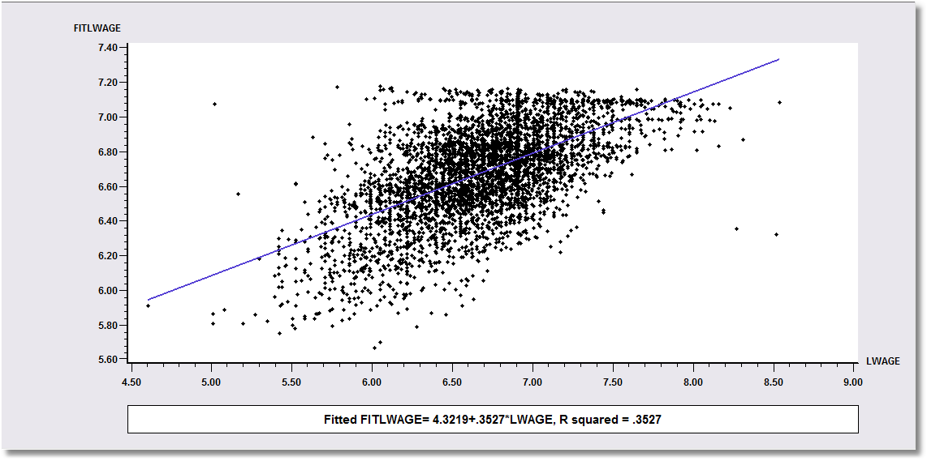
Model Fit
Predict the outcome and assess how well the predictions match the actual. R² = squared corr.

Slide 34
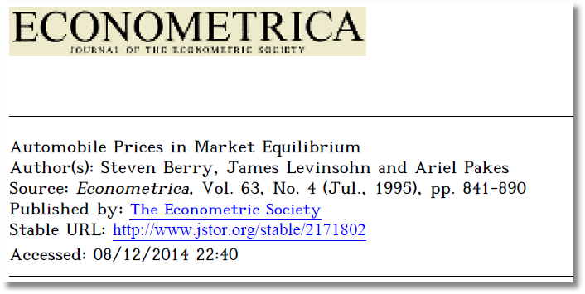
Source of Endogeneity: Omitted Variable
Aggregate Data and Multinomial Choice:
The Model of Berry, Levinsohn and Pakes

Slide 35
Theoretical Foundation
Consumer market for J differentiated brands of a good
  j =1,…, J_{t} brands or types
  i = 1,…, N consumers
  t = i,…,T “markets” (like panel data)
Consumer i’s utility for brand j (in market t) depends on
  p = price
  x = observable attributes
  f = unobserved attributes
  w = unobserved heterogeneity across consumers
  ε = idiosyncratic aspects of consumer preferences
Observed data consist of aggregate choices, prices and features of the brands.

Slide 36
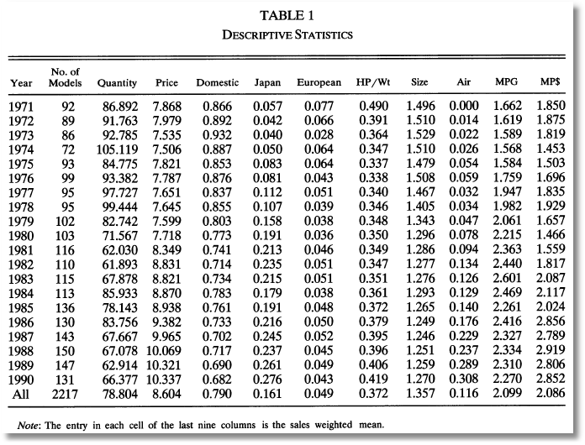
BLP Automobile Market
J_{t} N P X
t

Slide 37
Random Utility Model
Utility: U_{ijt}=U(w_{i},p_{jt},x_{jt},f_{jt},ε_{ijt} |θ), i = 1,…,(large) N, j=1,…,J
  w_{i} = individual heterogeneity; time (market) invariant. w has a continuous distribution across the population.
  p_{jt}, x_{jt}, f_{jt}, = price, observed attributes, unobserved features of brand j; all may vary through time (across markets)
Revealed Preference: Choice j provides maximum utility
Across the population, given market t, set of prices p_{t} and features (X_{t},f_{t}), there is a set of values of w_{i} that induces choice j, for each j=1,…,J_{t}; then, s_{j}(p_{t},X_{t},f_{t}|θ) is the market share of brand j in market t.
There is an outside good that attracts a nonnegligible market share, j=0. Therefore,

Slide 38
Endogenous Prices: Demand side
U_{ijt}=U(w_{i},p_{jt},x_{jt},f_{jt},ε_{ijt} |θ) = x_{jt}'β_{i} – αp_{j} + f_{jt} + ε_{ijt}
f_{jt} is unobserved features of model j
Utility responds to the unobserved f_{jt}
Price p_{jt} is partly determined by features f_{jt}.
In a choice model based on observables, price is correlated with the unobservables that determine the observed choices.

Slide 39
Cornwell and Rupert Data
Cornwell and Rupert Returns to Schooling Data, 595 Individuals, 7 Years
Variables in the file are
EXP = work experience
WKS = weeks worked
OCC = occupation, 1 if blue collar,
IND = 1 if manufacturing industry
SOUTH = 1 if resides in south
SMSA = 1 if resides in a city (SMSA)
MS = 1 if married
FEM = 1 if female
UNION = 1 if wage set by union contract
ED = years of education
LWAGE = log of wage = dependent variable in regressions
These data were analyzed in Cornwell, C. and Rupert, P., "Efficient Estimation with Panel Data: An Empirical Comparison of Instrumental Variable Estimators," Journal of Applied Econometrics, 3, 1988, pp. 149-155. See Baltagi, page 122 for further analysis. The data were downloaded from the website for Baltagi's text.
Notes:
39

Slide 40
The Effect of Education on LWAGE

Slide 41
What Influences LWAGE?

Slide 42
An Exogenous Influence

Slide 43
Instrumental Variable Estimation in the Most Common Case
One “problem” variable – the “last” one
y_{i} = β₁x_{1i} + β₂x_{2i} + … + β_{K}x_{Ki} + ε_{i}
[Endogeneity] E[ε_{i}|x_{Ki}] ≠ 0. (0 for all others)
[Instrument] There exists a variable z_{i} such that
  [RELEVANCE] E[x_{Ki}| x_{1i}, x_{2i},…, x_{K-1,i},z_{i}] = g(x_{1i}, x_{2i},…, x_{K-1,i},z_{i})
  In the presence of the other variables, z_{i} “explains” x_{Ki}
A projection interpretation: In the projection
x_{Ki} = θ₁x_{1i},+ θ₂x_{2i} + … + θ_{K-1}x_{K-1,i} + θ_{K} z_{i}, θ_{K} ≠ 0.
  [EXOGENEITY] E[ε_{i}| x_{1i}, x_{2i},…, x_{K-1,i},z_{i}] = 0
  In the presence of the other variables, z_{i} and ε_{i} are uncorrelated
  Relevance can be verified. Exogeneity cannot. (It is theoretical.)

Slide 44
Instrumental Variables
Structure – two equation model
  LWAGE (ED,
  EXP,EXPSQ,WKS,OCC,
  SOUTH,SMSA,UNION)
  ED (MS, FEM)
Reduced Form – combine equations:
LWAGE[ED (MS, FEM),
EXP,EXPSQ,WKS,OCC,
SOUTH,SMSA,UNION ]

Slide 45
Two Stage Least Squares Strategy
  Reduced Form:
  LWAGE[ ED (MS, FEM,X),
  EXP,EXPSQ,WKS,OCC,
  SOUTH,SMSA,UNION ]
Strategy
  (1) Purge ED of the influence of everything but MS, FEM (and the other variables). Predict ED using all exogenous information in the sample (X and Z).
  (2) Regress LWAGE on this prediction of ED and everything else.
  Standard errors must be adjusted for the predicted ED

Slide 46
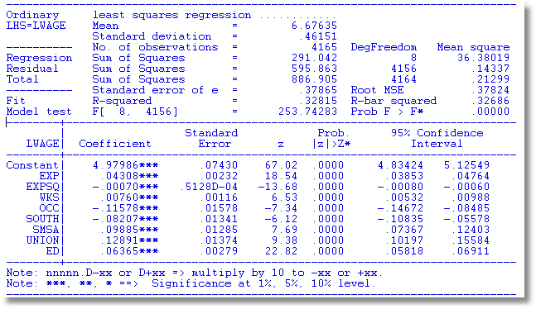
OLS Ignoring Endogeneity

Slide 47
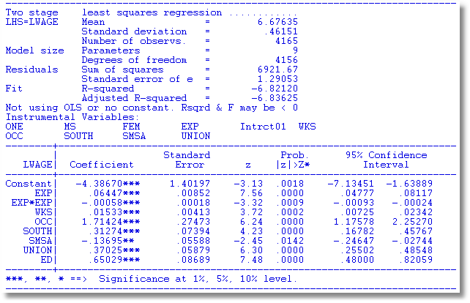
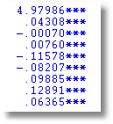
The weird results for the coefficient on ED happened because the instruments, MS and FEM are dummy variables. There is not enough variation in these variables.

Slide 48
Revisit the Source of Endogeneity
  LWAGE = f(ED,
  EXP,EXPSQ,WKS,OCC,
  SOUTH,SMSA,UNION) + ε
  ED = f(MS,FEM,
  EXP,EXPSQ,WKS,OCC,
  SOUTH,SMSA,UNION) + u

Slide 49
Remove the Endogeneity by Using a Control Function
  LWAGE = f(ED,
  EXP,EXPSQ,WKS,OCC,
  SOUTH,SMSA,UNION) + u + ε
  LWAGE = f(ED,
  EXP,EXPSQ,WKS,OCC,
  SOUTH,SMSA,UNION) + u + ε
  Problem: ED is correlated with (u+ε) so it is endogenous
  Strategy
    Estimate u
    Add u to the equation. ED is uncorrelated with ε when u is in the equation.

Slide 50
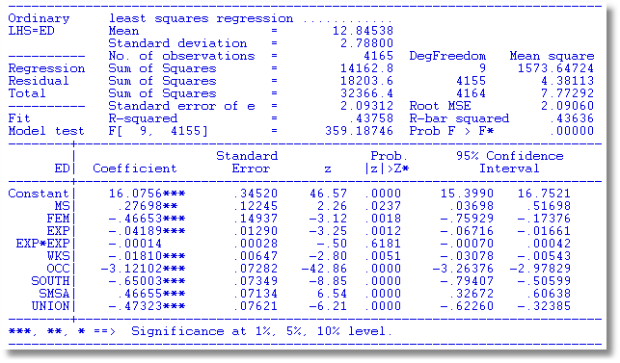
Auxiliary Regression for
ED to Obtain Residuals
IVs
Exog. Vars

Slide 51
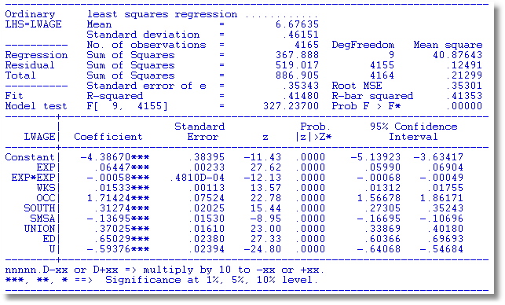
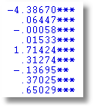
OLS with Residual (Control Function) Added
2SLS

Slide 52
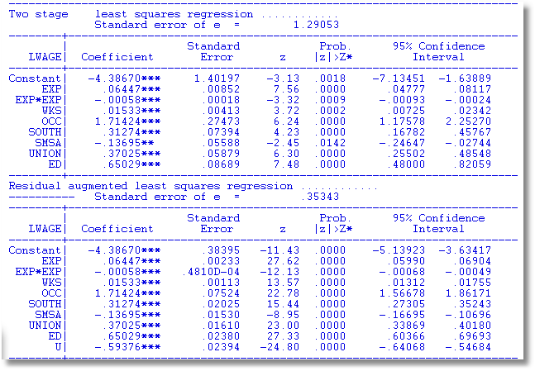
A Warning About Control Function Estimators:
The standard errors must be adjusted.
Sum of squares is not computed correctly because U is in the regression. A general result. Control function estimators usually require a fix to the estimated covariance matrix for the estimator.

Slide 53
An Endogeneity Test? (Hausman)
Exogenous Endogenous
OLS Consistent, Efficient Inconsistent
2SLS Consistent, Inefficient Consistent
Base a test on d = b_{2SLS} - b_{OLS}
Use a Wald statistic, d’[Var(d)]⁻¹d
What to use for the variance matrix?
Hausman: V_{2SLS} - V_{OLS}

Slide 54
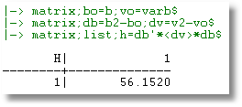
Hausman Test
Chi squared with 1 degree of freedom

Slide 55
Endogeneity Test: Wu
Simplified Hausman Test: Wu test.
Regress y on X and estimated for the endogenous part of X. Then use an ordinary Wald test.
Variable addition test

Slide 56
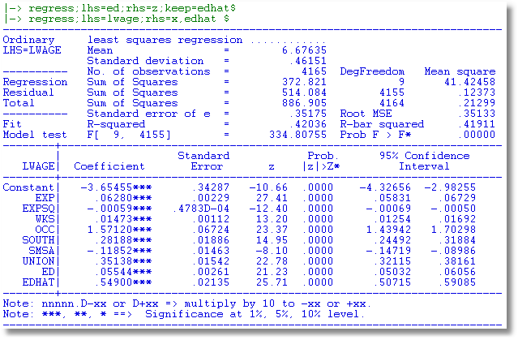
Wu Variable Addition Test

