Slide 1
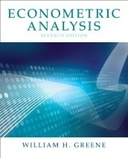


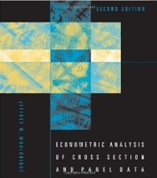
Microeconometric Modeling
William Greene
Stern School of Business
New York University
New York NY USA
1.2 Extensions of the
Linear Regression
Model

Slide 2
Concepts
Models
Robust Covariance Matrix
Bootstrap
Linear Regression Model
Quantile Regression

Slide 3

Regression with Conventional Standard Errors

Slide 4
Robust Covariance Matrices
Robust standard errors; (b is not “robust”)
  Robust to: Heteroscedasticty
  Not robust to: (all considered later)
    Correlation across observations
    Individual unobserved heterogeneity
    Incorrect model specification
Robust inference means hypothesis tests and confidence intervals using robust covariance matrices

Slide 5
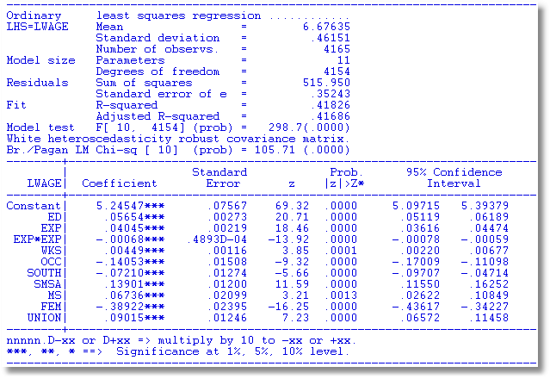
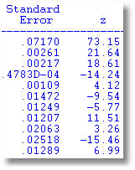
Heteroscedasticity Robust Covariance Matrix
Uncorrected
Note the conflict: Test favors heteroscedasticity.
Robust VC matrix is essentially the same.

Slide 6
Bootstrap Estimation of the Asymptotic
Variance of an Estimator
Known form of asymptotic variance:
Compute from known results
Unknown form, known generalities about properties: Use bootstrapping
  Root N consistency
  Sampling conditions amenable to central limit theorems
  Compute by resampling mechanism within the sample.

Slide 7
Bootstrapping Algorithm
1. Estimate parameters using full sample: → b
2. Repeat R times:
Draw n observations from the n, with replacement
Estimate β with b(r).
3. Estimate variance with

Slide 8
Application to Spanish Dairy Farms lny=b₁lnx₁+b₂lnx₂+b₃lnx₃+b₄lnx₄+ε
Input | Units | Mean | Std. Dev. | Minimum | Maximum
Y Milk | Milk production (liters) | 131,108 | 92,539 | 14,110 | 727,281
X1 Cows | # of milking cows | 2.12 | 11.27 | 4.5 | 82.3
X2 Labor | # man-equivalent units | 1.67 | 0.55 | 1.0 | 4.0
X3 Land | Hectares of land devoted to pasture and crops. | 12.99 | 6.17 | 2.0 | 45.1
X4 Feed | Total amount of feedstuffs fed to dairy cows (tons) | 57,941 | 47,981 | 3,924.14 | 376,732
N = 247 farms, T = 6 years (1993-1998)

Slide 9
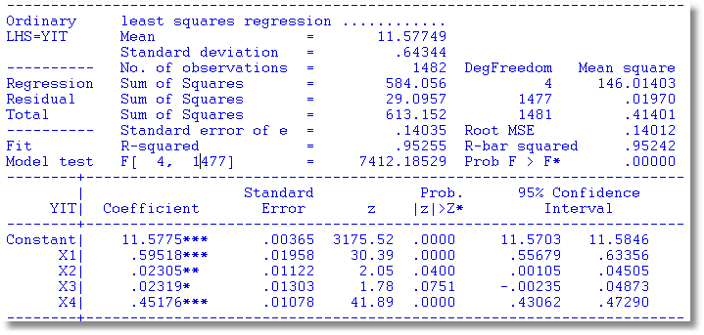
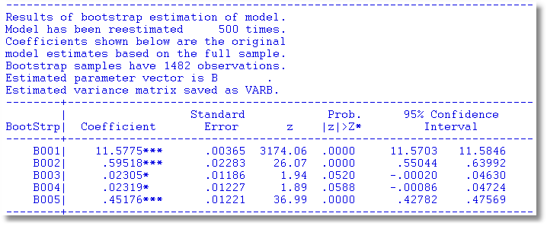
Bootstrapped Regression

Slide 10
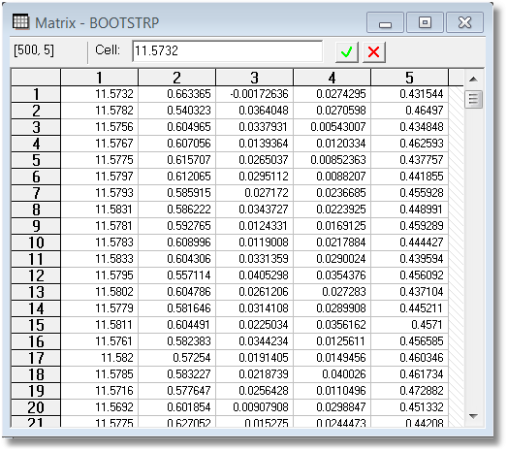
Example: Bootstrap Replications

Slide 11
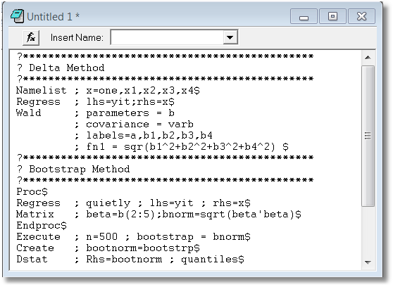
Bootstrapped Confidence Intervals
Estimate Norm(β)=(β₁² + β₂² + β₃² + β₄²)^{1/2}

Slide 12
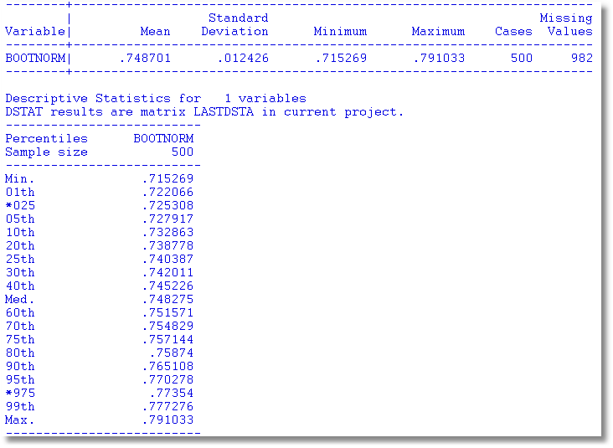
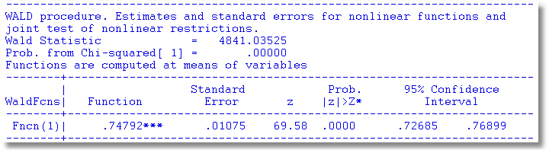

Slide 13
Quantile Regression
Q(y|x,α) = β′x, α = quantile
Estimated by linear programming
Q(y|x,.50) = β′x, .50 ➔ median regression
Median regression estimated by LAD (estimates same parameters as mean regression if symmetric conditional distribution)
Why use quantile (median) regression?
  Semiparametric
  Robust to some extensions (heteroscedasticity?)
  Complete characterization of conditional distribution

Slide 14
Estimated Variance for Quantile Regression

Slide 15
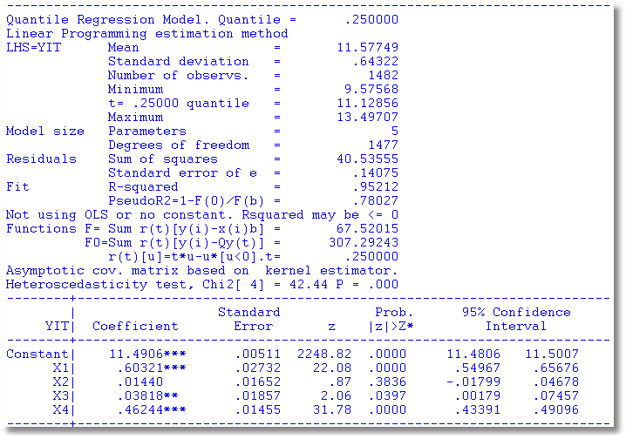
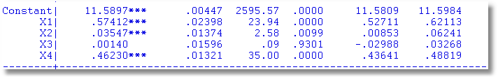
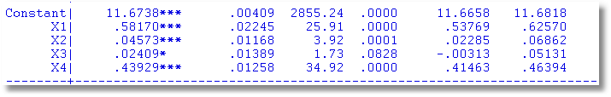
Quantile Regressions
α = .25
α = .50
α = .75

Slide 16
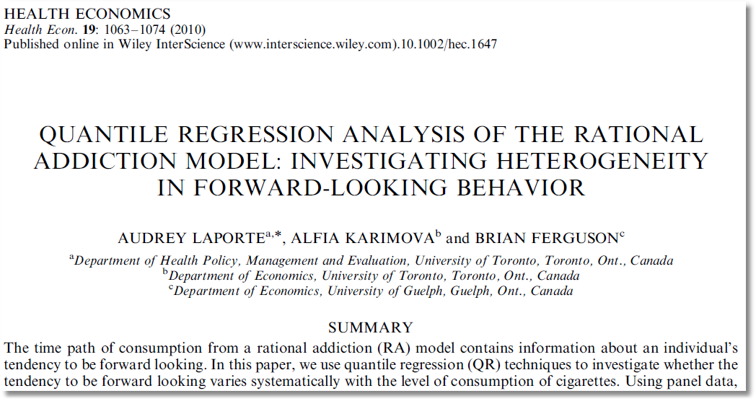

Slide 17
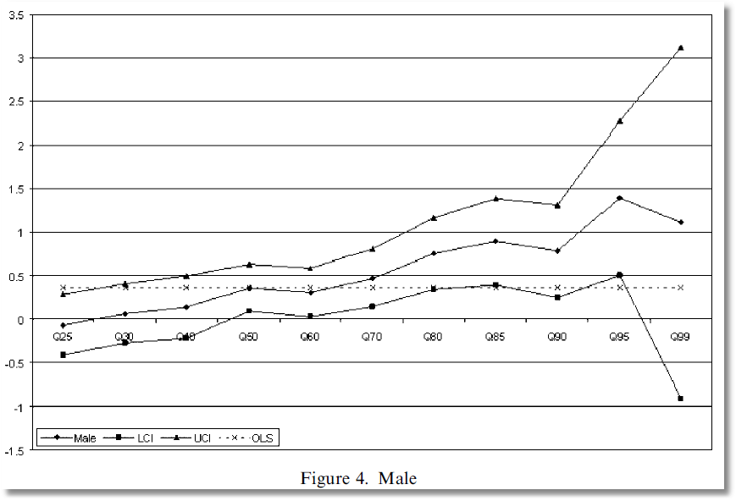
Coefficient on MALE dummy variable in quantile regressions

