Slide 1




Microeconometric Modeling
William Greene
Stern School of Business
New York University
New York NY USA
1.3 Linear Panel Data
Regression Models

Slide 2
Concepts
Models
Unbalanced Panel
Cluster Estimator
Block Bootstrap
Difference in Differences
Incidental Parameters
Problem
Endogeneity
Instrumental Variable
Control Function Estimator
Mundlak Form
Correlated Random Effects
Hausman Test
Lagrange Multiplier (LM) Test
Variable Addition (Wu) Test
Linear Regression
Fixed Effects LR Model
Random Effects LR Model

Slide 3

A Course in Panel Data Econometrics http://people.stern.nyu.edu/wgreene/Econometrics
/PanelDataEconometrics.htm

Slide 4


Slide 5


BHPS Has Evolved

Slide 6

Household Income and Labour Dynamics In Australia

Slide 7

German Socioeconomic Panel

Slide 8

Balanced and Unbalanced Panels
Distinction: Balanced vs. Unbalanced Panels
A notation to help with mechanics
  z_{i,t}, i = 1,…,N; t = 1,…,T_{i}
The role of the assumption
  Mathematical and notational convenience:
    Balanced, n=NT
    Unbalanced:
  The fixed T_{i} assumption almost never necessary.
  If unbalancedness is due to nonrandom attrition from an otherwise balanced panel, then this will require special considerations.

Slide 9
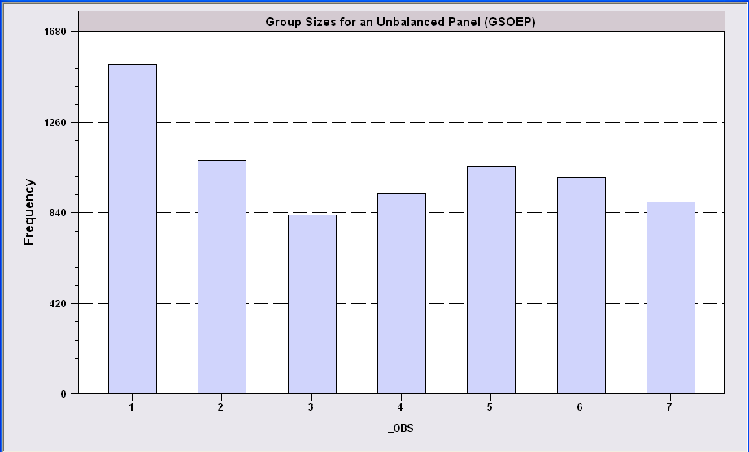
An Unbalanced Panel: RWM’s GSOEP Data on Health Care
N = 7,293 Households
Some households exited then returned

Slide 10
Cornwell and Rupert Data
Cornwell and Rupert Returns to Schooling Data, 595 Individuals, 7 Years
(Extracted from NLSY.) Variables in the file are
EXP = work experience
WKS = weeks worked
OCC = occupation, 1 if blue collar,
IND = 1 if manufacturing industry
SOUTH = 1 if resides in south
SMSA = 1 if resides in a city (SMSA)
MS = 1 if married
FEM = 1 if female
UNION = 1 if wage set by union contract
ED = years of education
LWAGE = log of wage = dependent variable in regressions
These data were analyzed in Cornwell, C. and Rupert, P., "Efficient Estimation with Panel Data: An Empirical Comparison of Instrumental Variable Estimators," Journal of Applied Econometrics, 3, 1988, pp. 149-155. See Baltagi, page 122 for further analysis. The data were downloaded from the website for Baltagi's text.
Notes:
10

Slide 11
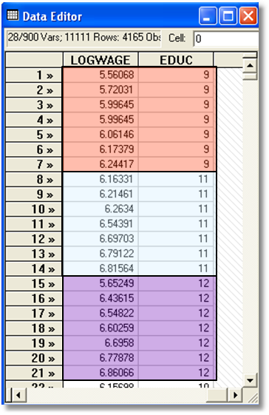

Slide 12
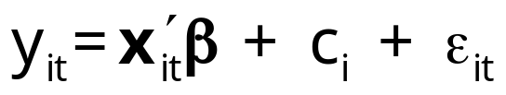
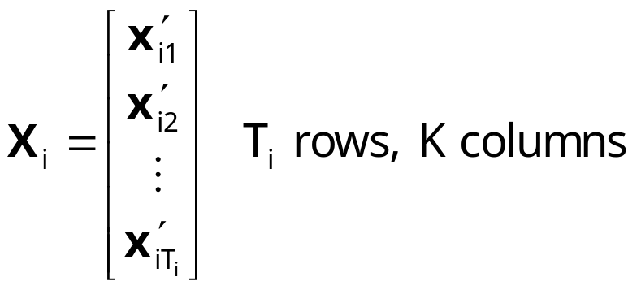
Common Effects Models
Unobserved individual effects in regression: E[y_{it} | x_{it}, c_{i}]
  Notation:
Linear specification:
  Fixed Effects: E[c_{i} | X_{i} ] = g(X_{i}). Cov[x_{it},c_{i}] ≠0
  effects are correlated with included variables.
  Random Effects: E[c_{i} | X_{i} ] = μ; effects are uncorrelated with included variables. If X_{i} contains a constant term, μ=0 WLOG. Common: Cov[x_{it},c_{i}] =0, but E[c_{i} | X_{i} ] = μ is needed for the full model

Slide 13
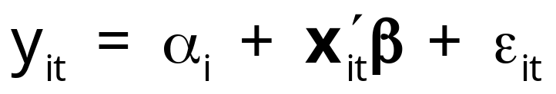
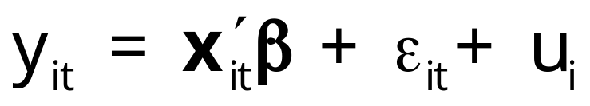
Convenient Notation
Fixed Effects – the ‘dummy variable model’
Random Effects – the ‘error components model’
Individual specific constant terms.
Compound (“composed”) disturbance

Slide 14
Estimating β
β is the partial effect of interest
Can it be estimated (consistently) in the
presence of (unmeasured) c_{i}?
  Does pooled least squares “work?”
  Strategies for “controlling for c_{i}” using the
  sample data.

Slide 15
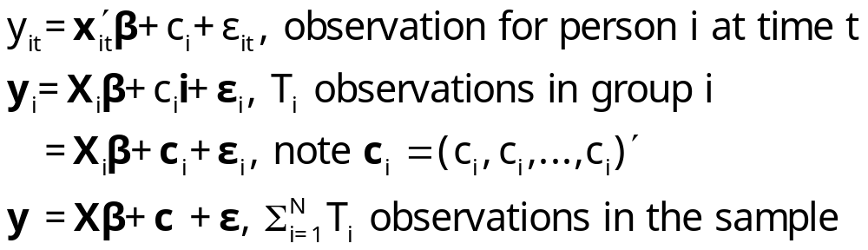
1. The Pooled Regression
Presence of omitted effects
Potential bias/inconsistency of OLS –
Depends on ‘fixed’ or ‘random’
  If FE, X is endogenous: Omitted Variables Bias
  If RE, OLS is OK but standard errors are incorrect.

Slide 16
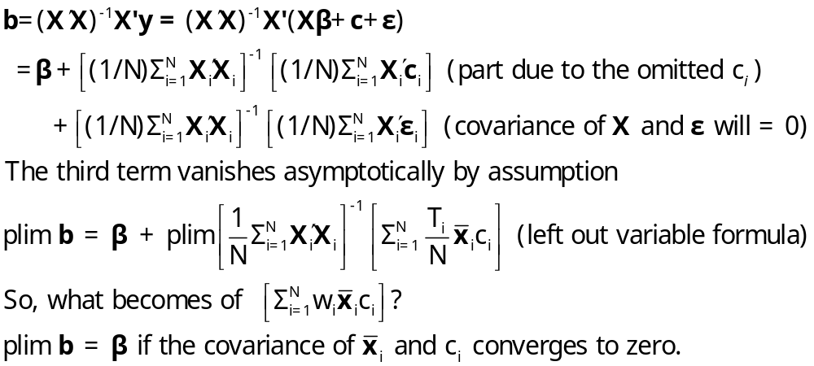
OLS with Individual Effects
The omitted variable(s) are the group means

Slide 17
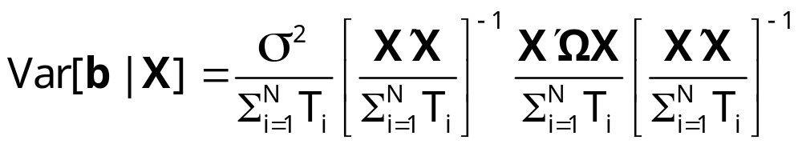
Ordinary Least Squares
Standard results for OLS in a generalized regression model
  Consistent if RE, inconsistent if FE.
  Unbiased for something in either case.
  Inefficient in all cases.
True Variance

Slide 18
Estimating the Sampling Variance of b
b may or may not be consistent for β. We estimate its variance regardless
s²(X ́X)⁻¹ is not the correct matrix
  Correlation across observations: Yes
  Heteroscedasticity: Maybe
Is there a “robust” covariance matrix?
  Robust estimation (in general)
  The White estimator for heteroscedasticity
  A Robust estimator for OLS.

Slide 19
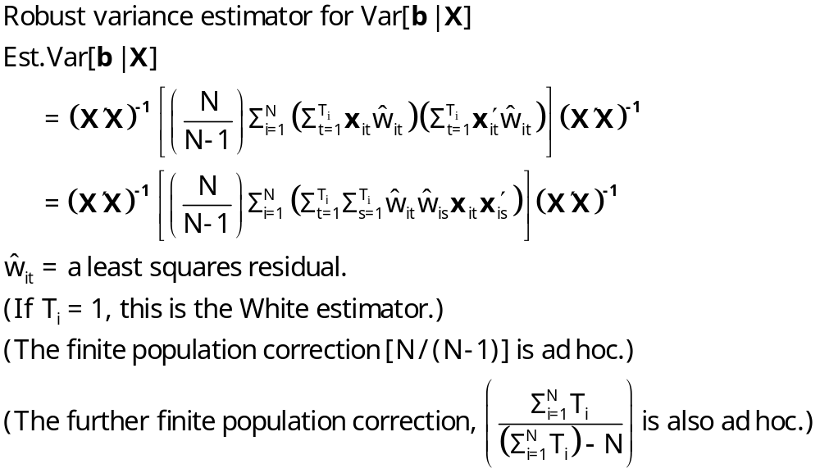
A Cluster Estimator

Slide 20

Alternative OLS Variance Estimators
Cluster correction increases SEs
+---------+--------------+----------------+--------+---------+
|Variable | Coefficient | Standard Error |b/St.Er.|P[|Z|>z] |
+---------+--------------+----------------+--------+---------+
Constant 5.40159723 .04838934 111.628 .0000
EXP .04084968 .00218534 18.693 .0000
EXPSQ -.00068788 .480428D-04 -14.318 .0000
OCC -.13830480 .01480107 -9.344 .0000
SMSA .14856267 .01206772 12.311 .0000
MS .06798358 .02074599 3.277 .0010
FEM -.40020215 .02526118 -15.843 .0000
UNION .09409925 .01253203 7.509 .0000
ED .05812166 .00260039 22.351 .0000
Robust
Constant 5.40159723 .10156038 53.186 .0000
EXP .04084968 .00432272 9.450 .0000
EXPSQ -.00068788 .983981D-04 -6.991 .0000
OCC -.13830480 .02772631 -4.988 .0000
SMSA .14856267 .02423668 6.130 .0000
MS .06798358 .04382220 1.551 .1208
FEM -.40020215 .04961926 -8.065 .0000
UNION .09409925 .02422669 3.884 .0001
ED .05812166 .00555697 10.459 .0000

Slide 21
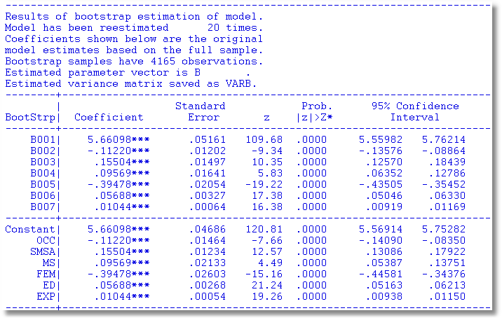
Results of Bootstrap Estimation

Slide 22

The bootstrap replication must account for panel data nature of the data set.
Bootstrap variance for a panel data estimator
Panel Bootstrap =
Block Bootstrap
Data set is N groups of size T_{i}
Bootstrap sample is N groups of size T_{i} drawn with replacement.

Slide 23
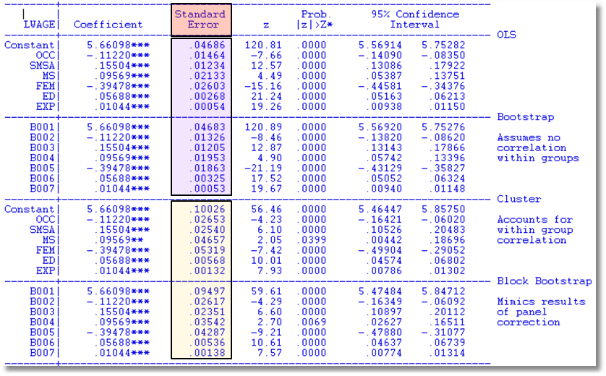
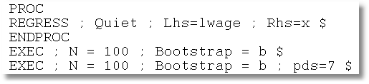

Slide 24
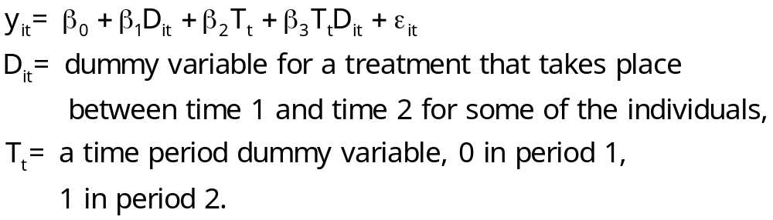
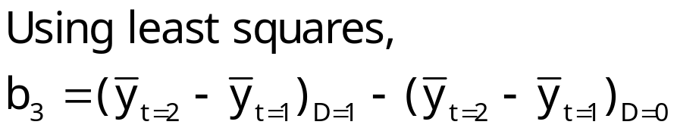
Difference-in-Differences Model
With two periods and strict exogeneity of D and T,
This is a linear regression model. If there are no regressors,

Slide 25
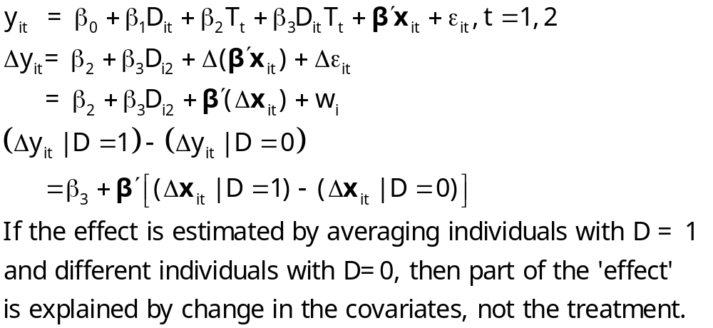
Difference in Differences

Slide 26
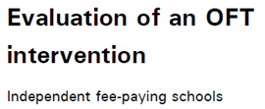

UK Office of Fair Trading, May 2012; Stephen Davies
http://dera.ioe.ac.uk/14610/1/oft1416.pdf

Slide 27
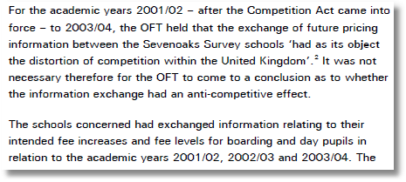

Outcome is the fees charged.
Activity is collusion on fees.

Slide 28
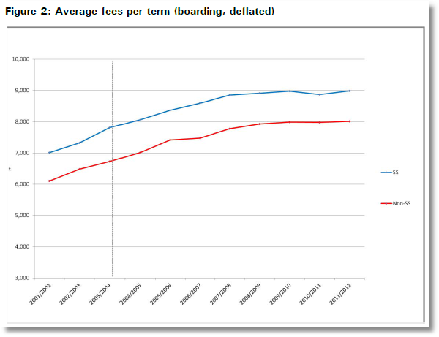
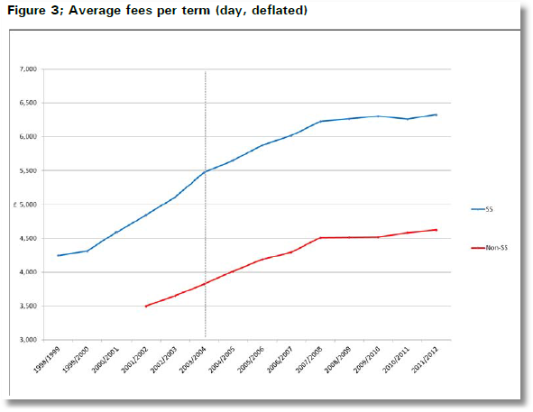
Treatment Schools: Treatment is an intervention by the Office of Fair Trading
Control Schools were not involved in the conspiracy
Treatment is not voluntary

Slide 29
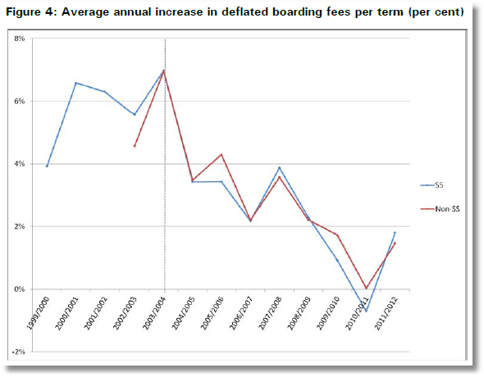
Apparent Impact of the Intervention

Slide 30
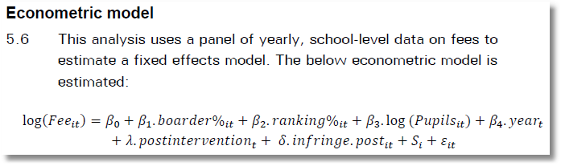

Slide 31
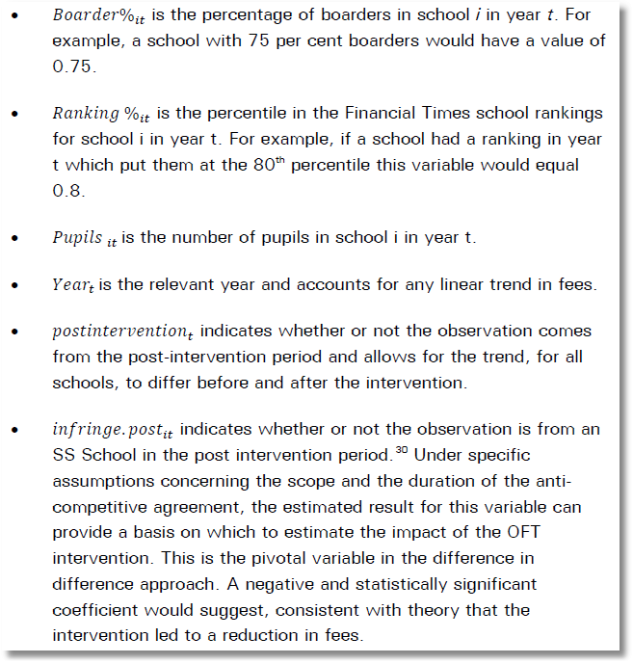
Treatment (Intervention) Effect = β₁ +
β₂ if SS school

Slide 32
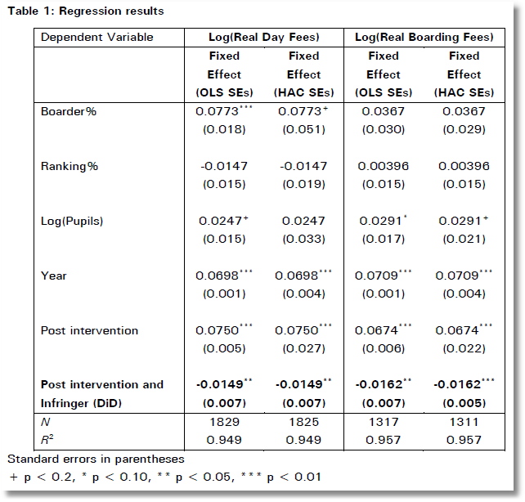
In order to test robustness two versions of the fixed effects model were run. The first is Ordinary Least Squares, and the second is heteroscedasticity and auto-correlation robust (HAC) standard errors in order to check for heteroscedasticity and autocorrelation.

Slide 33
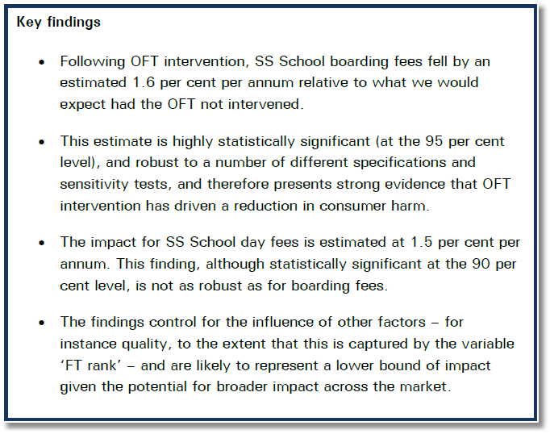

Slide 34
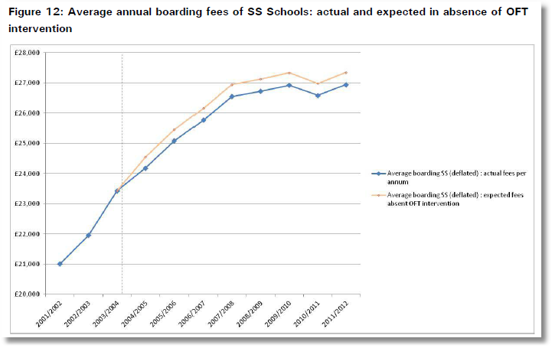
The cumulative impact of the intervention is the area between the two paths from intervention to time T.

Slide 35
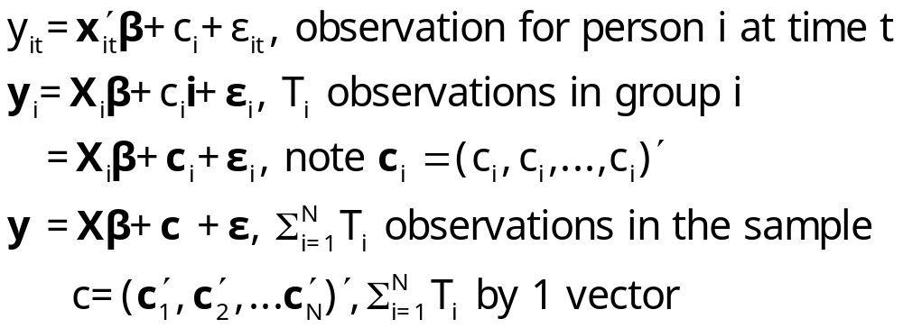
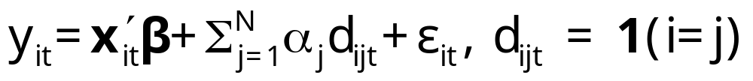
2. Estimation with Fixed Effects
The fixed effects model
c_{i} is arbitrarily correlated with x_{it} but E[ε_{it}|X_{i},c_{i}]=0
Dummy variable representation

Slide 36
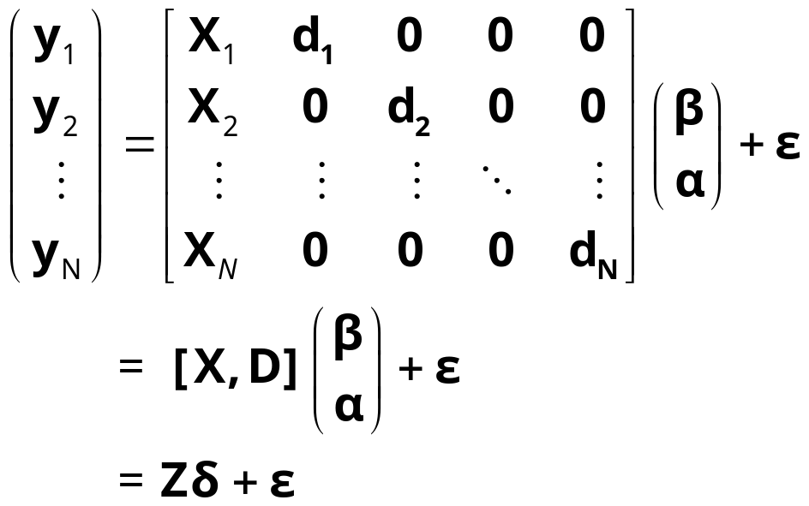
The Fixed Effects Model
y_{i} = X_{i}β + d_{i}α_{i} + ε_{i}, for each individual
  E[c_{i} | X_{i} ] = g(X_{i}); Effects are correlated with included variables.
  Cov[x_{it},c_{i}] ≠0

Slide 37
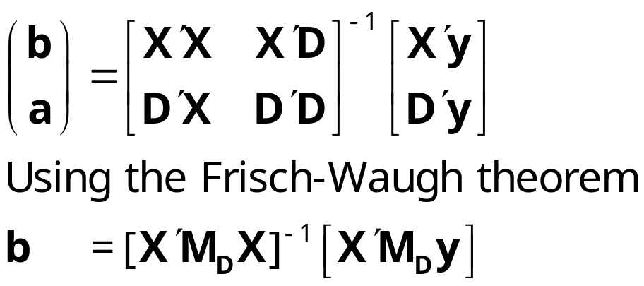
Estimating the Fixed Effects Model
The FEM is a plain vanilla regression model but with many independent variables
Least squares is unbiased, consistent, efficient, but inconvenient if N is large.

Slide 38
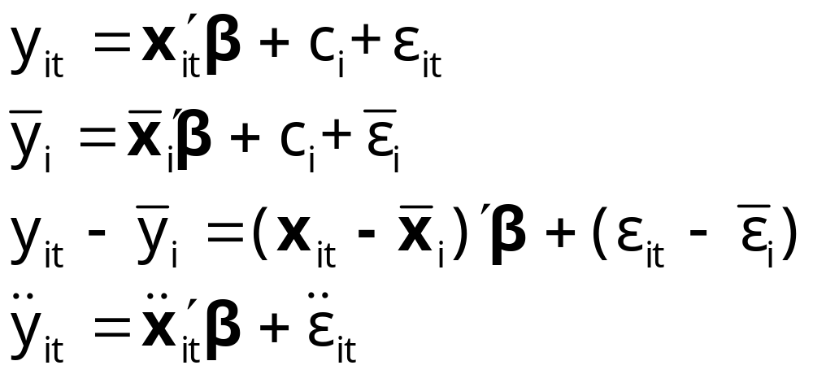
The Within Transformation Removes the Effects
Wooldridge notation for data in deviations from group means

Slide 39
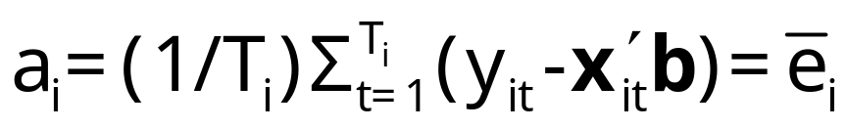
Least Squares Dummy Variable Estimator
b is obtained by ‘within’ groups least squares (group mean deviations)
Normal equations for a are D’Xb+D’Da=D’y
a = (D’D)⁻¹D’(y – Xb)
Notes: This is simple algebra – the estimator is just OLS
Least squares is an estimator, not a model. (Repeat twice.)
Note what a_{i} is when T_{i} = 1. Follow this with y_{it}-a_{i}-x_{it}’b=0 if T_{i}=1.

Slide 40
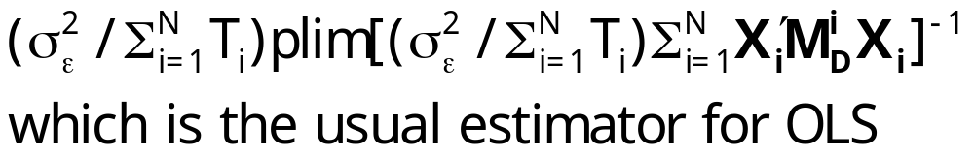
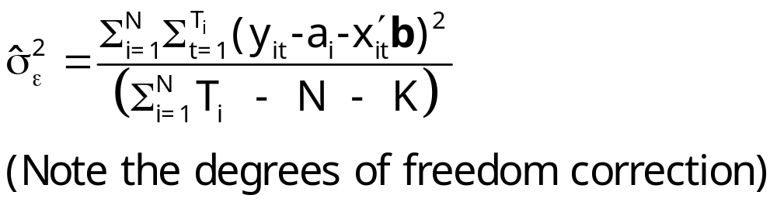
Inference About OLS
Assume strict exogeneity: Cov[ε_{it},(x_{js},c_{j})]=0. Every disturbance in every period for each person is uncorrelated with variables and effects for every person and across periods.
Now, it’s just least squares in a classical linear regression model.
Asy.Var[b] =

Slide 41
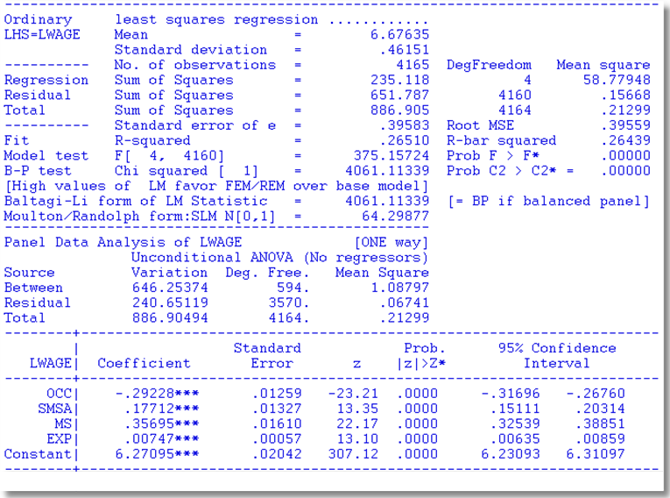
Application Cornwell and Rupert

Slide 42
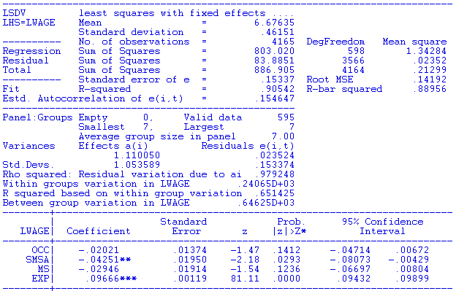

LSDV Results
Note huge changes in the coefficients. SMSA and MS change signs. Significance changes completely.
Pooled OLS

Slide 43
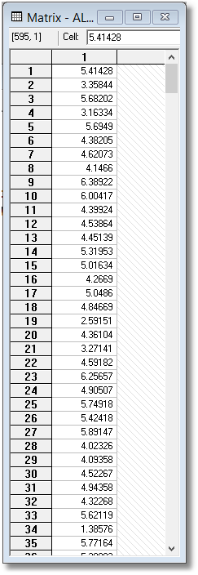
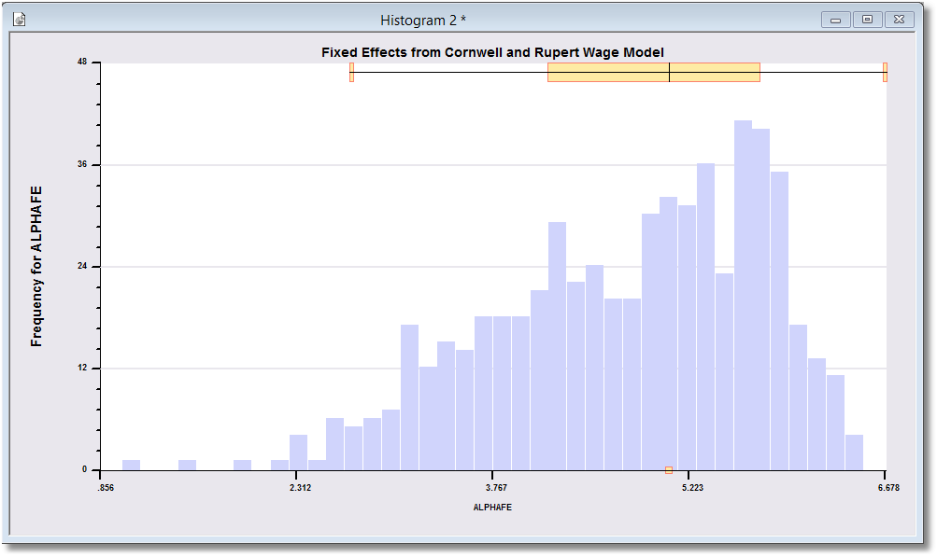
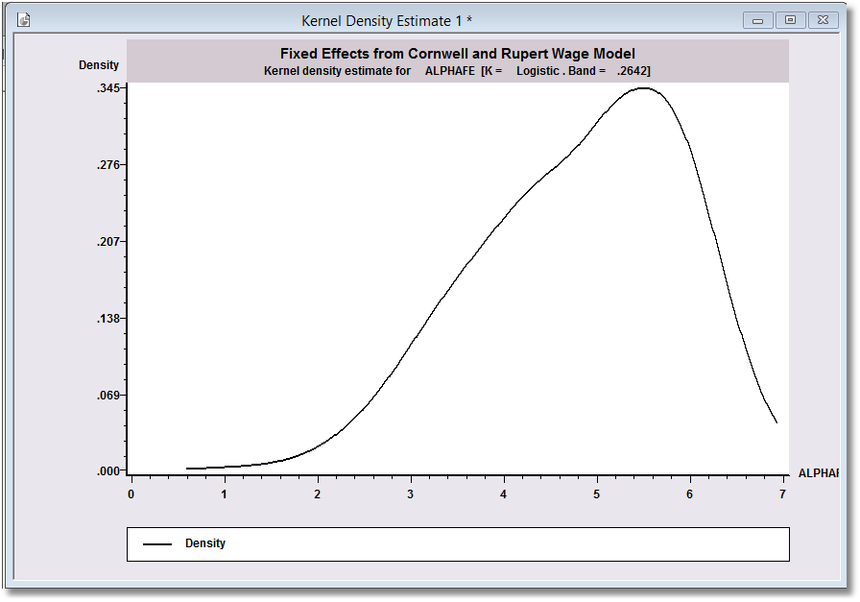
Estimated Fixed Effects

Slide 44
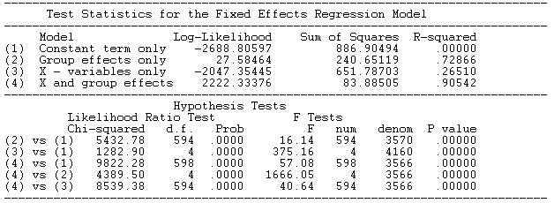
The Effect of the Effects
R² rises from .26510 to .90542

Slide 45
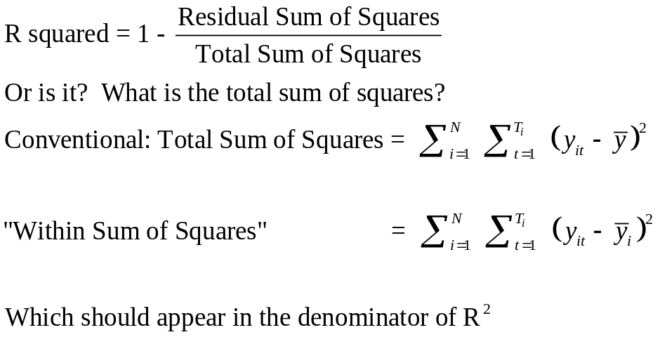
A Caution About Stata and R²
What is the appropriate denominator for R²?
For the FE model above,
R² = 0.90542 by areg
R² = 0.65142 by xtreg fe
The coefficient estimates and standard errors are the same. The calculation of the R² is different. In the areg procedure, you are estimating coefficients for each of your covariates plus each dummy variable for your groups. In the xtreg, fe procedure the R² reported is obtained by only fitting a mean deviated model where the effects of the groups (all of the dummy variables) are assumed to be fixed quantities. So, all of the effects for the groups are simply subtracted out of the model and no attempt is made to quantify their overall effect on the fit of the model.
Since the SSE is the same, the R²=1−SSE/SST is very different. The difference is real in that we are making different assumptions with the two approaches. In the xtreg, fe approach, the effects of the groups are fixed and unestimated quantities are subtracted out of the model before the fit is performed. In the areg approach, the group effects are estimated and affect the total sum of squares of the model under consideration.

Slide 46
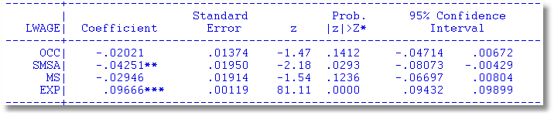
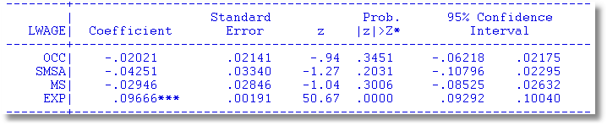

Robust Covariance Matrix for LSDV
Cluster Estimator for Within Estimator
Effect is less pronounced than for OLS

Slide 47
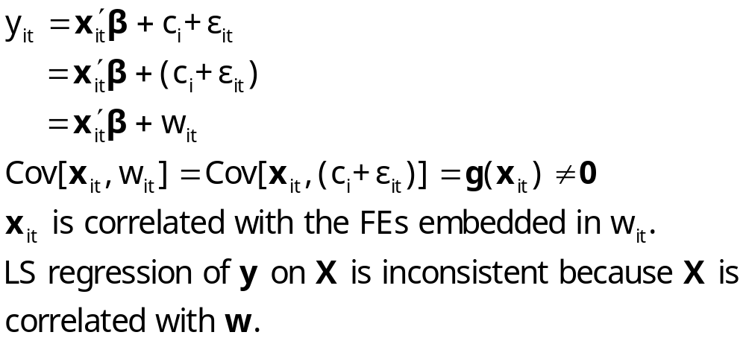
Endogeneity in the FEM

Slide 48
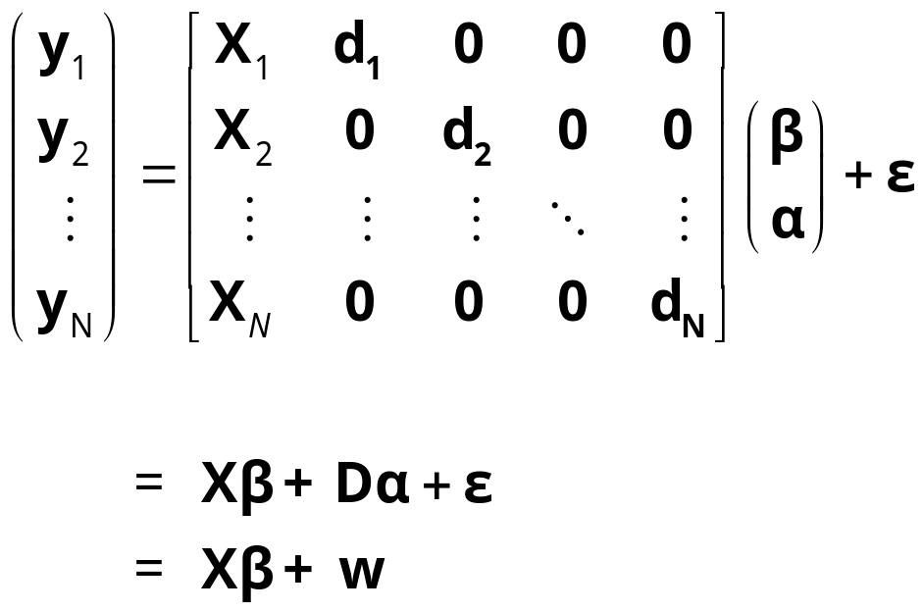
Endogeneity
y_{i} = X_{i}β + d_{i}α_{i} + ε_{i} for each individual
  E[w_{i} | X_{i} ] = g(X_{i});
  Effects are correlated with included variables. Cov[x_{it},w_{i}] ≠0
  X is endogenous because of the correlation between x_{it} and w_{i}

Slide 49
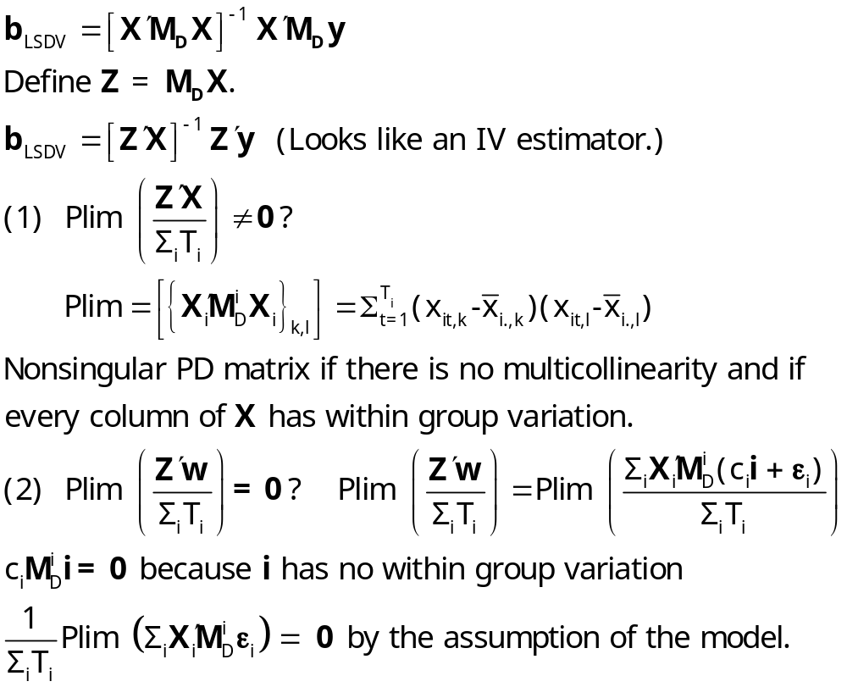
The within (LSDV) estimator is an
instrumental variable (IV) estimator

Slide 50
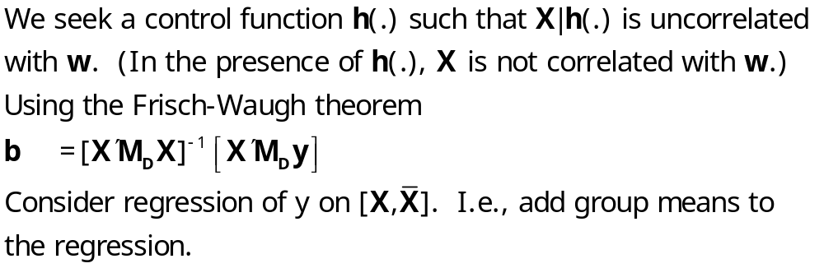
LSDV is a Control Function Estimator

Slide 51
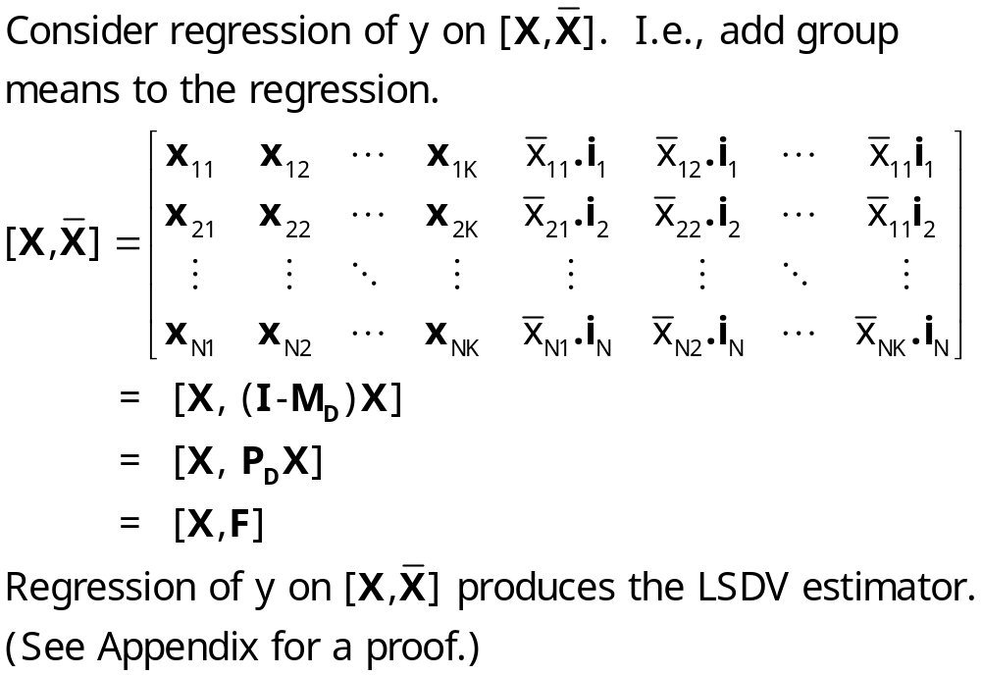
LSDV is a Control Function Estimator

Slide 52
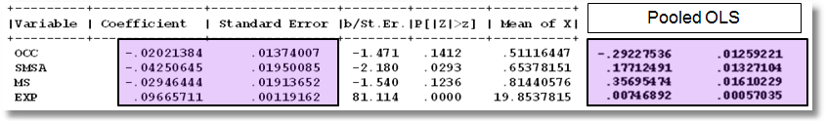
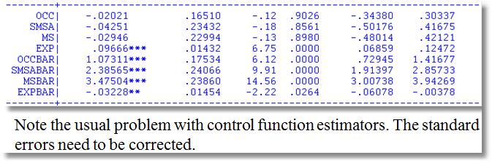
The problem here is the estimator of the disturbance variance. The matrix is OK.
Note, for example, .01374007/.01950085 (top panel)
= .16510 /.23432 (bottom panel).

Slide 53



Slide 54

Maximum Likelihood Estimation

Slide 55
The Incidental Parameters Problem
The model is correctly specified
The log likelihood is correctly specified and maximized
The estimator is inconsistent
  The number of parameters grows with N
  The “bias” in the MLE gets smaller as T grows
  At infinite T, the estimator is consistent in N
In the linear FEM, the MLE of σ² is affected by this problem.

Slide 56


Slide 57


The Incidental Parameters Problem

Slide 58

Two Way Fixed Effects
A two way FE model. Individual dummy variables and time dummy variables.
  y_{it} = α_{i} + γ_{t} + x_{it}’β + ε_{it}
  Normalization needed as the individual and time dummies both sum to one. Reformulate model:
  y_{it} = μ + α_{i}* + γ_{t}* + x_{it}’β + ε_{it} with
  Σ_{i} α_{i}* =0, Σ_{t} γ_{t}* = 0
  Full estimation:
  Practical estimation. Add T-1 dummies
  Complication: Unbalanced panels are complicated
  Complication in recent applications: Vary large N and very large T

Slide 59

Fixed Effects Estimators
Slope estimators, as usual with transformed data

Slide 60



Unbalanced Panel Data
(First 10 households in healthcare data)

Slide 61

Two Way FE with Unbalanced Data

Slide 62



Slide 63


Textbook formula application. This is incorrect.
Two way fixed effects as one way with time dummies

Slide 64
3. The Random Effects Model
The random effects model
c_{i} is uncorrelated with x_{it} for all t;
  E[c_{i} |X_{i}] = 0
  E[ε_{it}|X_{i},c_{i}]=0

Slide 65
Random vs. Fixed Effects
Random Effects
  Small number of parameters
  Efficient estimation
  Objectionable orthogonality assumption (c_{i} ⊥ X_{i})
Fixed Effects
  Robust – generally consistent
  Large number of parameters
  More reasonable assumption
  Precludes time invariant regressors ☹
Which is the more reasonable model?

Slide 66

Mundlak’s Estimator
Mundlak, Y., “On the Pooling of Time Series and Cross Section Data, Econometrica, 46, 1978, pp. 69-85.

Slide 67
Mundlak Form of FE Model
+--------+--------------+----------------+--------+--------+----------+
|Variable| Coefficient | Standard Error |b/St.Er.|P[|Z|>z]| Mean of X|
+--------+--------------+----------------+--------+--------+----------+
x(i,t)
OCC | -.02021384 .01375165 -1.470 .1416 .51116447
SMSA | -.04250645 .01951727 -2.178 .0294 .65378151
MS | -.02946444 .01915264 -1.538 .1240 .81440576
EXP | .09665711 .00119262 81.046 .0000 19.8537815
z(i)
FEM | -.34322129 .05725632 -5.994 .0000 .11260504
ED | .05099781 .00575551 8.861 .0000 12.8453782
Means of x(I,t) and constant
Constant| 5.72655261 .10300460 55.595 .0000
OCCB | -.10850252 .03635921 -2.984 .0028 .51116447
SMSAB | .22934020 .03282197 6.987 .0000 .65378151
MSB | .20453332 .05329948 3.837 .0001 .81440576
EXPB | -.08988632 .00165025 -54.468 .0000 19.8537815
Estimates: Var[e] = .0235632
Var[u] = .0773825

Slide 68

Mundlak’s Approach for an FE Model with Time Invariant Variables

Slide 69


4. Error Components Model
Generalized Regression Model

Slide 70

Generalized Least Squares

Slide 71

Estimators for the Variances

Slide 72

Computing Variance Estimators for Cornwell and Rupert

Slide 73

Testing for Effects: An LM Test

Slide 74
LM Tests
+--------------------------------------------------+
| Random Effects Model: v(i,t) = e(i,t) + u(i) | Unbalanced Panel
| Estimates: Var[e] = .216794D+02 | #(T=1) = 1525
| Var[u] = .958560D+01 | #(T=2) = 1079
| Corr[v(i,t),v(i,s)] = .306592 | #(T=3) = 825
| Lagrange Multiplier Test vs. Model (3) = 4419.33 | #(T=4) = 926
| ( 1 df, prob value = .000000) | #(T=5) = 1051
| (High values of LM favor FEM/REM over CR model.) | #(T=6) = 1200
| Baltagi-Li form of LM Statistic = 1618.75 | #(T=7) = 887
+--------------------------------------------------+
+--------------------------------------------------+
| Random Effects Model: v(i,t) = e(i,t) + u(i) |
| Estimates: Var[e] = .210257D+02 | Balanced Panel
| Var[u] = .860646D+01 | T = 7
| Corr[v(i,t),v(i,s)] = .290444 |
| Lagrange Multiplier Test vs. Model (3) = 1561.57 |
| ( 1 df, prob value = .000000) |
| (High values of LM favor FEM/REM over CR model.) |
| Baltagi-Li form of LM Statistic = 1561.57 |
+--------------------------------------------------+
REGRESS ; Lhs=docvis ; Rhs=one,hhninc,age,female,educ ; panel $

Slide 75

A One Way REM

Slide 76

Two Way REM
Note sum = .102705

Slide 77
A Hausman Test for FE vs. RE
Estimator | Random Effects E[c_{i}|X_{i}] = 0 | Fixed Effects E[c_{i}|X_{i}] ≠ 0
FGLS (Random Effects) | Consistent and Efficient | Inconsistent
LSDV (Fixed Effects) | Consistent Inefficient | Consistent Possibly Efficient

Slide 78
A Variable Addition Test
Asymptotically equivalent to Hausman
Also equivalent to Mundlak formulation
In the random effects model, using FGLS
  Only applies to time varying variables
  Add expanded group means to the regression (i.e., observation i,t gets same group means for all t.
  Use standard F or Wald test to test for coefficients on means equal to 0. Large F or chi-squared weighs against random effects specification.

Slide 79

Means Added

Slide 80

Wu (Variable Addition) Test

Slide 81
Appendix
Derivations and Expressions

Slide 82

Estimating the Variance for OLS

Slide 83

Algebra for the CF Estimator
LSDV is a Control Function Estimator

Slide 84

Robust Counterpart to White Estimator?
Assumes Var[ε_{i}] = Ω_{i} ≠σ²I_{Ti}
e_{i} = y_{i} – a_{i}i_{Ti} - X_{i}b = M_{D}y_{i} – M_{D}X_{i}b
(T_{i} x 1 vector of group residuals)
Resembles (and is based on) White, but treats a full vector of disturbances at a time. Robust to heteroscedasticity and autocorrelation (within the groups).

Slide 85
Appendix

Slide 86

USDA’s ARMS Data

Slide 87


Slide 88

Penn World Tables

Slide 89


Slide 90


Slide 91


Slide 92

Bootstrap Replications
Full sample result
Bootstrapped
sample results

Slide 93

Using First Differences
Eliminating the heterogeneity: Δc_{i} = 0.

Slide 94


Slide 95

A “Hierarchical” Model

Slide 96

Feasible GLS
x´ does not contain a constant term in the preceding.

Slide 97

Practical Problems with FGLS

Slide 98

Stata Variance Estimators

Slide 99

Correlated Random Effects

Slide 100

Notation

Slide 101

Notation

Slide 102

Hausman Test for Effects

Slide 103

Hausman
There is a built in procedure for this.
It is not always appropriate to compare estimators this way.

Slide 104

Variable Addition

Slide 105
Application: Wu Test
NAMELIST ; XV = exp,expsq,wks,occ,ind,south,smsa,ms,union,ed,fem$
create ; expb=groupmean(exp,pds=7)$
create ; expsqb=groupmean(expsq,pds=7)$
create ; wksb=groupmean(wks,pds=7)$
create ; occb=groupmean(occ,pds=7)$
create ; indb=groupmean(ind,pds=7)$
create ; southb=groupmean(south,pds=7)$
create ; smsab=groupmean(smsa,pds=7)$
create ; unionb=groupmean(union,pds=7)$
create ; msb = groupmean(ms,pds=7) $
namelist ; xmeans = expb,expsqb,wksb,occb,indb,southb,smsab,msb,
unionb $
REGRESS ; Lhs = lwage ; Rhs = xmeans,Xv,one ; panel ; random $
MATRIX ; bmean = b(1:9) ; vmean = varb(1:9,1:9) $
MATRIX ; List ; Wu = bmean'<vmean>bmean $

Slide 106
Basing Wu Test on a Robust VC
? Robust Covariance matrix for REM
Namelist ; XWU = wks,occ,ind,south,smsa,union,exp,expsq,ed,blk,fem,
wksb,occb,indb,southb,smsab,unionb,expb,expsqb,one $
Create ; ewu = lwage - xwu'b $
Matrix ; Robustvc = <Xwu'Xwu>*Gmmw(xwu,ewu,_stratum)*<XwU'xWU>
; Stat(b,RobustVc,Xwu) $
Matrix ; Means = b(12:19);Vmeans=RobustVC(12:19,12:19)
; List ; RobustW=Means'<Vmeans>Means $

Slide 107


Robust Standard Errors

