Slide 1




Microeconometric Modeling
William Greene
Stern School of Business
New York University
New York NY USA
2.1 Binary Choice Models

Slide 2
Concepts
Models
Random Utility
Maximum Likelihood
Parametric Model
Partial Effect
Average Partial Effect
Odds Ratio
Linear Probability Model
Cluster Correction
Pseudo R squared
Likelihood Ratio, Wald, LM
Decomposition of Effect
Exclusion Restrictions
Incoherent Model
Nonparametric Regression
Klein and Spady Model
Probit
Logit
Bivariate Probit
Recursive Bivariate Probit
Multivariate Probit
Sample Selection
Panel Probit

Slide 3

Model for a Binary Dependent Variable
Binary outcome.
  Event occurs or doesn’t (e.g., the person adopts green technology, the person enters the labor force, etc.)
  Model the probability of the event. P(x)=Prob(y=1|x)
  Probability responds to independent variables
Requirements for a probability
  0 < Probability < 1
  P(x) should be monotonic in x – it’s a CDF

Slide 4
Behavioral Utility Based Approach
Observed outcomes partially reveal underlying preferences
There exists an underlying preference scale defined over alternatives, U*(choices)
Revelation of preferences between two choices labeled 0 and 1 reveals the ranking of the underlying utility
  U*(choice 1) > U*(choice 0) Choose 1
  U*(choice 1) < U*(choice 0) Choose 0
Net utility = U = U*(choice 1) - U*(choice 0). U > 0 => choice 1

Slide 5
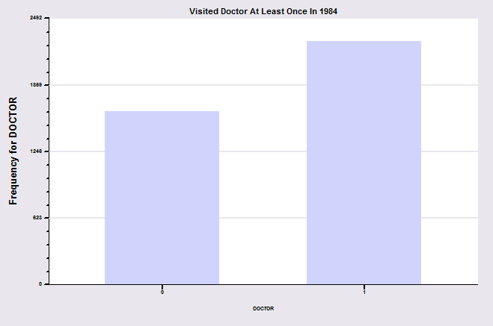
Binary Outcome: Visit Doctor
In the 1984 year of the GSOEP, 2265 of 3874 individuals visited the doctor at least once.

Slide 6
A Random Utility Model for the Binary Choice
Yes or No decision | Visit or not visit the doctor
Model: Net utility of visit at least once
Net utility depends on observables and unobservables
U_{doctor} = Net utility = U*_{visit} – U*_{not visit}
U_{doctor} = α + β₁Age + β₂Income + β₃Sex + ε
Choose to visit at least once if net utility is positive
Observed Data: X = Age, Income, Sex
y = 1 if choose visit, ⬄ U_{doctor} > 0, 0 if not.
Random Utility

Slide 7
Modeling the Binary Choice Between
the Two Alternatives
Net Utility U_{doctor} = U*_{visit} – U*_{not} _{visit}
U_{doctor} = α + β₁ Age + β₂ Income + β₃ Sex + ε
Chooses to visit: U_{doctor} > 0
α + β₁ Age + β₂ Income + β₃ Sex + ε > 0
Choosing to visit is a random outcome because of ε
ε > -(α + β₁ Age + β₂ Income + β₃ Sex)

Slide 8
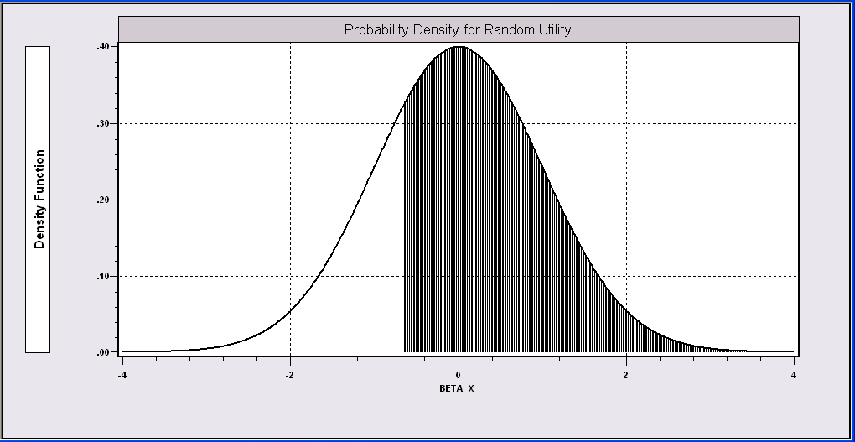
Probability Model for Choice Between Two Alternatives
People with the same (Age,Income,Sex) will make different choices because ε is random. We can model the probability that the random event “visits the doctor”will occur.
Probability is governed by ε, the random part of the utility function.
Event DOCTOR=1 occurs if ε > -(α + β₁Age + β₂Income + β₃Sex)
We model the probability of this event.

Slide 9
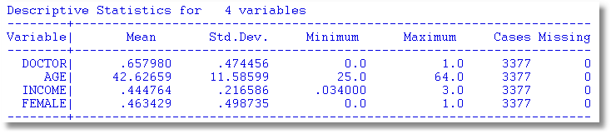
An Application
27,326 Observations in GSOEP Sample
  1 to 7 years, panel
  7,293 households observed
  We use the 1994 year; 3,337 household observations

Slide 10
An Econometric Model
Choose to visit iff U_{doctor} > 0
  Udoctor = α + β₁ Age + β₂ Income + β₃ Sex + ε
  Udoctor > 0 ⇔ ε > -(α + β₁ Age + β₂ Income + β₃ Sex)
  ε < α + β₁ Age + β₂ Income + β₃ Sex)
Probability model: For any person observed by the analyst,
Prob(doctor=1) = Prob(ε < α + β₁ Age + β₂ Income + β₃ Sex)
Note the relationship between the unobserved ε and the observed outcome DOCTOR.

Slide 11
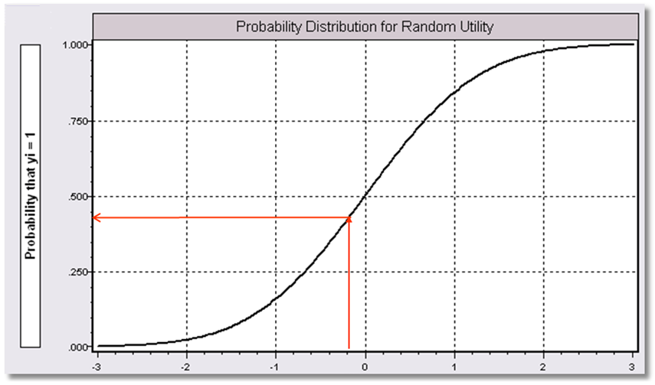
Index = α+β₁Age + β₂ Income + β3 Sex
Probability = a function of the Index.
P(Doctor = 1) = f(Index)
Internally consistent probabilities:
(1) (Coherence) 0 < Probability < 1
(2) (Monotonicity) Probability increases with Index.

Slide 12
Econometric Issues
Data may reveal information about coefficients
I.e., effect of observed variables on utilities
May reveal information about probabilities
I.e., probabilities under certain assumptions
Data on choices made do not reveal information about utility itself
The data contain no information about the scale of utilities or utility differences.
Variance of ε is not estimable so it is normalized at 1 or some other fixed (known) constant.

Slide 13
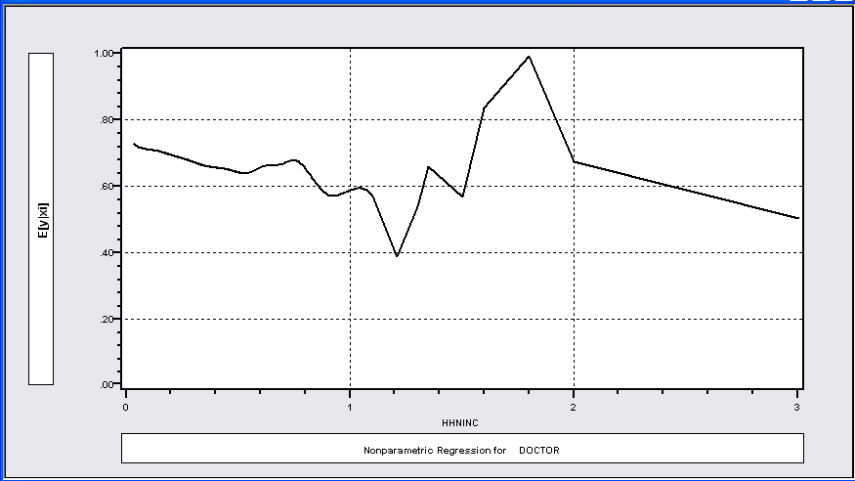
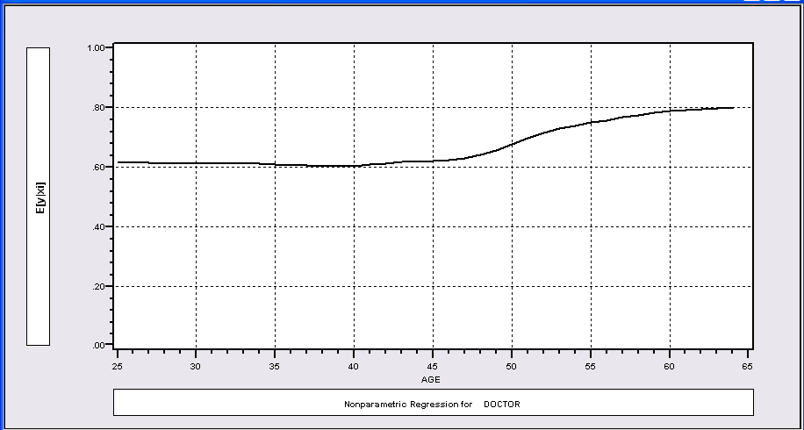
Modeling Approaches
Nonparametric Regressions
P(Doctor=1)=f(Income)
P(Doctor=1)=f(Age)
Essentially, at each value of Income or Age, examine the proportion of individuals who visit the doctor.

Slide 14
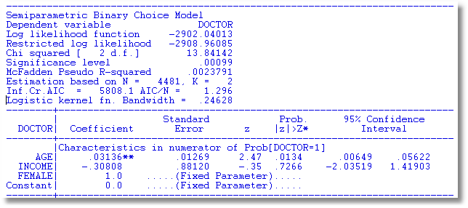
Klein and Spady Semiparametric Model
No specific distribution assumed
Prob(y_{i} = 1 | x_{i} ) = G(β’x) G is estimated by kernel methods
Note necessary normalizations. Coefficients are relative to FEMALE.

Slide 15
A Fully Parametric Model
Index Function: U = β’x + ε
Observation Mechanism: y = 1[U > 0]
Distribution: ε ~ f(ε); Normal, Logistic, …
Maximum Likelihood Estimation:
Max(β) logL = Σ_{i} log Prob(Y_{i} = y_{i}|x_{i})
We will focus on parametric models
We examine the linear probability “model” in passing.

Slide 16
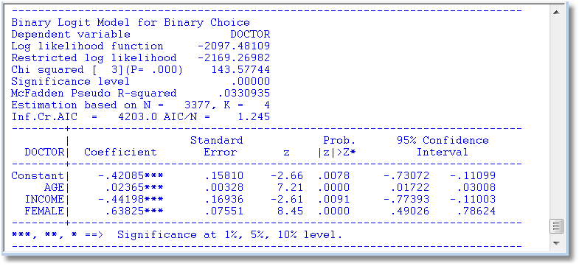
A Parametric Logit Model
We examine the model components.

Slide 17
Parametric Model Estimation
How to estimate α, β₁, β₂, β₃?
  The technique of maximum likelihood
  Prob[doctor=1] = Prob[ε > -(α + β₁ Age + β₂ Income + β₃ Sex)]
  Prob[doctor=0] = 1 – Prob[doctor=1]
Requires a model for the probability

Slide 18
Completing the Model: F(ε)
The distribution
  Normal: PROBIT, natural for behavior
  Logistic: LOGIT, allows “thicker tails”
  Gompertz: EXTREME VALUE, asymmetric
  Others…
Does it matter?
  Yes, large difference in estimates
  Not much, quantities of interest are more stable.

Slide 19
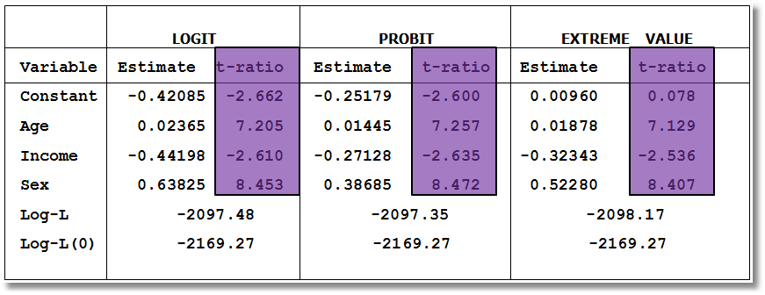
Estimated Binary Choice Models for Three Distributions
Log-L(0) = log likelihood for a model that has only a constant term.
Ignore the t ratios for now.

Slide 20
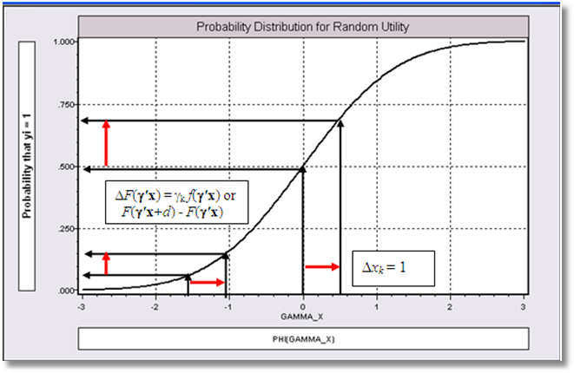
Effect on Predicted Probability of an Increase in Age
α + β₁ (Age+1) + β₂ (Income) + β₃ Sex (β₁ is positive)

Slide 21
Partial Effects in Probability Models
Prob[Outcome] = some F(α+β₁Income…)
“Partial effect” = ∂F(α+β₁Income…) / ∂”x” (derivative)
  Partial effects are derivatives
  Result varies with model
    Logit: ∂F(α+β₁Income…) /∂x = Prob * (1-Prob) × β
    Probit: ∂ F(α+β₁Income…)/∂x = Normal density × β
    Extreme Value: ∂ F(α+β₁Income…)/∂x = Prob * (-log Prob) × β
  Scaling usually erases model differences

Slide 23
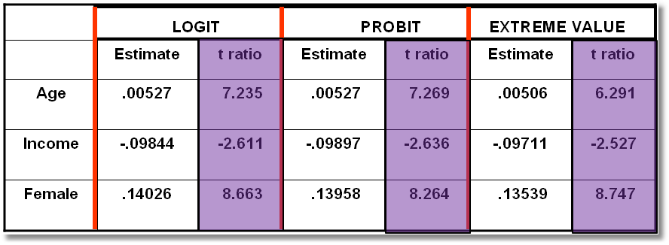
Estimated Partial Effects for Three Models
(Standard errors to be considered later)

Slide 24
Partial Effect for a Dummy Variable Computed
Using Means of Other Variables
Prob[y_{i} = 1|x_{i},d_{i}] = F(β’x_{i}+γd_{i}) where d is a dummy variable such as Sex in our doctor model.
For the probit model, Prob[y_{i} = 1|x_{i},d_{i}] = Φ(β′x+γd), Φ = the normal CDF.
Partial effect of d
Prob[y_{i} = 1|x_{i}, d_{i}=1] - Prob[y_{i} = 1|x_{i}, d_{i}=0]
=

Slide 25
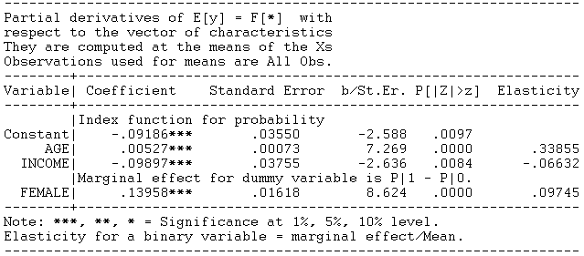
Partial Effect – Dummy Variable

Slide 26
Computing Partial Effects
Compute at the data means (PEA)
  Simple
  Inference is well defined.
  Not realistic for some variables, such as Sex
Average the individual effects (APE)
  More appropriate
  Asymptotic standard errors are slightly more complicated.

Slide 27
Partial Effects

Slide 28
Average Partial Partial Effects
Effects at Data Means
Age 0.00512 0.00527
Income -0.09609 -0.09871
Female 0.13792 0.13958
The two approaches usually give similar answers, though sometimes the results differ substantially.

Slide 29
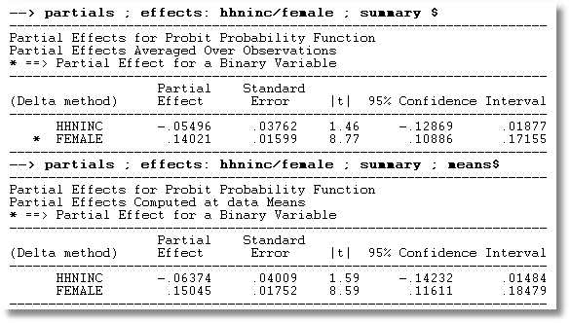
APE vs. Partial Effects at the Mean

Slide 30


Slide 31
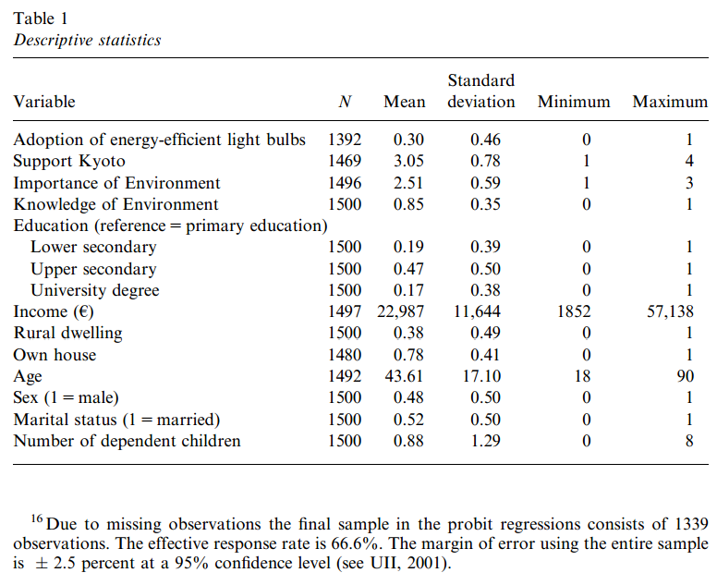
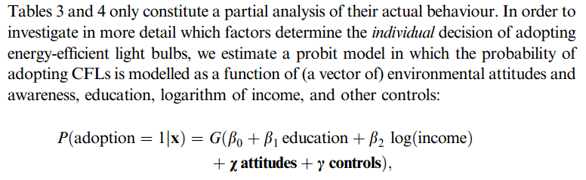

Slide 32
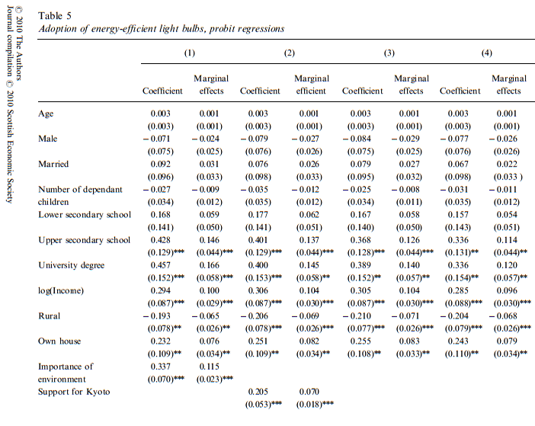

Slide 33
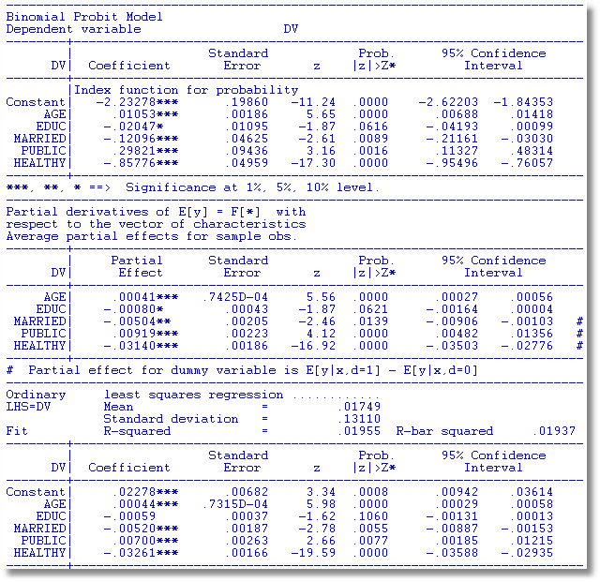
OLS approximates the partial effects, “directly,” without bothering with coefficients.
MLE
Average Partial Effects
OLS Coefficients

Slide 34

The Linear Probability “Model”

Slide 35
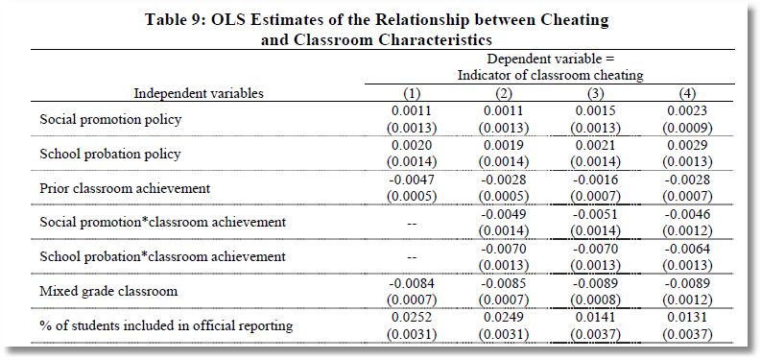
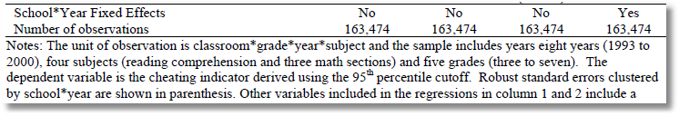
The Dependent Variable equals zero for 99.1% of the observations. In the sample of 163,474 observations, the LHS variable equals 1 about 1,500 times.

Slide 36
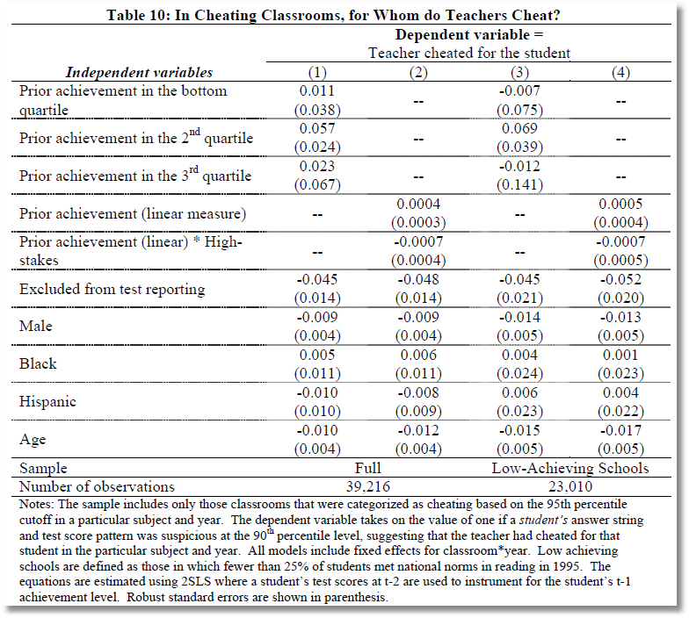
2SLS for a binary dependent variable.

Slide 37
Modeling a Binary Outcome
Did firm i produce a product or process innovation in year t ? y_{it} : 1=Yes/0=No
Observed N=1270 firms for T=5 years, 1984-1988
Observed covariates: x_{it} = Industry, competitive pressures, size, productivity, etc.
How to model?
  Binary outcome
  Correlation across time
  Heterogeneity across firms

Slide 38
Application

Slide 39
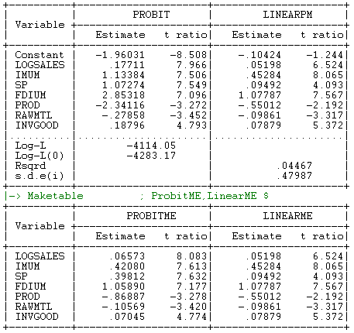
Probit and LPM

Slide 40
LPM Debate
Why the LPM is or is not better
  The obvious (see above)
  LPM is “robust” – (it isn’t)
  Strong distributional assumption behind probit – (an incoherent model is not a solution)
  You can compute robust standard errors
  You can cluster the standard errors
  You can use 2SLS

Slide 41
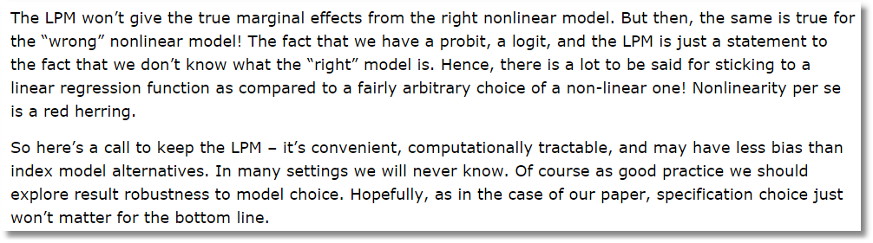
The world is nonlinear.
You would not use a linear model knowing that the world is nonlinear, for example, linear vs. loglinear.
  This argument is backwards.
  This argument is very defensive.
Use a probit model. You don’t have to defend it.
(PROBIT, IVPROBIT, BPROBIT)

Slide 42
Odds Ratios
This calculation is not meaningful if the model is not a binary logit model

Slide 43
Odds Ratio
Exp(γ) = multiplicative change in the odds ratio when z changes by 1 unit.
dOR(x,z)/dx = OR(x,z)*β, not exp(β)
The “odds ratio” is not a partial effect – it is not a derivative.
It is only meaningful when the odds ratio is itself of interest and the change of the variable by a whole unit is meaningful.
“Odds ratios” might be interesting for dummy variables

Slide 44
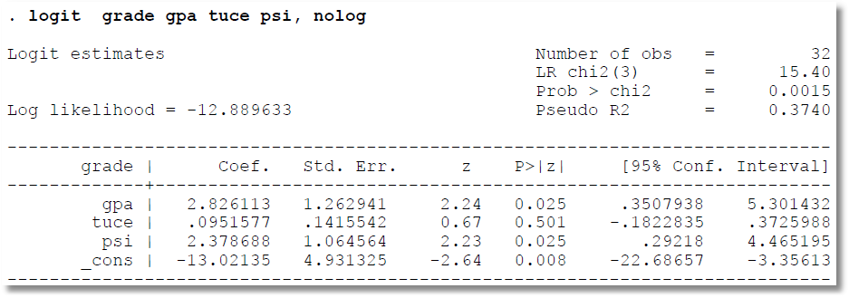
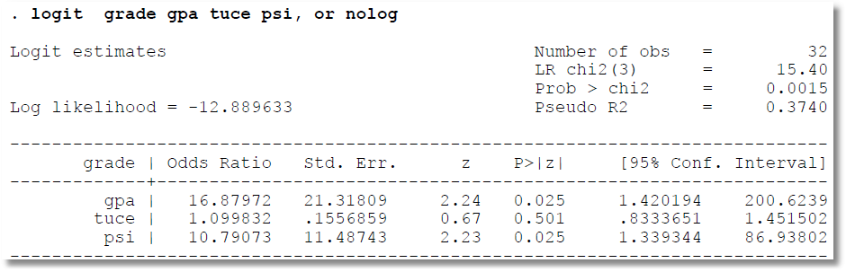
Cautions About reported Odds Ratios

Slide 45
How Well Does the Model Fit the Data?
There is no R squared for a probability model.
  Least squares for linear models is computed to maximize R²
  There are no residuals or sums of squares in a binary choice model
  The model is not computed to optimize the fit of the model to the data
How can we measure the “fit” of the model to the data?
  “Fit measures” computed from the log likelihood
    Pseudo R squared = 1 – logL/logL0
    Also called the “likelihood ratio index”
  Direct assessment of the effectiveness of the model at predicting the outcome

Slide 46
Pseudo R² = Likelihood Ratio Index

Slide 47
The Likelihood Ratio Index
Bounded by 0 and a number < 1
Rises when the model is expanded
Specific values between 0 and 1 have no meaning
Can be strikingly low even in a great model
Should not be used to compare models
  Use logL
  Use information criteria to compare nonnested models
Can be negative if the model is not a discrete choice model. For linear regression, logL=-N/2(1+log2π+log(e’e/N)]; Positive if e’e/N < 0.058497
Notes:
47

Slide 48
Fit Measures Based on LogL
----------------------------------------------------------------------
Binary Logit Model for Binary Choice
Dependent variable DOCTOR
Log likelihood function -2085.92452 Full model LogL
Restricted log likelihood -2169.26982 Constant term only LogL0
Chi squared [ 5 d.f.] 166.69058
Significance level .00000
McFadden Pseudo R-squared .0384209 1 – LogL/logL0
Estimation based on N = 3377, K = 6
Information Criteria: Normalization=1/N
Normalized Unnormalized
AIC 1.23892 4183.84905 -2LogL + 2K
Fin.Smpl.AIC 1.23893 4183.87398 -2LogL + 2K + 2K(K+1)/(N-K-1)
Bayes IC 1.24981 4220.59751 -2LogL + KlnN
Hannan Quinn 1.24282 4196.98802 -2LogL + 2Kln(lnN)
--------+-------------------------------------------------------------
Variable| Coefficient Standard Error b/St.Er. P[|Z|>z] Mean of X
--------+-------------------------------------------------------------
|Characteristics in numerator of Prob[Y = 1]
Constant| 1.86428*** .67793 2.750 .0060
AGE| -.10209*** .03056 -3.341 .0008 42.6266
AGESQ| .00154*** .00034 4.556 .0000 1951.22
INCOME| .51206 .74600 .686 .4925 .44476
AGE_INC| -.01843 .01691 -1.090 .2756 19.0288
FEMALE| .65366*** .07588 8.615 .0000 .46343
--------+-------------------------------------------------------------

Slide 49
Fit Measures Based on Predictions
Computation
  Use the model to compute predicted probabilities
  P = F(a + b₁Age + b₂Income + b₃Female+…)
  Use a rule to compute predicted y = 0 or 1
  Predict y=1 if P is “large” enough
  Generally use 0.5 for “large” (more likely than not)
Fit measure compares predictions to actuals
Count successes and failures

Slide 50
Cramer Fit Measure
+----------------------------------------+
| Fit Measures Based on Model Predictions|
| Efron = .04825|
| Ben Akiva and Lerman = .57139|
| Veall and Zimmerman = .08365|
| Cramer = .04771|
+----------------------------------------+

Slide 51
Computing test statistics requires the log likelihood and/or standard errors based on the Hessian of LogL

Slide 52
Robust Covariance Matrix
(Robust to the model specification? Latent heterogeneity? Correlation across observations? Not always clear)

Slide 53
Robust Covariance Matrix for Logit Model
Doesn’t change much. The model is well specified.
--------+--------------------------------------------------------------------
| Standard Prob. 95% Confidence
DOCTOR| Coefficient Error z |z|>Z* Interval
--------+--------------------------------------------------------------------
Conventional Standard Errors
Constant| 1.86428*** .67793 2.75 .0060 .53557 3.19299
AGE| -.10209*** .03056 -3.34 .0008 -.16199 -.04219
AGE^2.0| .00154*** .00034 4.56 .0000 .00088 .00220
INCOME| .51206 .74600 .69 .4925 -.95008 1.97420
|Interaction AGE*INCOME
_ntrct02| -.01843 .01691 -1.09 .2756 -.05157 .01470
FEMALE| .65366*** .07588 8.61 .0000 .50494 .80237
--------+--------------------------------------------------------------------
Robust Standard Errors
Constant| 1.86428*** .68518 2.72 .0065 .52135 3.20721
AGE| -.10209*** .03118 -3.27 .0011 -.16321 -.04098
AGE^2.0| .00154*** .00035 4.44 .0000 .00086 .00222
INCOME| .51206 .75171 .68 .4958 -.96127 1.98539
|Interaction AGE*INCOME
_ntrct02| -.01843 .01705 -1.08 .2796 -.05185 .01498
FEMALE| .65366*** .07594 8.61 .0000 .50483 .80249

Slide 54
The Effect of Clustering
Y_{it} must be correlated with Y_{is} across periods
Pooled estimator ignores correlation
Broadly, y_{it} = E[y_{it}|x_{it}] + w_{it},
  E[y_{it}|x_{it}] = Prob(y_{it} = 1|x_{it})
  w_{it} is correlated across periods
Assuming the marginal probability is the same, the pooled estimator is consistent. (We just saw that it might not be.)
Ignoring the correlation across periods generally leads to underestimating standard errors.

Slide 55
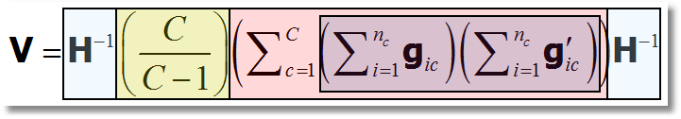
‘Cluster’ Corrected Covariance Matrix

Slide 56
Cluster Correction: Doctor
----------------------------------------------------------------------
Binomial Probit Model
Dependent variable DOCTOR
Log likelihood function -17457.21899
--------+-------------------------------------------------------------
Variable| Coefficient Standard Error b/St.Er. P[|Z|>z] Mean of X
--------+-------------------------------------------------------------
| Conventional Standard Errors
Constant| -.25597*** .05481 -4.670 .0000
AGE| .01469*** .00071 20.686 .0000 43.5257
EDUC| -.01523*** .00355 -4.289 .0000 11.3206
HHNINC| -.10914** .04569 -2.389 .0169 .35208
FEMALE| .35209*** .01598 22.027 .0000 .47877
--------+-------------------------------------------------------------
| Corrected Standard Errors
Constant| -.25597*** .07744 -3.305 .0009
AGE| .01469*** .00098 15.065 .0000 43.5257
EDUC| -.01523*** .00504 -3.023 .0025 11.3206
HHNINC| -.10914* .05645 -1.933 .0532 .35208
FEMALE| .35209*** .02290 15.372 .0000 .47877
--------+-------------------------------------------------------------

Slide 57
Hypothesis Tests
We consider “nested” models and parametric tests
Test statistics based on the usual 3 strategies
  Wald statistics: Use the unrestricted model
  Likelihood ratio statistics: Based on comparing the two models
  Lagrange multiplier: Based on the restricted model.
Test statistics require the log likelihood and/or the first and second derivatives of logL

Slide 58
Base Model for Hypothesis Tests
----------------------------------------------------------------------
Binary Logit Model for Binary Choice
Dependent variable DOCTOR
Log likelihood function -2085.92452
Restricted log likelihood -2169.26982
Chi squared [ 5 d.f.] 166.69058
Significance level .00000
McFadden Pseudo R-squared .0384209
Estimation based on N = 3377, K = 6
Information Criteria: Normalization=1/N
Normalized Unnormalized
AIC 1.23892 4183.84905
--------+-------------------------------------------------------------
Variable| Coefficient Standard Error b/St.Er. P[|Z|>z] Mean of X
--------+-------------------------------------------------------------
|Characteristics in numerator of Prob[Y = 1]
Constant| 1.86428*** .67793 2.750 .0060
AGE| -.10209*** .03056 -3.341 .0008 42.6266
AGESQ| .00154*** .00034 4.556 .0000 1951.22
INCOME| .51206 .74600 .686 .4925 .44476
AGE_INC| -.01843 .01691 -1.090 .2756 19.0288
FEMALE| .65366*** .07588 8.615 .0000 .46343
--------+-------------------------------------------------------------
H₀: Age is not a significant
determinant of
Prob(Doctor = 1)
H₀: β₂ = β₃ = β₅ = 0

Slide 59
Likelihood Ratio Test
Null hypothesis restricts the parameter vector
Alternative relaxes the restriction
Test statistic: Chi-squared =
2 (LogL|Unrestricted model – LogL|Restrictions) > 0
Degrees of freedom = number of restrictions

Slide 60
LR Test of H₀: β₂ = β₃ = β₅ = 0
UNRESTRICTED MODEL
Binary Logit Model for Binary Choice
Dependent variable DOCTOR
Log likelihood function -2085.92452
Restricted log likelihood -2169.26982
Chi squared [ 5 d.f.] 166.69058
Significance level .00000
McFadden Pseudo R-squared .0384209
Estimation based on N = 3377, K = 6
Information Criteria: Normalization=1/N
Normalized Unnormalized
AIC 1.23892 4183.84905
RESTRICTED MODEL
Binary Logit Model for Binary Choice
Dependent variable DOCTOR
Log likelihood function -2124.06568
Restricted log likelihood -2169.26982
Chi squared [ 2 d.f.] 90.40827
Significance level .00000
McFadden Pseudo R-squared .0208384
Estimation based on N = 3377, K = 3
Information Criteria: Normalization=1/N
Normalized Unnormalized
AIC 1.25974 4254.13136
Chi squared[3] = 2[-2085.92452 - (-2124.06568)] = 77.46456

Slide 61
Wald Test of H₀: β₂ = β₃ = β₅ = 0
Unrestricted parameter vector is estimated
Discrepancy: q= Rb – m is computed
(or r(b,m) if nonlinear)
Variance of discrepancy is estimated:
Var[q] = R V R’
Wald Statistic is q’[Var(q)]⁻¹q = q’[RVR’]⁻¹q

Slide 62
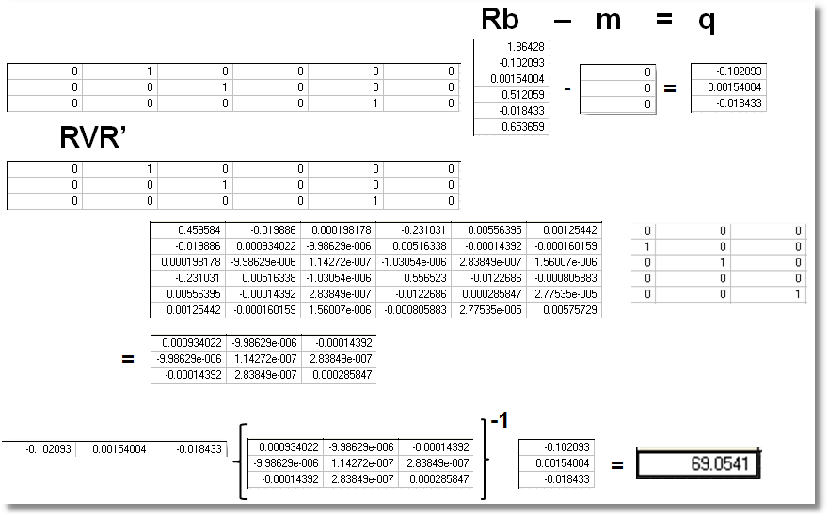
Wald Test
Chi squared[3] = 69.0541

Slide 63
Lagrange Multiplier Test of H₀: β₂ = β₃ = β₅ = 0
Restricted model is estimated
Derivatives of unrestricted model and variances of derivatives are computed at restricted estimates
Wald test of whether derivatives are zero tests the restrictions
Usually hard to compute – difficult to program the derivatives and their variances.

Slide 64
LM Test for a Logit Model
Compute b₀ (subject to restictions)
(e.g., with zeros in appropriate positions.
Compute P_{i}(b₀) for each observation.
Compute e_{i}(b₀) = [y_{i} – P_{i}(b₀)]
Compute g_{i}(b₀) = x_{i}e_{i} using full x_{i} vector
LM = [Σ_{i}g_{i}(b₀)]’[Σ_{i}g_{i}(b₀)g_{i}(b₀)’]⁻¹[Σ_{i}g_{i}(b₀)]

Slide 65
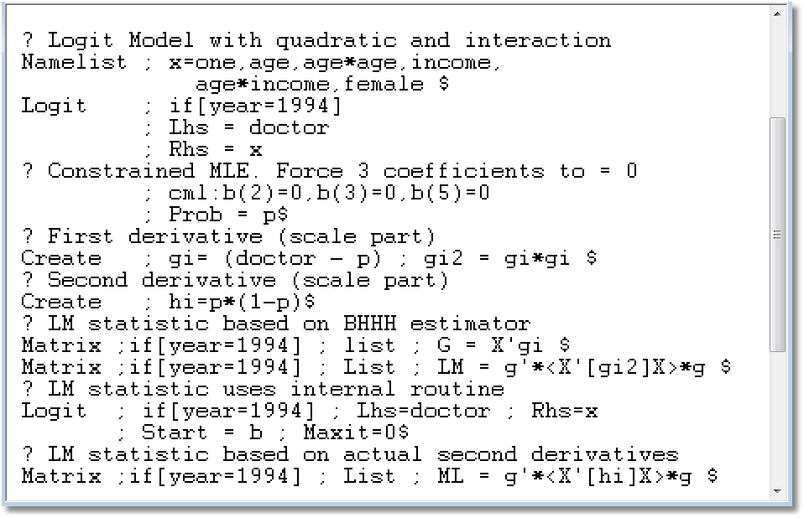
(There is a built in function for this computation.)

Slide 66
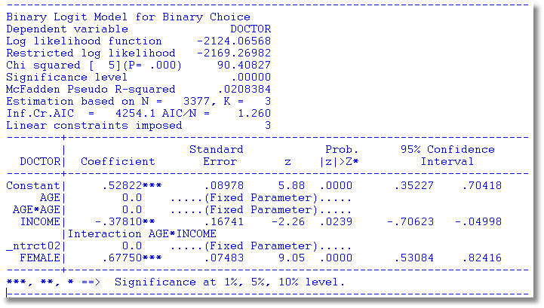
Restricted Model

Slide 67
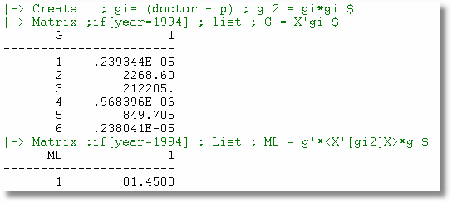
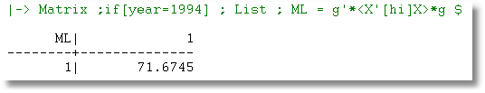
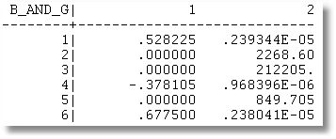

Slide 68
