Slide 1




Microeconometric Modeling
William Greene
Stern School of Business
New York University
New York NY USA
2.2 Binary Choice
Extensions

Slide 2
Concepts
Models
Mundlak Approach
Nonlinear Least Squares
Quasi Maximum Likelihood
Delta Method
Average Partial Effect
Krinsky and Robb Method
Interaction Term
Endogenous RHS Variable
Control Function
FIML
2 Step ML
Scaled Coefficient
Direct and Indirect Effect
GHK Simulator
Fractional Response Model
Probit
Logit
Multivariate Probit

Slide 3
Inference About
Partial Effects

Slide 4
Partial Effects for Binary Choice

Slide 5
The Delta Method

Slide 6
Computing Effects
Compute at the data means?
  Simple
  Inference is well defined
Average the individual effects
  More appropriate?
  Asymptotic standard errors more complicated.
Is testing about marginal effects meaningful?
  f(b’x) must be > 0; b is highly significant
  How could f(b’x)*b equal zero?

Slide 7
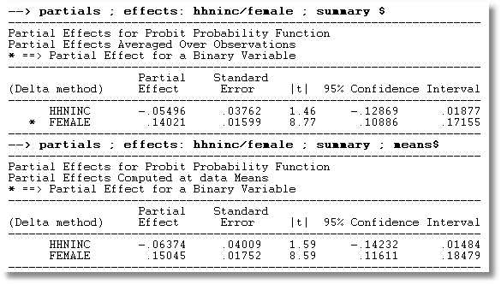
APE vs. Partial Effects at the Mean

Slide 8
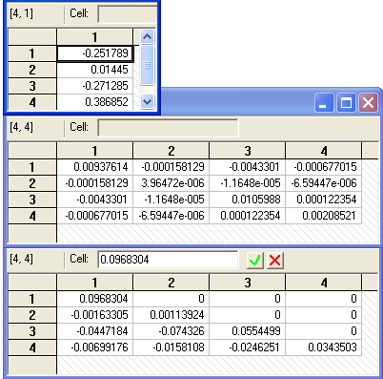
Method of Krinsky and Robb
Estimate β by Maximum Likelihood with b
Estimate asymptotic covariance matrix with V
Draw R observations b(r) from the normal
population N[b,V]
b(r) = b + C*v(r), v(r) drawn from N[0,I]
C = Cholesky matrix, V = CC’
Compute partial effects d(r) using b(r)
Compute the sample variance of d(r),r=1,…,R
Use the sample standard deviations of the R observations to estimate the sampling standard errors for the partial effects.

Slide 9
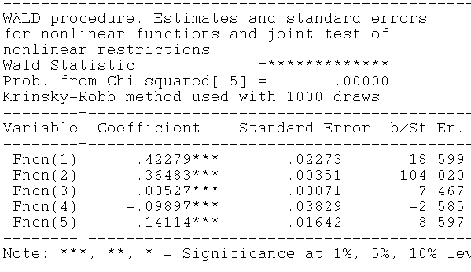
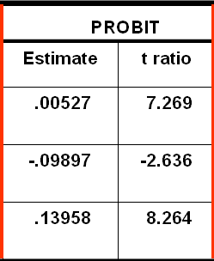
Krinsky and Robb
Delta Method

Slide 10
Partial Effect for Nonlinear Terms

Slide 11
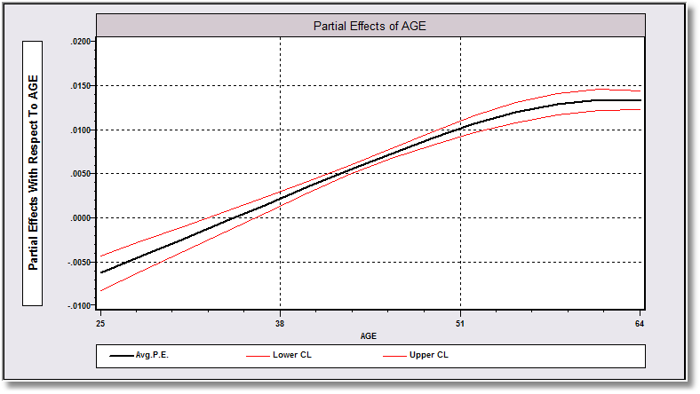
Average Partial Effect: Averaged over Sample Incomes and Genders for Specific Values of Age

Slide 12
Endogeneity

Slide 13
Endogenous RHS Variable
U* = β’x + θh + ε
y = 1[U* > 0]
E[ε|h] ≠ 0 (h is endogenous)
  Case 1: h is binary = a treatment effect
  Case 2: h is continuous
Approaches
  Parametric: Maximum Likelihood
  Semiparametric (not developed here):
    GMM
    Various approaches for case 2
  2 Stage least squares – a good approximation?

Slide 14
Endogenous Binary Variable
U* = β’x + θh + ε
y = 1[U* > 0]
h* = α’z + u
h = 1[h* > 0]
E[ε|h*] ≠ 0 ⬄ Cov[u, ε] ≠ 0
Additional Assumptions:
(u,ε) ~ N[(0,0),(σ_{u}², ρσ_{u}, 1)]
z = a valid set of exogenous
variables, uncorrelated with (u,ε)
⇐
Correlation = ρ.
This is the source of the endogeneity
This is not IV estimation. Z may be uncorrelated with X without problems.

Slide 15

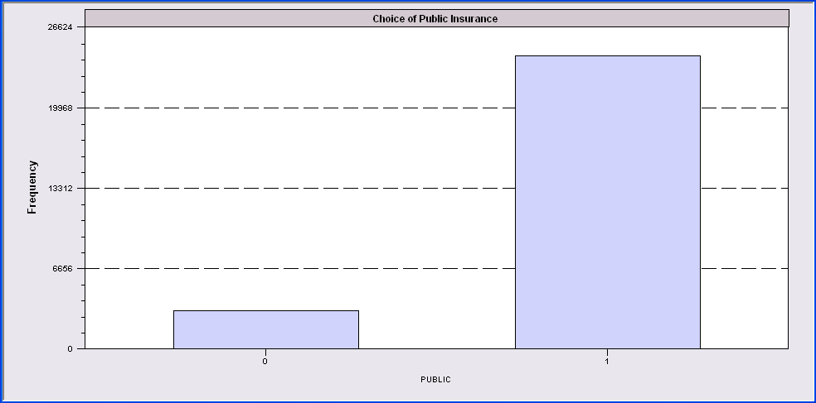
Endogenous Binary Variable
Doctor = F(age,age²,income,female,Public)
Public = F(age,educ,income,married,kids,female)

Slide 16
Log Likelihood for the RBP Model

Slide 17
FIML Estimates
-----------------------------------------------------------------------------
FIML - Recursive Bivariate Probit Model
Dependent variable PUBDOC
Log likelihood function -25671.32339
Estimation based on N = 27326, K = 14
Inf.Cr.AIC = 51370.6 AIC/N = 1.880
--------+--------------------------------------------------------------------
PUBLIC| Standard Prob. 95% Confidence
DOCTOR| Coefficient Error z |z|>Z* Interval
--------+--------------------------------------------------------------------
|Index equation for PUBLIC........................................
Constant| 3.55056*** .07446 47.68 .0000 3.40462 3.69650
AGE| .00067 .00115 .58 .5626 -.00159 .00293
EDUC| -.16835*** .00416 -40.48 .0000 -.17650 -.16020
INCOME| -.98735*** .05172 -19.09 .0000 -1.08872 -.88598
MARRIED| -.00997 .02922 -.34 .7329 -.06724 .04729
HHKIDS| -.08094*** .02510 -3.22 .0013 -.13014 -.03174
FEMALE| .12140*** .02231 5.44 .0000 .07768 .16512
|Index equation for DOCTOR........................................
Constant| .58983*** .14474 4.08 .0000 .30615 .87351
AGE| -.05740*** .00601 -9.56 .0000 -.06917 -.04563
AGESQ| .00082*** .6817D-04 12.10 .0000 .00069 .00096
INCOME| .08900* .05097 1.75 .0808 -.01091 .18890
FEMALE| .34580*** .01629 21.22 .0000 .31386 .37773
PUBLIC| .43595*** .07358 5.92 .0000 .29174 .58016
|Disturbance correlation.............................................
RHO(1,2)| -.17317*** .04075 -4.25 .0000 -.25303 -.09330
--------+--------------------------------------------------------------------

Slide 18
Partial Effects

Slide 19
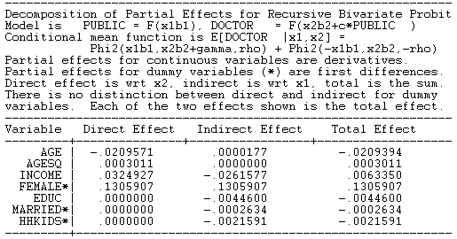
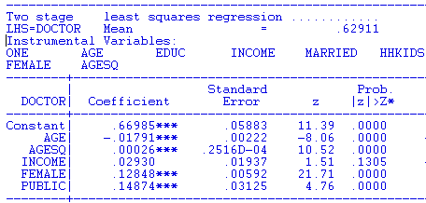
FIML Partial
Effects
Two Stage Least Squares Effects

Slide 20
Identification Issues
Exclusions are not needed for estimation
Identification is, in principle, by “functional form”
Researchers usually have a variable in the treatment equation that is not in the main probit equation “to improve identification”
A fully simultaneous model
  y1 = f(x1,y2), y2 = f(x2,y1)
  Not identified even with exclusion restrictions
  (Model is “incoherent”)

Slide 21
A Simultaneous Equations Model

Slide 22
Fully Simultaneous “Model”
----------------------------------------------------------------------
FIML Estimates of Bivariate Probit Model
Dependent variable DOCHOS
Log likelihood function -20318.69455
--------+-------------------------------------------------------------
Variable| Coefficient Standard Error b/St.Er. P[|Z|>z] Mean of X
--------+-------------------------------------------------------------
|Index equation for DOCTOR
Constant| -.46741*** .06726 -6.949 .0000
AGE| .01124*** .00084 13.353 .0000 43.5257
FEMALE| .27070*** .01961 13.807 .0000 .47877
EDUC| -.00025 .00376 -.067 .9463 11.3206
MARRIED| -.00212 .02114 -.100 .9201 .75862
WORKING| -.00362 .02212 -.164 .8701 .67705
HOSPITAL| 2.04295*** .30031 6.803 .0000 .08765
|Index equation for HOSPITAL
Constant| -1.58437*** .08367 -18.936 .0000
AGE| -.01115*** .00165 -6.755 .0000 43.5257
FEMALE| -.26881*** .03966 -6.778 .0000 .47877
HHNINC| .00421 .08006 .053 .9581 .35208
HHKIDS| -.00050 .03559 -.014 .9888 .40273
DOCTOR| 2.04479*** .09133 22.389 .0000 .62911
|Disturbance correlation
RHO(1,2)| -.99996*** .00048 ******** .0000
--------+-------------------------------------------------------------

Slide 23
A Recursive Bivariate Probit Model
Treatment Effects

Slide 24
-----------------------------------------------------------------------------
FIML - Recursive Bivariate Probit Model
Dependent variable PUBDOC
Log likelihood function -25671.32339
Estimation based on N = 27326, K = 14
Inf.Cr.AIC = 51370.6 AIC/N = 1.880
--------+--------------------------------------------------------------------
PUBLIC| Standard Prob. 95% Confidence
DOCTOR| Coefficient Error z |z|>Z* Interval
--------+--------------------------------------------------------------------
|Index equation for PUBLIC....................................
Constant| 3.55056*** .07446 47.68 .0000 3.40462 3.69650
AGE| .00067 .00115 .58 .5626 -.00159 .00293
EDUC| -.16835*** .00416 -40.48 .0000 -.17650 -.16020
INCOME| -.98735*** .05172 -19.09 .0000 -1.08872 -.88598
MARRIED| -.00997 .02922 -.34 .7329 -.06724 .04729
HHKIDS| -.08094*** .02510 -3.22 .0013 -.13014 -.03174
FEMALE| .12140*** .02231 5.44 .0000 .07768 .16512
|Index equation for DOCTOR....................................
Constant| .58983*** .14474 4.08 .0000 .30615 .87351
AGE| -.05740*** .00601 -9.56 .0000 -.06917 -.04563
AGESQ| .00082*** .6817D-04 12.10 .0000 .00069 .00096
INCOME| .08900* .05097 1.75 .0808 -.01091 .18890
FEMALE| .34580*** .01629 21.22 .0000 .31386 .37773
PUBLIC| .43595*** .07358 5.92 .0000 .29174 .58016
|Disturbance correlation.........................................
RHO(1,2)| -.17317*** .04075 -4.25 .0000 -.25303 -.09330
--------+--------------------------------------------------------------------

Slide 25
Treatment Effects
y₁ is a “treatment”
Treatment effect of y₁ on y₂.
Prob(y₂=1)_{y1=1} – Prob(y₂=1)_{y1=0}
= Φ(β’x + θ) - Φ(β’x)
Treatment effect on the treated involves an unobserved counterfactual. Compare being treated to being untreated for someone who was actually treated.
Prob(y₂=1|y₁=1)_{y1=1} - Prob(y₂=1|y₁=1)_{y1=0}

Slide 26
Treatment Effect on the Treated

Slide 27
Treatment Effects
---------------------------------------------------------------------
Partial Effects Analysis for RcrsvBvProb: ATE of PUBLIC on DOCTOR
---------------------------------------------------------------------
Effects on function with respect to PUBLIC
Results are computed by average over sample observations
Partial effects for binary var PUBLIC computed by first difference
---------------------------------------------------------------------
df/dPUBLIC Partial Standard
(Delta Method) Effect Error |t| 95% Confidence Interval
---------------------------------------------------------------------
APE. Function .16446 .02820 5.83 .10920 .21973
---------------------------------------------------------------------
Partial Effects Analysis for RcrsvBvProb: ATET of PUBLIC on DOCTOR
---------------------------------------------------------------------
Effects on function with respect to PUBLIC
Results are computed by average over sample observations
Partial effects for binary var PUBLIC computed by first difference
---------------------------------------------------------------------
df/dPUBLIC Partial Standard
(Delta Method) Effect Error |t| 95% Confidence Interval
---------------------------------------------------------------------
APE. Function .15417 .02482 6.21 .10553 .20282

Slide 28


Slide 29
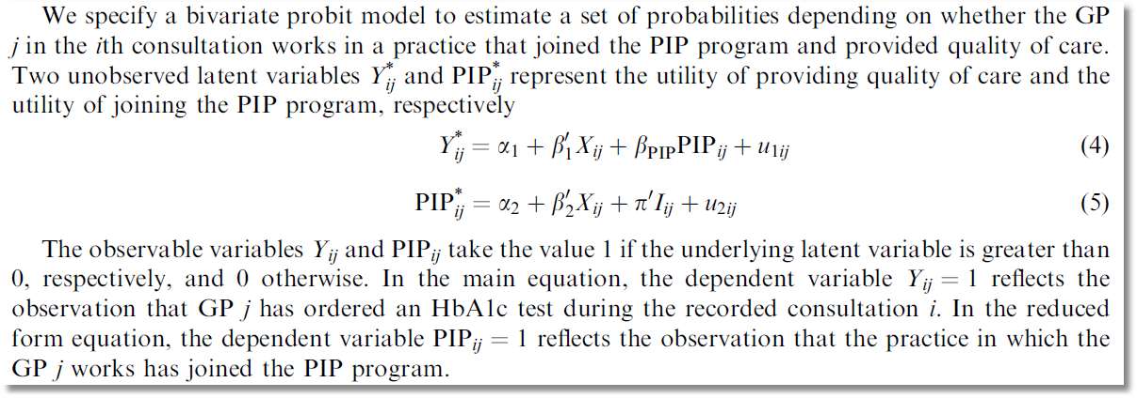
recursive

Slide 30

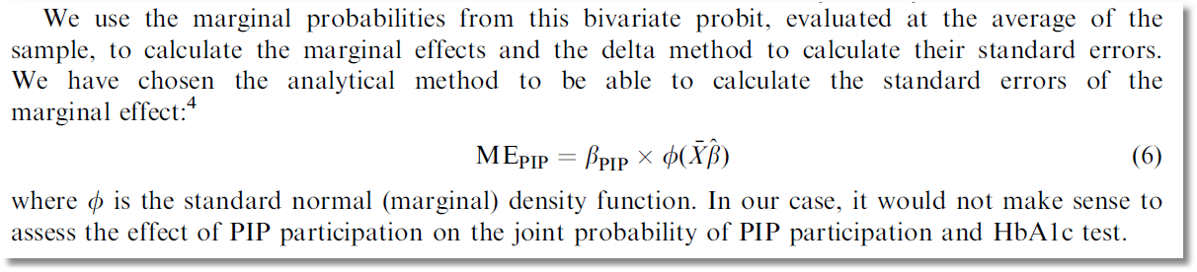
Causal Inference

Slide 31
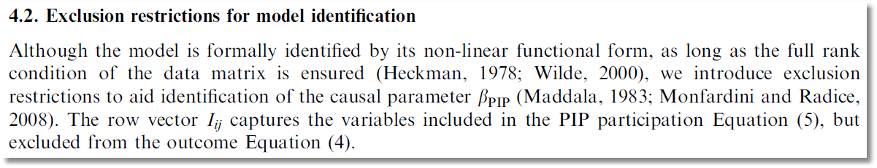

Slide 32
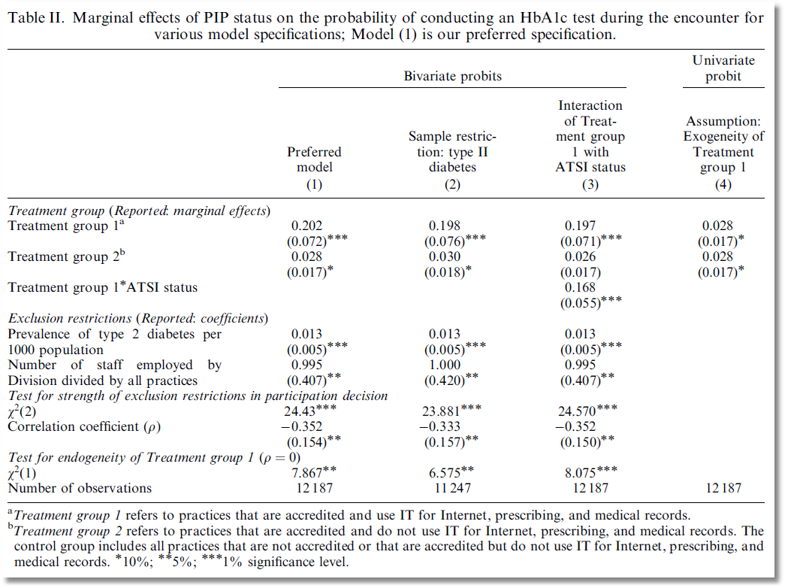

Slide 33
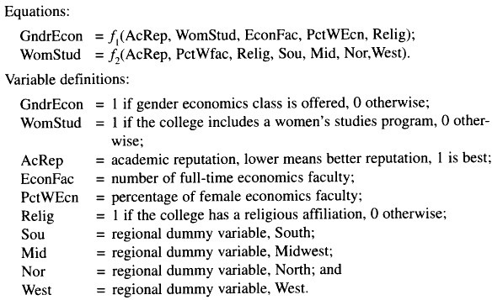
Application: Gender Economics at Liberal Arts Colleges
Journal of Economic Education, fall, 1998.

Slide 34
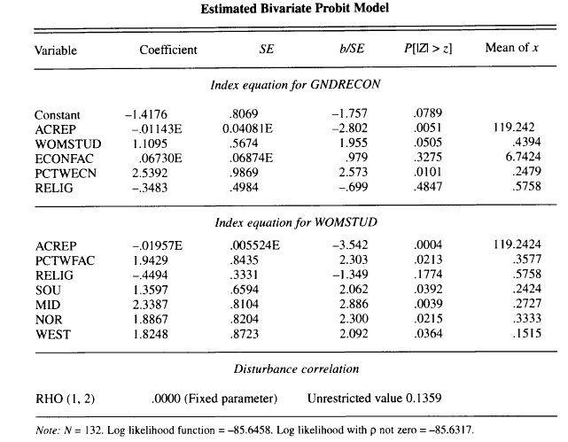
Estimated Recursive Model

Slide 35
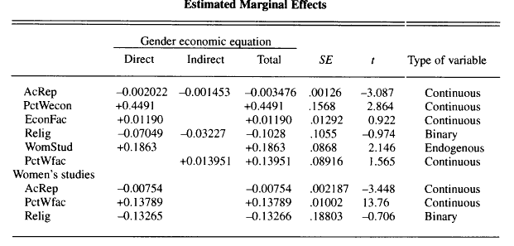
Estimated Effects: Decomposition

Slide 36
A Sample Selection Model

Slide 37
Sample Selection Model: Estimation

Slide 38
Application: Credit Scoring
American Express: 1992
N = 13,444 Applications
  Observed application data
  Observed acceptance/rejection of application
N₁ = 10,499 Cardholders
  Observed demographics and economic data
  Observed default or not in first 12 months
Full Sample is in AmEx.lpj; description shows when imported.

Slide 39
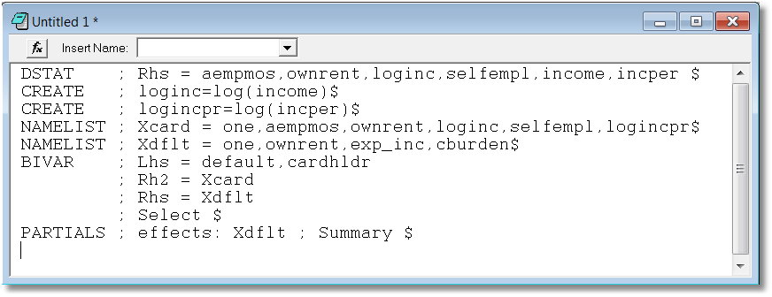
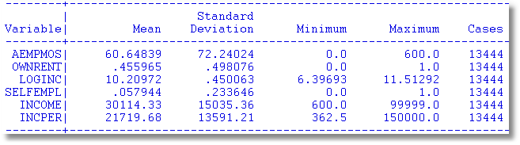

Slide 40
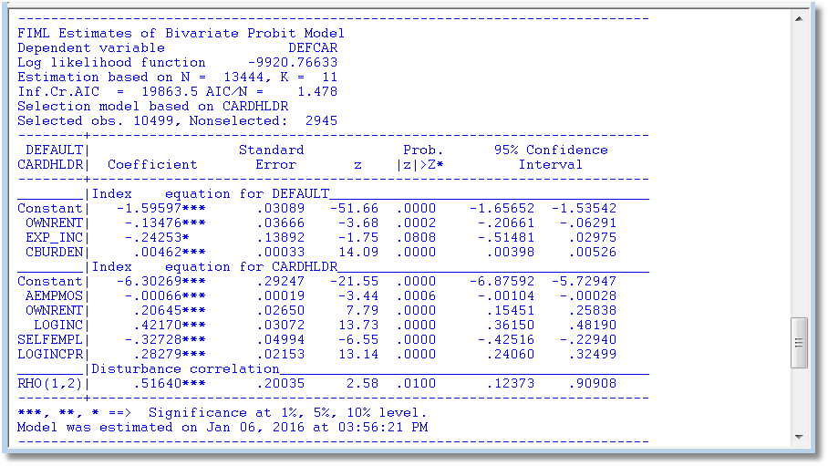

Slide 41
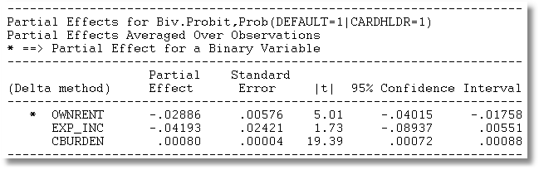

Slide 42
Endogenous Continuous Variable
U* = β’x + θh + ε
y = 1[U* > 0] ⇐
h = α’z + u
E[ε|h] ≠ 0 ⬄ Cov[u, ε] ≠ 0
Additional Assumptions:
(u,ε) ~ N[(0,0),(σ_{u}², ρσ_{u}, 1)]
z = a valid set of exogenous
variables, uncorrelated with (u,ε)
Correlation = ρ.
This is the source of the endogeneity
This is not IV estimation. Z may be uncorrelated with X without problems.

Slide 43


Endogenous Income
Income responds to
Age, Age², Educ, Married, Kids, Gender
0 = Not Healthy
1 = Healthy
Healthy = 0 or 1
Age, Married, Kids, Gender, Income
Determinants of Income (observed and unobserved) also determine health satisfaction.
Notes:
43

Slide 44
Estimation by ML (Control Function)

Slide 45
Two Approaches to ML

Slide 46
FIML Estimates
----------------------------------------------------------------------
Probit with Endogenous RHS Variable
Dependent variable HEALTHY
Log likelihood function -6464.60772
--------+-------------------------------------------------------------
Variable| Coefficient Standard Error b/St.Er. P[|Z|>z] Mean of X
--------+-------------------------------------------------------------
|Coefficients in Probit Equation for HEALTHY
Constant| 1.21760*** .06359 19.149 .0000
AGE| -.02426*** .00081 -29.864 .0000 43.5257
MARRIED| -.02599 .02329 -1.116 .2644 .75862
HHKIDS| .06932*** .01890 3.668 .0002 .40273
FEMALE| -.14180*** .01583 -8.959 .0000 .47877
INCOME| .53778*** .14473 3.716 .0002 .35208
|Coefficients in Linear Regression for INCOME
Constant| -.36099*** .01704 -21.180 .0000
AGE| .02159*** .00083 26.062 .0000 43.5257
AGESQ| -.00025*** .944134D-05 -26.569 .0000 2022.86
EDUC| .02064*** .00039 52.729 .0000 11.3206
MARRIED| .07783*** .00259 30.080 .0000 .75862
HHKIDS| -.03564*** .00232 -15.332 .0000 .40273
FEMALE| .00413** .00203 2.033 .0420 .47877
|Standard Deviation of Regression Disturbances
Sigma(w)| .16445*** .00026 644.874 .0000
|Correlation Between Probit and Regression Disturbances
Rho(e,w)| -.02630 .02499 -1.052 .2926
--------+-------------------------------------------------------------

Slide 47
Partial Effects: Scaled Coefficients

Slide 48
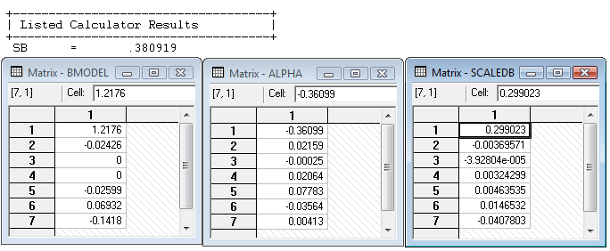
Partial Effects
θ = 0.53778
The scale factor is computed using the model coefficients, means of the variables and 35,000 draws from the standard normal population.

Slide 49
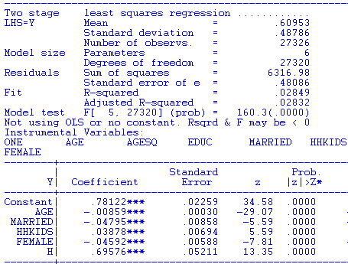
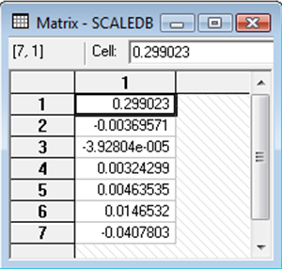
Two Stage Least Squares

Slide 50
Multivariate Binary Choice Models
Bivariate Probit Models
  Analysis of bivariate choices
  Marginal effects
  Prediction
  No bivariate logit – there is no reasonable bivariate counterpart
Simultaneous Equations and Recursive Models
A Sample Selection Bivariate Probit Model
The Multivariate Probit Model
  Specification
  Simulation based estimation
  Inference
  Partial effects and analysis
The ‘panel probit model’

Slide 51
The Bivariate Probit Model

Slide 52
ML Estimation of the Bivariate Probit Model

Slide 53
Application: Health Care Usage
German Health Care Usage Data, 7,293 Individuals, Varying Numbers of Periods
Variables in the file are
Data downloaded from Journal of Applied Econometrics Archive. This is an unbalanced panel with 7,293 individuals. They can be used for regression, count models, binary choice, ordered choice, and bivariate binary choice. This is a large data set. There are altogether 27,326 observations. The number of observations ranges from 1 to 7. (Frequencies are: 1=1525, 2=1079, 3=825, 4=926, 5=1051, 6=1000, 7=887). Note, the variable NUMOBS below tells how many observations there are for each person. This variable is repeated in each row of the data for the person.
DOCTOR = 1(Number of doctor visits > 0)
HOSPITAL = 1(Number of hospital visits > 0)
HSAT = health satisfaction, coded 0 (low) - 10 (high)
DOCVIS = number of doctor visits in last three months
HOSPVIS = number of hospital visits in last calendar year
PUBLIC = insured in public health insurance = 1; otherwise = 0
ADDON = insured by add-on insurance = 1; otherswise = 0
HHNINC = household nominal monthly net income in German marks / 10000.
(4 observations with income=0 were dropped)
HHKIDS = children under age 16 in the household = 1; otherwise = 0
EDUC = years of schooling
AGE = age in years
MARRIED = marital status
EDUC = years of education

Slide 54
Application to Health Care Data
x1=one,age,female,educ,married,working
x2=one,age,female,hhninc,hhkids
BivariateProbit ; lhs=doctor,hospital
; rh1=x1
; rh2=x2;marginal effects $

Slide 55
Parameter Estimates
----------------------------------------------------------------------
FIML Estimates of Bivariate Probit Model
Dependent variable DOCTOR HOSPITAL
Log likelihood function -25323.63074
Estimation based on N = 27326, K = 12
--------+-------------------------------------------------------------
Variable| Coefficient Standard Error b/St.Er. P[|Z|>z] Mean of X
--------+-------------------------------------------------------------
|Index equation for DOCTOR
Constant| -.20664*** .05832 -3.543 .0004
AGE| .01402*** .00074 18.948 .0000 43.5257
FEMALE| .32453*** .01733 18.722 .0000 .47877
EDUC| -.01438*** .00342 -4.209 .0000 11.3206
MARRIED| .00224 .01856 .121 .9040 .75862
WORKING| -.08356*** .01891 -4.419 .0000 .67705
|Index equation for HOSPITAL
Constant| -1.62738*** .05430 -29.972 .0000
AGE| .00509*** .00100 5.075 .0000 43.5257
FEMALE| .12143*** .02153 5.641 .0000 .47877
HHNINC| -.03147 .05452 -.577 .5638 .35208
HHKIDS| -.00505 .02387 -.212 .8323 .40273
|Disturbance correlation
RHO(1,2)| .29611*** .01393 21.253 .0000
--------+-------------------------------------------------------------

Slide 56
Partial Effects
What are the marginal effects
  Effect of what on what?
  Two equation model, what is the conditional mean?
Possible margins?
  Derivatives of joint probability = Φ₂(β₁’x_{i1}, β₂’x_{i2},ρ)
  Partials of E[y_{ij}|x_{ij}] =Φ(β_{j}’x_{ij}) (Univariate probability)
  Partials of E[y_{i1}|x_{i1},x_{i2},y_{i2}=1] = P(y_{i1},y_{i2}=1)/Prob[y_{i2}=1]
Note marginal effects involve both sets of regressors.
If there are common variables, there are two effects
in the derivative that are added.
(See Appendix for formulations.)

Slide 57
Bivariate Probit Conditional Means

Slide 58
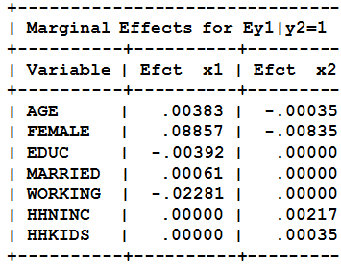
Partial Effects: Decomposition

Slide 59
Direct Effects
Derivatives of E[y₁|x₁,x₂,y₂=1] wrt x₁
+-------------------------------------------+
| Partial derivatives of E[y1|y2=1] with |
| respect to the vector of characteristics. |
| They are computed at the means of the Xs. |
| Effect shown is total of 4 parts above. |
| Estimate of E[y1|y2=1] = .819898 |
| Observations used for means are All Obs. |
| These are the direct marginal effects. |
+-------------------------------------------+
+---------+--------------+----------------+--------+---------+----------+
|Variable | Coefficient | Standard Error |b/St.Er.|P[|Z|>z] | Mean of X|
+---------+--------------+----------------+--------+---------+----------+
AGE .00382760 .00022088 17.329 .0000 43.5256898
FEMALE .08857260 .00519658 17.044 .0000 .47877479
EDUC -.00392413 .00093911 -4.179 .0000 11.3206310
MARRIED .00061108 .00506488 .121 .9040 .75861817
WORKING -.02280671 .00518908 -4.395 .0000 .67704750
HHNINC .000000 ......(Fixed Parameter)....... .35208362
HHKIDS .000000 ......(Fixed Parameter)....... .40273000

Slide 60
Indirect Effects
Derivatives of E[y₁|x₁,x₂,y₂=1] wrt x₂
+-------------------------------------------+
| Partial derivatives of E[y1|y2=1] with |
| respect to the vector of characteristics. |
| They are computed at the means of the Xs. |
| Effect shown is total of 4 parts above. |
| Estimate of E[y1|y2=1] = .819898 |
| Observations used for means are All Obs. |
| These are the indirect marginal effects. |
+-------------------------------------------+
+---------+--------------+----------------+--------+---------+----------+
|Variable | Coefficient | Standard Error |b/St.Er.|P[|Z|>z] | Mean of X|
+---------+--------------+----------------+--------+---------+----------+
AGE -.00035034 .697563D-04 -5.022 .0000 43.5256898
FEMALE -.00835397 .00150062 -5.567 .0000 .47877479
EDUC .000000 ......(Fixed Parameter)....... 11.3206310
MARRIED .000000 ......(Fixed Parameter)....... .75861817
WORKING .000000 ......(Fixed Parameter)....... .67704750
HHNINC .00216510 .00374879 .578 .5636 .35208362
HHKIDS .00034768 .00164160 .212 .8323 .40273000

Slide 61
Partial Effects: Total Effects
Sum of Two Derivative Vectors
+-------------------------------------------+
| Partial derivatives of E[y1|y2=1] with |
| respect to the vector of characteristics. |
| They are computed at the means of the Xs. |
| Effect shown is total of 4 parts above. |
| Estimate of E[y1|y2=1] = .819898 |
| Observations used for means are All Obs. |
| Total effects reported = direct+indirect. |
+-------------------------------------------+
+---------+--------------+----------------+--------+---------+----------+
|Variable | Coefficient | Standard Error |b/St.Er.|P[|Z|>z] | Mean of X|
+---------+--------------+----------------+--------+---------+----------+
AGE .00347726 .00022941 15.157 .0000 43.5256898
FEMALE .08021863 .00535648 14.976 .0000 .47877479
EDUC -.00392413 .00093911 -4.179 .0000 11.3206310
MARRIED .00061108 .00506488 .121 .9040 .75861817
WORKING -.02280671 .00518908 -4.395 .0000 .67704750
HHNINC .00216510 .00374879 .578 .5636 .35208362
HHKIDS .00034768 .00164160 .212 .8323 .40273000

Slide 62
Partial Effects: Dummy Variables
Using Differences of Probabilities
+-----------------------------------------------------------+
| Analysis of dummy variables in the model. The effects are |
| computed using E[y1|y2=1,d=1] - E[y1|y2=1,d=0] where d is |
| the variable. Variances use the delta method. The effect |
| accounts for all appearances of the variable in the model.|
+-----------------------------------------------------------+
|Variable Effect Standard error t ratio
+--------------------------------------------------
FEMALE .079694 .005290 15.065
MARRIED .000611 .005070 .121
WORKING -.022485 .005044 -4.457
HHKIDS .000348 .001641 .212

Slide 63
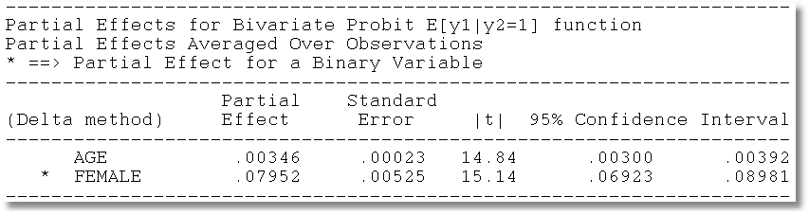
Average Partial Effects

Slide 64
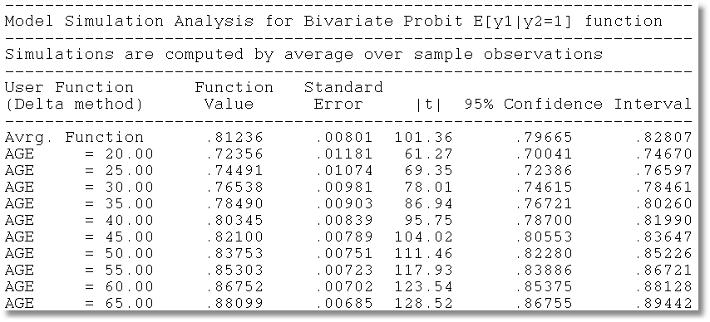
Model Simulation

Slide 65
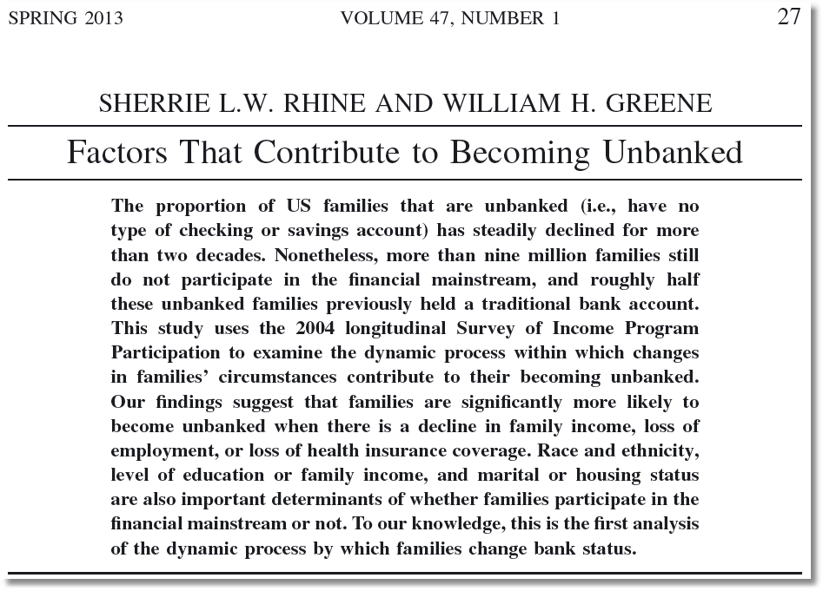

Slide 66
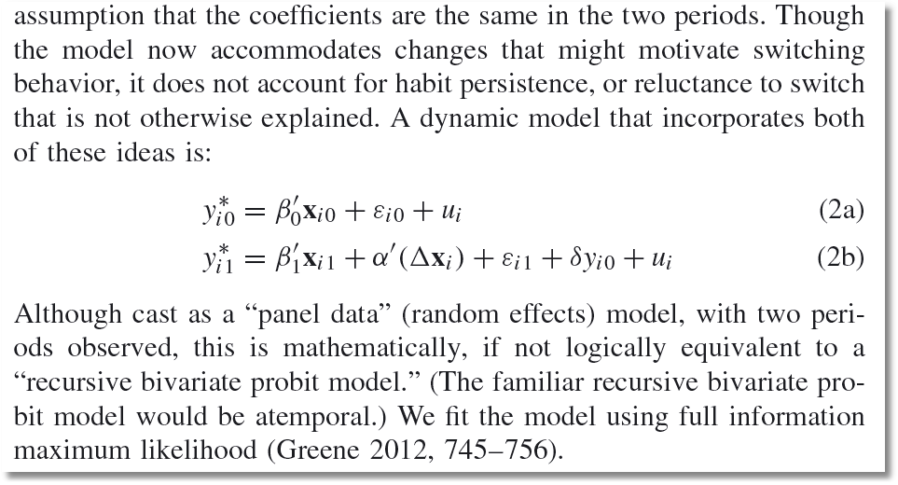

Slide 67
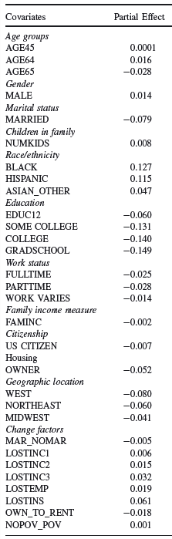


Slide 68
The Multivariate Probit Model

Slide 69
MLE: Simulation
Estimation of the multivariate probit model requires evaluation of M-order Integrals
The general case is usually handled with the GHK simulator. Much current research focuses on efficiency (speed) gains in this computation.
The “Panel Probit Model” is a special case.
  (Bertschek-Lechner, JE, 1999) – Construct a GMM estimator using only first order integrals of the univariate normal CDF
  (Greene, Emp.Econ, 2003) – Estimate the integrals with simulation (GHK) anyway.

Slide 70
----------------------------------------------------------------------
Multivariate Probit Model: 3 equations.
Dependent variable MVProbit
Log likelihood function -4751.09039
--------+-------------------------------------------------------------
Variable| Coefficient Standard Error b/St.Er. P[|Z|>z] Mean of X
--------+-------------------------------------------------------------
|Index function for DOCTOR
Constant| -.35527** .16715 -2.125 .0335 [-0.29987 .16195]
AGE| .01664*** .00194 8.565 .0000 43.9959 [ 0.01644 .00193]
FEMALE| .30931*** .04812 6.427 .0000 .47935 [ 0.30643 .04767]
EDUC| -.01566 .01024 -1.530 .1261 11.0909 [-0.01936 .00962]
MARRIED| -.04487 .05112 -.878 .3801 .78911 [-0.04423 .05139]
WORKING| -.14712*** .05075 -2.899 .0037 .63345 [-0.15390 .05054]
|Index function for HOSPITAL
Constant| -1.61787*** .15729 -10.286 .0000 [-1.58276 .16119]
AGE| .00717** .00283 2.536 .0112 43.9959 [ 0.00662 .00288]
FEMALE| -.00039 .05995 -.007 .9948 .47935 [-0.00407 .05991]
HHNINC| -.41050 .25147 -1.632 .1026 .29688 [-0.41080 .22891]
HHKIDS| -.01547 .06551 -.236 .8134 .44915 [-0.03688 .06615]
|Index function for PUBLIC
Constant| 1.51314*** .18608 8.132 .0000 [ 1.53542 .17060]
AGE| .00661** .00289 2.287 .0222 43.9959 [ 0.00646 .00268]
HSAT| -.06844*** .01385 -4.941 .0000 6.90062 [-0.07069 .01266]
MARRIED| -.00859 .06892 -.125 .9008 .78911 [-.00813 .06908]
|Correlation coefficients
R(01,02)| .28381*** .03833 7.404 .0000 [ was 0.29611 ]
R(01,03)| .03509 .03768 .931 .3517
R(02,03)| -.04100 .04831 -.849 .3960
--------+-------------------------------------------------------------

Slide 71
Partial Effects
There are M equations: “Effect of what on what?”
NLOGIT computes E[y1|all other ys, all xs]
Marginal effects are derivatives of this with respect to all xs. (EXTREMELY MESSY)
Standard errors are estimated with bootstrapping.

Slide 72
Appendix
Tetrachoric Correlation

Slide 73
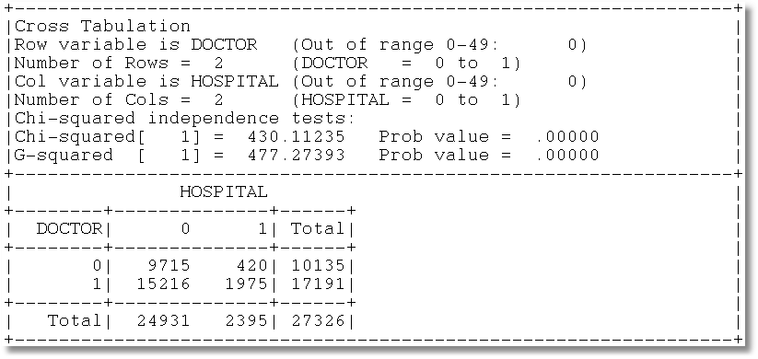
Gross Relation Between Two Binary Variables
Cross Tabulation Suggests Presence or
Absence of a Bivariate Relationship

Slide 74
Tetrachoric Correlation

Slide 75
Log Likelihood Function

Slide 76
Estimation
+---------------------------------------------+
| FIML Estimates of Bivariate Probit Model |
| Maximum Likelihood Estimates |
| Dependent variable DOCHOS |
| Weighting variable None |
| Number of observations 27326 |
| Log likelihood function -25898.27 |
| Number of parameters 3 |
+---------------------------------------------+
+---------+--------------+----------------+--------+---------+
|Variable | Coefficient | Standard Error |b/St.Er.|P[|Z|>z] |
+---------+--------------+----------------+--------+---------+
Index equation for DOCTOR
Constant .32949128 .00773326 42.607 .0000
Index equation for HOSPITAL
Constant -1.35539755 .01074410 -126.153 .0000
Tetrachoric Correlation between DOCTOR and HOSPITAL
RHO(1,2) .31105965 .01357302 22.918 .0000

