Slide 1




Microeconometric Modeling
William Greene
Stern School of Business
New York University
New York NY USA
3.1 Models for Ordered
Choices

Slide 2

Concepts
Models
Ordered Choice
Subjective Well Being
Health Satisfaction
Random Utility
Fit Measures
Normalization
Threshold Values (Cutpoints0
Differential Item Functioning
Anchoring Vignette
Panel Data
Incidental Parameters Problem
Attrition Bias
Inverse Probability Weighting
Transition Matrix
Ordered Probit and Logit
Generalized Ordered Probit
Hierarchical Ordered Probit
Vignettes
Fixed and Random Effects OPM
Dynamic Ordered Probit
Sample Selection OPM

Slide 3
Ordered Discrete Outcomes
E.g.: Taste test, credit rating, course grade, preference scale
Underlying random preferences:
  Existence of an underlying continuous preference scale
  Mapping to observed choices
Strength of preferences is reflected in the discrete outcome
Censoring and discrete measurement
The nature of ordered data

Slide 4

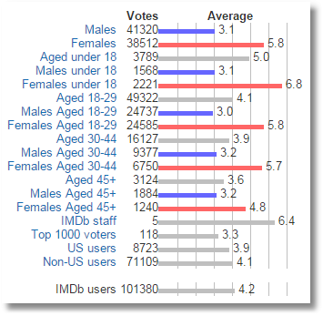
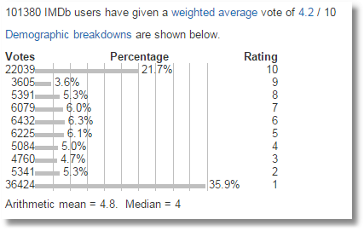
Ordered Choices at IMDb

Slide 5
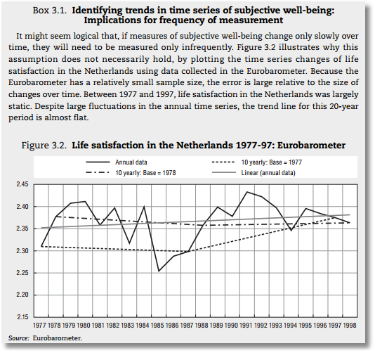


Slide 6
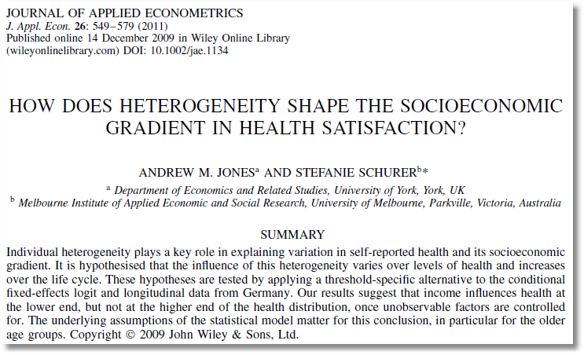

Slide 7
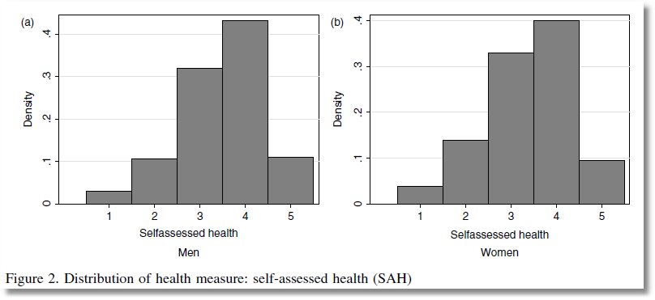
This study analyzes ‘self assessed health’ coded
1,2,3,4,5 = very low, low, med, high very high

Slide 8

Health Satisfaction (HSAT)
Self administered survey: Health Care Satisfaction (0 – 10)
Continuous Preference Scale

Slide 9
Modeling Ordered Choices
Random Utility (allowing a panel data setting)
Uit = α + β’xit + ε_{it}
= a_{it} + ε_{it}
Observe outcome j if utility is in region j
Probability of outcome = probability of cell
Pr[Yit=j] = F(μ_{j} – a_{it}) - F(μ_{j-1} – a_{it})

Slide 10
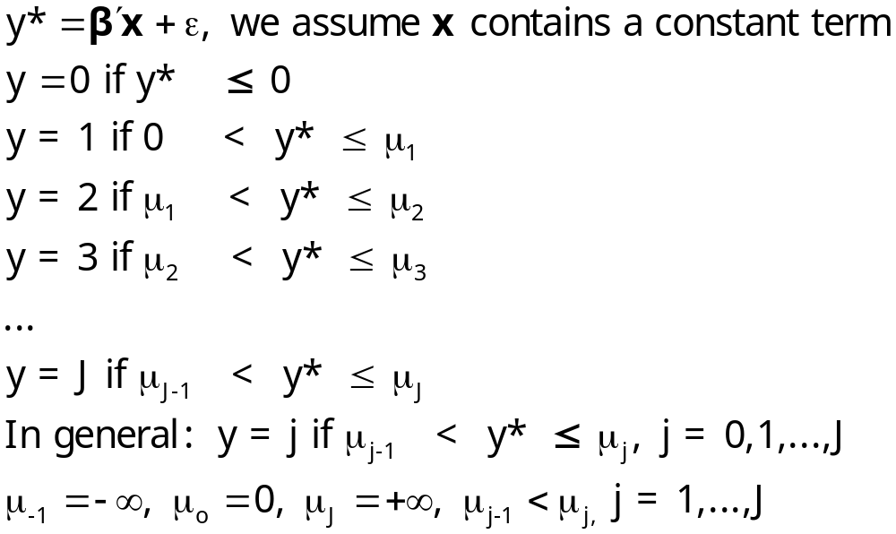
Ordered Probability Model

Slide 11

Combined Outcomes for Health Satisfaction
(0,1,2) (3,4,5) (6,7,8) (9) (10)

Slide 12
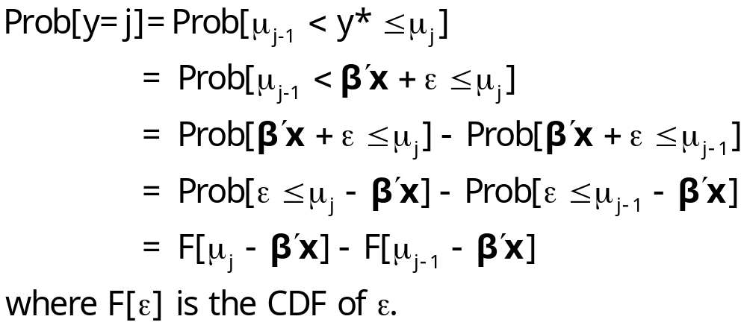
Ordered Probabilities

Slide 13
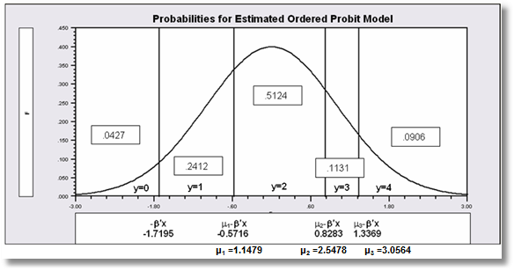

Slide 14
Different Normalizations
NLOGIT
  Y = 0,1,…,J, U* = α + β’x + ε
  One overall constant term, α
  J-1 “cutpoints;” μ₋₁ = -∞, μ₀ = 0, μ₁,… μ_{J-1}, μ_{J} = + ∞
Stata
  Y = 1,…,J+1, U* = β’x + ε
  No overall constant, α=0
  J “cutpoints;” μ₀ = -∞, μ₁,… μ_{J}, μ_{J+1} = + ∞

Slide 15
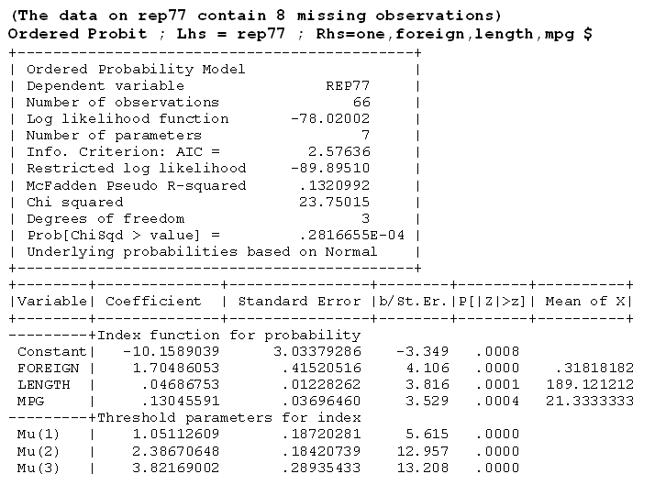



Slide 16
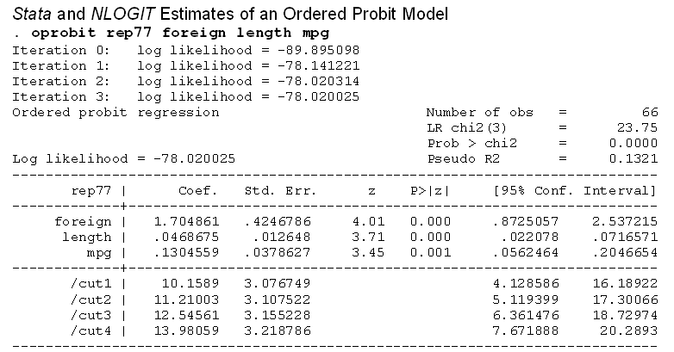



Slide 17
--------+--------------------------------------------------------------------
| Standard Prob. 95% Confidence
HLTHSAT| Coefficient Error z |z|>Z* Interval
--------+--------------------------------------------------------------------
|Index function for probability......................................
Constant| 1.96417*** .11905 16.50 .0000 1.73084 2.19751
FEMALE| .01223 .03250 .38 .7066 -.05146 .07593
EDUC| .03667*** .00717 5.11 .0000 .02261 .05073
AGE| -.01846*** .00154 -11.98 .0000 -.02148 -.01544
INCOME| .24009** .10103 2.38 .0175 .04208 .43809
HHKIDS| .04975 .03525 1.41 .1582 -.01934 .11884
|Threshold parameters for index......................................
Mu(01)| 1.14847*** .02116 54.28 .0000 1.10700 1.18994
Mu(02)| 2.54775*** .02162 117.86 .0000 2.50539 2.59012
Mu(03)| 3.05625*** .02646 115.50 .0000 3.00439 3.10811
As reported by Stata
--------+--------------------------------------------------------------------
|Index function for probability......................................
FEMALE| .01223 .03250 .38 .7066 -.05146 .07593
EDUC| .03667*** .00717 5.11 .0000 .02261 .05073
AGE| -.01846*** .00154 -11.98 .0000 -.02148 -.01544
INCOME| .24009** .10103 2.38 .0175 .04208 .43809
HHKIDS| .04975 .03525 1.41 .1582 -.01934 .11884
|Threshold parameters for index model................................
/Cut(1)| -1.96417*** .11905 -16.50 .0000 -2.19751 -1.73084
/Cut(2)| -.81570*** .11956 -6.82 .0000 -1.05004 -.58136
/Cut(3)| .58358*** .12079 4.83 .0000 .34684 .82033
/Cut(4)| 1.09208*** .12112 9.02 .0000 .85468 1.32947
Hypothesis tests about threshold values are not meaningful.

Slide 18
Analysis of Model Implications
Partial Effects
Fit Measures
Predicted Probabilities
  Averaged: They match sample proportions.
  By observation
  Segments of the sample
  Related to particular variables

Slide 19
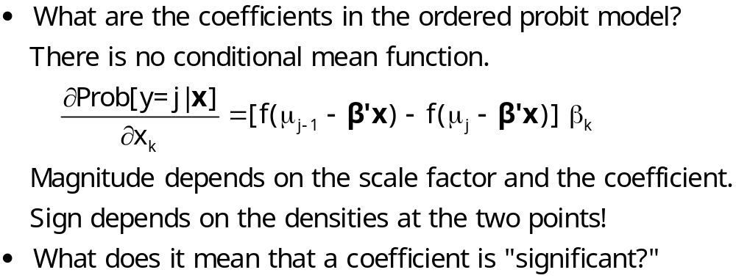
Coefficients

Slide 20
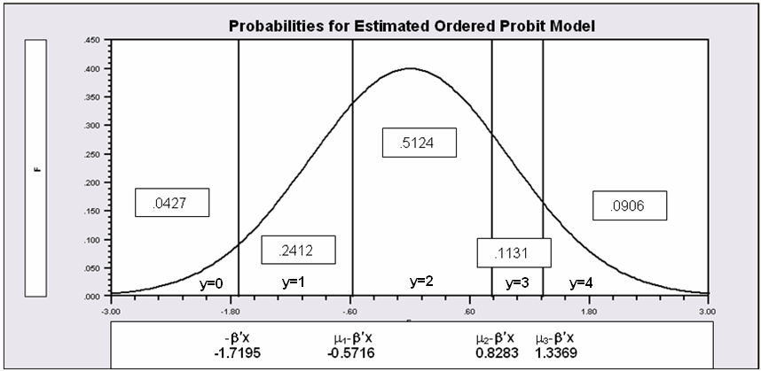
Partial Effects in the Ordered Choice Model
Assume the β_{k} is positive.
Assume that x_{k} increases.
β’x increases. μ_{j}- β’x shifts to the left for all 5 cells.
Prob[y=0] decreases
Prob[y=1] decreases – the mass shifted out is larger than the mass shifted in.
Prob[y=3] increases – same reason in reverse.
Prob[y=4] must increase.
When β_{k} > 0, increase in x_{k} decreases Prob[y=0] and increases Prob[y=J]. Intermediate cells are ambiguous, but there is only one sign change in the marginal effects from 0 to 1 to … to J

Slide 21
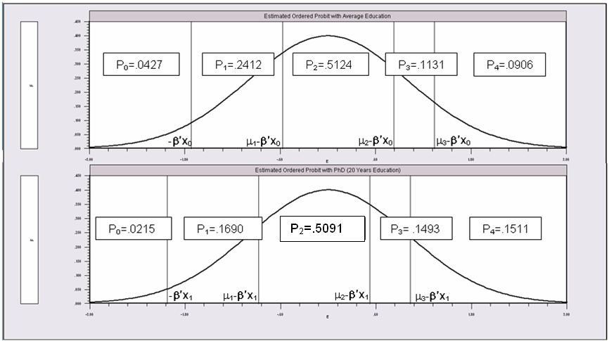
Partial Effects of 8 Years of Education

Slide 22
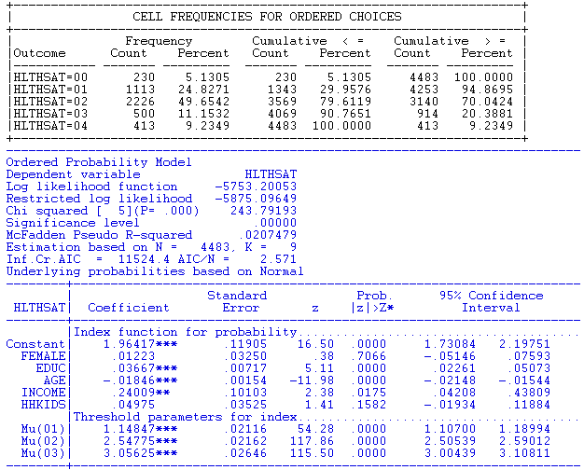
An Ordered Probability
Model for Health Satisfaction

Slide 23
Ordered Probability Partial Effects
-----------------------------------------------------------------------------
Marginal effects for ordered probability model
M.E.s for dummy variables are Pr[y|x=1]-Pr[y|x=0]
Names for dummy variables are marked by *.
--------+--------------------------------------------------------------------
| Partial Prob. 95% Confidence
HLTHSAT| Effect Elasticity z |z|>Z* Interval
--------+--------------------------------------------------------------------
|--------------[Partial effects on Prob[Y=00] at means]--------------
*FEMALE| -.00117 -.02600 -.38 .7065 -.00726 .00492
EDUC| -.00351*** -.89008 -5.04 .0000 -.00488 -.00215
AGE| .00177*** 1.70456 11.15 .0000 .00146 .00208
INCOME| -.02298** -.17806 -2.37 .0178 -.04199 -.00398
*HHKIDS| -.00472 -.10470 -1.42 .1545 -.01121 .00177
|--------------[Partial effects on Prob[Y=01] at means]--------------
...
|--------------[Partial effects on Prob[Y=02] at means]--------------
...
|--------------[Partial effects on Prob[Y=03] at means]--------------
*FEMALE| .00146 .01323 .38 .7067 -.00614 .00906
EDUC| .00437*** .45292 4.82 .0000 .00259 .00615
AGE| -.00220*** -.86738 -9.36 .0000 -.00266 -.00174
INCOME| .02863** .09061 2.35 .0189 .00473 .05254
*HHKIDS| .00594 .05386 1.40 .1607 -.00236 .01424
|--------------[Partial effects on Prob[Y=04] at means]--------------
*FEMALE| .00192 .02209 .38 .7067 -.00808 .01191
EDUC| .00575*** .75573 5.05 .0000 .00352 .00798
AGE| -.00289*** -1.44727 -11.11 .0000 -.00341 -.00238
INCOME| .03764** .15118 2.37 .0178 .00651 .06878
*HHKIDS| .00786 .09053 1.40 .1618 -.00315 .01888
--------+--------------------------------------------------------------------
z, prob values and confidence intervals are given for the partial effect
***, **, * ==> Significance at 1%, 5%, 10% level.

Slide 24
Partial Effects at Means vs. Average Partial Effects
-----------------------------------------------------------------------------
Marginal effects for ordered probability model
M.E.s for dummy variables are Pr[y|x=1]-Pr[y|x=0]
Names for dummy variables are marked by *.
[Partial effects on Prob[Y=j] at means]
--------+--------------------------------------------------------------------
| Partial Prob. 95% Confidence
HLTHSAT| Effect Elasticity z |z|>Z* Interval
--------+--------------------------------------------------------------------
*FEMALE| -.00117 -.02600 -.38 .7065 -.00726 .00492
*FEMALE| -.00304 -.01232 -.38 .7066 -.01890 .01281
*FEMALE| .00084 .00164 .38 .7065 -.00352 .00520
*FEMALE| .00146 .01323 .38 .7067 -.00614 .00906
*FEMALE| .00192 .02209 .38 .7067 -.00808 .01191
---------------------------------------------------------------------
Partial Effects Analysis for Ordered Probit Prob[Y =All]
Effects on function with respect to FEMALE
Results are computed by average over sample observations
Partial effects for binary var FEMALE computed by first difference
---------------------------------------------------------------------
df/dFEMALE Partial Standard
(Delta Method) Effect Error |t| 95% Confidence Interval
---------------------------------------------------------------------
APE Prob(y= 0) -.00124 .00329 .38 -.00768 .00521
APE Prob(y= 1) -.00288 .00765 .38 -.01788 .01212
APE Prob(y= 2) .00077 .00204 .38 -.00323 .00477
APE Prob(y= 3) .00138 .00367 .38 -.00581 .00857
APE Prob(y= 4) .00197 .00524 .38 -.00829 .01223

Slide 25
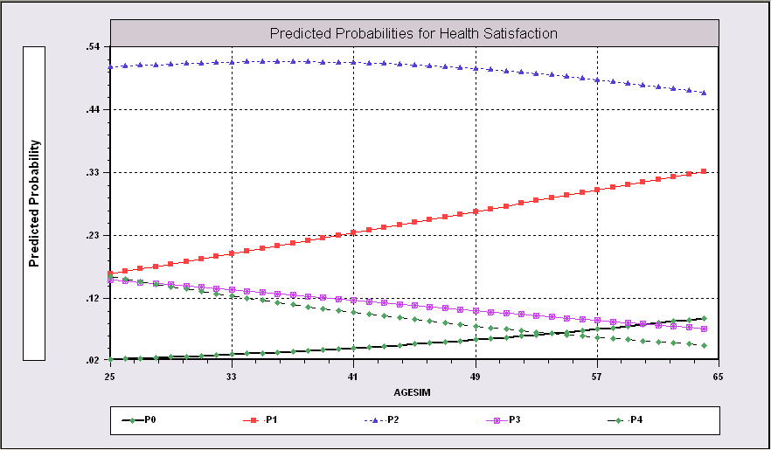
Predictions from the Model Related to Age

Slide 26
Fit Measures
There is no single “dependent variable” to explain.
There is no sum of squares or other measure of “variation” to explain.
Predictions of the model relate to a set of J+1 probabilities, not a single variable.
How to explain fit?
  Based on the underlying regression
  Based on the likelihood function
  Based on prediction of the outcome variable

Slide 27
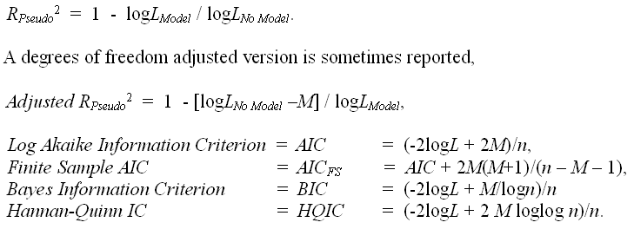
Log Likelihood Based Fit Measures

Slide 28
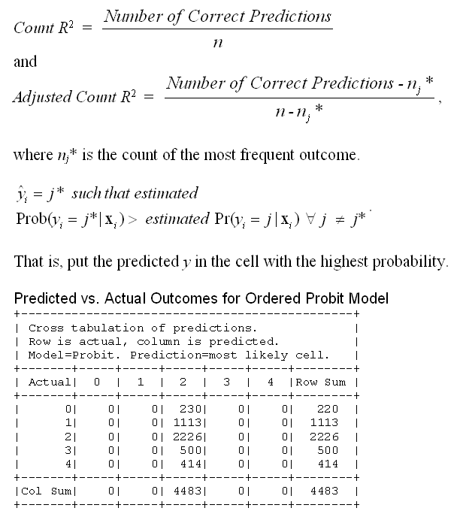

Slide 29
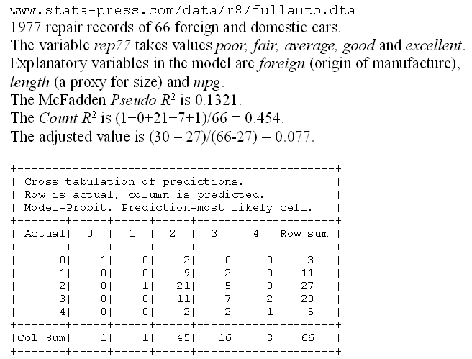
A Somewhat Better Fit

Slide 30
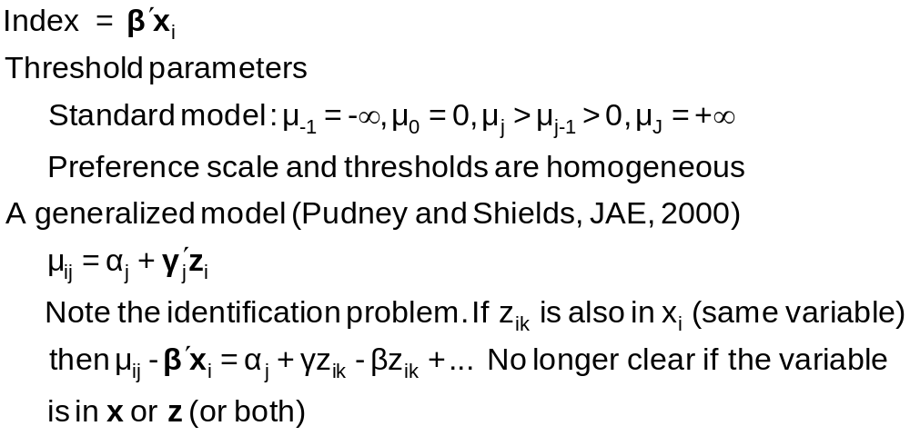
Generalizing the Ordered Probit with Heterogeneous Thresholds

Slide 31
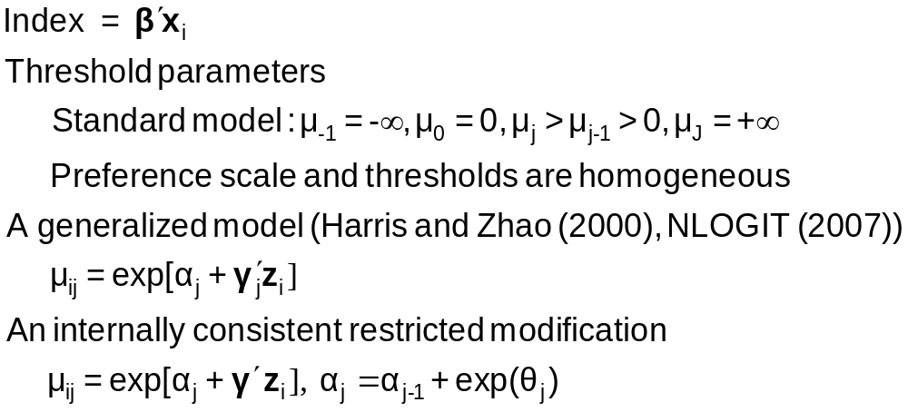
Hierarchical Ordered Probit

Slide 32
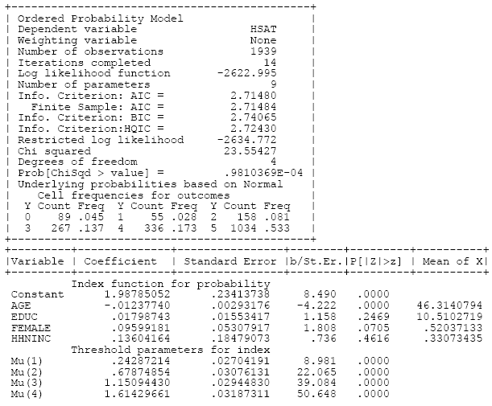
Ordered Choice Model

Slide 33
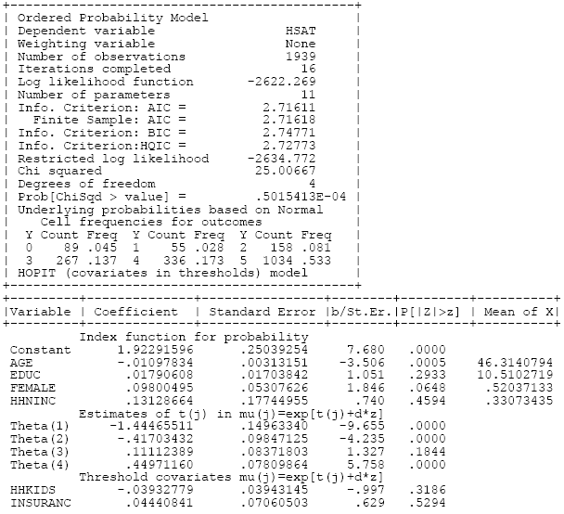
HOPit Model

Slide 34
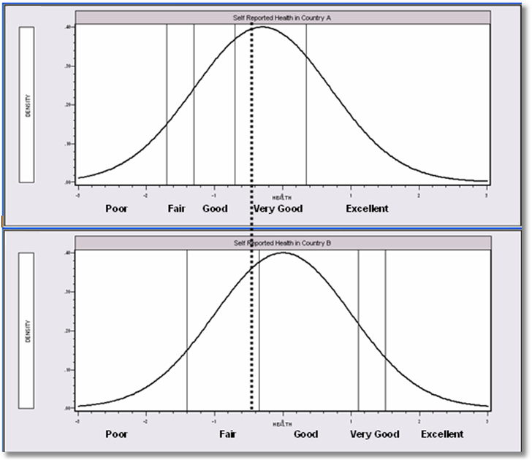
Differential Item Functioning

Slide 35


Slide 36
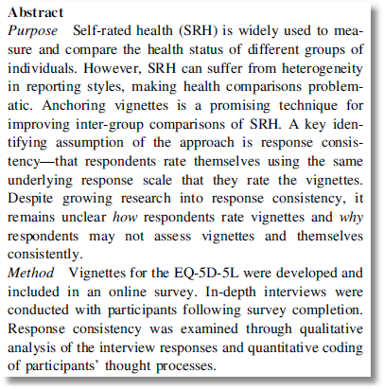

Slide 37
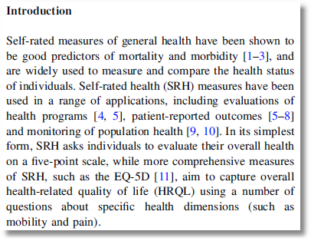

Slide 38
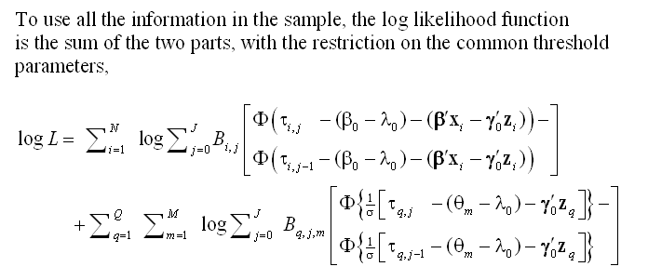
A Vignette Random Effects Model

Slide 39
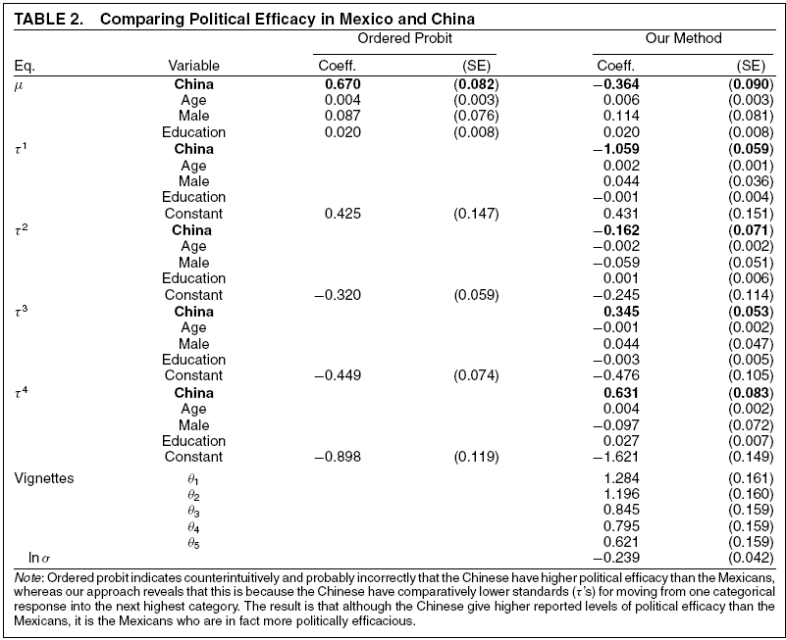
Vignettes

Slide 40
Panel Data
Fixed Effects
  The usual incidental parameters problem
  Partitioning Prob(y_{it} > j|x_{it}) produces estimable binomial logit models. (Find a way to combine multiple estimates of the same β.
Random Effects
  Standard application
  Extension to random parameters
Dynamics
Attrition

Slide 41
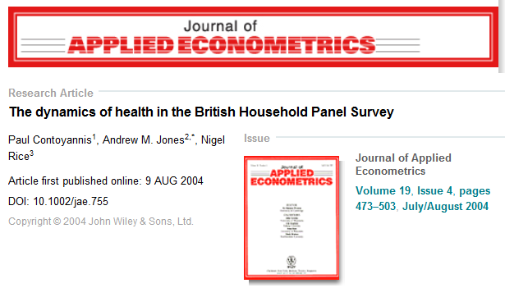
A Study of Health Status in the Presence of Attrition

Slide 42
Model for Self Assessed Health
British Household Panel Survey (BHPS)
  Waves 1-8, 1991-1998
  Self assessed health on 0,1,2,3,4 scale
  Sociological and demographic covariates
  Dynamics – inertia in reporting of top scale
Dynamic ordered probit model
  Balanced panel – analyze dynamics
  Unbalanced panel – examine attrition

Slide 43
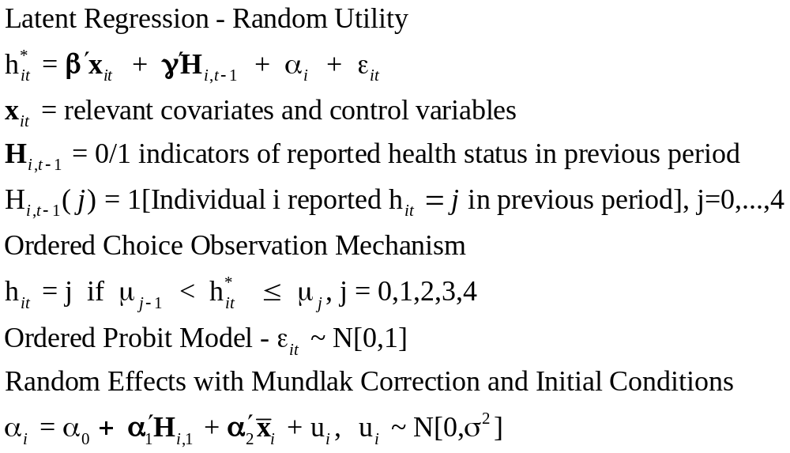
Dynamic Ordered Probit Model
It would not be appropriate to include h_{i,t-1} itself in the model as this is a label, not a measure

Slide 44
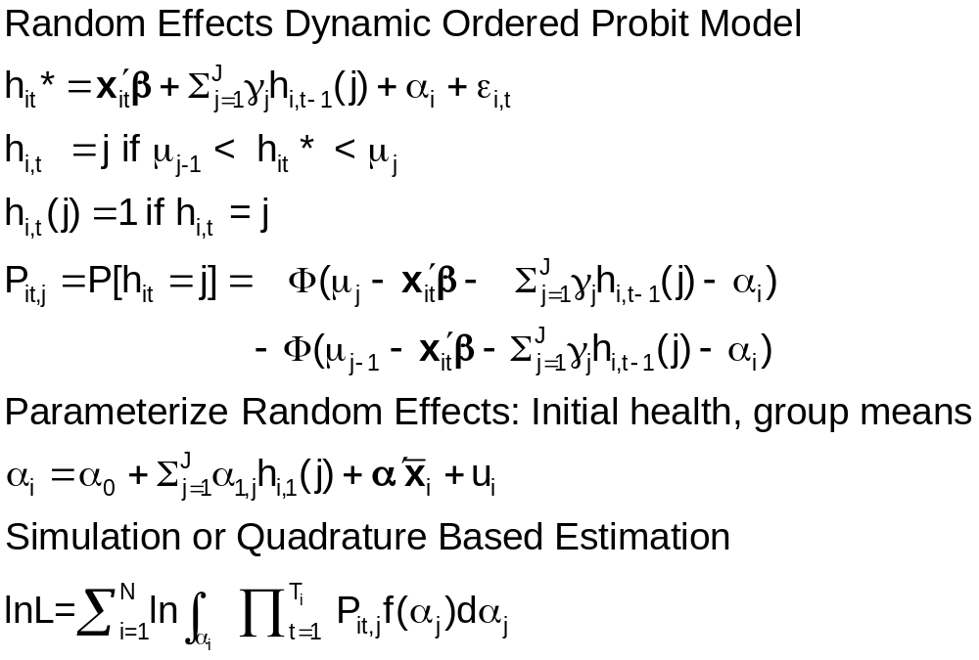
Random Effects Dynamic Ordered Probit Model

Slide 45
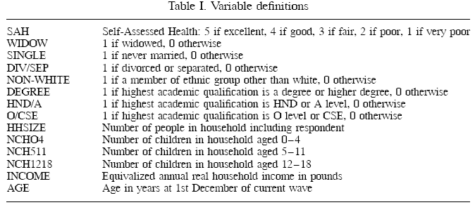
Data

Slide 46
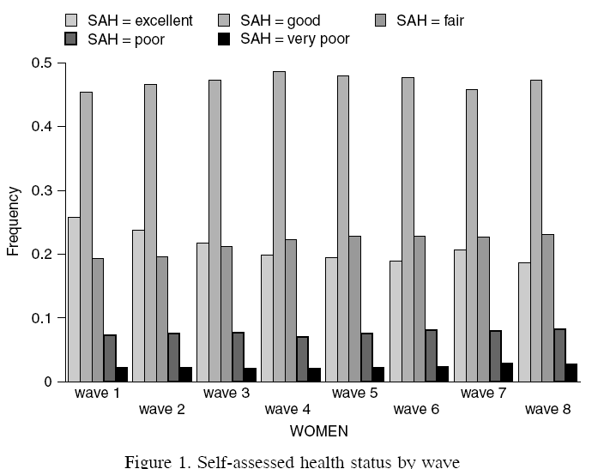
Variable of Interest

Slide 47
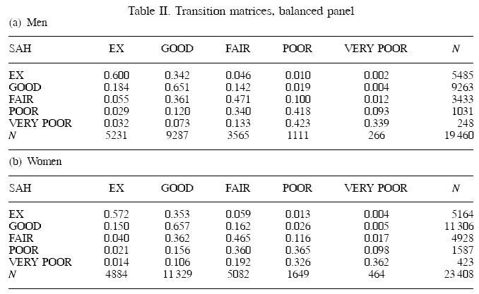
Dynamics

Slide 48
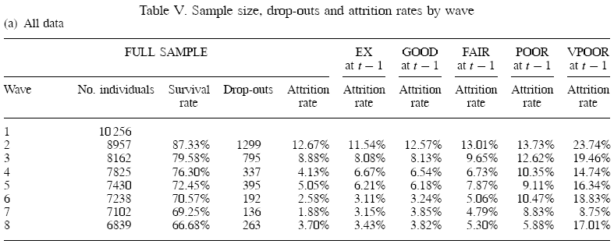
Attrition

Slide 49
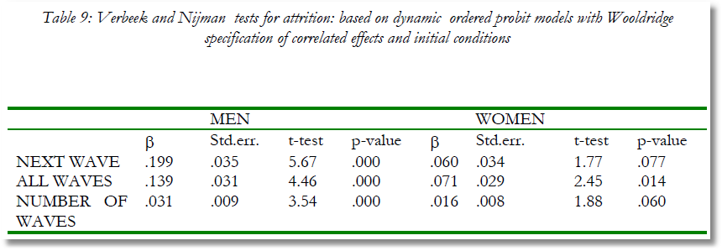
Testing for Attrition Bias
Three dummy variables added to full model with unbalanced panel suggest presence of attrition effects.

Slide 50
Probability Weighting Estimators
A Patch for Attrition
(1) Fit a participation probit equation for each wave.
(2) Compute p(i,t) = predictions of participation for each individual in each period.
  Special assumptions needed to make this work
Ignore common effects and fit a weighted pooled log likelihood: Σ_{i} Σ_{t} [d_{it}/p(i,t)]logLP_{it}.

Slide 51

Attrition Model with IP Weights
Assumes (1) Prob(attrition|all data) = Prob(attrition|selected variables) (ignorability)
(2) Attrition is an ‘absorbing state.’ No reentry.
Obviously not true for the GSOEP data above.
Can deal with point (2) by isolating a subsample of those present at wave 1 and the monotonically shrinking subsample as the waves progress.

Slide 52

Estimated Partial Effects by Model

Slide 53
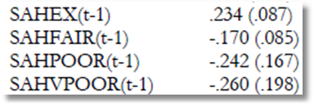
Partial Effect for a Category
These are 4 dummy variables for state in the previous period. Using first differences, the 0.234 estimated for SAHEX means transition from EXCELLENT in the previous period to GOOD in the previous period, where GOOD is the omitted category. Likewise for the other 3 previous state variables. The margin from ‘POOR’ to ‘GOOD’ was not interesting in the paper. The better margin would have been from EXCELLENT to POOR, which would have (EX,POOR) change from (1,0) to (0,1).

Slide 54
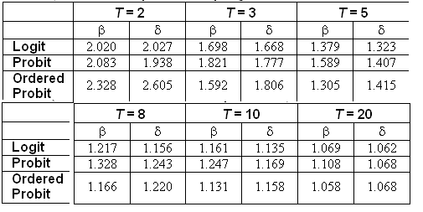
The Incidental Parameters Problem
Table 9.1 Monte Carlo Analysis of the Bias of the MLE in Fixed Effects Discrete Choice Models (Means of empirical sampling distributions, N = 1,000 individuals, R = 200 replications)

Slide 55
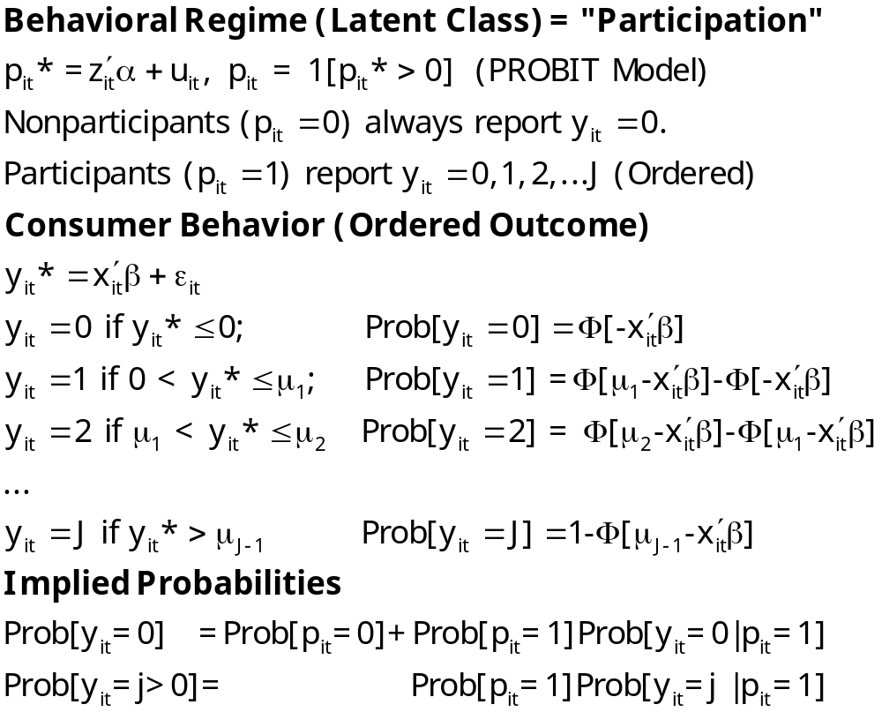
Zero Inflated Ordered Probit

Slide 56
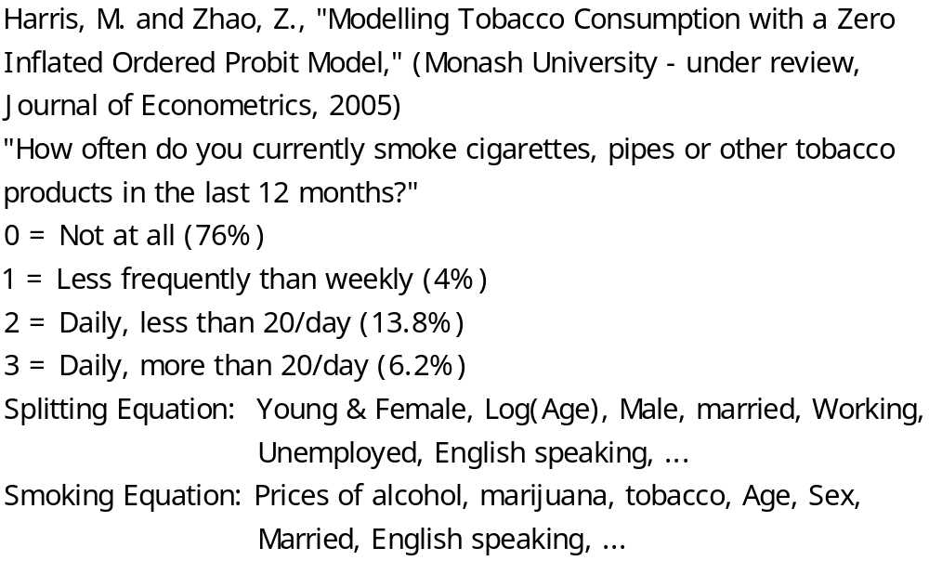
Teenage Smoking

Slide 57
Appendix.
Ordered Choice Model Extensions

Slide 58
Model Extensions
Multivariate
  Bivariate
  Multivariate
Inflation and Two Part
  Zero inflation
  Sample Selection
  Endogenous Latent Class

Slide 59
Generalizing the Ordered Probit with Heterogeneous Thresholds

Slide 60
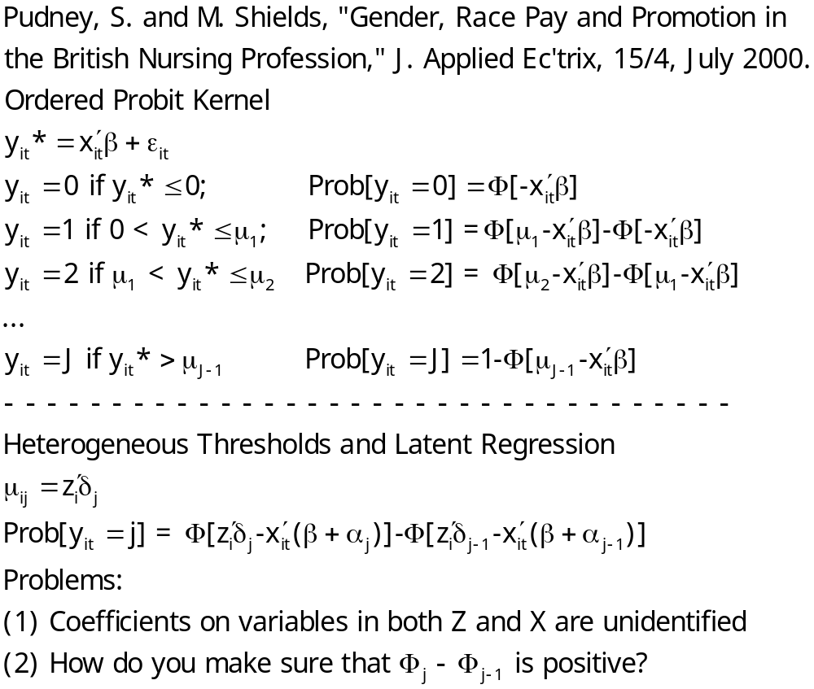
Generalized Ordered Probit-1
Y=Grade (rank)
Z=Sex, Race
X=Experience, Education, Training, History, Marital Status, Age

Slide 61
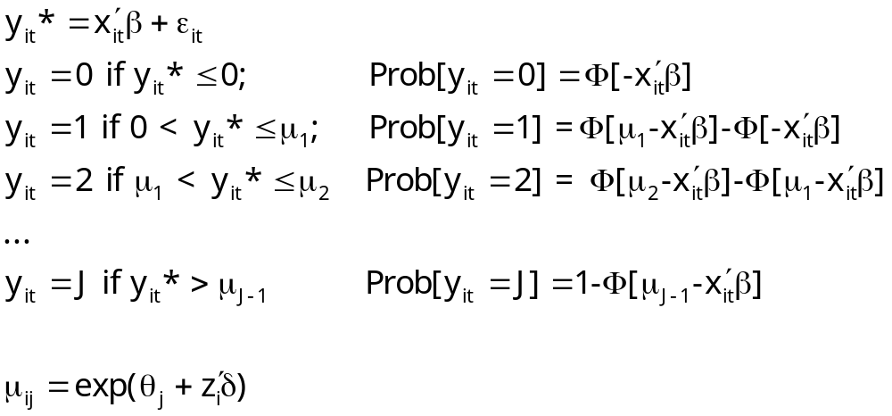
Generalized Ordered Probit-2

Slide 62
A G.O.P Model
+---------+--------------+----------------+--------+---------+----------+
|Variable | Coefficient | Standard Error |b/St.Er.|P[|Z|>z] | Mean of X|
+---------+--------------+----------------+--------+---------+----------+
Index function for probability
Constant 1.73737318 .13231824 13.130 .0000
AGE -.01458121 .00141601 -10.297 .0000 46.7491906
LOGINC .17724352 .03275857 5.411 .0000 -1.23143358
EDUC .03897560 .00780436 4.994 .0000 10.9669624
MARRIED .09391821 .03761091 2.497 .0125 .75458666
Estimates of t(j) in mu(j)=exp[t(j)+d*z]
Theta(1) -1.28275309 .06080268 -21.097 .0000
Theta(2) -.26918032 .03193086 -8.430 .0000
Theta(3) .36377472 .02109406 17.245 .0000
Theta(4) .85818206 .01656304 51.813 .0000
Threshold covariates mu(j)=exp[t(j)+d*z]
FEMALE .00987976 .01802816 .548 .5837
How do we interpret the result for FEMALE?

Slide 63
Hierarchical Ordered Probit

Slide 64
Ordered Choice Model

Slide 65
HOPit Model

Slide 66
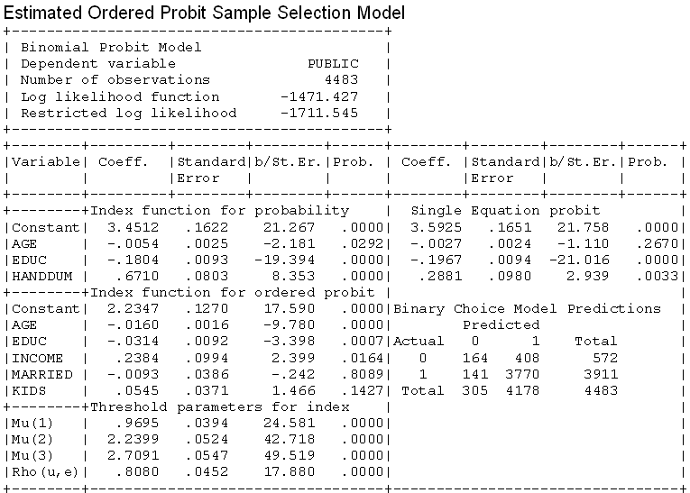
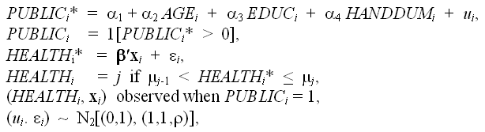
A Sample Selection Model

Slide 67
A Bivariate Latent Class Correlated Generalised Ordered
Probit Model with an Application to Modelling Observed Obesity Levels
William Greene
Stern School of Business, New York University
With Mark Harris, Bruce Hollingsworth, Pushkar Maitra
Monash University
Stern Economics Working Paper 08-18.
http://w4.stern.nyu.edu/emplibrary/ObesityLCGOPpaperReSTAT.pdf
Forthcoming, Economics Letters, 2014
Notes:
67

Slide 68
Obesity
The International Obesity Taskforce (http://www.iotf.org) calls obesity one of the most important medical and public health problems of our time.
Defined as a condition of excess body fat; associated with a large number of debilitating and life-threatening disorders
Health experts argue that given an individual’s height, their weight should lie within a certain range
  Most common measure = Body Mass Index (BMI):
  Weight (Kg)/height(Meters)²
WHO guidelines:
  BMI < 18.5 are underweight
  18.5 < BMI < 25 are normal
  25 < BMI < 30 are overweight
  BMI > 30 are obese
Around 300 million people worldwide are obese, a figure likely to rise
Notes:
68

Slide 69
Models for BMI
Simple Regression Approach Based on Actual BMI:
BMI* = β′x + ε, ε ~ N[0,σ²]
No accommodation of heterogeneity
Rigid measurement by the guidelines
Interval Censored Regression Approach
WT = 0 if BMI* < 25 Normal 1 if 25 < BMI* < 30 Overweight 2 if BMI* > 30 Obese 3 (Not used)
Inadequate accommodation of heterogeneity
Inflexible reliance on WHO classification
Notes:
69

Slide 70
An Ordered Probit Approach
A Latent Regression Model for “True BMI”
BMI* = β′x + ε, ε ~ N[0,σ²], σ² = 1
“True BMI” = a proxy for weight is
unobserved
Observation Mechanism for Weight Type
WT = 0 if BMI* < 0 Normal
1 if 0 < BMI* < μ Overweight
2 if BMI* > μ Obese
Notes:
70

Slide 71
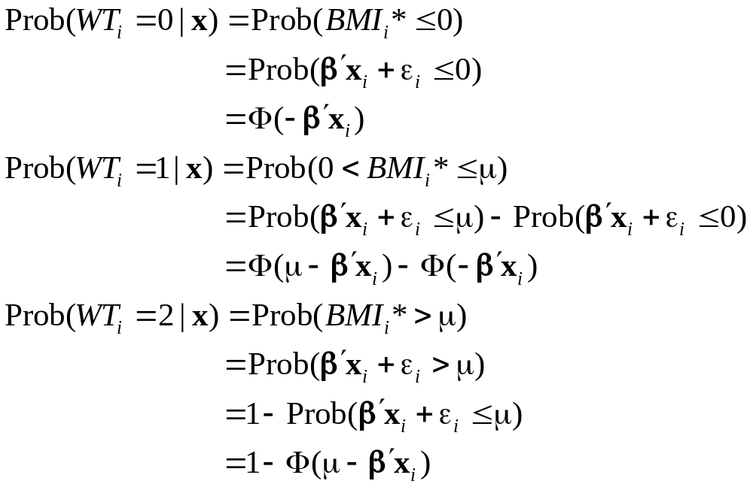
A Basic Ordered Probit Model
Notes:
71

Slide 72
Latent Class Modeling
Irrespective of observed weight category, individuals can be thought of being in one of several ‘types’ or ‘classes. e.g. an obese individual may be so due to genetic reasons or due to lifestyle factors
These distinct sets of individuals likely to have differing reactions to various policy tools and/or characteristics
The observer does not know from the data which class an individual is in.
Suggests use of a latent class approach
  Growing use in explaining health outcomes (Deb and Trivedi, 2002, and Bago d’Uva, 2005)
Notes:
72

Slide 73
A Latent Class Model
For modeling purposes, class membership is distributed with a discrete distribution,
Prob(individual i is a member of class = c)
= π_{ic} = π_{c}
Prob(WT_{i} = j | x_{i})
= Σ_{c} Prob(WT_{i} = j | x_{i},class = c)Prob(class = c).
Notes:
73

Slide 74
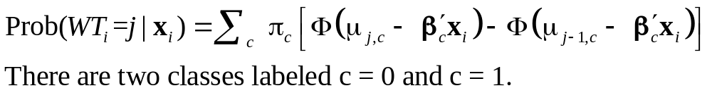
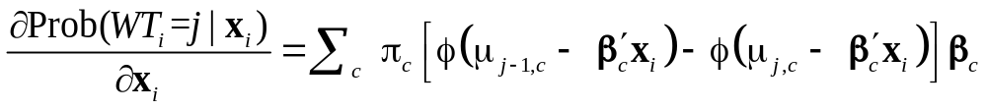
Probabilities in the Latent Class Model
Notes:
74

Slide 75
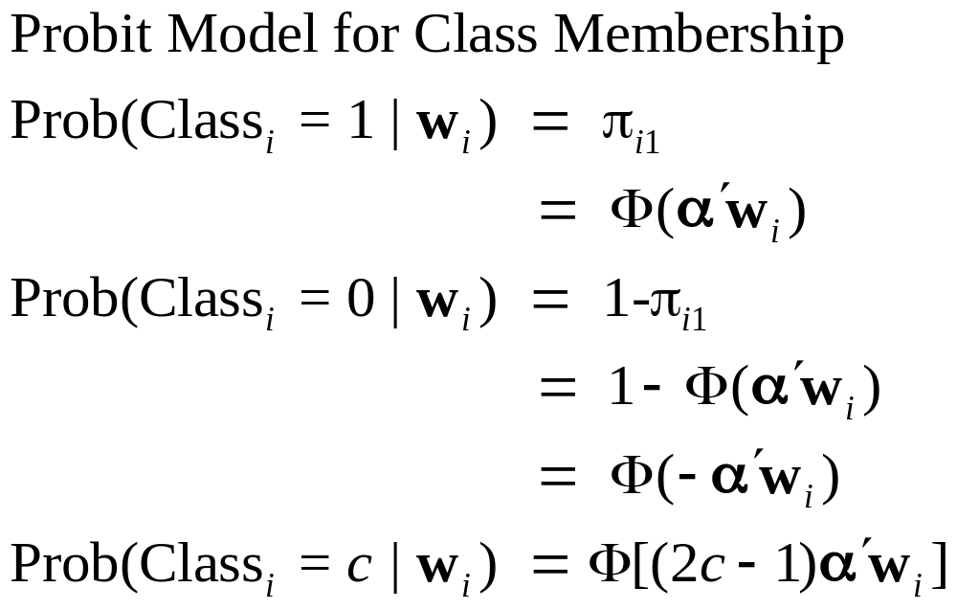
Class Assignment
Class membership may relate to demographics such as age and sex.
Notes:
75

Slide 76
Inflated Responses in Self-Assessed Health
Mark Harris
Department of Economics, Curtin University
Bruce Hollingsworth
Department of Economics, Lancaster University
William Greene
Stern School of Business, New York University

Slide 77
SAH vs. Objective Health Measures
Favorable SAH categories seem artificially high.
• 60% of Australians are either overweight or obese (Dunstan et. al, 2001)
• 1 in 4 Australians has either diabetes or a condition of impaired glucose metabolism
• Over 50% of the population has elevated cholesterol
• Over 50% has at least 1 of the “deadly quartet” of health conditions
(diabetes, obesity, high blood pressure, high cholestrol)
• Nearly 4 out of 5 Australians have 1 or more long term health conditions
(National Health Survey, Australian Bureau of Statistics 2006)
• Australia ranked #1 in terms of obesity rates
Similar results appear to appear for other countries

Slide 78
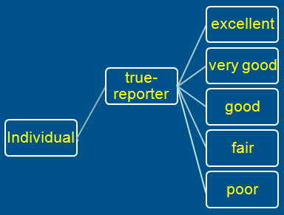
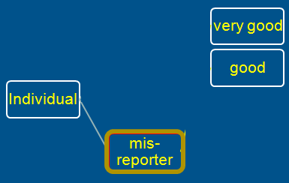
A Two Class Latent Class Model
True Reporter
Misreporter

Slide 79
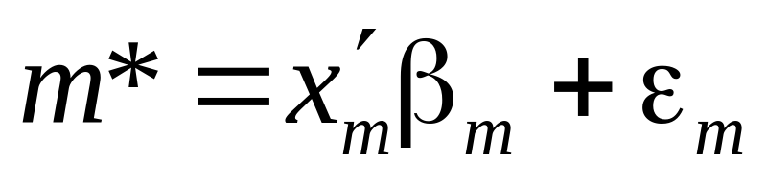
Mis-reporters choose either good or very good
The response is determined by a probit model
Y=3
Y=2

Slide 80

Y=4
Y=3
Y=2
Y=1
Y=0

Slide 81

Observed Mixture of Two Classes

Slide 82

Pr(true,y) = Pr(true) * Pr(y | true)

Slide 83


Slide 84


Slide 85
General Result

