Slide 1




Microeconometric Modeling
William Greene
Stern School of Business
New York University
New York NY USA
3.2 Models for Count Data

Slide 2
Concepts
Models
Count Data
Loglinear Model
Partial Effects
Overdispersion
Frailty/Heterogeneity
Nonlinear Least Squares
Maximum Likelihood
Vuong Statistic
Zero Inflation Model
2 Part Model
Adverse Selection
Moral Hazard
Participation Equation
Normal Mixture
Poisson Regression
Negative Binomial Regression
Normal-Poisson Model
NegBin2
NegBinP
ZIP and ZINB
Hurdle Model
Fixed Effects
Random Effects
Bivariate Random Effects Model

Slide 3
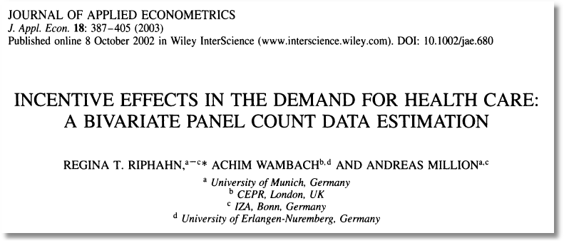

Slide 4

Doctor Visits

Slide 5
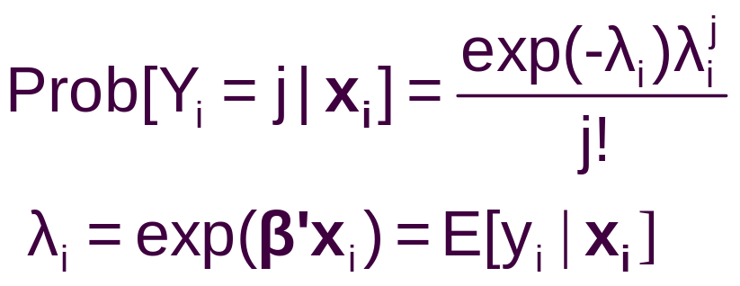
Basic Modeling for Counts of Events
E.g., Visits to recreation site, number of purchases, number of doctor visits, number of patents
Regression approach
  Quantitative outcome measured
  Discrete variable, model probabilities
Poisson probabilities – “loglinear model”

Slide 6
A Poisson Model for Doctor Visits
----------------------------------------------------------------------
Poisson Regression
Dependent variable DOCVIS
Log likelihood function -103727.29625
Restricted log likelihood -108662.13583
Chi squared [ 6 d.f.] 9869.67916
Significance level .00000
McFadden Pseudo R-squared .0454145
Estimation based on N = 27326, K = 7
Information Criteria: Normalization=1/N
Normalized Unnormalized
AIC 7.59235 207468.59251
Chi- squared =255127.59573 RsqP= .0818
G - squared =154416.01169 RsqD= .0601
Overdispersion tests: g=mu(i) : 20.974
Overdispersion tests: g=mu(i)^2: 20.943
--------+-------------------------------------------------------------
Variable| Coefficient Standard Error b/St.Er. P[|Z|>z] Mean of X
--------+-------------------------------------------------------------
Constant| .77267*** .02814 27.463 .0000
AGE| .01763*** .00035 50.894 .0000 43.5257
EDUC| -.02981*** .00175 -17.075 .0000 11.3206
FEMALE| .29287*** .00702 41.731 .0000 .47877
MARRIED| .00964 .00874 1.103 .2702 .75862
HHNINC| -.52229*** .02259 -23.121 .0000 .35208
HHKIDS| -.16032*** .00840 -19.081 .0000 .40273
--------+-------------------------------------------------------------

Slide 7
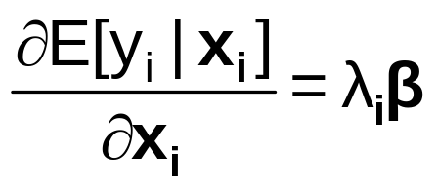
Partial Effects
----------------------------------------------------------------------
Partial derivatives of expected val. with
respect to the vector of characteristics.
Effects are averaged over individuals.
Observations used for means are All Obs.
Conditional Mean at Sample Point 3.1835
Scale Factor for Marginal Effects 3.1835
--------+-------------------------------------------------------------
Variable| Coefficient Standard Error b/St.Er. P[|Z|>z] Mean of X
--------+-------------------------------------------------------------
AGE| .05613*** .00131 42.991 .0000 43.5257
EDUC| -.09490*** .00596 -15.923 .0000 11.3206
FEMALE| .93237*** .02555 36.491 .0000 .47877
MARRIED| .03069 .02945 1.042 .2973 .75862
HHNINC| -1.66271*** .07803 -21.308 .0000 .35208
HHKIDS| -.51037*** .02879 -17.730 .0000 .40273
--------+-------------------------------------------------------------

Slide 8
Poisson Model Specification Issues
Equi-Dispersion: Var[y_{i}|x_{i}] = E[y_{i}|x_{i}].
Overdispersion: If λ_{i} = exp[β’x_{i} + ε_{i}],
  E[y_{i}|x_{i}] = γexp[β’x_{i}]
  Var[y_{i}] > E[y_{i}] (overdispersed)
  ε_{i} ~ log-Gamma ➔ Negative binomial model
  ε_{i} ~ Normal[0,σ²] ➔ Normal-mixture model
  ε_{i} is viewed as unobserved heterogeneity (“frailty”).
    Normal model may be more natural.
    Estimation is a bit more complicated.

Slide 9
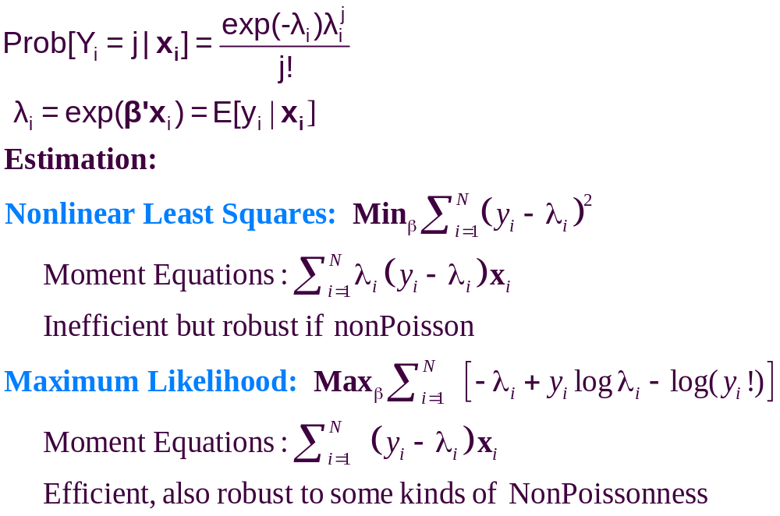

Slide 10
Poisson Model for Doctor Visits
----------------------------------------------------------------------
Poisson Regression
Dependent variable DOCVIS
Log likelihood function -103727.29625
Restricted log likelihood -108662.13583
Chi squared [ 6 d.f.] 9869.67916
Significance level .00000
McFadden Pseudo R-squared .0454145
Estimation based on N = 27326, K = 7
Information Criteria: Normalization=1/N
Normalized Unnormalized
AIC 7.59235 207468.59251
Chi- squared =255127.59573 RsqP= .0818
G - squared =154416.01169 RsqD= .0601
Overdispersion tests: g=mu(i) : 20.974
Overdispersion tests: g=mu(i)^2: 20.943
--------+-------------------------------------------------------------
Variable| Coefficient Standard Error b/St.Er. P[|Z|>z] Mean of X
--------+-------------------------------------------------------------
Constant| .77267*** .02814 27.463 .0000
AGE| .01763*** .00035 50.894 .0000 43.5257
EDUC| -.02981*** .00175 -17.075 .0000 11.3206
FEMALE| .29287*** .00702 41.731 .0000 .47877
MARRIED| .00964 .00874 1.103 .2702 .75862
HHNINC| -.52229*** .02259 -23.121 .0000 .35208
HHKIDS| -.16032*** .00840 -19.081 .0000 .40273
--------+-------------------------------------------------------------

Slide 11
--------+-------------------------------------------------------------
Variable| Coefficient Standard Error b/St.Er. P[|Z|>z] Mean of X
--------+-------------------------------------------------------------
| Standard – Negative Inverse of Second Derivatives
Constant| .77267*** .02814 27.463 .0000
AGE| .01763*** .00035 50.894 .0000 43.5257
EDUC| -.02981*** .00175 -17.075 .0000 11.3206
FEMALE| .29287*** .00702 41.731 .0000 .47877
MARRIED| .00964 .00874 1.103 .2702 .75862
HHNINC| -.52229*** .02259 -23.121 .0000 .35208
HHKIDS| -.16032*** .00840 -19.081 .0000 .40273
--------+-------------------------------------------------------------
| Robust – Sandwich
Constant| .77267*** .08529 9.059 .0000
AGE| .01763*** .00105 16.773 .0000 43.5257
EDUC| -.02981*** .00487 -6.123 .0000 11.3206
FEMALE| .29287*** .02250 13.015 .0000 .47877
MARRIED| .00964 .02906 .332 .7401 .75862
HHNINC| -.52229*** .06674 -7.825 .0000 .35208
HHKIDS| -.16032*** .02657 -6.034 .0000 .40273
--------+-------------------------------------------------------------
| Cluster Correction
Constant| .77267*** .11628 6.645 .0000
AGE| .01763*** .00142 12.440 .0000 43.5257
EDUC| -.02981*** .00685 -4.355 .0000 11.3206
FEMALE| .29287*** .03213 9.116 .0000 .47877
MARRIED| .00964 .03851 .250 .8023 .75862
HHNINC| -.52229*** .08295 -6.297 .0000 .35208
HHKIDS| -.16032*** .03455 -4.640 .0000 .40273

Slide 12
Negative Binomial Specification
Prob(Y_{i}=j|x_{i}) has greater mass to the right and left
of the mean
Conditional mean function is the same as the
Poisson: E[y_{i}|x_{i}] = λ_{i}=Exp(β’x_{i}), so marginal
effects have the same form.
Variance is Var[y_{i}|x_{i}] = λ_{i}(1 + α λ_{i}), α is the
overdispersion parameter; α = 0 reverts
to the Poisson.
Poisson is consistent when NegBin is appropriate.
Therefore, this is a case for the ROBUST
covariance matrix estimator. (Neglected
heterogeneity that is uncorrelated with x_{i}.)

Slide 13
NegBin Model for Doctor Visits
----------------------------------------------------------------------
Negative Binomial Regression
Dependent variable DOCVIS
Log likelihood function -60134.50735 NegBin LogL
Restricted log likelihood -103727.29625 Poisson LogL
Chi squared [ 1 d.f.] 87185.57782 Reject Poisson model
Significance level .00000
McFadden Pseudo R-squared .4202634
Estimation based on N = 27326, K = 8
Information Criteria: Normalization=1/N
Normalized Unnormalized
AIC 4.40185 120285.01469
NegBin form 2; Psi(i) = theta
--------+-------------------------------------------------------------
Variable| Coefficient Standard Error b/St.Er. P[|Z|>z] Mean of X
--------+-------------------------------------------------------------
Constant| .80825*** .05955 13.572 .0000
AGE| .01806*** .00079 22.780 .0000 43.5257
EDUC| -.03717*** .00386 -9.622 .0000 11.3206
FEMALE| .32596*** .01586 20.556 .0000 .47877
MARRIED| -.00605 .01880 -.322 .7477 .75862
HHNINC| -.46768*** .04663 -10.029 .0000 .35208
HHKIDS| -.15274*** .01729 -8.832 .0000 .40273
|Dispersion parameter for count data model
Alpha| 1.89679*** .01981 95.747 .0000
--------+-------------------------------------------------------------

Slide 14
Partial Effects
+---------------------------------------------------------------------
Scale Factor for Partial Effects 3.1835 POISSON
--------+-------------------------------------------------------------
Variable| Coefficient Standard Error b/St.Er. P[|Z|>z] Mean of X
--------+-------------------------------------------------------------
AGE| .05613*** .00131 42.991 .0000 43.5257
EDUC| -.09490*** .00596 -15.923 .0000 11.3206
FEMALE| .93237*** .02555 36.491 .0000 .47877
MARRIED| .03069 .02945 1.042 .2973 .75862
HHNINC| -1.66271*** .07803 -21.308 .0000 .35208
HHKIDS| -.51037*** .02879 -17.730 .0000 .40273
--------+-------------------------------------------------------------
Scale Factor for Partial Effects 3.1924 NEGATIVE BINOMIAL
--------+-------------------------------------------------------------
AGE| .05767*** .00317 18.202 .0000 43.5257
EDUC| -.11867*** .01348 -8.804 .0000 11.3206
FEMALE| 1.04058*** .06212 16.751 .0000 .47877
MARRIED| -.01931 .06382 -.302 .7623 .75862
HHNINC| -1.49301*** .16272 -9.176 .0000 .35208
HHKIDS| -.48759*** .06022 -8.097 .0000 .40273
--------+-------------------------------------------------------------

Slide 15
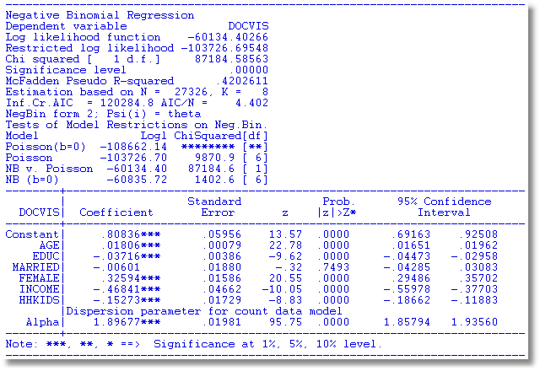

Slide 16
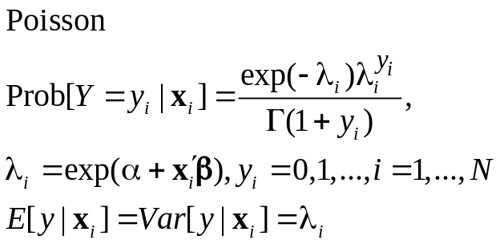
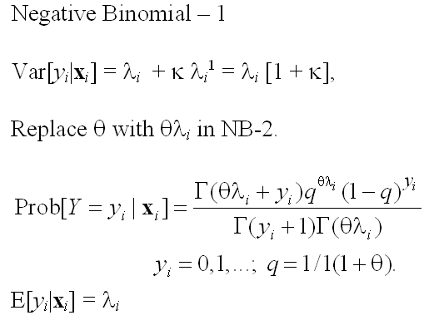
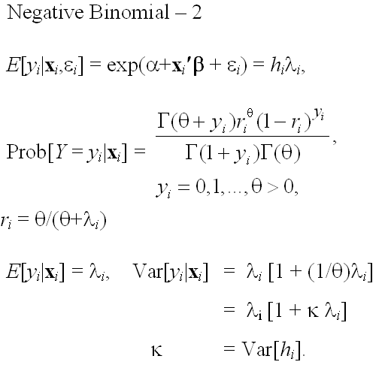
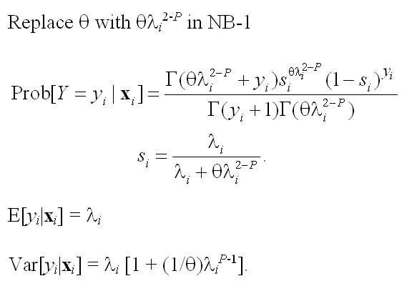
Four Model Formulations
E[y_{i} |x_{i} ]=λ_{i}

Slide 17
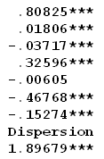
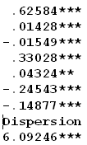
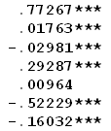
NegBin-P Model
----------------------------------------------------------------------
Negative Binomial (P) Model
Dependent variable DOCVIS
Log likelihood function -59992.32903
Restricted log likelihood -103727.29625
Chi squared [ 1 d.f.] 87469.93445
--------+-----------------------------------------
Variable| Coefficient Standard Error b/St.Er.
--------+-----------------------------------------
Constant| .60840*** .06452 9.429
AGE| .01710*** .00082 20.782
EDUC| -.02313*** .00414 -5.581
FEMALE| .36386*** .01640 22.187
MARRIED| .03670* .02030 1.808
HHNINC| -.35093*** .05146 -6.819
HHKIDS| -.16902*** .01911 -8.843
|Dispersion parameter for count data model
Alpha| 3.85713*** .14581 26.453
|Negative Binomial. General form, NegBin P
P| 1.38693*** .03142 44.140
--------+-------------------------------------------------------------
NB-2 NB-1 Poisson

Slide 18
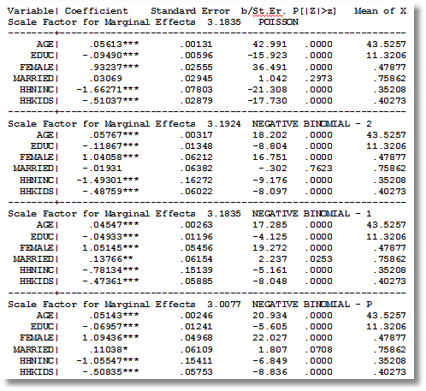

Slide 19
Zero Inflation – ZIP Models
Two regimes: (Recreation site visits)
  Zero (with probability 1). (Never visit site)
  Poisson with Pr(0) = exp[- β’x_{i}]. (Number of visits, including zero visits this season.)
Unconditional:
  Pr[0] = P(regime 0) + P(regime 1)*Pr[0|regime 1]
  Pr[j | j >0] = P(regime 1)*Pr[j|regime 1]
“Two inflation” – Number of children
These are “latent class models”

Slide 20
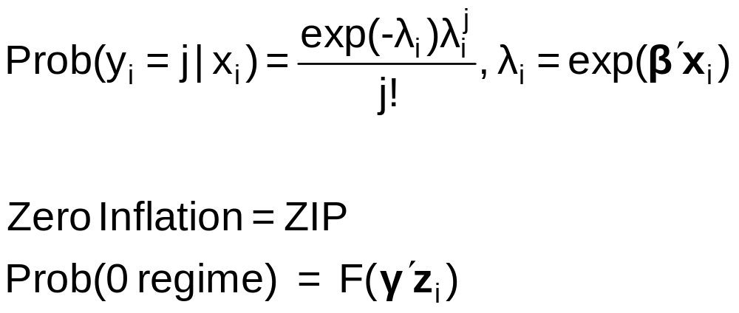
Zero Inflation Models

Slide 21
Notes on Zero Inflation Models
Poisson is not nested in ZIP. γ = 0 in ZIP does not produce Poisson; it produces ZIP with P(regime 0) = ½.
  Standard tests are not appropriate
  Use Vuong statistic. ZIP model almost always wins.
Zero Inflation models extend to NB models –ZINB is a standard model
  Creates two sources of overdispersion
  Generally difficult to estimate

Slide 22
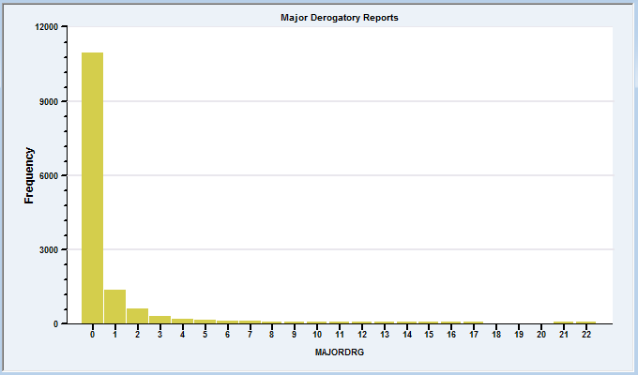
A Zip Model for Major Derogatory Reports
AmEx Credit Card Holders
N = 13,444
Number of major derogatory reports in 1 year
Issues:
Nonrandom selection
Excess zeros

Slide 23
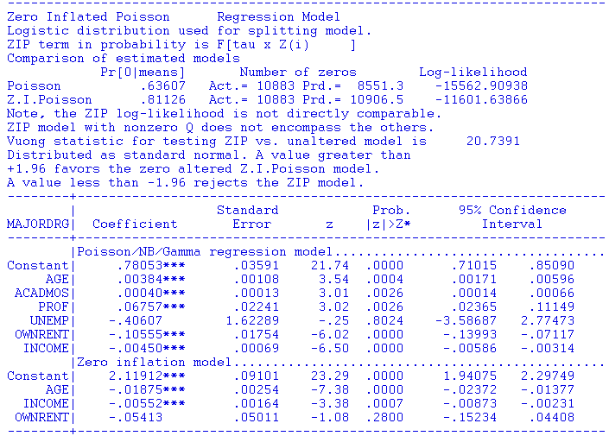

Slide 24
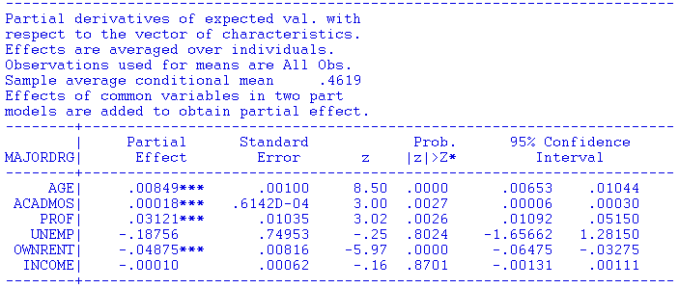

Slide 25
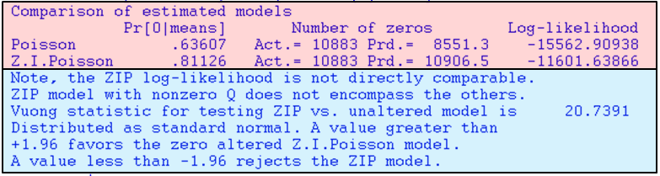
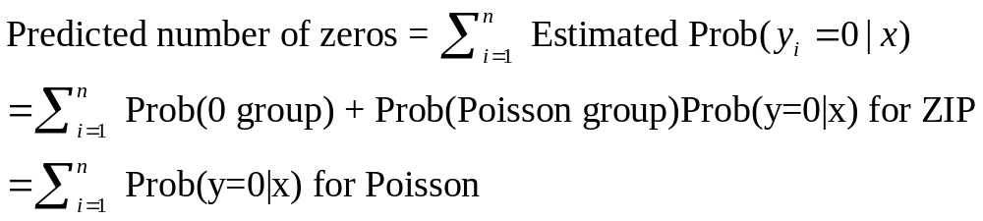

Slide 26
ZIP Model for Doctor Visits
----------------------------------------------------------------------
Zero Altered Poisson Regression Model
Logistic distribution used for splitting model.
ZAP term in probability is F[tau x Z(i) ]
Comparison of estimated models
Pr[0|means] Number of zeros Log-likelihood
Poisson .04933 Act.= 10135 Prd.= 1347.9 -103727.29625
Z.I.Poisson .36565 Act.= 10135 Prd.= 9991.8 -83843.36088
Vuong statistic for testing ZIP vs. unaltered model is 44.6739
Distributed as standard normal. A value greater than
+1.96 favors the zero altered Z.I.Poisson model.
A value less than -1.96 rejects the ZIP model.
--------+-------------------------------------------------------------
Variable| Coefficient Standard Error b/St.Er. P[|Z|>z] Mean of X
--------+-------------------------------------------------------------
|Poisson/NB/Gamma regression model
Constant| 1.47301*** .01123 131.119 .0000
AGE| .01100*** .00013 83.038 .0000 43.5257
EDUC| -.02164*** .00075 -28.864 .0000 11.3206
FEMALE| .10943*** .00256 42.728 .0000 .47877
MARRIED| -.02774*** .00318 -8.723 .0000 .75862
HHNINC| -.42240*** .00902 -46.838 .0000 .35208
HHKIDS| -.08182*** .00323 -25.370 .0000 .40273
|Zero inflation model
Constant| -.75828*** .06803 -11.146 .0000
FEMALE| -.59011*** .02652 -22.250 .0000 .47877
EDUC| .04114*** .00561 7.336 .0000 11.3206
--------+-------------------------------------------------------------

Slide 27
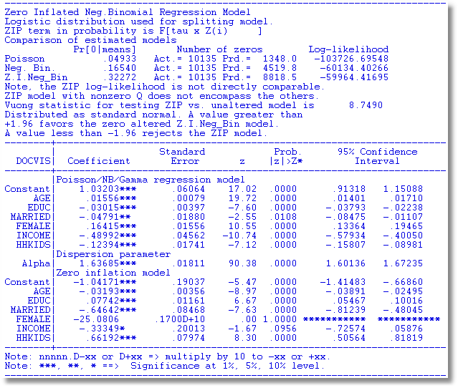
An Unidentified ZINB Model

Slide 28
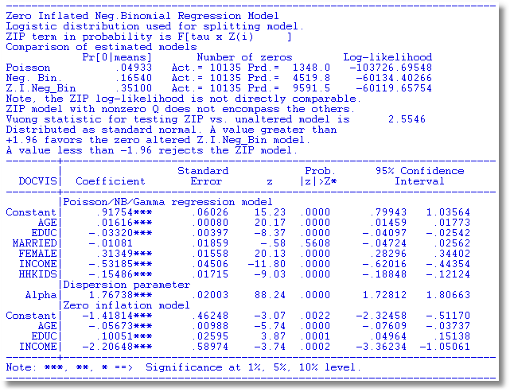
Remove FEMALE from ZIP Equation

Slide 29
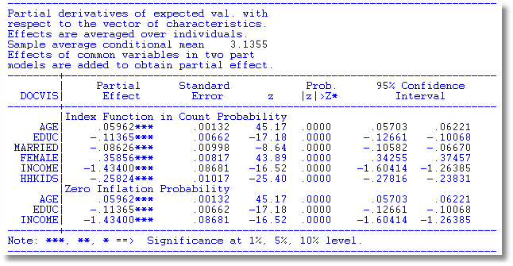
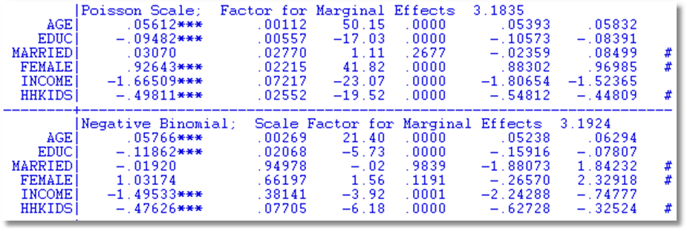
Partial Effects for Different Models
Notes:
29

Slide 30
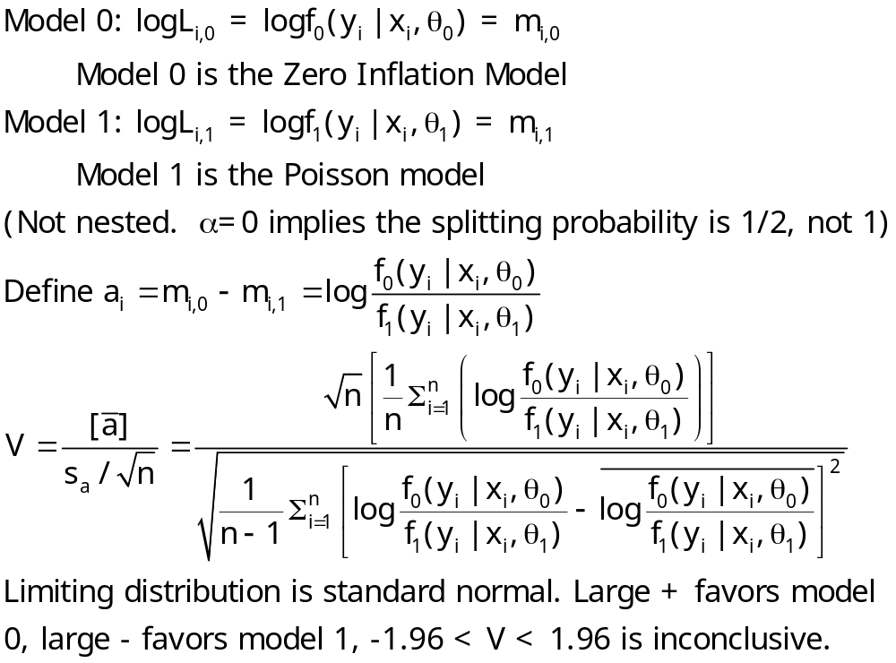
The Vuong Statistic for Nonnested Models

Slide 31
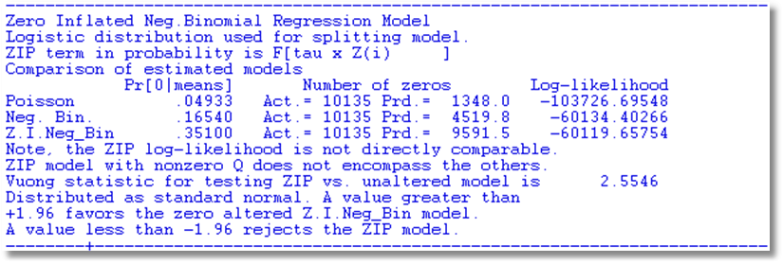

Slide 32
A Hurdle Model
Two part model:
  Model 1: Probability model for more than zero occurrences
  Model 2: Model for number of occurrences given that the number is greater than zero.
Applications common in health economics
  Usage of health care facilities
  Use of drugs, alcohol, etc.

Slide 34
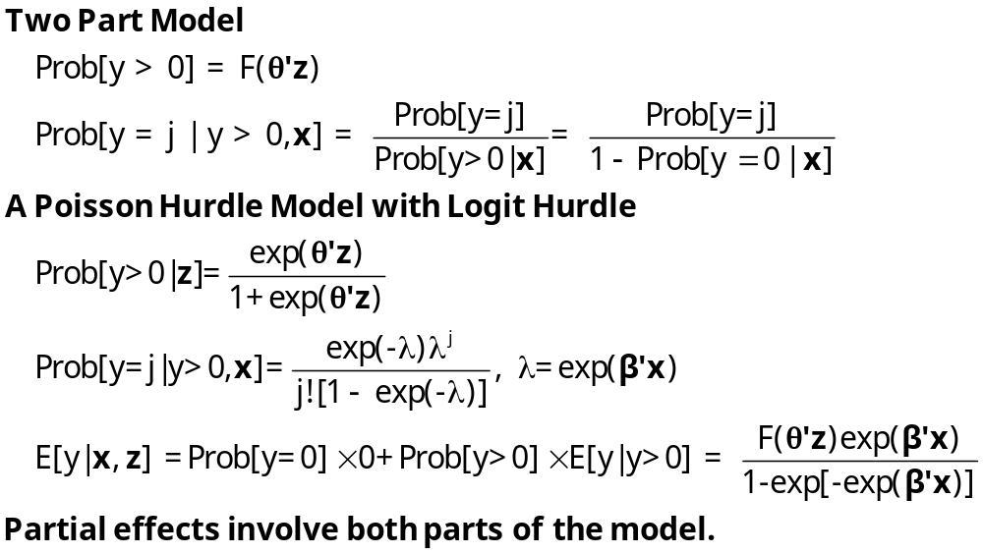
Hurdle Model

Slide 35
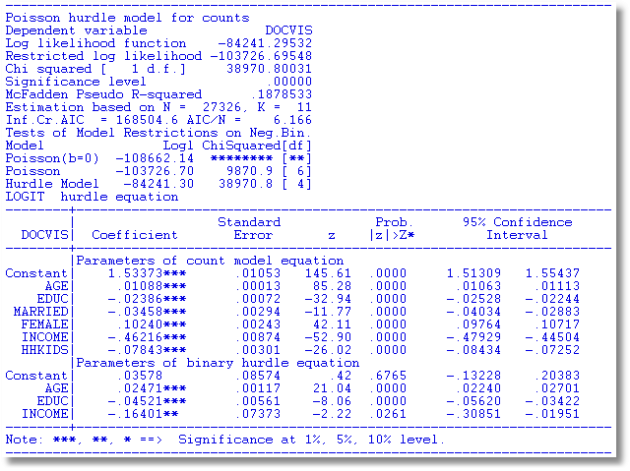
Hurdle Model for Doctor Visits

Slide 36
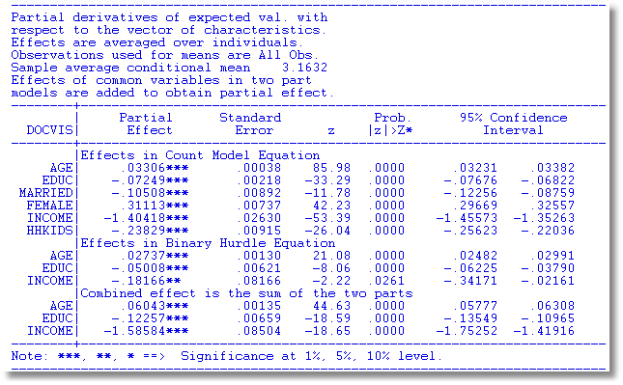
Partial Effects

Slide 37


Slide 38
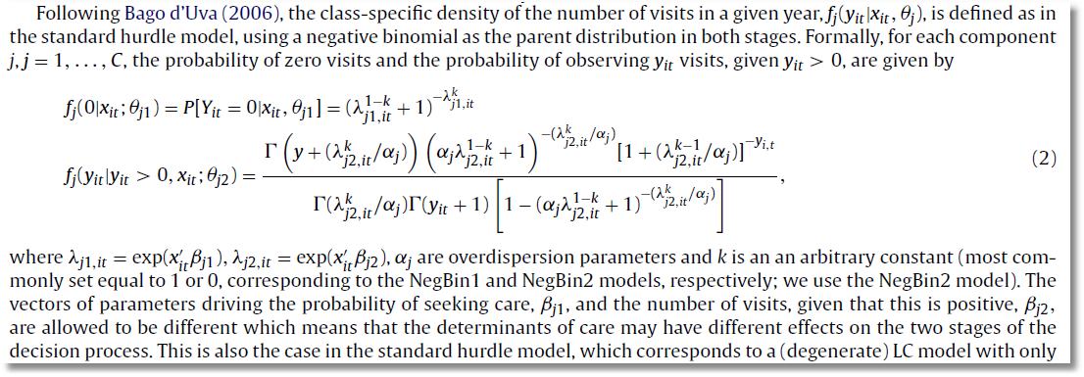
Negative Binomial Model with Hurdle

Slide 39
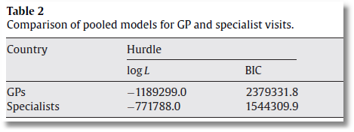
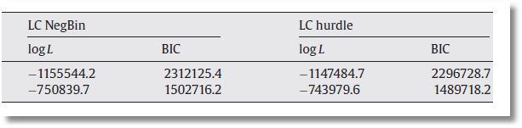

Slide 40

Application of Several of the Models
Discussed in this Section

Slide 41
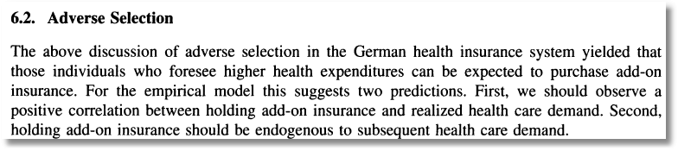
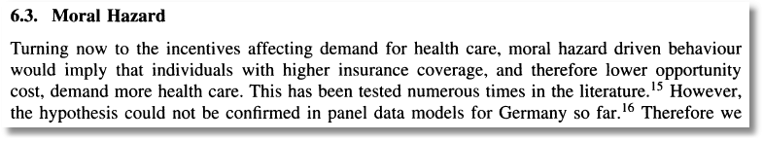

Slide 42
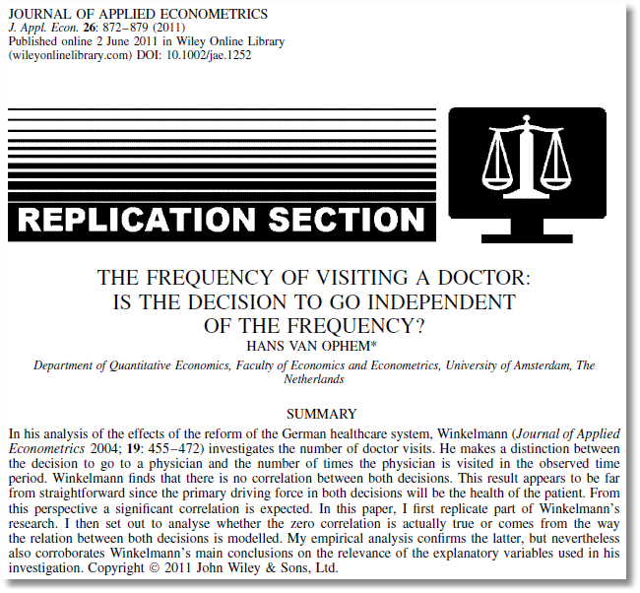
See also:
van Ophem H. 2000. Modeling selectivity in count data models. Journal of Business and Economic Statistics
18: 503–511.
Winkelmann finds that there is no correlation between the decisions… A significant correlation is expected … [T]he correlation comes from the way the relation between the decisions is modeled.

Slide 43
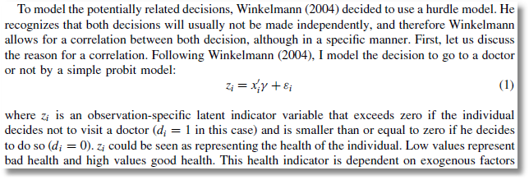
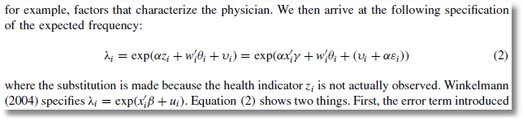
Probit Participation Equation
Poisson-Normal Intensity Equation

Slide 44
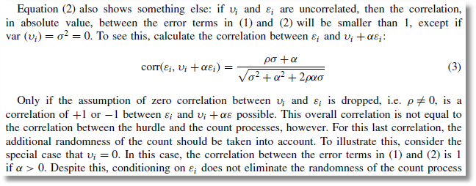
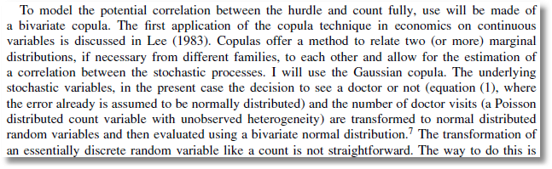
Bivariate-Normal Heterogeneity in Participation and Intensity Equations
Gaussian Copula for Participation and Intensity Equations

Slide 45
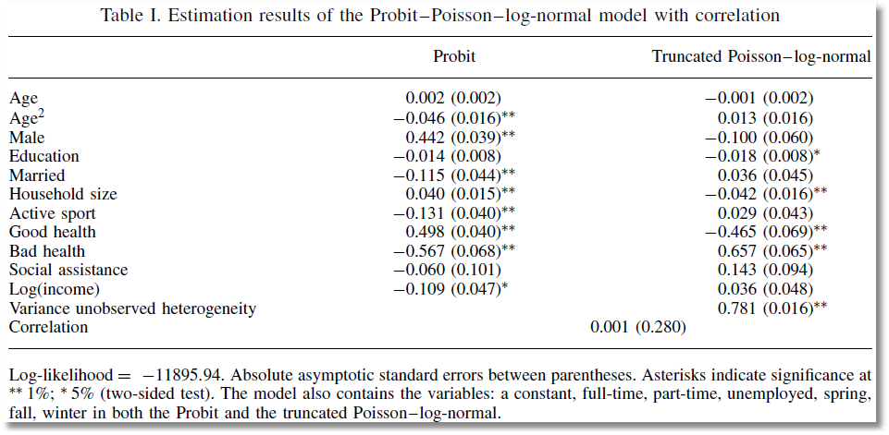
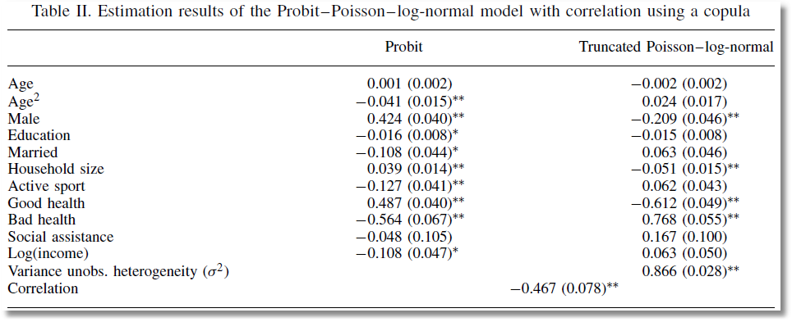
Correlation between Heterogeneity Terms
Correlation between Counts

Slide 46
Panel Data Models
Heterogeneity; λ_{it} = exp(β’x_{it} + c_{i})
  Fixed Effects
    Poisson: Standard, no incidental parameters issue
    Negative Binomial
      Hausman, Hall, Griliches (1984) put FE in variance, not the mean
      Use “brute force” to get a conventional FE model
  Random Effects
    Poisson
      Log-gamma heterogeneity becomes an NB model
      Contemporary treatments are using normal heterogeneity with simulation or quadrature based estimators
    NB with random effects is equivalent to two “effects” one time varying one time invariant. The model is probably overspecified
Random Parameters: Mixed models, latent class models, hiererchical – all extended to Poisson and NB

Slide 47

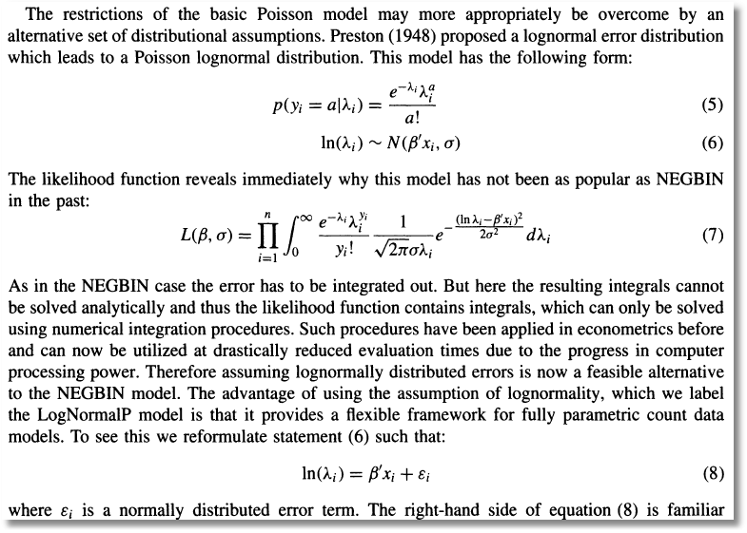
Poisson (log)Normal Mixture

Slide 48
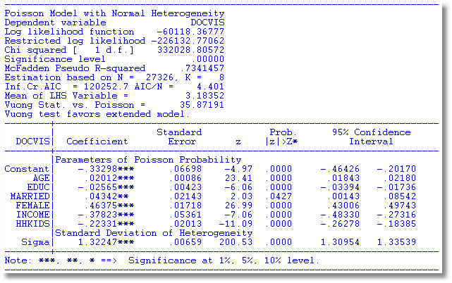
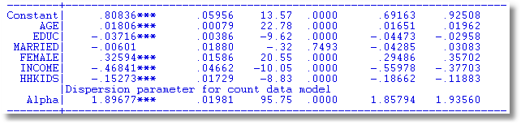

Slide 49
A Peculiarity of the FENB Model
‘True’ FE model has λ_{i}=exp(α_{i}+x_{it}’β). Cannot be fit if there are time invariant variables.
Hausman, Hall and Griliches (Econometrica, 1984) has α_{i} appearing in θ.
  Produces different results
  Implies that the FEM can contain time invariant variables.

Slide 50
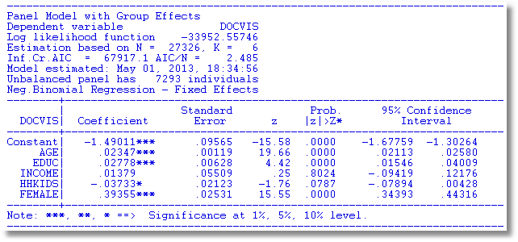
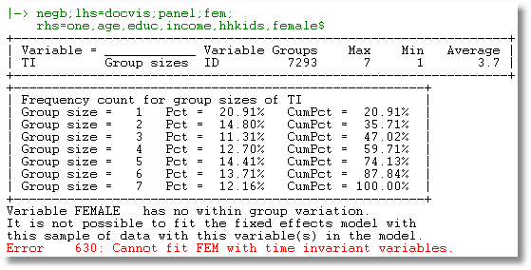

Slide 51

See: Allison and Waterman (2002),
Guimaraes (2007)
Greene, Econometric Analysis (2012)

Slide 52
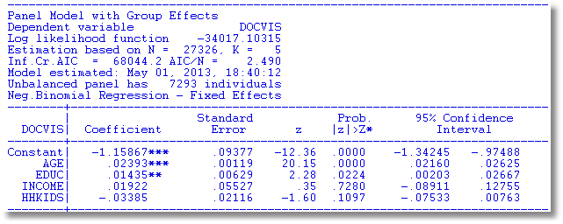
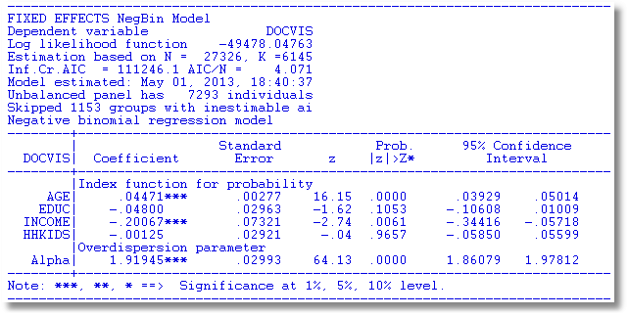

Slide 53
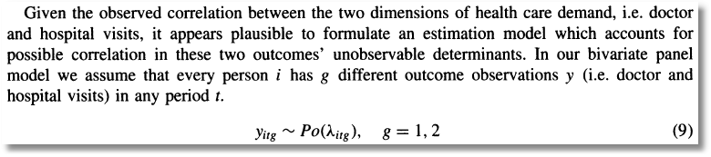
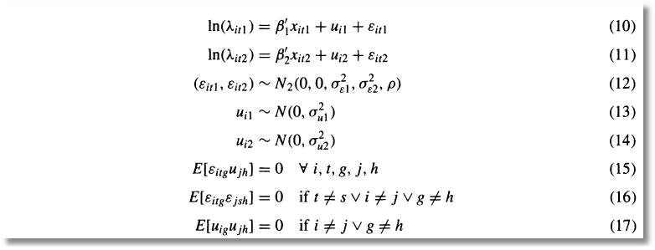
Bivariate Random Effects

Slide 54
