Slide 1




Microeconometric Modeling
William Greene
Stern School of Business
New York University
New York NY USA
3.3 Discrete Choice; The
Multinomial Logit
Model

Slide 2

Concepts
Models
Random Utility
Multinomial Choice
Attributes and Characteristics
Stated and Revealed Preference
Unlabeled Choice
IID and IIA
Consumer Surplus
Choice Based Sampling
Alternative Specific Constants
Partial Effects and Elasticities
Simulation
WTP Space
Hausman – McFadden Test for IIA
Random Regret
Minimum Distance Estimator
Scaled MNL Model
Nonlinear Utility Functions
Multinomial Logit Model
Conditional Logit
Fixed Effects Multinomial Logit
Best/Worst
Nested Logit
Exploded Logit
Heteroscedastic Extreme Value (HEV)
Generalized Mixed Logit

Slide 3
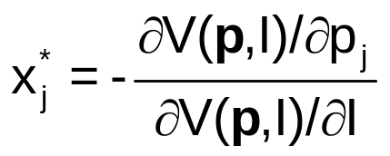
A Microeconomics Platform
Consumers Maximize Utility
Fundamental Choice Problem: Maximize U(x₁,x₂,…) subject to prices and budget constraints
A Crucial Result for the Classical Problem:
  Indirect Utility Function: V = V(p,I)
  Demand System of Continuous Choices
  Observed data usually consist of choices, prices, income
The Integrability Problem: Utility is not revealed by demands

Slide 4
Implications for Discrete Choice Models
Theory is silent about discrete choices
Translation of utilities to discrete choice requires:
  Well defined utility indexes: Completeness of rankings
  Rationality: Utility maximization
  Axioms of revealed preferences
Consumers often act to simplify choice situations
This allows us to build “models.”
  What common elements can be assumed?
  How can we account for heterogeneity?
However, revealed choices do not reveal utility, only rankings which are scale invariant.

Slide 5
Multinomial Choice
Among J Alternatives
• Random Utility Basis
Uitj = α_{ij} + β_{i}’x_{itj} + γ_{ij}z_{it} + ε_{ijt}
i = 1,…,N; j = 1,…,J(i,t); t = 1,…,T(i)
N individuals studied, J(i,t) alternatives in the choice
set, T(i) [usually 1] choice situations examined.
• Maximum Utility Assumption
Individual i will Choose alternative j in choice setting t if and only if
Uitj > Uitk for all k ≠ j.
• Underlying assumptions
  Smoothness of utilities
  Axioms of utility maximization: Transitive, Complete, Monotonic

Slide 6
Features of Utility Functions
The linearity assumption U_{itj} = α_{ij} + β_{i}′x_{itj} + γ_{j}′z_{it} + ε_{ijt}
To be relaxed later: U_{itj} = V(x_{itj},z_{it},β_{i}) + ε_{ijt}
The choice set:
  Individual (i) and situation (t) specific
  Unordered alternatives j = 1,…,J(i,t)
Deterministic (x,z,γ_{j}) and random components (α_{ij},β_{i},ε_{ijt})
Attributes of choices, x_{itj} and characteristics of the chooser, z_{it}.
  Alternative specific constants α_{ij} may vary by individual
  Preference weights, β_{i} may vary by individual
  Individual components, γ_{j} typically vary by choice, not by person
  Scaling parameters, σ_{ij} = Var[ε_{ijt}], subject to much modeling

Slide 7

Unordered Choices of 210 Travelers
Revealed Choice from 4 Alternatives

Slide 8
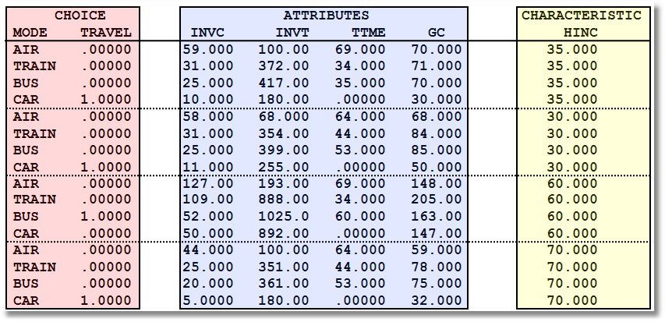
Data on Multinomial Discrete Choices

Slide 9

Stated Choice Experiment: Unlabeled Alternatives
1 observation = 8 stated choice tasks
t=1
t=2
t=3
t=4
t=5
t=6
t=7
t=8

Slide 10

Unlabeled Choices
This an unlabeled choice experiment:
Compare
Choice = (Air, Train, Bus, Car)
To
Choice = (Brand 1, Brand 2, Brand 3, None)
Brand 1 is only Brand 1 because it is first in the list.
What does it mean to substitute Brand 1 for Brand 2?
What does the own elasticity for Brand 1 mean?

Slide 11
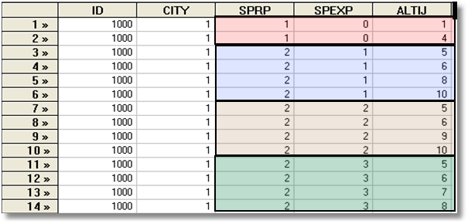
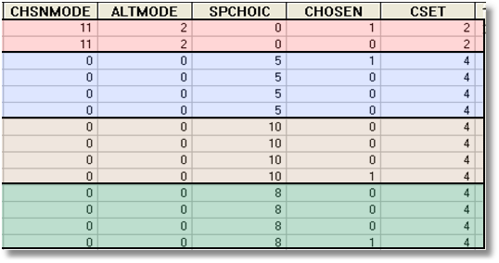
A Stated Choice Experiment with Variable Choice Sets
Each person makes four choices from a choice set that includes either two or four alternatives.
The first choice is the RP between two of the RP alternatives
The second-fourth are the SP among four of the six SP alternatives.
There are ten alternatives in total.

Slide 12
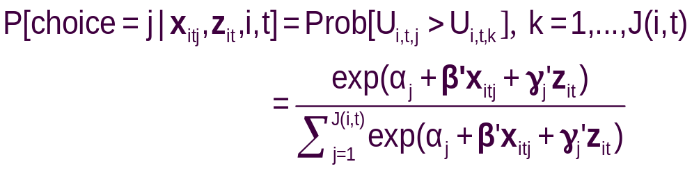
The Multinomial Logit (MNL) Model
Independent extreme value (Gumbel):
  F(εitj) = Exp(-Exp(-εitj)) (random part of each utility)
  Independence across utility functions
  Identical variances (means absorbed in constants)
  Same parameters for all individuals (temporary)
Implied probabilities for observed outcomes

Slide 13
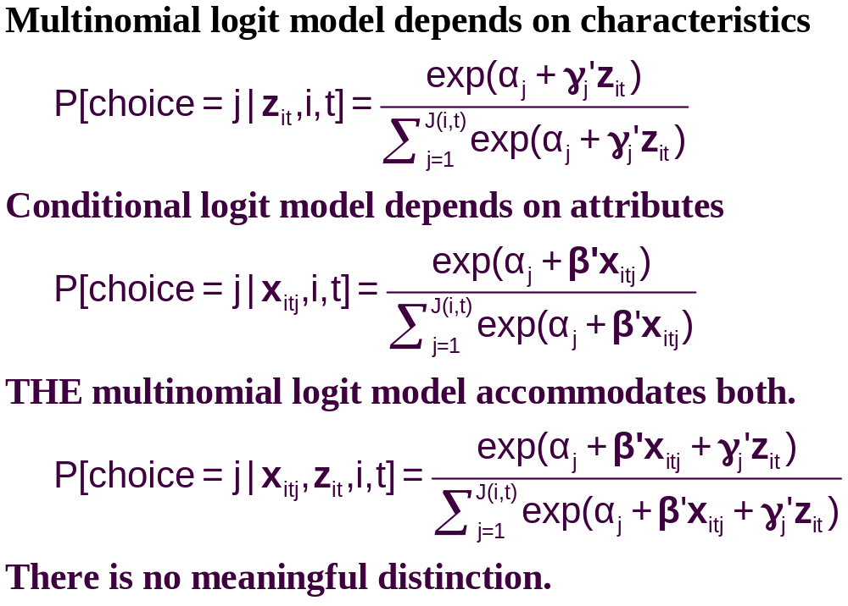
Multinomial Choice Models

Slide 14
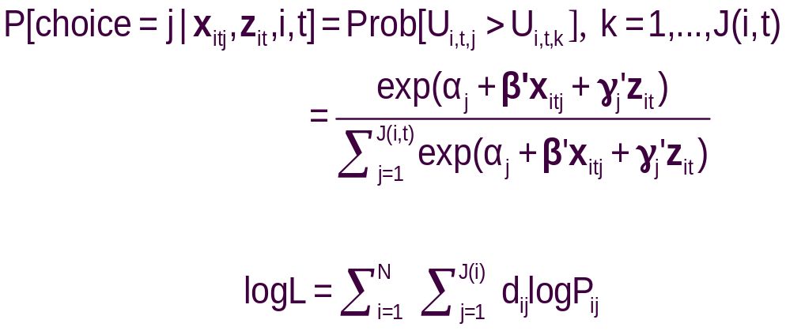
Specifying the Probabilities
• Choice specific attributes (X) vary by choices, multiply by generic
coefficients. E.g., TTME=terminal time, GC=generalized cost of travel mode
Generic characteristics (Income, constants) must be interacted with
choice specific constants.
• Estimation by maximum likelihood; d_{ij} = 1 if person i chooses j

Slide 15
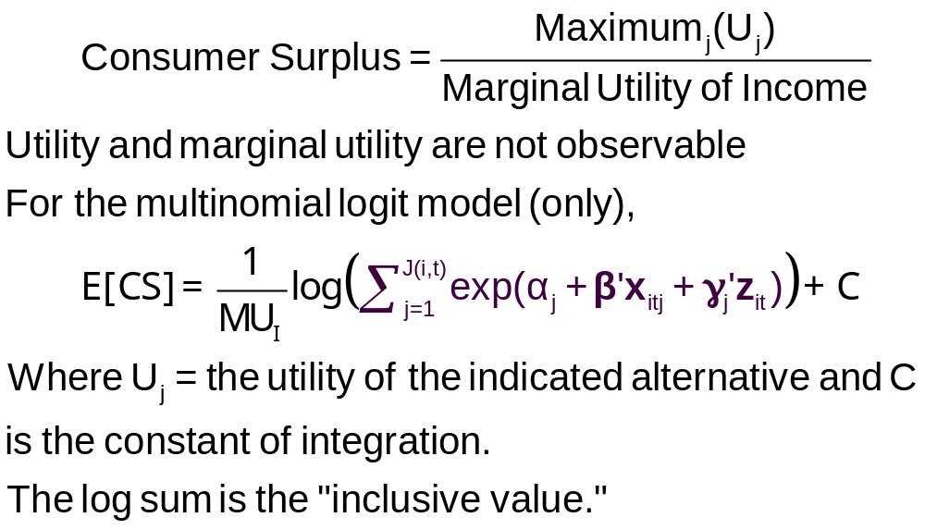
Using the Model to Measure Consumer Surplus

Slide 16
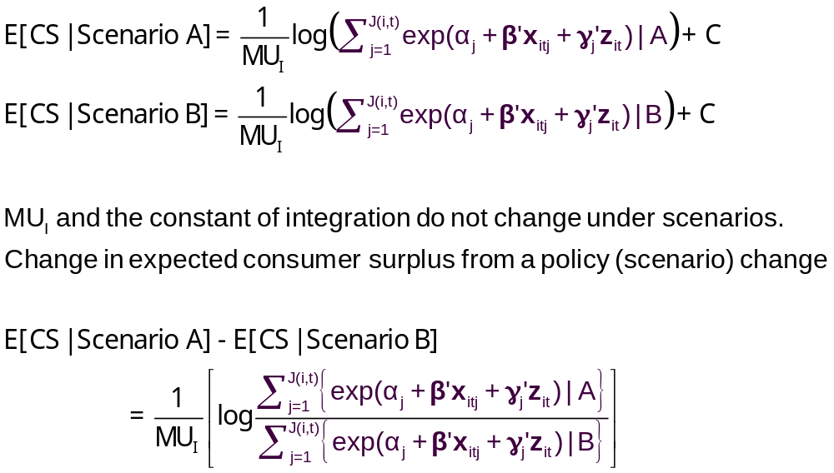
Measuring the Change in Consumer Surplus

Slide 17
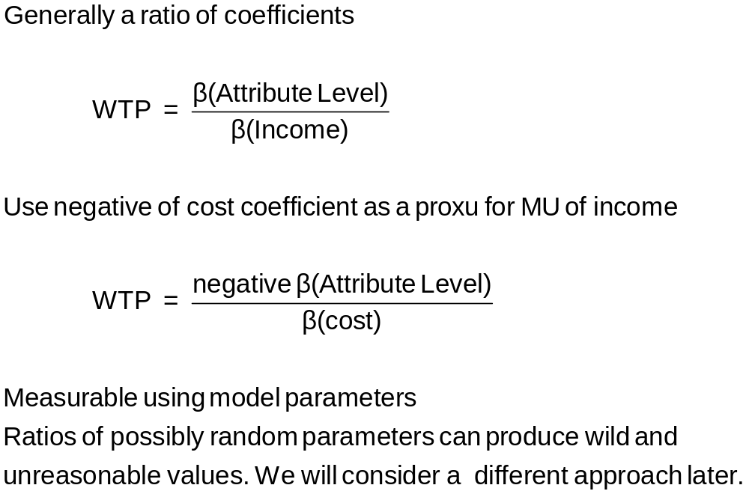
Willingness to Pay

Slide 18
Observed Data
Types of Data
  Individual choice
  Market shares – consumer markets
  Frequencies – vote counts
  Ranks – contests, preference rankings
Attributes and Characteristics
  Attributes are features of the choices such as price
  Characteristics are features of the chooser such as age, gender and income.
Choice Settings
  Cross section
  Repeated measurement (panel data)
    Stated choice experiments
    Repeated observations – THE scanner data on consumer choices

Slide 19
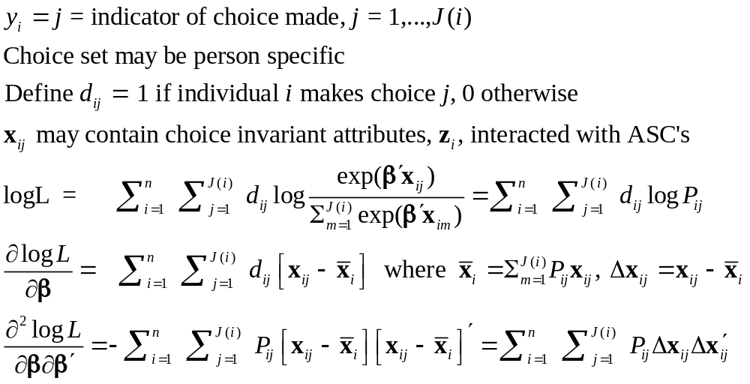
Maximum Likelihood Estimation

Slide 20
An Estimated MNL Model
-----------------------------------------------------------
Discrete choice (multinomial logit) model
Dependent variable Choice
Log likelihood function -199.97662
Estimation based on N = 210, K = 5
Information Criteria: Normalization=1/N
Normalized Unnormalized
AIC 1.95216 409.95325
Fin.Smpl.AIC 1.95356 410.24736
Bayes IC 2.03185 426.68878
Hannan Quinn 1.98438 416.71880
R2=1-LogL/LogL* Log-L fncn R-sqrd R2Adj
Constants only -283.7588 .2953 .2896
Chi-squared[ 2] = 167.56429
Prob [ chi squared > value ] = .00000
Response data are given as ind. choices
Number of obs.= 210, skipped 0 obs
--------+--------------------------------------------------
Variable| Coefficient Standard Error b/St.Er. P[|Z|>z]
--------+--------------------------------------------------
GC| -.01578*** .00438 -3.601 .0003
TTME| -.09709*** .01044 -9.304 .0000
A_AIR| 5.77636*** .65592 8.807 .0000
A_TRAIN| 3.92300*** .44199 8.876 .0000
A_BUS| 3.21073*** .44965 7.140 .0000
--------+--------------------------------------------------

Slide 21
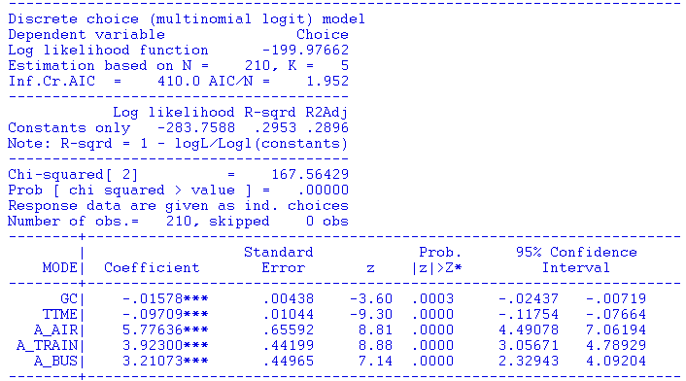
Estimated MNL Model:
What do the coefficients mean?
-----------------------------------------------------------
Discrete choice (multinomial logit) model
Dependent variable Choice
Log likelihood function -199.97662
Estimation based on N = 210, K = 5
Information Criteria: Normalization=1/N
Normalized Unnormalized
AIC 1.95216 409.95325
Fin.Smpl.AIC 1.95356 410.24736
Bayes IC 2.03185 426.68878
Hannan Quinn 1.98438 416.71880
R2=1-LogL/LogL* Log-L fncn R-sqrd R2Adj
Constants only -283.7588 .2953 .2896
Chi-squared[ 2] = 167.56429
Prob [ chi squared > value ] = .00000
Response data are given as ind. choices
Number of obs.= 210, skipped 0 obs
--------+--------------------------------------------------
Variable| Coefficient Standard Error b/St.Er. P[|Z|>z]
--------+--------------------------------------------------

Slide 22
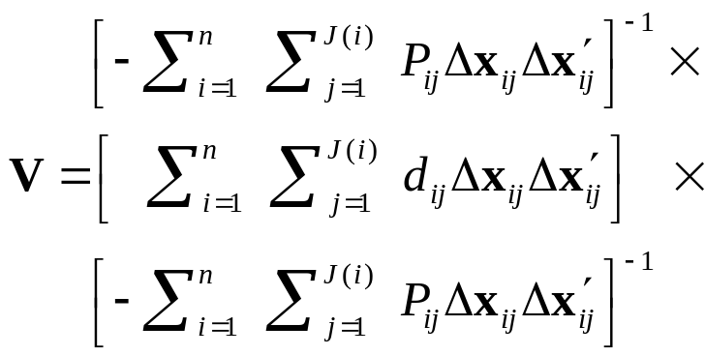
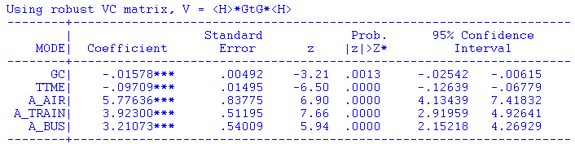
Robust Standard Errors: Robust to what?

Slide 23
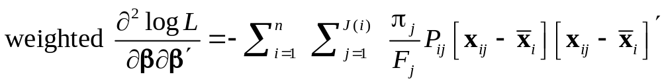
Choice Based Sampling
Over/Underrepresenting alternatives in the data set
May cause biases in parameter estimates. (Possibly constants only)
Certainly causes biases in estimated variances
  Weighted log likelihood, weight = πj / Fj for all i.
  Fixup of covariance matrix – uses “sandwich” estimator. Using weighted Hessian and weighted BHHH in the center of the sandwich
Choice | Air | Train | Bus | Car
True π_{j} | 0.14 | 0.13 | 0.09 | 0.64
Sample F_{j} | 0.28 | 0.30 | 0.14 | 0.28

Slide 24
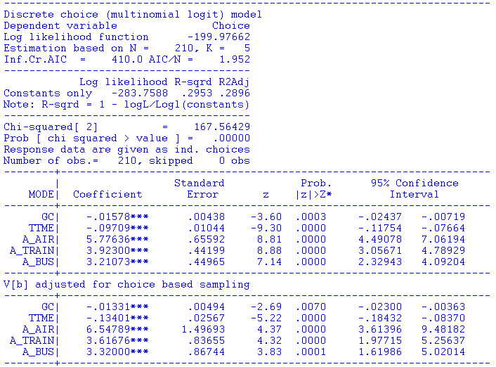
Effect of Choice Based Sampling Adjustment

Slide 25
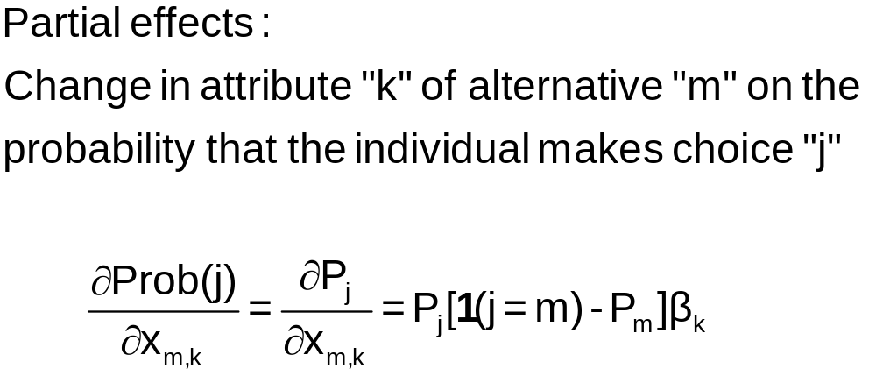
j = Train
m = Car
k = Price

Slide 26
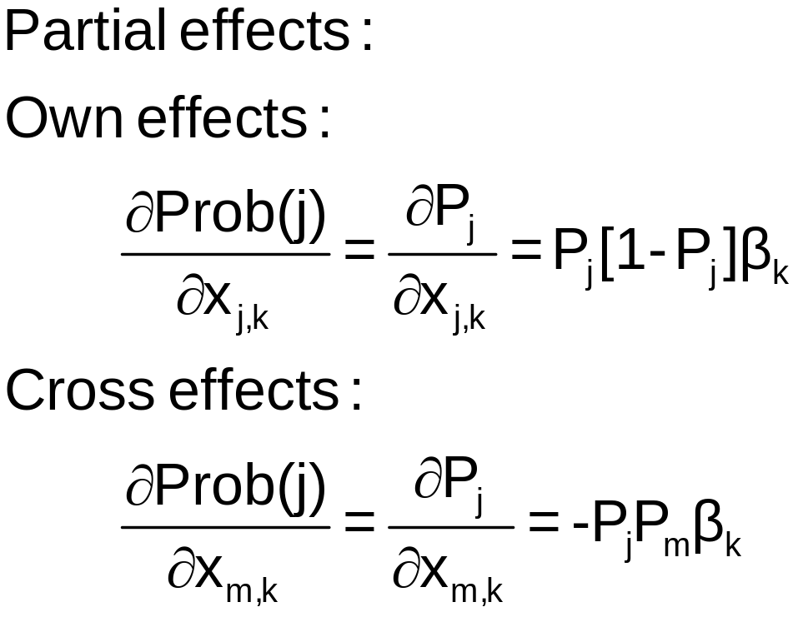
k = Price
j = Train
j = Train
m = Car

Slide 27
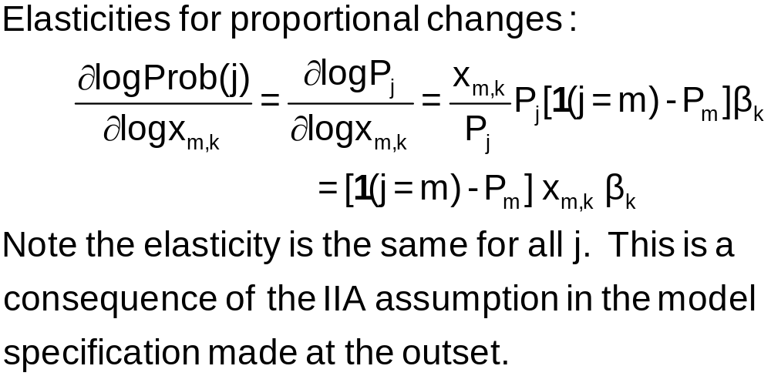

Slide 28
+---------------------------------------------------+
| Elasticity averaged over observations.|
| Attribute is INVT in choice AIR |
| Mean St.Dev |
| * Choice=AIR -.2055 .0666 |
| Choice=TRAIN .0903 .0681 |
| Choice=BUS .0903 .0681 |
| Choice=CAR .0903 .0681 |
+---------------------------------------------------+
| Attribute is INVT in choice TRAIN |
| Choice=AIR .3568 .1231 |
| * Choice=TRAIN -.9892 .5217 |
| Choice=BUS .3568 .1231 |
| Choice=CAR .3568 .1231 |
+---------------------------------------------------+
| Attribute is INVT in choice BUS |
| Choice=AIR .1889 .0743 |
| Choice=TRAIN .1889 .0743 |
| * Choice=BUS -1.2040 .4803 |
| Choice=CAR .1889 .0743 |
+---------------------------------------------------+
| Attribute is INVT in choice CAR |
| Choice=AIR .3174 .1195 |
| Choice=TRAIN .3174 .1195 |
| Choice=BUS .3174 .1195 |
| * Choice=CAR -.9510 .5504 |
+---------------------------------------------------+
| Effects on probabilities of all choices in model: |
| * = Direct Elasticity effect of the attribute. |
+---------------------------------------------------+
Note the effect of IIA on the cross effects.
Own effect
Cross effects
Elasticities are computed for each observation; the mean and standard deviation are then computed across the sample observations.

Slide 29
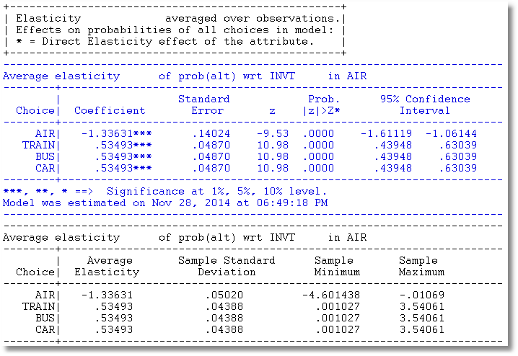
Use Krinsky and Robb to compute standard errors for elasticities

Slide 30
Analyzing the Behavior of Market
Shares to Examine Discrete Effects
Scenario: What happens to the number of people who make specific choices if a particular attribute changes in a specified way?
Fit the model first, then using the identical model setup, add
; Simulation = list of choices to be analyzed
; Scenario = Attribute (in choices) = type of change
For the CLOGIT application
; Simulation = * ? This is ALL choices
; Scenario: GC(car)=[*]1.25$ Car_GC rises by 25%

Slide 31
Model Simulation
+---------------------------------------------+
| Discrete Choice (One Level) Model |
| Model Simulation Using Previous Estimates |
| Number of observations 210 |
+---------------------------------------------+
+------------------------------------------------------+
|Simulations of Probability Model |
|Model: Discrete Choice (One Level) Model |
|Simulated choice set may be a subset of the choices. |
|Number of individuals is the probability times the |
|number of observations in the simulated sample. |
|Column totals may be affected by rounding error. |
|The model used was simulated with 210 observations.|
+------------------------------------------------------+
-------------------------------------------------------------------------
Specification of scenario 1 is:
Attribute Alternatives affected Change type Value
--------- ------------------------------- ------------------- ---------
GC CAR Scale base by value 1.250
-------------------------------------------------------------------------
The simulator located 209 observations for this scenario.
Simulated Probabilities (shares) for this scenario:
+----------+--------------+--------------+------------------+
|Choice | Base | Scenario | Scenario - Base |
| |%Share Number |%Share Number |ChgShare ChgNumber|
+----------+--------------+--------------+------------------+
|AIR | 27.619 58 | 29.592 62 | 1.973% 4 |
|TRAIN | 30.000 63 | 31.748 67 | 1.748% 4 |
|BUS | 14.286 30 | 15.189 32 | .903% 2 |
|CAR | 28.095 59 | 23.472 49 | -4.624% -10 |
|Total |100.000 210 |100.000 210 | .000% 0 |
+----------+--------------+--------------+------------------+
Changes in the predicted market shares when GC_CAR increases by 25%.

Slide 32
More Complicated Model Simulation
In vehicle cost of CAR falls by 10%
Market is limited to ground (Train, Bus, Car)
CLOGIT ; Lhs = Mode
; Choices = Air,Train,Bus,Car
; Rhs = GC,TTME,INVT
; Rh2 = One
; Simulation = TRAIN,BUS,CAR
; Scenario: GC(car)=[*].9$

Slide 33
Model Estimation Step
-----------------------------------------------------------------------------
Discrete choice (multinomial logit) model
Dependent variable Choice
Log likelihood function -194.99742
Estimation based on N = 210, K = 6
Inf.Cr.AIC = 402.0 AIC/N = 1.914
---------------------------------------
Log likelihood R-sqrd R2Adj
Constants only -283.7588 .3128 .3062
Note: R-sqrd = 1 - logL/Logl(constants)
---------------------------------------
Chi-squared[ 3] = 177.52270
Prob [ chi squared > value ] = .00000
Response data are given as ind. choices
Number of obs.= 210, skipped 0 obs
--------+--------------------------------------------------------------------
| Standard Prob. 95% Confidence
MODE| Coefficient Error z |z|>Z* Interval
--------+--------------------------------------------------------------------
GC| -.00286 .00610 -.47 .6390 -.01481 .00909
TTME| -.09746*** .01035 -9.41 .0000 -.11775 -.07717
INVT| -.00349*** .00115 -3.04 .0024 -.00574 -.00124
A_AIR| 4.05405*** .83662 4.85 .0000 2.41430 5.69380
A_TRAIN| 3.64460*** .44276 8.23 .0000 2.77680 4.51240
A_BUS| 3.19579*** .45194 7.07 .0000 2.31000 4.08158
--------+--------------------------------------------------------------------

Slide 34
+---------------------------------------------+
| Discrete Choice (One Level) Model |
| Model Simulation Using Previous Estimates |
| Number of observations 210 |
+---------------------------------------------+
+------------------------------------------------------+
|Simulations of Probability Model |
|Model: Discrete Choice (One Level) Model |
|Simulated choice set may be a subset of the choices. |
|Number of individuals is the probability times the |
|number of observations in the simulated sample. |
|Column totals may be affected by rounding error. |
|The model used was simulated with 210 observations.|
+------------------------------------------------------+
-------------------------------------------------------------------------
Specification of scenario 1 is:
Attribute Alternatives affected Change type Value
--------- ------------------------------- ------------------- ---------
GC CAR Scale base by value .900
-------------------------------------------------------------------------
The simulator located 210 observations for this scenario.
Simulated Probabilities (shares) for this scenario:
+----------+--------------+--------------+------------------+
|Choice | Base | Scenario | Scenario - Base |
| |%Share Number |%Share Number |ChgShare ChgNumber|
+----------+--------------+--------------+------------------+
|TRAIN | 38.986 82 | 38.646 81 | -.340% -1 |
|BUS | 18.669 39 | 18.501 39 | -.168% 0 |
|CAR | 42.345 89 | 42.853 90 | .508% 1 |
|Total |100.000 210 |100.000 210 | .000% 0 |
+----------+--------------+--------------+------------------+
Model Simulation Step

Slide 35
Willingness to Pay
U(alt) = a_{j} + b_{INCOME}*INCOME + b_{Attribute}*Attribute + …
WTP = MU(Attribute)/MU(Income)
When MU(Income) is not available, an approximation
often used is –MU(Cost).
U(Air,Train,Bus,Car)
= α_{alt} + β_{cost} Cost + β_{INVT} INVT + β_{TTME} TTME + ε_{alt}
WTP for less in vehicle time = -β_{INVT} / β_{COST}
WTP for less terminal time = -β_{TIME} / β_{COST}

Slide 36
WTP from CLOGIT Model
-----------------------------------------------------------
Discrete choice (multinomial logit) model
Dependent variable Choice
--------+--------------------------------------------------
Variable| Coefficient Standard Error b/St.Er. P[|Z|>z]
--------+--------------------------------------------------
GC| -.00286 .00610 -.469 .6390
INVT| -.00349*** .00115 -3.037 .0024
TTME| -.09746*** .01035 -9.414 .0000
AASC| 4.05405*** .83662 4.846 .0000
TASC| 3.64460*** .44276 8.232 .0000
BASC| 3.19579*** .45194 7.071 .0000
--------+--------------------------------------------------
WALD ; fn1=WTP_INVT=b_invt/b_gc ; fn2=WTP_TTME=b_ttme/b_gc$
-----------------------------------------------------------
WALD procedure.
--------+--------------------------------------------------
Variable| Coefficient Standard Error b/St.Er. P[|Z|>z]
--------+--------------------------------------------------
WTP_INVT| 1.22006 2.88619 .423 .6725
WTP_TTME| 34.0771 73.07097 .466 .6410
--------+--------------------------------------------------
Very different estimates suggests this might not be a very good model.

Slide 37
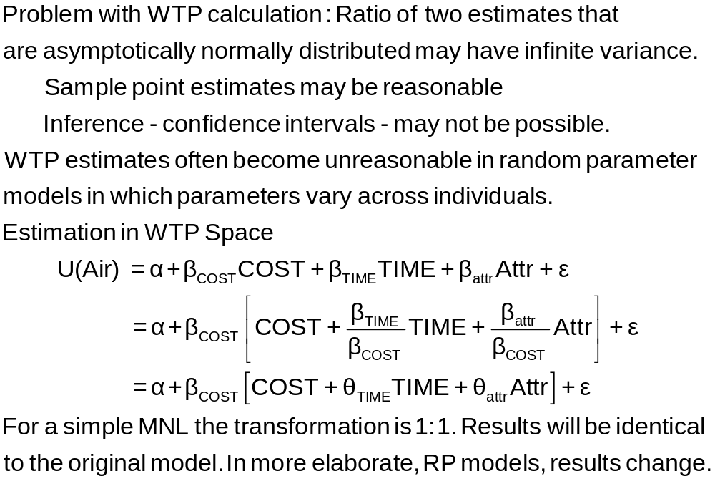
Estimation in WTP Space

Slide 38
Model Fit Based on Log Likelihood
Three sets of predicted probabilities
  No model: Pij = 1/J (.25)
  Constants only: Pij = (1/N)Σi dij
  (58,63,30,59)/210=.286,.300,.143,.281
  Constants only model matches sample shares
  Estimated model: Logit probabilities
Compute log likelihood
Measure improvement in log likelihood with
Pseudo R-squared = 1 – LogL/LogL₀
(“Adjusted” for number of parameters in the model.)

Slide 39
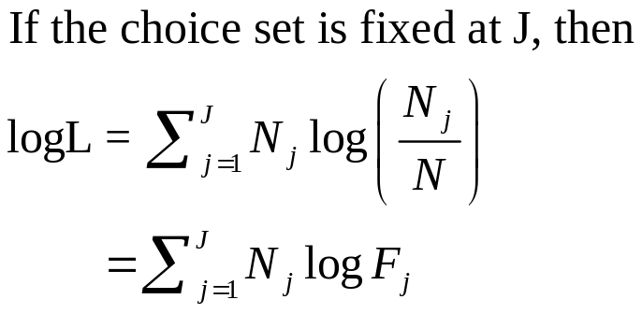
Fit the Model with Only ASCs
If the choice set varies across observations, this is the only way to obtain the restricted log likelihood.
-----------------------------------------------------------
Discrete choice (multinomial logit) model
Dependent variable Choice
Log likelihood function -283.75877
Estimation based on N = 210, K = 3
Information Criteria: Normalization=1/N
Normalized Unnormalized
AIC 2.73104 573.51754
Fin.Smpl.AIC 2.73159 573.63404
Bayes IC 2.77885 583.55886
Hannan Quinn 2.75037 577.57687
R2=1-LogL/LogL* Log-L fncn R-sqrd R2Adj
Constants only -283.7588 .0000-.0048
Response data are given as ind. choices
Number of obs.= 210, skipped 0 obs
--------+--------------------------------------------------
Variable| Coefficient Standard Error b/St.Er. P[|Z|>z]
--------+--------------------------------------------------
A_AIR| -.01709 .18491 -.092 .9263
A_TRAIN| .06560 .18117 .362 .7173
A_BUS| -.67634*** .22424 -3.016 .0026
--------+--------------------------------------------------

Slide 40
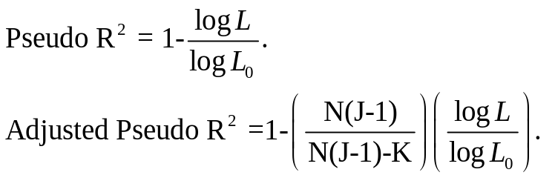
Estimated MNL Model
-----------------------------------------------------------
Discrete choice (multinomial logit) model
Dependent variable Choice
Log likelihood function -199.97662
Estimation based on N = 210, K = 5
Information Criteria: Normalization=1/N
Normalized Unnormalized
AIC 1.95216 409.95325
Fin.Smpl.AIC 1.95356 410.24736
Bayes IC 2.03185 426.68878
Hannan Quinn 1.98438 416.71880
R2=1-LogL/LogL* Log-L fncn R-sqrd R2Adj
Constants only -283.7588 .2953 .2896
Chi-squared[ 2] = 167.56429
Prob [ chi squared > value ] = .00000
Response data are given as ind. choices
Number of obs.= 210, skipped 0 obs
--------+--------------------------------------------------
Variable| Coefficient Standard Error b/St.Er. P[|Z|>z]
--------+--------------------------------------------------
GC| -.01578*** .00438 -3.601 .0003
TTME| -.09709*** .01044 -9.304 .0000
A_AIR| 5.77636*** .65592 8.807 .0000
A_TRAIN| 3.92300*** .44199 8.876 .0000
A_BUS| 3.21073*** .44965 7.140 .0000
--------+--------------------------------------------------

Slide 41
Model Fit Based on Predictions
Nj = actual number of choosers of “j.”
Nfitj = Σi Predicted Probabilities for “j”
Cross tabulate:
Predicted vs. Actual, cell prediction is cell probability
Predicted vs. Actual, cell prediction is the cell
with the largest probability
Nfitj = Σi dij × Predicted P(i,j)

Slide 42
Fit Measures Based on Crosstabulation
+-------------------------------------------------------+
| Cross tabulation of actual choice vs. predicted P(j) |
| Row indicator is actual, column is predicted. |
| Predicted total is F(k,j,i)=Sum(i=1,...,N) P(k,j,i). |
| Column totals may be subject to rounding error. |
+-------------------------------------------------------+
NLOGIT Cross Tabulation for 4 outcome Multinomial Choice Model
AIR TRAIN BUS CAR Total
+-------------+-------------+-------------+-------------+-------------+
AIR | 32 | 8 | 5 | 13 | 58 |
TRAIN | 8 | 37 | 5 | 14 | 63 |
BUS | 3 | 5 | 15 | 6 | 30 |
CAR | 15 | 13 | 6 | 26 | 59 |
+-------------+-------------+-------------+-------------+-------------+
Total | 58 | 63 | 30 | 59 | 210 |
+-------------+-------------+-------------+-------------+-------------+
NLOGIT Cross Tabulation for 4 outcome Constants Only Choice Model
AIR TRAIN BUS CAR Total
+-------------+-------------+-------------+-------------+-------------+
AIR | 16 | 17 | 8 | 16 | 58 |
TRAIN | 17 | 19 | 9 | 18 | 63 |
BUS | 8 | 9 | 4 | 8 | 30 |
CAR | 16 | 18 | 8 | 17 | 59 |
+-------------+-------------+-------------+-------------+-------------+
Total | 58 | 63 | 30 | 59 | 210 |
+-------------+-------------+-------------+-------------+-------------+

Slide 43

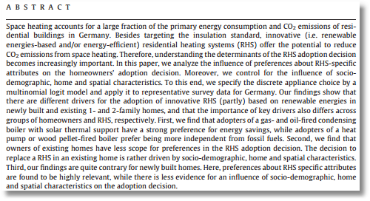

Slide 44
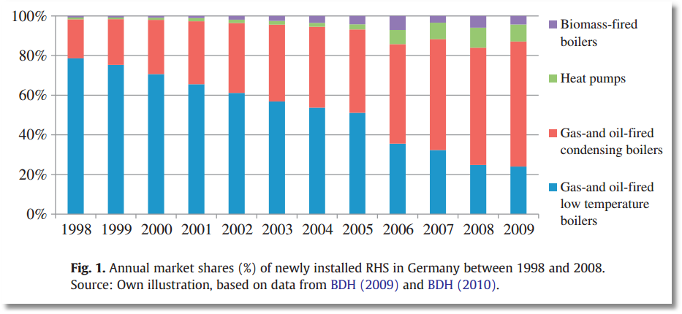

Slide 45
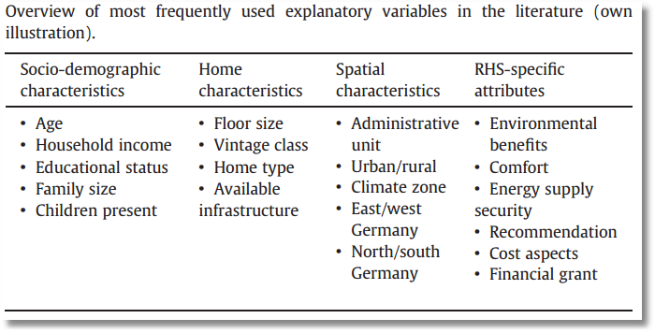

Slide 46
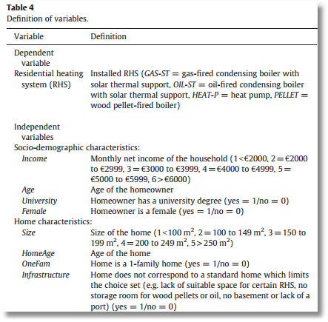
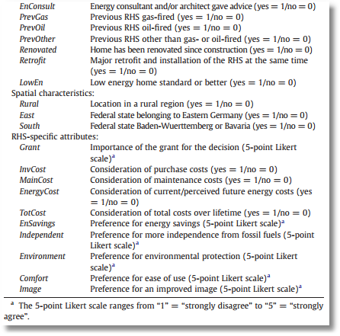

Slide 47
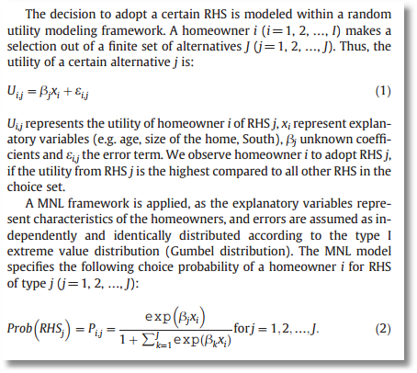
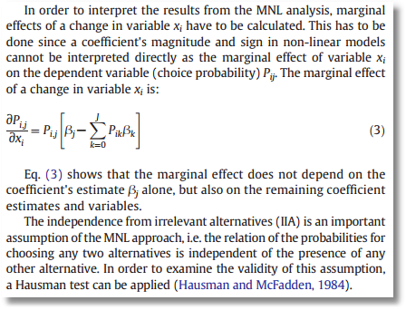
This is a (choice invariant) characteristics only choice model

Slide 48
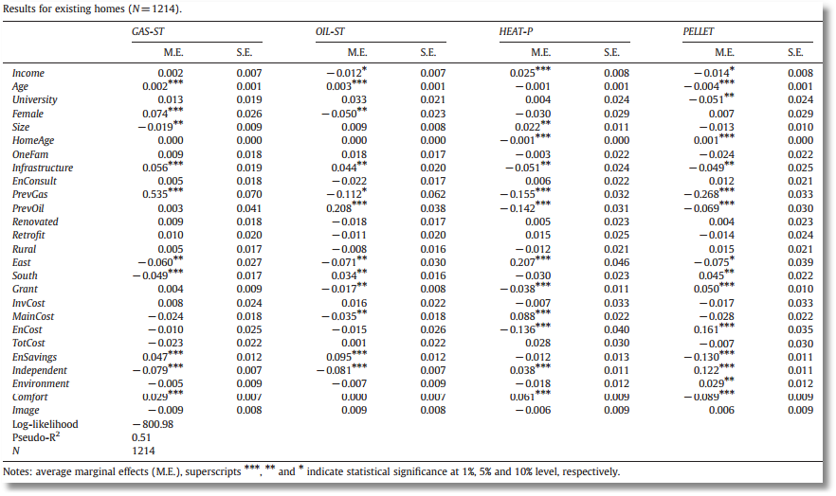
These are derivatives of the probabilities. Note that the rows all sum to zero as Σ_{j} P_{j} = 1.

Slide 49
The I.I.D Assumption
U_{itj} = α_{ij} + β’x_{itj} + γ’z_{it} + ε_{ijt}
  F(ε_{itj}) = Exp(-Exp(-εitj)) (random part of each utility)
  Independence across utility functions
  Identical variances (means absorbed in constants)
Restriction on equal scaling may be inappropriate
Correlation across alternatives may be suppressed
Equal cross elasticities is a substantive restriction
Behavioral implication of IID is independence from irrelevant
alternatives. If an alternative is removed, probability is
spread equally across the remaining alternatives. This is
unreasonable

Slide 50
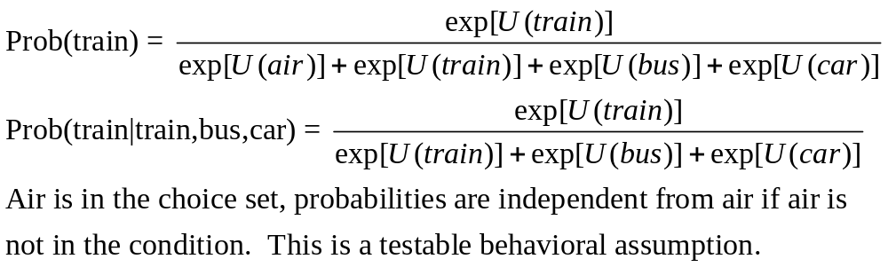
IIA Implication of IID

Slide 51
+---------------------------------------------------+
| Elasticity averaged over observations.|
| Attribute is INVT in choice AIR |
| Mean St.Dev |
| * Choice=AIR -.2055 .0666 |
| Choice=TRAIN .0903 .0681 |
| Choice=BUS .0903 .0681 |
| Choice=CAR .0903 .0681 |
+---------------------------------------------------+
| Attribute is INVT in choice TRAIN |
| Choice=AIR .3568 .1231 |
| * Choice=TRAIN -.9892 .5217 |
| Choice=BUS .3568 .1231 |
| Choice=CAR .3568 .1231 |
+---------------------------------------------------+
| Attribute is INVT in choice BUS |
| Choice=AIR .1889 .0743 |
| Choice=TRAIN .1889 .0743 |
| * Choice=BUS -1.2040 .4803 |
| Choice=CAR .1889 .0743 |
+---------------------------------------------------+
| Attribute is INVT in choice CAR |
| Choice=AIR .3174 .1195 |
| Choice=TRAIN .3174 .1195 |
| Choice=BUS .3174 .1195 |
| * Choice=CAR -.9510 .5504 |
+---------------------------------------------------+
| Effects on probabilities of all choices in model: |
| * = Direct Elasticity effect of the attribute. |
+---------------------------------------------------+
Behavioral Implication of IIA
Own effect
Cross effects
Note the effect of IIA on the cross effects.
Elasticities are computed for each observation; the mean and standard deviation are then computed across the sample observations.

Slide 52
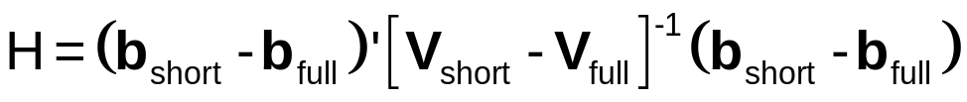
A Hausman and McFadden Test for IIA
Estimate full model with “irrelevant alternatives”
Estimate the short model eliminating the irrelevant alternatives
  Eliminate individuals who chose the irrelevant alternatives
  Drop attributes that are constant in the surviving choice set.
Do the coefficients change? Under the IIA assumption, they should not.
  Use a Hausman test:
  Chi-squared, d.f. Number of parameters estimated

Slide 53
IIA Test for Choice AIR
+--------+--------------+----------------+--------+--------+
|Variable| Coefficient | Standard Error |b/St.Er.|P[|Z|>z]|
+--------+--------------+----------------+--------+--------+
GC | .06929537 .01743306 3.975 .0001
TTME | -.10364955 .01093815 -9.476 .0000
INVC | -.08493182 .01938251 -4.382 .0000
INVT | -.01333220 .00251698 -5.297 .0000
AASC | 5.20474275 .90521312 5.750 .0000
TASC | 4.36060457 .51066543 8.539 .0000
BASC | 3.76323447 .50625946 7.433 .0000
+--------+--------------+----------------+--------+--------+
GC | .53961173 .14654681 3.682 .0002
TTME | -.06847037 .01674719 -4.088 .0000
INVC | -.58715772 .14955000 -3.926 .0001
INVT | -.09100015 .02158271 -4.216 .0000
TASC | 4.62957401 .81841212 5.657 .0000
BASC | 3.27415138 .76403628 4.285 .0000
Matrix IIATEST has 1 rows and 1 columns.
1
+--------------
1| 33.78445 Test statistic
+------------------------------------+
| Listed Calculator Results |
+------------------------------------+
Result = 9.487729 Critical value
IIA is rejected

Slide 54
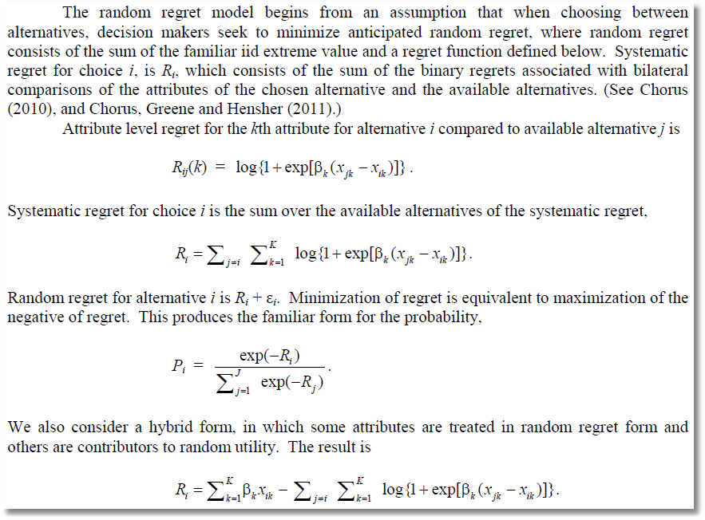
Alternative to Utility Maximization (!)
Minimizing Random Regret

Slide 55
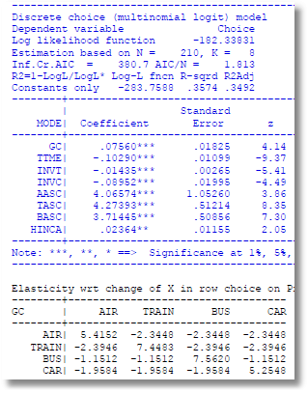
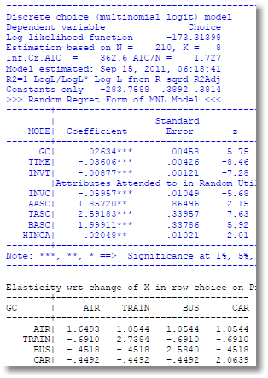
RUM vs. Random Regret

Slide 56
A Stated Choice Experiment

Slide 57
Stated Choice Experiment: Unlabeled Alternatives
1 observation = 8 stated choice tasks
t=1
t=2
t=3
t=4
t=5
t=6
t=7
t=8

Slide 58
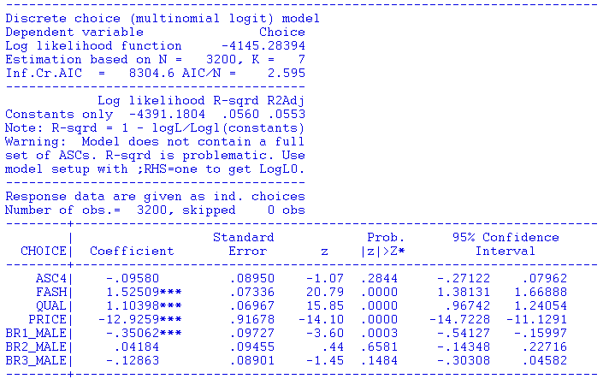
This is 400 sets of 8 repetitions by the same person. How do we tie these observations together to account for the common underlying preferences?

Slide 59
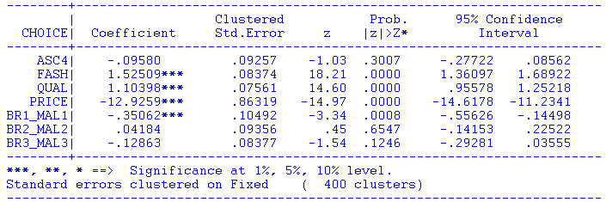
“Clustering” the standard errors does not address the problem. The estimates do not account for the connections within the groups.

Slide 60
Rank Data and Best/Worst

Slide 61


Slide 62
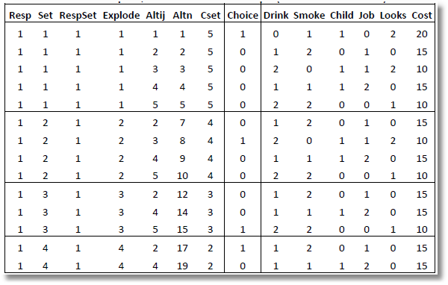
Rank Data and Exploded Logit
Ranks = 1,3,5,2,4
Alt 1 is the best overall
Alt 3 is the best among
remaining alts 2,3,4,5
Alt 5 is the best among
remaining alts 2,4,5
Alt 2 is the best among remaining alts 2,4
Alt 4 is the worst.

Slide 63
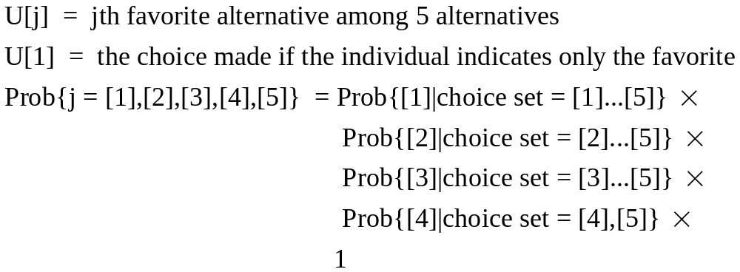
Exploded Logit

Slide 64
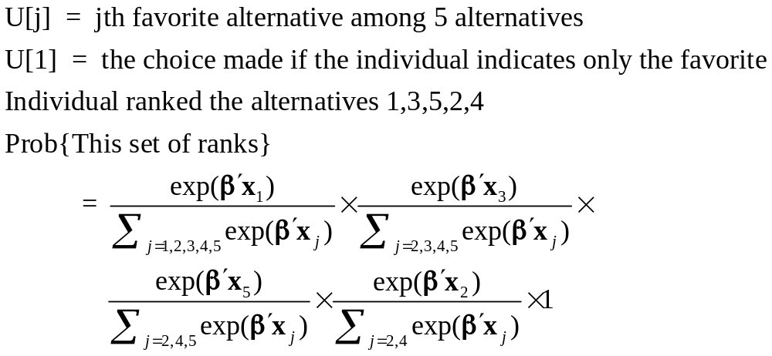
Exploded Logit

Slide 65
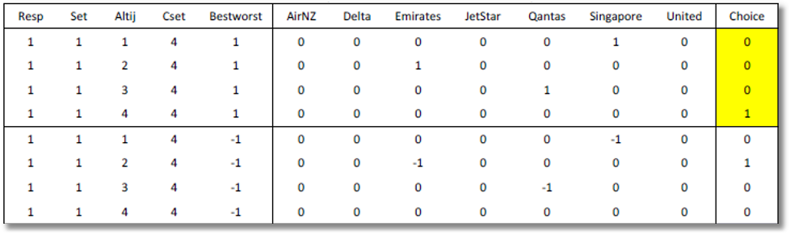
Best Worst
Individual simultaneously ranks best and worst alternatives.
Prob(alt j) = best = exp[U(j)] / Σ_{m}exp[U(m)]
Prob(alt k) = worst = exp[-U(k)] / Σ_{m}exp[-U(m)]

Slide 66
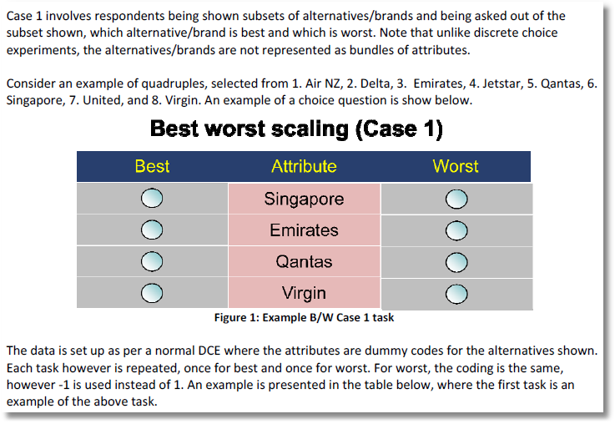

Slide 67
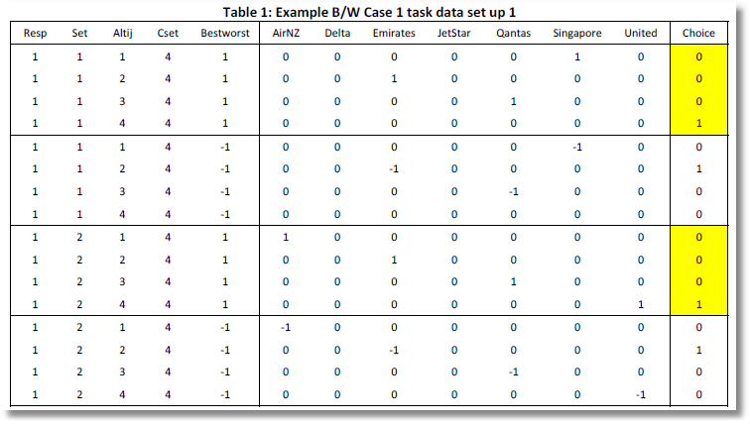
Choices

Slide 68
Best

Slide 69
Worst

Slide 70
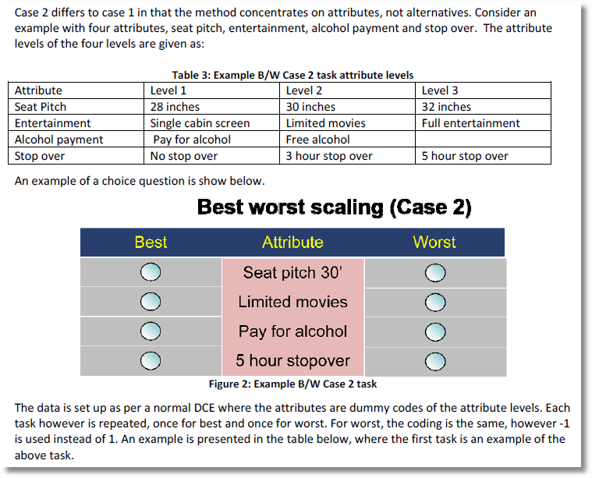

Slide 71
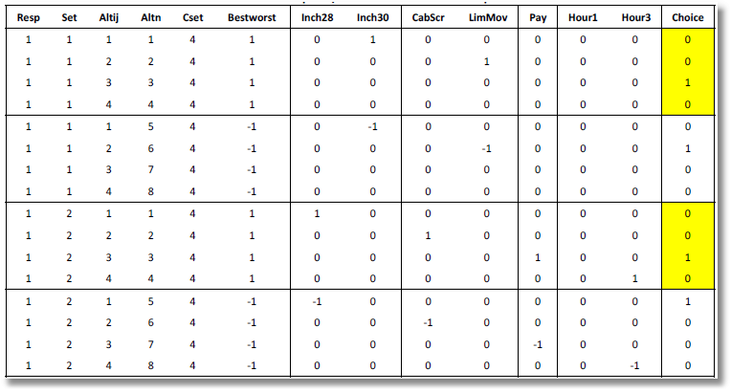
Uses the result that if U(i,j) is the lowest utility, -U(i,j) is the highest.

Slide 72
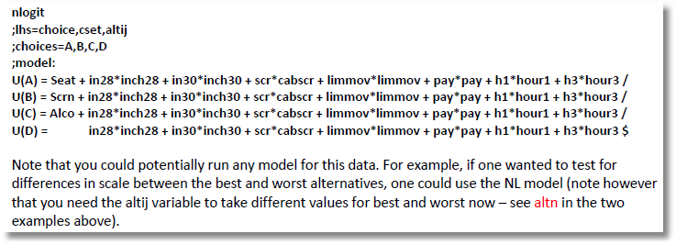
Uses the result that if U(i,j) is the lowest utility, -U(i,j) is the highest.

Slide 73
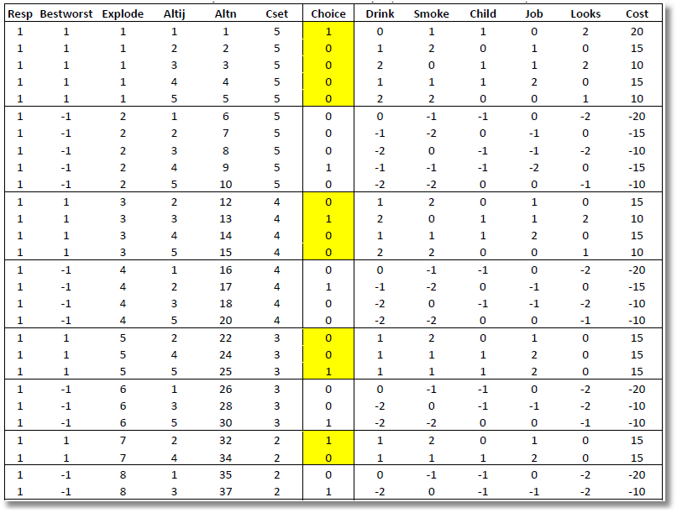

Slide 74
Fixed Effects Multinomial Logit:
Application of Minimum Distance Estimation

Slide 75
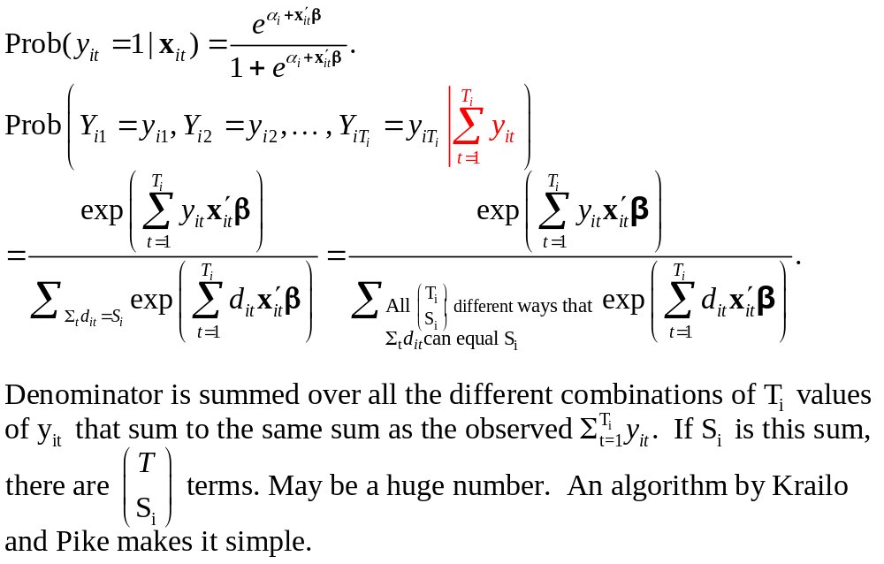
Binary Logit Conditional Probabiities

Slide 76
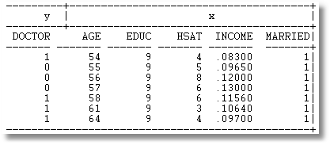

Example: Seven Period Binary Logit

Slide 77



Slide 78



Slide 79

The sample is 200 individuals each observed 50 times.

Slide 80

The data are generated from a probit process with b1 = b2 = .5. But, it is fit as a logit model. The coefficients obey the familiar relationship, 1.6*probit.

Slide 81

Multinomial Logit Model: J+1 choices including a base choice.

Slide 82
Estimation Strategy
Conditional ML of the full MNL model. Impressively complicated.
A Minimum Distance (MDE) Strategy
  Each alternative treated as a binary choice vs. the base provides an estimator of β
    Select subsample that chose either option j or the base
    Estimate β using this binary choice setting
    This provides J different estimators of the same β
  Optimally combine the different estimators of β

Slide 83

Minimum Distance Estimation

Slide 84

MDE Estimation

Slide 85

MDE Estimation

Slide 86


Slide 87


Slide 88


Slide 89


Slide 90


Slide 91



Slide 92


Slide 93


Slide 94
Why a 500 fold increase in speed?
MDE is much faster
Not using Krailo and Pike, or not using efficiently
Numerical derivatives for an extremely messy function (increase the number of function evaluations by at least 5 times)

