Slide 1




Microeconometric Modeling
William Greene
Stern School of Business
New York University
New York NY USA
4.1 Nested Logit and
Multinomial Probit
Models

Slide 2

Concepts
Models
Correlation
Random Utility
RU1 and RU2
Tree
2 Step vs. FIML
Decomposition of Elasticity
Degenerate Branch
Scaling
Normalization
Stata/MPROBIT
Multinomial Logit
Nested Logit
Best/Worst Nested Logit
Error Components Logit
Multinomial Probit

Slide 3
Extended Formulation of the MNL
Sets of similar alternatives
Compound Utility: U(Alt)=U(Alt|Branch)+U(branch)
Behavioral implications – Correlations within branches
LIMB
Travel
BRANCH
Private
Public
TWIG
Air
Car
Train
Bus

Slide 4
Correlation Structure for a Two Level Model
Within a branch
  Identical variances (IIA (MNL) applies)
  Covariance (all same) = variance at higher level
Branches have different variances (scale factors)
Nested logit probabilities: Generalized Extreme Value
Prob[Alt,Branch] = Prob(branch) * Prob(Alt|Branch)

Slide 5
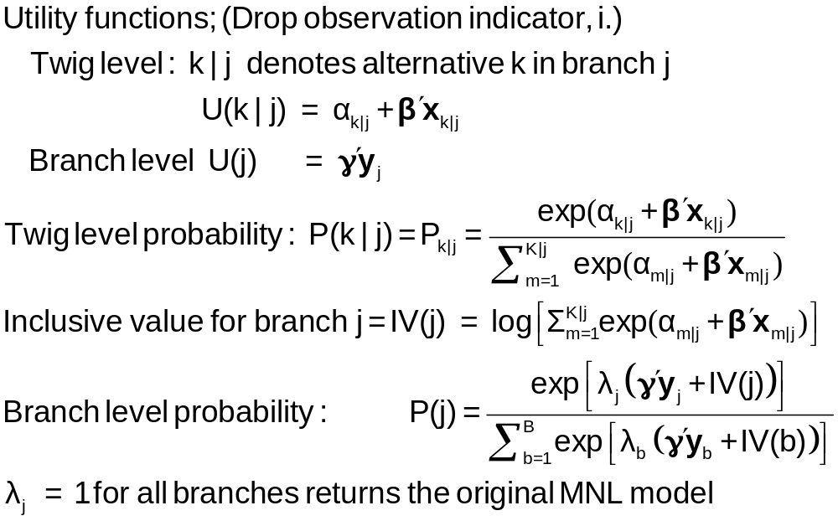
Probabilities for a Nested Logit Model

Slide 6
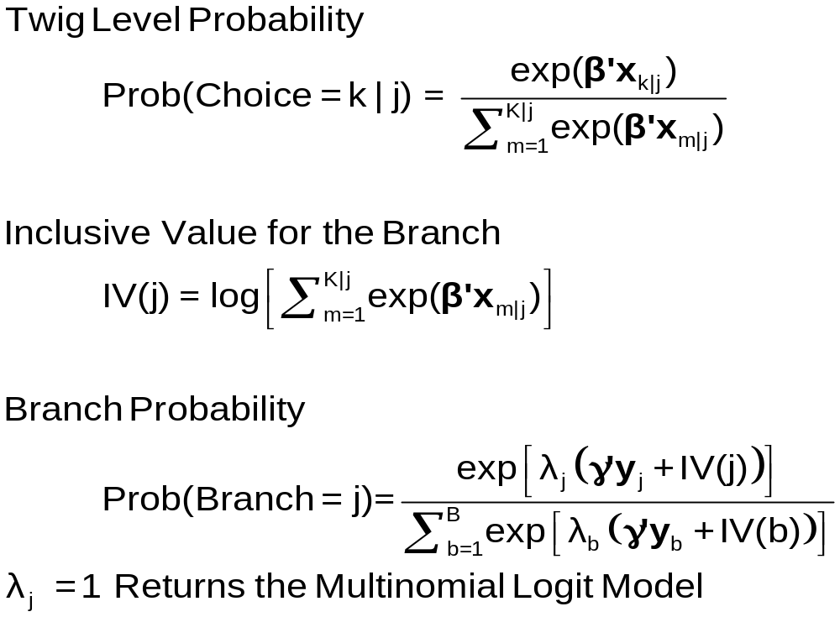
Model Form RU1

Slide 7
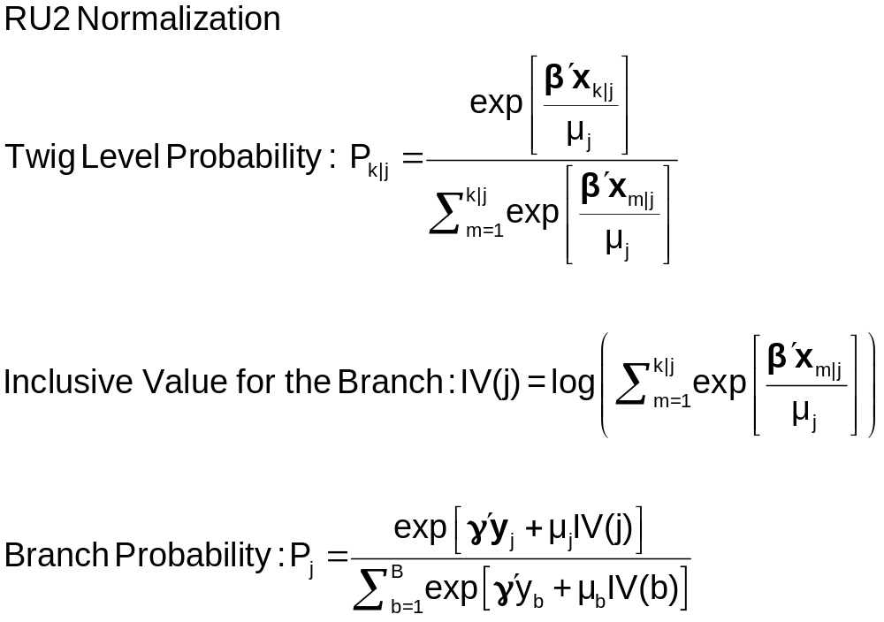
Moving Scaling Down to the Twig Level

Slide 8
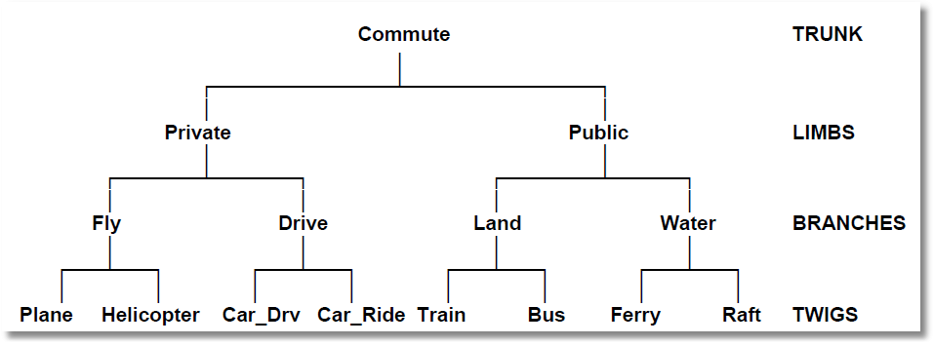
Higher Level Trees
E.g., Location (Neighborhood)
Housing Type (Rent, Buy, House, Apt)
Housing (# Bedrooms)

Slide 9
Estimation Strategy for
Nested Logit Models
Two step estimation (ca. 1980s)
  For each branch, just fit MNL
    Loses efficiency – replicates coefficients
  For branch level, fit separate model, just including y and the inclusive values in the branch level utility function
    Again loses efficiency
Full information ML (current)
Fit the entire model at once, imposing all restrictions

Slide 10
MNL Baseline
-----------------------------------------------------------
Discrete choice (multinomial logit) model
Dependent variable Choice
Log likelihood function -172.94366
Estimation based on N = 210, K = 10
R2=1-LogL/LogL* Log-L fncn R-sqrd R2Adj
Constants only -283.7588 .3905 .3787
Chi-squared[ 7] = 221.63022
Prob [ chi squared > value ] = .00000
Response data are given as ind. choices
Number of obs.= 210, skipped 0 obs
--------+--------------------------------------------------
Variable| Coefficient Standard Error b/St.Er. P[|Z|>z]
--------+--------------------------------------------------
GC| .07578*** .01833 4.134 .0000
TTME| -.10289*** .01109 -9.280 .0000
INVT| -.01399*** .00267 -5.240 .0000
INVC| -.08044*** .01995 -4.032 .0001
A_AIR| 4.37035*** 1.05734 4.133 .0000
AIR_HIN1| .00428 .01306 .327 .7434
A_TRAIN| 5.91407*** .68993 8.572 .0000
TRA_HIN3| -.05907*** .01471 -4.016 .0001
A_BUS| 4.46269*** .72333 6.170 .0000
BUS_HIN4| -.02295 .01592 -1.442 .1493
--------+--------------------------------------------------

Slide 11
FIML Parameter Estimates
-----------------------------------------------------------
FIML Nested Multinomial Logit Model
Dependent variable MODE
Log likelihood function -166.64835
The model has 2 levels.
Random Utility Form 1:IVparms = LMDAb|l
Number of obs.= 210, skipped 0 obs
--------+--------------------------------------------------
Variable| Coefficient Standard Error b/St.Er. P[|Z|>z]
--------+--------------------------------------------------
|Attributes in the Utility Functions (beta)
GC| .06579*** .01878 3.504 .0005
TTME| -.07738*** .01217 -6.358 .0000
INVT| -.01335*** .00270 -4.948 .0000
INVC| -.07046*** .02052 -3.433 .0006
A_AIR| 2.49364** 1.01084 2.467 .0136
AIR_HIN1| .00357 .01057 .337 .7358
A_TRAIN| 3.49867*** .80634 4.339 .0000
TRA_HIN3| -.03581*** .01379 -2.597 .0094
A_BUS| 2.30142*** .81284 2.831 .0046
BUS_HIN4| -.01128 .01459 -.773 .4395
|IV parameters, lambda(b|l),gamma(l)
PRIVATE| 2.16095*** .47193 4.579 .0000
PUBLIC| 1.56295*** .34500 4.530 .0000
--------+--------------------------------------------------

Slide 12
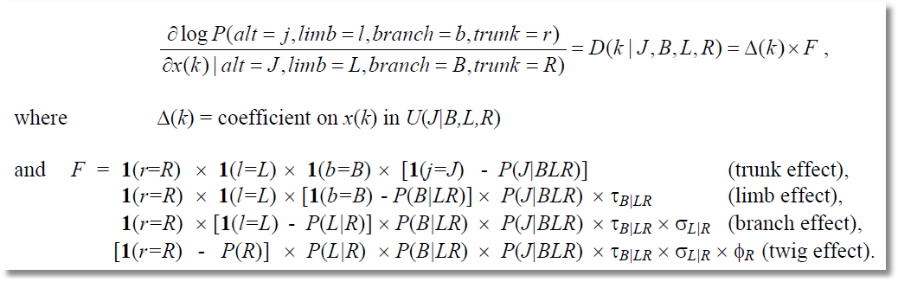
Elasticities Decompose Additively

Slide 13
+-----------------------------------------------------------------------+
| Elasticity averaged over observations. |
| Attribute is INVC in choice AIR |
| Decomposition of Effect if Nest Total Effect|
| Trunk Limb Branch Choice Mean St.Dev|
| Branch=PRIVATE |
| * Choice=AIR .000 .000 -2.456 -3.091 -5.547 3.525 |
| Choice=CAR .000 .000 -2.456 2.916 .460 3.178 |
| Branch=PUBLIC |
| Choice=TRAIN .000 .000 3.846 .000 3.846 4.865 |
| Choice=BUS .000 .000 3.846 .000 3.846 4.865 |
+-----------------------------------------------------------------------+
| Attribute is INVC in choice CAR |
| Branch=PRIVATE |
| Choice=AIR .000 .000 -.757 .650 -.107 .589 |
| * Choice=CAR .000 .000 -.757 -.830 -1.587 1.292 |
| Branch=PUBLIC |
| Choice=TRAIN .000 .000 .647 .000 .647 .605 |
| Choice=BUS .000 .000 .647 .000 .647 .605 |
+-----------------------------------------------------------------------+
| Attribute is INVC in choice TRAIN |
| Branch=PRIVATE |
| Choice=AIR .000 .000 1.340 .000 1.340 1.475 |
| Choice=CAR .000 .000 1.340 .000 1.340 1.475 |
| Branch=PUBLIC |
| * Choice=TRAIN .000 .000 -1.986 -1.490 -3.475 2.539 |
| Choice=BUS .000 .000 -1.986 2.128 .142 1.321 |
+-----------------------------------------------------------------------+
| * indicates direct Elasticity effect of the attribute. |
+-----------------------------------------------------------------------+

Slide 14
Testing vs. the MNL
Log likelihood for the NL model
Constrain IV parameters to equal 1 with
; IVSET(list of branches)=[1]
Use likelihood ratio test
For the example:
  LogL (NL) = -166.68435
  LogL (MNL) = -172.94366
  Chi-squared with 2 d.f. = 2(-166.68435-(-172.94366))
  = 12.51862
  The critical value is 5.99 (95%)
  The MNL (and a fortiori, IIA) is rejected

Slide 15
Degenerate Branches
LIMB
Travel
BRANCH
Fly
Ground
TWIG
Air
Train
Car
Bus

Slide 16
NL Model with a Degenerate Branch
-----------------------------------------------------------
FIML Nested Multinomial Logit Model
Dependent variable MODE
Log likelihood function -148.63860
--------+--------------------------------------------------
Variable| Coefficient Standard Error b/St.Er. P[|Z|>z]
--------+--------------------------------------------------
|Attributes in the Utility Functions (beta)
GC| .44230*** .11318 3.908 .0001
TTME| -.10199*** .01598 -6.382 .0000
INVT| -.07469*** .01666 -4.483 .0000
INVC| -.44283*** .11437 -3.872 .0001
A_AIR| 3.97654*** 1.13637 3.499 .0005
AIR_HIN1| .02163 .01326 1.631 .1028
A_TRAIN| 6.50129*** 1.01147 6.428 .0000
TRA_HIN2| -.06427*** .01768 -3.635 .0003
A_BUS| 4.52963*** .99877 4.535 .0000
BUS_HIN3| -.01596 .02000 -.798 .4248
|IV parameters, lambda(b|l),gamma(l)
FLY| .86489*** .18345 4.715 .0000
GROUND| .24364*** .05338 4.564 .0000
--------+--------------------------------------------------

Slide 17
Simulation
NLOGIT ; lhs=mode;rhs=gc,ttme,invt,invc ; rh2=one,hinc; choices=air,train,bus,car
; tree=Travel[Private(Air,Car),Public(Train,Bus)] ; ru1
; simulation = * ; scenario:gc(car)=[*]1.5
|Simulations of Probability Model |
|Model: FIML: Nested Multinomial Logit Model |
|Number of individuals is the probability times the |
|number of observations in the simulated sample. |
|Column totals may be affected by rounding error. |
|The model used was simulated with 210 observations.|
Specification of scenario 1 is:
Attribute Alternatives affected Change type Value
--------- ------------------------------- ------------------- ---------
GC CAR Scale base by value 1.500
Simulated Probabilities (shares) for this scenario:
+----------+--------------+--------------+------------------+
|Choice | Base | Scenario | Scenario - Base |
| |%Share Number |%Share Number |ChgShare ChgNumber|
+----------+--------------+--------------+------------------+
|AIR | 26.515 56 | 8.854 19 |-17.661% -37 |
|CAR | 29.200 61 | 6.836 14 |-22.364% -47 |
|TRAIN | 29.782 63 | 12.487 26 |-17.296% -37 |
|BUS | 14.504 30 | 71.824 151 | 57.320% 121 |
|Total |100.000 210 |100.000 210 | .000% 0 |
+----------+--------------+--------------+------------------+

Slide 18
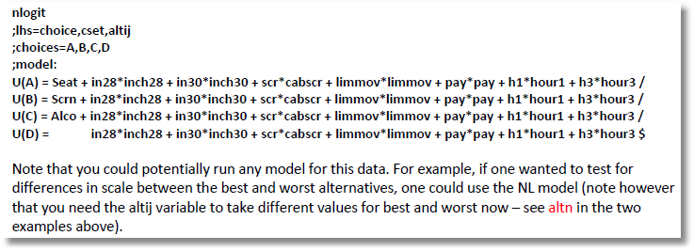
Nested Logit Approach for Best/Worst
Uses the result that if U(i,j) is the lowest utility, -U(i,j) is the highest.

Slide 19
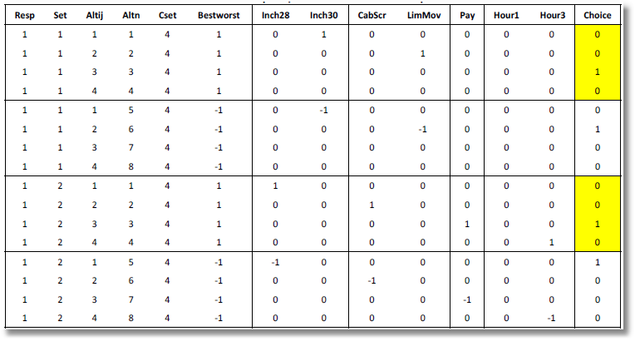
Nested Logit Approach

Slide 20
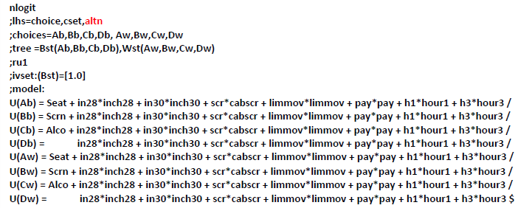
Nested Logit Approach
Different Scaling for Worst
8 choices are two blocks of 4.
Best in one brance, worst in the second branch

Slide 21
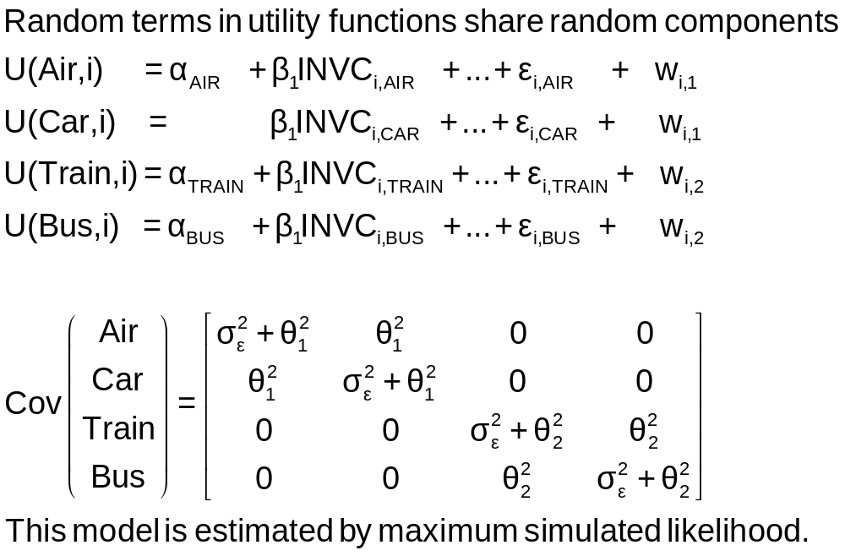
An Error Components Model

Slide 22
Error Components
Logit Model
-----------------------------------------------------------
Error Components (Random Effects) model
Dependent variable MODE
Log likelihood function -182.27368
Response data are given as ind. choices
Replications for simulated probs. = 25
Halton sequences used for simulations
ECM model with panel has 70 groups
Fixed number of obsrvs./group= 3
Hessian is not PD. Using BHHH estimator
Number of obs.= 210, skipped 0 obs
--------+--------------------------------------------------
Variable| Coefficient Standard Error b/St.Er. P[|Z|>z]
--------+--------------------------------------------------
|Nonrandom parameters in utility functions
GC| .07293*** .01978 3.687 .0002
TTME| -.10597*** .01116 -9.499 .0000
INVT| -.01402*** .00293 -4.787 .0000
INVC| -.08825*** .02206 -4.000 .0001
A_AIR| 5.31987*** .90145 5.901 .0000
A_TRAIN| 4.46048*** .59820 7.457 .0000
A_BUS| 3.86918*** .67674 5.717 .0000
|Standard deviations of latent random effects
SigmaE01| .27336 3.25167 .084 .9330
SigmaE02| 1.21988 .94292 1.294 .1958
--------+--------------------------------------------------

Slide 23
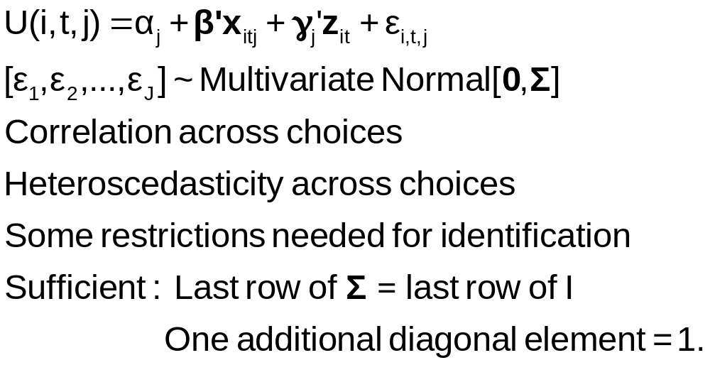
The Multinomial Probit Model

Slide 24
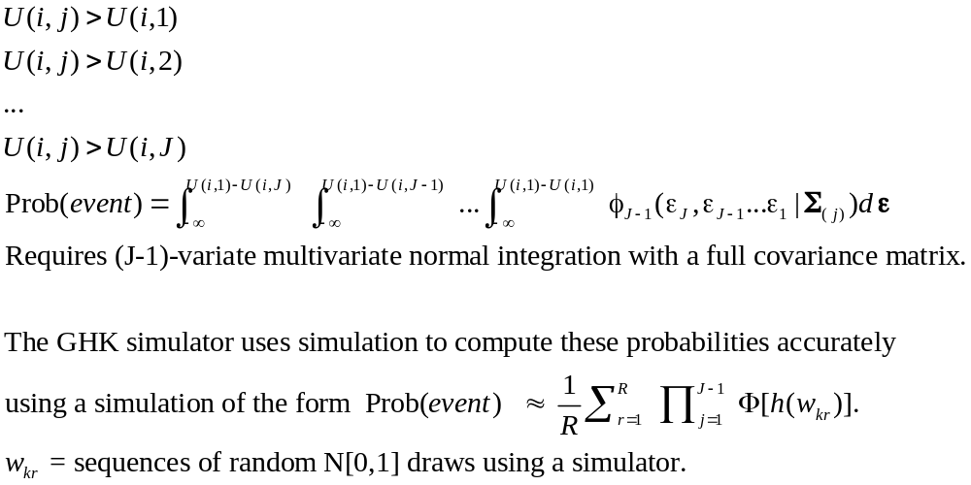
Multinomial Probit Probabilities

Slide 25
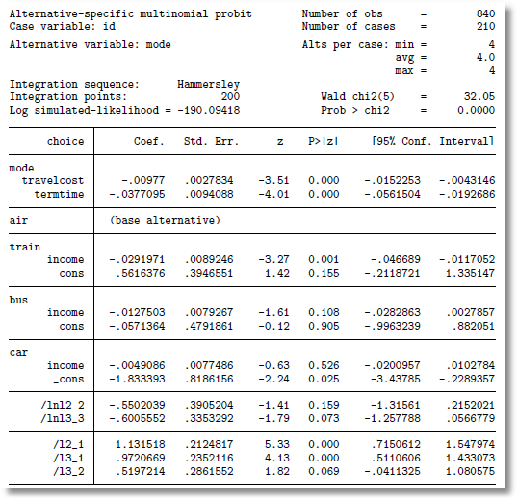
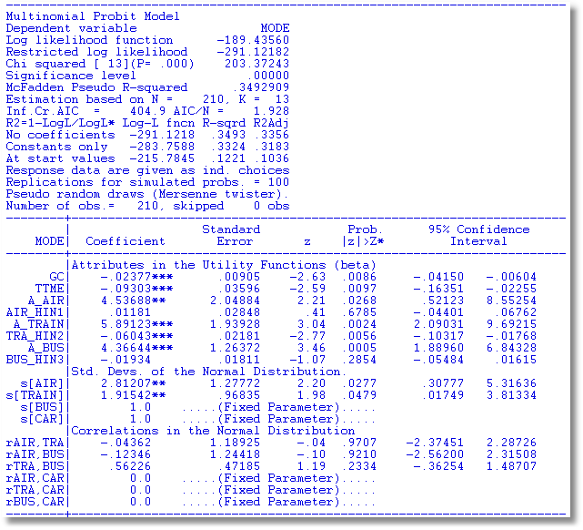
The problem of just reporting coefficients
Stata: AIR = “base alternative” Normalizes on CAR

Slide 26
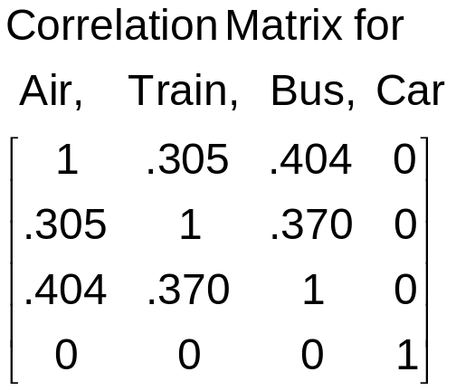
Multinomial Probit Model
+---------------------------------------------+
| Multinomial Probit Model |
| Dependent variable MODE |
| Number of observations 210 ||
| Log likelihood function -184.7619 | Not comparable to MNL
| Response data are given as ind. choice. |
+---------------------------------------------+
+--------+--------------+----------------+--------+--------+
|Variable| Coefficient | Standard Error |b/St.Er.|P[|Z|>z]|
+--------+--------------+----------------+--------+--------+
---------+Attributes in the Utility Functions (beta)
GC | .10822534 .04339733 2.494 .0126
TTME | -.08973122 .03381432 -2.654 .0080
INVC | -.13787970 .05010551 -2.752 .0059
INVT | -.02113622 .00727190 -2.907 .0037
AASC | 3.24244623 1.57715164 2.056 .0398
TASC | 4.55063845 1.46158257 3.114 .0018
BASC | 4.02415398 1.28282031 3.137 .0017
---------+Std. Devs. of the Normal Distribution.
s[AIR] | 3.60695794 1.42963795 2.523 .0116
s[TRAIN]| 1.59318892 .81711159 1.950 .0512
s[BUS] | 1.00000000 ......(Fixed Parameter).......
s[CAR] | 1.00000000 ......(Fixed Parameter).......
---------+Correlations in the Normal Distribution
rAIR,TRA| .30491746 .49357120 .618 .5367
rAIR,BUS| .40383018 .63548534 .635 .5251
rTRA,BUS| .36973127 .42310789 .874 .3822
rAIR,CAR| .000000 ......(Fixed Parameter).......
rTRA,CAR| .000000 ......(Fixed Parameter).......
rBUS,CAR| .000000 ......(Fixed Parameter).......

Slide 27
Multinomial Probit Elasticities
+---------------------------------------------------+
| Elasticity averaged over observations.|
| Attribute is INVC in choice AIR |
| Effects on probabilities of all choices in model: |
| * = Direct Elasticity effect of the attribute. |
| Mean St.Dev |
| * Choice=AIR -4.2785 1.7182 |
| Choice=TRAIN 1.9910 1.6765 |
| Choice=BUS 2.6722 1.8376 |
| Choice=CAR 1.4169 1.3250 |
| Attribute is INVC in choice TRAIN |
| Choice=AIR .8827 .8711 |
| * Choice=TRAIN -6.3979 5.8973 |
| Choice=BUS 3.6442 2.6279 |
| Choice=CAR 1.9185 1.5209 |
| Attribute is INVC in choice BUS |
| Choice=AIR .3879 .6303 |
| Choice=TRAIN 1.2804 2.1632 |
| * Choice=BUS -7.4014 4.5056 |
| Choice=CAR 1.5053 2.5220 |
| Attribute is INVC in choice CAR |
| Choice=AIR .2593 .2529 |
| Choice=TRAIN .8457 .8093 |
| Choice=BUS 1.7532 1.3878 |
| * Choice=CAR -2.6657 3.0418 |
+---------------------------------------------------+
Multinomial Logit
+---------------------------+
| INVC in AIR |
| Mean St.Dev |
| * -5.0216 2.3881 |
| 2.2191 2.6025 |
| 2.2191 2.6025 |
| 2.2191 2.6025 |
| INVC in TRAIN |
| 1.0066 .8801 |
| * -3.3536 2.4168 |
| 1.0066 .8801 |
| 1.0066 .8801 |
| INVC in BUS |
| .4057 .6339 |
| .4057 .6339 |
| * -2.4359 1.1237 |
| .4057 .6339 |
| INVC in CAR |
| .3944 .3589 |
| .3944 .3589 |
| .3944 .3589 |
| * -1.3888 1.2161 |
+---------------------------+

Slide 28
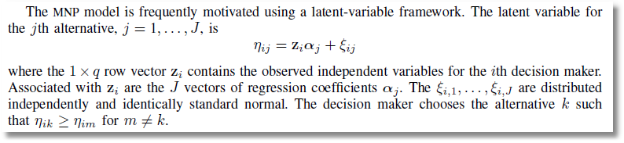
Not the Multinomial Probit Model
MPROBIT
This is identical to the multinomial logit – a trivial difference of scaling that disappears from the partial effects.
(Use ASMProbit for a true multinomial probit model.)

Slide 29
Scaling in Choice Models

Slide 30
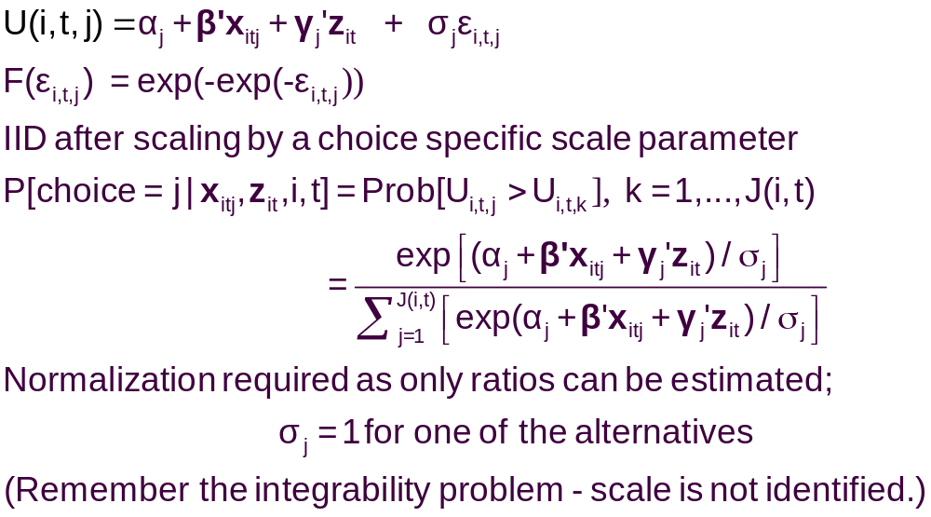
A Model with Choice Heteroscedasticity

Slide 31
Heteroscedastic Extreme Value Model (1)
+---------------------------------------------+
| Start values obtained using MNL model |
| Maximum Likelihood Estimates |
| Log likelihood function -184.5067 |
| Dependent variable Choice |
| Response data are given as ind. choice. |
| Number of obs.= 210, skipped 0 bad obs. |
+---------------------------------------------+
+--------+--------------+----------------+--------+--------+
|Variable| Coefficient | Standard Error |b/St.Er.|P[|Z|>z]|
+--------+--------------+----------------+--------+--------+
GC | .06929537 .01743306 3.975 .0001
TTME | -.10364955 .01093815 -9.476 .0000
INVC | -.08493182 .01938251 -4.382 .0000
INVT | -.01333220 .00251698 -5.297 .0000
AASC | 5.20474275 .90521312 5.750 .0000
TASC | 4.36060457 .51066543 8.539 .0000
BASC | 3.76323447 .50625946 7.433 .0000

Slide 32
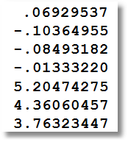
Heteroscedastic Extreme Value Model (2)
+---------------------------------------------+
| Heteroskedastic Extreme Value Model |
| Log likelihood function -182.4440 | (MNL logL was -184.5067)
| Number of parameters 10 |
| Restricted log likelihood -291.1218 |
+---------------------------------------------+
+--------+--------------+----------------+--------+--------+
|Variable| Coefficient | Standard Error |b/St.Er.|P[|Z|>z]|
+--------+--------------+----------------+--------+--------+
---------+Attributes in the Utility Functions (beta)
GC | .11903513 .06402510 1.859 .0630
TTME | -.11525581 .05721397 -2.014 .0440
INVC | -.15515877 .07928045 -1.957 .0503
INVT | -.02276939 .01122762 -2.028 .0426
AASC | 4.69411460 2.48091789 1.892 .0585
TASC | 5.15629868 2.05743764 2.506 .0122
BASC | 5.03046595 1.98259353 2.537 .0112
---------+Scale Parameters of Extreme Value Distns Minus 1.0
s_AIR | -.57864278 .21991837 -2.631 .0085
s_TRAIN | -.45878559 .34971034 -1.312 .1896
s_BUS | .26094835 .94582863 .276 .7826
s_CAR | .000000 ......(Fixed Parameter).......
---------+Std.Dev=pi/(theta*sqr(6)) for H.E.V. distribution.
s_AIR | 3.04385384 1.58867426 1.916 .0554
s_TRAIN | 2.36976283 1.53124258 1.548 .1217
s_BUS | 1.01713111 .76294300 1.333 .1825
s_CAR | 1.28254980 ......(Fixed Parameter).......
Normalized for estimation
Structural parameters

Slide 33
HEV Model - Elasticities
+---------------------------------------------------+
| Elasticity averaged over observations.|
| Attribute is INVC in choice AIR |
| Effects on probabilities of all choices in model: |
| * = Direct Elasticity effect of the attribute. |
| Mean St.Dev |
| * Choice=AIR -4.2604 1.6745 |
| Choice=TRAIN 1.5828 1.9918 |
| Choice=BUS 3.2158 4.4589 |
| Choice=CAR 2.6644 4.0479 |
| Attribute is INVC in choice TRAIN |
| Choice=AIR .7306 .5171 |
| * Choice=TRAIN -3.6725 4.2167 |
| Choice=BUS 2.4322 2.9464 |
| Choice=CAR 1.6659 1.3707 |
| Attribute is INVC in choice BUS |
| Choice=AIR .3698 .5522 |
| Choice=TRAIN .5949 1.5410 |
| * Choice=BUS -6.5309 5.0374 |
| Choice=CAR 2.1039 8.8085 |
| Attribute is INVC in choice CAR |
| Choice=AIR .3401 .3078 |
| Choice=TRAIN .4681 .4794 |
| Choice=BUS 1.4723 1.6322 |
| * Choice=CAR -3.5584 9.3057 |
+---------------------------------------------------+
Multinomial Logit
+---------------------------+
| INVC in AIR |
| Mean St.Dev |
| * -5.0216 2.3881 |
| 2.2191 2.6025 |
| 2.2191 2.6025 |
| 2.2191 2.6025 |
| INVC in TRAIN |
| 1.0066 .8801 |
| * -3.3536 2.4168 |
| 1.0066 .8801 |
| 1.0066 .8801 |
| INVC in BUS |
| .4057 .6339 |
| .4057 .6339 |
| * -2.4359 1.1237 |
| .4057 .6339 |
| INVC in CAR |
| .3944 .3589 |
| .3944 .3589 |
| .3944 .3589 |
| * -1.3888 1.2161 |
+---------------------------+

Slide 34
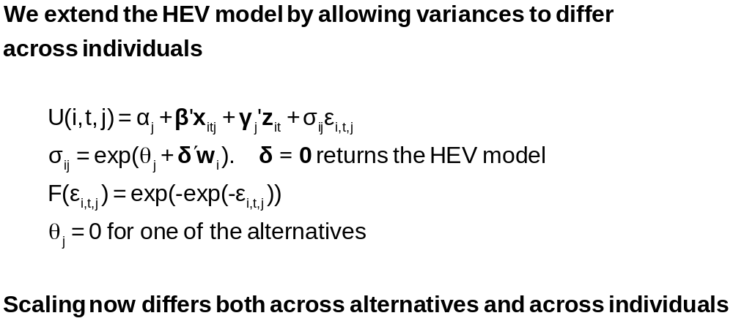
Variance Heterogeneity in MNL

Slide 35
Application: Shoe Brand Choice
Simulated Data: Stated Choice, 400 respondents, 8 choice situations, 3,200 observations
3 choice/attributes + NONE
  Fashion = High / Low
  Quality = High / Low
  Price = 25/50/75,100 coded 1,2,3,4
Heterogeneity: Sex, Age (<25, 25-39, 40+)
Underlying data generated by a 3 class latent class process (100, 200, 100 in classes)

Slide 36
Multinomial Logit Baseline Values
+---------------------------------------------+
| Discrete choice (multinomial logit) model |
| Number of observations 3200 |
| Log likelihood function -4158.503 |
| Number of obs.= 3200, skipped 0 bad obs. |
+---------------------------------------------+
+--------+--------------+----------------+--------+--------+
|Variable| Coefficient | Standard Error |b/St.Er.|P[|Z|>z]|
+--------+--------------+----------------+--------+--------+
FASH | 1.47890473 .06776814 21.823 .0000
QUAL | 1.01372755 .06444532 15.730 .0000
PRICE | -11.8023376 .80406103 -14.678 .0000
ASC4 | .03679254 .07176387 .513 .6082

Slide 37
Multinomial Logit Elasticities
+---------------------------------------------------+
| Elasticity averaged over observations.|
| Attribute is PRICE in choice BRAND1 |
| Effects on probabilities of all choices in model: |
| * = Direct Elasticity effect of the attribute. |
| Mean St.Dev |
| * Choice=BRAND1 -.8895 .3647 |
| Choice=BRAND2 .2907 .2631 |
| Choice=BRAND3 .2907 .2631 |
| Choice=NONE .2907 .2631 |
| Attribute is PRICE in choice BRAND2 |
| Choice=BRAND1 .3127 .1371 |
| * Choice=BRAND2 -1.2216 .3135 |
| Choice=BRAND3 .3127 .1371 |
| Choice=NONE .3127 .1371 |
| Attribute is PRICE in choice BRAND3 |
| Choice=BRAND1 .3664 .2233 |
| Choice=BRAND2 .3664 .2233 |
| * Choice=BRAND3 -.7548 .3363 |
| Choice=NONE .3664 .2233 |
+---------------------------------------------------+

Slide 38
HEV Model without Heterogeneity
+---------------------------------------------+
| Heteroskedastic Extreme Value Model |
| Dependent variable CHOICE |
| Number of observations 3200 |
| Log likelihood function -4151.611 |
| Response data are given as ind. choice. |
+---------------------------------------------+
+--------+--------------+----------------+--------+--------+
|Variable| Coefficient | Standard Error |b/St.Er.|P[|Z|>z]|
+--------+--------------+----------------+--------+--------+
---------+Attributes in the Utility Functions (beta)
FASH | 1.57473345 .31427031 5.011 .0000
QUAL | 1.09208463 .22895113 4.770 .0000
PRICE | -13.3740754 2.61275111 -5.119 .0000
ASC4 | -.01128916 .22484607 -.050 .9600
---------+Scale Parameters of Extreme Value Distns Minus 1.0
s_BRAND1| .03779175 .22077461 .171 .8641
s_BRAND2| -.12843300 .17939207 -.716 .4740
s_BRAND3| .01149458 .22724947 .051 .9597
s_NONE | .000000 ......(Fixed Parameter).......
---------+Std.Dev=pi/(theta*sqr(6)) for H.E.V. distribution.
s_BRAND1| 1.23584505 .26290748 4.701 .0000
s_BRAND2| 1.47154471 .30288372 4.858 .0000
s_BRAND3| 1.26797496 .28487215 4.451 .0000
s_NONE | 1.28254980 ......(Fixed Parameter).......
Essentially no differences in variances across choices
Makes sense. Choice labels are meaningless

Slide 39
Homogeneous HEV Elasticities
Multinomial Logit
+---------------------------------------------------+
| Attribute is PRICE in choice BRAND1 |
| Mean St.Dev |
| * Choice=BRAND1 -1.0585 .4526 |
| Choice=BRAND2 .2801 .2573 |
| Choice=BRAND3 .3270 .3004 |
| Choice=NONE .3232 .2969 |
| Attribute is PRICE in choice BRAND2 |
| Choice=BRAND1 .3576 .1481 |
| * Choice=BRAND2 -1.2122 .3142 |
| Choice=BRAND3 .3466 .1426 |
| Choice=NONE .3429 .1411 |
| Attribute is PRICE in choice BRAND3 |
| Choice=BRAND1 .4332 .2532 |
| Choice=BRAND2 .3610 .2116 |
| * Choice=BRAND3 -.8648 .4015 |
| Choice=NONE .4156 .2436 |
+---------------------------------------------------+
| Elasticity averaged over observations.|
| Effects on probabilities of all choices in model: |
| * = Direct Elasticity effect of the attribute. |
+---------------------------------------------------+
+--------------------------+
| PRICE in choice BRAND1|
| Mean St.Dev |
| * -.8895 .3647 |
| .2907 .2631 |
| .2907 .2631 |
| .2907 .2631 |
| PRICE in choice BRAND2|
| .3127 .1371 |
| * -1.2216 .3135 |
| .3127 .1371 |
| .3127 .1371 |
| PRICE in choice BRAND3|
| .3664 .2233 |
| .3664 .2233 |
| * -.7548 .3363 |
| .3664 .2233 |
+--------------------------+

Slide 40
Heteroscedasticity Across Individuals
+---------------------------------------------+
| Heteroskedastic Extreme Value Model | Homog-HEV MNL
| Log likelihood function -4129.518[10] | -4151.611[7] -4158.503[4]
+---------------------------------------------+
+--------+--------------+----------------+--------+--------+
|Variable| Coefficient | Standard Error |b/St.Er.|P[|Z|>z]|
+--------+--------------+----------------+--------+--------+
---------+Attributes in the Utility Functions (beta)
FASH | 1.01640726 .20261573 5.016 .0000
QUAL | .55668491 .11604080 4.797 .0000
PRICE | -7.44758292 1.52664112 -4.878 .0000
ASC4 | .18300524 .09678571 1.891 .0586
---------+Scale Parameters of Extreme Value Distributions
s_BRAND1| .81114924 .10099174 8.032 .0000
s_BRAND2| .72713522 .08931110 8.142 .0000
s_BRAND3| .80084114 .10316939 7.762 .0000
s_NONE | 1.00000000 ......(Fixed Parameter).......
---------+Heterogeneity in Scales of Ext.Value Distns.
MALE | .21512161 .09359521 2.298 .0215
AGE25 | .79346679 .13687581 5.797 .0000
AGE39 | .38284617 .16129109 2.374 .0176

Slide 41
Variance Heterogeneity Elasticities
Multinomial Logit
+---------------------------------------------------+
| Attribute is PRICE in choice BRAND1 |
| Mean St.Dev |
| * Choice=BRAND1 -.8978 .5162 |
| Choice=BRAND2 .2269 .2595 |
| Choice=BRAND3 .2507 .2884 |
| Choice=NONE .3116 .3587 |
| Attribute is PRICE in choice BRAND2 |
| Choice=BRAND1 .2853 .1776 |
| * Choice=BRAND2 -1.0757 .5030 |
| Choice=BRAND3 .2779 .1669 |
| Choice=NONE .3404 .2045 |
| Attribute is PRICE in choice BRAND3 |
| Choice=BRAND1 .3328 .2477 |
| Choice=BRAND2 .2974 .2227 |
| * Choice=BRAND3 -.7458 .4468 |
| Choice=NONE .4056 .3025 |
+---------------------------------------------------+
+--------------------------+
| PRICE in choice BRAND1|
| Mean St.Dev |
| * -.8895 .3647 |
| .2907 .2631 |
| .2907 .2631 |
| .2907 .2631 |
| PRICE in choice BRAND2|
| .3127 .1371 |
| * -1.2216 .3135 |
| .3127 .1371 |
| .3127 .1371 |
| PRICE in choice BRAND3|
| .3664 .2233 |
| .3664 .2233 |
| * -.7548 .3363 |
| .3664 .2233 |
+--------------------------+

Slide 42
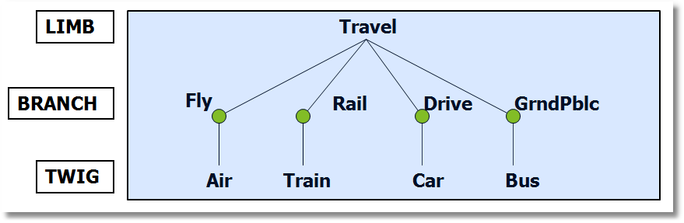
Using Degenerate Branches to Reveal Scaling

Slide 43
Scaling in Transport Modes
-----------------------------------------------------------
FIML Nested Multinomial Logit Model
Dependent variable MODE
Log likelihood function -182.42834
The model has 2 levels.
Nested Logit form:IVparms=Taub|l,r,Sl|r
& Fr.No normalizations imposed a priori
Number of obs.= 210, skipped 0 obs
--------+--------------------------------------------------
Variable| Coefficient Standard Error b/St.Er. P[|Z|>z]
--------+--------------------------------------------------
|Attributes in the Utility Functions (beta)
GC| .09622** .03875 2.483 .0130
TTME| -.08331*** .02697 -3.089 .0020
INVT| -.01888*** .00684 -2.760 .0058
INVC| -.10904*** .03677 -2.966 .0030
A_AIR| 4.50827*** 1.33062 3.388 .0007
A_TRAIN| 3.35580*** .90490 3.708 .0002
A_BUS| 3.11885** 1.33138 2.343 .0192
|IV parameters, tau(b|l,r),sigma(l|r),phi(r)
FLY| 1.65512** .79212 2.089 .0367
RAIL| .92758*** .11822 7.846 .0000
LOCLMASS| 1.00787*** .15131 6.661 .0000
DRIVE| 1.00000 ......(Fixed Parameter)......
NLOGIT ; Lhs=mode
; Rhs=gc,ttme,invt,invc,one
; Choices=air,train,bus,car
; Tree=Fly(Air),
Rail(train),
LoclMass(bus),
Drive(Car)
; ivset:(drive)=[1]$

Slide 44
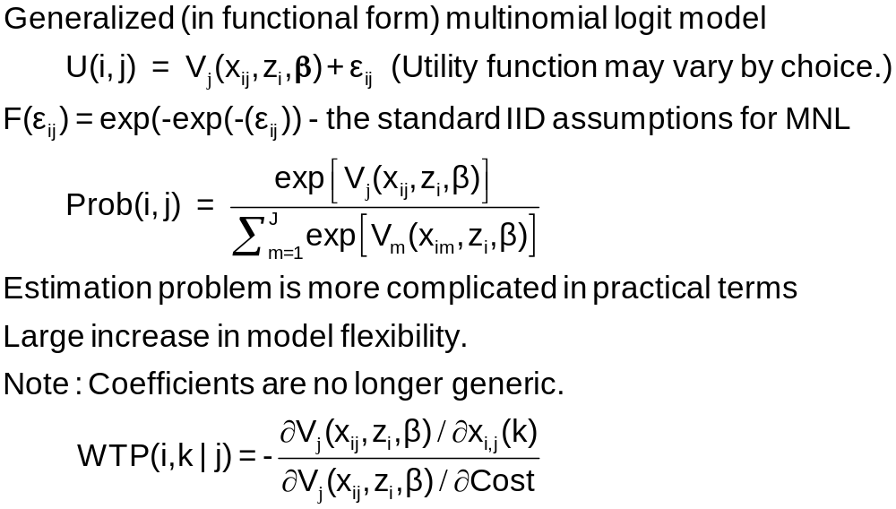
Nonlinear Utility Functions

Slide 45
Assessing Prospect Theoretic Functional Forms and Risk in a Nonlinear Logit Framework: Valuing Reliability Embedded Travel Time Savings
David Hensher
The University of Sydney, ITLS
William Greene
Stern School of Business, New York University
8th Annual Advances in Econometrics Conference
Louisiana State University
Baton Rouge, LA
November 6-8, 2009
Hensher, D., Greene, W., “Embedding Risk Attitude and Decisions Weights in Non-linear Logit to Accommodate Time Variability in the Value of Expected Travel Time Savings,” Transportation Research Part B
Notes:
45

Slide 46
Prospect Theory
Marginal value function for an attribute (outcome)
v(x_{m}) = subjective value of attribute
Decision weight w(p_{m}) = impact of a probability on
utility of a prospect
Value function V(x_{m},p_{m}) = v(x_{m})w(p_{m}) = value of a prospect that delivers outcome x_{m} with probability p_{m}
We explore functional forms for w(p_{m}) with
implications for decisions

Slide 47
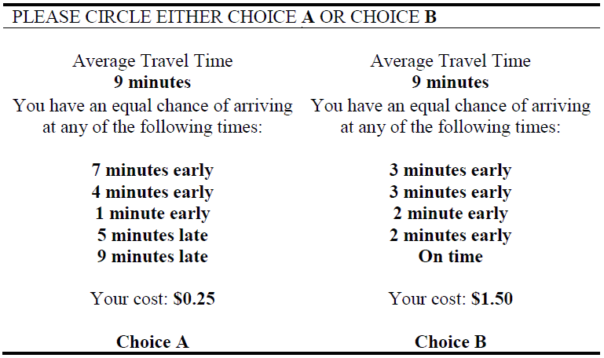
An Application of Valuing Reliability (due to Ken Small)
late
late

Slide 48
Stated Choice Survey
Trip Attributes in Stated Choice Design
  Routes A and B
  Free flow travel time
  Slowed down travel time
  Stop/start/crawling travel time
  Minutes arriving earlier than expected
  Minutes arriving later than expected
  Probability of arriving earlier than expected
  Probability of arriving at the time expected
  Probability of arriving later than expected
  Running cost
  Toll Cost
Individual Characteristics: Age, Income, Gender

Slide 49
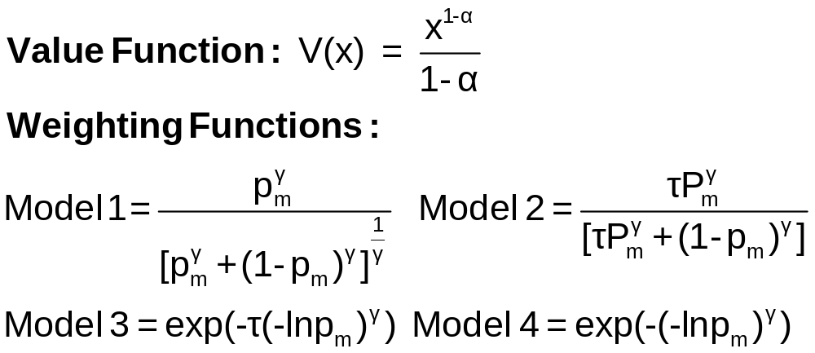
Value and Weighting Functions

Slide 50
Choice Model
U(j) = β_{ref} + β_{cost}Cost + β_{Age}Age + β_{Toll}TollASC
+ β_{curr} w(p_{curr})v(t_{curr})
+ β_{late} w(p_{late}) v(t_{late})
+ β_{early} w(p_{early})v(t_{early}) + ε_{j}
Constraint: β_{curr} = β_{late} = β_{early}
U(j) = β_{ref} + β_{cost}Cost + β_{Age}Age + β_{Toll}TollASC
+ β[w(p_{curr})v(t_{curr}) + w(p_{late})v(t_{late}) + w(p_{early})v(t_{early})]
+ ε_{j}

Slide 51
Application
2008 study undertaken in Australia
  toll vs. free roads
  stated choice (SC) experiment involving two SC alternatives (i.e., route A and route B) pivoted around the knowledge base of travellers (i.e., the current trip).
280 Individuals
32 Choice Situations (2 blocks of 16)

Slide 52
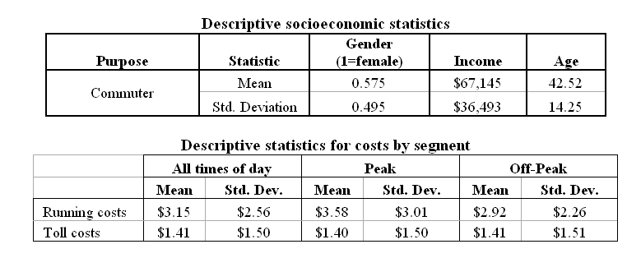
Data

Slide 53
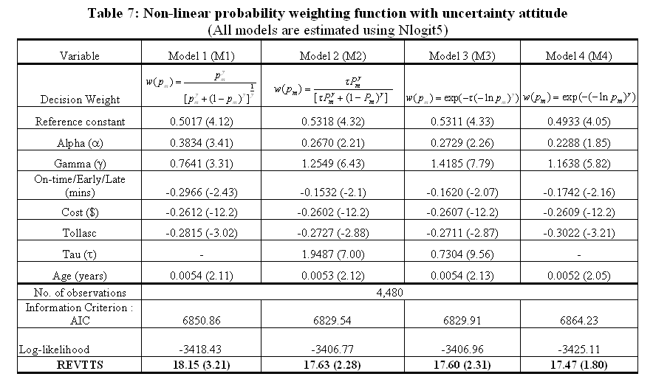

Slide 54
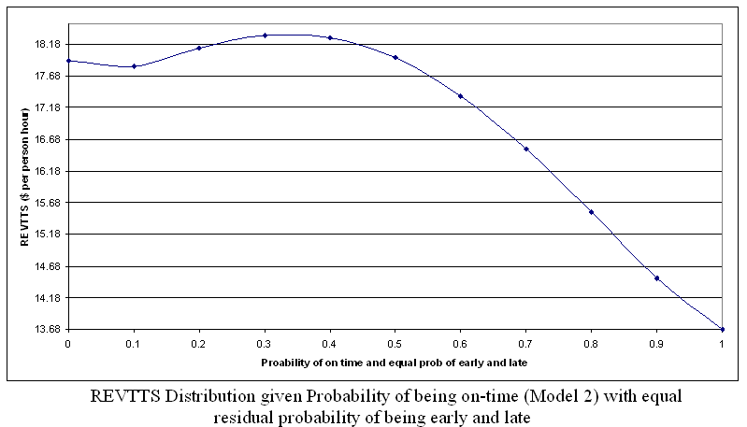
Reliability Embedded Value of Travel Time Savings in Au$/hr
$4.50

