Slide 1




Microeconometric Modeling
William Greene
Stern School of Business
New York University
New York NY USA
4.2 Latent Class Models

Slide 2

Concepts
Models
Latent Class
Prior and Posterior Probabilities
Classification Problem
Finite Mixture
Normal Mixture
Health Satisfaction
EM Algorithm
ZIP Model
Hurdle Model
NB2 Model
Obesity/BMI Model
Misreporter
Value of Travel Time Saved
Decision Strategy
Multinomial Logit Model
Latent Class MNL
Heckman – Singer Model
Latent Class Ordered Probit
Attribute Nonattendance Model
2^{K} Model

Slide 3
Latent Classes
A population contains a mixture of individuals of different types (classes)
Common form of the data generating mechanism within the classes
Observed outcome y is governed by the common process F(y|x,θ_{j} )
Classes are distinguished by the parameters, θ_{j}.

Slide 4

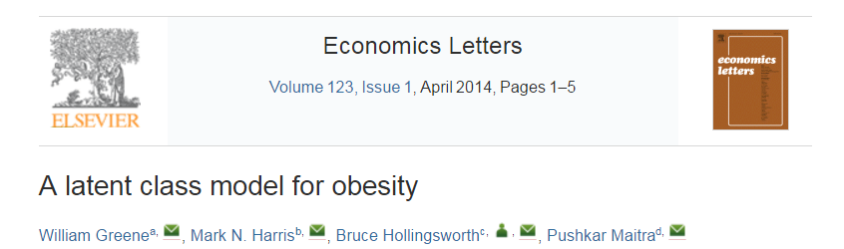

Slide 5
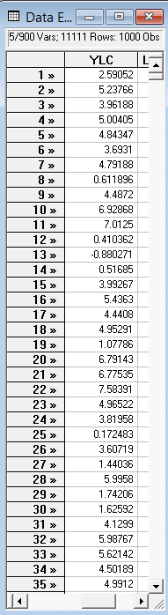
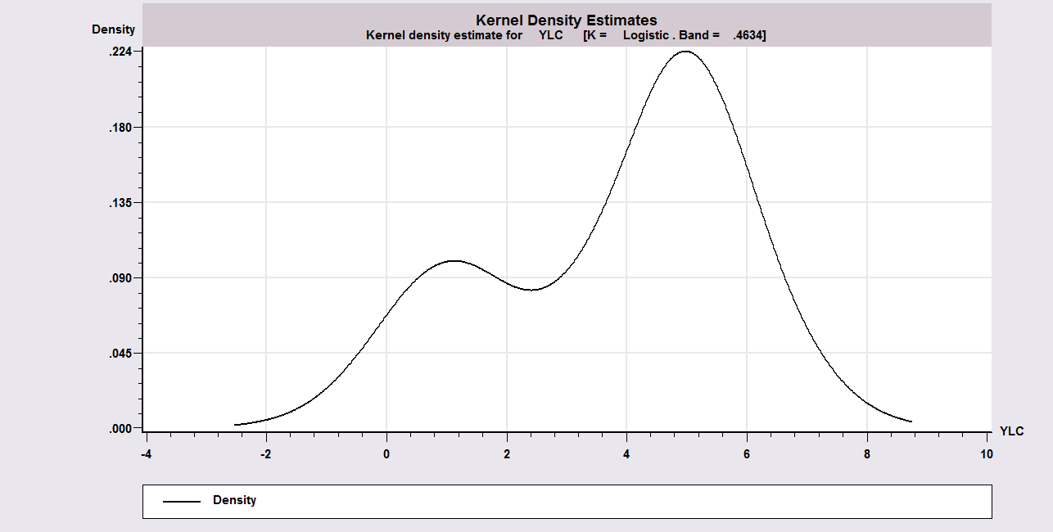
Unmixing a Mixed Sample
Sample ; 1 – 1000$
Calc ; Ran(123457)$
Create ; lc1=rnn(1,1) ;lc2=rnn(5,1)$
Create ; class=rnu(0,1)$ Uniform[0,1]
Create ; if(class<.3)ylc=lc1 ; (else)ylc=lc2$
Kernel ; rhs=ylc $
Regress ; lhs=ylc;rhs=one;lcm;pts=2;pds=1$

Slide 6
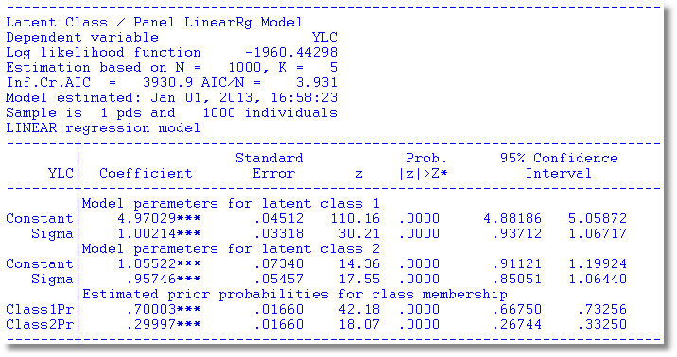
A Mixture of Normals

Slide 7

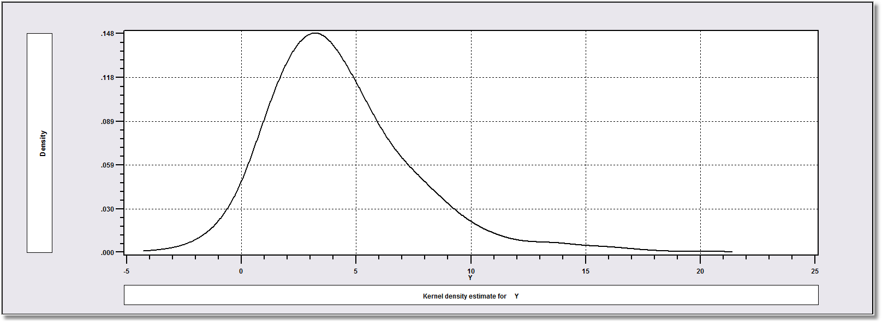
How Finite Mixture Models Work
Density? Note significant mass below zero. Not a gamma or lognormal or any other familiar density.

Slide 8
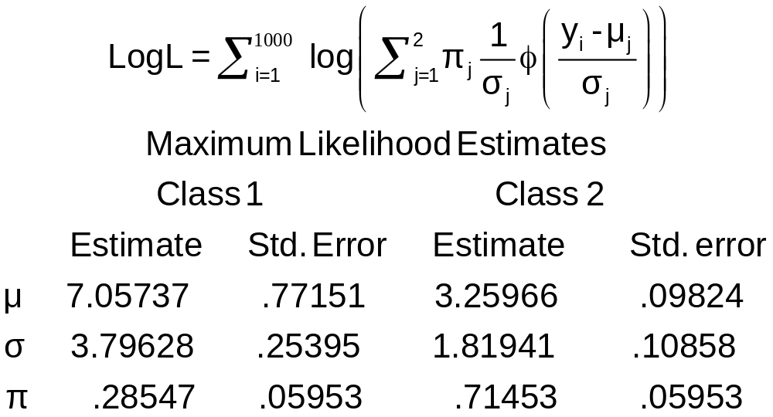
Find the ‘Best’ Fitting Mixture of Two Normal Densities

Slide 9
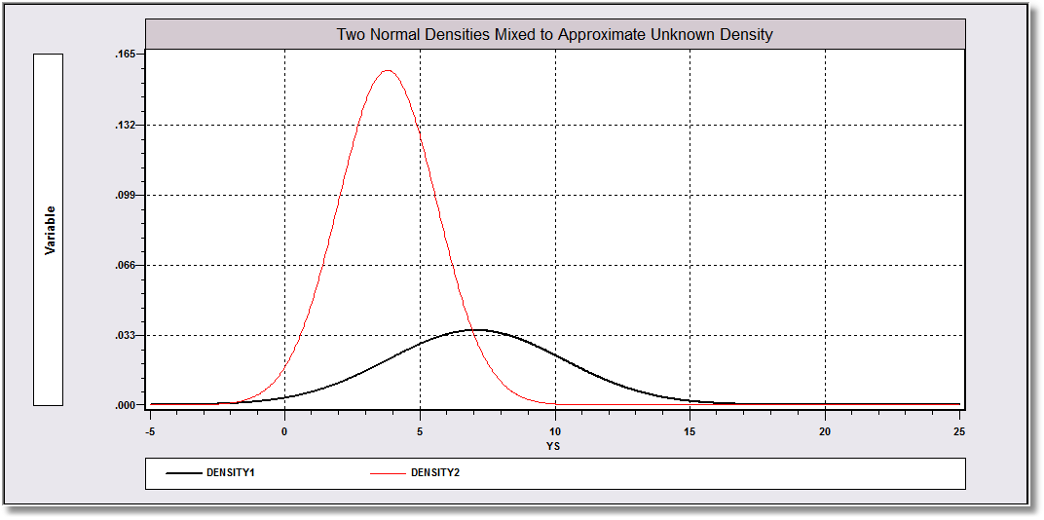
Mixing probabilities .715 and .285

Slide 10
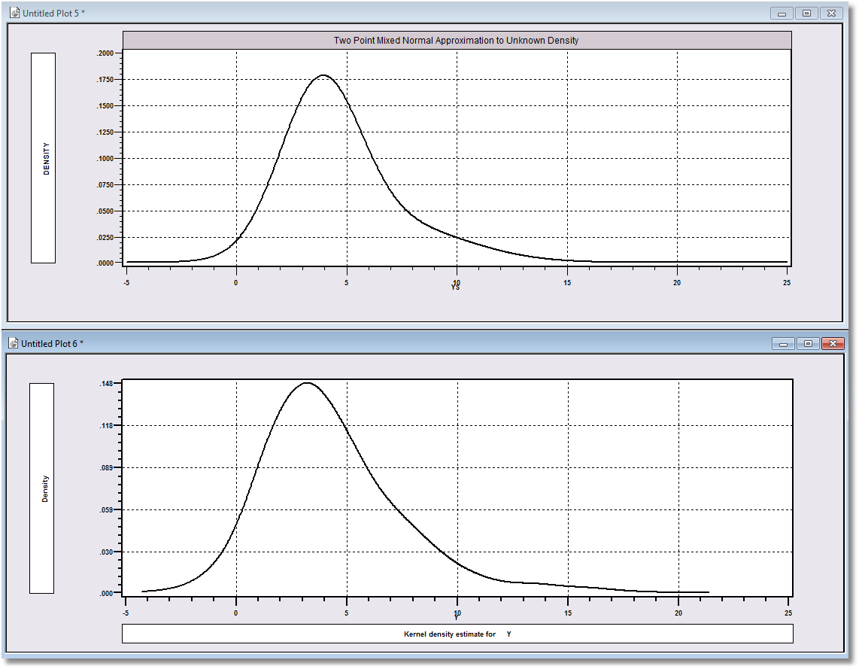
Approximation
Actual Distribution

Slide 11
A Practical Distinction
Finite Mixture (Discrete Mixture):
  Functional form strategy
  Component densities have no meaning
  Mixing probabilities have no meaning
  There is no question of “class membership”
  The number of classes is uninteresting – enough to get a good fit
Latent Class:
  Mixture of subpopulations
  Component densities are believed to be definable “groups”
  (Low Users and High Users in Bago d’Uva and Jones application)
  The classification problem is interesting – who is in which class?
  Posterior probabilities, P(class|y,x) have meaning
  Question of the number of classes has meaning in the context of the analysis

Slide 12
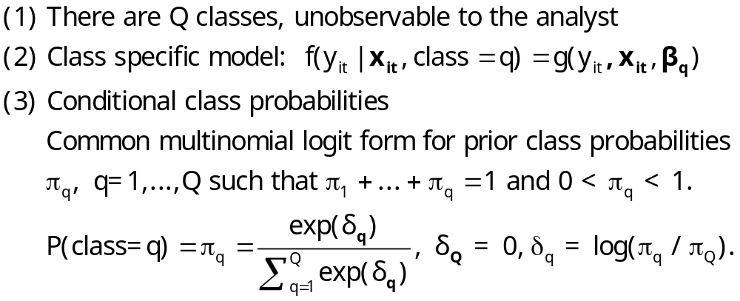
The Latent Class Model

Slide 13
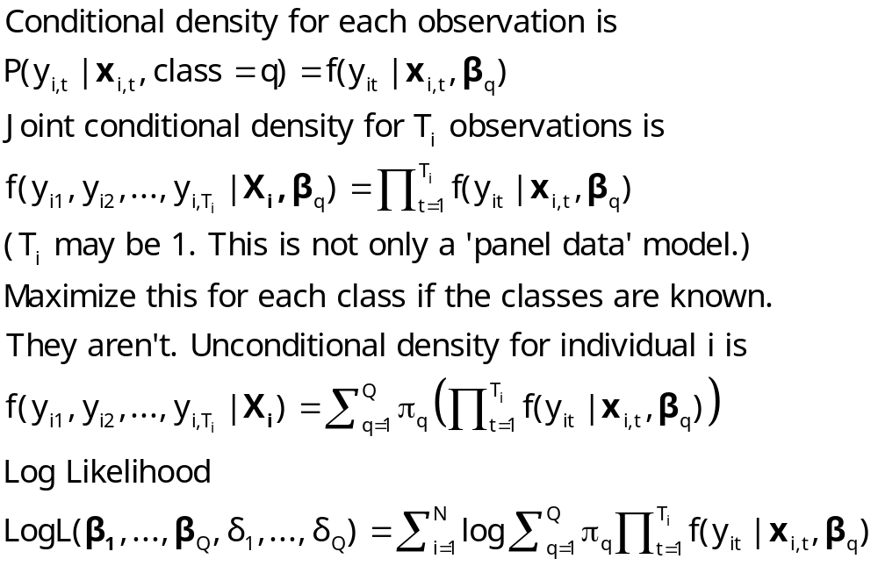
Log Likelihood for an LC Model

Slide 14
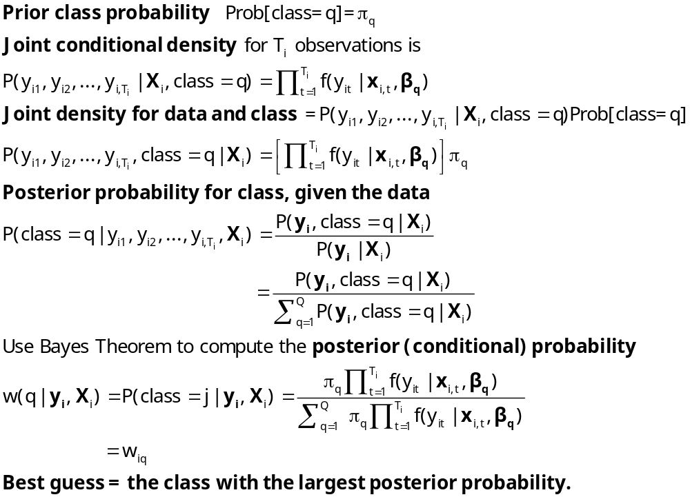
Estimating Which Class

Slide 15
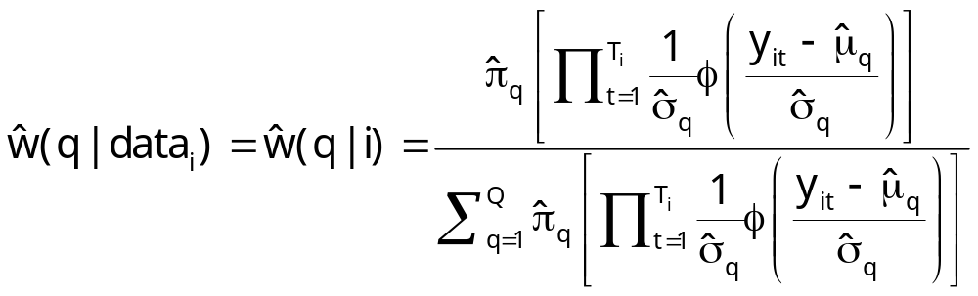
Posteriors for Normal Mixture

Slide 16
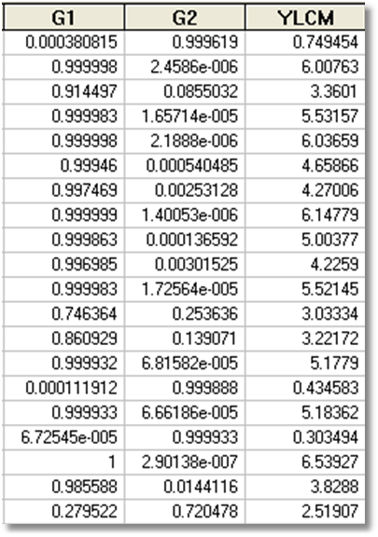
Estimated Posterior Probabilities

Slide 17
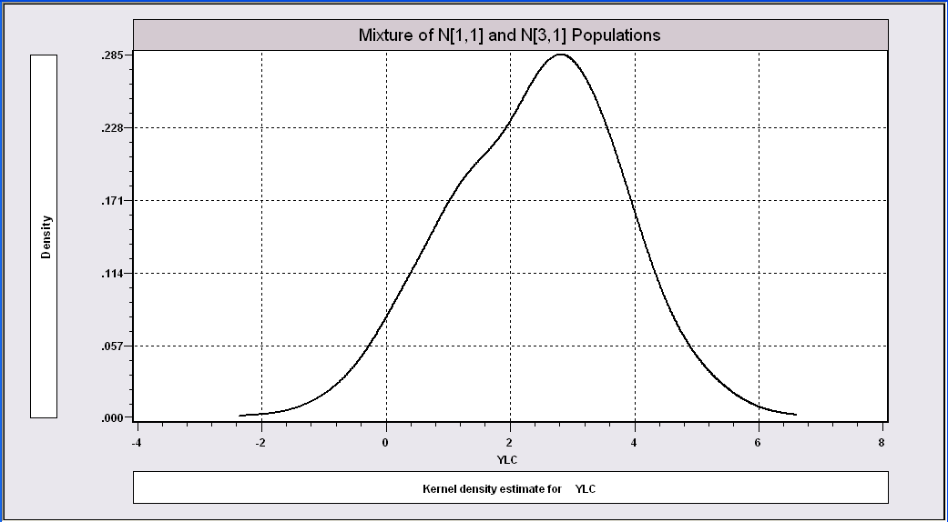
More Difficult When the
Populations are Close Together

Slide 18
The Technique Still Works
----------------------------------------------------------------------
Latent Class / Panel LinearRg Model
Dependent variable YLC
Sample is 1 pds and 1000 individuals
LINEAR regression model
Model fit with 2 latent classes.
--------+-------------------------------------------------------------
Variable| Coefficient Standard Error b/St.Er. P[|Z|>z] Mean of X
--------+-------------------------------------------------------------
|Model parameters for latent class 1
Constant| 2.93611*** .15813 18.568 .0000
Sigma| 1.00326*** .07370 13.613 .0000
|Model parameters for latent class 2
Constant| .90156*** .28767 3.134 .0017
Sigma| .86951*** .10808 8.045 .0000
|Estimated prior probabilities for class membership
Class1Pr| .73447*** .09076 8.092 .0000
Class2Pr| .26553*** .09076 2.926 .0034
--------+-------------------------------------------------------------

Slide 19
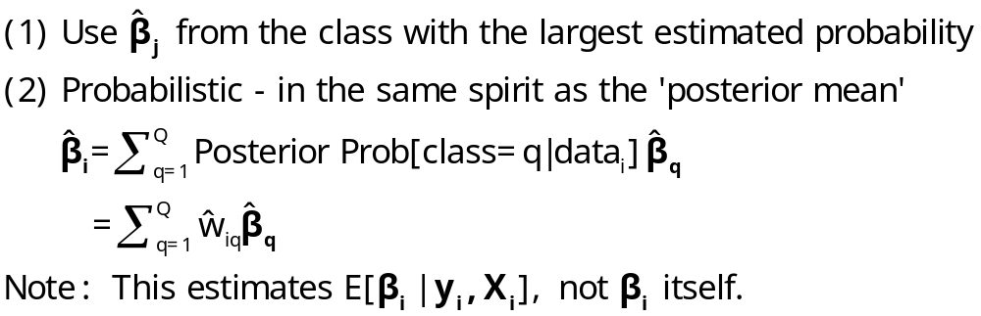
‘Estimating’ β_{i}

Slide 20
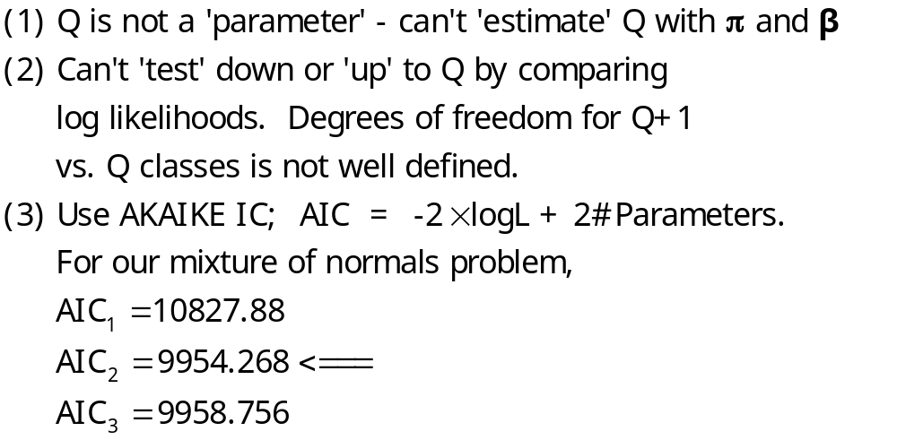
How Many Classes?

Slide 21
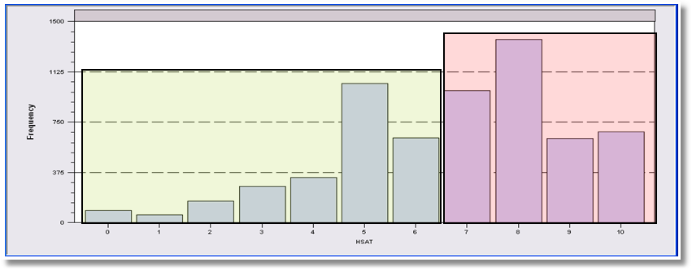
LCM for Health Status
Self Assessed Health Status = 0,1,…,10
Recoded: Healthy = HSAT > 6
Using only groups observed T=7 times; N=887
Prob = Φ(Age,Educ,Income,Married,Kids)
2, 3 classes

Slide 22
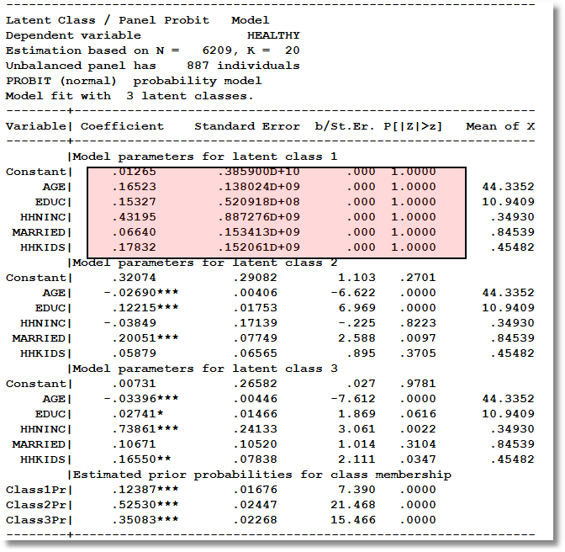
Too Many Classes

Slide 23
Two Class Model
----------------------------------------------------------------------
Latent Class / Panel Probit Model
Dependent variable HEALTHY
Unbalanced panel has 887 individuals
PROBIT (normal) probability model
Model fit with 2 latent classes.
--------+-------------------------------------------------------------
Variable| Coefficient Standard Error b/St.Er. P[|Z|>z] Mean of X
--------+-------------------------------------------------------------
|Model parameters for latent class 1
Constant| .61652** .28620 2.154 .0312
AGE| -.02466*** .00401 -6.143 .0000 44.3352
EDUC| .11759*** .01852 6.351 .0000 10.9409
HHNINC| .10713 .20447 .524 .6003 .34930
MARRIED| .11705 .09574 1.223 .2215 .84539
HHKIDS| .04421 .07017 .630 .5287 .45482
|Model parameters for latent class 2
Constant| .18988 .31890 .595 .5516
AGE| -.03120*** .00464 -6.719 .0000 44.3352
EDUC| .02122 .01934 1.097 .2726 10.9409
HHNINC| .61039*** .19688 3.100 .0019 .34930
MARRIED| .06201 .10035 .618 .5367 .84539
HHKIDS| .19465** .07936 2.453 .0142 .45482
|Estimated prior probabilities for class membership
Class1Pr| .56604*** .02487 22.763 .0000
Class2Pr| .43396*** .02487 17.452 .0000

Slide 24
Partial Effects in LC Model
----------------------------------------------------------------------
Partial derivatives of expected val. with
respect to the vector of characteristics.
They are computed at the means of the Xs.
Conditional Mean at Sample Point .6116
Scale Factor for Partial Effects .3832
B for latent class model is a wghted avrg.
--------+-------------------------------------------------------------
Variable| Coefficient Standard Error b/St.Er. P[|Z|>z] Elasticity
--------+-------------------------------------------------------------
|Two class latent class model
AGE| -.01054*** .00134 -7.860 .0000 -.76377
EDUC| .02904*** .00589 4.932 .0000 .51939
HHNINC| .12475** .05598 2.228 .0259 .07124
MARRIED| .03570 .02991 1.194 .2326 .04934
HHKIDS| .04196** .02075 2.022 .0432 .03120
--------+-------------------------------------------------------------
|Pooled Probit Model
AGE| -.00846*** .00081 -10.429 .0000 -.63399
EDUC| .03219*** .00336 9.594 .0000 .59568
HHNINC| .16699*** .04253 3.927 .0001 .09865
|Partial effect for dummy variable is P|1 - P|0.
MARRIED| .02414 .01877 1.286 .1986 .03451
|Partial effect for dummy variable is P|1 - P|0.
HHKIDS| .06754*** .01483 4.555 .0000 .05195
--------+-------------------------------------------------------------

Slide 25
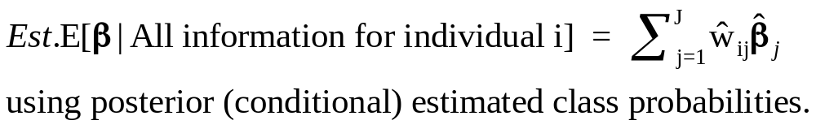
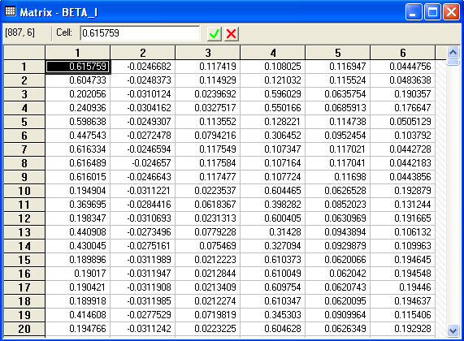
Conditional Means of Parameters

Slide 26
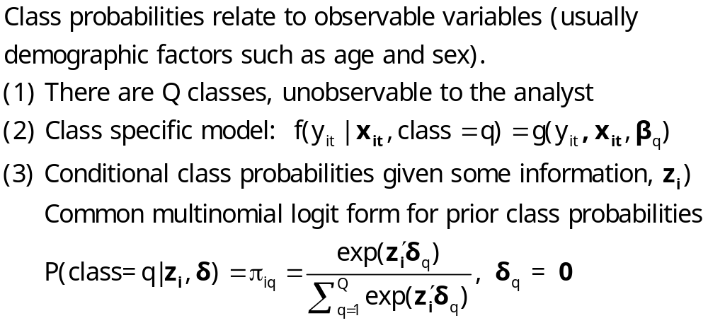
An Extended Latent Class Model
Notes:
26

Slide 27

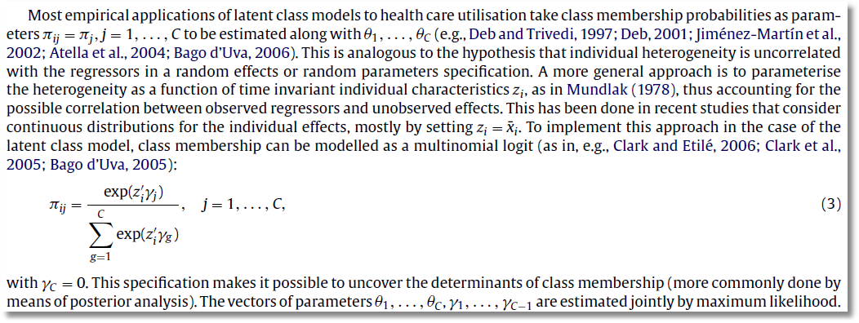

Slide 28
A Health Satisfaction Model
----------------------------------------------------------------------
Latent Class / Panel Probit Model Used mean AGE and FEMALE
Dependent variable HEALTHY in class probability model
Log likelihood function -3465.98697
--------+-------------------------------------------------------------
Variable| Coefficient Standard Error b/St.Er. P[|Z|>z] Mean of X
--------+-------------------------------------------------------------
|Model parameters for latent class 1
Constant| .60050** .29187 2.057 .0396
AGE| -.02002*** .00447 -4.477 .0000 44.3352
EDUC| .10597*** .01776 5.968 .0000 10.9409
HHNINC| .06355 .20751 .306 .7594 .34930
MARRIED| .07532 .10316 .730 .4653 .84539
HHKIDS| .02632 .07082 .372 .7102 .45482
|Model parameters for latent class 2
Constant| .10508 .32937 .319 .7497
AGE| -.02499*** .00514 -4.860 .0000 44.3352
EDUC| .00945 .01826 .518 .6046 10.9409
HHNINC| .59026*** .19137 3.084 .0020 .34930
MARRIED| -.00039 .09478 -.004 .9967 .84539
HHKIDS| .20652*** .07782 2.654 .0080 .45482
|Estimated prior probabilities for class membership
ONE_1| 1.43661*** .53679 2.676 .0074 (.56519)
AGEBAR_1| -.01897* .01140 -1.664 .0960
FEMALE_1| -.78809*** .15995 -4.927 .0000
ONE_2| .000 ......(Fixed Parameter)...... (.43481)
AGEBAR_2| .000 ......(Fixed Parameter)......
FEMALE_2| .000 ......(Fixed Parameter)......
--------+-------------------------------------------------------------

Slide 29

Zero Inflation?

Slide 30
Zero Inflation – ZIP Models
Two regimes: (E.g., recreation site visits)
  Zero (with probability 1). (Never visit site)
  Poisson with Pr(0) = exp[- β’x_{i}]. (Number of visits, including zero visits this season.)
Unconditional:
  Pr[0] = P(regime 0) + P(regime 1)*Pr[0|regime 1]
  Pr[j | j >0] = P(regime 1)*Pr[j|regime 1]
This is a “latent class model”

Slide 31
Hurdle Models
Two decisions:
  Whether or not to participate: y=0 or +.
  If participate, how much. y|y>0
One ‘regime’ – individual always makes both decisions.
Implies different models for zeros and positive values
  Prob(0) = 1 – F(γ′z), Prob(+) = F(γ′z)
  Prob(y|+) = P(y)/[1 – P(0)]

Slide 32



Slide 33
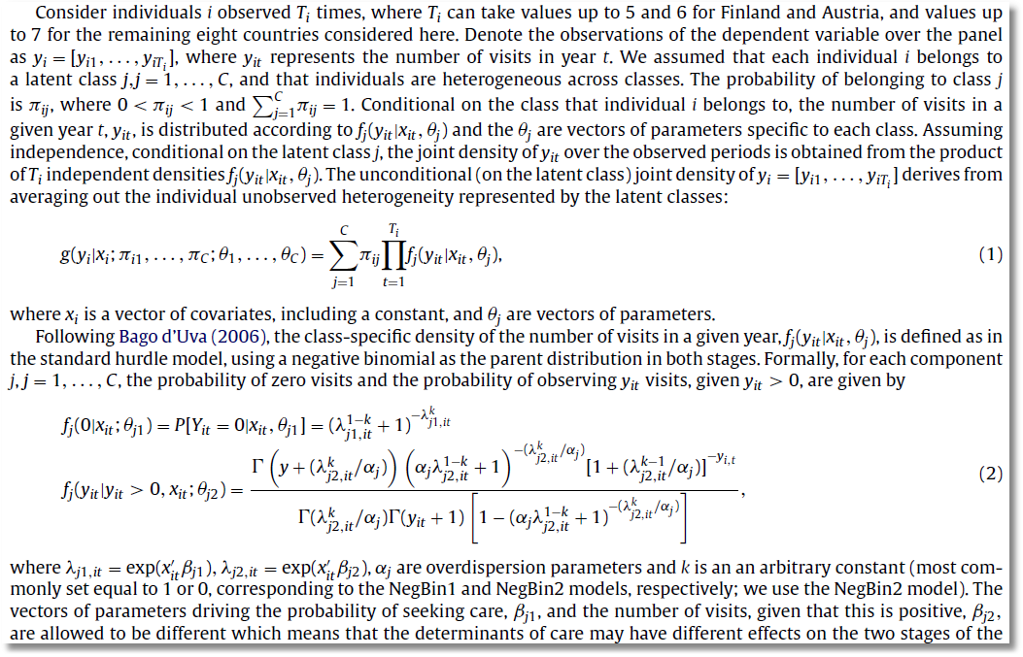

Slide 34
A Latent Class Hurdle NB2 Model
Analysis of ECHP panel data (1994-2001)
Two class Latent Class Model
  Typical in health economics applications
Hurdle model for physician visits
  Poisson hurdle for participation and negative binomial intensity given participation
  Contrast to a negative binomial model

Slide 35
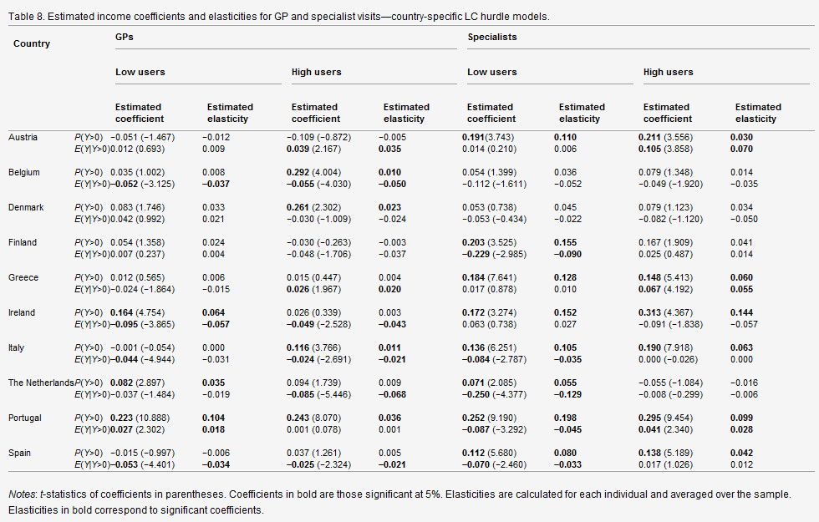

Slide 36
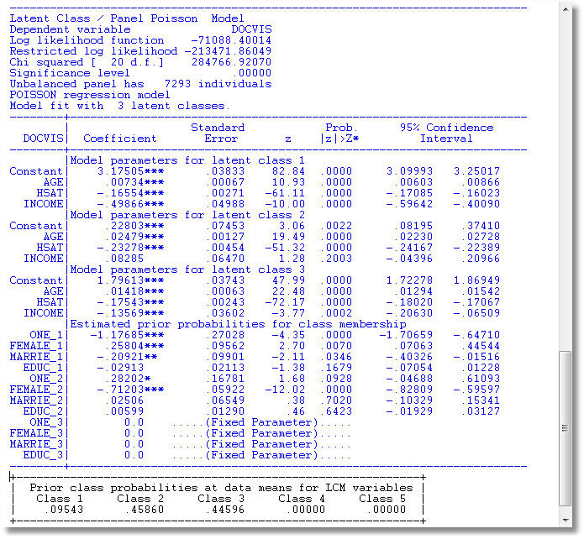
LC Poisson Regression for Doctor Visits

Slide 37
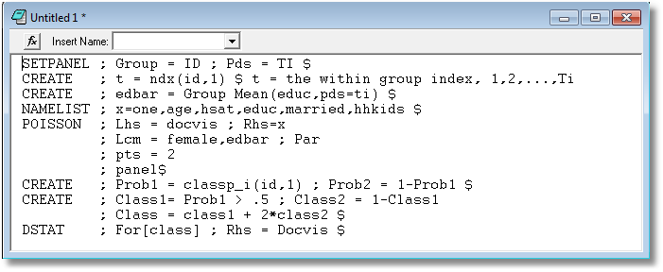
Is the LCM Finding High and Low Users?

Slide 38
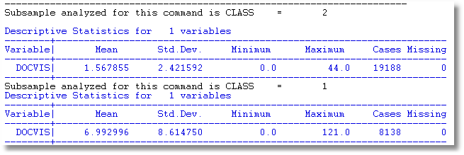
Is the LCM Finding High and Low Users? Apparently So.

Slide 39
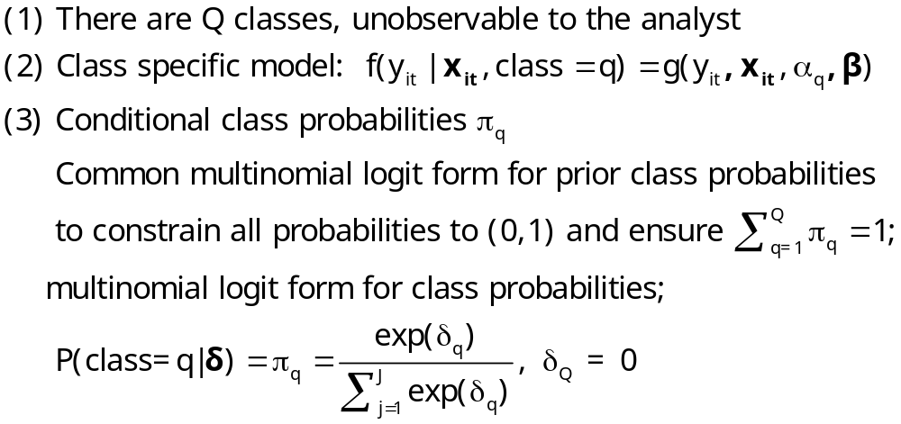
Heckman and Singer’s RE Model
Random Effects Model
Random Constants with Discrete Distribution

Slide 40
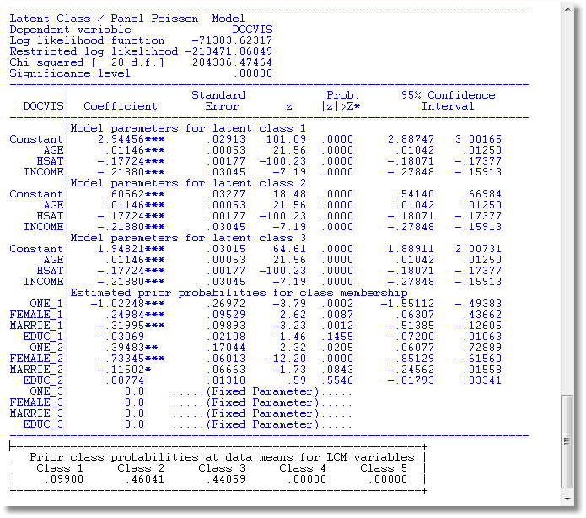
3 Class Heckman-Singer Form

Slide 41
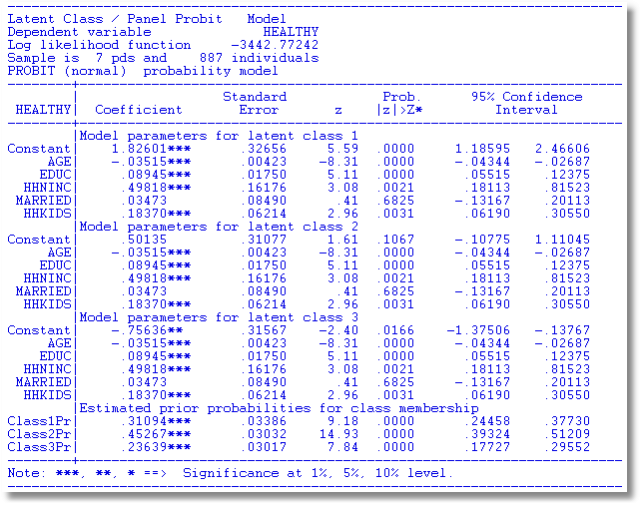
Heckman and Singer Binary
ChoiceModel – 3 Points

Slide 42
Heckman/Singer vs. REM
-----------------------------------------------------------------------------
Random Effects Binary Probit Model
Sample is 7 pds and 887 individuals.
--------+--------------------------------------------------------------------
| Standard Prob. 95% Confidence
HEALTHY| Coefficient Error z |z|>Z* Interval
--------+--------------------------------------------------------------------
Constant| .33609 .29252 1.15 .2506 -.23723 .90941
(Other coefficients omitted)
Rho| .52565*** .02025 25.96 .0000 .48596 .56534
--------+--------------------------------------------------------------------
Rho = σ²/(1+s2) so σ² = rho/(1-rho) = 1.10814.
Mean = .33609, Variance = 1.10814
For Heckman and Singer model,
3 points a1,a2,a3 = 1.82601, .50135, -.75636
3 probabilities p1,p2,p3 = .31094, .45267, .23639
Mean = .61593 variance = .90642

Slide 44
An Ordered Probit Approach
A Latent Regression Model for “True BMI”
BMI* = β′x + ε, ε ~ N[0,σ²], σ² = 1
“True BMI” = a proxy for weight is unobserved
Observation Mechanism for Weight Type
WT = 0 if BMI* < 0 Normal
1 if 0 < BMI* < μ Overweight
2 if μ < BMI* Obese

Slide 45
Latent Class Modeling
Several ‘types’ or ‘classes. Obesity be due to genetic reasons (the FTO gene) or lifestyle factors
Distinct sets of individuals may have differing reactions to various policy tools and/or characteristics
The observer does not know from the data which class an individual is in.
Suggests a latent class approach for health outcomes
(Deb and Trivedi, 2002, and Bago d’Uva, 2005)

Slide 46
Latent Class Application
Two class model (considering FTO gene):
  More classes make class interpretations much more difficult
  Parametric models proliferate parameters
Two classes allow us to correlate the unobservables driving class membership and observed weight outcomes.
Theory for more than two classes not yet developed.

Slide 47
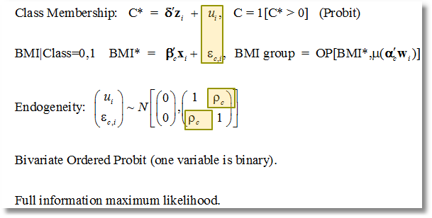
Correlation of Unobservables in Class Membership and BMI Equations

Slide 48
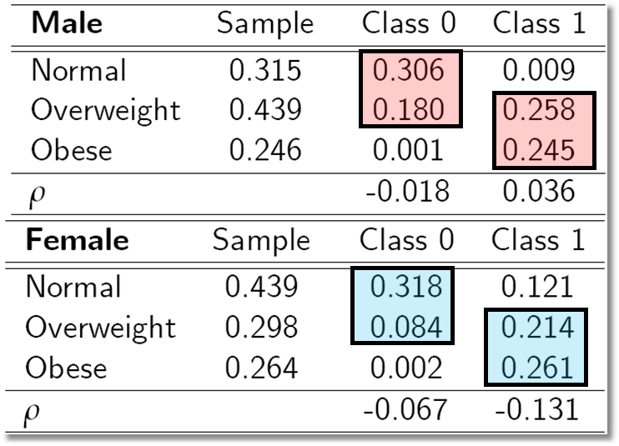
Outcome Probabilities
Class 0 dominated by normal and overweight probabilities ‘normal weight’ class
Class 1 dominated by probabilities at top end of the scale ‘non-normal weight’
Unobservables for weight class membership, negatively correlated with those determining weight levels:

Slide 49
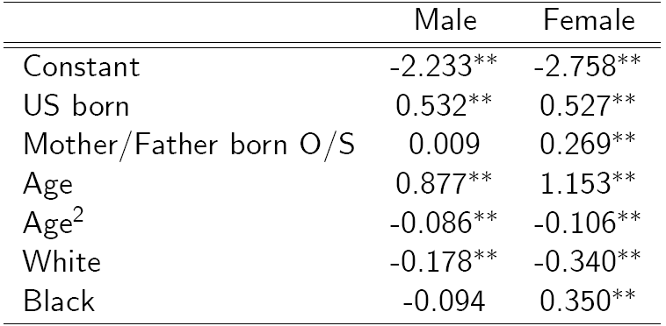
Classification (Latent Probit) Model

Slide 50
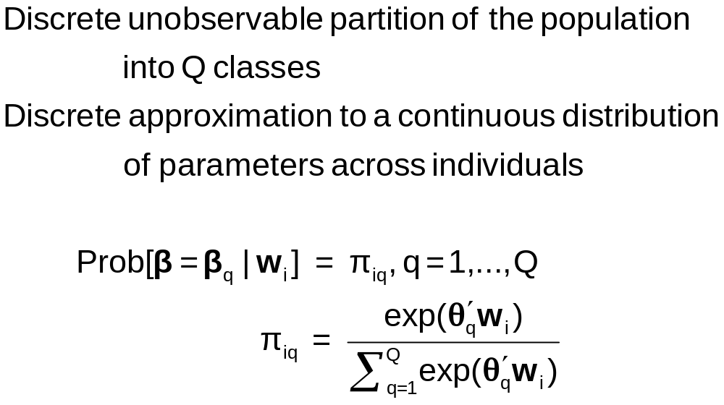
Discrete Parameter Heterogeneity
Latent Classes

Slide 51
Latent Class Probabilities
Ambiguous – Classical Bayesian model?
  The randomness of the class assignment is from the point of view of the observer, not a natural process governed by a discrete distribution.
Equivalent to random parameters models with discrete parameter variation
  Using nested logits, etc. does not change this
  Precisely analogous to continuous ‘random parameter’ models
Not always equivalent – zero inflation models – in which classes have completely different models

Slide 52
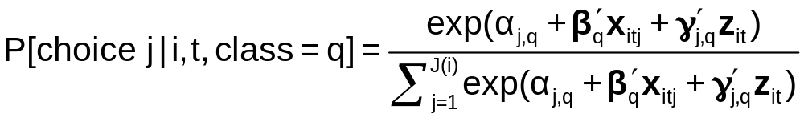
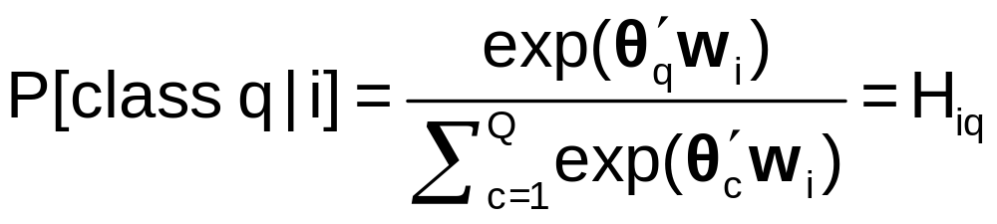
A Latent Class MNL Model
Within a “class”
Class sorting is probabilistic (to the analyst) determined by individual characteristics

Slide 53
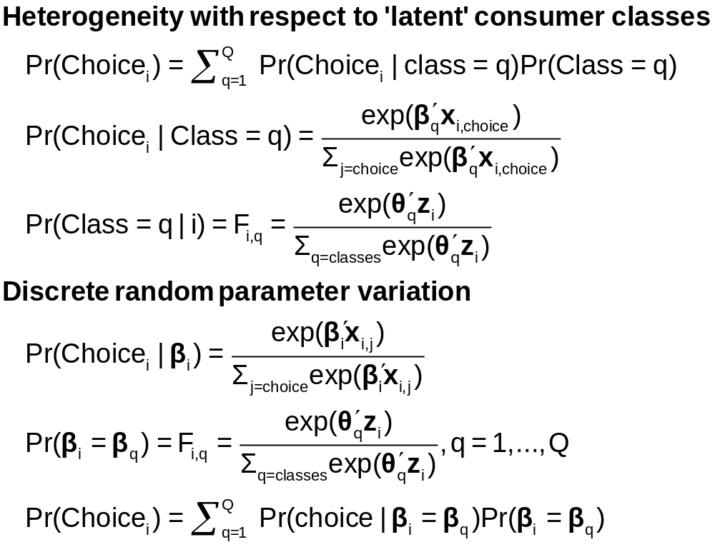
Two Interpretations of Latent Classes

Slide 54
Estimates from the LCM
Taste parameters within each class β_{q}
Parameters of the class probability model, θ_{q}
For each person:
  Posterior estimates of the class they are in q|i
  Posterior estimates of their taste parameters E[β_{q}|i]
  Posterior estimates of their behavioral parameters, elasticities, marginal effects, etc.

Slide 55
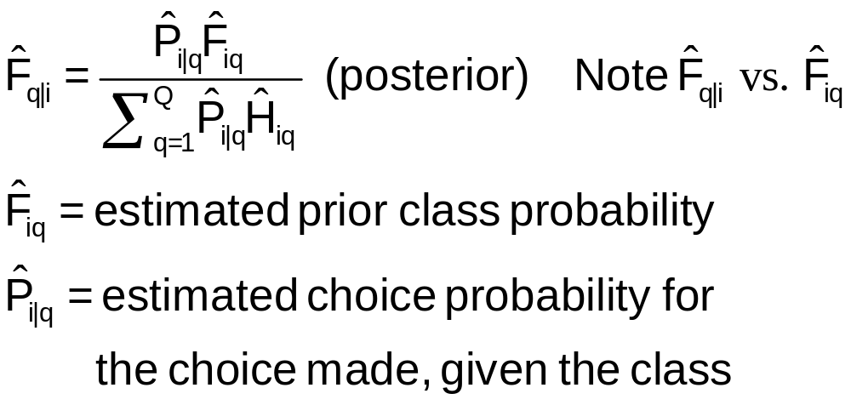
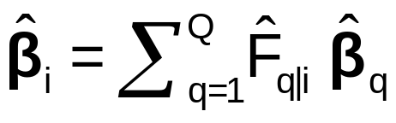
Using the Latent Class Model
Computing posterior (individual specific) class probabilities
Computing posterior (individual specific) taste parameters

Slide 56
Application: Shoe Brand Choice
Simulated Data: Stated Choice, 400 respondents, 8 choice situations, 3,200 observations
3 choice/attributes + NONE
  Fashion = High / Low
  Quality = High / Low
  Price = 25/50/75,100 coded 1,2,3,4
Heterogeneity: Sex (Male=1), Age (<25, 25-39, 40+)
Underlying data generated by a 3 class latent class process (100, 200, 100 in classes)

Slide 57
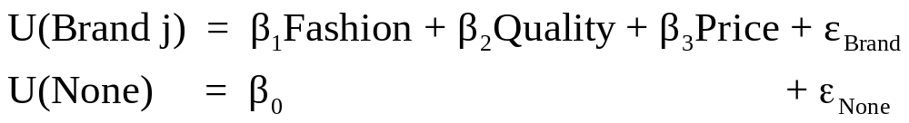
Degenerate Branches
Shoe Choice
Choice Situation
Purchase
Opt Out
Choose Brand
Brand
None
Brand1
Brand2
Brand3

Slide 58
One Class MNL Estimates
-----------------------------------------------------------
Discrete choice (multinomial logit) model
Dependent variable Choice
Log likelihood function -4158.50286
Estimation based on N = 3200, K = 4
R2=1-LogL/LogL* Log-L fncn R-sqrd R2Adj
Constants only -4391.1804 .0530 .0510
Response data are given as ind. choices
Number of obs.= 3200, skipped 0 obs
--------+--------------------------------------------------
Variable| Coefficient Standard Error b/St.Er. P[|Z|>z]
--------+--------------------------------------------------
FASH|1| 1.47890*** .06777 21.823 .0000
QUAL|1| 1.01373*** .06445 15.730 .0000
PRICE|1| -11.8023*** .80406 -14.678 .0000
ASC4|1| .03679 .07176 .513 .6082
--------+--------------------------------------------------

Slide 59
Application: Brand Choice
True underlying model is a three class LCM
NLOGIT
; Lhs=choice
; Choices=Brand1,Brand2,Brand3,None
; Rhs = Fash,Qual,Price,ASC4
; LCM=Male,Age25,Age39
; Pts=3
; Pds=8
; Parameters (Save posterior results) $

Slide 60
Three Class LCM
Normal exit from iterations. Exit status=0.
-----------------------------------------------------------
Latent Class Logit Model
Dependent variable CHOICE
Log likelihood function -3649.13245
Restricted log likelihood -4436.14196
Chi squared [ 20 d.f.] 1574.01902
Significance level .00000
McFadden Pseudo R-squared .1774085
Estimation based on N = 3200, K = 20
R2=1-LogL/LogL* Log-L fncn R-sqrd R2Adj
No coefficients -4436.1420 .1774 .1757
Constants only -4391.1804 .1690 .1673
At start values -4158.5428 .1225 .1207
Response data are given as ind. choices
Number of latent classes = 3
Average Class Probabilities
.506 .239 .256
LCM model with panel has 400 groups
Fixed number of obsrvs./group= 8
Number of obs.= 3200, skipped 0 obs
--------+--------------------------------------------------
LogL for one class MNL = -4158.503
Based on the LR statistic it would seem unambiguous to reject the one class model. The degrees of freedom for the test are uncertain, however.

Slide 61
Estimated LCM: Utilities
--------+--------------------------------------------------
Variable| Coefficient Standard Error b/St.Er. P[|Z|>z]
--------+--------------------------------------------------
|Utility parameters in latent class -->> 1
FASH|1| 3.02570*** .14549 20.796 .0000
QUAL|1| -.08782 .12305 -.714 .4754
PRICE|1| -9.69638*** 1.41267 -6.864 .0000
ASC4|1| 1.28999*** .14632 8.816 .0000
|Utility parameters in latent class -->> 2
FASH|2| 1.19722*** .16169 7.404 .0000
QUAL|2| 1.11575*** .16356 6.821 .0000
PRICE|2| -13.9345*** 1.93541 -7.200 .0000
ASC4|2| -.43138** .18514 -2.330 .0198
|Utility parameters in latent class -->> 3
FASH|3| -.17168 .16725 -1.026 .3047
QUAL|3| 2.71881*** .17907 15.183 .0000
PRICE|3| -8.96483*** 1.93400 -4.635 .0000
ASC4|3| .18639 .18412 1.012 .3114

Slide 62
Estimated LCM: Class Probability Model
--------+--------------------------------------------------
Variable| Coefficient Standard Error b/St.Er. P[|Z|>z]
--------+--------------------------------------------------
|This is THETA(01) in class probability model.
Constant| -.90345** .37612 -2.402 .0163
_MALE|1| .64183* .36245 1.771 .0766
_AGE25|1| 2.13321*** .32096 6.646 .0000
_AGE39|1| .72630* .43511 1.669 .0951
|This is THETA(02) in class probability model.
Constant| .37636 .34812 1.081 .2796
_MALE|2| -2.76536*** .69325 -3.989 .0001
_AGE25|2| -.11946 .54936 -.217 .8279
_AGE39|2| 1.97657*** .71684 2.757 .0058
|This is THETA(03) in class probability model.
Constant| .000 ......(Fixed Parameter)......
_MALE|3| .000 ......(Fixed Parameter)......
_AGE25|3| .000 ......(Fixed Parameter)......
_AGE39|3| .000 ......(Fixed Parameter)......
--------+--------------------------------------------------

Slide 63
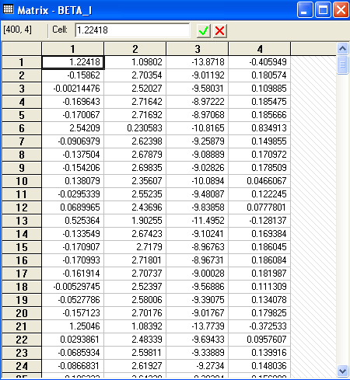
Estimated LCM:
Conditional Parameter Estimates

Slide 64
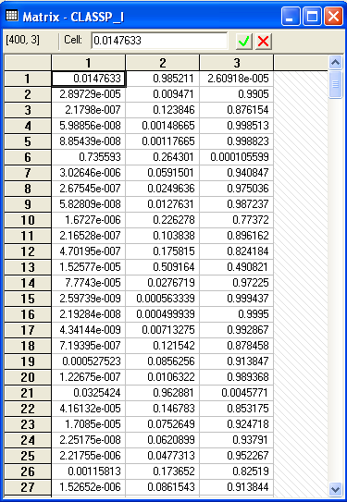
Estimated LCM: Conditional (Posterior) Class Probabilities

Slide 65
Average Estimated Class Probabilities
MATRIX ; list ; 1/400 * classp_i'1$
Matrix Result has 3 rows and 1 columns.
1
+--------------
1| .50555
2| .23853
3| .25593
This is how the data were simulated. Class probabilities are .5, .25, .25. The model ‘worked.’

Slide 66
Elasticities
+---------------------------------------------------+
| Elasticity averaged over observations.|
| Effects on probabilities of all choices in model: |
| * = Direct Elasticity effect of the attribute. |
| Attribute is PRICE in choice BRAND1 |
| Mean St.Dev |
| * Choice=BRAND1 -.8010 .3381 |
| Choice=BRAND2 .2732 .2994 |
| Choice=BRAND3 .2484 .2641 |
| Choice=NONE .2193 .2317 |
+---------------------------------------------------+
| Attribute is PRICE in choice BRAND2 |
| Choice=BRAND1 .3106 .2123 |
| * Choice=BRAND2 -1.1481 .4885 |
| Choice=BRAND3 .2836 .2034 |
| Choice=NONE .2682 .1848 |
+---------------------------------------------------+
| Attribute is PRICE in choice BRAND3 |
| Choice=BRAND1 .3145 .2217 |
| Choice=BRAND2 .3436 .2991 |
| * Choice=BRAND3 -.6744 .3676 |
| Choice=NONE .3019 .2187 |
+---------------------------------------------------+
Elasticities are computed by averaging individual elasticities computed at the expected (posterior) parameter vector.
This is an unlabeled choice experiment. It is not possible to attach any significance to the fact that the elasticity is different for Brand1 and Brand 2 or Brand 3.

Slide 67
Application: Long Distance Drivers’
Preference for Road Environments
New Zealand survey, 2000, 274 drivers
Mixed revealed and stated choice experiment
4 Alternatives in choice set
  The current road the respondent is/has been using;
  A hypothetical 2-lane road;
  A hypothetical 4-lane road with no median;
  A hypothetical 4-lane road with a wide grass median.
16 stated choice situations for each with 2 choice profiles
  choices involving all 4 choices
  choices involving only the last 3 (hypothetical)
Hensher and Greene, A Latent Class Model for Discrete Choice Analysis: Contrasts with Mixed Logit – Transportation Research B, 2003

Slide 68
Attributes
Time on the open road which is free flow (in minutes);
Time on the open road which is slowed by other traffic (in minutes);
Percentage of total time on open road spent with other vehicles close behind (ie tailgating) (%);
Curviness of the road (A four-level attribute - almost straight, slight, moderate, winding);
Running costs (in dollars);
Toll cost (in dollars).

Slide 69
Experimental Design
The four levels of the six attributes chosen are:
Free Flow Travel Time: -20%, -10%, +10%, +20%
Time Slowed Down: -20%, -10%, +10%, +20%
Percent of time with vehicles close behind:
-50%, -25%, +25%, +50%
Curviness:almost, straight, slight, moderate, winding
Running Costs: -10%, -5%, +5%, +10%
Toll cost for car and double for truck if trip duration is:
1 hours or less 0, 0.5, 1.5, 3
Between 1 hour and 2.5 hours 0, 1.5, 4.5, 9
More than 2.5 hours 0, 2.5, 7.5, 15

Slide 70
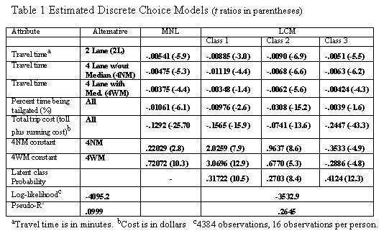
Estimated Latent Class Model

Slide 71
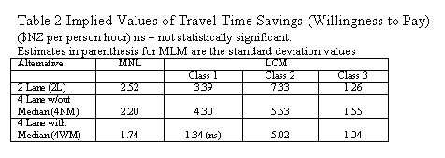
Estimated Value of Time Saved

Slide 72
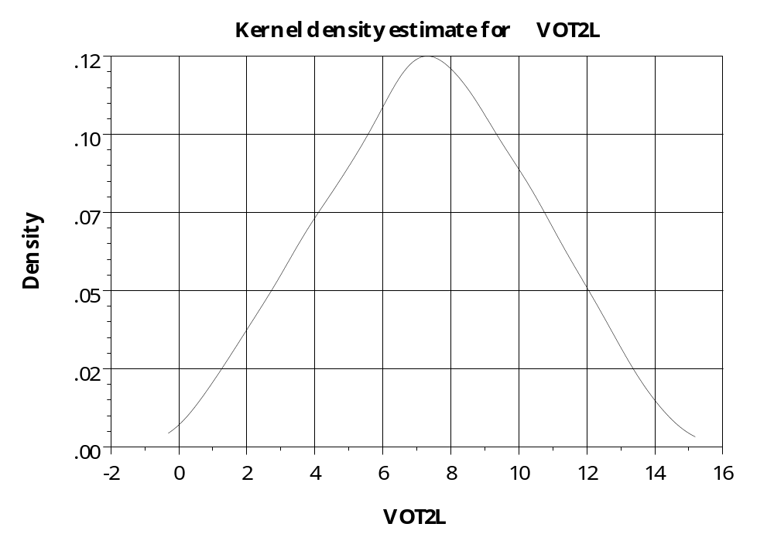
Distribution of Parameters –
Value of Time on 2 Lane Road

Slide 73
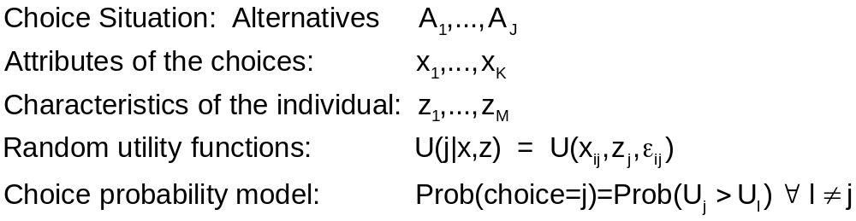
Decision Strategy in Multinomial Choice

Slide 74
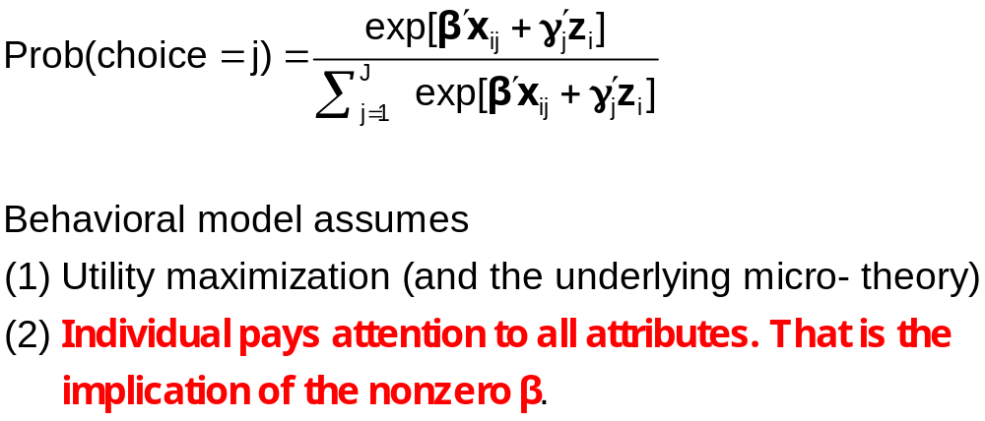
Multinomial Logit Model

Slide 75
Individual Explicitly Ignores Attributes
Hensher, D.A., Rose, J. and Greene, W. (2005) The Implications on Willingness to Pay of Respondents Ignoring Specific Attributes (DoD#6) Transportation, 32 (3), 203-222.
Hensher, D.A. and Rose, J.M. (2009) Simplifying Choice through Attribute Preservation or Non-Attendance: Implications for Willingness to Pay, Transportation Research Part E, 45, 583-590.
Rose, J., Hensher, D., Greene, W. and Washington, S. Attribute Exclusion Strategies in Airline Choice: Accounting for Exogenous Information on Decision Maker Processing Strategies in Models of Discrete Choice, Transportmetrica, 2011
Choice situations in which the individual explicitly states that they ignored certain attributes in their decisions.

Slide 76
Appropriate Modeling Strategy
Fix ignored attributes at zero? Definitely not!
  Zero is an unrealistic value of the attribute (price)
  The probability is a function of x_{ij} – x_{il}, so the substitution distorts the probabilities
Appropriate model: for that individual, the specific coefficient is zero – consistent with the utility assumption. A person specific, exogenously determined model
Surprisingly simple to implement

Slide 77
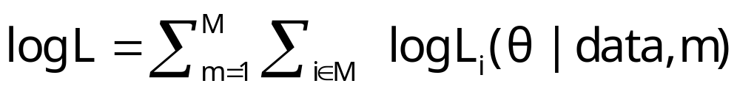
Choice Strategy Heterogeneity
Methodologically, a rather minor point – construct appropriate likelihood given known information
Not a latent class model. Classes are not latent.
Not the ‘variable selection’ issue (the worst form of “stepwise” modeling)
Familiar strategy gives the wrong answer.

Slide 78
Application: Sydney
Commuters’ Route Choice
Stated Preference study – several possible choice situations considered by each person
Multinomial and mixed (random parameters) logit
Consumers included data on which attributes were ignored.
Ignored attributes visibly coded as ignored are automatically treated by constraining β=0 for that observation.

Slide 79
Data for Application of Information Strategy
Stated/Revealed preference study, Sydney car commuters. 500+ surveyed, about 10 choice situations for each.
Existing route vs. 3 proposed alternatives.
Attribute design
  Original: respondents presented with 3, 4, 5, or 6 attributes
  Attributes – four level design.
    Free flow time
    Slowed down time
    Stop/start time
    Trip time variability
    Toll cost
    Running cost
  Final: respondents use only some attributes and indicate when surveyed which ones they ignored

Slide 80
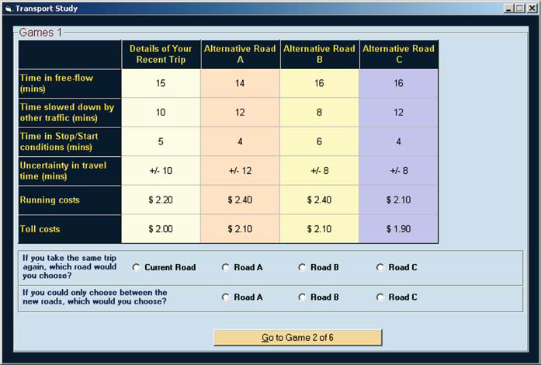
Stated Choice Experiment
Ancillary questions: Did you ignore any of these attributes?

Slide 81
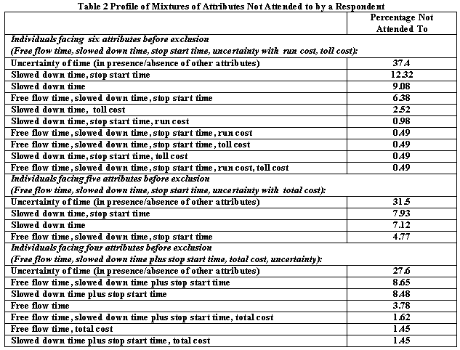

Slide 82
Individual Implicitly Ignores Attributes
Hensher, D.A. and Greene, W.H. (2010) Non-attendance and dual processing of common-metric attributes in choice analysis: a latent class specification, Empirical Economics 39 (2), 413-426
Campbell, D., Hensher, D.A. and Scarpa, R. Non-attendance to Attributes in Environmental Choice Analysis: A Latent Class Specification, Journal of Environmental Planning and Management, proofs 14 May 2011.
Hensher, D.A., Rose, J.M. and Greene, W.H. Inferring attribute non-attendance from stated choice data: implications for willingness to pay estimates and a warning for stated choice experiment design, 14 February 2011, Transportation, online 2 June 2001 DOI 10.1007/s11116-011-9347-8.

Slide 83
Stated Choice Experiment
Individuals seem to be ignoring attributes. Unknown to the analyst

Slide 84
The 2^{K} model
The analyst believes some attributes are ignored. There is no indicator.
Classes distinguished by which attributes are ignored
Same model applies, now a latent class. For K attributes there are 2^{K} candidate coefficient vectors

Slide 85

Latent Class Models with
Cross Class Restrictions
8 Class Model: 6 structural utility parameters, 7 unrestricted prior probabilities.
Reduced form has 8(6)+8 = 56 parameters. (π_{j} = exp(α_{j})/∑_{j}exp(α_{j}), α_{J} = 0.)
EM Algorithm: Does not provide any means to impose cross class restrictions.
“Bayesian” MCMC Methods: May be possible to force the restrictions – it will not be simple.
Conventional Maximization: Simple

Slide 86

Results for the 2^{K} model

Slide 87


Slide 88


Choice Model with 6 Attributes

Slide 89


Stated Choice Experiment

Slide 90

Latent Class Model – Prior Class Probabilities

Slide 91

Latent Class Model – Posterior Class Probabilities

Slide 92

6 attributes implies 64 classes. Strategy to reduce the computational burden on a small sample

Slide 93

Posterior probabilities of membership in the nonattendance class for 6 models

Slide 94

The EM Algorithm

Slide 95

Implementing EM for LC Models

Slide 96
Inflated Responses in Self-Assessed Health
Mark Harris
Department of Economics, Curtin University
Bruce Hollingsworth
Department of Economics, Lancaster University
William Greene
Stern School of Business, New York University

Slide 97
SAH vs. Objective Health Measures
Favorable SAH categories seem artificially high.
• 60% of Australians are either overweight or obese (Dunstan et. al, 2001)
• 1 in 4 Australians has either diabetes or a condition of impaired glucose metabolism
• Over 50% of the population has elevated cholesterol
• Over 50% has at least 1 of the “deadly quartet” of health conditions
(diabetes, obesity, high blood pressure, high cholestrol)
• Nearly 4 out of 5 Australians have 1 or more long term health conditions
(National Health Survey, Australian Bureau of Statistics 2006)
• Australia ranked #1 in terms of obesity rates
Similar results appear to appear for other countries

Slide 98


A Two Class Latent Class Model
True Reporter
Misreporter

Slide 99

Mis-reporters choose either good or very good
The response is determined by a probit model
Y=3
Y=2

Slide 100

Y=4
Y=3
Y=2
Y=1
Y=0

Slide 101

Observed Mixture of Two Classes

Slide 102

Pr(true,y) = Pr(true) * Pr(y | true)

Slide 103


Slide 104


Slide 105
General Result

