Slide 1




Microeconometric Modeling
William Greene
Stern School of Business
New York University
New York NY USA
4.3 Mixed Models and
Random Parameters

Slide 2

Concepts
Models
Random Effects
Simulation
Random Parameters
Maximum Simulated Likelihood
Cholesky Decomposition
Heterogeneity
Hierarchical Model
Conditional Means
Population Distribution
Nested Logit
Willingness to Pay (WTP)
Random Parameters and WTP
WTP Space
Endogeneity
Market Share Data
Random Parameters
RP Logit
Error Components Logit
Generalized Mixed Logit
Berry-Levinsohn-Pakes Model
Hybrid Choice

Slide 3
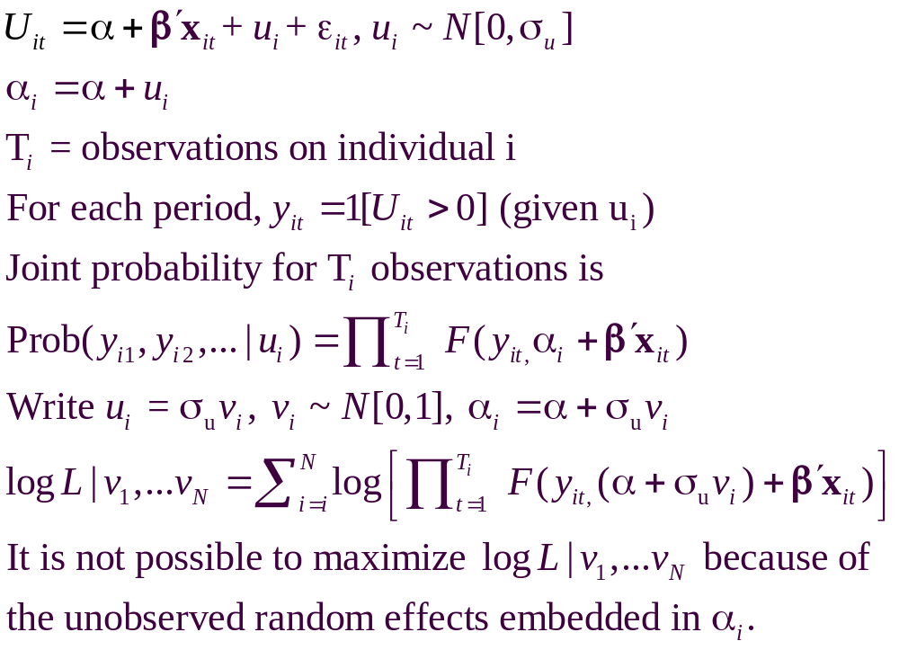
A Recast Random Effects Model

Slide 4
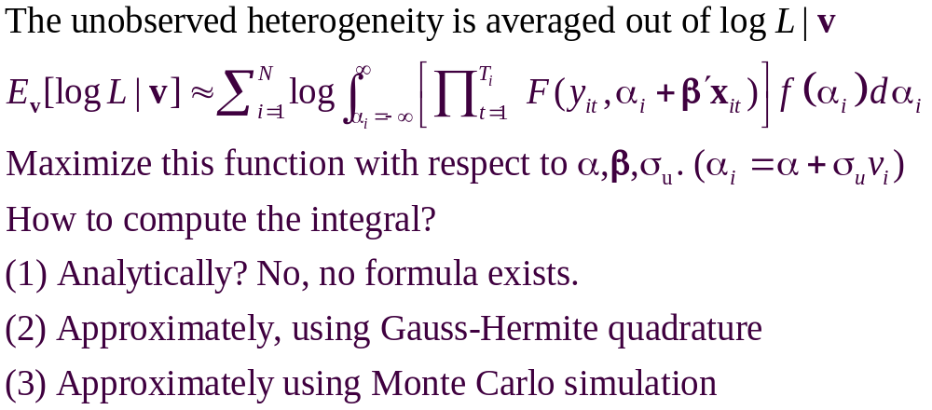
A Computable Log Likelihood

Slide 5
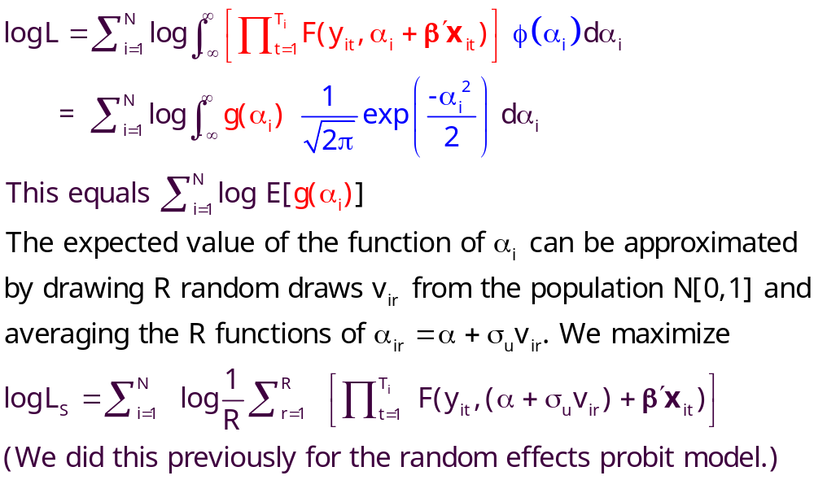
Simulation

Slide 6
Random Effects Model: Simulation
----------------------------------------------------------------------
Random Coefficients Probit Model
Dependent variable DOCTOR (Quadrature Based)
Log likelihood function -16296.68110 (-16290.72192)
Restricted log likelihood -17701.08500
Chi squared [ 1 d.f.] 2808.80780
Simulation based on 50 Halton draws
--------+-------------------------------------------------
Variable| Coefficient Standard Error b/St.Er. P[|Z|>z]
--------+-------------------------------------------------
|Nonrandom parameters
AGE| .02226*** .00081 27.365 .0000 ( .02232)
EDUC| -.03285*** .00391 -8.407 .0000 (-.03307)
HHNINC| .00673 .05105 .132 .8952 ( .00660)
|Means for random parameters
Constant| -.11873** .05950 -1.995 .0460 (-.11819)
|Scale parameters for dists. of random parameters
Constant| .90453*** .01128 80.180 .0000
--------+-------------------------------------------------------------
Implied ρ from these estimates is .90454²/(1+.90453²) = .449998.

Slide 7
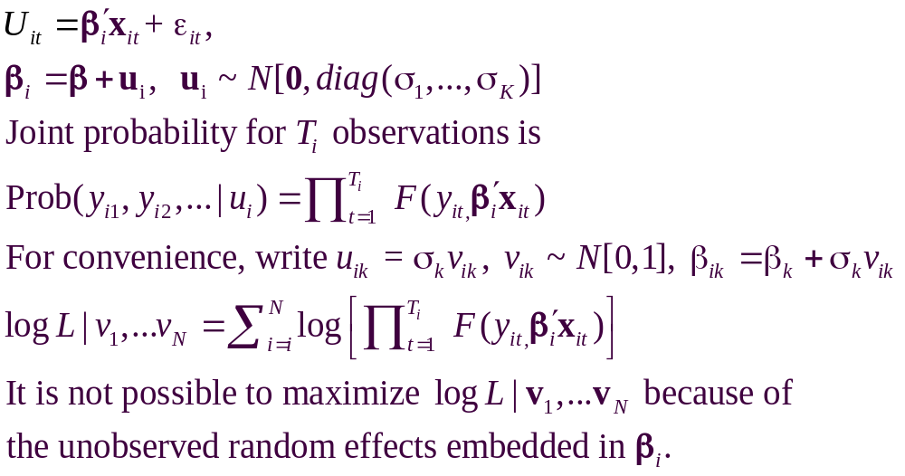
The Entire Parameter Vector is Random

Slide 8
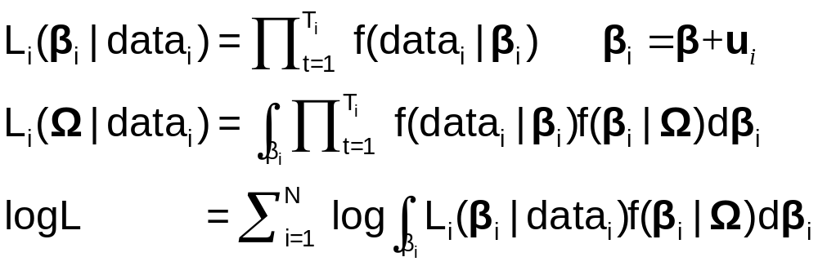
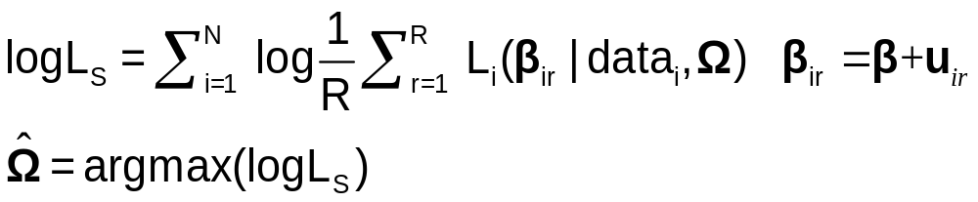
Maximum Simulated Likelihood
True log likelihood
Simulated log likelihood

Slide 9
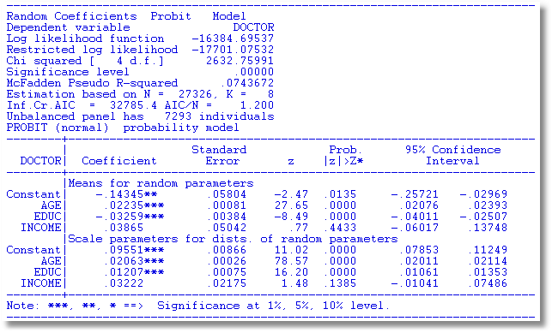
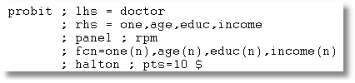

Slide 10
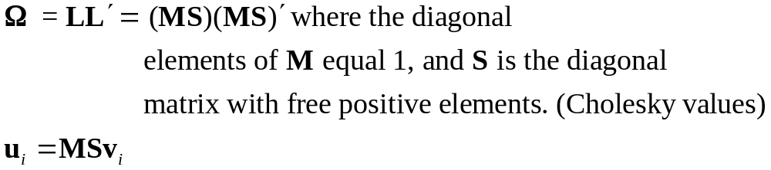
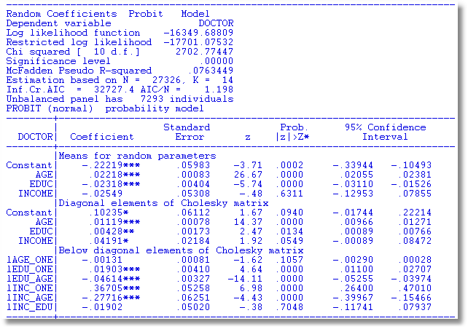
S
M

Slide 11
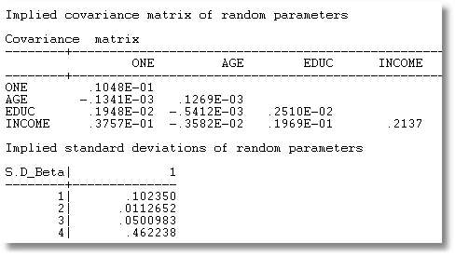
MSS′M′

Slide 12
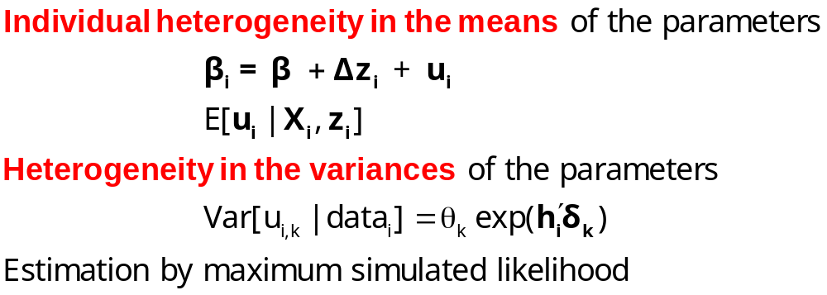
Modeling Parameter Heterogeneity

Slide 13
A Hierarchical Probit Model
U_{it} = β_{1i} + β_{2i}Age_{it} + β_{3i}Educ_{it} + β_{4i}Income_{it} + ε_{it}.
β_{1i}=β₁+Δ₁₁ Female_{i} + Δ₁₂ Married_{i} + u_{1i}
β_{2i}=β₂+Δ₂₁ Female_{i} + Δ₂₂ Married_{i} + u_{2i}
β_{3i}=β₃+Δ₃₁ Female_{i} + Δ₃₂ Married_{i} + u_{3i}
β_{4i}=β₄+Δ₄₁ Female_{i} + Δ₄₂ Married_{i} + u_{4i}
Y_{it} = 1[U_{it} > 0]
All random variables normally distributed.

Slide 14
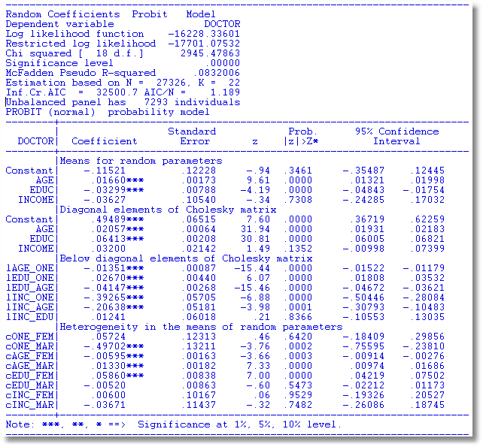

Slide 15
Estimating Individual Parameters
Model estimates = structural parameters, α, β, ρ, Δ, Σ, Γ
Objective, a model of individual specific parameters, β_{i}
Can individual specific parameters be estimated?
  Not quite – β_{i} is a single realization of a random process; one random draw.
  We estimate E[β_{i} | all information about i]
  (This is also true of Bayesian treatments, despite claims to the contrary.)

Slide 16
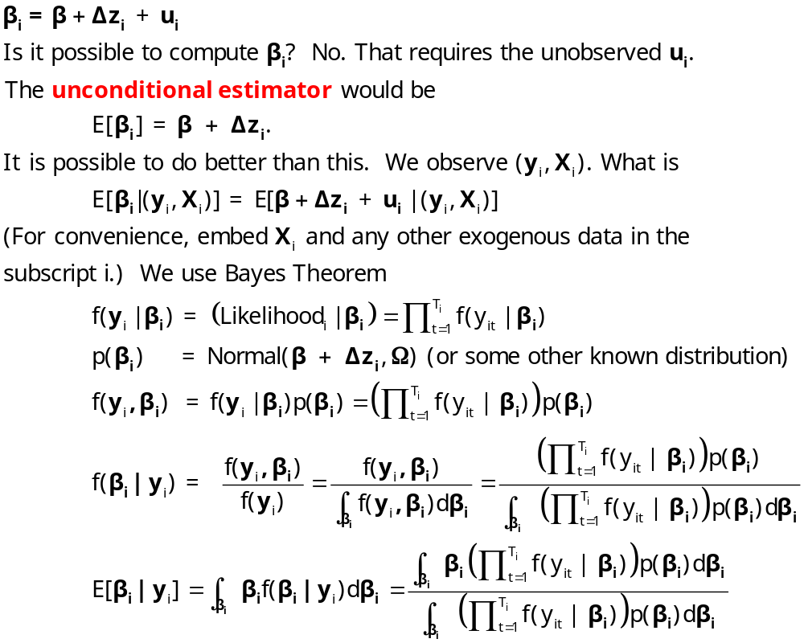
Estimating β_{i}

Slide 17
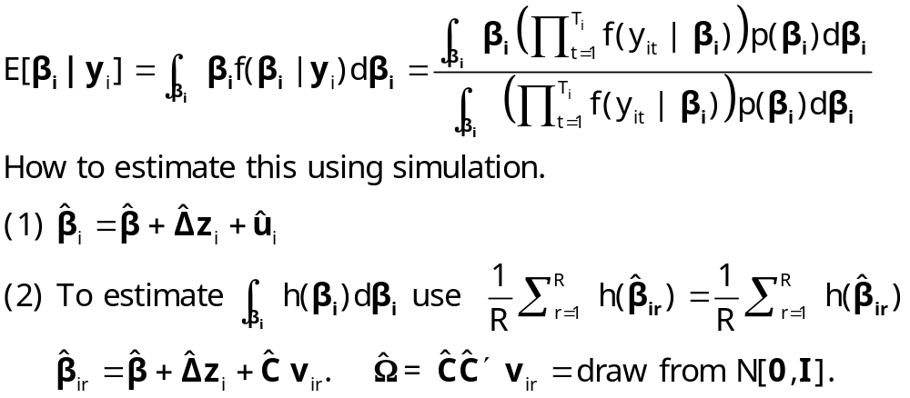
Conditional Estimate of β_{i}

Slide 18
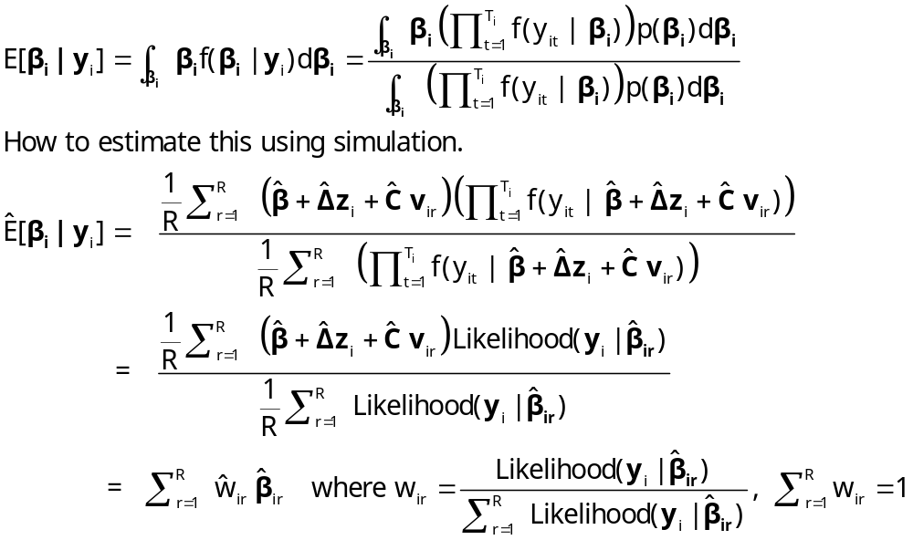
Conditional Estimate of β_{i}

Slide 19
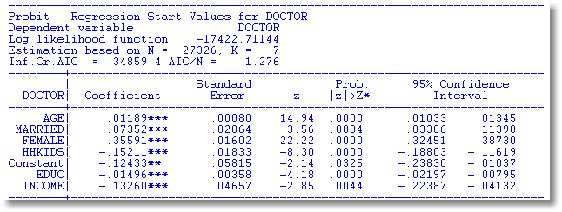

Slide 20
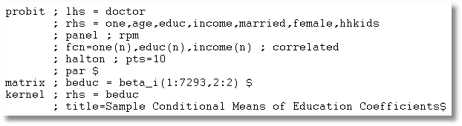

Slide 21
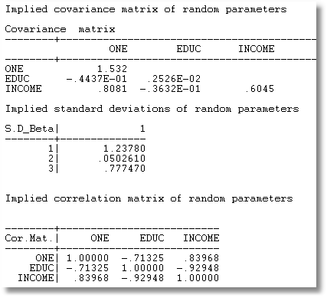
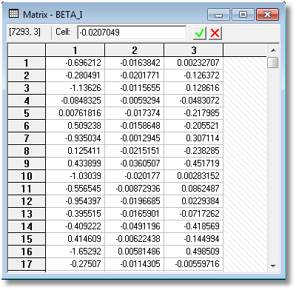

Slide 22
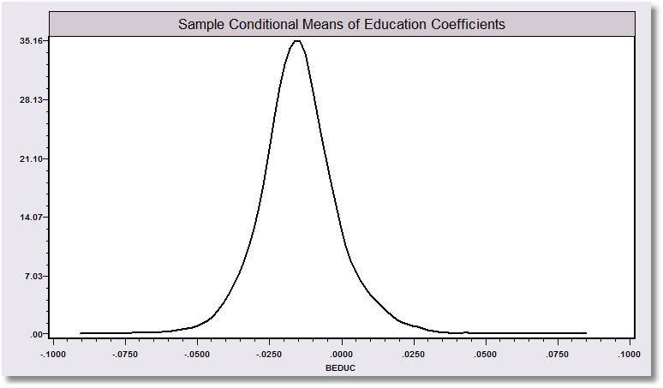
“Individual Coefficients”

Slide 23
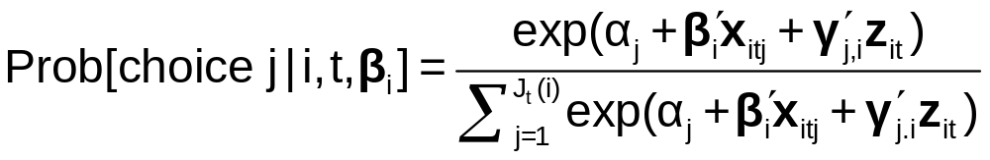
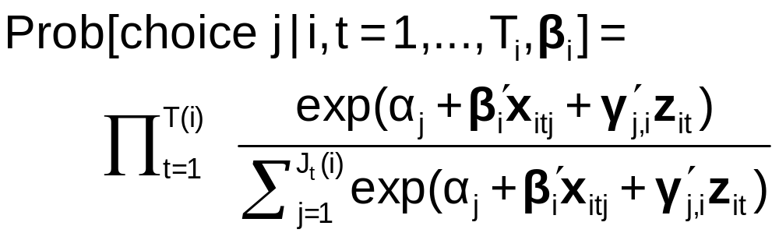
The Random Parameters Logit Model
Multiple choice situations: Independent conditioned on the individual specific parameters

Slide 24
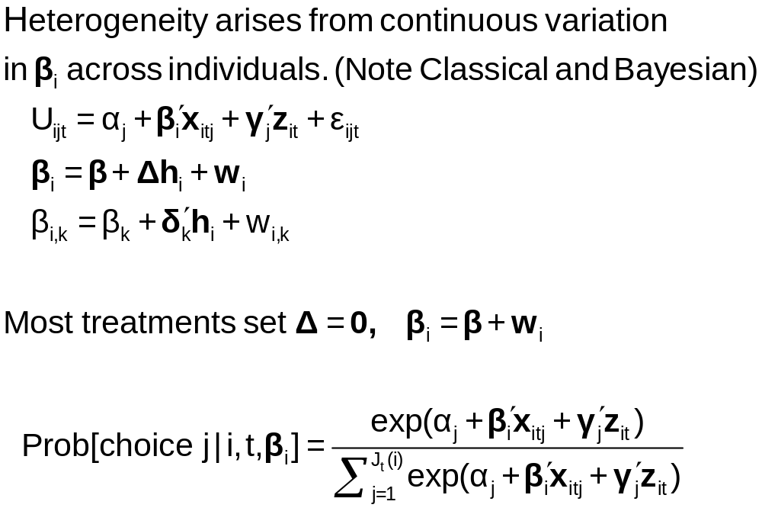
Continuous Random Variation in Preference Weights

Slide 25
Random Parameters Model
Allow model parameters as well as constants to be random
Allow multiple observations with persistent effects
Allow a hierarchical structure for parameters – not completely random
U_{itj} = β₁’x_{i1tj} + β_{2i}’x_{i2tj} + γ_{i}’z_{it} + ε_{ijt}
Random parameters in multinomial logit model
  β1 = nonrandom (fixed) parameters
  β2i = random parameters that may vary across
  individuals and across time
Maintain I.I.D. assumption for ε_{ijt} (given β)

Slide 26
Modeling Variations
Parameter specification
  “Nonrandom” – variance = 0
  Correlation across parameters – random parts correlated
  Fixed mean – not to be estimated. Free variance
  Fixed range – mean estimated, triangular from 0 to 2β
  Hierarchical structure - β_{ik} = β_{k} + δ_{k}’z_{i}
Stochastic specification
  Normal, uniform, triangular (tent) distributions
  Strictly positive – lognormal parameters (e.g., on income)
  Autoregressive: v(i,t,k) = u(i,t,k) + r(k)v(i,t-1,k) [this picks up time effects in multiple choice situations, e.g., fatigue.]

Slide 27
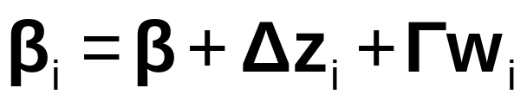
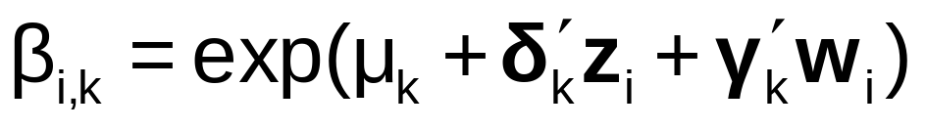
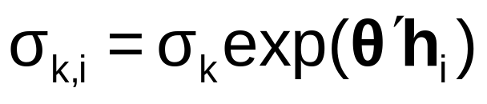
Model Extensions
AR(1): w_{i,k,t} = ρ_{k}w_{i,k,t-1} + v_{i,k,t}
Dynamic effects in the model
Restricting sign – lognormal distribution:
Restricting Range and Sign: Using triangular distribution and range = 0 to 2β.
Heteroscedasticity and heterogeneity

Slide 28
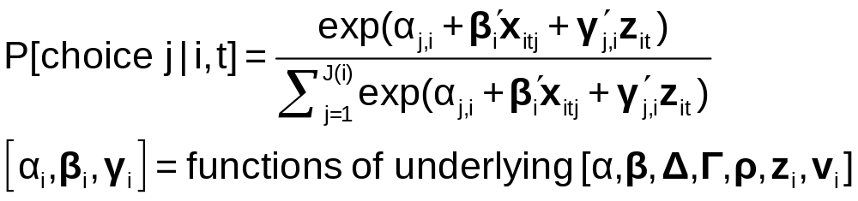
Estimating the Model
Denote by β₁ all “fixed” parameters in the model
Denote by β_{2i,t} all random and hierarchical parameters in the model

Slide 29
Customers’ Choice of Energy Supplier
California, Stated Preference Survey
361 customers presented with 8-12 choice situations each
Supplier attributes:
  Fixed price: cents per kWh
  Length of contract
  Local utility
  Well-known company
  Time-of-day rates (11¢ in day, 5¢ at night)
  Seasonal rates (10¢ in summer, 8¢ in winter, 6¢ in spring/fall)
(TrainCalUtilitySurvey.lpj)

Slide 30
Population Distributions
Normal for:
  Contract length
  Local utility
  Well-known company
Log-normal for:
  Time-of-day rates
  Seasonal rates
Price coefficient held fixed

Slide 31
Estimated Model
Estimate Std error
Price -.883 0.050
Contract mean -.213 0.026
std dev .386 0.028
Local mean 2.23 0.127
std dev 1.75 0.137
Known mean 1.59 0.100
std dev .962 0.098
TOD mean* 2.13 0.054
std dev* .411 0.040
Seasonal mean* 2.16 0.051
std dev* .281 0.022
*Parameters of underlying normal.

Slide 32
Distribution of Brand Value
Standard deviation
=2.0¢
10% dislike local utility
0
2.5¢
Brand value of local utility

Slide 33
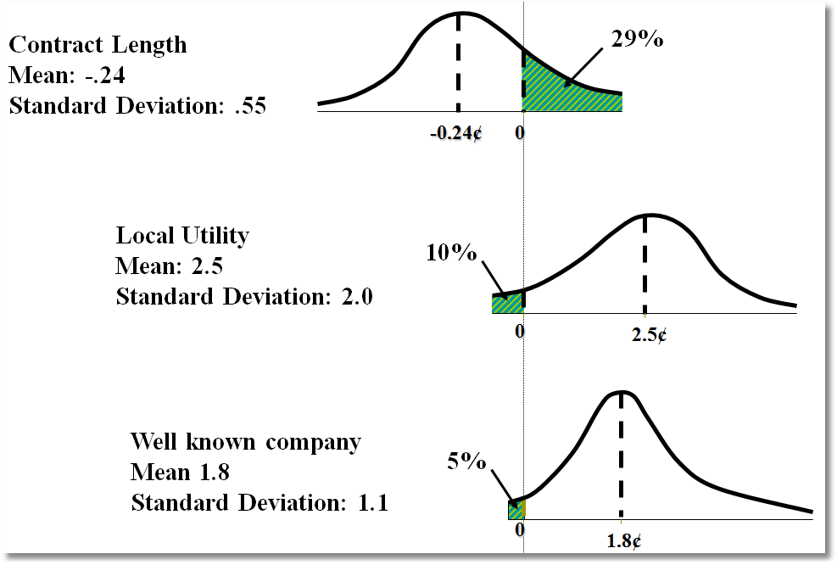
Random Parameter Distributions

Slide 34
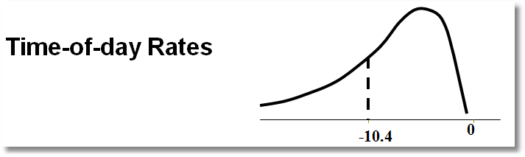
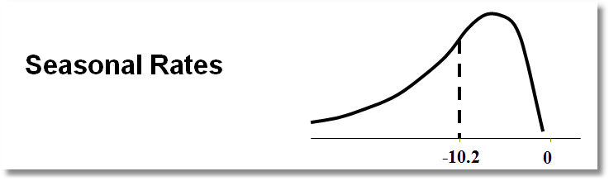
Time of Day Rates (Customers do not like – lognormal coefficient. Multiply variable by -1.)

Slide 35
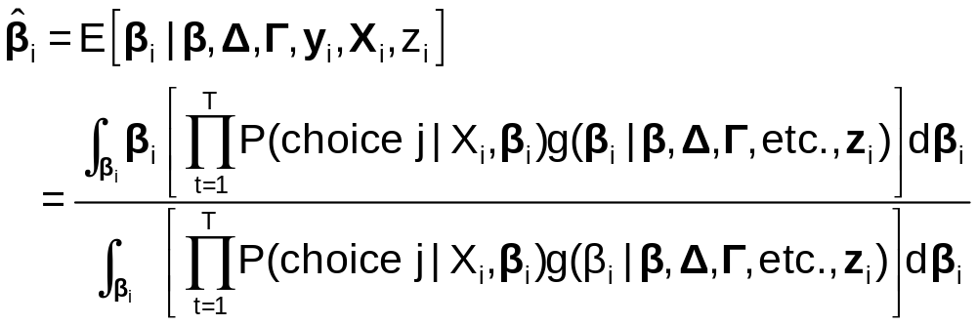
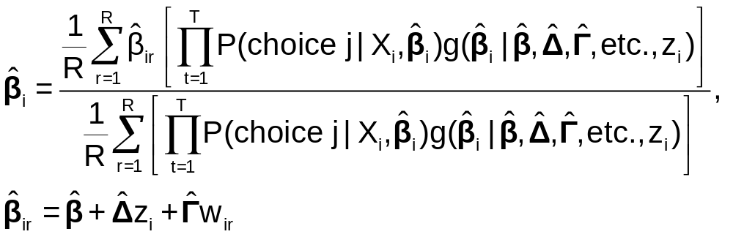
Posterior Estimation of β_{i}
Estimate by simulation

Slide 36
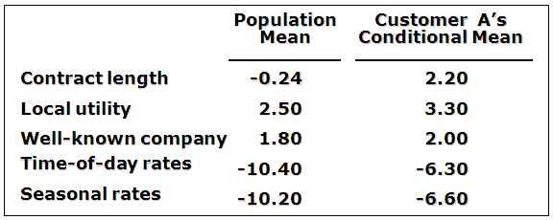
Expected Preferences of Each Customer
Customer likes long-term contract, local utility, and non-fixed rates.
Local utility can retain and make profit from this customer by offering a long-term contract with time-of-day or seasonal rates.

Slide 37
Application: Shoe Brand Choice
Simulated Data: Stated Choice,
  400 respondents,
  8 choice situations, 3,200 observations
3 choice/attributes + NONE
  Fashion = High / Low
  Quality = High / Low
  Price = 25/50/75,100 coded 1,2,3,4
Heterogeneity: Sex (Male=1), Age (<25, 25-39, 40+)
Underlying data generated by a 3 class latent class process (100, 200, 100 in classes)

Slide 38

Stated Choice Experiment: Unlabeled Alternatives, One Observation
t=1
t=2
t=3
t=4
t=5
t=6
t=7
t=8

Slide 39
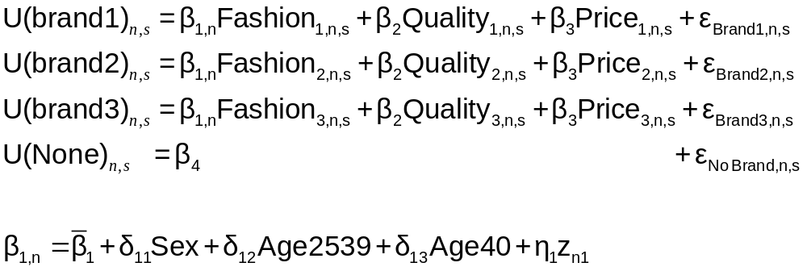
Random Parameters Logit Model

Slide 40
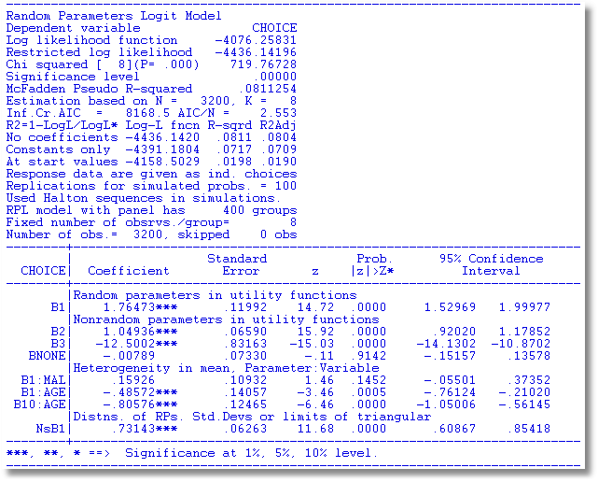

Slide 41
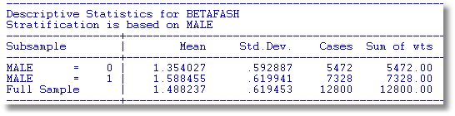
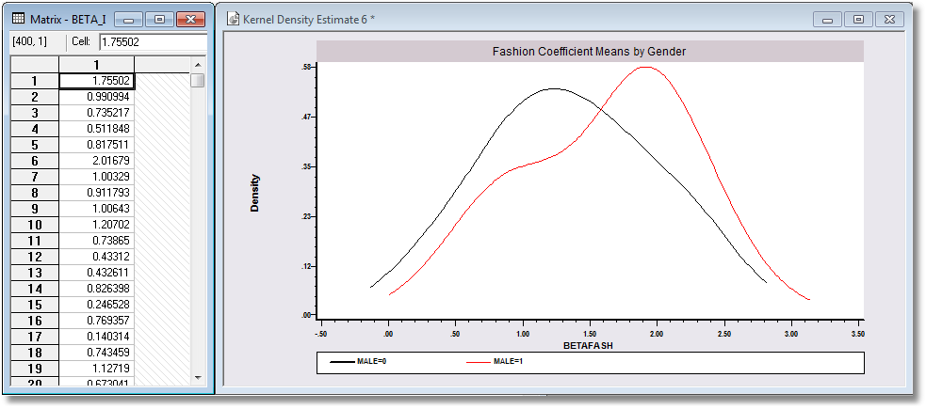

Slide 42
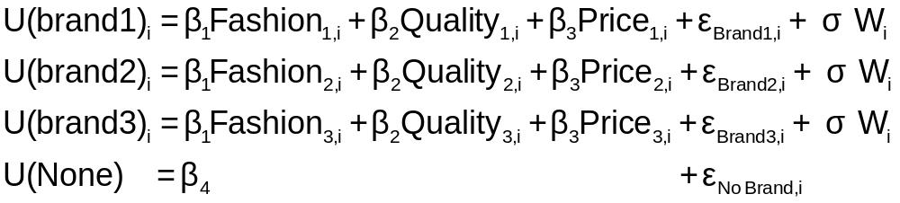
Error Components Logit Modeling
Alternative approach to building cross choice correlation
Common ‘effects.’ W_{i} is a ‘random individual effect.’

Slide 43
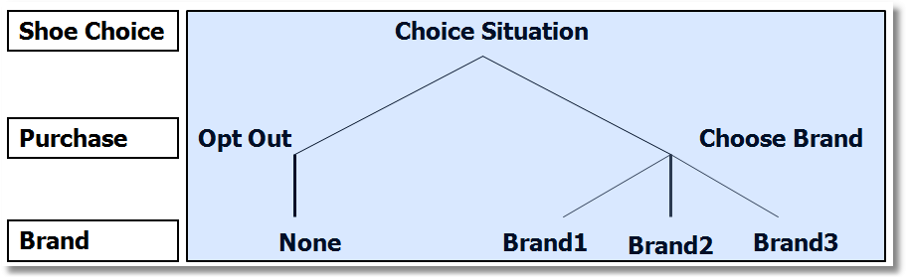
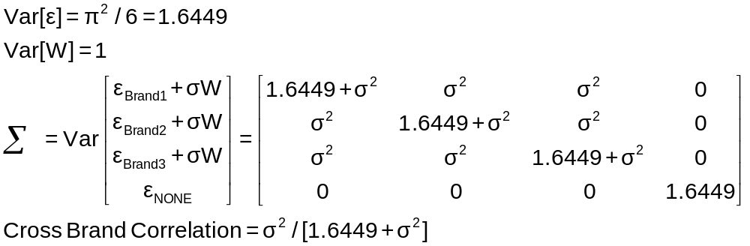
Implied Covariance Matrix
Nested Logit Formulation

Slide 44
Error Components Logit Model
-----------------------------------------------------------
Error Components (Random Effects) model
Dependent variable CHOICE
Log likelihood function -4158.45044
Estimation based on N = 3200, K = 5
Response data are given as ind. choices
Replications for simulated probs. = 50
Halton sequences used for simulations
ECM model with panel has 400 groups
Fixed number of obsrvs./group= 8
Number of obs.= 3200, skipped 0 obs
--------+--------------------------------------------------
Variable| Coefficient Standard Error b/St.Er. P[|Z|>z]
--------+--------------------------------------------------
|Nonrandom parameters in utility functions
FASH| 1.47913*** .06971 21.218 .0000
QUAL| 1.01385*** .06580 15.409 .0000
PRICE| -11.8052*** .86019 -13.724 .0000
ASC4| .03363 .07441 .452 .6513
SigmaE01| .09585*** .02529 3.791 .0002
--------+--------------------------------------------------
Random Effects Logit Model
Appearance of Latent Random
Effects in Utilities
Alternative E01
+-------------+---+
| BRAND1 | * |
+-------------+---+
| BRAND2 | * |
+-------------+---+
| BRAND3 | * |
+-------------+---+
| NONE | |
+-------------+---+
Correlation = {0.0959² / [1.6449 + 0.0959²]}^{1/2} = 0.0954

Slide 45
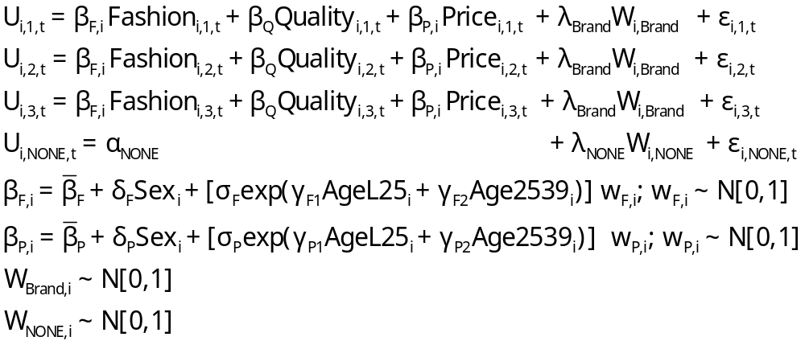
Extended MNL Model
Utility Functions

Slide 46
Extending the Basic MNL Model
Random Utility

Slide 47
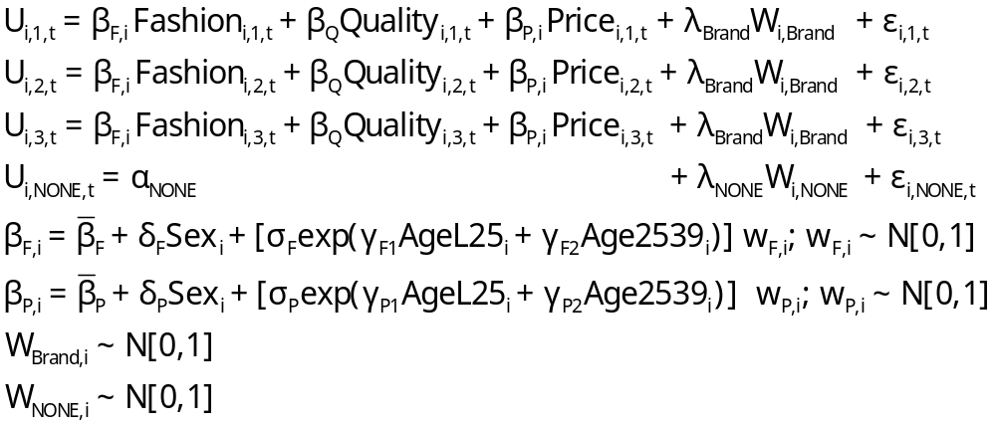
Error Components Logit Model
Error Components

Slide 48
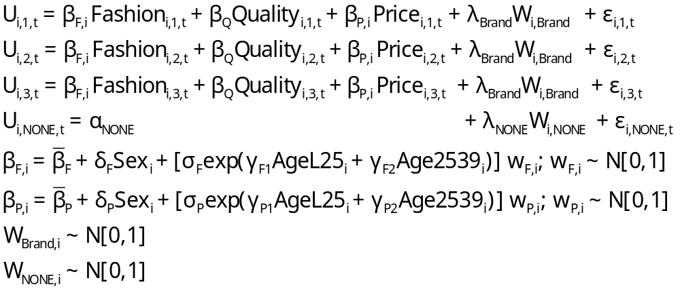
Random Parameters Model
Random Parameters

Slide 49
Heterogeneous (in the Means)
Random Parameters Model
Heterogeneity in Means

Slide 50
Heterogeneity in Both
Means and Variances
Heteroscedasticity

Slide 51
---------------------------------------------------------------
Random Parms/Error Comps. Logit Model
Dependent variable CHOICE
Log likelihood function -4019.23544 (-4158.50286 for MNL)
Restricted log likelihood -4436.14196 (Chi squared = 278.5)
Chi squared [ 12 d.f.] 833.81303
Significance level .00000
McFadden Pseudo R-squared .0939795
Estimation based on N = 3200, K = 12
Information Criteria: Normalization=1/N
Normalized Unnormalized
AIC 2.51952 8062.47089
R2=1-LogL/LogL* Log-L fncn R-sqrd R2Adj
No coefficients -4436.1420 .0940 .0928
Constants only -4391.1804 .0847 .0836
At start values -4158.5029 .0335 .0323
Response data are given as ind. choices
Replications for simulated probs. = 50
Halton sequences used for simulations
RPL model with panel has 400 groups
Fixed number of obsrvs./group= 8
Number of obs.= 3200, skipped 0 obs
---------------------------------------------------------------

Slide 52
Estimated RP/ECL Model
--------+--------------------------------------------------
Variable| Coefficient Standard Error b/St.Er. P[|Z|>z]
--------+--------------------------------------------------
|Random parameters in utility functions
FASH| .62768*** .13498 4.650 .0000
PRICE| -7.60651*** 1.08418 -7.016 .0000
|Nonrandom parameters in utility functions
QUAL| 1.07127*** .06732 15.913 .0000
ASC4| .03874 .09017 .430 .6675
|Heterogeneity in mean, Parameter:Variable
FASH:AGE| 1.73176*** .15372 11.266 .0000
FAS0:AGE| .71872*** .18592 3.866 .0001
PRIC:AGE| -9.38055*** 1.07578 -8.720 .0000
PRI0:AGE| -4.33586*** 1.20681 -3.593 .0003
|Distns. of RPs. Std.Devs or limits of triangular
NsFASH| .88760*** .07976 11.128 .0000
NsPRICE| 1.23440 1.95780 .631 .5284
|Heterogeneity in standard deviations
|(cF1, cF2, cP1, cP2 omitted...)
|Standard deviations of latent random effects
SigmaE01| .23165 .40495 .572 .5673
SigmaE02| .51260** .23002 2.228 .0258
--------+--------------------------------------------------
Note: ***, **, * = Significance at 1%, 5%, 10% level.
-----------------------------------------------------------
Random Effects Logit
Model Appearance of
Latent Random Effects
in Utilities
Alternative E01 E02
+-------------+---+---+
| BRAND1 | * | |
+-------------+---+---+
| BRAND2 | * | |
+-------------+---+---+
| BRAND3 | * | |
+-------------+---+---+
| NONE | | * |
+-------------+---+---+
Heterogeneity in Means.
Delta: 2 rows, 2 cols.
AGE25 AGE39
FASH 1.73176 .71872
PRICE -9.38055 -4.33586

Slide 53
Estimated Elasticities
Multinomial Logit
+---------------------------------------------------+
| Elasticity averaged over observations.|
| Attribute is PRICE in choice BRAND1 |
| Effects on probabilities of all choices in model: |
| * = Direct Elasticity effect of the attribute. |
| Mean St.Dev |
| * Choice=BRAND1 -.9210 .4661 |
| Choice=BRAND2 .2773 .3053 |
| Choice=BRAND3 .2971 .3370 |
| Choice=NONE .2781 .2804 |
+---------------------------------------------------+
| Attribute is PRICE in choice BRAND2 |
| Choice=BRAND1 .3055 .1911 |
| * Choice=BRAND2 -1.2692 .6179 |
| Choice=BRAND3 .3195 .2127 |
| Choice=NONE .2934 .1711 |
+---------------------------------------------------+
| Attribute is PRICE in choice BRAND3 |
| Choice=BRAND1 .3737 .2939 |
| Choice=BRAND2 .3881 .3047 |
| * Choice=BRAND3 -.7549 .4015 |
| Choice=NONE .3488 .2670 |
+---------------------------------------------------+
+--------------------------+
| Effects on probabilities |
| * = Direct effect te. |
| Mean St.Dev |
| PRICE in choice BRAND1 |
| * BRAND1 -.8895 .3647 |
| BRAND2 .2907 .2631 |
| BRAND3 .2907 .2631 |
| NONE .2907 .2631 |
+--------------------------+
| PRICE in choice BRAND2 |
| BRAND1 .3127 .1371 |
| * BRAND2 -1.2216 .3135 |
| BRAND3 .3127 .1371 |
| NONE .3127 .1371 |
+--------------------------+
| PRICE in choice BRAND3 |
| BRAND1 .3664 .2233 |
| BRAND2 .3664 .2233 |
| * BRAND3 -.7548 .3363 |
| NONE .3664 .2233 |
+--------------------------+

Slide 54
Estimating Individual Distributions
Form posterior estimates of E[β_{i}|data_{i}]
Use the same methodology to estimate E[β_{i}²|data_{i}] and Var[β_{i}|data_{i}]
Plot individual “confidence intervals” (assuming near normality)
Sample from the distribution and plot kernel density estimates

Slide 55
What is the ‘Individual Estimate?’
Point estimate of mean, variance and range of
random variable β_{i} | data_{i}.
Value is NOT an estimate of β_{i} ; it is an estimate
of E[β_{i} | data_{i}]
This would be the best estimate of the actual
realization β_{i}|data_{i}
An interval estimate would account for the sampling
‘variation’ in the estimator of Ω.
Bayesian counterpart to the preceding: Posterior
mean and variance. Same kind of plot could be done.

Slide 56
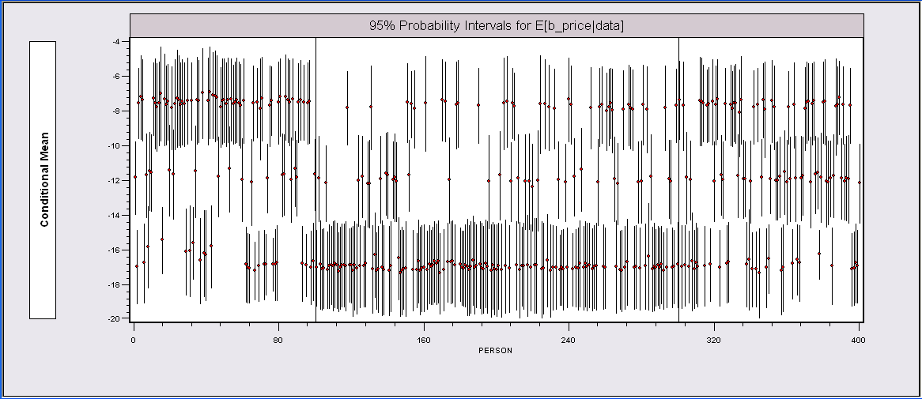
Individual E[β_{i}|data_{i}] Estimates*
The random parameters model is uncovering the latent class feature of the data.
*The intervals could be made wider to account for the sampling
variability of the underlying (classical) parameter estimators.

Slide 57
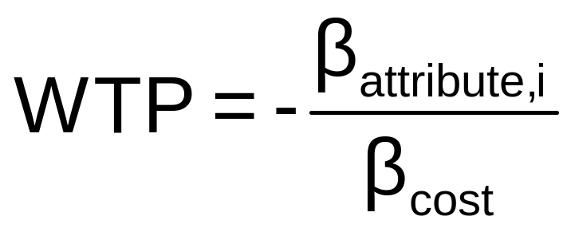
WTP Application (Value of Time Saved)
Estimating Willingness to Pay for Increments to an Attribute in a Discrete Choice Model
WTP = MU(attribute) / MU(Income)
Random

Slide 58
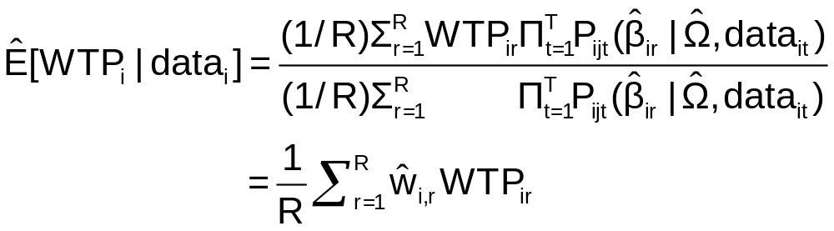
Extending the RP Model to WTP
Use the model to estimate conditional
distributions for any function of
parameters
Willingness to pay = -β_{i,time} / β_{i,cost}
Use simulation method

Slide 59
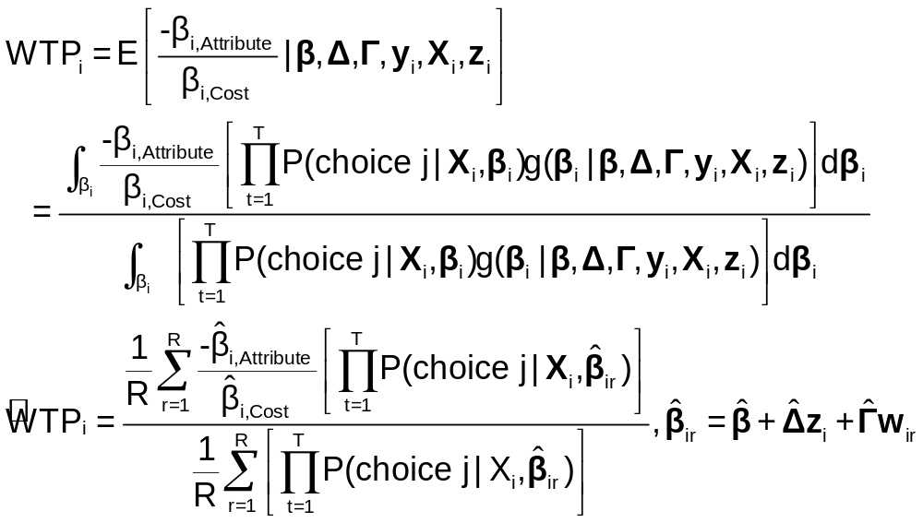
Simulation of WTP from β_{i}

Slide 60
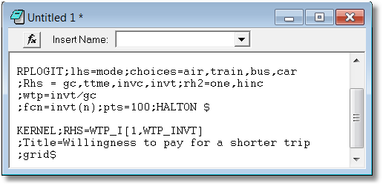
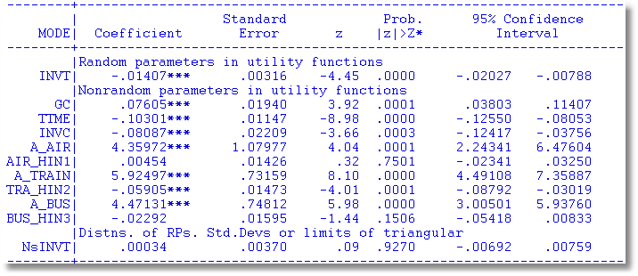

Slide 61

WTP

Slide 62


Slide 63


Slide 64

Generalized Mixed Logit Model

Slide 65

Unobserved Heterogeneity in Scaling

Slide 66


Scaled MNL

Slide 67

Observed and Unobserved Heterogeneity

Slide 68

Price Elasticities

Slide 69
Data on Discrete Choices
CHOICE ATTRIBUTES CHARACTERISTIC
MODE TRAVEL INVC INVT TTME GC HINC
AIR .00000 59.000 100.00 69.000 70.000 35.000
TRAIN .00000 31.000 372.00 34.000 71.000 35.000
BUS .00000 25.000 417.00 35.000 70.000 35.000
CAR 1.0000 10.000 180.00 .00000 30.000 35.000
AIR .00000 58.000 68.000 64.000 68.000 30.000
TRAIN .00000 31.000 354.00 44.000 84.000 30.000
BUS .00000 25.000 399.00 53.000 85.000 30.000
CAR 1.0000 11.000 255.00 .00000 50.000 30.000
AIR .00000 127.00 193.00 69.000 148.00 60.000
TRAIN .00000 109.00 888.00 34.000 205.00 60.000
BUS 1.0000 52.000 1025.0 60.000 163.00 60.000
CAR .00000 50.000 892.00 .00000 147.00 60.000
AIR .00000 44.000 100.00 64.000 59.000 70.000
TRAIN .00000 25.000 351.00 44.000 78.000 70.000
BUS .00000 20.000 361.00 53.000 75.000 70.000
CAR 1.0000 5.0000 180.00 .00000 32.000 70.000
This is the ‘long form.’ In the ‘wide form,’ all data for the individual appear on a single ‘line’. The ‘wide form’ is unmanageable for models of any complexity and for stated preference applications.

Slide 70

A Generalized Mixed Logit Model

Slide 71

Generalized Multinomial Choice Model

Slide 72

Estimation in Willingness to Pay Space
Both parameters in the WTP calculation are random.

Slide 73
--------+--------------------------------------------------
Variable| Coefficient Standard Error b/St.Er. P[|Z|>z]
--------+--------------------------------------------------
|Random parameters in utility functions
QUAL| -.32668*** .04302 -7.593 .0000 1.01373 renormalized
PRICE| 1.00000 ......(Fixed Parameter)...... -11.80230 renormalized
|Nonrandom parameters in utility functions
FASH| 1.14527*** .05788 19.787 .0000 1.4789 not rescaled
ASC4| .84364*** .05554 15.189 .0000 .0368 not rescaled
|Heterogeneity in mean, Parameter:Variable
QUAL:AGE| .05843 .04836 1.208 .2270 interaction terms
QUA0:AGE| -.11620 .13911 -.835 .4035
PRIC:AGE| .23958 .25730 .931 .3518
PRI0:AGE| 1.13921 .76279 1.493 .1353
|Diagonal values in Cholesky matrix, L.
NsQUAL| .13234*** .04125 3.208 .0013 correlated parameters
CsPRICE| .000 ......(Fixed Parameter)...... but coefficient is fixed
|Below diagonal values in L matrix. V = L*Lt
PRIC:QUA| .000 ......(Fixed Parameter)......
|Heteroscedasticity in GMX scale factor
sdMALE| .23110 .14685 1.574 .1156 heteroscedasticity
|Variance parameter tau in GMX scale parameter
TauScale| 1.71455*** .19047 9.002 .0000 overall scaling, tau
|Weighting parameter gamma in GMX model
GammaMXL| .000 ......(Fixed Parameter)......
|Coefficient on PRICE in WTP space form
Beta0WTP| -3.71641*** .55428 -6.705 .0000 new price coefficient
S_b0_WTP| .03926 .40549 .097 .9229 standard deviation
| Sample Mean Sample Std.Dev.
Sigma(i)| .70246 1.11141 .632 .5274 overall scaling
|Standard deviations of parameter distributions
sdQUAL| .13234*** .04125 3.208 .0013
sdPRICE| .000 ......(Fixed Parameter)......
--------+--------------------------------------------------
Estimated Model for WTP

Slide 74


Slide 75


Slide 76


Slide 77


Slide 78


Slide 79



Slide 80


Slide 81


Slide 82


Slide 83


Latent Class Mixed Logit

Slide 84




Slide 85




Slide 86


Slide 87

Appendix: Maximum Simulated Likelihood

Slide 88

Monte Carlo Integration

Slide 89


Monte Carlo Integration

Slide 90

Example: Monte Carlo Integral

Slide 91

Simulated Log Likelihood for a Mixed Probit Model

Slide 92

Generating Random Draws

Slide 93

Drawing Uniform Random Numbers

Slide 94

Quasi-Monte Carlo Integration Based on Halton Sequences
For example, using base p=5, the integer r=37 has b₀ = 2, b₁ = 2, and b₂ = 1; (37=1x5² + 2x5¹ + 2x5⁰). Then
H(37|5) = 2×5⁻¹ + 2×5⁻² + 1×5⁻³ = 0.448.

Slide 95

Halton Sequences vs. Random Draws
Requires far fewer draws – for one dimension, about 1/10. Accelerates estimation by a factor of 5 to 10.

Slide 96
Estimating the RPL Model
Estimation: β₁
β_{2it} = β₂ + Δz_{i} + Γv_{i,t}
Uncorrelated: Γ is diagonal
Autocorrelated: v_{i,t} = Rv_{i,t-1} + u_{i,t}
(1) Estimate “structural parameters”
(2) Estimate individual specific utility parameters
(3) Estimate elasticities, etc.

Slide 97

Classical Estimation Platform:
The Likelihood
Expected value over all possible realizations of β_{i}. I.e., over all possible samples.

Slide 98


Slide 99

Simulation Based Estimation
Probability = P[data |β(β₁,β₂,Δ,Γ,R,v_{i,t})]
Need to integrate out the unobserved random term
E{P[data | β(β₁,β₂,Δ,Γ,R,v_{i,t})]}
= P[…|v_{i,t}]f(v_{i,t})dv_{i,t}
Integration is done by simulation
  Draw values of v and compute β then probabilities
  Average many draws
  Maximize the sum of the logs of the averages
  (See Train[Cambridge, 2003] on simulation methods.)

Slide 100
Programs differ on the models fitted, the algorithms, the paradigm, and the extensions provided to the simplest RPM, β_{i} = β+w_{i}.
WinBUGS:
  MCMC
  User specifies the model – constructs the Gibbs Sampler/Metropolis Hastings
MLWin:
  Linear and some nonlinear – logit, Poisson, etc.
  Uses MCMC for MLE (noninformative priors)
SAS: Proc Mixed.
  Classical
  Uses primarily a kind of GLS/GMM (method of moments algorithm for loglinear models)
Stata: Classical
  Several loglinear models – GLAMM. Mixing done by quadrature.
  Maximum simulated likelihood for multinomial choice (Arne Hole, user provided)
LIMDEP/NLOGIT
  Classical
  Mixing done by Monte Carlo integration – maximum simulated likelihood
  Numerous linear, nonlinear, loglinear models
Ken Train’s Gauss Code, miscellaneous freelance R and Matlab code
  Monte Carlo integration
  Mixed Logit (mixed multinomial logit) model only (but free!)
Biogeme
  Multinomial choice models
  Many experimental models (developer’s hobby)

