Slide 1




Microeconometric Modeling
William Greene
Stern School of Business
New York University
New York NY USA
5.1 Modeling Stated
Preference Data

Slide 2

Concepts
Models
Revealed Preference
Stated Preference
Attribute Nonattendance
Random Utility
Attribute Space
Experimental Design
Choice Experiment
Environmental Attitude
Multinomial Logit Model
Latent Class MNL
Nested Logit
Mixed Logit
Error Components Logit

Slide 3
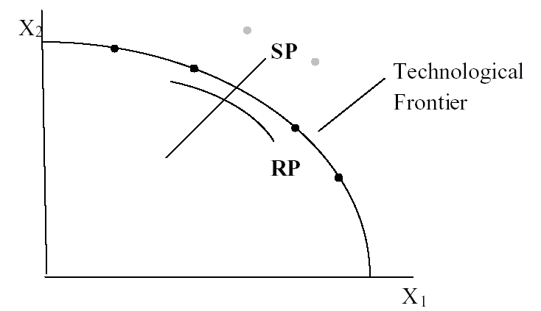
Revealed Preference Data
Advantage: Actual observations on actual behavior
  Market (ex-post, e.g., supermarket scanner data)
  Individual observations
Disadvantage: Limited range of choice sets and attributes – does not allow analysis of switching behavior; requires strong homogeneity assumptions to model potential switching.

Slide 4
Stated Preference Data
Disadvantages
  Purely hypothetical – does the subject take it seriously?
  No necessary anchor to real market situations
  Vast heterogeneity across individuals
  E.g., contingent valuation
Advantage
  Analysis of person specific behavior, e.g., switching
  Modeling cross section heterogeneity

Slide 5
Strategy
Repeated choice situations to explore the attribute space
Ideally combined RP/SP constructions
  Mixed data
  Expanded choice sets
Accommodating “panel data”
  Multinomial Probit [marginal, impractical]
  Latent Class
  Random and Fixed Effects, Mixed Logit

Slide 6
Application: Shoe Brand Choice
Simulated Data: Stated Choice,
  400 respondents,
  8 choice situations, 3,200 observations
3 choice/attributes + NONE
  Fashion = High / Low
  Quality = High / Low
  Price = 25/50/75,100 coded 1,2,3,4
Heterogeneity: Sex (Male=1), Age (<25, 25-39, 40+)
Underlying data generated by a 3 class latent class process (100, 200, 100 in classes)

Slide 7

Stated Choice Experiment: Unlabeled Alternatives, One Observation
t=1
t=2
t=3
t=4
t=5
t=6
t=7
t=8

Slide 8

Application: Pregnancy Care Guidelines

Slide 9
Application: Travel Mode
Survey sample of 2,688 trips, 2 or 4 choices per situation
Sample consists of 672 individuals
Choice based sample
Revealed/Stated choice experiment:
Revealed: Drive,ShortRail,Bus,Train
Hypothetical: Drive,ShortRail,Bus,Train,LightRail,ExpressBus
Attributes:
Cost –Fuel or fare
Transit time
Parking cost
Access and Egress time

Slide 10
Customers’ Choice of Energy Supplier
California, Stated Preference Survey
361 customers presented with 8-12 choice situations each
Supplier attributes:
  Fixed price: cents per kWh
  Length of contract
  Local utility
  Well-known company
  Time-of-day rates (11¢ in day, 5¢ at night)
  Seasonal rates (10¢ in summer, 8¢ in winter, 6¢ in spring/fall)

Slide 11
Combining RP and SP Data Sets - 1
Enrich the attribute set by replicating choices
E.g.:
  RP: Bus,Car,Train (actual)
  SP: Bus(1),Car(1),Train(1)
  Bus(2),Car(2),Train(2),…
How to combine?

Slide 12
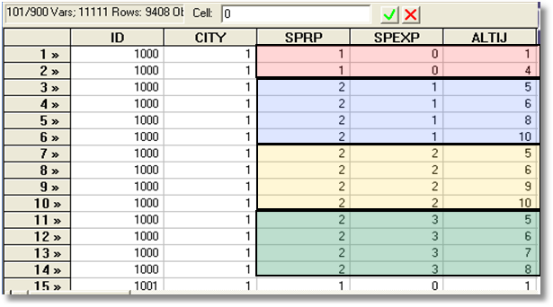
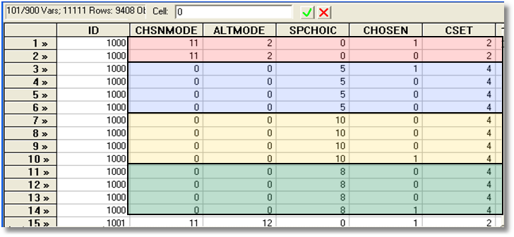
Each person makes four choices from a choice set that includes either two or four alternatives.
The first choice is the RP between two of the RP alternatives
The second-fourth are the SP among four of the six SP alternatives.
There are ten alternatives in total.

Slide 13
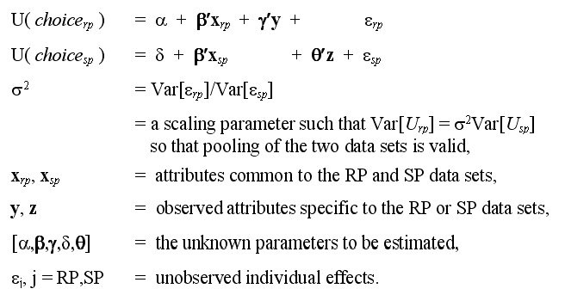
An Underlying Random Utility Model

Slide 14
Nested Logit Approach
Mode
RP
Car Train Bus SPCar SPTrain SPBus
Use a two level nested model, and constrain three SP IV parameters to be equal.

Slide 15
Enriched Data Set – Vehicle Choice
Choosing between Conventional, Electric and LPG/CNG Vehicles in Single-Vehicle Households
David A. Hensher William H. Greene
Institute of Transport Studies Department of Economics
School of Business Stern School of Business
The University of Sydney New York University
NSW 2006 Australia New York USA
Conventional, Electric, Alternative
1,400 Sydney Households
Automobile choice survey
RP + 3 SP fuel classes
Nested logit – 2 level approach – to handle the scaling issue

Slide 16
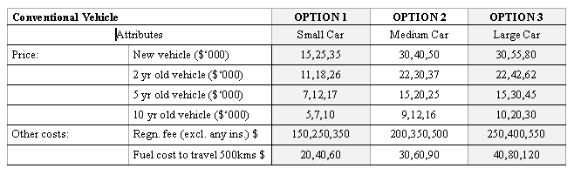
Attribute Space: Conventional

Slide 17
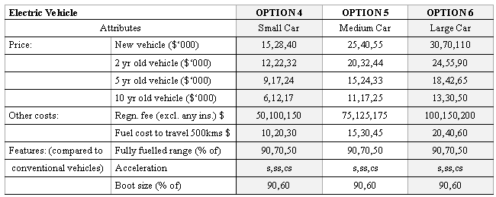
Attribute Space: Electric

Slide 18
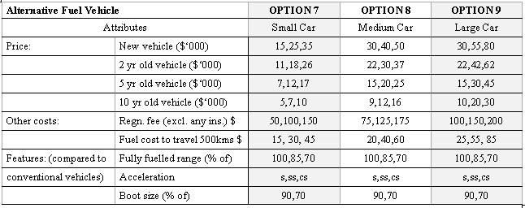
Attribute Space: Alternative

Slide 19


Survey sample of 2,688 trips, 2 or 4 choices per situation
Sample consists of 672 individuals
Choice based sample
Revealed/Stated choice experiment:
Revealed: Drive, ShortRail, Bus, Train
Hypothetical: Drive, ShortRail, Bus, Train,
LightRail, ExpressBus
Attributes:
Cost –Fuel or fare
Transit time
Parking cost
Access and Egress time

Slide 20
Mixed Logit Approaches
Pivot SP choices around an RP outcome.
Scaling is handled directly in the model
Continuity across choice situations is handled by random elements of the choice structure that are constant through time
  Preference weights – coefficients
  Scaling parameters
    Variances of random parameters
    Overall scaling of utility functions

Slide 21
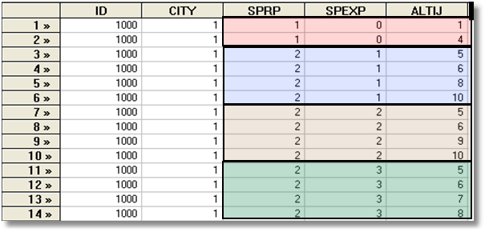
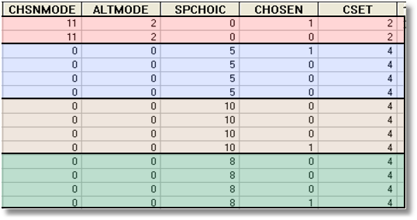
Each person makes four choices from a choice set that includes either 2 or 4 alternatives.
The first choice is the RP between two of the 4 RP alternatives
The second-fourth are the SP among four of the 6 SP alternatives.
There are 10 alternatives in total.
A Stated Choice Experiment with Variable Choice Sets

Slide 22
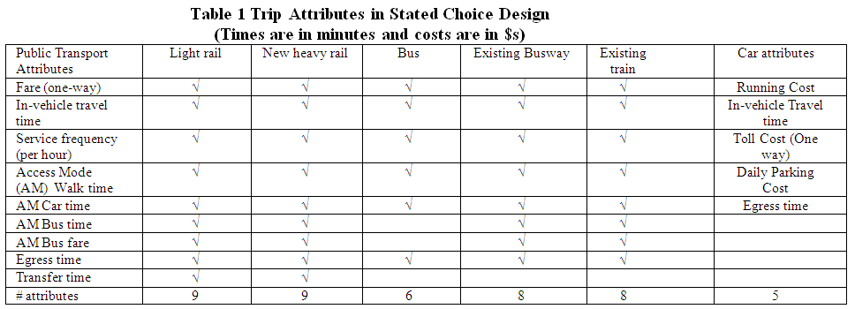
Experimental Design: SP Alternatives

Slide 23

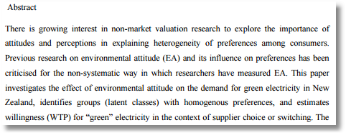
Willingness to Pay for Green Energy

Slide 24


Slide 25
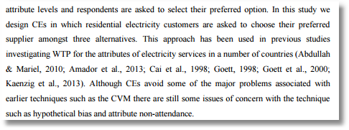

Slide 26
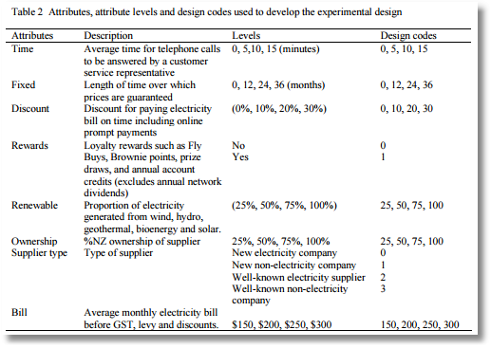

Slide 27
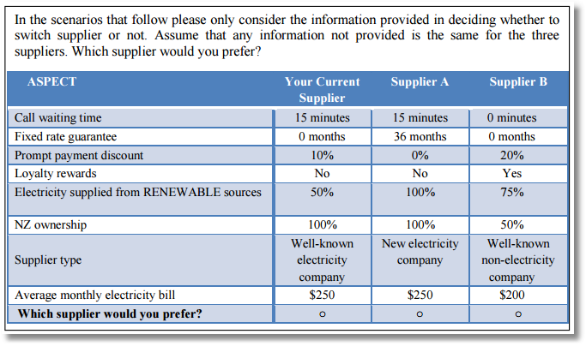

Slide 28
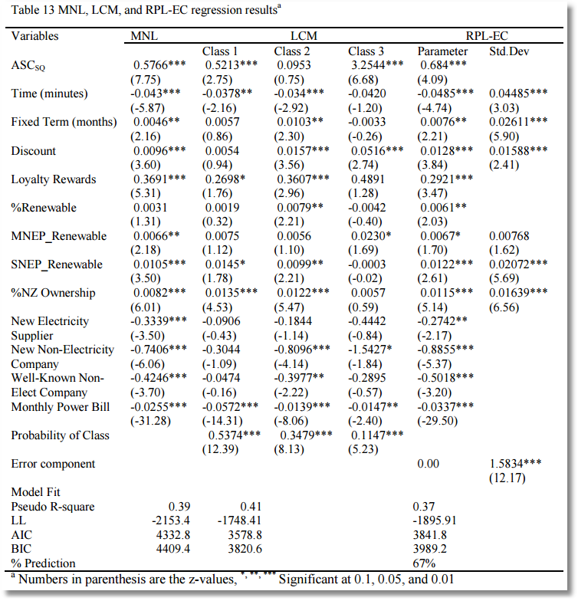

Slide 29
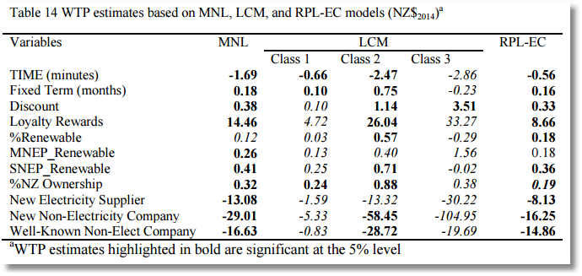

Slide 30
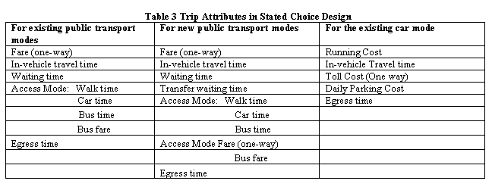
Stated Choice Experiment: Travel
Mode by Sydney Commuters

Slide 31
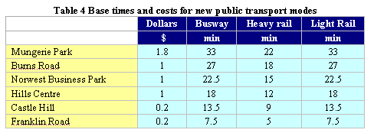
Would You Use a New Mode?

Slide 32
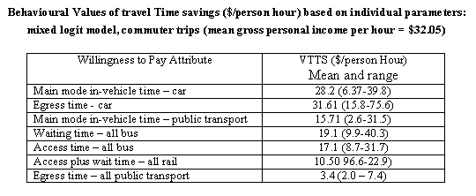
Value of Travel Time Saved

Slide 33
Hybrid Choice Models
Incorporates latent variables in choice model
Extends development of discrete choice model to incorporate other aspects of preference structure of the chooser
Develops endogeneity of the preference structure.

Slide 34
Endogeneity
"Recent Progress on Endogeneity in Choice Modeling" with Jordan Louviere & Kenneth Train & Moshe Ben-Akiva & Chandra Bhat & David Brownstone & Trudy Cameron & Richard Carson & J. Deshazo & Denzil Fiebig & William Greene & David Hensher & Donald Waldman, 2005. Marketing Letters Springer, vol. 16(3), pages 255-265, December.
Narrow view: U(i,j) = b’x(i,j) + ε(i,j), x(i,j) correlated with ε(i,j)
(Berry, Levinsohn, Pakes, brand choice for cars, endogenous price attribute.)
Implications for estimators that assume it is.
Broader view: Sounds like heterogeneity.
  Preference structure: RUM vs. RRM
  Heterogeneity in choice strategy – e.g., omitted attribute models
  Heterogeneity in taste parameters: location and scaling
  Heterogeneity in functional form: Possibly nonlinear utility functions

Slide 35
Heterogeneity
Narrow view: Random variation in marginal utilities and scale
  RPM, LCM
  Scaling model
  Generalized Mixed model
Broader view: Heterogeneity in preference weights
  RPM and LCM with exogenous variables
  Scaling models with exogenous variables in variances
  Looks like hierarchical models

Slide 36
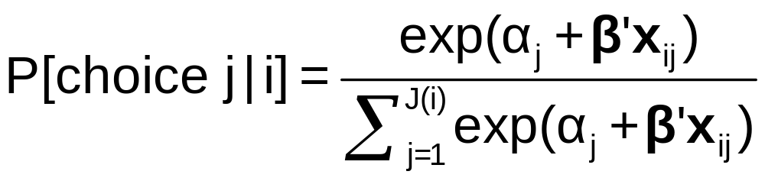
The MNL Model

Slide 37
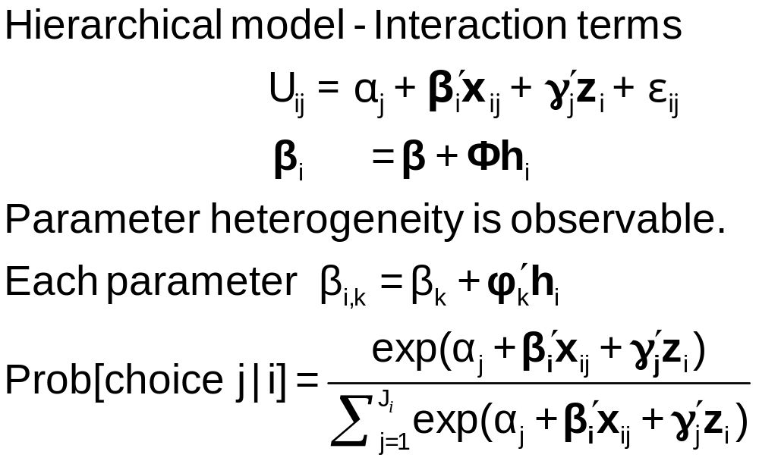
Observable Heterogeneity in
Preference Weights

Slide 38
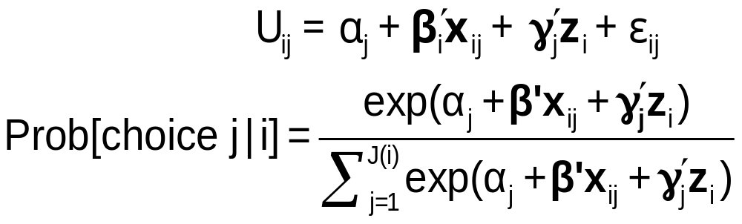
Observable Heterogeneity in Utility Levels
Choice, e.g., among brands of cars
x_{itj} = attributes: price, features
z_{i} = observable characteristics: age, sex, income

Slide 39
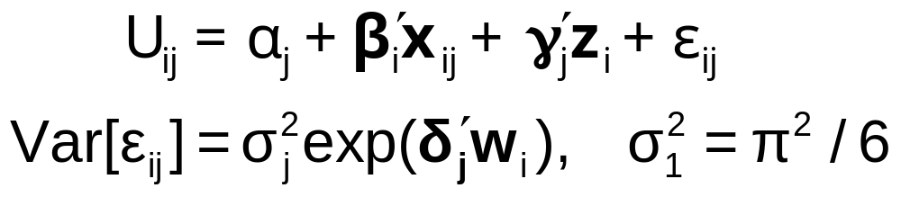
‘Quantifiable’ Heterogeneity in Scaling
w_{i} = observable characteristics: age, sex, income, etc.

Slide 40
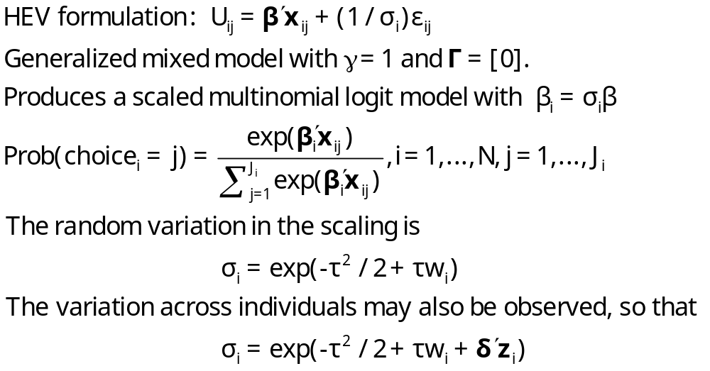
Unobserved Heterogeneity in Scaling

Slide 41
A Helpful Way to View
Hybrid Choice Models
Adding attitude variables to the choice model
In some formulations, it makes them look like random parameter models

Slide 42
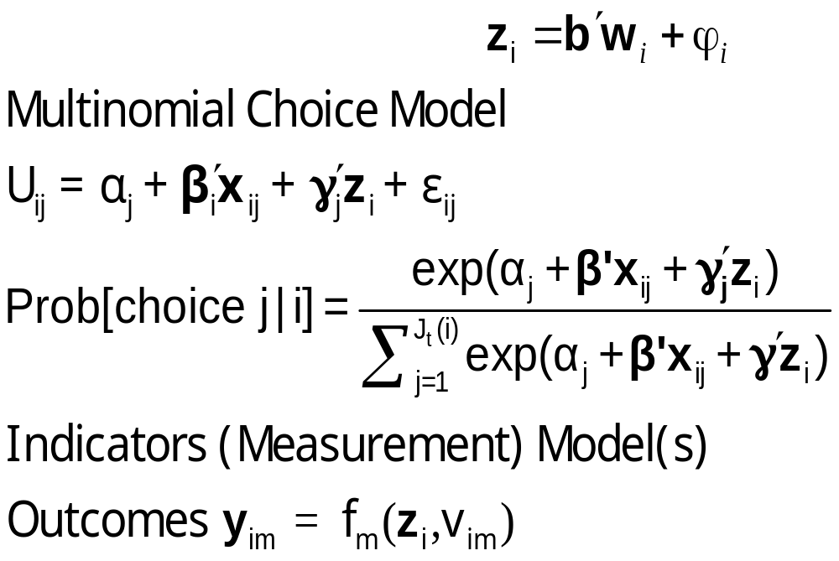
Unbservable Heterogeneity in Utility Levels and Other Preference Indicators

Slide 43


Slide 44
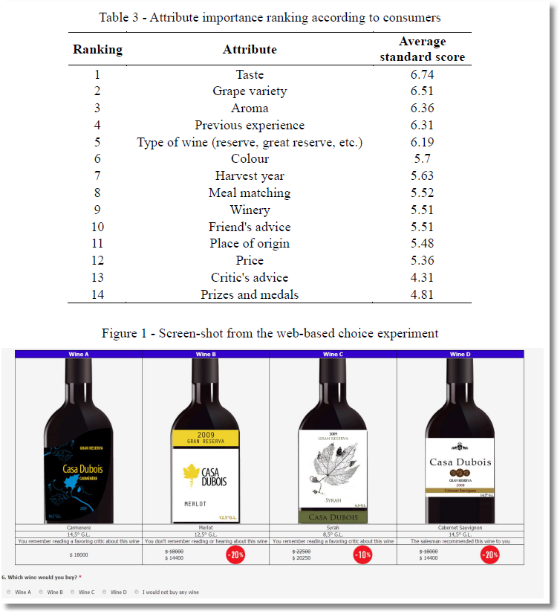

Slide 45
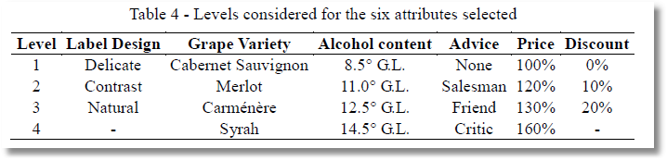

Slide 46
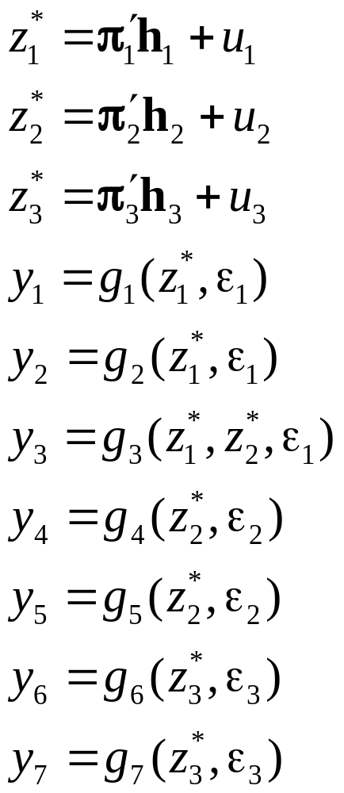
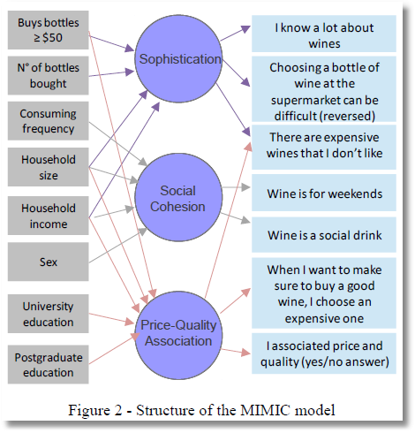
Observed Latent Observed
x → z* → y

Slide 47
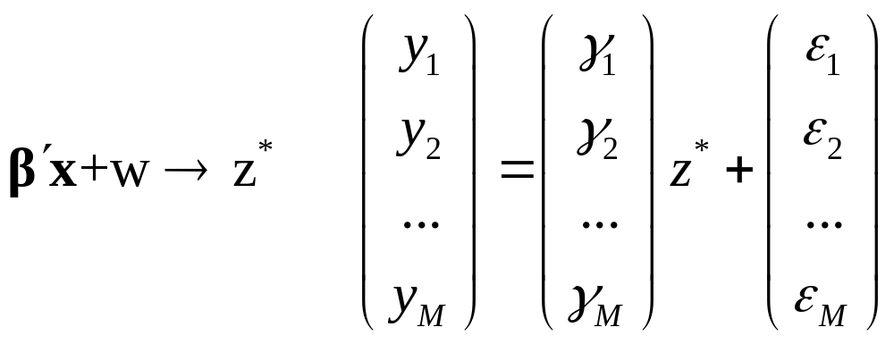
MIMIC Model
Multiple Causes and Multiple Indicators
X z* Y

Slide 48
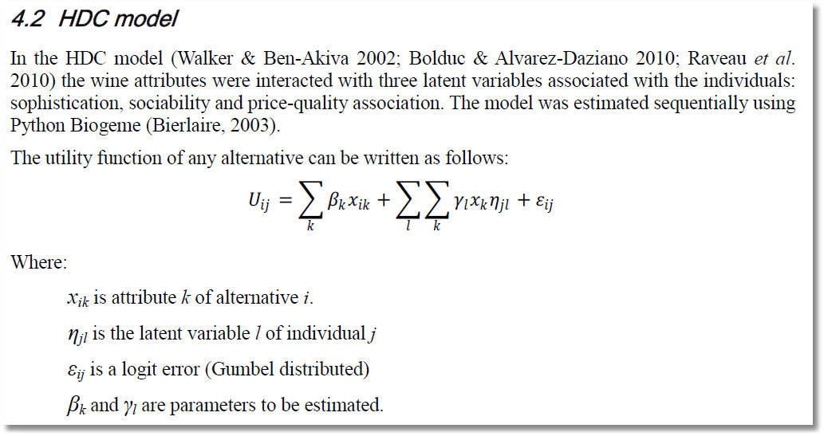

Note. Alternative i, Individual j.

Slide 49
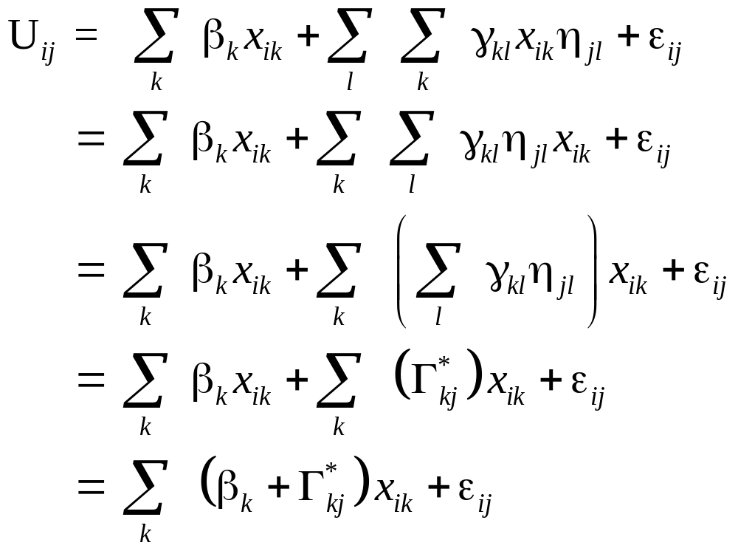
This is a mixed logit model. The interesting extension is the source of the individual heterogeneity in the random parameters.

Slide 50
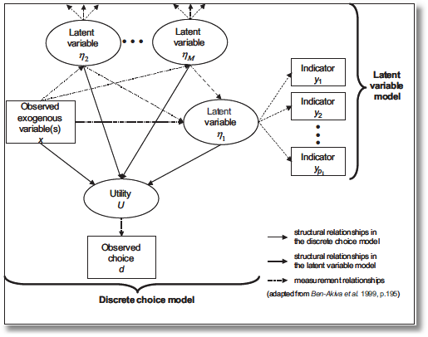
“Integrated Model”
Incorporate attitude measures in preference structure

Slide 51
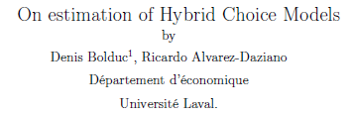
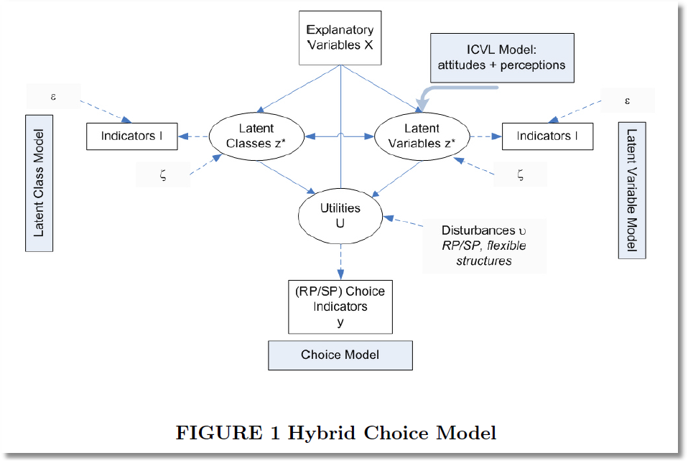

Slide 52
Swait, J., “A Structural Equation Model of Latent Segmentation and Product Choice for Cross Sectional Revealed Preference Choice Data,” Journal of Retailing and Consumer Services, 1994
Bahamonde-Birke and Ortuzar, J., “On the Variabiity of Hybrid Discrete Choice Models, Transportmetrica, 2012
Vij, A. and J. Walker, “Preference Endogeneity in Discrete Choice Models,” TRB, 2013
Sener, I., M. Pendalaya, R., C. Bhat, “Accommodating Spatial Correlation Across Choice Alternatives in Discrete Choice Models: An Application to Modeling Residential Location Choice Behavior,” Journal of Transport Geography, 2011
Palma, D., Ortuzar, J., G. Casaubon, L. Rizzi, Agosin, E., “Measuring Consumer Preferences Using Hybrid Discrete Choice Models,” 2013
Daly, A., Hess, S., Patruni, B., Potoglu, D., Rohr, C., “Using Ordered Attitudinal Indicators in a Latent Variable Choice Model: A Study of the Impact of Security on Rail Travel Behavior”

