Slide 1



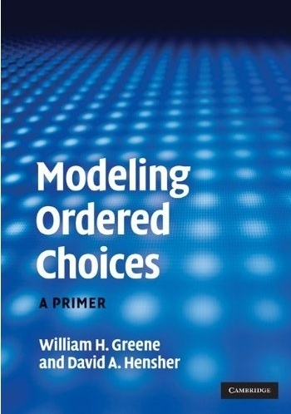

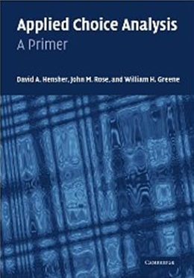
3. Binary Choice – Inference

Slide 2
Hypothesis Testing in Binary Choice Models

Slide 3
Hypothesis Tests
Restrictions: Linear or nonlinear functions of the model parameters
Structural ‘change’: Constancy of parameters
Specification Tests:
  Model specification: distribution
  Heteroscedasticity: Generally parametric

Slide 4
Hypothesis Testing
There is no F statistic
Comparisons of Likelihood Functions: Likelihood Ratio Tests
Distance Measures: Wald Statistics
Lagrange Multiplier Tests

Slide 5
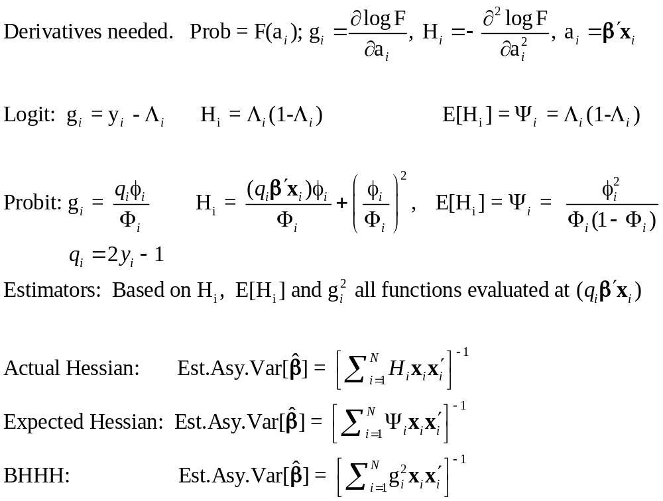
Requires an Estimator of the Covariance Matrix for b

Slide 6
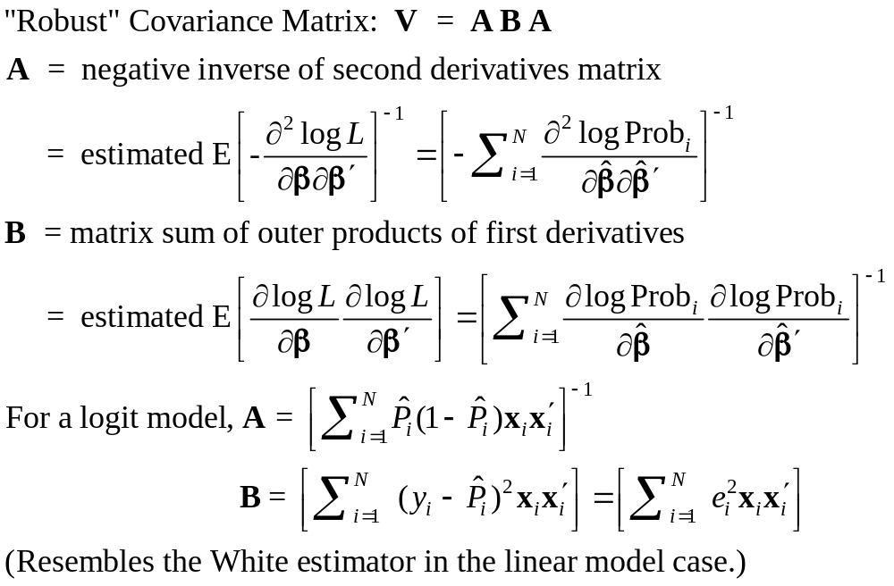
Robust Covariance Matrix(?)

Slide 7
The Robust Matrix is Not Robust
To:
  Heteroscedasticity
  Correlation across observations
  Omitted heterogeneity
  Omitted variables (even if orthogonal)
  Wrong distribution assumed
  Wrong functional form for index function
In all cases, the estimator is inconsistent so a “robust” covariance matrix is pointless.
(In general, it is merely harmless.)

Slide 8
Estimated Robust Covariance Matrix for Logit Model
--------+-------------------------------------------------------------
Variable| Coefficient Standard Error b/St.Er. P[|Z|>z] Mean of X
--------+-------------------------------------------------------------
|Robust Standard Errors
Constant| 1.86428*** .68442 2.724 .0065
AGE| -.10209*** .03115 -3.278 .0010 42.6266
AGESQ| .00154*** .00035 4.446 .0000 1951.22
INCOME| .51206 .75103 .682 .4954 .44476
AGE_INC| -.01843 .01703 -1.082 .2792 19.0288
FEMALE| .65366*** .07585 8.618 .0000 .46343
--------+-------------------------------------------------------------
|Conventional Standard Errors Based on Second Derivatives
Constant| 1.86428*** .67793 2.750 .0060
AGE| -.10209*** .03056 -3.341 .0008 42.6266
AGESQ| .00154*** .00034 4.556 .0000 1951.22
INCOME| .51206 .74600 .686 .4925 .44476
AGE_INC| -.01843 .01691 -1.090 .2756 19.0288
FEMALE| .65366*** .07588 8.615 .0000 .46343

Slide 9
Testing: Base Model
----------------------------------------------------------------------
Binary Logit Model for Binary Choice
Dependent variable DOCTOR
Log likelihood function -2085.92452
Restricted log likelihood -2169.26982
Chi squared [ 5 d.f.] 166.69058
Significance level .00000
McFadden Pseudo R-squared .0384209
Estimation based on N = 3377, K = 6
--------+-------------------------------------------------------------
Variable| Coefficient Standard Error b/St.Er. P[|Z|>z] Mean of X
--------+-------------------------------------------------------------
Constant| 1.86428*** .67793 2.750 .0060
AGE| -.10209*** .03056 -3.341 .0008 42.6266
AGESQ| .00154*** .00034 4.556 .0000 1951.22
INCOME| .51206 .74600 .686 .4925 .44476
AGE_INC| -.01843 .01691 -1.090 .2756 19.0288
FEMALE| .65366*** .07588 8.615 .0000 .46343
--------+-------------------------------------------------------------
H₀: Age is not a significant
determinant of
Prob(Doctor = 1)
H₀: β₂ = β₃ = β₅ = 0

Slide 10
Likelihood Ratio Tests
Null hypothesis restricts the parameter vector
Alternative releases the restriction
Test statistic: Chi-squared =
2 (LogL|Unrestricted model –
LogL|Restrictions) > 0
Degrees of freedom = number of restrictions

Slide 11
LR Test of H₀
UNRESTRICTED MODEL
Binary Logit Model for Binary Choice
Dependent variable DOCTOR
Log likelihood function -2085.92452
Restricted log likelihood -2169.26982
Chi squared [ 5 d.f.] 166.69058
Significance level .00000
McFadden Pseudo R-squared .0384209
Estimation based on N = 3377, K = 6
RESTRICTED MODEL
Binary Logit Model for Binary Choice
Dependent variable DOCTOR
Log likelihood function -2124.06568
Restricted log likelihood -2169.26982
Chi squared [ 2 d.f.] 90.40827
Significance level .00000
McFadden Pseudo R-squared .0208384
Estimation based on N = 3377, K = 3
Chi squared[3] = 2[-2085.92452 - (-2124.06568)] = 77.46456

Slide 12
Wald Test
Unrestricted parameter vector is estimated
Discrepancy: q= Rb – m
Variance of discrepancy is estimated:
Var[q] = RVR’
Wald Statistic is q’[Var(q)]⁻¹q = q’[RVR’]⁻¹q

Slide 13
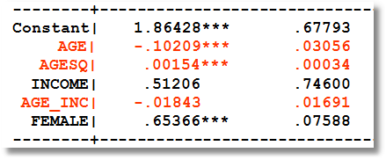
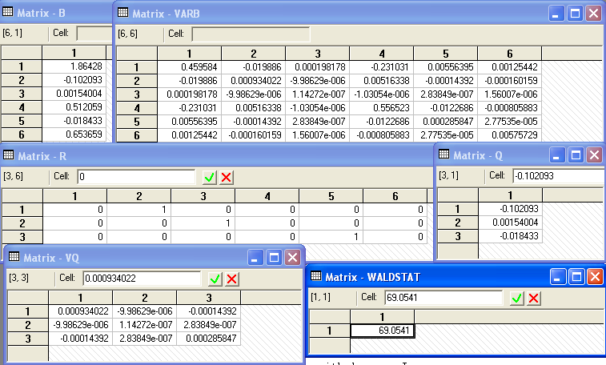
Carrying Out a Wald Test
b₀
V₀
R
Rb₀ - m
Wald
RV₀R′
Chi squared[3] = 69.0541

Slide 14
Lagrange Multiplier Test
Restricted model is estimated
Derivatives of unrestricted model and variances of derivatives are computed at restricted estimates
Wald test of whether derivatives are zero tests the restrictions
Usually hard to compute – difficult to program the derivatives and their variances.

Slide 15
LM Test for a Logit Model
Compute b₀ (subject to restictions)
(e.g., with zeros in appropriate positions.
Compute P_{i}(b₀) for each observation using restricted estimator in the full model.
Compute e_{i}(b₀) = [y_{i} – P_{i}(b₀)]
Compute g_{i}(b₀) = x_{i}e_{i} using full x_{i} vector
LM = [Σ_{i}g_{i}(b₀)]′[Σ_{i}g_{i}(b₀)g_{i}(b₀)′]⁻¹[Σ_{i}g_{i}(b₀)]

Slide 16
Test Results
Matrix DERIV has 6 rows and 1 columns.
+-------------+
1| .2393443D-05 zero from FOC
2| 2268.60186
3| .2122049D+06
4| .9683957D-06 zero from FOC
5| 849.70485
6| .2380413D-05 zero from FOC
+-------------+
Matrix LM has 1 rows and 1 columns.
1
+-------------+
1| 81.45829 |
+-------------+
Wald Chi squared[3] = 69.0541
LR Chi squared[3] = 2[-2085.92452 - (-2124.06568)] = 77.46456

Slide 17
A Test of Structural Stability
In the original application, separate models were fit for men and women.
We seek a counterpart to the Chow test for linear models.
Use a likelihood ratio test.

Slide 18
Testing Structural Stability
Fit the same model in each subsample
Unrestricted log likelihood is the sum of the subsample log likelihoods: LogL1
Pool the subsamples, fit the model to the pooled sample
Restricted log likelihood is that from the pooled sample: LogL0
Chi-squared = 2*(LogL1 – LogL0)
Degrees of freedom = (#Groups - 1)*model size.

Slide 19
Structural Change (Over Groups) Test
----------------------------------------------------------------------
Dependent variable DOCTOR
Pooled Log likelihood function -2123.84754
--------+-------------------------------------------------------------
Variable| Coefficient Standard Error b/St.Er. P[|Z|>z] Mean of X
--------+-------------------------------------------------------------
Constant| 1.76536*** .67060 2.633 .0085
AGE| -.08577*** .03018 -2.842 .0045 42.6266
AGESQ| .00139*** .00033 4.168 .0000 1951.22
INCOME| .61090 .74073 .825 .4095 .44476
AGE_INC| -.02192 .01678 -1.306 .1915 19.0288
--------+-------------------------------------------------------------
Male Log likelihood function -1198.55615
--------+-------------------------------------------------------------
Constant| 1.65856* .86595 1.915 .0555
AGE| -.10350*** .03928 -2.635 .0084 41.6529
AGESQ| .00165*** .00044 3.760 .0002 1869.06
INCOME| .99214 .93005 1.067 .2861 .45174
AGE_INC| -.02632 .02130 -1.235 .2167 19.0016
--------+-------------------------------------------------------------
Female Log likelihood function -885.19118
--------+-------------------------------------------------------------
Constant| 2.91277*** 1.10880 2.627 .0086
AGE| -.10433** .04909 -2.125 .0336 43.7540
AGESQ| .00143*** .00054 2.673 .0075 2046.35
INCOME| -.17913 1.27741 -.140 .8885 .43669
AGE_INC| -.00729 .02850 -.256 .7981 19.0604
--------+-------------------------------------------------------------
Chi squared[5] = 2[-885.19118+(-1198.55615) – (-2123.84754] = 80.2004

Slide 20
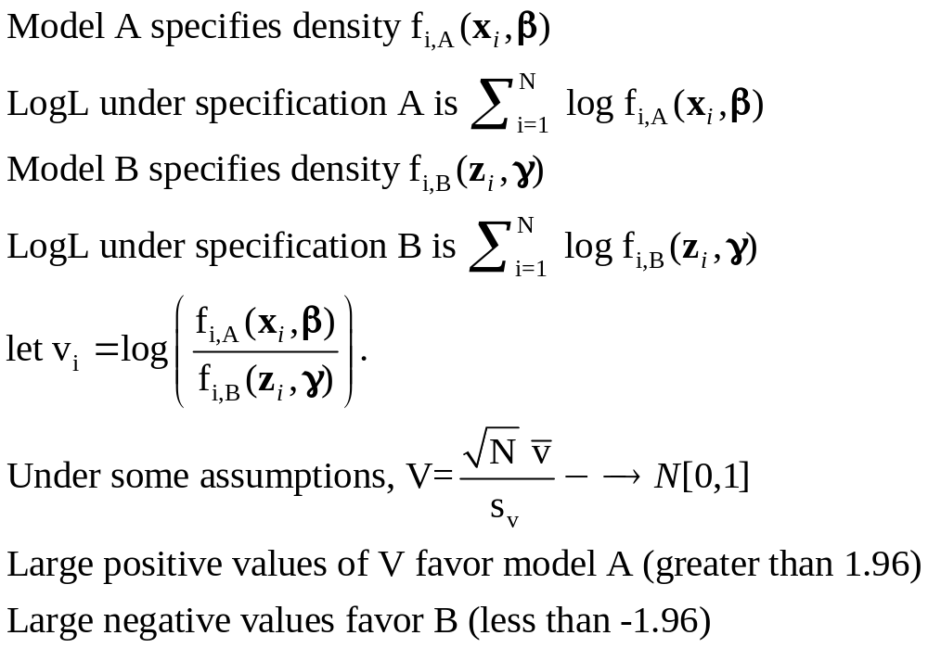
Vuong Test for Nonnested Models
Test of Logit (Model A) vs. Probit (Model B)?
+------------------------------------+
| Listed Calculator Results |
+------------------------------------+
VUONGTST= 1.570052

Slide 21
Inference About
Partial Effects

Slide 22
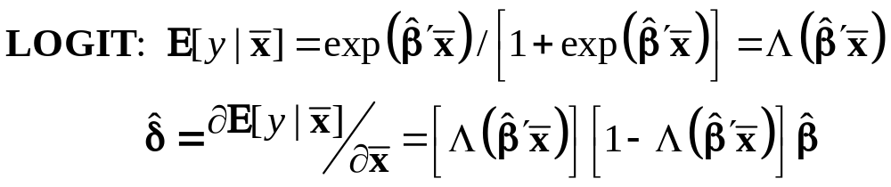
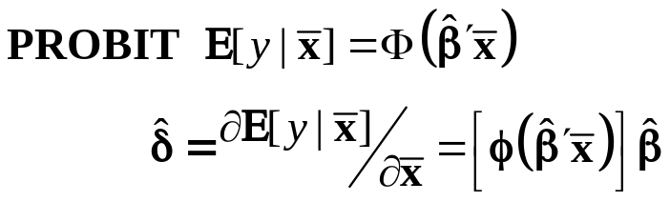
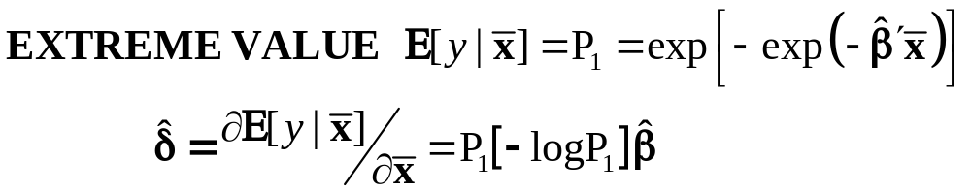
Partial Effects for Binary Choice

Slide 23
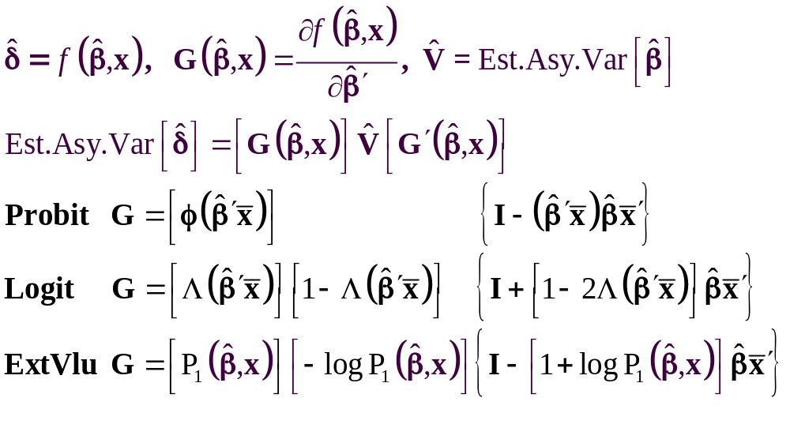
The Delta Method

Slide 24
Computing Effects
Compute at the data means?
  Simple
  Inference is well defined
Average the individual effects
  More appropriate?
  Asymptotic standard errors a bit more complicated.

Slide 25
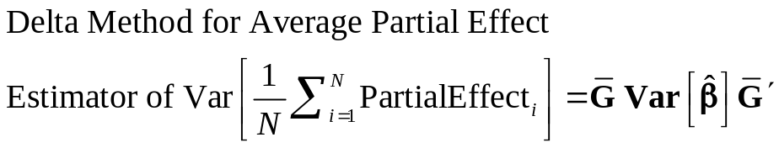
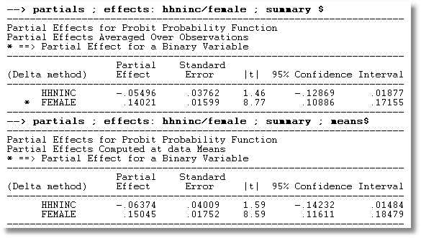
APE vs. Partial Effects at the Mean

Slide 26
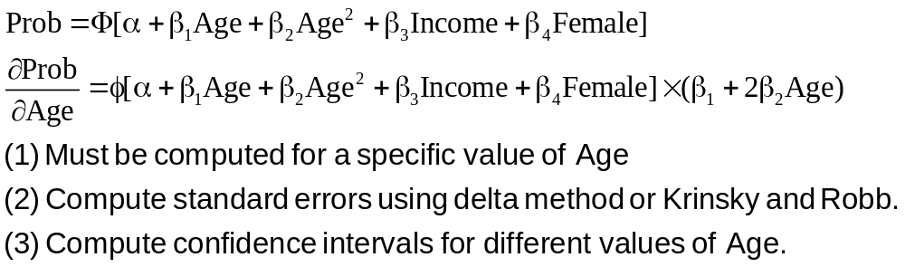
Partial Effect for Nonlinear Terms

Slide 27
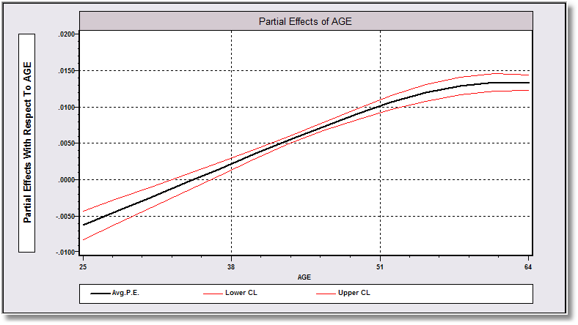
Average Partial Effect: Averaged over Sample Incomes and Genders for Specific Values of Age

Slide 28
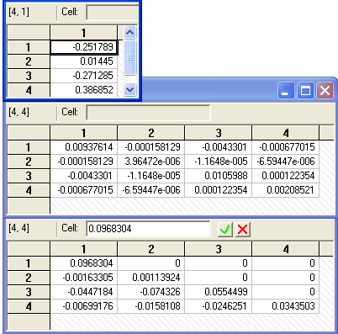
Krinsky and Robb
Estimate β by Maximum Likelihood with b
Estimate asymptotic covariance matrix with V
Draw R observations b(r) from the normal
population N[b,V]
b(r) = b + C*v(r), v(r) drawn from N[0,I]
C = Cholesky matrix, V = CC’
Compute partial effects d(r) using b(r)
Compute the sample variance of d(r),r=1,…,R
Use the sample standard deviations of the R observations to estimate the sampling standard errors for the partial effects.

Slide 29
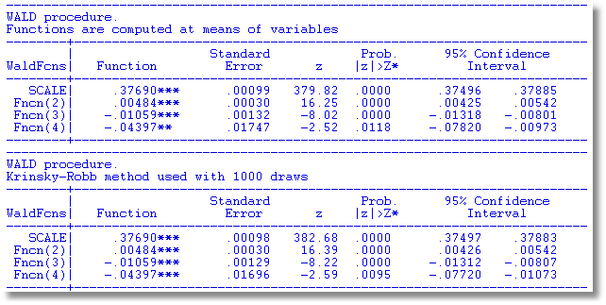
Krinsky and Robb vs. Delta Method

