Slide 1






5. Extensions of Binary Choice Models

Slide 2
Heteroscedasticity

Slide 3
Heteroscedasticity in Marginal Effects
For the univariate case:
E[y_{i}|x_{i},z_{i}] = Φ[β’x_{i} / exp(γ’z_{i})]
∂ E[y_{i}|x_{i},z_{i}] /∂x_{i} = Φ[β’x_{i} / exp(γ’z_{i})] times
[ 1/ exp(γ’z_{i})] β
∂ E[y_{i}|x_{i},z_{i}] /∂z_{i} = Φ[β’x_{i} / exp(γ’z_{i})] times
[- β’x_{i}/exp(γ’z_{i})] γ
If the variables are the same in x and z, these are added. Sign and magnitude are ambiguous

Slide 4
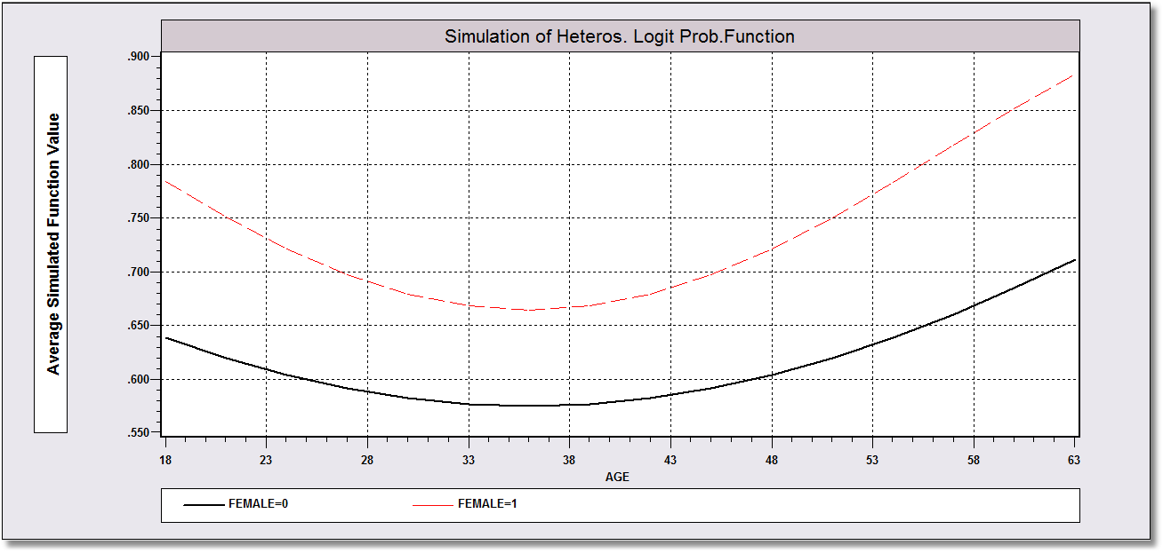
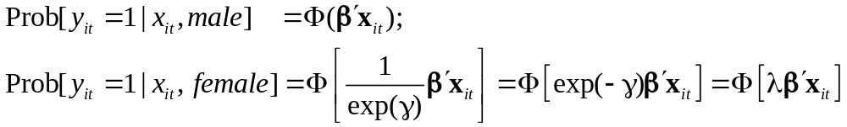
Heteroscedastic Probit Model: Probabilities by Age

Slide 5
Partial Effects in the Scaling Model
------------------------------------------------------------------------------------
Partial derivatives of probabilities with respect to the vector of characteristics.
They are computed at the means of the Xs. Effects are the sum of the mean and var-
iance term for variables which appear in both parts of the function.
--------+---------------------------------------------------------------------------
Variable| Coefficient Standard Error b/St.Er. P[|Z|>z] Elasticity
--------+---------------------------------------------------------------------------
AGE| -.02121*** .00637 -3.331 .0009 -1.32701
AGESQ| .00032*** .717036D-04 4.527 .0000 .92966
INCOME| .13342 .15190 .878 .3797 .08709
AGE_INC| -.00439 .00344 -1.276 .2020 -.12264
FEMALE| .19362*** .04043 4.790 .0000 .13169
|Disturbance Variance Terms
FEMALE| -.05339 .05604 -.953 .3407 -.03632
|Sum of terms for variables in both parts
FEMALE| .14023*** .02509 5.588 .0000 .09538
--------+---------------------------------------------------------------------------
|Marginal effect for variable in probability – Homoscedastic Model
AGE| -.02266*** .00677 -3.347 .0008 -1.44664
AGESQ| .00034*** .747582D-04 4.572 .0000 .99890
INCOME| .11363 .16552 .687 .4924 .07571
AGE_INC| -.00409 .00375 -1.091 .2754 -.11660
|Marginal effect for dummy variable is P|1 - P|0.
FEMALE| .14306*** .01619 8.837 .0000 .09931
--------+---------------------------------------------------------------------------

Slide 6
Testing for Heteroscedasticity
Likelihood Ratio, Wald and Lagrange Multiplier tests are all straightforward
All tests require a specification of the model of heteroscedasticity
There is no generic ‘White’ style robust covariance matrix.
There is no generic ‘test for heteroscedasticity’

Slide 7
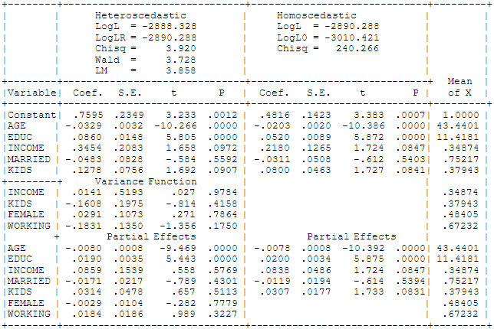
Heteroscedastic Probit Model: Tests

Slide 8
Endogeneity

Slide 9
Endogenous RHS Variable
U* = β’x + θh + ε
y = 1[U* > 0]
E[ε|h] ≠ 0 (h is endogenous)
  Case 1: h is continuous
  Case 2: h is binary, e.g., a treatment effect
Approaches
  Parametric: Maximum Likelihood
  Semiparametric (not developed here):
    GMM
    Various approaches for case 2

Slide 10
Endogenous Continuous Variable
U* = β’x + θh + ε
y = 1[U* > 0] ⇐
h = α’z + u
E[ε|h] ≠ 0 ⬄ Cov[u, ε] ≠ 0
Additional Assumptions:
(u,ε) ~ N[(0,0),(σ_{u}², ρσ_{u}, 1)]
z = a valid set of exogenous
variables, uncorrelated with (u,ε)
Correlation = ρ.
This is the source of the endogeneity

Slide 11


Endogenous Income in Health
Income responds to
Age, Age², Educ, Married, Kids, Gender
0 = Not Healthy
1 = Healthy
Healthy = 0 or 1
Age, Married, Kids, Gender, Income
Determinants of Income (observed and unobserved) also determine health satisfaction.
Notes:
11

Slide 12
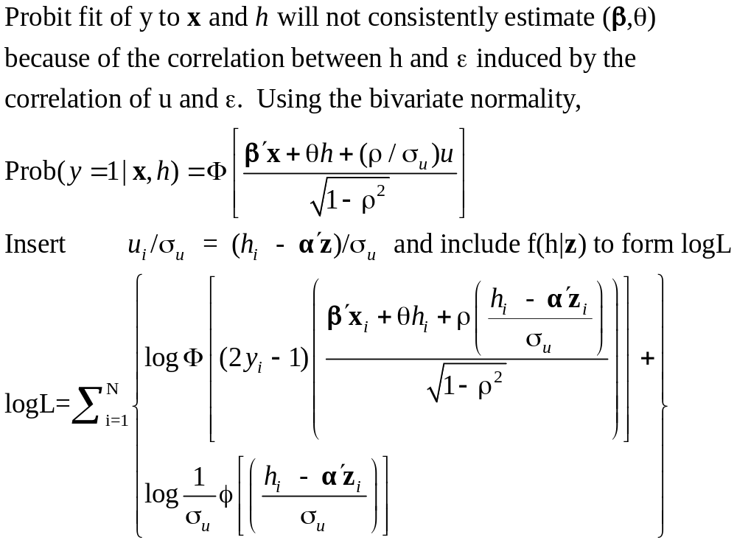
Estimation by ML (Control Function)

Slide 13
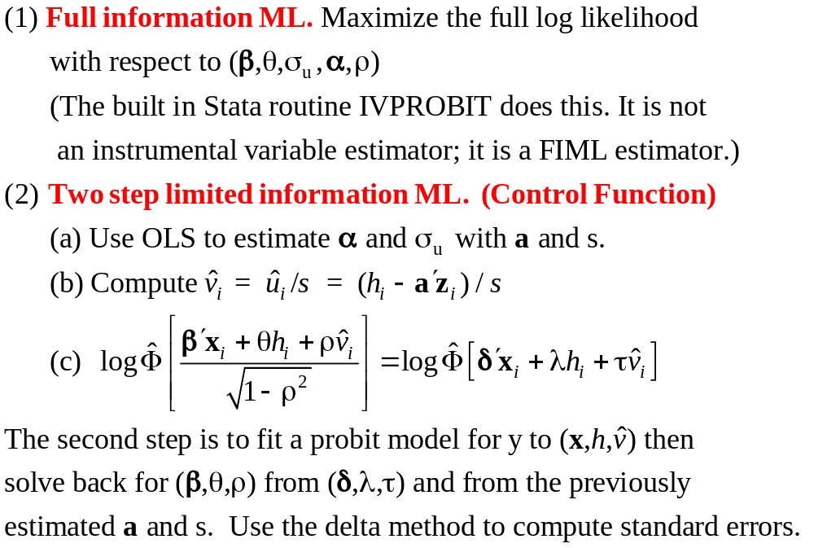
Two Approaches to ML

Slide 14
FIML Estimates
----------------------------------------------------------------------
Probit with Endogenous RHS Variable
Dependent variable HEALTHY
Log likelihood function -6464.60772
--------+-------------------------------------------------------------
Variable| Coefficient Standard Error b/St.Er. P[|Z|>z] Mean of X
--------+-------------------------------------------------------------
|Coefficients in Probit Equation for HEALTHY
Constant| 1.21760*** .06359 19.149 .0000
AGE| -.02426*** .00081 -29.864 .0000 43.5257
MARRIED| -.02599 .02329 -1.116 .2644 .75862
HHKIDS| .06932*** .01890 3.668 .0002 .40273
FEMALE| -.14180*** .01583 -8.959 .0000 .47877
INCOME| .53778*** .14473 3.716 .0002 .35208
|Coefficients in Linear Regression for INCOME
Constant| -.36099*** .01704 -21.180 .0000
AGE| .02159*** .00083 26.062 .0000 43.5257
AGESQ| -.00025*** .944134D-05 -26.569 .0000 2022.86
EDUC| .02064*** .00039 52.729 .0000 11.3206
MARRIED| .07783*** .00259 30.080 .0000 .75862
HHKIDS| -.03564*** .00232 -15.332 .0000 .40273
FEMALE| .00413** .00203 2.033 .0420 .47877
|Standard Deviation of Regression Disturbances
Sigma(w)| .16445*** .00026 644.874 .0000
|Correlation Between Probit and Regression Disturbances
Rho(e,w)| -.02630 .02499 -1.052 .2926
--------+-------------------------------------------------------------

Slide 15
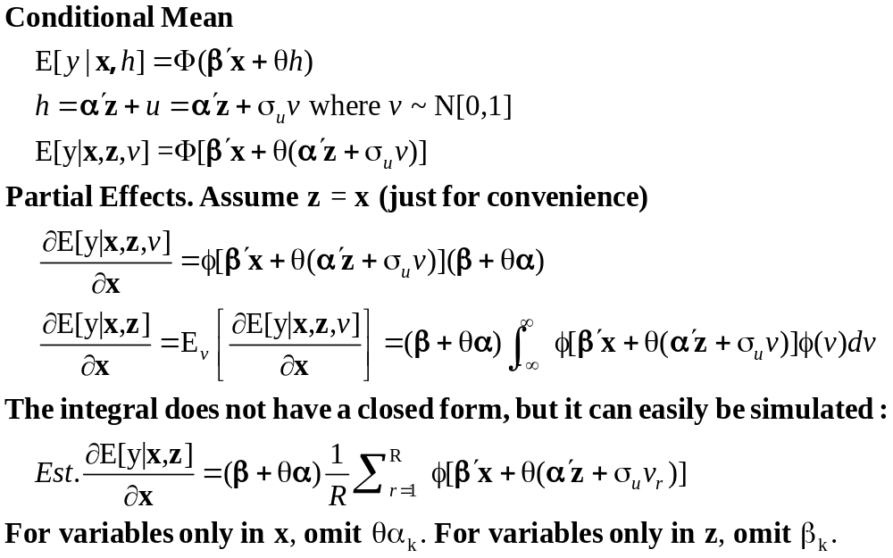
Partial Effects: Scaled Coefficients

Slide 16
Endogenous Binary Variable
U* = β’x + θh + ε
y = 1[U* > 0]
h* = α’z + u
h = 1[h* > 0]
E[ε|h*] ≠ 0 ⬄ Cov[u, ε] ≠ 0
Additional Assumptions:
(u,ε) ~ N[(0,0),(σ_{u}², ρσ_{u}, 1)]
z = a valid set of exogenous
variables, uncorrelated with (u,ε)
⇐
Correlation = ρ.
This is the source of the endogeneity

Slide 17
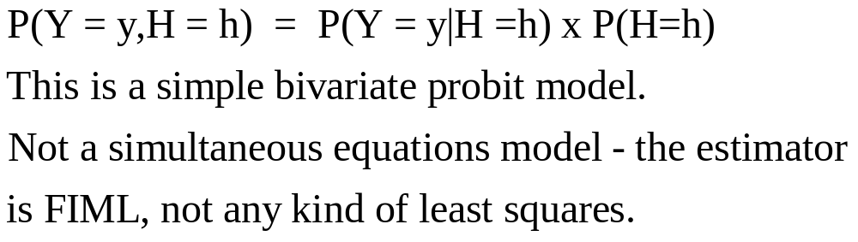

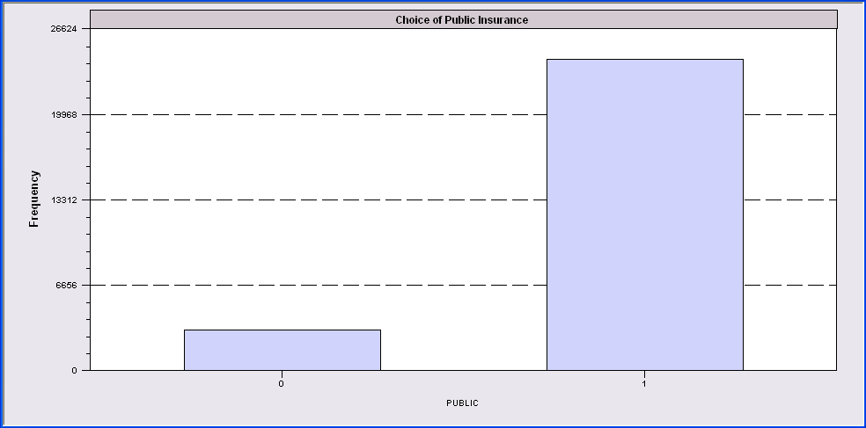
Endogenous Binary Variable
Doctor = F(age,age²,income,female,Public)
Public = F(age,educ,income,married,kids,female)

Slide 18
FIML Estimates
----------------------------------------------------------------------
FIML Estimates of Bivariate Probit Model
Dependent variable DOCPUB
Log likelihood function -25671.43905
Estimation based on N = 27326, K = 14
--------+-------------------------------------------------------------
Variable| Coefficient Standard Error b/St.Er. P[|Z|>z] Mean of X
--------+-------------------------------------------------------------
|Index equation for DOCTOR
Constant| .59049*** .14473 4.080 .0000
AGE| -.05740*** .00601 -9.559 .0000 43.5257
AGESQ| .00082*** .681660D-04 12.100 .0000 2022.86
INCOME| .08883* .05094 1.744 .0812 .35208
FEMALE| .34583*** .01629 21.225 .0000 .47877
PUBLIC| .43533*** .07357 5.917 .0000 .88571
|Index equation for PUBLIC
Constant| 3.55054*** .07446 47.681 .0000
AGE| .00067 .00115 .581 .5612 43.5257
EDUC| -.16839*** .00416 -40.499 .0000 11.3206
INCOME| -.98656*** .05171 -19.077 .0000 .35208
MARRIED| -.00985 .02922 -.337 .7361 .75862
HHKIDS| -.08095*** .02510 -3.225 .0013 .40273
FEMALE| .12139*** .02231 5.442 .0000 .47877
|Disturbance correlation
RHO(1,2)| -.17280*** .04074 -4.241 .0000
--------+-------------------------------------------------------------

Slide 19
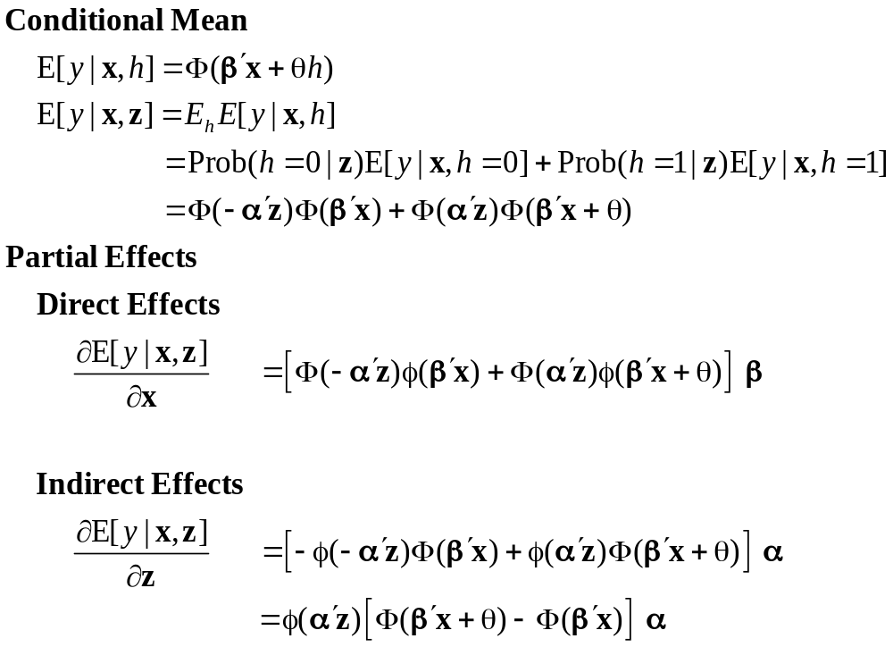
Partial Effects

Slide 20
Identification Issues
Exclusions are not needed for estimation
Identification is, in principle, by “functional form”
Researchers usually have a variable in the treatment equation that is not in the main probit equation “to improve identification”
A fully simultaneous model
  y1 = f(x1,y2), y2 = f(x2,y1)
  Not identified even with exclusion restrictions
  (Model is “incoherent”)

Slide 21
Selection

Slide 22
A Sample Selection Model
U* = β’x + ε
y = 1[U* > 0]
h* = α’z + u
h = 1[h* > 0]
E[ε|h] ≠ 0 ⬄ Cov[u, ε] ≠ 0
(y,x) are observed only when h = 1
Additional Assumptions:
(u,ε) ~ N[(0,0),(σ_{u}², ρσ_{u}, 1)]
z = a valid set of exogenous
variables, uncorrelated with (u,ε)
Correlation = ρ.
This is the source of the “selectivity:

Slide 23
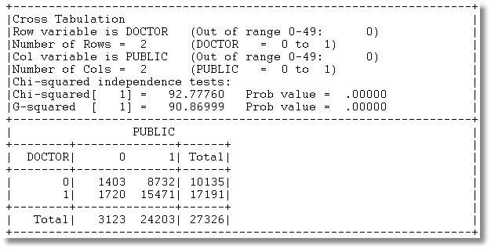
Application: Doctor,Public
3 Groups of observations: (Public=0), (Doctor=0|Public=1), (Doctor=1|Public=1)

Slide 24
Sample Selection
Doctor = F(age,age²,income,female,Public=1)
Public = F(age,educ,income,married,kids,female)

Slide 25
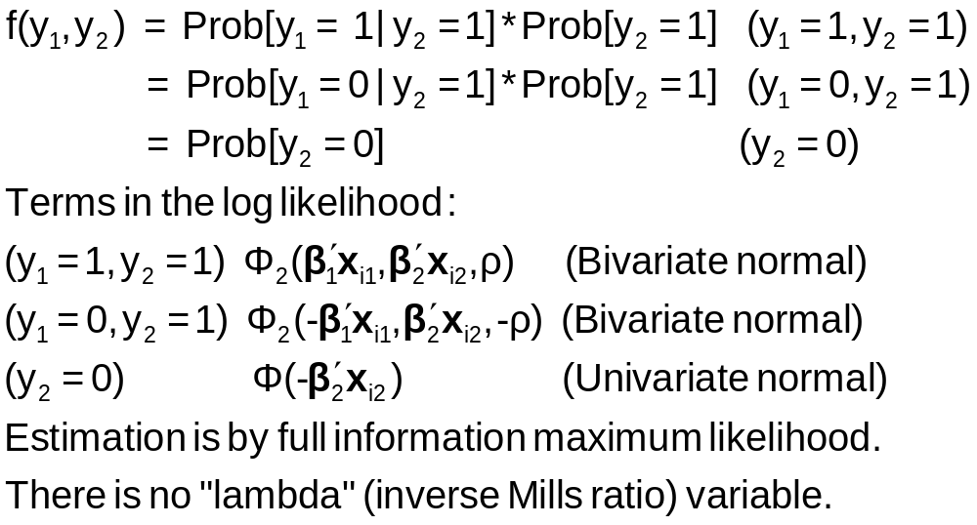
Sample Selection Model: Estimation

Slide 26
ML Estimates
----------------------------------------------------------------------
FIML Estimates of Bivariate Probit Model
Dependent variable DOCPUB
Log likelihood function -23581.80697
Estimation based on N = 27326, K = 13
Selection model based on PUBLIC
Means for vars. 1- 5 are after selection.
--------+-------------------------------------------------------------
Variable| Coefficient Standard Error b/St.Er. P[|Z|>z] Mean of X
--------+-------------------------------------------------------------
|Index equation for DOCTOR
Constant| 1.09027*** .13112 8.315 .0000
AGE| -.06030*** .00633 -9.532 .0000 43.6996
AGESQ| .00086*** .718153D-04 11.967 .0000 2041.87
INCOME| .07820 .05779 1.353 .1760 .33976
FEMALE| .34357*** .01756 19.561 .0000 .49329
|Index equation for PUBLIC
Constant| 3.54736*** .07456 47.580 .0000
AGE| .00080 .00116 .690 .4899 43.5257
EDUC| -.16832*** .00416 -40.490 .0000 11.3206
INCOME| -.98747*** .05162 -19.128 .0000 .35208
MARRIED| -.01508 .02934 -.514 .6072 .75862
HHKIDS| -.07777*** .02514 -3.093 .0020 .40273
FEMALE| .12154*** .02231 5.447 .0000 .47877
|Disturbance correlation
RHO(1,2)| -.19303*** .06763 -2.854 .0043
--------+-------------------------------------------------------------

Slide 27
Estimation Issues
This is a sample selection model applied to a nonlinear model
  There is no lambda
  Estimated by FIML, not two step least squares
  Estimator is a type of BIVARIATE PROBIT MODEL
The model is identified without exclusions (again)

Slide 28
A Dynamic
Model

Slide 29
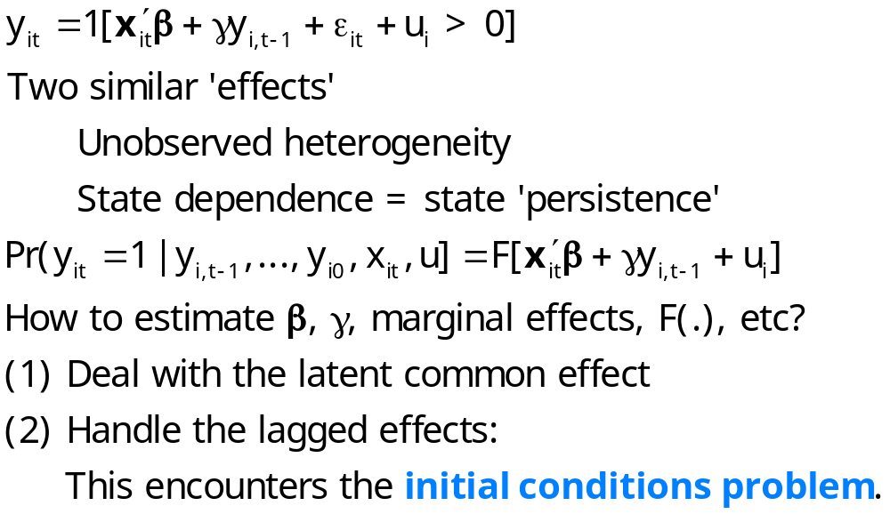
Dynamic Models

Slide 30
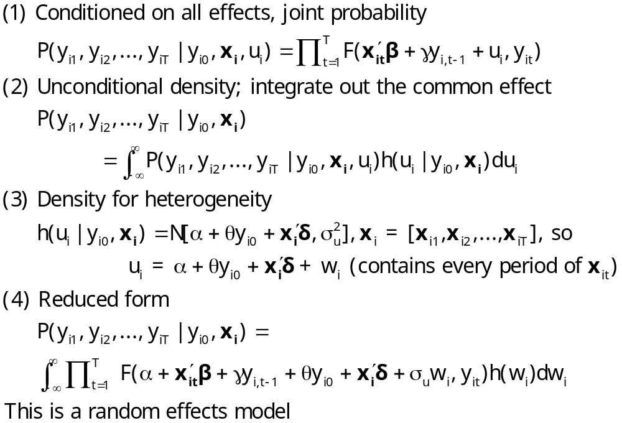
Dynamic Probit Model: A Standard Approach

Slide 31
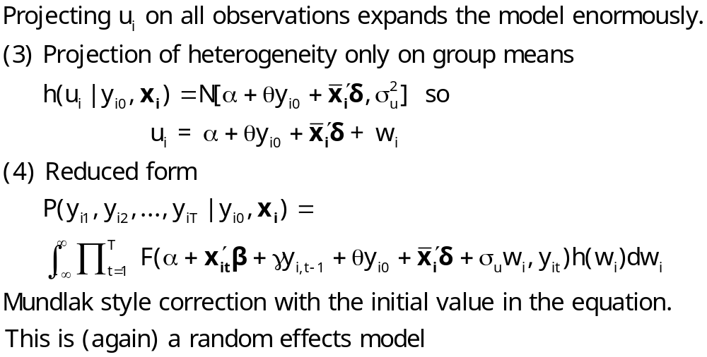
Simplified Dynamic Model

Slide 32
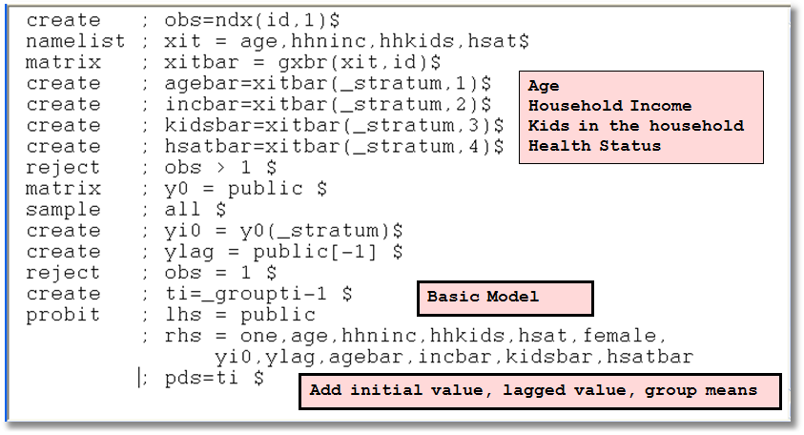
A Dynamic Model for Public Insurance

Slide 33
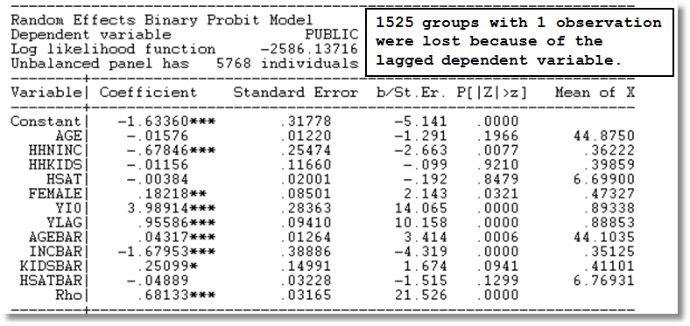
Dynamic Common Effects Model

Slide 34
Bivariate
Model

Slide 35
Gross Relation Between Two Binary Variables
+-----------------------------------------------------------------+
|Cross Tabulation |
|Row variable is DOCTOR (Out of range 0-49: 0) |
|Number of Rows = 2 (DOCTOR = 0 to 1) |
|Col variable is HOSPITAL (Out of range 0-49: 0) |
|Number of Cols = 2 (HOSPITAL = 0 to 1) |
+-----------------------------------------------------------------+
| HOSPITAL |
+--------+--------------+------+ |
| DOCTOR| 0 1| Total| |
+--------+--------------+------+ |
| 0| 9715 420| 10135| |
| 1| 15216 1975| 17191| |
+--------+--------------+------+ |
| Total| 24931 2395| 27326| |
+-----------------------------------------------------------------+
Cross Tabulation Suggests Presence or
Absence of a Bivariate Relationship

Slide 36
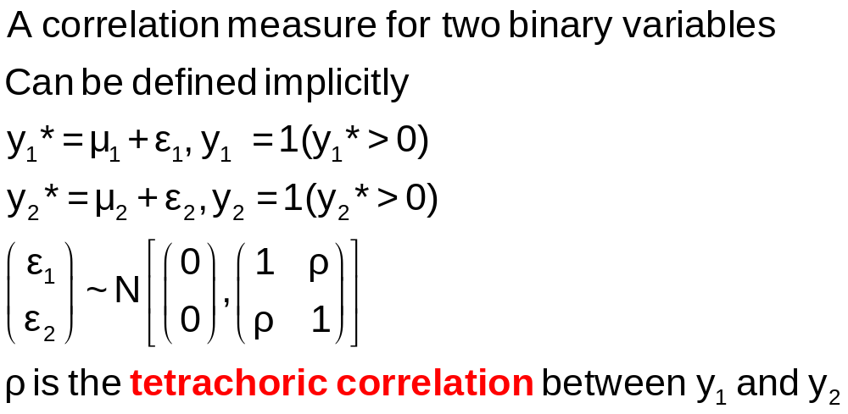
Tetrachoric Correlation

Slide 37
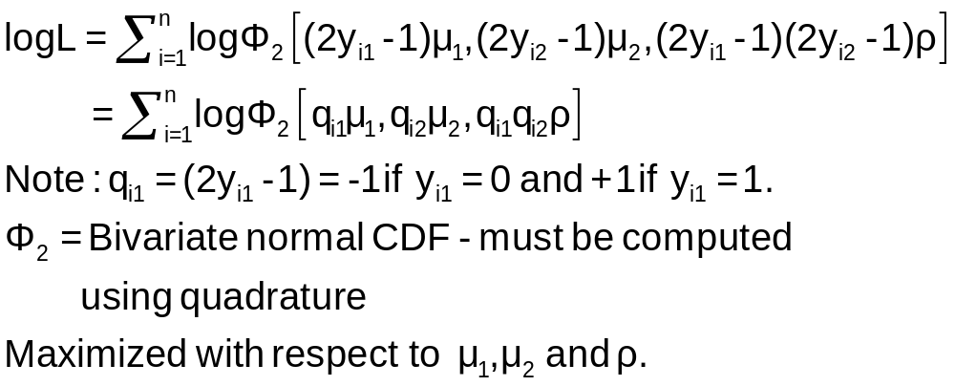
Log Likelihood Function for Tetrachoric Correlation

Slide 38
Estimation
+---------------------------------------------+
| FIML Estimates of Bivariate Probit Model |
| Maximum Likelihood Estimates |
| Dependent variable DOCHOS |
| Weighting variable None |
| Number of observations 27326 |
| Log likelihood function -25898.27 |
| Number of parameters 3 |
+---------------------------------------------+
+---------+--------------+----------------+--------+---------+
|Variable | Coefficient | Standard Error |b/St.Er.|P[|Z|>z] |
+---------+--------------+----------------+--------+---------+
Index equation for DOCTOR
Constant .32949128 .00773326 42.607 .0000
Index equation for HOSPITAL
Constant -1.35539755 .01074410 -126.153 .0000
Tetrachoric Correlation between DOCTOR and HOSPITAL
RHO(1,2) .31105965 .01357302 22.918 .0000

Slide 39
A Bivariate Probit Model
Two Equation Probit Model
No bivariate logit – there is no reasonable bivariate counterpart
Why fit the two equation model?
  Analogy to SUR model: Efficient
  Make tetrachoric correlation conditional on covariates – i.e., residual correlation

Slide 40
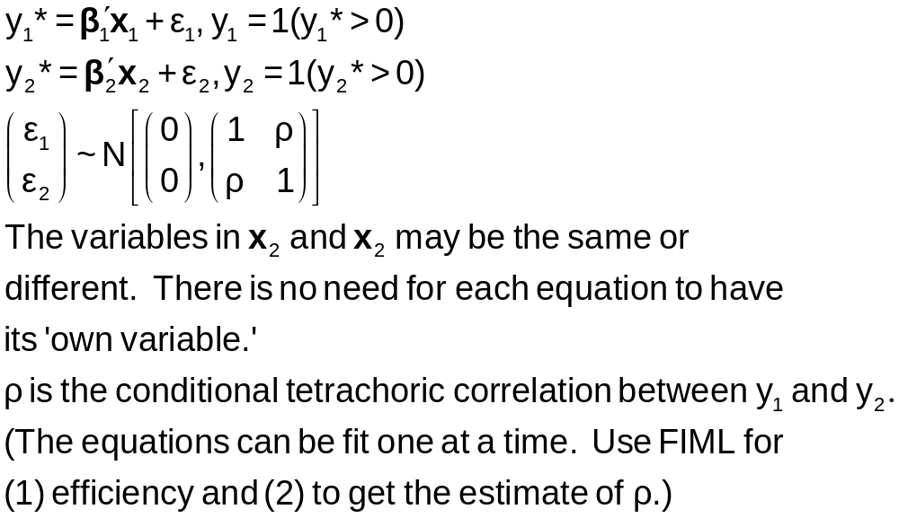
Bivariate Probit Model

Slide 41
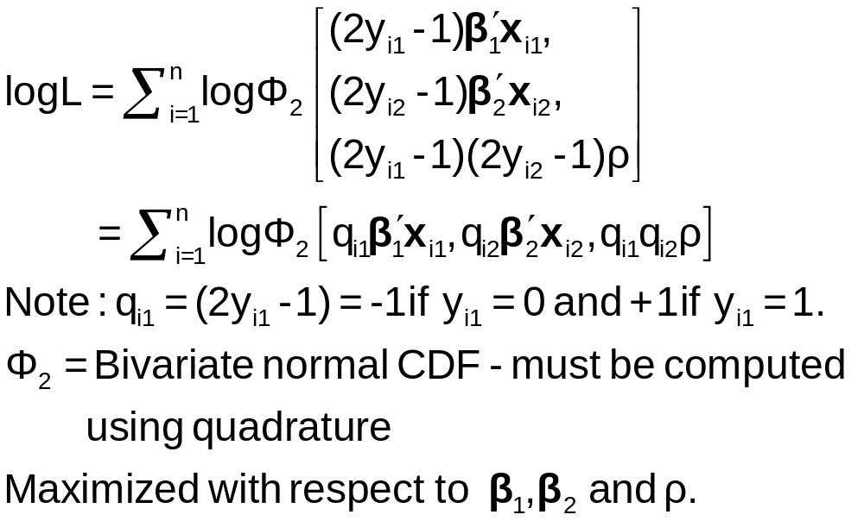
Estimation of the Bivariate Probit Model

Slide 42
Parameter Estimates
----------------------------------------------------------------------
FIML Estimates of Bivariate Probit Model for DOCTOR and HOSPITAL
Dependent variable DOCHOS
Log likelihood function -25323.63074
Estimation based on N = 27326, K = 12
--------+-------------------------------------------------------------
Variable| Coefficient Standard Error b/St.Er. P[|Z|>z] Mean of X
--------+-------------------------------------------------------------
|Index equation for DOCTOR
Constant| -.20664*** .05832 -3.543 .0004
AGE| .01402*** .00074 18.948 .0000 43.5257
FEMALE| .32453*** .01733 18.722 .0000 .47877
EDUC| -.01438*** .00342 -4.209 .0000 11.3206
MARRIED| .00224 .01856 .121 .9040 .75862
WORKING| -.08356*** .01891 -4.419 .0000 .67705
|Index equation for HOSPITAL
Constant| -1.62738*** .05430 -29.972 .0000
AGE| .00509*** .00100 5.075 .0000 43.5257
FEMALE| .12143*** .02153 5.641 .0000 .47877
HHNINC| -.03147 .05452 -.577 .5638 .35208
HHKIDS| -.00505 .02387 -.212 .8323 .40273
|Disturbance correlation (Conditional tetrachoric correlation)
RHO(1,2)| .29611*** .01393 21.253 .0000
----------------------------------------------------------------------
| Tetrachoric Correlation between DOCTOR and HOSPITAL
RHO(1,2)| .31106 .01357 22.918 .0000
--------+-------------------------------------------------------------

Slide 43
Marginal Effects
What are the marginal effects
  Effect of what on what?
  Two equation model, what is the conditional mean?
Possible margins?
  Derivatives of joint probability = Φ₂(β₁’x_{i1}, β₂’x_{i2},ρ)
  Partials of E[y_{ij}|x_{ij}] =Φ(β_{j}’x_{ij}) (Univariate probability)
  Partials of E[y_{i1}|x_{i1},x_{i2},y_{i2}=1] = P(y_{i1},y_{i2}=1)/Prob[y_{i2}=1]
Note marginal effects involve both sets of regressors.
If there are common variables, there are two effects
in the derivative that are added.

Slide 44
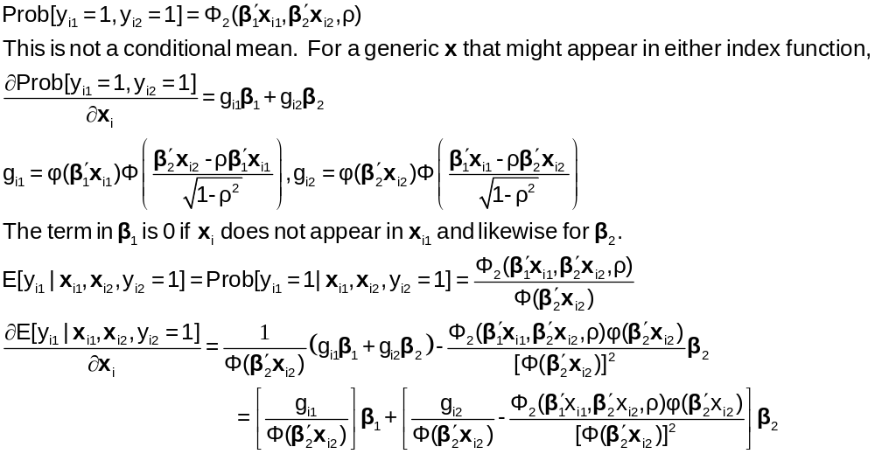
Bivariate Probit Conditional Means

Slide 45
Direct Effects
Derivatives of E[y₁|x₁,x₂,y₂=1] wrt x₁
+-------------------------------------------+
| Partial derivatives of E[y1|y2=1] with |
| respect to the vector of characteristics. |
| They are computed at the means of the Xs. |
| Effect shown is total of 4 parts above. |
| Estimate of E[y1|y2=1] = .819898 |
| Observations used for means are All Obs. |
| These are the direct marginal effects. |
+-------------------------------------------+
+---------+--------------+----------------+--------+---------+----------+
|Variable | Coefficient | Standard Error |b/St.Er.|P[|Z|>z] | Mean of X|
+---------+--------------+----------------+--------+---------+----------+
AGE .00382760 .00022088 17.329 .0000 43.5256898
FEMALE .08857260 .00519658 17.044 .0000 .47877479
EDUC -.00392413 .00093911 -4.179 .0000 11.3206310
MARRIED .00061108 .00506488 .121 .9040 .75861817
WORKING -.02280671 .00518908 -4.395 .0000 .67704750
HHNINC .000000 ......(Fixed Parameter)....... .35208362
HHKIDS .000000 ......(Fixed Parameter)....... .40273000

Slide 46
Indirect Effects
Derivatives of E[y₁|x₁,x₂,y₂=1] wrt x₂
+-------------------------------------------+
| Partial derivatives of E[y1|y2=1] with |
| respect to the vector of characteristics. |
| They are computed at the means of the Xs. |
| Effect shown is total of 4 parts above. |
| Estimate of E[y1|y2=1] = .819898 |
| Observations used for means are All Obs. |
| These are the indirect marginal effects. |
+-------------------------------------------+
+---------+--------------+----------------+--------+---------+----------+
|Variable | Coefficient | Standard Error |b/St.Er.|P[|Z|>z] | Mean of X|
+---------+--------------+----------------+--------+---------+----------+
AGE -.00035034 .697563D-04 -5.022 .0000 43.5256898
FEMALE -.00835397 .00150062 -5.567 .0000 .47877479
EDUC .000000 ......(Fixed Parameter)....... 11.3206310
MARRIED .000000 ......(Fixed Parameter)....... .75861817
WORKING .000000 ......(Fixed Parameter)....... .67704750
HHNINC .00216510 .00374879 .578 .5636 .35208362
HHKIDS .00034768 .00164160 .212 .8323 .40273000

Slide 47
Marginal Effects: Total Effects
Sum of Two Derivative Vectors
+-------------------------------------------+
| Partial derivatives of E[y1|y2=1] with |
| respect to the vector of characteristics. |
| They are computed at the means of the Xs. |
| Effect shown is total of 4 parts above. |
| Estimate of E[y1|y2=1] = .819898 |
| Observations used for means are All Obs. |
| Total effects reported = direct+indirect. |
+-------------------------------------------+
+---------+--------------+----------------+--------+---------+----------+
|Variable | Coefficient | Standard Error |b/St.Er.|P[|Z|>z] | Mean of X|
+---------+--------------+----------------+--------+---------+----------+
AGE .00347726 .00022941 15.157 .0000 43.5256898
FEMALE .08021863 .00535648 14.976 .0000 .47877479
EDUC -.00392413 .00093911 -4.179 .0000 11.3206310
MARRIED .00061108 .00506488 .121 .9040 .75861817
WORKING -.02280671 .00518908 -4.395 .0000 .67704750
HHNINC .00216510 .00374879 .578 .5636 .35208362
HHKIDS .00034768 .00164160 .212 .8323 .40273000

Slide 48
Marginal Effects: Dummy Variables
Using Differences of Probabilities
+-----------------------------------------------------------+
| Analysis of dummy variables in the model. The effects are |
| computed using E[y1|y2=1,d=1] - E[y1|y2=1,d=0] where d is |
| the variable. Variances use the delta method. The effect |
| accounts for all appearances of the variable in the model.|
+-----------------------------------------------------------+
|Variable Effect Standard error t ratio (deriv) |
+-----------------------------------------------------------+
FEMALE .079694 .005290 15.065 (.080219)
MARRIED .000611 .005070 .121 (.000511)
WORKING -.022485 .005044 -4.457 (-.022807)
HHKIDS .000348 .001641 .212 (.000348)
Computed using difference of probabilities
Computed using scaled coefficients

Slide 49
Simultaneous Equations

Slide 50
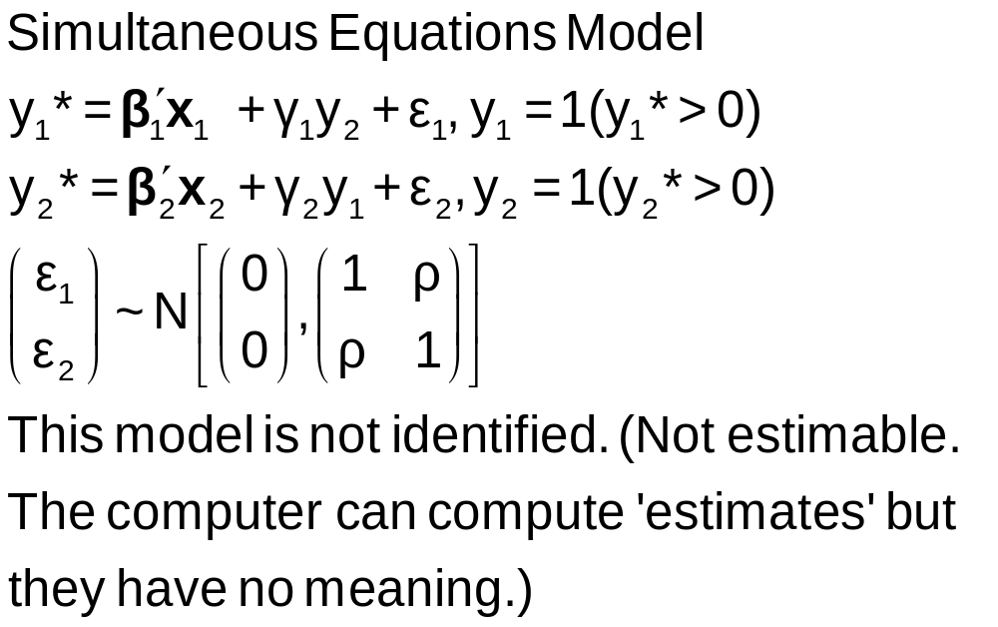
A Simultaneous Equations Model
bivariate probit;lhs=doctor,hospital
;rh1=one,age,educ,married,female,hospital
;rh2=one,age,educ,married,female,doctor$
Error 809: Fully simultaneous BVP model is not identified

Slide 51
Fully Simultaneous ‘Model’
(Obtained by bypassing internal control)
----------------------------------------------------------------------
FIML Estimates of Bivariate Probit Model
Dependent variable DOCHOS
Log likelihood function -20318.69455
--------+-------------------------------------------------------------
Variable| Coefficient Standard Error b/St.Er. P[|Z|>z] Mean of X
--------+-------------------------------------------------------------
|Index equation for DOCTOR
Constant| -.46741*** .06726 -6.949 .0000
AGE| .01124*** .00084 13.353 .0000 43.5257
FEMALE| .27070*** .01961 13.807 .0000 .47877
EDUC| -.00025 .00376 -.067 .9463 11.3206
MARRIED| -.00212 .02114 -.100 .9201 .75862
WORKING| -.00362 .02212 -.164 .8701 .67705
HOSPITAL| 2.04295*** .30031 6.803 .0000 .08765
|Index equation for HOSPITAL
Constant| -1.58437*** .08367 -18.936 .0000
AGE| -.01115*** .00165 -6.755 .0000 43.5257
FEMALE| -.26881*** .03966 -6.778 .0000 .47877
HHNINC| .00421 .08006 .053 .9581 .35208
HHKIDS| -.00050 .03559 -.014 .9888 .40273
DOCTOR| 2.04479*** .09133 22.389 .0000 .62911
|Disturbance correlation
RHO(1,2)| -.99996*** .00048 ******** .0000
--------+-------------------------------------------------------------

Slide 52
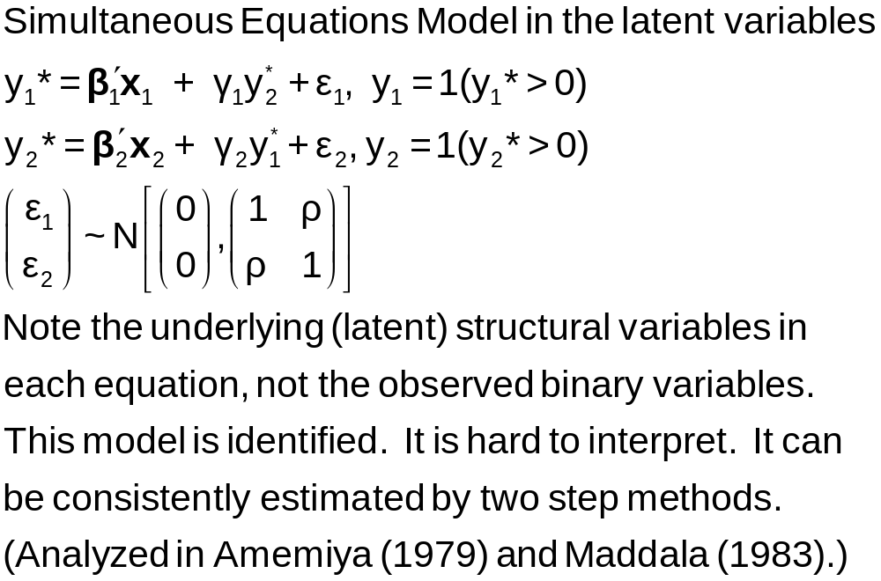
A Latent Simultaneous Equations Model

Slide 53
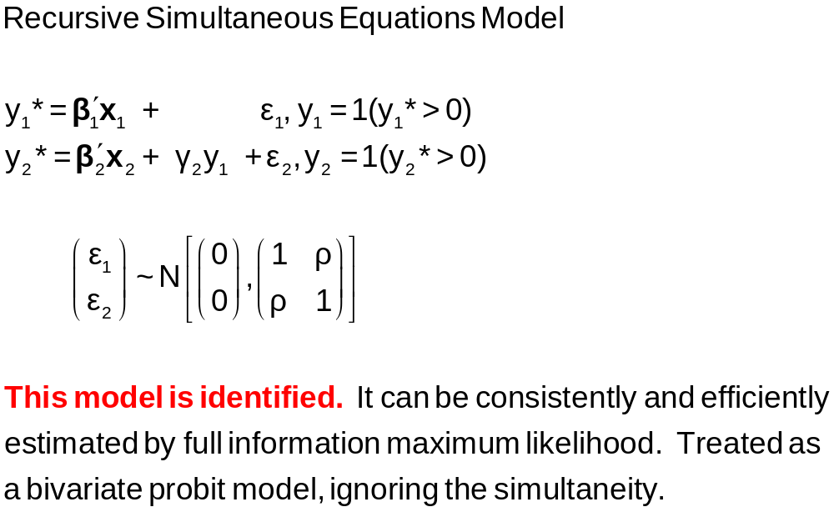
A Recursive Simultaneous Equations Model

Slide 54


Slide 55
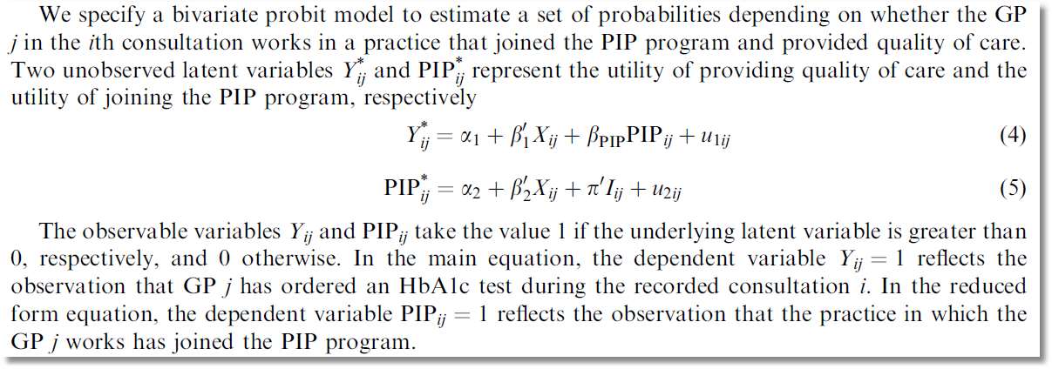
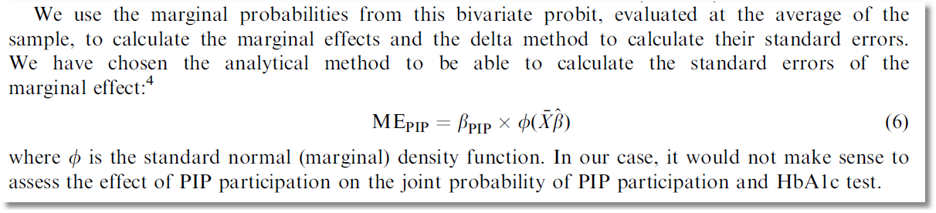

Slide 56
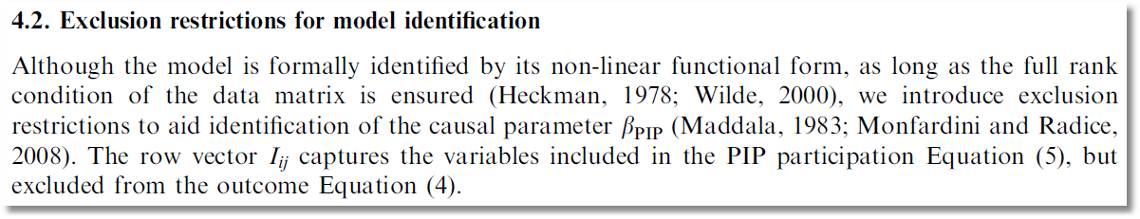

Slide 57
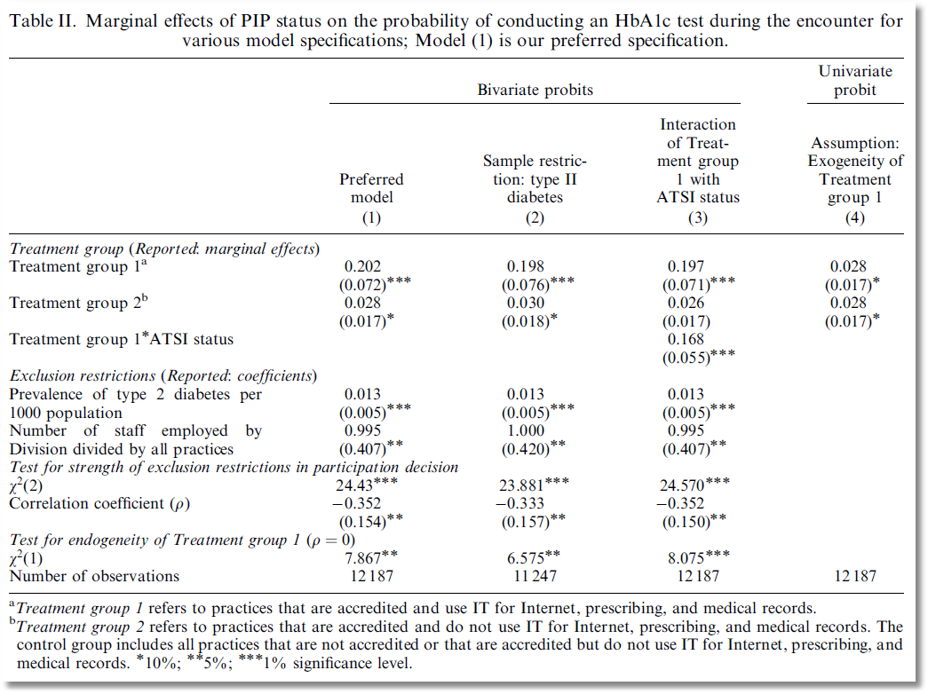

Slide 58
Multivariate Probit

Slide 59
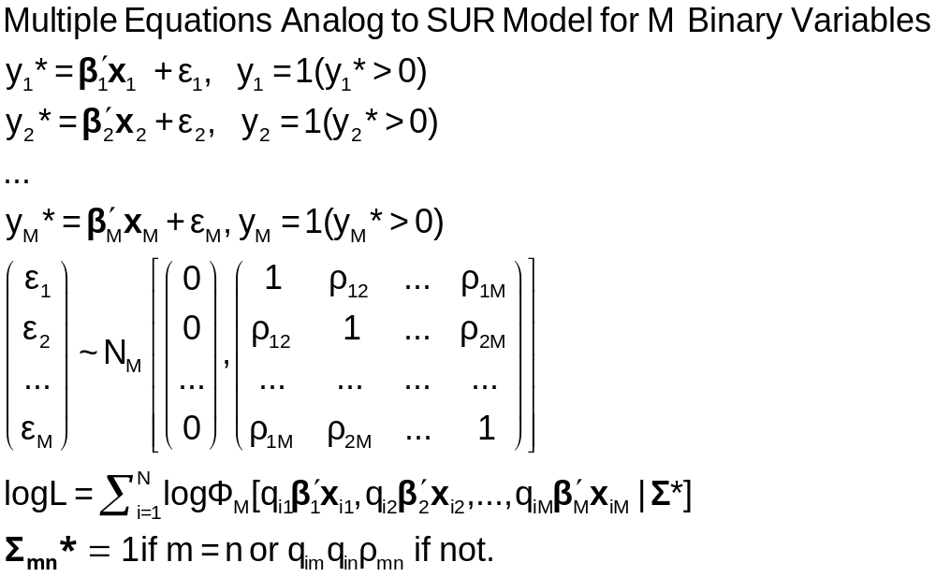
The Multivariate Probit Model

Slide 60
MLE: Simulation
Estimation of the multivariate probit model requires evaluation of M-order Integrals
The general case is usually handled with the GHK simulator. Much current research focuses on efficiency (speed) gains in this computation.
The “Panel Probit Model” is a special case.
  (Bertschek-Lechner, JE, 1999) – Construct a GMM estimator using only first order integrals of the univariate normal CDF
  (Greene, Emp.Econ, 2003) – Estimate the integrals with (GHK) simulation anyway.

Slide 61
----------------------------------------------------------------------
Multivariate Probit Model: 3 equations.
Dependent variable MVProbit
Log likelihood function -4751.09039
--------+-------------------------------------------------------------
Variable| Coefficient Standard Error b/St.Er. P[|Z|>z] Mean of X Univariate
--------+------------------------------------------------------------- Estimates
|Index function for DOCTOR
Constant| -.35527** .16715 -2.125 .0335 [-0.29987 .16195]
AGE| .01664*** .00194 8.565 .0000 43.9959 [ 0.01644 .00193]
FEMALE| .30931*** .04812 6.427 .0000 .47935 [ 0.30643 .04767]
EDUC| -.01566 .01024 -1.530 .1261 11.0909 [-0.01936 .00962]
MARRIED| -.04487 .05112 -.878 .3801 .78911 [-0.04423 .05139]
WORKING| -.14712*** .05075 -2.899 .0037 .63345 [-0.15390 .05054]
|Index function for HOSPITAL
Constant| -1.61787*** .15729 -10.286 .0000 [-1.58276 .16119]
AGE| .00717** .00283 2.536 .0112 43.9959 [ 0.00662 .00288]
FEMALE| -.00039 .05995 -.007 .9948 .47935 [-0.00407 .05991]
HHNINC| -.41050 .25147 -1.632 .1026 .29688 [-0.41080 .22891]
HHKIDS| -.01547 .06551 -.236 .8134 .44915 [-0.03688 .06615]
|Index function for PUBLIC
Constant| 1.51314*** .18608 8.132 .0000 [ 1.53542 .17060]
AGE| .00661** .00289 2.287 .0222 43.9959 [ 0.00646 .00268]
HSAT| -.06844*** .01385 -4.941 .0000 6.90062 [-0.07069 .01266]
MARRIED| -.00859 .06892 -.125 .9008 .78911 [-.00813 .06908]
|Correlation coefficients
R(01,02)| .28381*** .03833 7.404 .0000 [ was 0.29611 ]
R(01,03)| .03509 .03768 .931 .3517
R(02,03)| -.04100 .04831 -.849 .3960
--------+-------------------------------------------------------------

Slide 62
Marginal Effects
There are M equations: “Effect of what on what?”
NLOGIT computes E[y1|all other ys, all xs]
Marginal effects are derivatives of this with respect to all xs. (EXTREMELY MESSY)
Standard errors are estimated with bootstrapping.

Slide 63
Application: The ‘Panel Probit Model’
M equations are M periods of the same equation
Parameter vector is the same in every period (equation)
Correlation matrix is unrestricted across periods

Slide 64
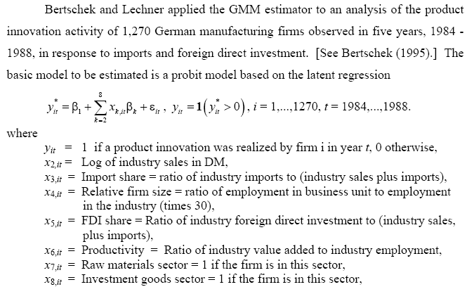
Application: Innovation

Slide 65
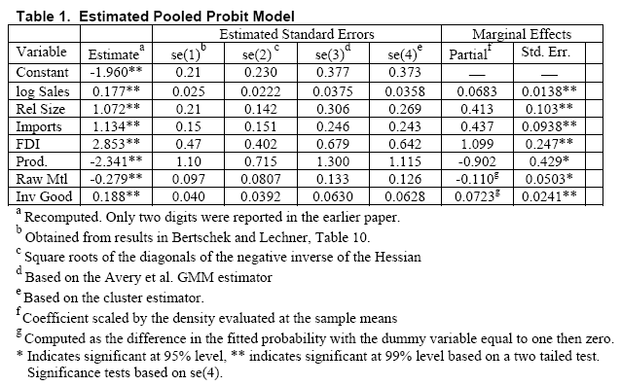
Pooled Probit – Ignoring Correlation

Slide 66
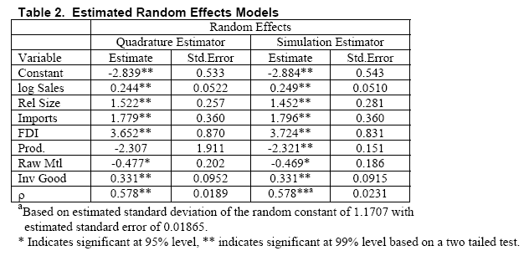
Random Effects: Σ=(1- ρ)I+ρii’

Slide 67
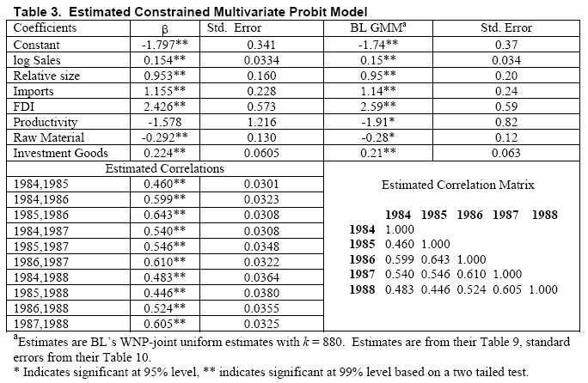
Unrestricted Correlation Matrix

