Slide 1



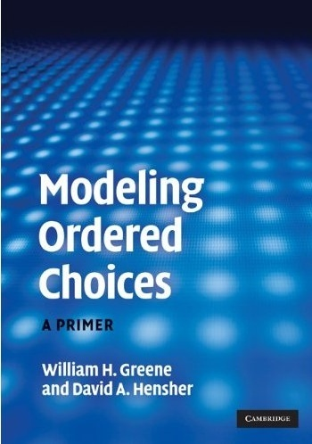

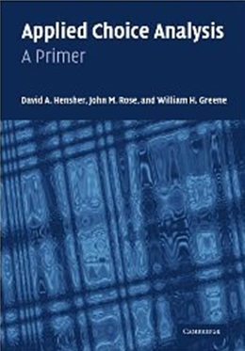
6. Ordered Choice Models

Slide 2
Ordered Choices

Slide 3
Ordered Discrete Outcomes
E.g.: Taste test, credit rating, course grade, preference scale
Underlying random preferences:
  Existence of an underlying continuous preference scale
  Mapping to observed choices
Strength of preferences is reflected in the discrete outcome
Censoring and discrete measurement
The nature of ordered data

Slide 4
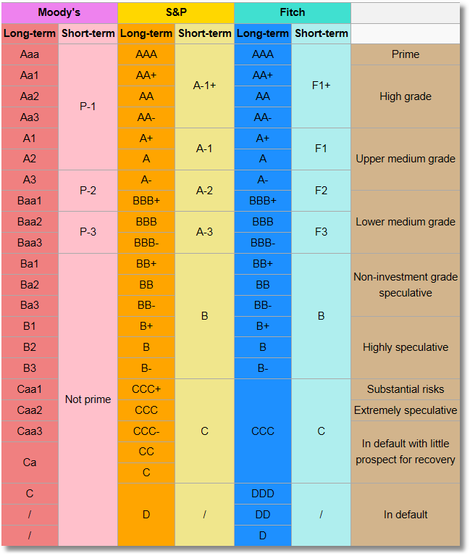
Bond Ratings

Slide 5
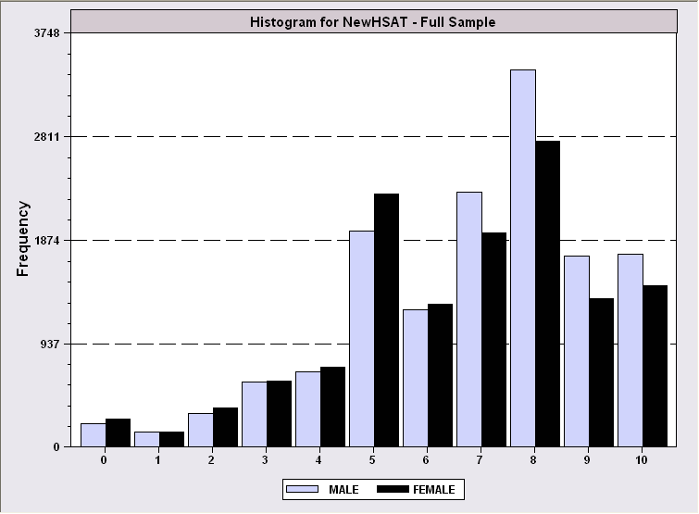
Health Satisfaction (HSAT)
Self administered survey: Health Satisfaction (0 – 10)
Continuous Preference Scale

Slide 6
Modeling Ordered Choices
Random Utility (allowing a panel data setting)
Uit = α + β'x_{it} + ε_{it}
= a_{it} + ε_{it}
Observe outcome j if utility is in region j
Probability of outcome = probability of cell
Pr[Yit=j] = Prob[Yit < j] - Prob[Yit < j-1]
= F(μ_{j} – a_{it}) - F(μ_{j-1} – a_{it})

Slide 7
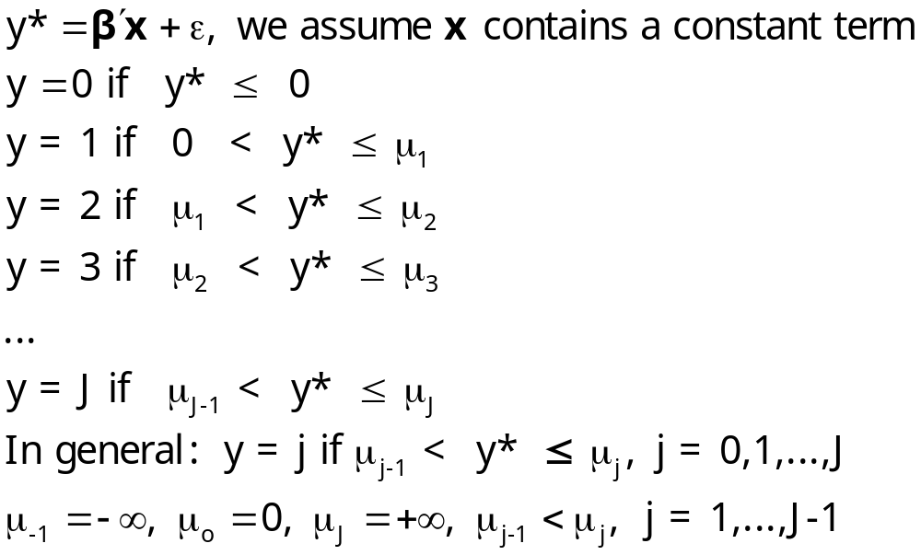
Ordered Probability Model

Slide 8
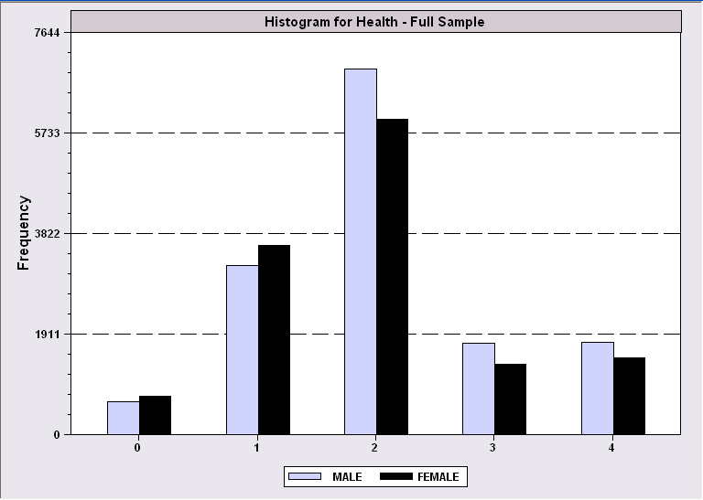
Combined Outcomes for Health Satisfaction

Slide 9
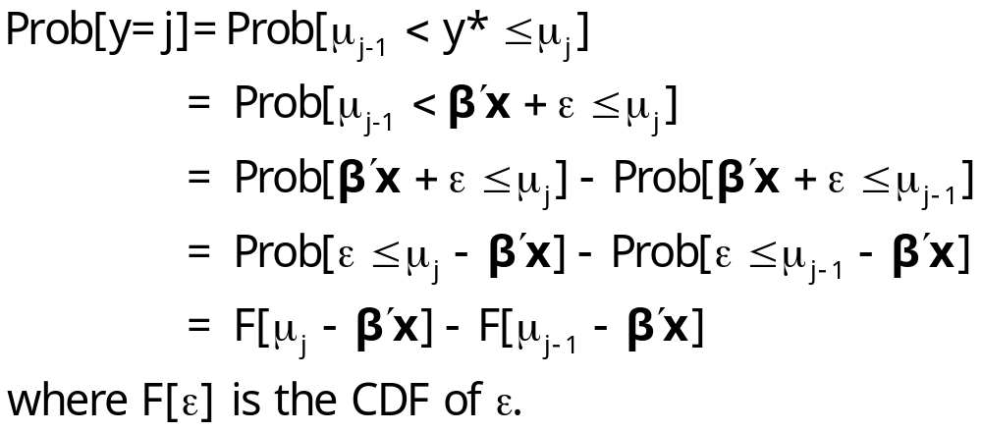
Probabilities for Ordered Choices

Slide 10
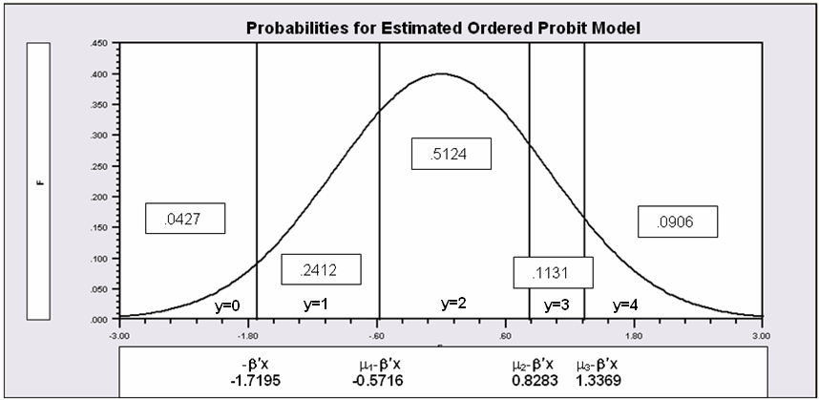
Probabilities for Ordered Choices
μ₁ =1.1479 μ₂ =2.5478 μ₃ =3.0564

Slide 11
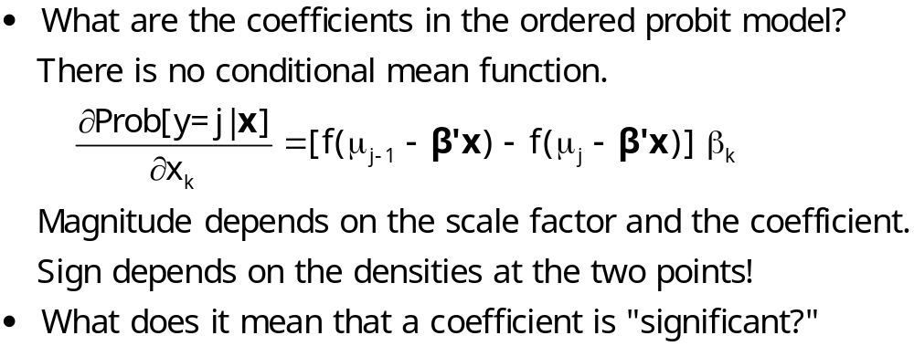
Coefficients

Slide 12
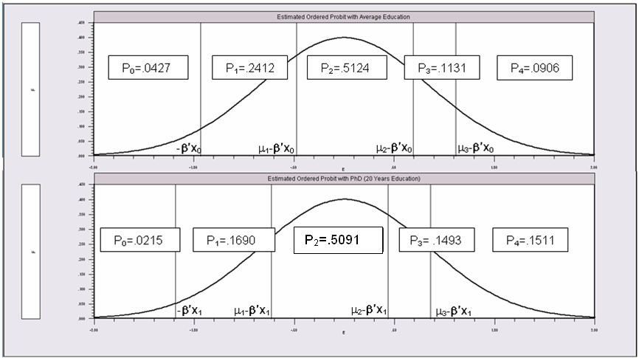
Effects of 8 More Years of Education

Slide 13
An Ordered Probability
Model for Health Satisfaction
+---------------------------------------------+
| Ordered Probability Model |
| Dependent variable HSAT |
| Number of observations 27326 |
| Underlying probabilities based on Normal |
| Cell frequencies for outcomes |
| Y Count Freq Y Count Freq Y Count Freq |
| 0 447 .016 1 255 .009 2 642 .023 |
| 3 1173 .042 4 1390 .050 5 4233 .154 |
| 6 2530 .092 7 4231 .154 8 6172 .225 |
| 9 3061 .112 10 3192 .116 |
+---------------------------------------------+
+---------+--------------+----------------+--------+---------+----------+
|Variable | Coefficient | Standard Error |b/St.Er.|P[|Z|>z] | Mean of X|
+---------+--------------+----------------+--------+---------+----------+
Index function for probability
Constant 2.61335825 .04658496 56.099 .0000
FEMALE -.05840486 .01259442 -4.637 .0000 .47877479
EDUC .03390552 .00284332 11.925 .0000 11.3206310
AGE -.01997327 .00059487 -33.576 .0000 43.5256898
HHNINC .25914964 .03631951 7.135 .0000 .35208362
HHKIDS .06314906 .01350176 4.677 .0000 .40273000
Threshold parameters for index
Mu(1) .19352076 .01002714 19.300 .0000
Mu(2) .49955053 .01087525 45.935 .0000
Mu(3) .83593441 .00990420 84.402 .0000
Mu(4) 1.10524187 .00908506 121.655 .0000
Mu(5) 1.66256620 .00801113 207.532 .0000
Mu(6) 1.92729096 .00774122 248.965 .0000
Mu(7) 2.33879408 .00777041 300.987 .0000
Mu(8) 2.99432165 .00851090 351.822 .0000
Mu(9) 3.45366015 .01017554 339.408 .0000

Slide 14
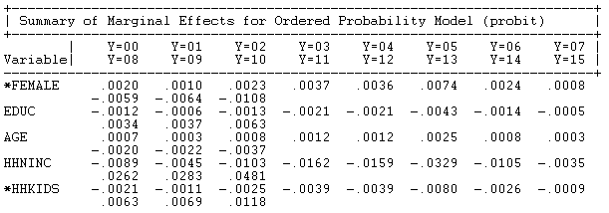
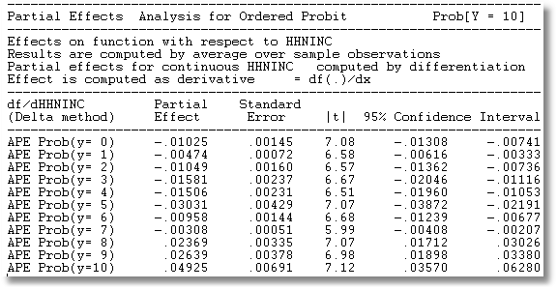
Ordered Probit Partial Effects
Partial effects at means of the data
Average Partial Effect of HHNINC

Slide 15
Fit Measures
There is no single “dependent variable” to explain.
There is no sum of squares or other measure of “variation” to explain.
Predictions of the model relate to a set of J+1 probabilities, not a single variable.
How to explain fit?
  Based on the underlying regression
  Based on the likelihood function
  Based on prediction of the outcome variable

Slide 16
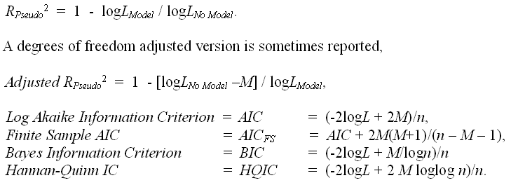
Log Likelihood Based Fit Measures

Slide 17
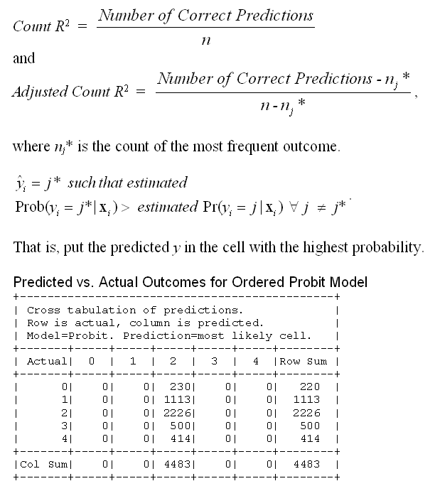
Fit Measure Based on Counting Predictions
This model always predicts the same cell.

Slide 18
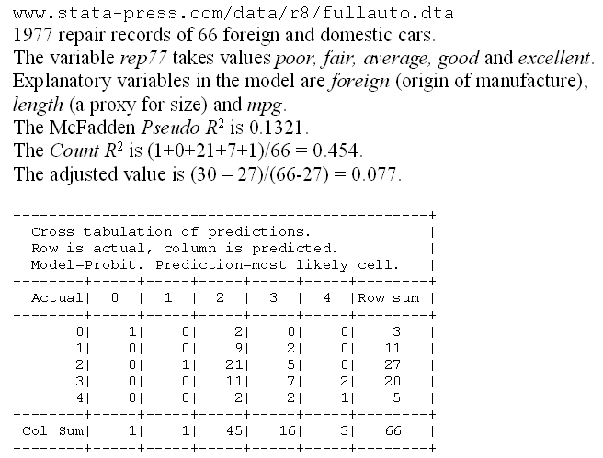
A Somewhat Better Fit

Slide 19
Different Normalizations
NLOGIT
  Y = 0,1,…,J, U* = α + β’x + ε
  One overall constant term, α
  J-1 “thresholds;” μ₋₁ = -∞, μ₀ = 0, μ₁,… μ_{J-1}, μ_{J} = + ∞
Stata
  Y = 1,…,J+1, U* = β’x + ε
  No overall constant, α=0
  J “cutpoints;” μ₀ = -∞, μ₁,… μ_{J}, μ_{J+1} = + ∞

Slide 20
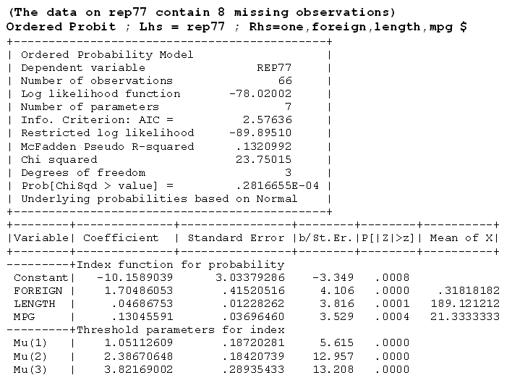



Slide 21
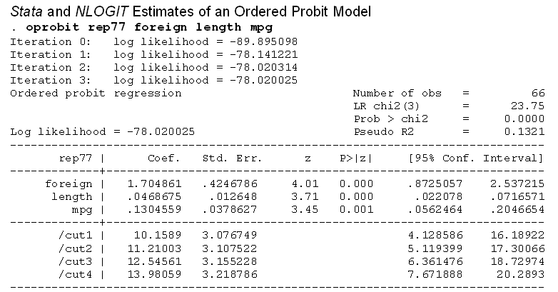



Slide 22
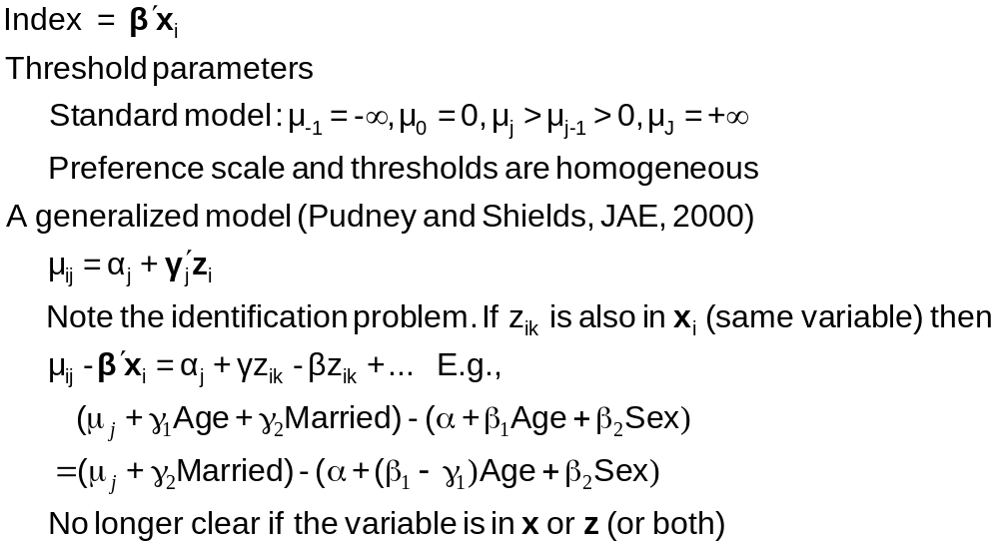
Generalizing the Ordered Probit with Heterogeneous Thresholds

Slide 23
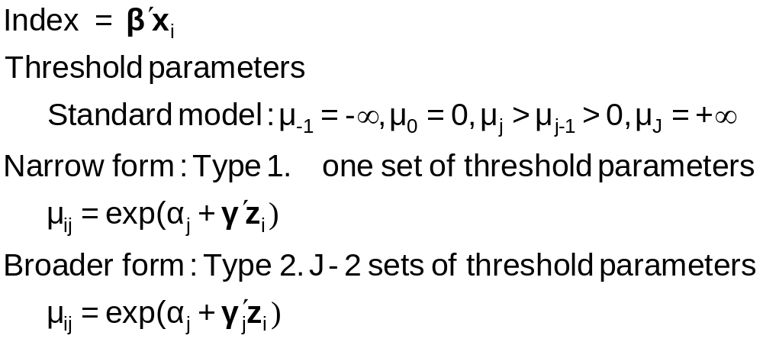
Generalizing the Ordered Probit
with Heterogeneous Thresholds
An example of identification by functional form (nonlinearity)

Slide 24
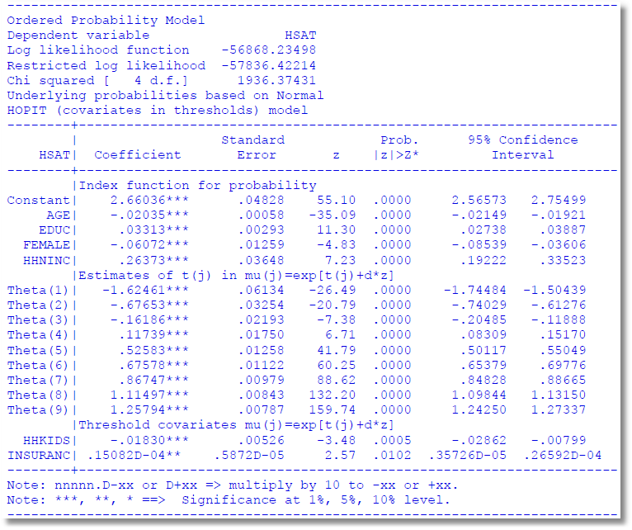

Slide 25
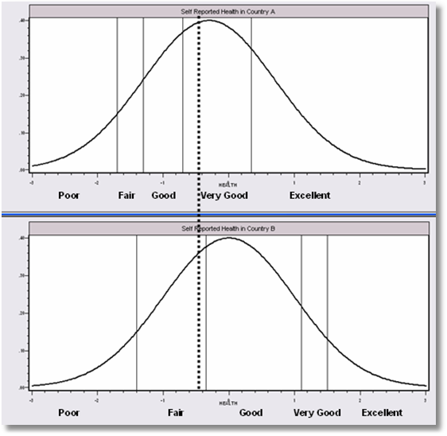
Differential Item Functioning
People in this country are optimistic – they report this value as ‘very good.’
People in this country are pessimistic – they report this same value as ‘fair’

Slide 26
Panel Data
Fixed Effects
  The usual incidental parameters problem
  Partitioning Prob(y_{it} > j|x_{it}) produces estimable binomial logit models. (Find a way to combine multiple estimates of the same β.)
Random Effects
  Standard application

Slide 27
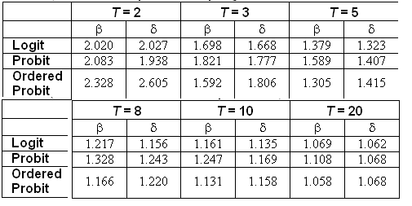
Incidental Parameters Problem
Monte Carlo Analysis of the Bias of the MLE in Fixed Effects Discrete Choice Models (Means of empirical sampling distributions, N = 1,000 individuals, R = 200 replications)

Slide 28
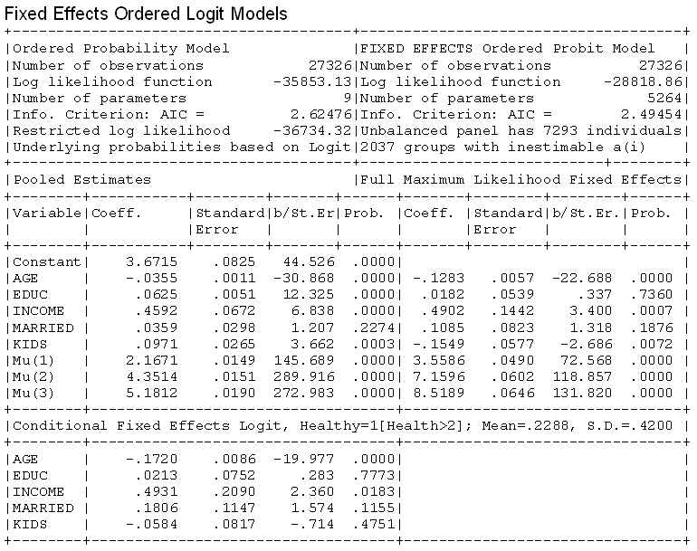

Slide 29
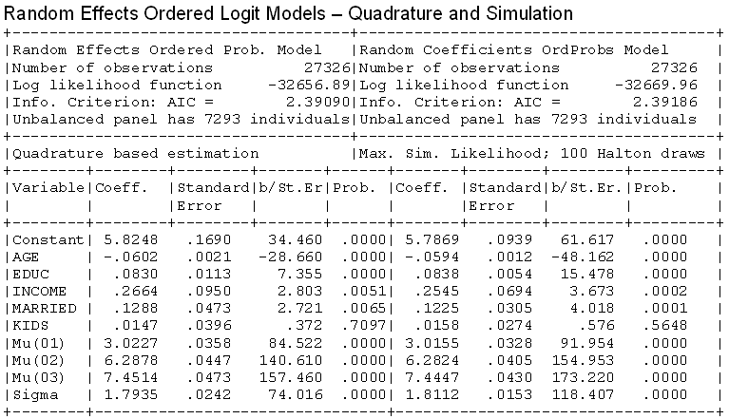
Random Effects

Slide 30

Dynamic Ordered Probit Model

Slide 31
Model for Self Assessed Health
British Household Panel Survey (BHPS)
  Waves 1-8, 1991-1998
  Self assessed health on 0,1,2,3,4 scale
  Sociological and demographic covariates
  Dynamics – inertia in reporting of top scale
Dynamic ordered probit model
  Balanced panel – analyze dynamics
  Unbalanced panel – examine attrition

Slide 32
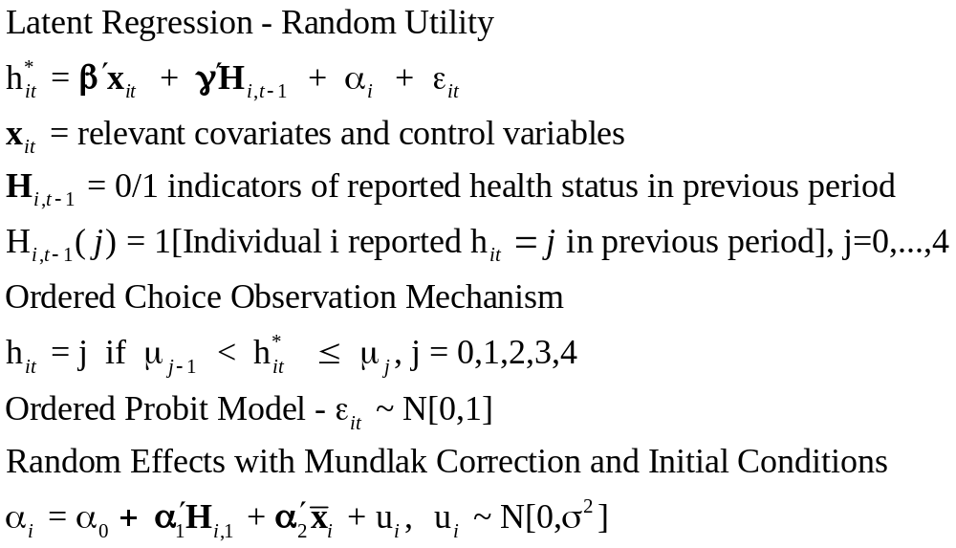
Dynamic Ordered Probit Model
It would not be appropriate to include h_{i,t-1} itself in the model as this is a label, not a measure

Slide 33
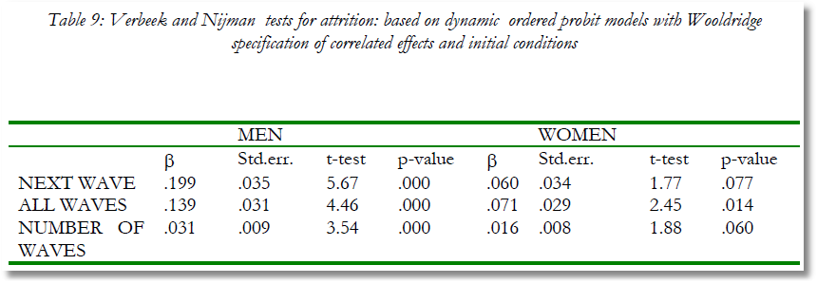
Testing for Attrition Bias
Three dummy variables added to full model with unbalanced panel suggest presence of attrition effects.

Slide 34
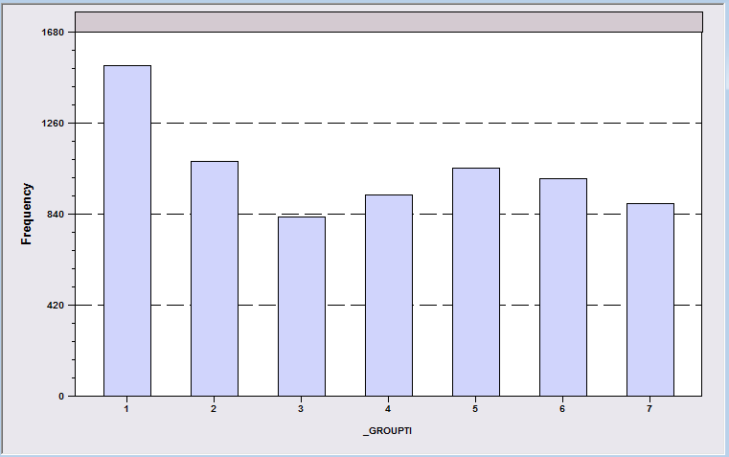
Attrition Model with IP Weights
Assumes (1) Prob(attrition|all data) = Prob(attrition|selected variables) (ignorability)
(2) Attrition is an ‘absorbing state.’ No reentry.
Obviously not true for the GSOEP data above.
Can deal with point (2) by isolating a subsample of those present at wave 1 and the monotonically shrinking subsample as the waves progress.

Slide 35
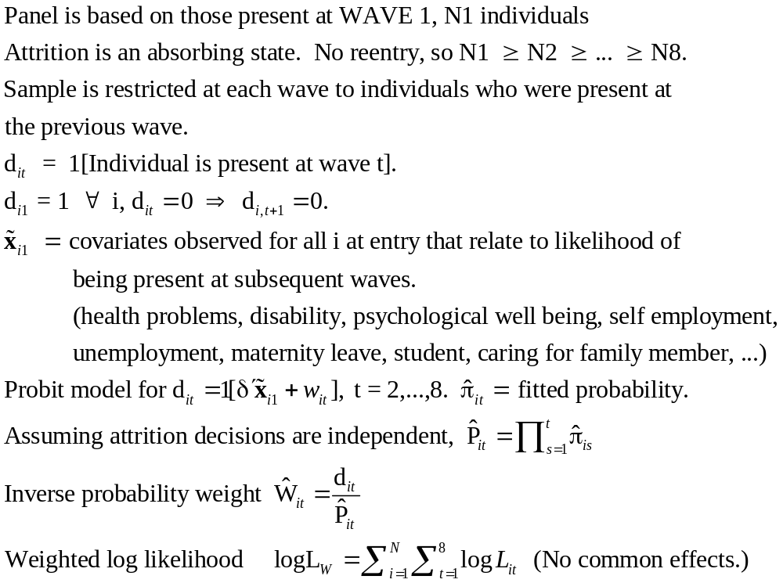
Inverse Probability Weighting

Slide 36
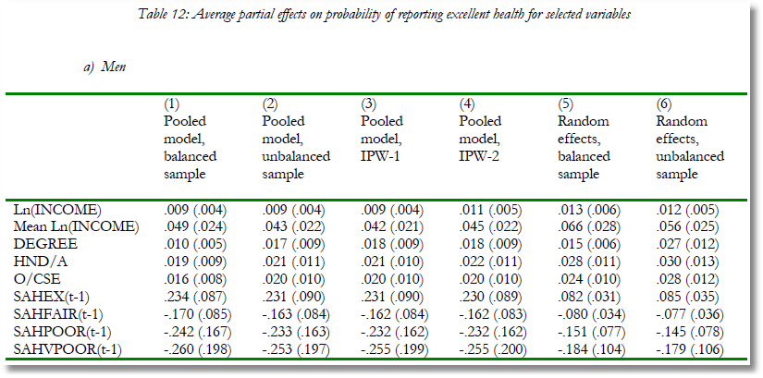
Estimated Partial Effects by Model

Slide 37
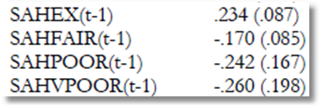
Partial Effect for a Category
These are 4 dummy variables for state in the previous period. Using first differences, the 0.234 estimated for SAHEX means transition from EXCELLENT in the previous period to GOOD in the previous period, where GOOD is the omitted category. Likewise for the other 3 previous state variables. The margin from ‘POOR’ to ‘GOOD’ was not interesting in the paper. The better margin would have been from EXCELLENT to POOR, which would have (EX,POOR) change from (1,0) to (0,1).

