Slide 1






7. Models for Count Data, Inflation Models

Slide 2
Models for
Count Data

Slide 3
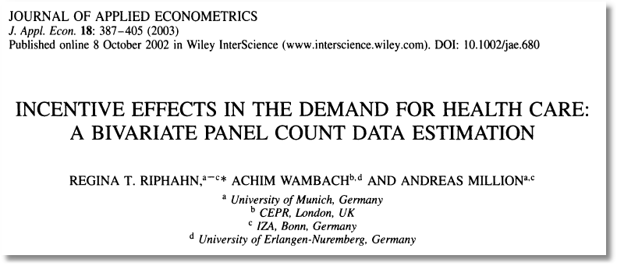

Slide 4

Doctor Visits

Slide 5
Basic Model for Counts of Events
E.g., Visits to site, number of purchases, number of doctor visits
Regression approach
  Quantitative outcome measured
  Discrete variable, model probabilities
  Nonnegative random variable
Poisson probabilities – “loglinear model”

Slide 6
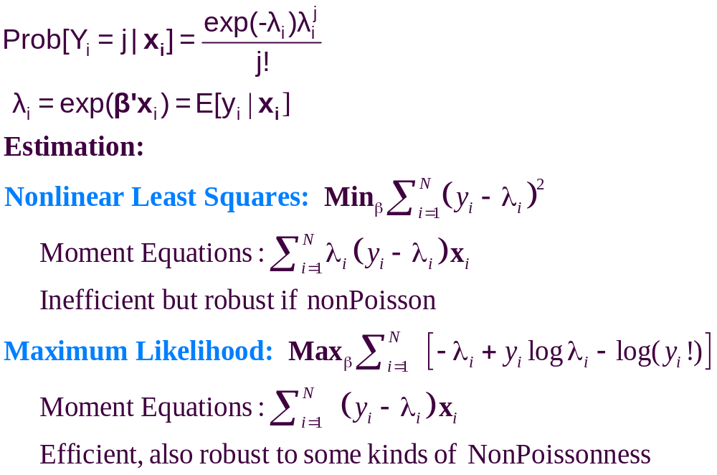

Slide 7
Efficiency and Robustness
Nonlinear Least Squares
  Robust – uses only the conditional mean
  Inefficient – does not use distribution information
Maximum Likelihood
  Less robust – specific to loglinear model forms
  Efficient – uses distributional information
Pseudo-ML
  Same as Poisson
  Robust to some kinds of nonPoissonness

Slide 8
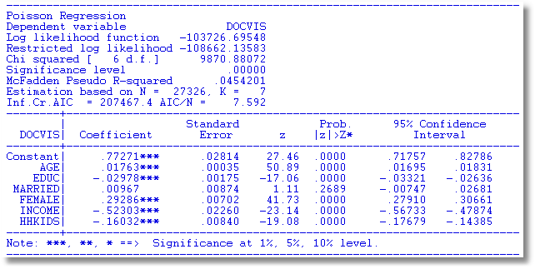
Poisson Model for Doctor Visits

Slide 9
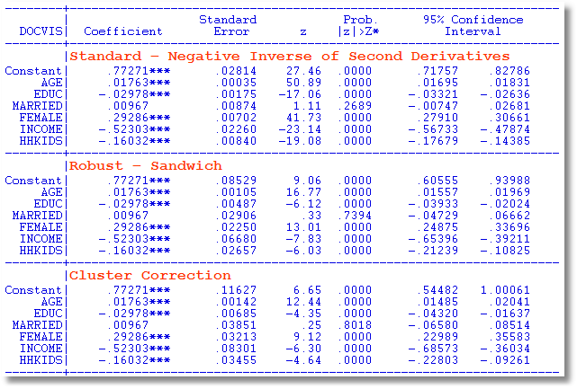
Alternative Covariance Matrices

Slide 10
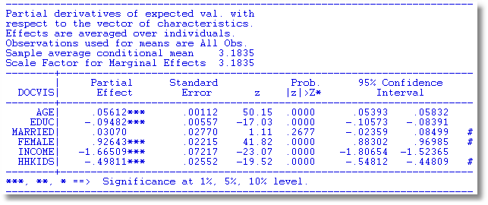
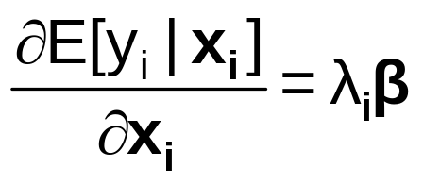
Partial Effects

Slide 11
Poisson Model Specification Issues
Equi-dispersion: Var[y_{i}|x_{i}] = E[y_{i}|x_{i}].
Overdispersion: If λ_{i} = exp[β’x_{i} + ε_{i}],
  E[y_{i}|x_{i}] = γexp[β’x_{i}]
  Var[y_{i}] > E[y_{i}] (overdispersed)
  ε_{i} ~ log-Gamma ➔ Negative binomial model
  ε_{i} ~ Normal[0,σ²] ➔ Normal-mixture model
  ε_{i} is viewed as unobserved heterogeneity (“frailty”).
    Normal model may be more natural.
    Estimation is a bit more complicated.

Slide 12
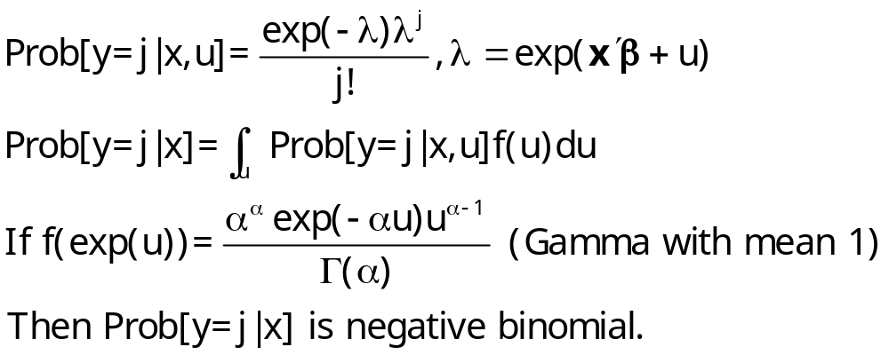
Overdispersion
In the Poisson model, Var[y|x]=E[y|x]
Equidispersion is a strong assumption
Negbin II: Var[y|x]=E[y|x] + σ²E[y|x]²
How does overdispersion arise:
  NonPoissonness
  Omitted Heterogeneity

Slide 13
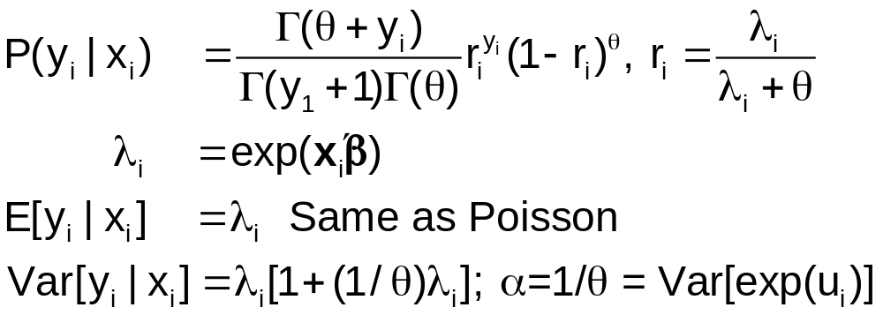
Negative Binomial Regression

Slide 14
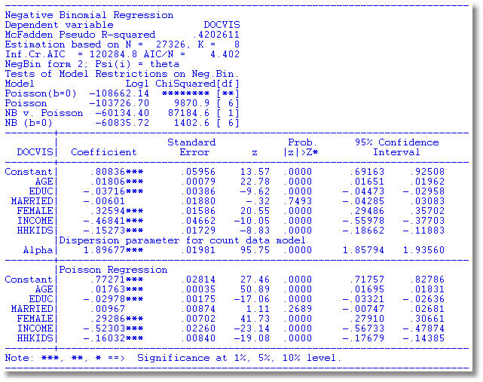
NegBin Model for Doctor Visits

Slide 15

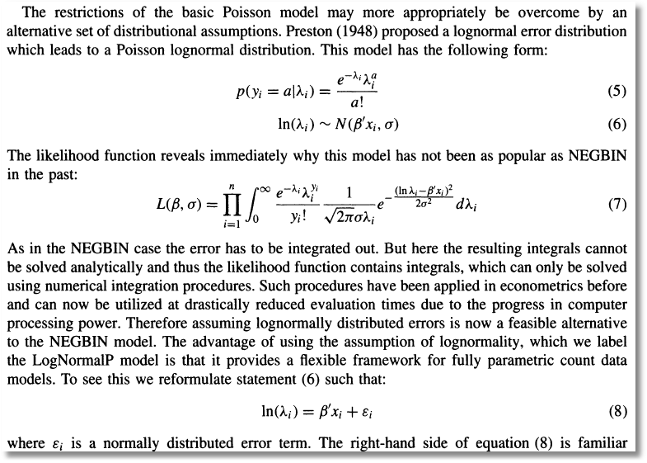
Poisson (log)Normal Mixture

Slide 16
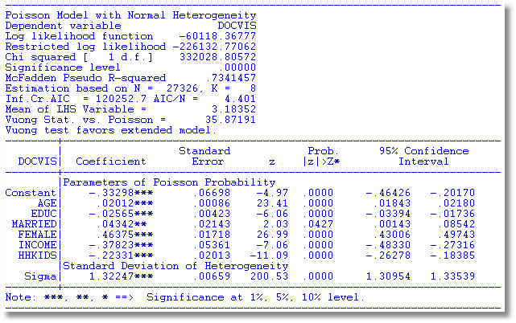
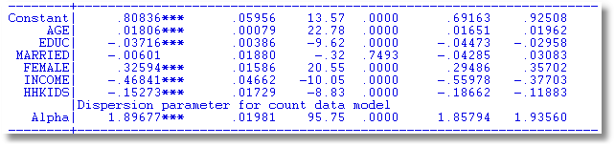

Slide 17
Negative Binomial Specification
Prob(Y_{i}=j|x_{i}) has greater mass to the right and left
of the mean
Conditional mean function is the same as the
Poisson: E[y_{i}|x_{i}] = λ_{i}=Exp(β’x_{i}),
so marginal effects have the same form.
Variance is Var[y_{i}|x_{i}] = λ_{i}(1 + α λ_{i}), α is the
overdispersion parameter;
α = 0 reverts to the Poisson.
Poisson is consistent when NegBin is appropriate.
Therefore, this is a case for the ROBUST
covariance matrix estimator. (Neglected
heterogeneity that is uncorrelated with x_{i}.)

Slide 18
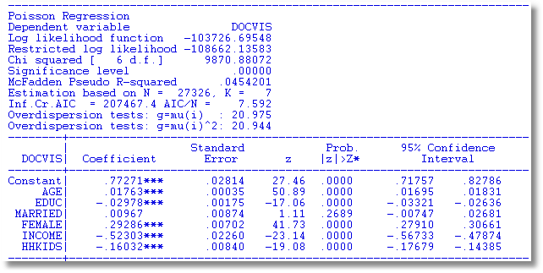
Testing for Overdispersion
Regression based test: Regress (y-mean)² on mean: Slope should = 1.

Slide 19
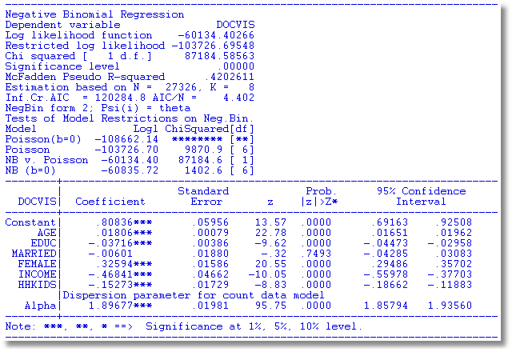
Wald Test for Overdispersion

Slide 20
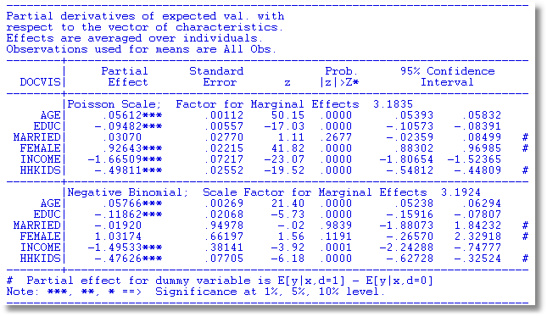
Partial Effects Should Be the Same

Slide 21

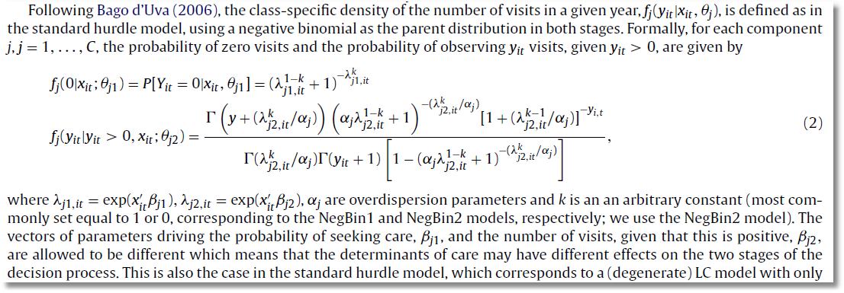

Slide 23
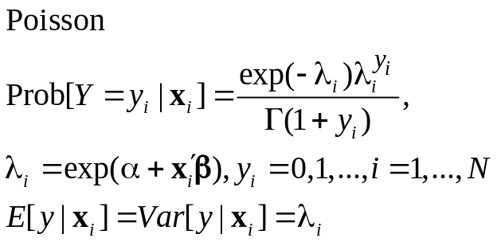
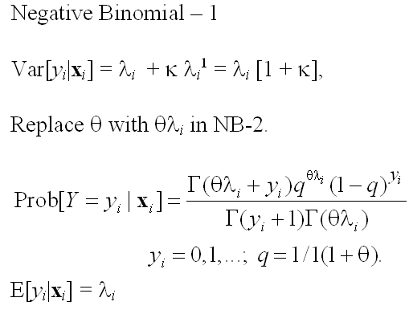
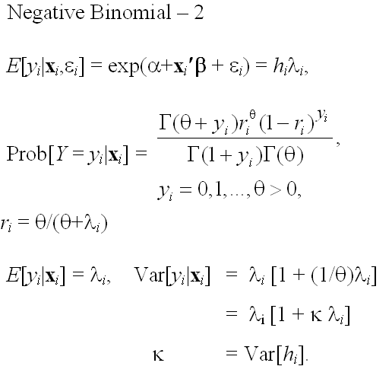
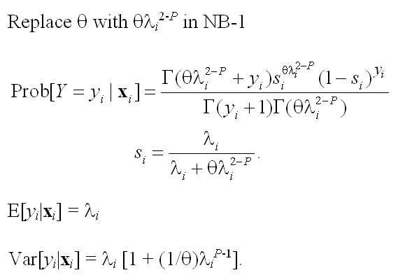
Model Formulations for Negative Binomial
E[y_{i} |x_{i} ]=λ_{i}

Slide 24
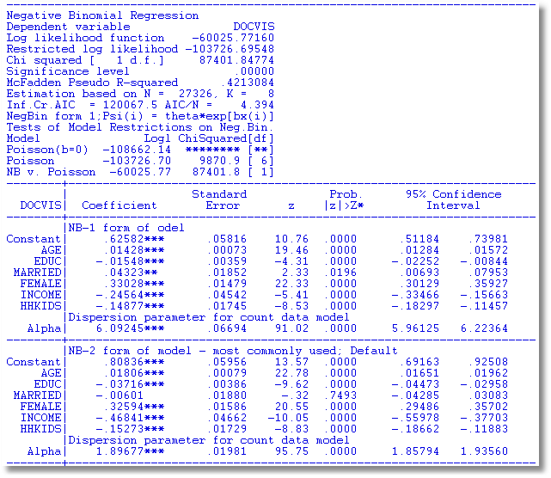
NegBin-1 Model

Slide 25
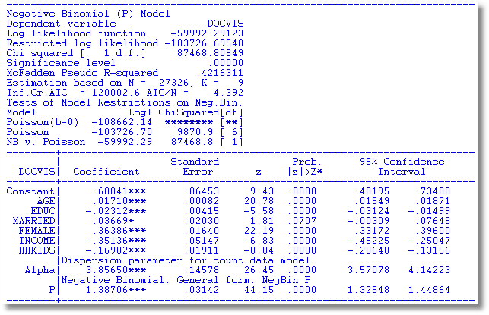
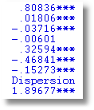
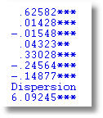
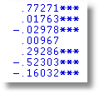
NegBin-P Model
NB-2 NB-1 Poisson

Slide 26
Censoring and Truncation in Count Models
Observations > 10 seem to come from a different process. What to do with them?
Censored Poisson: Treat any observation > 10 as 10.
Truncated Poisson: Examine the distribution only with observations less than or equal to 10.
  Intensity equation in hurdle models
  On site counts for recreation usage.
Censoring and truncation both change the model. Adjust the distribution (log likelihood) to account for the censoring or truncation.

Slide 27
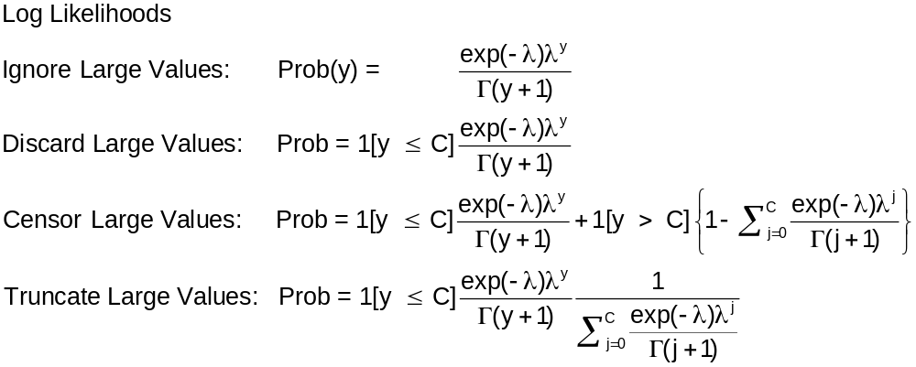

Slide 28
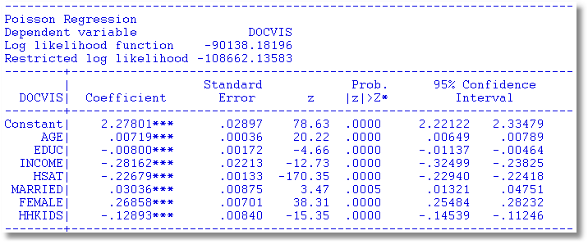
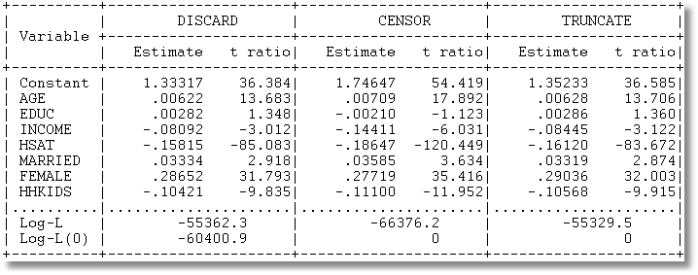

Slide 29
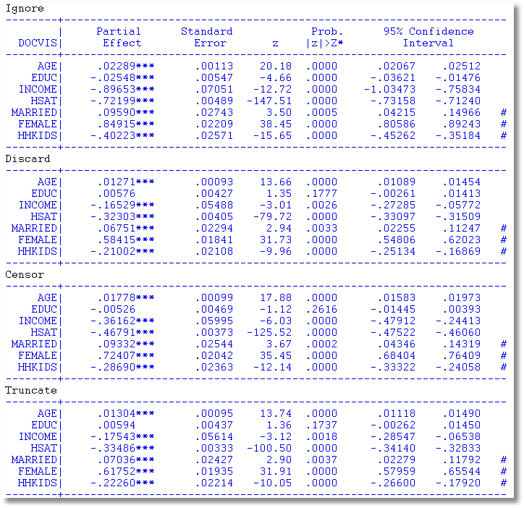
Effect of Specification on Partial Effects

Slide 30
Two Part Models

Slide 31
Zero Inflation?

Slide 32
Zero Inflation – ZIP Models
Two regimes: (Recreation site visits)
  Zero (with probability 1). (Never visit site)
  Poisson with Pr(0) = exp[- β’x_{i}]. (Number of visits, including zero visits this season.)
Unconditional:
  Pr[0] = P(regime 0) + P(regime 1)*Pr[0|regime 1]
  Pr[j | j >0] = P(regime 1)*Pr[j|regime 1]
This is a “latent class model”

Slide 33
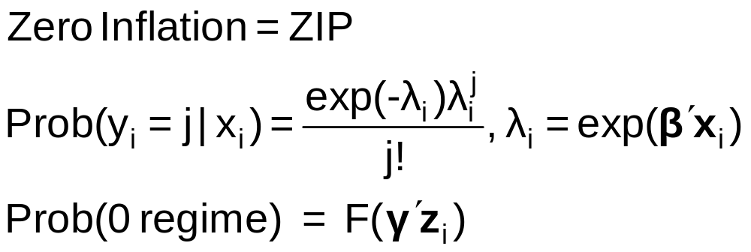
Zero Inflation Models

Slide 34
Notes on Zero Inflation Models
Poisson is not nested in ZIP. γ = 0 in ZIP does not produce Poisson; it produces ZIP with P(regime 0) = ½.
  Standard tests are not appropriate
  Use Vuong statistic. ZIP model almost always wins.
Zero Inflation models extend to NB models – ZINB(tau) and ZINB are standard models
  Creates two sources of overdispersion
  Generally difficult to estimate

Slide 35
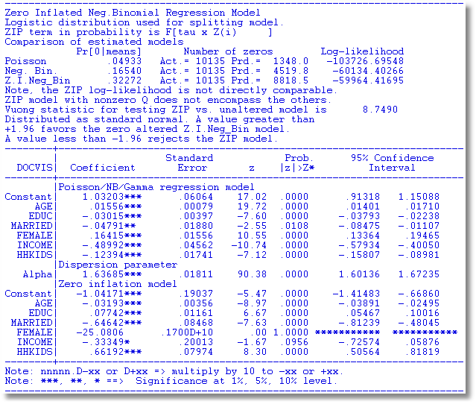
An Unidentified ZINB Model

Slide 36
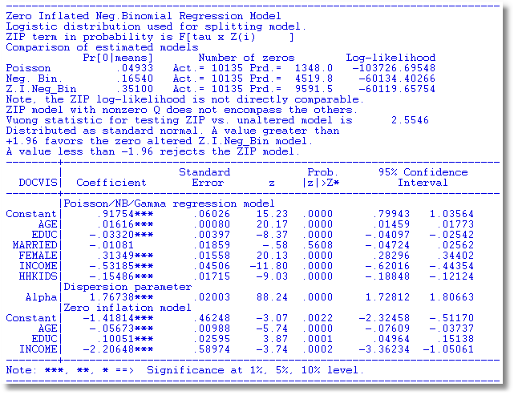

Slide 38
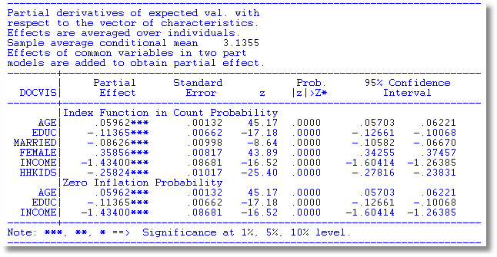
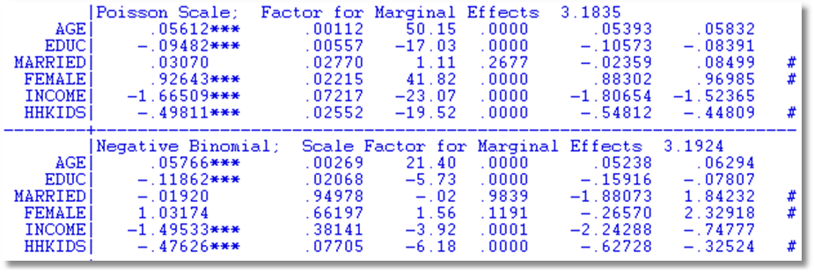
Partial Effects for Different Models
Notes:
38

Slide 39
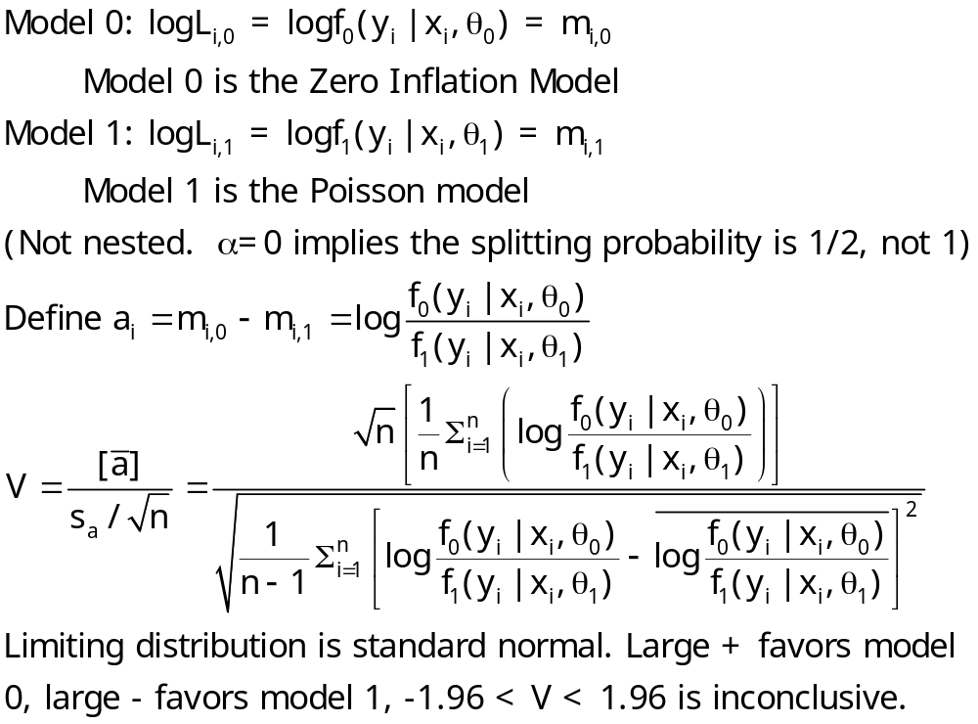
The Vuong Statistic for Nonnested Models

Slide 40
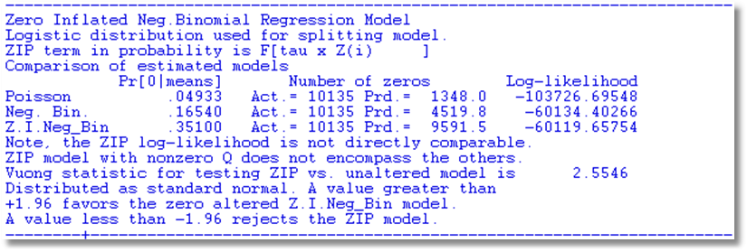

Slide 41
A Hurdle Model
Two part model:
  Model 1: Probability model for more than zero occurrences
  Model 2: Model for number of occurrences given that the number is greater than zero.
Applications common in health economics
  Usage of health care facilities
  Use of drugs, alcohol, etc.

Slide 43
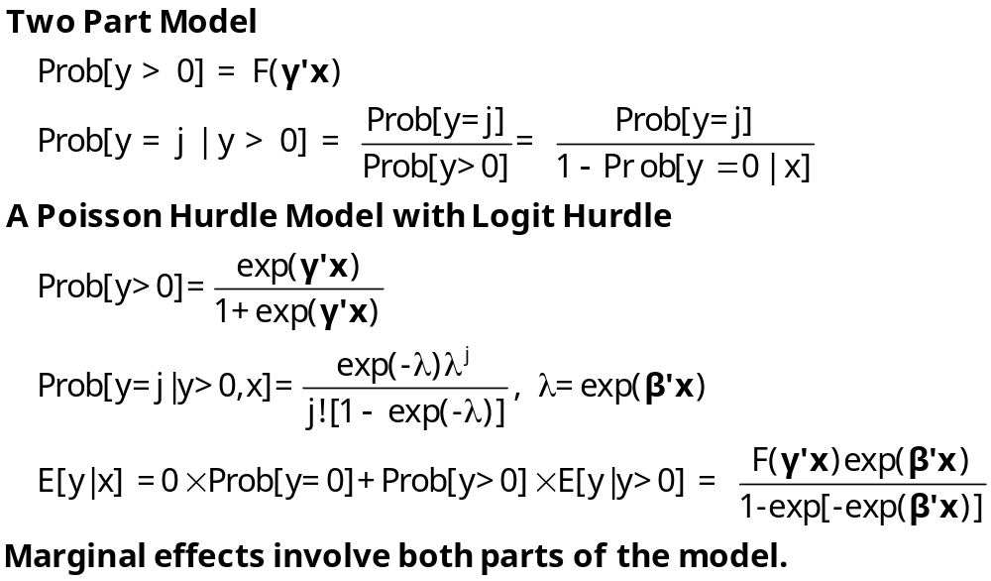
Hurdle Model

Slide 44
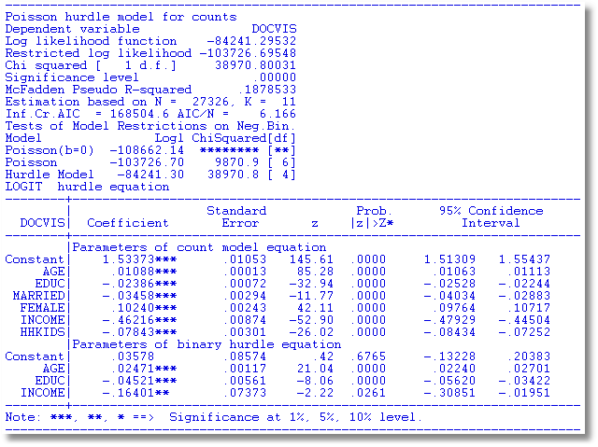
Hurdle Model for Doctor Visits

Slide 45
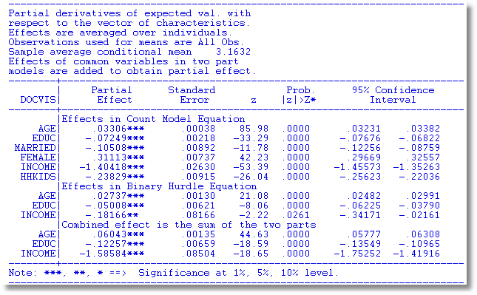
Partial Effects

Slide 48
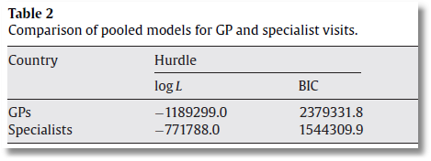
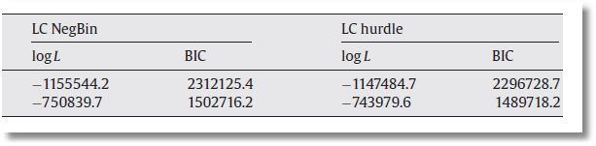

Slide 49

Application of Several of the Models
Discussed in this Section

Slide 50
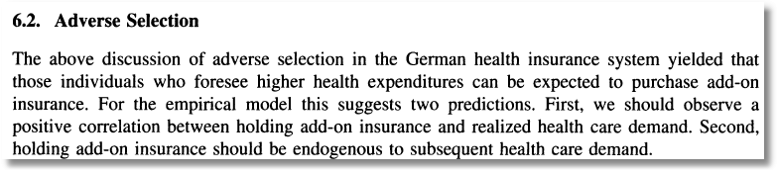
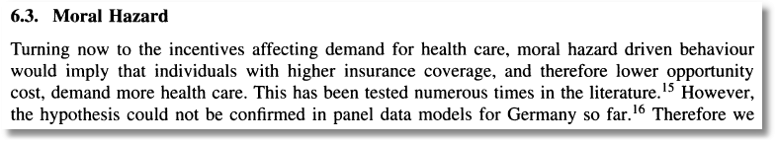

Slide 51
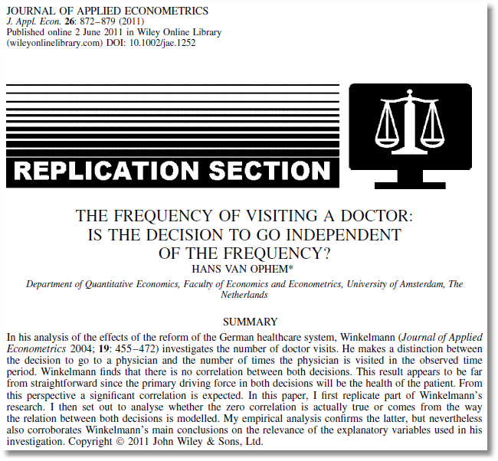
See also:
van Ophem H. 2000. Modeling selectivity in count data models. Journal of Business and Economic Statistics
18: 503–511.
Winkelmann finds that there is no correlation between the decisions… A significant correlation is expected … [T]he correlation comes from the way the relation between the decisions is modeled.

Slide 52
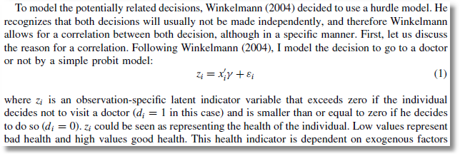
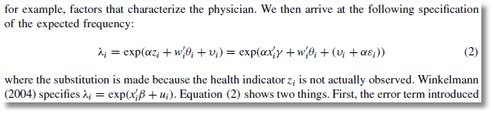
Probit Participation Equation
Poisson-Normal Intensity Equation

Slide 53
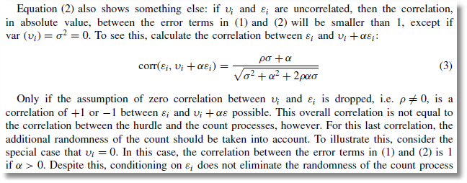
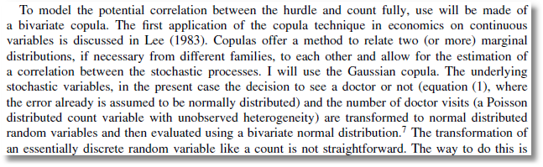
Bivariate-Normal Heterogeneity in Participation and Intensity Equations
Gaussian Copula for Participation and Intensity Equations

Slide 54
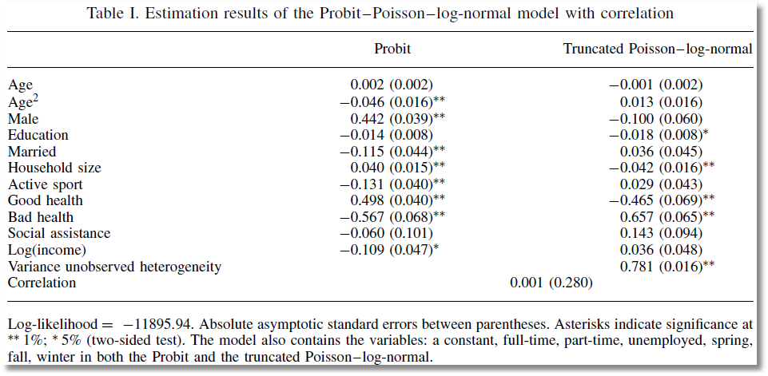
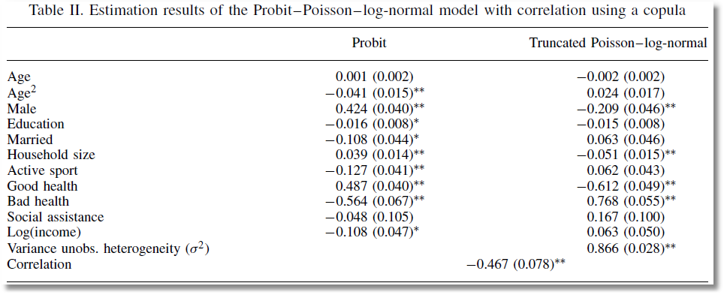
Correlation between Heterogeneity Terms
Correlation between Counts

Slide 55
Panel Data Models for Counts

Slide 56
Panel Data Models
Heterogeneity; λ_{it} = exp(β’x_{it} + c_{i})
  Fixed Effects
    Poisson: Standard, no incidental parameters issue
    NB
      Hausman, Hall, Griliches (1984) put FE in variance, not the mean
      Use “brute force” to get a conventional FE model
  Random Effects
    Poisson
      Log-gamma heterogeneity becomes an NB model
      Contemporary treatments are using normal heterogeneity with simulation or quadrature based estimators
    NB with random effects is equivalent to two “effects” one time varying one time invariant. The model is probably overspecified
Random parameters: Mixed models, latent class models, hierarchical – all extended to Poisson and NB

Slide 57


Random Effects

Slide 58
A Peculiarity of the FENB Model
‘True’ FE model has λ_{i}=exp(α_{i}+x_{it}’β). Cannot be fit if there are time invariant variables.
Hausman, Hall and Griliches (Econometrica, 1984) has α_{i} appearing in θ.
  Produces different results
  Implies that the FEM can contain time invariant variables.

Slide 59



Slide 60

See: Allison and Waterman (2002),
Guimaraes (2007)
Greene, Econometric Analysis (2011)

Slide 61



Slide 62


Bivariate Random Effects

Slide 63



