Slide 1






8. Heterogeneity: Latent Class Models

Slide 2


Slide 3
Latent Classes
A population contains a mixture of individuals of different types (classes)
Common form of the data generating mechanism within the classes
Observed outcome y is governed by the common process F(y|x,θ_{j} )
Classes are distinguished by the parameters, θ_{j}.

Slide 4

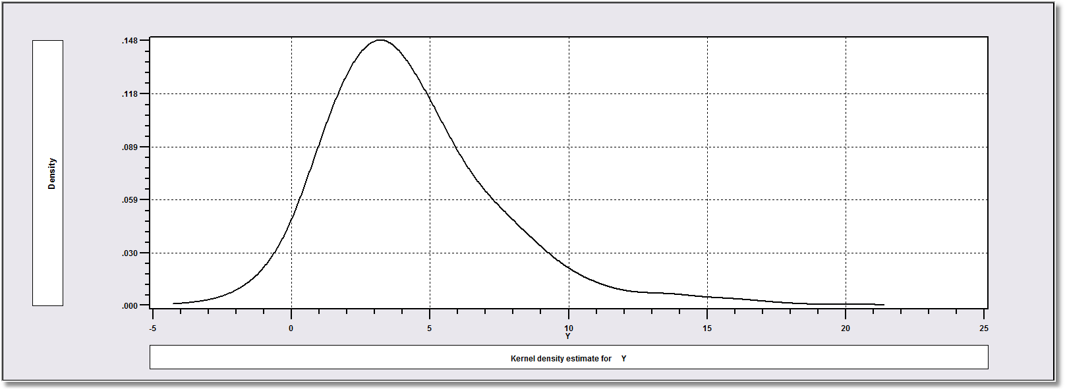
How Finite Mixture Models Work
Density? Note significant mass below zero. Not a gamma or lognormal or any other familiar density.

Slide 5
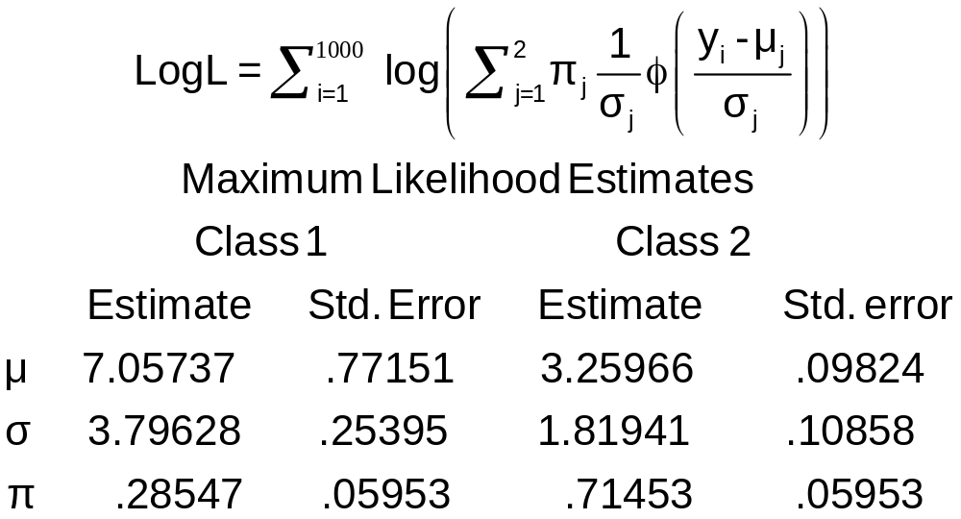
Find the ‘Best’ Fitting Mixture of Two Normal Densities

Slide 6
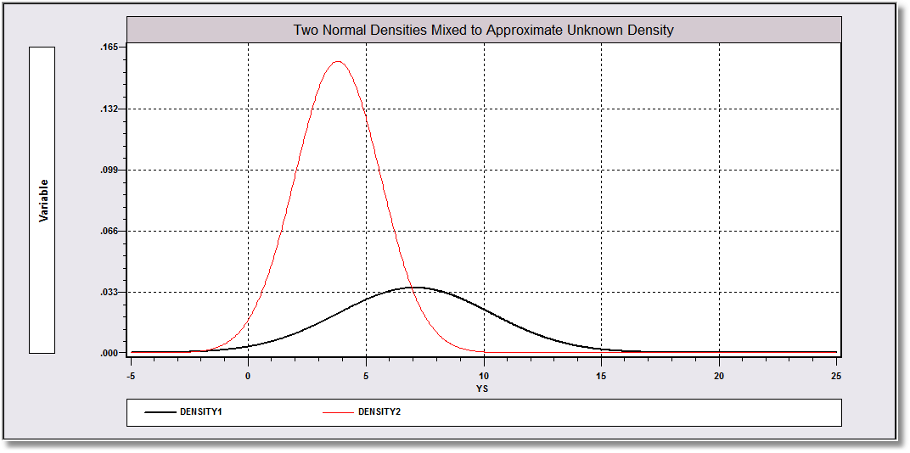
Mixing probabilities .715 and .285

Slide 7
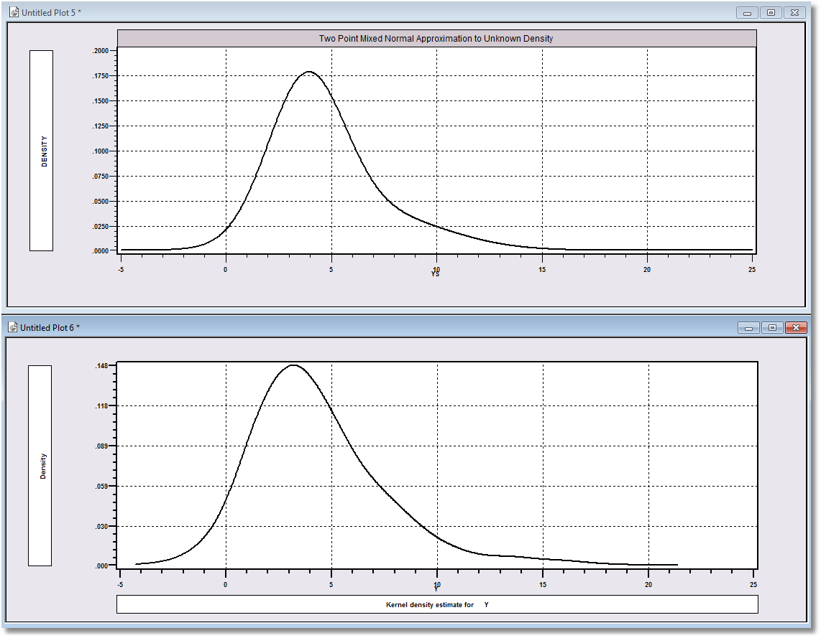
Approximation
Actual Distribution

Slide 8
A Practical Distinction
Finite Mixture (Discrete Mixture):
  Functional form strategy
  Component densities have no meaning
  Mixing probabilities have no meaning
  There is no question of “class membership”
  The number of classes is uninteresting – enough to get a good fit
Latent Class:
  Mixture of subpopulations
  Component densities are believed to be definable “groups”
  (Low Users and High Users in Bago d’Uva and Jones application)
  The classification problem is interesting – who is in which class?
  Posterior probabilities, P(class|y,x) have meaning
  Question of the number of classes has content in the context of the analysis

Slide 9
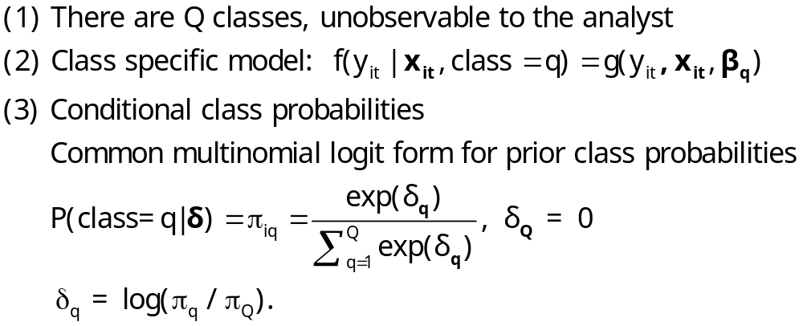
The Latent Class Model

Slide 10
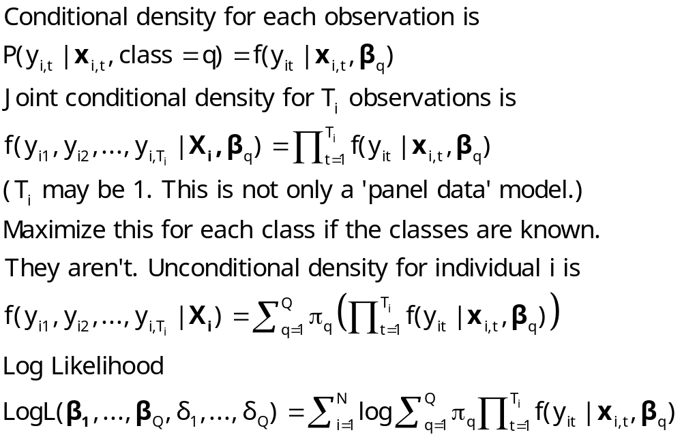
Log Likelihood for an LC Model

Slide 11
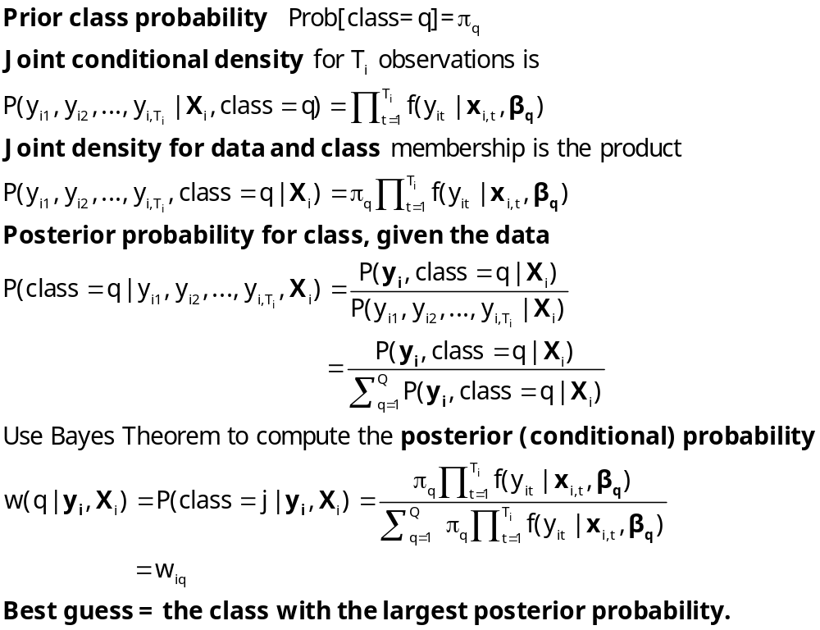
Estimating Which Class

Slide 12
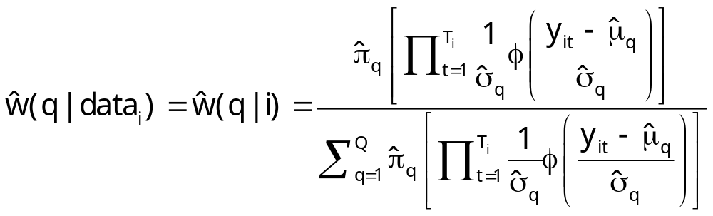
Posterior for Normal Mixture

Slide 13
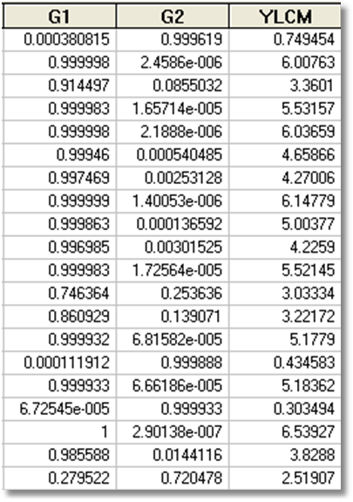
Estimated Posterior Probabilities

Slide 14
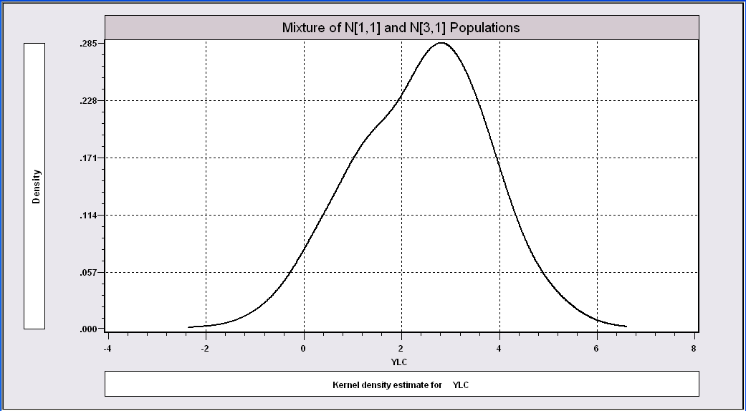
More Difficult When the
Populations are Close Together

Slide 15
The Technique Still Works
----------------------------------------------------------------------
Latent Class / Panel LinearRg Model
Dependent variable YLC
Sample is 1 pds and 1000 individuals
LINEAR regression model
Model fit with 2 latent classes.
--------+-------------------------------------------------------------
Variable| Coefficient Standard Error b/St.Er. P[|Z|>z] Mean of X
--------+-------------------------------------------------------------
|Model parameters for latent class 1
Constant| 2.93611*** .15813 18.568 .0000
Sigma| 1.00326*** .07370 13.613 .0000
|Model parameters for latent class 2
Constant| .90156*** .28767 3.134 .0017
Sigma| .86951*** .10808 8.045 .0000
|Estimated prior probabilities for class membership
Class1Pr| .73447*** .09076 8.092 .0000
Class2Pr| .26553*** .09076 2.926 .0034
--------+-------------------------------------------------------------

Slide 16
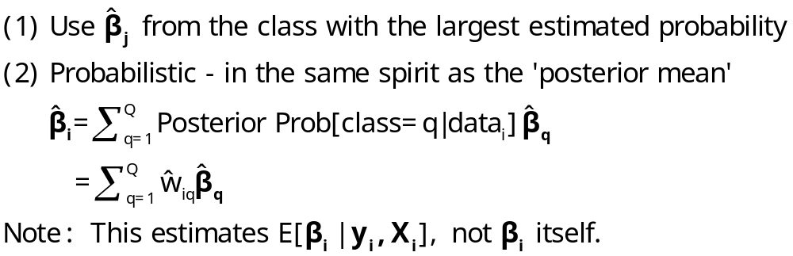
‘Estimating’ β_{i}

Slide 17
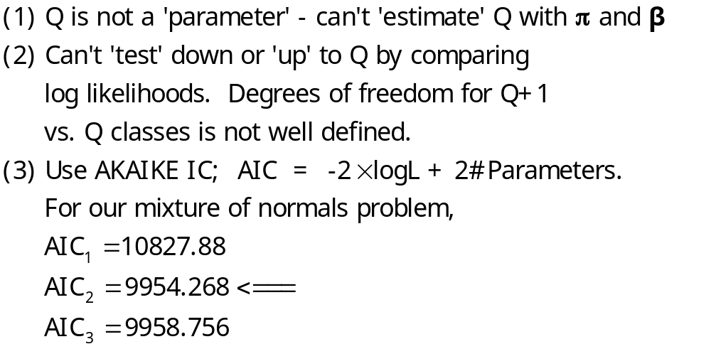
How Many Classes?

Slide 18
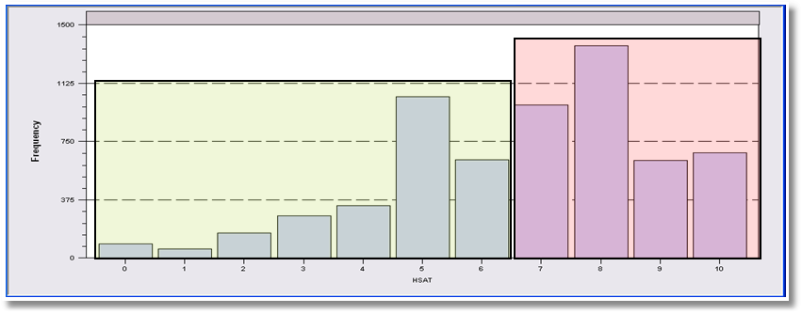
LCM for Health Status
Self Assessed Health Status = 0,1,…,10
Recoded: Healthy = HSAT > 6
Using only groups observed T=7 times; N=887
Prob = Φ(Age,Educ,Income,Married,Kids)
2, 3 classes

Slide 19
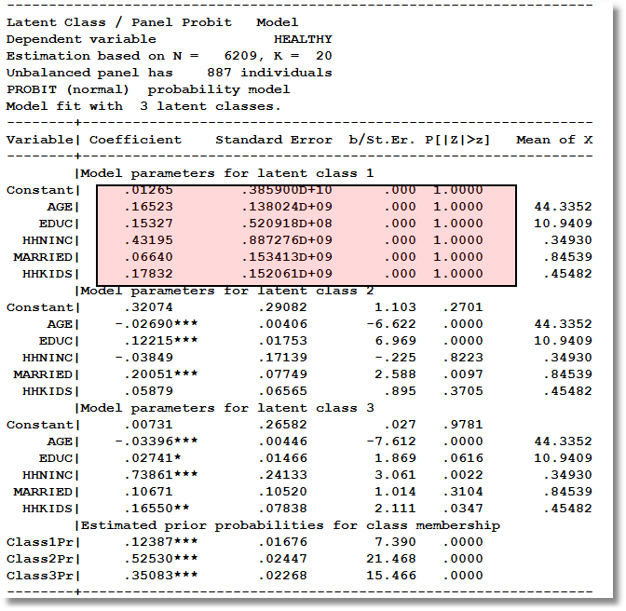
Too Many Classes

Slide 20
Two Class Model
----------------------------------------------------------------------
Latent Class / Panel Probit Model
Dependent variable HEALTHY
Unbalanced panel has 887 individuals
PROBIT (normal) probability model
Model fit with 2 latent classes.
--------+-------------------------------------------------------------
Variable| Coefficient Standard Error b/St.Er. P[|Z|>z] Mean of X
--------+-------------------------------------------------------------
|Model parameters for latent class 1
Constant| .61652** .28620 2.154 .0312
AGE| -.02466*** .00401 -6.143 .0000 44.3352
EDUC| .11759*** .01852 6.351 .0000 10.9409
HHNINC| .10713 .20447 .524 .6003 .34930
MARRIED| .11705 .09574 1.223 .2215 .84539
HHKIDS| .04421 .07017 .630 .5287 .45482
|Model parameters for latent class 2
Constant| .18988 .31890 .595 .5516
AGE| -.03120*** .00464 -6.719 .0000 44.3352
EDUC| .02122 .01934 1.097 .2726 10.9409
HHNINC| .61039*** .19688 3.100 .0019 .34930
MARRIED| .06201 .10035 .618 .5367 .84539
HHKIDS| .19465** .07936 2.453 .0142 .45482
|Estimated prior probabilities for class membership
Class1Pr| .56604*** .02487 22.763 .0000
Class2Pr| .43396*** .02487 17.452 .0000

Slide 21
Partial Effects in LC Model
----------------------------------------------------------------------
Partial derivatives of expected val. with
respect to the vector of characteristics.
They are computed at the means of the Xs.
Conditional Mean at Sample Point .6116
Scale Factor for Marginal Effects .3832
B for latent class model is a wghted avrg.
--------+-------------------------------------------------------------
Variable| Coefficient Standard Error b/St.Er. P[|Z|>z] Elasticity
--------+-------------------------------------------------------------
|Two class latent class model
AGE| -.01054*** .00134 -7.860 .0000 -.76377
EDUC| .02904*** .00589 4.932 .0000 .51939
HHNINC| .12475** .05598 2.228 .0259 .07124
MARRIED| .03570 .02991 1.194 .2326 .04934
HHKIDS| .04196** .02075 2.022 .0432 .03120
--------+-------------------------------------------------------------
|Pooled Probit Model
AGE| -.00846*** .00081 -10.429 .0000 -.63399
EDUC| .03219*** .00336 9.594 .0000 .59568
HHNINC| .16699*** .04253 3.927 .0001 .09865
|Marginal effect for dummy variable is P|1 - P|0.
MARRIED| .02414 .01877 1.286 .1986 .03451
|Marginal effect for dummy variable is P|1 - P|0.
HHKIDS| .06754*** .01483 4.555 .0000 .05195
--------+-------------------------------------------------------------

Slide 22
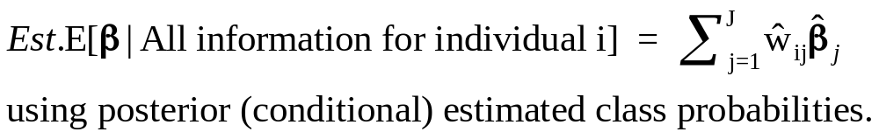
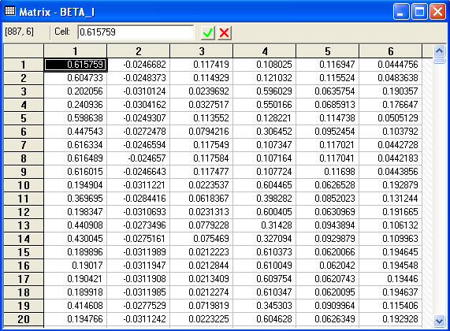
Conditional Means of Parameters

Slide 23
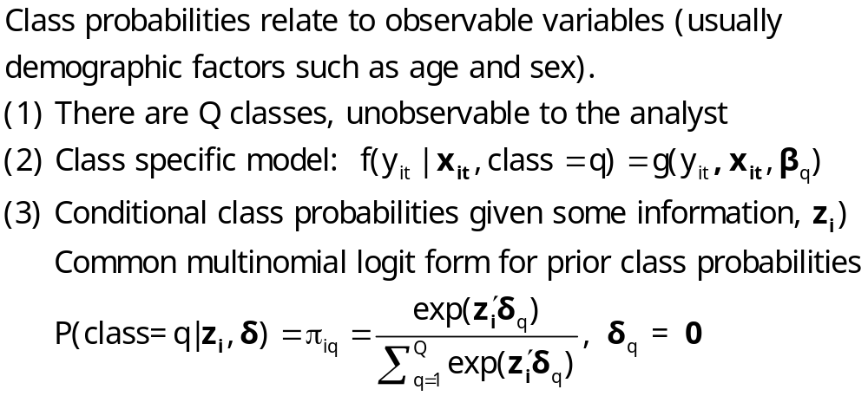
An Extended Latent Class Model
Notes:
23

Slide 24

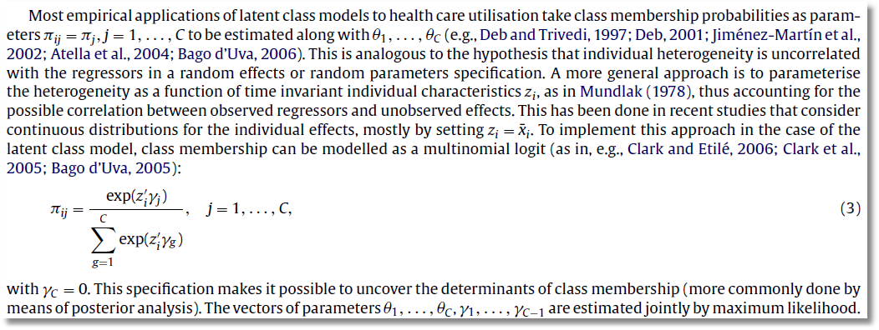

Slide 25
Health Satisfaction Model
----------------------------------------------------------------------
Latent Class / Panel Probit Model Used mean AGE and FEMALE
Dependent variable HEALTHY in class probability model
Log likelihood function -3465.98697
--------+-------------------------------------------------------------
Variable| Coefficient Standard Error b/St.Er. P[|Z|>z] Mean of X
--------+-------------------------------------------------------------
|Model parameters for latent class 1
Constant| .60050** .29187 2.057 .0396
AGE| -.02002*** .00447 -4.477 .0000 44.3352
EDUC| .10597*** .01776 5.968 .0000 10.9409
HHNINC| .06355 .20751 .306 .7594 .34930
MARRIED| .07532 .10316 .730 .4653 .84539
HHKIDS| .02632 .07082 .372 .7102 .45482
|Model parameters for latent class 2
Constant| .10508 .32937 .319 .7497
AGE| -.02499*** .00514 -4.860 .0000 44.3352
EDUC| .00945 .01826 .518 .6046 10.9409
HHNINC| .59026*** .19137 3.084 .0020 .34930
MARRIED| -.00039 .09478 -.004 .9967 .84539
HHKIDS| .20652*** .07782 2.654 .0080 .45482
|Estimated prior probabilities for class membership
ONE_1| 1.43661*** .53679 2.676 .0074 (.56519)
AGEBAR_1| -.01897* .01140 -1.664 .0960
FEMALE_1| -.78809*** .15995 -4.927 .0000
ONE_2| .000 ......(Fixed Parameter)...... (.43481)
AGEBAR_2| .000 ......(Fixed Parameter)......
FEMALE_2| .000 ......(Fixed Parameter)......
--------+-------------------------------------------------------------

Slide 26
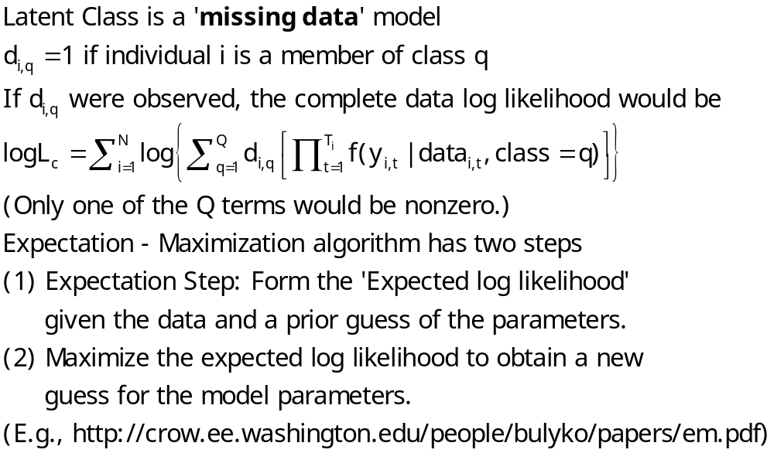
The EM Algorithm

Slide 27
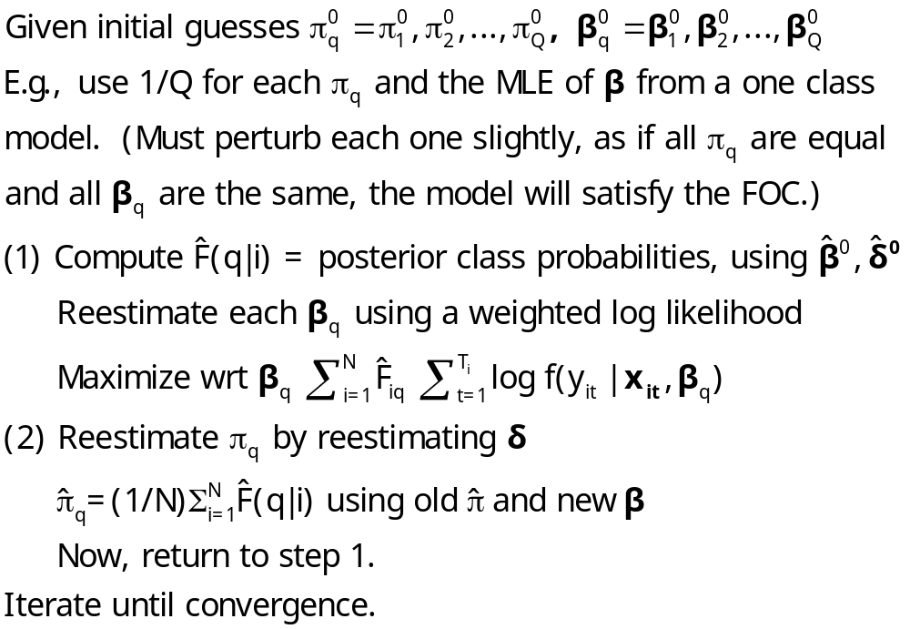
Implementing EM for LC Models

Slide 28

Zero Inflation?

Slide 29
Zero Inflation – ZIP Models
Two regimes: (Recreation site visits)
  Zero (with probability 1). (Never visit site)
  Poisson with Pr(0) = exp[- β’x_{i}]. (Number of visits, including zero visits this season.)
Unconditional:
  Pr[0] = P(regime 0) + P(regime 1)*Pr[0|regime 1]
  Pr[j | j >0] = P(regime 1)*Pr[j|regime 1]
This is a “latent class model”

Slide 30
Hurdle Models
Two decisions:
  Whether or not to participate: y=0 or +.
  If participate, how much. y|y>0
One ‘regime’ – individual always makes both decisions.
Implies different models for zeros and positive values
  Prob(0) = 1 – F(γ′z), Prob(+) = F(γ′z)
  Prob(y|+) = P(y)/[1 – P(0)]

Slide 31


Slide 32
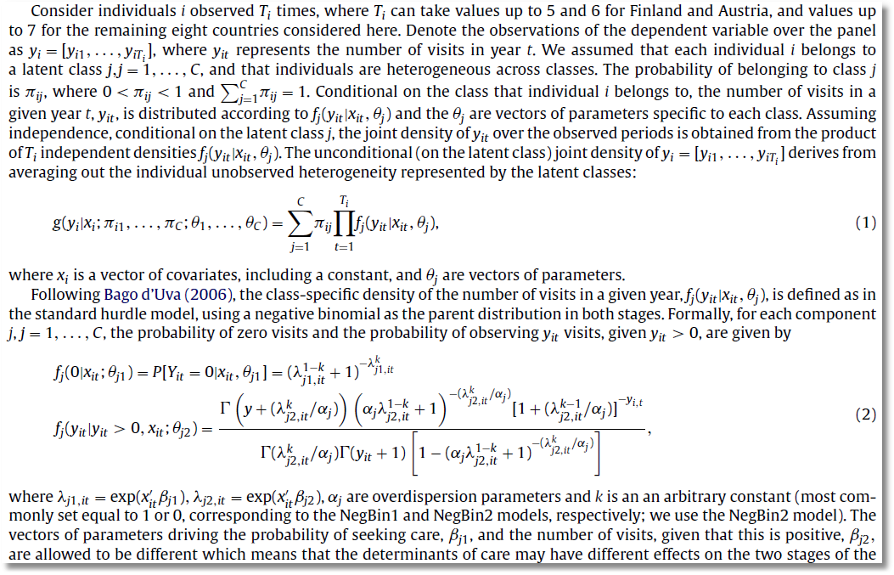

Slide 33
A Latent Class Hurdle NB2 Model
Analysis of ECHP panel data (1994-2001)
Two class Latent Class Model
  Typical in health economics applications
Hurdle model for physician visits
  Poisson hurdle for participation and negative binomial intensity given participation
  Contrast to a negative binomial model

Slide 34
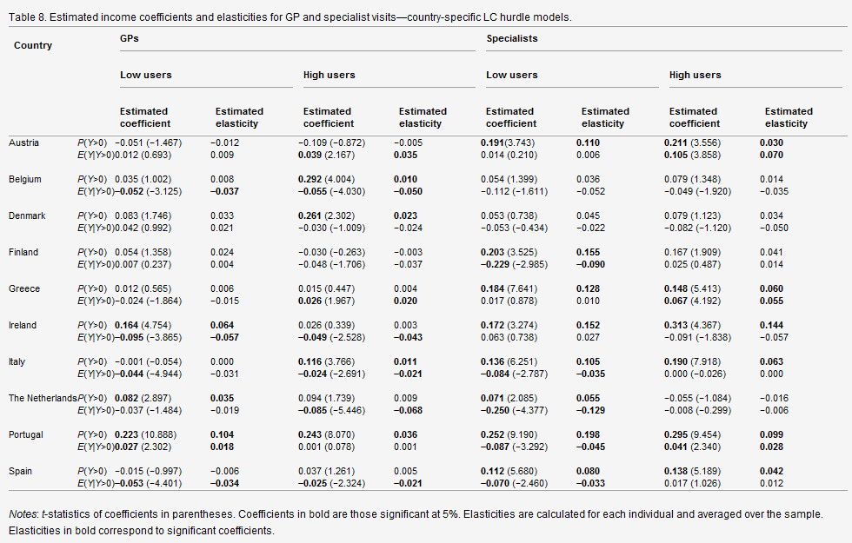

Slide 35
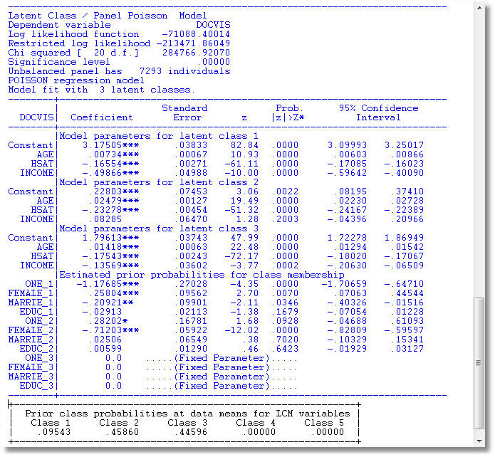
LC Poisson Regression for Doctor Visits

Slide 36
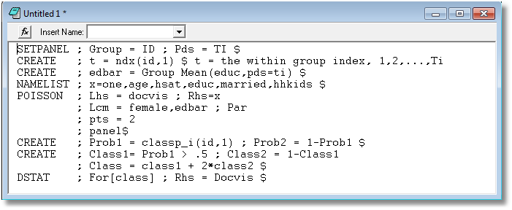
Is the LCM Finding High and Low Users?

Slide 37
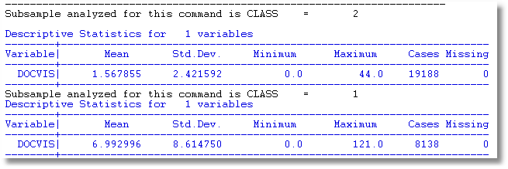
Is the LCM Finding High and Low Users? Apparently So.

Slide 38
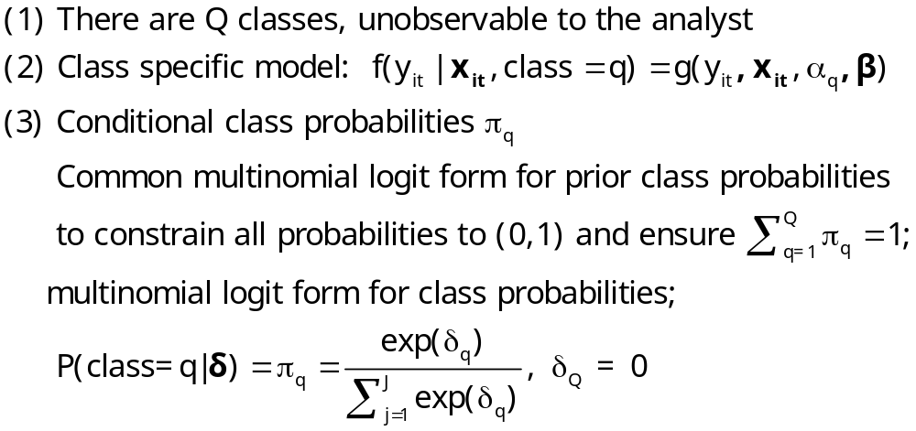
Heckman and Singer’s RE Model
Random Effects Model
Random Constants with Discrete Distribution

Slide 39
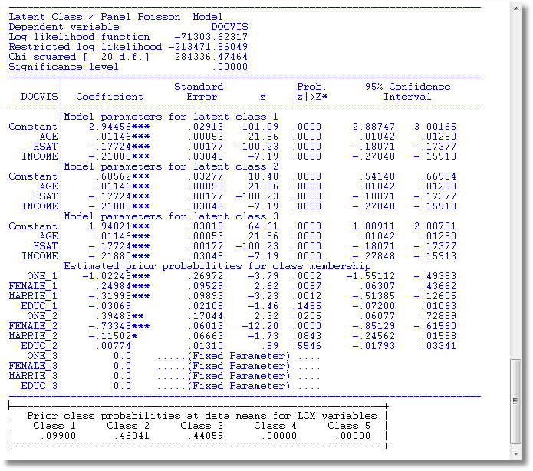
3 Class Heckman-Singer Form

Slide 40
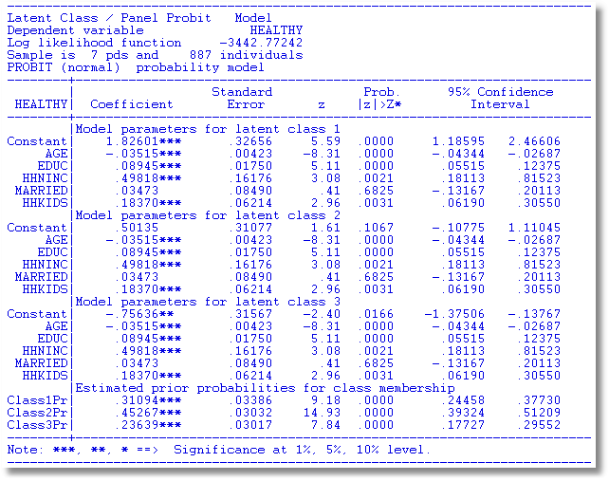
Heckman and Singer Binary
ChoiceModel – 3 Points

Slide 41
Heckman/Singer vs. REM
-----------------------------------------------------------------------------
Random Effects Binary Probit Model
Sample is 7 pds and 887 individuals.
--------+--------------------------------------------------------------------
| Standard Prob. 95% Confidence
HEALTHY| Coefficient Error z |z|>Z* Interval
--------+--------------------------------------------------------------------
Constant| .33609 .29252 1.15 .2506 -.23723 .90941
(Other coefficients omitted)
Rho| .52565*** .02025 25.96 .0000 .48596 .56534
--------+--------------------------------------------------------------------
Rho = σ²/(1+s2) so σ² = rho/(1-rho) = 1.10814.
Mean = .33609, Variance = 1.10814
For Heckman and Singer model,
3 points a1,a2,a3 = 1.82601, .50135, -.75636
3 probabilities p1,p2,p3 = .31094, .45267, .23639
Mean = .61593 variance = .90642

Slide 42
Modeling Obesity with a
Latent Class Model
Mark Harris
Department of Economics, Curtin University
Bruce Hollingsworth
Department of Economics, Lancaster University
William Greene
Stern School of Business, New York University
Pushkar Maitra
Department of Economics, Monash University

Slide 43
Two Latent Classes: Approximately Half of European Individuals

Slide 44
An Ordered Probit Approach
A Latent Regression Model for “True BMI”
BMI* = β′x + ε, ε ~ N[0,σ²], σ² = 1
“True BMI” = a proxy for weight is unobserved
Observation Mechanism for Weight Type
WT = 0 if BMI* < 0 Normal
1 if 0 < BMI* < μ Overweight
2 if μ < BMI* Obese

Slide 45
Latent Class Modeling
Several ‘types’ or ‘classes. Obesity be due to genetic reasons (the FTO gene) or lifestyle factors
Distinct sets of individuals may have differing reactions to various policy tools and/or characteristics
The observer does not know from the data which class an individual is in.
Suggests a latent class approach for health outcomes
(Deb and Trivedi, 2002, and Bago d’Uva, 2005)

Slide 46
Latent Class Application
Two class model (considering FTO gene):
  More classes make class interpretations much more difficult
  Parametric models proliferate parameters
Two classes allow us to correlate the unobservables driving class membership and observed weight outcomes.
Theory for more than two classes not yet developed.

Slide 47
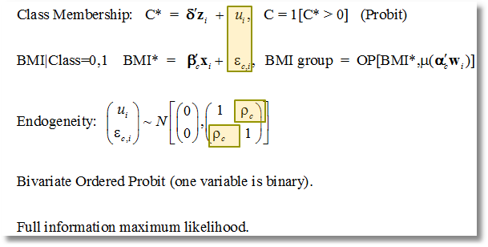
Correlation of Unobservables in Class Membership and BMI Equations

Slide 48
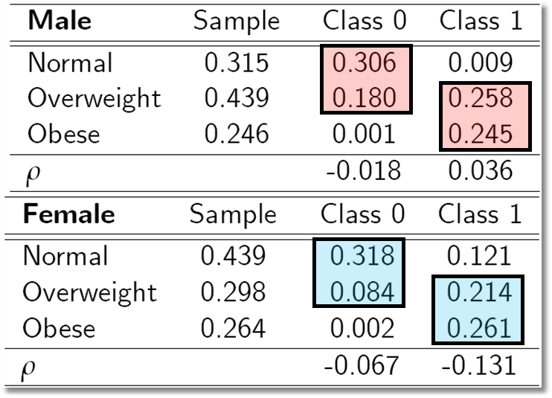
Outcome Probabilities
Class 0 dominated by normal and overweight probabilities ‘normal weight’ class
Class 1 dominated by probabilities at top end of the scale ‘non-normal weight’
Unobservables for weight class membership, negatively correlated with those determining weight levels:

Slide 49
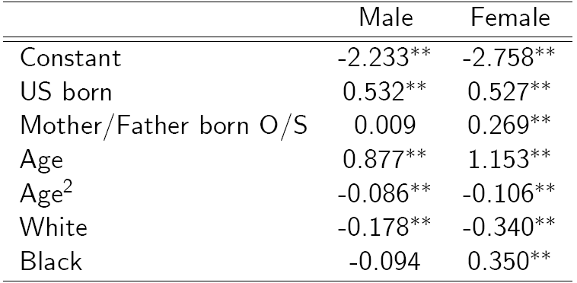
Classification (Latent Probit) Model

Slide 50
Inflated Responses in Self-Assessed Health
Mark Harris
Department of Economics, Curtin University
Bruce Hollingsworth
Department of Economics, Lancaster University
William Greene
Stern School of Business, New York University

Slide 51
SAH vs. Objective Health Measures
Favorable SAH categories seem artificially high.
• 60% of Australians are either overweight or obese (Dunstan et. al, 2001)
• 1 in 4 Australians has either diabetes or a condition of impaired glucose metabolism
• Over 50% of the population has elevated cholesterol
• Over 50% has at least 1 of the “deadly quartet” of health conditions
(diabetes, obesity, high blood pressure, high cholestrol)
• Nearly 4 out of 5 Australians have 1 or more long term health conditions
(National Health Survey, Australian Bureau of Statistics 2006)
• Australia ranked #1 in terms of obesity rates
Similar results appear to appear for other countries

Slide 52
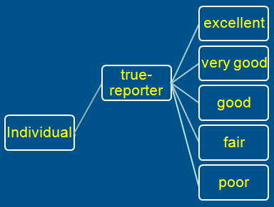
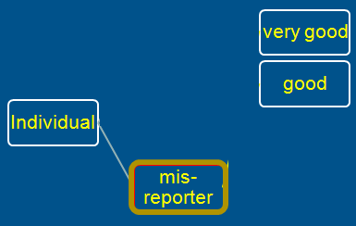
A Two Class Latent Class Model
True Reporter
Misreporter

Slide 53
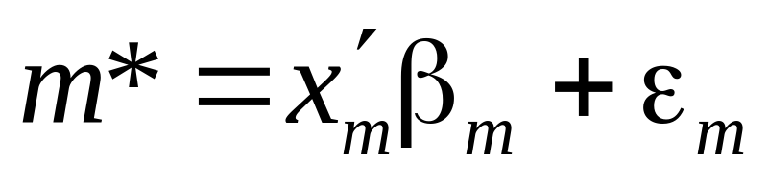
Mis-reporters choose either good or very good
The response is determined by a probit model
Y=3
Y=2

Slide 54
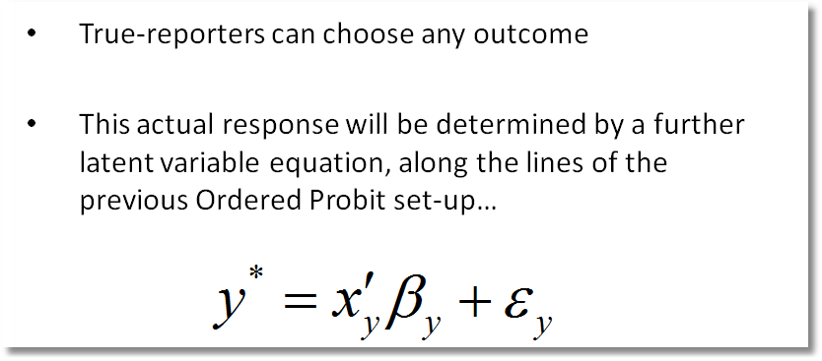
Y=4
Y=3
Y=2
Y=1
Y=0

Slide 55
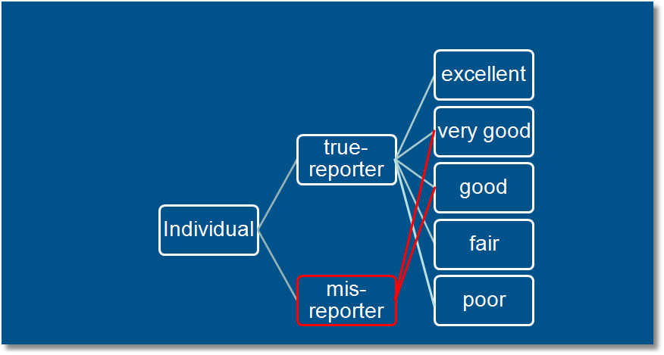
Observed Mixture of Two Classes

Slide 56
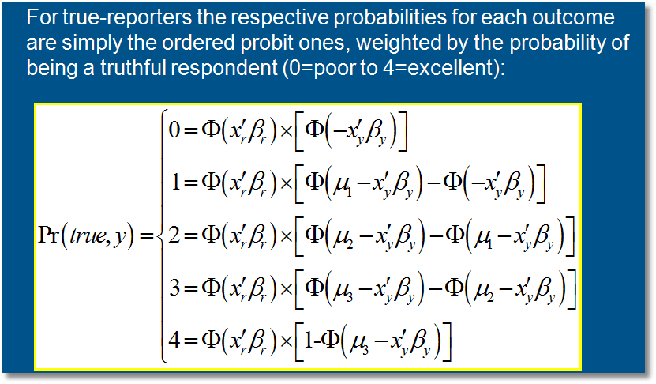
Pr(true,y) = Pr(true) * Pr(y | true)

Slide 57
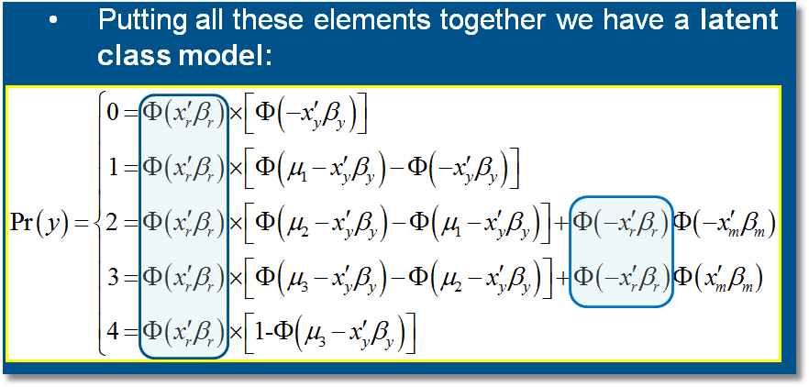

Slide 58
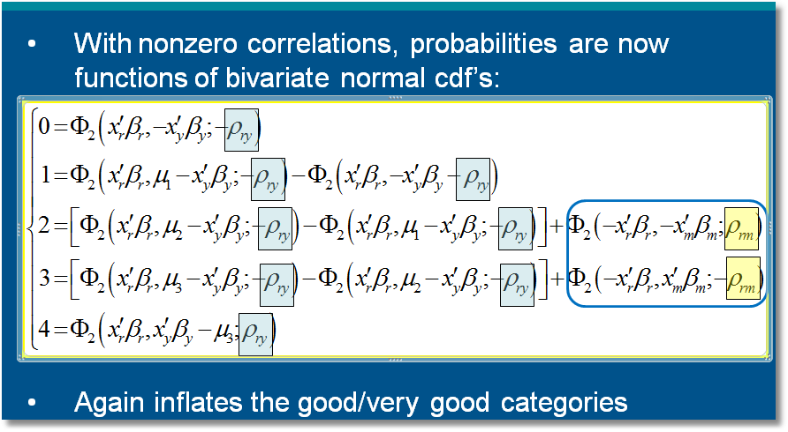

Slide 59
General Result

Slide 60


Slide 61
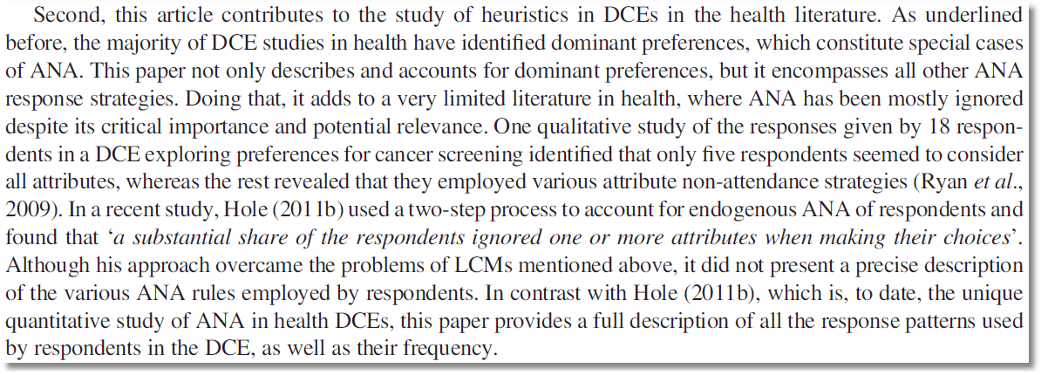
… only five respondents seemed to consider all attributes, whereas the rest revealed that they employed various attribute nonattendance strategies …

Slide 62
The 2^{K} model
Latent Class Modeling 
Applications 
The analyst believes some attributes are ignored. There is no definitive indicator.
Classes distinguished by which attributes are ignored
A latent class model applies. For K attributes there are 2^{K} candidate coefficient vectors

Slide 63
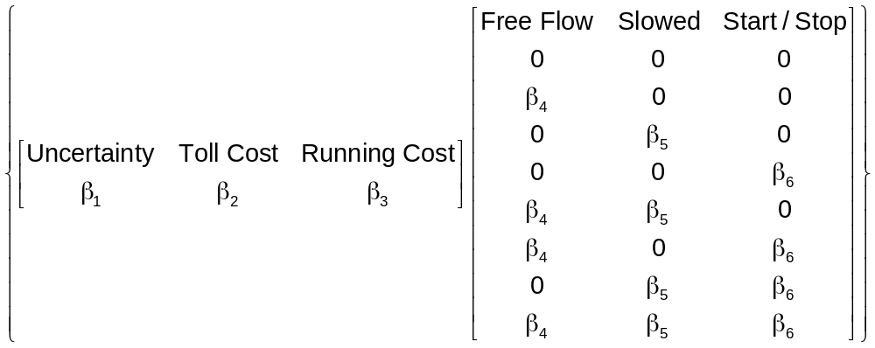
A Latent Class Model
Latent Class Modeling 
Applications 

Slide 64
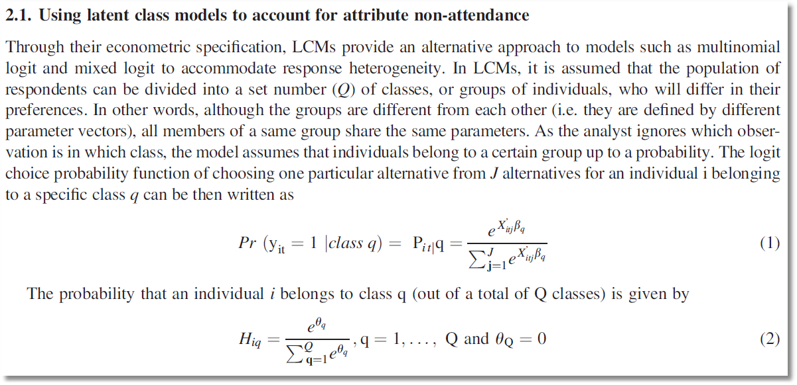

Slide 65
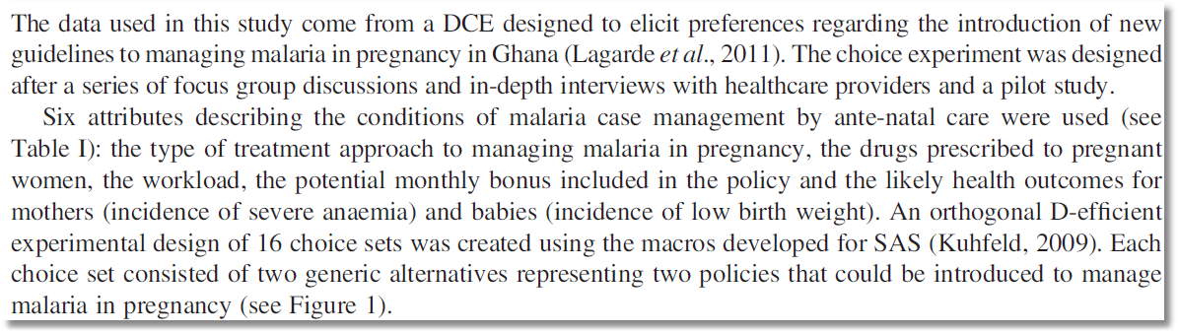
… a discrete choice experiment designed to elicit preferences regarding the introduction of new guidelines to managing malaria in pregnancy in Ghana …

Slide 66
