Slide 1


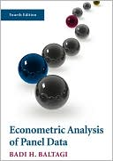

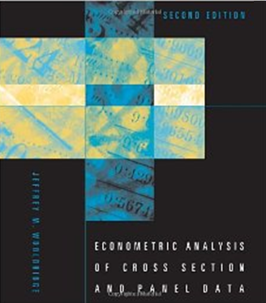

9. Heterogeneity: Mixed Models

Slide 2
RANDOM Parameter
Models

Slide 3
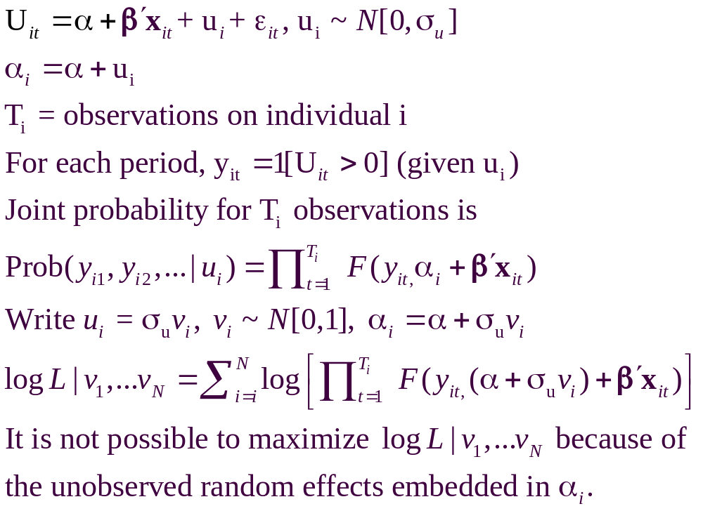
A Recast Random Effects Model

Slide 4
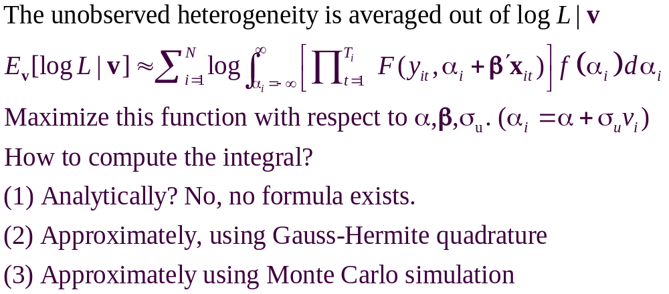
A Computable Log Likelihood

Slide 5
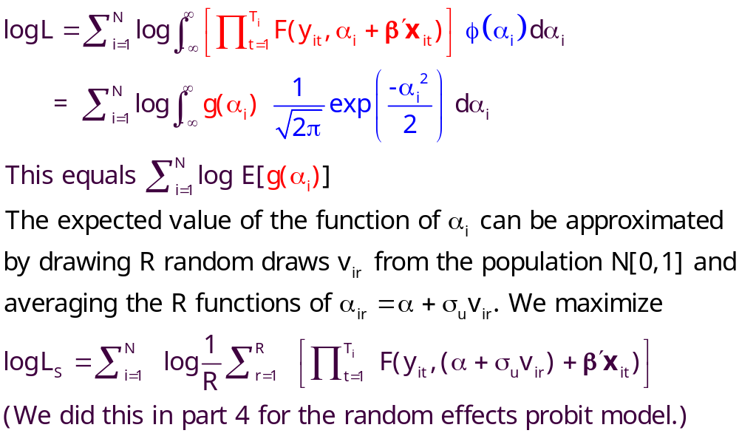
Simulation

Slide 6
Random Effects Model: Simulation
----------------------------------------------------------------------
Random Coefficients Probit Model
Dependent variable DOCTOR (Quadrature Based)
Log likelihood function -16296.68110 (-16290.72192)
Restricted log likelihood -17701.08500
Chi squared [ 1 d.f.] 2808.80780
Simulation based on 50 Halton draws
--------+-------------------------------------------------
Variable| Coefficient Standard Error b/St.Er. P[|Z|>z]
--------+-------------------------------------------------
|Nonrandom parameters
AGE| .02226*** .00081 27.365 .0000 ( .02232)
EDUC| -.03285*** .00391 -8.407 .0000 (-.03307)
HHNINC| .00673 .05105 .132 .8952 ( .00660)
|Means for random parameters
Constant| -.11873** .05950 -1.995 .0460 (-.11819)
|Scale parameters for dists. of random parameters
Constant| .90453*** .01128 80.180 .0000
--------+-------------------------------------------------------------
Implied ρ from these estimates is .90454²/(1+.90453²) = .449998.

Slide 7
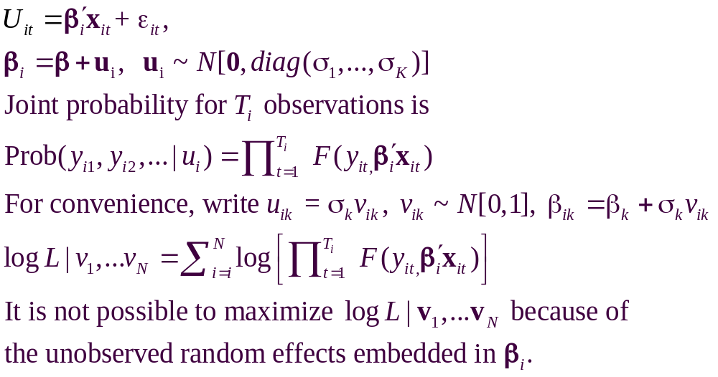
Recast the Entire Parameter Vector

Slide 8
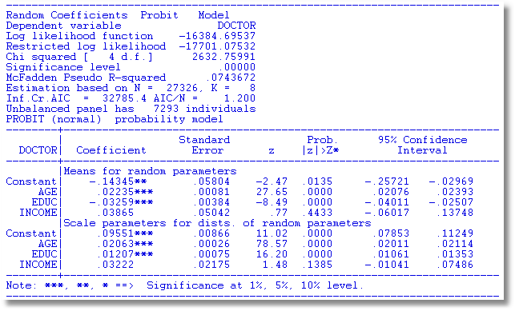
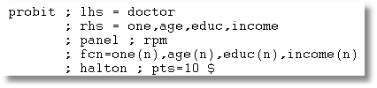

Slide 9
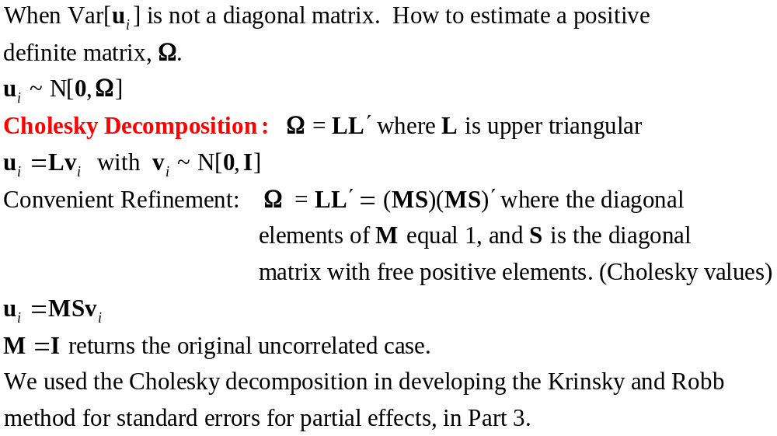

Slide 10
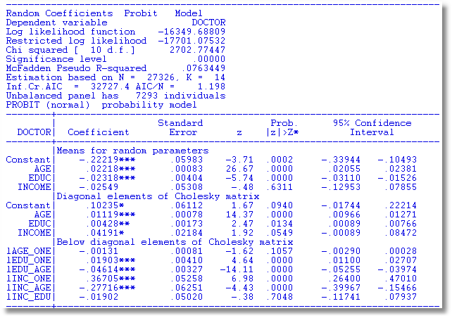
S
M

Slide 11
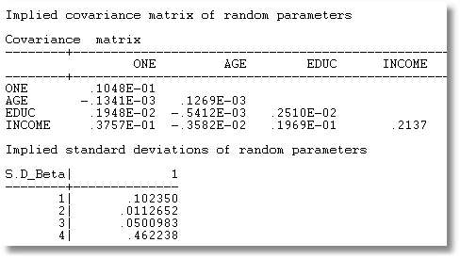
MSS′M′

Slide 12
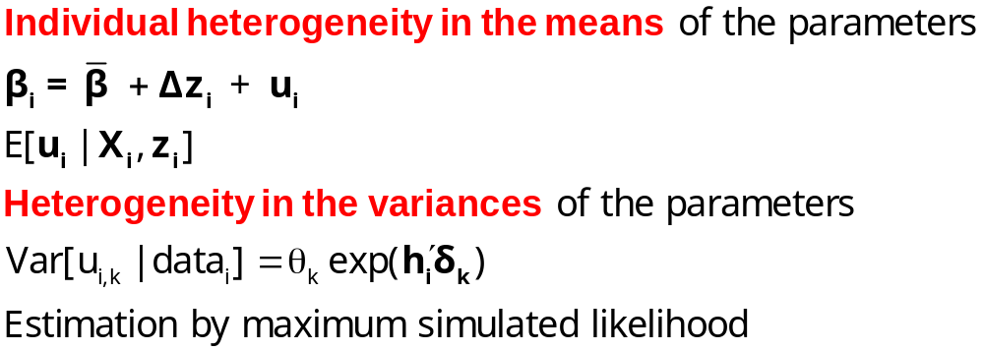
Modeling Parameter Heterogeneity

Slide 13
A Hierarchical Probit Model
U_{it} = β_{1i} + β_{2i}Age_{it} + β_{3i}Educ_{it} + β_{4i}Income_{it} + ε_{it}.
β_{1i}=β₁+Δ₁₁ Female_{i} + Δ₁₂ Married_{i} + u_{1i}
β_{2i}=β₂+Δ₂₁ Female_{i} + Δ₂₂ Married_{i} + u_{2i}
β_{3i}=β₃+Δ₃₁ Female_{i} + Δ₃₂ Married_{i} + u_{3i}
β_{4i}=β₄+Δ₄₁ Female_{i} + Δ₄₂ Married_{i} + u_{4i}
Y_{it} = 1[U_{it} > 0]
All random variables normally distributed.

Slide 14
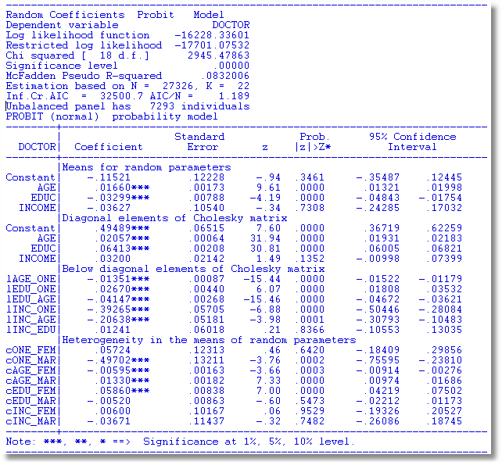

Slide 15
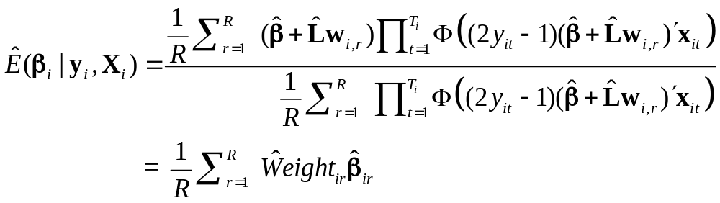
Simulating Conditional Means for Individual Parameters
Posterior estimates of E[parameters(i) | Data(i)]

Slide 16
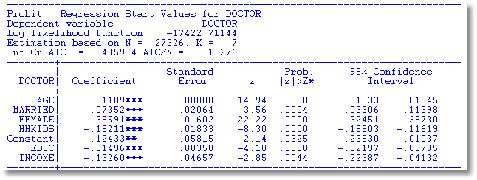
Probit

Slide 17
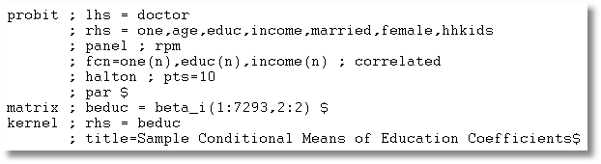

Slide 18
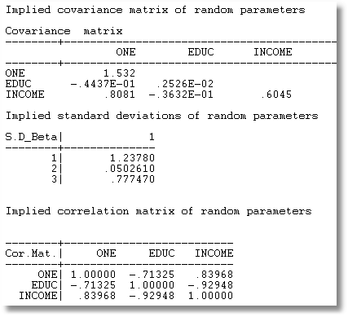
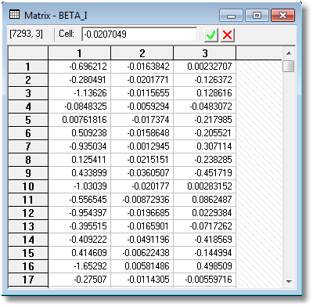

Slide 19
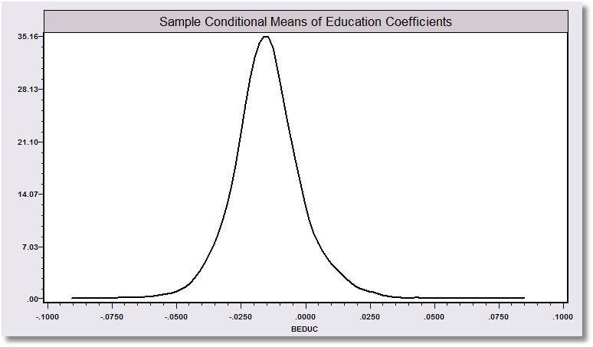
“Individual Coefficients”

Slide 20
Mixed Model Estimation
Programs differ on the models fitted, the algorithms, the paradigm, and the extensions provided to the simplest RPM, β_{i} = β+w_{i}.
WinBUGS:
  MCMC
  User specifies the model – constructs the Gibbs Sampler/Metropolis Hastings
MLWin:
  Linear and some nonlinear – logit, Poisson, etc.
  Uses MCMC for MLE (noninformative priors)
SAS: Proc Mixed.
  Classical
  Uses primarily a kind of GLS/GMM (method of moments algorithm for loglinear models)
Stata: Classical
  Several loglinear models – GLAMM. Mixing done by quadrature.
  Maximum simulated likelihood for multinomial choice (Arne Hole, user provided)
LIMDEP/NLOGIT
  Classical
  Mixing done by Monte Carlo integration – maximum simulated likelihood
  Numerous linear, nonlinear, loglinear models
Ken Train’s Gauss Code
  Monte Carlo integration
  Mixed Logit (mixed multinomial logit) model only (but free!)
Biogeme
  Multinomial choice models
  Many experimental models (developer’s hobby)

Slide 21
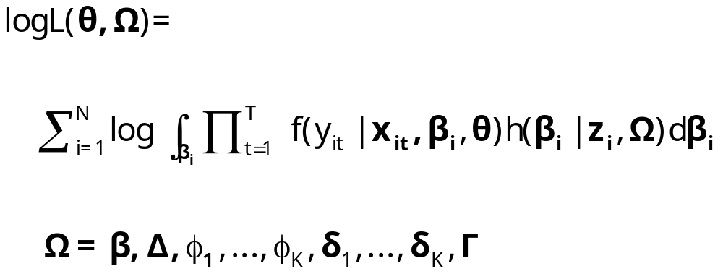
Appendix:
Maximum Simulated Likelihood

Slide 22
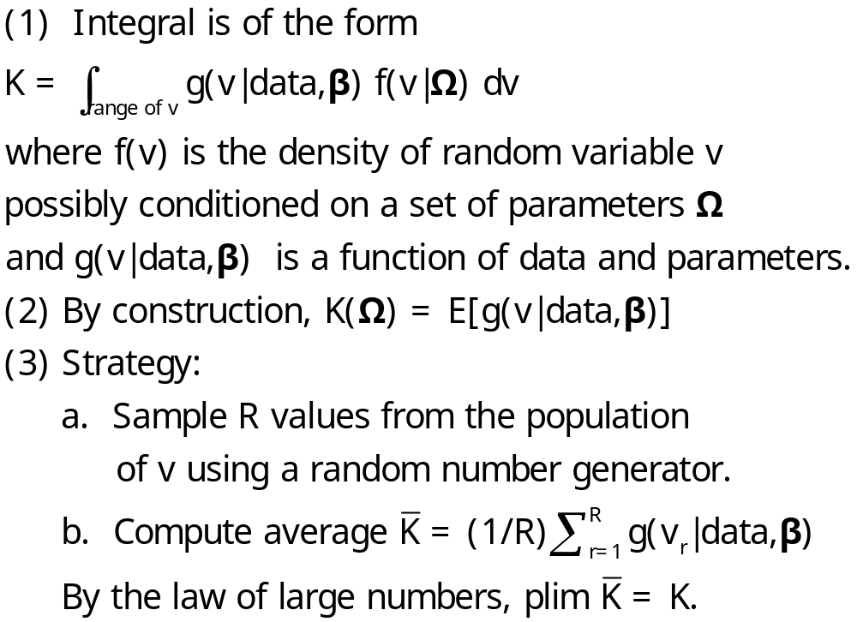
Monte Carlo Integration

Slide 23
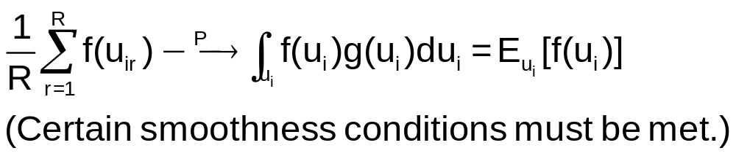
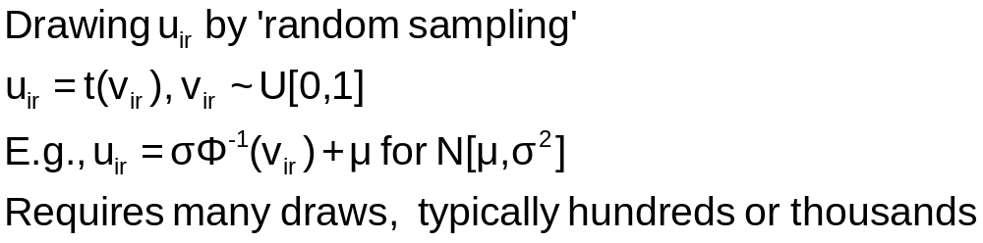
Monte Carlo Integration

Slide 24
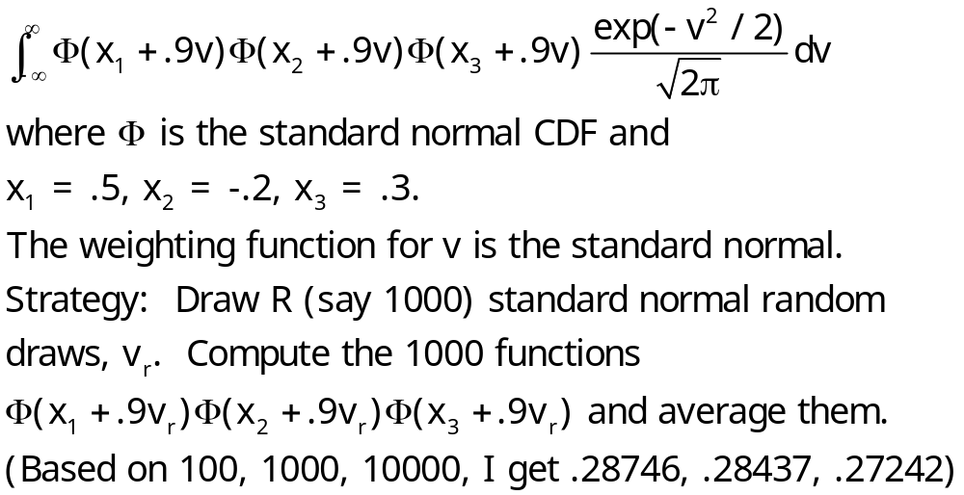
Example: Monte Carlo Integral

Slide 25
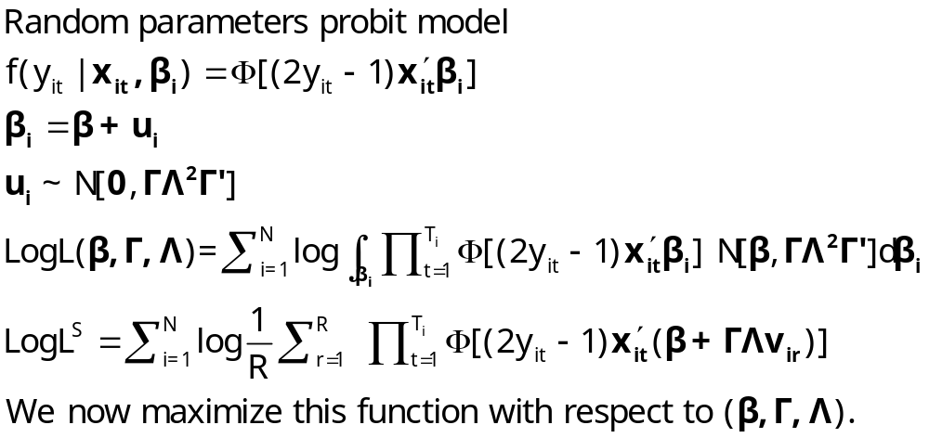
Simulated Log Likelihood for a Mixed Probit Model

Slide 26
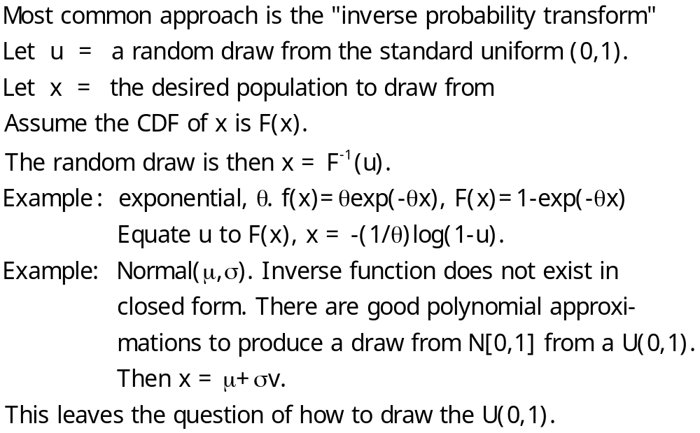
Generating a Random Draw

Slide 27
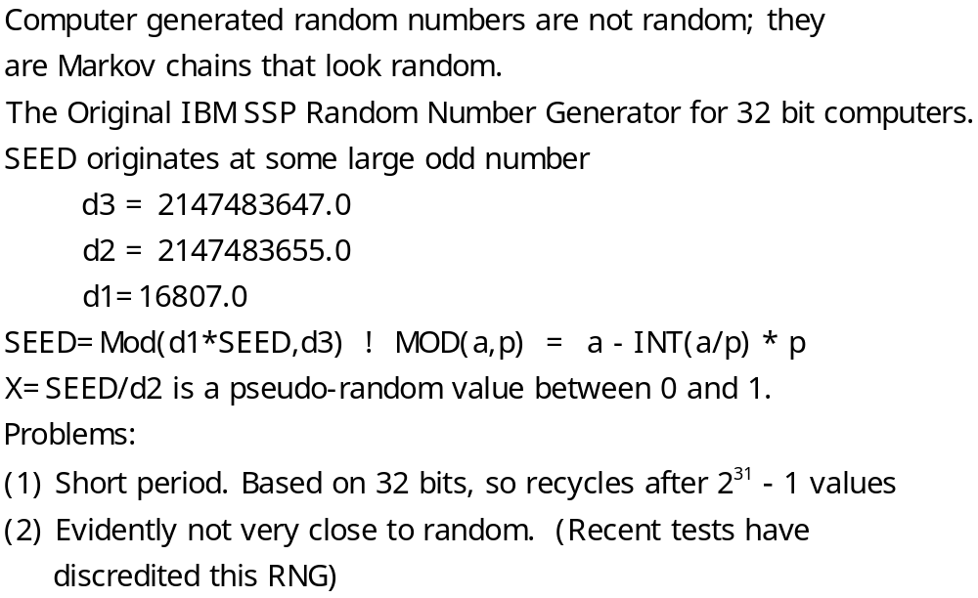
Drawing Uniform Random Numbers

Slide 28
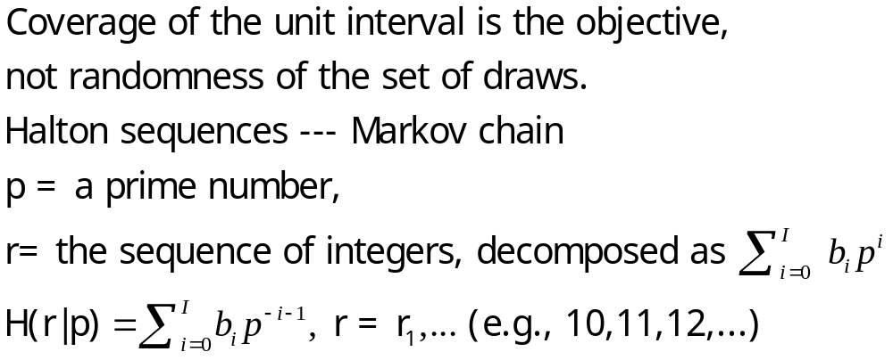
Quasi-Monte Carlo Integration Based on Halton Sequences
For example, using base p=5, the integer r=37 has b₀ = 2, b₁ = 2, and b₂ = 1; (37=1x5² + 2x5¹ + 2x5⁰). Then
H(37|5) = 2×5⁻¹ + 2×5⁻² + 1×5⁻³ = 0.448.

Slide 29
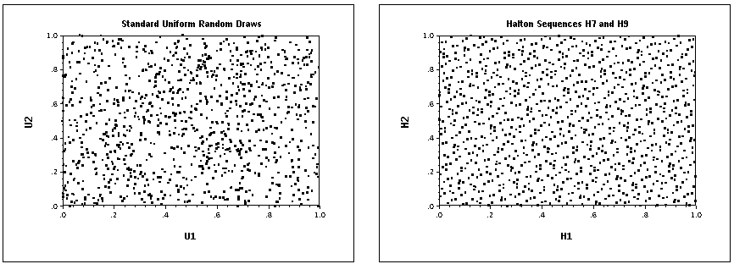
Halton Sequences vs. Random Draws
Requires far fewer draws – for one dimension, about 1/10. Accelerates estimation by a factor of 5 to 10.

