Slide 1
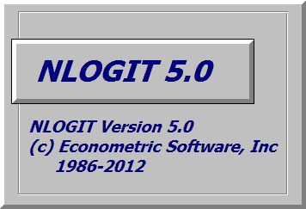
Discrete Choice Modeling
William Greene
Stern School of Business
New York University
Lab Sessions

Slide 2
Lab Session 1
Getting Started with NLOGIT

Slide 3
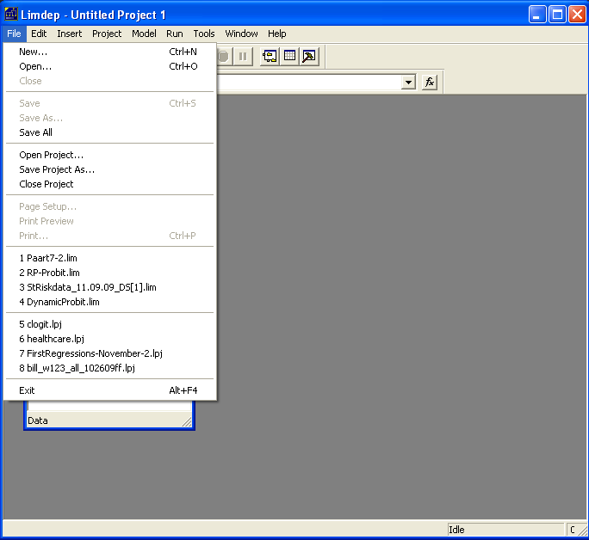

Slide 4
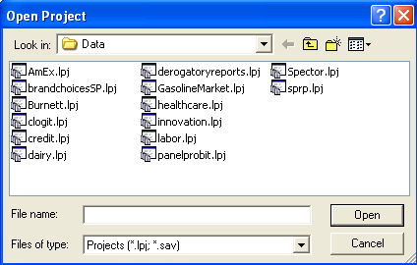
Locate file dairy.lpj
Locate file Dairy.lpj

Slide 5
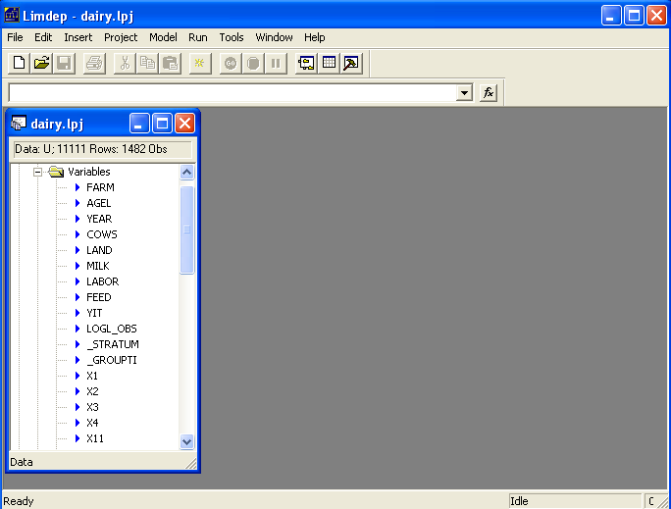
Project Window
Note: Name
Sample Size
Variables

Slide 6
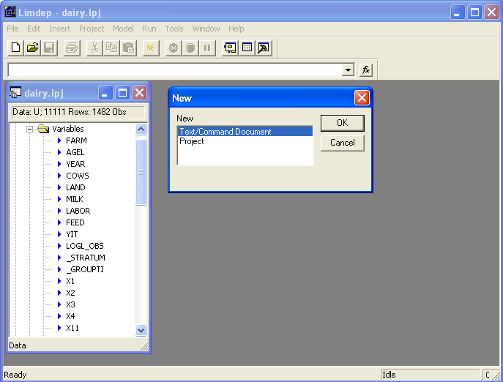
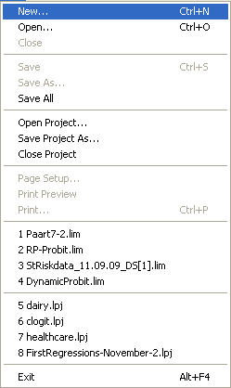
Use File:New/OK for an Editing Window

Slide 7
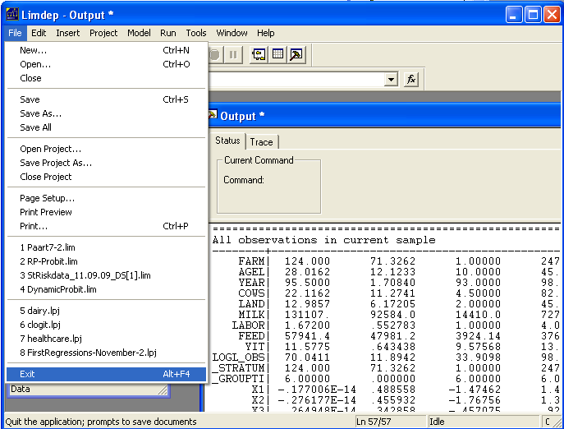
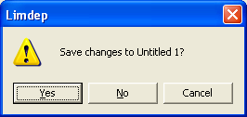
Save Your Work When You Exit

Slide 8
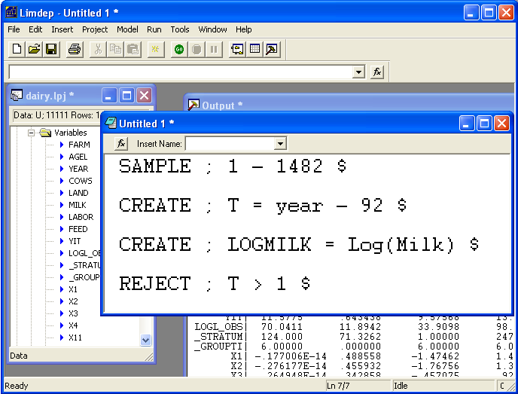
Typing Commands in the Editor

Slide 9
Important Commands:
SAMPLE ; first - last $
  Sample ; 1 – 1000 $
  Sample ; All $
CREATE ; Variable = transformation $
  Create ; LogMilk = Log(Milk) $
  Create ; LMC = .5*Log(Milk)*Log(Cows) $
  Create ; … any algebraic transformation $

Slide 10
Name Conventions
CREATE ; name = any result desired $
Name is the name of a new variable
  No more than 8 characters in a name
  The first character must be a letter
  May not contain -,+,*,/. May contain _.

Slide 11
Model Command
Model ; Lhs = dependent variable
; Rhs = list of independent variables $
  Regress ; Lhs = Milk ; Rhs = ONE,Feed,Labor,Land $
  ONE requests the constant term
Models are REGRESS, PROBIT, POISSON, LOGIT, TOBIT, … and about 100 others. All have the same form.

Slide 12
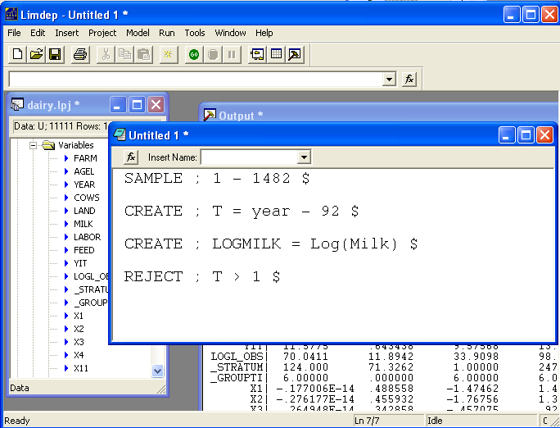
The Go Button

Slide 13
“Submitting” Commands
One Command
  Place cursor on that line
  Press “Go” button
More than one command
  Highlight all lines (like any text editor)
  Press “Go” button

Slide 14
Compute a Regression
Sample ; All $
Regress ; Lhs = YIT
; Rhs = One,X1,X2,X3,X4 $
The constant term in the model

Slide 15
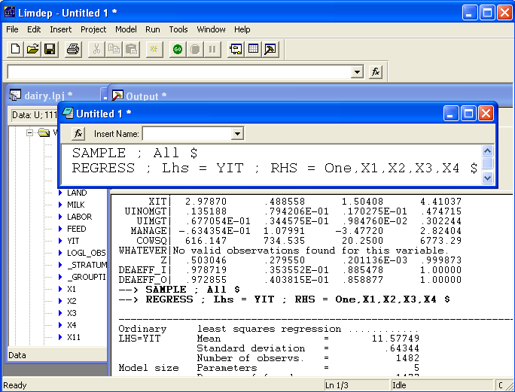

Slide 16
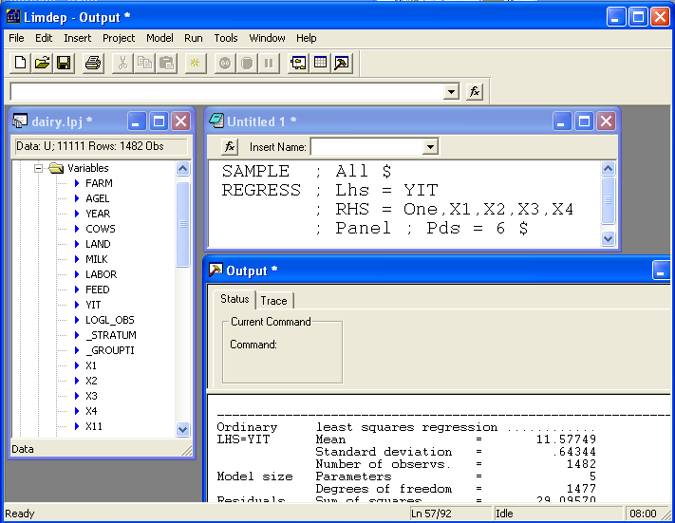
Standard Three Window Operation
Commands typed in editing window
Project window shows variables
Results appear in output window

Slide 17
Model Results
Sample ; All $
Regress ; Lhs = YIT
; Rhs =One,X1,X2,X3,X4
; Res = e ? (Regression with residuals saved)
; Plot Residuals
Produces results: Displayed results in output
Displayed plot in its own window
Variables added to data set
Matrices
Named Scalars

Slide 18
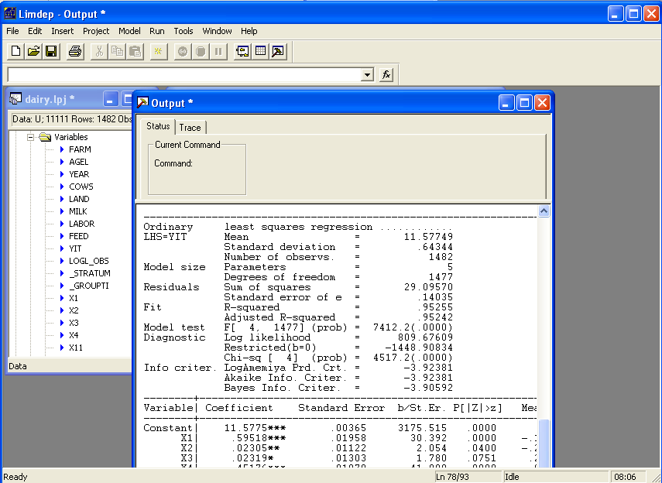
Output Window

Slide 19
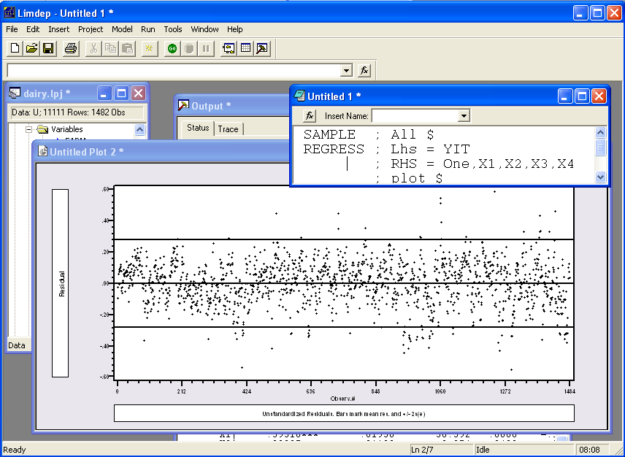
Residual Plot

Slide 20
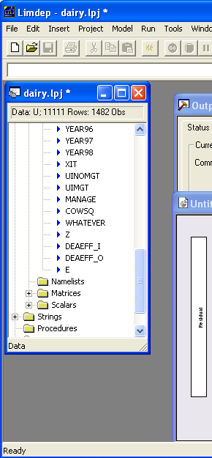
New Variable
Regress;Lhs=Yit;Rhs=One,x1,x2,x3,x4
; Res = e ; Plot Residuals $
? We can now manipulate the new
? variable created by the regression.
Namelist ; z = Year94,Year95,Year96,
Year97,Year98$
Create;esq = e*e / (sumsqdev/nreg) – 1 $
Regress; Lhs = esq ; Rhs=One,z $
Calc ; List ; LMTstHet = nreg*Rsqrd $

Slide 21
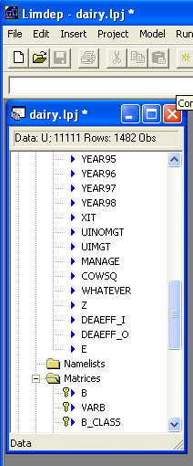
Saved Matrices
B=estimated coefficients and VARB=estimated asymptotic covariance matrix are saved by every model command. Different model estimators save other results as well. Here, we manipulate B and VARB to compute a restricted least squares estimator the hard way.
REGRESS ; Lhs = Yit ; Rhs=One,x1,x2,x3,x4 $
NAMELIST ; X = One,x1,x2,x3,x4 $
MATRIX ; R = [0,1,1,1,1] ; q = [1] ; XXI = <X’X>
; m = R*B – q ; C=R*XXI*R’
; bstar = B - XXI*R’*<C>*m
; Vbstar=VARB – ssqrd*XXI*R’*<C>*R*XXI $

Slide 22
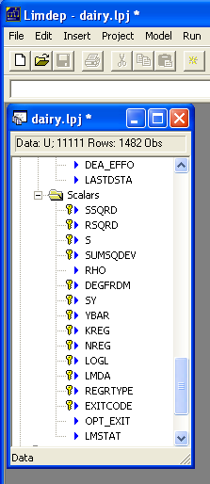
Saved Scalars
Model estimates include named scalars. Linear regressions save numerous scalars. Others usually save 3 or 4, such as LOGL, and others.
The program on the previous page used SSQRD saved by the regression. The LM test two pages back used NREG (the number of observations used) and RSQRD (the R² in the most recent regression).

Slide 23
Model Commands
Generic form:
Model name ; Lhs = dependent variable
; Rhs = independent variables $
Rhs should generally include ONE to request a constant term.

Slide 24
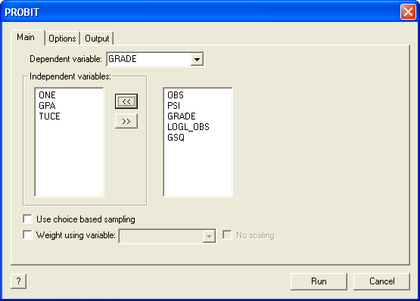
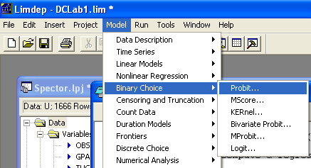
Probit Model Command
Load Spector.lpj
Text Editor
Probit ; Lhs = Grade
; Rhs = one,gpa,tuce,psi $
Command builder

Slide 25
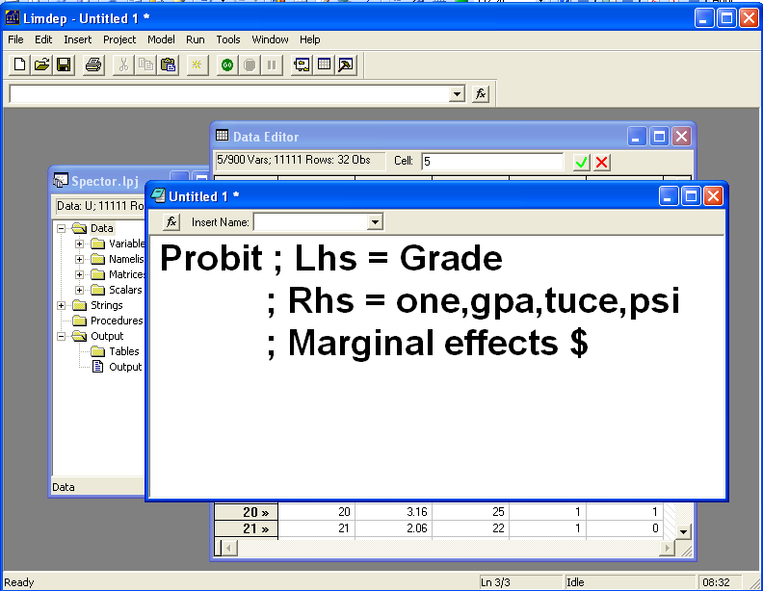
Model Command

