Slide 1

Discrete Choice Modeling
William Greene
Stern School of Business
New York University
Lab Sessions

Slide 2
Lab Session 8
Discrete Choice, Multinomial Logit Model

Slide 3
Observed Data
Types of Data
  Individual choice
  Market shares
  Frequencies
  Ranks
Attributes and Characteristics
Choice Settings
  Cross section
  Repeated measurement (panel data)

Slide 4
Data for Multinomial Choice
Line MODE TRAVEL INVC INVT TTME GC HINC
1 AIR .00000 59.000 100.00 69.000 70.000 35.000
2 TRAIN .00000 31.000 372.00 34.000 71.000 35.000
3 BUS .00000 25.000 417.00 35.000 70.000 35.000
4 CAR 1.0000 10.000 180.00 .00000 30.000 35.000
5 AIR .00000 58.000 68.000 64.000 68.000 30.000
6 TRAIN .00000 31.000 354.00 44.000 84.000 30.000
7 BUS .00000 25.000 399.00 53.000 85.000 30.000
8 CAR 1.0000 11.000 255.00 .00000 50.000 30.000
321 AIR .00000 127.00 193.00 69.000 148.00 60.000
322 TRAIN .00000 109.00 888.00 34.000 205.00 60.000
323 BUS 1.0000 52.000 1025.0 60.000 163.00 60.000
324 CAR .00000 50.000 892.00 .00000 147.00 60.000
325 AIR .00000 44.000 100.00 64.000 59.000 70.000
326 TRAIN .00000 25.000 351.00 44.000 78.000 70.000
327 BUS .00000 20.000 361.00 53.000 75.000 70.000
328 CAR 1.0000 5.0000 180.00 .00000 32.000 70.000

Slide 5
Using NLOGIT To Fit the Model
Start program
Load CLOGIT.LPJ project
Use command builder dialog box
or
Use typed commands in editor

Slide 6
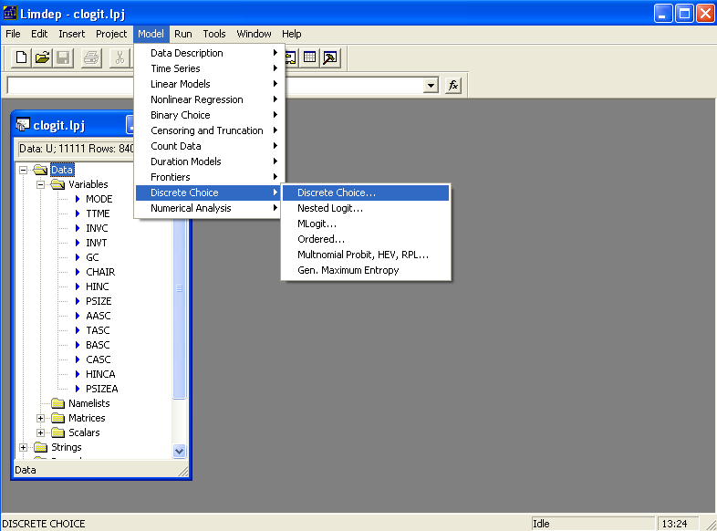

Slide 7
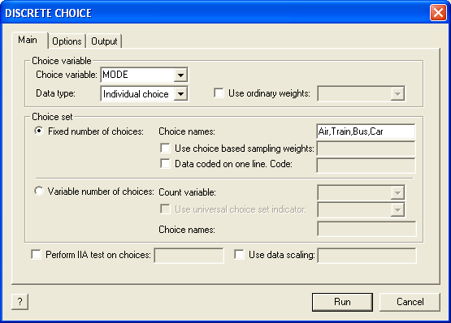
Specification of Choice Variable

Slide 8
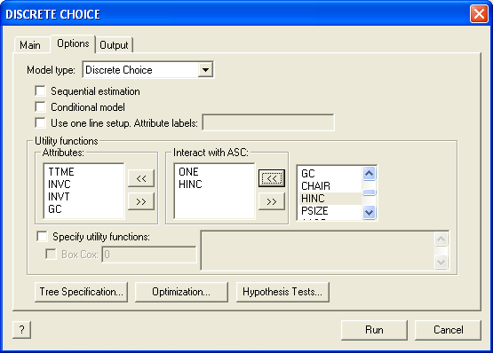
Specification of Utility Functions
Copy the variable names from the list at the right into the appropriate window at the left, then press Run

Slide 9
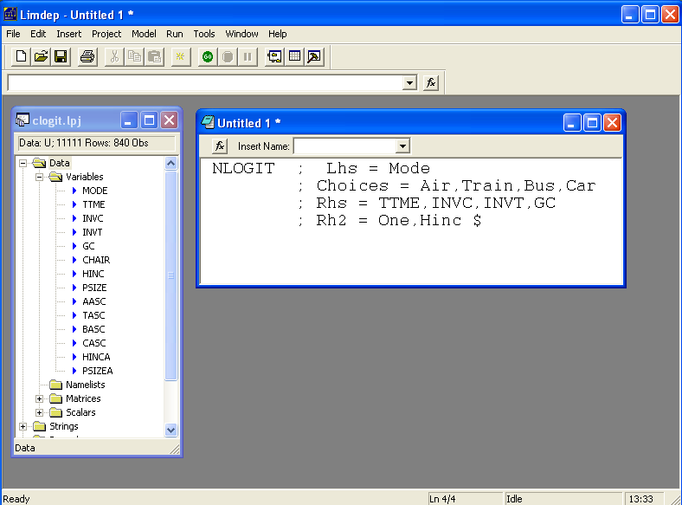
Submit Command from Editor
Type commands in editor
Highlight by dragging mouse
Press GO button

Slide 10
Command Structure
Generic
CLOGIT (or NLOGIT) ; Lhs = choice variable
; Choices = list of labels for the J choices
; RHS = list of attributes that vary by choice
; RH2 = list of attributes that do not vary by choice $
For this application
CLOGIT (or NLOGIT) ; Lhs = MODE
; Choices = Air, Train, Bus, Car
; RHS = TTME,INVC,INVT,GC
; RH2 = ONE, HINC $

Slide 11
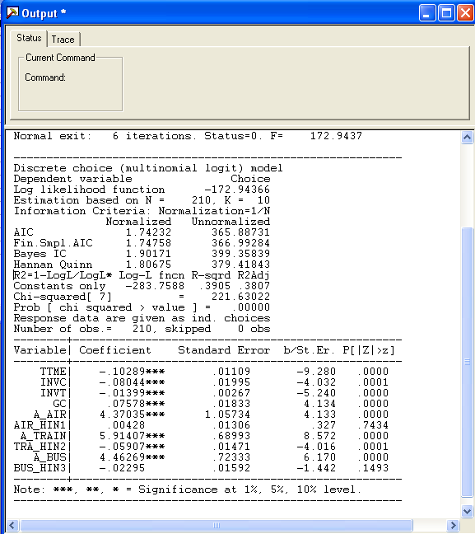
Output Window
Note: coef. on GC has the wrong sign!

Slide 12
Effects of Changes in Attributes on Probabilities
Partial Effects: Effect of a change in attribute “k” of alternative “m” on the probability that choice “j” will be made is
Proportional changes: Elasticities
Note the elasticity is the same for all choices “j.” (IIA)

Slide 13
Elasticities for CLOGIT
Request: ;Effects: attribute (choices where changes )
; Effects: INVT(*) (INVT changes in all choices)
+---------------------------------------------------+
| Elasticity averaged over observations.|
| Attribute is INVT in choice AIR |
| Effects on probabilities of all choices in model: |
| * = Direct Elasticity effect of the attribute. |
| Mean St.Dev |
| * Choice=AIR -1.3363 .7275 |
| Choice=TRAIN .5349 .6358 |
| Choice=BUS .5349 .6358 |
| Choice=CAR .5349 .6358 |
| Attribute is INVT in choice TRAIN |
| Choice=AIR 2.2153 2.4366 |
| * Choice=TRAIN -6.2976 4.0280 |
| Choice=BUS 2.2153 2.4366 |
| Choice=CAR 2.2153 2.4366 |
| Attribute is INVT in choice BUS |
| Choice=AIR 1.1942 1.7469 |
| Choice=TRAIN 1.1942 1.7469 |
| * Choice=BUS -7.6150 3.4417 |
| Choice=CAR 1.1942 1.7469 |
| Attribute is INVT in choice CAR |
| Choice=AIR 2.0852 2.0953 |
| Choice=TRAIN 2.0852 2.0953 |
| Choice=BUS 2.0852 2.0953 |
| * Choice=CAR -5.9367 3.7493 |
+---------------------------------------------------+
Own effect
Cross effects
Note the effect of IIA on the cross effects.

Slide 14
Other Useful Options
; Describe for descriptive by statistics, by alternative
; Crosstab for crosstabulations of actuals and predicted
; List for listing of outcomes and predictions
; Prob = name to create a new variable with fitted probabilities
; IVB = log sum, inclusive value. New variable

Slide 15
Analyzing Behavior of Market Shares
Scenario: What happens to the number of people how make specific choices if a particular attribute changes in a specified way?
Fit the model first, then using the identical model setup, add
; Simulation = list of choices to be analyzed
; Scenario = Attribute (in choices) = type of change
For the CLOGIT application, for example
; Simulation = * ? This is ALL choices
; Scenario: INVC(car)=[*]1.25$ INVC rises by 25%

Slide 16
More Complicated Model Simulation
In vehicle cost of CAR rises by 25%
Market is limited to ground (Train, Bus, Car)
NLOGIT ; Lhs = Mode
; Choices = Air,Train,Bus,Car
; Rhs = TTME,INVC,INVT,GC
; Rh2 = One ,Hinc
; Simulation = TRAIN,BUS,CAR
; Scenario: INVC(car)=[*]1.25$

Slide 17
Model Simulation
In vehicle cost of CAR rises by 25%
+------------------------------------------------------+
|Simulations of Probability Model |
|Model: Discrete Choice (One Level) Model |
|Simulated choice set may be a subset of the choices. |
|Number of individuals is the probability times the |
|number of observations in the simulated sample. |
|Column totals may be affected by rounding error. |
|The model used was simulated with 210 observations.|
+------------------------------------------------------+
-------------------------------------------------------------------------
Specification of scenario 1 is:
Attribute Alternatives affected Change type Value
--------- ------------------------------- ------------------- ---------
INVC CAR Scale base by value 1.250
-------------------------------------------------------------------------
The simulator located 209 observations for this scenario.
Simulated Probabilities (shares) for this scenario:
+----------+--------------+--------------+------------------+
|Choice | Base | Scenario | Scenario - Base |
| |%Share Number |%Share Number |ChgShare ChgNumber|
+----------+--------------+--------------+------------------+
|TRAIN | 37.321 78 | 40.711 85 | 3.390% 7 |
|BUS | 19.805 42 | 22.560 47 | 2.755% 5 |
|CAR | 42.874 90 | 36.729 77 | -6.145% -13 |
|Total |100.000 210 |100.000 209 | .000% -1 |
+----------+--------------+--------------+------------------+
Changes in the predicted market shares when INVC_CAR changes

Slide 18
Compound Scenario: INVC(Car) falls by 10%,
TTME (Air,Train) rises by 25%
(at the same time).
+------------------------------------------------------+
|Simulations of Probability Model |
|Model: Discrete Choice (One Level) Model |
|Simulated choice set may be a subset of the choices. |
|Number of individuals is the probability times the |
|number of observations in the simulated sample. |
|Column totals may be affected by rounding error. |
|The model used was simulated with 210 observations.|
+------------------------------------------------------+
-------------------------------------------------------------------------
Specification of scenario 1 is:
Attribute Alternatives affected Change type Value
--------- ------------------------------- ------------------- ---------
INVC CAR Scale base by value .900
TTME AIR TRAIN Scale base by value 1.250
-------------------------------------------------------------------------
The simulator located 209 observations for this scenario.
Simulated Probabilities (shares) for this scenario:
+----------+--------------+--------------+------------------+
|Choice | Base | Scenario | Scenario - Base |
| |%Share Number |%Share Number |ChgShare ChgNumber|
+----------+--------------+--------------+------------------+
|AIR | 27.619 58 | 16.516 35 |-11.103% -23 |
|TRAIN | 30.000 63 | 23.012 48 | -6.988% -15 |
|BUS | 14.286 30 | 18.495 39 | 4.209% 9 |
|CAR | 28.095 59 | 41.977 88 | 13.882% 29 |
|Total |100.000 210 |100.000 210 | .000% 0 |
+----------+--------------+--------------+------------------+
;simulation=*
; scenario: INVC(car)=[*]0.9 /
TTME(air,train)=[*]1.25

Slide 19
Choice Based Sampling
Over/Underrepresenting alternatives in the data set
Biases in parameter estimates
Biases in estimated variances
Weighted log likelihood, weight = πj / Fj for all i.
Fixup of covariance matrix
; Choices = list of names / list of true proportions $
; Choices = Air,Train,Bus,Car / 0.14, 0.13, 0.09, 0.64
Choice | Air | Train | Bus | Car
True | 0.14 | 0.13 | 0.09 | 0.64
Sample | 0.28 | 0.30 | 0.14 | 0.28

Slide 20
Choice Based Sampling Estimators
--------+--------------------------------------------------
Variable| Coefficient Standard Error b/St.Er. P[|Z|>z]
--------+--------------------------------------------------
Unweighted
TTME| -.10289*** .01109 -9.280 .0000
INVC| -.08044*** .01995 -4.032 .0001
INVT| -.01399*** .00267 -5.240 .0000
GC| .07578*** .01833 4.134 .0000
A_AIR| 4.37035*** 1.05734 4.133 .0000
AIR_HIN1| .00428 .01306 .327 .7434
A_TRAIN| 5.91407*** .68993 8.572 .0000
TRA_HIN2| -.05907*** .01471 -4.016 .0001
A_BUS| 4.46269*** .72333 6.170 .0000
BUS_HIN3| -.02295 .01592 -1.442 .1493
--------+--------------------------------------------------
Weighted
TTME| -.13611*** .02538 -5.363 .0000
INVC| -.10351*** .02470 -4.190 .0000
INVT| -.01772*** .00323 -5.486 .0000
GC| .10225*** .02107 4.853 .0000
A_AIR| 4.52505*** 1.75589 2.577 .0100
AIR_HIN1| .00746 .01481 .504 .6145
A_TRAIN| 5.53229*** .97331 5.684 .0000
TRA_HIN2| -.06026*** .02235 -2.696 .0070
A_BUS| 4.36579*** .97182 4.492 .0000
BUS_HIN3| -.01957 .01631 -1.200 .2302

Slide 21
Changes in Estimated Elasticities
+---------------------------------------------------+
| Unweighted |
| Elasticity averaged over observations.|
| Attribute is INVC in choice CAR |
| Effects on probabilities of all choices in model: |
| * = Direct Elasticity effect of the attribute. |
| Mean St.Dev |
| Choice=AIR .3622 .3437 |
| Choice=TRAIN .3622 .3437 |
| Choice=BUS .3622 .3437 |
| * Choice=CAR -1.3266 1.1731 |
+---------------------------------------------------+
| Weighted |
| Elasticity averaged over observations.|
| Attribute is INVC in choice CAR |
| Effects on probabilities of all choices in model: |
| * = Direct Elasticity effect of the attribute. |
| Mean St.Dev |
| Choice=AIR .8371 .7363 |
| Choice=TRAIN .8371 .7363 |
| Choice=BUS .8371 .7363 |
| * Choice=CAR -1.3362 1.4557 |
+---------------------------------------------------+

Slide 22
Testing IIA vs. AIR Choice
? No alternative constants in the model
NLOGIT ; Lhs = Mode
; Choices = Air,Train,Bus,Car
; Rhs = TTME,INVC,INVT,GC$
NLOGIT ; Lhs = Mode
; Choices = Air,Train,Bus,Car
; Rhs = TTME,INVC,INVT,GC
; IAS = Air $

Slide 23
Testing IIA – Dealing with Constants
With ASCs in the model, the covariance matrix becomes singular because the constant for AIR is always zero within the reduced sample. Do the test against the other coefficients.
NLOGIT ; Lhs = Mode
; Choices = Air,Train,Bus,Car
; Rhs = TTME,INVC,INVT,GC,One$
MATRIX ; Bair = b(1:4) ; Vair = Varb(1:4,1:4) $
NLOGIT ; Lhs = Mode
; Choices = Air,Train,Bus,Car
; Rhs = TTME,INVC,INVT,GC,One
; IAS = Air$
MATRIX ; BNoair=b(1:4) ; VNoair = Varb(1:4,1:4) $
MATRIX ; Db = BNoair-BAir ; Dv = VNoair - Vair $
MATRIX ; List ; H = Db'<Dv>Db $

Slide 24
Lab Session 8
Part 2
Nested Logit Models
Extensions of the MNL

Slide 25
Using NLOGIT To Fit the Model
Start program
Load CLOGIT.LPJ project
Specify trees with
:TREE = name1(alt1,alt2…),
name2(alt…. ),…
“Names” are optional names for branches.

Slide 26
Nested Logit Model
? Load the CLOGIT data
?
? (1) A simple nested logit model
?
NLOGIT ; Lhs = Mode
; RHS = GC, TTME, INVT ; RH2 = ONE
; Choices = Air,Train,Bus,Car
; Tree = Private (Air,Car) , Public (Train,Bus) $

Slide 27
Model Form RU1

Slide 28
Moving Scaling Down to the Twig Level
Notes:
28

Slide 29
Normalizations
There are different ways to normalize the variances in the nested logit model, at the lowest level, or up at the highest level. Use
;RU1 for the low level
or
;RU2 to normalize at the branch level

Slide 30
Normalizations of Nested Logit Models
?
? (2) Renormalize the nested logit model
?
NLOGIT ; Lhs = Mode ; RHS = GC, TTME, INVT
; RH2 = ONE
; Choices = Air,Train,Bus,Car
; Tree = Private (Air,Car) , Public (Train,Bus)
; RU1 $
NLOGIT ; Lhs = Mode ; RHS = GC, TTME, INVT
; RH2 = ONE
; Choices = Air,Train,Bus,Car
; Tree = Private (Air,Car) , Public (Train,Bus)
; RU2 $

Slide 31
Fixing IV Parameters
With branches defined by
;TREE = br1(…),br2(…),…,brK(…)
(a) Force IV parameters to be equal with
; IVSET: (br1,…) The list may contain
any or all of the branch names
(b) Force IV parameters to equal specific
values
; IVSET: (br1,…) = [ the value ]

Slide 32
Constraining the IV Parameters
? (3) Force the IV parameters to be equal
NLOGIT ; Lhs = Mode ; RHS = GC, TTME, INVT
; RH2 = ONE
; Choices = Air,Train,Bus,Car
; Tree = Private (Air,Car) , Public (Train,Bus)
; RU2 ; IVSET: (Private,Public) $
NLOGIT ; Lhs = Mode ; RHS = GC, TTME, INVT
; RH2 = ONE
; Choices = Air,Train,Bus,Car
; Tree = Private (Air,Car) , Public (Train,Bus)
; RU2 ; IVSET: (Private,Public) = [1] $
? The preceding constraint produces the simple MNL model
NLOGIT ; Lhs = Mode ; RHS = GC, TTME, INVT
; RH2 = ONE
; Choices = Air,Train,Bus,Car $

Slide 33
Degenerate Branch
? (4) Fit the model with a degenerate branch
NLOGIT ; Lhs = Mode ; RHS = GC, TTME, INVT
; RH2 = ONE
; Choices = Air,Train,Bus,Car
; Tree = Fly (Air) , Ground (Train,Bus,Car) $
? (5) Study scaling differences with nested logit rather
? than HEV. Make all alts their own branch. One is
? normalized to 1.000.
NLOGIT ; Lhs = Mode ; RHS = GC, TTME, INVT
; RH2 = ONE
; Choices = Air,Train,Bus,Car
; Tree = Fly(Air),Rail(Train), Autobus(Bus),Auto(Car)
; IVSET: (Fly) = [1] $

Slide 34
Heteroscedasticity in the MNL Model
Add ;HET to the generic NLOGIT command. No other changes.
NLOGIT ; Lhs = Mode
; Choices = Air,Train,Bus,Car
; Rhs = TTME,INVC,INVT,GC,One
; Het
; Effects: INVT(*) $

Slide 35
Heteroscedastic Extreme Value Model (1)
-----------------------------------------------------------
Start values obtained using MNL model
Dependent variable Choice
Log likelihood function -184.50669
Estimation based on N = 210, K = 7
Information Criteria: Normalization=1/N
Normalized Unnormalized
AIC 1.82387 383.01339
Fin.Smpl.AIC 1.82651 383.56784
Bayes IC 1.93544 406.44314
Hannan Quinn 1.86898 392.48517
R2=1-LogL/LogL* Log-L fncn R-sqrd R2Adj
Constants only -283.7588 .3498 .3393
Chi-squared[ 4] = 198.50415
Prob [ chi squared > value ] = .00000
Response data are given as ind. choices
Number of obs.= 210, skipped 0 obs
--------+--------------------------------------------------
Variable| Coefficient Standard Error b/St.Er. P[|Z|>z]
--------+--------------------------------------------------
TTME| -.10365*** .01094 -9.476 .0000
INVC| -.08493*** .01938 -4.382 .0000
INVT| -.01333*** .00252 -5.297 .0000
GC| .06930*** .01743 3.975 .0001
A_AIR| 5.20474*** .90521 5.750 .0000
A_TRAIN| 4.36060*** .51067 8.539 .0000
A_BUS| 3.76323*** .50626 7.433 .0000
--------+--------------------------------------------------

Slide 36
Heteroscedastic Extreme Value Model (2)
-----------------------------------------------------------
Heteroskedastic Extreme Value Model
Dependent variable MODE
Log likelihood function -182.44396
Restricted log likelihood -291.12182
Chi squared [ 10 d.f.] 217.35572
R2=1-LogL/LogL* Log-L fncn R-sqrd R2Adj
No coefficients -291.1218 .3733 .3632
Constants only -283.7588 .3570 .3467
At start values -218.6505 .1656 .1521
Response data are given as ind. choices
Number of obs.= 210, skipped 0 obs
--------+--------------------------------------------------
Variable| Coefficient Standard Error b/St.Er. P[|Z|>z]
--------+--------------------------------------------------
|Attributes in the Utility Functions (beta)
TTME| -.11526** .05721 -2.014 .0440
INVC| -.15516* .07928 -1.957 .0503
INVT| -.02277** .01123 -2.028 .0426
GC| .11904* .06403 1.859 .0630
A_AIR| 4.69411* 2.48092 1.892 .0585
A_TRAIN| 5.15630** 2.05744 2.506 .0122
A_BUS| 5.03047** 1.98259 2.537 .0112
|Scale Parameters of Extreme Value Distns Minus 1.
s_AIR| -.57864*** .21992 -2.631 .0085
s_TRAIN| -.45879 .34971 -1.312 .1896
s_BUS| .26095 .94583 .276 .7826
s_CAR| .000 ......(Fixed Parameter)......
|Std.Dev=pi/(theta*sqr(6)) for H.E.V. distribution
s_AIR| 3.04385* 1.58867 1.916 .0554
s_TRAIN| 2.36976 1.53124 1.548 .1217
s_BUS| 1.01713 .76294 1.333 .1825
s_CAR| 1.28255 ......(Fixed Parameter)......
--------+--------------------------------------------------
Use to test vs. IIA assumption in MNL model? LogL₀ = -184.5067.
IIA would not be rejected on this basis. (Not necessarily a test of that methodological assumption.)
Normalized for estimation
Structural parameters

Slide 37
HEV Model - Elasticities
+---------------------------------------------------+
| Elasticity averaged over observations.|
| Attribute is INVC in choice AIR |
| Effects on probabilities of all choices in model: |
| * = Direct Elasticity effect of the attribute. |
| Mean St.Dev |
| * Choice=AIR -4.2604 1.6745 |
| Choice=TRAIN 1.5828 1.9918 |
| Choice=BUS 3.2158 4.4589 |
| Choice=CAR 2.6644 4.0479 |
| Attribute is INVC in choice TRAIN |
| Choice=AIR .7306 .5171 |
| * Choice=TRAIN -3.6725 4.2167 |
| Choice=BUS 2.4322 2.9464 |
| Choice=CAR 1.6659 1.3707 |
| Attribute is INVC in choice BUS |
| Choice=AIR .3698 .5522 |
| Choice=TRAIN .5949 1.5410 |
| * Choice=BUS -6.5309 5.0374 |
| Choice=CAR 2.1039 8.8085 |
| Attribute is INVC in choice CAR |
| Choice=AIR .3401 .3078 |
| Choice=TRAIN .4681 .4794 |
| Choice=BUS 1.4723 1.6322 |
| * Choice=CAR -3.5584 9.3057 |
+---------------------------------------------------+
Multinomial Logit
+---------------------------+
| INVC in AIR |
| Mean St.Dev |
| * -5.0216 2.3881 |
| 2.2191 2.6025 |
| 2.2191 2.6025 |
| 2.2191 2.6025 |
| INVC in TRAIN |
| 1.0066 .8801 |
| * -3.3536 2.4168 |
| 1.0066 .8801 |
| 1.0066 .8801 |
| INVC in BUS |
| .4057 .6339 |
| .4057 .6339 |
| * -2.4359 1.1237 |
| .4057 .6339 |
| INVC in CAR |
| .3944 .3589 |
| .3944 .3589 |
| .3944 .3589 |
| * -1.3888 1.2161 |
+---------------------------+
Notes:
37

Slide 38
Heterogeneous HEV Model
Does the variance depend on
household income?
NLOGIT ; Lhs = Mode
; Choices = Air,Train,Bus,Car
; Rhs = TTME,INVC,INVT,GC,One
; Het ; Hfn = HINC
; Effects: INVT(*) $

Slide 39
Lab Session 9
Multinomial Probit
Mixed Logit (Random Parameters)
Latent Class Models

Slide 40
Multinomial Probit Model
Add ;MNP to the generic command
Use ;PTS=number to specify the number of points in the simulations. Use a small number (15) for demonstrations and examples. Use a large number (200+) for real estimation.
(Don’t fit this now. Takes forever to compute. Much less practical – and probably less useful – than other specifications.)

Slide 41
Multinomial Probit Model
--------+--------------------------------------------------
Variable| Coefficient Standard Error b/St.Er. P[|Z|>z]
--------+--------------------------------------------------
|Attributes in the Utility Functions (beta)
GC| .11825** .04783 2.472 .0134
TTME| -.09105*** .03439 -2.647 .0081
INVC| -.14880*** .05495 -2.708 .0068
INVT| -.02300*** .00797 -2.886 .0039
A_AIR| 2.94413* 1.59671 1.844 .0652
A_TRAIN| 4.64736*** 1.50865 3.080 .0021
A_BUS| 4.09869*** 1.29880 3.156 .0016
|Std. Devs. of the Normal Distribution.
s[AIR]| 3.99782** 1.59304 2.510 .0121
s[TRAIN]| 1.63224* .86143 1.895 .0581
s[BUS]| 1.00000 ......(Fixed Parameter)......
s[CAR]| 1.00000 ......(Fixed Parameter)......
|Correlations in the Normal Distribution
rAIR,TRA| .31999 .53343 .600 .5486
rAIR,BUS| .40675 .70841 .574 .5659
rTRA,BUS| .37434 .41343 .905 .3652
rAIR,CAR| .000 ......(Fixed Parameter)......
rTRA,CAR| .000 ......(Fixed Parameter)......
rBUS,CAR| .000 ......(Fixed Parameter)......
--------+--------------------------------------------------

Slide 42
MNP Elasticities
+---------------------------------------------------+
| Elasticity averaged over observations.|
| Attribute is INVT in choice AIR |
| Effects on probabilities of all choices in model: |
| * = Direct Elasticity effect of the attribute. |
| Mean St.Dev |
| * Choice=AIR -1.0154 .4600 |
| Choice=TRAIN .4773 .4052 |
| Choice=BUS .6124 .4282 |
| Choice=CAR .3237 .3037 |
+---------------------------------------------------+
| Attribute is INVT in choice TRAIN |
| Choice=AIR 1.8113 1.6718 |
| * Choice=TRAIN -11.8375 10.1346 |
| Choice=BUS 7.9668 6.8088 |
| Choice=CAR 4.3257 4.4078 |
+---------------------------------------------------+
| Attribute is INVT in choice BUS |
| Choice=AIR .9635 1.4635 |
| Choice=TRAIN 3.9555 6.7724 |
| * Choice=BUS -23.3467 14.2837 |
| Choice=CAR 4.6840 7.8314 |
+---------------------------------------------------+
| Attribute is INVT in choice CAR |
| Choice=AIR 1.3324 1.4476 |
| Choice=TRAIN 4.5062 4.7695 |
| Choice=BUS 9.6001 7.6406 |
| * Choice=CAR -10.8870 10.0449 |
+---------------------------------------------------+

Slide 43
Data Sets for Random Parameters Modeling
(1) clogit.lpj (as before)
(2) brandchoicesSP.LPJ is 8 choice situations per person, 4 choices. True underlying model is a three class latent class model
(3) panelprobit.lpj is 5 binary outcome situations per firm, 1270 firms. This has only firm specific data, no “choice specific” data. Suitable for Random Parameters Probit Models
(4) innovation.lpj is 5 “choice” situations per firm. Converted the panel probit.lpj data to a format amenable to the RPL program in NLOGIT. Second line of each outcome is the other outcome, “not innovate” plus zeros for the “attributes.”
(5) healthcare.lpj is a panel data set with numerous variables (DocVis, HospVis, DOCTOR, HOSPITAL, HSAT) that can be modeled with random parameters models. There are varying numbers of observations per person.
(6) sprp.lpj is a mixed revealed/stated multinomial choice data set. There are a mixture of a variable number of choices per person as well as a choice among the elements of a master choice set.

Slide 44
Panel Data Formats
In case (1) ; PDS = 1
(2) use ; PDS = 8
(3) ; PDS = 5
(4) ; PDS = 5
(5) ; PDS = _Groupti
(6) ; PDS = 4
(See discussion in Lab Session 10)

Slide 45
Commands for Random Parameters
Model name
; Lhs = …
; Rhs = …
; … < any other specifications >
; RPM if not NLOGIT or ;RPL if NLOGIT model
; PTS = the number of points (use 25 for our class)
; PDS = the panel data spedification
; Halton (to get better results)
; FCN = the specification of the random parameters $

Slide 46
Random Parameter Specifications
All models in LIMDEP/NLOGIT may be fit with random parameters, with panel or cross sections. NLOGIT has more options (not shown here) than the more general cases.
Options for specifications
; Correlated parameters (otherwise, independent)
  ; FCN = name ( type ).
  Type is N = normal,
  U = uniform,
  L = lognormal (positive),
  T = tent shaped distributions.
  C = nonrandom (variance = 0 – only in NLOGIT)
  Name is the name of a variable or parameter in the model or
  A_choice for ASCs (up to 8 characters). In the CLOGIT model, they are A_AIR A_TRAIN A_BUS.

Slide 47
Replicability
Consecutive runs of the identical model give different results. Why? Different random draws.
Achieve replicability
  Use ;HALTON
  Set random number generator before each run with the same value.
  CALC ; Ran( large odd number) $

Slide 48
Random Parameters Models
PROBIT ; Lhs = IP
; Rhs = One,IMUM,FDIUM,LogSales
; RPM ; Pts = 25 ; Halton ; Pds = 5
; Fcn = IMUM(N),FDIUM(N) ; Correlated $
POISSON ; Lhs = Doctor
; Rhs = One,Educ,Age,Hhninc,Hhkids
; Fcn = Educ(N)
; Pds=_Groupti ; Pts=100 ; Halton
; Maxit = 25 $
And so on…

Slide 49
Random Effects in Utility Functions
Model has
U(i,j,t) = β’x(i,j,t) + e(i,j,t) + w(i,j)
w(i,j) is constant across time, correlated across utilities
RPLogit ; lhs=mode ; choices=air,train,bus,car
; rhs=gc,ttme
; rh2=one
; rpl ; maxit=50;pts=25;halton ; pds=5
; fcn=a_air(n),a_train(n),a_bus(n)
; Correlated $

Slide 50
Random Effects in Utility Functions
Model has
U(i,j,t) = β’x(i,j,t) + e(i,j,t) + w(i,m)
w(i,m) is constant across time, the same for specified groups of utilities.
? This specifies two effects, one for private, one for public
ECLogit ; lhs=mode
; choices=air,train,bus,car
; rhs=gc,ttme
; rh2=one
; rpl ; maxit=50;pts=25;halton ; pds=5
; fcn=a_air(n),a_train(n),a_bus(n)
; ECM= (air,car),(bus,car) $

Slide 51
Options for Random Parameters in NLOGIT Only
Name ( type ) = as described above
Name ( C ) = a constant parameter. Variance = 0
Name (T,*) = triangular with one end at 0 the other at 2β
Name (type | value) = fixes the mean at value, variance is free
Name (type | # ) if variables in RPL=list, they do not apply to this parameter. Mean is constant.
Name (type | #pattern) as above, but pattern is used to remove only some variables in RPL=list. Pattern is 1s and 0s. E.g., if RPL=Hinc,Psize, GC(N | #10) allows only Hinc in the mean.
Name (type , value ) = forces standard deviation to equal value times absolute value of β.
Name (type,*,value) forces mean equal to value, variance is free, any variables in RPL=list are removed for this parameter.

Slide 52
Some Random Parameters Models
? Basic random parameters model
Nlogit ; lhs=mode ; choices=air,train,bus,car
; rhs=gc,ttme,invt ; rh2=one
; rpl ; maxit=50 ;pts=25 ; halton ; pds=5
; fcn=gc(n),ttme(n),invt(n) $
?
? Random parameters model with constrained parameter.
Nlogit ; lhs=mode ; choices=air,train,bus,car
; rhs=gc,ttme,invt ; rh2=one
; rpl ; maxit=50 ;pts=25 ; halton ; pds=5
; fcn=gc(t,*),ttme(n),invt(n) $
?
? Random parameters with effects to induce correlation
Nlogit ; lhs=mode ; choices=air,train,bus,car
; rhs=gc,ttme,invt ; rh2=one
; rpl ; maxit=50 ;pts=25 ; halton ; pds=5
; fcn=gc(n),ttme(n),invt(n)
; kernel = (air,car),(bus,train) $

Slide 53
Constructed Parameters with Restrictions
? Dummy variables for PUBLIC or PRIVATE mode
Create ; apriv = aasc + casc ; apub = tasc + basc$
? Model contains a “type” effect (random effect) in the
? Utility functions. Note, no coefficients, just random variation.
Nlogit ; lhs=mode ; choices=air,train,bus,car
; rhs=gc,ttme,apriv,apub
; rh2=one
; rpl ; maxit=50;pts=25;halton;output=3; pds=5
; fcn=apriv(n,*,0), apub(n,*,0) $

Slide 54
Using NLOGIT To Fit an LC Model
Start program
Load BrandChoices.lpj project
This is the artificial shoe brand choice data.
Specify the model with
; LCM ; PTS = number of classes
To request class probabilities to depend on
variables in the data, use
; LCM = the variables
(Do not include ONE in this variables list.)

Slide 55
Latent Choice Models
? Load the BrandChoicesSP.lpj data set.
(1) Three class model. (The truth)
NLOGIT ;Lhs=choice
;Choices=Brand1,Brand2,Brand3,None
;Rhs = Fash,Qual,Price,ASC4
;lcm;pds=8 ;pts=3 ;Crosstab $
(2) Try with different numbers of classes
NLOGIT ;Lhs=choice
;Choices=Brand1,Brand2,Brand3,None
;Rhs = Fash,Qual,Price,ASC4
;lcm;pds=8 ;pts=2 ;Crosstab $
NLOGIT ;Lhs=choice
;Choices=Brand1,Brand2,Brand3,None
;Rhs = Fash,Qual,Price,ASC4
;lcm;pds=8 ;pts=4 ;Crosstab $

Slide 56
Latent Class Models
(3) More elaborate model for class probabilities
NLOGIT ;Lhs=choice
;Choices=Brand1,Brand2,Brand3,None
;Rhs = Fash,Qual,Price,ASC4
;lcm=Male,Agel25,Age2539 ;pds=8 ;pts=4
;Crosstab $
(4) Compare LCM to a simpler model - Nested Logit
NLOGIT ;Lhs=choice
;Choices=Brand1,Brand2,Brand3,None
;Rhs = Fash,Qual,Price,ASC4
;Tree=Shoes(brand*),NoShoes(none)
;ivset:(noshoes)=[1]
;Crosstab $
(5) Try some other experiments

Slide 57
Lab Session 10
Discrete Choice
Combining RP and SP Data

Slide 58
Application
Survey sample of 2,688 trips, 2 or 4 choices per situation
Sample consists of 672 individuals
Choice based sample
Revealed/Stated choice experiment:
Revealed: Drive,ShortRail,Bus,Train
Hypothetical: Drive,ShortRail,Bus,Train,LightRail,ExpressBus
Attributes:
Cost –Fuel or fare
Transit time
Parking cost
Access and Egress time

Slide 59
Data Set
Load data set RPSP.LPJ
9408 observations
We fit separate models for RP and SP subsets of the data, then a combined, nested model that accommodates the different scaling.

Slide 60
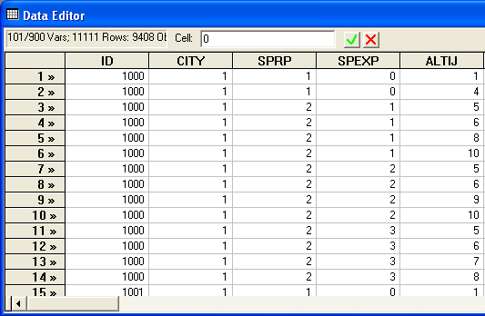
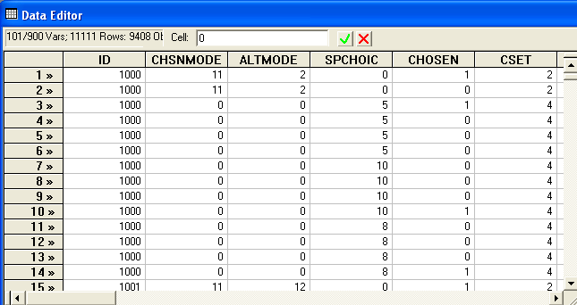
Each person makes four choices from a choice set that includes either two or four alternatives.
The first choice is the RP between two of the RP alternatives
The second-fourth are the SP among four of the six SP alternatives.
There are ten alternatives in total.

Slide 61
Model for Revealed Preference Data
? Using only Revealed Preference Data
sample;all$
reject;sprp=2$ deleting SP data
dstats;rhs=autotime,fcost,mptrtime,mptrfare$
NLOGIT
;lhs=chosen,cset,altij
;choices=RPDA,RPRS,RPBS,RPTN
;descriptives;crosstab
;maxit=100
;model:
U(RPDA) = rdasc+ fl*fcost+tm*autotime/
U(RPRS) = rrsasc+ fl*fcost+tm*autotime/
U(RPBS) = rbsasc + ptc*mptrfare+mt*mptrtime/
U(RPTN) = ptc*mptrfare+mt*mptrtime$

Slide 62
Model for Stated Preference Data
? Using only Stated Preference Data
sample;all$
reject;sprp=1$ deleting RP data
? BASE MODEL
nlogit
;lhs=chosen,cset,alt
;choices=SPDA,SPRS,SPBS,SPTN,SPLR,SPBW
;descriptives;crosstab
;maxit=150
;model:
U(SPDA) = dasc +cst*fueld+ tmcar*time+prk*parking
+pincda*pincome +cavda*carav/
U(SPRS) = rsasc+cst*fueld+ tmcar*time+prk*parking/
U(SPBS) = bsasc+cst*fared+ tmpt*time+act*acctime+egt*eggtime/
U(SPTN) = tnasc+cst*fared+ tmpt*time+act*acctime+egt*eggtime/
U(SPLR) = lrasc+cst*fared+ tmpt*time+act*acctime +egt*eggtime/
U(SPBW) = cst*fared+ tmpt*time+act*acctime+egt*eggtime$

Slide 63
A Nested Logit Model for RP/SP Data
NLOGIT
;lhs=chosen,cset,altij
;choices=RPDA,RPRS,RPBS,RPTN,SPDA,SPRS,SPBS,SPTN,SPLR,SPBW
/.592,.208,.089,.111,1.0,1.0,1.0,1.0,1.0,1.0
;tree=mode[rp(RPDA,RPRS,RPBS,RPTN),spda(SPDA),
sprs(SPRS),spbs(SPBS),sptn(SPTN),splr(SPLR),spbw(SPBW)]
;ivset: (rp)=[1.0];ru1
;maxit=150
;model:
U(RPDA) = rdasc+ invc*fcost+tmrs*autotime ?+prkda*vehprkct+
+ pinc*pincome+CAVDA*CARAV/
U(RPRS) = rrsasc + invc*fcost+tmrs*autotime/?+
U(RPBS) = rbsasc + invc*mptrfare+mtpt*mptrtime/?+acegt*rpacegtm/
U(RPTN) = cstrs*mptrfare+mtpt*mptrtime/?+acegt*rpacegtm/
U(SPDA) = sdasc + invc*fueld + tmrs*time+cavda*carav ?+prkda*parking
+ pinc*pincome/
U(SPRS) = srsasc + invc*fueld + tmrs*time/? cavrs*carav/
U(SPBS) = invc*fared + mtpt*time +acegt*spacegtm/
U(SPTN) = stnasc + invc*fared + mtpt*time+acegt*spacegtm/
U(SPLR) = slrasc + invc*fared + mtpt*time+acegt*spacegtm/
U(SPBW) = sbwasc + invc*fared + mtpt*time+acegt*spacegtm$

Slide 64
A Random Parameters Approach
NLOGIT
;lhs=chosen,cset,altij
;choices=RPDA,RPRS,RPBS,RPTN,SPDA,SPRS,SPBS,SPTN,SPLR,SPBW
/.592,.208,.089,.111,1.0,1.0,1.0,1.0,1.0,1.0
; rpl
; pds=4
; halton ; pts=25
; fcn=invc(n)
; model:
U(RPDA) = rdasc+ invc*fcost+tmrs*autotime ?+prkda*vehprkct+
+ pinc*pincome+CAVDA*CARAV/
U(RPRS) = rrsasc + invc*fcost+tmrs*autotime/?+ ?egt*autoegtm+prk*vehprkct+
U(RPBS) = rbsasc + invc*mptrfare+mtpt*mptrtime/?+acegt*rpacegtm/
U(RPTN) = cstrs*mptrfare+mtpt*mptrtime/?+acegt*rpacegtm/
U(SPDA) = sdasc + invc*fueld + tmrs*time+cavda*carav ?+prkda*parking
+ pinc*pincome/
U(SPRS) = srsasc + invc*fueld + tmrs*time/? cavrs*carav/
U(SPBS) = invc*fared + mtpt*time +acegt*spacegtm/
U(SPTN) = stnasc + invc*fared + mtpt*time+acegt*spacegtm/
U(SPLR) = slrasc + invc*fared + mtpt*time+acegt*spacegtm/
U(SPBW) = sbwasc + invc*fared + mtpt*time+acegt*spacegtm$

Slide 65
Connecting Choice
Situations through RPs
--------+--------------------------------------------------
Variable| Coefficient Standard Error b/St.Er. P[|Z|>z]
--------+--------------------------------------------------
|Random parameters in utility functions
INVC| -.58944*** .03922 -15.028 .0000
|Nonrandom parameters in utility functions
RDASC| -.75327 .56534 -1.332 .1827
TMRS| -.05443*** .00789 -6.902 .0000
PINC| .00482 .00451 1.068 .2857
CAVDA| .35750*** .13103 2.728 .0064
RRSASC| -2.18901*** .54995 -3.980 .0001
RBSASC| -1.90658*** .53953 -3.534 .0004
MTPT| -.04884*** .00741 -6.591 .0000
CSTRS| -1.57564*** .23695 -6.650 .0000
SDASC| -.13612 .27616 -.493 .6221
SRSASC| -.10172 .18943 -.537 .5913
ACEGT| -.02943*** .00384 -7.663 .0000
STNASC| .13402 .11475 1.168 .2428
SLRASC| .27250** .11017 2.473 .0134
SBWASC| -.00685 .09861 -.070 .9446
|Distns. of RPs. Std.Devs or limits of triangular
NsINVC| .45285*** .05615 8.064 .0000
--------+--------------------------------------------------

