Slide 1
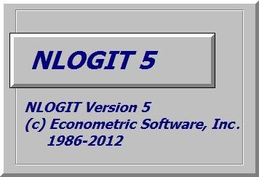
Discrete Choice Modeling
William Greene
Stern School of Business
New York University
Lab Sessions

Slide 2
Lab 1
Getting Started

Slide 3
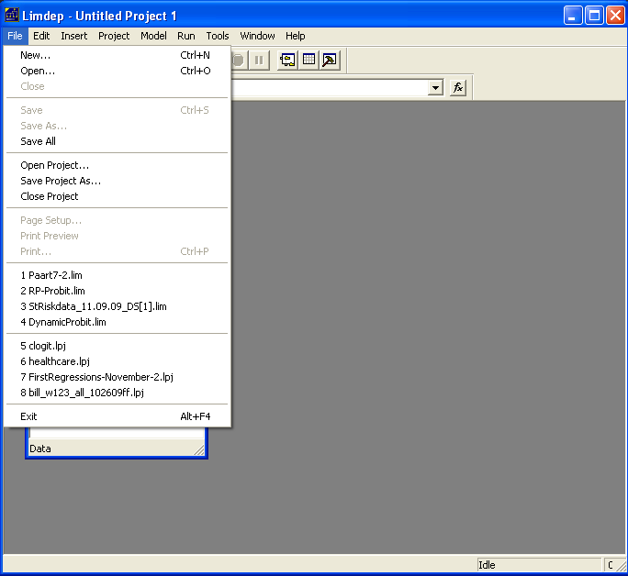

Slide 4
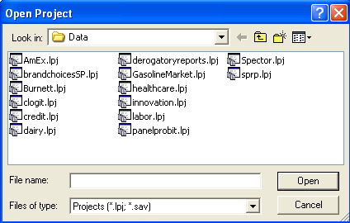
Locate file dairy.lpj
Locate file Dairy.lpj

Slide 5
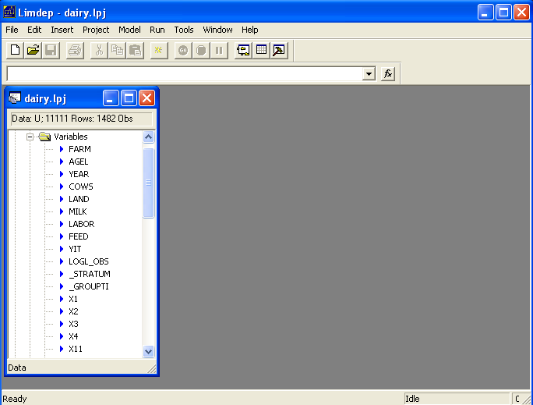
Project Window
Note: Name
Sample Size
Variables

Slide 6
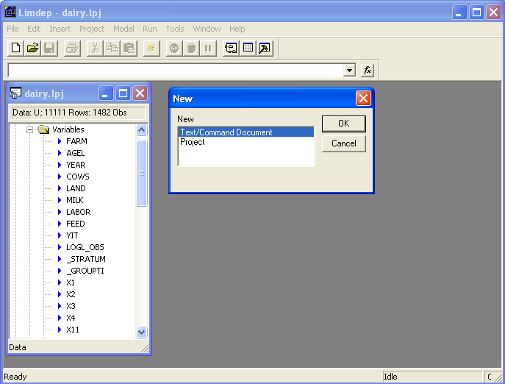
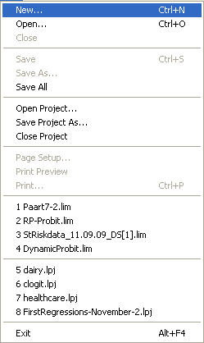
Use File:New/OK for an Editing Window

Slide 7
Generic Command Format
Verb ; specification ; specification ; … $
• Every command ends with $
• Use as many lines as desired.
• Use spaces wherever desired.
• Capital or lower case – no matter.
Example:
Create ; x = z*y + log(Income) $
Example;
PROBIT ; Lhs = doctor ; Rhs = one,X $

Slide 8
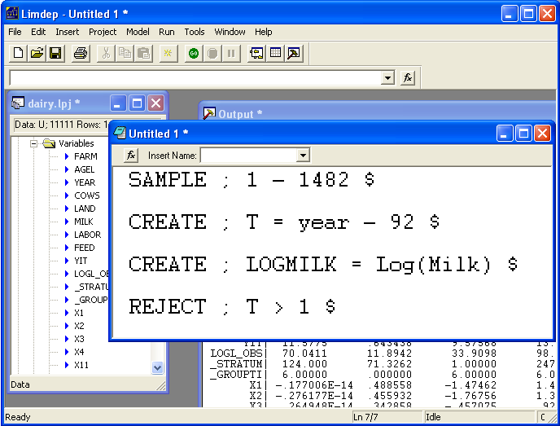
Typing Commands in the Editor

Slide 9
Important Commands:
SAMPLE ; first - last $
  Sample ; 1 – 1000 $
  Sample ; All $
CREATE ; Variable = transformation $
  Create ; LogMilk = Log(Milk) $
  Create ; LMC = .5*Log(Milk)*Log(Cows) $
  Create ; … any algebraic transformation $

Slide 10
Name Conventions
CREATE ; name = any result desired $
Name is the name of a new variable
  No more than 8 characters in a name
  The first character must be a letter
  May not contain -,+,*,/. May contain _.

Slide 11
Model Command
Model ; Lhs = dependent variable
; Rhs = list of independent variables $
  Regress ; Lhs = Milk ; Rhs = ONE,Feed,Labor,Land $
  ONE requests the constant term
Models are REGRESS, PROBIT, POISSON, LOGIT, TOBIT, … and about 100 others. All have the same form.

Slide 12
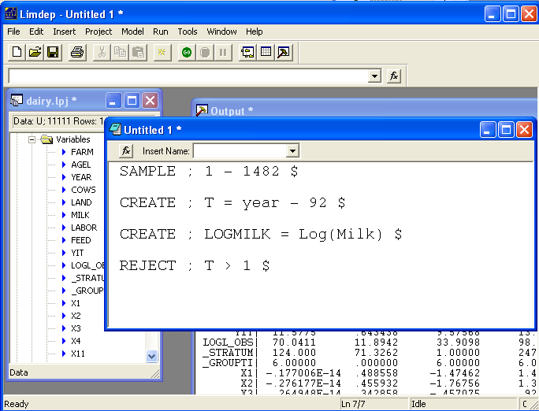
The Go Button

Slide 13
“Submitting” Commands
One Command
  Place cursor on that line
  Press “Go” button
More than one command
  Highlight all lines (like any text editor)
  Press “Go” button

Slide 14
Compute a Regression
Sample ; All $
Regress ; Lhs = YIT
; Rhs = One,X1,X2,X3,X4 $
The constant term in the model

Slide 15
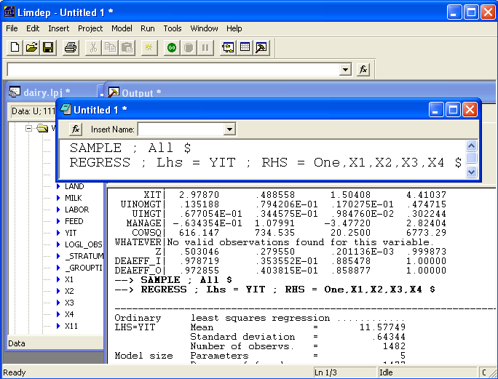

Slide 16
Interactions and Nonlinearities
Sample ; All $
Regress ; Lhs = YIT
; Rhs = One,X1,X2,X3,X4,
x1^2,
x2*x1,x2^2,
x3*x1,x3*x2,x3^2,
x4*x1,x4*x2,x4*x3,x4^2 $

Slide 17
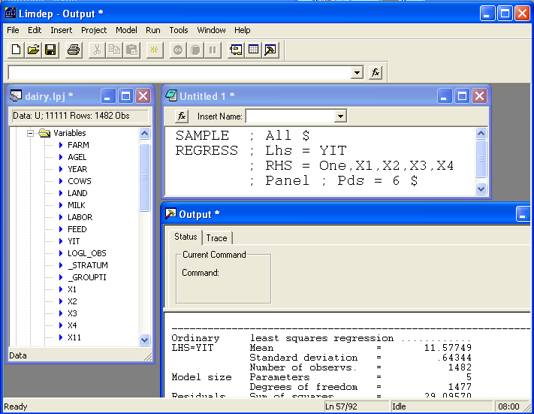
Standard Three Window Operation
Commands typed in editing window
Project window shows variables
Results appear in output window

Slide 18
Model Results
Sample ; All $
Regress ; Lhs = YIT
; Rhs =One,X1,X2,X3,X4
; Res = e ? (Regression with residuals saved)
; Plot Residuals
Produces results: Displayed results in output
Displayed plot in its own window
Variables added to data set
Matrices
Named Scalars

Slide 19
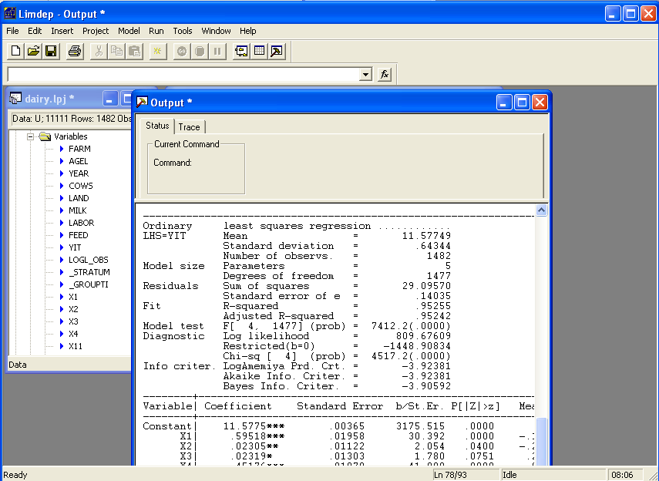
Output Window

Slide 20
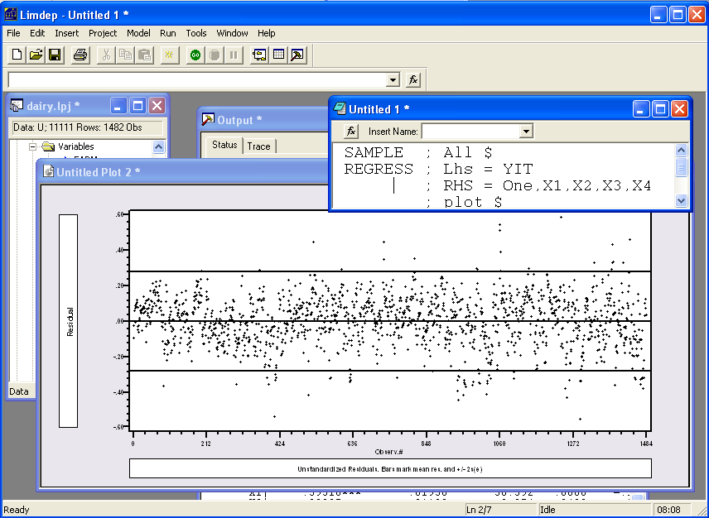
Residual Plot

Slide 21
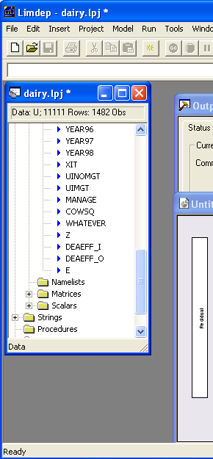
New Variable
Regress;Lhs=Yit;Rhs=One,x1,x2,x3,x4
; Res = e ; Plot Residuals $
? We can now manipulate the new
? variable created by the regression.
Namelist ; z = Year94,Year95,Year96,
Year97,Year98$
Create;esq = e*e / (sumsqdev/nreg) – 1 $
Regress; Lhs = esq ; Rhs=One,z $
Calc ; List ; LMTstHet = nreg*Rsqrd $

Slide 22
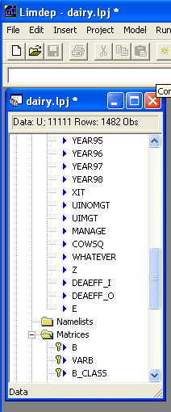
Saved Matrices
B=estimated coefficients and VARB=estimated asymptotic covariance matrix are saved by every model command. Different model estimators save other results as well. Here, we manipulate B and VARB to compute a restricted least squares estimator the hard way.
REGRESS ; Lhs = Yit ; Rhs=One,x1,x2,x3,x4 $
NAMELIST ; X = One,x1,x2,x3,x4 $
MATRIX ; R = [0,1,1,1,1] ; q = [1] ; XXI = <X’X>
; m = R*B – q ; C=R*XXI*R’
; bstar = B - XXI*R’*<C>*m
; Vbstar=VARB – ssqrd*XXI*R’*<C>*R*XXI $

Slide 23
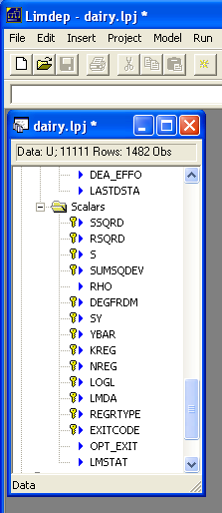
Saved Scalars
Model estimates include named scalars. Linear regressions save numerous scalars. Others usually save 3 or 4, such as LOGL, and others.
The program on the previous page used SSQRD saved by the regression. The LM test two pages back used NREG (the number of observations used) and RSQRD (the R² in the most recent regression).

Slide 24
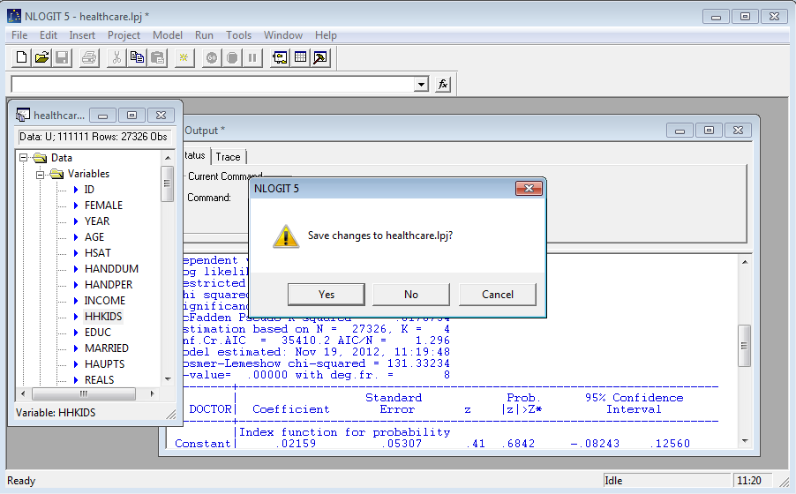
Save Your Work When You Exit

Slide 25
Analyzing Binary Choice Data

Slide 26
Model Commands
Generic form:
Model name ; Lhs = dependent variable
; Rhs = independent variables $
Almost all models require ;Lhs and ;Rhs.
Rhs should generally include ONE to request a constant term.
Models have different other required specifications
Many optional specifications.

Slide 27
Probit Model Command
Load healthcare.lpj
Text Editor
Probit ; Lhs = doctor
; Rhs = one,age,income,educ
; Marginal effects$

Slide 28
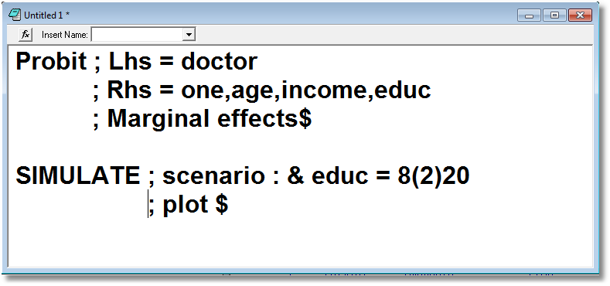

Slide 29
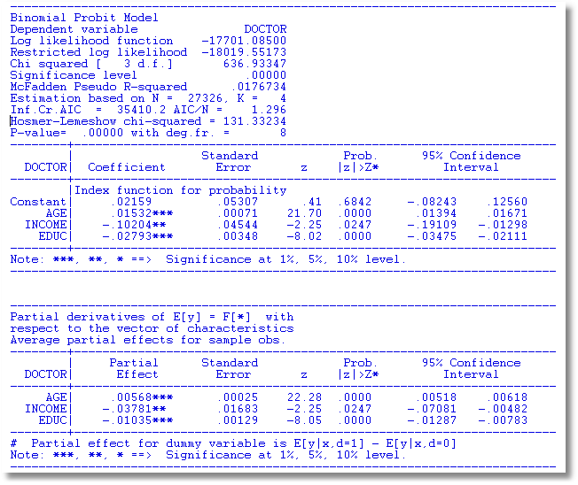

Slide 30
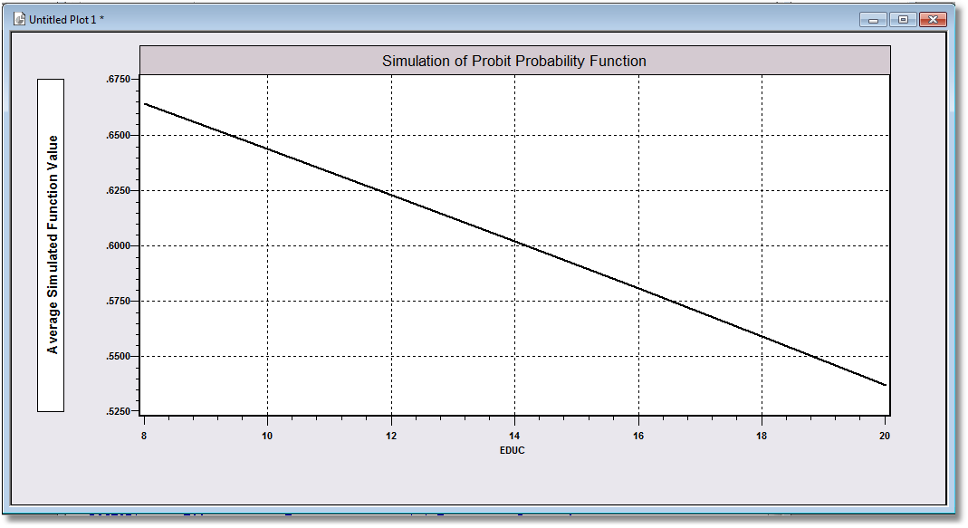

Slide 31
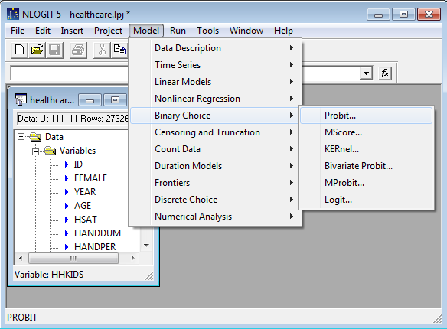
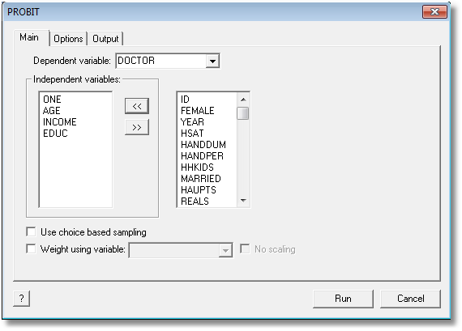
Command Builder
Go button in command builder

Slide 32
Partial Effects for Interactions

Slide 33
Partial Effects
Build the interactions into the model statement
PROBIT ; Lhs = Doctor; Rhs = one,age,educ,age^2,age*educ $
Built in command for model simulation
SIMULATE $
Built in computation for partial effects
PARTIALS
; Effects: Age & Educ = 8(2)20
; Plot(ci) $

Slide 34
Average Partial Effects
---------------------------------------------------------------------
Partial Effects Analysis for Probit Probability Function
---------------------------------------------------------------------
Partial effects on function with respect to AGE
Partial effects are computed by average over sample observations
Partial effects for continuous variable by differentiation
Partial effect is computed as derivative = df(.)/dx
---------------------------------------------------------------------
df/dAGE Partial Standard
(Delta method) Effect Error |t| 95% Confidence Interval
---------------------------------------------------------------------
Partial effect .00441 .00059 7.47 .00325 .00557
EDUC = 8.00 .00485 .00101 4.80 .00287 .00683
EDUC = 10.00 .00463 .00068 6.80 .00329 .00596
EDUC = 12.00 .00439 .00061 7.18 .00319 .00558
EDUC = 14.00 .00412 .00091 4.53 .00234 .00591
EDUC = 16.00 .00384 .00138 2.78 .00113 .00655
EDUC = 18.00 .00354 .00192 1.84 -.00023 .00731
EDUC = 20.00 .00322 .00250 1.29 -.00168 .00813

Slide 35
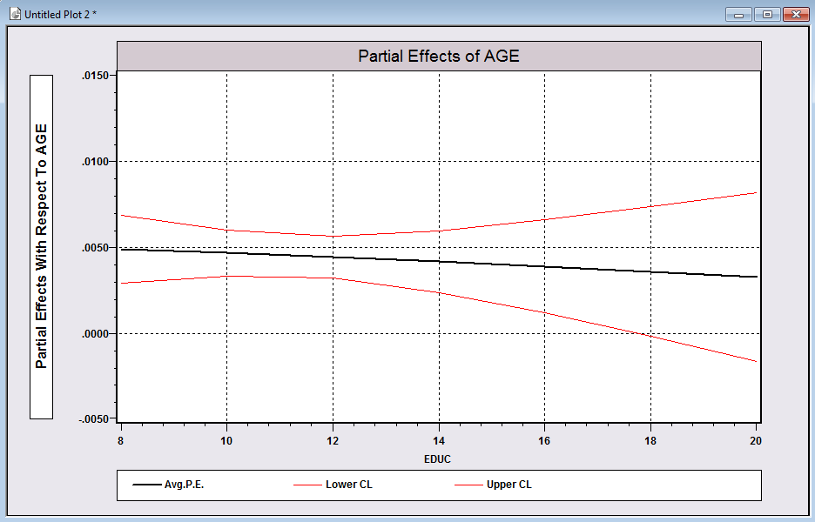
Useful Plot

Slide 36
More Elaborate Partial Effects
PROBIT ; Lhs = Doctor
; Rhs = one,age,educ,age^2,age*educ,
female,female*educ,income $
PARTIAL ; Effects: income
@ female = 0,1 ? Do for each subsample
| educ = 12,16,20 ? Set 3 fixed values
& age = 20(10)50 ? APE for each setting

Slide 37
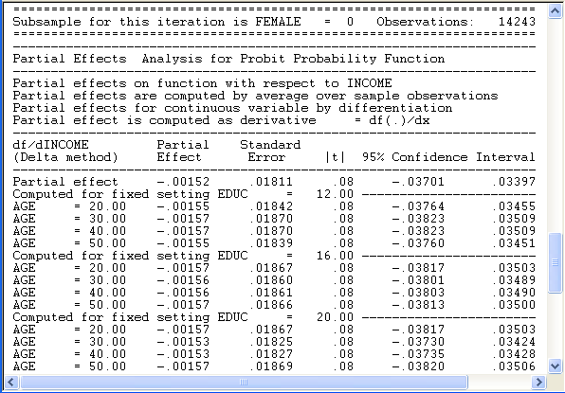
Constructed Partial Effects

Slide 38
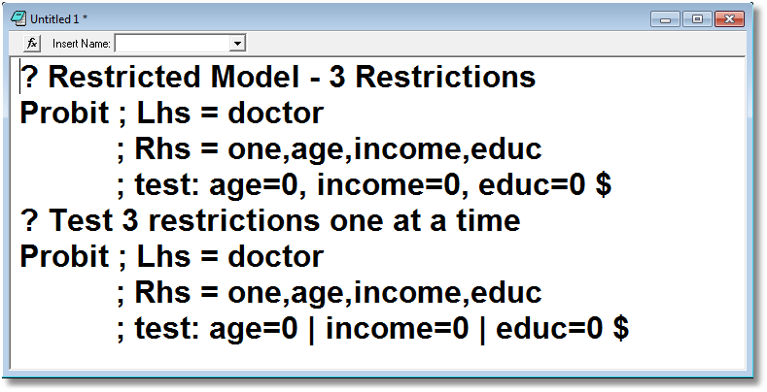
Testing Restrictions

Slide 39
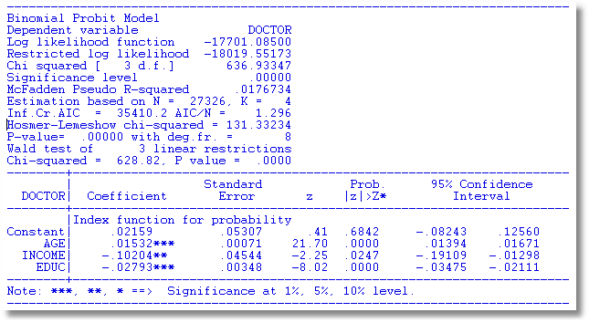

Slide 40
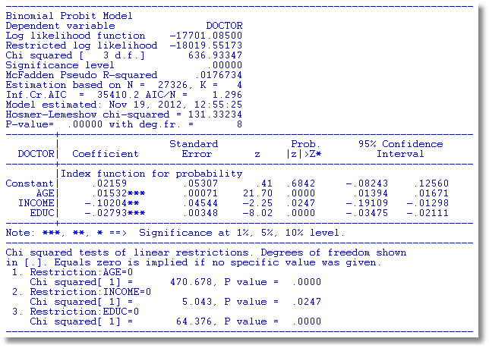

Slide 41
