Slide 1

Discrete Choice Modeling
William Greene
Stern School of Business
New York University
Lab Sessions

Slide 2
Lab 2
Analyzing Binary Choice Data

Slide 3
Model Commands
Generic form:
Model name ; Lhs = dependent variable
; Rhs = independent variables $
Almost all models require ;Lhs and ;Rhs.
Rhs should generally include ONE to request a constant term.
Models have different other required specifications
Many optional specifications.

Slide 4
Probit Model Command
Load healthcare.lpj
Text Editor
Probit ; Lhs = doctor
; Rhs = one,age,income,educ
; Marginal effects$

Slide 5
Partial Effects for Interactions

Slide 6
Partial Effects
Build the interactions into the model statement
PROBIT ; Lhs = Doctor
; Rhs = one,age,educ,age^2,age*educ $
Built in computation for partial effects
PARTIALS ; Effects:
Age & Educ = 8(2)20
; Plot(ci) $

Slide 7
Average Partial Effects
---------------------------------------------------------------------
Partial Effects Analysis for Probit Probability Function
---------------------------------------------------------------------
Partial effects on function with respect to AGE
Partial effects are computed by average over sample observations
Partial effects for continuous variable by differentiation
Partial effect is computed as derivative = df(.)/dx
---------------------------------------------------------------------
df/dAGE Partial Standard
(Delta method) Effect Error |t| 95% Confidence Interval
---------------------------------------------------------------------
Partial effect .00441 .00059 7.47 .00325 .00557
EDUC = 8.00 .00485 .00101 4.80 .00287 .00683
EDUC = 10.00 .00463 .00068 6.80 .00329 .00596
EDUC = 12.00 .00439 .00061 7.18 .00319 .00558
EDUC = 14.00 .00412 .00091 4.53 .00234 .00591
EDUC = 16.00 .00384 .00138 2.78 .00113 .00655
EDUC = 18.00 .00354 .00192 1.84 -.00023 .00731
EDUC = 20.00 .00322 .00250 1.29 -.00168 .00813

Slide 8
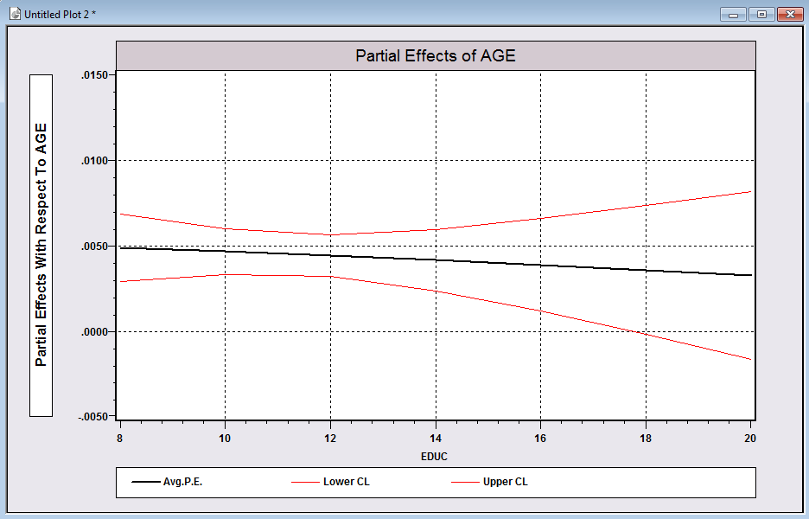
Useful Plot

Slide 9
More Elaborate Partial Effects
PROBIT ; Lhs = Doctor
; Rhs = one,age,educ,age^2,age*educ,
female,female*educ,income $
PARTIAL ; Effects: income
@ female = 0,1 ? Do for each subsample
| educ = 12,16,20 ? Set 3 fixed values
& age = 20(10)50 ? APE for each setting

Slide 10
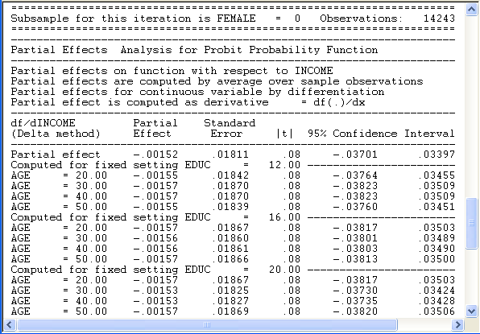
Constructed Partial Effects

Slide 11
Predictions
List and keep predictions
Add ; List ; Prob = PFIT
to the probit or logit command
(Tip: Do not use ;LIST with large samples!)
Sample ; 1-100 $
PROBIT ; Lhs=ip ; Rhs=x1
; List ; Prob=Pfit $
DSTAT ; Rhs = IP,PFIT $

Slide 12
Using the Binary Choice Simulator
Fit the model with MODEL ; Lhs = … ; Rhs = …
Simulate the model with
BINARY CHOICE ; <same LHS and RHS > ; Start = B (coefficients)
; Model = the kind of model (Probit or Logit)
; Scenario: variable <operation> = value / (may repeat)
; Plot: Variable ( range of variation is optional)
; Limit = P* (is optional, 0.5 is the default) $
E.g.: Probit ; Lhs = IP ; Rhs = One,LogSales,Imum,FDIum $
BinaryChoice ; Lhs = IP ; Rhs = One,LogSales,IMUM,FDIUM
; Model = Probit ; Start = B
; Scenario: LogSales * = 1.1 ; Plot: LogSales $

Slide 13
Estimated Model for Innovation
+---------+--------------+----------------+--------+---------+----------+
|Variable | Coefficient | Standard Error |b/St.Er.|P[|Z|>z] | Mean of X|
+---------+--------------+----------------+--------+---------+----------+
Index function for probability
Constant -1.89382186 .20520881 -9.229 .0000
LOGSALES .16345837 .01766902 9.251 .0000 10.5400961
IMUM .99773826 .14091020 7.081 .0000 .25275054
FDIUM 3.66322280 .37793285 9.693 .0000 .04580618
+---------------------------------------------------------+
|Predictions for Binary Choice Model. Predicted value is |
|1 when probability is greater than .500000, 0 otherwise.|
|------+---------------------------------+----------------+
|Actual| Predicted Value | |
|Value | 0 1 | Total Actual |
+------+----------------+----------------+----------------+
| 0 | 531 ( 8.4%)| 2033 ( 32.0%)| 2564 ( 40.4%)|
| 1 | 454 ( 7.1%)| 3332 ( 52.5%)| 3786 ( 59.6%)|
+------+----------------+----------------+----------------+
|Total | 985 ( 15.5%)| 5365 ( 84.5%)| 6350 (100.0%)|
+------+----------------+----------------+----------------+

Slide 14
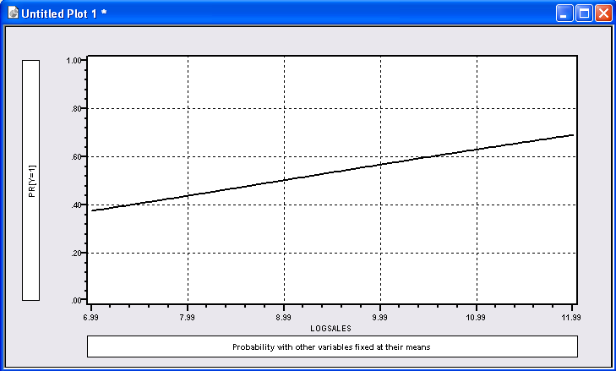
Effect of logSales on Probability

Slide 15
Model Simulation:
logSales Increases by 10% for all Firms in the Sample
+-------------------------------------------------------------+
|Scenario 1. Effect on aggregate proportions. Probit Model |
|Threshold T* for computing Fit = 1[Prob > T*] is .50000 |
|Variable changing = LOGSALES, Operation = *, value = 1.100 |
+-------------------------------------------------------------+
|Outcome Base case Under Scenario Change |
| 0 985 = 15.51% 300 = 4.72% -685 |
| 1 5365 = 84.49% 6050 = 95.28% 685 |
| Total 6350 = 100.00% 6350 = 100.00% 0 |
+-------------------------------------------------------------+

Slide 16
Testing a Hypothesis – Wald Test
SAMPLE ; All $
PROBIT ; Lhs = IP ; RHS = Sectors,X1 $
MATRIX ; b1 = b(1:3) ; v1 = Varb(1:3,1:3) $
MATRIX ; List ; Waldstat = b1'<V1>b1 $
CALC ; List ; CStar = CTb(.95,3) $

Slide 17
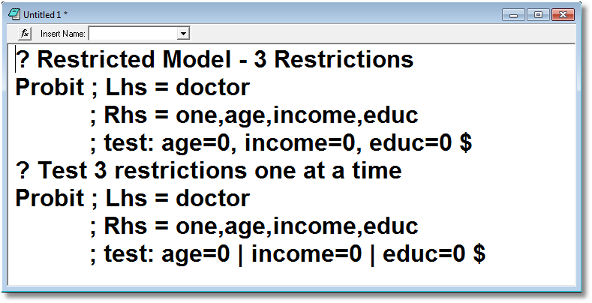
Testing Restrictions

Slide 18
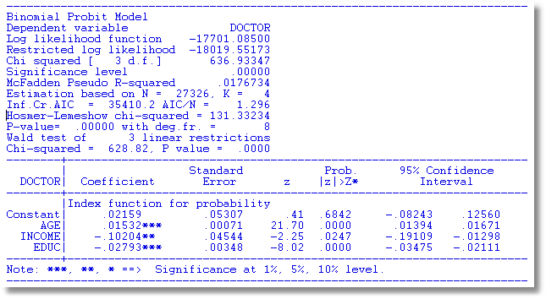

Slide 19
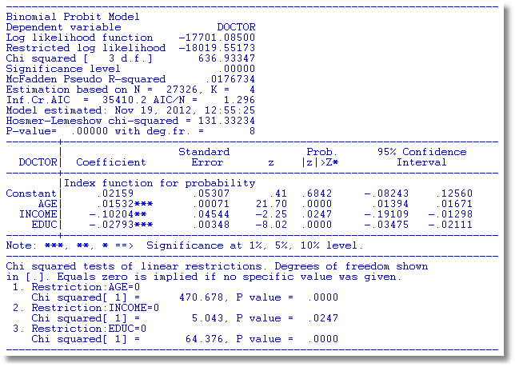

Slide 20
Testing a Hypothesis – LM Test
PROBIT ; LHS = IP ; RHS = X1 $
PROBIT ; LHS = IP ; RHS = X1,Sectors
; Start = b,0,0,0 ; MAXIT = 0 $

Slide 21
Results of an LM test
Maximum iterations reached. Exit iterations with status=1.
Maxit = 0. Computing LM statistic at starting values.
No iterations computed and no parameter update done.
+---------------------------------------------+
| Binomial Probit Model |
| Dependent variable IP |
| Number of observations 6350 |
| Iterations completed 1 |
| LM Stat. at start values 163.8261 |
| LM statistic kept as scalar LMSTAT |
| Log likelihood function -4228.350 |
| Restricted log likelihood -4283.166 |
| Chi squared 109.6320 |
| Degrees of freedom 6 |
| Prob[ChiSqd > value] = .0000000 |
+---------+--------------+----------------+--------+---------+----------+
|Variable | Coefficient | Standard Error |b/St.Er.|P[|Z|>z] | Mean of X|
+---------+--------------+----------------+--------+---------+----------+
Constant -.01060549 .04902957 -.216 .8287
IMUM .43885789 .14633344 2.999 .0027 .25275054
FDIUM 2.59443123 .39703852 6.534 .0000 .04580618
SP .43672968 .11922200 3.663 .0002 .07428482
RAWMTL .000000 .06217590 .000 1.0000 .08661417
INVGOOD .000000 .03590410 .000 1.0000 .50236220
FOOD .000000 .07923549 .000 1.0000 .04724409
Note: Wald equaled 163.236.

Slide 22
Likelihood Ratio Test
PROBIT ; Lhs = IP ; Rhs = X1,Sectors $
CALC ; LOGLU = Logl $
PROBIT ; Lhs = IP ; Rhs = X1 $
CALC ; LOGLR = Logl $
CALC ; List ; LRStat = 2*(LOGLU – LOGLR) $
Result is 164.878.

Slide 23
Miscellaneous Topics
Two Step Estimation
Robust (Sandwich) Covariance matrix
Matrix Algebra – Testing for Normality

Slide 24
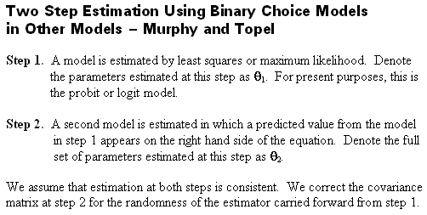
Two Step Estimation

Slide 25
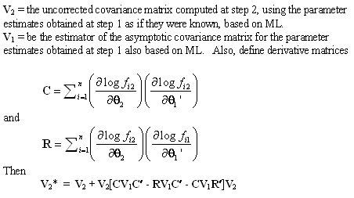
Murphy and Topel
This can usually easily be programmed using the models,
CREATE, CALC and MATRIX. Several leading cases are built in.

Slide 26
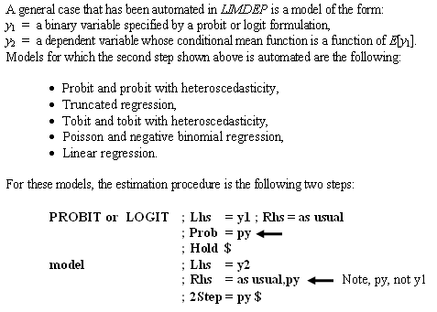
Two Step Estimation: Automated

Slide 27
Application: Recursive Probit
Hospital = bh’xh + c*Doctor + eh
Doctor = bd’xd + ed
Sample ; All $
Namelist ; xD=one,age,female,educ,married,working
; xH=one,age,female,hhninc,hhkids $
Reject ; _Groupti < 7 $
Probit ; lhs=hospital;rhs=xh,doctor$
Probit ; lhs=doctor;rhs=xd;prob=pd;hold$
Probit ; lhs=hospital;rhs=xh,pd;2step=pd$

Slide 28
Using Matrix Algebra
Namelists with the current sample serve 2 major functions:
(1) Define lists of variables for model estimation
(2) Define the columns of matrices built from the data.
NAMELIST ; X = a list ; Z = a list … $
Set the sample any way you like. Observations are now
the rows of all matrices. When the sample changes,
the matrices change.
Lists may be anything, may contain ONE, may overlap
(some or all variables) and may contain the same
variable(s) more than once

Slide 29
Matrix Functions
Matrix Product: MATRIX ; XZ = X’Z $
Moments and Inverse MATRIX ; XPX = X’X
; InvXPX = <X’X> $
Moments with individual specific weights in variable w.
Σ_{i} w_{i} x_{i}x_{i}’ = X’[w]X.
[Σ_{i} w_{i} x_{i}x_{i}’ ]⁻¹ = <X’[w]X>
Unweighted Sum of Rows in a Matrix
Σ_{i} x_{i} = 1’X
Column of Sample Means
(1/n) Σ_{i} x_{i} = 1/n * X’1 or MEAN(X)
(Matrix function. There are over 100 others.)
Weighted Sum of rows in matrix
Σ_{i} w_{i} x_{i} = 1’[w]X

Slide 30
Normality Test for Probit
Thanks to Joachim Wilde, Univ. Halle, Germany for suggesting this.

Slide 31
Normality Test for Probit
NAMELIST ; XI = One,... $
CREATE ; yi = the dependent variable $
PROBIT ; Lhs = yi ; Rhs = Xi ; Prob = Pfi $
CREATE ; bxi = b'Xi ; fi = N01(bxi) $
CREATE ; zi3 = -1/2*(bxi^2 - 1) ; zi4 = 1/4*(bxi*(bxi^2+3)) $
NAMELIST ; Zi = Xi,zi3,zi4 $
CREATE ; di = fi/sqr(pfi*(1-pfi)) ; ei = yi - pfi
; eidi = ei*di ; di2 = di*di $
MATRIX ; List ; LM = 1'[eidi]Zi * <ZI'[di2]Zi> * Zi'[eidi]1 $

Slide 32
Endogenous Variable in Probit Model
PROBIT ; Lhs = y1, y2
; Rh1 = rhs for the probit model,y2
; Rh2 = exogenous variables for y2 $
SAMPLE ; All $
CREATE ; GoodHlth = Hsat > 5 $
PROBIT ; Lhs = GoodHlth,Hhninc
; Rh1 = One,Female,Hhninc
; Rh2 = One,Age,Educ $

Slide 33
Binary Choice Models with Panel Data

Slide 34
Telling NLOGIT You are Fitting a Panel Data Model
Balanced Panel
Model ; … ; PDS = number of periods $
REGRESS ; Lhs = Milk ; Rhs = One,Labor ; Pds = 6 ; Panel $
(Note ;Panel is needed only for REGRESS)
Unbalanced Panel
Model ; … ; PDS = group size variable $
REGRESS ; Lhs = Milk ; Rhs = One,Labor ; Pds = FarmPrds
; Panel $
FarmPrds gives the number of periods, in every period.
(More later about unbalanced panels)

Slide 35
Group Size Variables for
Unbalanced Panels
Farm | Milk | Cows | FarmPrds
1 | 23.3 | 10.7 | 3
1 | 23.3 | 10.6 | 3
1 | 25 | 9.4 | 3
2 | 19.6 | 11 | 2
2 | 22.2 | 11 | 2
3 | 24.7 | 11 | 4
3 | 25.4 | 12 | 4
3 | 25.3 | 13.5 | 4
3 | 26.1 | 14.5 | 4
4 | 55.4 | 22 | 2
4 | 63.5 | 22 | 2

Slide 36
Application to Spanish
Dairy Farms Dairy.lpj
N = 247 farms, T = 6 years (1993-1998)
Input | Units | Mean | Std. Dev. | Minimum | Maximum
Milk | Milk production (liters) | 131,108 | 92,539 | 14,110 | 727,281
Cows | # of milking cows | 2.12 | 11.27 | 4.5 | 82.3
Labor | # man-equivalent units | 1.67 | 0.55 | 1.0 | 4.0
Land | Hectares of land devoted to pasture and crops. | 12.99 | 6.17 | 2.0 | 45.1
Feed | Total amount of feedstuffs fed to dairy cows (tons) | 57,941 | 47,981 | 3,924.14 | 376,732

Slide 37
Global Setting for Panels
SETPANEL ; Group = the name of the ID variable
; PDS = the name of the groupsize variable to create $
Subsequent model commands state ;PANEL
with no other specifications requred to set the panel.
Some other specifications usually required for the
specific model – e.g., fixed vs. random effects.

Slide 38
Load the Probit Data Set
Data for this session are
PANELPROBIT.LPJ
Various Fixed and Random Effects
Models
Random Parameters
Latent Class

Slide 39
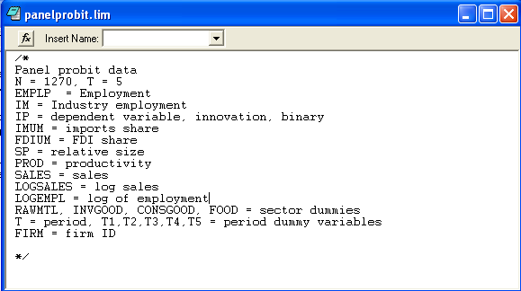
Data Set: Load PANELPROBIT.LPJ

Slide 40
Fit Basic Models

Slide 41
Robust Covariance Matrix

Slide 42
Robust Covariance Matrix
; ROBUST
Using the health care data:
+---------------------------------------------+
| Binomial Probit Model |
+---------------------------------------------+
+---------+--------------+----------------+--------+---------+
|Variable | Coefficient | Standard Error |b/St.Er.|P[|Z|>z] |
+---------+--------------+----------------+--------+---------+
|Index function for probability
Constant| -.17336*** .05874 -2.951 .0032
AGE| .01393*** .00074 18.920 .0000 43.5257
FEMALE| .32097*** .01718 18.682 .0000 .47877
EDUC| -.01602*** .00344 -4.650 .0000 11.3206
MARRIED| -.00153 .01869 -.082 .9347 .75862
WORKING| -.09257*** .01893 -4.889 .0000 .67705
Robust VC=<H>G<H> used for estimates.
Constant| -.17336*** .05881 -2.948 .0032
AGE| .01393*** .00073 19.024 .0000 43.5257
FEMALE| .32097*** .01701 18.869 .0000 .47877
EDUC| -.01602*** .00345 -4.648 .0000 11.3206
MARRIED| -.00153 .01874 -.082 .9348 .75862
WORKING| -.09257*** .01885 -4.911 .0000 .67705

Slide 43
Cluster Correction
PROBIT ; Lhs = doctor
; Rhs = one,age,female,educ,married,working
; Cluster = ID $
Normal exit: 4 iterations. Status=0. F= 17448.10
+---------------------------------------------------------------------+
| Covariance matrix for the model is adjusted for data clustering. |
| Sample of 27326 observations contained 7293 clusters defined by |
| variable ID which identifies by a value a cluster ID. |
+---------------------------------------------------------------------+
Variable| Coefficient Standard Error b/St.Er. P[|Z|>z] Mean of X
--------+-------------------------------------------------------------
|Index function for probability
Constant| -.17336** .08118 -2.135 .0327
AGE| .01393*** .00102 13.691 .0000 43.5257
FEMALE| .32097*** .02378 13.497 .0000 .47877
EDUC| -.01602*** .00492 -3.259 .0011 11.3206
MARRIED| -.00153 .02553 -.060 .9521 .75862
WORKING| -.09257*** .02423 -3.820 .0001 .67705
--------+-------------------------------------------------------------

Slide 44
Fixed Effects Models
? Fixed Effects Probit.
? Looks like an incidental parameters problem.
Sample ; All $
Namelist ; X = IMUM,FDIUM,SP,LogSales $
Probit ; Lhs = IP ; Rhs = X ; FEM ; Marginal ; Pds=5 $
Probit ; Lhs = IP ; Rhs = X,one ; Marginal $

Slide 45
Logit Fixed Effects Models
Conditional and Unconditional FE
? Logit, conditional vs. unconditional
Logit ; Lhs = IP ; Rhs = X ; Pds = 5 $ (Conditional)
Logit ; Lhs = IP ; Rhs = X ; Pds = 5 ; Fixed $

Slide 46
Hausman Test for Fixed Effects
? Logit: Hausman test for fixed effects
?
Logit ; Lhs = IP ; Rhs = X ; Pds = 5 $
Matrix ; Bf = B ; Vf = Varb $
Logit ; Lhs = IP ; Rhs = X,One $
Calc ; K = Col(X) $
Matrix ; Bp = b(1:K) ; Vp = Varb(1:K,1:K) $
Matrix ; Db = Bf - Bp ; DV = Vf - Vp
; List ; Hausman = Db'<DV>Db $
Calc ; List ; Ctb(.95,k) $

Slide 47
A Fixed Effects Probit Model
Probit ;lhs=doctor ; rhs=age,hhninc,educ,married
; fem ; panel ; Parameters $
+---------------------------------------------+
| Probit Regression Start Values for DOCTOR |
| Maximum Likelihood Estimates |
| Dependent variable DOCTOR |
| Weighting variable None |
| Number of observations 27326 |
| Iterations completed 10 |
| Log likelihood function -17700.96 |
| Number of parameters 5 |
| Akaike IC=35411.927 Bayes IC=35453.005 |
| Finite sample corrected AIC =35411.929 |
+---------------------------------------------+
+---------+--------------+----------------+--------+---------+----------+
|Variable | Coefficient | Standard Error |b/St.Er.|P[|Z|>z] | Mean of X|
+---------+--------------+----------------+--------+---------+----------+
AGE .01538640 .00071823 21.423 .0000 43.5256898
HHNINC -.09775927 .04626475 -2.113 .0346 .35208362
EDUC -.02811308 .00350079 -8.031 .0000 11.3206310
MARRIED -.00930667 .01887548 -.493 .6220 .75861817
Constant .02642358 .05397131 .490 .6244
These are the pooled data estimates used to obtain starting values for the iterations to get the full fixed effects model.

Slide 48
Fixed Effects Model
Nonlinear Estimation of Model Parameters
Method=Newton; Maximum iterations=100
Convergence criteria: max|dB| .1000D-08, dF/F= .1000D-08, g<H>g= .1000D-08
Normal exit from iterations. Exit status=0.
+---------------------------------------------+
| FIXED EFFECTS Probit Model |
| Maximum Likelihood Estimates |
| Dependent variable DOCTOR |
| Number of observations 27326 |
| Iterations completed 11 |
| Log likelihood function -9454.061 |
| Number of parameters 4928 |
| Akaike IC=28764.123 Bayes IC=69250.570 |
| Finite sample corrected AIC =30933.173 |
| Unbalanced panel has 7293 individuals. |
| Bypassed 2369 groups with inestimable a(i). |
| PROBIT (normal) probability model |
+---------------------------------------------+
+---------+--------------+----------------+--------+---------+----------+
|Variable | Coefficient | Standard Error |b/St.Er.|P[|Z|>z] | Mean of X|
+---------+--------------+----------------+--------+---------+----------+
Index function for probability
AGE .06334017 .00425865 14.873 .0000 42.8271810
HHNINC -.02495794 .10712886 -.233 .8158 .35402169
EDUC -.07547019 .04062770 -1.858 .0632 11.3602526
MARRIED -.04864731 .06193652 -.785 .4322 .76348771

Slide 49
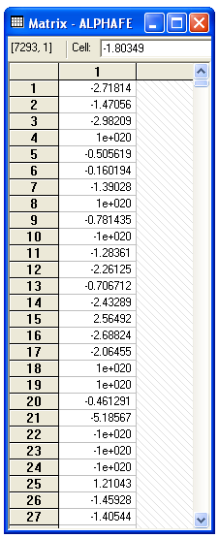
Computed Fixed Effects Parameters

Slide 50
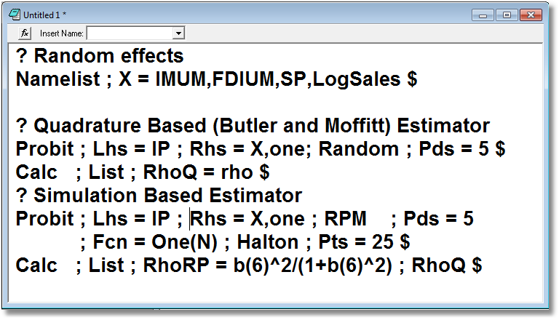
Random Effects and Random Constant

Slide 51
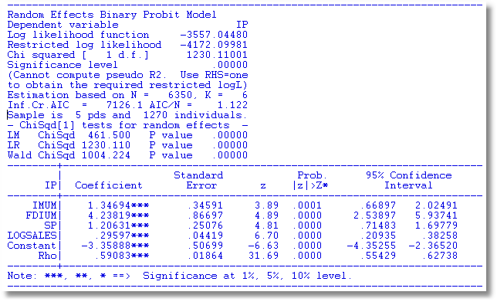

Slide 52
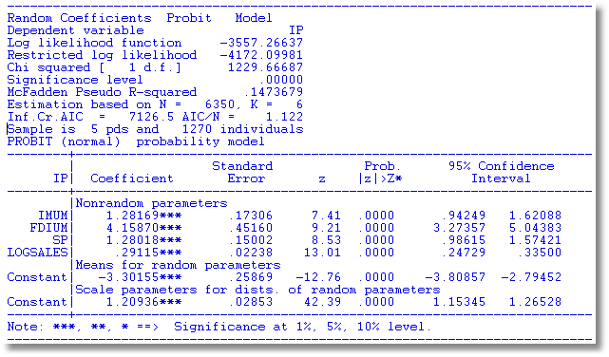

Slide 53


Slide 54
Unbalanced Panel Data Set
Load healthcare.lpj
Create group size variable
Examine Distribution of Group Sizes
Sample ; all$
Setpanel ; Group = id ; Pds = ti $
Create ; t = ndx(id,1) $
Histogram ; if[t=1] ; rhs = ti $
Probit ; Lhs=doctor ; Rhs = one,age,educ,income
; panel ; random $

Slide 55
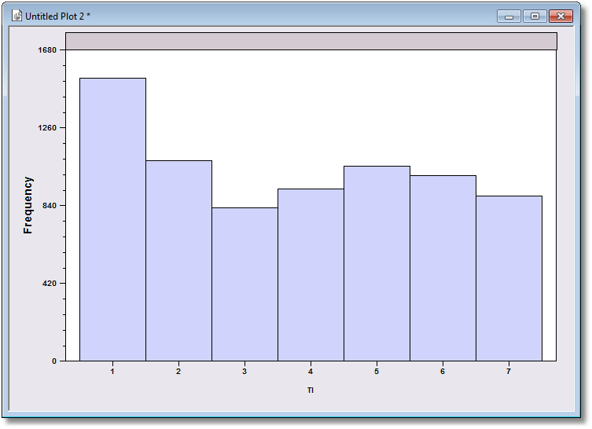
Group Sizes

Slide 56
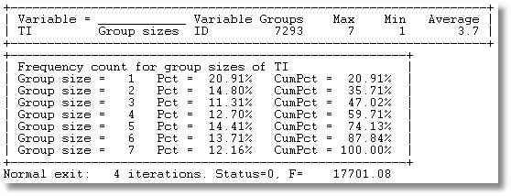

Slide 57
