Slide 1

Discrete Choice Modeling
William Greene
Stern School of Business
New York University
Lab Sessions

Slide 2
Lab Session 3
Bivariate Extensions of the Probit Model

Slide 3
Bivariate Probit Model
Two equation model
General usage of
  LHS = the set of dependent variables
  RH1 = one set of independent variables
  RH2 = a second set of variables
Economical use of namelists is useful here
Namelist ; x1=one,age,female,educ,married,working $
Namelist ; x2=one,age,female,hhninc,hhkids $
BivariateProbit ;lhs=doctor,hospital
;rh1=x1
;rh2=x2;marginal effects $

Slide 4
Heteroscedasticity in the Bivariate Probit Model
General form of heteroscedasticity in
LIMDEP/NLOGIT: Exponential
σ_{i} = σ exp(γ’z_{i}) so that σ_{i} > 0
  γ = 0 returns the homoscedastic case σ_{i} = σ
  Easy to specify
Namelist ; x1=one,age,female,educ,married,working ; z1 = … $
Namelist ; x2=one,age,female,hhninc,hhkids ; z2 = … $
BivariateProbit ;lhs=doctor,hospital
;rh1=x1 ; hf1 = z1
;rh2=x2 ; hf2 = z2$

Slide 5
Heteroscedasticity in Marginal Effects
Univariate case:
If the variables are the same in x and z,
these terms are added.
Sign and magnitude are ambiguous
Vastly more complicated for the bivariate
probit case. NLOGIT handles it internally.

Slide 6
Marginal Effects: Heteroscedasticity
+------------------------------------------------------+
| Partial Effects for Ey1|y2=1 |
+----------+---------------------+---------------------+
| | Regression Function | Heteroscedasticity |
| +---------------------+---------------------+
| | Direct | Indirect | Direct | Indirect |
| Variable | Efct x1 | Efct x2 | Efct h1 | Efct h2 |
+----------+----------+----------+----------+----------+
| AGE | .00190 | -.00012 | .00000 | .00000 |
| FEMALE | .10215 | .20688 | -.05880 | -.30944 |
| EDUC | -.00247 | .00000 | .00000 | .00000 |
| MARRIED | .00103 | .00000 | .00064 | .00476 |
| WORKING | -.02139 | .00000 | .00000 | .00000 |
| HHNINC | .00000 | .00154 | .00000 | .00000 |
| HHKIDS | .00000 | .00005 | .00000 | .00000 |
+----------+----------+----------+----------+----------+

Slide 7
Marginal Effects: Total Effects
+-------------------------------------------+
| Partial derivatives of E[y1|y2=1] with |
| respect to the vector of characteristics. |
| They are computed at the means of the Xs. |
| Effect shown is total of 4 parts above. |
| Estimate of E[y1|y2=1] = .819898 |
| Observations used for means are All Obs. |
| Total effects reported = direct+indirect. |
+-------------------------------------------+
+---------+--------------+----------------+--------+---------+----------+
|Variable | Coefficient | Standard Error |b/St.Er.|P[|Z|>z] | Mean of X|
+---------+--------------+----------------+--------+---------+----------+
Constant .000000 ......(Fixed Parameter).......
AGE .00347726 .00022941 15.157 .0000 43.5256898
FEMALE .08021863 .00535648 14.976 .0000 .47877479
EDUC -.00392413 .00093911 -4.179 .0000 11.3206310
MARRIED .00061108 .00506488 .121 .9040 .75861817
WORKING -.02280671 .00518908 -4.395 .0000 .67704750
HHNINC .00216510 .00374879 .578 .5636 .35208362
HHKIDS .00034768 .00164160 .212 .8323 .40273000

Slide 8
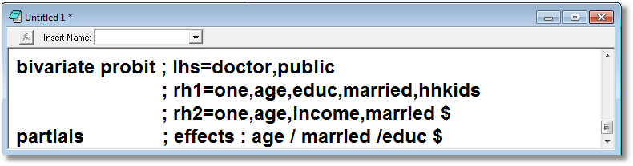

Slide 9
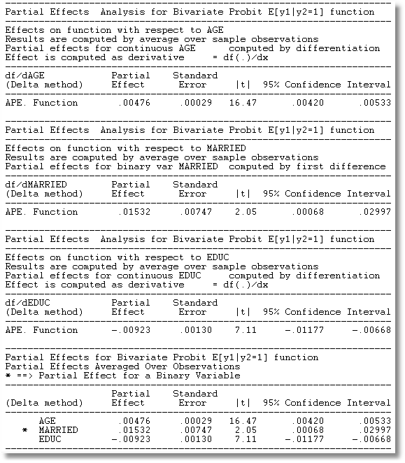

Slide 10
Imposing Fixed Value and Equality Constraints
Used throughout NLOGIT in all models,
model parameters appear as a long list:
β₁ β₂ β₃ β₄ α₁ α₂ α₃ α₄ σ and so on.
M parameters in total.
Use ; RST = list of symbols for the model parameters, in the right order
This may be used for nonlinear models. Not in REGRESS. Use ;CLS:… for linear models
Use the same name for equal parameters
Use specific numbers to fix the values

Slide 11
BivariateProbit ; lhs=doctor,hospital
; rh1=one,age,female,educ,married,working
; rh2=one,age,female,hhninc,hhkids
; rst = beta1,beta2,beta3,be,bm,bw,
beta1,beta2,beta3,bi,bk, 0.4 $
--------+-------------------------------------------------------------
Variable| Coefficient Standard Error b/St.Er. P[|Z|>z] Mean of X
--------+-------------------------------------------------------------
|Index equation for DOCTOR
Constant| -1.69181*** .08938 -18.928 .0000
AGE| .01244*** .00167 7.440 .0000 44.3352
FEMALE| .38543*** .03157 12.209 .0000 .42277
EDUC| .08144*** .00457 17.834 .0000 10.9409
MARRIED| .42021*** .03987 10.541 .0000 .84539
WORKING| .03310 .03910 .847 .3972 .73941
|Index equation for HOSPITAL
Constant| -1.69181*** .08938 -18.928 .0000
AGE| .01244*** .00167 7.440 .0000 44.3352
FEMALE| .38543*** .03157 12.209 .0000 .42277
HHNINC| -.98617*** .08917 -11.060 .0000 .34930
HHKIDS| -.09406** .04600 -2.045 .0409 .45482
|Disturbance correlation
RHO(1,2)| .40000 ......(Fixed Parameter)......
--------+-------------------------------------------------------------

Slide 12
Multivariate Probit
MPROBIT ; LHS = y1,y2,…,yM
; Eq1 = RHS for equation 1
; Eq2 = RHS for equation 2
…
; EqM = RHS for equation M $
Parameters are the slope vectors followed by the
lower triangle of the correlation matrix

Slide 13
Estimated Multivariate Probit
+---------------------------------------------+
| Multivariate Probit Model: 3 equations. |
| Number of observations 1270 |
| Log likelihood function -2423.732 |
| Number of parameters 6 |
| Replications for simulated probs. = 15 |
+---------------------------------------------+
+---------+--------------+----------------+--------+---------+----------+
|Variable | Coefficient | Standard Error |b/St.Er.|P[|Z|>z] | Mean of X|
+---------+--------------+----------------+--------+---------+----------+
Index function for IP84
Constant .13489406 .03467525 3.890 .0001
FDIUM84 .33571101 .47118274 .712 .4762 .05055702
SP84 .65662961 .13801209 4.758 .0000 .11012047
Index function for IP85
Constant .13489406 .03467525 3.890 .0001
FDIUM85 .33571101 .47118274 .712 .4762 .05051809
SP85 .65662961 .13801209 4.758 .0000 .11014611
Index function for IP86
Constant .13489406 .03467525 3.890 .0001
FDIUM86 .33571101 .47118274 .712 .4762 .05049439
SP86 .65662961 .13801209 4.758 .0000 .11016926
Correlation coefficients
R(01,02) .46759312 .03716428 12.582 .0000
R(01,03) .37251014 .03946383 9.439 .0000
R(02,03) .46215054 .03721312 12.419 .0000

Slide 15
Constrained Panel Probit
Sample ; 1 - 1270 $
MPROBIT ; LHS = IP84, IP85, IP86 ; MarginalEffects
; Eq1 = One,Fdium84,SP84
; Eq2 = One,Fdium85,SP85
; Eq3 = One,Fdium86,SP86
; Rst = b1,b2,b3,b1,b2,b3,b1,b2,b3,r45, r46, r56
; Maxit = 3 ; Pts = 15 $ (Reduces time to compute)

Slide 16
Endogenous Variable in Probit Model
PROBIT ; Lhs = y1, y2
; Rh1 = rhs for the probit model,y2
; Rh2 = exogenous variables for y2 $
SAMPLE ; All $
CREATE ; GoodHlth = Hsat > 5 $
PROBIT ; Lhs = GoodHlth,Hhninc
; Rh1 = One,Female,Hhninc
; Rh2 = One,Age,Educ $

Slide 17
Modeling Heterogeneity with Random Parameters and Latent Classes

Slide 18
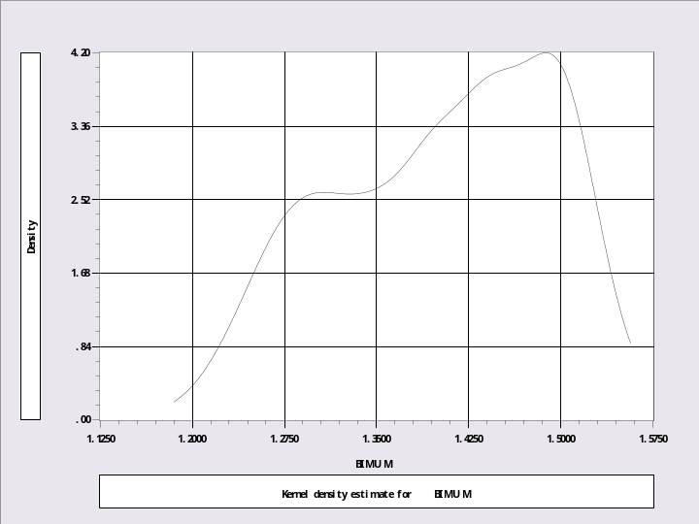
Random Parameters Model
? Random parameters specification
?
Logit ; Lhs = IP ; Rhs = One,IMUM,FDIUM,SP,LogSales
; Pds = 5 ; RPM ; Halton ; Pts = 25 ; Cor
; Fcn = One(n),IMUM(n),FDIUM(n) ; Marginal
; Parameters $
Sample ; 1 - 1270 $
Create ; bimum = 0 $
Matrix ; bi = beta_i(1:1270,2:2) $
Create ; bimum = bi $
Kernel ; Rhs = bimum $

Slide 19
Random Parameters with
Industry Heterogeneity
? Random parameters with industry heterogeneity
? Examine effect of industry heterogeneity.
Sample ; All $
Logit ; Lhs = IP ; Rhs = One,IMUM,FDIUM,SP,LogSales
; Pds = 5 ; RPM = InvGood,RawMtl
; Halton ; Pts = 15 ; Cor
; Fcn = One(n),IMUM(n),FDIUM(n) ; Marginal
; Parameters $
Create; Bimum = beta_i(firm,2) $
Regress ; Lhs = Bimum ; Rhs = one,InvGood,RawMtl $

Slide 20
Latent Class Models
? Latent class models
Sample ; All $
Logit ; Lhs = IP ; Rhs = X ; LCM ; Pds=5 ; Pts = 3 $
Logit ; Lhs = IP ; Rhs = X ; LCM=Invgood,Rawmtl
; Pds=5 ; Pts = 3 $
Logit ; Lhs = IP ; Rhs = X ; LCM ; Pds=5 ; Pts = 4 $
Logit ; Lhs = IP ; Rhs = X ; LCM ; Pds=5 ; Pts = 5 $

