Slide 1

Discrete Choice Modeling
William Greene
Stern School of Business
New York University
Lab Sessions

Slide 2
Lab 5
Discrete Choice, Multinomial Logit and Probit Models

Slide 3
Observed Data
Types of Data
  Individual choice
  Market shares
  Frequencies
  Ranks
Attributes and Characteristics
Choice Settings
  Cross section
  Repeated measurement (panel data)

Slide 4
Data for Multinomial Choice
Line MODE TRAVEL INVC INVT TTME GC HINC
1 AIR .00000 59.000 100.00 69.000 70.000 35.000
2 TRAIN .00000 31.000 372.00 34.000 71.000 35.000
3 BUS .00000 25.000 417.00 35.000 70.000 35.000
4 CAR 1.0000 10.000 180.00 .00000 30.000 35.000
5 AIR .00000 58.000 68.000 64.000 68.000 30.000
6 TRAIN .00000 31.000 354.00 44.000 84.000 30.000
7 BUS .00000 25.000 399.00 53.000 85.000 30.000
8 CAR 1.0000 11.000 255.00 .00000 50.000 30.000
321 AIR .00000 127.00 193.00 69.000 148.00 60.000
322 TRAIN .00000 109.00 888.00 34.000 205.00 60.000
323 BUS 1.0000 52.000 1025.0 60.000 163.00 60.000
324 CAR .00000 50.000 892.00 .00000 147.00 60.000
325 AIR .00000 44.000 100.00 64.000 59.000 70.000
326 TRAIN .00000 25.000 351.00 44.000 78.000 70.000
327 BUS .00000 20.000 361.00 53.000 75.000 70.000
328 CAR 1.0000 5.0000 180.00 .00000 32.000 70.000

Slide 5
Using NLOGIT To Fit the Model
Start program
Load CLOGIT.LPJ project
Use command builder dialog box
or
Use typed commands in editor

Slide 6
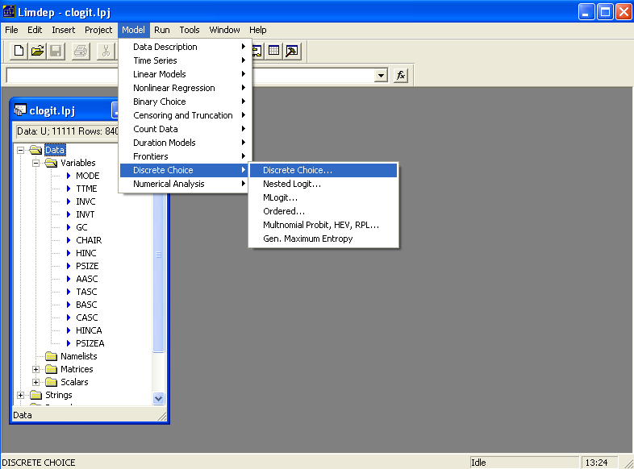

Slide 7
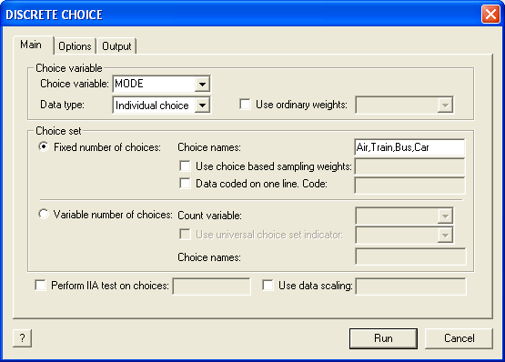
Specification of Choice Variable

Slide 8
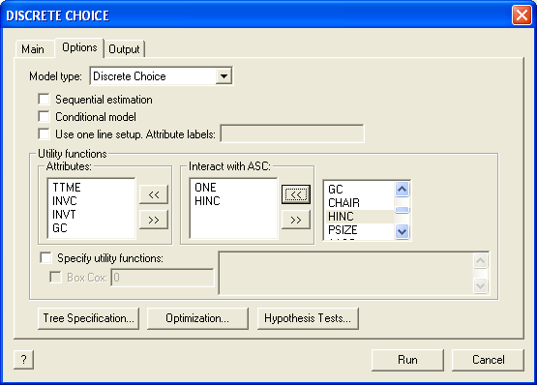
Specification of Utility Functions
Copy the variable names from the list at the right into the appropriate window at the left, then press Run

Slide 9
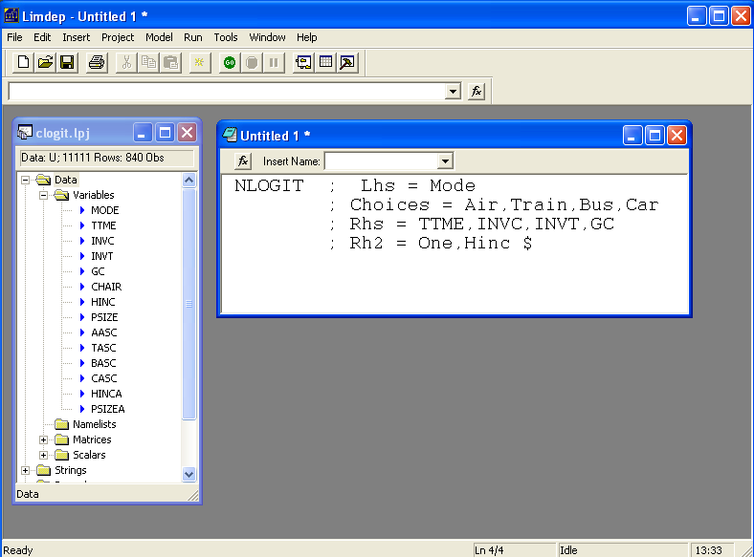
Submit Command from Editor
Type commands in editor
Highlight by dragging mouse
Press GO button

Slide 10
Command Structure
Generic
CLOGIT (or NLOGIT) ; Lhs = choice variable
; Choices = list of labels for the J choices
; RHS = list of attributes that vary by choice
; RH2 = list of attributes that do not vary by choice $
For this application
CLOGIT (or NLOGIT) ; Lhs = MODE
; Choices = Air, Train, Bus, Car
; RHS = TTME,INVC,INVT,GC
; RH2 = ONE, HINC $

Slide 11
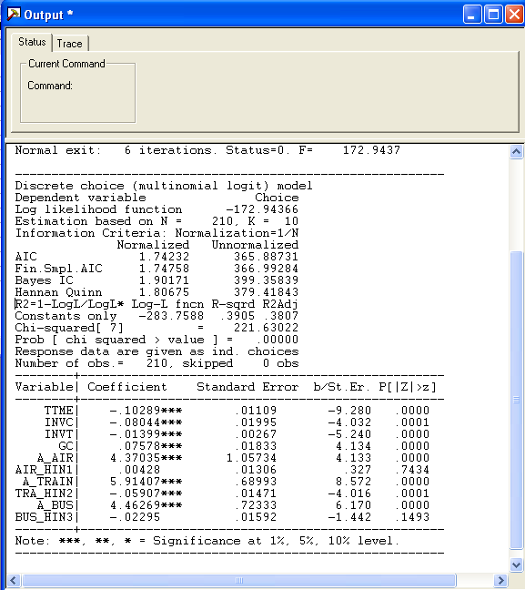
Output Window
Note: coef. on GC has the wrong sign!

Slide 12
Effects of Changes in Attributes on Probabilities
Partial Effects: Effect of a change in attribute “k” of alternative “m” on the probability that choice “j” will be made is
Proportional changes: Elasticities
Note the elasticity is the same for all choices “j.” (IIA)

Slide 13
Elasticities for CLOGIT
Request: ;Effects: attribute (choices where changes )
; Effects: INVT(*) (INVT changes in all choices)
+---------------------------------------------------+
| Elasticity averaged over observations.|
| Attribute is INVT in choice AIR |
| Effects on probabilities of all choices in model: |
| * = Direct Elasticity effect of the attribute. |
| Mean St.Dev |
| * Choice=AIR -1.3363 .7275 |
| Choice=TRAIN .5349 .6358 |
| Choice=BUS .5349 .6358 |
| Choice=CAR .5349 .6358 |
| Attribute is INVT in choice TRAIN |
| Choice=AIR 2.2153 2.4366 |
| * Choice=TRAIN -6.2976 4.0280 |
| Choice=BUS 2.2153 2.4366 |
| Choice=CAR 2.2153 2.4366 |
| Attribute is INVT in choice BUS |
| Choice=AIR 1.1942 1.7469 |
| Choice=TRAIN 1.1942 1.7469 |
| * Choice=BUS -7.6150 3.4417 |
| Choice=CAR 1.1942 1.7469 |
| Attribute is INVT in choice CAR |
| Choice=AIR 2.0852 2.0953 |
| Choice=TRAIN 2.0852 2.0953 |
| Choice=BUS 2.0852 2.0953 |
| * Choice=CAR -5.9367 3.7493 |
+---------------------------------------------------+
Own effect
Cross effects
Note the effect of IIA on the cross effects.

Slide 14
Other Useful Options
; Describe for descriptive by statistics, by alternative
; Crosstab for crosstabulations of actuals and predicted
; List for listing of outcomes and predictions
; Prob = name to create a new variable with fitted probabilities
; IVB = log sum, inclusive value. New variable

Slide 15
Analyzing Behavior of Market Shares
Scenario: What happens to the number of people how make specific choices if a particular attribute changes in a specified way?
Fit the model first, then using the identical model setup, add
; Simulation = list of choices to be analyzed
; Scenario = Attribute (in choices) = type of change
For the CLOGIT application, for example
; Simulation = * ? This is ALL choices
; Scenario: INVC(car)=[*]1.25$ INVC rises by 25%

Slide 16
More Complicated Model Simulation
In vehicle cost of CAR rises by 25%
Market is limited to ground (Train, Bus, Car)
NLOGIT ; Lhs = Mode
; Choices = Air,Train,Bus,Car
; Rhs = TTME,INVC,INVT,GC
; Rh2 = One ,Hinc
; Simulation = TRAIN,BUS,CAR
; Scenario: INVC(car)=[*]1.25$

Slide 17
Model Simulation
In vehicle cost of CAR rises by 25%
+------------------------------------------------------+
|Simulations of Probability Model |
|Model: Discrete Choice (One Level) Model |
|Simulated choice set may be a subset of the choices. |
|Number of individuals is the probability times the |
|number of observations in the simulated sample. |
|Column totals may be affected by rounding error. |
|The model used was simulated with 210 observations.|
+------------------------------------------------------+
-------------------------------------------------------------------------
Specification of scenario 1 is:
Attribute Alternatives affected Change type Value
--------- ------------------------------- ------------------- ---------
INVC CAR Scale base by value 1.250
-------------------------------------------------------------------------
The simulator located 209 observations for this scenario.
Simulated Probabilities (shares) for this scenario:
+----------+--------------+--------------+------------------+
|Choice | Base | Scenario | Scenario - Base |
| |%Share Number |%Share Number |ChgShare ChgNumber|
+----------+--------------+--------------+------------------+
|TRAIN | 37.321 78 | 40.711 85 | 3.390% 7 |
|BUS | 19.805 42 | 22.560 47 | 2.755% 5 |
|CAR | 42.874 90 | 36.729 77 | -6.145% -13 |
|Total |100.000 210 |100.000 209 | .000% -1 |
+----------+--------------+--------------+------------------+
Changes in the predicted market shares when INVC_CAR changes

Slide 18
Compound Scenario: INVC(Car) falls by 10%,
TTME (Air,Train) rises by 25%
(at the same time).
+------------------------------------------------------+
|Simulations of Probability Model |
|Model: Discrete Choice (One Level) Model |
|Simulated choice set may be a subset of the choices. |
|Number of individuals is the probability times the |
|number of observations in the simulated sample. |
|Column totals may be affected by rounding error. |
|The model used was simulated with 210 observations.|
+------------------------------------------------------+
-------------------------------------------------------------------------
Specification of scenario 1 is:
Attribute Alternatives affected Change type Value
--------- ------------------------------- ------------------- ---------
INVC CAR Scale base by value .900
TTME AIR TRAIN Scale base by value 1.250
-------------------------------------------------------------------------
The simulator located 209 observations for this scenario.
Simulated Probabilities (shares) for this scenario:
+----------+--------------+--------------+------------------+
|Choice | Base | Scenario | Scenario - Base |
| |%Share Number |%Share Number |ChgShare ChgNumber|
+----------+--------------+--------------+------------------+
|AIR | 27.619 58 | 16.516 35 |-11.103% -23 |
|TRAIN | 30.000 63 | 23.012 48 | -6.988% -15 |
|BUS | 14.286 30 | 18.495 39 | 4.209% 9 |
|CAR | 28.095 59 | 41.977 88 | 13.882% 29 |
|Total |100.000 210 |100.000 210 | .000% 0 |
+----------+--------------+--------------+------------------+
;simulation=*
; scenario: INVC(car)=[*]0.9 /
TTME(air,train)=[*]1.25

Slide 19
Choice Based Sampling
Over/Underrepresenting alternatives in the data set
Biases in parameter estimates
Biases in estimated variances
Weighted log likelihood, weight = πj / Fj for all i.
Fixup of covariance matrix
; Choices = list of names / list of true proportions $
; Choices = Air,Train,Bus,Car / 0.14, 0.13, 0.09, 0.64
Choice | Air | Train | Bus | Car
True | 0.14 | 0.13 | 0.09 | 0.64
Sample | 0.28 | 0.30 | 0.14 | 0.28

Slide 20
Choice Based Sampling Estimators
--------+--------------------------------------------------
Variable| Coefficient Standard Error b/St.Er. P[|Z|>z]
--------+--------------------------------------------------
Unweighted
TTME| -.10289*** .01109 -9.280 .0000
INVC| -.08044*** .01995 -4.032 .0001
INVT| -.01399*** .00267 -5.240 .0000
GC| .07578*** .01833 4.134 .0000
A_AIR| 4.37035*** 1.05734 4.133 .0000
AIR_HIN1| .00428 .01306 .327 .7434
A_TRAIN| 5.91407*** .68993 8.572 .0000
TRA_HIN2| -.05907*** .01471 -4.016 .0001
A_BUS| 4.46269*** .72333 6.170 .0000
BUS_HIN3| -.02295 .01592 -1.442 .1493
--------+--------------------------------------------------
Weighted
TTME| -.13611*** .02538 -5.363 .0000
INVC| -.10351*** .02470 -4.190 .0000
INVT| -.01772*** .00323 -5.486 .0000
GC| .10225*** .02107 4.853 .0000
A_AIR| 4.52505*** 1.75589 2.577 .0100
AIR_HIN1| .00746 .01481 .504 .6145
A_TRAIN| 5.53229*** .97331 5.684 .0000
TRA_HIN2| -.06026*** .02235 -2.696 .0070
A_BUS| 4.36579*** .97182 4.492 .0000
BUS_HIN3| -.01957 .01631 -1.200 .2302

Slide 21
Changes in Estimated Elasticities
+---------------------------------------------------+
| Unweighted |
| Elasticity averaged over observations.|
| Attribute is INVC in choice CAR |
| Effects on probabilities of all choices in model: |
| * = Direct Elasticity effect of the attribute. |
| Mean St.Dev |
| Choice=AIR .3622 .3437 |
| Choice=TRAIN .3622 .3437 |
| Choice=BUS .3622 .3437 |
| * Choice=CAR -1.3266 1.1731 |
+---------------------------------------------------+
| Weighted |
| Elasticity averaged over observations.|
| Attribute is INVC in choice CAR |
| Effects on probabilities of all choices in model: |
| * = Direct Elasticity effect of the attribute. |
| Mean St.Dev |
| Choice=AIR .8371 .7363 |
| Choice=TRAIN .8371 .7363 |
| Choice=BUS .8371 .7363 |
| * Choice=CAR -1.3362 1.4557 |
+---------------------------------------------------+

Slide 22
Testing IIA vs. AIR Choice
? No alternative constants in the model
NLOGIT ; Lhs = Mode
; Choices = Air,Train,Bus,Car
; Rhs = TTME,INVC,INVT,GC$
NLOGIT ; Lhs = Mode
; Choices = Air,Train,Bus,Car
; Rhs = TTME,INVC,INVT,GC
; IAS = Air $

Slide 23
Testing IIA – Dealing with Constants
With ASCs in the model, the covariance matrix becomes singular because the constant for AIR is always zero within the reduced sample. Do the test against the other coefficients.
NLOGIT ; Lhs = Mode
; Choices = Air,Train,Bus,Car
; Rhs = TTME,INVC,INVT,GC,One$
MATRIX ; Bair = b(1:4) ; Vair = Varb(1:4,1:4) $
NLOGIT ; Lhs = Mode
; Choices = Air,Train,Bus,Car
; Rhs = TTME,INVC,INVT,GC,One
; IAS = Air$
MATRIX ; BNoair=b(1:4) ; VNoair = Varb(1:4,1:4) $
MATRIX ; Db = BNoair-BAir ; Dv = VNoair - Vair $
MATRIX ; List ; H = Db'<Dv>Db $

Slide 24
Nested Logit Models
Extensions of the MNL

Slide 25
Using NLOGIT To Fit the Model
Start program
Load CLOGIT.LPJ project
Specify trees with
:TREE = name1(alt1,alt2…),
name2(alt…. ),…
“Names” are optional names for branches.

Slide 26
Nested Logit Model
? Load the CLOGIT data
?
? (1) A simple nested logit model
?
NLOGIT ; Lhs = Mode
; RHS = GC, TTME, INVT ; RH2 = ONE
; Choices = Air,Train,Bus,Car
; Tree = Private (Air,Car) , Public (Train,Bus) $

Slide 27
Model Form RU1

Slide 28
Moving Scaling Down to the Twig Level
Notes:
28

Slide 29
Normalizations
There are different ways to normalize the variances in the nested logit model, at the lowest level, or up at the highest level. Use
;RU1 for the low level
or
;RU2 to normalize at the branch level

Slide 30
Normalizations of Nested Logit Models
?
? (2) Renormalize the nested logit model
?
NLOGIT ; Lhs = Mode ; RHS = GC, TTME, INVT
; RH2 = ONE
; Choices = Air,Train,Bus,Car
; Tree = Private (Air,Car) , Public (Train,Bus)
; RU1 $
NLOGIT ; Lhs = Mode ; RHS = GC, TTME, INVT
; RH2 = ONE
; Choices = Air,Train,Bus,Car
; Tree = Private (Air,Car) , Public (Train,Bus)
; RU2 $

Slide 31
Fixing IV Parameters
With branches defined by
;TREE = br1(…),br2(…),…,brK(…)
(a) Force IV parameters to be equal with
; IVSET: (br1,…) The list may contain
any or all of the branch names
(b) Force IV parameters to equal specific
values
; IVSET: (br1,…) = [ the value ]

Slide 32
Constraining the IV Parameters
? (3) Force the IV parameters to be equal
NLOGIT ; Lhs = Mode ; RHS = GC, TTME, INVT
; RH2 = ONE
; Choices = Air,Train,Bus,Car
; Tree = Private (Air,Car) , Public (Train,Bus)
; RU2 ; IVSET: (Private,Public) $
NLOGIT ; Lhs = Mode ; RHS = GC, TTME, INVT
; RH2 = ONE
; Choices = Air,Train,Bus,Car
; Tree = Private (Air,Car) , Public (Train,Bus)
; RU2 ; IVSET: (Private,Public) = [1] $
? The preceding constraint produces the simple MNL model
NLOGIT ; Lhs = Mode ; RHS = GC, TTME, INVT
; RH2 = ONE
; Choices = Air,Train,Bus,Car $

Slide 33
Degenerate Branch
? (4) Fit the model with a degenerate branch
NLOGIT ; Lhs = Mode ; RHS = GC, TTME, INVT
; RH2 = ONE
; Choices = Air,Train,Bus,Car
; Tree = Fly (Air) , Ground (Train,Bus,Car) $
? (5) Study scaling differences with nested logit rather
? than HEV. Make all alts their own branch. One is
? normalized to 1.000.
NLOGIT ; Lhs = Mode ; RHS = GC, TTME, INVT
; RH2 = ONE
; Choices = Air,Train,Bus,Car
; Tree = Fly(Air),Rail(Train), Autobus(Bus),Auto(Car)
; IVSET: (Fly) = [1] $

Slide 34
Heteroscedasticity in the MNL Model
Add ;HET to the generic NLOGIT command. No other changes.
NLOGIT ; Lhs = Mode
; Choices = Air,Train,Bus,Car
; Rhs = TTME,INVC,INVT,GC,One
; Het
; Effects: INVT(*) $

Slide 35
Heteroscedastic Extreme Value Model (1)
-----------------------------------------------------------
Start values obtained using MNL model
Dependent variable Choice
Log likelihood function -184.50669
Estimation based on N = 210, K = 7
Information Criteria: Normalization=1/N
Normalized Unnormalized
AIC 1.82387 383.01339
Fin.Smpl.AIC 1.82651 383.56784
Bayes IC 1.93544 406.44314
Hannan Quinn 1.86898 392.48517
R2=1-LogL/LogL* Log-L fncn R-sqrd R2Adj
Constants only -283.7588 .3498 .3393
Chi-squared[ 4] = 198.50415
Prob [ chi squared > value ] = .00000
Response data are given as ind. choices
Number of obs.= 210, skipped 0 obs
--------+--------------------------------------------------
Variable| Coefficient Standard Error b/St.Er. P[|Z|>z]
--------+--------------------------------------------------
TTME| -.10365*** .01094 -9.476 .0000
INVC| -.08493*** .01938 -4.382 .0000
INVT| -.01333*** .00252 -5.297 .0000
GC| .06930*** .01743 3.975 .0001
A_AIR| 5.20474*** .90521 5.750 .0000
A_TRAIN| 4.36060*** .51067 8.539 .0000
A_BUS| 3.76323*** .50626 7.433 .0000
--------+--------------------------------------------------

Slide 36
Heteroscedastic Extreme Value Model (2)
-----------------------------------------------------------
Heteroskedastic Extreme Value Model
Dependent variable MODE
Log likelihood function -182.44396
Restricted log likelihood -291.12182
Chi squared [ 10 d.f.] 217.35572
R2=1-LogL/LogL* Log-L fncn R-sqrd R2Adj
No coefficients -291.1218 .3733 .3632
Constants only -283.7588 .3570 .3467
At start values -218.6505 .1656 .1521
Response data are given as ind. choices
Number of obs.= 210, skipped 0 obs
--------+--------------------------------------------------
Variable| Coefficient Standard Error b/St.Er. P[|Z|>z]
--------+--------------------------------------------------
|Attributes in the Utility Functions (beta)
TTME| -.11526** .05721 -2.014 .0440
INVC| -.15516* .07928 -1.957 .0503
INVT| -.02277** .01123 -2.028 .0426
GC| .11904* .06403 1.859 .0630
A_AIR| 4.69411* 2.48092 1.892 .0585
A_TRAIN| 5.15630** 2.05744 2.506 .0122
A_BUS| 5.03047** 1.98259 2.537 .0112
|Scale Parameters of Extreme Value Distns Minus 1.
s_AIR| -.57864*** .21992 -2.631 .0085
s_TRAIN| -.45879 .34971 -1.312 .1896
s_BUS| .26095 .94583 .276 .7826
s_CAR| .000 ......(Fixed Parameter)......
|Std.Dev=pi/(theta*sqr(6)) for H.E.V. distribution
s_AIR| 3.04385* 1.58867 1.916 .0554
s_TRAIN| 2.36976 1.53124 1.548 .1217
s_BUS| 1.01713 .76294 1.333 .1825
s_CAR| 1.28255 ......(Fixed Parameter)......
--------+--------------------------------------------------
Use to test vs. IIA assumption in MNL model? LogL₀ = -184.5067.
IIA would not be rejected on this basis. (Not necessarily a test of that methodological assumption.)
Normalized for estimation
Structural parameters

Slide 37
HEV Model - Elasticities
+---------------------------------------------------+
| Elasticity averaged over observations.|
| Attribute is INVC in choice AIR |
| Effects on probabilities of all choices in model: |
| * = Direct Elasticity effect of the attribute. |
| Mean St.Dev |
| * Choice=AIR -4.2604 1.6745 |
| Choice=TRAIN 1.5828 1.9918 |
| Choice=BUS 3.2158 4.4589 |
| Choice=CAR 2.6644 4.0479 |
| Attribute is INVC in choice TRAIN |
| Choice=AIR .7306 .5171 |
| * Choice=TRAIN -3.6725 4.2167 |
| Choice=BUS 2.4322 2.9464 |
| Choice=CAR 1.6659 1.3707 |
| Attribute is INVC in choice BUS |
| Choice=AIR .3698 .5522 |
| Choice=TRAIN .5949 1.5410 |
| * Choice=BUS -6.5309 5.0374 |
| Choice=CAR 2.1039 8.8085 |
| Attribute is INVC in choice CAR |
| Choice=AIR .3401 .3078 |
| Choice=TRAIN .4681 .4794 |
| Choice=BUS 1.4723 1.6322 |
| * Choice=CAR -3.5584 9.3057 |
+---------------------------------------------------+
Multinomial Logit
+---------------------------+
| INVC in AIR |
| Mean St.Dev |
| * -5.0216 2.3881 |
| 2.2191 2.6025 |
| 2.2191 2.6025 |
| 2.2191 2.6025 |
| INVC in TRAIN |
| 1.0066 .8801 |
| * -3.3536 2.4168 |
| 1.0066 .8801 |
| 1.0066 .8801 |
| INVC in BUS |
| .4057 .6339 |
| .4057 .6339 |
| * -2.4359 1.1237 |
| .4057 .6339 |
| INVC in CAR |
| .3944 .3589 |
| .3944 .3589 |
| .3944 .3589 |
| * -1.3888 1.2161 |
+---------------------------+
Notes:
37

Slide 38
Heterogeneous HEV Model
Does the variance depend on
household income?
NLOGIT ; Lhs = Mode
; Choices = Air,Train,Bus,Car
; Rhs = TTME,INVC,INVT,GC,One
; Het ; Hfn = HINC
; Effects: INVT(*) $

Slide 39
Multinomial Probit
Mixed Logit (Random Parameters)
Latent Class Models

Slide 40
Multinomial Probit Model
Add ;MNP to the generic command
Use ;PTS=number to specify the number of points in the simulations. Use a small number (15) for demonstrations and examples. Use a large number (200+) for real estimation.
(Don’t fit this now. Takes forever to compute. Much less practical – and probably less useful – than other specifications.)

Slide 41
Multinomial Probit Model
--------+--------------------------------------------------
Variable| Coefficient Standard Error b/St.Er. P[|Z|>z]
--------+--------------------------------------------------
|Attributes in the Utility Functions (beta)
GC| .11825** .04783 2.472 .0134
TTME| -.09105*** .03439 -2.647 .0081
INVC| -.14880*** .05495 -2.708 .0068
INVT| -.02300*** .00797 -2.886 .0039
A_AIR| 2.94413* 1.59671 1.844 .0652
A_TRAIN| 4.64736*** 1.50865 3.080 .0021
A_BUS| 4.09869*** 1.29880 3.156 .0016
|Std. Devs. of the Normal Distribution.
s[AIR]| 3.99782** 1.59304 2.510 .0121
s[TRAIN]| 1.63224* .86143 1.895 .0581
s[BUS]| 1.00000 ......(Fixed Parameter)......
s[CAR]| 1.00000 ......(Fixed Parameter)......
|Correlations in the Normal Distribution
rAIR,TRA| .31999 .53343 .600 .5486
rAIR,BUS| .40675 .70841 .574 .5659
rTRA,BUS| .37434 .41343 .905 .3652
rAIR,CAR| .000 ......(Fixed Parameter)......
rTRA,CAR| .000 ......(Fixed Parameter)......
rBUS,CAR| .000 ......(Fixed Parameter)......
--------+--------------------------------------------------

Slide 42
MNP Elasticities
+---------------------------------------------------+
| Elasticity averaged over observations.|
| Attribute is INVT in choice AIR |
| Effects on probabilities of all choices in model: |
| * = Direct Elasticity effect of the attribute. |
| Mean St.Dev |
| * Choice=AIR -1.0154 .4600 |
| Choice=TRAIN .4773 .4052 |
| Choice=BUS .6124 .4282 |
| Choice=CAR .3237 .3037 |
+---------------------------------------------------+
| Attribute is INVT in choice TRAIN |
| Choice=AIR 1.8113 1.6718 |
| * Choice=TRAIN -11.8375 10.1346 |
| Choice=BUS 7.9668 6.8088 |
| Choice=CAR 4.3257 4.4078 |
+---------------------------------------------------+
| Attribute is INVT in choice BUS |
| Choice=AIR .9635 1.4635 |
| Choice=TRAIN 3.9555 6.7724 |
| * Choice=BUS -23.3467 14.2837 |
| Choice=CAR 4.6840 7.8314 |
+---------------------------------------------------+
| Attribute is INVT in choice CAR |
| Choice=AIR 1.3324 1.4476 |
| Choice=TRAIN 4.5062 4.7695 |
| Choice=BUS 9.6001 7.6406 |
| * Choice=CAR -10.8870 10.0449 |
+---------------------------------------------------+

