Slide 1
Discrete Choice Modeling
William Greene
Stern School of Business
New York University

Slide 2
Part 1
Introduction

Slide 3
Modeling Categorical Variables
Theoretical foundations
Econometric methodology
  Models
  Statistical bases
  Econometric methods
Applications

Slide 4
Discrete Choice Modeling
Econometric Methodology
  Regression Basics
  Discrete Choice Models for Categorical Data
  Binary Choice Models
  Ordered and Bi-/Multivariate Choice
  Models for Count Data
  Multinomial Choice Models
Model Building
  Specification
  Estimation
  Analysis and Hypothesis Testing
  Applications

Slide 5
Course Objectives
Theory: Theoretical underpinnings of the models
  Models and data generating mechanisms
  Econometric Theory
Practice
  Tools for estimation and inference
  Model specification
  Analysis and interpretation of numerical results

Slide 6
The Sample and Measurement
Population
Measurement
Theory
Characteristics
Behavior Patterns
Choices

Slide 7
Inference
Population
Measurement
Econometrics
Characteristics
Behavior Patterns
Choices

Slide 8
Classical Inference
Population
Measurement
Econometrics
Characteristics
Behavior Patterns
Choices
Imprecise inference about the entire population – sampling theory and asymptotics

Slide 9
Bayesian Inference
Population
Measurement
Econometrics
Characteristics
Behavior Patterns
Choices
Sharp, ‘exact’ inference about only the sample – the ‘posterior’ density.

Slide 10
Issues in Model Building
Estimation
  Coefficients
  Interesting Partial Effects
Functional Form and Specification
Statistical Inference
Prediction
  Individuals
  Aggregates
Model Assessment and Evaluation

Slide 11
Regression Basics
The “MODEL” = conditional mean function
  Modeling the mean
  Modeling probabilities for discrete choice
Specification
Estimation – coefficients and partial effects
Hypothesis testing
Prediction… and Fit
Estimation Methods

Slide 12
Econometric Frameworks
Nonparametric
Semiparametric
Parametric
  Classical (Sampling Theory)
  Bayesian
We will focus on classical inference methods

Slide 13
Application: Health Care Usage
German Health Care Usage Data, 7,293 Individuals, Varying Numbers of Periods
Variables in the file are
Data downloaded from Journal of Applied Econometrics Archive. This is an unbalanced panel with 7,293 individuals. They can be used for regression, count models, binary choice, ordered choice, and bivariate binary choice. This is a large data set. There are altogether 27,326 observations. The number of observations ranges from 1 to 7. (Frequencies are: 1=1525, 2=2158, 3=825, 4=926, 5=1051, 6=1000, 7=987). Note, the variable NUMOBS below tells how many observations there are for each person. This variable is repeated in each row of the data for the person. (Downloaded from the JAE Archive)
DOCTOR = 1(Number of doctor visits > 0)
HOSPITAL = 1(Number of hospital visits > 0)
HSAT = health satisfaction, coded 0 (low) - 10 (high)
DOCVIS = number of doctor visits in last three months
HOSPVIS = number of hospital visits in last calendar year
PUBLIC = insured in public health insurance = 1; otherwise = 0
ADDON = insured by add-on insurance = 1; otherswise = 0
HHNINC = household nominal monthly net income in German marks / 10000.
(4 observations with income=0 were dropped)
HHKIDS = children under age 16 in the household = 1; otherwise = 0
EDUC = years of schooling
AGE = age in years
MARRIED = marital status
EDUC = years of education
Notes:
13

Slide 14

Household Income

Slide 15
Regression - Income
----------------------------------------------------------------------
Ordinary least squares regression ............
LHS=LOGINC Mean = -.92882
Standard deviation = .47948
Number of observs. = 887
Model size Parameters = 2
Degrees of freedom = 885
Residuals Sum of squares = 183.19359
Standard error of e = .45497
Fit R-squared = .10064
Adjusted R-squared = .09962
Model test F[ 1, 885] (prob) = 99.0(.0000)
Diagnostic Log likelihood = -559.06527
Restricted(b=0) = -606.10609
Chi-sq [ 1] (prob) = 94.1(.0000)
Info criter. LogAmemiya Prd. Crt. = -1.57279
Akaike Info. Criter. = -1.57279
Bayes Info. Criter. = -1.56200
--------+-------------------------------------------------------------
Variable| Coefficient Standard Error b/St.Er. P[|Z|>z] Mean of X
--------+-------------------------------------------------------------
Constant| -1.71604*** .08057 -21.299 .0000
EDUC| .07176*** .00721 9.951 .0000 10.9707
--------+-------------------------------------------------------------
Note: ***, **, * = Significance at 1%, 5%, 10% level.
----------------------------------------------------------------------

Slide 16
Specification and Functional Form
----------------------------------------------------------------------
Ordinary least squares regression ............
LHS=LOGINC Mean = -.92882
Standard deviation = .47948
Number of observs. = 887
Model size Parameters = 3
Degrees of freedom = 884
Residuals Sum of squares = 183.00347
Standard error of e = .45499
Fit R-squared = .10157
Adjusted R-squared = .09954
Model test F[ 2, 884] (prob) = 50.0(.0000)
Diagnostic Log likelihood = -558.60477
Restricted(b=0) = -606.10609
Chi-sq [ 2] (prob) = 95.0(.0000)
Info criter. LogAmemiya Prd. Crt. = -1.57158
Akaike Info. Criter. = -1.57158
Bayes Info. Criter. = -1.55538
--------+-------------------------------------------------------------
Variable| Coefficient Standard Error b/St.Er. P[|Z|>z] Mean of X
--------+-------------------------------------------------------------
Constant| -1.68303*** .08763 -19.207 .0000
EDUC| .06993*** .00746 9.375 .0000 10.9707
FEMALE| -.03065 .03199 -.958 .3379 .42277
--------+-------------------------------------------------------------

Slide 17
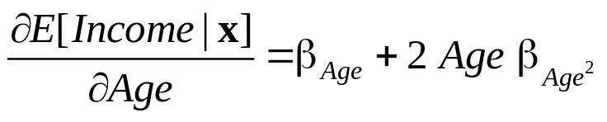
Interesting Partial Effects
----------------------------------------------------------------------
Ordinary least squares regression ............
LHS=LOGINC Mean = -.92882
Standard deviation = .47948
Number of observs. = 887
Model size Parameters = 5
Degrees of freedom = 882
Residuals Sum of squares = 171.87964
Standard error of e = .44145
Fit R-squared = .15618
Adjusted R-squared = .15235
Model test F[ 4, 882] (prob) = 40.8(.0000)
Diagnostic Log likelihood = -530.79258
Restricted(b=0) = -606.10609
Chi-sq [ 4] (prob) = 150.6(.0000)
Info criter. LogAmemiya Prd. Crt. = -1.62978
Akaike Info. Criter. = -1.62978
Bayes Info. Criter. = -1.60279
--------+-------------------------------------------------------------
Variable| Coefficient Standard Error b/St.Er. P[|Z|>z] Mean of X
--------+-------------------------------------------------------------
Constant| -5.26676*** .56499 -9.322 .0000
EDUC| .06469*** .00730 8.860 .0000 10.9707
FEMALE| -.03683 .03134 -1.175 .2399 .42277
AGE| .15567*** .02297 6.777 .0000 50.4780
AGE*AGE| -.00161*** .00023 -7.014 .0000 2620.79
--------+-------------------------------------------------------------

Slide 18
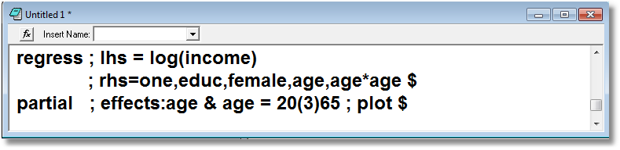
Partial Effects

Slide 19
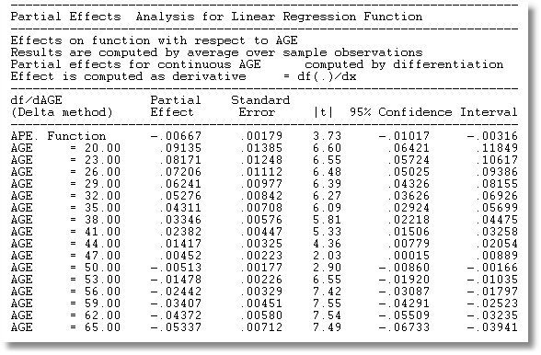

Slide 20
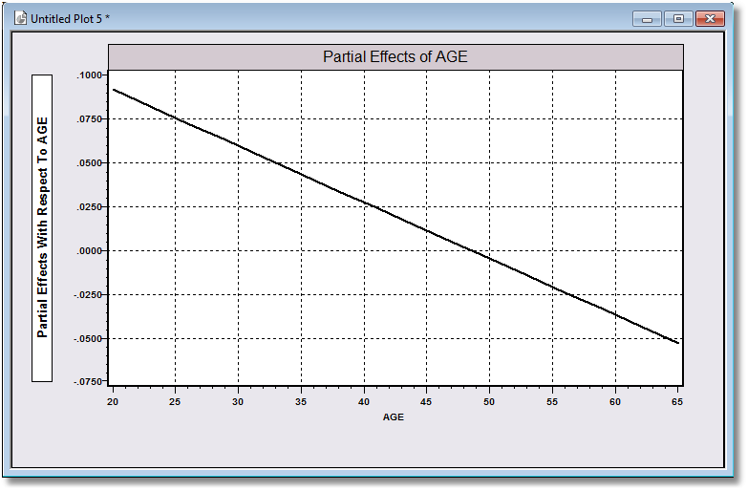

Slide 21
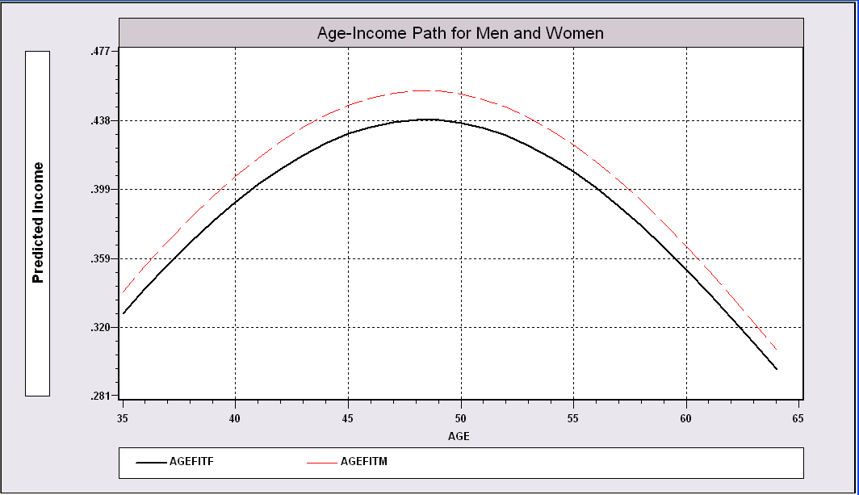
Impact of Age on Simulated Income

Slide 22
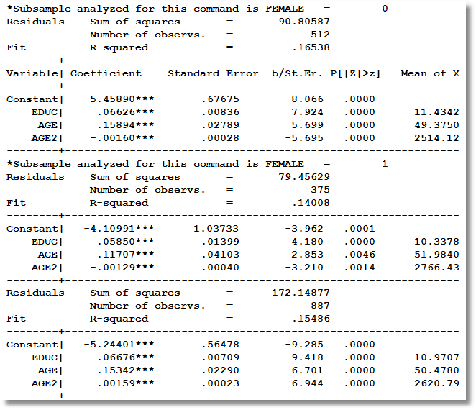
Inference: Does the same model apply to men and women?

Slide 23
Modeling Approaches
Nonparametric – “relationship”
  Minimal Assumptions
  Minimal Conclusions
Semiparametric – usually “index function;” β′x
  Somewhat stronger assumptions
  Robust to model misspecification (heteroscedasticity)
  Still weak conclusions
Parametric – “Probability function and index”
  Strongest assumptions – complete specification
  Strongest conclusions
  Possibly less robust.

Slide 24
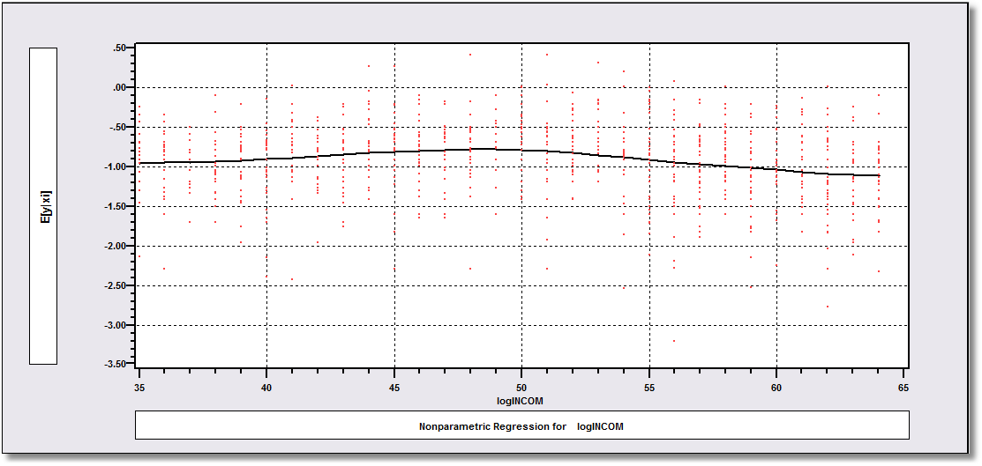
Nonparametric Regression
for log Income

Slide 25
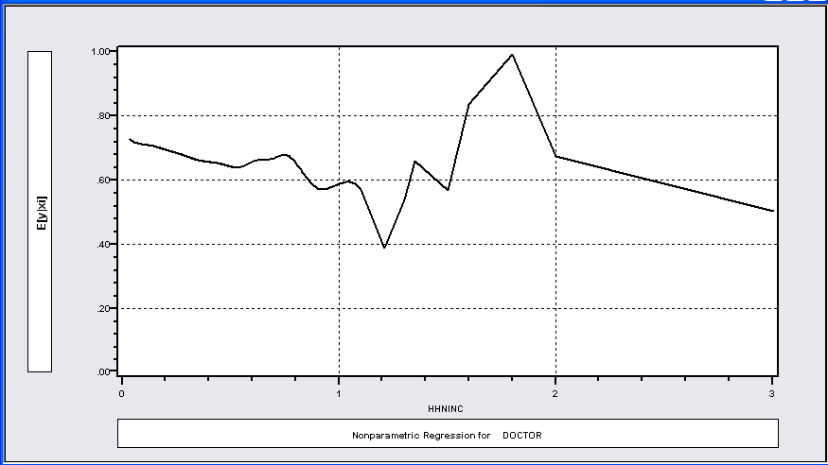
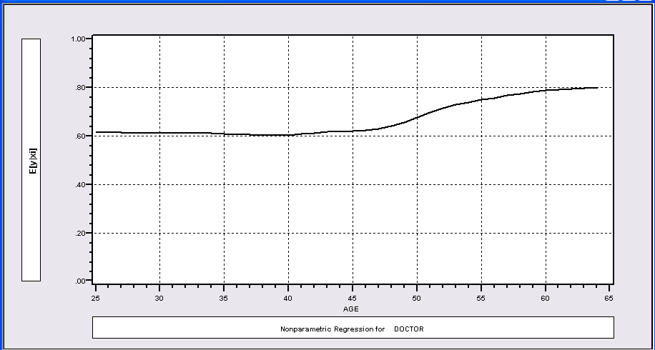
Nonparametric Regressions for a Binary Outcome (Visit Doctor)
P(Visit)=f(Age)
P(Visit)=f(Income)

Slide 26
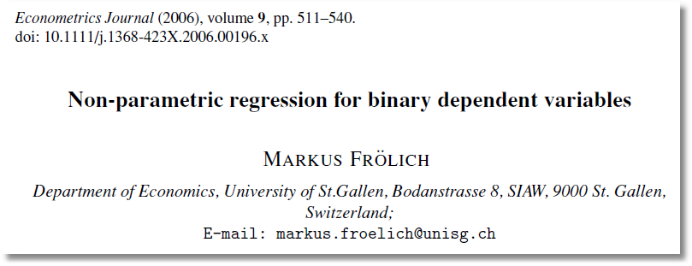

Slide 27
Semiparametric Approaches
The current standard:
Klein and Spady: Find b to maximize a semiparametric likelihood of G(b’x)

Slide 28
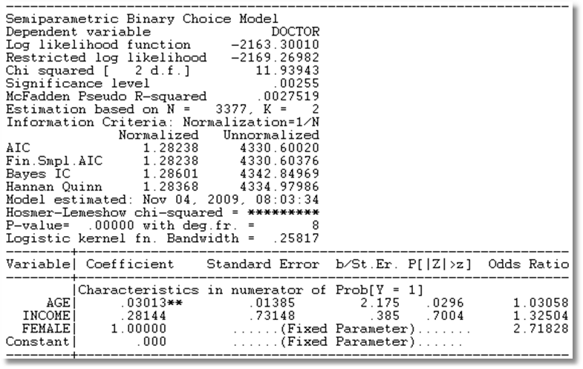
Klein and Spady Semiparametric
Note necessary normalizations. Coefficients are not meaningful.
Prob(y_{i} = 1 | x_{i} ) = G(β̒x) G is estimated by kernel methods

Slide 29
Fully Parametric
Index Function: U* = β’x + ε
Observation Mechanism: y = 1[U* > 0]
Distribution: ε ~ f(ε); Normal, Logistic, …
Maximum Likelihood Estimation:
Max(β) logL = Σ_{i} log Prob(Y_{i} = y_{i}|x_{i})

Slide 30
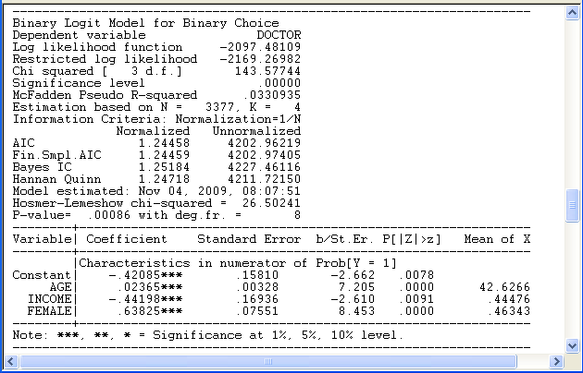

Slide 31
Modeling Approaches
The contemporary social science literature is overwhelmingly dominated by parametric models for categorical variables
We will focus on parametric models from this point on.

Slide 32
Categorical Variables
Observed outcomes
  Inherently discrete: number of occurrences, e.g., family size
  Implicitly continuous: The observed data are discrete by construction, e.g., revealed preferences; our main subject
  Multinomial: The observed outcome indexes a set of unordered labeled choices.
Implications
  For model building
  For analysis and prediction of behavior

Slide 33

Binary Outcome

Slide 34

Self Reported Health Satisfaction

Slide 35
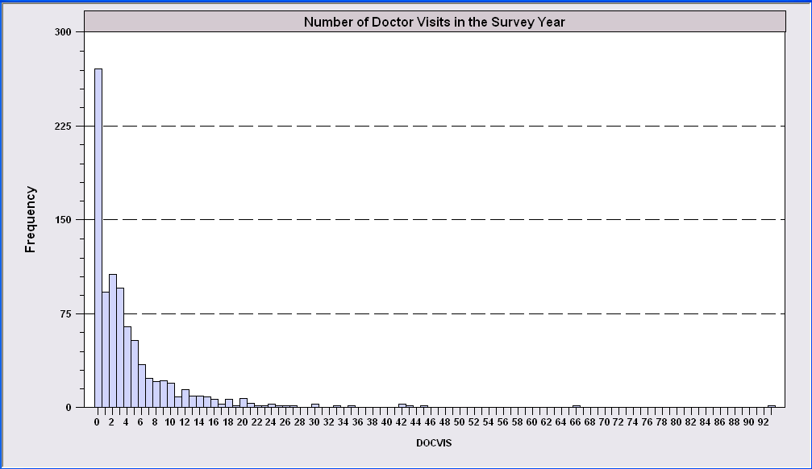
Count of Occurrences

Slide 36

Multinomial Unordered Choice

Slide 37
Heterogeneity and Endogeneity
How to model panel data
  Take advantage of richness of the data
  Appropriately accommodate unobserved heterogeneity (with fixed effects, random effects, other models)
How to handle endogeneity
  Omitted effects
  Structural models of simultaneous causality

Slide 38
Frameworks
Discrete Outcomes
  Binary Choices
  Ordered Choices
  Models for Counts
  Multinomial Choice
Modeling Methods
  Modeling the conditional mean
  Modeling Probabilities

